Slide 1
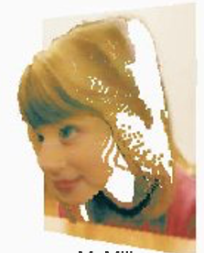
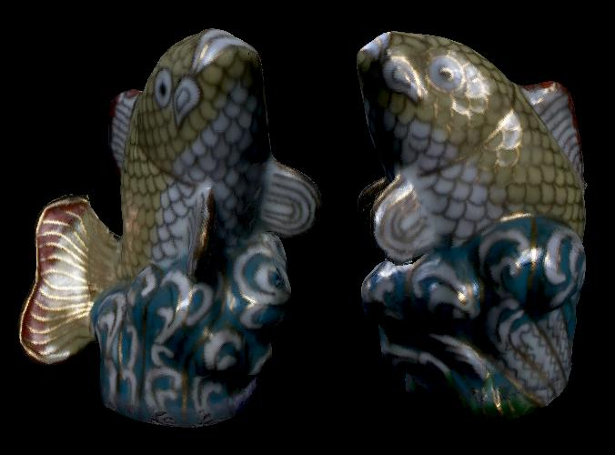
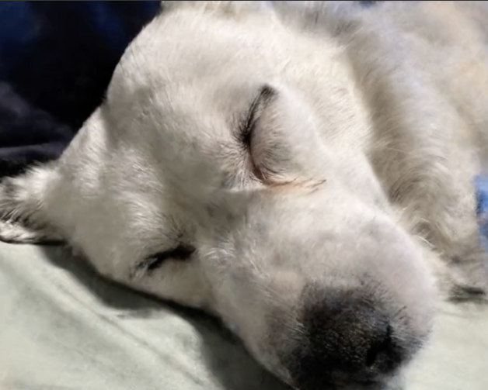
Image-Based Rendering
CSE 274, Lecture 7: IBR as Sampled Data
Ravi Ramamoorthi
http://www.cs.ucsd.edu/~ravir

Slide 2
To Do

Slide 3
Motivation
IBR is not just view synthesis (4D)
Broader trend of sampled data (data-driven)
Data for lighting, BRDFs, motion, textures etc.
  Modern Generative AI is essentially advanced data-driven texture synthesis
Precomputed Light Transport or Radiance Transfer extends this even to synthetic scenes
All of these remain active areas of research

Slide 4

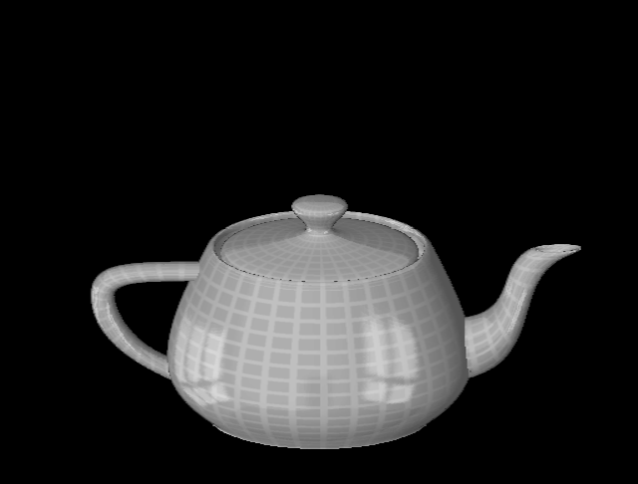
Reflection Maps
Blinn and Newell, 1976

Slide 5
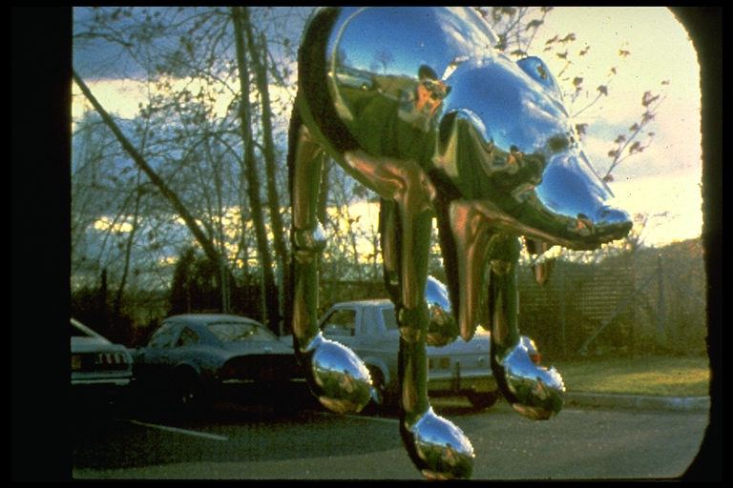
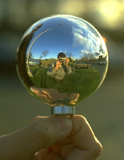
Environment Maps
Miller and Hoffman, 1984

Slide 6
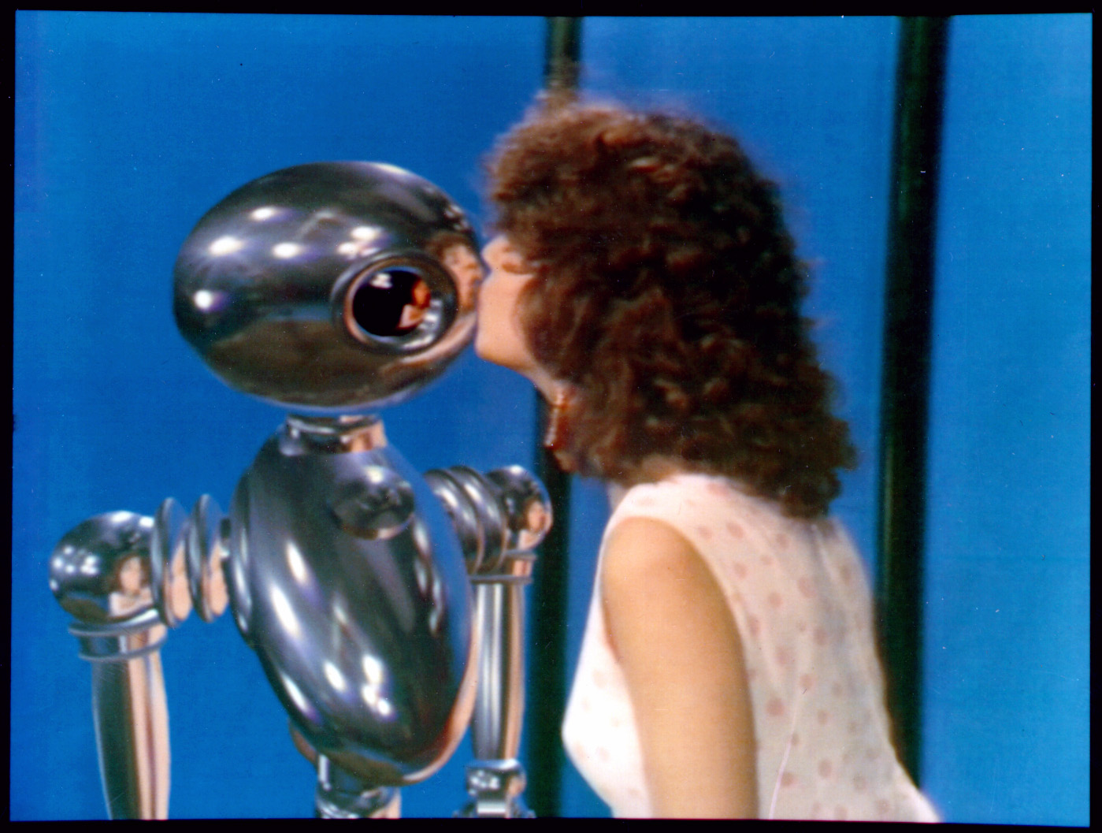
Environment Maps
Interface, Chou and Williams (ca. 1985)

Slide 7
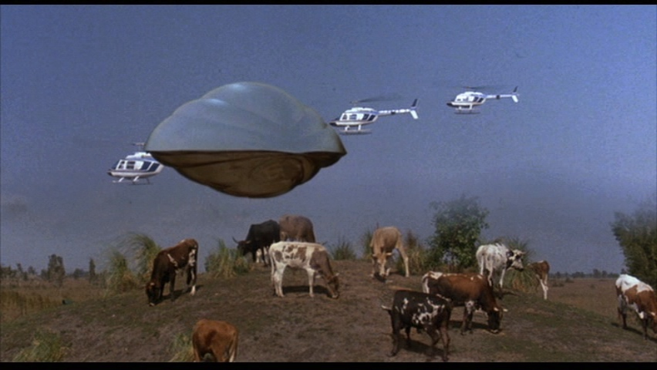
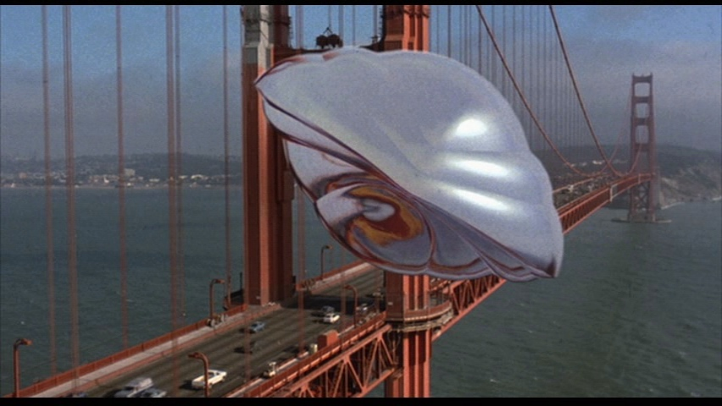
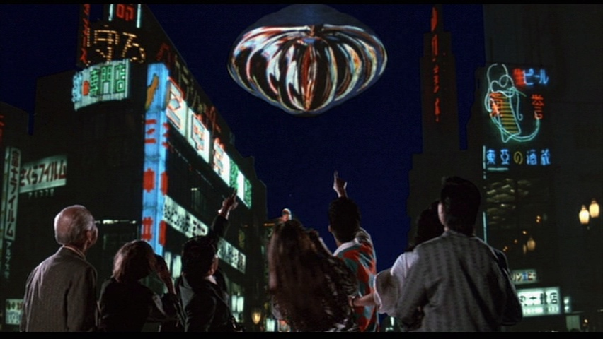
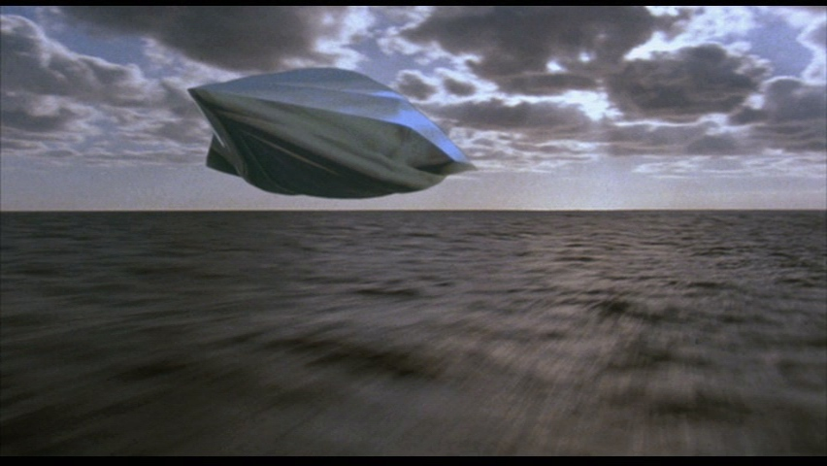
Reflection Maps in the Movies
From history, pauldebevec.com/ReflectionMapping
First movie, Flight of the Navigator 1986

Slide 8
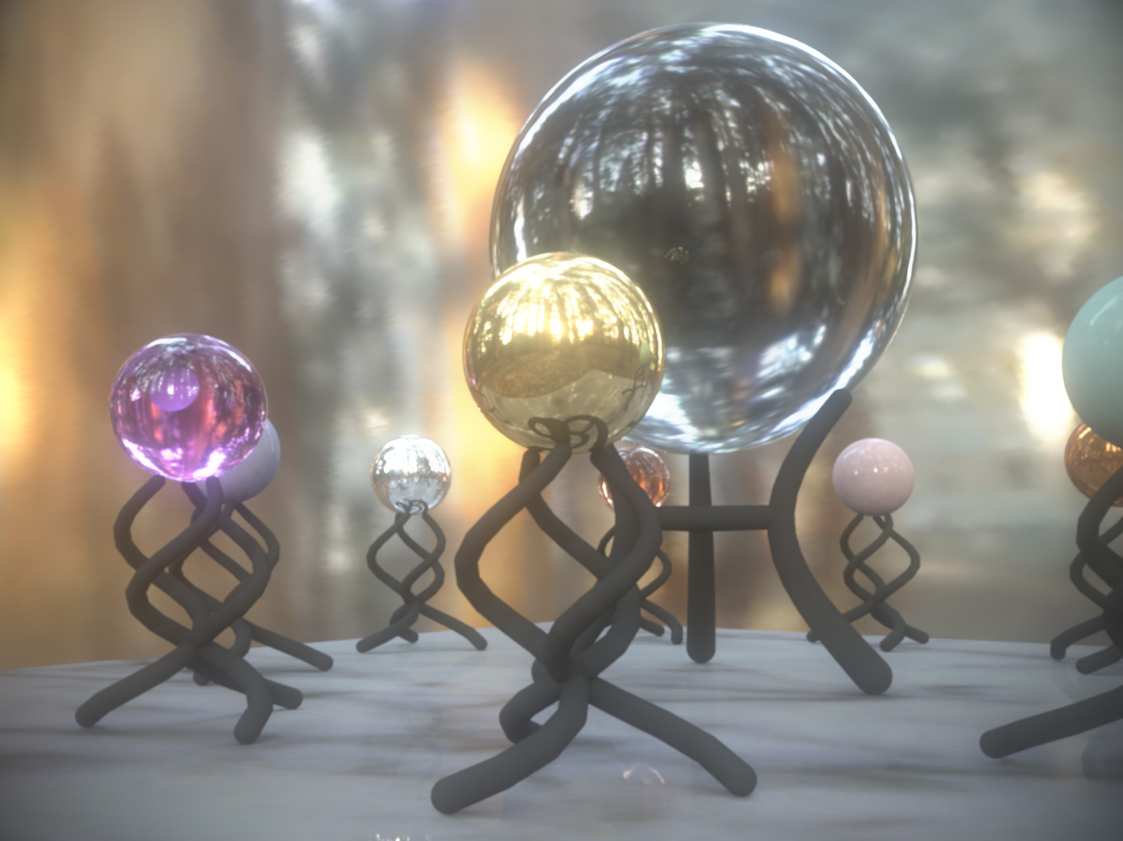
Rendering with Natural Light
Rendering with Natural Light, Debevec 98

Slide 9

Rendering with Natural Light
Rendering with Natural Light, Debevec 98

Slide 10
Fiat Lux (Debevec 99)
https://www.youtube.com/watch?v=vgJuzml0dIw
https://www.pauldebevec.com/Probes/

Slide 11
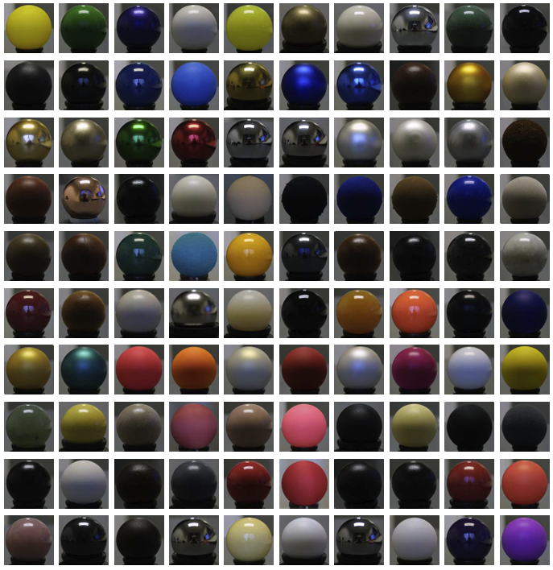
Data-Driven BRDFs
A Data-Driven Reflectance Model. Matusik et al. 03 (MERL 100 BRDF Database)

Slide 12
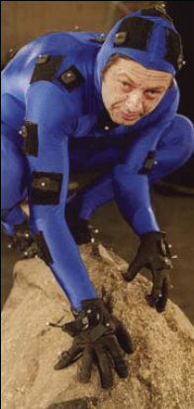
Motion Capture: “Signature” of Actor

Slide 13
Facial MoCap

Slide 14
Weather Forecast for Dummies
Let’s predict weather:
  Given today’s weather only, we want to know tomorrow’s
  Suppose weather can only be {Sunny, Cloudy, Raining}
The “Weather Channel” algorithm:
  Over a long period of time, record:
    How often S followed by R
    How often S followed by S
    Etc.
  Compute percentages for each state:
    P(R|S), P(S|S), etc.
  Predict the state with highest probability!
  It’s a Markov Chain
Notes:
14

Slide 15
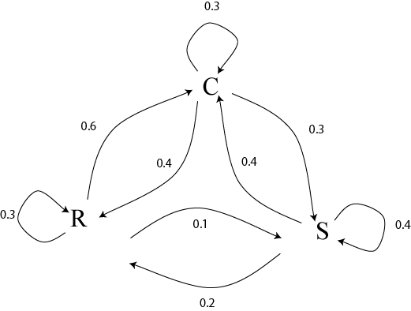
Markov Chain
What if we know today and yesterday’s weather?
Notes:
15

Slide 16
Text Synthesis
[Shannon,’48] proposed a way to generate English-looking text using N-grams:
  Assume a generalized Markov model
  Use a large text to compute prob. distributions of each letter given N-1 previous letters
  Starting from a seed repeatedly sample this Markov chain to generate new letters
  Also works for whole words
WE NEED
TO
EAT
CAKE
Notes:
16

Slide 17
Mark V. Shaney (Bell Labs)
Results (using alt.singles corpus):
  “As I've commented before, really relating to someone involves standing next to impossible.”
  “One morning I shot an elephant in my arms and kissed him.”
  “I spent an interesting evening recently with a grain of salt”
Notes:
17

Slide 18
Texture
Texture depicts spatially repeating patterns
Many natural phenomena are textures
radishes
rocks
yogurt
Notes:
18

Slide 19
Texture Synthesis
Goal of Texture Synthesis: create new samples of a given texture
Many applications: virtual environments, hole-filling, texturing surfaces
Notes:
19

Slide 20
Today: Text to Image
https://www.youtube.com/watch?v=GYyP7Ova8KA&list=PLWfDJ5nla8UpwShx-lzLJqcp575fKpsSO&index=25
https://www.youtube.com/watch?v=lyodbLwb2lY&list=PLWfDJ5nla8UpwShx-lzLJqcp575fKpsSO&index=26
(From Steve Seitz 5 minute videos, also check out language model videos at) https://www.youtube.com/playlist?list=PLWfDJ5nla8UpwShx-lzLJqcp575fKpsSO

Slide 21
Motivation
IBR is not just view synthesis (4D)
Broader trend of sampled data (data-driven)
Data for lighting, BRDFs, motion, textures etc.
  Modern Generative AI is essentially advanced data-driven texture synthesis
Precomputed Light Transport or Radiance Transfer extends this even to synthetic scenes
All of these remain active areas of research

Slide 22
Precomputed Rendering
Image-Based Rendering: Use measured data (real photographs) and interpolate for realistic real-time
Why not apply to real-time rendering?
  Precompute (offline) some information (images) of interest
  Must assume something about scene is constant to do so
  Thereafter real-time rendering. Often accelerate hardware
Easier and harder than conventional IBR
  Easier because synthetic scenes give info re geometry, reflectance (but CG rendering often longer than nature)
  Harder because of more complex effects (lighting from all directions for instance, not just changing view)
Representations and Signal-Processing crucial

Slide 23
My General Philosophy
This general line of work is a large data management and signal-processing problem
Precompute high-dimensional complex data
Store efficiently (find right mathematical represent.)
Render in real-time
  Worry about systems issues like caching
  Good signal-processing: use only small amount of data but guarantee high fidelity
Many insights into structure of lighting, BRDFs, …
  Not just blind interpolation; signal processing

Slide 24

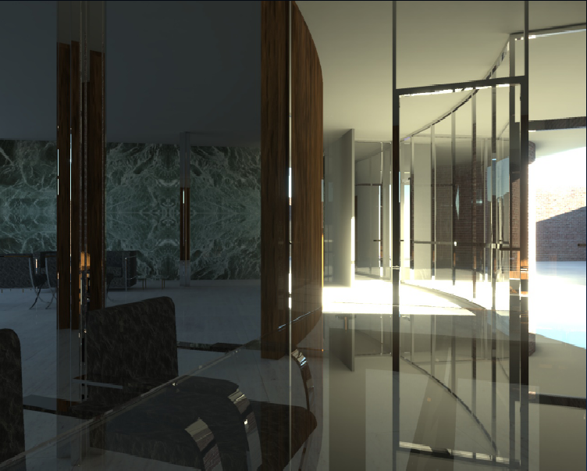
Precomputation-Based Relighting
Analyze precomputed images of scene
Synthesize relit images from precomputed data
Jensen 2000

Slide 25
Precomputation-Based Relighting
Analyze precomputed images of scene
Synthesize relit images from precomputed data
Jensen 2000

Slide 26
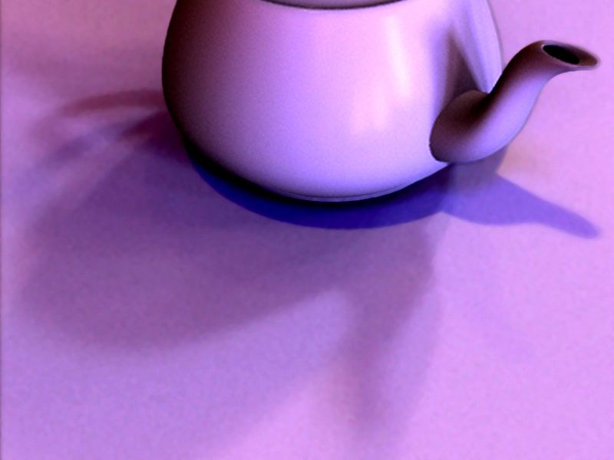
Assumptions
Static geometry
Precomputation
Real-Time Rendering (relight all-frequency effects)
  Exploit linearity of light transport for this
  Later, change viewpoint as well

Slide 27
Why is This Hard?
Plain graphics hardware supports only simple (point) lights, BRDFs (Phong) without any shadows
Shadow maps can handle point lights (hard shadows)
Environment maps complex lighting, BRDFs but no shadows
IBR can often do changing view, fixed lighting
How to do complex shadows in complex lighting?
With dynamically changing illumination and view?

Slide 28
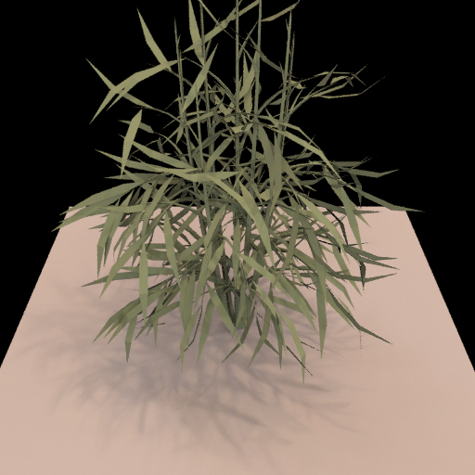
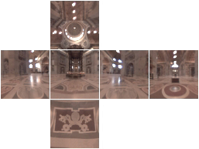
Relighting as a Matrix-Vector Multiply
Notes:
I’d first like to quickly review the concept of relighting as a matrix vector multiplication.

Slide 29
Relighting as a Matrix-Vector Multiply
Output Image
(Pixel Vector)
Input Lighting
(Cubemap Vector)
Precomputed Transport
Matrix
Notes:
The input to the multiplication is the lighting environment, here shown as an unfolded cubemap. The input vector contains a linearization of the cubemap pixels. The output of the multiplication is an image of the scene lit by the input environment. The output vector contains relit image pixels. We call the matrix that transforms from input lighting to output image the light-transport matrix.
TODO: Add change of environment, and corresponding update of the plant image.

Slide 30
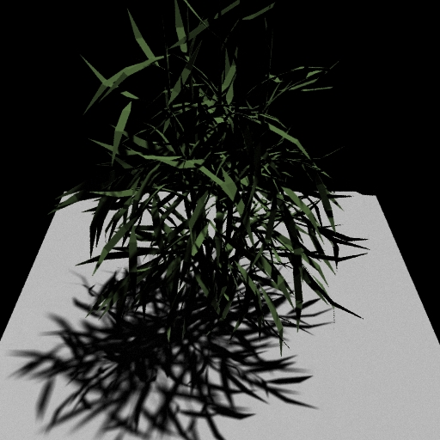

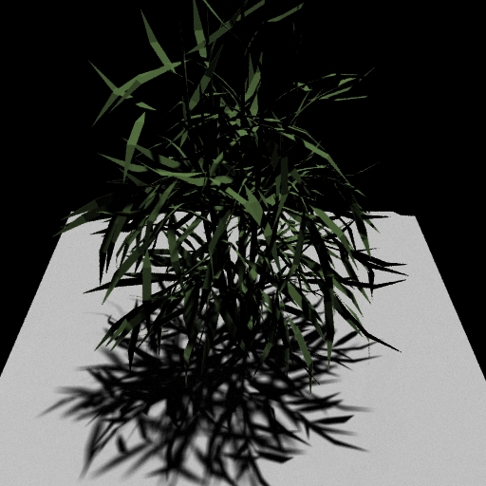
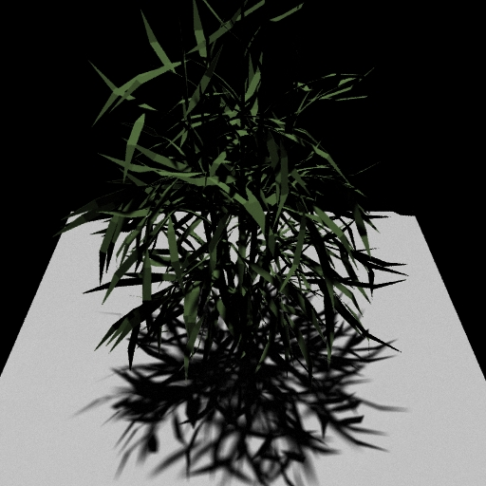
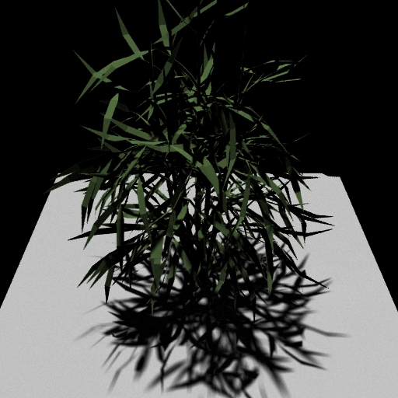
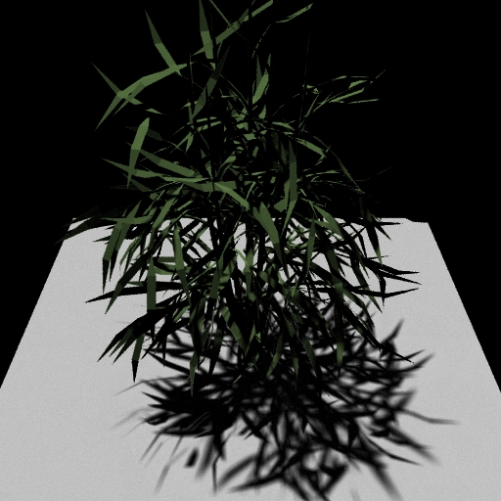
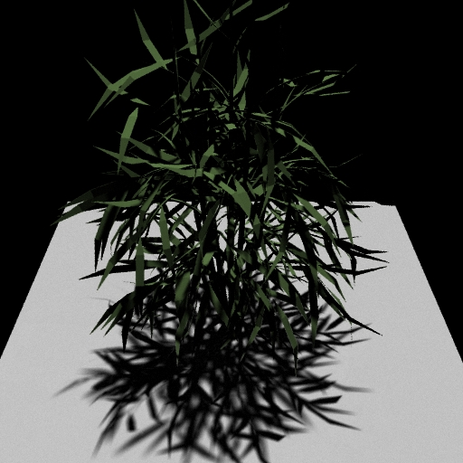
Matrix Columns (Images)
Notes:
The columns of the marix are just images of the scene lit by a single basis light.

Slide 31
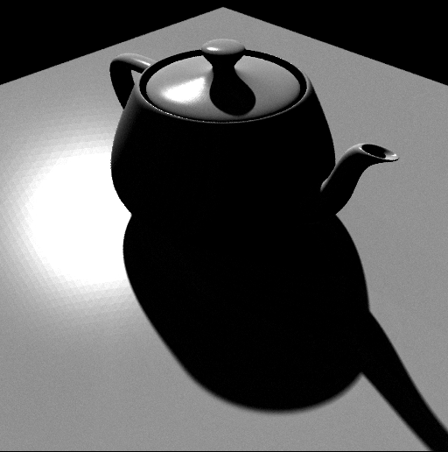
Precompute: Ray-Trace Image Cols
Notes:
Computing the columns is simple and flexible. We can just ray-trace images of the scene under each light. This means that we can handle any light transport effect that we can ray-trace, like glossy reflections and global illumination.

Slide 32
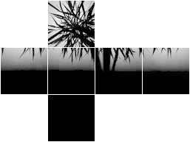
Precompute 2: Rasterize Matrix Rows
Notes:
Alternatively, we can compute the matrix rows. The rows tell us how energy is transported from the environment to a single output pixel. For example, if we consider the row for a pixel on the floor of the plant scene, we would see the silhouette of the plant blocking part of the sky.
To compute a row, we use graphics hardware to render a visibility hemicube at that point, read back the pixels and weight it by the reflection function.

Slide 33
Problem Definition
Matrix is Enormous
  512 x 512 pixel images
  6 x 64 x 64 cubemap environments
Full matrix-vector multiplication is intractable
  On the order of 10¹⁰ operations per frame
How to relight quickly?
Notes:
This brings us to our main problem with using high-resolution, all-frequency lighting. While the matrix formulation is simple mathematically, it’s intractable numerically. The matrix is enormous. We use 512 x 512 images, and cubemaps with 64 x 64 faces. That’s a matrix with a quarter of a million rows and over 24,000 columns. A full multiplication would use on the order of 10 billion operations per frame.
One thing we could do is reduce the dimension to achieve real-time rates; the original precomputed radiance transfer technique is so fast because it uses only 25 – 50 lights. But that blurs output image detail.
Our goal is to try to maintain the fidelity of high resolution light transport, but do it at interactive rates.

Slide 34
Outline
Motivation and Background
Compression methods
  Low frequency linear spherical harmonic approximation
  Factorization and PCA
  Local factorization and clustered PCA
  Non-linear wavelet approximation
Changing view as well as lighting

Slide 35
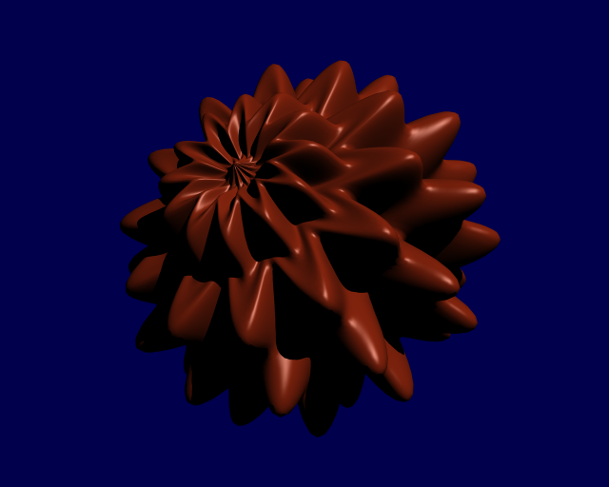
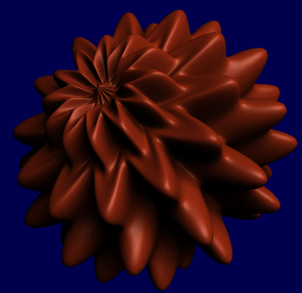
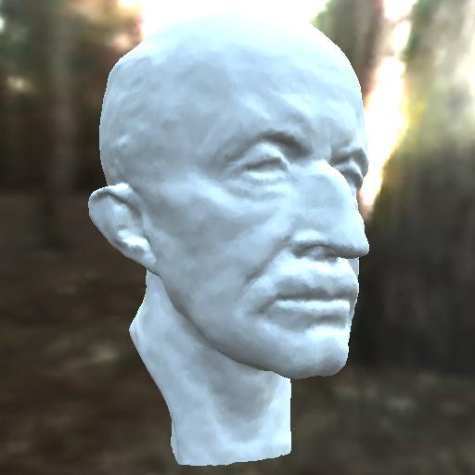
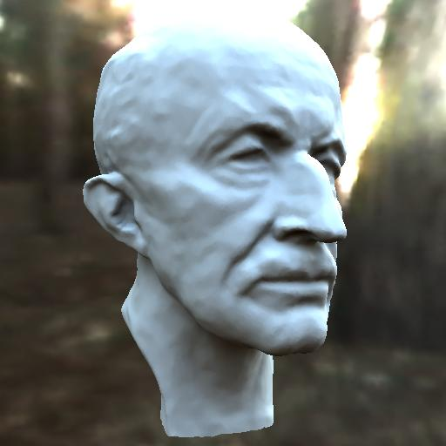
Precomputed Radiance Transfer
Better light integration and transport
  dynamic, area lights
  self-shadowing
  interreflections
For diffuse and
glossy surfaces
At real-time rates
Sloan et al. 02 (most cited rendering paper in last 20 years 1000+, widely used in games, movie production: Spherical Harmonic Lighting)
point light
area light
area lighting,
no shadows
area lighting,
shadows
Notes:
We think there’s good reason to concentrate on this part of the lighting/transport complexity space.
We wanted to handle dynamic and large area lights, including their self-shadowing and interreflection effects.
Area lights can add a sense of realism that is difficult to obtain with point lights – in the top row we have a displacement mapped sphere illuminated with a point light (casting hard shadows) and an area light (casting soft shadows.) The object shape’s is more effectively conveyed with soft shadows.
Shadows also add much more realism than area lighting without shadows.
In the bottom row we have a bust of the max planc head rendered on the left using ravi’s technique from last year (no shadows) and on the right using our technique. Though both are lit by an entire environment, the shadowed image on the right looks more realistic.
We wanted to achieve these effects for both diffuse and glossy surfaces at real-time rendering rates.

Slide 36
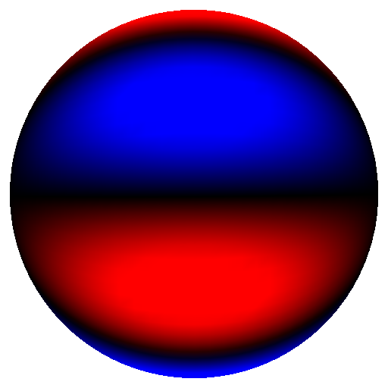
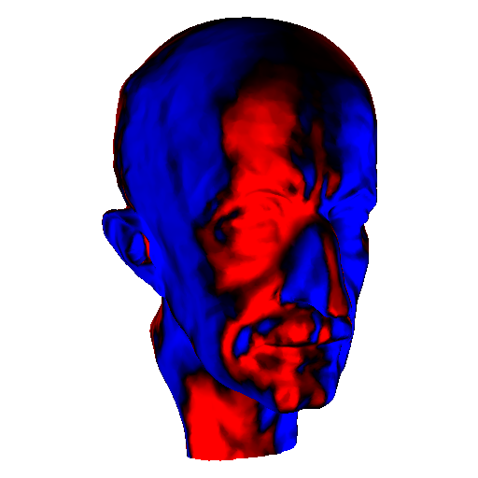
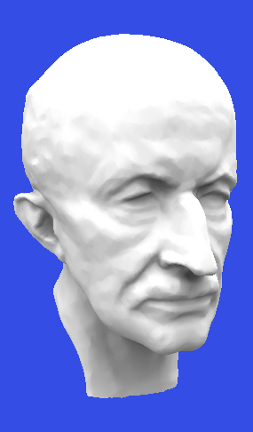
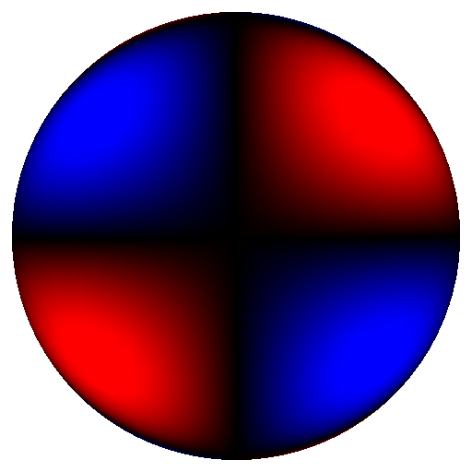
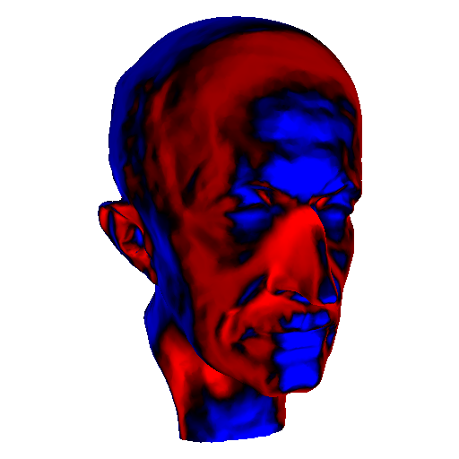
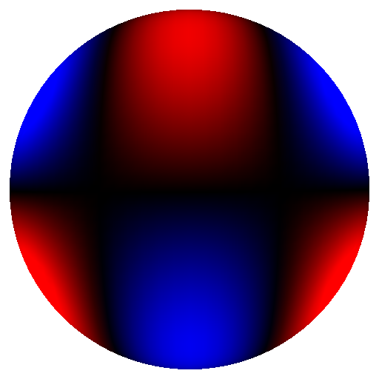
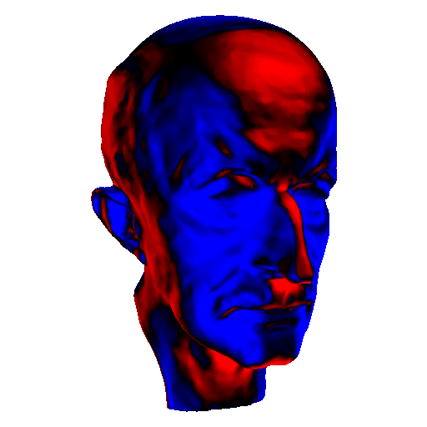
Precomputation: Spherical Harmonics
.
.
.
Basis 16
Basis 17
illuminate
result
Basis 18
.
.
.
Notes:
This slide illustrates the precomputation for direct lighting. Each image on the right is generated by placing the head model into a lighting environment that simply consists of the corresponding basis function (SH basis in this case illustrated on the left.) This just requires rendering software that can deal with negative lights.
The result is a spatialy varying set of transfer coefficients shown on the right.
To reconstruct reflected radiance just compute a linear combination of the transfer coefficient images scaled by the corresponding coefficient for the lighting environment.

Slide 37
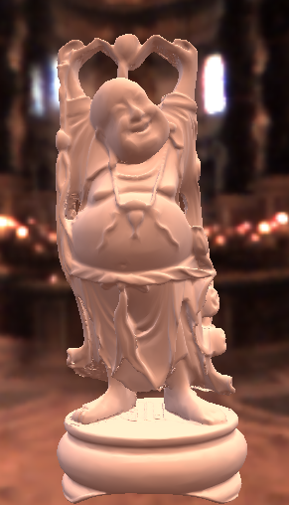
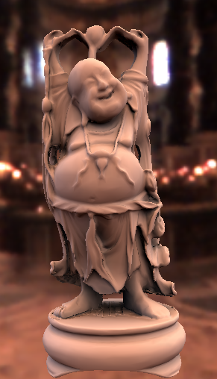
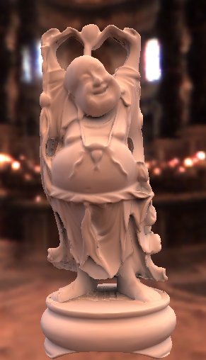
Diffuse Transfer Results
No Shadows/Inter Shadows Shadows+Inter
Notes:
This set of images shows the buddha model lit in the same lighting environment, without shadows, with shadows and with shadows and inter reflections.

Slide 38
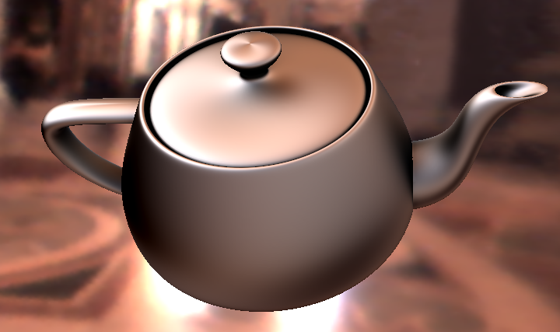
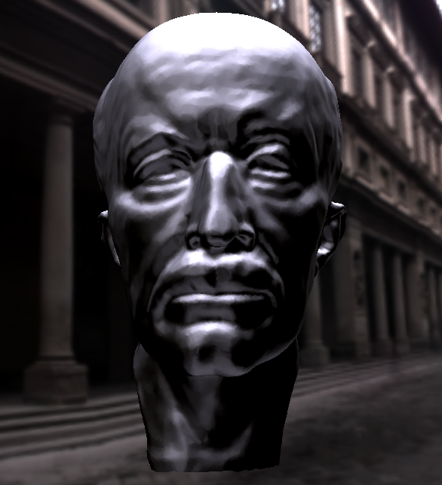
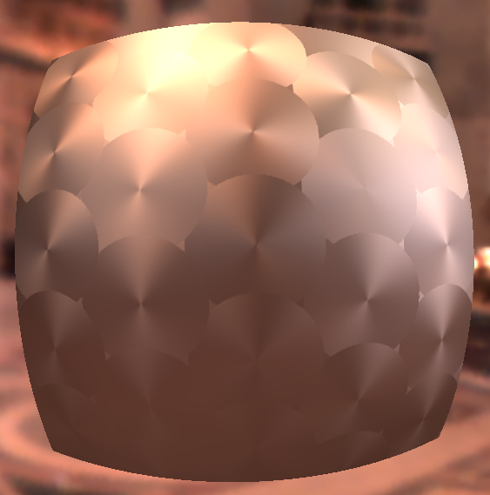
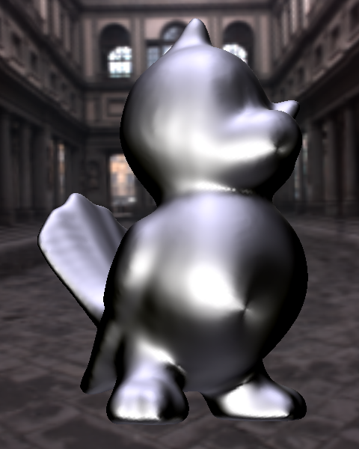
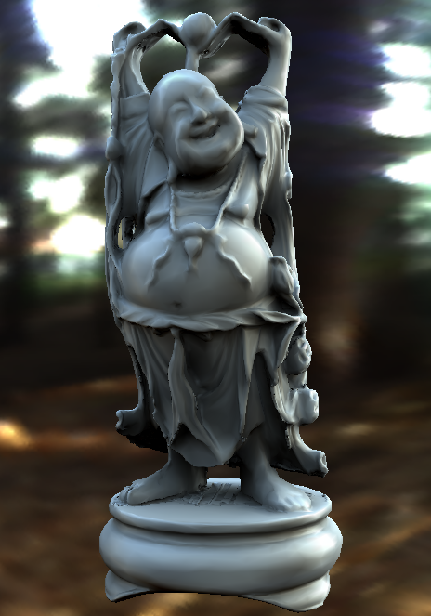
Arbitrary BRDF Results
Anisotropic BRDFs
Other BRDFs
Spatially Varying
Notes:
Here are a few results. On the left you can see renderings with anisotropic BRDFs, in the middle renderings with the Ashikhmin-Shirley BRDF and with measured vinyl. On the right you can see spatially varying BRDFs. All of these examples can be rendered at interactive rates.

Slide 39
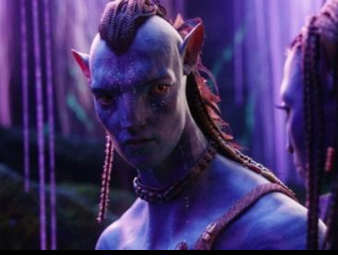
Precomputed Lighting (Avatar 2010)

Slide 40
Relighting as a Matrix-Vector Multiply
Notes:
I’d first like to quickly review the concept of relighting as a matrix vector multiplication.

Slide 41
Idea of Compression
The vector is projected onto low-frequency components (say 25). Size greatly reduced.
Hence, only 25 matrix columns
But each pixel still treated separately (still have 300000 matrix rows for 512 x 512 image)
Actually, for each pixel, dot product of matrix row (25 elems) and lighting vector (25 elems) in hardware
Good technique (common in games, movies) but useful only for broad low-frequency lighting

Slide 42
Outline
Motivation and Background
Compression methods
  Low frequency linear spherical harmonic approximation
  Factorization and PCA
  Local factorization and clustered PCA
  Non-linear wavelet approximation
Changing view as well as lighting
  Clustered PCA
  Factored BRDFs
  Triple Product Integrals

Slide 43
PCA or SVD factorization
SVD:
I^{j}
=
E^{j}
x
S^{j}
x
p x n
p x p
p x n
C^{jT}
diagonal matrix
(singular values)
n x n
Applying Rank b:
I^{j}
=
p x n
x
x
E^{j}
S^{j}
C^{jT}
p x b
b x b
b x n
Absorbing S^{j} values into C^{iT}:
I^{j}
=
p x n
x
E^{j}
L^{j}
p x b
b x n

Slide 44
Idea of Compression
Represent matrix (rather than light vector) compactly
Can be (and is) combined with low frequency vector
Useful in broad contexts.
  BRDF factorization for real-time rendering (reduce 4D BRDF to 2D texture maps) McCool et al. 01 etc
  Surface Light field factorization for real-time rendering (4D to 2D maps) Chen et al. 02, Nishino et al. 01
  Factorization of Orientation Light field for complex lighting and BRDFs (4D to 2D) Latta et al. 02
Not too useful for general precomput. relighting
  Transport matrix not low-dimensional!!

Slide 45
Local or Clustered PCA
Exploit local coherence (in say 16x16 pixel blocks)
  Idea: light transport is locally low-dimensional. Why?
  Even though globally complex
  See Mahajan et al. 07 for theoretical analysis
Original idea: Each triangle separately
  Example: Surface Light Fields 3D subspace works well
  Vague analysis of size of triangles
  Instead of triangle, 16x16 image blocks [Nayar et al. 04]
Clustered PCA [Sloan et al. 2003]
  Combines two widely used compression techniques: Vector Quantization or VQ and Principal Component Analysis
  For complex geometry, no need for parameterization / topology

Slide 46
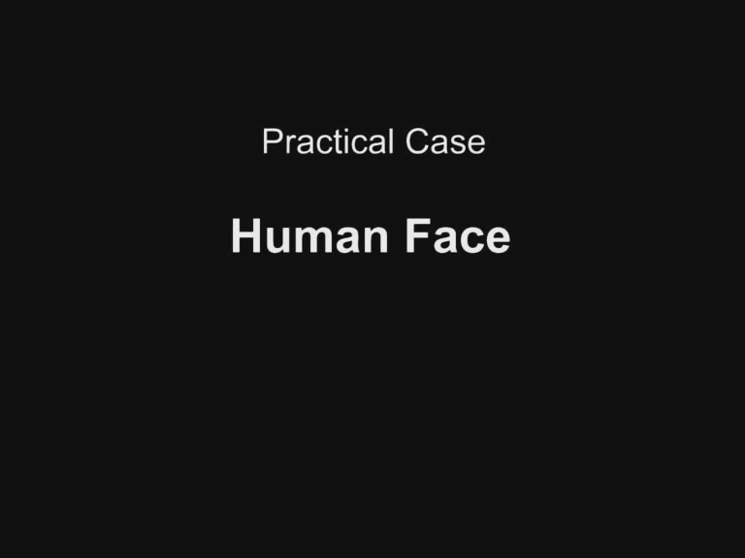
Image-Based Rendering
Zickler, Enrique, Ramamoorthi, Belhumeur 05, 06

Slide 47
Outline
Motivation and Background
Compression methods
  Low frequency linear spherical harmonic approximation
  Factorization and PCA
  Local factorization and clustered PCA
  Non-linear wavelet approximation
Changing view as well as lighting

Slide 48
Sparse Matrix-Vector Multiplication
Choose data representations with mostly zeroes
Vector: Use non-linear wavelet approximation
on lighting
Matrix: Wavelet-encode transport rows
Notes:
Our solution is to compress the computation by choosing data representations with mostly zeroes for both the lighting vector and the matrix. We then implement relighting as a sparse matrix-vector multiplication. I’m going to tell about each of these sources of compression. The lighting compression is dominant – it’s the title of our paper – so let’s talk about that first.

Slide 49
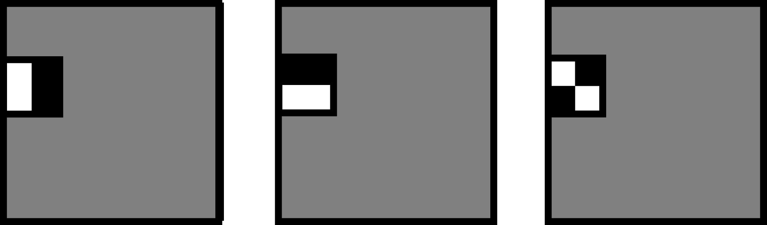
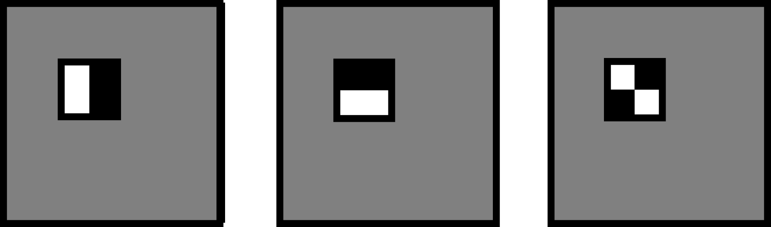










Haar Wavelet Basis
Notes:
I just want to give a quick visual review of the 2D Haar basis.
The Haar basis starts with three mother wavelets, shown here for horizontal, vertical and diagonal differencing. White is positive and black is negative.
The Haar basis is a subdivision series based on quartering these mother wavelets and replicating them in all positions. In these pictures gray is zero.
The next level of subdivision quarters the functions again, and here are a few of basis functions at that level.
Of course this subdivision continues for higher order basis expansions. We typically use 6 to 8 subdivision levels.

Slide 50
Non-linear Wavelet Approximation
Wavelets provide dual space / frequency locality
  Large wavelets capture low frequency area lighting
  Small wavelets capture high frequency compact features
Non-linear Approximation
  Use a dynamic set of approximating functions (depends on each frame’s lighting)
  By contrast, linear approx. uses fixed set of basis functions (like 25 lowest frequency spherical harmonics)
  We choose 10’s - 100’s from a basis of 24,576 wavelets
Notes:
Another you might have is whether we need a wavelet basis? Why not non-linear spherical harmonics, or why not just the brightest pixels in the cubemap?
Wavelet bases are good approximating spaces for relighting because they contain functions of all different sizes and positions. Some are as small as a single cubemap pixel; others cover essentially the whole environment. The large wavelets can capture low-frequency features. And the small wavelets can capture compact, high-frequency features. In signal processing terms, a wavelet basis provides energy localization in both frequency and space.
In contrast, spherical harmonics localize well in frequency but not in space. A point light would need many harmonics to be approximated well. Conversely, a pixel basis localizes well in space but not in frequency. A large area light needs many pixels to resolve it well.
So that’s why we choose a wavelet basis.

Slide 51





Non-linear Wavelet Light Approximation
Wavelet Transform
Notes:
What is non-linear wavelet approximation? Well, we take the input lighting cubemap, and wavelet transform each face. I’m not going to review wavelet transforms, but basically this consists of recursively averaging down each face and storing the differences between the averaged image and original. This gives us a vector of wavelet transformed coefficients. The wavelet transform turns coherence in the environment into small coefficients – so the majority of these L coefficients are now close to zero.

Slide 52

Non-linear Wavelet Light Approximation
Non-linear
Approximation
Retain 0.1% – 1% terms
Notes:
The next step is non-linear approximation, where we choose some coefficients to keep, and discard the others – we make them zero. We use a very aggressive, lossy approximation, where we keep only a hundredth or a thousandth of the coefficients.

Slide 53


Error in Lighting: St Peter’s Basilica
Sph. Harmonics
Relative L² Error (%)
Non-linear Wavelets
Approximation Terms
Ng, Ramamoorthi, Hanrahan 03
Notes:
This graph shows the relative error in the lighting approximation of St Peter’s as we increase the number of approximation terms. As we increase the number of terms, the error decreases to zero. The top, dashed curve is for linear spherical harmonics, the bottom is for non-linear wavelets. Note that the horizontal scale is on a log plot, so the separation between the two curves means that non-linear wavelets converge about two orders of magnitude more quickly.

Slide 54


Output Image Comparison
Top: Linear Spherical Harmonic Approximation
Bottom: Non-linear Wavelet Approximation
25
200
2,000
20,000
Notes:
And here is the visual comparison. Note that 200 wavelets resolve essentially all image details. 200 harmonics still blur the reflection of the window. And 2000 harmonics still blur the tip of the shadow under the teapot.

Slide 55

Video: Real Time Relighting

Slide 56
Outline
Motivation and Background
Compression methods
  Low frequency linear spherical harmonic approximation
  Factorization and PCA
  Local factorization and clustered PCA
  Non-linear wavelet approximation
Changing view as well as lighting

Slide 57






Changing Only The View
Notes:
Here are a pair of views changing just the camera as in the photos. Note that the diffuse shadows here on the floor stay fixed – they’re caused by a bright light scattering equally in all directions. They don’t change with the viewpoint.
In contrast, these glossy shadows evolve dramatically with change in viewpoint. On the left the specular lobe intersects essentially one window, and on the right it intersects parts of three windows.
These images were rendered without texture to emphasize the lighting details.

Slide 58

Problem Characterization
6D Precomputation Space
Distant Lighting (2D)
View (2D)
Rigid Geometry (2D)
With ~ 100 samples per dimension
  ~ 10¹² samples total!! : Intractable computation, rendering
Notes:
So what we’ve seen is that the transport function is 6 dimensional, because it varies over the hemisphere of incoming lighting directions, the hemisphere of viewing directions, and the surface position.
In all-frequency relighting, we need at least 100 samples per dimension, typically, so that means the 6D space uses 10^12 samples – a terasample. That’s much too much data to precompute, store or relight with.

Slide 59
Clustered PCA
Use low-frequency light and view variation (Order 4 spherical harmonic = 25 for both; total = 25*25=625)
625 element vector for each vertex
Apply CPCA directly (Sloan et al. 2003)
Does not easily scale to high frequencies
  Really cubic complexity (number of vertices, illumination directions or harmonics, and view directions or harmonics)
Practical real-time method on GPU

Slide 60
Factored BRDFs
Sloan et al. 04, Wang et al. 04: All-frequency effects
Combines lots of things: BRDF factorization, CPCA, nonlinear approx. with wavelets
Idea: Factor BRDF to depend on incident, outgoing
  Incident part handled with view-independent relighting
  Then linearly combine based on outgoing factor
Effectively, break problem into a few subproblems that can be solved view-independently and added up
  Can apply nonlinear wavelet approx. to each subproblem
  And CPCA to the matrices for further compression

Slide 61



Factorization Approach
6D Transport
=
~ 10¹² samples
*
4D Visibility
4D BRDF
~ 10⁸ samples
~ 10⁸ samples
Notes:
The approach we propose in this paper is a bit different. For direct illumination, the 6D transport operator is exactly given by the product of the 4D visibility, which tells us where we can see the sky and where we’re blocked, and the 4D BRDF. So instead of using 10^12 samples, in factored form we need 10^8 samples.

Slide 62




Triple Product Integral Relighting
Notes:
The tricky part is that where we had two functions before to multiply and integrate, we now have…

Slide 63




Relit Images (3-5 sec/frame)
Notes:
Using this factored algorithm we can produce images of this 300,000 vertex scene in 3-5 seconds. The cubemaps faces here are 64x64.

Slide 64
Summary
Really a big data compression and signal-processing problem
Apply many standard methods
  PCA, wavelet, spherical harmonic, factor compression
And invent new ones
  VQPCA, wavelet triple products
Guided by and gives insights into properties of illumination, reflectance, visibility
  How many terms enough? How much sparsity?

Slide 65
Subsequent Work
My survey 2009 (lecture only covers 2002-2004)
Varied lighting/view. What about dynamic scenes, BRDFs
  Much subsequent work [Zhou et al. 05, Ben-Artzi et al. 06]. But still limited for dynamic scenes
Must work on GPU to be practical
Sampling on object geometry remains a challenge
Near-Field Lighting has had some work, remains a challenge
Applications to lighting design, direct to indirect transfer
New basis functions and theory
Newer methods do not require precompute, various GPU tricks
So far, low-frequency spherical harmonics used in games, all-frequency techniques have had limited applicability

Slide 66

Analytic SH Gradients

