Slide 1
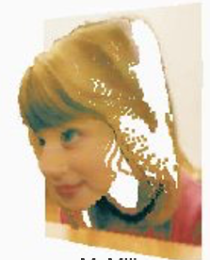
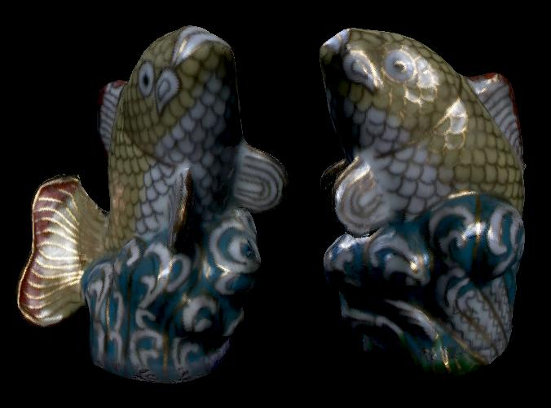
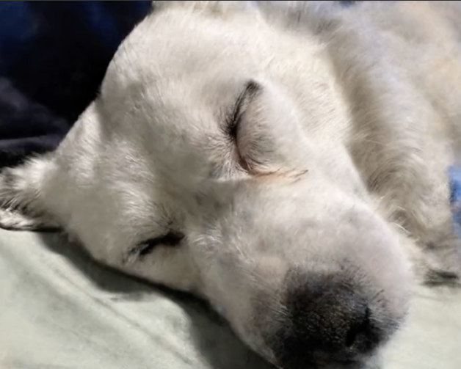
Image-Based Rendering
CSE 274, Lecture 6: Photo Tourism (and Façade)
Ravi Ramamoorthi
http://www.cs.ucsd.edu/~ravir

Slide 2
Motivation
Today IBR models whole urban world (think of Streetview with 3D modeling, NeRFs)
Remains important topic for sparse views
Actively working on WRIVA project
Briefly trace two key developments
Façade system (Debevec et al. 96)
[Not covered: ] Teller ~00: Automated Model Capture in Extended Urban Environments
Photo Tourism (Snavely et al. 06)

Slide 3
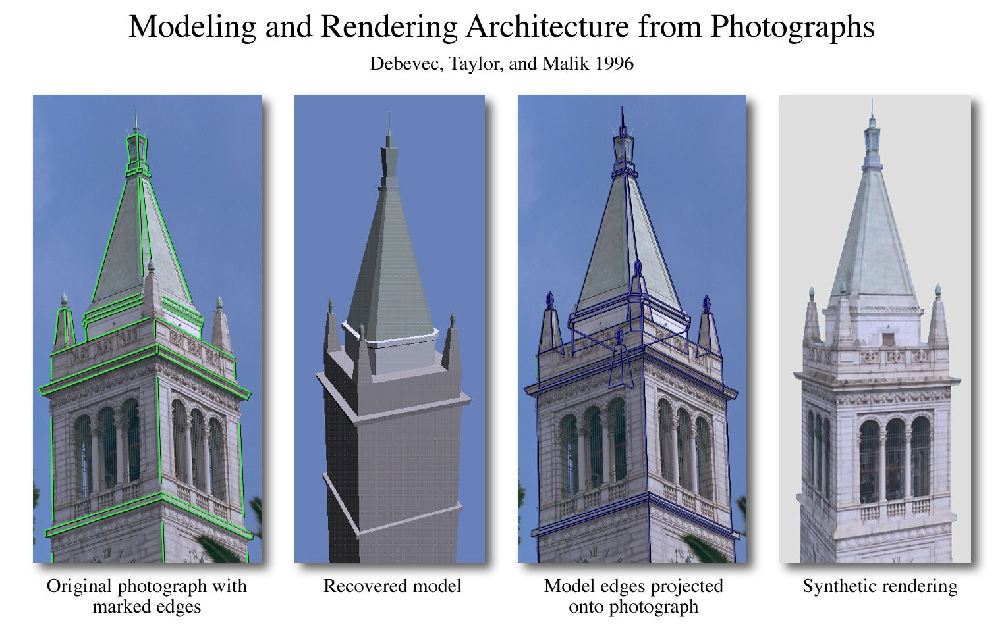

Slide 4
FACADE
Photogrammetric Modeling
Interactively recover 3D models and camera positions from photographs for simple structures
View-Dependent Texture Mapping (3D model and set of photos into renderings)
Model-Based Stereo refines geometric model
Video: https://youtu.be/F-L5qnTZEFg

Slide 5

Campanile Movie (SIGGRAPH 97 ET)
For audio, play off debevec-campanile.mov

Slide 6
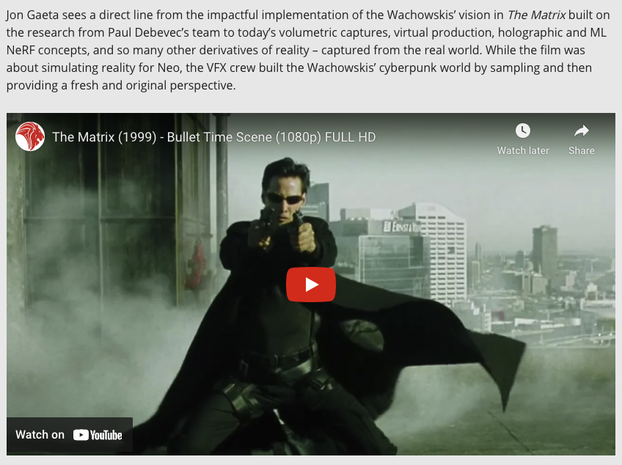
https://www.fxguide.com/fxfeatured/why-the-campanile-movie-25-years-on-is-still-so-important/

Slide 7
Photo Tourism: Exploring Photo Collections in 3D
Noah Snavely
Steven M. Seitz
University of Washington
Richard Szeliski
Microsoft Research
© 2006 Noah Snavely

Slide 8
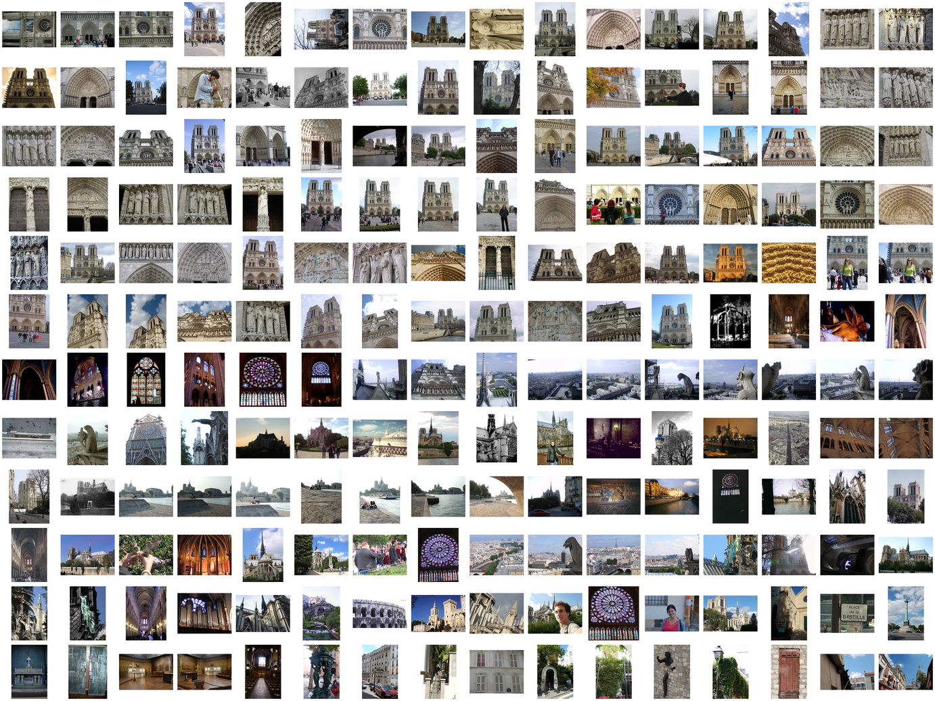
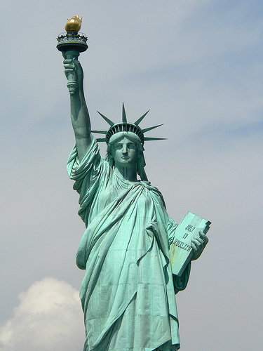
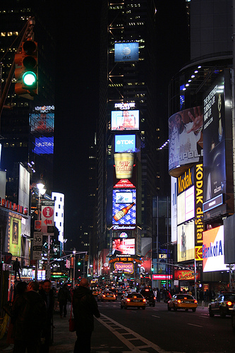
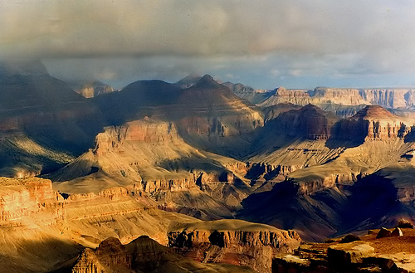
15,464
37,383
76,389

Slide 9
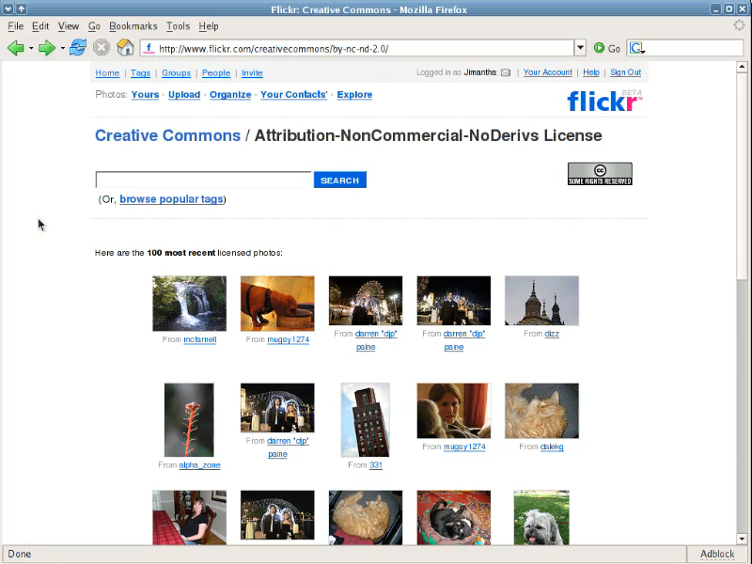
Reproduced with permission of Yahoo! Inc. © 2005 by Yahoo! Inc.
YAHOO! and the YAHOO! logo are trademarks of Yahoo! Inc.
Notes:
Advances in digital camera technology and the popularity of photo-sharing sites such as Flickr have resulted in the availability of vast numbers of photos. Doing a Flickr search for a famous place like the Trevi Fountain, returns thousands of photos. Unfortunately, common image browsing tools don’t give a sense of a rich relationships between all of the photos.
The goal of Photo Tourism is to use location information to build a better visualization and photo exploration tool for collections of photos of the same scene.
[If I do a search for Trevi and Rome in Flickr, you’ll see a typical way of browsing such collections – looking at page after page of thumbnails. If I have a specific kind of photo of the Trevi Fountain in mind, it can be hard to find it this way, and the relationships between all the photos isn’t clear.
The goal of the Photo Tourism project is to use location information to build a better visualization and photo exploration tool for collections of photos of the same scene.]
[Here’s a sample search for “Trevi Fountain” on Flickr – results are returned on pages and pages of thumbnails. Finding a photo of a specific part of the fountain amounts to scrolling through the thumbnails, and it’s not clear how all the photos are related to each other.
The goal of the Photo Tourism project is to use location information to build a better visualization and photo exploration tool for collections of photos of the same scene.]
11/27/24
9

Slide 10
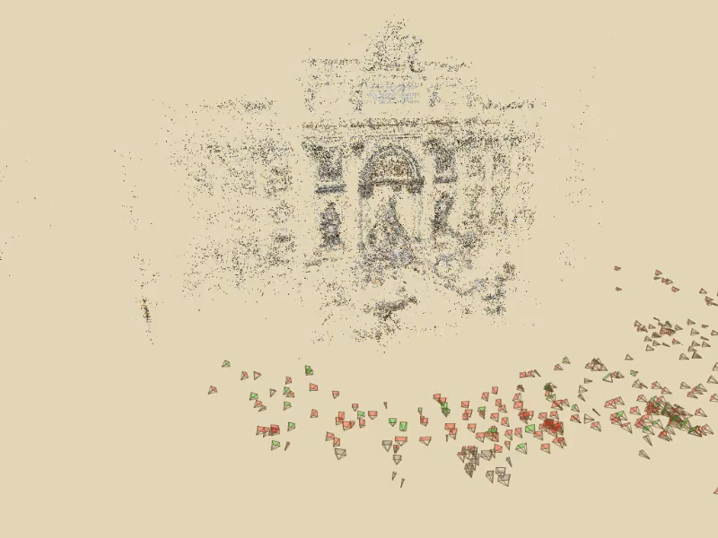
Photo Tourism
Notes:
Here’s how the same set of photos appear in our photo explorer. Our system takes the set of photos and automatically determines the relative positions and orientations from which each photo was taken. We can then load the photos into our immersive 3D browser where the user can visualize and explore the photos using spatial relationships.

Slide 11
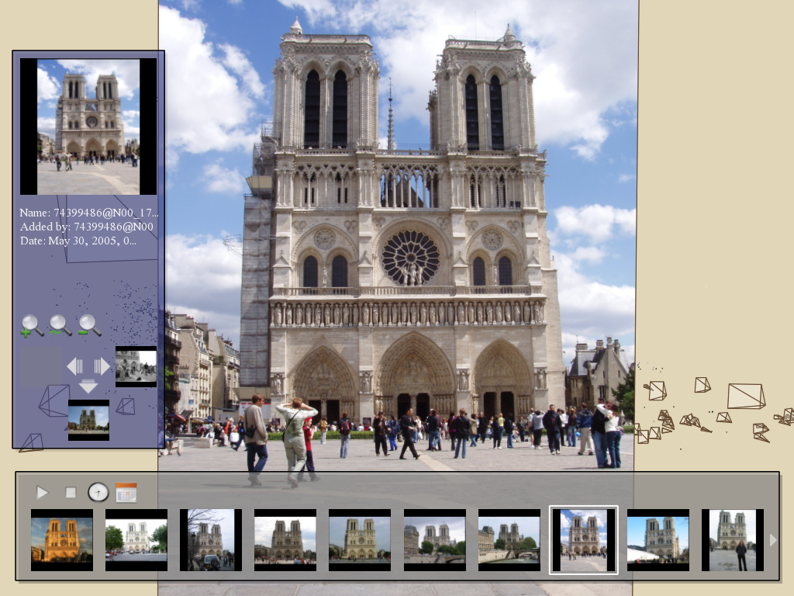
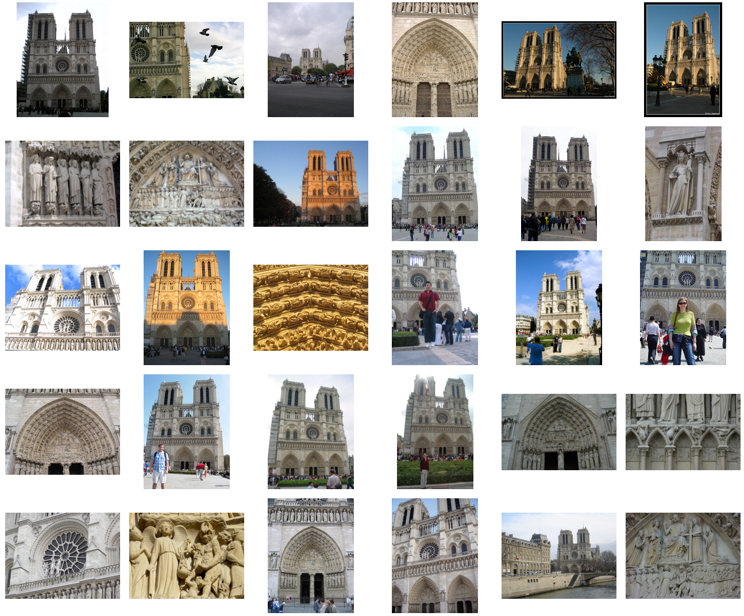
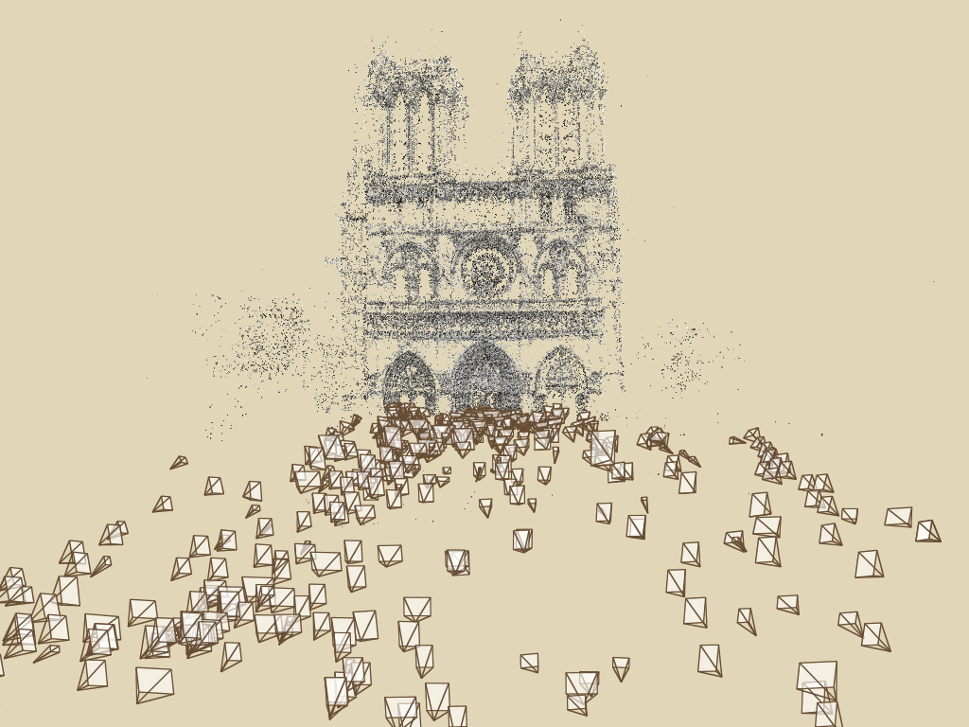
Photo Tourism overview
Photo Explorer
Scene reconstruction
Input photographs
Relative camera positions and orientations
Point cloud
Sparse correspondence
[Note: change to Trevi for consistency]
Notes:
Our system takes as input an unordered set of photos, either from an Internet search or from a large personal collection. We assume the photos are largely from the same static scene.
The first step of our system is to apply a computer vision techniques to reconstruct the geometry of the scene. The output of this procedure is the relative positions and orientation for the cameras used to take a connected set of the photographs, as well as a point cloud representing the geometry of the scene, and a sparse set of correspondences between the photos.
This information is then loaded into our interactive photo explorer tool.

Slide 12
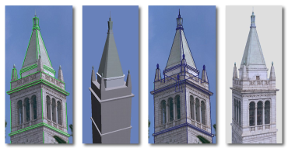
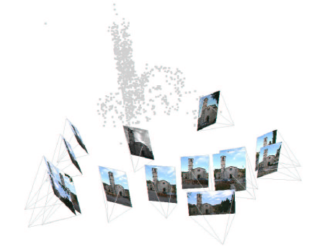
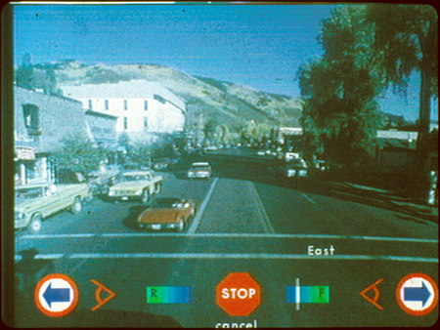
Related work
Image-based modeling
Image-based rendering
Debevec, et al.
SIGGRAPH 1996
Schaffalitzky and Zisserman ECCV 2002
Brown and Lowe
3DIM 2005
Photorealistic IBR:
Levoy and Hanrahan, SIGGRAPH 1996
Gortler, et al, SIGGRAPH 1996
Seitz and Dyer, SIGGRAPH 1996
Aliaga, et al, SIGGRAPH 2001
and many others
Aspen Movie Map
Lippman, et al., 1978
Notes:
Before I get into the details of our system, I’ll briefly discuss some relevant prior work.
Our system uses automatic image-based modeling to recover the geometry of the scene. Prior work in this area includes the semi-automatic Façade system of Debevec and collegues, as well as other work, such as that of Schaffaltzky and Zisserman and Brown and Lowe on automatic structure from motion on unordered sets of images. However, to our knowledge, our modeling system is the first to be successfully applied to hundreds of images taken from the Internet.
Our work also uses image-based rendering to depict transitions between images. The Aspen Movie Map project at MIT, which created an interactive virtual tour of the city of Aspen, is one system in this area with many of the same exploration features as ours, but which required extensive manual effort to create.
More recent image-based rendering techniques seek to create photo-realistic in-between images, while our system focuses on the photographs themselves, using transitions only as a way to get between two photos.

Slide 13
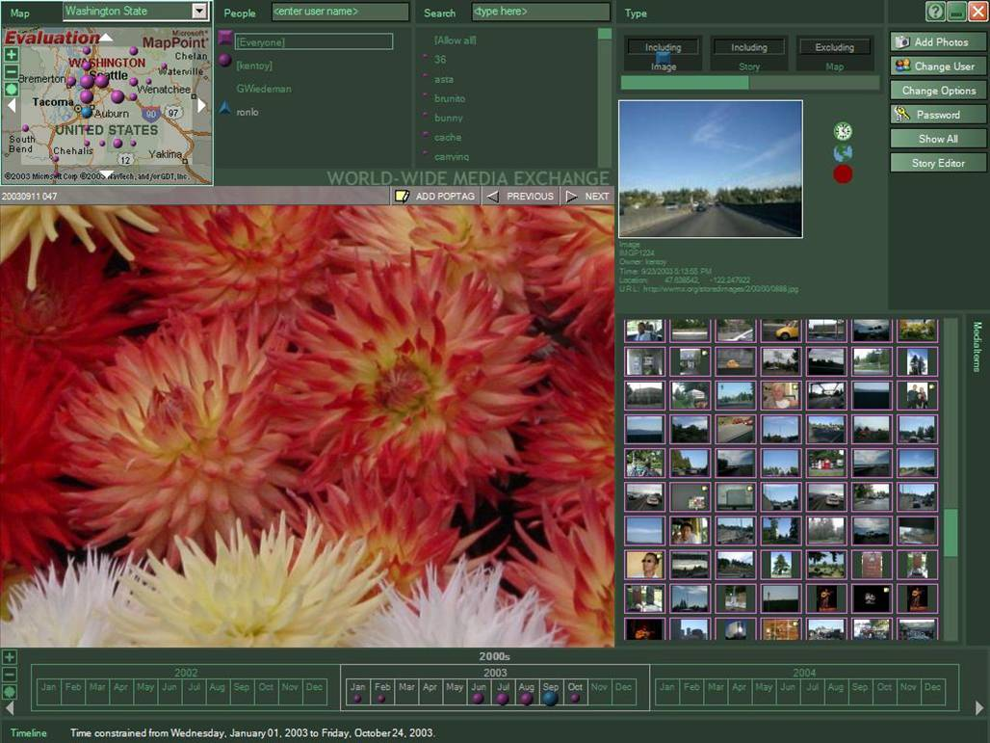
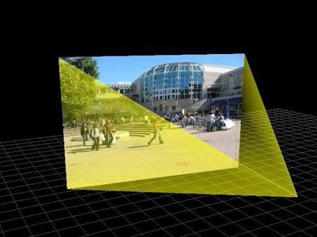
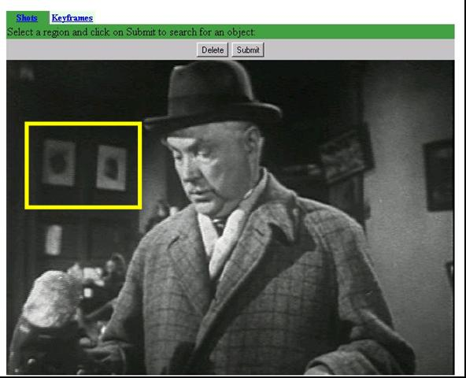
Related work
Image browsing
Toyama, et al,
Int. Conf. Multimedia, 2003
McCurdy and Griswold
Mobisys 2003
Sivic and Zisserman
ICCV 2003
Notes:
Finally, there is a lot of related work in the field of image browsing and image retrieval. WWMX is a photo-browsing web site that also uses location information to organize photos, but doesn’t provide an immersive browsing experience. The Realityflythrough project uses GPS information to situate video streams in space in an interface similar to ours, but our system works without GPS. Finally, Video Google allows users to find objects in videos by selecting them. We have similar tools in our explorer, but in the context of a 3D photo browser.

Slide 14
Photo Tourism overview
Photo Explorer
Scene reconstruction
Input photographs
[Note: change to Trevi for consistency]
Notes:
Now I will describe the Photo Tourism system, beginning with the scene reconstruction procedure.

Slide 15
Scene reconstruction
Automatically estimate
position, orientation, and focal length of cameras
3D positions of feature points
Feature detection
Incremental structure from motion
Pairwise
feature matching
Correspondence estimation
Notes:
Again, the goal of the reconstruction procedure is to automatically estimate the relative positions and orientations, as well as the focal length or zoom, of each of the photographs in a connected component of the scene. The process consists of four steps: detecting features in each of the input photos; matching features between each pair of photos; grouping the matches into correspondences across multiple photos; and using the correspondences to estimate the geometry of the scene and the cameras in a technique known as structure from motion.
I’ll now describe each of these steps in more detail.
[Structure from motion techniques for unordered image collections have also been developed by others, such as Brown and Lowe and Schaffalitzky and Zisserman, and the basic pipeline of our system closely follows that of Brown and Lowe. To our knowledge, our system is the first to have been demonstrated on large collections of photos from the Internet.]

Slide 16
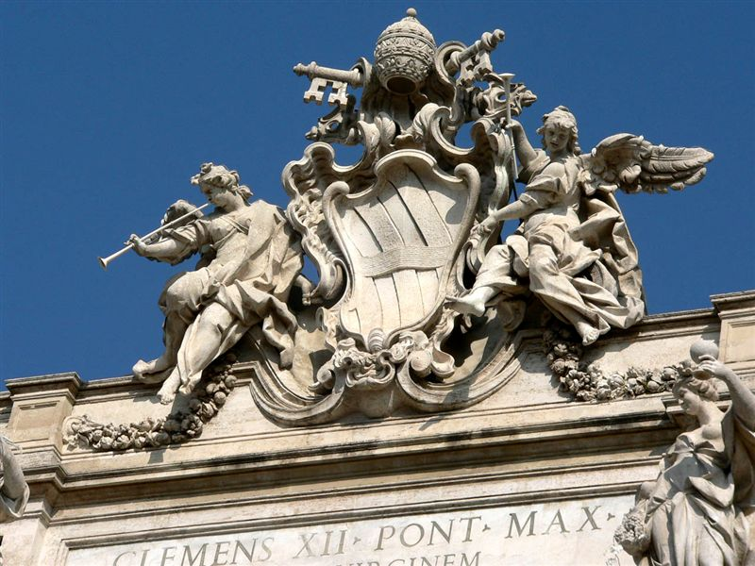
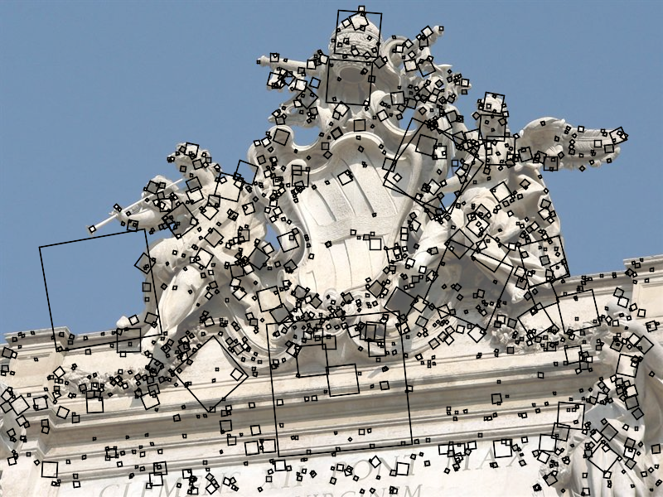
Feature detection
Detect features using SIFT [Lowe, IJCV 2004]
Notes:
The core of the reconstruction process is the ability to reliably match feature points between images. Fortunately, over the last few years feature detection and matching techniques have improved dramatically. Many different technique exist – we use SIFT, or scale-invariant feature transform, developed by David Lowe. SIFT is designed to be invariant to image scale and rotation, as well as affine changes in image intensity.
Here is an image from the Trevi Fountain, and here are the features SIFT detects in the image, shown as square patches. The squares are scaled and rotated to reflect the scale and orientation of the features.

Slide 17
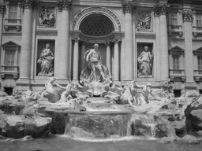
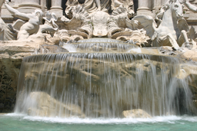
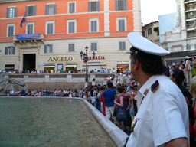
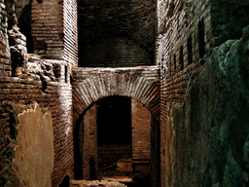
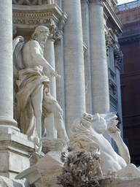
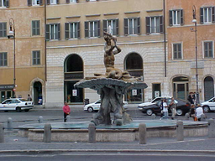
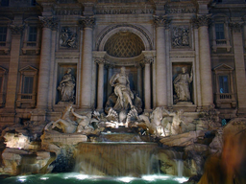
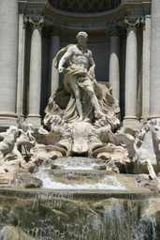
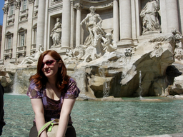
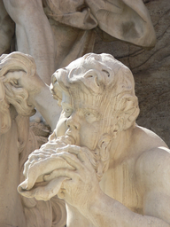
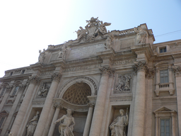
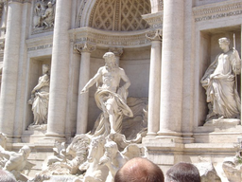
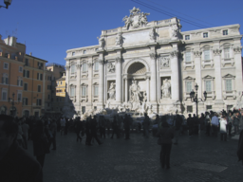
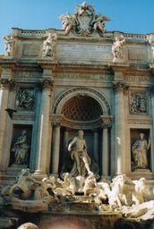
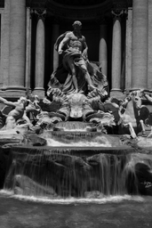
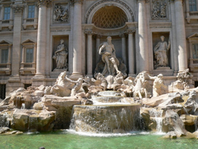
Feature detection
Detect features using SIFT [Lowe, IJCV 2004]
Notes:
So, we begin by detecting SIFT features in each photo.
[We detect SIFT features in each photo, resulting in a set of feature locations and 128-byte feature descriptors…]

Slide 18
Feature detection
Detect features using SIFT [Lowe, IJCV 2004]

Slide 19
Feature matching
Match features between each pair of images
Notes:
Next, we match features across each pair of photos using approximate nearest neighbor matching.

Slide 20
Feature matching
Refine matching using RANSAC [Fischler & Bolles 1987] to estimate fundamental matrices between pairs
Notes:
The matches are refined by using RANSAC, which is a robust model-fitting technique, to estimate a fundamental matrix between each pair of matching images and keeping only matches consistent with that fundamental matrix.
We then link connected components of pairwise feature matches together to form correspondences across multiple images.
Once we have correspondences, we run structure from motion to recover the camera and scene geometry. Structure from motion solves the following problem:

Slide 21
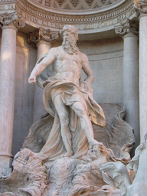
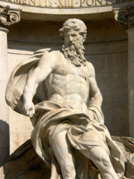
Correspondence estimation
Link up pairwise matches to form connected components of matches across several images
Image 1
Image 2
Image 3
Image 4
Notes:
The next step of our reconstruction algorithm is to link up matches between pairs of images into correspondences between multiple images, by finding connected components of matches. Suppose among these images, these features are matched only between consecutive pairs of images, perhaps because the scales of the images are so different. During correspondence estimation we link these matches and consider them to be 2D projections of a single 3D point in the scene.

Slide 22
Structure from motion
p₄
p₁
p₃
minimize
p₂
f (R, T, P)
p₅
p₇
p₆
Camera 1
Camera 3
R₁,t₁
R₃,t₃
Camera 2
R₂,t₂
Notes:
Structure from motion solves the following problem:
Given a set of images of a static scene with 2D points in correspondence, shown here as color-coded points, find…
a set of 3D points P and
a rotation R and position t of the cameras that explain the observed correspondences. In other words, when we project a point into any of the cameras, the reprojection error between the projected and observed 2D points is low.
This problem can be formulated as an optimization problem where we want to find the rotations R, positions t, and 3D point locations P that minimize sum of squared reprojection errors f. This is a non-linear least squares problem and can be solved with algorithms such as Levenberg-Marquart. However, because the problem is non-linear, it can be susceptible to local minima. Therefore, it’s important to initialize the parameters of the system carefully. In addition, we need to be able to deal with erroneous correspondences.

Slide 23
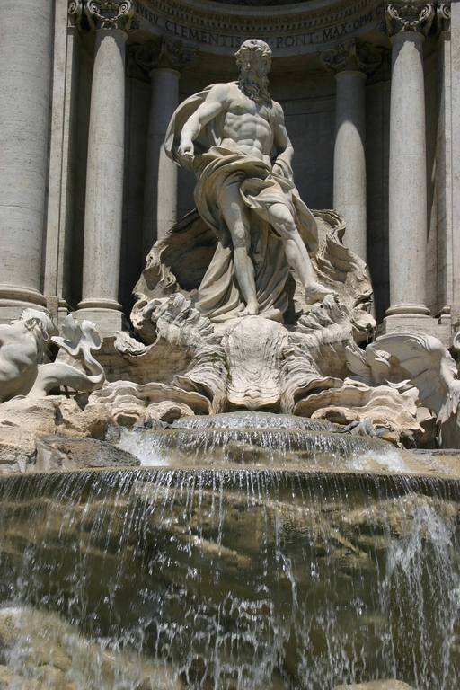

Incremental structure from motion
Notes:
To help get good initializations for all of the parameters of the system, we reconstruct the scene incrementally, starting from two images, then adding images one at a time. To begin, we automatically find a pair of images with many correspondences and which seem to have a large baseline, in order to get well-conditioned estimates of the parameters.
Here is the initial pair of images our system chose from the Trevi Fountain set. The images are similar enough to have a lot of features, but there is some distance between the cameras – the first camera is below the lip of the fountain and the second camera is above it. We first initialize these images to the origin…

Slide 24
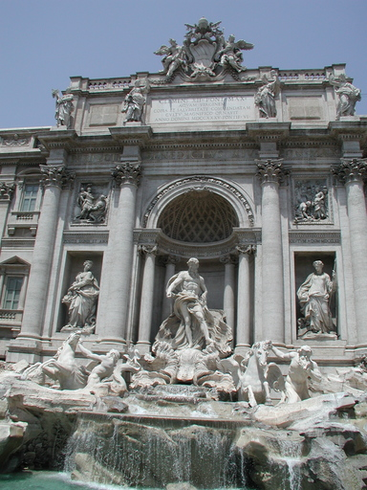
Incremental structure from motion
Optimize parameters for two cameras and common points
Find new image with most matches to existing points
Initialize new camera using pose estimation
Bundle adjust
Add new points
Bundle adjust
Notes:
and initialize the points observed by the images to a fixed depth from the cameras. We then run a non-linear optimization to refine the point locations and camera parameters.
Next, we add a new image to the optimization, choosing the image that observes the most existing 3D points. The parameters of the new camera are initialized using pose estimation, then a global refinement is run again. Finally, we add new points to the scene observed by at least two cameras using triangulation.

Slide 25

Incremental structure from motion
Notes:
To help get good initializations for all of the parameters of the system, we reconstruct the scene incrementally, starting from two images, then adding a small number of images at a time.
Here’s a video of the incremental reconstruction of the Trevi Fountain photo set, starting from two cameras, and growing to a total of 350 cameras.
The process terminates when no more images has any matches to points in the scene.

Slide 26
Incremental structure from motion
Notes:
To help get good initializations for all of the parameters of the system, we reconstruct the scene incrementally, starting from two photographs and the points they observe.

Slide 27
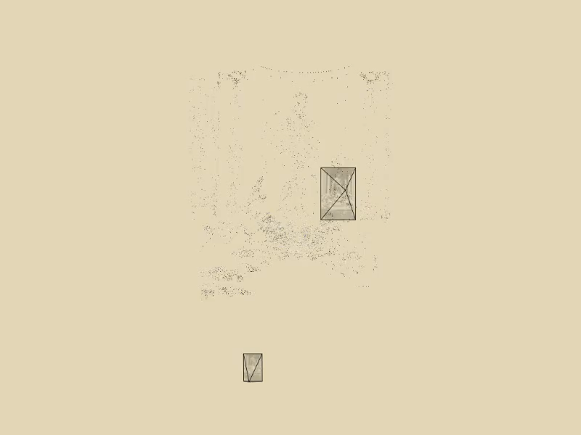
Incremental structure from motion
Notes:
To help get good initializations for all of the parameters of the system, we reconstruct the scene incrementally, starting from two photographs and the points they observe.

Slide 28
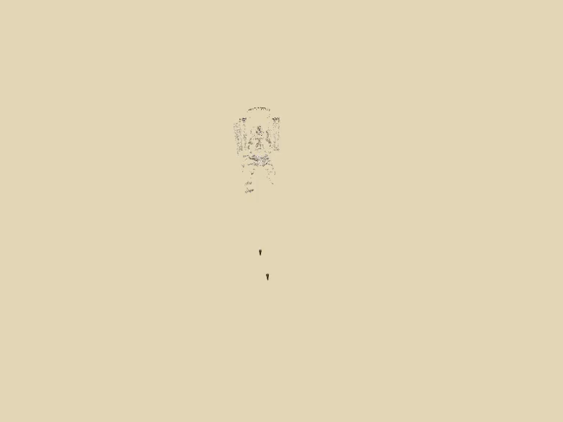
Incremental structure from motion
Notes:
We then add several photos at a time to the reconstruction, refine the model, and repeat until no more photos match any points in the scene.

Slide 29
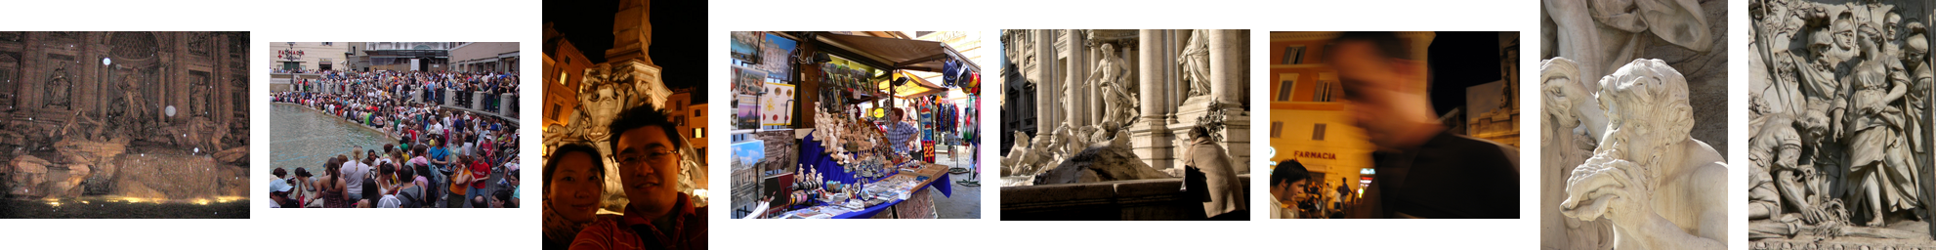
Reconstruction performance
For photo sets from the Internet, 20% to 75% of the photos were registered
Most unregistered photos belonged to different connected components
Running time: < 1 hour for 80 photos
> 1 week for 2600 photo
Notes:
We’ve applied our reconstruction algorithm to many different datasets, both from the Internet and from collections taken by individuals. It has worked well across a variety of collections, although it is not always able to register 100% of the photos. For photo sets from the Internet in particular, we found that anywhere from 20% to 75% of the photos were registered.
The main reason for this is that our algorithm only reconstructs a single connected component of the photos, while many collections are broken into large disjoint sets (for instance, when searching for the Notre Dame cathedral, you get back photos of both the interior and exterior).
For the Trevi Fountain example, about 75% of the photos in the set were registered. Here are some of the ones that weren’t. A few are too noisy or dark, some don’t contain recognizable features, others are too low-resolution or are viewed from too different an angle than other photos.
The running time for our algorithm is fairly small for small collections, but grows approximately quadratically with the number of photos. For an 80 photo collection from the Great Wall of China, our algorithm took less than an hour, including all stages of the reconstruction. Given 2600 photos of the Notre Dame cathedral from Flickr, the algorithm ran for more than a week (not all the photos were registered).

Slide 30
Photo Tourism overview
Photo Explorer
Scene reconstruction
Input photographs
Notes:
Once we reconstruct a scene, we can view it in our photo explorer. I’ll now describe the explore, starting with a demo of the system.

Slide 31
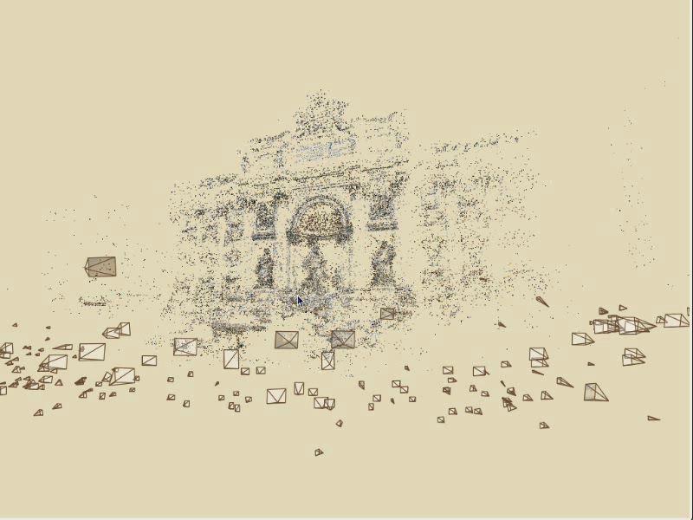
Photo Explorer

Slide 32
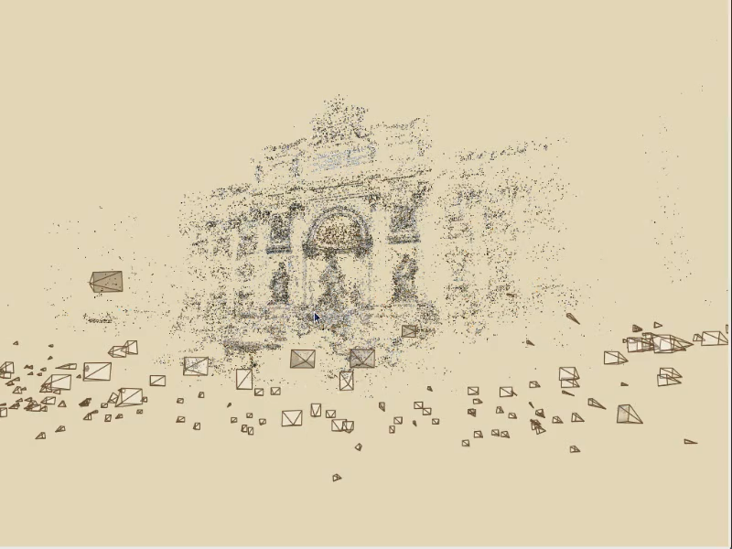
Photo Explorer

Slide 33
Demo
Notes:
There are two main components of the system: the navigation controls and the rendering of the scene.

Slide 34
Photo Tourism overview
Photo Explorer
Scene reconstruction
Input photographs
Navigation
Rendering
Annotations
Notes:
Now I’ll describe the features of our photo explorer system. There are three main components to our system: navigation controls, rendering, and annotation support.

Slide 35
Navigation controls
Free-flight navigation
Object-based browsing
Relation-based browsing
Overhead map
Notes:
I’ll start by talking about the navigation controls
There are four basic types of controls supported by our system.
Free-flight navigation
Object-based browsing
Relation-based browsing
And an overhead map

Slide 36
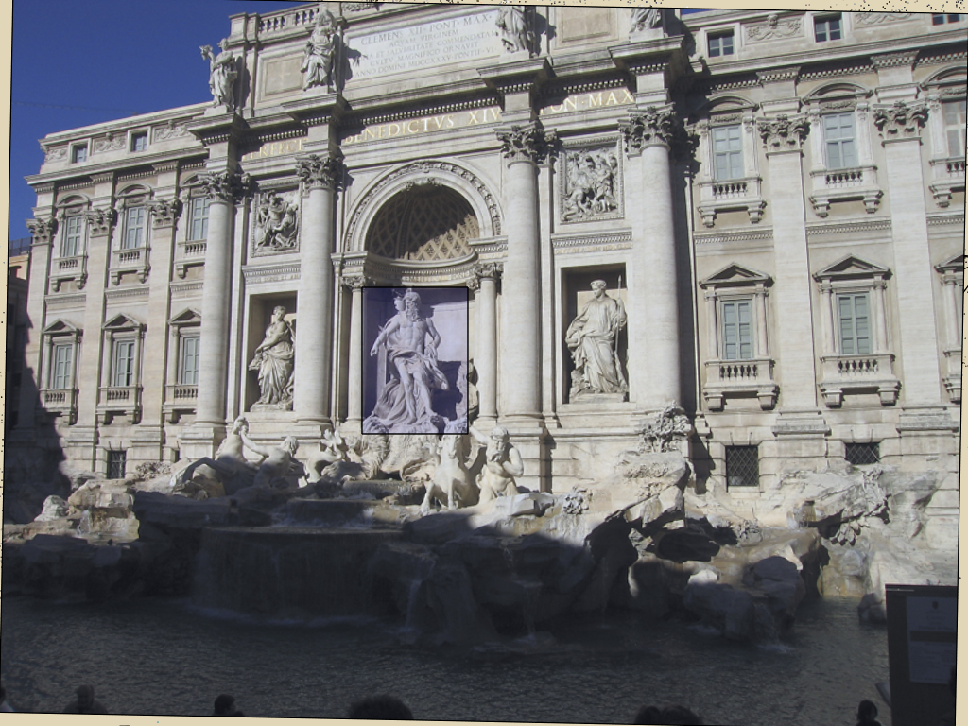
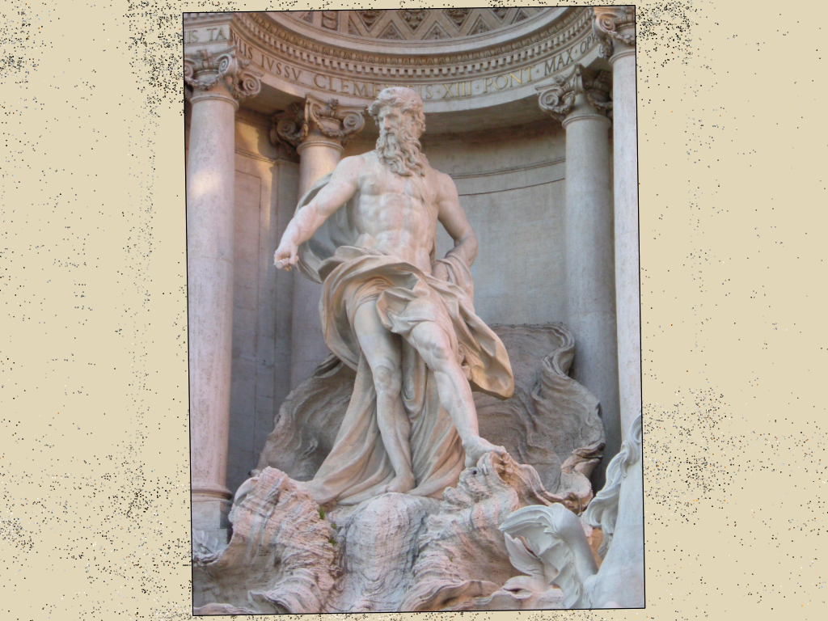
Object-based browsing

Slide 37
Object-based browsing
Visibility
Resolution
Head-on view
Notes:
Object-based browsing allows a user to find a photo by directly selecting a region of a photo or of the point cloud, as when I selected the statue of Neptune in the demo. To see how this works, suppose this is the point cloud representation of the scene, and the user is currently visiting this photograph and wants to see a photo of the house on the right. By dragging a box around it, the user is selecting a set of feature points in the image, which correspond to a set of 3D points in the scene. These points are shown in red.
The system then finds the photo that best depicts the selected points, perhaps this photo.
To choose the best photo, the system scores every photograph based on three criteria:
How many of the points actually project inside the photo
The resolution of the photo in the region of the selected object
Whether the photo is a head-on or oblique view of the object (head-on views are scored higher)
For each image, each of these scores are computed from the geometry of the scene and a final score is computed as a weighted sum. The photo with the highest score is selected as the next photo to be viewed.

Slide 38
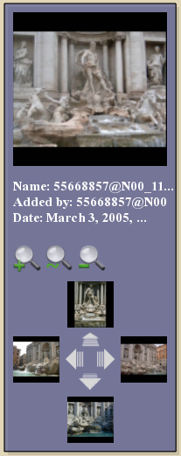
Relation-based browsing
Find all similar images
Find all details
Find all zoom outs
Zoom in
Move left
Move right
Zoom out

Slide 39
Relation-based browsing
is to the left of
Image B
is detail of
is a zoom out of
Image A
Image C
Image D
Notes:
Relation-based browsing allows the user to find photos wth certain geometric relationships, such as to the left of and is a detail of, to the current photo. These relations are inferred based on the relative positions of corresponding feature points between photographs.
For instance if this is the current image, with feature points in black, then
In image B, the bounding box of the feature points has moved right, so the system infers that image B has moved left
The bounding box of the feature points in image C is smaller in image A, so we infer that B is a detail of A
The opposite is true for image D. The bounding box of the points seen by image A is larger than the bounding box of the same points in image D, so image D is a zoom out of image A
These relations are computed in a preprocessing step, and as I demonstrated, can be explored using various tools in the photo explorer.

Slide 40
Relation-based browsing
is to the left of
Image B
is detail of
is a zoom out of
Image A
Image C
Image D
Notes:
Relation-based browsing allows the user to find photos wth certain geometric relationships, such as to the left of and is a detail of, to the current photo. These relations are inferred based on the relative positions of corresponding feature points between photographs.
For instance if this is the current image, with feature points in black, then
In image B, the bounding box of the feature points has moved right, so the system infers that image B has moved left
The bounding box of the feature points in image C is smaller in image A, so we infer that B is a detail of A
The opposite is true for image D. The bounding box of the points seen by image A is larger than the bounding box of the same points in image D, so image D is a zoom out of image A
These relations are computed in a preprocessing step, and as I demonstrated, can be explored using various tools in the photo explorer.

Slide 41
Relation-based browsing
Image A
Image B
Notes:
Relation-based browsing allows the user to find photos wth certain geometric relationships, such as to the left of and is a detail of, to the current photo. These relations are inferred based on the relative positions of corresponding feature points between photographs.
For instance if this is the current image, with feature points in black, then
In image B, the bounding box of the feature points has moved right, so the system infers that image B has moved left
The bounding box of the feature points in image C is smaller in image A, so we infer that B is a detail of A
The opposite is true for image D. The bounding box of the points seen by image A is larger than the bounding box of the same points in image D, so image D is a zoom out of image A
These relations are computed in a preprocessing step, and as I demonstrated, can be explored using various tools in the photo explorer.

Slide 42
Relation-based browsing
Image A
Image B
Notes:
Relation-based browsing allows the user to find photos wth certain geometric relationships, such as to the left of and is a detail of, to the current photo. These relations are inferred based on the relative positions of corresponding feature points between photographs.
For instance if this is the current image, with feature points in black, then
In image B, the bounding box of the feature points has moved right, so the system infers that image B has moved left
The bounding box of the feature points in image C is smaller in image A, so we infer that B is a detail of A
The opposite is true for image D. The bounding box of the points seen by image A is larger than the bounding box of the same points in image D, so image D is a zoom out of image A
These relations are computed in a preprocessing step, and as I demonstrated, can be explored using various tools in the photo explorer.

Slide 43
Relation-based browsing
to the right of
Image A
Image B
Image C
Notes:
Relation-based browsing allows the user to find photos wth certain geometric relationships, such as to the left of and is a detail of, to the current photo. These relations are inferred based on the relative positions of corresponding feature points between photographs.
For instance if this is the current image, with feature points in black, then
In image B, the bounding box of the feature points has moved right, so the system infers that image B has moved left
The bounding box of the feature points in image C is smaller in image A, so we infer that B is a detail of A
The opposite is true for image D. The bounding box of the points seen by image A is larger than the bounding box of the same points in image D, so image D is a zoom out of image A
These relations are computed in a preprocessing step, and as I demonstrated, can be explored using various tools in the photo explorer.

Slide 44
Relation-based browsing
to the right of
Image A
Image B
Image C
Notes:
Relation-based browsing allows the user to find photos wth certain geometric relationships, such as to the left of and is a detail of, to the current photo. These relations are inferred based on the relative positions of corresponding feature points between photographs.
For instance if this is the current image, with feature points in black, then
In image B, the bounding box of the feature points has moved right, so the system infers that image B has moved left
The bounding box of the feature points in image C is smaller in image A, so we infer that B is a detail of A
The opposite is true for image D. The bounding box of the points seen by image A is larger than the bounding box of the same points in image D, so image D is a zoom out of image A
These relations are computed in a preprocessing step, and as I demonstrated, can be explored using various tools in the photo explorer.

Slide 45
Relation-based browsing
to the right of
Image A
Image B
is detail of
Image C
Image D
Notes:
Relation-based browsing allows the user to find photos wth certain geometric relationships, such as to the left of and is a detail of, to the current photo. These relations are inferred based on the relative positions of corresponding feature points between photographs.
For instance if this is the current image, with feature points in black, then
In image B, the bounding box of the feature points has moved right, so the system infers that image B has moved left
The bounding box of the feature points in image C is smaller in image A, so we infer that B is a detail of A
The opposite is true for image D. The bounding box of the points seen by image A is larger than the bounding box of the same points in image D, so image D is a zoom out of image A
These relations are computed in a preprocessing step, and as I demonstrated, can be explored using various tools in the photo explorer.

Slide 46
Relation-based browsing
to the right of
Image A
Image B
is detail of
Image C
Image D
Notes:
Relation-based browsing allows the user to find photos wth certain geometric relationships, such as to the left of and is a detail of, to the current photo. These relations are inferred based on the relative positions of corresponding feature points between photographs.
For instance if this is the current image, with feature points in black, then
In image B, the bounding box of the feature points has moved right, so the system infers that image B has moved left
The bounding box of the feature points in image C is smaller in image A, so we infer that B is a detail of A
The opposite is true for image D. The bounding box of the points seen by image A is larger than the bounding box of the same points in image D, so image D is a zoom out of image A
These relations are computed in a preprocessing step, and as I demonstrated, can be explored using various tools in the photo explorer.

Slide 47
Relation-based browsing
to the left of
to the right of
Image A
Image B
is detail of
is detail of
is zoom-out of
is zoom-out of
is detail of
is zoom-out of
Image C
is detail of
Image D
Notes:
Relation-based browsing allows the user to find photos wth certain geometric relationships, such as to the left of and is a detail of, to the current photo. These relations are inferred based on the relative positions of corresponding feature points between photographs.
For instance if this is the current image, with feature points in black, then
In image B, the bounding box of the feature points has moved right, so the system infers that image B has moved left
The bounding box of the feature points in image C is smaller in image A, so we infer that B is a detail of A
The opposite is true for image D. The bounding box of the points seen by image A is larger than the bounding box of the same points in image D, so image D is a zoom out of image A
These relations are computed in a preprocessing step, and as I demonstrated, can be explored using various tools in the photo explorer.

Slide 48

Overhead map
Notes:
Another way to navigate a photo collection is by using an overhead map. Before we can use this tool, however, we need to align the reconstruction with a map. Here is a video of a user manually aligning a reconstruction, shown in black, with an aerial photograph inside our explorer tool.

Slide 49

Prague
Rome

Slide 50

Prague Old Town Square
Notes:
Now we’ll move on to another dataset to demonstrate some more of the navigation features of our system.
This is a reconstruction of the Old Town Square in Prague from about 200 photos, shown inside our photo explorer. An overhead map is shown in the upper right corner.
For this dataset, we render the scene using 3D line segments and add color to the scene by projecting blurred, partially transparent versions of the photos onto detected planes.
The user can select photos from the map, and the map tracks the movement of the virtual camera. Here the user selects a building to see a better picture.
Now here’s another example of relation-based browsing – the user can click on the “move right” button to move right to the next building in the row of façades.
Now the user clicks on the zoom out button to see more of the scene.

Slide 51
Photo Tourism overview
Photo Explorer
Scene reconstruction
Input photographs
Navigation
Rendering
Annotations
Notes:
Now I’ll describe the features of our photo explorer system. There are three main components to our system: navigation controls, rendering, and annotation support.

Slide 52

Rendering
Notes:
Here is the simplest rendering mode of our system. The cameras are rendered as frusta, and the scene is rendered simply by coloring the points using color information from the images.

Slide 53





Rendering
Notes:
Here’s a screenshot of the Prague photo collection in our explorer. In this case, the scene is rendered using 3D line segments extracted automatically from the photo collection and these washed-out looking colors. Color is added into the scene by, for each image, fitting a plane to the points seen by that image, projecting a low-resolution, semi-transparent version of the image onto the plane, and cropping the projected image to the region where the points are well-approximated by a plane. By blending all the image projections together, we get a kind of watercolor effect seen here.

Slide 54

Rendering

Slide 55


Rendering transitions

Slide 56
Rendering transitions

Slide 57

Rendering transitions

Slide 58
Rendering transitions
Camera A
Camera B
Notes:
In addition to rendering the scene, we render transitions between photographs using a simple image-based rendering technique to blend between the source and target photographs. The reason for using image-based rendering is to give more of a sense of the relationship between the two photos and to create more visually appealing transitions.
The default mode of our system is to use single planes as impostors for the geometry of the scene during transitions.

Slide 59
Photo Tourism overview
Photo Explorer
Scene reconstruction
Input photographs
Navigation
Rendering
Annotations
Notes:
Now I’ll describe the features of our photo explorer system. There are three main components to our system: navigation controls, rendering, and annotation support.

Slide 60
Prague
Paris
Rome

Slide 61

Annotations

Slide 62

Annotations

Slide 63

Annotations
Reproduced with permission of Yahoo! Inc. © 2005 by Yahoo! Inc.
YAHOO! and the YAHOO! logo are trademarks of Yahoo! Inc.

Slide 64

Annotations

Slide 65

Paris
Prague
Rome
Yosemite

Slide 66

Yosemite

Slide 67


Yosemite
Topographic data courtesy USGS

Slide 68
Contributions
Automated system for registering photo collections in 3D for interactive exploration
Structure from motion algorithm demonstrated on hundreds of photos from the Internet
Photo exploration system combining new image-based rendering and photo navigation techniques

Slide 69

Limitations / Future work
Not all photos can be reliably matched
→ Better feature detection / matching
→ Integrating GPS & other localization info.
Structure from motion scalability
→ More efficient (sparse) algorithms
Plane-based transitions lack parallax

Slide 70

Limitations / Future work

Slide 71
Limitations / Future work
Not all photos can be reliably matched
→ Better feature detection / matching
→ Integrating GPS & other localization info.
Structure from motion scalability
→ More efficient (sparse) algorithms
Plane-based transitions lack parallax
→ Richer transitions
Photo explorer scalability…

Slide 72
Future work
Photo explorer scalability
Design client-server architecture for streaming images and geometry at required resolution
Scale to all of the world’s photos (and videos…)
Photosynth project at Microsoft Live Labs (live demo)
Notes:
Rick takes over at the start of this slide
After quick intro (20 seconds) to read these bullets [need PhotoSynth logo here], Rick introduces Blaise and starts talking over his demo…

Slide 73
Acknowledgements
National Science Foundation
Achievement Rewards for College Scientists (ARCS)
The many people who allowed use of their photos
UW GRAIL Lab
MSR Interactive Visual Media Lab
Kevin Chiu and Andy Hou for writing the Java applet

Slide 74




Conclusion
Indexing everyone’s photos provides a new way to share and experience our world
To find out more:
http://phototour.cs.washington.edu
http://research.microsoft.com/IVM/PhotoTourism
http://labs.live.com/photosynth
Exhibition booth #2619
Saint Basil's Cathedral
Trafalgar Square
Rockefeller Center
Mount Rushmore

Slide 75

Today: NeRFs for Landscapes
Instant NeRF (@jonstephens85 on Twitter); slide courtesy Thomas Muller

Slide 76

NeRFs in StreetView

