Slide 1
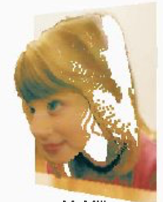
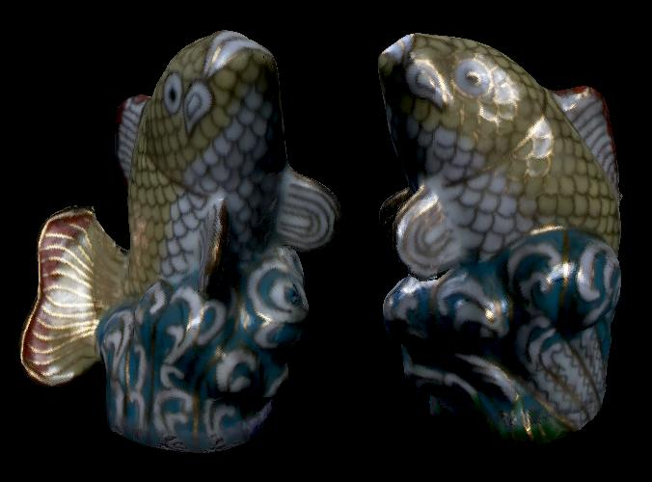

Image-Based Rendering
CSE 274, Lecture 4: IBR and Light Fields
Ravi Ramamoorthi
http://www.cs.ucsd.edu/~ravir

Slide 2
To Do
Project Milestone Reports Due ??
1-2 page PDF or weblink with at least one image or video to show current results
Describe project, progress to date, and final proposal based on results

Slide 3
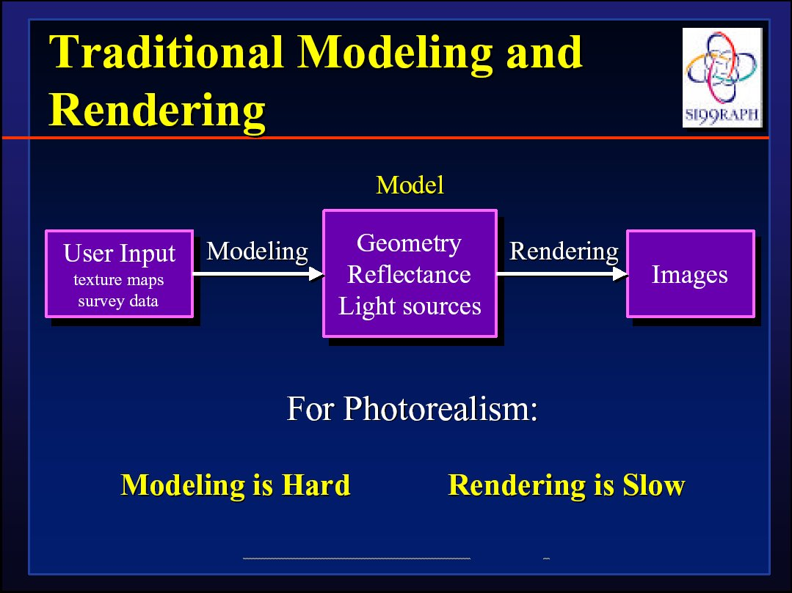
Next few slides courtesy Paul Debevec; SIGGRAPH 99 course notes

Slide 4
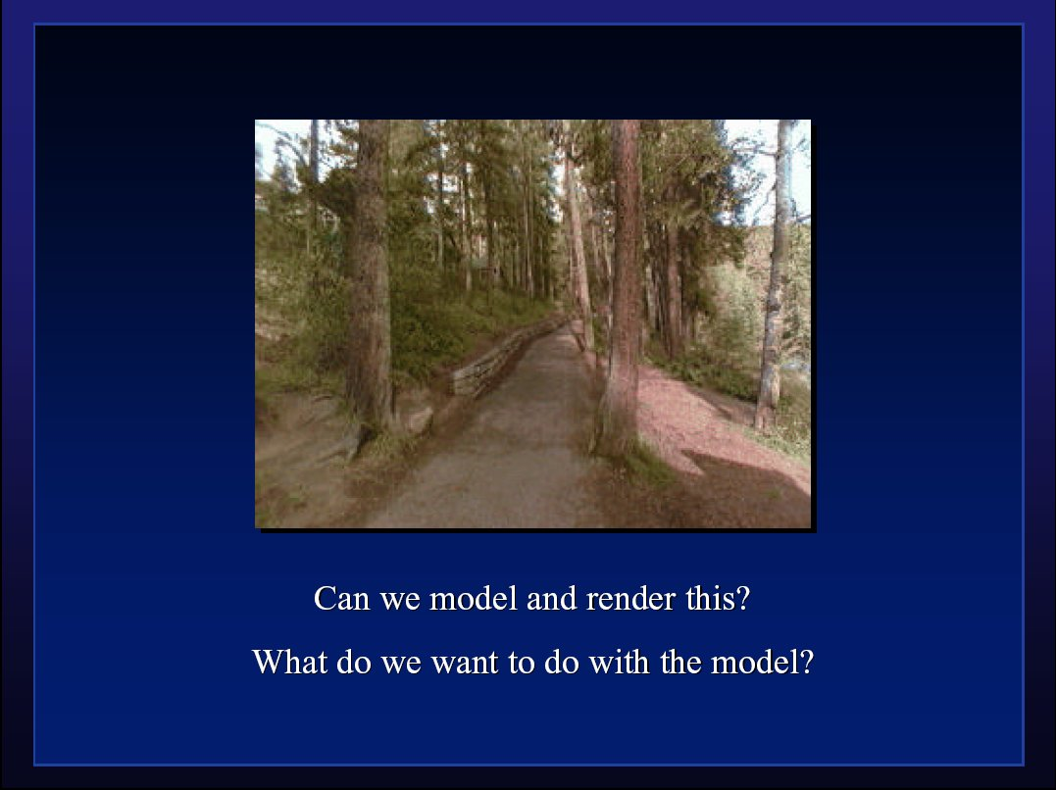

Slide 5
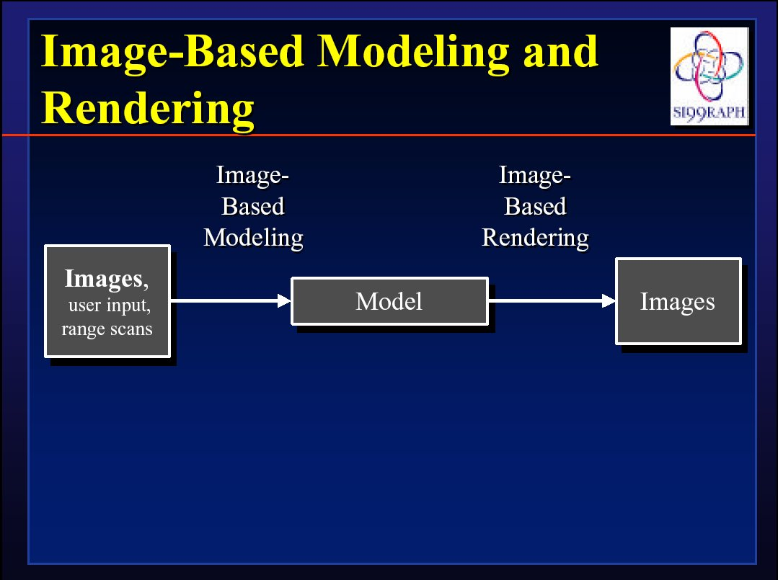

Slide 6
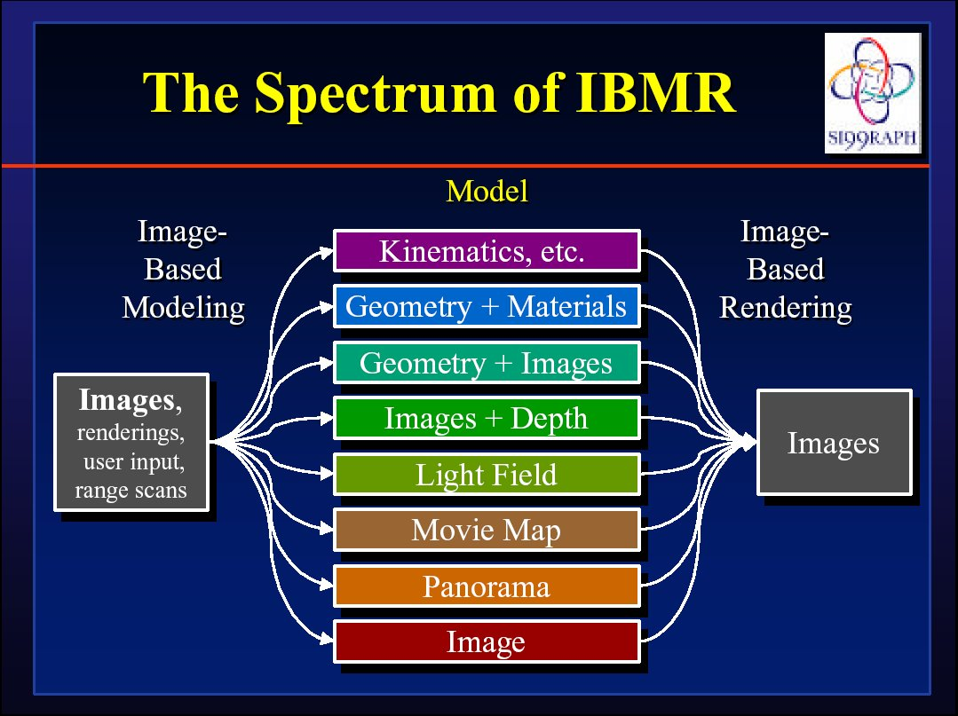

Slide 7
IBR: Pros and Cons
Advantages
  Easy to capture images: photorealistic by definition
  Simple, universal representation
  Often bypass geometry estimation?
  Independent of scene complexity?
Disadvantages
  WYSIWYG but also WYSIAYG
  Explosion of data as flexibility increased
  Often discards intrinsic structure of model?
Today, IBR-type methods also often used in synthetic rendering (e.g. real-time rendering PRT)
  General concept of data-driven graphics, appearance
  Also, data-driven geometry, animation, simulation
  Spawned light field cameras for image capture

Slide 8
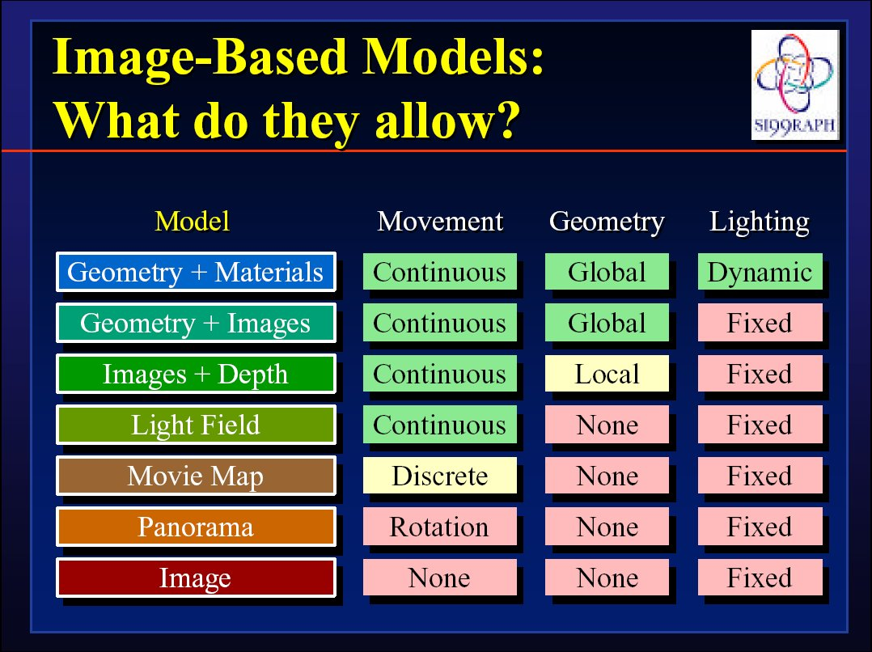

Slide 9
IBR: A brief history
Texture maps, bump maps, environment maps [70s]
Poggio MIT 90s: Faces, image-based analysis/synthesis
Mid-Late 90s
  Chen and Williams 93, View Interpolation [Images+depth]
  Chen 95 Quicktime VR [Images from many viewpoints]
  McMillan and Bishop 95 Plenoptic Modeling [Images w disparity]
  Gortler et al, Levoy and Hanrahan 96 Light Fields [4D]
  Shade et al. 98 Layered Depth Images [2.5D]
  Debevec et al. 00 Reflectance Field [4D]
  Inverse rendering (Marschner,Sato,Yu,Boivin,…)
Today: IBR hasn’t replaced conventional rendering, but has brought sampled and data-driven representations to graphics

Slide 10
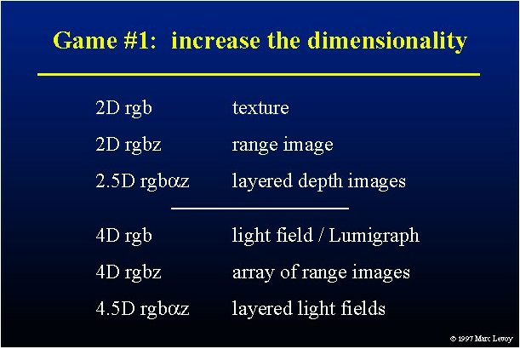

Slide 11
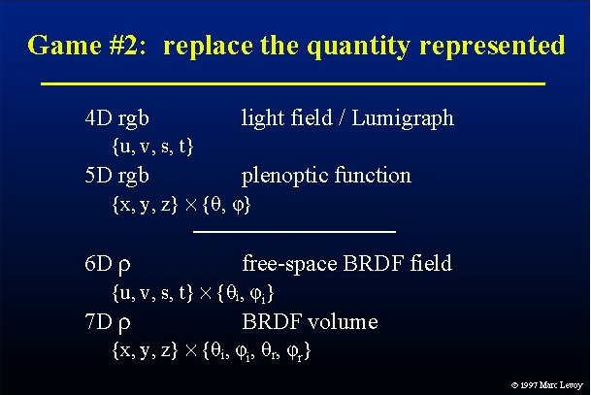

Slide 12
Outline
Overview of IBR
Basic approaches
  Image Warping
    [2D + depth. Requires correspondence/disparity]
  Light Fields [4D]
  Survey of some early work

Slide 13
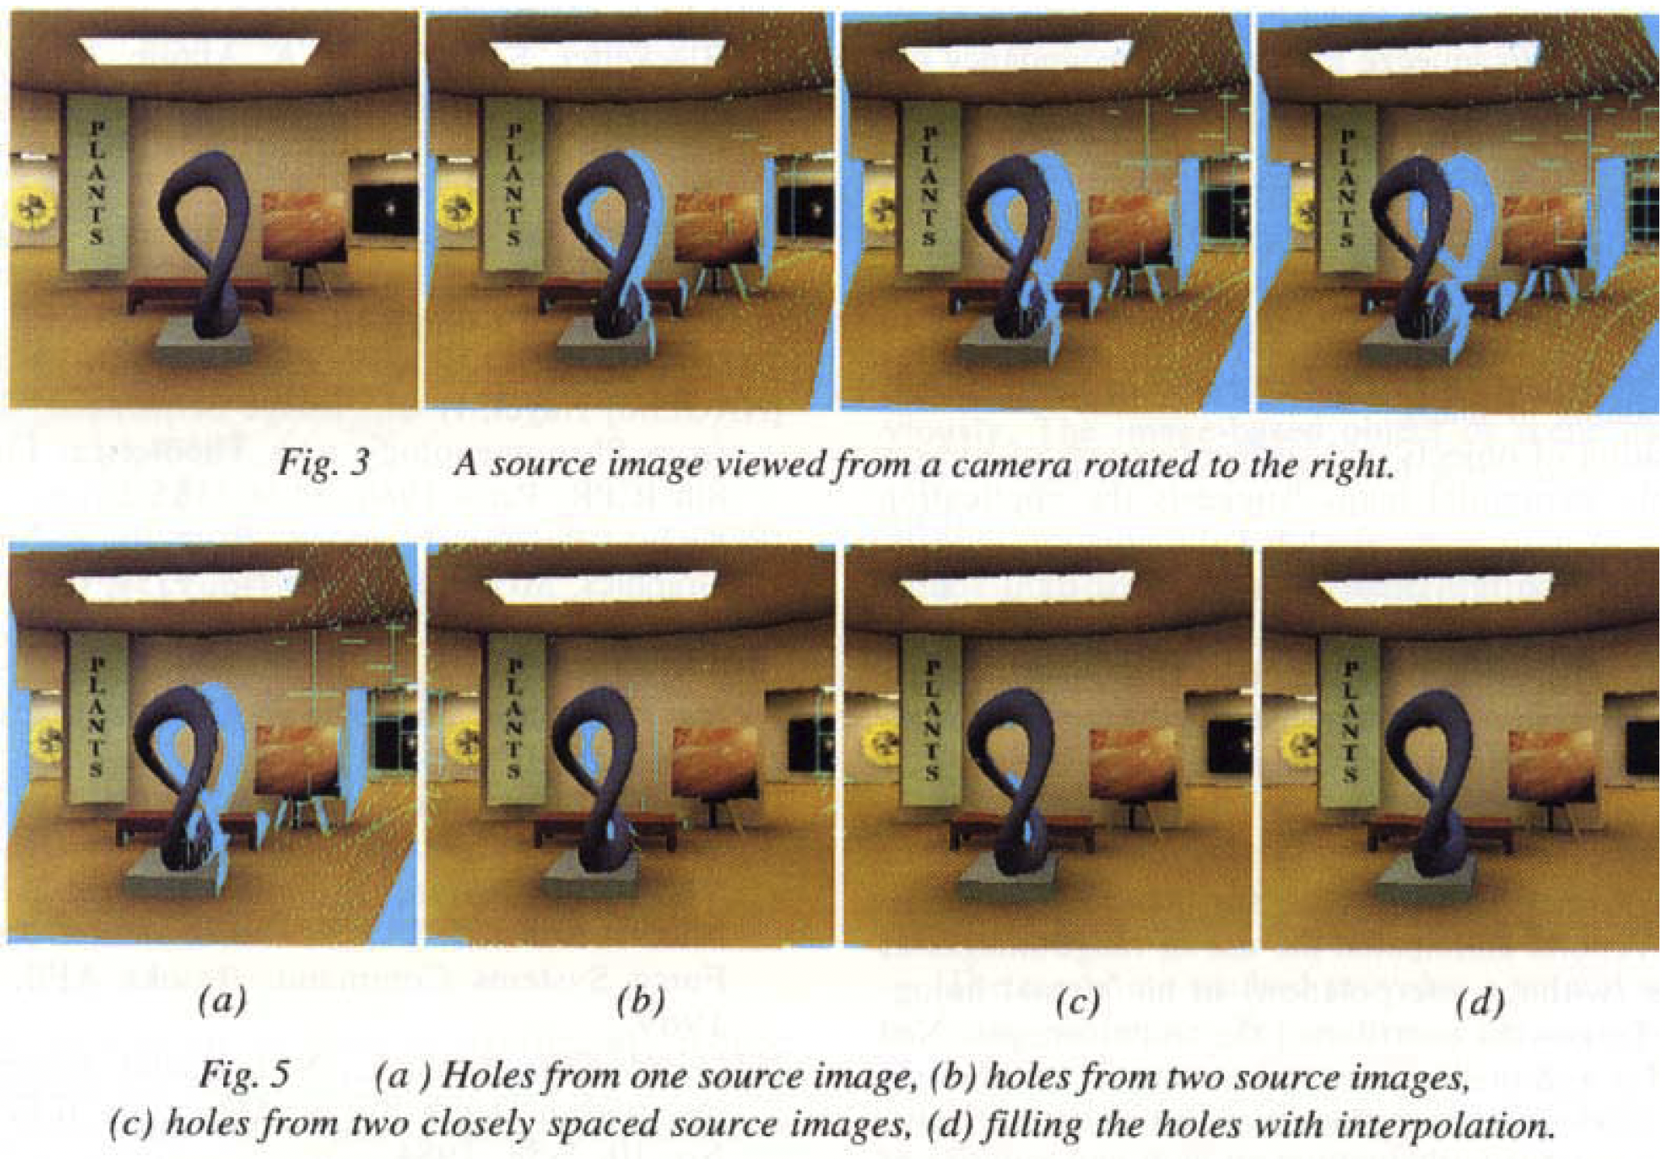
View Interpolation for Image Synthesis
Chen and Williams. View Interpolation for Image Synthesis. SIGGRAPH 93

Slide 14
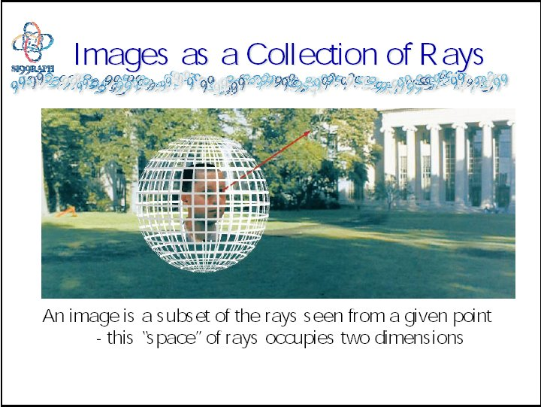
Warping slides courtesy Leonard McMillan, SIGGRAPH 99 course notes

Slide 15
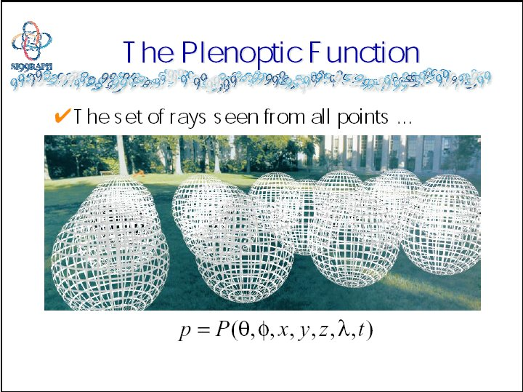

Slide 16
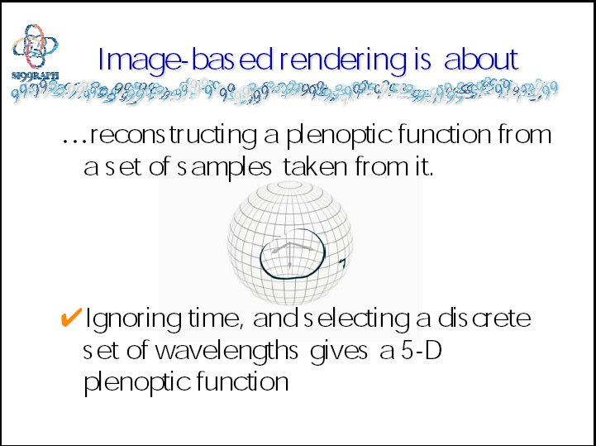

Slide 17
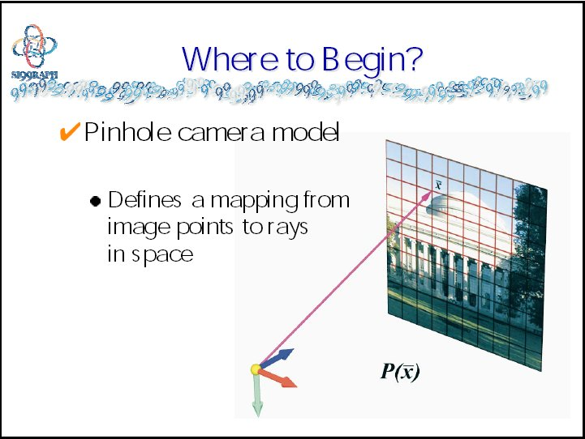

Slide 18
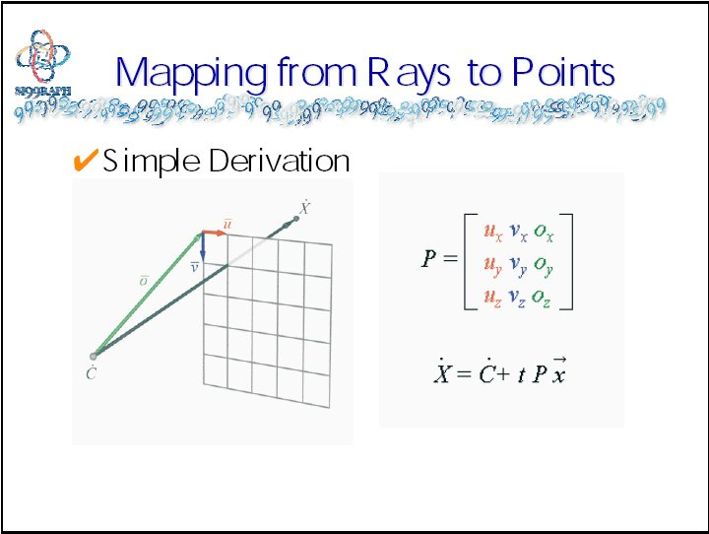

Slide 19
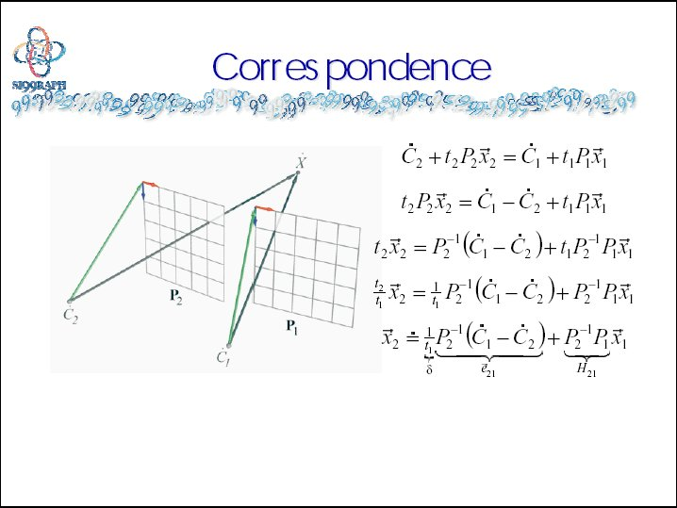

Slide 20
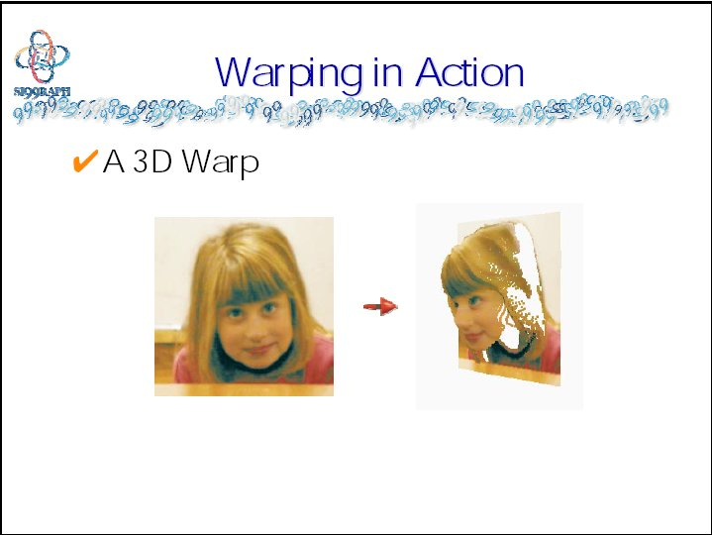

Slide 21
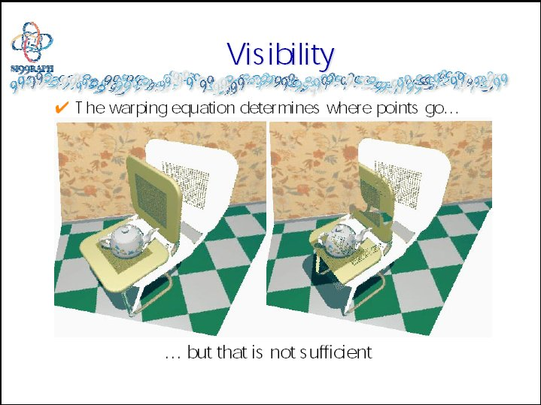

Slide 22
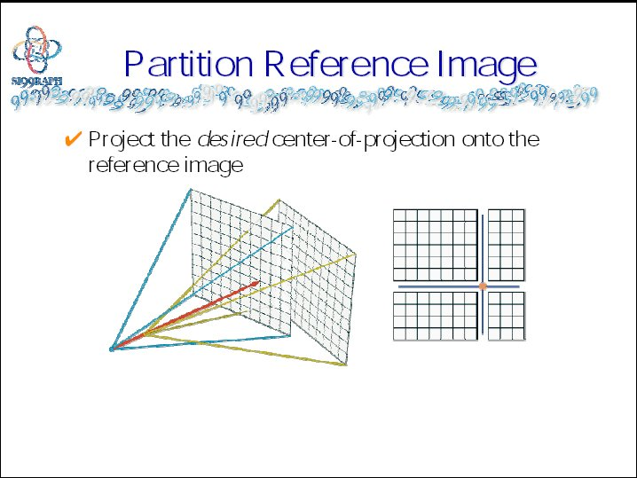

Slide 23
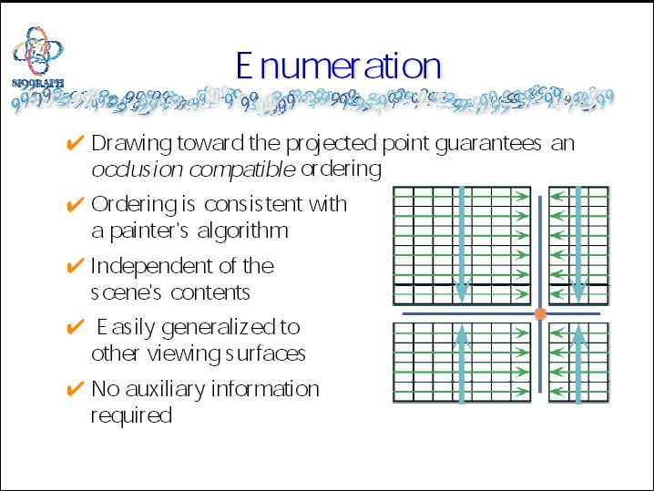

Slide 24
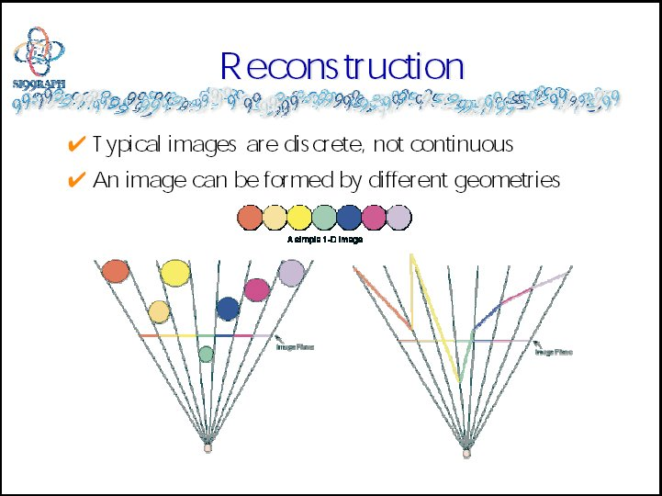

Slide 25
Outline
Overview of IBR
Basic approaches
  Image Warping
    [2D + depth. Requires correspondence/disparity]
  Light Fields [4D]
  Survey of some early work

Slide 26
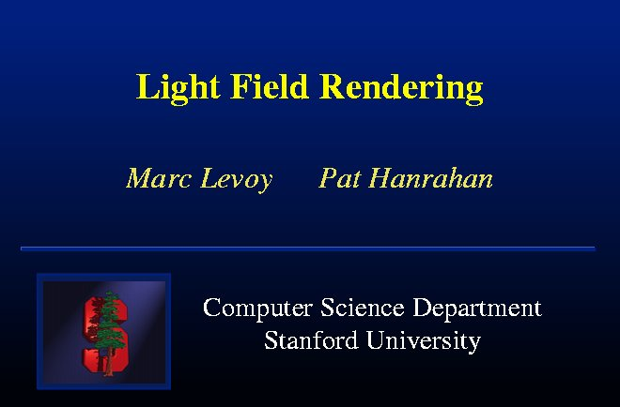

Slide 27
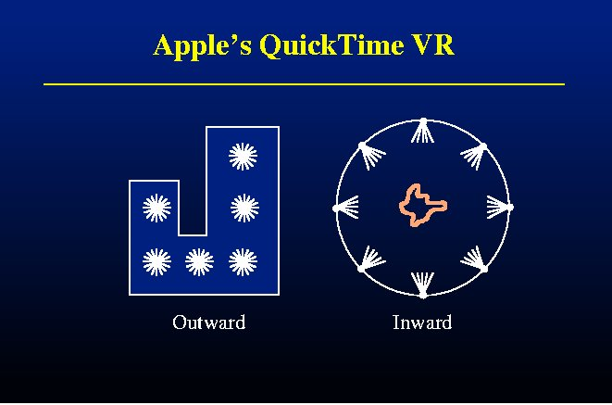

Slide 28
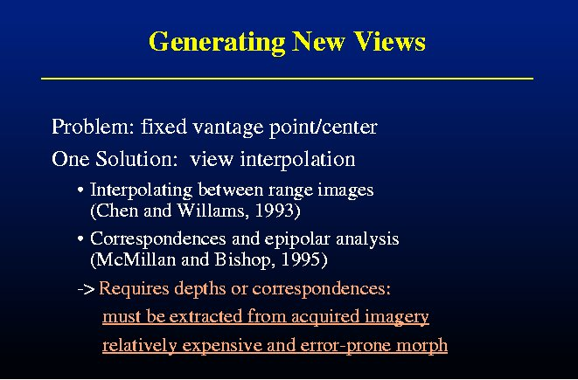

Slide 29
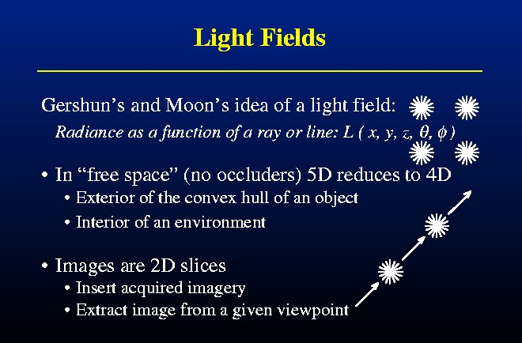

Slide 30
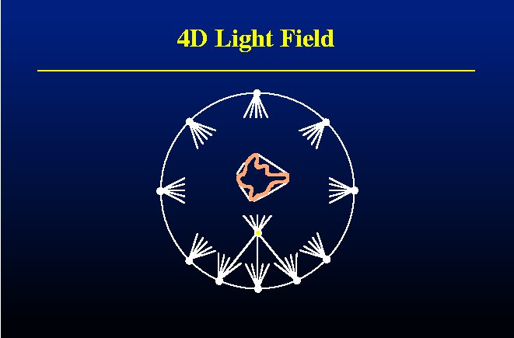

Slide 31
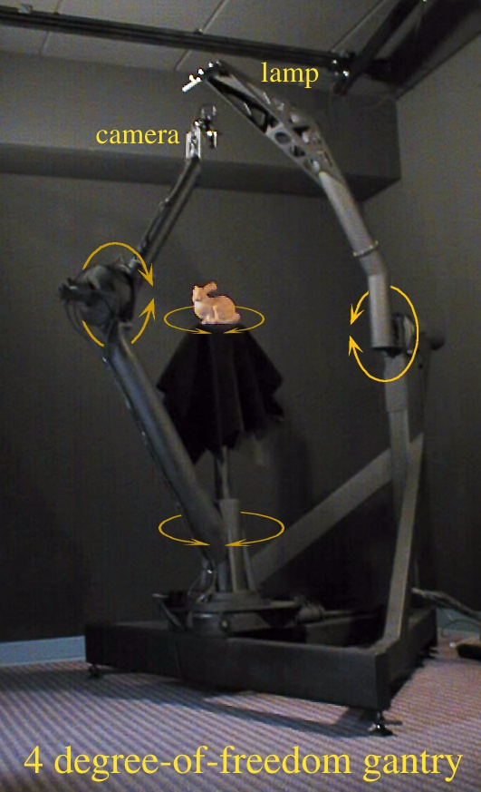
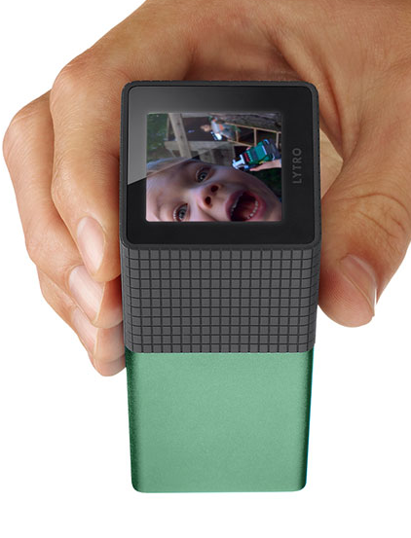
Lytro Camera

Slide 32
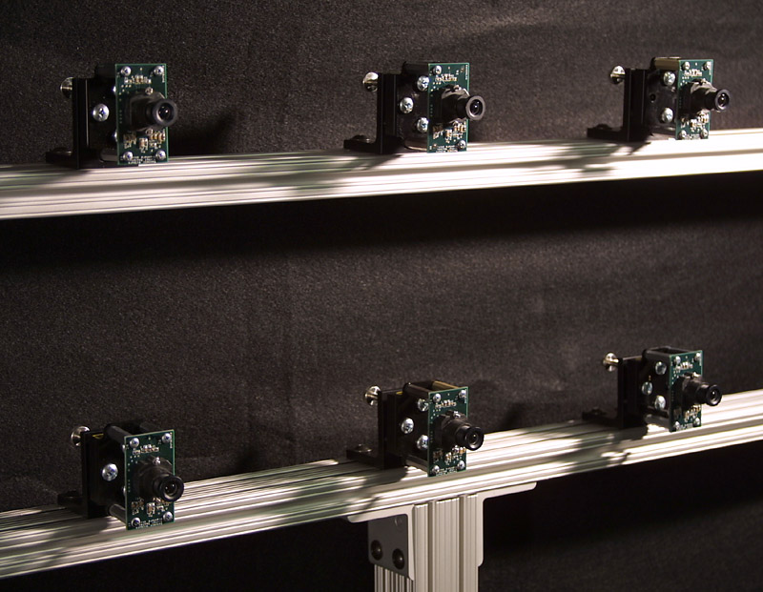

Slide 33
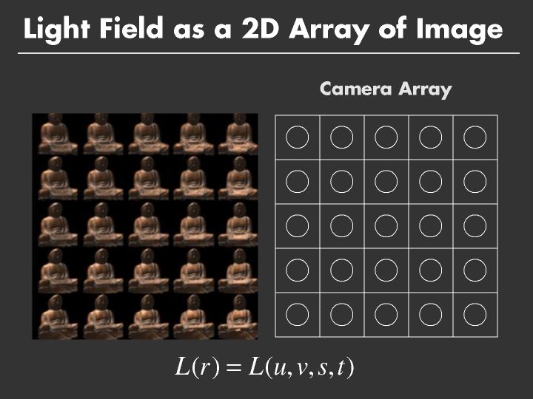

Slide 34
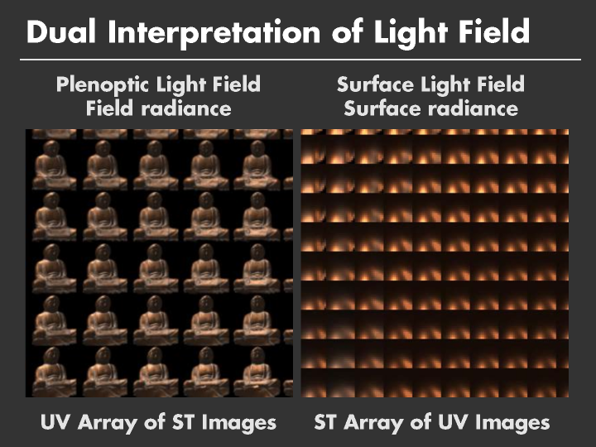

Slide 35
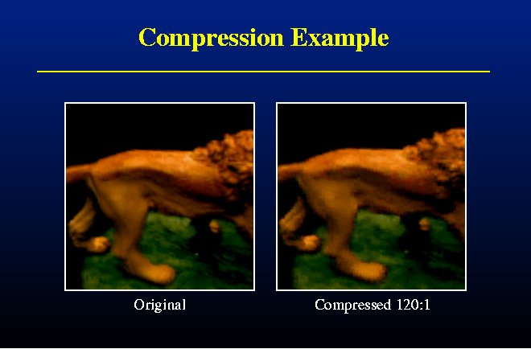

Slide 36
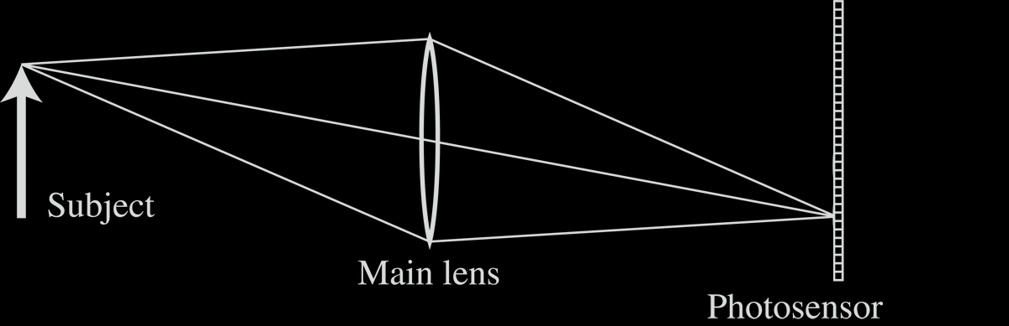
Light Field Inside a Camera
Notes:
36

Slide 37
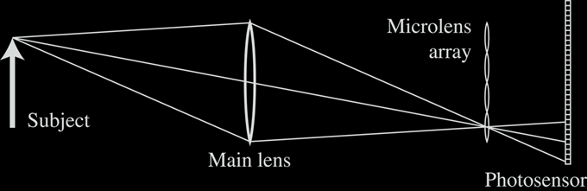
Lenslet-based Light Field camera
Light Field Inside a Camera
[Adelson and Wang, 1992, Ng et al. 2005 ]
Notes:
37

Slide 38
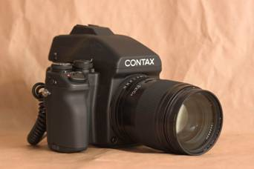
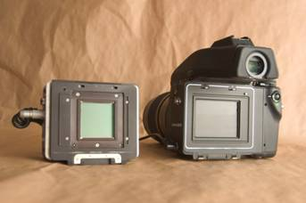
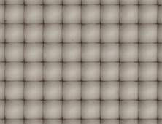
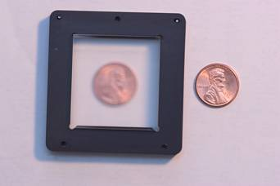
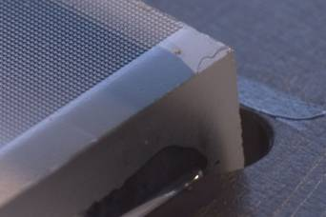
Stanford Plenoptic Camera [Ng et al 2005]
Contax medium format camera
Kodak 16-megapixel sensor
Adaptive Optics microlens array
125μ square-sided microlenses
4000 × 4000 pixels ÷ 292 × 292 lenses = 14 × 14 pixels per lens
Notes:
38

Slide 39





Digital Refocusing
[Ng et al 2005]
Demo at: https://pictures.lytro.com/
Notes:
39

Slide 40

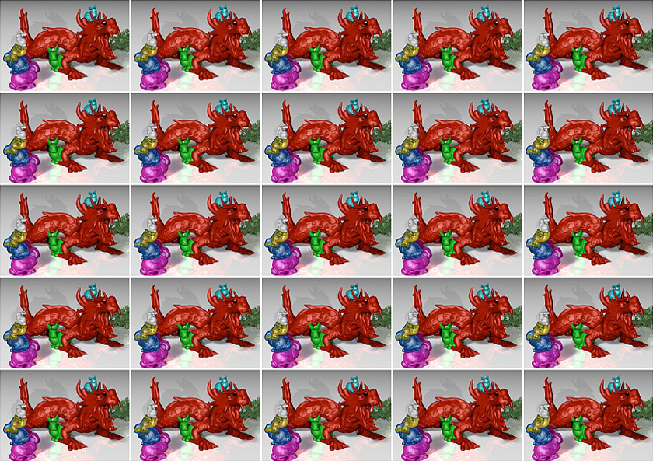
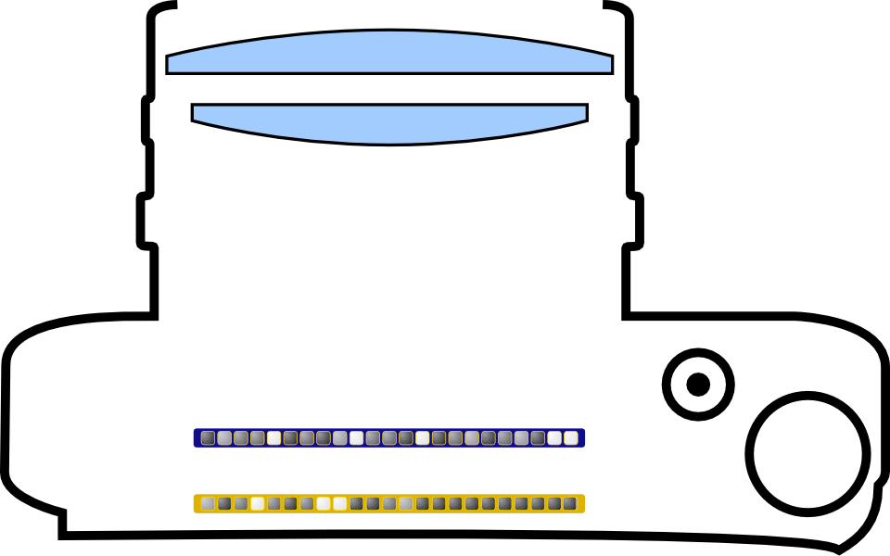
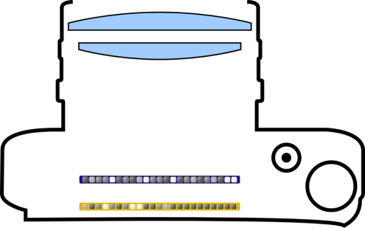
Scene from
Above
Integral Imaging
# Sensor Pixels Y
Lenslet Array
# Sensor Pixels X
[Lippman 1908], [Adelson and Wang 1992], [Ng et al. 2005]

Slide 41
Scene from
Above
Integral Imaging

Slide 42
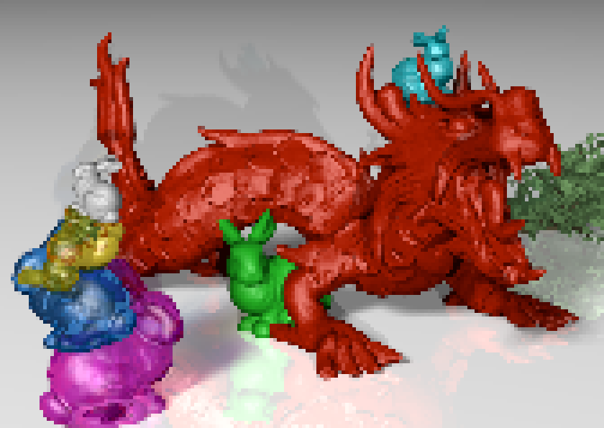
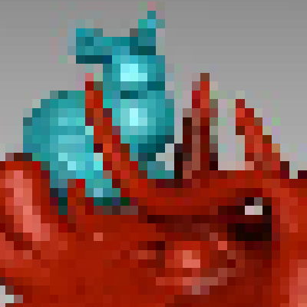
Scene from
Above
Integral Imaging: Spatio-Angular Resolution Tradeoff!
Spatio-Angular Resolution Tradeoff!
Example
Sensor with 2000 x 1000 pixels
5 x 5 light field views,
each with 400 x 200 pixels
# Sensor Pixels Y / # Views Y
our approach: explore ways to
overcome resolution tradeoff!
# Sensor Pixels X / # Views X

Slide 43
Scene from
Above
Light Field is Redundant!

Slide 44
Outline
Overview of IBR
Basic approaches
  Image Warping
    [2D + depth. Requires correspondence/disparity]
  Light Fields [4D]
  Survey of some early work

Slide 45
Layered Depth Images [Shade 98]
Camera
Geometry
Slide from Agrawala, Ramamoorthi, Heirich, Moll, SIGGRAPH 2000
Notes:
(1:00)
First, let’s briefly consider Shade’s original formulation for the layered depth image.
To create an LDI, from a given camera location, we trace a ray thru each pixel, noting all intersections.
The LDI is just a list of layers for each pixel, with each fragment storing depth and color information.

Slide 46
Layered Depth Images [Shade 98]
LDI

Slide 47
Layered Depth Images [Shade 98]
LDI
(Depth, Color)

Slide 48
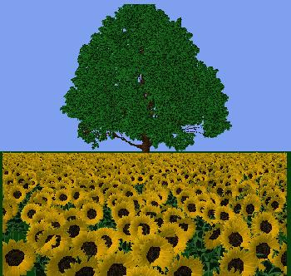

Slide 49
Surface Light Fields
Miller 98, Nishino 99, Wood 00
Reflected light field (lumisphere) on surface
Explicit geometry as against light fields. Easier compress

Slide 50
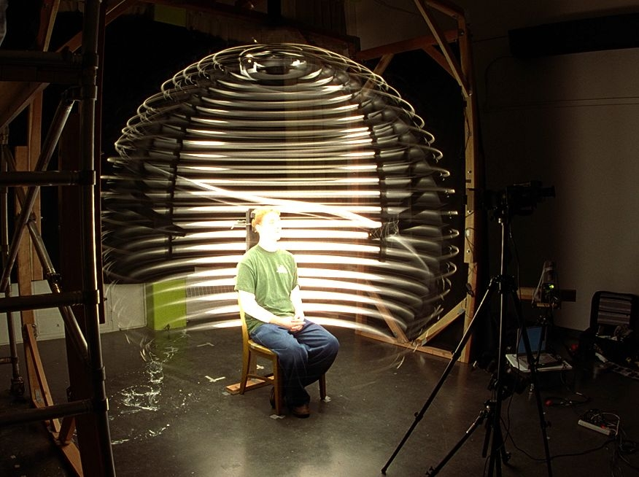
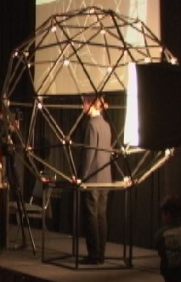
Acquiring Reflectance Field of Human Face [Debevec et al. SIGGRAPH 00]
Illuminate subject from many incident directions

Slide 51
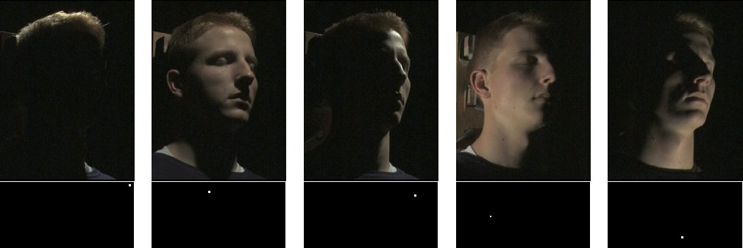
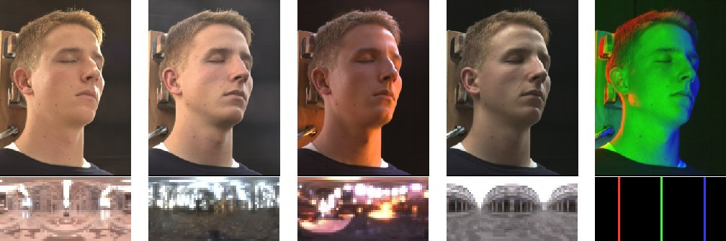
Example Images

