Slide 1
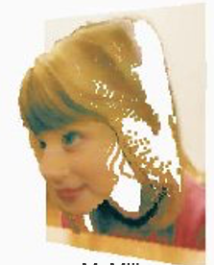
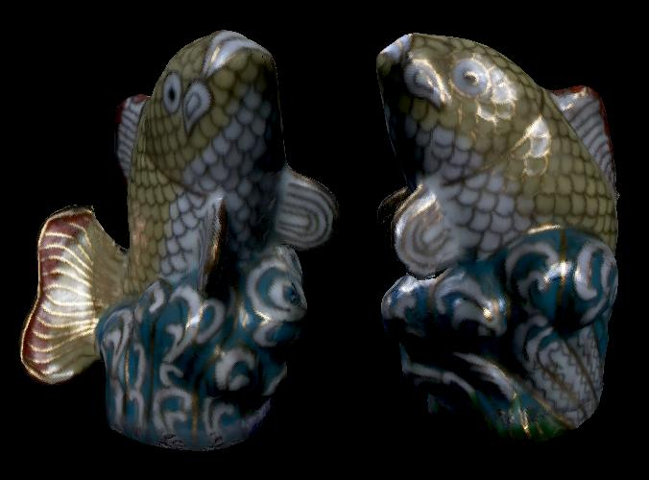
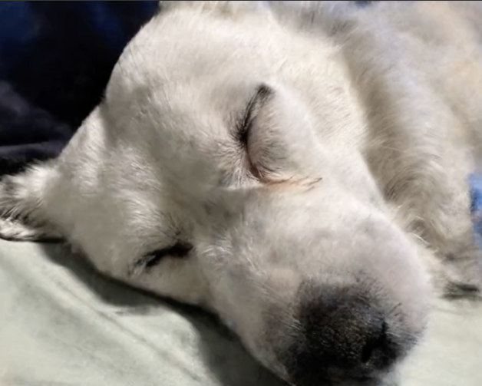
Image-Based Rendering
CSE 274, Lecture 3: Preliminaries
Ravi Ramamoorthi
http://www.cs.ucsd.edu/~ravir

Slide 2
Outline
Will cover many preliminaries today briefly
Monte Carlo Integration
Path Tracing
Volumetric Rendering
Deep Learning: CNNs and MLPs
(consider vision course for multi-view geometry)
To Do: Papers to present, etc

Slide 3
Motivation: Monte Carlo Integration
Rendering = integration
Reflectance equation: Integrate over incident illumination
Rendering equation: Integral equation
Many sophisticated shading effects involve integrals
Antialiasing
Soft shadows
Indirect illumination
Caustics

Slide 4
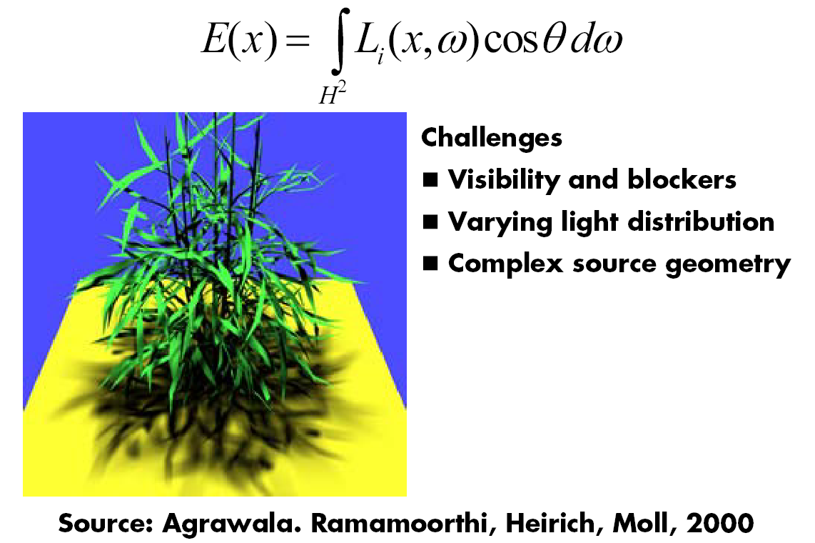
Example: Soft Shadows

Slide 5
Monte Carlo
Algorithms based on statistical sampling and random numbers
Coined in the beginning of 1940s. Originally used for neutron transport, nuclear simulations
Von Neumann, Ulam, Metropolis, …
Canonical example: 1D integral done numerically
Choose a set of random points to evaluate function, and then average (expectation or statistical average)

Slide 6
Monte Carlo Algorithms
Advantages
Robust for complex integrals in computer graphics (irregular domains, shadow discontinuities and so on)
Efficient for high dimensional integrals (common in graphics: time, light source directions, and so on)
Quite simple to implement
Work for general scenes, surfaces
Easy to reason about (but care taken re statistical bias)
Disadvantages
Noisy
Slow (many samples needed for convergence)
Not used if alternative analytic approaches exist (but those are rare)

Slide 7
Or we can average
f(x)
E(f(x))
x=1
Slide courtesy of Peter Shirley

Slide 8
Estimating the average
Monte Carlo methods (random choose samples)
Advantages:
Robust for discontinuities
Converges reasonably for large dimensions
Can handle complex geometry, integrals
Relatively simple to implement, reason about
f(x)
E(f(x))
x₁
x_{N}
Slide courtesy of Peter Shirley

Slide 9
Other Domains
f(x)
< f >_{ab}
x=a
x=b
Slide courtesy of Peter Shirley

Slide 10
Multidimensional Domains
Same ideas apply for integration over …
Pixel areas
Surfaces
Projected areas
Directions
Camera apertures
Time
Paths
Eye
Pixel
x
Surface

Slide 11
Importance Sampling
Put more samples where f(x) is bigger
E(f(x))
x₁
x_{N}

Slide 12
Importance Sampling
This is still unbiased
E(f(x))
x₁
x_{N}
for all N

Slide 13
Importance Sampling
Zero variance if p(x) ~ f(x)
E(f(x))
Less variance with better
importance sampling
x₁
x_{N}

Slide 14
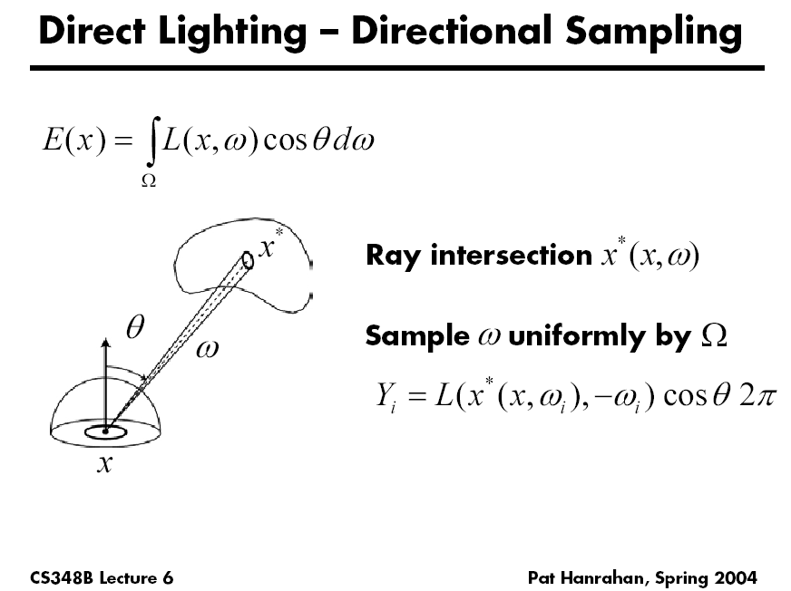

Slide 15
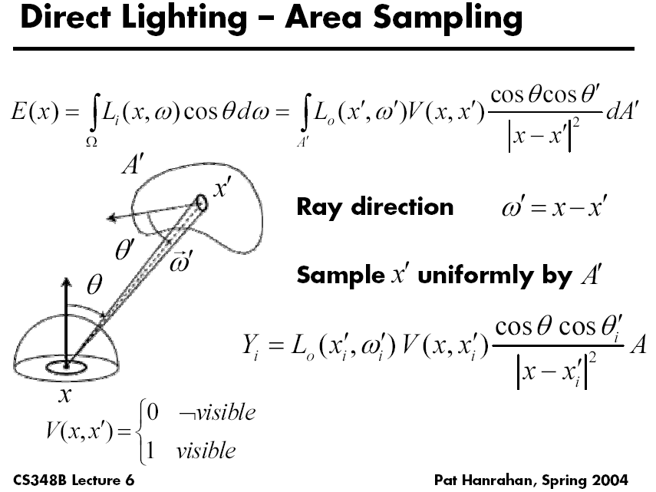

Slide 16
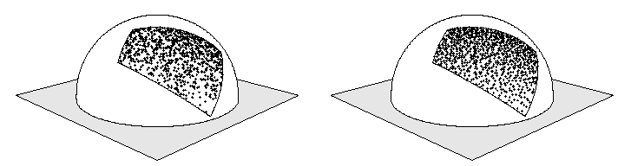
Stratified Sampling
Estimate subdomains separately
Arvo
E_{k}(f(x))
x₁
x_{N}

Slide 17
Stratified Sampling
Less overall variance if less variance in subdomains
E_{k}(f(x))
x₁
x_{N}

Slide 18
More Information
Veach PhD thesis chapter (linked to from website)
Course Notes (links from website)
Mathematical Models for Computer Graphics, Stanford, Fall 1997
State of the Art in Monte Carlo Methods for Realistic Image Synthesis, Course 29, SIGGRAPH 2001

Slide 19
Motivation: Monte Carlo Path Tracing
Core method to solve rendering equation
Widely used production+realtime (with denoising)
General solution to rendering, global illumination
Suitable for a variety of general scenes
Based on Monte Carlo methods
Enumerate all paths of light transport

Slide 20
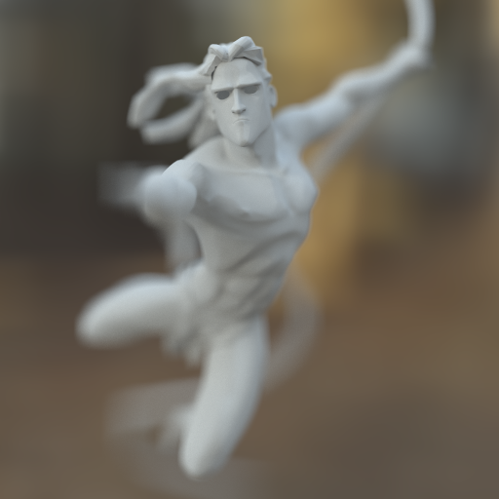
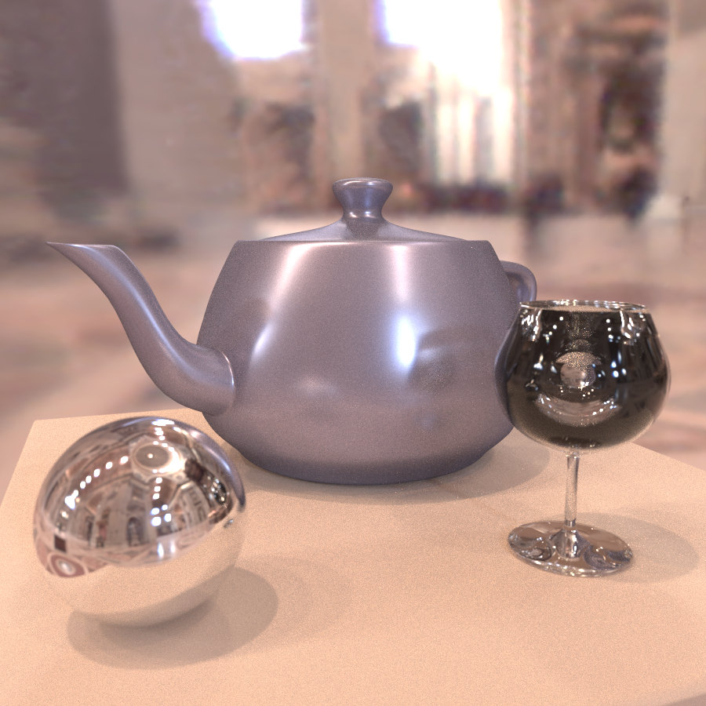
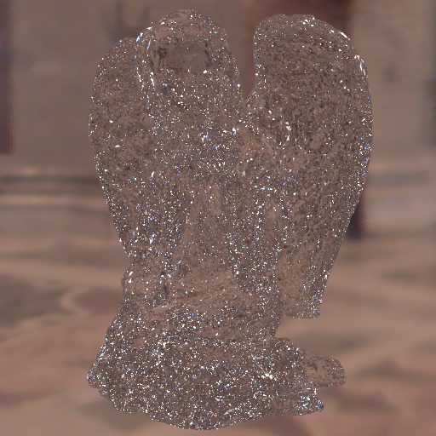
From UCB class many years ago

Slide 21
Simplest Monte Carlo Path Tracer
For each pixel, cast n samples and average
Choose a ray with p=camera, d=(θ,ϕ ) within pixel
Pixel color += (1/n) * TracePath(p, d)
TracePath(p, d) returns (r,g,b) [and calls itself recursively]:
Trace ray (p, d) to find nearest intersection p’
Select with probability (say) 50%:
Emitted: return 2 * (Le_{red}, Le_{green}, Le_{blue}) // 2 = 1/(50%)
Reflected: generate ray in random direction d’ return 2 * f_{r}(d ➔d’) * (n•d’) * TracePath(p’, d’)
Weight = 1/probability
Remember: unbiased
requires having f(x) / p(x)

Slide 22
Simplest Monte Carlo Path Tracer
For each pixel, cast n samples and average
Choose a ray with p=camera, d=(θ,ϕ) within pixel
Pixel color += (1/n) * TracePath(p, d)
TracePath(p, d) returns (r,g,b) [and calls itself recursively]:
Trace ray (p, d) to find nearest intersection p’
Select with probability (say) 50%:
Emitted: return 2 * (Le_{red}, Le_{green}, Le_{blue}) // 2 = 1/(50%)
Reflected: generate ray in random direction d’ return 2 * f_{r}(d ➔d’) * (n•d’) * TracePath(p’, d’)
Path terminated when
Emission evaluated

Slide 23
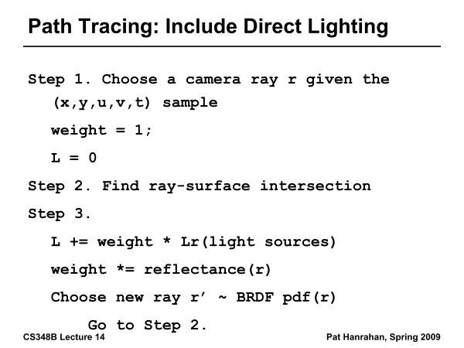

Slide 24
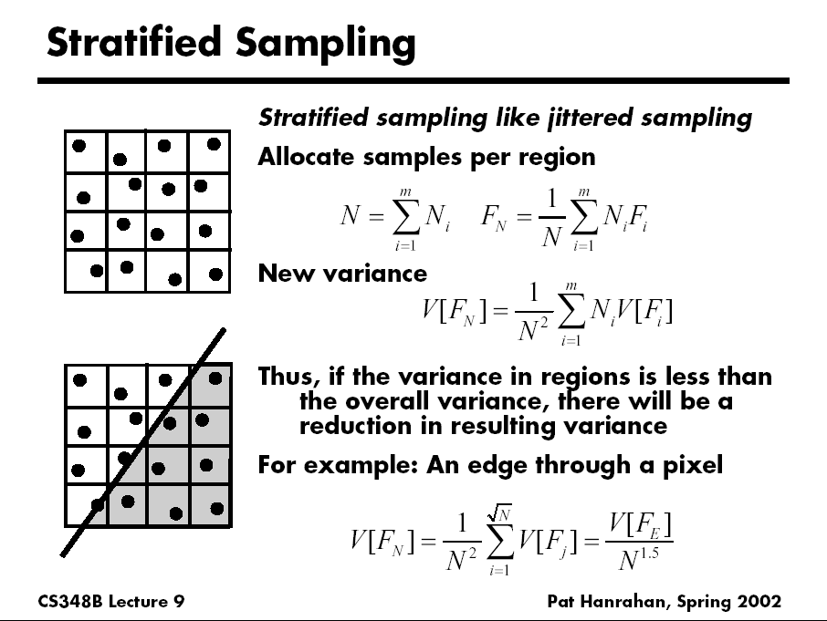
D. Mitchell 95, Consequences of stratified sampling in graphics

Slide 25
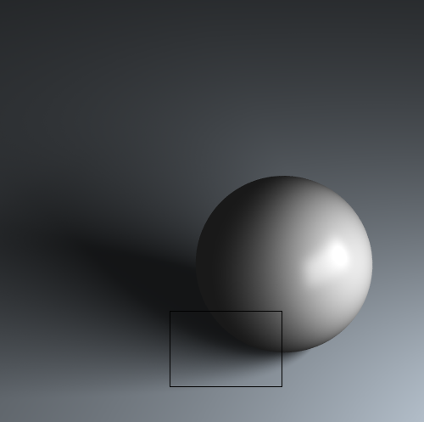
Comparison of simple patterns
Latin Hypercube
Quasi Monte Carlo
Ground Truth
Uniform
Random
Stratified
16 samples for area light, 4 samples per pixel, total 64 samples
If interested, see my recent paper “A Theory of Monte Carlo Visibility Sampling”
Figures courtesy Tianyu Liu

Slide 26
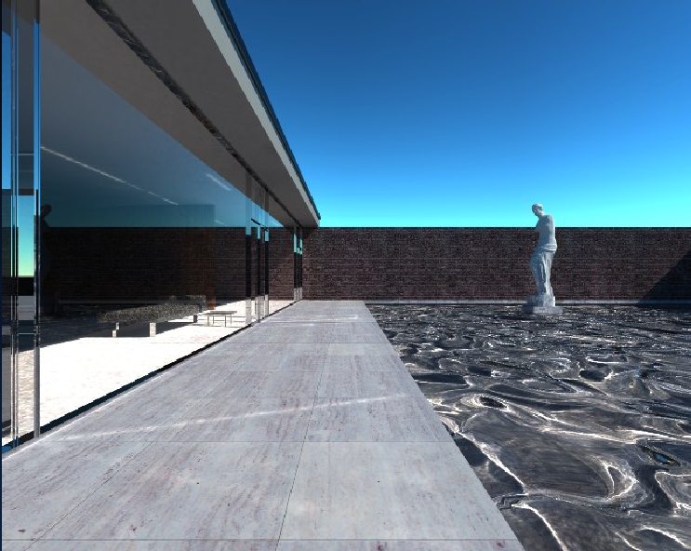
Mies House: Swimming Pool

Slide 27
Optional Path Tracing Assignment
If you have not taken CSE 168 or done path tracer
Follow CSE 168 on edX or edX edge (ask me for access if needed), build path tracer
Includes guide for raytracing if not already done
For your benefit only, optional do not turn in (since many people wanted it for knowledge)
You can use it in final project, but don’t need to, and may be better off using off-the-shelf renderer
If you do use it in final project, document it
Again, it is optional and not directly graded

Slide 28
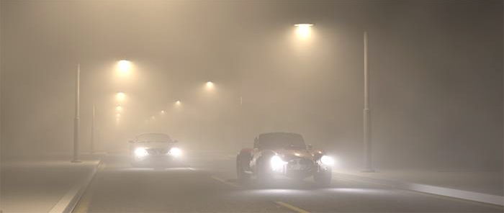
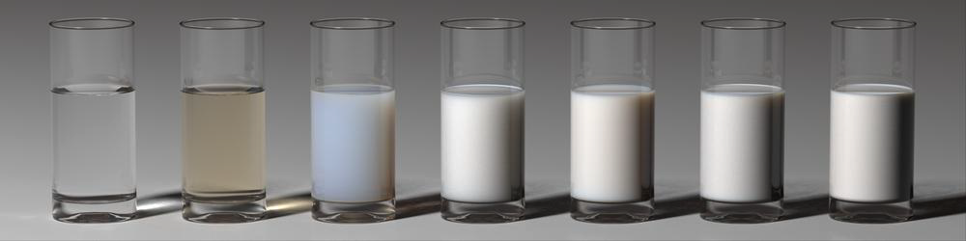
Volumetric Scattering

Slide 29
Volumetric Rendering
Participating Media (light participates via scattering)
Volumetric phenomena like clouds, smoke, fire
Subsurface scattering, translucency (wax, human skin)
Medium is often known as a participating medium
For IBR/NeRF, only absorption, emission no scattering
Surface Rendering: Radiance Constant along Ray
Only true in absence of participating media
No longer true for volumetric scattering
Often replace ray tracing with ray marching in medium
Volumetric Properties
BRDF replaced by phase function
Must consider absorption and scattering in medium

Slide 30



Full Volumetric Rendering Formulation
Absorption
Scattering
Emission
http://commons.wikimedia.org
http://coclouds.com
http://wikipedia.org
Slide credit: Novak et al 2018, Monte Carlo methods for physically based volume rendering
Notes:
So what are all of the physical effects considered in the full volume rendering equation? There’s
Absorption
Scattering
And Emission

Slide 31
Volumetric Interactions
4 different processes affect radiance of a beam
Absorption
Out-Scattering (not used in IBR/NeRF)
Emission
In-Scattering (not used in IBR/NeRF)

Slide 32
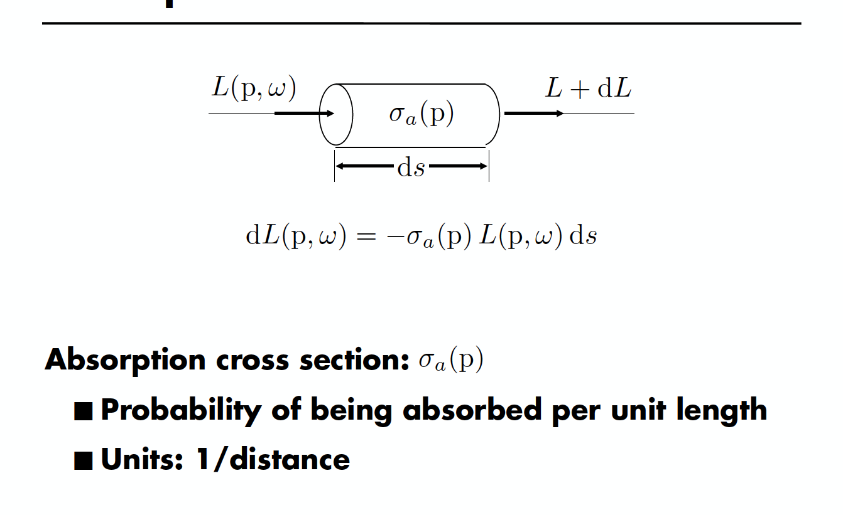
Absorption

Slide 33
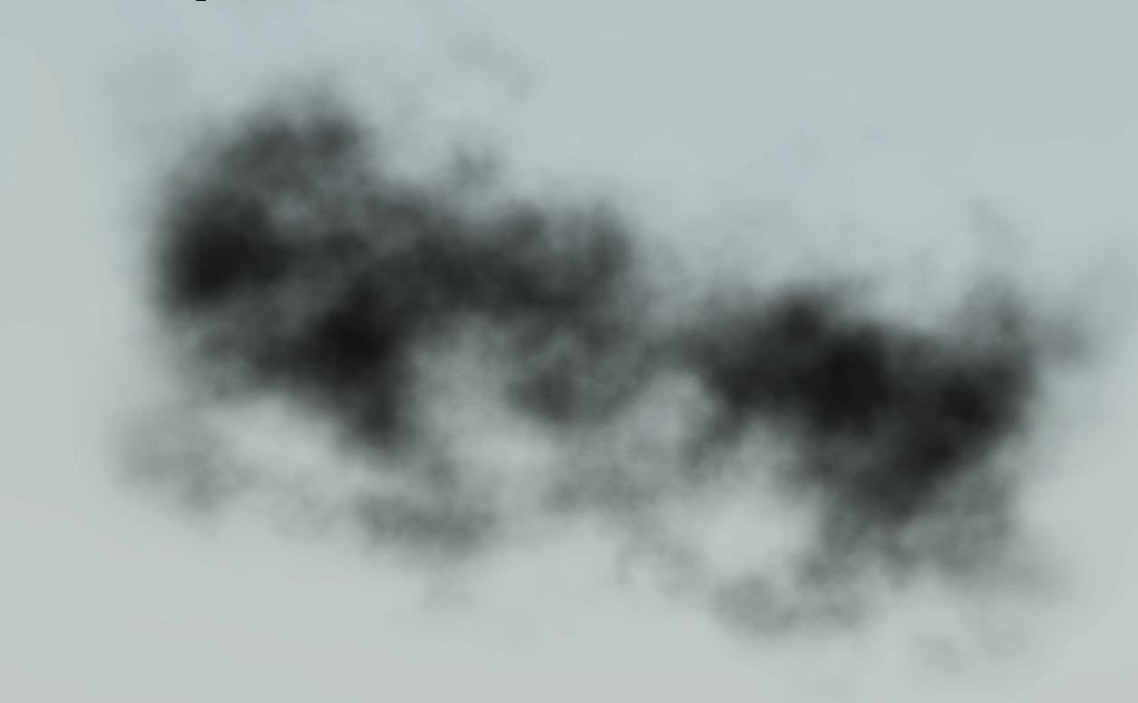
Absorption

Slide 34
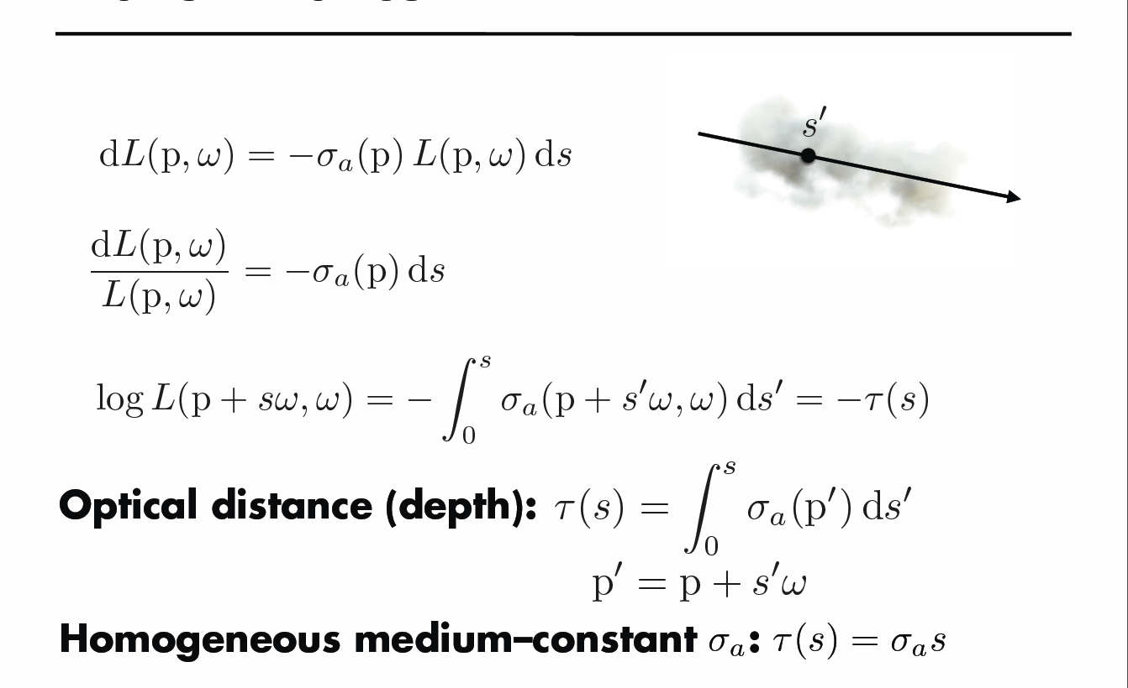
Transmittance

Slide 35
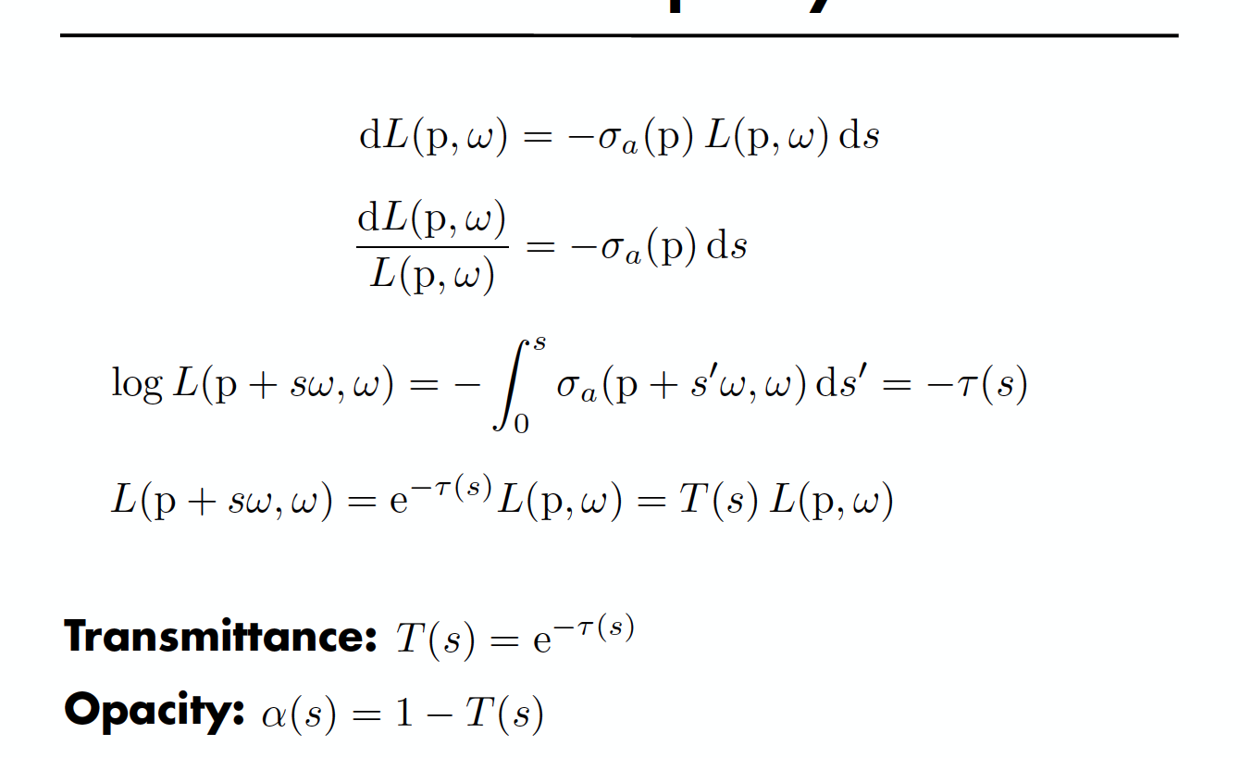
Transmittance and Opacity

Slide 36
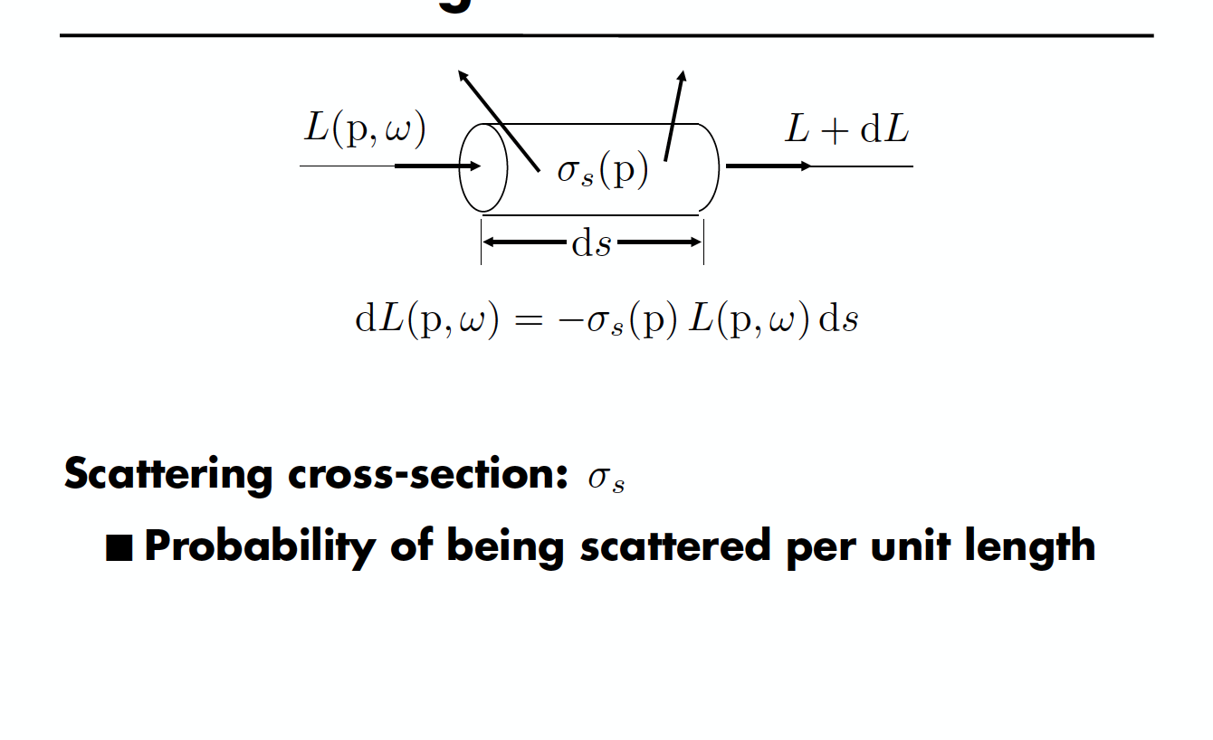
Out-Scattering

Slide 37
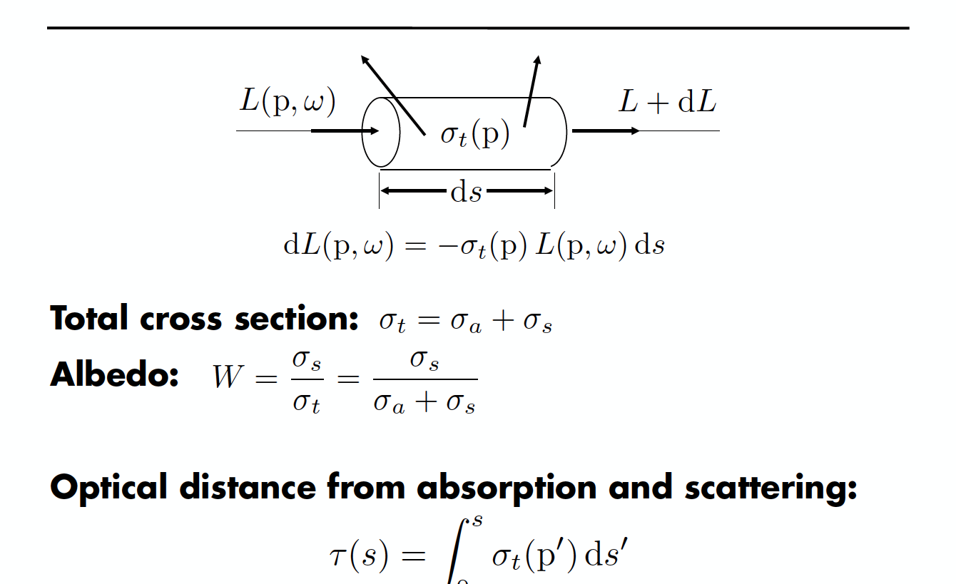
Extinction

Slide 38
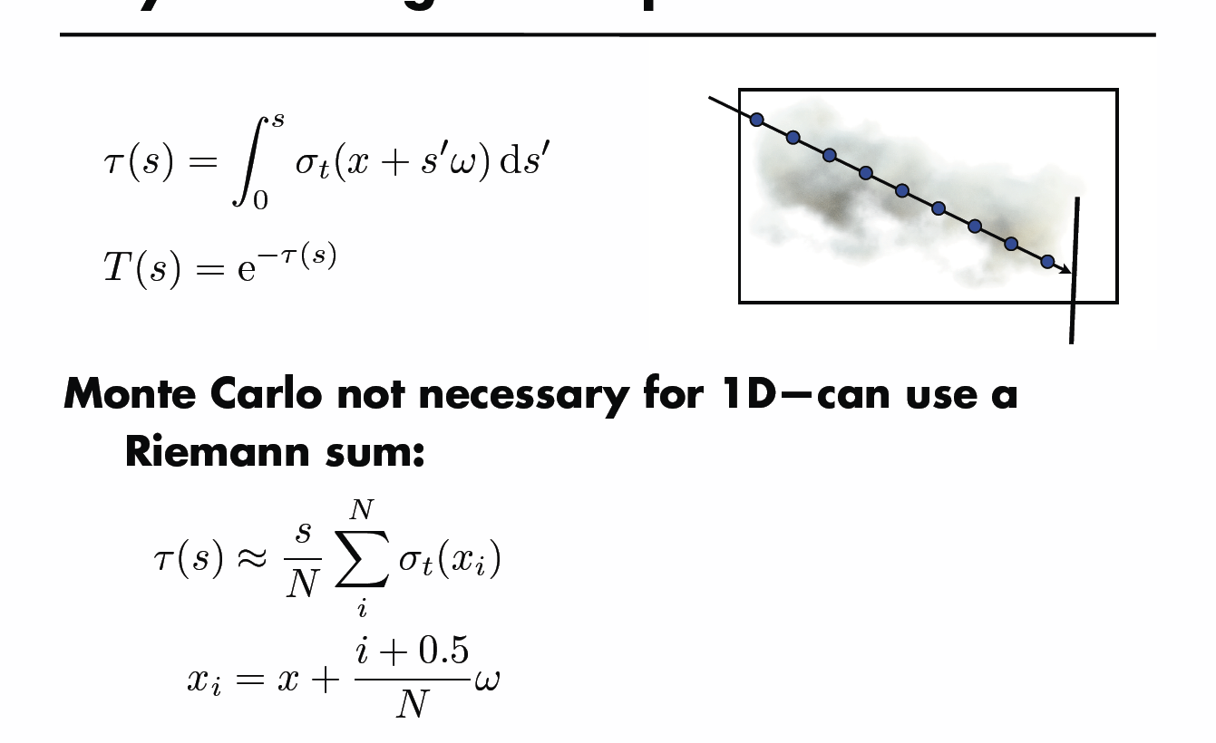
Ray Marching for Transmittance

Slide 39
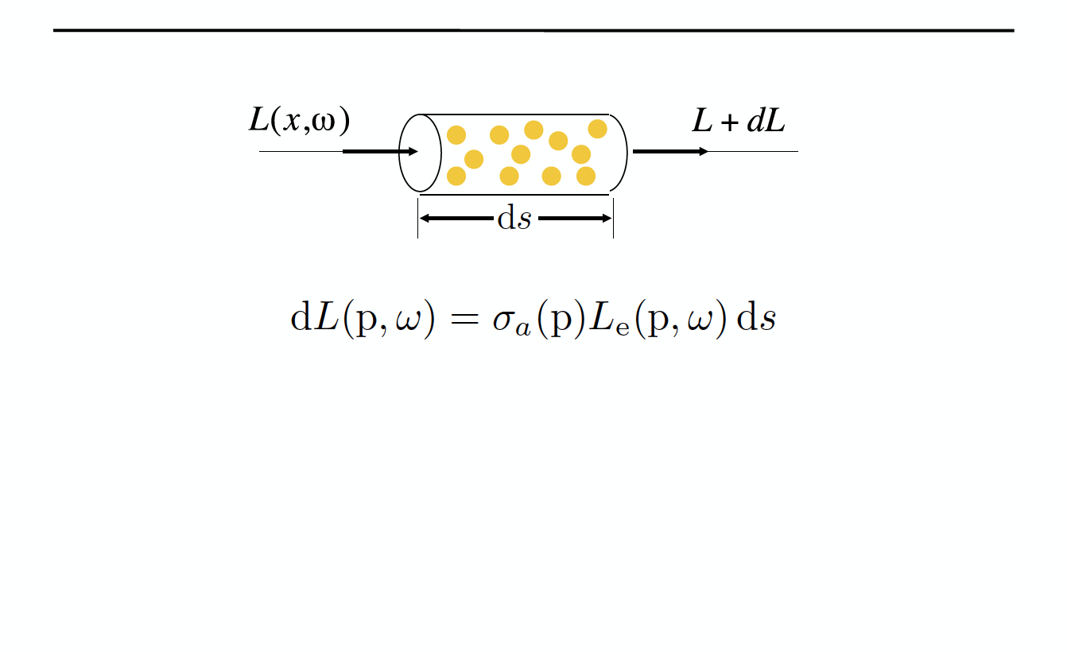
Emission

Slide 40
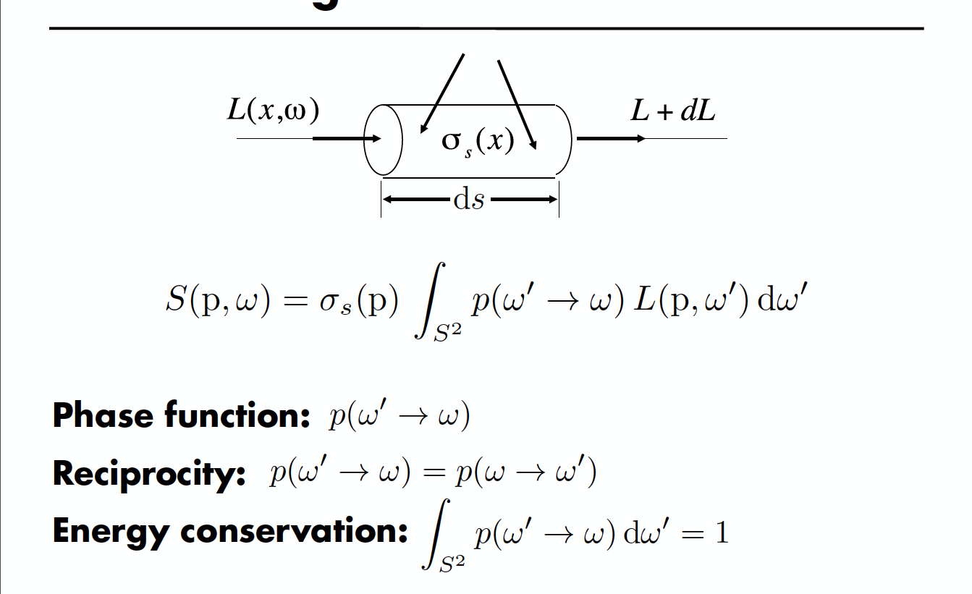
In-Scattering

Slide 41
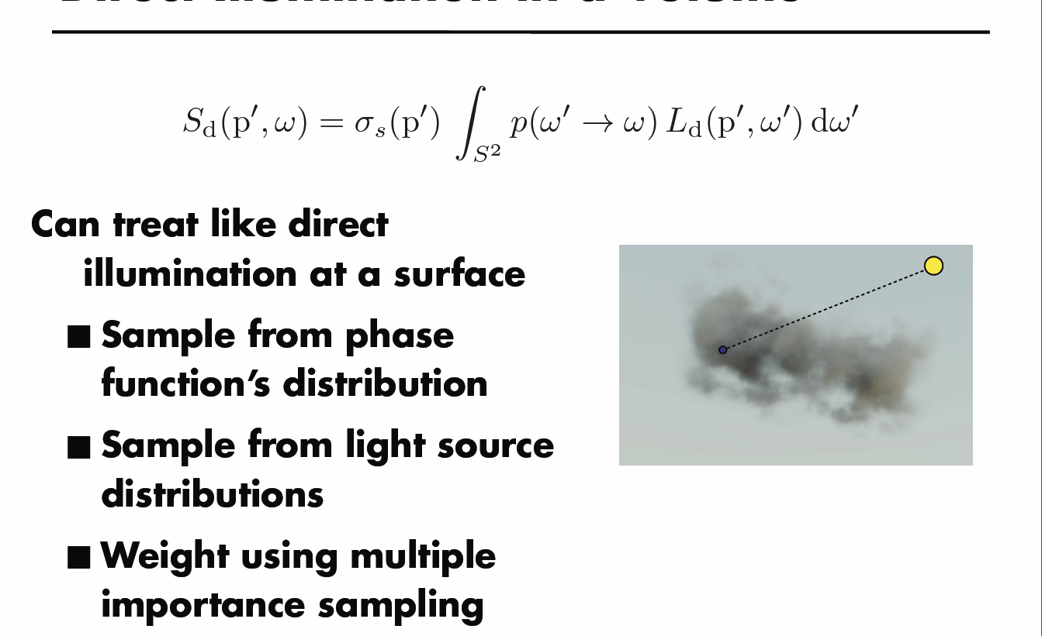
Direct Illumination in a Volume

Slide 42
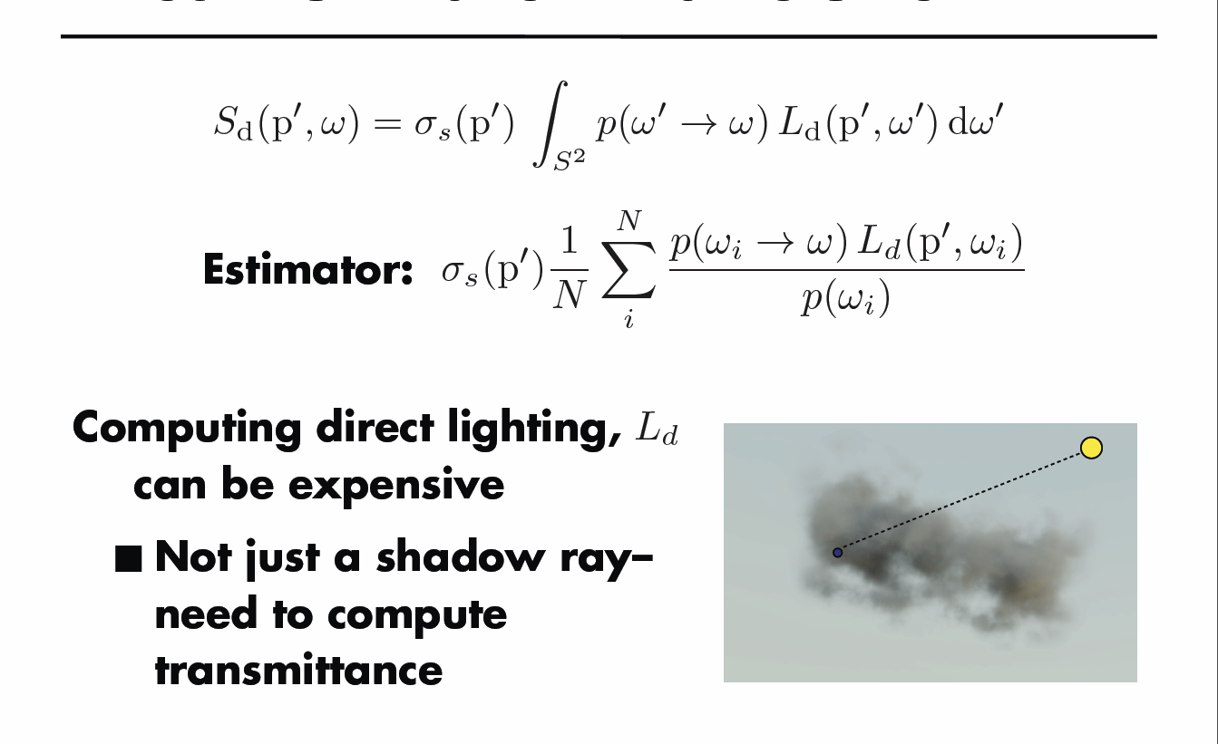
Direct Illumination in a Volume

Slide 43
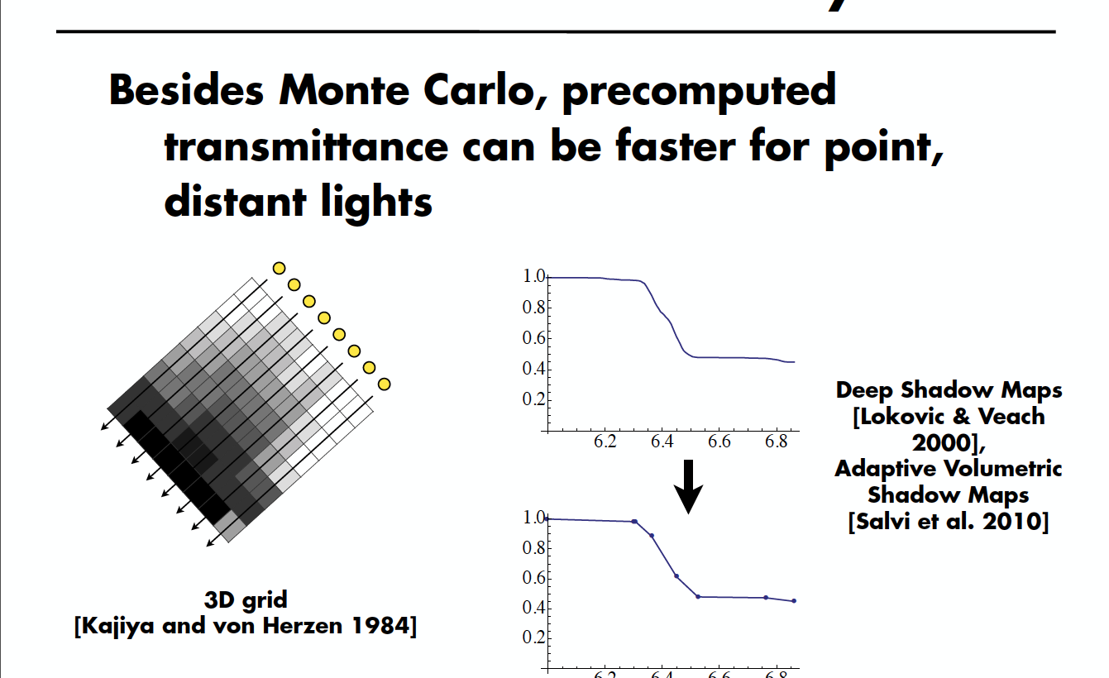
Transmittance for Shadow Rays

Slide 44
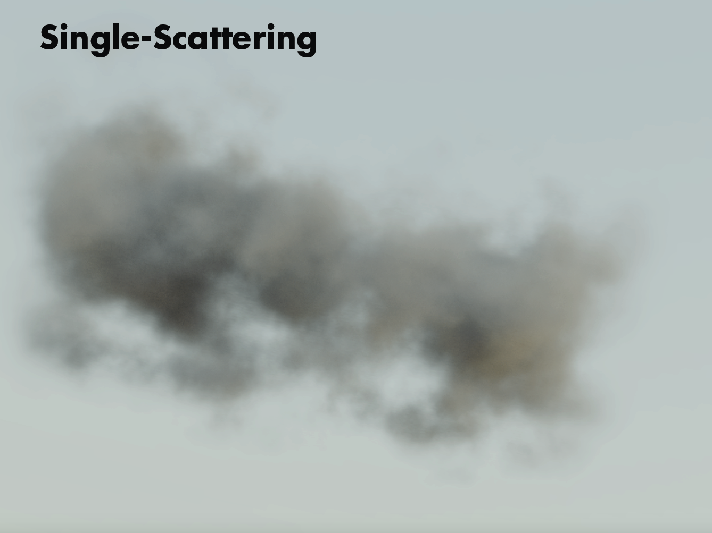

Slide 45
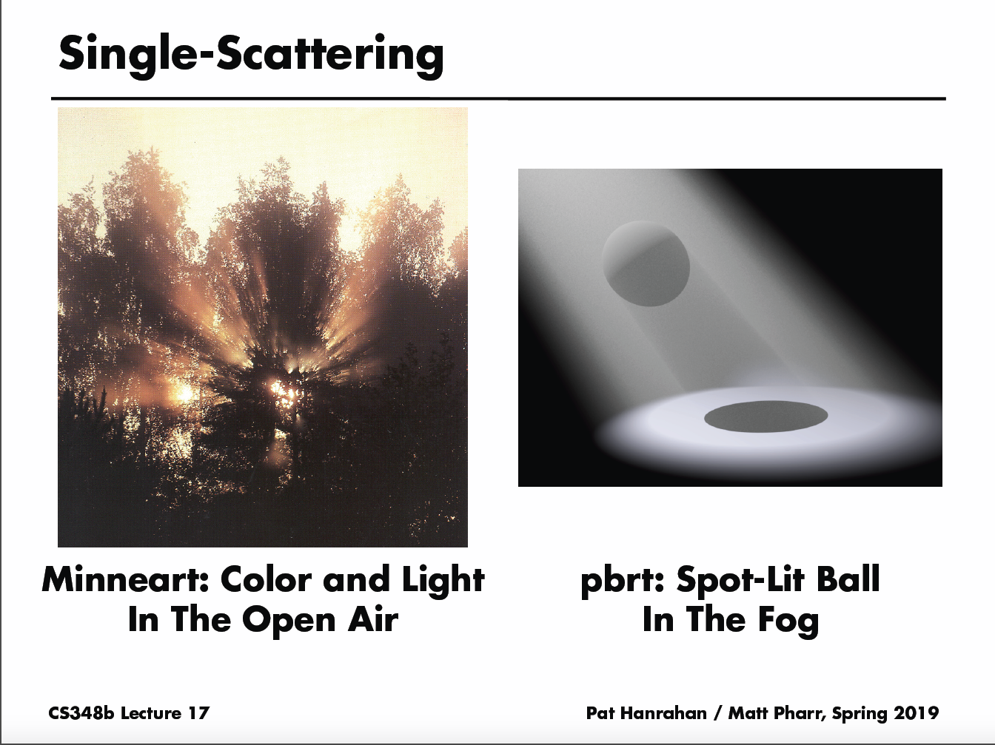

Slide 46
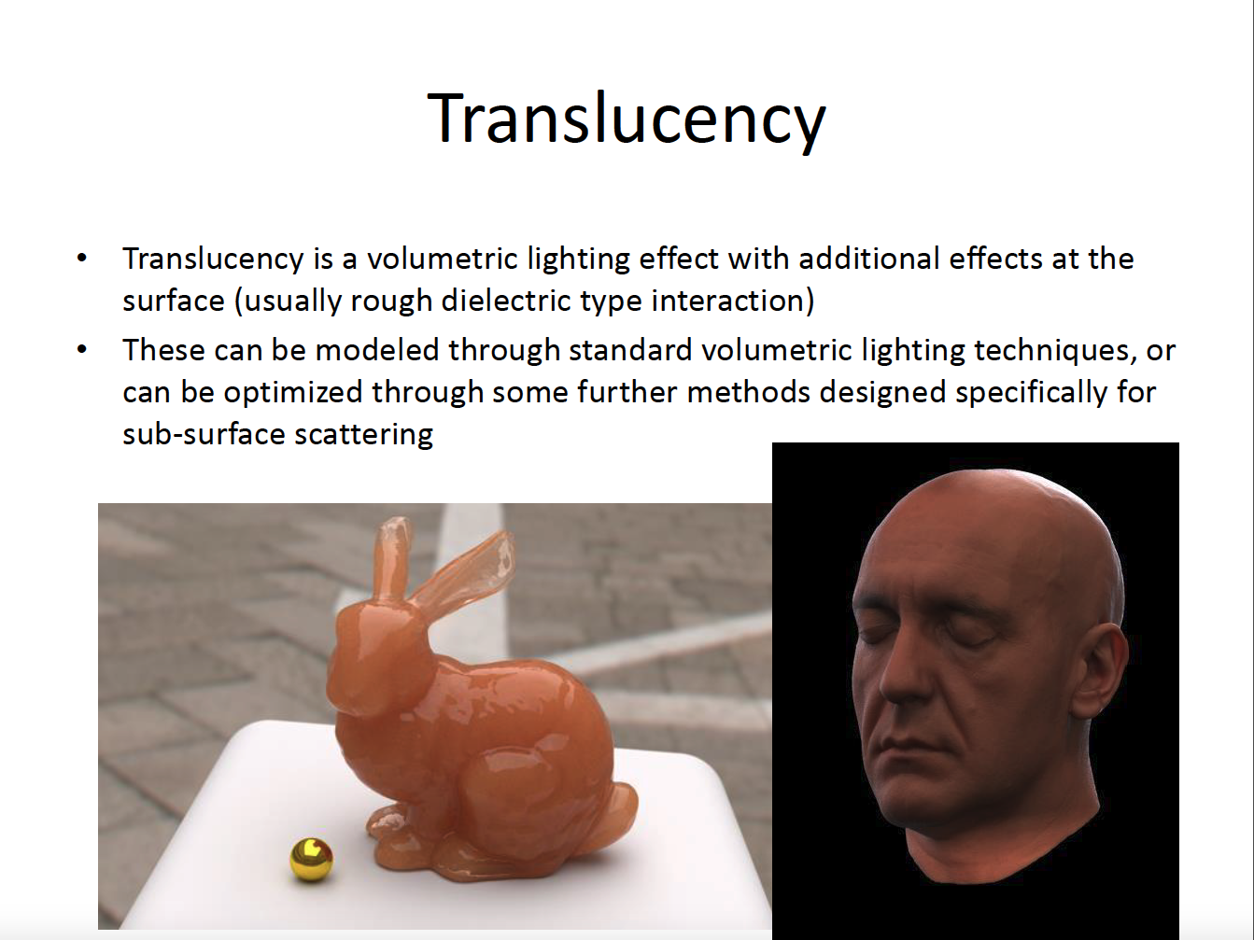

Slide 47
Deep learning
Significant interest in deep learning
Successfully applied to analysis applications
Image Classification
[Krizhevsky et al. 2012]
Object Detection
[Ren et al. 2015]
Video Classification
[Karpathy et al. 2014]
Image Captioning
[Karpathy and Fei-Fei 2015]
Notes:
Recently there has been significant interest in using deep learning and it’s been successfully used for a variety of analysis applications such as image classification and object detection.
To explain the reason for progress, I am going to step back and look at how previous approaches have handled the analysis applications.

Slide 48

Analysis applications
Hand-Crafted
Features
Learning
System
Dog
Traditional Methods
Deep Neural Network
Dog
Deep Learning Methods
Notes:
The traditional methods for analysis applications like classification would take an image and extract a set of hand crafted features from it. They then would pass these features to a learning system to output the label. Deep learning approaches replace the whole pipeline with a deep neural network. So of course deep networks are better in this case because they can replace the hand crafted features with learned and optimal features.
This is a desirable property and it would be great to use them for synthesis applications, which are the majority of problems in graphics.

Slide 49
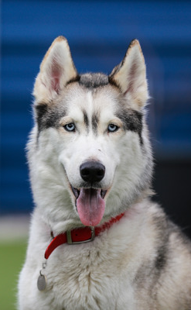

Convolutional neural network (CNN)
Efficient (can be implemented on GPUs)
Model the process systematically
Far less progress for synthesis applications
Offline Training
Testing
Input
Output
Reference
Optimal
Filter
Filter
=
Optimal
Filter
Optimal
Filter
Notes:
Fortunately, deep learning systems in their core use convolutional neural networks which are suitable for synthesizing images. These networks are basically a set of filters applied to the input in a convolutional way to produce the output. We can stack multiple of these layers to model more complex relationships which is why they are called deep networks. As you can see since the filters are applied in a convolutional way, these networks are naturally able synthesize images.
Each filter is basically a set of learnable weights. The goal of offline training process is to find optimal filter weights by minimizing the error between the network output and the reference or ground truth output. This training process is usually done iteratively and the filter weights are updated at each iteration until convergence. Once converged we have the optimal weights and we can use them to quickly evaluate the network on new test scenes.
These networks are efficient and can be implemented on GPUs. And they also model the process in different applications systematically and in a data driven way. Therefore, these networks are a perfect candidate for addressing the synthesis applications. Despite this, there has been far less progress in using deep learning for synthesis applications, specially in graphics.

Slide 50
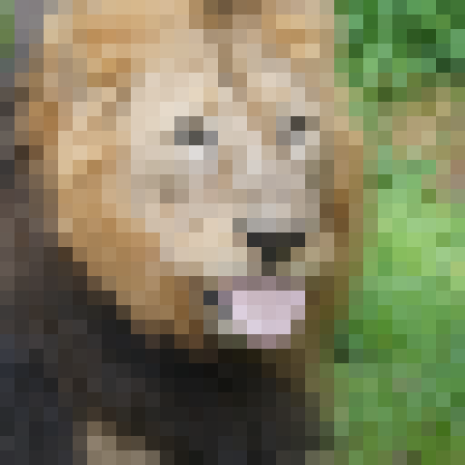
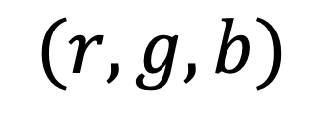
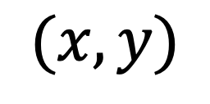
MLPs Toy problem: storing 2D image data
$$(x,y)$$
$$(r,g,b)$$
Usually we store an image as a 2D grid of RGB color values
Notes:
In the case of volume rendering we’re trying to store a complicated 3d function, for the sake of simplicity let’s drop down to the lower dimensional setting of 2d color images.
Usually we store an image as a simple 2d array. To get the color of a pixel, you just index into the array and grab the RGB color triplet sitting there in memory.

Slide 51
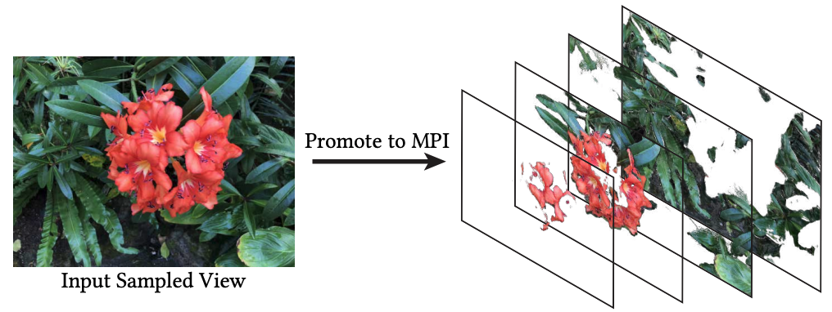







Use neural network to replace large N-d array
$$z$$
$$(r,g,b,σ)$$
$$y$$
$$x$$
versus
$$(x,y,z,θ,φ)$$
$$(r,g,b,σ)$$
$$F_{Ω}$$
Notes:
Prior ML view synthesis work explicitly stored RGBA volumes as voxel grids, but here we’re replacing that with a network, which ends up substantially compressing the data.
And it also lets us throw in another couple input coordinates for free - we add the ray direction as well, to let the color of particles in the volume vary when viewed from different angles, just like shiny materials in the real world.

Slide 52


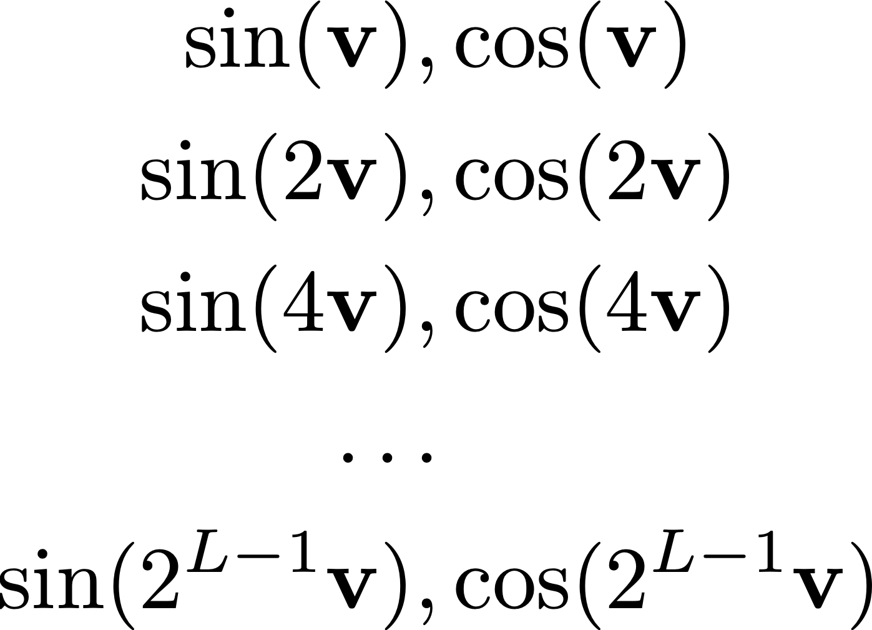
Example mapping: “positional encoding”
Notes:
This positional encoding is very simple: we just send each of the scalar input coordinates through a sequence of sinusoids with exponentially increasing frequencies before passing them into the fully connected network. This is quite similar to how Transformer networks encode the position of a word in a sentence for natural language processing. It’s really easy to implement and only adds a negligible amount of extra computation to the network, about the same as if we’d added one extra fully connected layer.

Slide 53
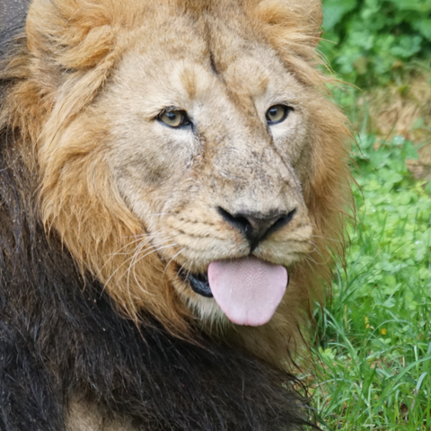
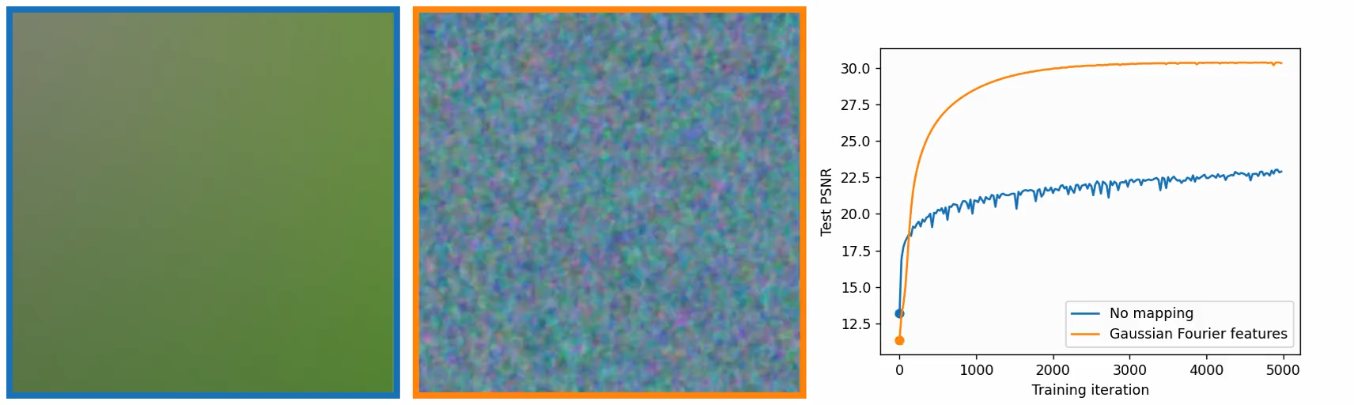
Preserve High-Frequency Features
Ground truth image
Neural network output without high frequency mapping
Neural network output with high frequency mapping
Fourier Features Let Networks Learn High Frequency Functions in Low Dimensional Domains. Tancik et al. Neurips 20
Notes:
What if we trained a neural network to learn this pixel to color mapping? We can take a 2D pixel coordinate xy as a pair of floating point numbers, put it through a network, and ask it to give us the RGB color of the corresponding pixel. This is a simple supervised learning problem, we can just use simple gradient descent to train the network weights and see what happens.

