Slide 1
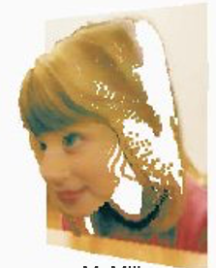
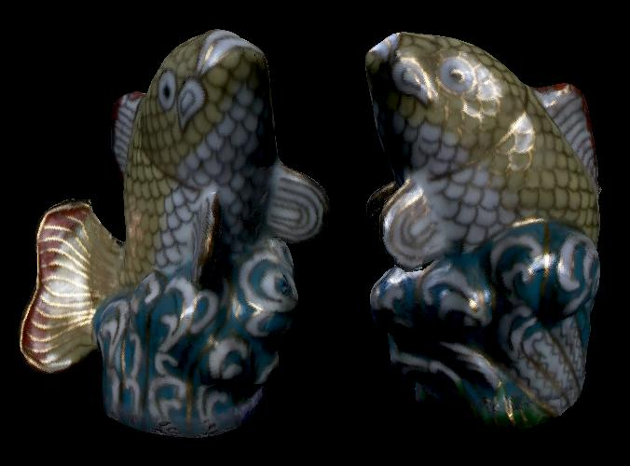
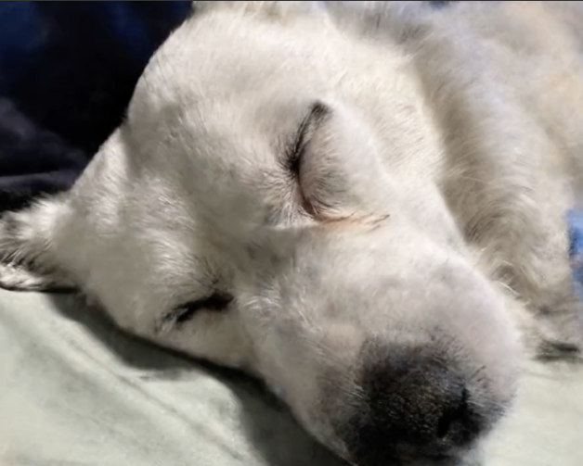
Image-Based Rendering
CSE 274, Lecture 2: Basics and Background
Ravi Ramamoorthi
http://www.cs.ucsd.edu/~ravir

Slide 2
Motivation: BRDFs, Ray Tracing, ...
Basics of Illumination, Reflection
Formal radiometric analysis (not ad-hoc)
Ray Tracing
Reflection Equation and Rendering Equation
Monte Carlo Rendering next lecture
Appreciate formal analysis in a graduate course, even if not absolutely essential in practice
Please e-mail re papers you want to present (by Th)

Slide 3
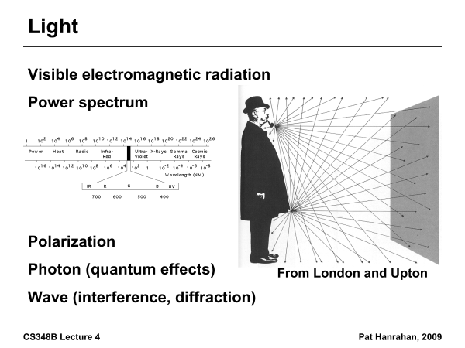

Slide 4
Radiometry
Physical measurement of electromagnetic energy
Measure spatial (and angular) properties of light
Radiance, Irradiance
Reflection functions: Bi-Directional Reflectance Distribution Function or BRDF
Reflection Equation
Simple BRDF models

Slide 5
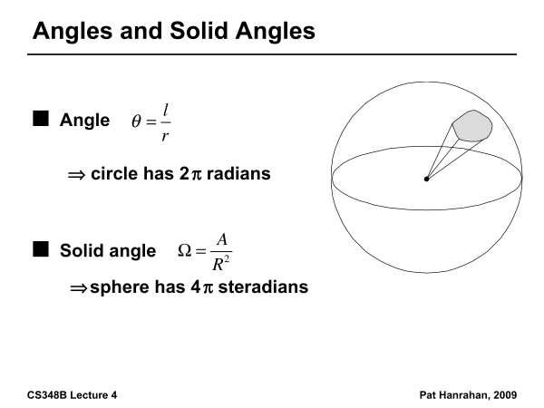

Slide 6
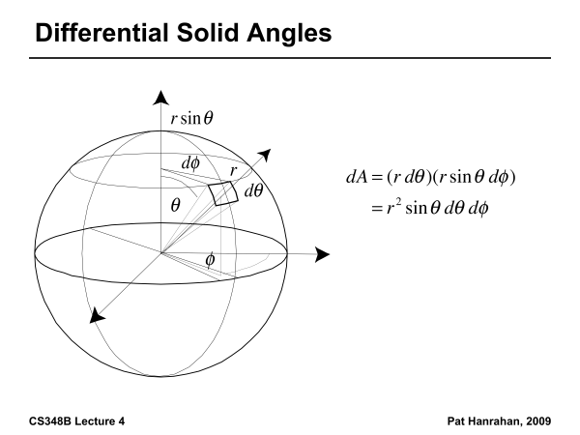

Slide 7
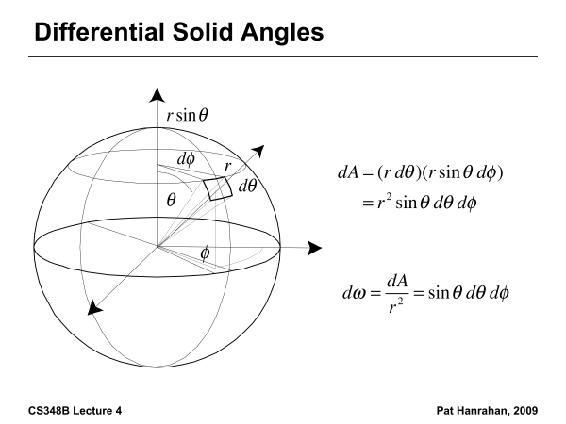

Slide 8
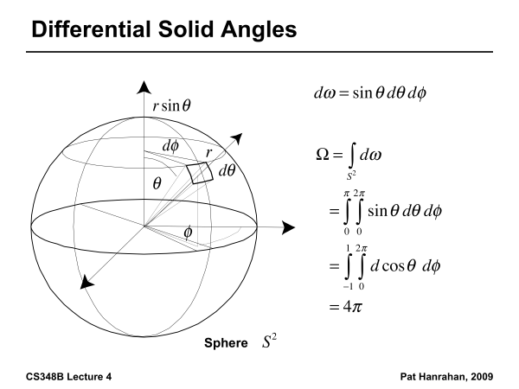

Slide 9
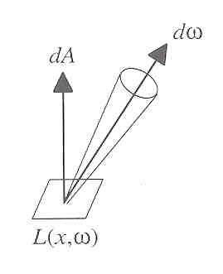
Radiance
Power per unit projected area perpendicular to the ray per unit solid angle in the direction of the ray
Symbol: L(x,ω) (W/m² sr)
Flux given by dΦ = L(x,ω) cos θ dω dA

Slide 10
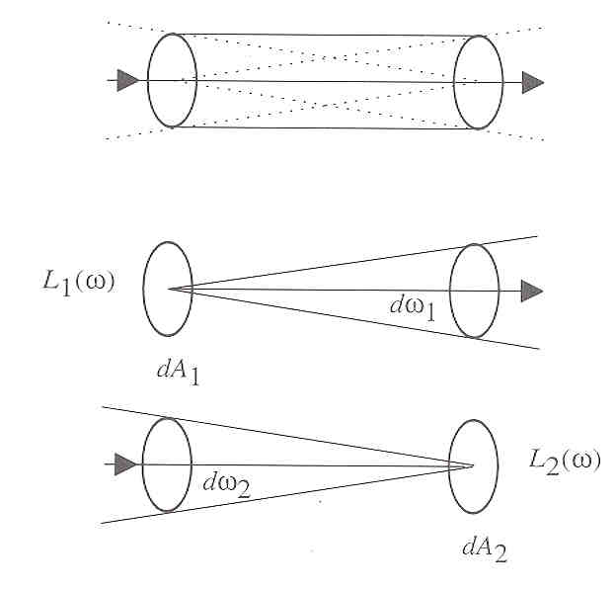
Radiance properties
Radiance constant as propagates along ray
Derived from conservation of flux
Fundamental in Light Transport.

Slide 11
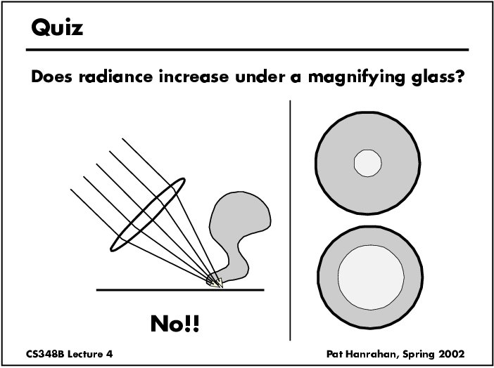

Slide 12
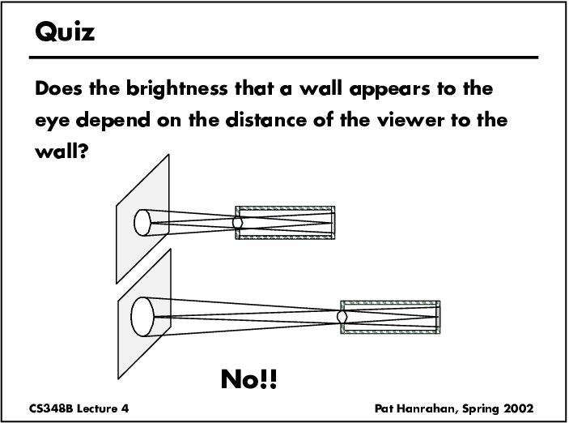

Slide 13
Radiance properties
Sensor response proportional to radiance (constant of proportionality is throughput)
Far away surface: See more, but subtends smaller angle
Wall equally bright across viewing distances
Consequences
Radiance associated with rays in a ray tracer
Other radiometric quants derived from radiance

Slide 14
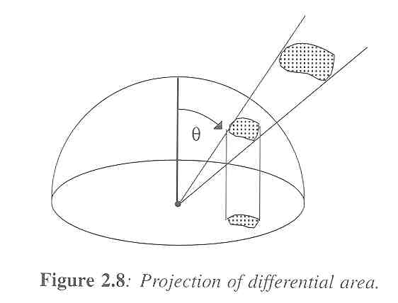
Irradiance, Radiosity
Irradiance E is radiant power per unit area
Integrate incoming radiance over hemisphere
Projected solid angle (cos θ dω)
Uniform illumination: Irradiance = π [CW 24,25]
Units: W/m²
Radiant Exitance (radiosity)
Power per unit area leaving surface (like irradiance)

Slide 15
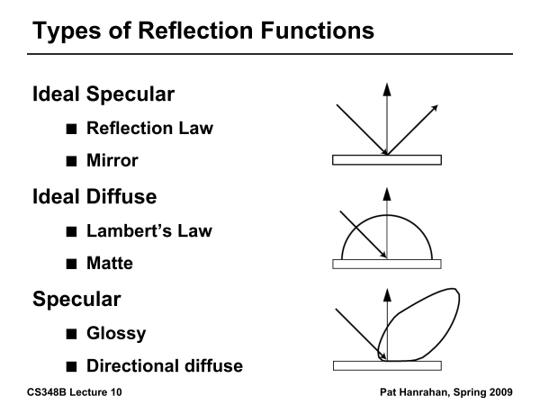

Slide 16
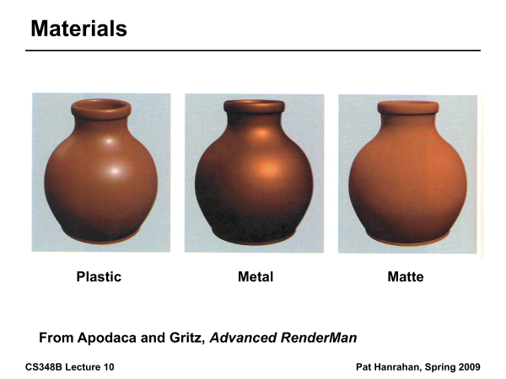

Slide 17
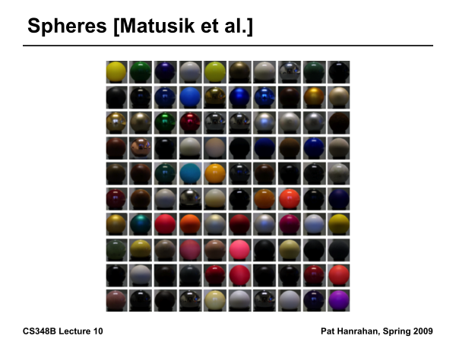

Slide 18
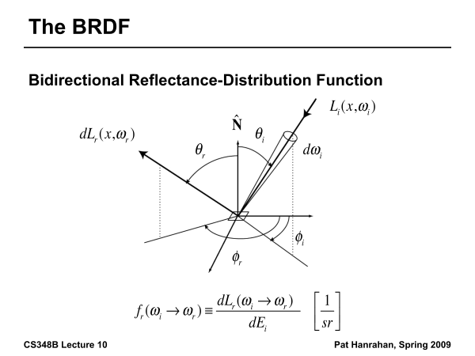

Slide 19
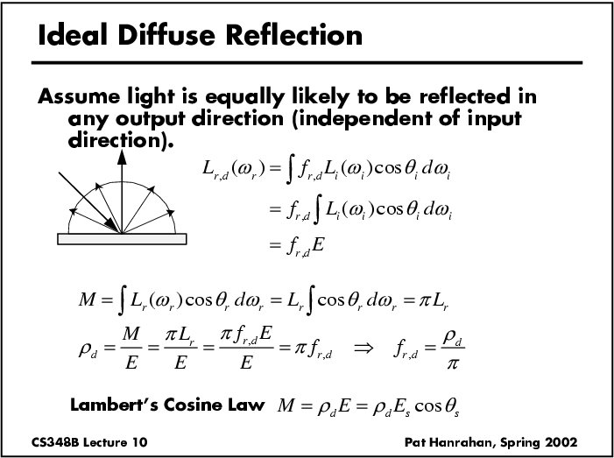

Slide 20
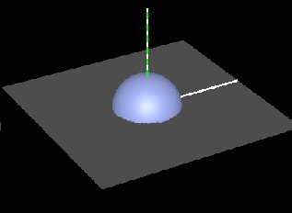
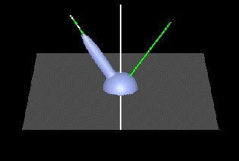
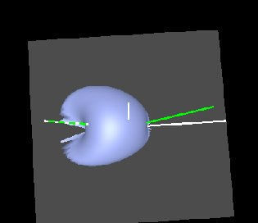
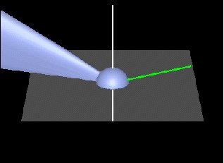
Brdf Viewer plots
Diffuse
Torrance-Sparrow
Anisotropic
bv written by Szymon Rusinkiewicz

Slide 21
Torrance-Sparrow
Fresnel term:
allows for wavelength dependency
Geometric Attenuation:
reduces the output based on the amount of shadowing or masking that occurs.
Distribution:
distribution function determines what percentage of microfacets are oriented to reflect in the viewer direction.
How much of the macroscopic surface is visible to the light source
How much of the macroscopic surface is visible to the viewer

Slide 22
Motivation: BRDFs, Ray Tracing, ...
Basics of Illumination, Reflection
Formal radiometric analysis (not ad-hoc)
Ray Tracing
Reflection Equation and Rendering Equation
Monte Carlo Rendering next lecture
Appreciate formal analysis in a graduate course, even if not absolutely essential in practice
Please e-mail re papers you want to present (by Th)

Slide 23
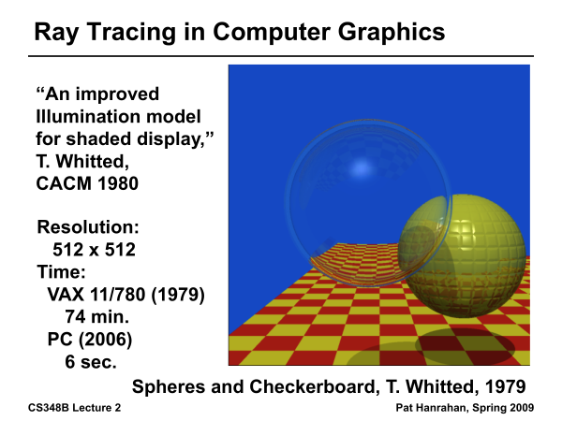
Ray Tracing History

Slide 24
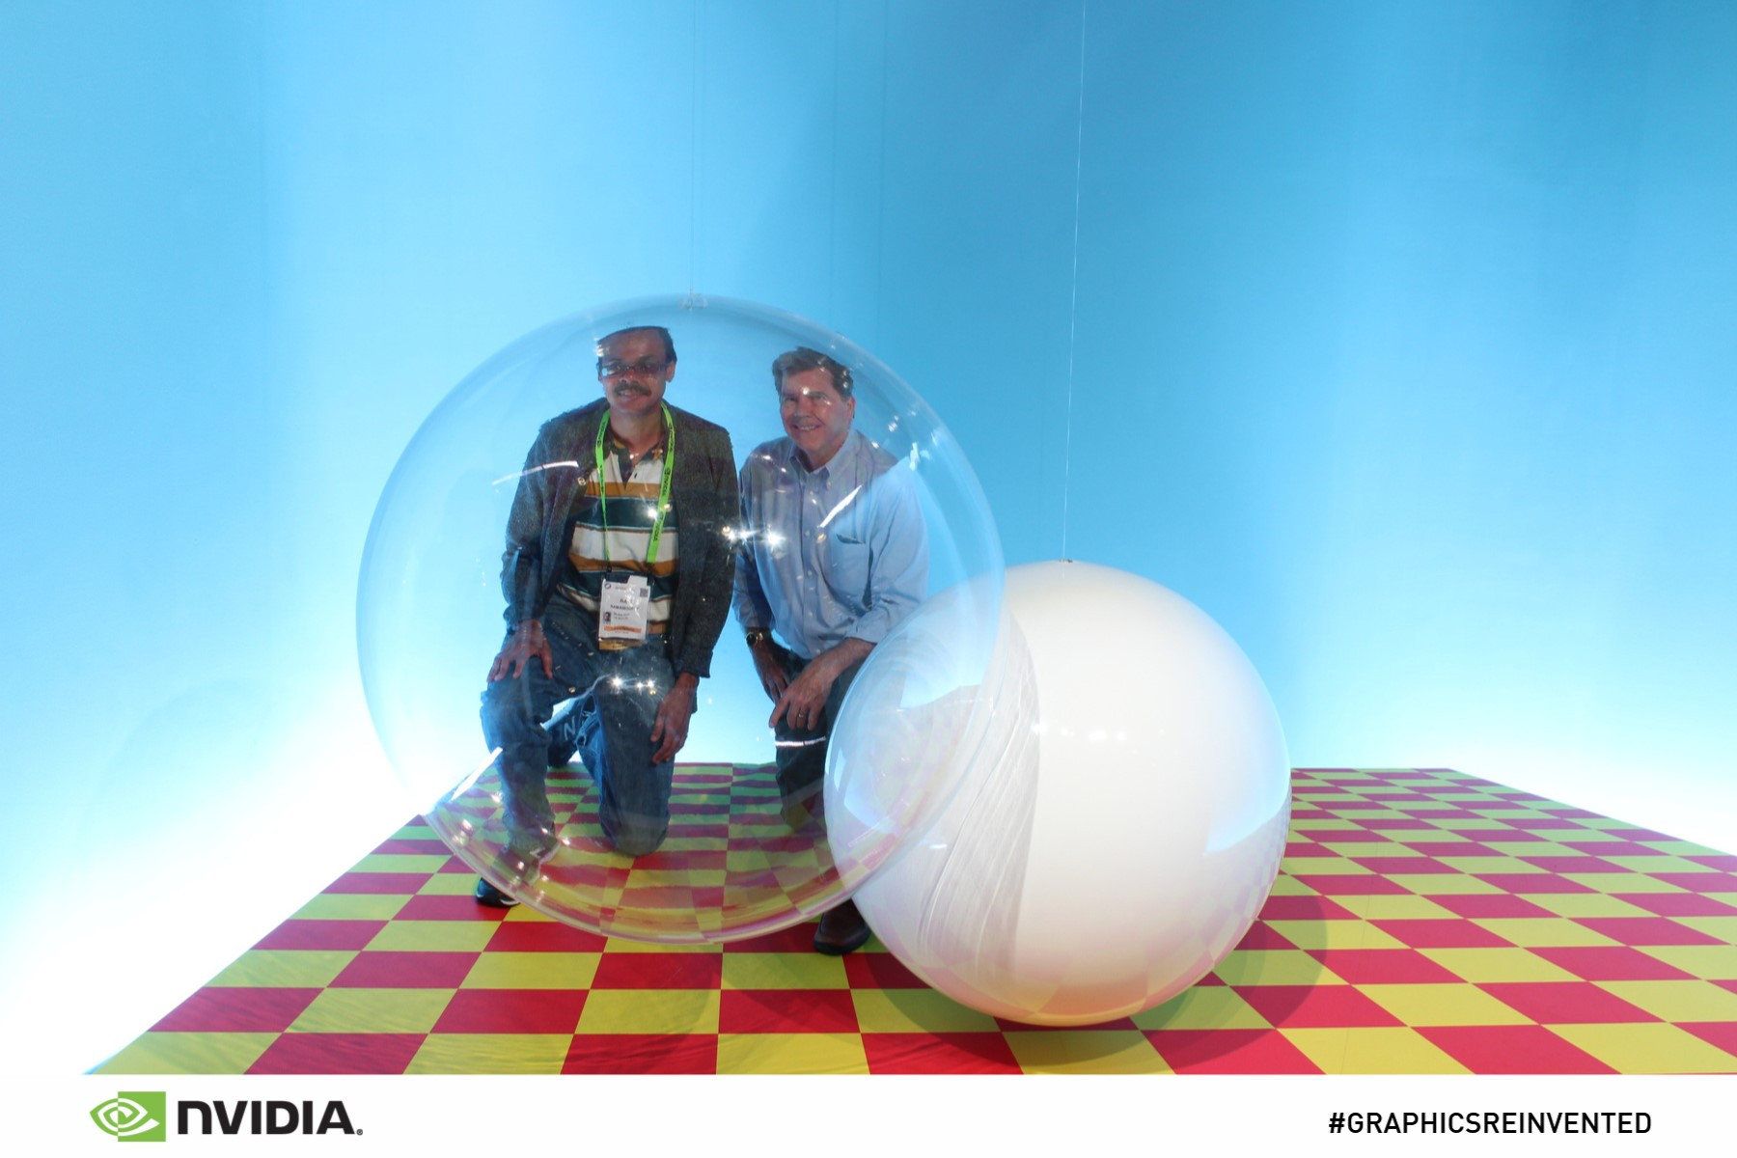
From SIGGRAPH 18
Real Photo: Instructor and Turner Whitted at SIGGRAPH 18

Slide 25
Ray Casting
Virtual Viewpoint
Virtual Screen
Objects
Multiple intersections: Use closest one (as does OpenGL)
Ray misses all objects: Pixel colored black
Ray intersects object: shade using color, lights, materials

Slide 26
Outline in Code
Image Raytrace (Camera cam, Scene scene, int width, int height)
{
Image image = new Image (width, height) ;
for (int i = 0 ; i < height ; i++)
for (int j = 0 ; j < width ; j++) {
Ray ray = RayThruPixel (cam, i, j) ;
Intersection hit = Intersect (ray, scene) ;
image[i][j] = FindColor (hit) ;
}
return image ;
}

Slide 27
Ray/Object Intersections
Heart of Ray Tracer
One of the main initial research areas
Optimized routines for wide variety of primitives
Various types of info
Shadow rays: Intersection/No Intersection
Primary rays: Point of intersection, material, normals
Texture coordinates
Work out examples
Triangle, sphere, polygon, general implicit surface

Slide 28
Ray-Sphere Intersection
C
P₀

Slide 29
Ray-Sphere Intersection
Substitute
Simplify

Slide 30
Ray-Sphere Intersection
2 real positive roots: pick smaller root
Both roots same: tangent to sphere
One positive, one negative root: ray origin inside sphere (pick + root)
Complex roots: no intersection (check discriminant of equation first)
Solve quadratic equations for t

Slide 31
Ray-Sphere Intersection
Intersection point:
Normal (for sphere, this is same as coordinates in sphere frame of reference, useful other tasks)

Slide 32
Ray-Triangle Intersection
One approach: Ray-Plane intersection, then check if inside triangle
Plane equation:
B
A
C

Slide 33
Ray-Triangle Intersection
One approach: Ray-Plane intersection, then check if inside triangle
Plane equation:
Combine with ray equation:
B
A
C

Slide 34
Ray inside Triangle
Once intersect with plane, still need to find if in triangle
Many possibilities for triangles, general polygons (point in polygon tests)
We find parametrically [barycentric coordinates]. Also useful for other applications (texture mapping)
B
A
α
β
P
γ
C

Slide 35
Ray inside Triangle
B
A
α
β
P
γ
C

Slide 36
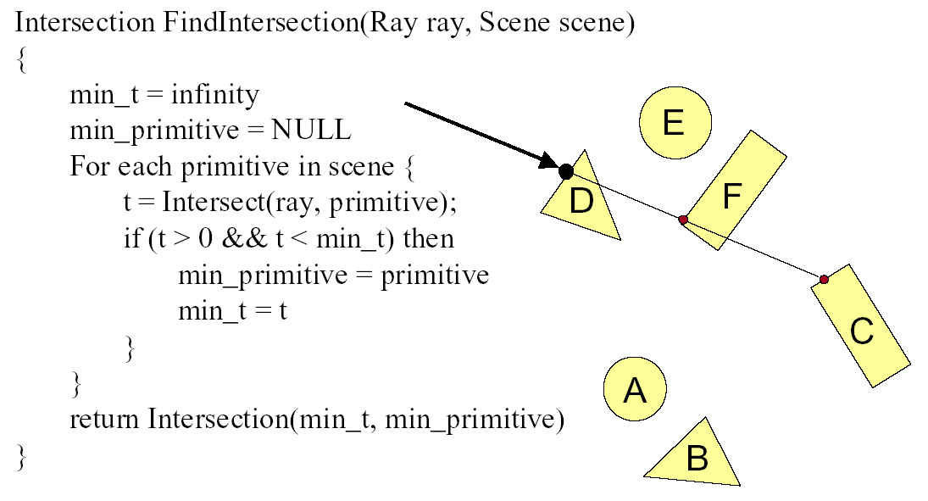
Ray Scene Intersection

Slide 37
Shadows
Light Source
Virtual Viewpoint
Virtual Screen
Objects
Shadow ray to light is blocked: object in shadow
Shadow ray to light is unblocked: object visible

Slide 38
Shadows: Numerical Issues
Numerical inaccuracy may cause intersection to be
below surface (effect exaggerated in figure)
Causing surface to incorrectly shadow itself
Move a little towards light before shooting shadow ray

Slide 39
Mirror Reflections/Refractions
Virtual Viewpoint
Virtual Screen
Objects
Generate reflected ray in mirror direction,
Get reflections and refractions of objects

Slide 40
Recursive Ray Tracing
For each pixel
Trace Primary Eye Ray, find intersection
Trace Secondary Shadow Ray(s) to all light(s)
Color = Visible ? Illumination Model : 0 ;
Trace Reflected Ray
Color += reflectivity * Color of reflected ray
Need acceleration structure for performance

Slide 41
Interactive Raytracing
Ray tracing historically slow
Now viable alternative for complex scenes
Key is sublinear complexity with acceleration; need not process all triangles in scene
Allows many effects hard in hardware
Today graphics hardware and software (NVIDIA Optix 6, RTX chips 10G+ rays per second).Video

Slide 42
Motivation: BRDFs, Ray Tracing, ...
Basics of Illumination, Reflection
Formal radiometric analysis (not ad-hoc)
Ray Tracing
Reflection Equation and Rendering Equation
Monte Carlo Rendering next lecture
Appreciate formal analysis in a graduate course, even if not absolutely essential in practice
Please e-mail re papers you want to present (by Th)

Slide 43
Reflection Equation
Reflected Light
(Output Image)
Emission
Incident
Light (from
light source)
BRDF
Cosine of
Incident angle

Slide 44
Reflection Equation
Sum over all light sources
Reflected Light
(Output Image)
Emission
Incident
Light (from
light source)
BRDF
Cosine of
Incident angle

Slide 45
Reflection Equation
Replace sum with integral
Reflected Light
(Output Image)
Emission
Incident
Light (from
light source)
BRDF
Cosine of
Incident angle

Slide 46
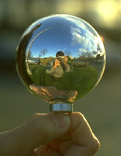
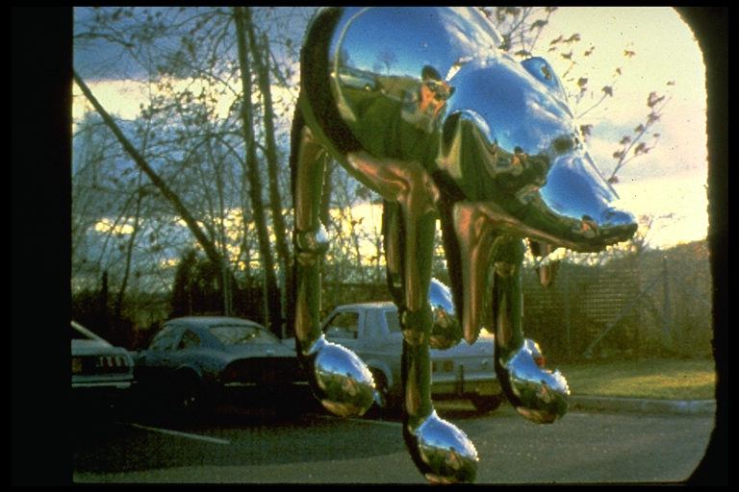
Environment Maps
Light as a function of direction, from entire environment
Captured by photographing a chrome steel or mirror sphere
Accurate only for one point, but distant lighting same at other scene locations (typically use only one env. map)
Blinn and Newell 1976, Miller and Hoffman, 1984
Later, Greene 86, Cabral et al. 87

Slide 47
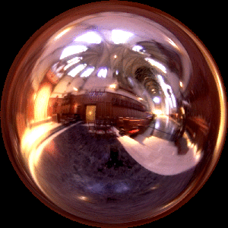
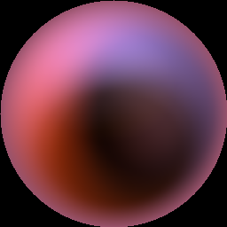
Irradiance Environment Maps
R
N
Incident Radiance
(Illumination Environment Map)
Irradiance Environment Map

Slide 48
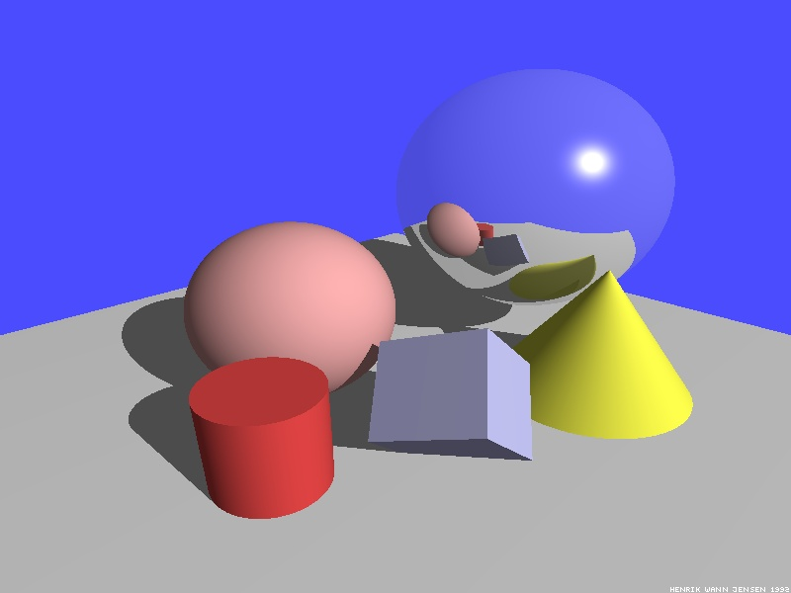
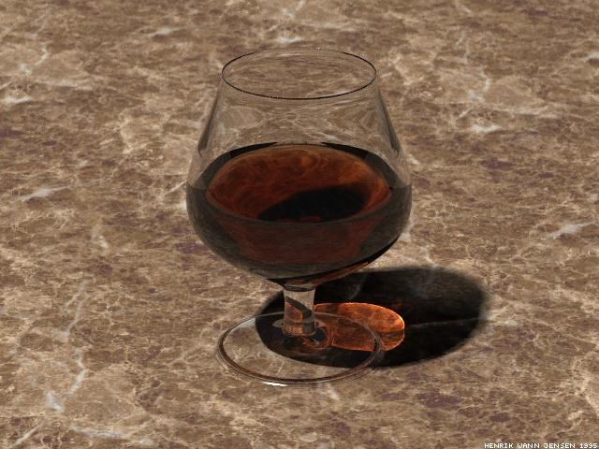
Illumination Models
Local Illumination
Light directly from light sources to surface
No shadows (cast shadows are a global effect)
Global Illumination: multiple bounces (indirect light)
Hard and soft shadows
Reflections/refractions (already seen in ray tracing)
Diffuse and glossy interreflections (radiosity, caustics)
Some images courtesy Henrik Wann Jensen

Slide 49
The Challenge
Computing reflectance equation requires knowing the incoming radiance from surfaces
But determining incoming radiance requires knowing the reflected radiance from surfaces

Slide 50
Rendering Equation
Surfaces (interreflection)
Reflected Light
(Output Image)
Emission
Reflected
Light
BRDF
Cosine of
Incident angle
UNKNOWN
KNOWN
UNKNOWN
KNOWN
KNOWN

Slide 51
Outline
Reflectance Equation
Global Illumination
Rendering Equation
As a general Integral Equation and Operator
Approximations (Ray Tracing, Radiosity)
Surface Parameterization (Standard Form)

Slide 52
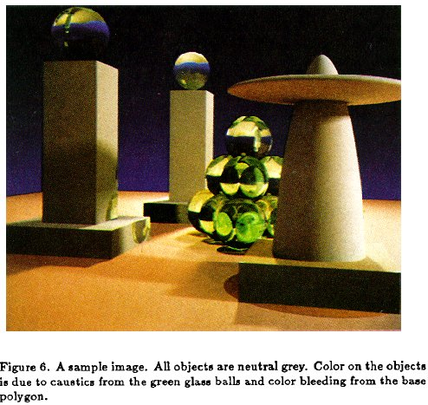
Rendering Equation (Kajiya 86)

Slide 53
Rendering Equation as Integral Equation
Reflected Light
(Output Image)
Emission
Reflected
Light
BRDF
Cosine of
Incident angle
UNKNOWN
KNOWN
UNKNOWN
KNOWN
KNOWN
Is a Fredholm Integral Equation of second kind
[extensively studied numerically] with canonical form
Kernel of equation

Slide 54
Linear Operator Theory
Linear operators act on functions like matrices act on vectors or discrete representations
Basic linearity relations hold
Examples include integration and differentiation
M is a linear operator.
f and h are functions of u
a and b are scalars
f and g are functions

Slide 55
Linear Operator Equation
Kernel of equation
Light Transport Operator
Can be discretized to a simple matrix equation
[or system of simultaneous linear equations]
(L, E are vectors, K is the light transport matrix)

Slide 56
Solving the Rendering Equation
Too hard for analytic solution, numerical methods
Approximations, that compute different terms, accuracies of the rendering equation
Two basic approaches are ray tracing, radiosity. More formally, Monte Carlo and Finite Element. Today Monte Carlo path tracing is core rendering method
Monte Carlo techniques sample light paths, form statistical estimate (example, path tracing)
Finite Element methods discretize to matrix equation

Slide 57
Solving the Rendering Equation
General linear operator solution. Within raytracing:
General class numerical Monte Carlo methods
Approximate set of all paths of light in scene
Binomial Theorem
Term n corresponds to n bounces of light

Slide 58
Ray Tracing
Emission directly
From light sources
Direct Illumination
on surfaces
Global Illumination
(One bounce indirect)
[Mirrors, Refraction]
(Two bounce indirect)
[Caustics etc]

Slide 59
Ray Tracing
Emission directly
From light sources
Direct Illumination
on surfaces
Global Illumination
(One bounce indirect)
[Mirrors, Refraction]
OpenGL Shading
(Two bounce indirect)
[Caustics etc]

Slide 60
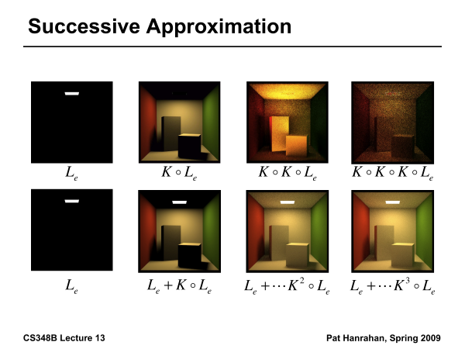

Slide 61
Outline
Reflectance Equation (review)
Global Illumination
Rendering Equation
As a general Integral Equation and Operator
Approximations (Ray Tracing, Radiosity)
Surface Parameterization (Standard Form)

Slide 62
Rendering Equation
Surfaces (interreflection)
Reflected Light
(Output Image)
Emission
Reflected
Light
BRDF
Cosine of
Incident angle
UNKNOWN
KNOWN
UNKNOWN
KNOWN
KNOWN

Slide 63
Change of Variables
Integral over angles sometimes insufficient. Write integral in terms of surface radiance only (change of variables)

Slide 64
Change of Variables
Integral over angles sometimes insufficient. Write integral in terms of surface radiance only (change of variables)

Slide 65
Rendering Equation: Standard Form
Integral over angles sometimes insufficient. Write integral in terms of surface radiance only (change of variables)
Domain integral awkward. Introduce binary visibility fn V
Same as equation 2.52 Cohen Wallace. It swaps primed
And unprimed, omits angular args of BRDF, - sign.
Same as equation above 19.3 in Shirley, except he has
no emission, slightly diff. notation

