Slide 1
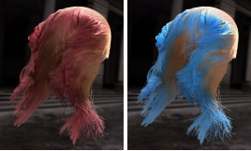
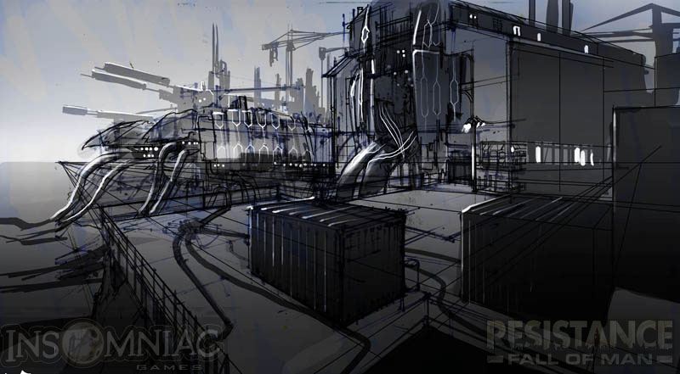
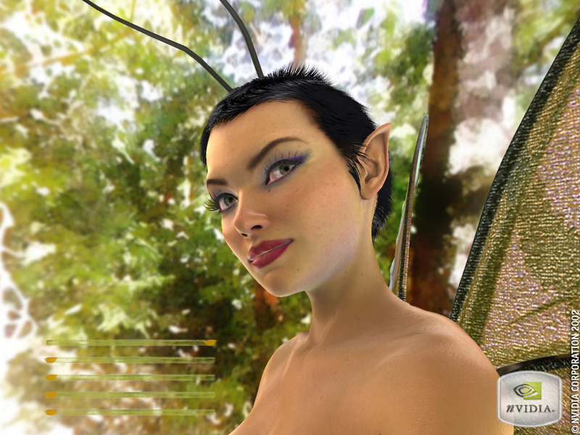
Real-Time High Quality Rendering
CSE 274 [Fall 2015], Lecture 7
Signal-Processing for Rendering
http://www.cs.ucsd.edu/~ravir

Slide 2
Motivation
Signal-processing provides new understanding
Methods based on (Spherical) Fourier analysis
  Including multi-dimensional analysis [Durand 05]
Allows understanding of sampling rates (in IBR)
Frequency-domain algorithms like convolution
Newer wedge Fourier spectra multidim. Rendering
  Variants are now possible in real-time
This lecture high-level, mostly conceptual ideas.
  Follow original papers for details, applications

Slide 3
Plenoptic Sampling
Plenoptic Sampling. Chai, Tong, Chan, Shum 00
Signal-processing on light field
Minimal sampling rate for antialiased rendering
Relates to depth range, Fourier analysis
Fourier spectra derived for 2D light fields for simplicity. Same ideas extend to 4D
Key paper in many newer methods on sheared and axis-aligned filtering for adaptive sampling

Slide 4
A Geometrical Intuition
Z_{opt}
Z_{min}
Camera i
Camera i+1

Slide 5
A Geometrical Intuition
Z_{opt}
Disparity Error
<
1 Pixel
Z_{min}
Camera i
Camera i+1
Rendering Camera

Slide 6
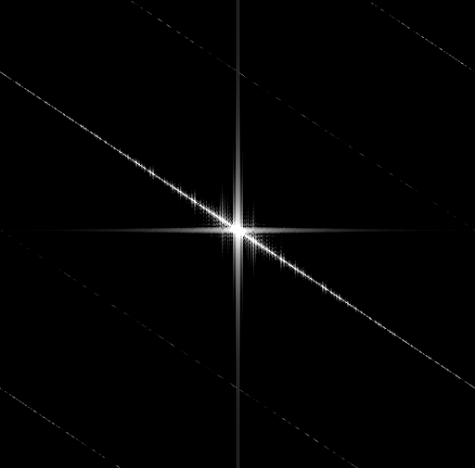
A Constant Plane
v
Z
t
t
v
Z₁
Z₁

Slide 7

Two Constant Planes
v
Z
t
Z₂
t
v
Z₁
Z₁
Z₂

Slide 8
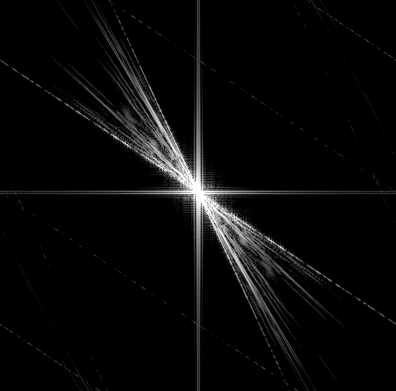
Between Two Planes
v
Z
t
Z₂
t
v
Z₁
Z₁
Z₂

Slide 9

Between Two Planes
v
Z
t
Z₂
t
v
Z₁
Z₁
Z₂
Notes:
Now we know the shape of the spectral support of the 2D continuous light field is like a wedge.

Slide 10
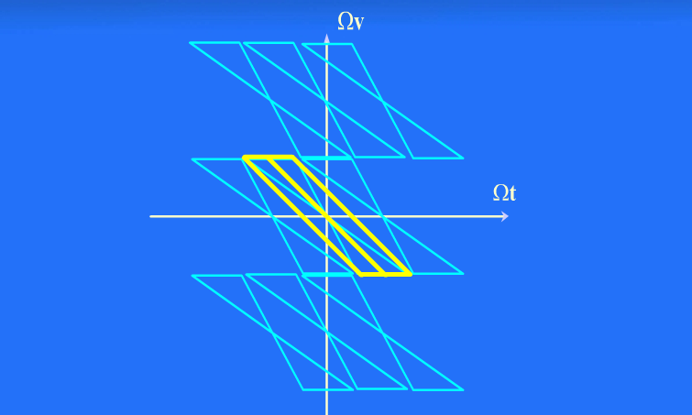
Light Field Reconstruction

Slide 11
Minimum Sampling Curve
Number of Images
Joint Image
and
Geometry Space
32x32
Minimum Sampling Curve
16x16
8x8
4x4
2x2
1
2
3
6
12
Accurate Depth
Number of Depth Layers

Slide 12
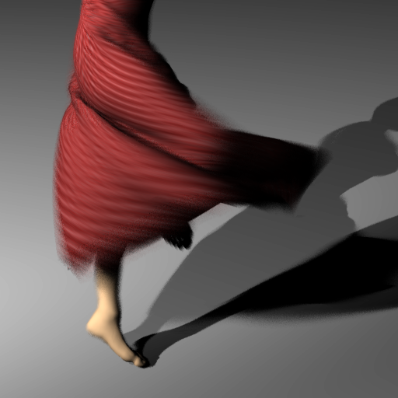

Frequency Analysis and Sheared Reconstruction for Rendering Motion Blur
Kevin Egan
Yu-Ting Tseng
Nicolas Holzschuch
Frédo Durand
Ravi Ramamoorthi
Columbia University
Columbia University
INRIA -- LJK
MIT CSAIL
University of California, Berkeley
Notes:
12

Slide 13
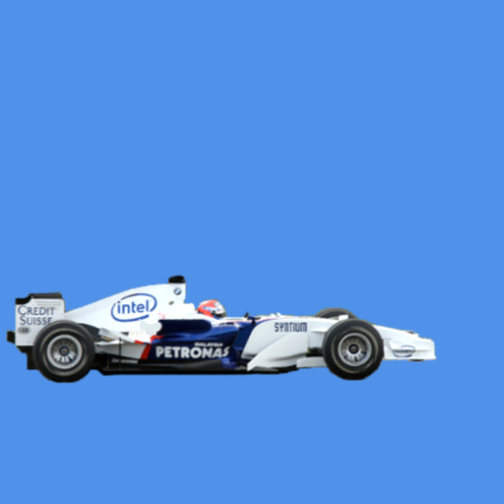

Observation
Motion blur is expensive
Motion blur removes spatial complexity
Notes:
13

Slide 14
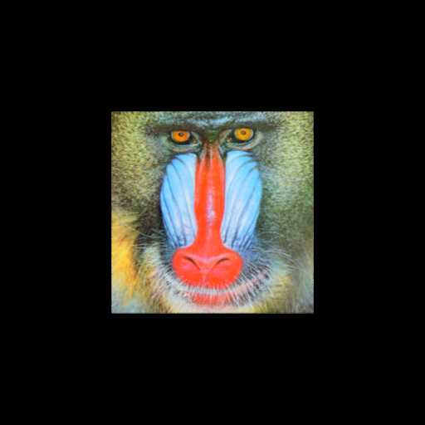
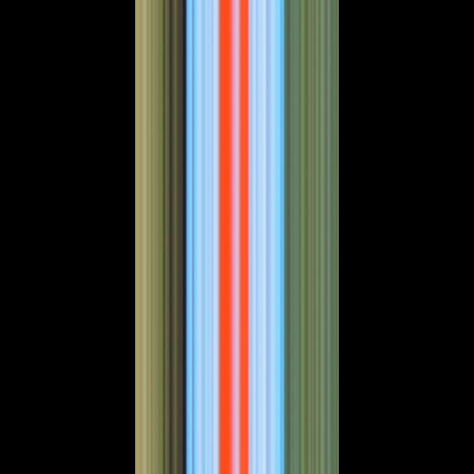
Basic Example
Space-time graph
Object not moving
f(x, y)
f(x, t)
y
TIME
x
SPACE
Notes:
14

Slide 15

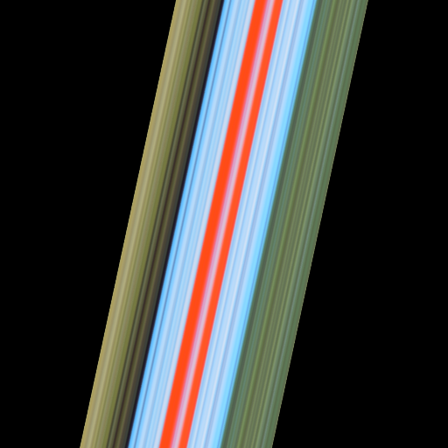
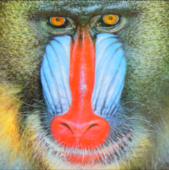
Basic Example
Low velocity, t ε [ 0.0, 1.0 ]
f(x, y)
f(x, t)
t
y
x
x
Notes:
15
And if we animate this…

Slide 16
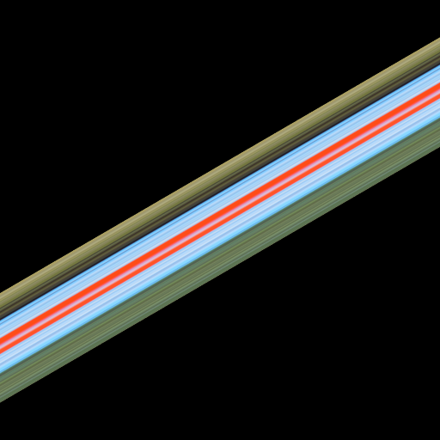
Basic Example
High velocity, t ε [ 0.0, 1.0 ]
f(x, y)
f(x, t)
t
y
x
x
Notes:
16
And if we animate this…

Slide 17
Shear in Space-Time
shear
Object moving with low velocity
f(x, y)
f(x, t)
t
y
x
x
Notes:
17

Slide 18
Shear in Space-Time
Object moving with high velocity
f(x, y)
f(x, t)
t
y
x
x
Notes:
18

Slide 19
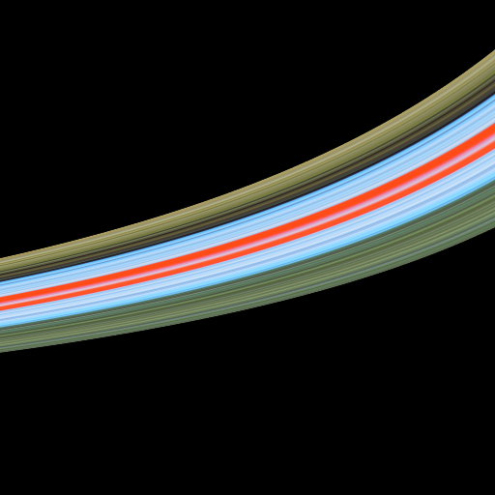
Shear in Space-Time
Object moving away from camera
f(x, y)
f(x, t)
t
y
x
x
Notes:
19

Slide 20
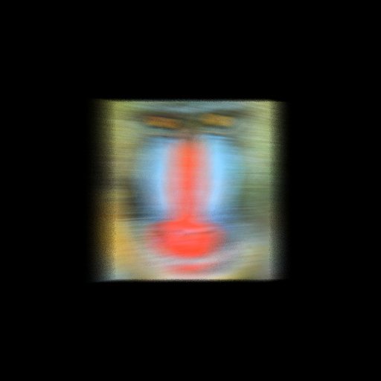

Basic Example
Applying shutter blurs across time
f(x, y)
f(x, t)
t
y
x
x
Notes:
20

Slide 21
Basic Example – Fourier Domain
Fourier spectrum, zero velocity
f(x, t)
F(Ω_{x}, Ω_{t})
texture bandwidth
Ω_{x}
t
Ω_{t}
x
Notes:
21

Slide 22
Basic Example – Fourier Domain
Low velocity, small shear in both domains
f(x, t)
F(Ω_{x}, Ω_{t})
slope = -speed
Ω_{x}
t
Ω_{t}
x
Notes:
22

Slide 23
Basic Example – Fourier Domain
Large shear
f(x, t)
F(Ω_{x}, Ω_{t})
Ω_{x}
t
Ω_{t}
x
Notes:
23

Slide 24
Basic Example – Fourier Domain
Non-linear motion, wedge shaped spectra
f(x, t)
F(Ω_{x}, Ω_{t})
Ω_{x}
t
-min speed
shutter applies blur across time
indirectly bandlimits in space
shutter bandlimits in time
-max speed
Ω_{t}
x
Notes:
24

Slide 25
Sampling in Fourier Domain
Sampling produces replicas in Fourier domain
Sparse sampling produces dense replicas
Primal Domain
Fourier Domain
Ω_{x}
t
₊
Ω_{t}
x
Notes:
25

Slide 26
Standard Reconstruction Filtering
Standard filter, dense sampling (slow)
replicas
Fourier Domain
Ω_{x}
no aliasing
Ω_{t}
Notes:
26

Slide 27
Standard Reconstruction Filter
Standard filter, sparse sampling (fast)
Fourier Domain
Ω_{x}
aliasing
Ω_{t}
Notes:
27

Slide 28
Sheared Reconstruction Filter
Our sheared filter, sparse sampling (fast)
Fourier Domain
Ω_{x}
No aliasing!
Ω_{t}
Notes:
28

Slide 29
Sheared Reconstruction Filter
Compact shape in Fourier = wide in primal
Primal Domain
Fourier Domain
x
Ω_{x}
t
Ω_{t}
Notes:
29

Slide 30
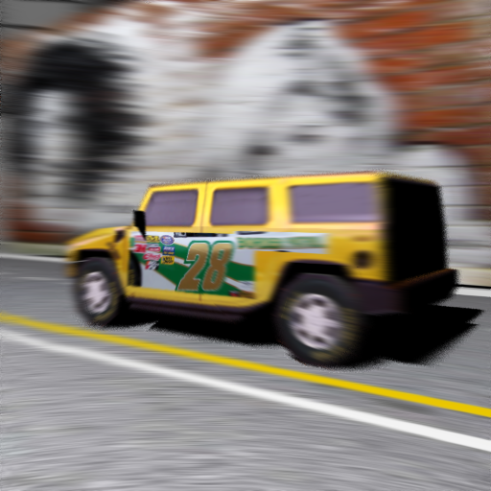

Car Scene
Our Method,
4 samples per pixel
Stratified Sampling
4 samples per pixel
Notes:
30

Slide 31
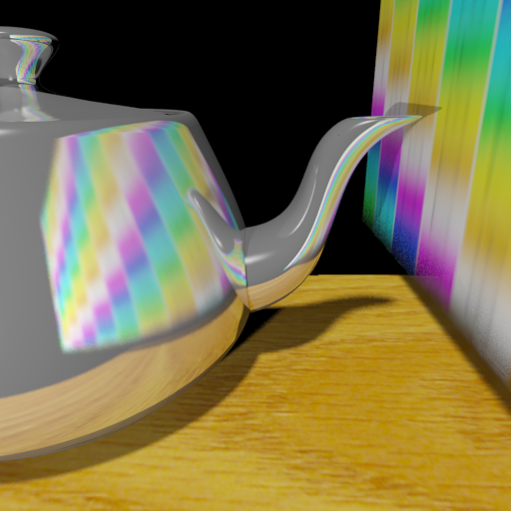
Teapot Scene
Our Method
8 samples / pix
motion blurred reflection
Notes:
31

Slide 32
Reflection as Convolution
My PhD thesis (A signal-processing framework for forward and inverse rendering Stanford 2002)
Rewrite reflection equation on curved surfaces as a convolution with frequency-space product form
Theoretical underpinning for much work on relighting (next lecture), limits of inverse problems
Low-dimensional lighting models for Lambertian

Slide 33
Assumptions
Known geometry
Convex curved surfaces: no shadows, interreflection
Distant illumination
Homogeneous isotropic materials
Later precomputed methods: relax many assumptions

Slide 34
Reflection
L
B
ρ
Reflected Light Field
Lighting
BRDF

Slide 35
Reflection as Convolution (2D)
L
L
B
L
B
Reflected Light Field
Lighting
BRDF

Slide 36
Reflection as Convolution (2D)
L
L
B
B
Reflected Light Field
Lighting
BRDF

Slide 37
Reflection as Convolution (2D)
L
L
B
B

Slide 38
Convolution
x
u
Signal f(x)
Filter g(x)
Output h(u)

Slide 39
Convolution
u₁
x
u
Signal f(x)
Filter g(x)
Output h(u)

Slide 40
Convolution
u₂
x
u
Signal f(x)
Filter g(x)
Output h(u)

Slide 41
Convolution
u₃
x
u
Signal f(x)
Filter g(x)
Output h(u)

Slide 42
Convolution
x
u
Signal f(x)
Filter g(x)
Output h(u)
Fourier analysis

Slide 43
Reflection as Convolution (2D)
L
L
B
B
Spatial: integral
Fourier analysis
Frequency: product
R. Ramamoorthi and P. Hanrahan “Analysis of Planar Light Fields from Homogeneous Convex Curved Surfaces under Distant Illumination” SPIE Photonics West 2001: Human Vision and Electronic Imaging VI pp 195-208

Slide 44




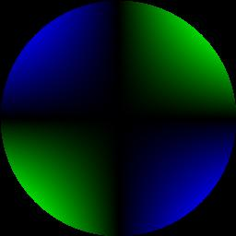
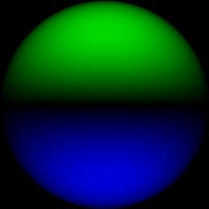
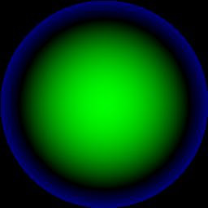
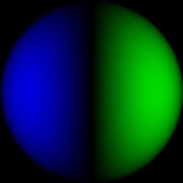

Spherical Harmonics
0
1
2
.
.
.
-2
-1
0
1
2

Slide 45
Spherical Harmonic Analysis
2D:
3D:

Slide 46
Insights: Signal Processing
Signal processing framework for reflection
  Light is the signal
  BRDF is the filter
  Reflection on a curved surface is convolution

Slide 47
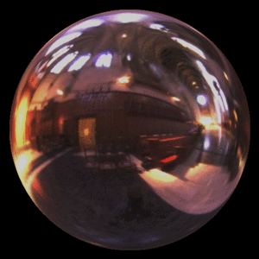
Insights: Signal Processing
Signal processing framework for reflection
  Light is the signal
  BRDF is the filter
  Reflection on a curved surface is convolution
Filter is Delta function : Output = Signal
Mirror BRDF : Image = Lighting
[Miller and Hoffman 84]
Image courtesy Paul Debevec

Slide 48
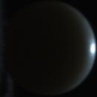
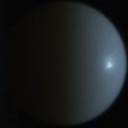
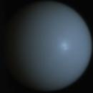
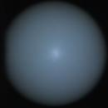
Insights: Signal Processing
Signal processing framework for reflection
  Light is the signal
  BRDF is the filter
  Reflection on a curved surface is convolution
Signal is Delta function : Output = Filter
Point Light Source : Images = BRDF
[Marschner et al. 00]

Slide 49
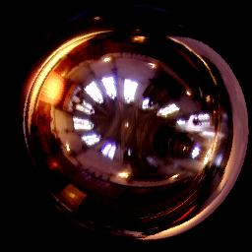
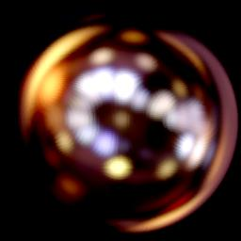
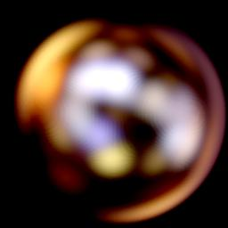
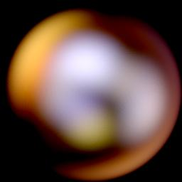
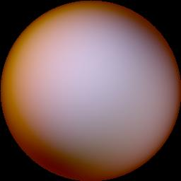

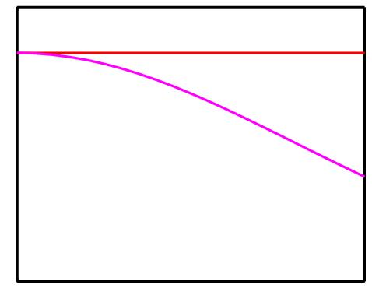
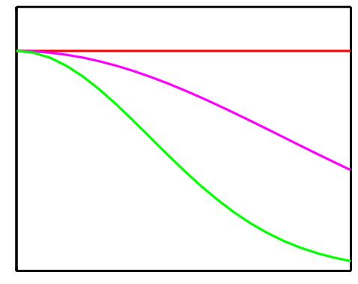
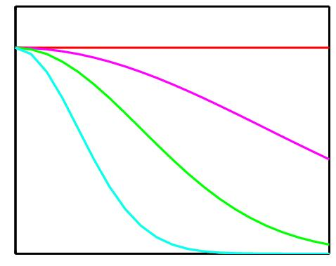
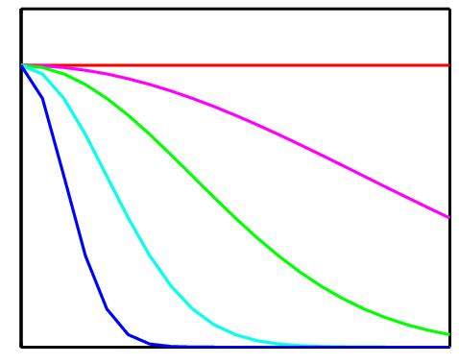
Phong, Microfacet Models
Mirror
Roughness
Illumination estimation
ill-posed for rough surfaces
Amplitude
Analytic formulae in R. Ramamoorthi and P. Hanrahan
“A Signal-Processing Framework for Inverse Rendering”
SIGGRAPH 2001 pp 117-128
Frequency

Slide 50
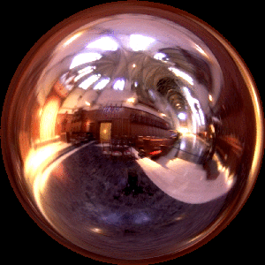
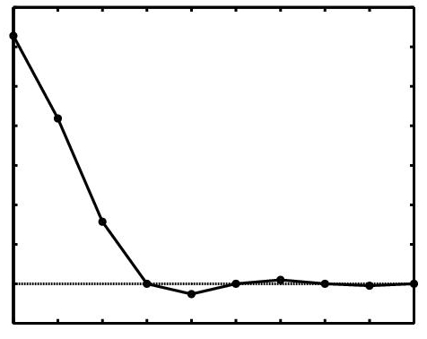
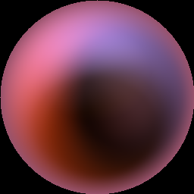
Lambertian
Incident radiance (mirror sphere)
0
N
0
1
2
R. Ramamoorthi and P. Hanrahan “On the Relationship between Radiance and Irradiance:
Determining the Illumination from Images of a Convex Lambertian Object”
Journal of the Optical Society of America A 18(10) Oct 2001 pp 2448-2459
R. Basri and D. Jacobs “Lambertian Reflectance and Linear Subspaces” ICCV 2001 pp 383-390
Irradiance (Lambertian)

Slide 51






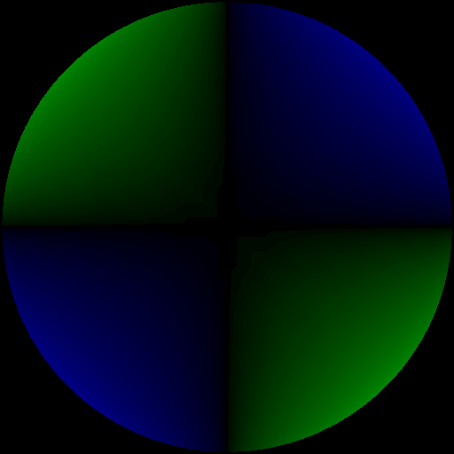

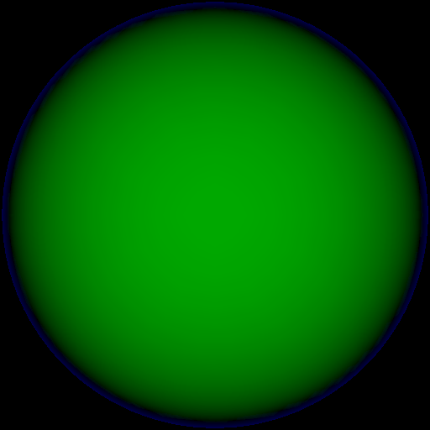

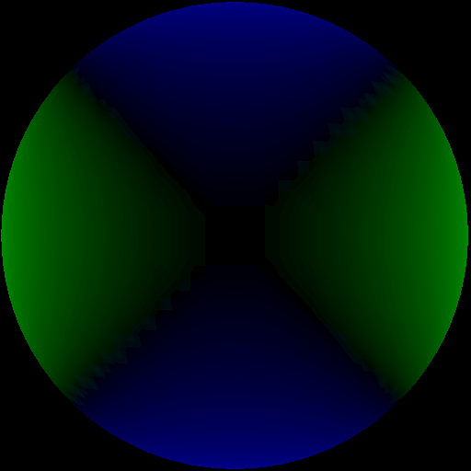
9 Parameter Approximation
Order 2
9 terms
Exact image
0
RMS Error = 1%
1
For any illumination, average
error < 3% [Basri Jacobs 01]
2
Ramamoorthi and Hanrahan 01b
-2
-1
0
1
2

Slide 52
Convolution for general materials
Spatial: integral
Spherical
harmonic analysis
Frequency: product
Ramamoorthi and Hanrahan 01

Slide 53
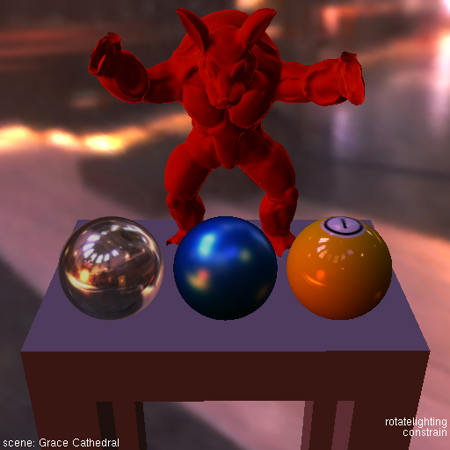
Real-Time Rendering
Motivation: Interactive rendering with natural illumination and realistic, measured materials
Ramamoorthi and Hanrahan 02

Slide 54

Normal Map Filtering and Rendering
Han, Sun, Ramamoorthi, Grinspun 07

Slide 55
More Frequency Analysis
Many other papers
  Shadows: Soler and Sillion 98, Ramamoorthi et al. 04
  Gradients: Ward, Heckbert, Arvo, Igehy, Holzschuch, Chen, Ramamoorthi, …
  Wavelets: Gortler et al. 93, …, Ng et al. 03
Full frequency analysis of light transport
  Durand et al. 05
  Space and Angle, generalizes previous work
Many recent papers in computational imaging [Levin et al. 08, 09]
Multidimensional Rendering [Egal et al 11, Mehta et al. 12,13,14 Belcour et al. etc.]

