Slide 1
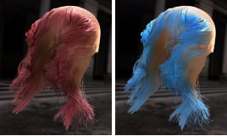
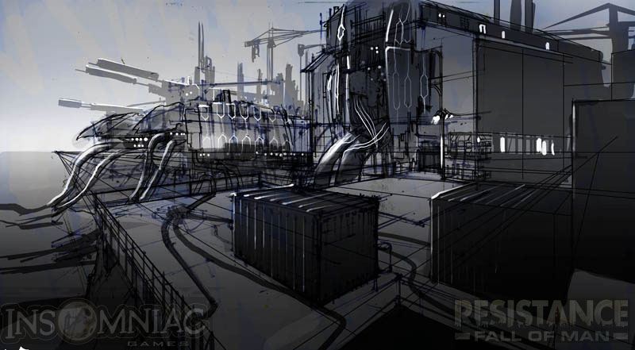
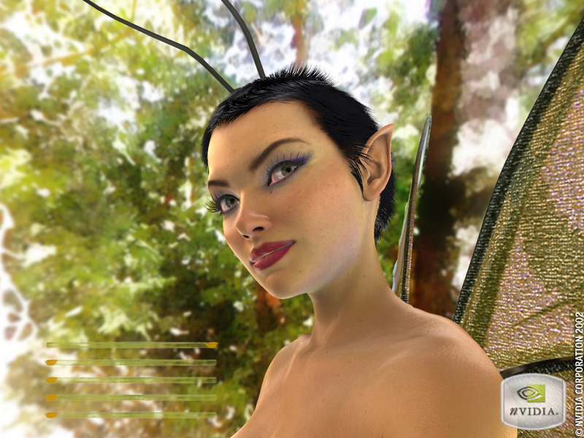
Real-Time High Quality Rendering
CSE 274 [Fall 2015], Lecture 5
Tour of Modern Offline Rendering
http://www.cs.ucsd.edu/~ravir

Slide 2
To Do
Project milestone (1-2 pages), final project proposal
  Due on Oct 27
Please get in touch with me if want to meet, have problems

Slide 3
Motivation for Lecture
Must understand modern offline rendering, before considering real-time extensions
Papers discuss ways to accelerate some effects
Many more interesting possibilities ahead

Slide 4
Monte Carlo Path Tracing
General solution to rendering and global illumination
Suitable for a variety of general scenes
Based on Monte Carlo methods
Enumerate all paths of light transport
Long history, traces back to rendering eqn Kajiya 86
Increasingly, basis for production rendering
Path tracing today real-time in hardware (for example, using NVIDIA’s Optix)

Slide 5
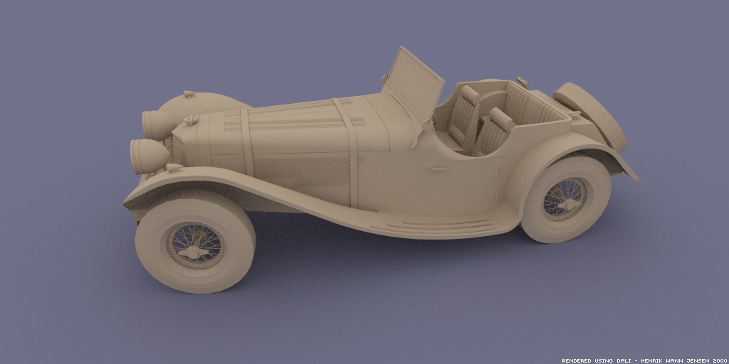
Monte Carlo Path Tracing
Big diffuse light source, 20 minutes
Jensen

Slide 6
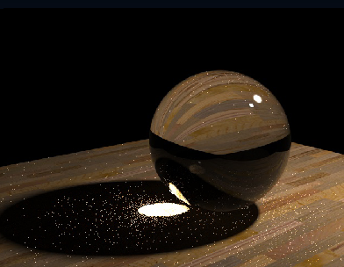
Monte Carlo Path Tracing
1000 paths/pixel
Jensen

Slide 7
Monte Carlo Path Tracing
Advantages
  Any type of geometry (procedural, curved, ...)
  Any type of BRDF (specular, glossy, diffuse, ...)
  Samples all types of paths (L(SD)*E)
  Accuracy controlled at pixel level
  Low memory consumption
  Unbiased - error appears as noise in final image
Disadvantages (standard Monte Carlo problems)
  Slow convergence (square root of number of samples)
  Noise in final image

Slide 8
Monte Carlo Path Tracing
Integrate radiance
for each pixel
by sampling paths
randomly
Specular
Surface
Light
Eye
Pixel
x
Diffuse Surface

Slide 9
Simplest Monte Carlo Path Tracer
For each pixel, cast n samples and average
  Choose a ray with p=camera, d=(θ,ϕ ) within pixel
  Pixel color += (1/n) * TracePath(p, d)
TracePath(p, d) returns (r,g,b) [and calls itself recursively]:
  Trace ray (p, d) to find nearest intersection p’
  Select with probability (say) 50%:
    Emitted:
    return 2 * (Le_{red}, Le_{green}, Le_{blue}) // 2 = 1/(50%)
    Reflected:
    generate ray in random direction d’
    return 2 * f_{r}(d ➔d’) * (n•d’) * TracePath(p’, d’)

Slide 10
Simplest Monte Carlo Path Tracer
For each pixel, cast n samples and average over paths
  Choose a ray with p=camera, d=(θ,ϕ) within pixel
  Pixel color += (1/n) * TracePath(p, d)
TracePath(p, d) returns (r,g,b) [and calls itself recursively]:
  Trace ray (p, d) to find nearest intersection p’
  Select with probability (say) 50%:
    Emitted:
    return 2 * (Le_{red}, Le_{green}, Le_{blue}) // 2 = 1/(50%)
    Reflected:
    generate ray in random direction d’
    return 2 * f_{r}(d ➔d’) * (n•d’) * TracePath(p’, d’)

Slide 11
Simplest Monte Carlo Path Tracer
For each pixel, cast n samples and average
  Choose a ray with p=camera, d=(θ,ϕ ) within pixel
  Pixel color += (1/n) * TracePath(p, d)
TracePath(p, d) returns (r,g,b) [and calls itself recursively]:
  Trace ray (p, d) to find nearest intersection p’
  Select with probability (say) 50%:
    Emitted:
    return 2 * (Le_{red}, Le_{green}, Le_{blue}) // 2 = 1/(50%)
    Reflected:
    generate ray in random direction d’
    return 2 * f_{r}(d ➔d’) * (n•d’) * TracePath(p’, d’)
Weight = 1/probability
Remember: unbiased
requires having f(x) / p(x)

Slide 12
Simplest Monte Carlo Path Tracer
For each pixel, cast n samples and average
  Choose a ray with p=camera, d=(θ,ϕ) within pixel
  Pixel color += (1/n) * TracePath(p, d)
TracePath(p, d) returns (r,g,b) [and calls itself recursively]:
  Trace ray (p, d) to find nearest intersection p’
  Select with probability (say) 50%:
    Emitted:
    return 2 * (Le_{red}, Le_{green}, Le_{blue}) // 2 = 1/(50%)
    Reflected:
    generate ray in random direction d’
    return 2 * f_{r}(d ➔d’) * (n•d’) * TracePath(p’, d’)
Path terminated when
Emission evaluated

Slide 13
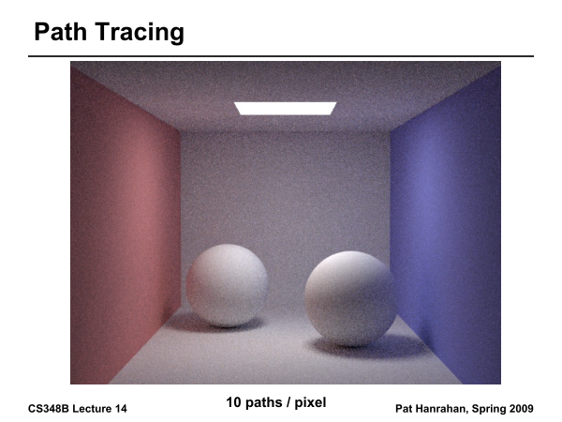

Slide 14
Arnold Renderer (M. Fajardo)
Works well diffuse surfaces, hemispherical light

Slide 15
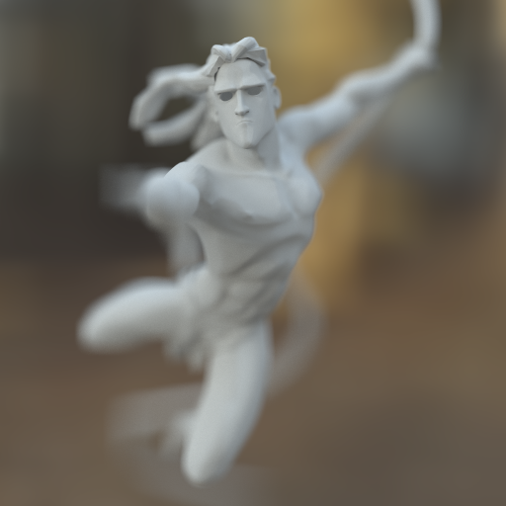
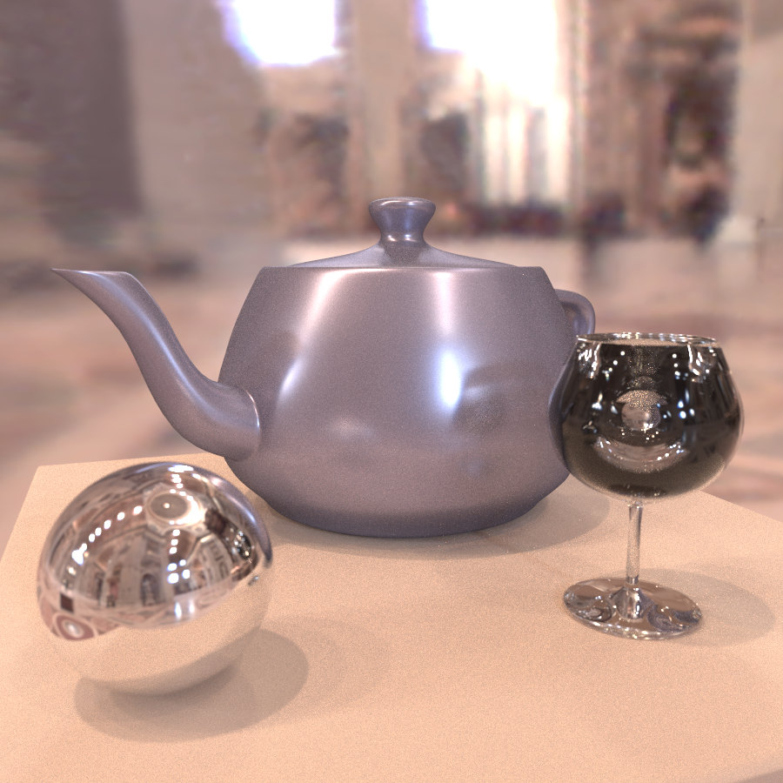
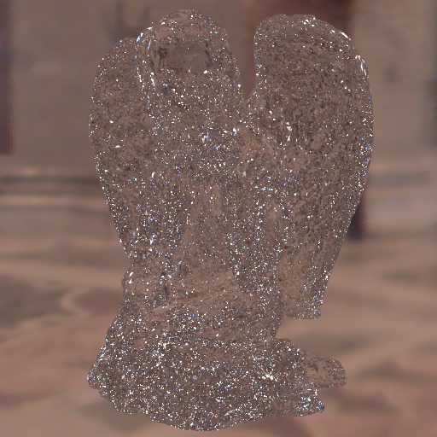
From UCB CS 294 a few years ago
Daniel Ritchie and Lita Cho

Slide 16
Importance Sampling
Pick paths based on energy or expected contribution
  More samples for high-energy paths
  Don’t pick low-energy paths
At “macro” level, use to select between reflected vs emitted, or in casting more rays toward light sources
At “micro” level, importance sample the BRDF to pick ray directions
Tons of papers in 90s on tricks to reduce variance in Monte Carlo rendering
Importance sampling now standard in production. I consulted on Pixar’s system for upcoming movies

Slide 17
Importance Sampling
Can pick paths however we want, but contribution weighted by 1/probability
  Already seen this division of 1/prob in weights to emission, reflectance
E(f(x))
x₁
x_{N}

Slide 18
Importance sample Emit vs Reflect
TracePath(p, d) returns (r,g,b) [and calls itself recursively]:
  Trace ray (p, d) to find nearest intersection p’
  If Le = (0,0,0) then p_{emit}= 0 else p_{emit}= 0.9 (say)
  If random() < p_{emit} then:
    Emitted:
    return (1/ p_{emit}) * (Le_{red}, Le_{green}, Le_{blue})
    Else Reflected:
    generate ray in random direction d’
    return (1/(1- p_{emit})) * f_{r}(d ➔d’) * (n•d’) * TracePath(p’, d’)

Slide 19
More variance reduction
Discussed “macro” importance sampling
  Emitted vs reflected
How about “micro” importance sampling
  Shoot rays towards light sources in scene
  Distribute rays according to BRDF

Slide 20
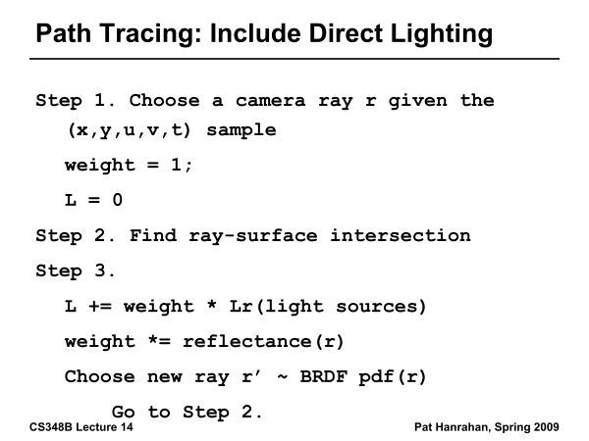

Slide 21
Monte Carlo Extensions
Unbiased
  Bidirectional path tracing
  Metropolis light transport
Biased, but consistent
  Noise filtering
  Adaptive sampling
  Irradiance caching

Slide 22
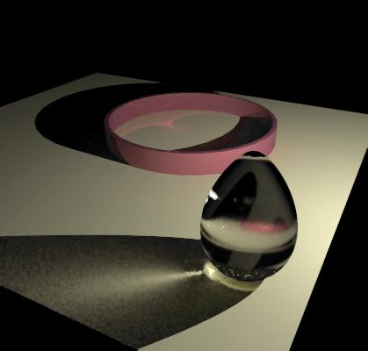
Monte Carlo Extensions
Unbiased
  Bidirectional path tracing
  Metropolis light transport
Biased, but consistent
  Noise filtering
  Adaptive sampling
  Irradiance caching
RenderPark

Slide 23
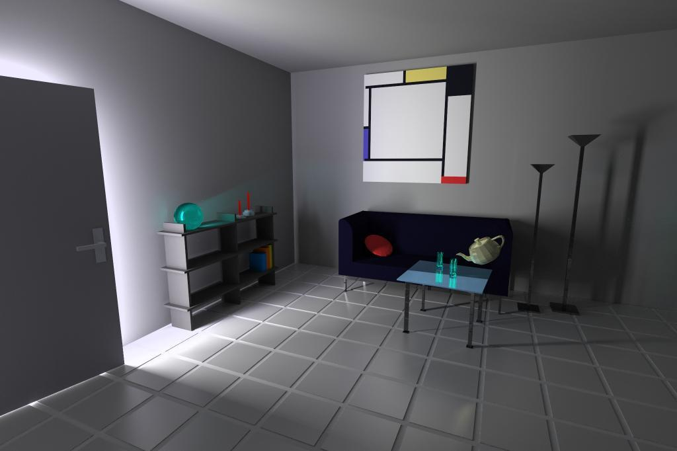
Monte Carlo Extensions
Unbiased
  Bidirectional path tracing
  Metropolis light transport
Biased, but consistent
  Noise filtering
  Adaptive sampling
  Irradiance caching
Heinrich

Slide 24
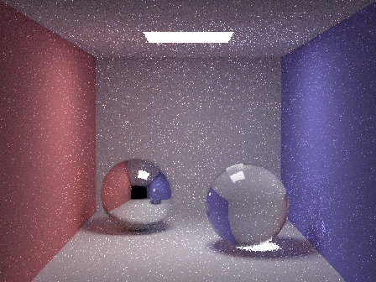

Monte Carlo Extensions
Unbiased
  Bidirectional path tracing
  Metropolis light transport
Biased, but consistent
  Noise filtering
  Adaptive sampling
  Irradiance caching
Unfiltered
Filtered
Jensen

Slide 25
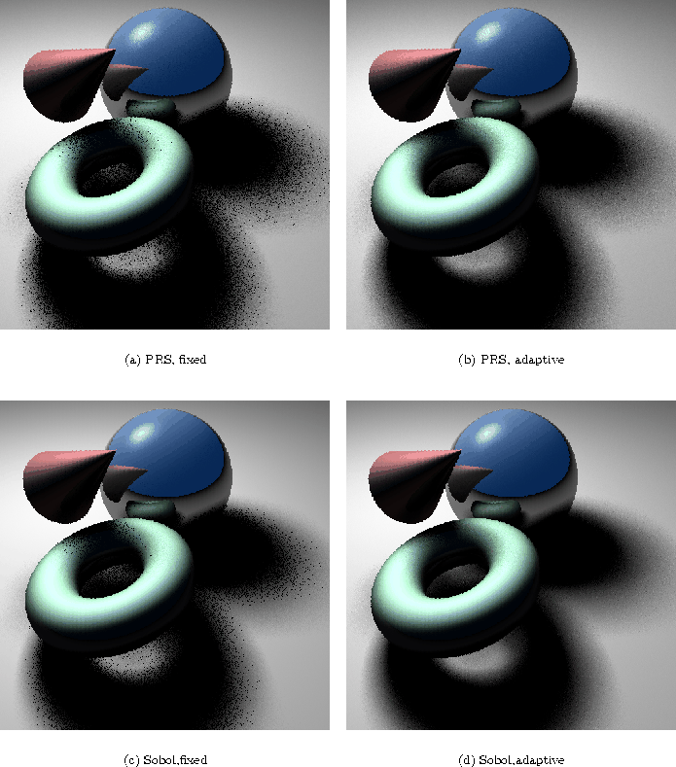
Monte Carlo Extensions
Unbiased
  Bidirectional path tracing
  Metropolis light transport
Biased, but consistent
  Noise filtering
  Adaptive sampling
  Irradiance caching
Fixed
Adaptive
Ohbuchi

Slide 26

Monte Carlo Extensions
Unbiased
  Bidirectional path tracing
  Metropolis light transport
Biased, but consistent
  Noise filtering
  Adaptive sampling
  Irradiance caching
Jensen

Slide 27
Summary
Monte Carlo methods robust and simple (at least until nitty gritty details) for global illumination
Must handle many variance reduction methods in practice
Importance sampling, Bidirectional path tracing, Russian roulette etc.
Rich field with many papers, systems researched over last 10 years
Today, hardware for real-time ray, path tracing
Promising physically-based GPU approach

Slide 28
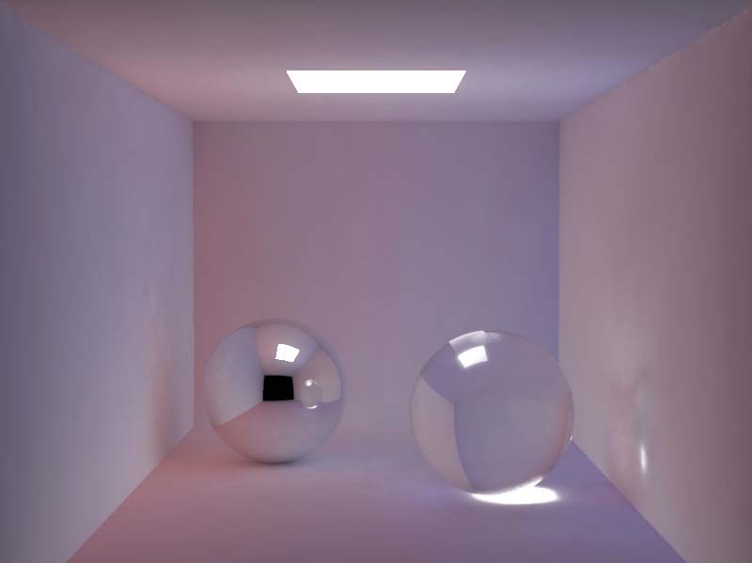
Smoothness of Indirect Lighting
Direct
Indirect
Direct + Indirect

Slide 29
Irradiance Caching
Empirically, (diffuse) interreflections low frequency
Therefore, should be able to sample sparsely
Irradiance caching samples irradiance at few points on surfaces, and then interpolates
Ward, Rubinstein, Clear. SIGGRAPH 88, A ray tracing solution for diffuse interreflection

Slide 30
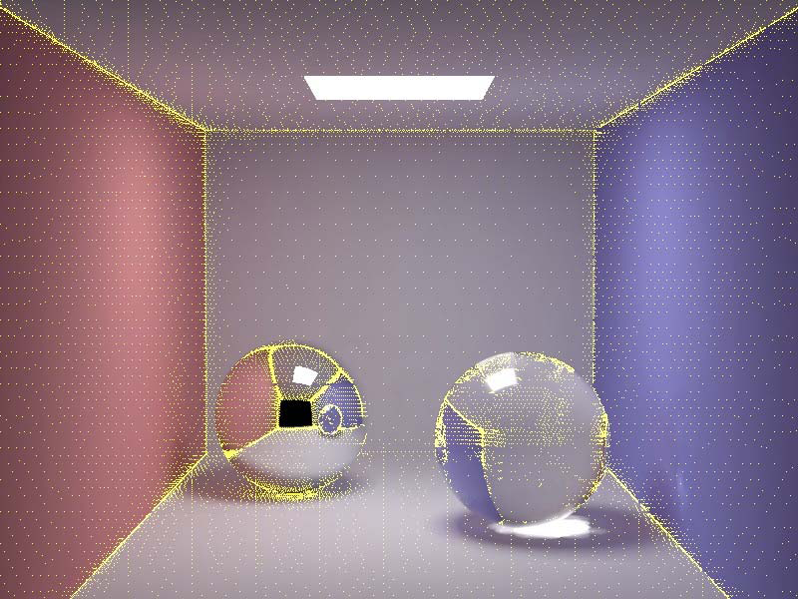
Irradiance Caching Example
Final Image
Sample Locations

Slide 31
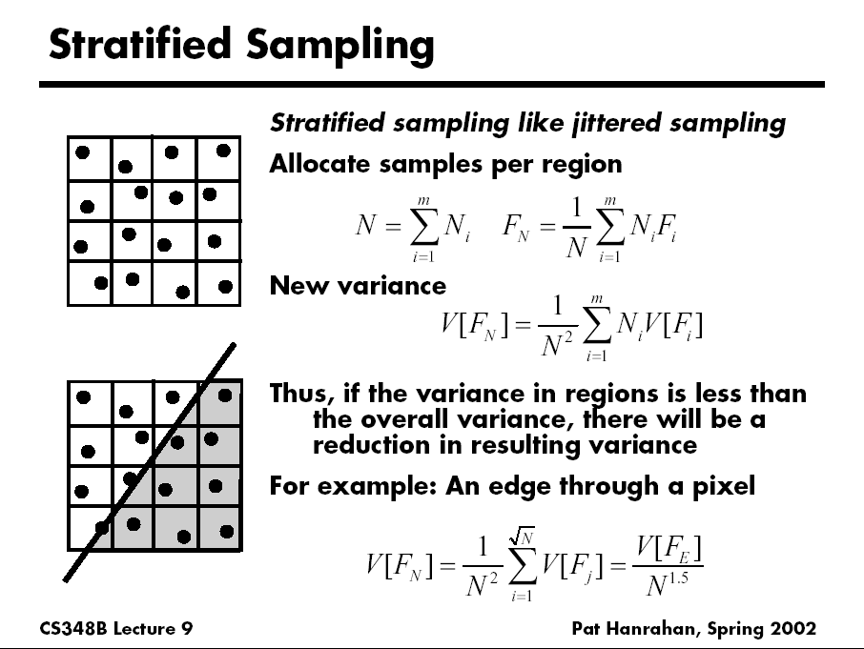
D. Mitchell 95, Consequences of stratified sampling in graphics

Slide 32
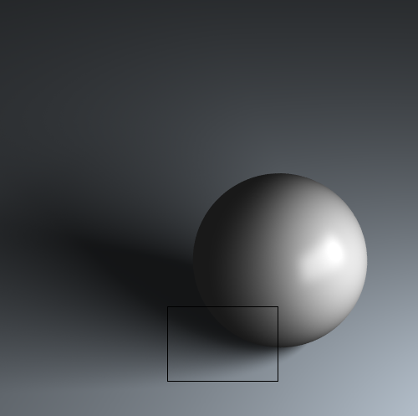
Comparison of simple patterns
Latin Hypercube
Quasi Monte Carlo
Ground Truth
Uniform
Random
Stratified
16 samples for area light, 4 samples per pixel, total 64 samples
If interested, see my recent paper “A Theory of Monte Carlo Visibility Sampling”
Figures courtesy Tianyu Liu

Slide 33
Path Tracing: From Lights
Step 1. Choose a light ray
Step 2. Find ray-surface intersection
Step 3. Reflect or transmit
  u = Uniform()
  if u < reflectance(x)
  Choose new direction d ~ BRDF(O|I)
  goto Step 2
else if u < reflectance(x)+transmittance(x)
  Choose new direction d ~ BTDF(O|I)
  goto Step 2
else // absorption=1–reflectance-transmittance
  terminate on surface; deposit energy

Slide 34
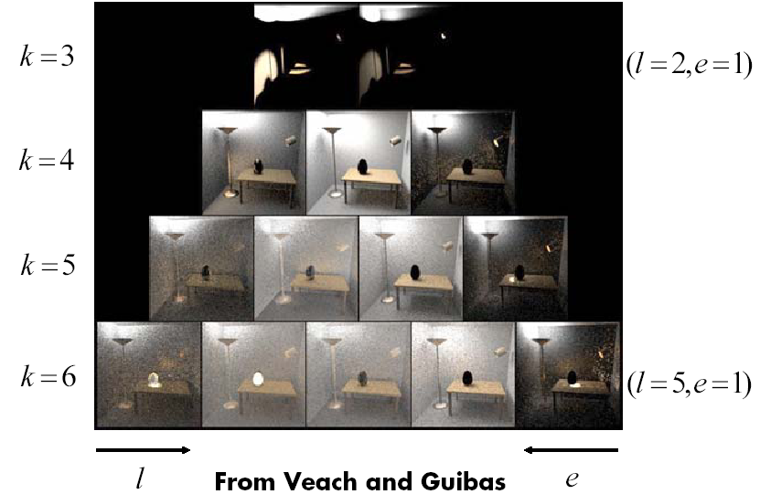
Bidirectional Path Tracing
Path pyramid (k = l + e = total number of bounces)

Slide 35
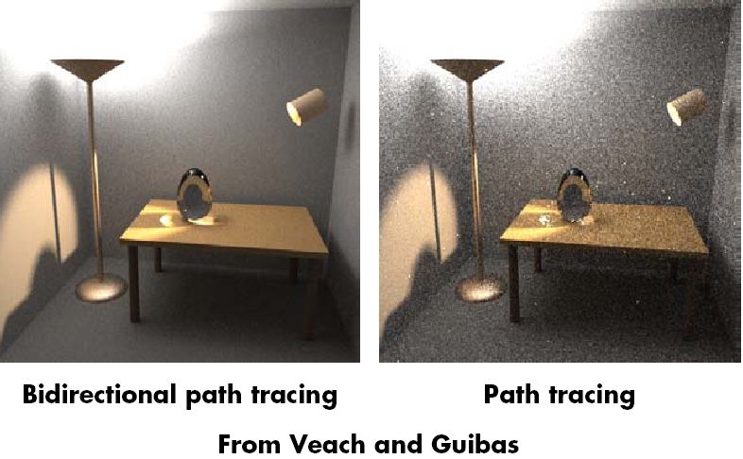
Comparison

Slide 36
Why Photon Map?
Some visual effects like caustics hard with standard path tracing from eye
May usually miss light source altogether
Instead, store “photons” from light in kd-tree
Look-up into this as needed
Combines tracing from light source, and eye
Similar to bidirectional path tracing, but compute photon map only once for all eye rays
Global Illumination using Photon Maps H. Jensen. Rendering Techniques (EGSR 1996), pp 21-30. (Also book: Realistic Image Synthesis using Photon Mapping)

Slide 37
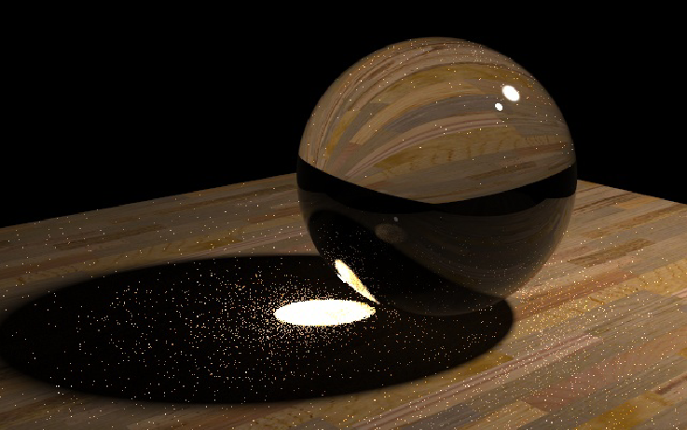
Caustics
Path Tracing: 1000 paths/pixel
Note noise in caustics
Slides courtesy Henrik Wann Jensen

Slide 38
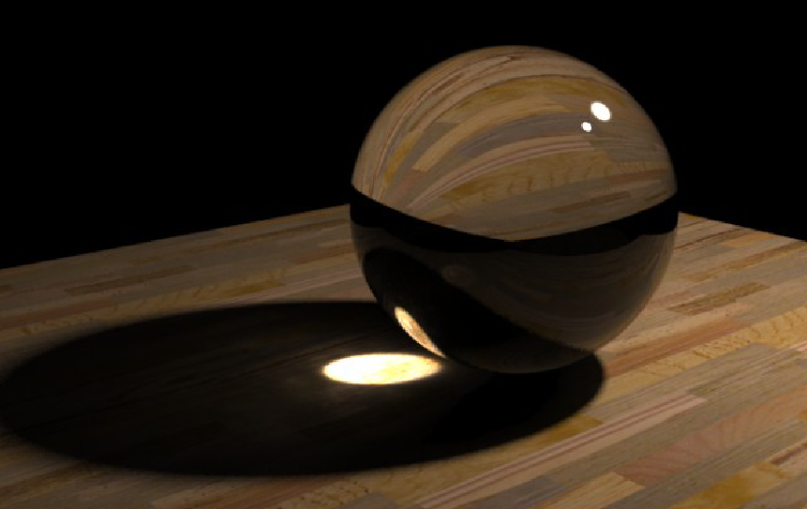
Caustics
Photon Mapping: 10000 photons
50 photons in radiance estimate

Slide 39
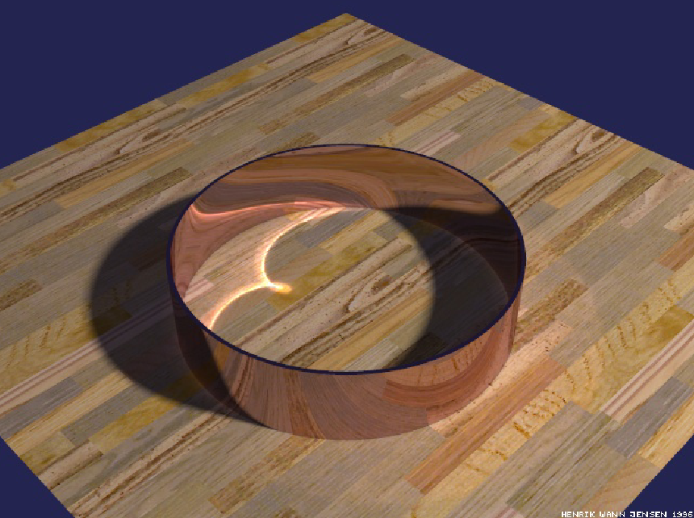
Reflections Inside a Metal Ring
50000 photons
50 photons to estimate radiance

Slide 40
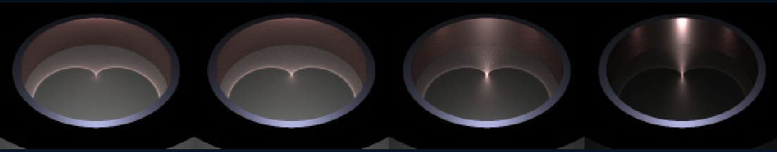
Caustics on Glossy Surfaces
340000 photons, 100 photons in radiance estimate

Slide 41
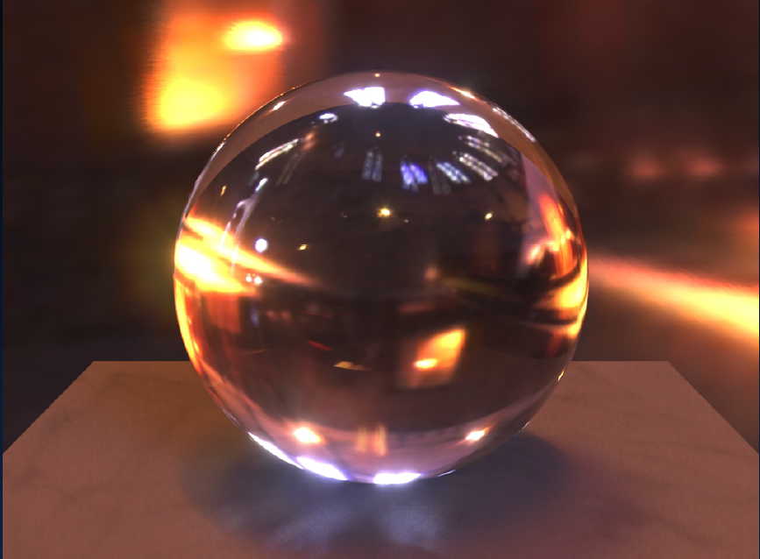
HDR Environment Illumination

Slide 42
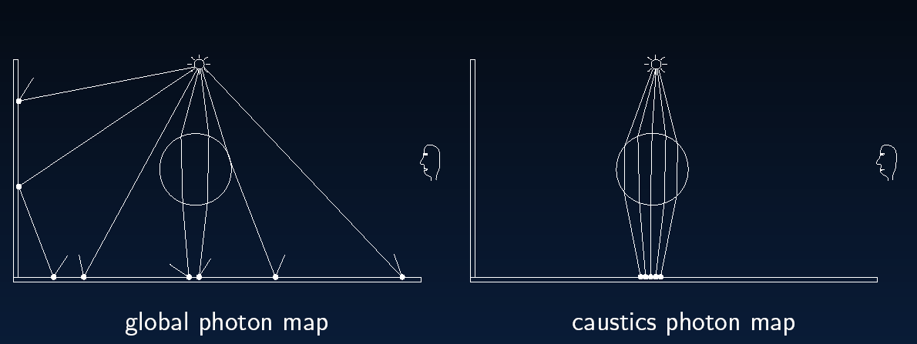
Global Illumination

Slide 43
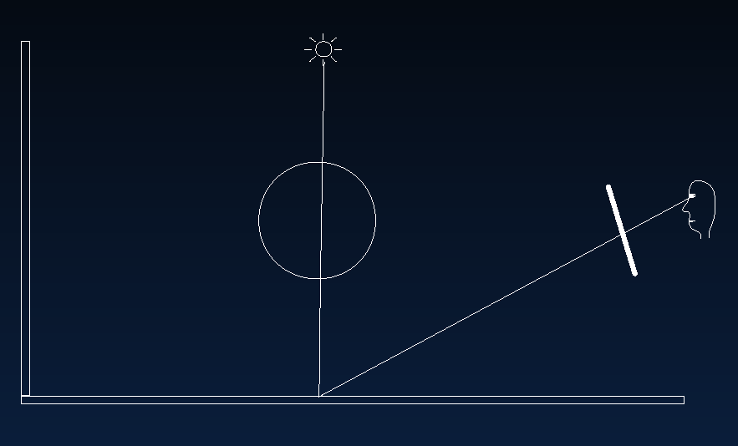
Direct Illumination

Slide 44
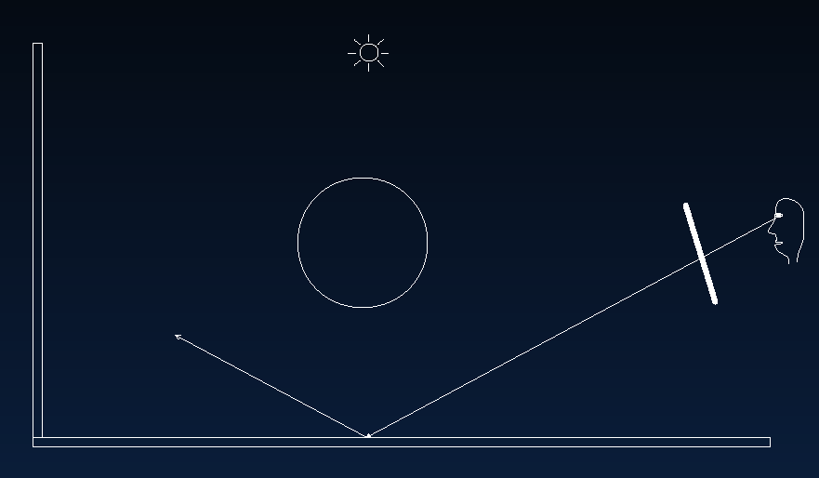
Specular Reflection

Slide 45
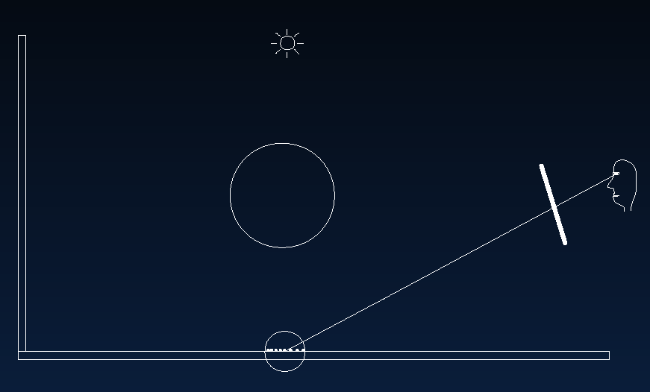
Caustics

Slide 46
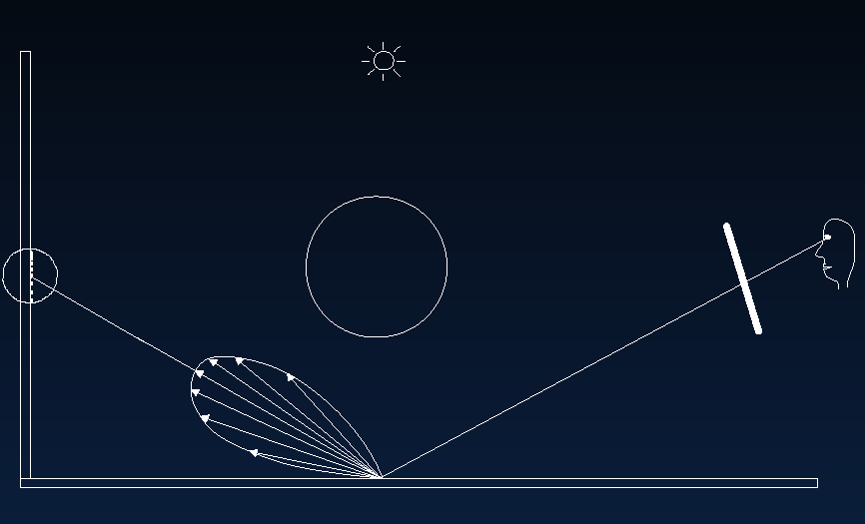
Indirect Illumination

Slide 47
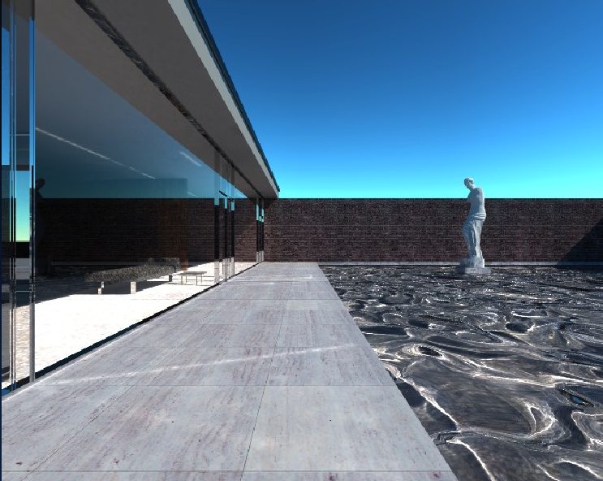
Mies House: Swimming Pool

Slide 48
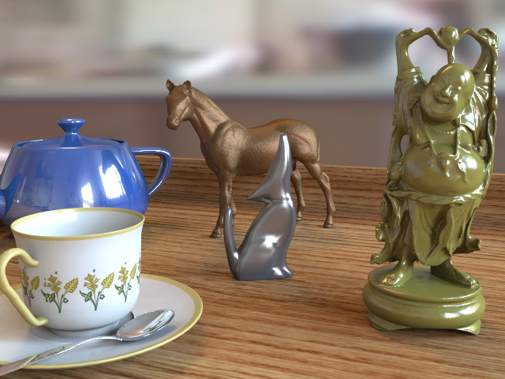
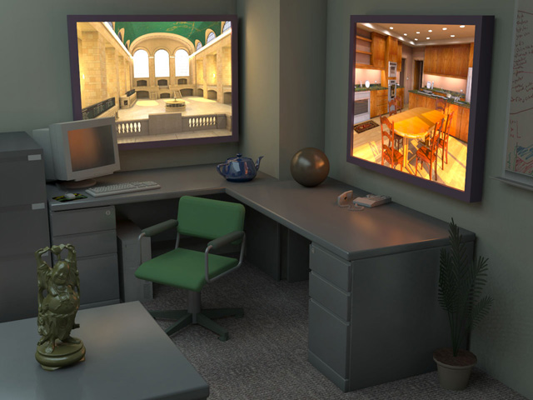
Lightcuts
Efficient, accurate complex illumination
Environment map lighting & indirect
Time 111s
Textured area lights & indirect
Time 98s
(640x480, Anti-aliased, Glossy materials)
From Walter et al. SIGGRAPH 05
Notes:
What is lightcuts? Lightcuts is a new scalable solution for efficiently computing complex illumination. Two examples are shown here. The image on the left is lit by an environment map with illumination captured from the real world, while the image on the right includes two simulated high dynamic range flat-panel displays. Both are challenging illumination problems. In addition both images include indirect illumination, glossy materials, and anti-aliasing. Yet our method was able to produce each image in under two minutes on a single machine.

Slide 49
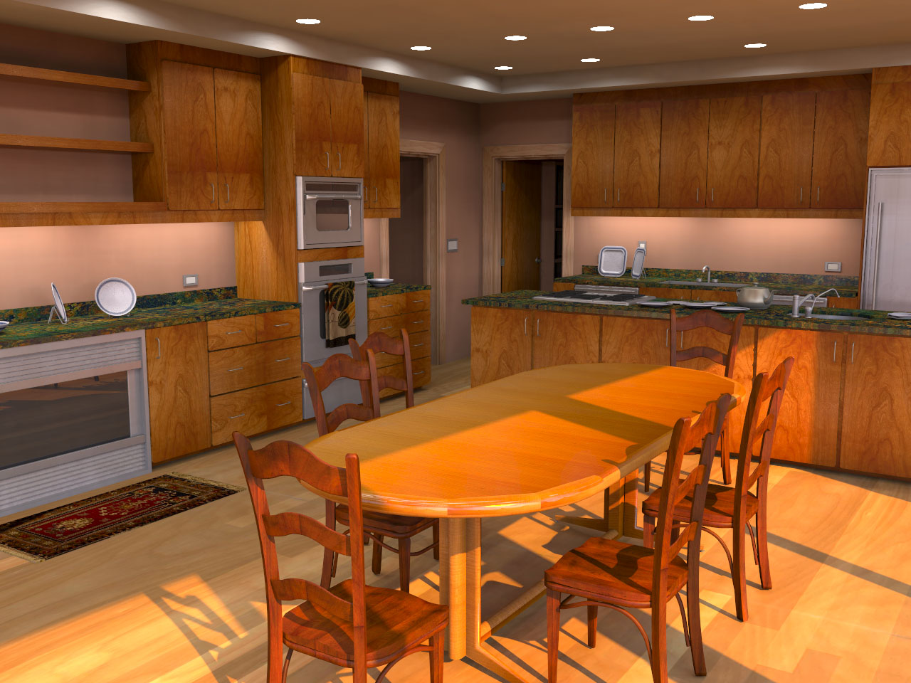
Complex Lighting
Simulate complex illumination using point lights
  Area lights
  HDR environment maps
  Sun & sky light
  Indirect illumination
Unifies illumination
  Enables tradeoffs
  between components
Area lights + Sun/sky + Indirect
Notes:
Once we have a scalable solution for many point lights, we can use this to compute other types of complex illumination. The four examples we demonstrate in the paper are area lights, high dynamic range environment maps, sun & sky light, and indirect illumination. Moreover this allows us to unify the handling of different illumination types and enables new types of tradeoffs. For example, bright illumination from one source allows coarser approximations of other sources.

Slide 50
Key Concepts
Light Cluster
Light Tree
  Binary tree of lights and clusters
Clusters
Individual
Lights
Notes:
Second is the light tree which is a binary tree of lights and clusters. The leaves of this tree are the individual lights while the interior nodes represent clusters which get progressively larger as we go up the tree.

Slide 51
Three Example Cuts
Three Cuts
#1
#2
#4
#1
#3
#4
#1
#4
4
4
4
1
4
1
4
1
4
1
2
3
4
1
2
3
4
1
2
3
4
Notes:
And here we show three example cuts through the light tree. Highlighted above each cut are the regions where that cut produces an accurate approximation of the exact illumination.

Slide 52

Tableau, 630K polygons, 13 000 lights, (EnvMap+Indirect)
Avg. shadow rays per eye ray 17 (0.13%)
Notes:
Here is another results that show cases our ability to handle glossy objects. This scene is illuminated by a captured environment map and indirect illumination. And here is a short animation of this scene.

Slide 53
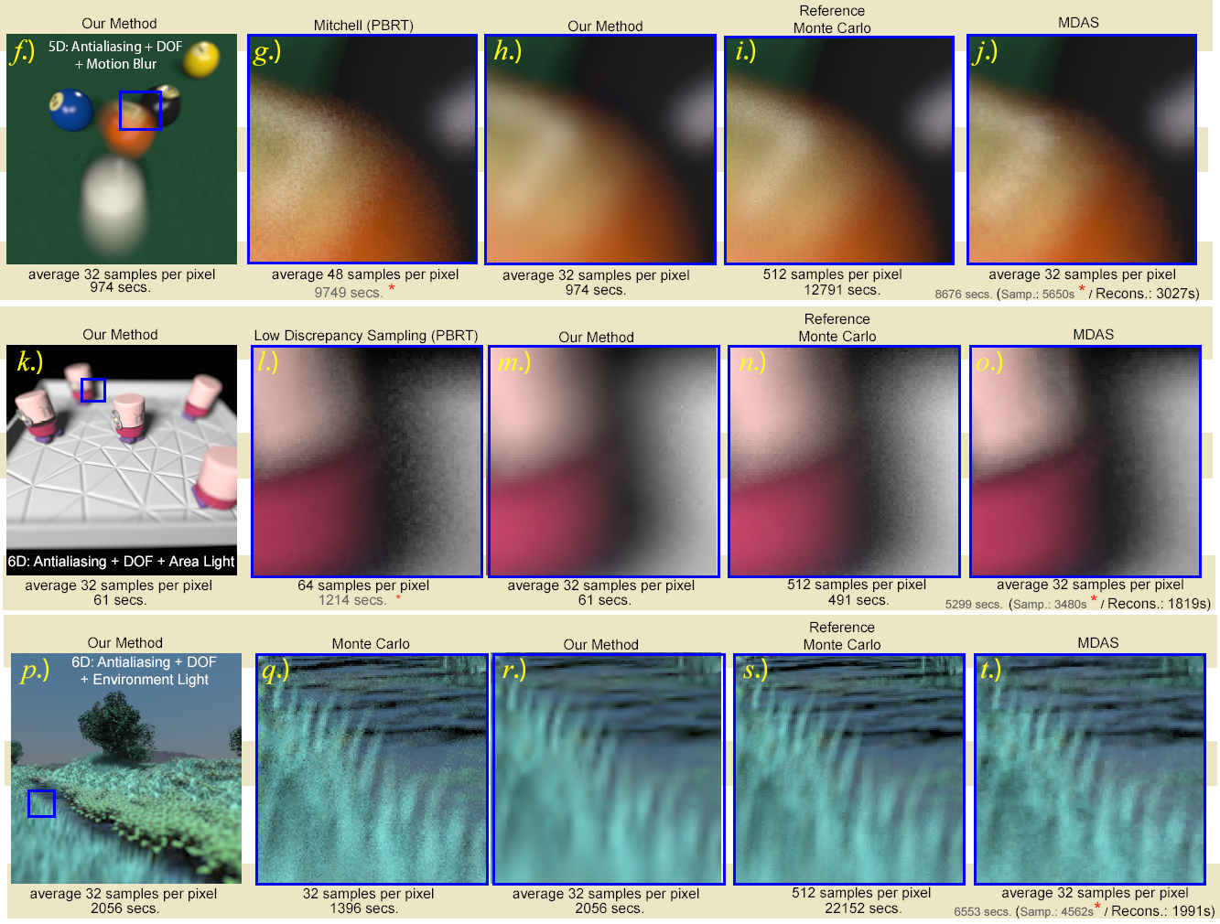
Adaptive Wavelet Rendering

