Slide 1
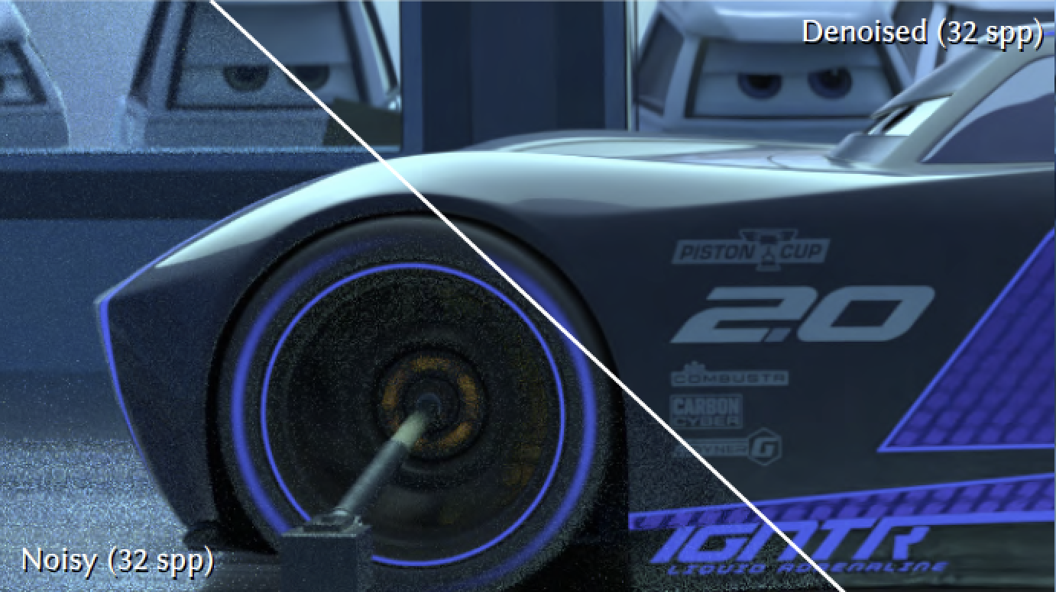
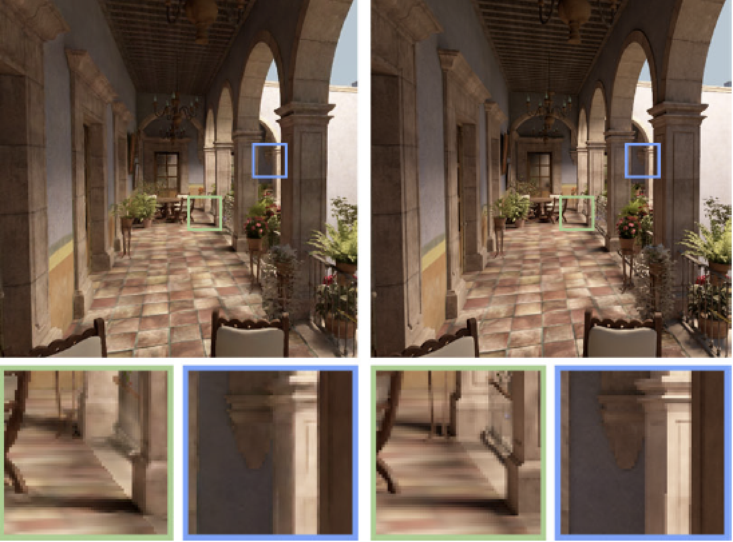
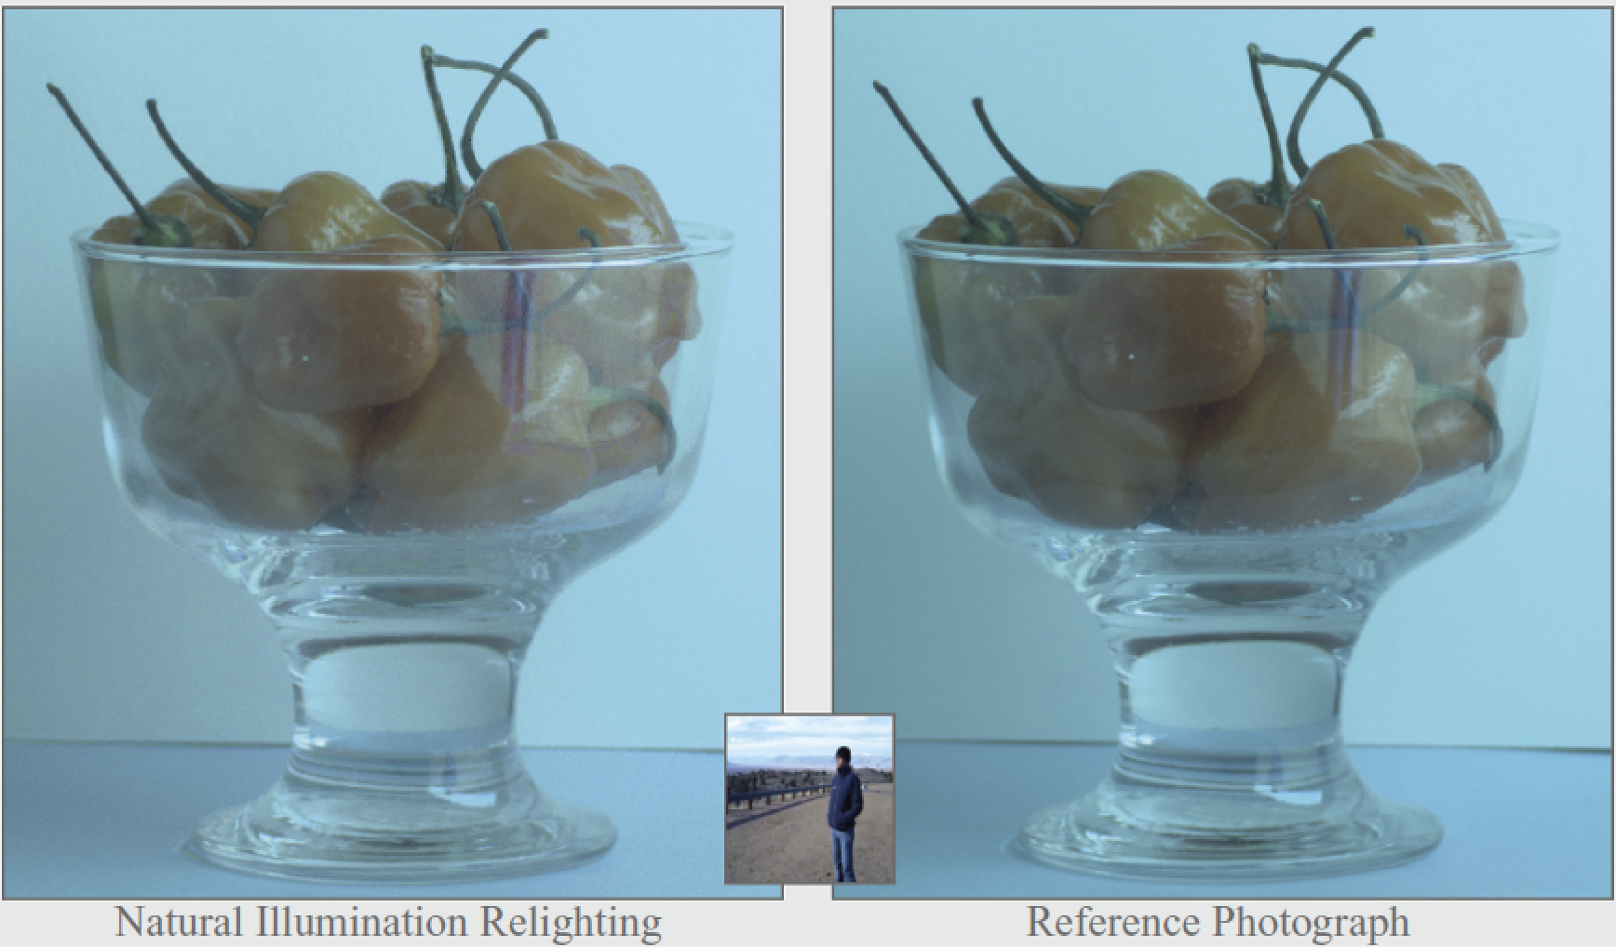
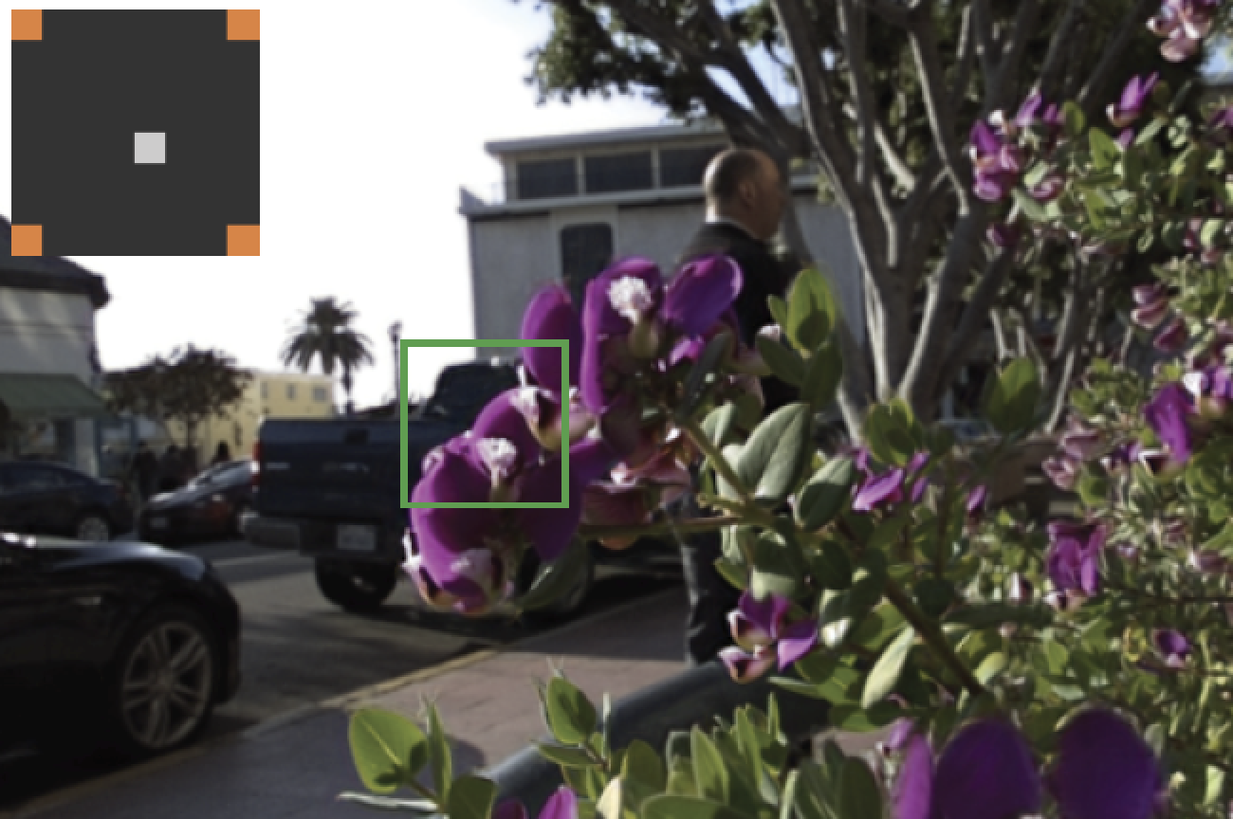
Sampling and Reconstruction of Visual Appearance
CSE 274 [Winter 2018], Lecture 3
Ravi Ramamoorthi
http://www.cs.ucsd.edu/~ravir

Slide 2
Motivation: Monte Carlo Rendering
Key application area for sampling/reconstruction
Modern methods for denoising now popular
1-3 order of magnitude speedups in mature area
Denoising now standard in production rendering
This week: Basic background in rendering
Reflection and Rendering Equations
Monte Carlo Integration
Path Tracing (Basic Monte Carlo rendering method)
A review for those who have taken CSE 168

Slide 3
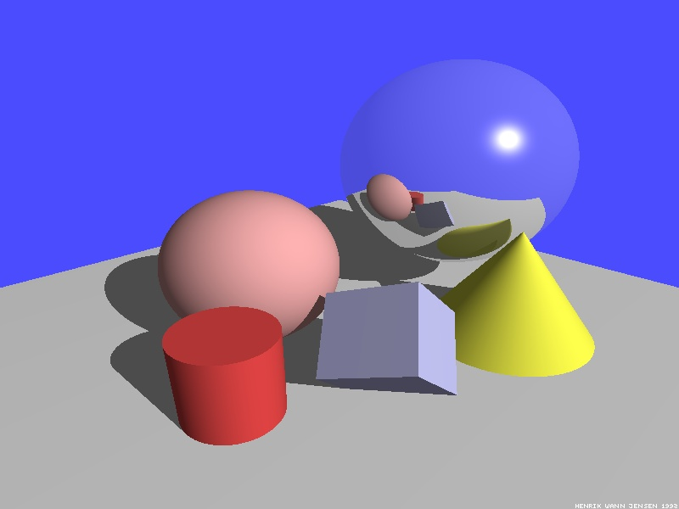
Illumination Models
Local Illumination
Light directly from light sources to surface
No shadows (cast shadows are a global effect)
Global Illumination: multiple bounces (indirect light)
Hard and soft shadows
Reflections/refractions (already seen in ray tracing)
Diffuse and glossy interreflections (radiosity, caustics)
Some images courtesy Henrik Wann Jensen

Slide 4

Caustics
Caustics: Focusing through specular surface
Major research effort in 80s, 90s till today

Slide 5
Overview of lecture
Theory for all global illumination methods (ray tracing, path tracing, radiosity)
We derive Rendering Equation [Kajiya 86]
Major theoretical development in field
Unifying framework for all global illumination
Introduced Path Tracing: core rendering method
Discuss existing approaches as special cases
Fairly theoretical lecture (but important). Not well covered in textbooks (though see Eric Veach’s thesis). See reading if you are interested.

Slide 6
Outline
Reflectance Equation
Global Illumination
Rendering Equation
As a general Integral Equation and Operator
Approximations (Ray Tracing, Radiosity)
Surface Parameterization (Standard Form)

Slide 7
Reflection Equation
Reflected Light
(Output Image)
Emission
Incident
Light (from
light source)
BRDF
Cosine of
Incident angle

Slide 8
Reflection Equation
Sum over all light sources
Reflected Light
(Output Image)
Emission
Incident
Light (from
light source)
BRDF
Cosine of
Incident angle

Slide 9
Reflection Equation
Replace sum with integral
Reflected Light
(Output Image)
Emission
Incident
Light (from
light source)
BRDF
Cosine of
Incident angle

Slide 10

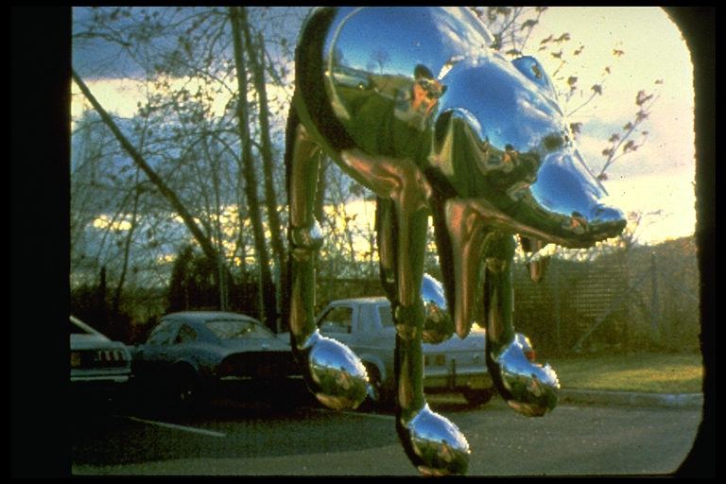
Environment Maps
Light as a function of direction, from entire environment
Captured by photographing a chrome steel or mirror sphere
Accurate only for one point, but distant lighting same at other scene locations (typically use only one env. map)
Blinn and Newell 1976, Miller and Hoffman, 1984
Later, Greene 86, Cabral et al. 87

Slide 11
The Challenge
Computing reflectance equation requires knowing the incoming radiance from surfaces
But determining incoming radiance requires knowing the reflected radiance from surfaces

Slide 12
Rendering Equation
Surfaces (interreflection)
Reflected Light
(Output Image)
Emission
Reflected
Light
BRDF
Cosine of
Incident angle
UNKNOWN
KNOWN
UNKNOWN
KNOWN
KNOWN

Slide 13
Outline
Reflectance Equation (review)
Global Illumination
Rendering Equation
As a general Integral Equation and Operator
Approximations (Ray Tracing, Radiosity)
Surface Parameterization (Standard Form)

Slide 14
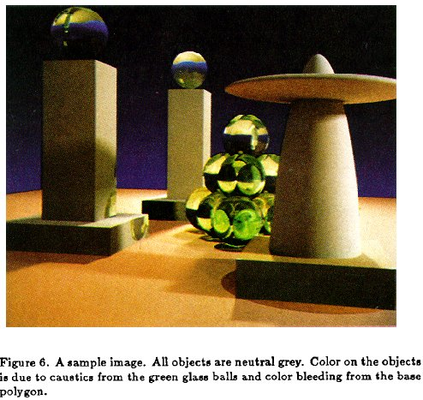
Rendering Equation (Kajiya 86)

Slide 15
Rendering Equation as Integral Equation
Reflected Light
(Output Image)
Emission
Reflected
Light
BRDF
Cosine of
Incident angle
UNKNOWN
KNOWN
UNKNOWN
KNOWN
KNOWN
Is a Fredholm Integral Equation of second kind
[extensively studied numerically] with canonical form
Kernel of equation

Slide 16
Linear Operator Theory
Linear operators act on functions like matrices act on vectors or discrete representations
Basic linearity relations hold
Examples include integration and differentiation
M is a linear operator.
f and h are functions of u
a and b are scalars
f and g are functions

Slide 17
Linear Operator Equation
Kernel of equation
Light Transport Operator
Can be discretized to a simple matrix equation
[or system of simultaneous linear equations]
(L, E are vectors, K is the light transport matrix)

Slide 18
Solving the Rendering Equation
Too hard for analytic solution, numerical methods
Approximations, that compute different terms, accuracies of the rendering equation
Two basic approaches are ray tracing, radiosity. More formally, Monte Carlo and Finite Element. Today Monte Carlo path tracing is core rendering method
Monte Carlo techniques sample light paths, form statistical estimate (example, path tracing)
Finite Element methods discretize to matrix equation

Slide 19
Solving the Rendering Equation
General linear operator solution. Within raytracing:
General class numerical Monte Carlo methods
Approximate set of all paths of light in scene
Binomial Theorem
Term n corresponds to n bounces of light

Slide 20
Ray Tracing
Emission directly
From light sources
Direct Illumination
on surfaces
Global Illumination
(One bounce indirect)
[Mirrors, Refraction]
(Two bounce indirect)
[Caustics etc]

Slide 21
Ray Tracing
Emission directly
From light sources
Direct Illumination
on surfaces
Global Illumination
(One bounce indirect)
[Mirrors, Refraction]
OpenGL Shading
(Two bounce indirect)
[Caustics etc]

Slide 22
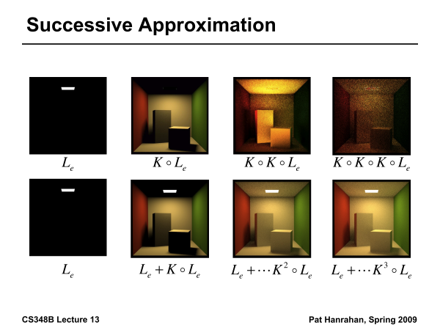

Slide 23
Outline
Reflectance Equation (review)
Global Illumination
Rendering Equation
As a general Integral Equation and Operator
Approximations (Ray Tracing, Radiosity)
Surface Parameterization (Standard Form)

Slide 24
Rendering Equation
Surfaces (interreflection)
Reflected Light
(Output Image)
Emission
Reflected
Light
BRDF
Cosine of
Incident angle
UNKNOWN
KNOWN
UNKNOWN
KNOWN
KNOWN

Slide 25
Change of Variables
Integral over angles sometimes insufficient. Write integral in terms of surface radiance only (change of variables)

Slide 26
Change of Variables
Integral over angles sometimes insufficient. Write integral in terms of surface radiance only (change of variables)

Slide 27
Rendering Equation: Standard Form
Integral over angles sometimes insufficient. Write integral in terms of surface radiance only (change of variables)
Domain integral awkward. Introduce binary visibility fn V
Same as equation 2.52 Cohen Wallace. It swaps primed
And unprimed, omits angular args of BRDF, - sign.
Same as equation above 19.3 in Shirley, except he has
no emission, slightly diff. notation

Slide 28
Summary
Theory for all global illumination methods (ray tracing, path tracing, radiosity)
We derive Rendering Equation [Kajiya 86]
Major theoretical development in field
Unifying framework for all global illumination
Discuss existing approaches as special cases

Slide 29
Motivation: Monte Carlo Integration
Rendering = integration
Reflectance equation: Integrate over incident illumination
Rendering equation: Integral equation
Many sophisticated shading effects involve integrals
Antialiasing
Soft shadows
Indirect illumination
Caustics
Most Sampling/Reconstruction treats actual rendering as a black box. But still helpful to know some basics

Slide 30
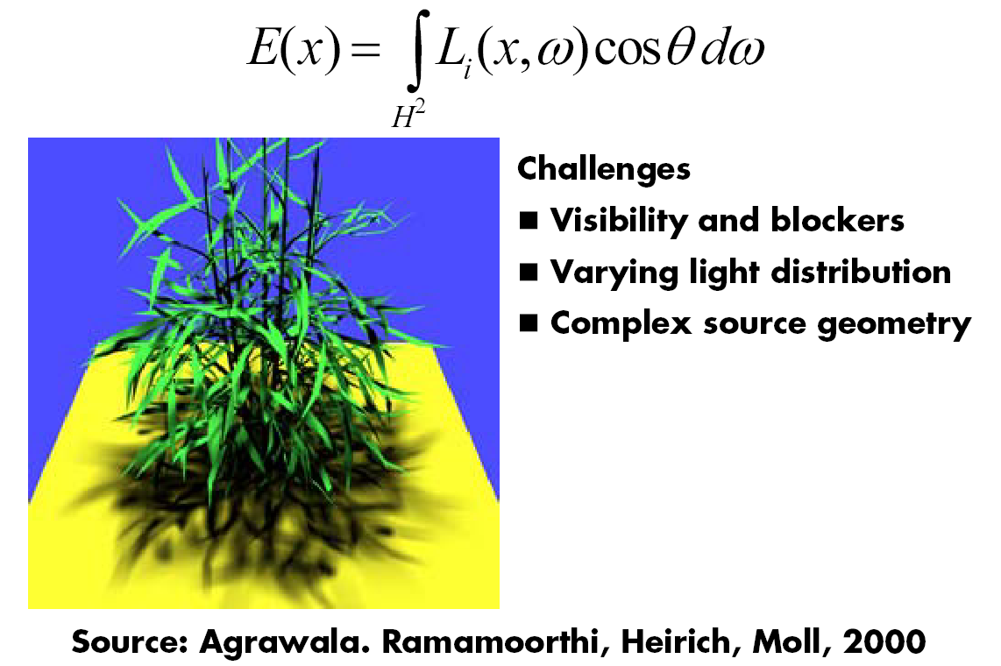
Example: Soft Shadows

Slide 31
Monte Carlo
Algorithms based on statistical sampling and random numbers
Coined in the beginning of 1940s. Originally used for neutron transport, nuclear simulations
Von Neumann, Ulam, Metropolis, …
Canonical example: 1D integral done numerically
Choose a set of random points to evaluate function, and then average (expectation or statistical average)

Slide 32
Monte Carlo Algorithms
Advantages
Robust for complex integrals in computer graphics (irregular domains, shadow discontinuities and so on)
Efficient for high dimensional integrals (common in graphics: time, light source directions, and so on)
Quite simple to implement
Work for general scenes, surfaces
Easy to reason about (but care taken re statistical bias)
Disadvantages
Noisy
Slow (many samples needed for convergence)
Not used if alternative analytic approaches exist (but those are rare)

Slide 33
Integration in 1D
f(x)
x=1
Slide courtesy of Peter Shirley

Slide 34
We can approximate
Standard integration methods like trapezoidal
rule and Simpsons rule
Advantages:
Converges fast for smooth integrands
Deterministic
Disadvantages:
Exponential complexity in many dimensions
Not rapid convergence for discontinuities
g(x)
f(x)
x=1
Slide courtesy of Peter Shirley

Slide 35
Or we can average
f(x)
E(f(x))
x=1
Slide courtesy of Peter Shirley

Slide 36
Estimating the average
Monte Carlo methods (random choose samples)
Advantages:
Robust for discontinuities
Converges reasonably for large dimensions
Can handle complex geometry, integrals
Relatively simple to implement, reason about
f(x)
E(f(x))
x₁
x_{N}
Slide courtesy of Peter Shirley

Slide 37
Other Domains
f(x)
< f >_{ab}
x=a
x=b
Slide courtesy of Peter Shirley

Slide 38
Multidimensional Domains
Same ideas apply for integration over …
Pixel areas
Surfaces
Projected areas
Directions
Camera apertures
Time
Paths
Eye
Pixel
x
Surface

Slide 39
Random Variables
Describes possible outcomes of an experiment
In discrete case, e.g. value of a dice roll [x = 1-6]
Probability p associated with each x (1/6 for dice)
Continuous case is obvious extension

Slide 40
Expected Value
Expectation
For Dice example:

Slide 41
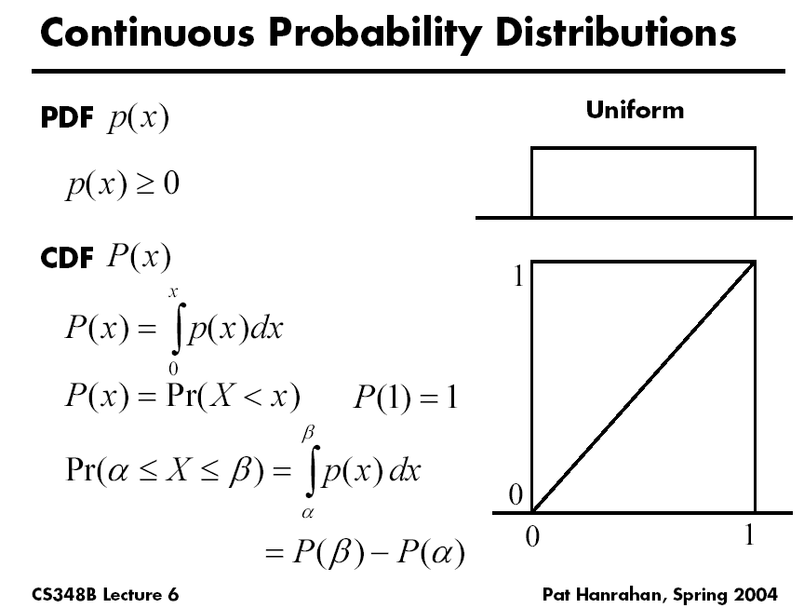

Slide 42
Sampling Techniques
Problem: how do we generate random points/directions during path tracing?
Non-rectilinear domains
Importance (BRDF)
Stratified
Eye
x
Surface

Slide 43
Generating Random Points
Uniform distribution:
Use random number generator
1
Probability
0
Ω

Slide 44
Generating Random Points
Specific probability distribution:
Function inversion
Rejection
Metropolis
1
Probability
0
Ω

Slide 45
Common Operations
Want to sample probability distributions
Draw samples distributed according to probability
Useful for integration, picking important regions, etc.
Common distributions
Disk or circle
Uniform
Upper hemisphere for visibility
Area luminaire
Complex lighting like an environment map
Complex reflectance like a BRDF

Slide 46
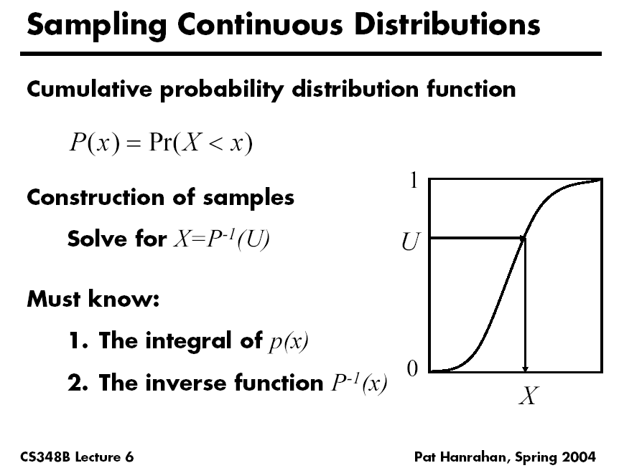

Slide 47
Generating Random Points
1
Cumulative Probability
0
Ω

Slide 48
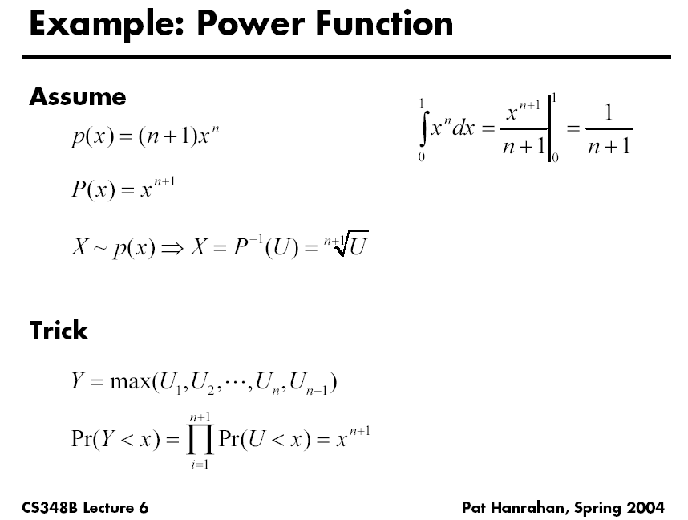

Slide 49
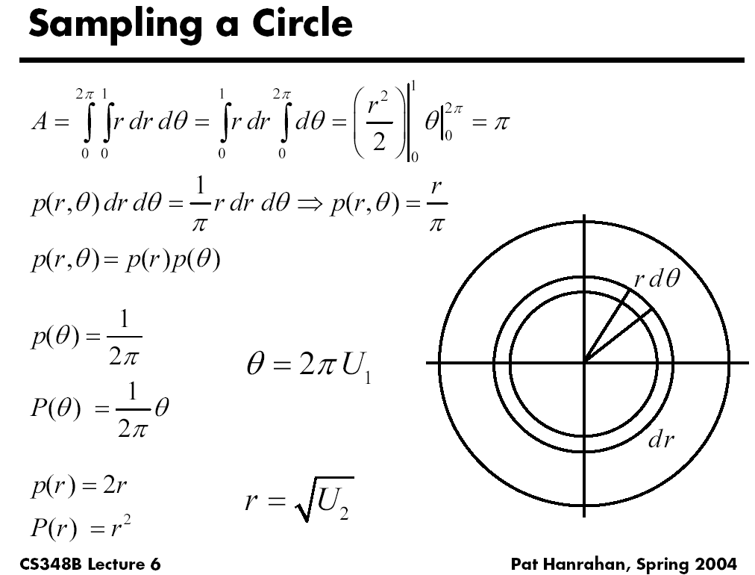

Slide 50
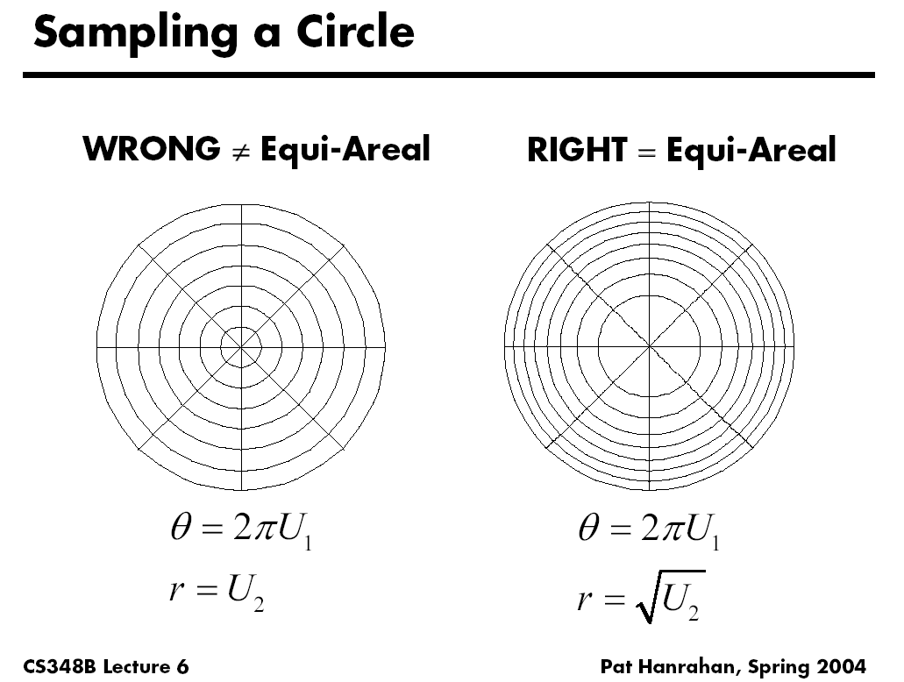

Slide 51
Rejection Sampling
1
x
x
x
x
x
x
Probability
x
x
x
x
0
Ω

Slide 52
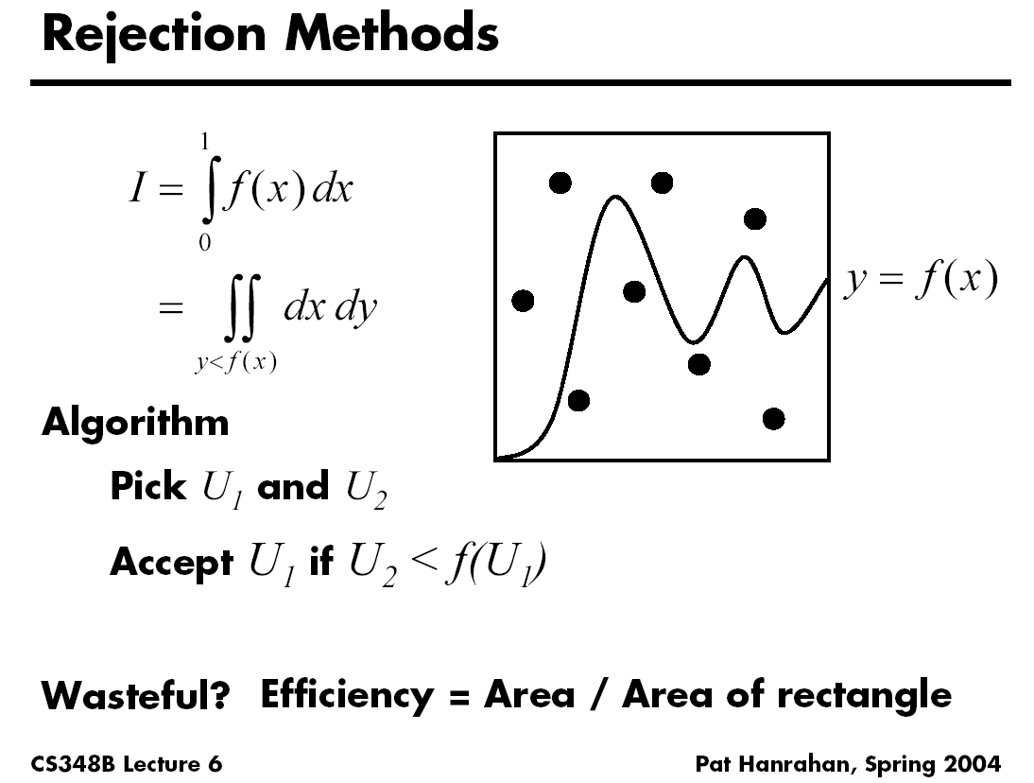

Slide 53
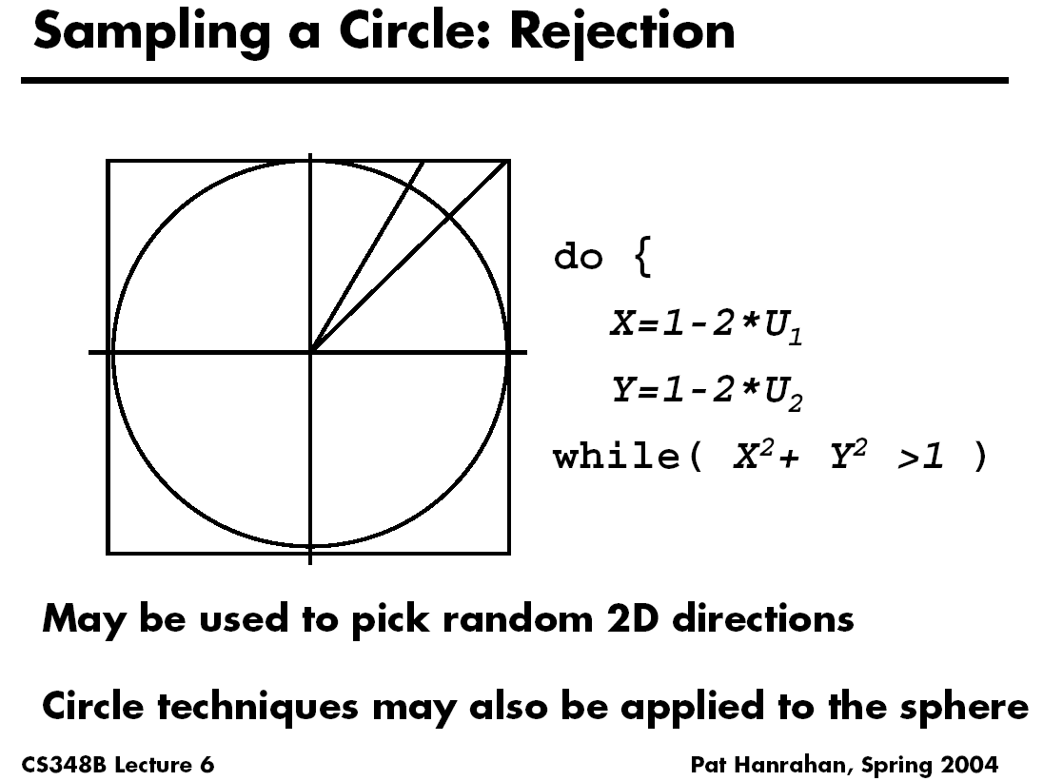

Slide 54
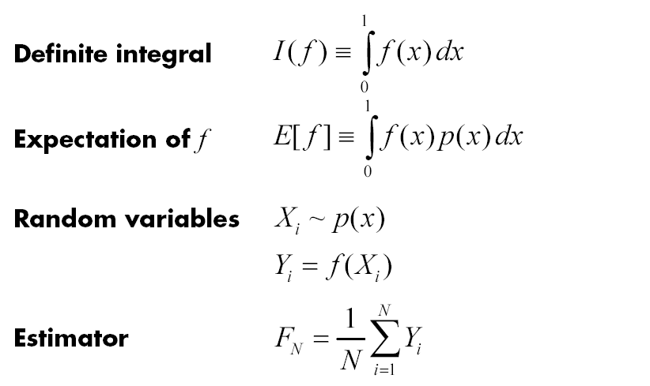
More formally

Slide 55
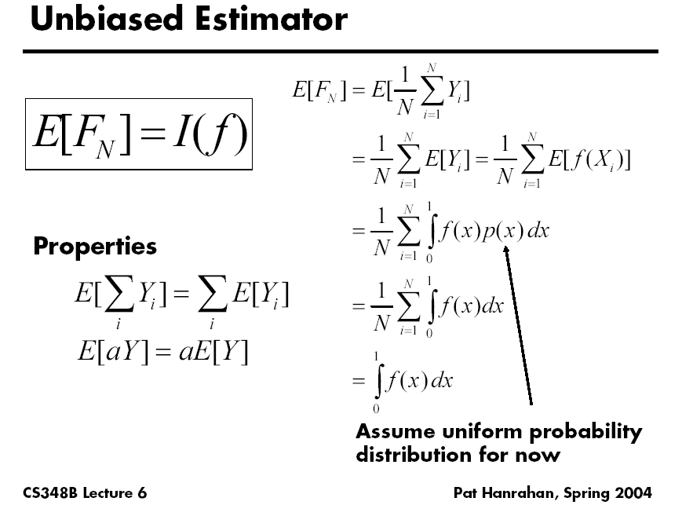

Slide 56
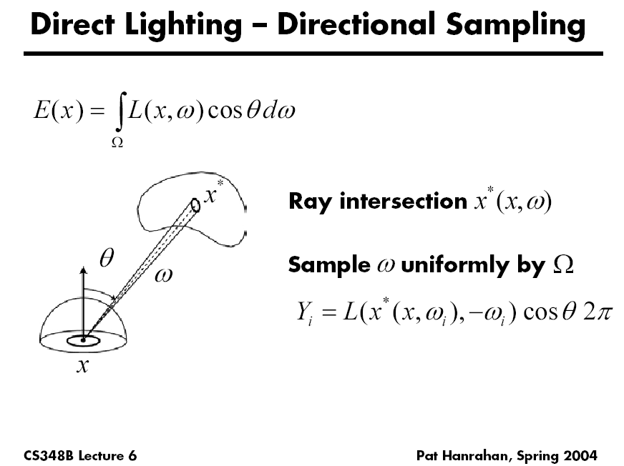

Slide 57
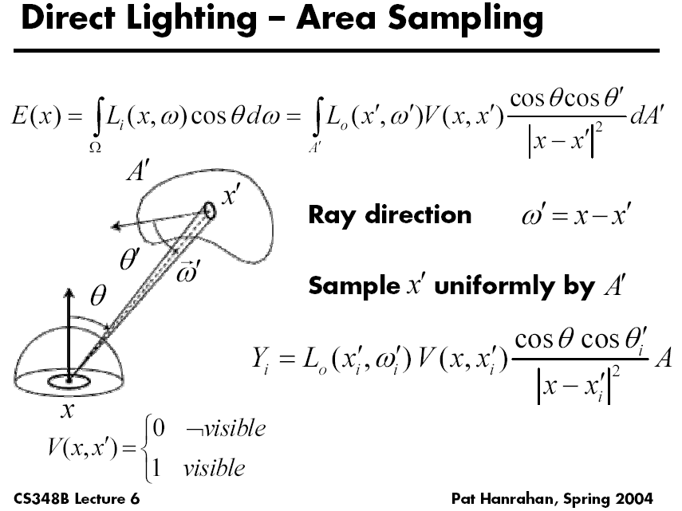

Slide 58
Importance Sampling
Put more samples where f(x) is bigger
E(f(x))
x₁
x_{N}

Slide 59
Importance Sampling
This is still unbiased
E(f(x))
x₁
x_{N}
for all N

Slide 60
Importance Sampling
Zero variance if p(x) ~ f(x)
E(f(x))
Less variance with better
importance sampling
x₁
x_{N}

Slide 61
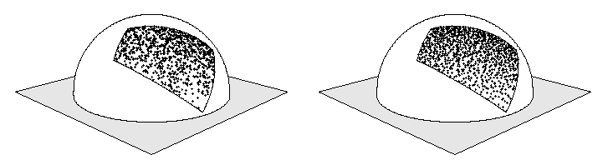
Stratified Sampling
Estimate subdomains separately
Arvo
E_{k}(f(x))
x₁
x_{N}

Slide 62
Stratified Sampling
Less overall variance if less variance in subdomains
E_{k}(f(x))
x₁
x_{N}

Slide 63
More Information
Veach PhD thesis chapter (linked to from website)
Course Notes (links from website)
Mathematical Models for Computer Graphics, Stanford, Fall 1997
State of the Art in Monte Carlo Methods for Realistic Image Synthesis, Course 29, SIGGRAPH 2001

