Slide 1
Advanced Computer Graphics
(Spring 2013)
CS 283, Lecture 8: Illumination and Reflection
http://inst.eecs.berkeley.edu/~cs283/sp13
Many slides courtesy Pat Hanrahan

Slide 2
Overview
Moving from geometry to rendering and appearance
Major part of course: 10 lectures
  Includes discussion of current research topics
  Assignments 2 and 3
First couple of lectures recap of 184 for those in it
  Formal illumination, reflection, global illumination
  But quickly move to new and advanced material
Remember Mesh Assignment due Feb 22

Slide 3
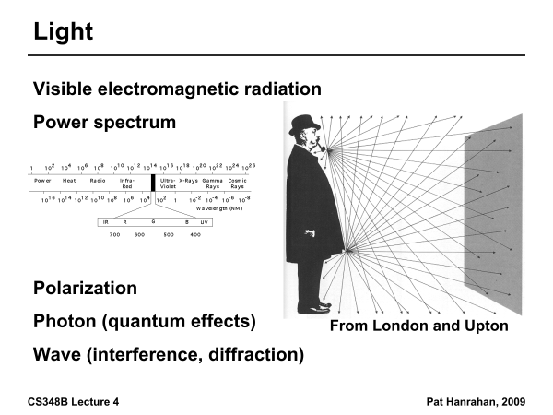

Slide 4
Radiometry
Physical measurement of electromagnetic energy
Measure spatial (and angular) properties of light
  Radiance, Irradiance
  Reflection functions: Bi-Directional Reflectance Distribution Function or BRDF
  Reflection Equation
  Simple BRDF models
Environment Maps

Slide 5
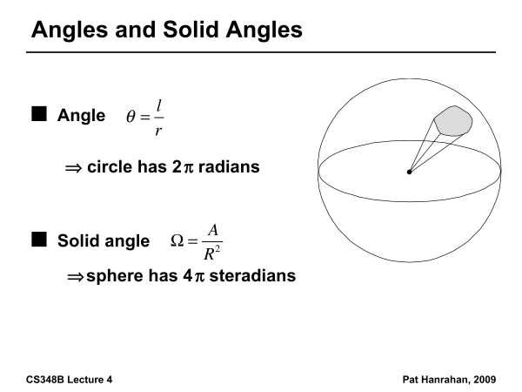

Slide 6
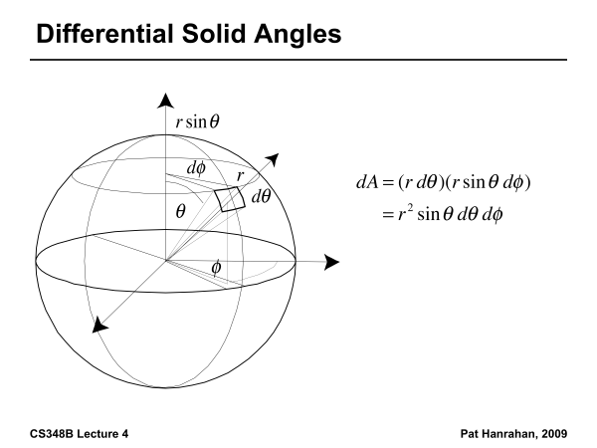

Slide 7
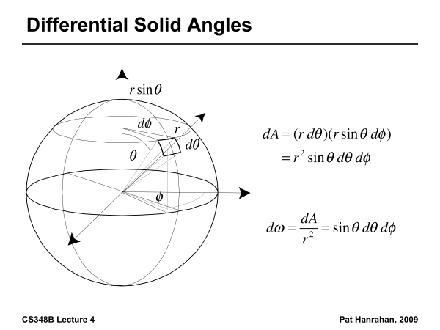

Slide 8
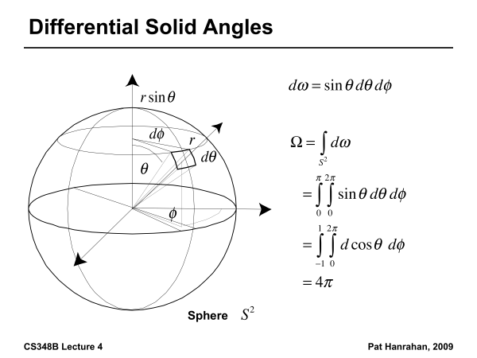

Slide 9
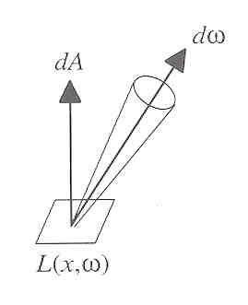
Radiance
Power per unit projected area perpendicular to the ray per unit solid angle in the direction of the ray
Symbol: L(x,ω) (W/m² sr)
Flux given by dΦ = L(x,ω) cos θ dω dA

Slide 10
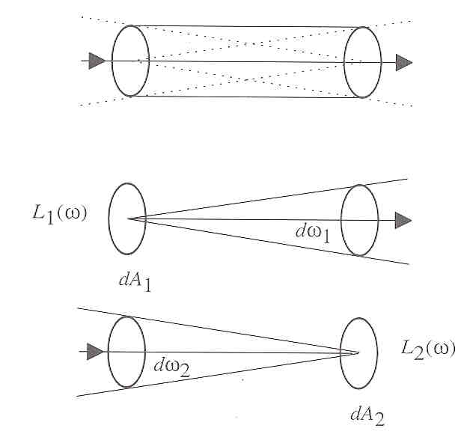
Radiance properties
Radiance constant as propagates along ray
  Derived from conservation of flux
  Fundamental in Light Transport.

Slide 11
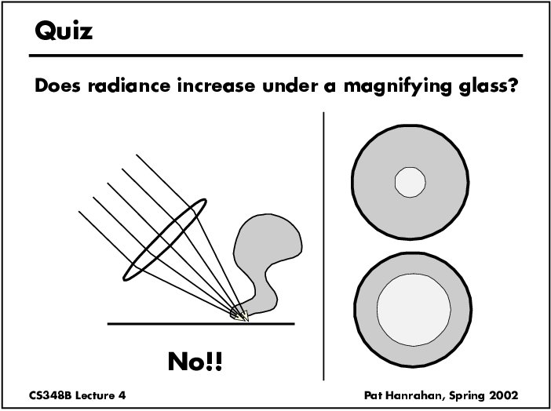

Slide 12
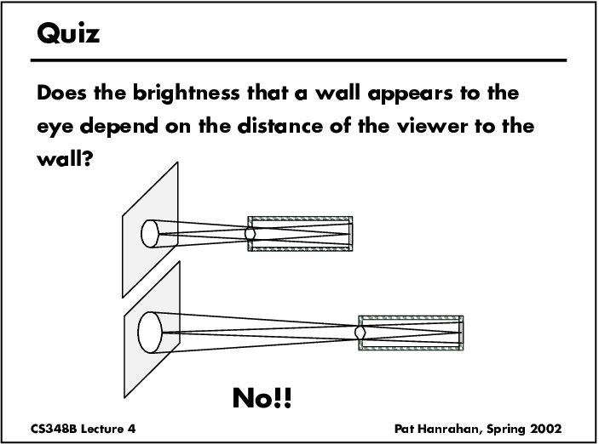

Slide 13
Radiance properties
Sensor response proportional to radiance (constant of proportionality is throughput)
  Far away surface: See more, but subtends smaller angle
  Wall equally bright across viewing distances
Consequences
  Radiance associated with rays in a ray tracer
  Other radiometric quants derived from radiance

Slide 14
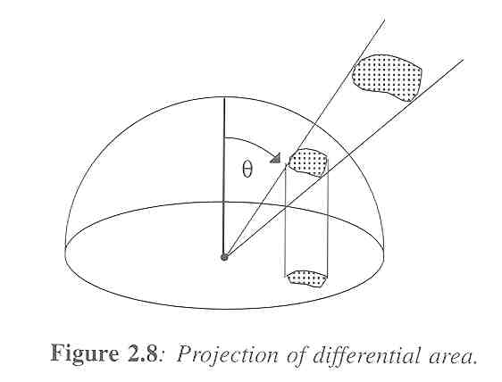
Irradiance, Radiosity
Irradiance E is radiant power per unit area
Integrate incoming radiance over hemisphere
  Projected solid angle (cos θ dω)
  Uniform illumination: Irradiance = π [CW 24,25]
  Units: W/m²
Radiant Exitance (radiosity)
  Power per unit area leaving surface (like irradiance)

Slide 15
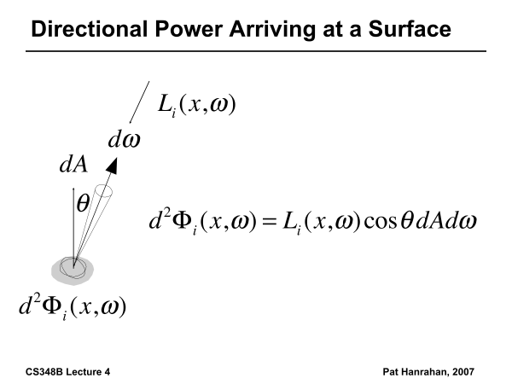

Slide 16
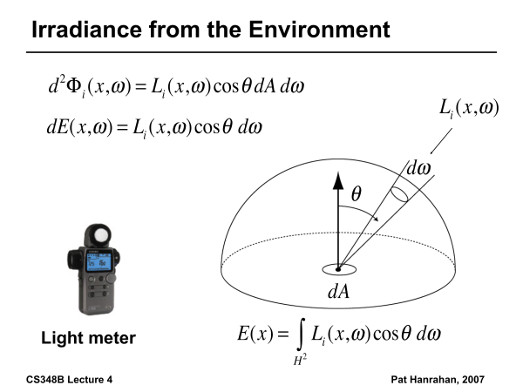

Slide 17
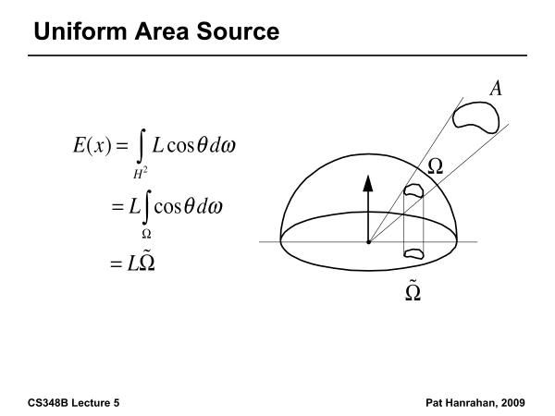

Slide 18
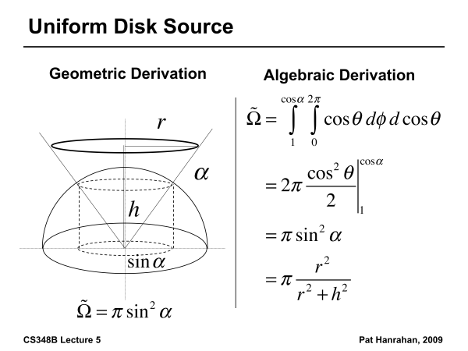

Slide 19
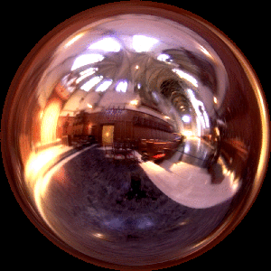
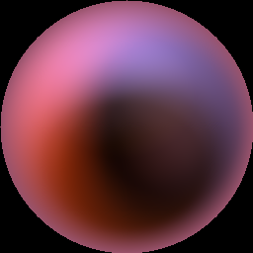
Irradiance Environment Maps
R
N
Incident Radiance
(Illumination Environment Map)
Irradiance Environment Map

Slide 20
Radiometry
Physical measurement of electromagnetic energy
Measure spatial (and angular) properties of light
  Radiance, Irradiance
  Reflection functions: Bi-Directional Reflectance Distribution Function or BRDF
  Reflection Equation
  Simple BRDF models
Environment Maps

Slide 21
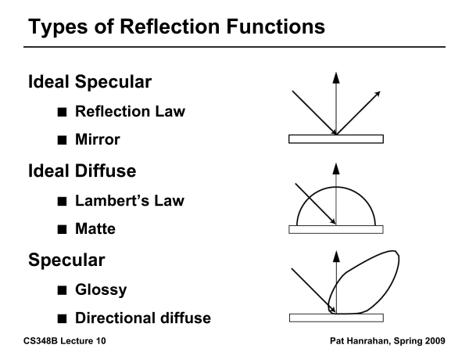

Slide 22
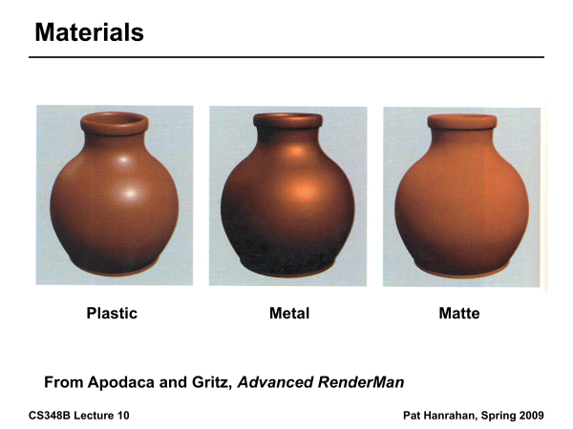

Slide 23
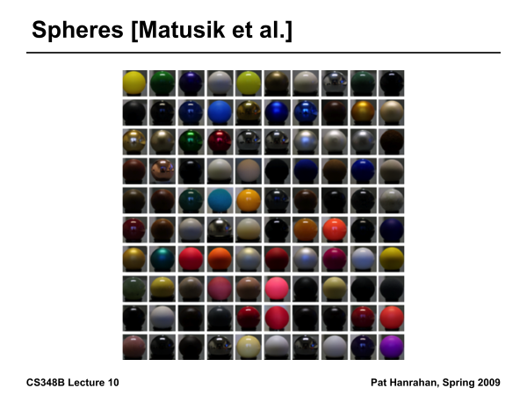

Slide 24
Building up the BRDF
Bi-Directional Reflectance Distribution Function [Nicodemus 77]
Function based on incident, view direction
Relates incoming light energy to outgoing
Unifying framework for many materials

Slide 25
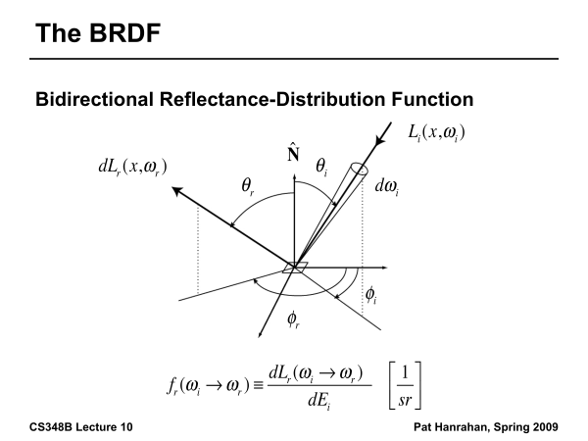

Slide 26
BRDF
Reflected Radiance proportional Irradiance
Constant proportionality: BRDF
Ratio of outgoing light (radiance) to incoming light (irradiance)
  Bidirectional Reflection Distribution Function
  (4 Vars) units 1/sr

Slide 27
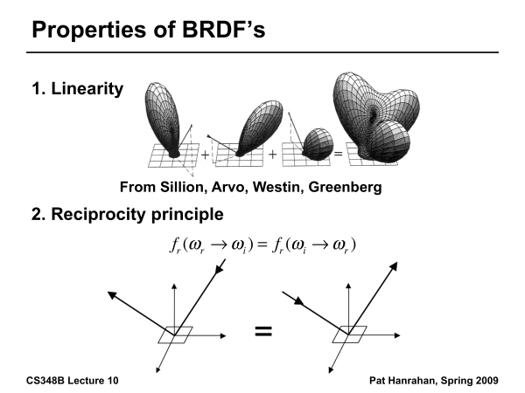

Slide 28
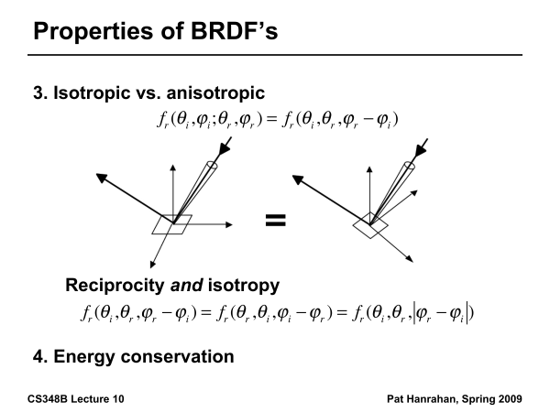

Slide 29
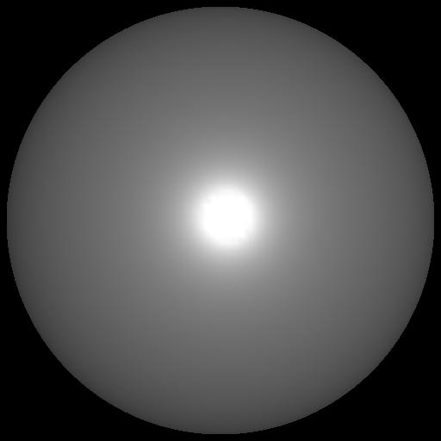
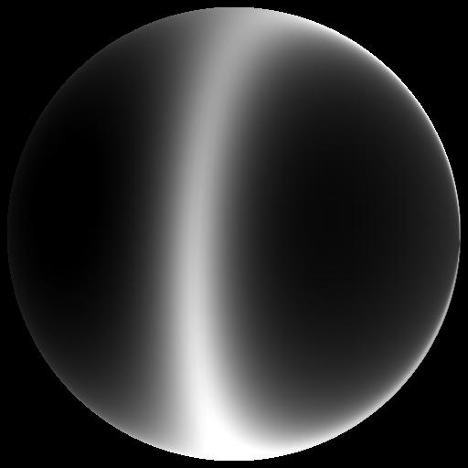
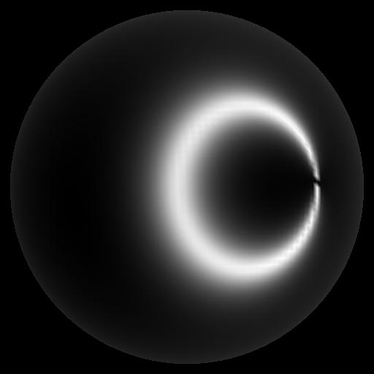
Isotropic vs Anisotropic
Isotropic: Most materials (you can rotate about normal without changing reflections)
Anisotropic: brushed metal etc. preferred tangential direction
Isotropic
Anisotropic

Slide 30
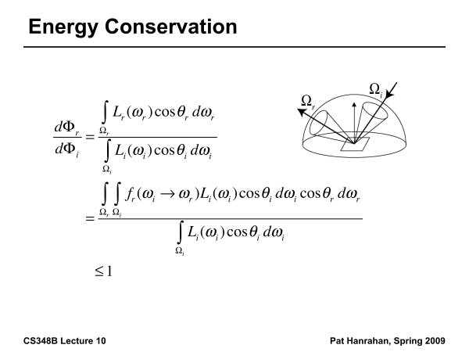

Slide 31
Reflection Equation
Reflected Radiance
(Output Image)
Incident
radiance (from
light source)
BRDF
Cosine of
Incident angle

Slide 32
Reflection Equation
Sum over all light sources
Reflected Radiance
(Output Image)
Incident
radiance (from
light source)
BRDF
Cosine of
Incident angle

Slide 33
Reflection Equation
Replace sum with integral
Reflected Radiance
(Output Image)
Incident
radiance (from
light source)
BRDF
Cosine of
Incident angle

Slide 34
Radiometry
Physical measurement of electromagnetic energy
Measure spatial (and angular) properties of light
  Radiance, Irradiance
  Reflection functions: Bi-Directional Reflectance Distribution Function or BRDF
  Reflection Equation
  Simple BRDF models
Environment Maps

Slide 35
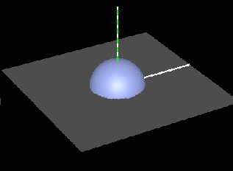
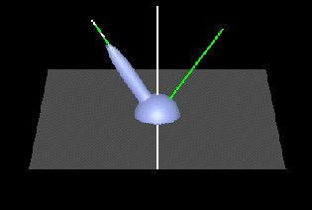
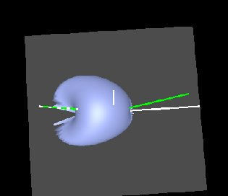
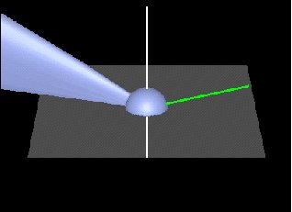
Brdf Viewer plots
Diffuse
Torrance-Sparrow
Anisotropic
bv written by Szymon Rusinkiewicz

Slide 36
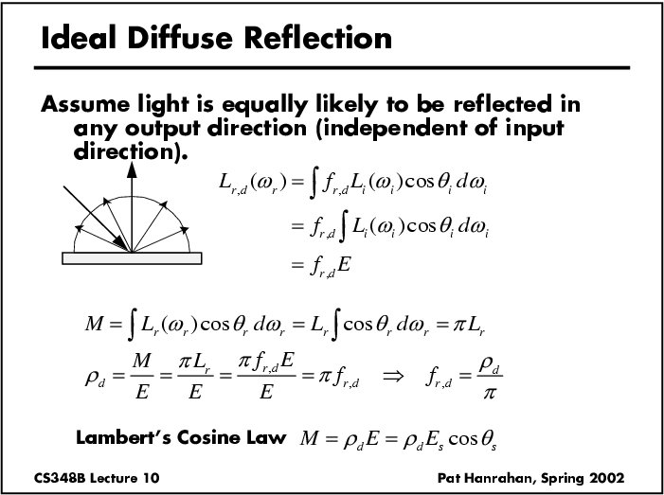

Slide 37
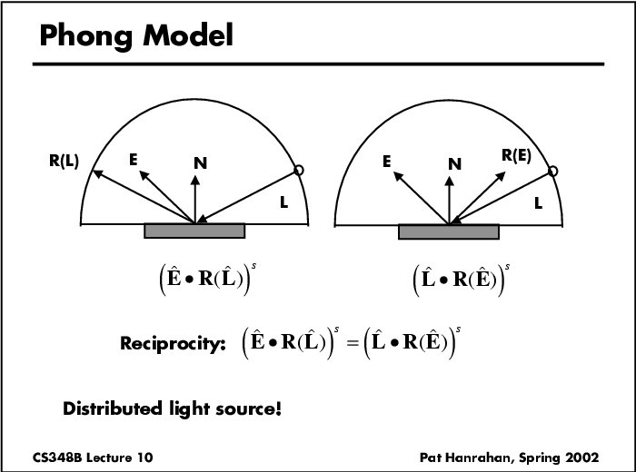

Slide 38
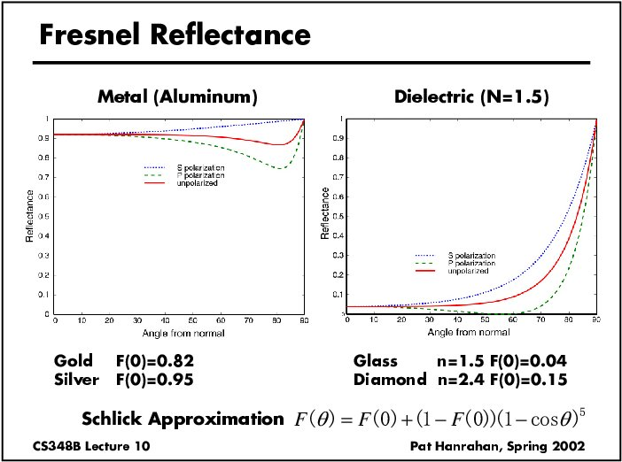

Slide 39
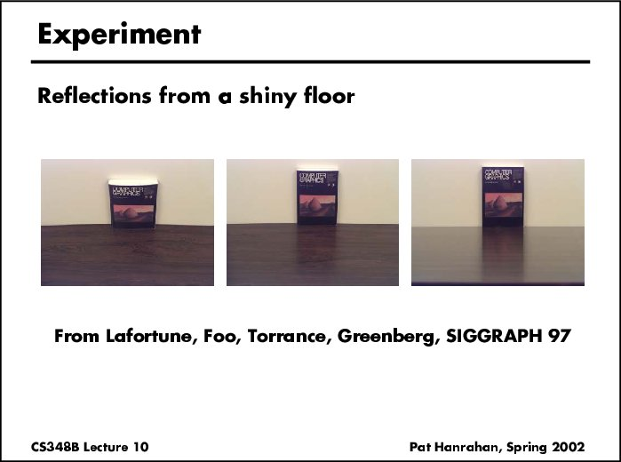

Slide 40
Analytical BRDF: TS example
One famous analytically derived BRDF is the Torrance-Sparrow model.
T-S is used to model specular surface, like the Phong model.
  more accurate than Phong
  has more parameters that can be set to match different materials
  derived based on assumptions of underlying geometry. (instead of ‘because it works well’)

Slide 41
Torrance-Sparrow
Assume the surface is made up grooves at the microscopic level.
Assume the faces of these grooves (called microfacets) are perfect reflectors.
Take into account 3 phenomena
Shadowing
Masking
Interreflection

Slide 42
Torrance-Sparrow Result
Fresnel term:
allows for wavelength dependency
Geometric Attenuation:
reduces the output based on the amount of shadowing or masking that occurs.
Distribution:
distribution function determines what percentage of microfacets are oriented to reflect in the viewer direction.
How much of the macroscopic surface is visible to the light source
How much of the macroscopic surface is visible to the viewer

Slide 43
Other BRDF models
Empirical: Measure and build a 4D table
Anisotropic models for hair, brushed steel
Cartoon shaders, funky BRDFs
Capturing spatial variation
Very active area of research

Slide 44
Radiometry
Physical measurement of electromagnetic energy
Measure spatial (and angular) properties of light
  Radiance, Irradiance
  Reflection functions: Bi-Directional Reflectance Distribution Function or BRDF
  Reflection Equation
  Simple BRDF models
Environment Maps

Slide 45
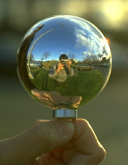
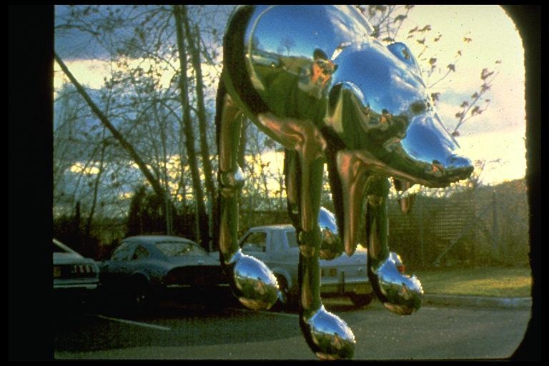
Environment Maps
Light as a function of direction, from entire environment
Captured by photographing a chrome steel or mirror sphere
Accurate only for one point, but distant lighting same at other scene locations (typically use only one env. map)
Blinn and Newell 1976, Miller and Hoffman, 1984
Later, Greene 86, Cabral et al. 87

Slide 46
Reflection Equation
Replace sum with integral
Environment
Map (continuous)
Cosine of
Incident angle
Reflected Radiance
(Output Image)
BRDF

Slide 47
Environment Maps
Environment maps widely used as lighting representation
Many modern methods deal with offline and real-time rendering with environment maps
Image-based complex lighting + complex BRDFs

