Slide 1


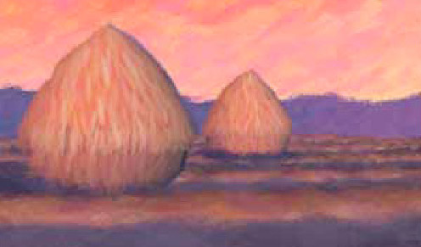
Advanced Computer Graphics
(Spring 2013)
CS 283, Lecture 12: Recent Advances in Monte Carlo Offline Rendering
Ravi Ramamoorthi
http://inst.eecs.berkeley.edu/~cs283/sp13
Some slides/ideas courtesy Pat Hanrahan, Henrik Jensen

Slide 2
Discussion
Problems different over years. Initially, how to make rendering a single picture fast.
Now, multidimensional effects, multiple images. Include image-based lighting, reflectance.
Monte Carlo itself is a well known numerical method. But, many recent insights, more to come
  Many papers from my group and others: Share information among multiple pixels, denoise/reconstruct
Lecture surveys much work in last decade at high-level. Need to read papers for more depth.

Slide 3
History and Outline
Is Monte Carlo Rendering solved?
Can it be made more efficient (90s):
  Irradiance caching takes advantage of coherence
  Correct sampling: Stratified, Multiple Importance, Bidirectional path tracing, Metropolis…
  Photon Mapping
  Now becoming standard in movie production
Work with Image-Based Appearance (02-06)
  Importance sampling environment maps, BRDFs
Multidimensional effects [depth-of field, soft shadows, motion blur] (08-present)
  Adaptive multidimensional sampling
  Cut-based hierarchical integration
  Frequency space analysis, Denoising

Slide 4
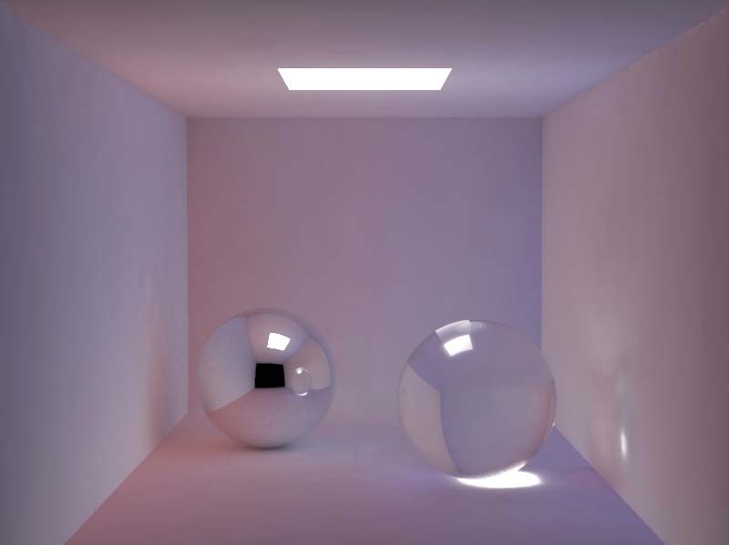
Smoothness of Indirect Lighting
Direct
Indirect
Direct + Indirect

Slide 5
Irradiance Caching
Empirically, (diffuse) interreflections low frequency
Therefore, should be able to sample sparsely
Irradiance caching samples irradiance at few points on surfaces, and then interpolates
Ward, Rubinstein, Clear. SIGGRAPH 88, A ray tracing solution for diffuse interreflection

Slide 6
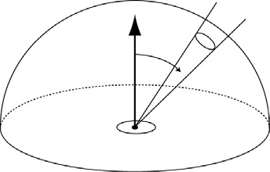


Irradiance Calculation
position
rotation
Derivation in Ward paper

Slide 7
Algorithm Outline
Find all samples with w(x) > q
if ( samples found )
  interpolate
else
  compute new irradiance
N.B. Subsample the image first and then fill in

Slide 8
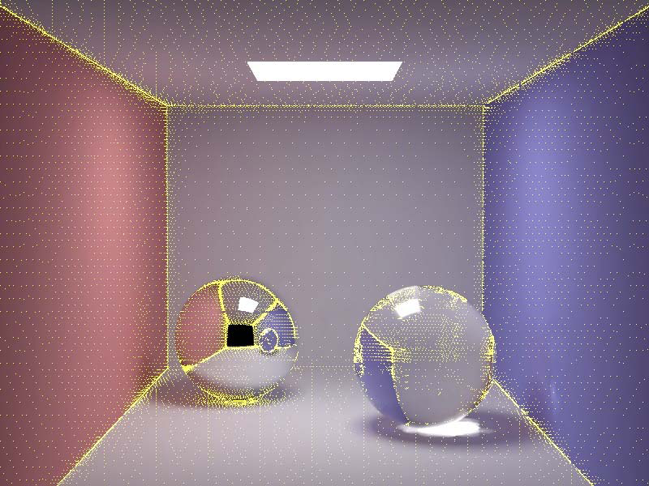
Irradiance Caching Example
Final Image
Sample Locations

Slide 9
History and Outline
Is Monte Carlo Rendering solved?
Can it be made more efficient (90s):
  Irradiance caching takes advantage of coherence
  Correct sampling: Stratified, Multiple Importance, Bidirectional path tracing, Metropolis…
  Photon Mapping
Work with Image-Based Appearance (02-06)
  Importance sampling environment maps, BRDFs
Multidimensional effects [depth-of field, soft shadows, motion blur] (08-present)
  Adaptive multidimensional sampling
  Cut-based hierarchical integration
  Frequency space analysis, denoising

Slide 10
Better Sampling
Smarter ways to Monte Carlo sample
Long history: Stratified, Importance, Bi-Directional, Multiple Importance, Metropolis
Good reference is Veach thesis
We only briefly discuss a couple of strategies

Slide 11
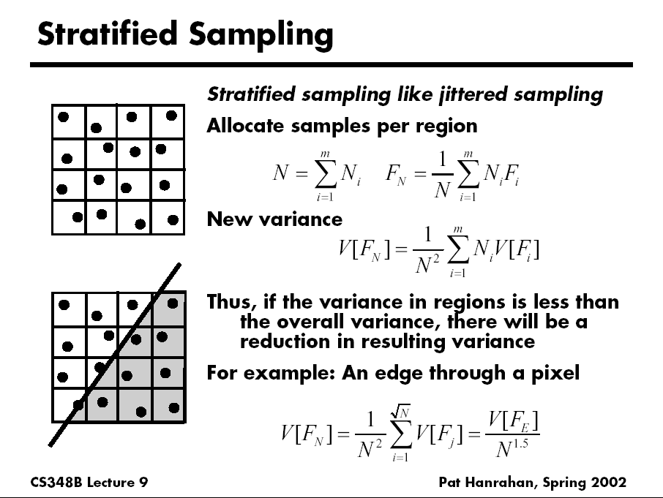
D. Mitchell 95, Consequences of stratified sampling in graphics

Slide 12
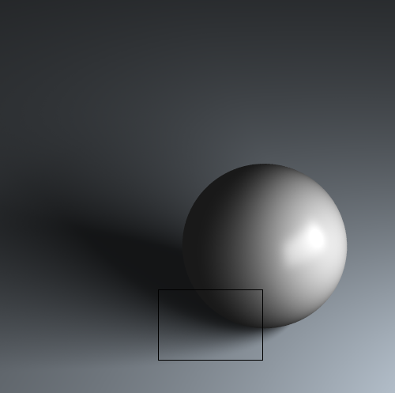
Comparison of simple patterns
Latin Hypercube
Quasi Monte Carlo
Ground Truth
Uniform
Random
Stratified
16 samples for area light, 4 samples per pixel, total 64 samples
If interested, see my recent paper “A Theory of Monte Carlo Visibility Sampling”
Figures courtesy Tianyu Liu

Slide 13
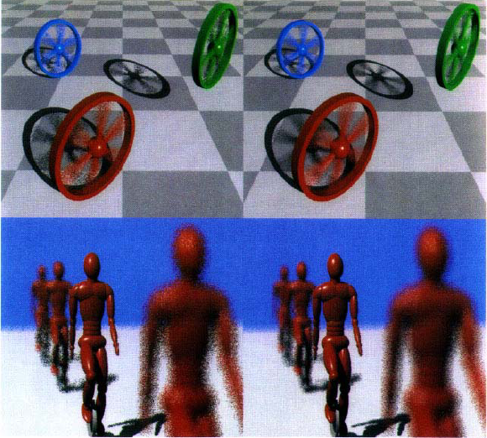
Spectrally Optimal Sampling
Mitchell 91

Slide 14
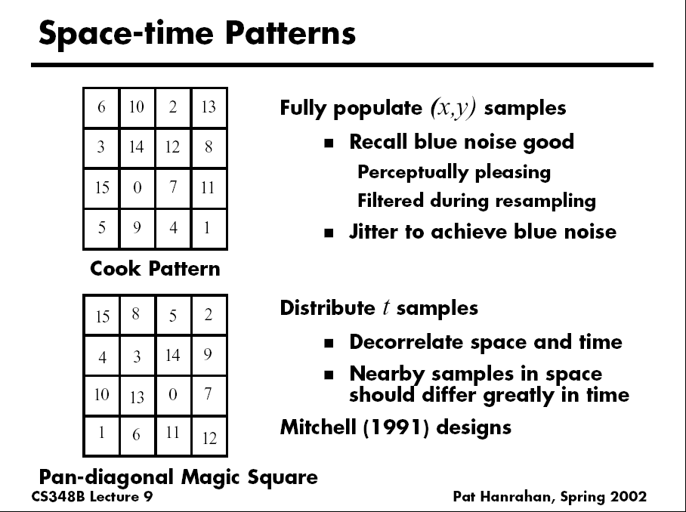

Slide 15
History and Outline
Is Monte Carlo Rendering solved?
Can it be made more efficient (90s):
  Irradiance caching takes advantage of coherence
  Correct sampling: Stratified, Multiple Importance, Bidirectional path tracing, Metropolis…
  Photon Mapping
Work with Image-Based Appearance (02-06)
  Importance sampling environment maps, BRDFs
Multidimensional effects [depth-of field, soft shadows, motion blur] (08-present)
  Adaptive multidimensional sampling
  Cut-based hierarchical integration
  Frequency space analysis, denoising

Slide 16
Light Ray Tracing
Backwards Ray Tracing
[Arvo 86]

Slide 17
Path Tracing: From Lights
Step 1. Choose a light ray
Step 2. Find ray-surface intersection
Step 3. Reflect or transmit
  u = Uniform()
  if u < reflectance(x)
  Choose new direction d ~ BRDF(O|I)
  goto Step 2
else if u < reflectance(x)+transmittance(x)
  Choose new direction d ~ BTDF(O|I)
  goto Step 2
else // absorption=1–reflectance-transmittance
  terminate on surface; deposit energy

Slide 18
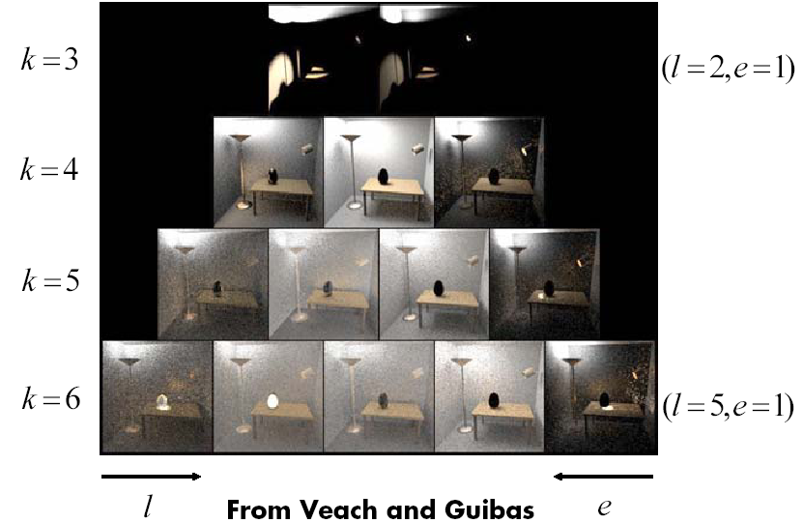
Bidirectional Path Tracing
Path pyramid (k = l + e = total number of bounces)

Slide 19
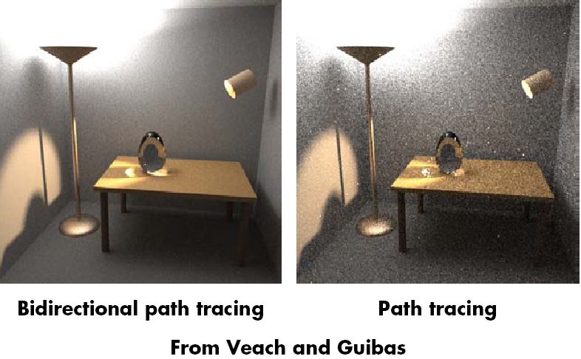
Comparison

Slide 20
Why Photon Map?
Some visual effects like caustics hard with standard path tracing from eye
May usually miss light source altogether
Instead, store “photons” from light in kd-tree
Look-up into this as needed
Combines tracing from light source, and eye
Similar to bidirectional path tracing, but compute photon map only once for all eye rays
Global Illumination using Photon Maps H. Jensen. Rendering Techniques (EGSR 1996), pp 21-30. (Also book: Realistic Image Synthesis using Photon Mapping)

Slide 21
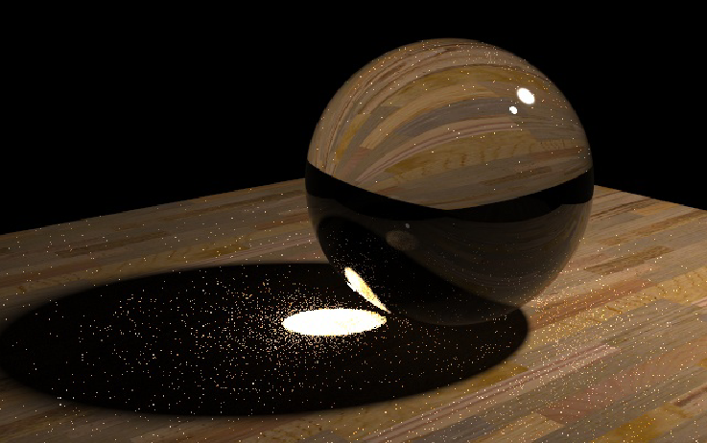
Caustics
Path Tracing: 1000 paths/pixel
Note noise in caustics
Slides courtesy Henrik Wann Jensen

Slide 22
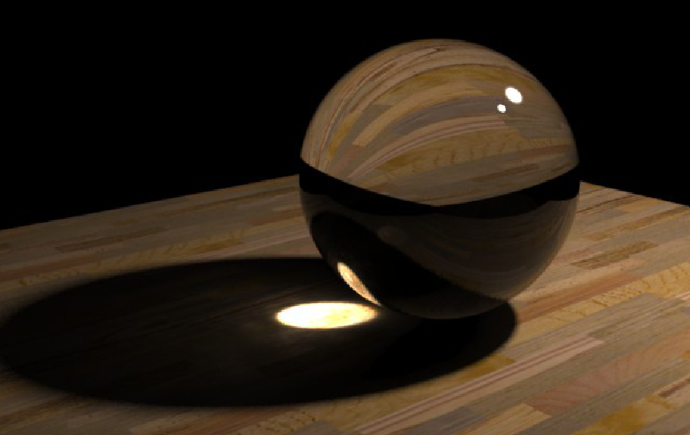
Caustics
Photon Mapping: 10000 photons
50 photons in radiance estimate

Slide 23
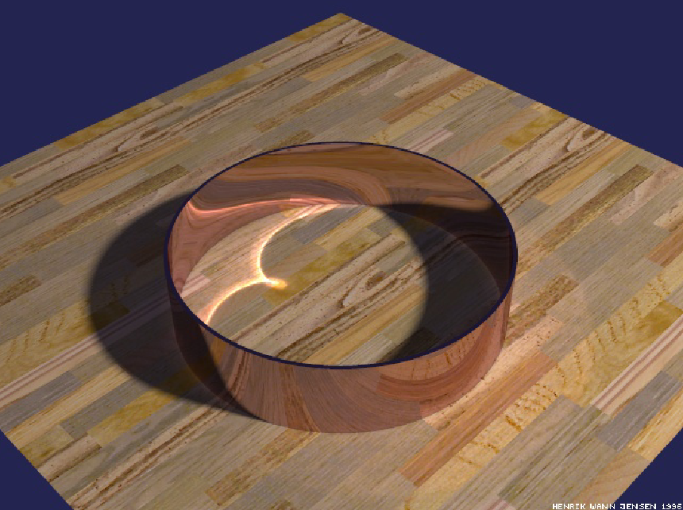
Reflections Inside a Metal Ring
50000 photons
50 photons to estimate radiance

Slide 24
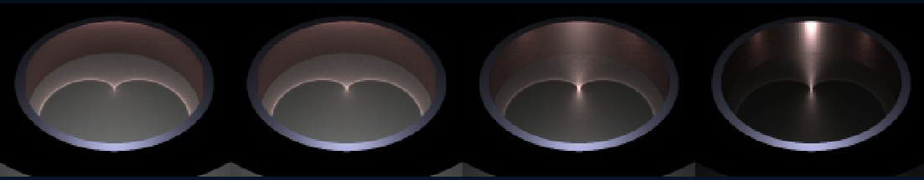
Caustics on Glossy Surfaces
340000 photons, 100 photons in radiance estimate

Slide 25
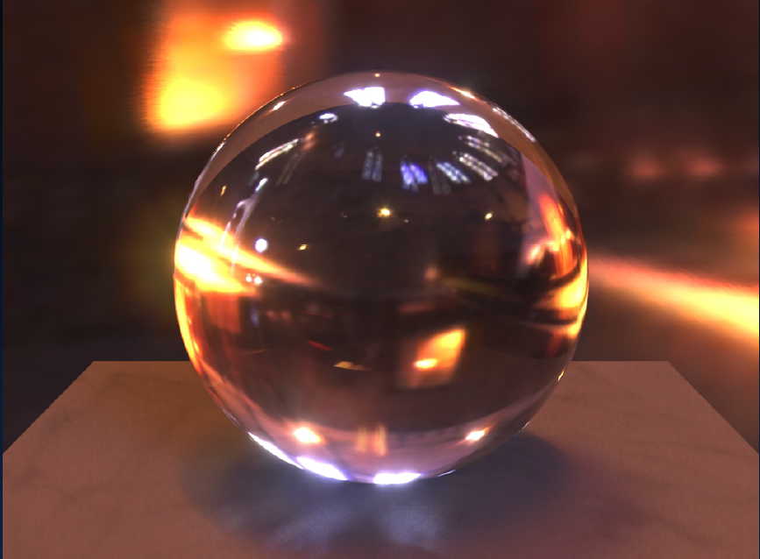
HDR Environment Illumination

Slide 26
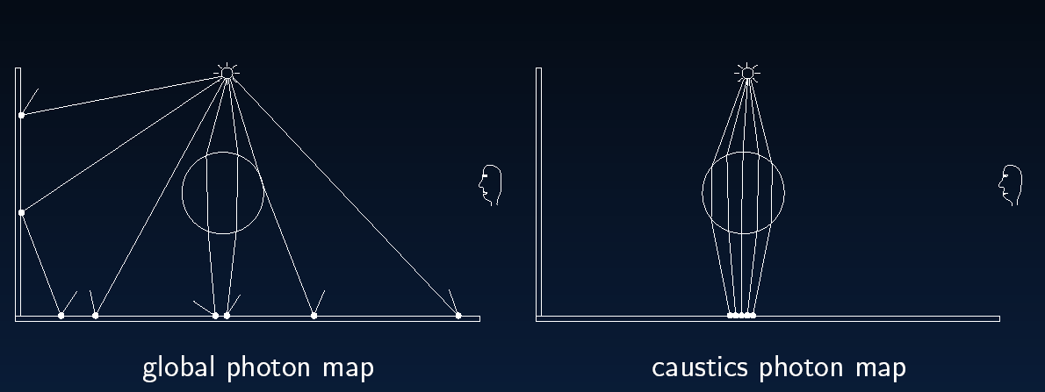
Global Illumination

Slide 27
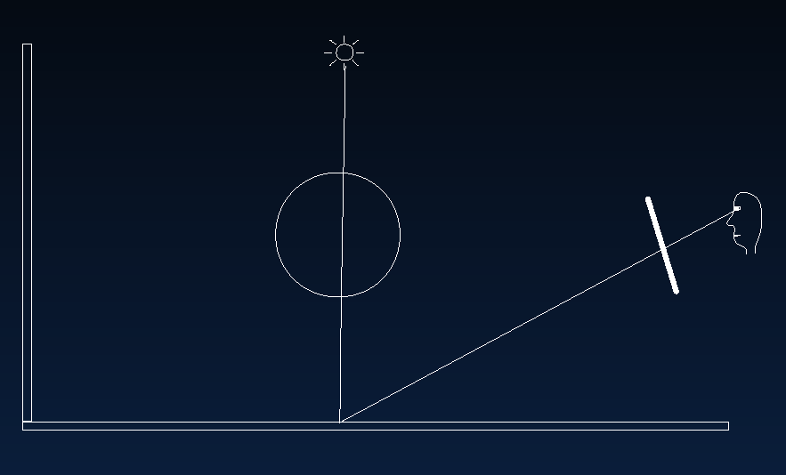
Direct Illumination

Slide 28
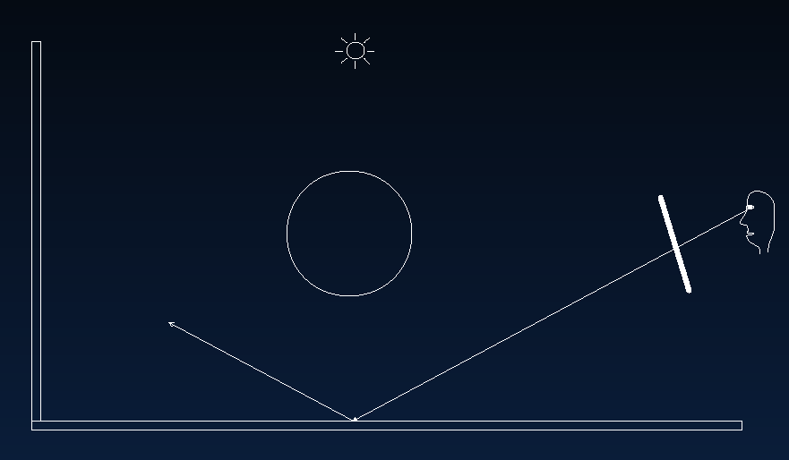
Specular Reflection

Slide 29
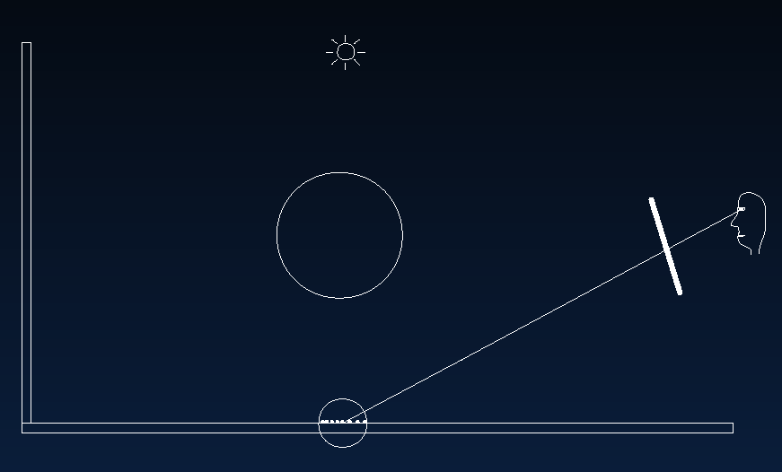
Caustics

Slide 30
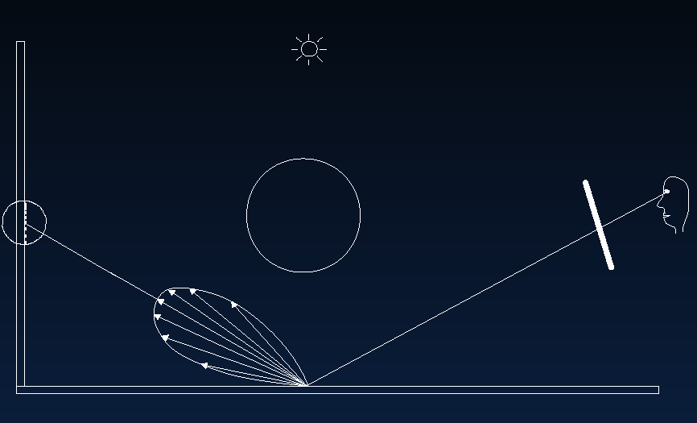
Indirect Illumination

Slide 31
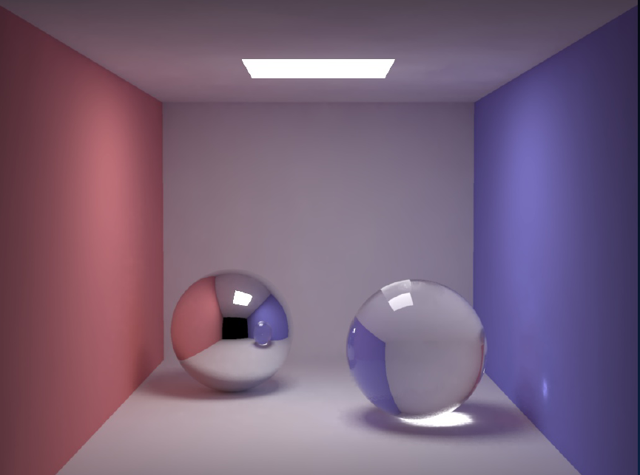
Cornell Box
200000 global photons, 50000 caustic photons

Slide 32
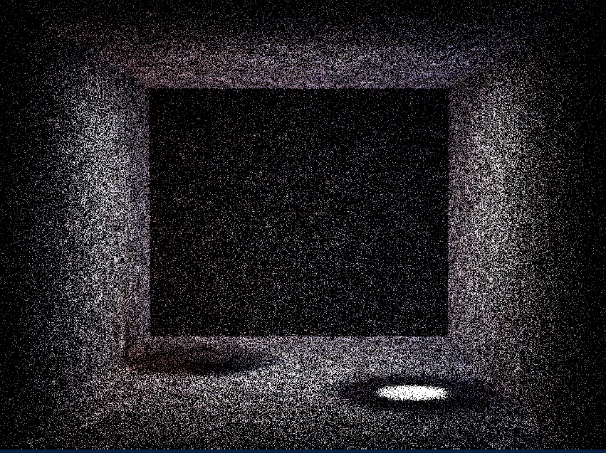
Box: Global Photons

Slide 33
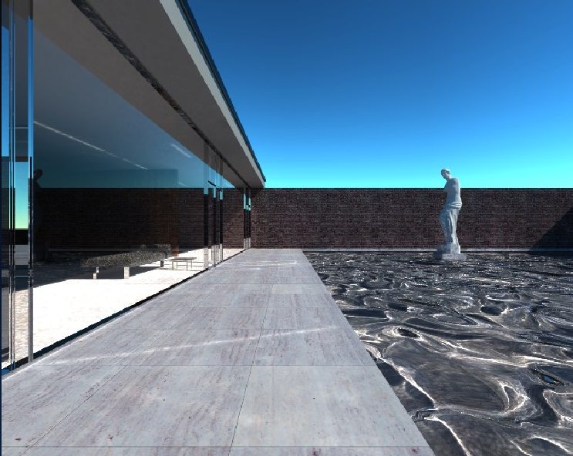
Mies House: Swimming Pool

Slide 34
History and Outline
Is Monte Carlo Rendering solved?
Can it be made more efficient (90s):
  Irradiance caching takes advantage of coherence
  Correct sampling: Stratified, Multiple Importance, Bidirectional path tracing, Metropolis…
  Photon Mapping
Work with Image-Based Appearance (02-06)
  Importance sampling environment maps, BRDFs
Multidimensional effects [depth-of field, soft shadows, motion blur] (08-present)
  Adaptive multidimensional sampling
  Cut-based hierarchical integration
  Frequency space analysis, denoising

Slide 35
Image-Based Appearance
Standard global illumination is difficult, but the emitters and reflective properties are simple
In mid-1990s, interest in appearance acquired from real world, such as image-based lighting
Environment Maps, measured BRDFs. These are functions. E.g. any of million pixels emitter
How to (importance) sample lighting, BRDFs?
  Agarwal et al. SIGGRAPH 03, Lawrence et al. SIGGRAPH 04, Clarberg et al. SIGGRAPH 05

Slide 36
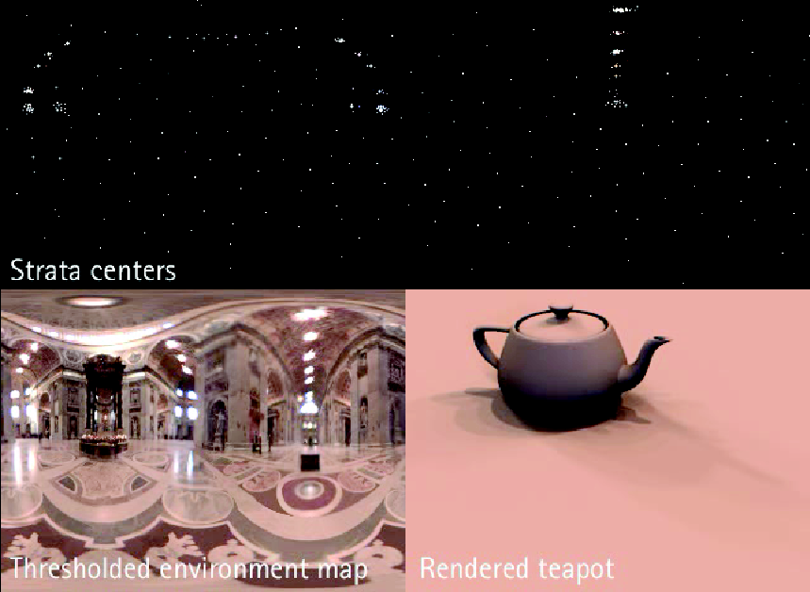
Structured Importance Sampling
Goal: Reduce environment to point lights

Slide 37
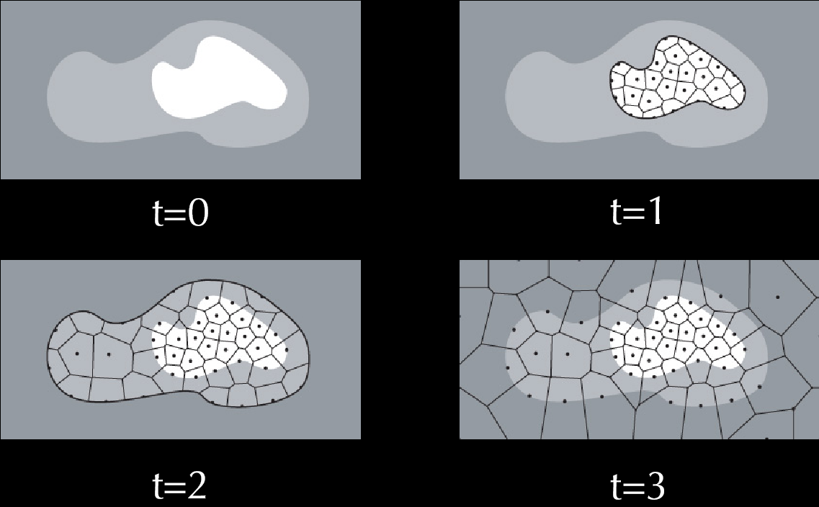
Hierarchical Stratification

Slide 38
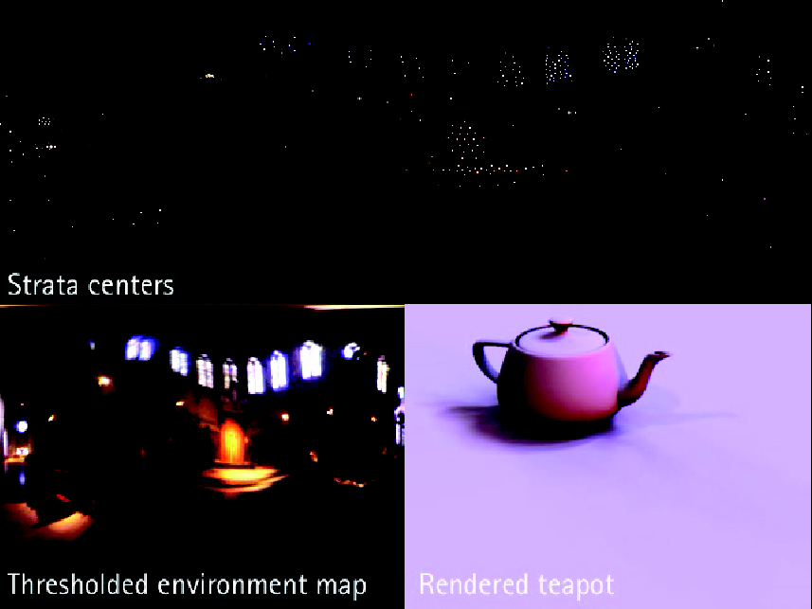
Structured Importance Sampling

Slide 39
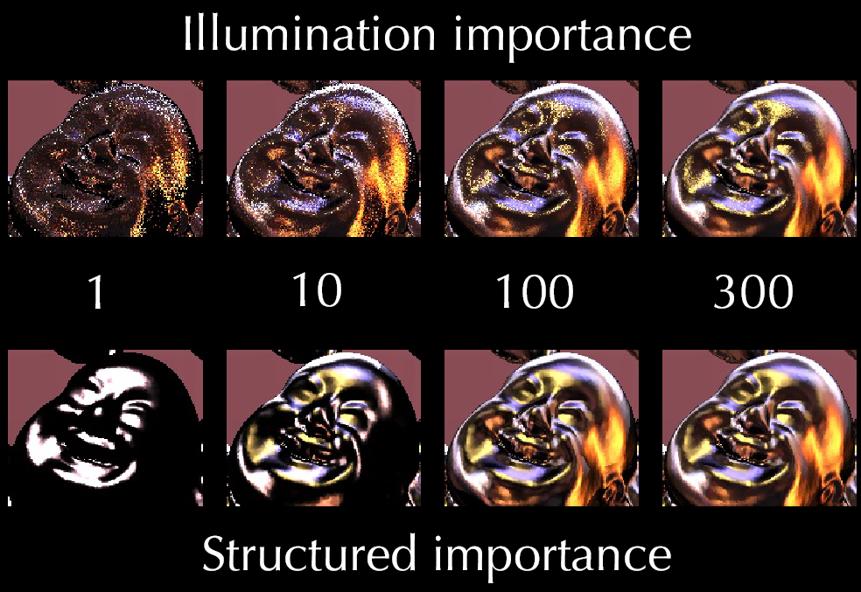
Glossy BRDF

Slide 40
BRDF Sampling
Lighting is only one component. Must be able to importance sample the BRDF in glob. Illum.
In 2004, no good importance sampling schemes for most BRDFs, including common Torrance-Sparrow
From Lawrence et al. 04, factor BRDF into data-driven terms that can each be importance sampled
Now some form of light/BRDF sampling common in production (standard in RenderMan 16, 2011-)

Slide 41
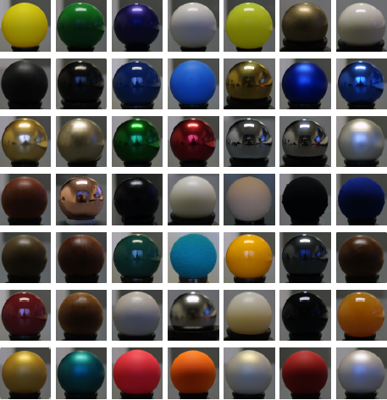
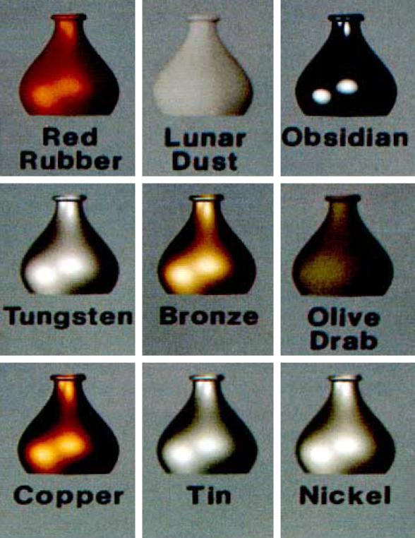
Complex BRDF Models
Analytic
Measured
[Cook & Torrance 1982]
[Matusik et. al. 2003]
Notes:
There has been a lot of effort in measuring BRDFs and developing complex analytic models that better capture physical phenomenon. However, so far these BRDFs have not been adopted in global illumination algorithms.

Slide 42
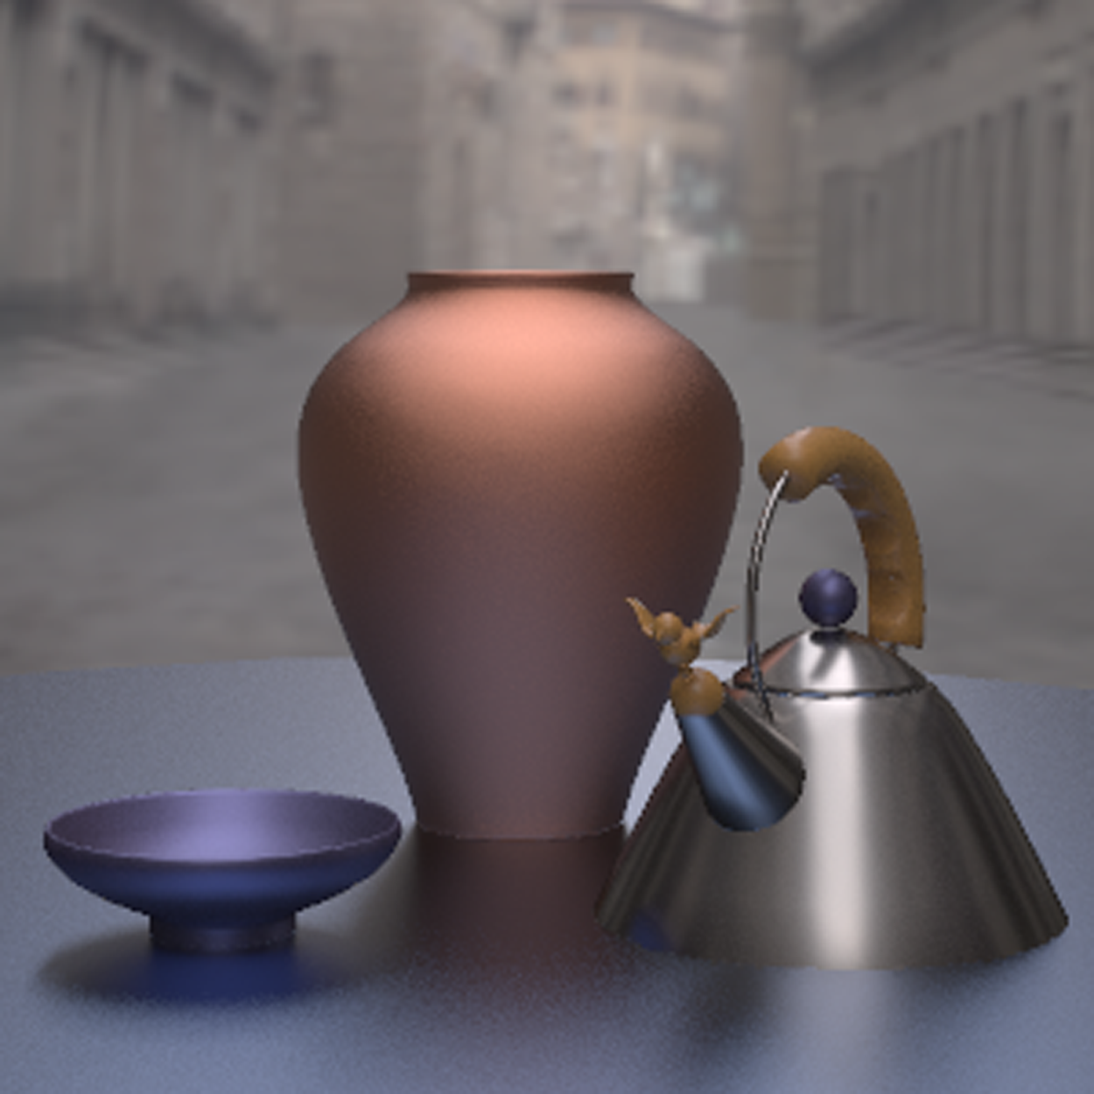
Motivation
Measured Plastic
Cook-Torrance
Measured Nickel
Measured Metallic-Blue
Notes:
So far, however, the state of the art has made it difficult to use these complex BRDFs in standard global illumination algorithms. For example, we would like to render a scene with several different measured and complex-analytic BRDFs using Monte Carlo path tracing, but there are no good techniques for importance sampling these BRDFs.
so far state of the art has made it difficult to use these complex BRDFs in global illumination algorithms where the norm is still
using simple BRDFs like the Phong that can be directly sampled.

Slide 43
Key Idea
Project 4D BRDF into sum of products of 2D function dependent on and
2D function dependent on :
depends only on the incoming direction and
some re-parameterization of the hemisphere.
Notes:
Needs animation to promote description of this key contribution…

Slide 44
Key Idea
Project 4D BRDF into sum of products of 2D function dependent on and
2D function dependent on :
depends only on the incoming direction and
some re-parameterization of the hemisphere.
Notes:
Needs animation to promote description of this key contribution…

Slide 45
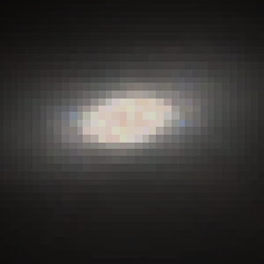
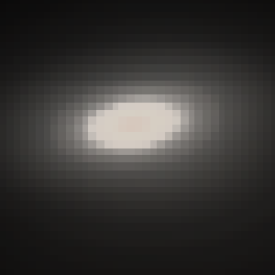
Measured Nickel BRDF
Reconstruction of 2-Term
Factored Representation
(18KB)
Original
Notes:
Underscore the fact that a low-term factorization naturally performs some regularization of measurement error. Of course, had we used as many terms as samples in the view, we would have captured the noise without loss.

Slide 46
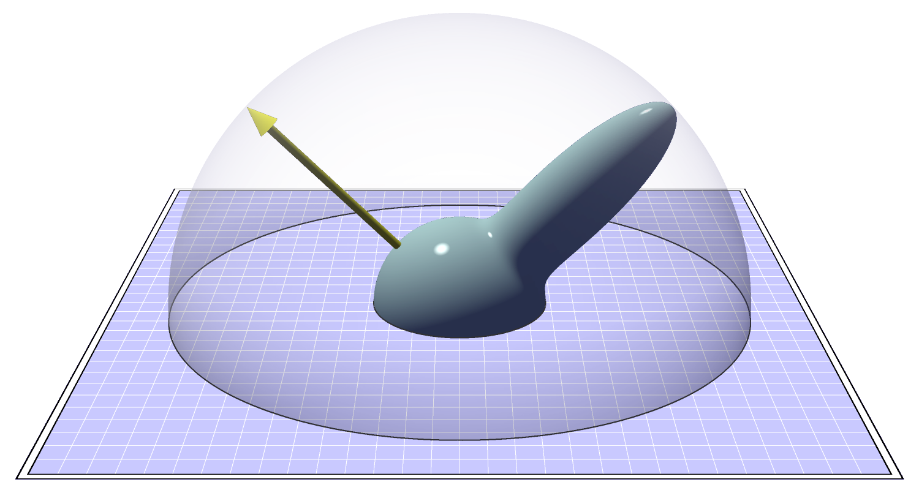
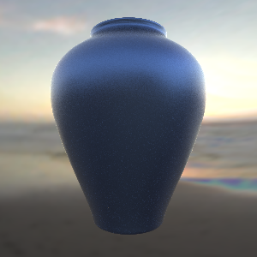
Sampling Factored BRDF
…
EVALUATE
0.1
0.75
0.1
SELECT TERM
SAMPLE
Notes:
As this process is repeated, because we are using the weights computed from the F functions…the second term will be selected most often.

Slide 47
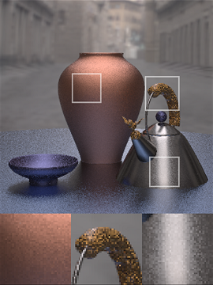
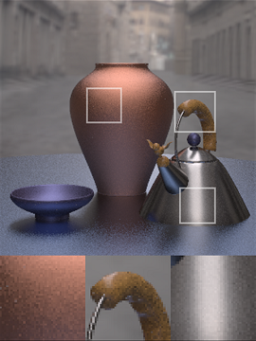
300 Samples/Pixel
Sampling Lafortune Fit
Our Method

Slide 48
Subsequent Work
Multiple Importance Sampling [Veach 95] of BRDF and Environment Map [Lawrence 05]
Fast Wavelet Products [Ng et al. 04]
Wavelet Importance Sampling of product of lighting and BRDF [Clarberg et al. 05]
Some efforts to also consider visibility
Inclusion in production (Renderman 16)

Slide 49
History and Outline
Is Monte Carlo Rendering solved?
Can it be made more efficient (90s):
  Irradiance caching takes advantage of coherence
  Correct sampling: Stratified, Multiple Importance, Bidirectional path tracing, Metropolis…
  Photon Mapping
Work with Image-Based Appearance (02-06)
  Importance sampling environment maps, BRDFs
Multidimensional effects [depth-of field, soft shadows, motion blur] (08-present)
  Adaptive multidimensional sampling
  Cut-based hierarchical integration
  Frequency space analysis, denoising

Slide 50
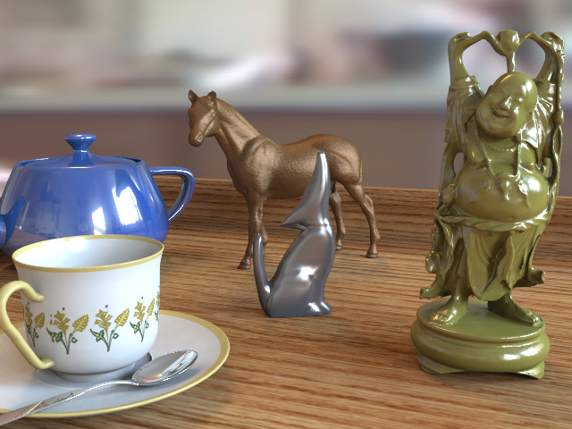
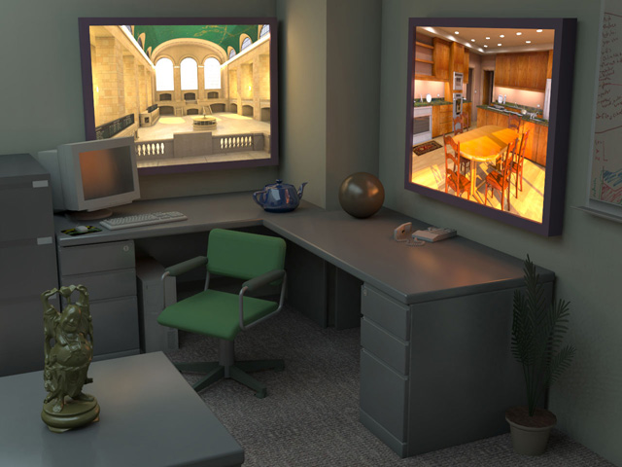
Lightcuts
Efficient, accurate complex illumination
Environment map lighting & indirect
Time 111s
Textured area lights & indirect
Time 98s
(640x480, Anti-aliased, Glossy materials)
From Walter et al. SIGGRAPH 05
Notes:
What is lightcuts? Lightcuts is a new scalable solution for efficiently computing complex illumination. Two examples are shown here. The image on the left is lit by an environment map with illumination captured from the real world, while the image on the right includes two simulated high dynamic range flat-panel displays. Both are challenging illumination problems. In addition both images include indirect illumination, glossy materials, and anti-aliasing. Yet our method was able to produce each image in under two minutes on a single machine.

Slide 51
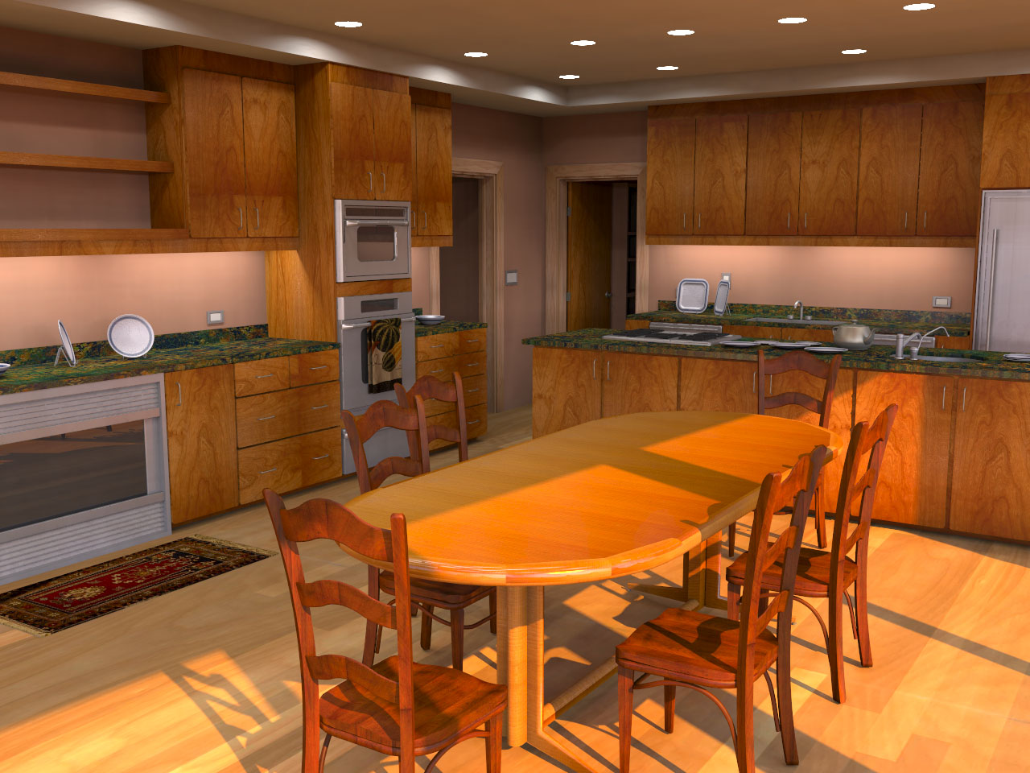
Complex Lighting
Simulate complex illumination using point lights
  Area lights
  HDR environment maps
  Sun & sky light
  Indirect illumination
Unifies illumination
  Enables tradeoffs
  between components
Area lights + Sun/sky + Indirect
Notes:
Once we have a scalable solution for many point lights, we can use this to compute other types of complex illumination. The four examples we demonstrate in the paper are area lights, high dynamic range environment maps, sun & sky light, and indirect illumination. Moreover this allows us to unify the handling of different illumination types and enables new types of tradeoffs. For example, bright illumination from one source allows coarser approximations of other sources.

Slide 52
Key Concepts
Light Cluster
Light Tree
  Binary tree of lights and clusters
Clusters
Individual
Lights
Notes:
Second is the light tree which is a binary tree of lights and clusters. The leaves of this tree are the individual lights while the interior nodes represent clusters which get progressively larger as we go up the tree.

Slide 53
Key Concepts
Light Cluster
Light Tree
A Cut
  A set of nodes that partitions the lights into clusters
Notes:
The third is a cut which is a set of nodes that partitions the lights into clusters. Here illustrated by the orange line.

Slide 54
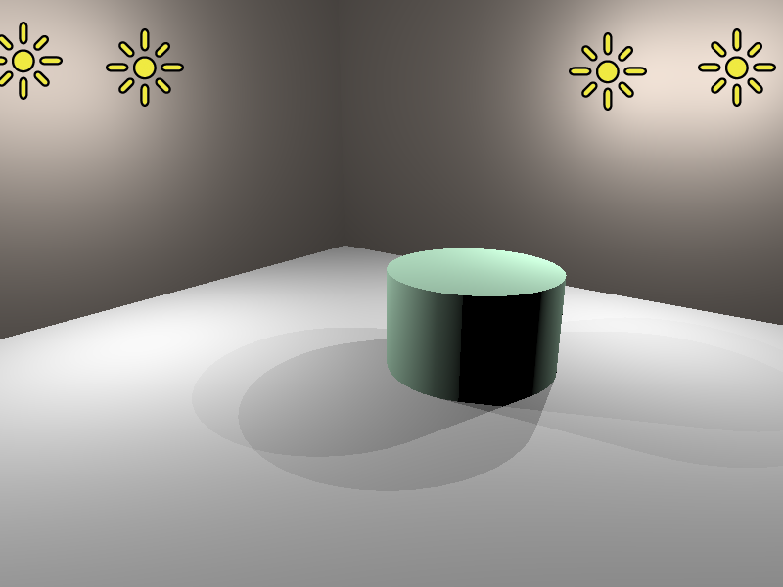
Simple Example
Light Tree
Representative
4
#1
#2
#3
#4
Light
Clusters
1
4
1
2
3
4
Individual
Lights
Notes:
Here is a simple scene with four lights and its corresponding light tree.

Slide 55
Three Example Cuts
Three Cuts
#1
#2
#4
#1
#3
#4
#1
#4
4
4
4
1
4
1
4
1
4
1
2
3
4
1
2
3
4
1
2
3
4
Notes:
And here we show three example cuts through the light tree. Highlighted above each cut are the regions where that cut produces an accurate approximation of the exact illumination.

Slide 56
Three Example Cuts
Three Cuts
#1
#2
#4
#1
#3
#4
#1
#4
4
4
4
1
4
1
4
1
4
1
2
3
4
1
2
3
4
1
2
3
4
Good
Bad
Bad
Notes:
If we look at this green point on the left of the images, the orange cut produces a good approximation while the blue and purple cuts would cause too much error.

Slide 57
Three Example Cuts
Three Cuts
#1
#2
#4
#1
#3
#4
#1
#4
4
4
4
1
4
1
4
1
4
1
2
3
4
1
2
3
4
1
2
3
4
Bad
Good
Bad
Notes:
Conversely for this point in the center of the images, the blue cut is a good approximation while the orange and purple cuts are not usable. This illustrates an important point. We will want to use different cuts in different parts of the image.

Slide 58
Three Example Cuts
Three Cuts
#1
#2
#4
#1
#3
#4
#1
#4
4
4
4
1
4
1
4
1
4
1
2
3
4
1
2
3
4
1
2
3
4
Good
Good
Good
Notes:
For this point on the right side of the images, all three cuts usable. In this case the purple cut is the best choice because it will be the cheapest to compute as it contains the fewest nodes.

Slide 59

Tableau, 630K polygons, 13 000 lights, (EnvMap+Indirect)
Avg. shadow rays per eye ray 17 (0.13%)
Notes:
Here is another results that show cases our ability to handle glossy objects. This scene is illuminated by a captured environment map and indirect illumination. And here is a short animation of this scene.

Slide 60
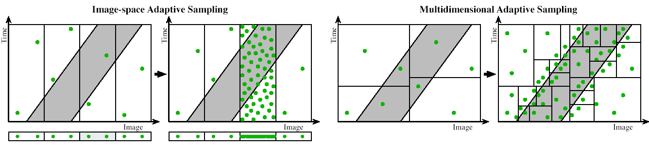
Multidimensional Adaptive Sampling
Scenes with motion blur, depth of field, soft shadows
Involves high-dimensional integral, converges slowly
Exploit high-dimensional info to sample adaptively
Multi-Dimensional Adaptive Sampling [Hachisuka 08]

Slide 61
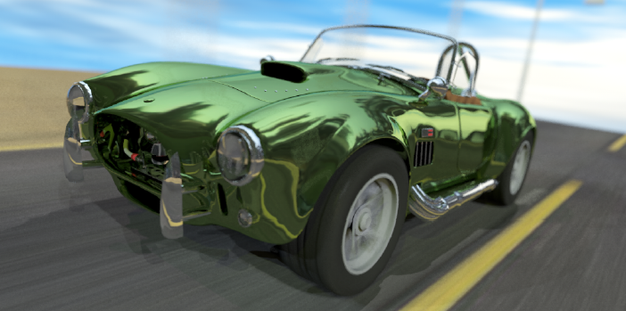
Multi-Dimensional Adaptive Sampling
Motion Blur and Depth of Field 32 samples per pixel

Slide 62
Recent Results
Frequency Analysis and Sheared Reconstruction for Rendering Motion Blur Egan et al. 09,11a,b
Fourier Depth of Field Subr et al. 09
These papers consider frequency analysis of particular phenomena – sparse sampling, reconstruction. Lots of follow on work
Video of recent submission real-time GI
Adaptive Wavelet Rendering Overbeck et al. 09 renders directly into wavelet domain for general high-D effects. Minimal overhead: simple and fast

Slide 63
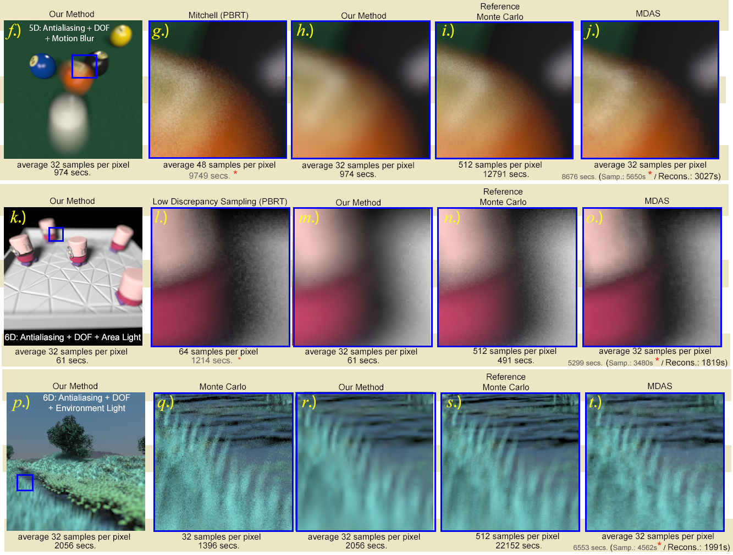
Adaptive Wavelet Rendering

