Slide 1
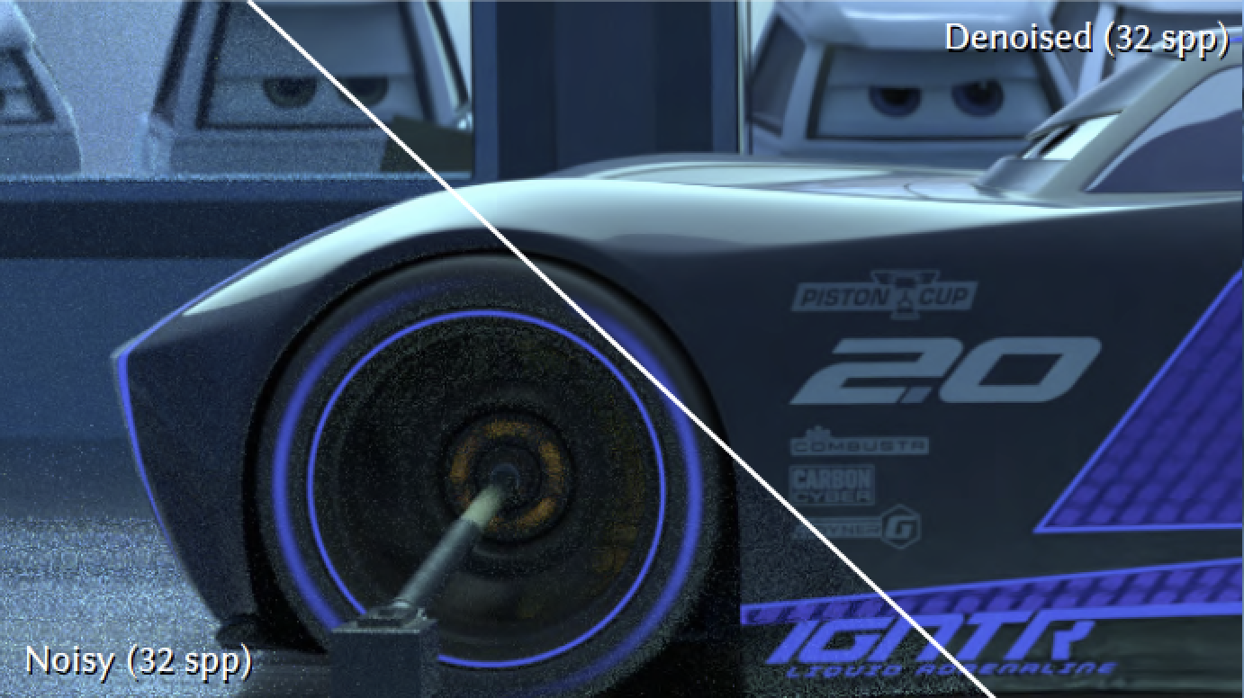
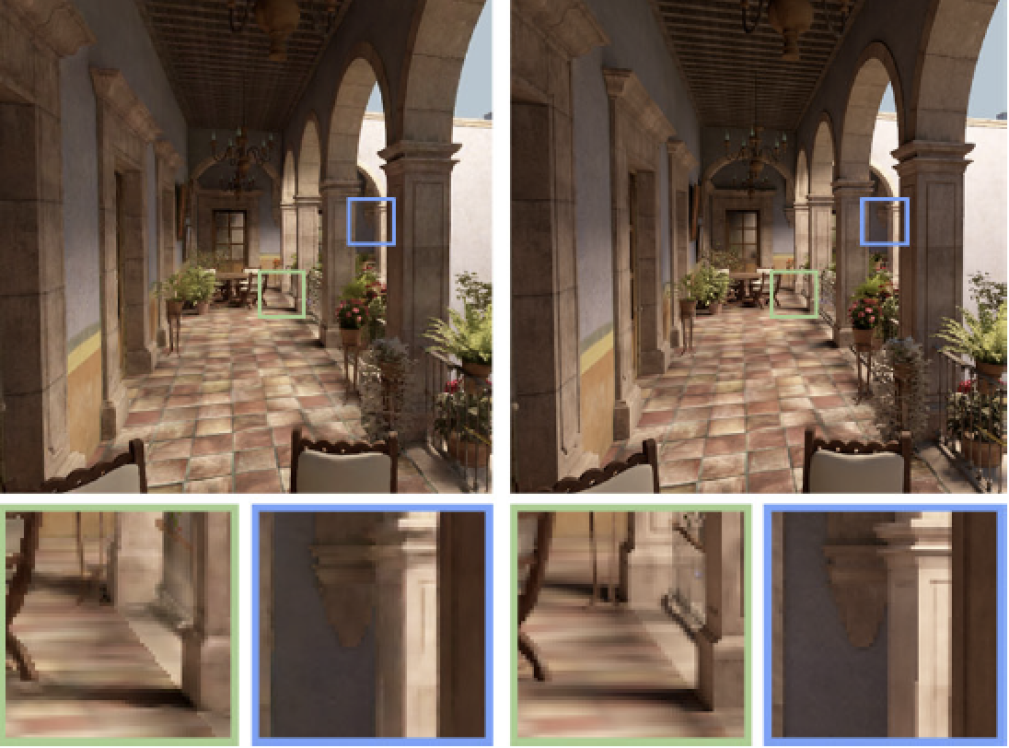
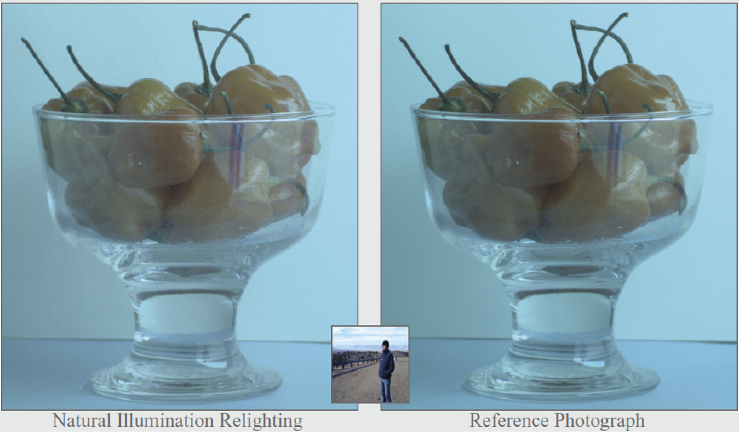
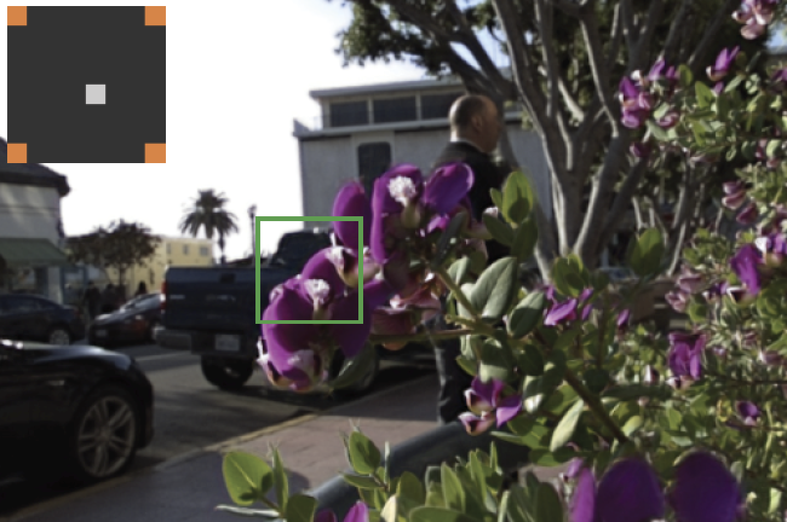
Sampling and Reconstruction of Visual Appearance: From Denoising to View Synthesis
CSE 274 [Fall 2022], Lecture 9
Ravi Ramamoorthi
http://www.cs.ucsd.edu/~ravir

Slide 2
Applications
Monte Carlo Rendering
Light Transport Acquisition / Many Light Rendering
Light Fields and Computational Photography
View Synthesis
Animation/Simulation (not covered in course)
Introduce concepts of sparsity, coherence, compressive sensing for reconstruction

Slide 3
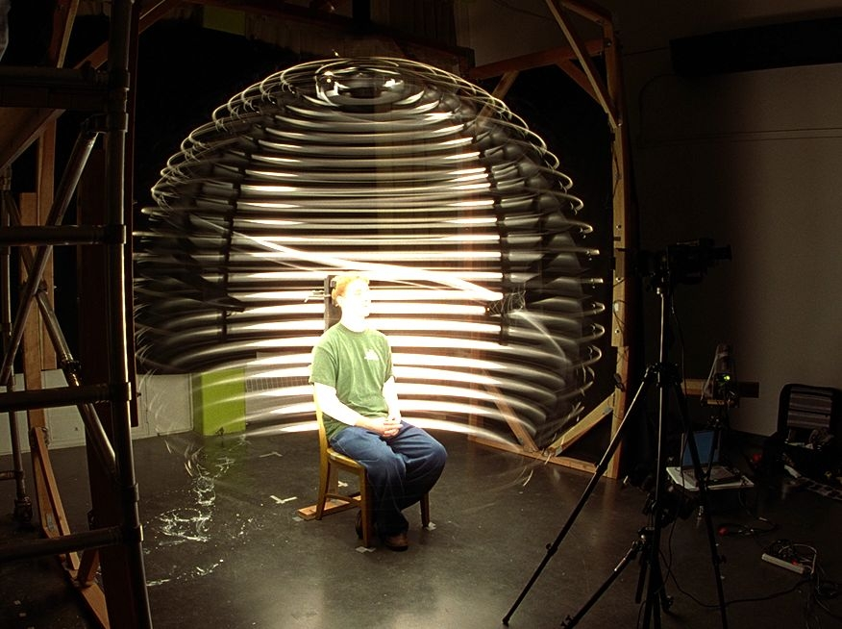
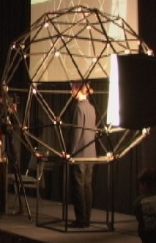
Acquiring Reflectance Field of Human Face [Debevec et al. SIGGRAPH 00]
Illuminate subject from many incident directions

Slide 4
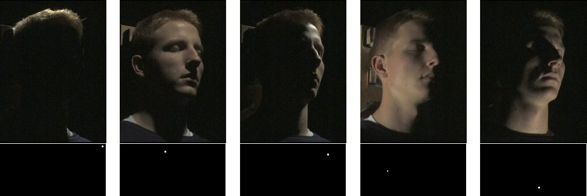
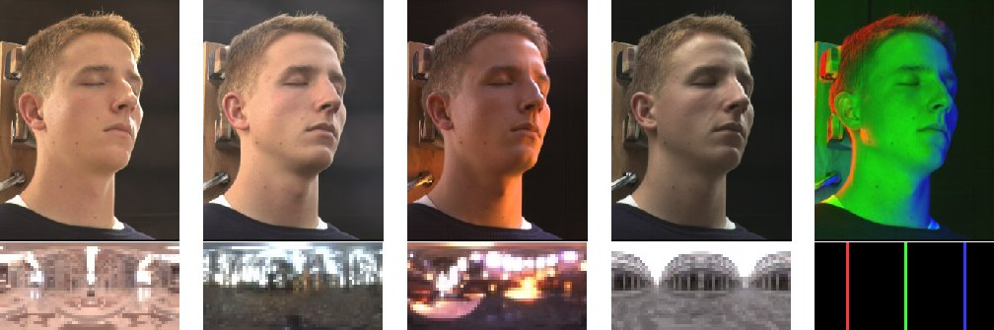
Example Images

Slide 5
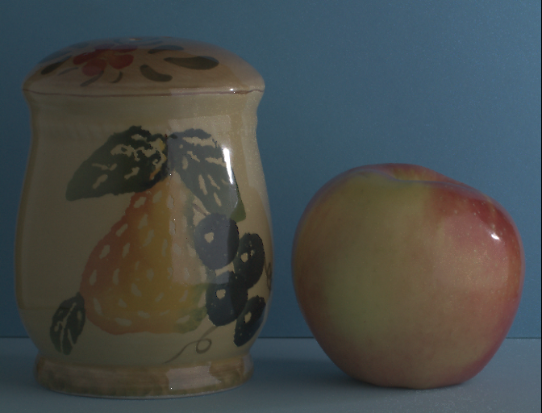
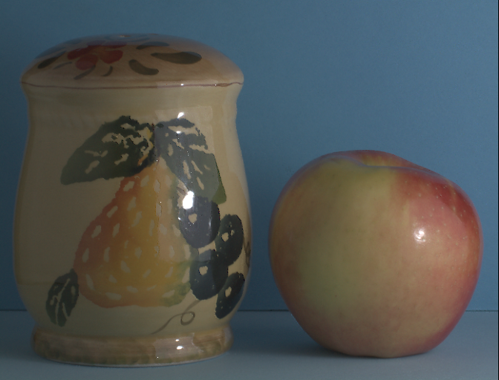
Motivation: Image-based Relighting
Sample Lighting Directions

Slide 6
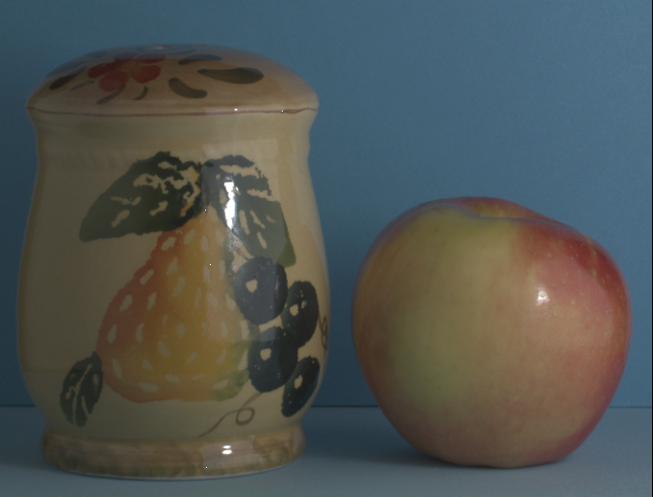
Motivation: Image-based Relighting
Sample Lighting Directions

Slide 7
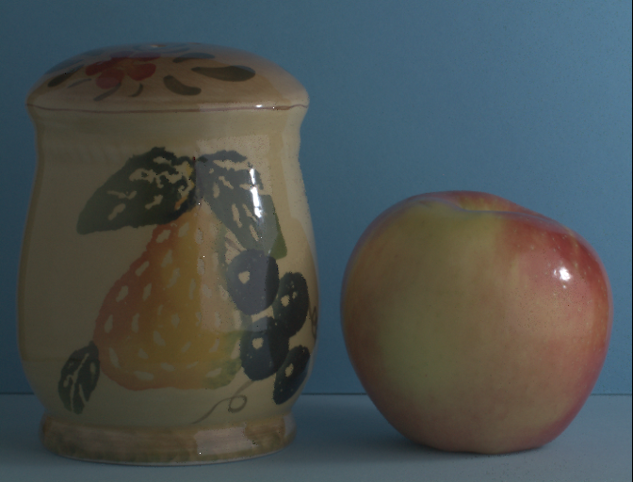
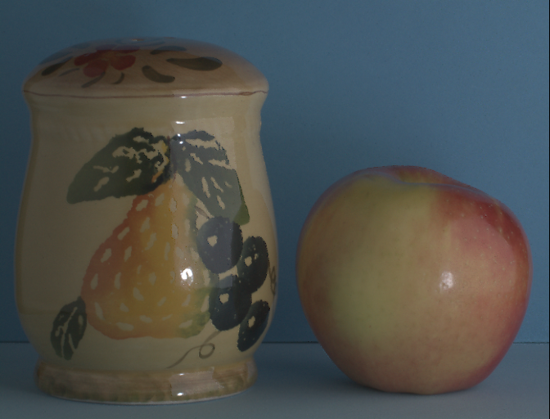
Motivation: Image-based Relighting
Sample Lighting Directions

Slide 8
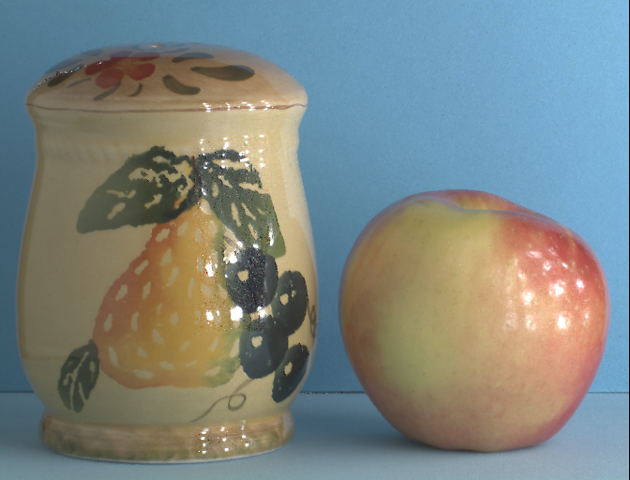
Motivation: Image-based Relighting
Relight
16 Samples
Sample Lighting Directions

Slide 9
Motivation: Image-based Relighting
Relight
16 Samples
Sample Lighting Directions

Slide 10

Motivation: Image-based Relighting
Relight
64 Samples
Sample Lighting Directions

Slide 11
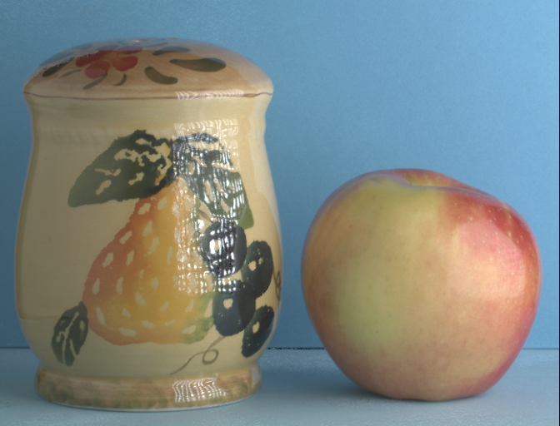
Motivation: Image-based Relighting
Relight
256 Samples
Sample Lighting Directions

Slide 12
Motivation: Image-based Relighting
Relight
256 Samples
Sample Lighting Directions

Slide 13
Motivation: Image-based Relighting
Relight
256 Samples
Sample Lighting Directions

Slide 14
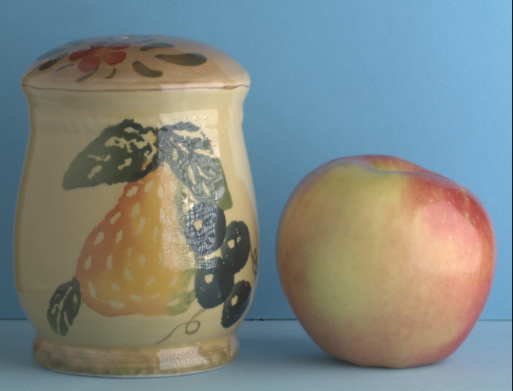
Motivation: Image-based Relighting
Relight
4096 Samples
Sample Lighting Directions

Slide 15

Motivation: Image-based Relighting
Relight
+10000 Samples
Sample Lighting Directions

Slide 16
Motivation: Image-based Relighting
Brute Force Capture Practically Impossible
Relight
+10000 Samples
Sample Lighting Directions

Slide 17
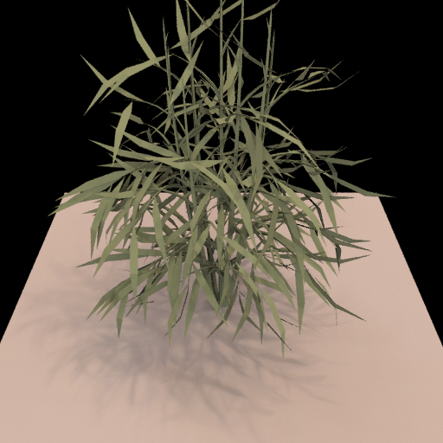
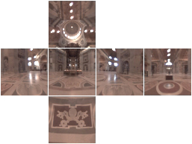
Relighting as a Matrix-Vector Multiply
Notes:
I’d first like to quickly review the concept of relighting as a matrix vector multiplication.

Slide 18
Relighting as a Matrix-Vector Multiply
Output Image (Pixel Vector)
Input Lighting (Cubemap Vector)
Precomputed Transport Matrix
Notes:
The input to the multiplication is the lighting environment, here shown as an unfolded cubemap. The input vector contains a linearization of the cubemap pixels. The output of the multiplication is an image of the scene lit by the input environment. The output vector contains relit image pixels. We call the matrix that transforms from input lighting to output image the light-transport matrix.
TODO: Add change of environment, and corresponding update of the plant image.

Slide 19
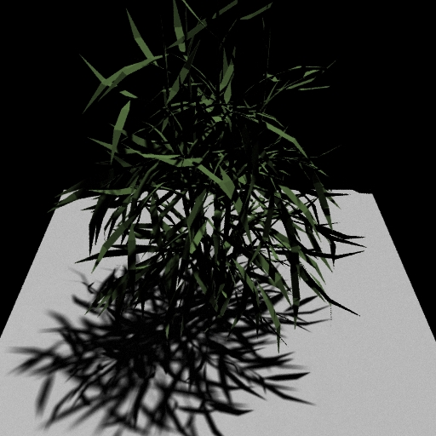

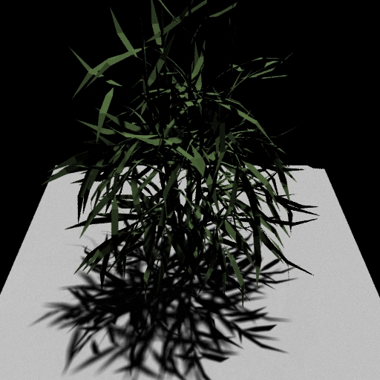
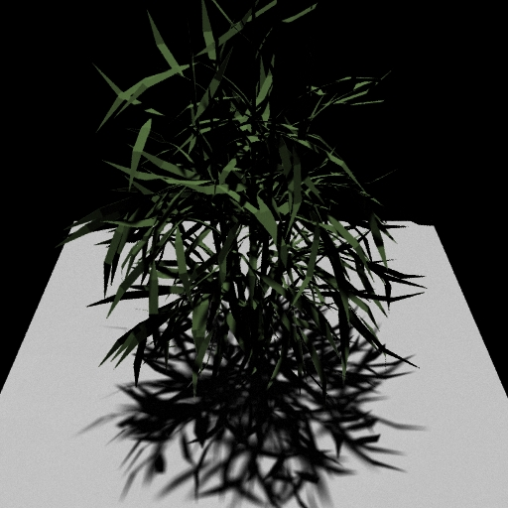
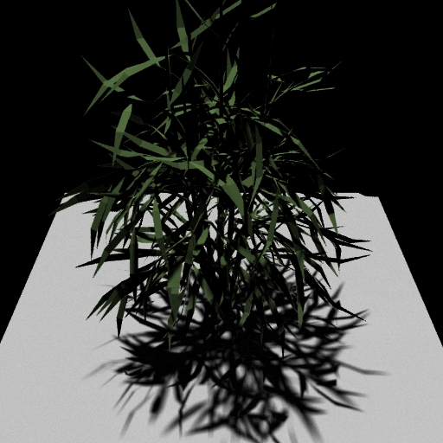
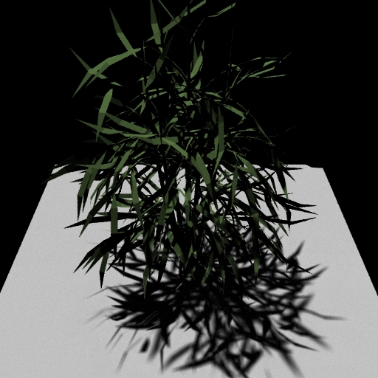
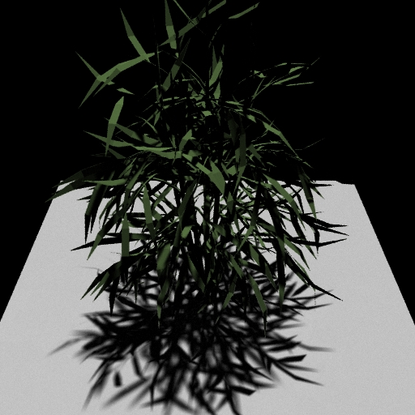
Matrix Columns (Images)
Notes:
The columns of the marix are just images of the scene lit by a single basis light.

Slide 20
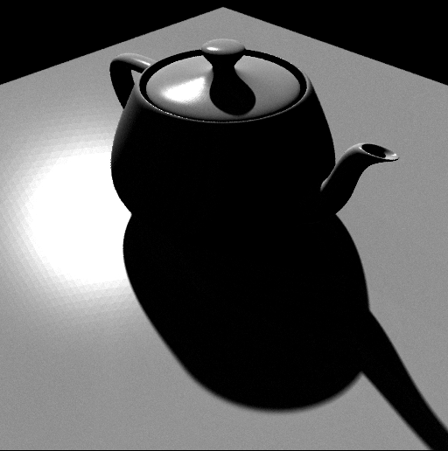
(Pre)compute: Ray-Trace Image Cols
Notes:
Computing the columns is simple and flexible. We can just ray-trace images of the scene under each light. This means that we can handle any light transport effect that we can ray-trace, like glossy reflections and global illumination.

Slide 21
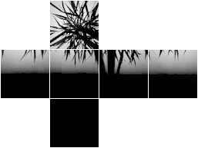
(Pre)compute 2: Rasterize Matrix Rows
Notes:
Alternatively, we can compute the matrix rows. The rows tell us how energy is transported from the environment to a single output pixel. For example, if we consider the row for a pixel on the floor of the plant scene, we would see the silhouette of the plant blocking part of the sky.
To compute a row, we use graphics hardware to render a visibility hemicube at that point, read back the pixels and weight it by the reflection function.

Slide 22
Outline
Matrix Row-Column Sampling (Many Lights)
(clustering for matrix completion of light transport)
Compressive Sensing for Light Transport
Matrix Completion
Hasan, Pellacini, Bala SIGGRAPH 07

Slide 23
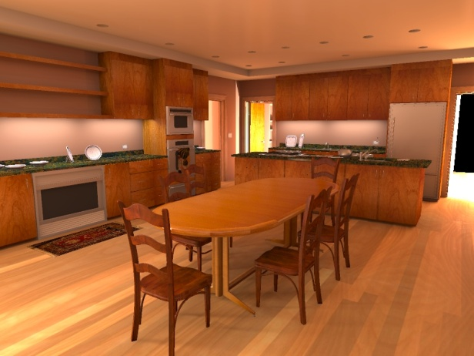
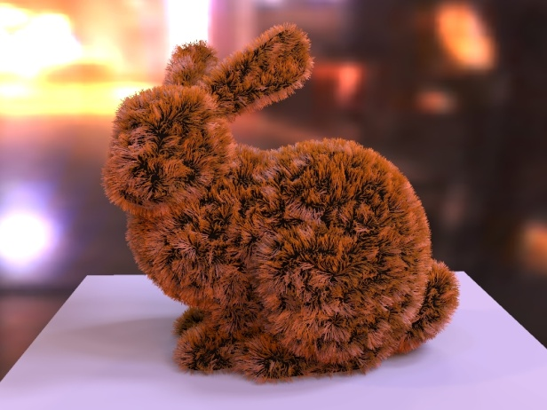
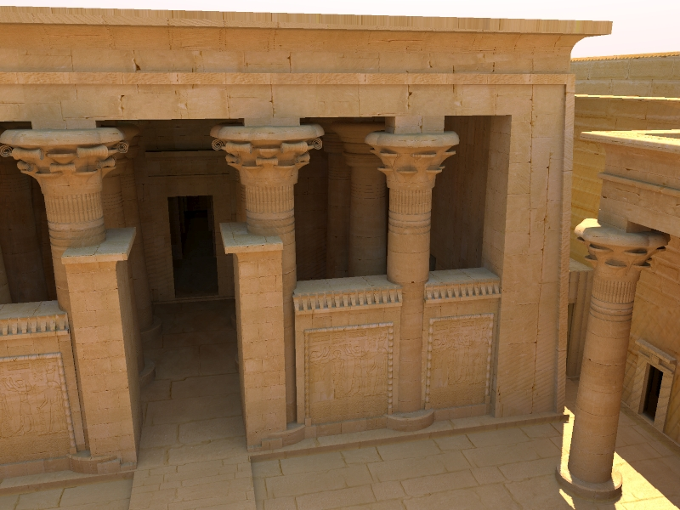
Complex Illumination: A Challenge
Notes:
A long-standing problem in rendering is to efficiently and accurately render complex scenes with indirect illumination,
Environment lighting
Or a combination of these.

Slide 24
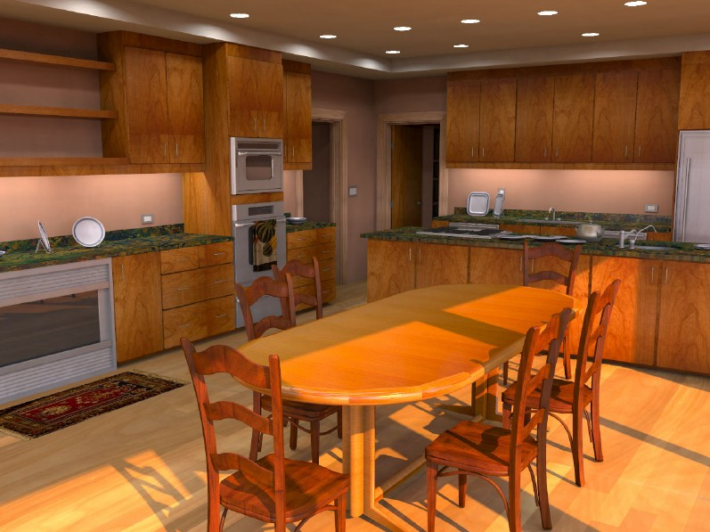
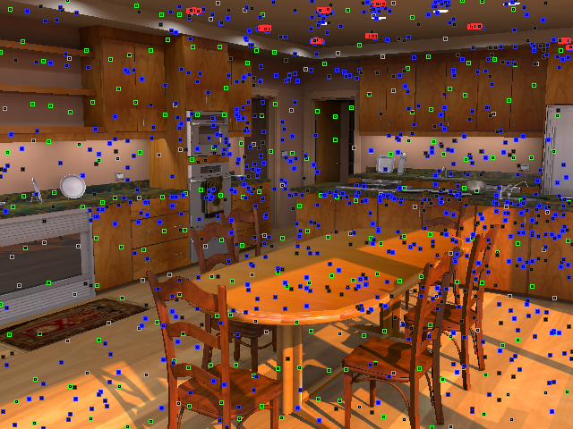
Conversion to Many Lights
Area, indirect, sun/sky
Courtesy Walter et al., Lightcuts, SIGGRAPH 05/06
Notes:
One particular approach is to convert the illumination into a large number of point lights.
The conversion process is described in previous research.
Here you can see the created lights as colored dots.

Slide 25

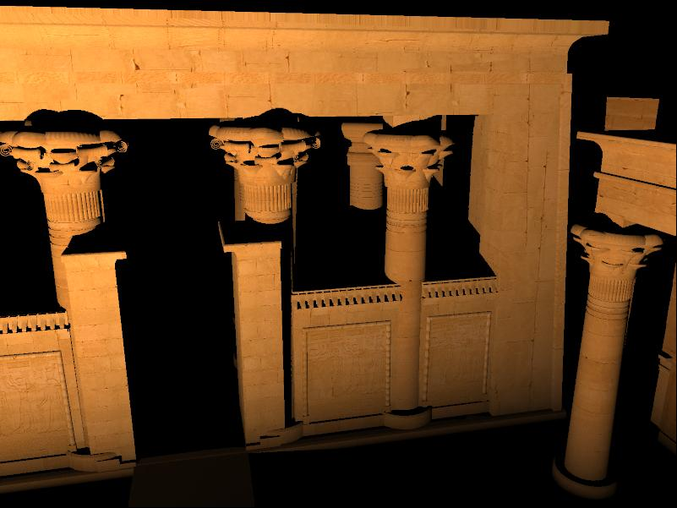
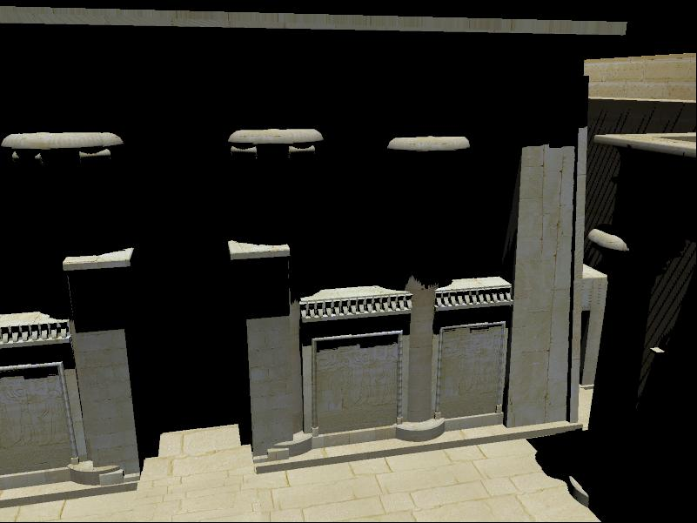
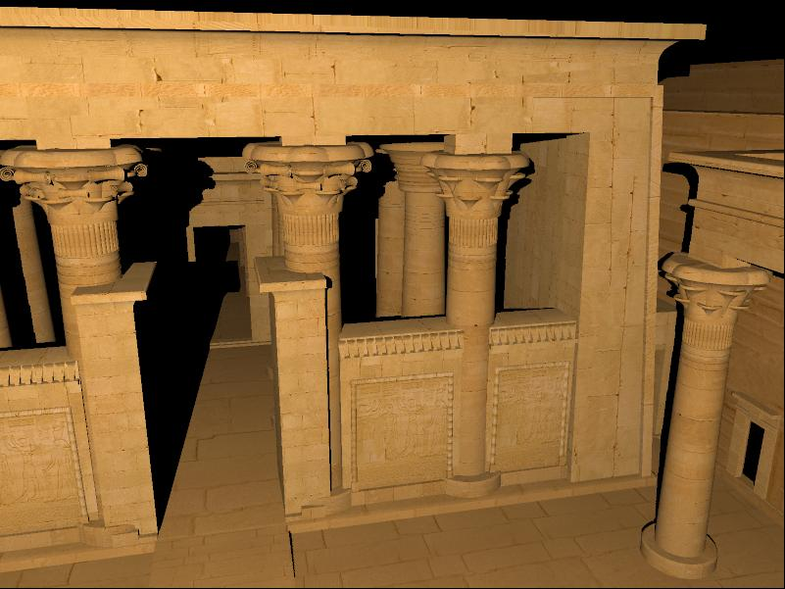
A Matrix Interpretation
Lights (100,000)
Pixels
(2,000,000)
Notes:
We can interpret the many light problem as a matrix of light-pixel interactions.
This means that each element of the matrix is the contribution of a single light to a single pixel.
So, the columns of the matrix are really images rendered with a single point light.
The rows represent contributions of all the lights to a particular pixel.

Slide 26
Problem Statement
Compute sum of columns
Note: We don’t have the matrix data
Lights
= Σ (
)
Pixels
Notes:
In this setting, the ideal image we would like to render is equal to the sum of the columns of the matrix.
Or, to put it differently, the color of each pixel is equal to the sum of the matrix row corresponding to that pixel.
It is important to note thart we don’t have the matrix data, we just have a shader that can evaluate the elements on demand.

Slide 27

Image as a Weighted Column Sum
The following is possible:
compute very small subset of columns
compute weighted sum
Use rows to choose a good set of columns!
Notes:
It’s usually possible to find a very small subset of the columns such that some linear combination of them is a very good approximation to the ideal result.
If we only knew which subset it is, and what are the weights!
But, given that we know nothing about the matrix up front, it seems impossible to guess this subset.
However, there is a solution: compute a subset of rows, and use them to choose a good set of columns and weights.

Slide 28
Exploration and Exploitation
?
compute rows (explore)
how to choose columns and weights?
choose columns and weights
compute columns (exploit)
weighted sum
Notes:
This leads us to the idea of designing our algorithm as a combination of exploration and exploitation.
As a first step, we explore the structure of the matrix by computing a small, randomly chosen subset of rows.
Next, we analyze the gathered information, and decide which columns to choose and their appropriate weights.
The exploitation step then computes the selected columns, which are finally accumulated into an image.
So, this is the whole algorithm, except for the black box that analyzes the rows and chooses the columns.

Slide 29



Reduced Matrix
Reduced columns
Notes:
First, let’s take the rows that we computed in the exploration stage,
And assemble them into this long, but not very tall reduced matrix.
Now let’s flip attention to the columns of this matrix, which we’ll call reduced columns.
These can in fact be thought of as tiny images that are sub-sampled versions of the full columns.

Slide 30
Clustering Approach
Choose representative columns
Reduced columns
Choose k clusters
Notes:
We decide to use the following approach to choosing columns.
We cluster similar reduced columns, and we pick a representative in each cluster.
The accuracy of the algorithm is highly dependent on the quality of the clustering, so we should design the clustering algorithm carefully.

Slide 31
Reduced to Full
Representative columns
Use the same representatives for the full matrix
Weighted sum
Notes:
So we have chosen a set of columns and weights for the reduced matrix.
Now we can use the same set and weights on the full matrix, because there’s a pretty good chance that they will work well there too.
That’s all there is to picking columns, except for one crucial piece: we need to know how to cluster.
And I’m going to address this in the next few slides.

Slide 32

Full Algorithm
Assemble rows into reduced matrix
Cluster reduced columns
Compute rows (GPU)
Choose representatives
Weighted sum
Compute columns (GPU)
Notes:
So here’s the full algorithm:
In the exploration stage, we evaluate some rows on the GPU, then focus on the reduced columns.
We obtain a clustering through the techniques I just described, then pick representatives.
Finally, we accumulate the columns into an image.

Slide 33
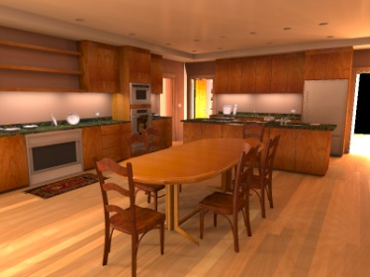

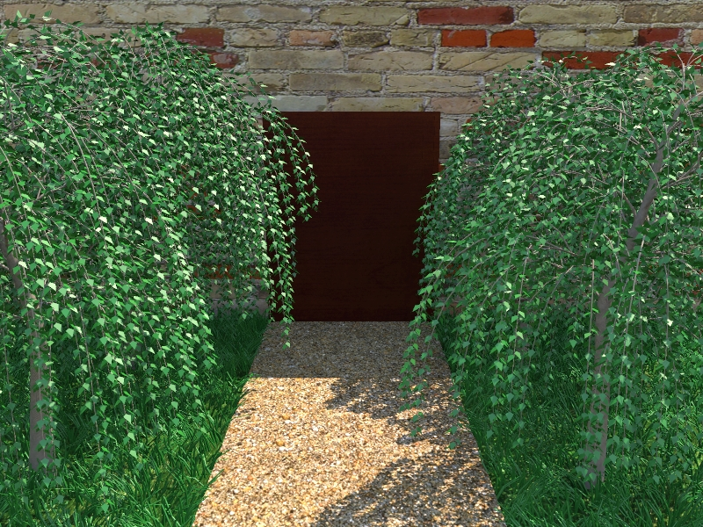
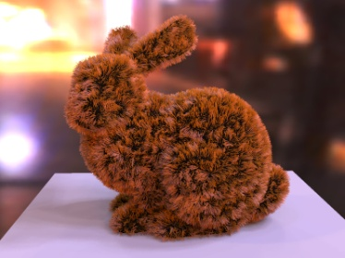
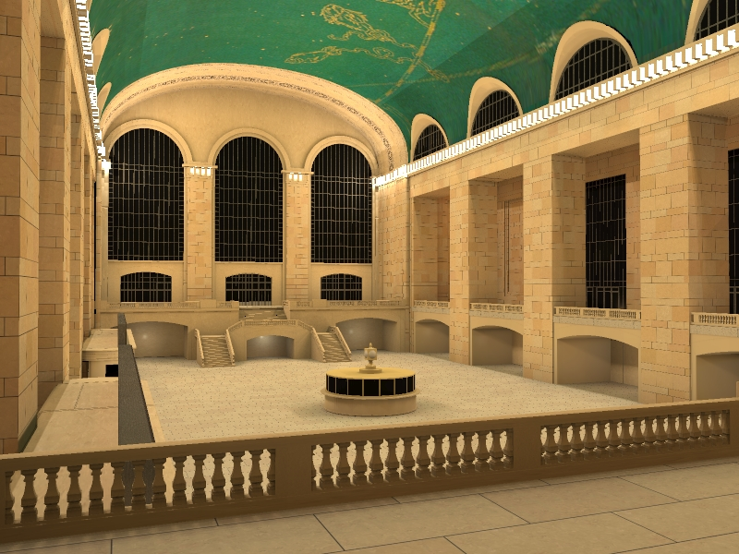
Results
We show 5 scenes:
Show reference and 5x difference image
All scenes have 100,000+ lights
Timings
NVidia GeForce 8800 GTX
Light / surface sample creation not included
Kitchen
Temple
Trees
Bunny
Grand Central
Notes:
In the next few slides, we will show result images for these 5 scenes.
All of them have roughly 100k lights, which consist of direct, environment (or sky), indirect lights.
We use a consumer level G80 to measure the timings.
The timings don’t include light and sample creation, but that should not take more than 1 or 2 seconds.

Slide 34
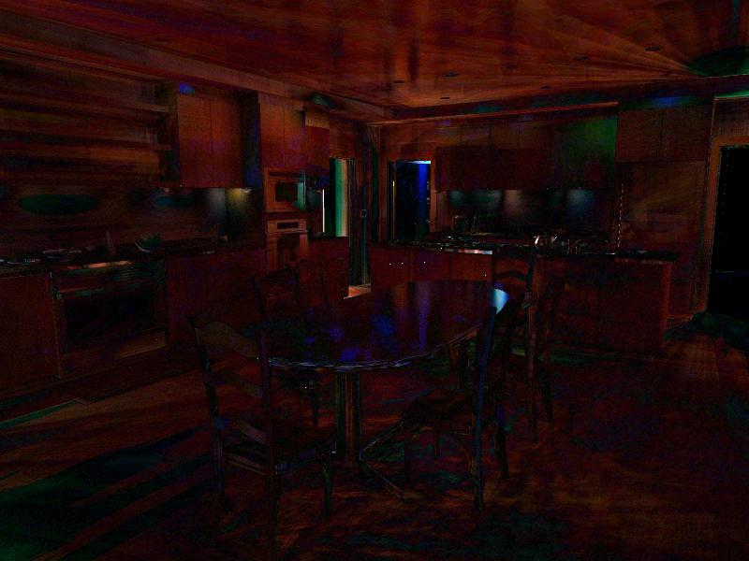

Results: Kitchen
388k polygons
Mostly indirect illumination
Glossy surfaces
Indirect shadows
5x diff
Our result: 13.5 sec (432 rows + 864 columns)
Reference: 13 min (using all 100k lights)
Notes:
Most of the illumination in this kitchen scene is indirect.
There are a few direct light sources positioned behind the corners and not directly visible to the camera.
Most of the materials have a glossy component.
Indirect shadows are handled accurately.

Slide 35
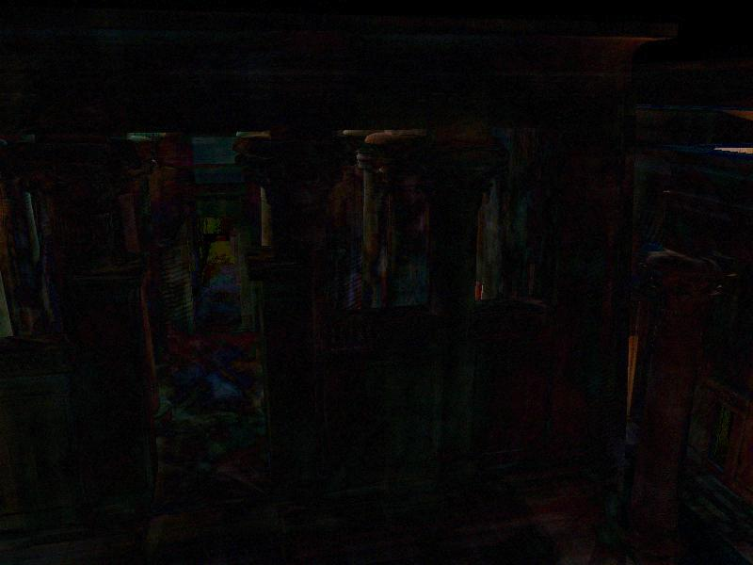

Results: Temple
2.1m polygons
Mostly indirect & sky illumination
Indirect shadows
5x diff
Our result: 16.9 sec (300 rows + 900 columns)
Reference: 20 min (using all 100k lights)
Notes:
The temple is our largest scene, not only in terms of the number of polygons, but also its spatial extent. In fact, only a tiny portion of the scene is in view.
Most of the illumination in the scene is indirect or sky illumination.
Also note the detailed indirect shadows on the fine geometry of the pylons.

Slide 36
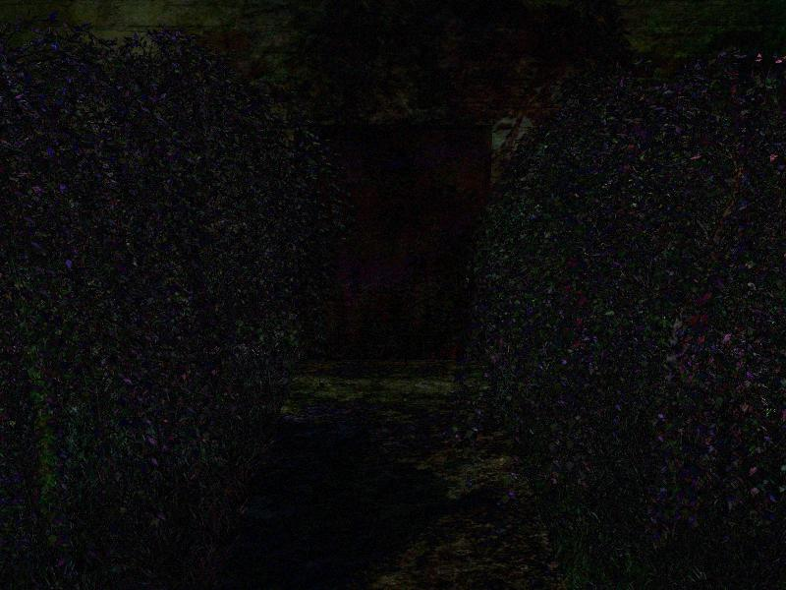
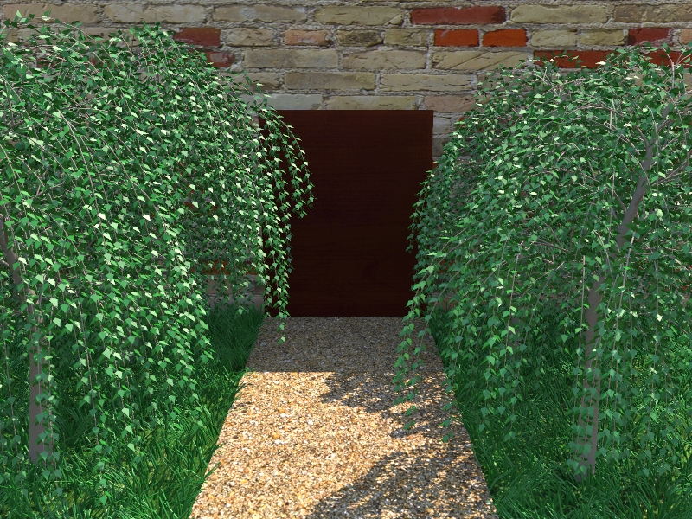
Results: Trees
328k polygons
Complex incoherent geometry
5x diff
Our result: 2.9 sec (100 rows + 200 columns)
Reference: 14 min (using all 100k lights)
Notes:
This tree scene shows complex incoherent geometry.
Approaches based on interpolating illumination across coherent surfaces would have a difficult time rendering this image.
However, our algorithm makes no assumptions about image-space coherence.

Slide 37
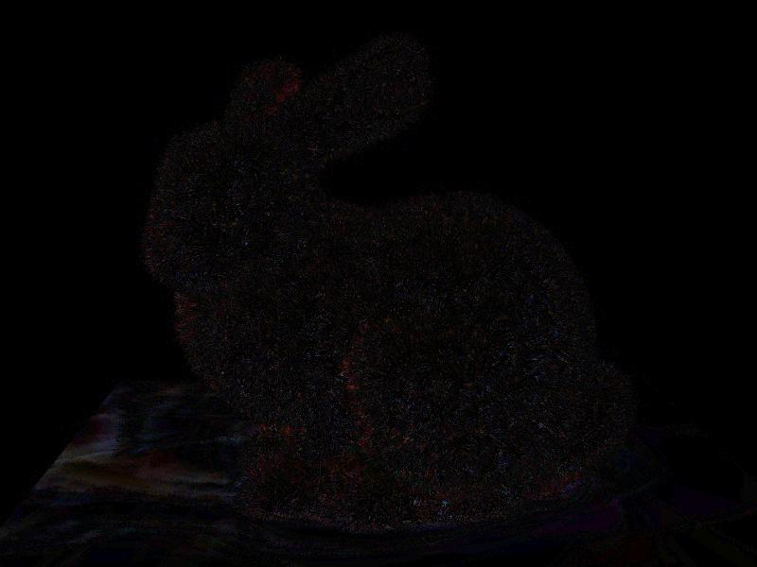
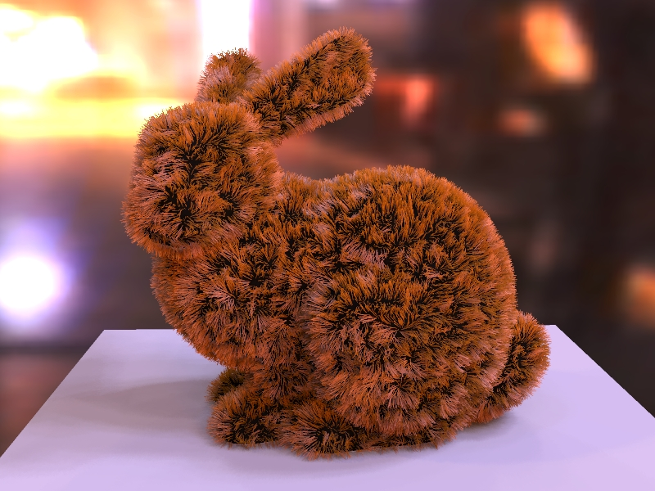
Results: Bunny
869k polygons
Incoherent geometry
High-frequency lighting
Kajiya-Kay hair shader
5x diff
Our result: 3.8 sec (100 rows + 200 columns)
Reference: 10 min (using all 100k lights)
Notes:
The bunny image shows that our algorithm can handle complexity and incoherence both in geometry and in lighting.
Also note that the Kajiya Kay hair shader, showing that arbitrary shaders can be incorporated into our framework.

Slide 38
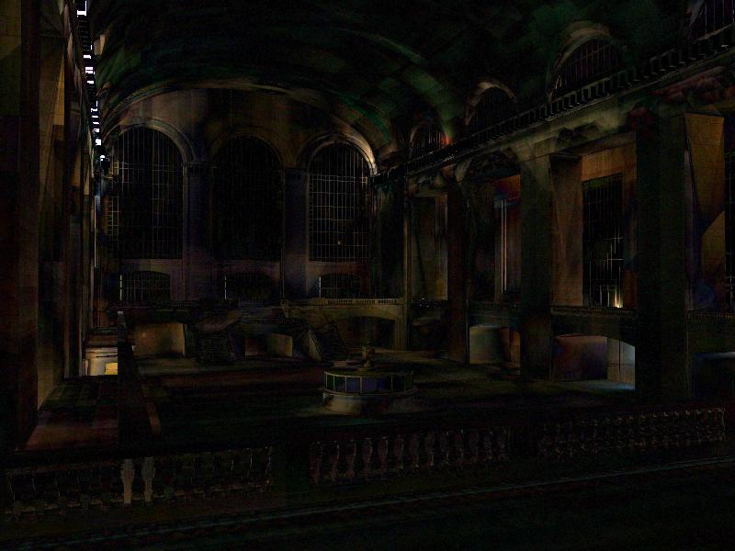

Results: Grand Central
1.5m polygons
Point lights between stone blocks
5x diff
Our result: 24.2 sec (588 rows + 1176 columns)
Reference: 44 min (using all 100k lights)
Notes:
A unique feature of this scene are the omni-directional lights positioned in small recesses between stone blocks.
These lights pose a problem to our algorithm since they violate the low-rank assumption. This is because the columns corresponding to these lights are pretty much linearly independent.
Even though a larger number of rows and columns, is required here, we still provide a high quality approximation.

Slide 39
Outline
Matrix Row-Column Sampling (Many Lights)
(clustering for matrix completion of light transport)
Compressive Sensing for Light Transport
Matrix Completion
Gu et al. ECCV 08
Peers et al. SIGGRAPH 09
Sen and Darabi EG 09 (reading)

Slide 40
Motivation: Image-based Relighting
Brute Force Capture Practically Impossible
Relight
+10000 Samples
Sample Lighting Directions

Slide 41
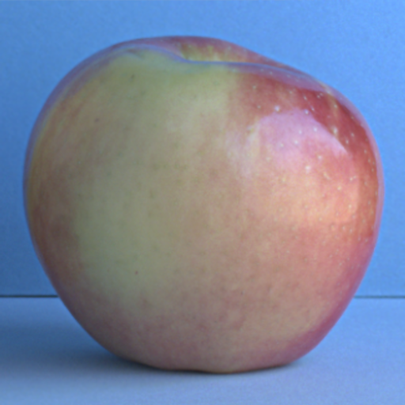
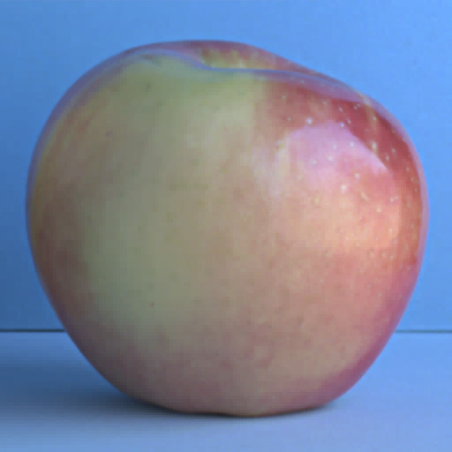
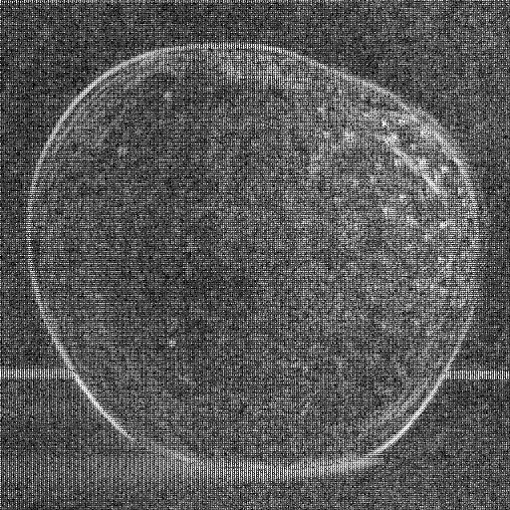
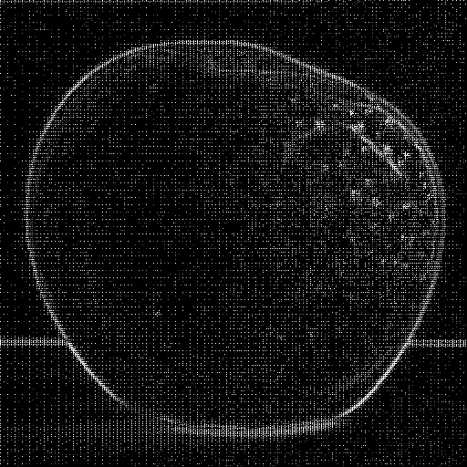
Compressible / Sparseness
ψ
ψ
All Coefficients
5% Largest Coeff.

Slide 42

Measurements
Canonical Domain
ψ
Wavelet Domain
Measured Quanta

Slide 43
Measurements
Canonical Domain
ψ
Wavelet Domain
Measured Quanta

Slide 44
Measurements
Canonical Domain
ψ
Wavelet Domain
Measured Quanta

Slide 45
Compressible / Sparseness
Canonical Domain
ψ
Wavelet Domain
Measured Quanta

Slide 46
Compressible / Sparseness
Canonical Domain
Exhaustive Measurements?
ψ
Wavelet Domain
Measured Quanta

Slide 47
Compressive Sensing: A Brief Introduction
[Candes et al., 06][Donoho, 06]…
Sparsity / Compressibility:
Signals can be represented as a few non-zero coefficients in an appropriately-chosen basis, e.g., wavelet, gradient, PCA.
For sparse signals, acquire measurements (condensed representations of the signals) with random projections.
A
=
b
X
Measurement Ensemble
m×n, where m<n
Signal
n×1
Measurements
m×1

Slide 48

Compressive Sensing
x

Slide 49

Compressive Sensing
x

Slide 50
Compressive Sensing
x
.
.
.
.
.
.

Slide 51

Compressive Sensing
x
.
.
.

Slide 52
Compressive Sensing
x
.
.
.
Sparse Signal: x
Measurement Ensemble: Φ

Slide 53
Compressive Sensing
x
.
.
.
=
Sparse Signal: x
Measured Quanta: y
Measurement Ensemble: Φ

Slide 54
Compressive Sensing
M
N
M
x
.
.
.
=
Sparse Signal: x
Measured Quanta: y
Measurement Ensemble: Φ

Slide 55
Compressive Sensing
M
N
M
x
.
.
.
=
Sparse Signal: x
Measured Quanta: y
Measurement Ensemble: Φ
M ~ K logN

Slide 56
Compressive Sensing
x
.
.
.
=
Sparse Signal: x
Measured Quanta: y
Approximation: x
Measurement Ensemble: Φ
Reconstruction
x = argmin_{x} ||x||₁ s.t. Φx = y

Slide 57
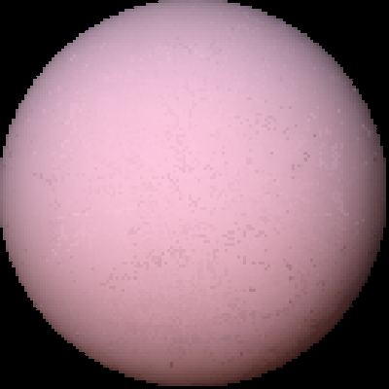
Brute Force: Result
Diffuse Sphere
128 x 128
1000 Normal Distributed Noise Light Conditions
100 Haar Wavelet Coefficients
Scene:
Lighting Resolution:
Measurements:
Reconstruction:

Slide 58
Brute Force: Result
Diffuse Sphere
128 x 128
1000 Normal Distributed Noise Light Conditions
100 Haar Wavelet Coefficients
Scene:
Lighting Resolution:
Measurements:
Reconstruction:

Slide 59
Brute Force: Result
Each pixel computed separately
Spatial Coherence not exploited
Diffuse Sphere
128 x 128
1000 Normal Distributed Noise Light Conditions
100 Haar Wavelet Coefficients
Scene:
Lighting Resolution:
Measurements:
Reconstruction:

Slide 60



Multi-resolution Approach

Slide 61
Multi-resolution Approach

Slide 62




Multi-resolution Approach
Brute Force Compressive Decoding
Compressive Decoding
Compressive Decoding
Compressive Decoding
Init
Init
Init
Reflectance Func.

Slide 63

Results
Brute Force Algorithm
Hierarchical Algorithm

Slide 64






Resolution
1000 Measurements
128 x 128 Lighting Resolution 128 Haar Wavelet Coefficients

Slide 65
Resolution
1000 Measurements
128 x 128 Lighting Resolution 128 Haar Wavelet Coefficients

Slide 66



Results
Reference
1000 Measurement
128 x 128 Lighting Resolution
128 Haar Wavelet Coefficients

Slide 67
Results
Reference
1000 Measurement
128 x 128 Lighting Resolution
128 Haar Wavelet Coefficients

Slide 68


Results
0.30
Reference
1000 Measurement
128 x 128 Lighting Resolution
128 Haar Wavelet Coefficients
0.25
0.17
0.13
0.09
0.06
0.04

Slide 69


Inhomogeneous Participating Media
Volume densities rather than boundary surfaces.
Efficiency in acquisition is critical, especially for time-varying participating media.
Drifting Smoke of Incense
(532fps Camera)
Mixing a Pink Drink with Water
(1000fps Camera)
Video clips are from http://www.lucidmovement.com

Slide 70

Compressive Structured Light
Projector: DLP, 1024x768, 360 fps
Camera: Dragonfly Express 8bit, 320x140 at 360 fps
24 measurements per time instance, and thus recover dynamic volumes up to 360/24 = 15 fps.
Projector
Camera
Milk Drops
Gu, Nayar, Grinspun, Belhumeur, Ramamoorthi 08, 13

Slide 71



Milk Dissolving: One Instance of time
Milk drops dissolving in a water tank.
Photograph
Measurements (24 images of size 128x250)
Reconstructed Volume (128x128x250)

Slide 72

Milk Dissolving: Time-varying Volume
Milk drops dissolving in a water tank.
Video (15fps)
Reconstructed Volume
(128x128x250)

Slide 73
Outline
Matrix Row-Column Sampling (Many Lights)
(clustering for matrix completion of light transport)
Compressive Sensing for Light Transport
Matrix Completion
Extension to compressive sensing: Low rank matrices
Minimize matrix norm (rank), given some entries
Combine many ideas seen previously
Huo et al. SIGGRAPH Asia 16

Slide 74

Outline
Matrix Completion
Extension to compressive sensing: Low rank matrices
Minimize matrix norm (rank), given some entries
Combine many ideas seen previously
Huo et al. SIGGRAPH Asia 16

Slide 75


Results (Participating Media)

Slide 76
Summary
Light Transport for Acquisition, Many Light Rendering
Compressive Sensing for projected patterns
Matrix Completion for many light rendering
Leverages popular ideas in applied math
Consider all forms of coherence
Think about modern extensions with deep learning

