Slide 1
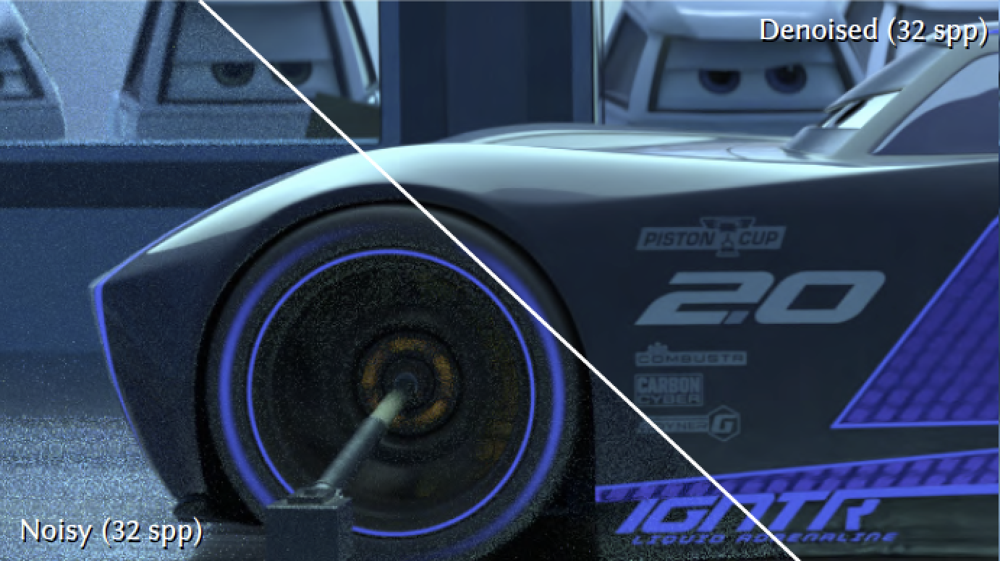
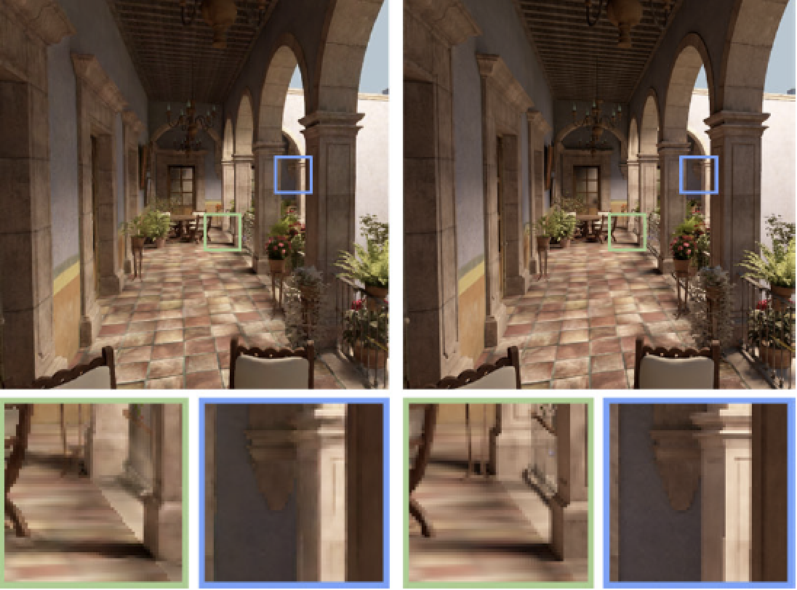
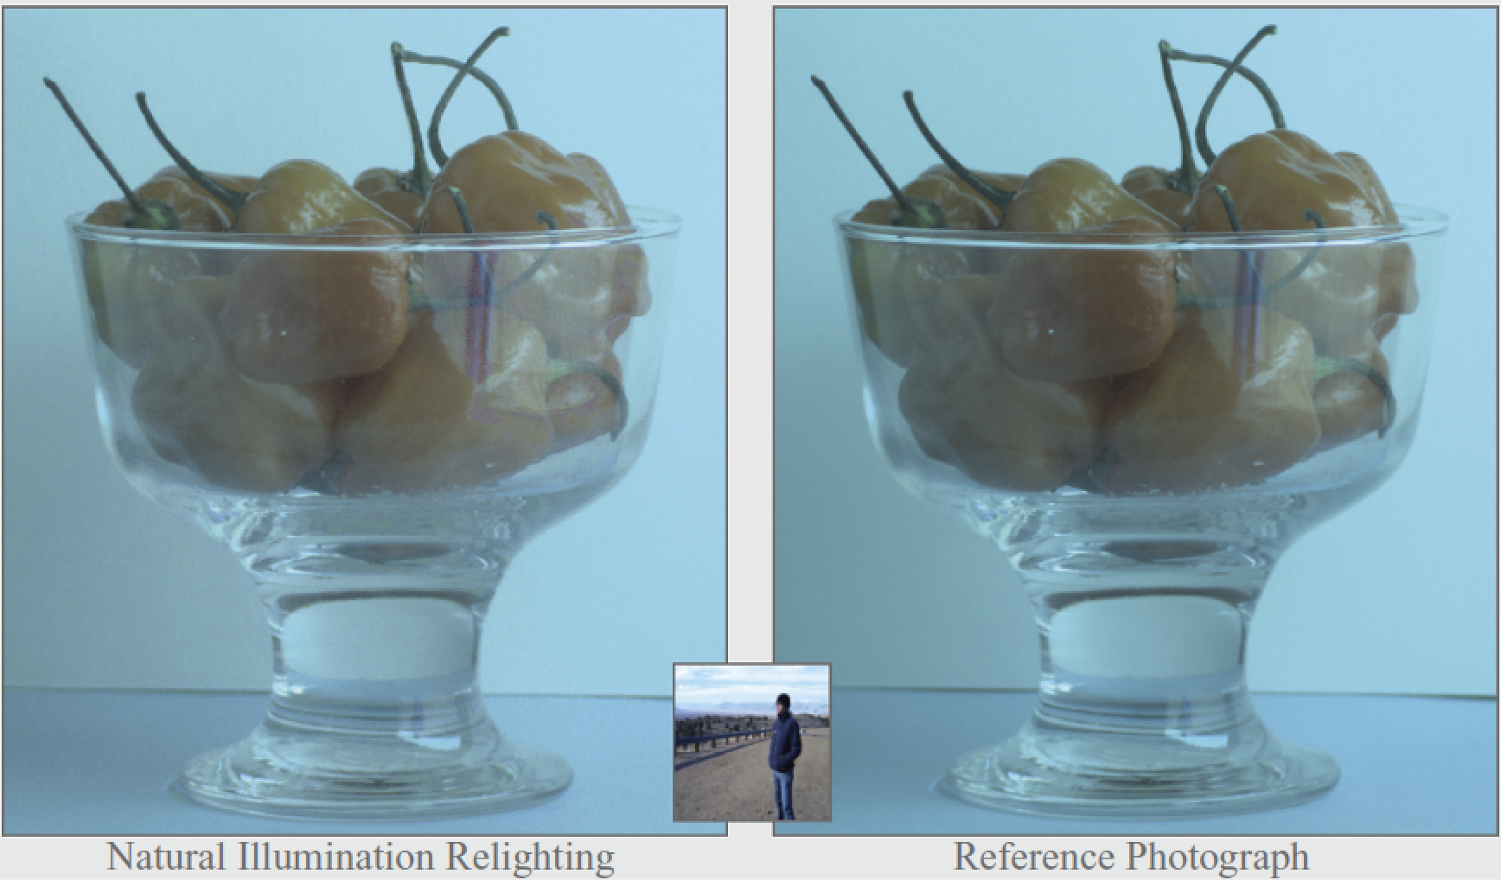
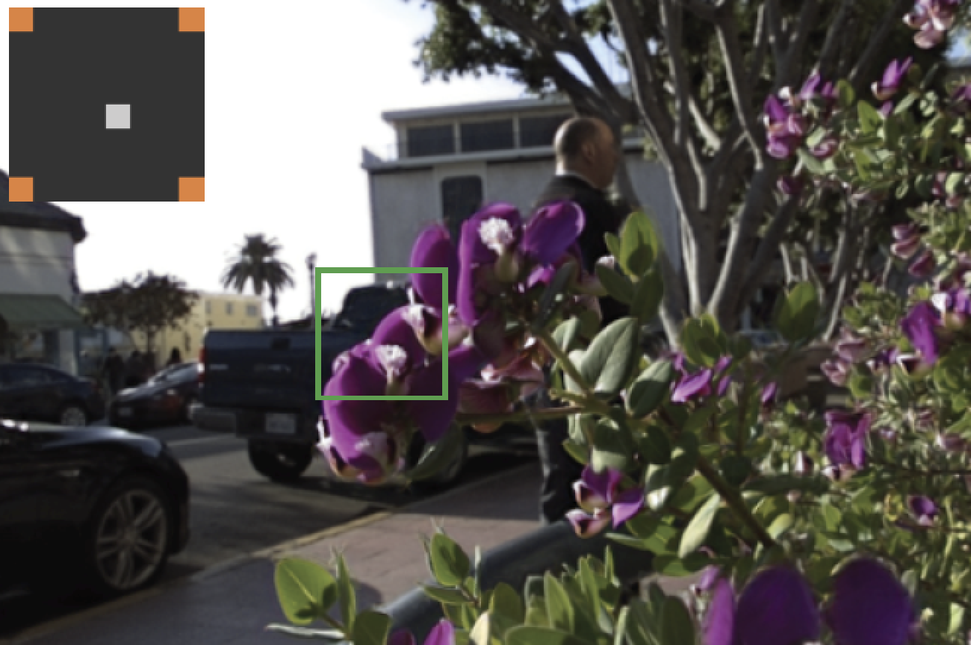
Sampling and Reconstruction of Visual Appearance: From Denoising to View Synthesis
CSE 274 [Fall 2021], Lecture 8
Ravi Ramamoorthi
http://www.cs.ucsd.edu/~ravir

Slide 2
Real-Time Rendering
Previous reconstruction methods high overhead
What about real-time for games, interactive?
Ray/Path-Tracing interactive at low sample counts (e.g., NVIDIA Optix), used in games
Need real-time reconstruction (simpler filters)
Area my group started 9 years ago (papers today)
Axis-Aligned Filtering (Mehta et al. 12, 13, 14)
Faster than sheared filters, can run in real-time
Fast Sheared Filtering (Yan et al. 15)
Multiple Axis Aligned Filtering (Wu et al. 17)

Slide 3
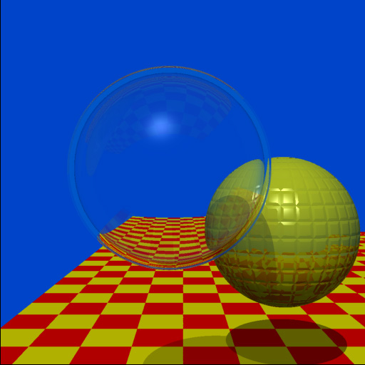
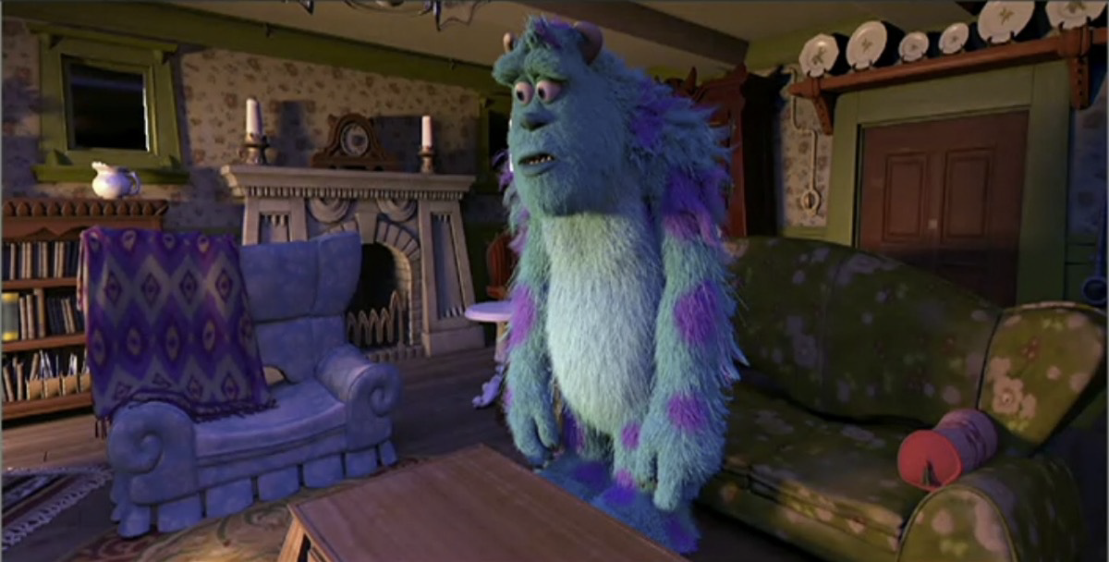
Impact: Real-Time
Extend AAF, FSF, MAAF: Predict Filter based on Deep Learning (sample and AI-based denoising)
NVIDIA software (OptiX 2017), hardware (RTX 2018)
40-year journey: ray tracing curiosity to every pixel
Whitted 79 (74 min 512x512)
NVIDIA RTX 2018, OptiX: Pixar real-time previewer

Slide 4
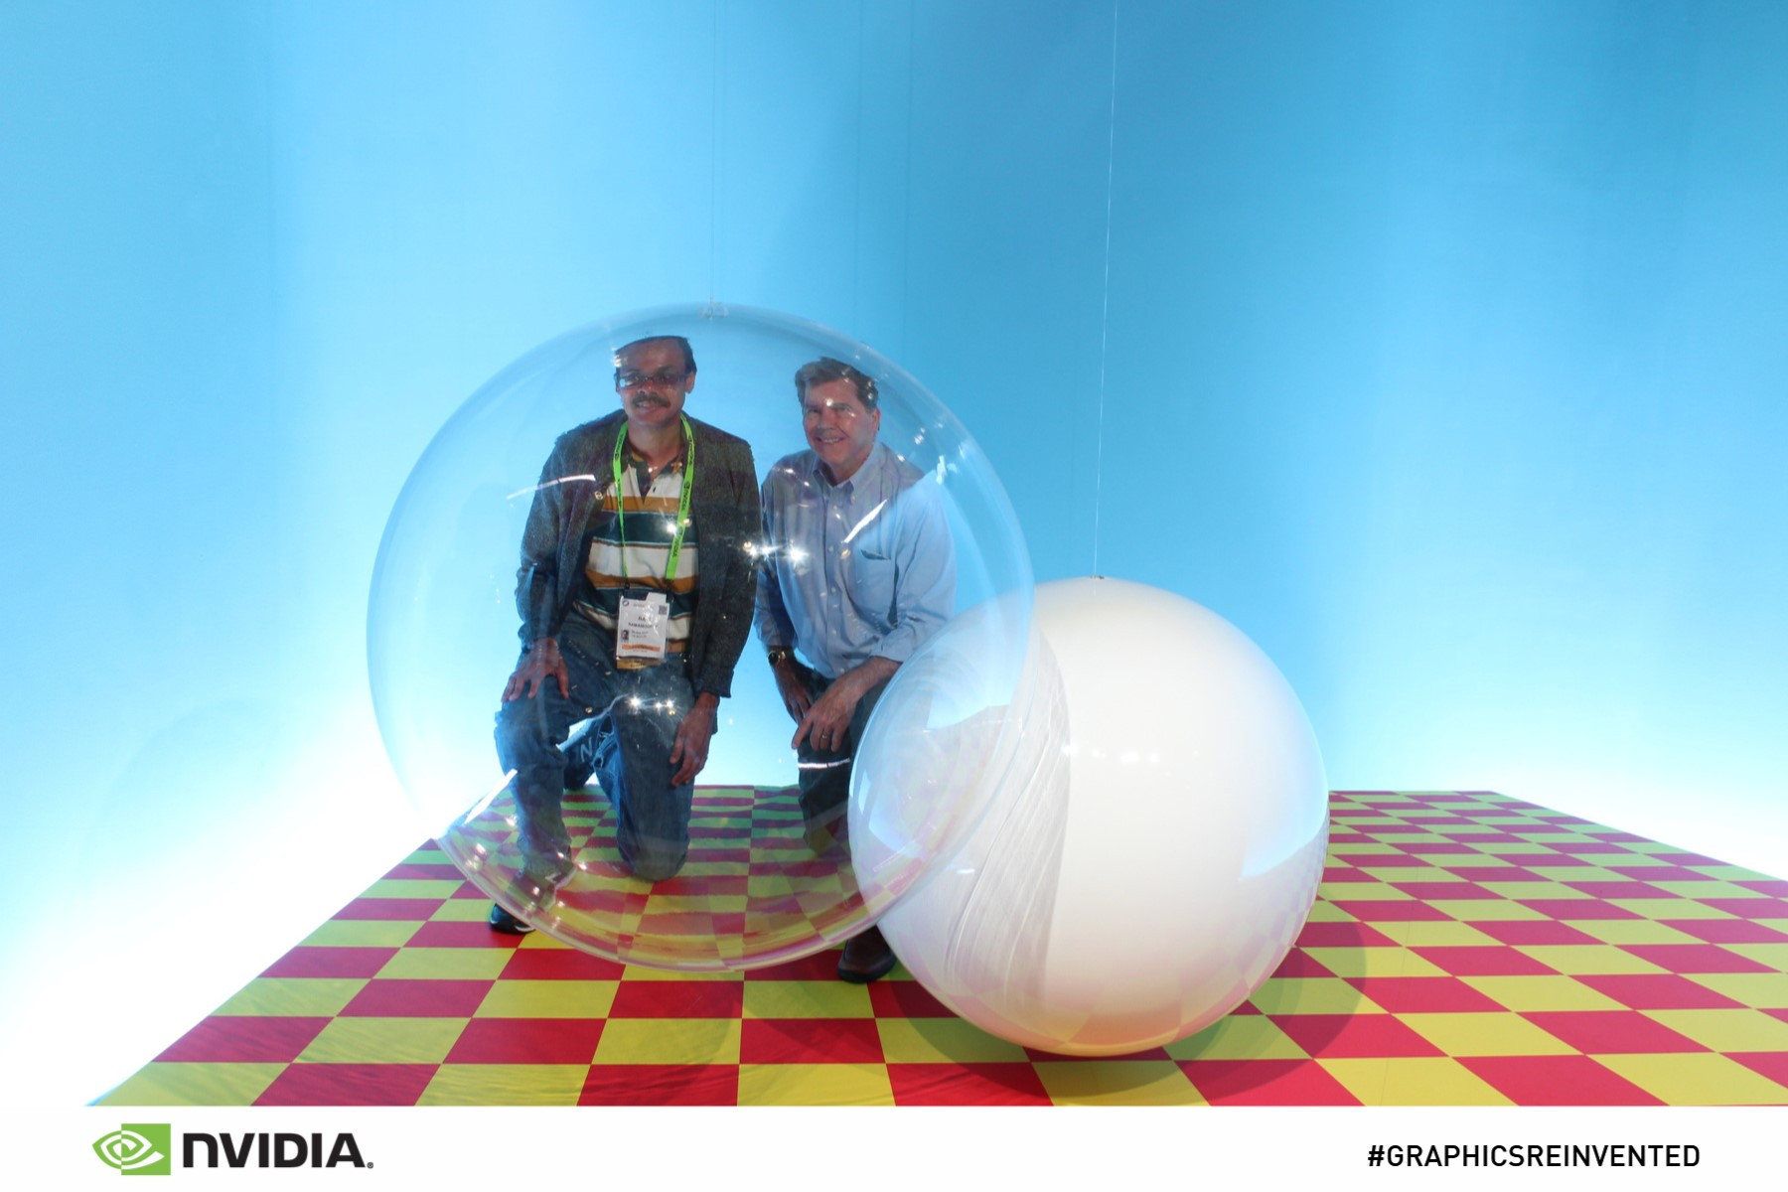
From SIGGRAPH 18
Real Photo: Speaker and Turner Whitted at SIGGRAPH 18

Slide 5
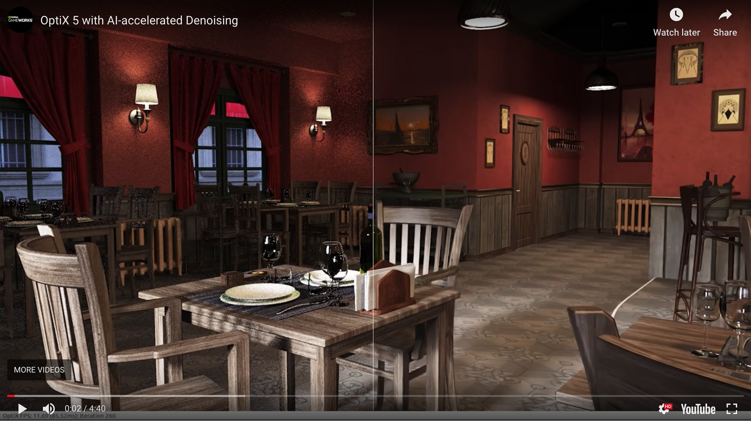
Impact: Real-Time

Slide 6
Real-Time in Practice
Major practical advances in recent years
Latest papers machine learning + 1 sample per pixel
Recent commercial product release: NVIDIA Optix 5 with denoising, NRD https://youtu.be/OC637pfAJs8
Essentially feels like magic nowadays (has brought real-time path tracing decade[s] earlier than expected)
Today: presentation of 3 papers precursors
But note that these papers are still clunky, barely real-time

