Slide 1
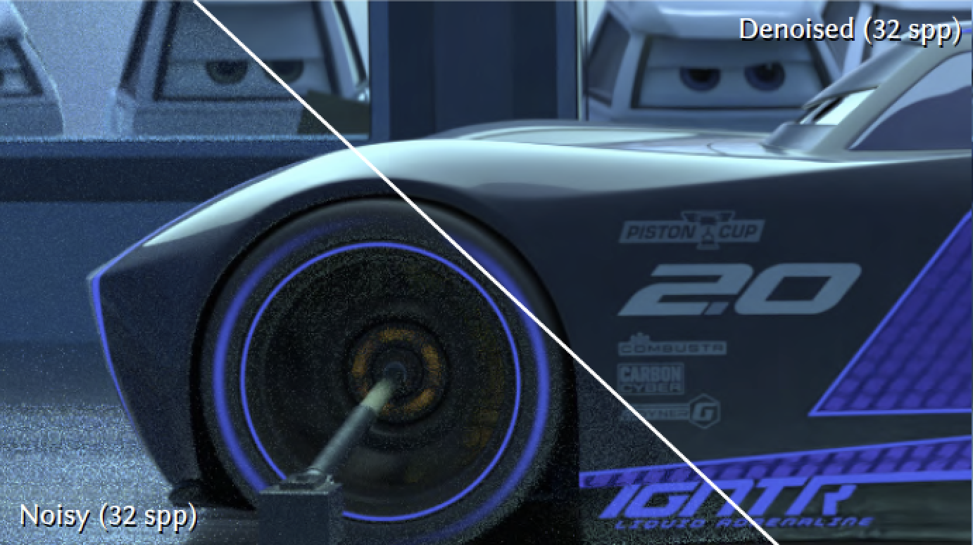
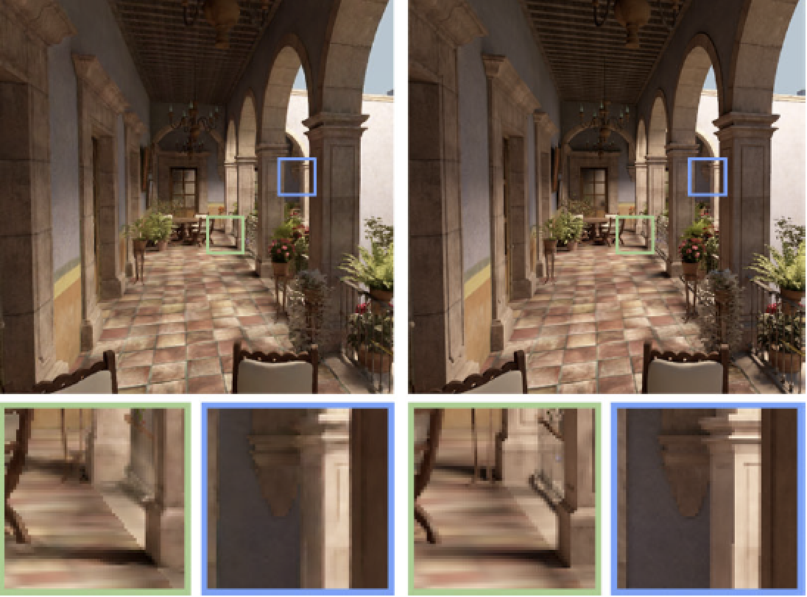
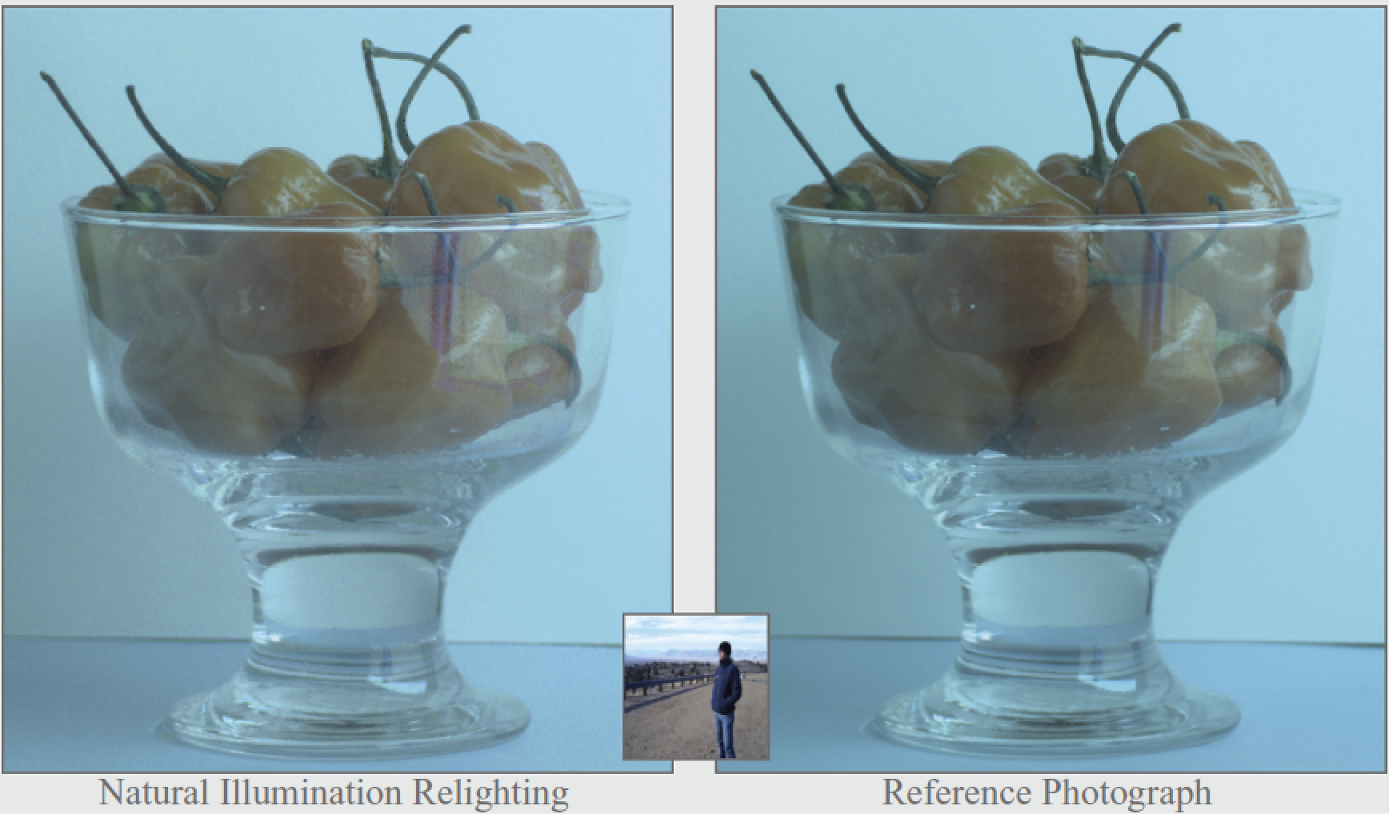
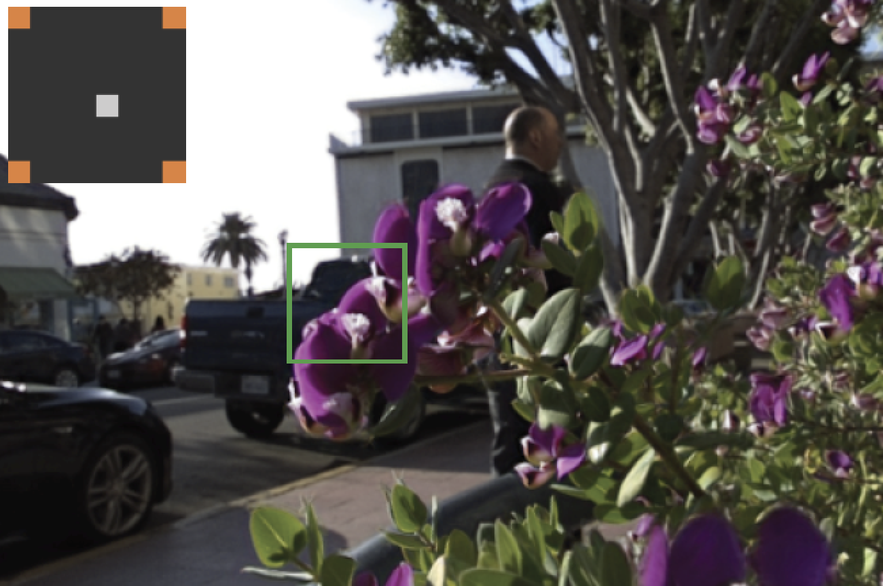
Sampling and Reconstruction of Visual Appearance: From Denoising to View Synthesis
CSE 274 [Fall 2021], Lecture 7
Ravi Ramamoorthi
http://www.cs.ucsd.edu/~ravir

Slide 2
Feature-Space Methods
Monte Carlo Rendering (biggest application)
General practical denoising (no frequency) [2012-]
General effects (Sec 2.3 of EG STAR Report)
General image-space denoising framework
But use auxiliary features (depth, normals, etc.)
Basis for methods deployed in industry today
Students present 3 key papers today

Slide 3
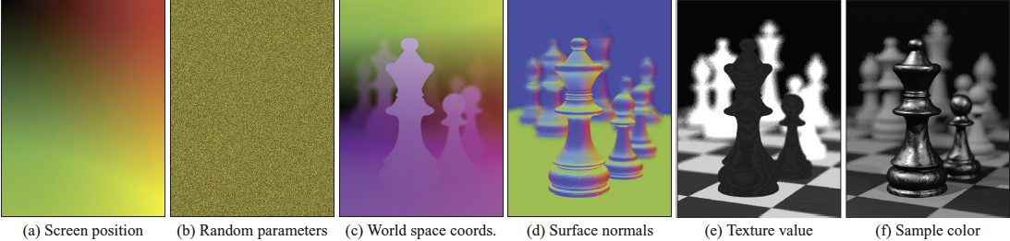
Random Parameter Filtering
Sen Darabi 12, importance of each feature
  Addresses noisy features (e.g. depth of field)
  Notion of mutual information
Weighted bilateral filter, very good at low samples
  Parameters determined by feature importance
  Auxiliary features are key to beat image denoising
  Has led to newer methods, commercialization

Slide 4
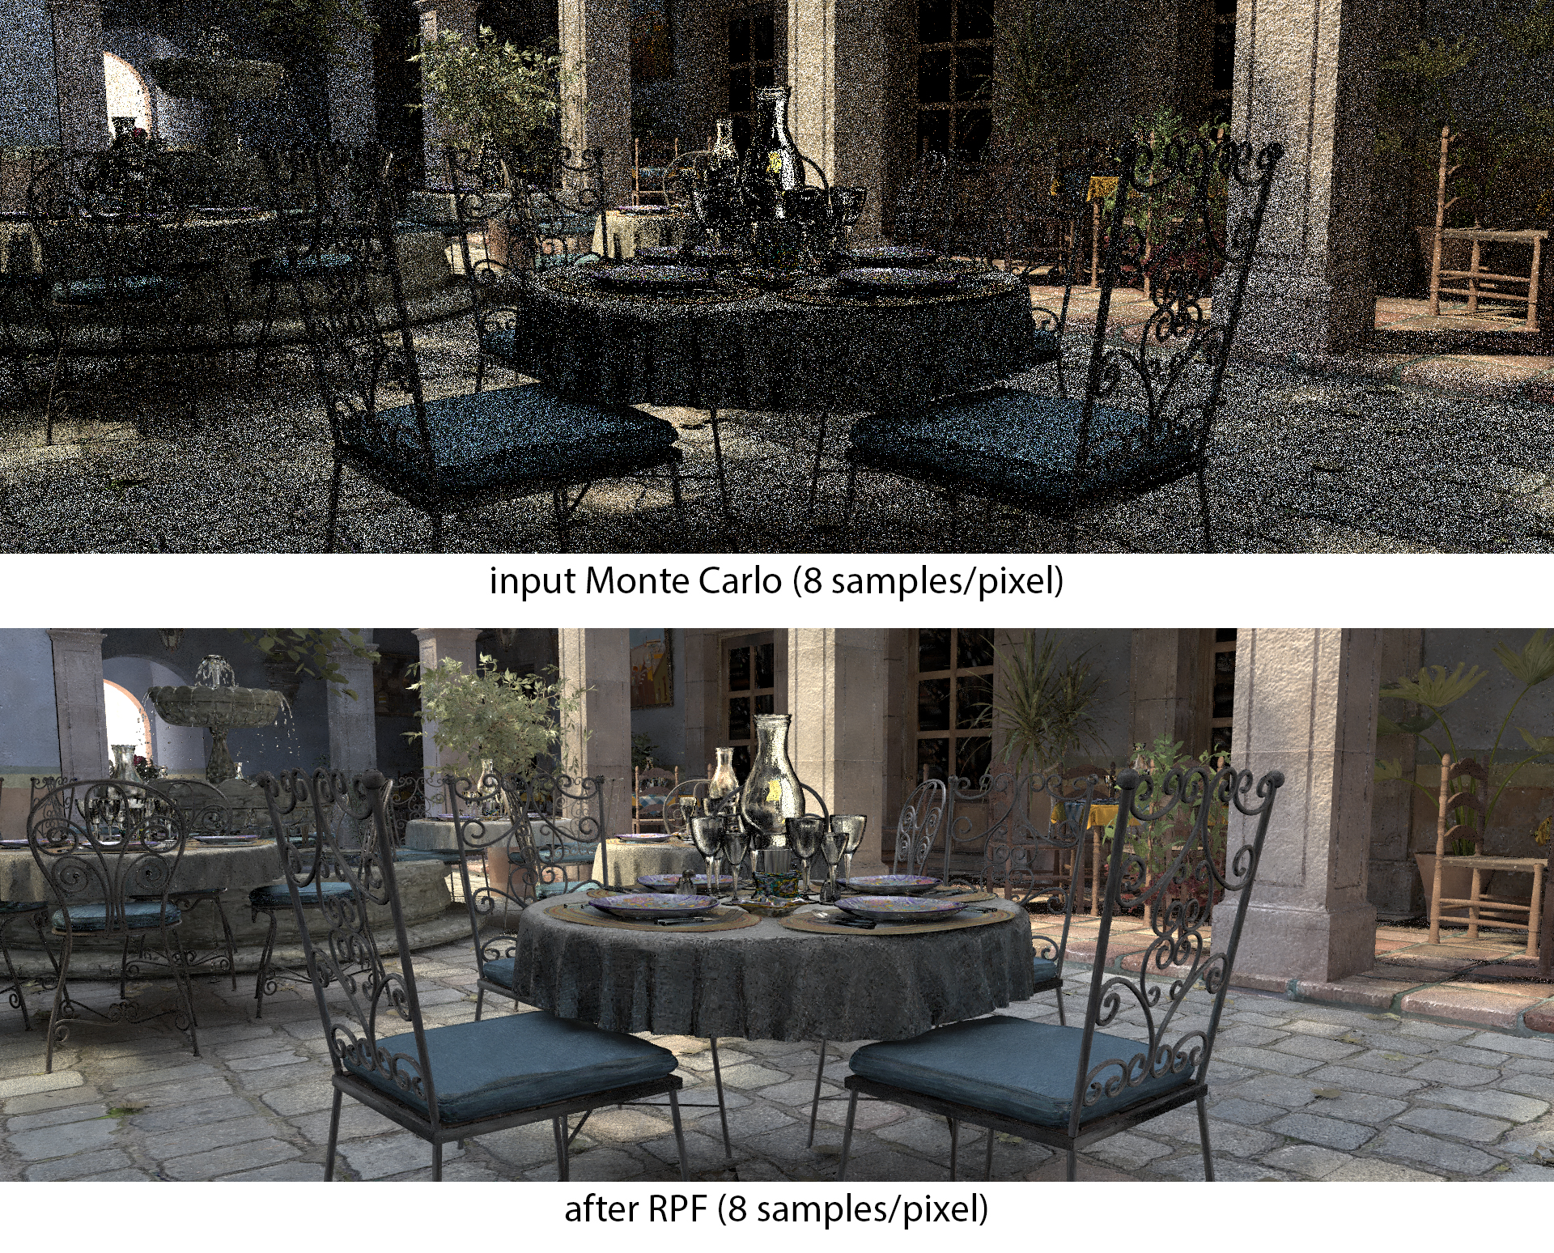
Random Parameter Filtering

Slide 5
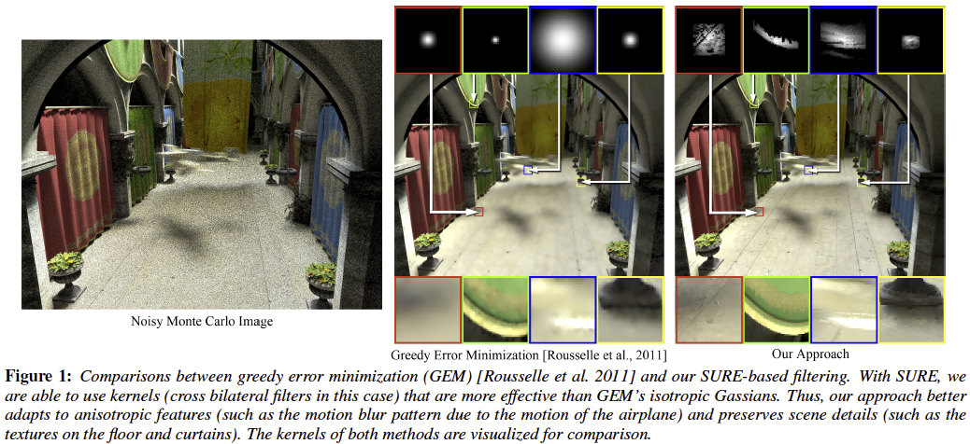
Subsequent Work
SURE (Stein’s unbiased risk estimator: general kernels, adaptive sampling, general effects) Li12

Slide 6
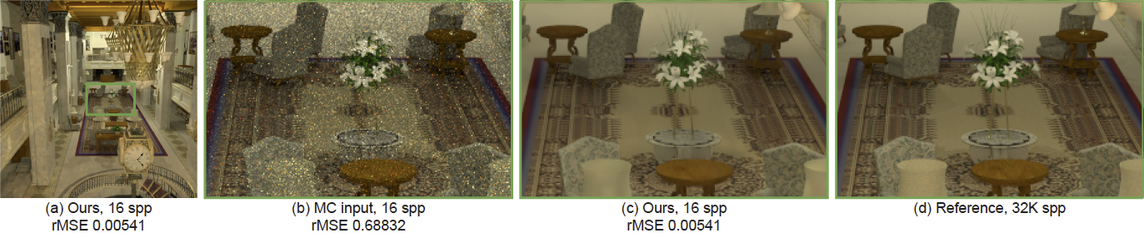
Subsequent Work
Moon et al. local linear or polynomial models, treat as regression. Many other methods
APR: Polynomial order chosen to minimize error
Newest methods use learning instead (later in course)

