Slide 1
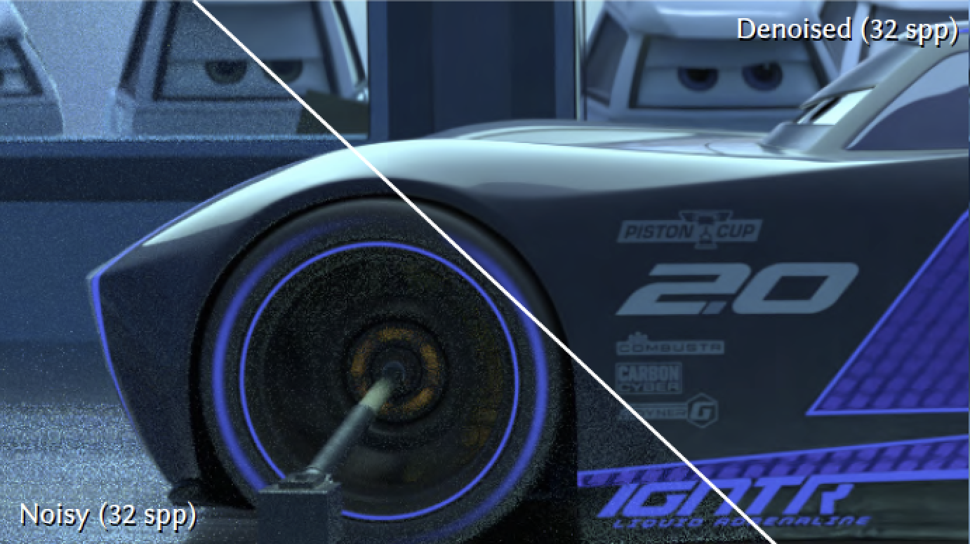
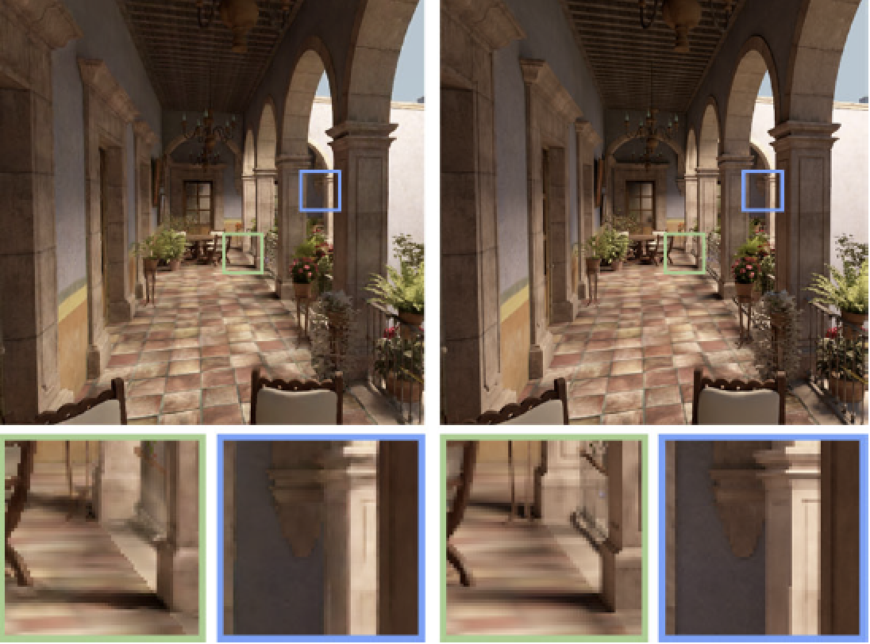
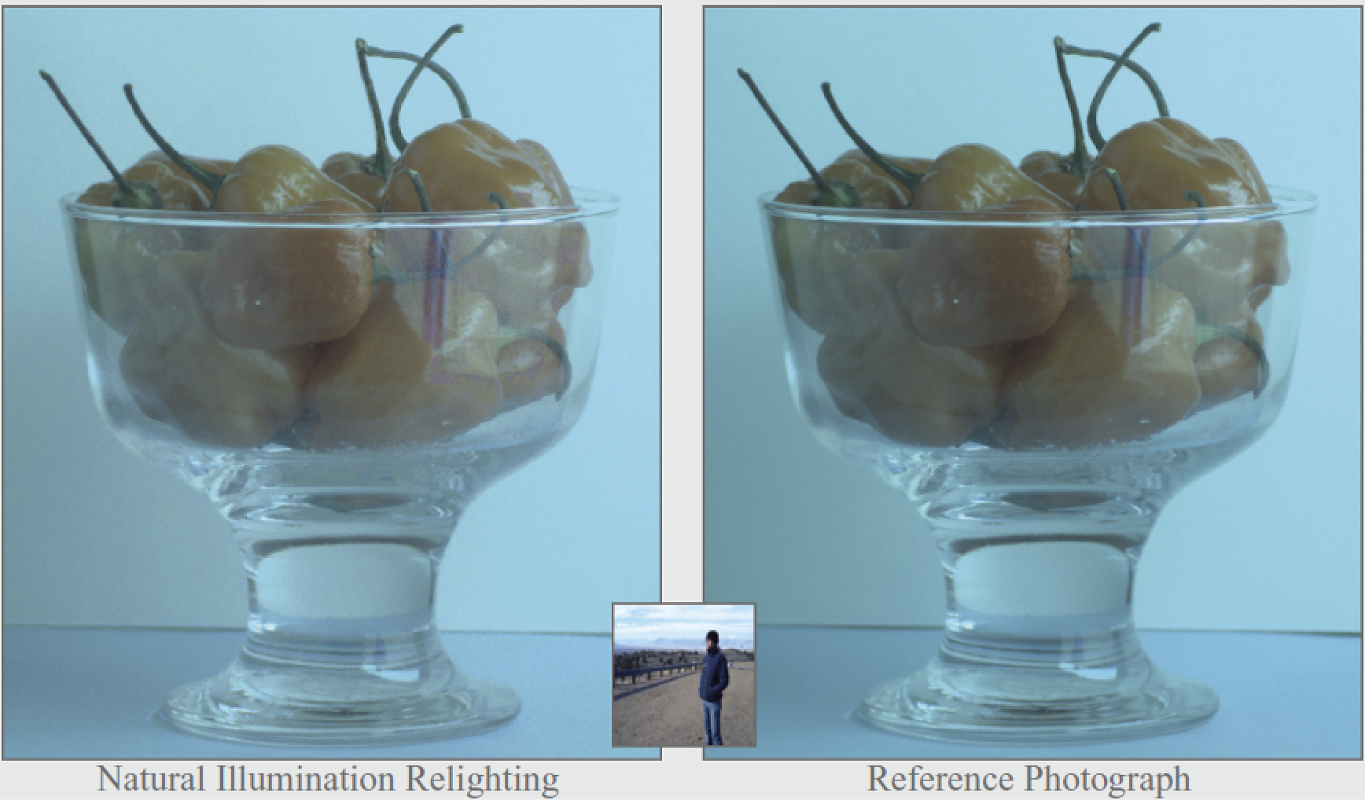
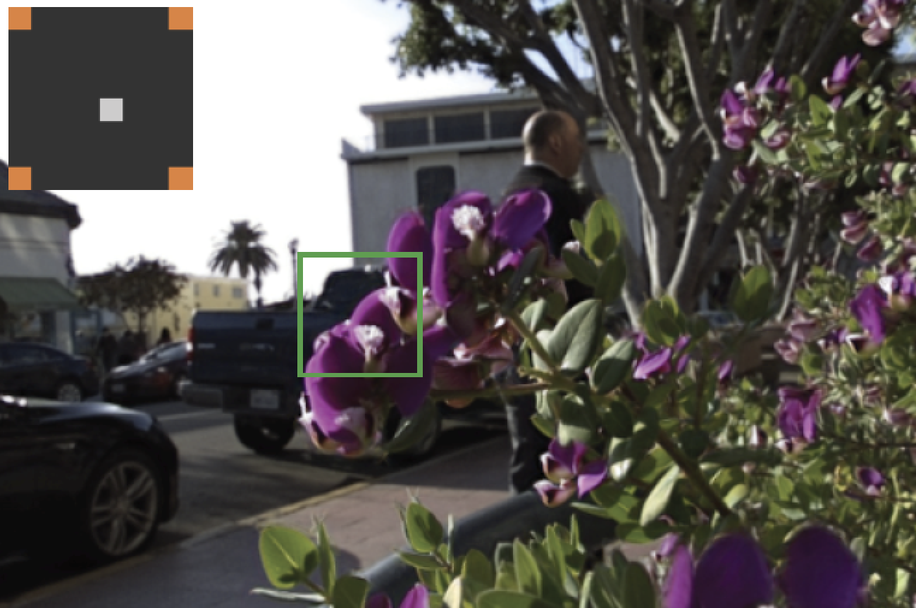
Sampling and Reconstruction of Visual Appearance: From Denoising to View Synthesis
CSE 274 [Fall 2021], Lecture 2
Ravi Ramamoorthi
http://www.cs.ucsd.edu/~ravir

Slide 2
Motivation: BRDFs, Radiometry
Basics of Illumination, Reflection
Formal radiometric analysis (not ad-hoc)
Reflection Equation
Ray Tracing and Rendering Equation 2nd half
Monte Carlo Rendering next week
Appreciate formal analysis in a graduate course, even if not absolutely essential in practice
Please e-mail re papers you want to present (by Th)

Slide 3
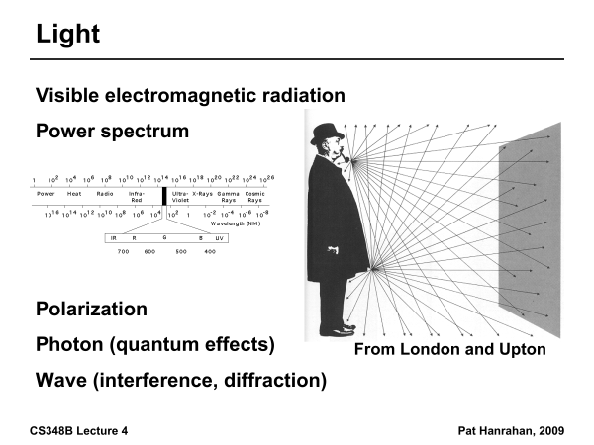

Slide 4
Radiometry
Physical measurement of electromagnetic energy
Measure spatial (and angular) properties of light
Radiance, Irradiance
Reflection functions: Bi-Directional Reflectance Distribution Function or BRDF
Reflection Equation
Simple BRDF models

Slide 5
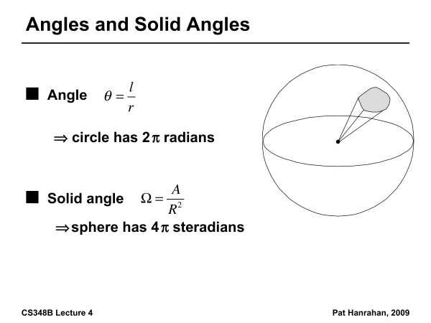

Slide 6
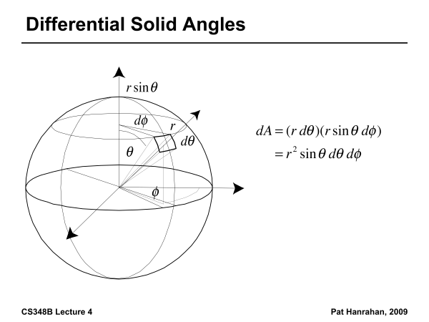

Slide 7
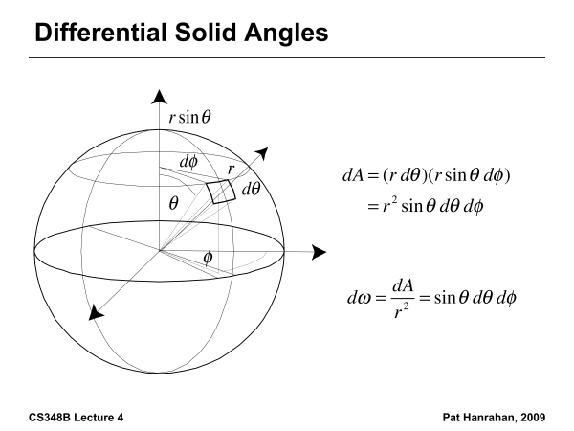

Slide 8
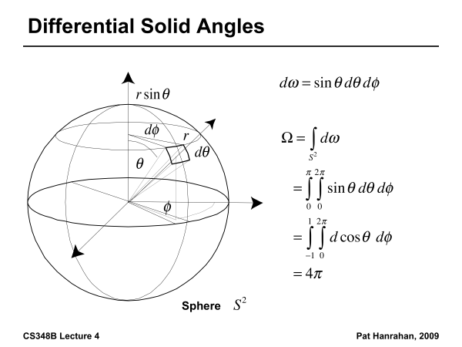

Slide 9
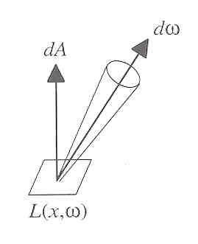
Radiance
Power per unit projected area perpendicular to the ray per unit solid angle in the direction of the ray
Symbol: L(x,ω) (W/m² sr)
Flux given by dΦ = L(x,ω) cos θ dω dA

Slide 10
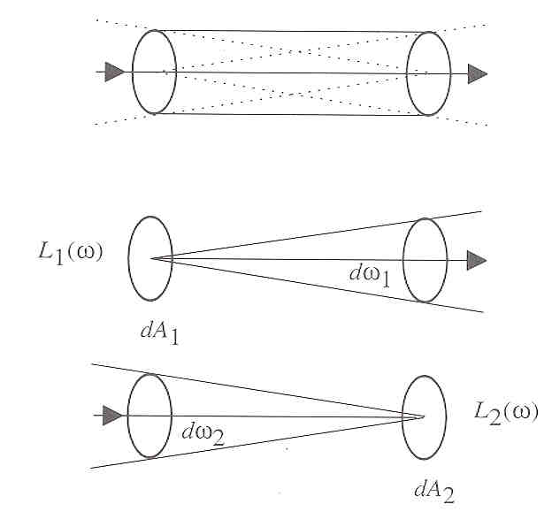
Radiance properties
Radiance constant as propagates along ray
Derived from conservation of flux
Fundamental in Light Transport.

Slide 11
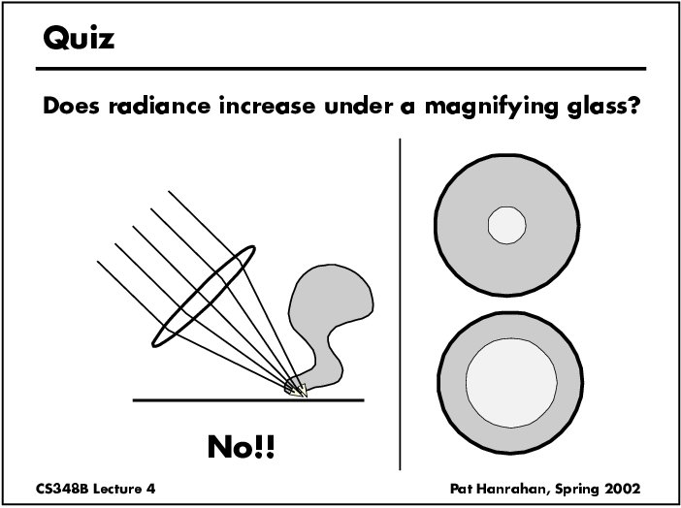

Slide 12
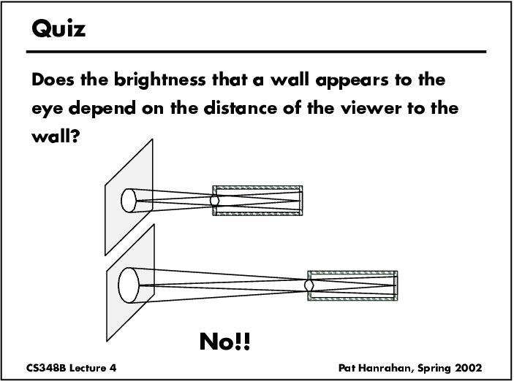

Slide 13
Radiance properties
Sensor response proportional to radiance (constant of proportionality is throughput)
Far away surface: See more, but subtends smaller angle
Wall equally bright across viewing distances
Consequences
Radiance associated with rays in a ray tracer
Other radiometric quants derived from radiance

Slide 14
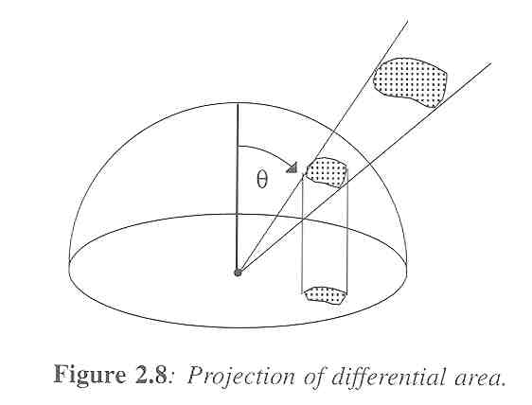
Irradiance, Radiosity
Irradiance E is radiant power per unit area
Integrate incoming radiance over hemisphere
Projected solid angle (cos θ dω)
Uniform illumination: Irradiance = π [CW 24,25]
Units: W/m²
Radiant Exitance (radiosity)
Power per unit area leaving surface (like irradiance)

Slide 15
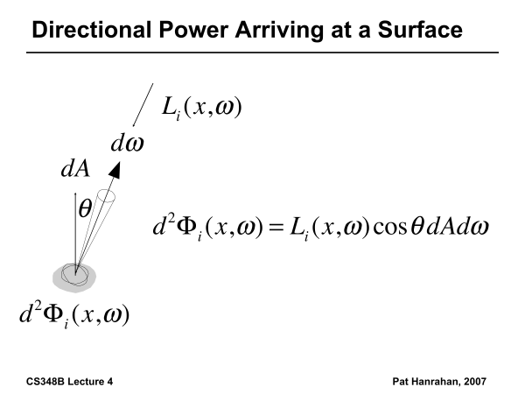

Slide 16
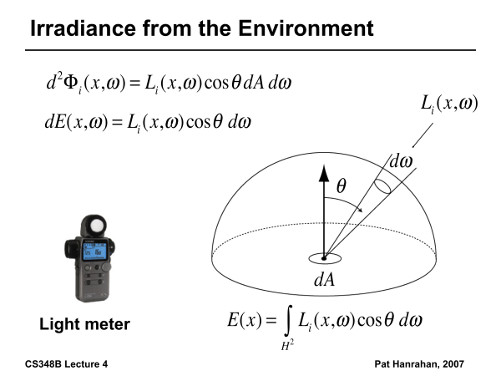

Slide 17
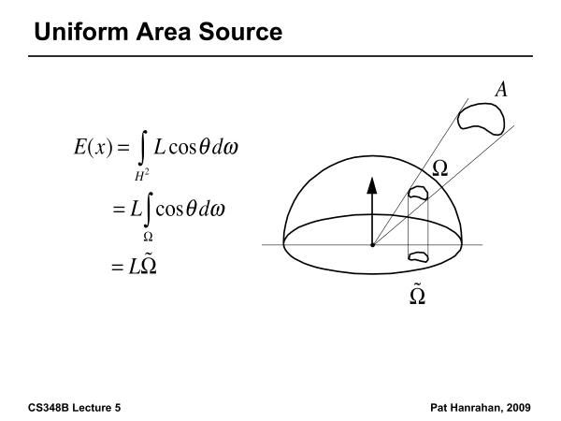

Slide 18
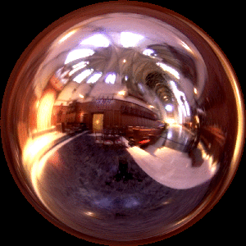
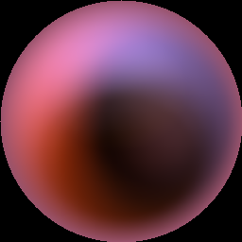
Irradiance Environment Maps
R
N
Incident Radiance
(Illumination Environment Map)
Irradiance Environment Map

Slide 19
Radiometry
Physical measurement of electromagnetic energy
Measure spatial (and angular) properties of light
Radiance, Irradiance
Reflection functions: Bi-Directional Reflectance Distribution Function or BRDF
Reflection Equation
Simple BRDF models

Slide 20
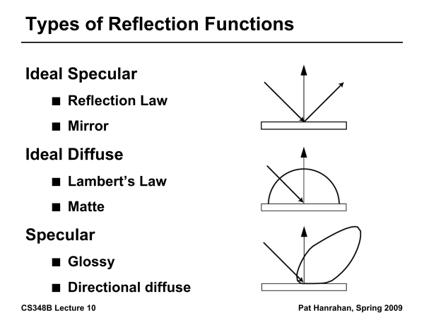

Slide 21
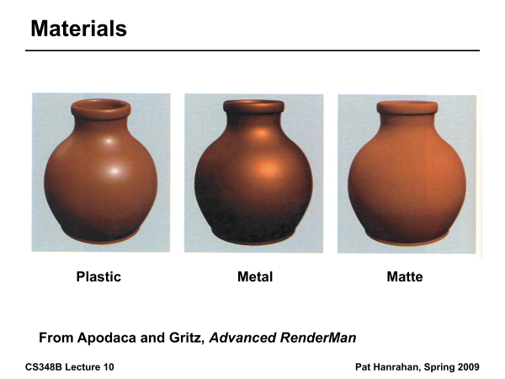

Slide 22
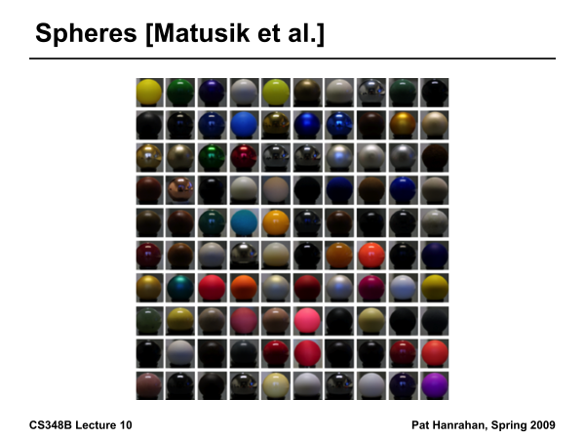

Slide 23
Building up the BRDF
Bi-Directional Reflectance Distribution Function [Nicodemus 77]
Function based on incident, view direction
Relates incoming light energy to outgoing
Unifying framework for many materials

Slide 24
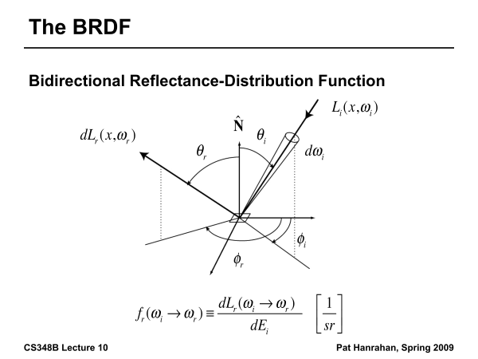

Slide 25
BRDF
Reflected Radiance proportional Irradiance
Constant proportionality: BRDF
Ratio of outgoing light (radiance) to incoming light (irradiance)
Bidirectional Reflection Distribution Function
(4 Vars) units 1/sr

Slide 26
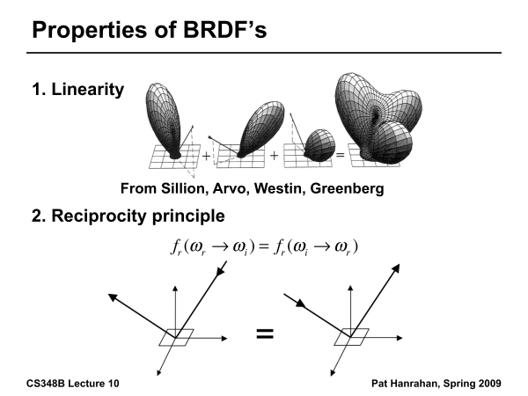

Slide 27
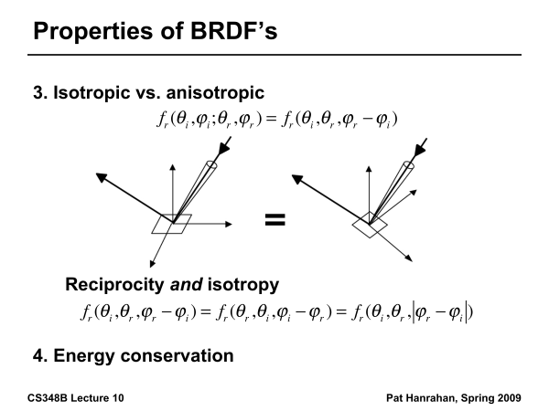

Slide 28
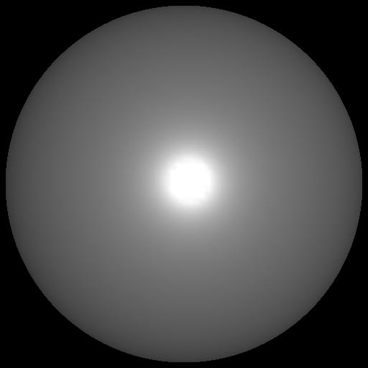
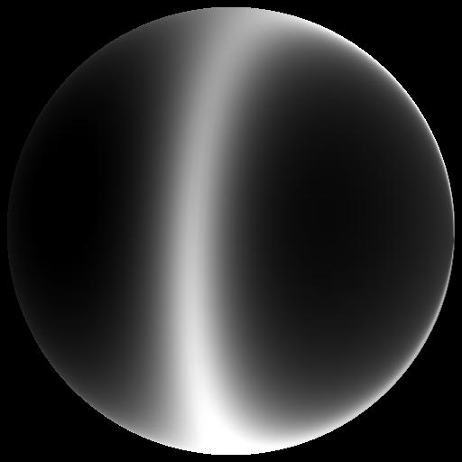
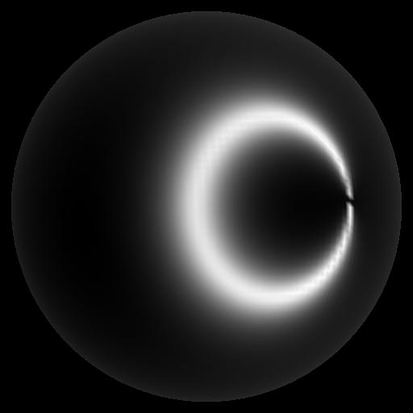
Isotropic vs Anisotropic
Isotropic: Most materials (you can rotate about normal without changing reflections)
Anisotropic: brushed metal etc. preferred tangential direction
Isotropic
Anisotropic

Slide 29
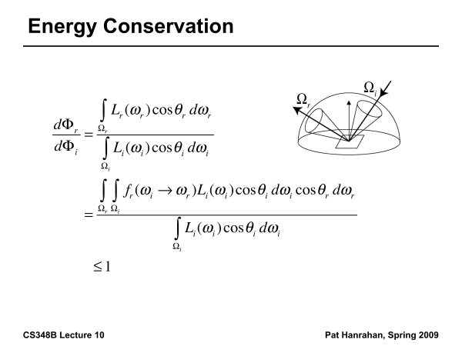

Slide 30
Reflection Equation
Reflected Light
(Output Image)
Emission
Incident
Light (from
light source)
BRDF
Cosine of
Incident angle

Slide 31
Reflection Equation
Sum over all light sources
Reflected Light
(Output Image)
Emission
Incident
Light (from
light source)
BRDF
Cosine of
Incident angle

Slide 32
Reflection Equation
Replace sum with integral
Reflected Light
(Output Image)
Emission
Incident
Light (from
light source)
BRDF
Cosine of
Incident angle

Slide 33
Radiometry
Physical measurement of electromagnetic energy
Measure spatial (and angular) properties of light
Radiance, Irradiance
Reflection functions: Bi-Directional Reflectance Distribution Function or BRDF
Reflection Equation
Simple BRDF models

Slide 34
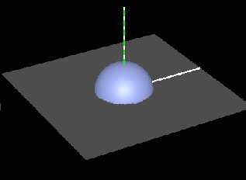
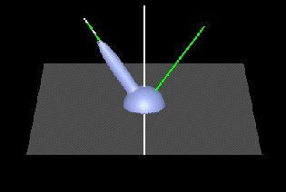
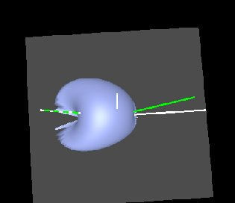
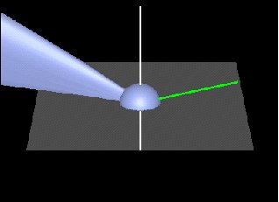
Brdf Viewer plots
Diffuse
Torrance-Sparrow
Anisotropic
bv written by Szymon Rusinkiewicz

Slide 35
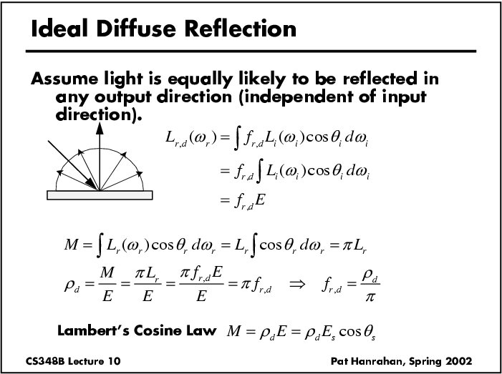

Slide 36
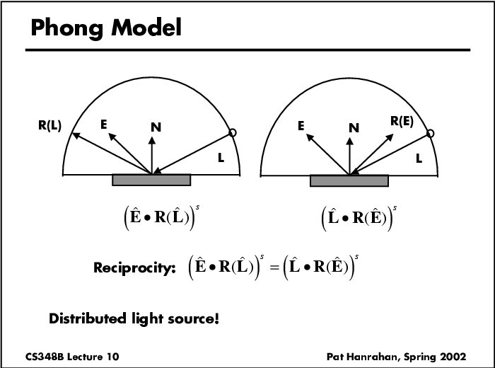

Slide 37
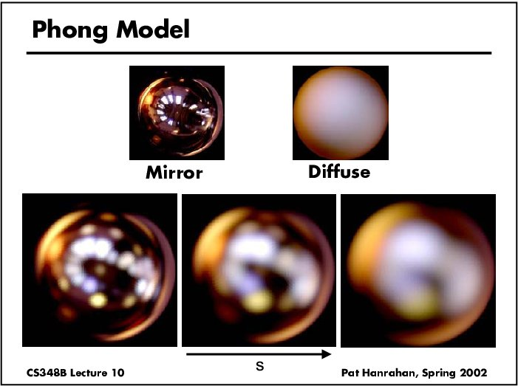
Specular Term (Phong)

Slide 38
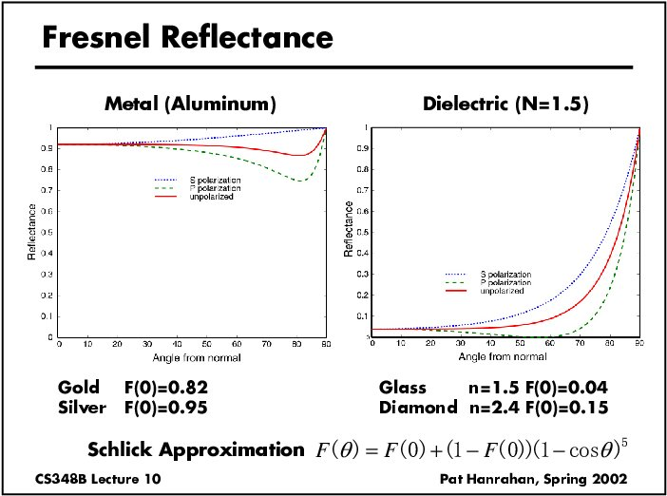

Slide 39
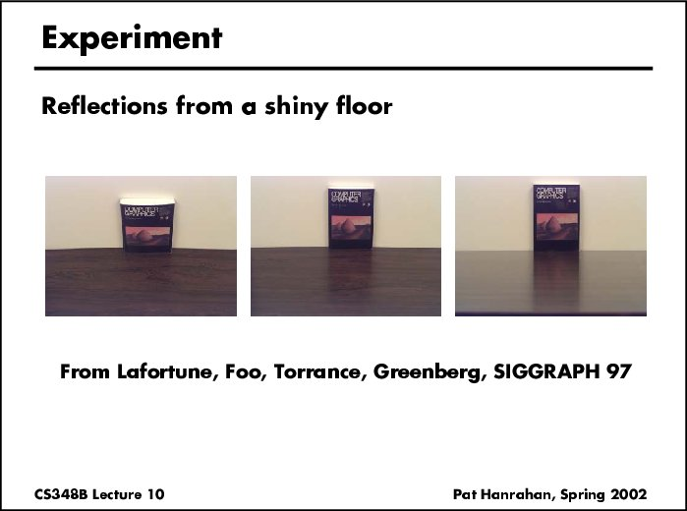

Slide 40
Torrance-Sparrow
Fresnel term:
allows for wavelength dependency
Geometric Attenuation:
reduces the output based on the amount of shadowing or masking that occurs.
Distribution:
distribution function determines what percentage of microfacets are oriented to reflect in the viewer direction.
How much of the macroscopic surface is visible to the light source
How much of the macroscopic surface is visible to the viewer

Slide 41
Other BRDF models
Empirical: Measure and build a 4D table
Anisotropic models for hair, brushed steel
Cartoon shaders, funky BRDFs
Capturing spatial variation
Very active area of research

Slide 42
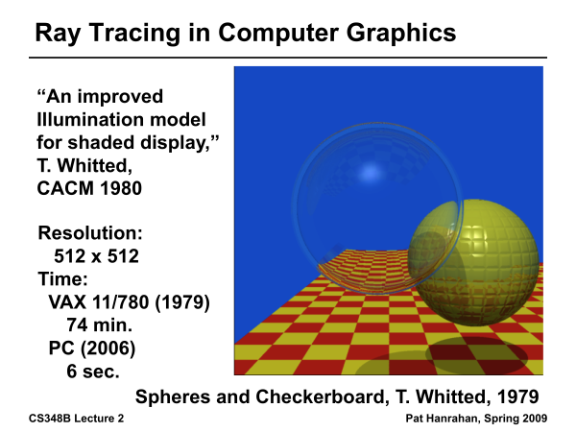
Ray Tracing History

Slide 43
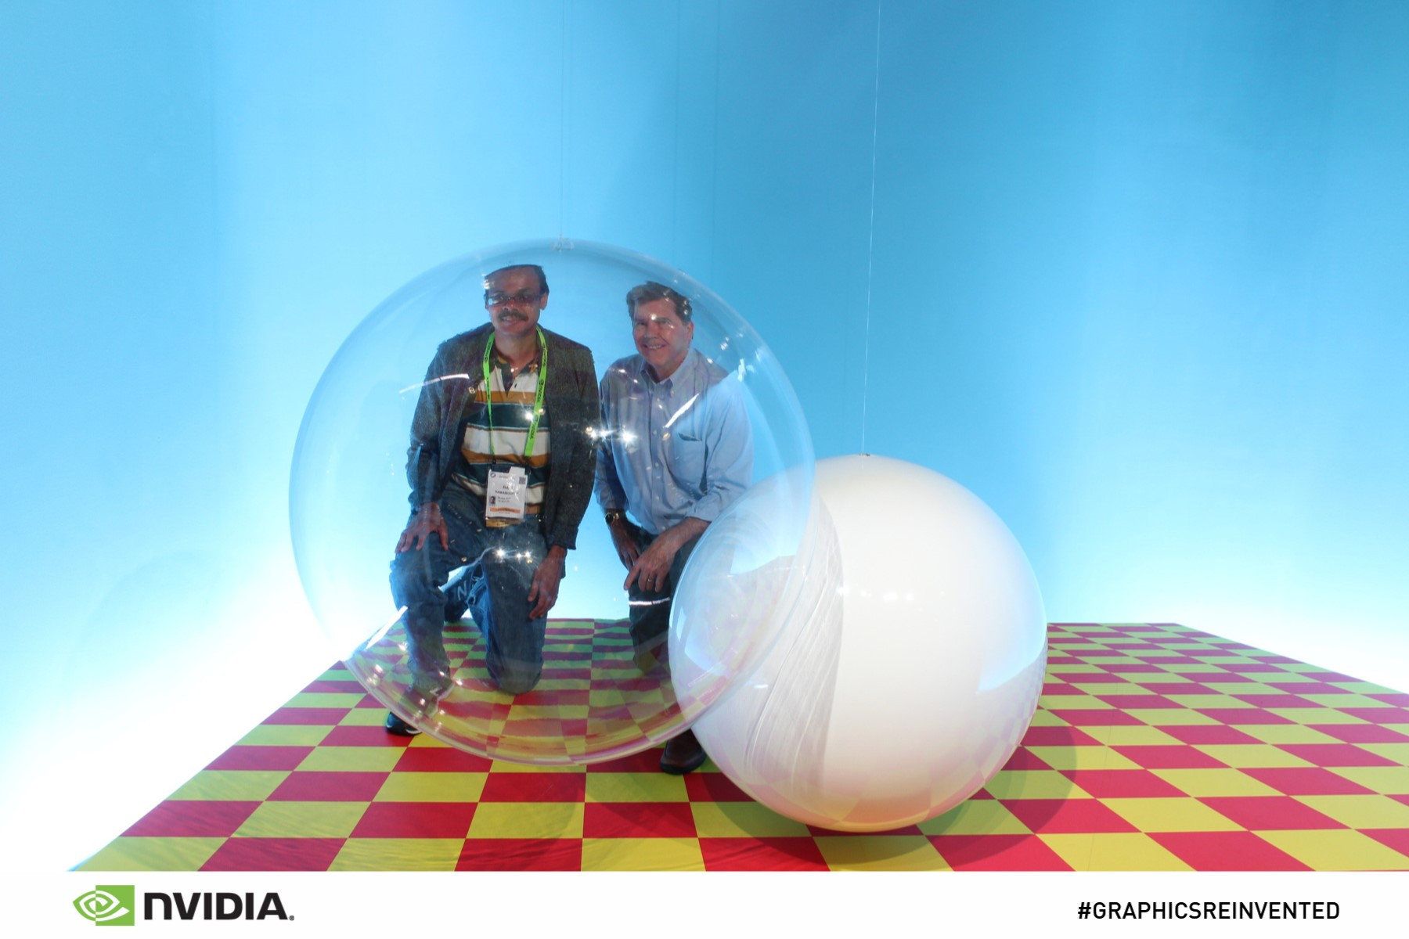
From SIGGRAPH 18
Real Photo: Instructor and Turner Whitted at SIGGRAPH 18

Slide 44
Ray Casting
Virtual Viewpoint
Virtual Screen
Objects
Multiple intersections: Use closest one (as does OpenGL)
Ray misses all objects: Pixel colored black
Ray intersects object: shade using color, lights, materials

Slide 45
Outline in Code
Image Raytrace (Camera cam, Scene scene, int width, int height)
{
Image image = new Image (width, height) ;
for (int i = 0 ; i < height ; i++)
for (int j = 0 ; j < width ; j++) {
Ray ray = RayThruPixel (cam, i, j) ;
Intersection hit = Intersect (ray, scene) ;
image[i][j] = FindColor (hit) ;
}
return image ;
}

Slide 46
Ray/Object Intersections
Heart of Ray Tracer
One of the main initial research areas
Optimized routines for wide variety of primitives
Various types of info
Shadow rays: Intersection/No Intersection
Primary rays: Point of intersection, material, normals
Texture coordinates
Work out examples
Triangle, sphere, polygon, general implicit surface

Slide 47
Ray-Sphere Intersection
C
P₀

Slide 48
Ray-Sphere Intersection
Substitute
Simplify

Slide 49
Ray-Sphere Intersection
2 real positive roots: pick smaller root
Both roots same: tangent to sphere
One positive, one negative root: ray origin inside sphere (pick + root)
Complex roots: no intersection (check discriminant of equation first)
Solve quadratic equations for t

Slide 50
Ray-Sphere Intersection
Intersection point:
Normal (for sphere, this is same as coordinates in sphere frame of reference, useful other tasks)

Slide 51
Ray-Triangle Intersection
One approach: Ray-Plane intersection, then check if inside triangle
Plane equation:
B
A
C

Slide 52
Ray-Triangle Intersection
One approach: Ray-Plane intersection, then check if inside triangle
Plane equation:
Combine with ray equation:
B
A
C

Slide 53
Ray inside Triangle
Once intersect with plane, still need to find if in triangle
Many possibilities for triangles, general polygons (point in polygon tests)
We find parametrically [barycentric coordinates]. Also useful for other applications (texture mapping)
B
A
α
β
P
γ
C

Slide 54
Ray inside Triangle
B
A
α
β
P
γ
C

Slide 55
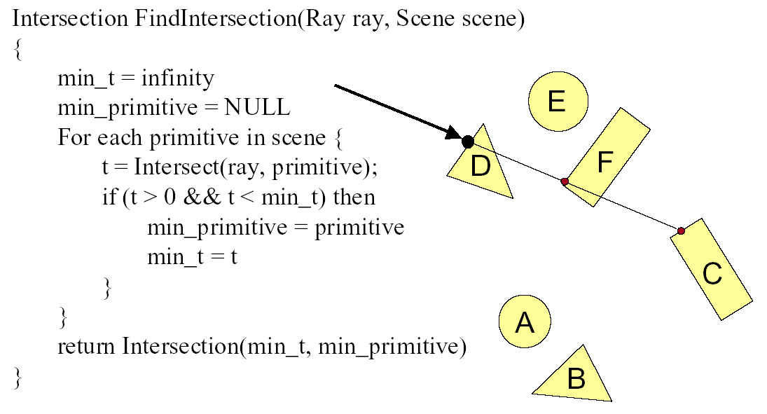
Ray Scene Intersection

Slide 56
Shadows
Light Source
Virtual Viewpoint
Virtual Screen
Objects
Shadow ray to light is blocked: object in shadow
Shadow ray to light is unblocked: object visible

Slide 57
Shadows: Numerical Issues
Numerical inaccuracy may cause intersection to be
below surface (effect exaggerated in figure)
Causing surface to incorrectly shadow itself
Move a little towards light before shooting shadow ray

Slide 58
Mirror Reflections/Refractions
Virtual Viewpoint
Virtual Screen
Objects
Generate reflected ray in mirror direction,
Get reflections and refractions of objects

Slide 59
Recursive Ray Tracing
For each pixel
Trace Primary Eye Ray, find intersection
Trace Secondary Shadow Ray(s) to all light(s)
Color = Visible ? Illumination Model : 0 ;
Trace Reflected Ray
Color += reflectivity * Color of reflected ray
Need acceleration structure for performance

Slide 60
Interactive Raytracing
Ray tracing historically slow
Now viable alternative for complex scenes
Key is sublinear complexity with acceleration; need not process all triangles in scene
Allows many effects hard in hardware
Today graphics hardware and software (NVIDIA Optix 6, RTX chips 10G+ rays per second).Video

