Slide 1
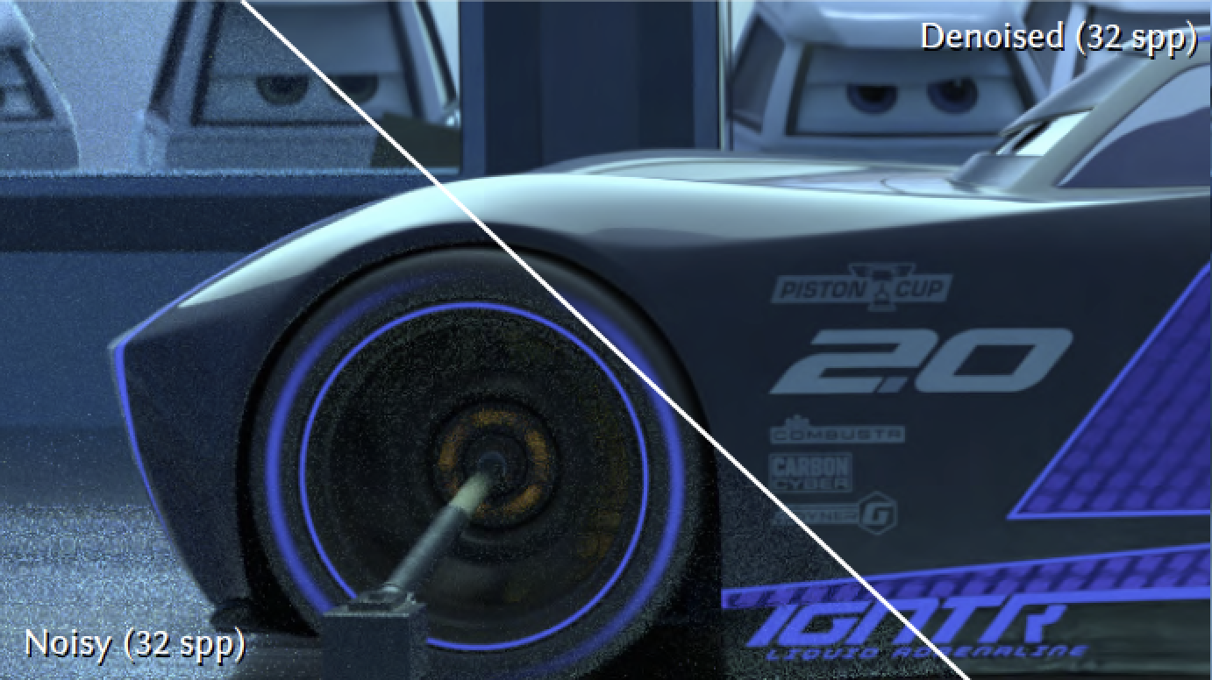
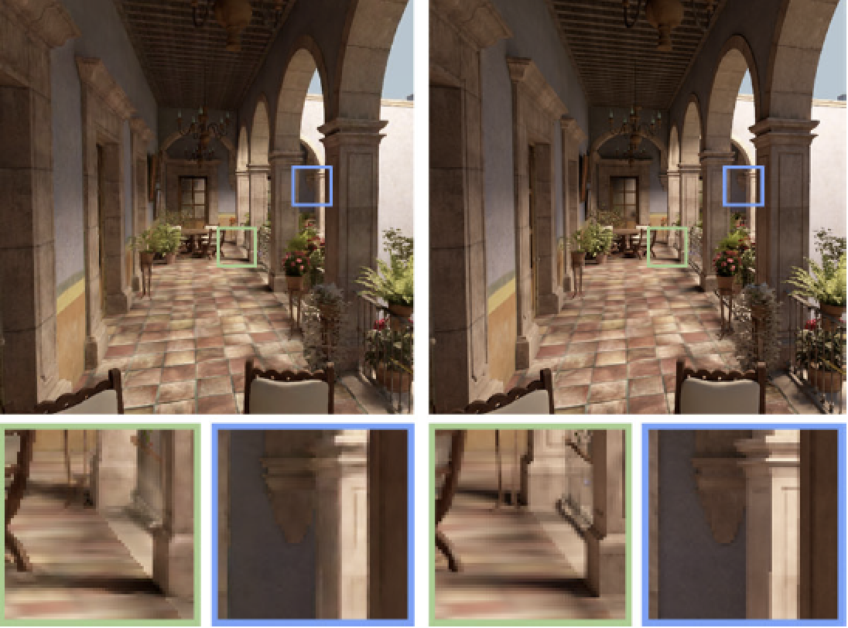
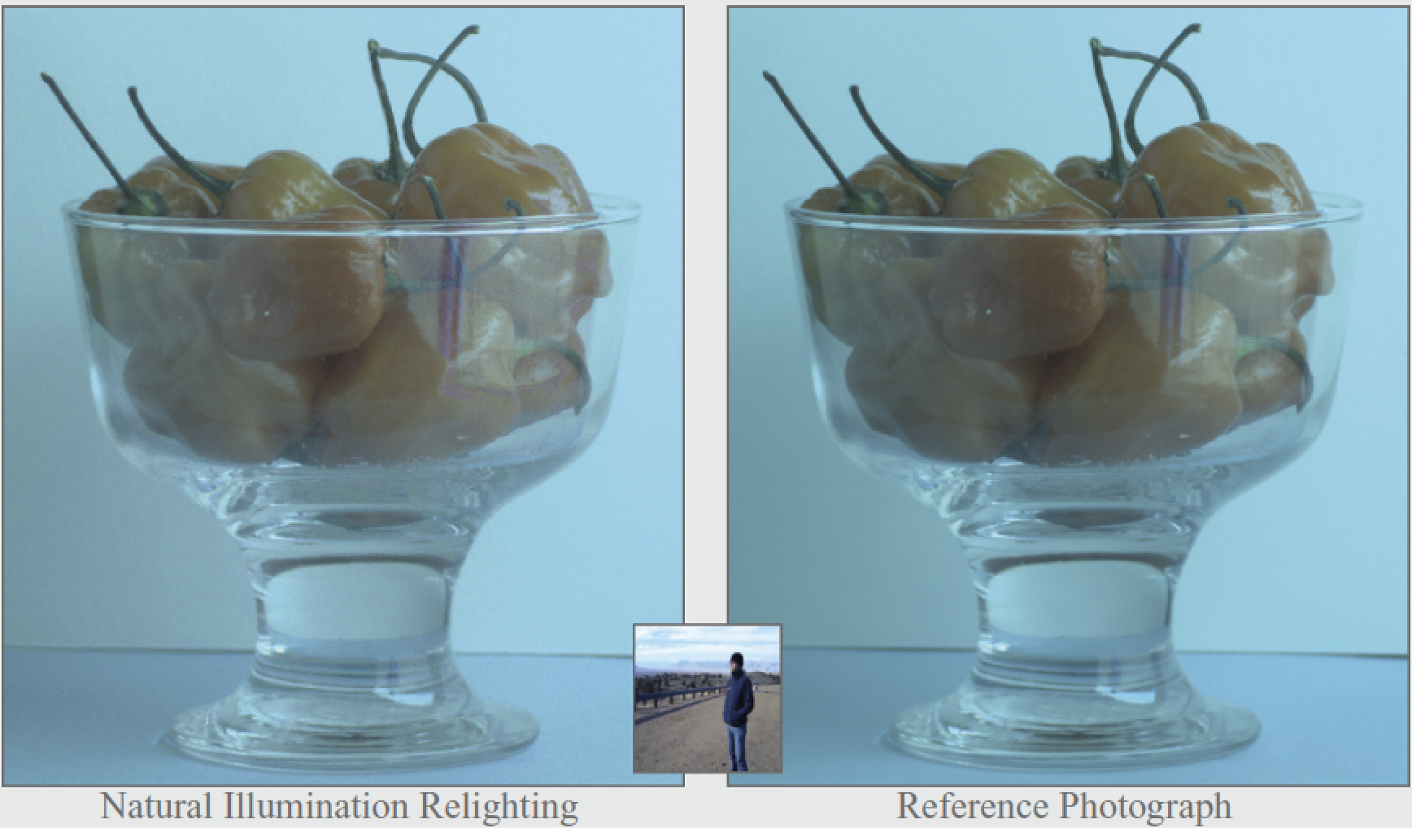
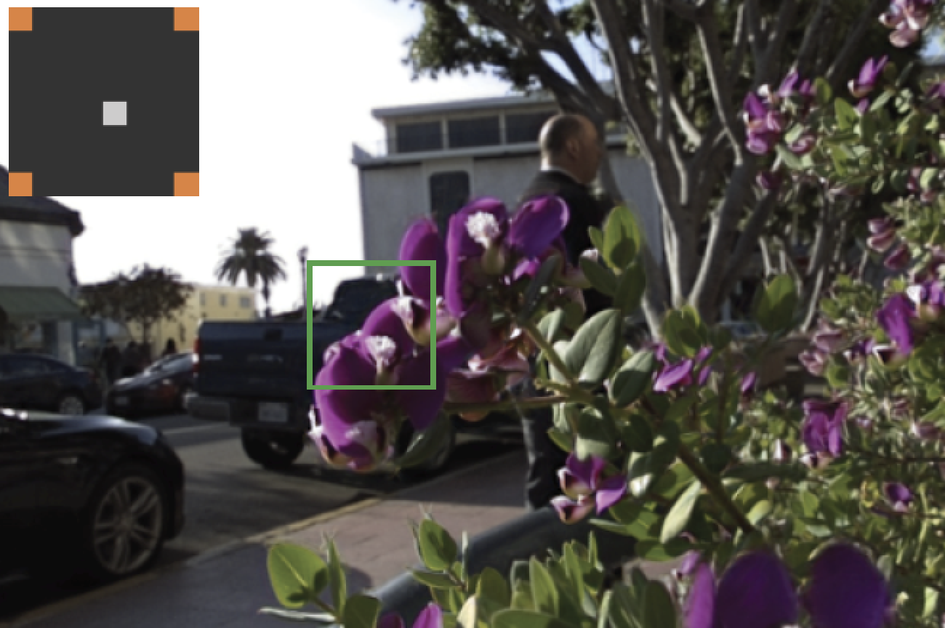
Sampling and Reconstruction of Visual Appearance
CSE 274 [Fall 2018], Special Lecture Ray Tracing
Ravi Ramamoorthi
http://www.cs.ucsd.edu/~ravir

Slide 2
Motivation
Ray Tracing is a core aspect of both offline and real-time rendering today
Basic topic which I cover in CSE 167
But not everyone does, this class also covers 168 (ray tracing is a prelude to key path tracing algorithm)
Background for some (most?) of you, but critical topic for those who haven’t seen it before, go over it fast
Important if you want to do the optional path tracer assignment (includes a ray tracing assignment)
http://www.edx.org/course/computer-graphics

Slide 3
Effects needed for Realism
(Soft) Shadows
Reflections (Mirrors and Glossy)
Transparency (Water, Glass)
Interreflections (Color Bleeding)
Complex Illumination (Natural, Area Light)
Realistic Materials (Velvet, Paints, Glass)
And many more

Slide 4
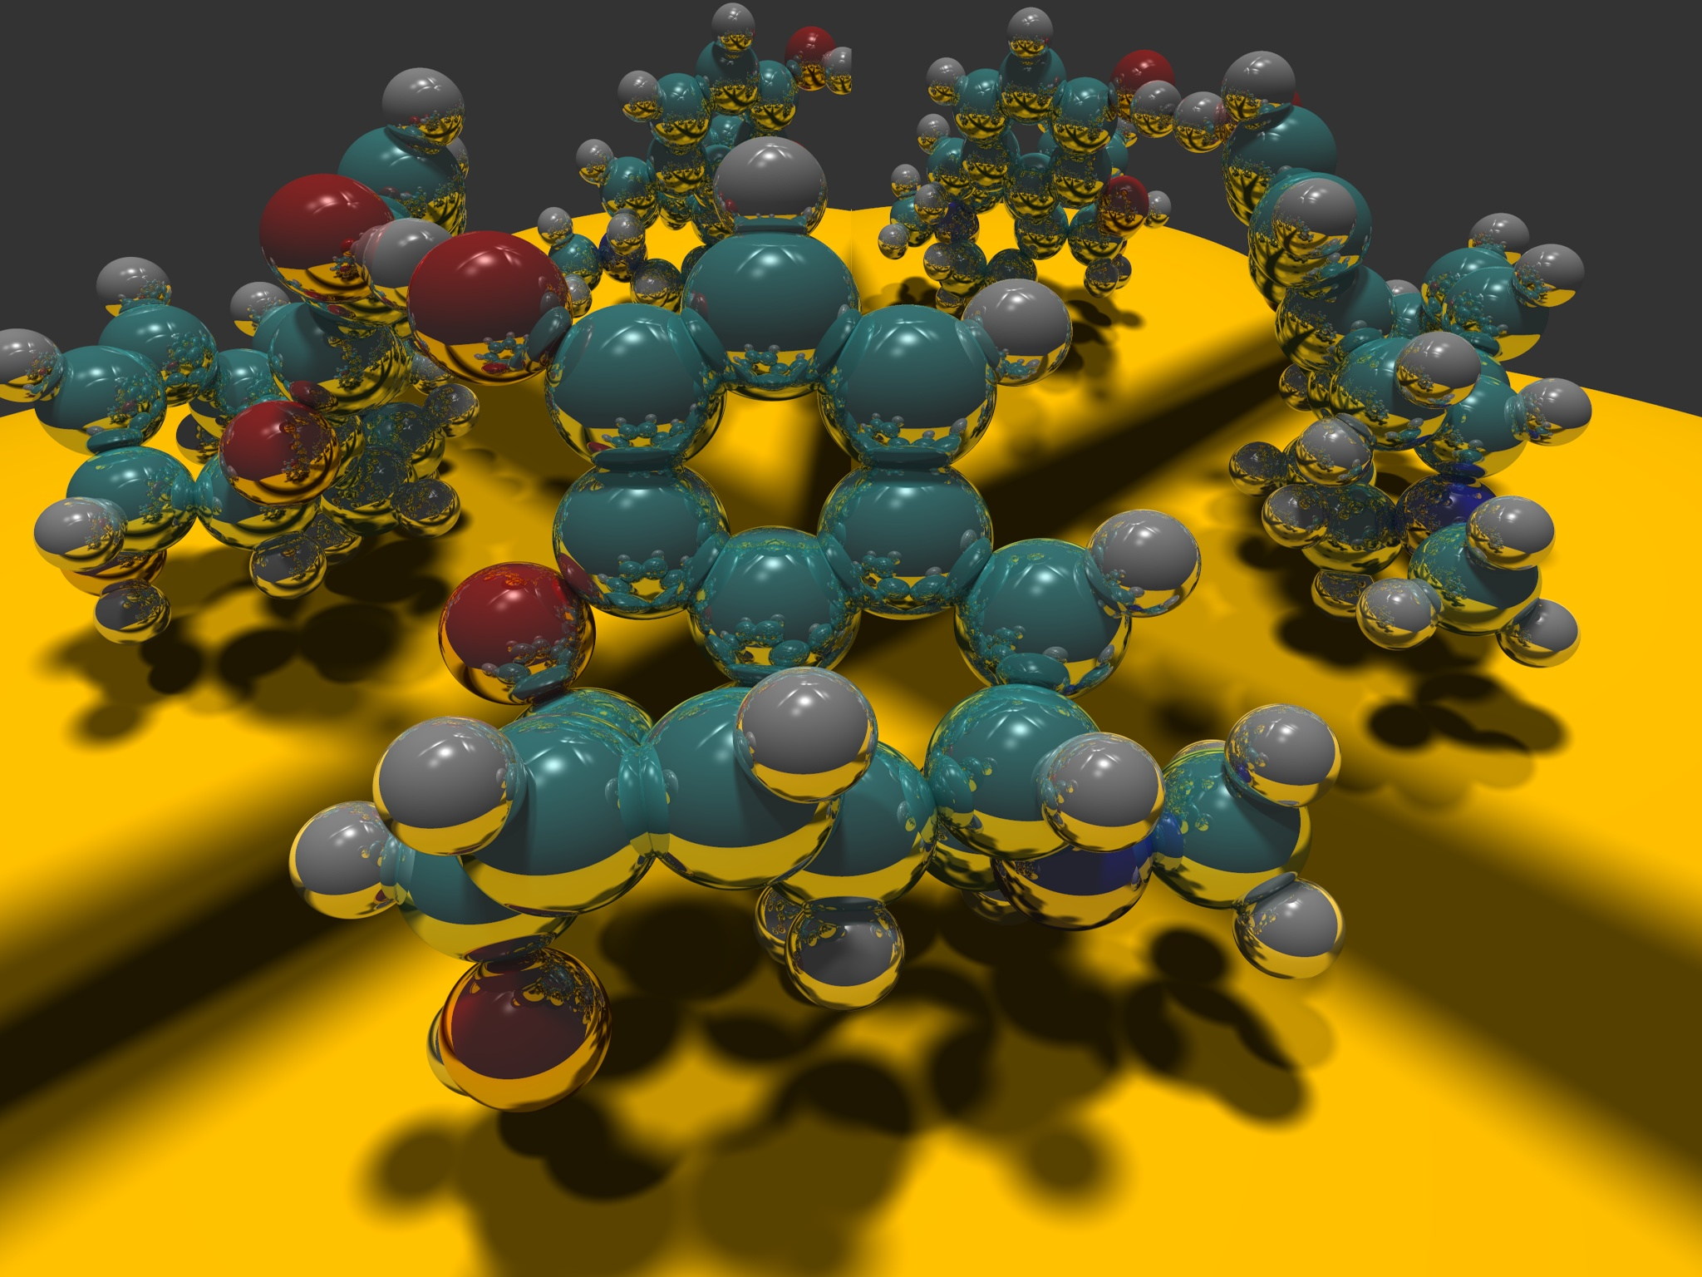
Image courtesy Paul Heckbert 1983

Slide 5
Ray Tracing
Different Approach to Image Synthesis as compared to Hardware pipeline (OpenGL)
Pixel by Pixel instead of Object by Object
Easy to compute shadows/transparency/etc

Slide 6
Outline
History
Basic Ray Casting (instead of rasterization)
Comparison to hardware scan conversion
Ray-Surface Intersection
Shadows / Reflections (core algorithm)
Optimizations
Current Research

Slide 7
Ray Tracing: History
Appel 68
Whitted 80 [recursive ray tracing]
Landmark in computer graphics
Lots of work on various geometric primitives
Lots of work on accelerations
Current Research
Real-Time raytracing (historically, slow technique)
Ray tracing architecture

Slide 8
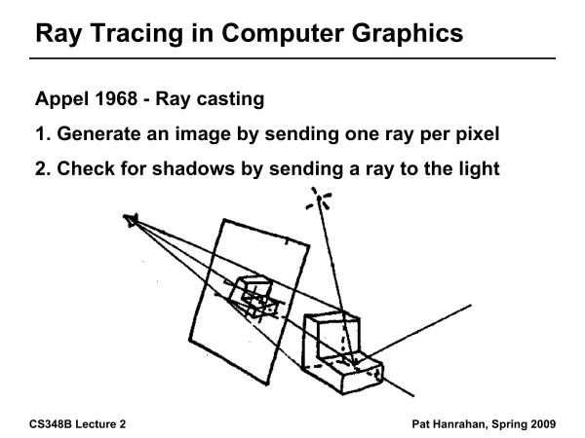
Ray Tracing History

Slide 9
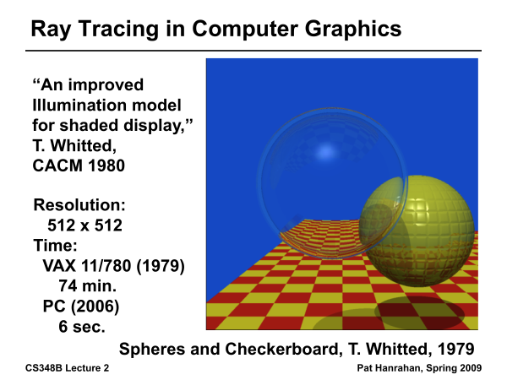
Ray Tracing History

Slide 10
Outline
History
Basic Ray Casting (instead of rasterization)
Comparison to hardware scan conversion
Ray-Surface Intersection
Shadows / Reflections (core algorithm)
Optimizations
Current Research

Slide 11
Outline in Code
Image Raytrace (Camera cam, Scene scene, int width, int height)
{
Image image = new Image (width, height) ;
for (int i = 0 ; i < height ; i++)
for (int j = 0 ; j < width ; j++) {
Ray ray = RayThruPixel (cam, i, j) ;
Intersection hit = Intersect (ray, scene) ;
image[i][j] = FindColor (hit) ;
}
return image ;
}

Slide 12
Ray Casting
Produce same images as with OpenGL
Visibility per pixel instead of Z-buffer
Find nearest object by shooting rays into scene
Shade it as in standard OpenGL

Slide 13
Ray Casting
Virtual Viewpoint
Virtual Screen
Objects
Multiple intersections: Use closest one (as does OpenGL)
Ray misses all objects: Pixel colored black
Ray intersects object: shade using color, lights, materials

Slide 14
Comparison to hardware scan-line
Per-pixel evaluation, per-pixel rays (not scan-convert each object). On face of it, costly
But good for walkthroughs of extremely large models (amortize preprocessing, low complexity)
More complex shading, lighting effects possible

Slide 15
Finding Ray Direction
Goal is to find ray direction for given pixel i and j
Many ways to approach problem
Objects in world coord, find dirn of each ray (we do this)
Camera in canonical frame, transform objects (OpenGL)
Basic idea
Ray has origin (camera center) and direction
Find direction given camera params and i and j
Camera params as in gluLookAt
Lookfrom[3], LookAt[3], up[3], fov

Slide 16
Similar to gluLookAt derivation
gluLookAt(eyex, eyey, eyez, centerx, centery, centerz, upx, upy, upz)
Camera at eye, looking at center, with up direction being up
Up vector
Eye
Center
From OpenGL lecture on deriving gluLookAt (see edX MOOC)

Slide 17
Constructing a coordinate frame?
We want to associate w with a, and v with b
But a and b are neither orthogonal nor unit norm
And we also need to find u
From basic math lecture - Vectors: Orthonormal Basis Frames

Slide 18
Camera coordinate frame
We want to position camera at origin, looking down –Z dirn
Hence, vector a is given by eye – center
The vector b is simply the up vector
Up vector
Eye
Center

Slide 19
Canonical viewing geometry
βv
-w
αu

Slide 20
Outline
History
Basic Ray Casting (instead of rasterization)
Comparison to hardware scan conversion
Ray-Surface Intersection
Shadows / Reflections (core algorithm)
Optimizations
Current Research

Slide 21
Ray/Object Intersections
Heart of Ray Tracer
One of the main initial research areas
Optimized routines for wide variety of primitives
Various types of info
Shadow rays: Intersection/No Intersection
Primary rays: Point of intersection, material, normals
Texture coordinates
Work out examples
Triangle, sphere, polygon, general implicit surface

Slide 22
Outline in Code
Image Raytrace (Camera cam, Scene scene, int width, int height)
{
Image image = new Image (width, height) ;
for (int i = 0 ; i < height ; i++)
for (int j = 0 ; j < width ; j++) {
Ray ray = RayThruPixel (cam, i, j) ;
Intersection hit = Intersect (ray, scene) ;
image[i][j] = FindColor (hit) ;
}
return image ;
}

Slide 23
Ray-Sphere Intersection
C
P₀

Slide 24
Ray-Sphere Intersection
Substitute
Simplify

Slide 25
Ray-Sphere Intersection
2 real positive roots: pick smaller root
Both roots same: tangent to sphere
One positive, one negative root: ray origin inside sphere (pick + root)
Complex roots: no intersection (check discriminant of equation first)
Solve quadratic equations for t

Slide 26
Ray-Sphere Intersection
Intersection point:
Normal (for sphere, this is same as coordinates in sphere frame of reference, useful other tasks)

Slide 27
Ray-Triangle Intersection
One approach: Ray-Plane intersection, then check if inside triangle
Plane equation:
B
A
C

Slide 28
Ray-Triangle Intersection
One approach: Ray-Plane intersection, then check if inside triangle
Plane equation:
Combine with ray equation:
B
A
C

Slide 29
Ray inside Triangle
Once intersect with plane, still need to find if in triangle
Many possibilities for triangles, general polygons (point in polygon tests)
We find parametrically [barycentric coordinates]. Also useful for other applications (texture mapping)
B
A
α
β
P
γ
C

Slide 30
Ray inside Triangle
B
A
α
β
P
γ
C

Slide 31
Other primitives
Much early work in ray tracing focused on ray-primitive intersection tests
Cones, cylinders, ellipsoids
Boxes (especially useful for bounding boxes)
General planar polygons
Many more

Slide 32
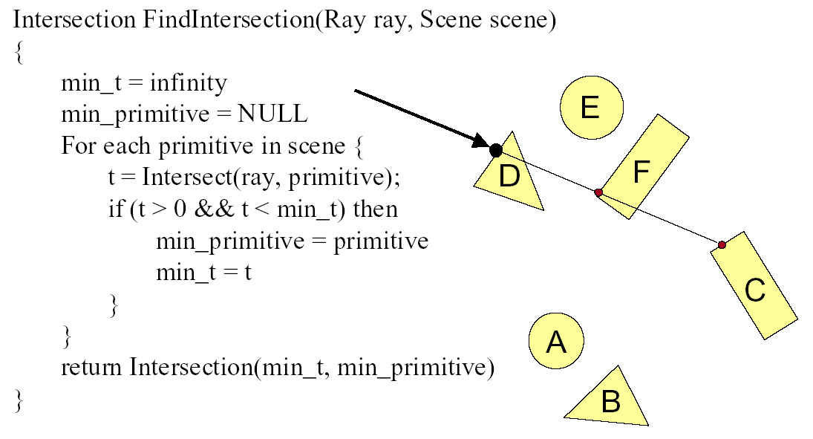
Ray Scene Intersection

Slide 33
Transformed Objects
E.g. transform sphere into ellipsoid
Could develop routine to trace ellipsoid (compute parameters after transformation)
May be useful for triangles, since triangle after transformation is still a triangle in any case
But can also use original optimized routines

Slide 34
Ray-Tracing Transformed Objects
We have an optimized ray-sphere test
But we want to ray trace an ellipsoid…
Solution: Ellipsoid transforms sphere
Apply inverse transform to ray, use ray-sphere
Allows for instancing (traffic jam of cars)
Same idea for other primitives

Slide 35
Transformed Objects
Consider a general 4x4 transform M
Will need to implement matrix stacks like in OpenGL
Apply inverse transform M⁻¹ to ray
Locations stored and transform in homogeneous coordinates
Vectors (ray directions) have homogeneous coordinate set to 0 [so there is no action because of translations]
Do standard ray-surface intersection as modified
Transform intersection back to actual coordinates
Intersection point p transforms as Mp
Distance to intersection if used may need recalculation
Normals n transform as M^{-t}n. Do all this before lighting

Slide 36
Outline
History
Basic Ray Casting (instead of rasterization)
Comparison to hardware scan conversion
Ray-Surface Intersection
Shadows / Reflections (core algorithm)
Optimizations
Current Research

Slide 37
Outline in Code
Image Raytrace (Camera cam, Scene scene, int width, int height)
{
Image image = new Image (width, height) ;
for (int i = 0 ; i < height ; i++)
for (int j = 0 ; j < width ; j++) {
Ray ray = RayThruPixel (cam, i, j) ;
Intersection hit = Intersect (ray, scene) ;
image[i][j] = FindColor (hit) ;
}
return image ;
}

Slide 38
Shadows
Light Source
Virtual Viewpoint
Virtual Screen
Objects
Shadow ray to light is blocked: object in shadow
Shadow ray to light is unblocked: object visible

Slide 39
Shadows: Numerical Issues
Numerical inaccuracy may cause intersection to be
below surface (effect exaggerated in figure)
Causing surface to incorrectly shadow itself
Move a little towards light before shooting shadow ray

Slide 40
Shading Model
Global ambient term, emission from material
For each light, diffuse specular terms
Note visibility/shadowing for each light (not in OpenGL)
Evaluated per pixel per light (not per vertex)

Slide 41
Mirror Reflections/Refractions
Virtual Viewpoint
Virtual Screen
Objects
Generate reflected ray in mirror direction,
Get reflections and refractions of objects

Slide 42
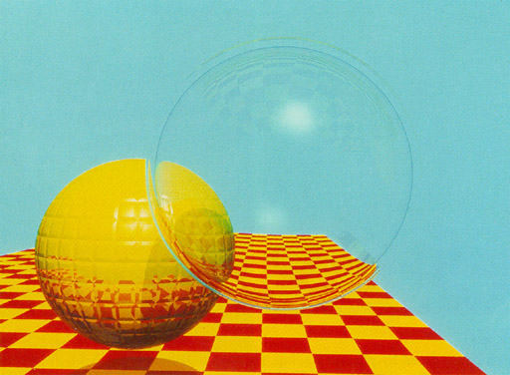
Turner Whitted 1980

Slide 43
Recursive Ray Tracing
For each pixel
Trace Primary Eye Ray, find intersection
Trace Secondary Shadow Ray(s) to all light(s)
Color = Visible ? Illumination Model : 0 ;
Trace Reflected Ray
Color += reflectivity * Color of reflected ray

Slide 44
Recursive Shading Model
Highlighted terms are recursive specularities [mirror reflections] and transmission (latter is extra credit)
Trace secondary rays for mirror reflections and refractions, include contribution in lighting model
GetColor calls RayTrace recursively (the I values in equation above of secondary rays are obtained by recursive calls)

Slide 45
Problems with Recursion
Reflection rays may be traced forever
Generally, set maximum recursion depth
Same for transmitted rays (take refraction into account)

Slide 46
Effects needed for Realism
(Soft) Shadows
Reflections (Mirrors and Glossy)
Transparency (Water, Glass)
Interreflections (Color Bleeding)
Complex Illumination (Natural, Area Light)
Realistic Materials (Velvet, Paints, Glass)
Discussed in this lecture
Not discussed but possible with distribution ray tracing
Hard (but not impossible) with ray tracing; path tracing next time

Slide 47
Outline
History
Basic Ray Casting (instead of rasterization)
Comparison to hardware scan conversion
Ray-Surface Intersection
Shadows / Reflections (core algorithm)
Optimizations
Current Research

Slide 48
Some basic add ons
Area light sources and soft shadows: break into grid of n x n point lights
Use jittering: Randomize direction of shadow ray within small box for given light source direction
Jittering also useful for antialiasing shadows when shooting primary rays
More complex reflectance models
Simply update shading model
But at present, we can handle only mirror global illumination calculations

Slide 49
Acceleration
Testing each object for each ray is slow
Fewer Rays
Adaptive sampling, depth control
Generalized Rays
Beam tracing, cone tracing, pencil tracing etc.
Faster Intersections
Optimized Ray-Object Intersections
Fewer Intersections
We just discuss some approaches at high level

Slide 50
Acceleration Structures
Bounding boxes (possibly hierarchical)
If no intersection bounding box, needn’t check objects
Bounding Box
Ray
Spatial Hierarchies (Oct-trees, kd trees, BSP trees)

Slide 51
Acceleration Structures: Grids

Slide 52
Acceleration and Regular Grids
Simplest acceleration, for example 5x5x5 grid
For each grid cell, store overlapping triangles
March ray along grid (need to be careful with this), test against each triangle in grid cell
More sophisticated: kd-tree, oct-tree bsp-tree
Or use (hierarchical) bounding boxes
Some acceleration is critical for path tracing

Slide 53
Outline
History
Basic Ray Casting (instead of rasterization)
Comparison to hardware scan conversion
Ray-Surface Intersection
Shadows / Reflections (core algorithm)
Optimizations
Current Research

Slide 54
Interactive Raytracing
Ray tracing historically slow
Now viable alternative for complex scenes
Key is sublinear complexity with acceleration; need not process all triangles in scene
Allows many effects hard in hardware
NVIDIA OptiX ray-tracing API like OpenGL
Recent NVIDIA OptiX release major advance
Ray tracing now practical for games
Integration with Microsoft’s DirectX
Dedicated Hardware
Machine Learning for denoising (later in course)

Slide 55
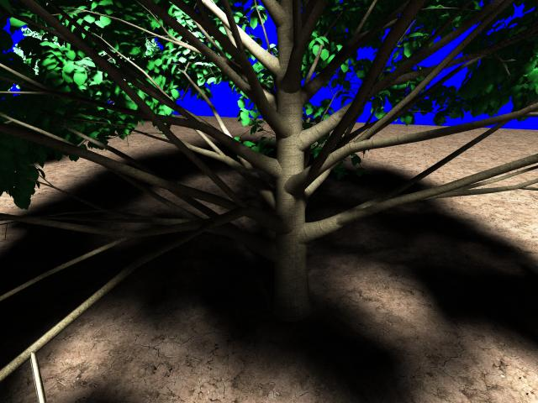
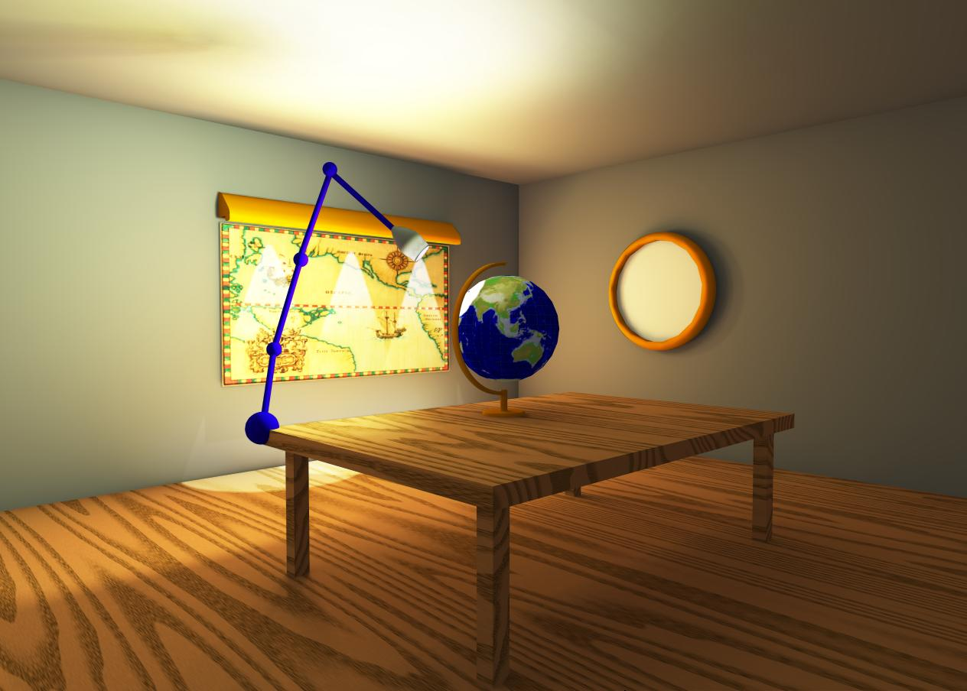
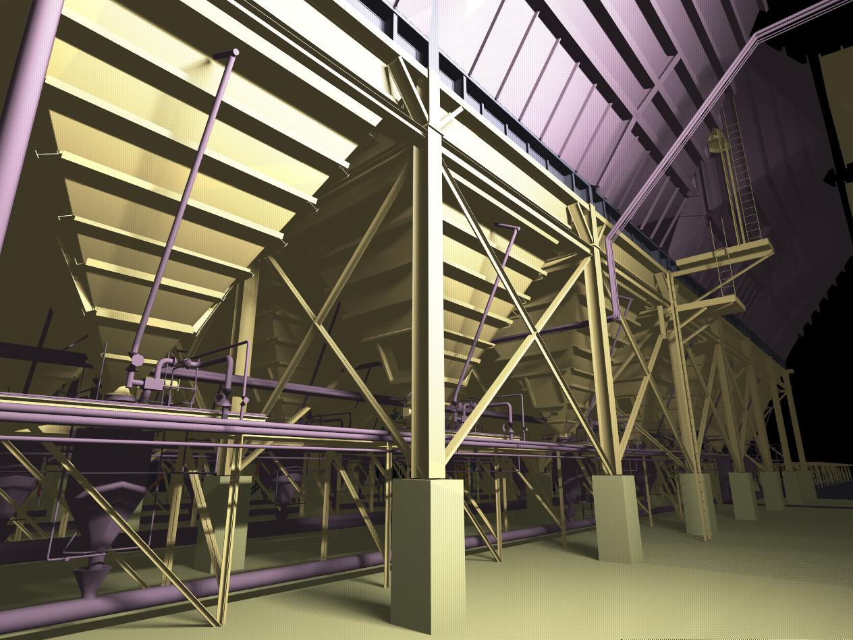
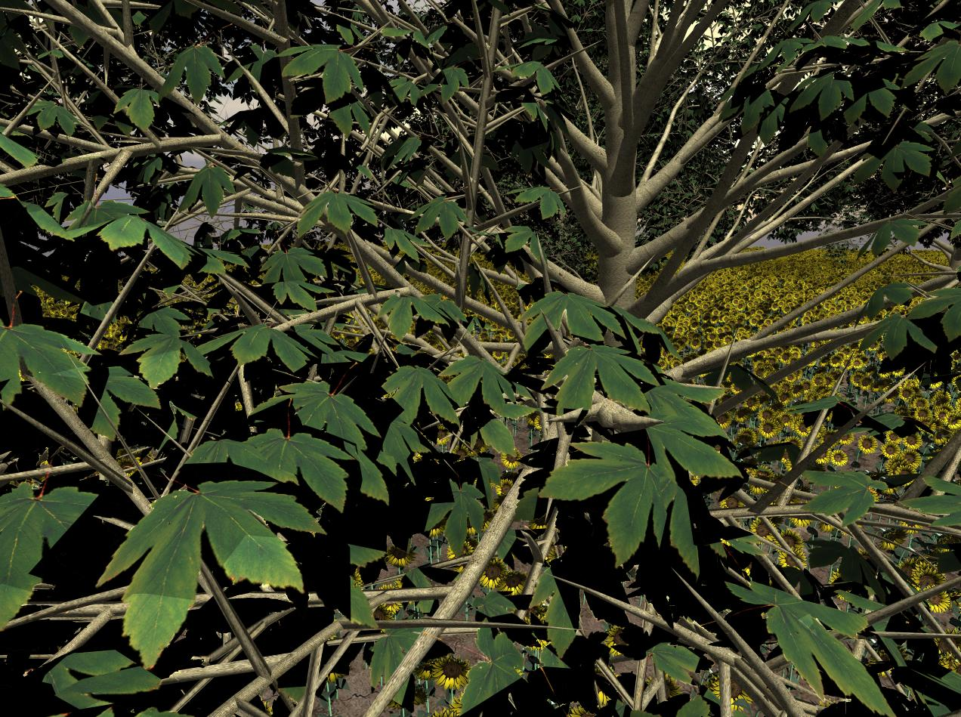

Slide 56
Raytracing on Graphics Hardware
Modern Programmable Hardware general streaming architecture
Can map various elements of ray tracing
Kernels like eye rays, intersect etc.
In vertex or fragment programs
Convergence between hardware, ray tracing
[Purcell et al. 2002, 2003]
http://graphics.stanford.edu/papers/photongfx

Slide 57
