Slide 1
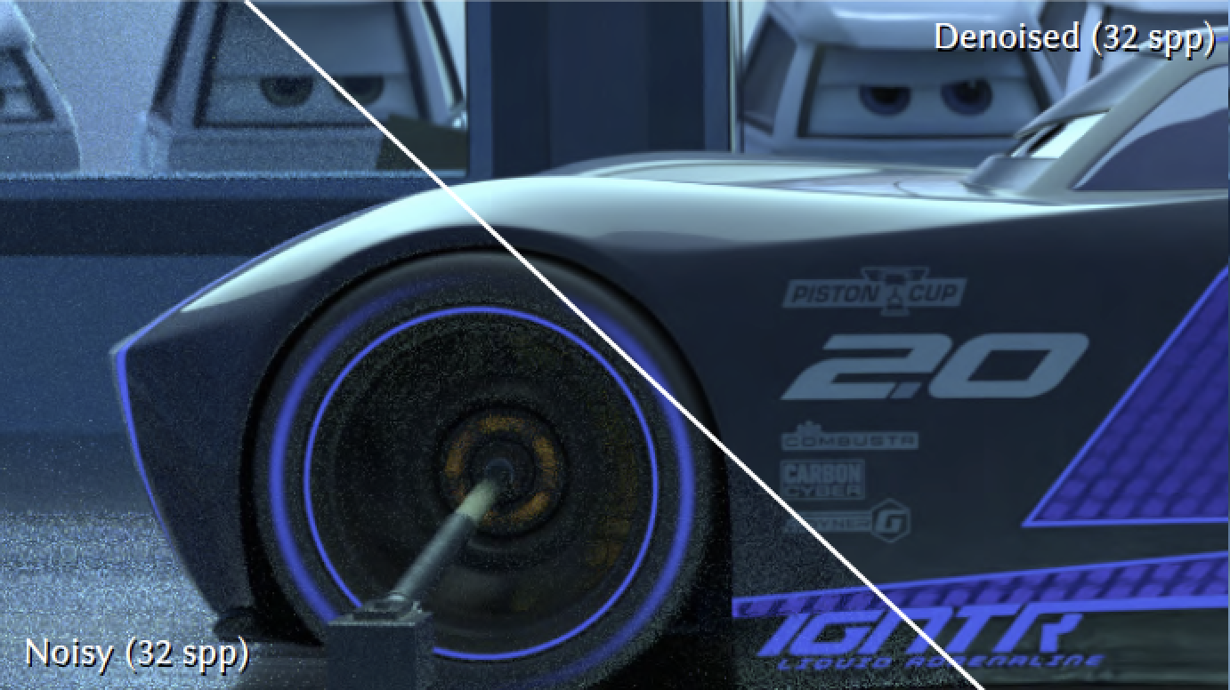
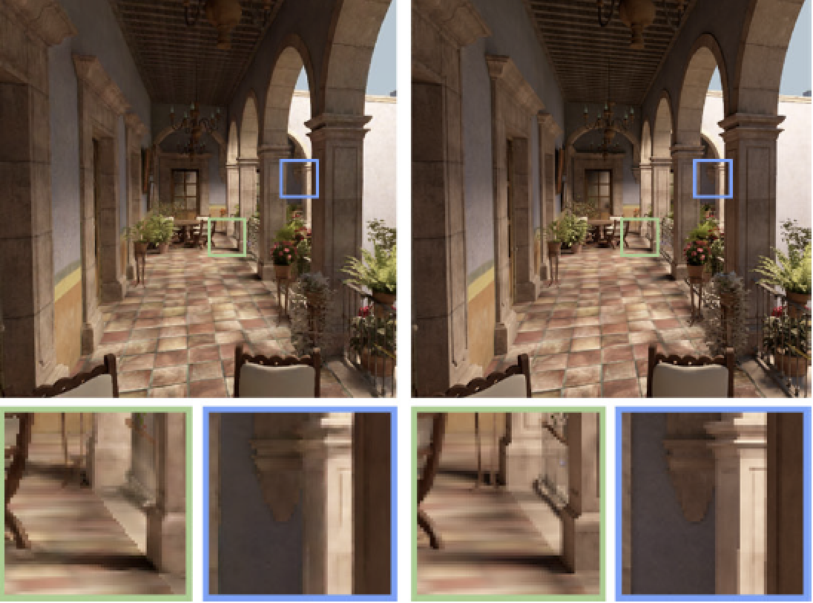
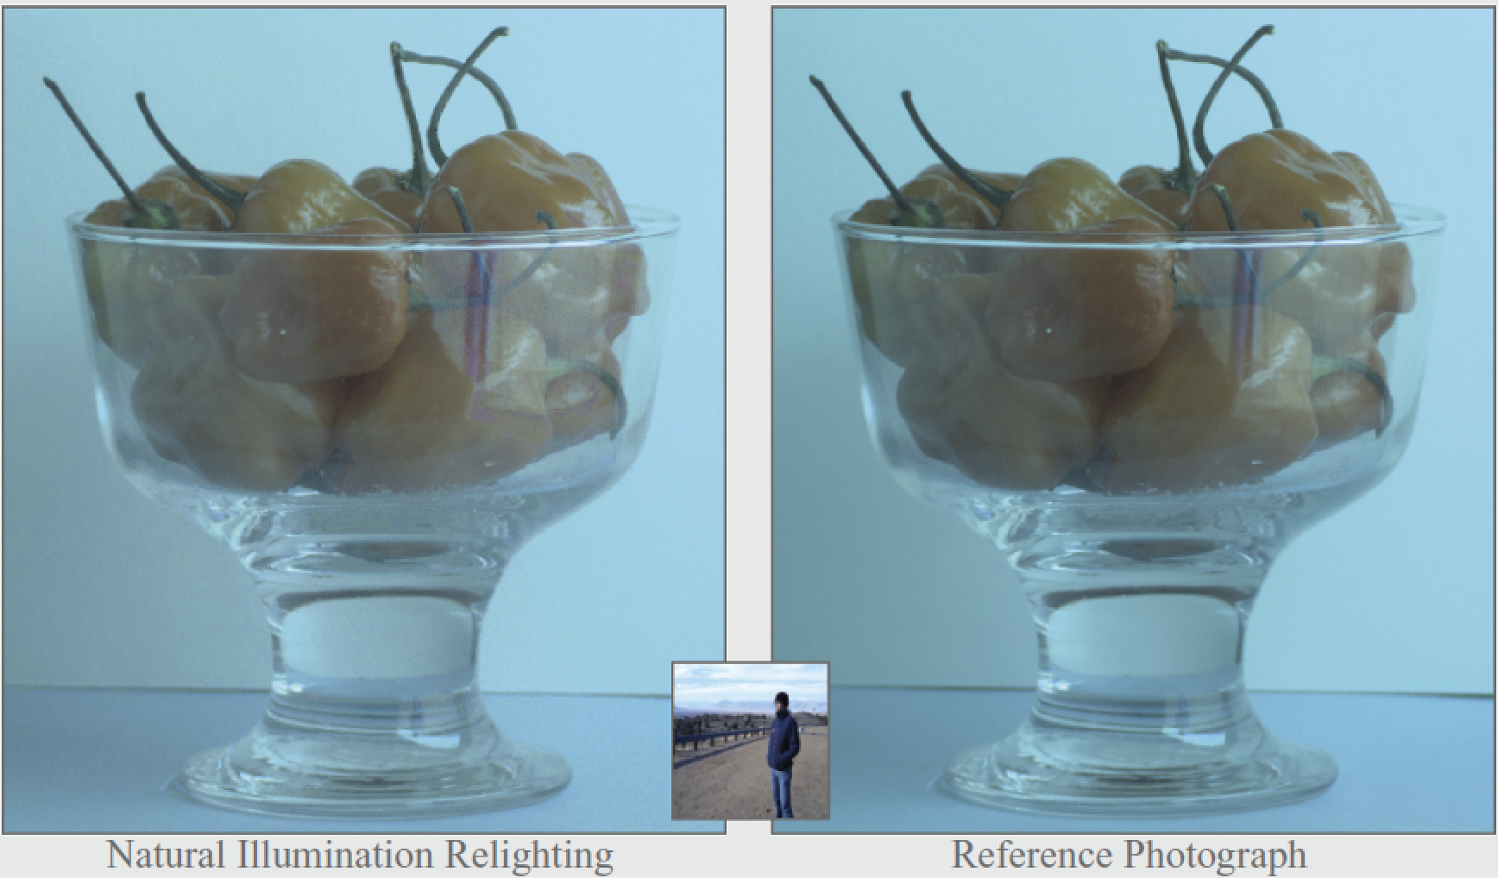
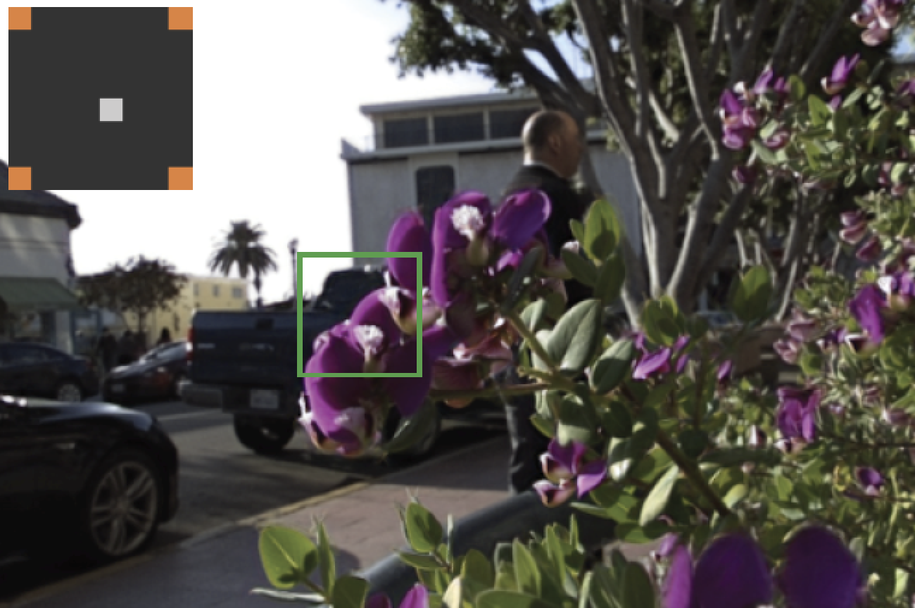
Sampling and Reconstruction of Visual Appearance
CSE 274 [Fall 2018], Lecture 7
Ravi Ramamoorthi
http://www.cs.ucsd.edu/~ravir

Slide 2
Basics of Denoising, Frequency Analysis
Monte Carlo Rendering (biggest application)
Basic idea of denoising
Frequency analysis one key concept
Presentation of key papers at next class
Relevant to other applications as well

Slide 3
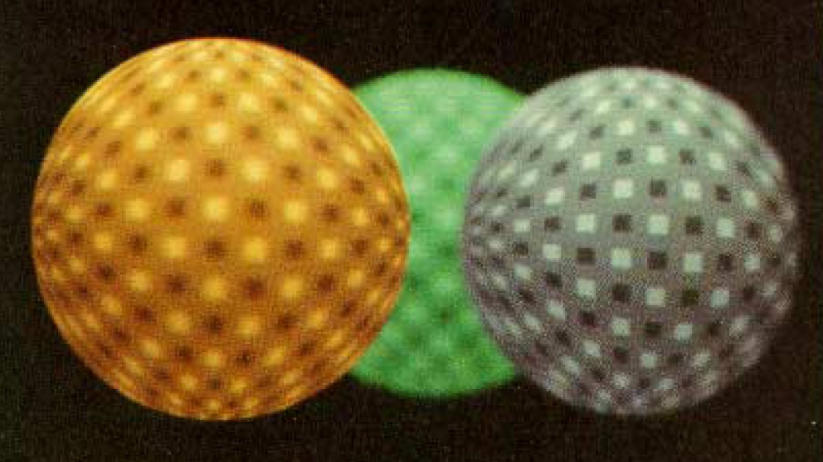
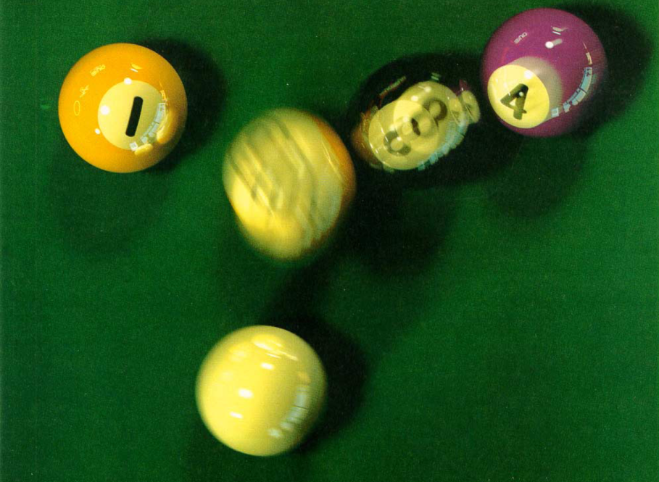
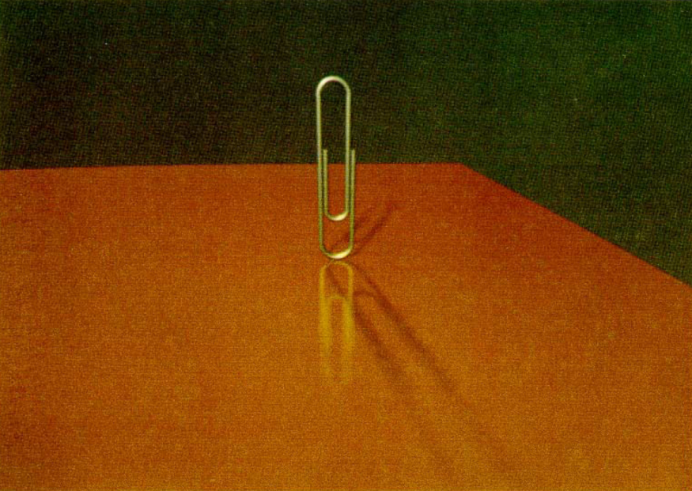
Cook et al. [1984] results
depth of field
motion blur
soft shadows
glossy reflection
Notes:
They were able to demonstrate some very impressive distributed effects.

Slide 4
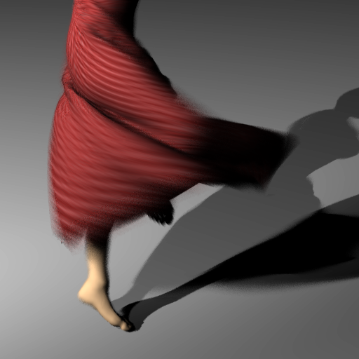
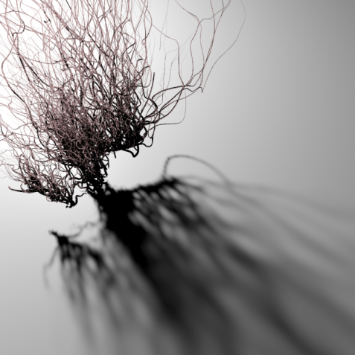
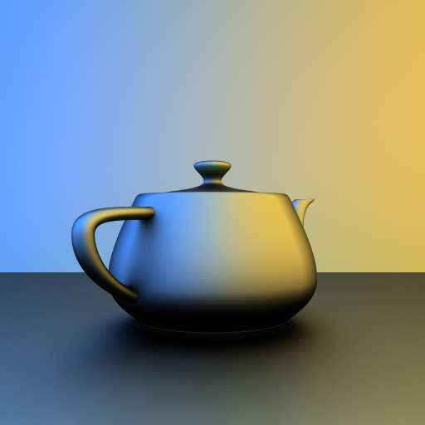
Motivation
Distribution effects (depth of field, motion blur, global illumination, soft shadows) are slow. Many dimensions sample
Ray Tracing physically accurate but slow, not real-time
Can we adaptively sample and filter for fast, real-time?

Slide 5
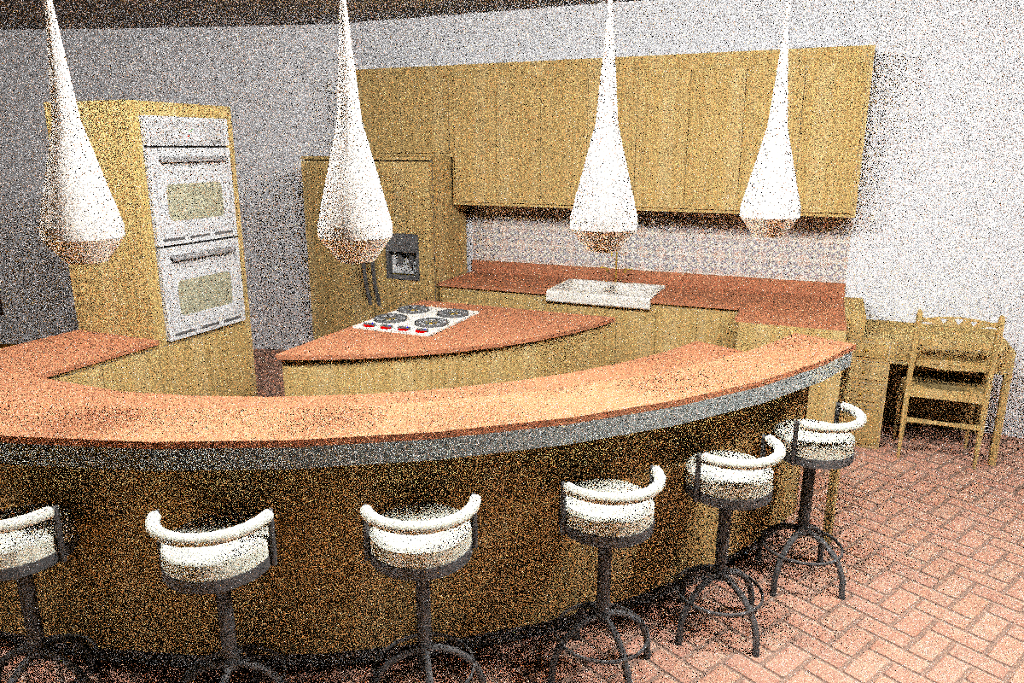
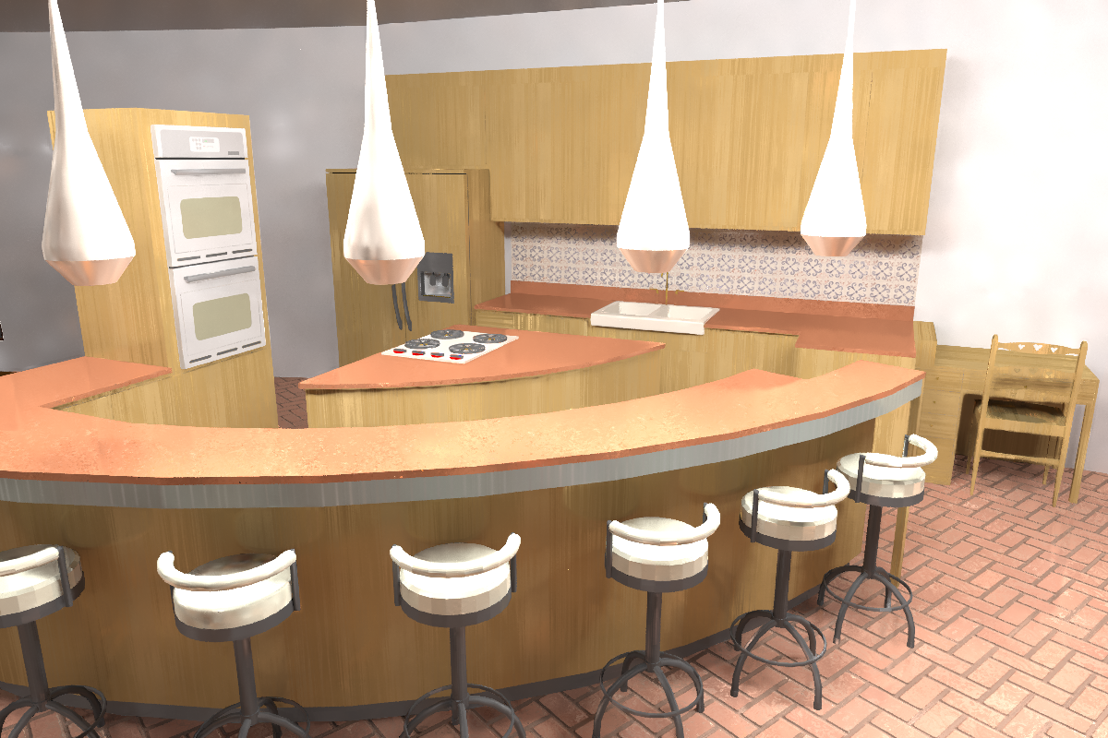
Sample result
[Kalantari et al. 2015]
Path traced scene
Filtered result
scene by Jo Ann Elliott
4 samples/pixel
(40.8 sec)
4 samples/pixel
(48.9 sec)
using only post-process filter!

Slide 6
Adaptive sampling + reconstruction
These algorithms use 2 kinds of noise reduction strategies, sometimes combined:
Adaptive sampling algorithms
Use information from renderer to position new samples better to reduce noise
Reconstruction (filtering) algorithms
Use information from renderer to remove MC noise directly
Both methods have been explored in the past, but new algorithms make remarkable advances

Slide 7
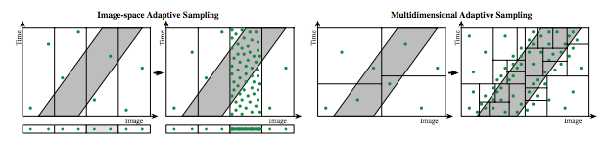
Multi-Dimensional Adaptive Sampling
Hachisuka, Jarosz, … Zwicker, Jensen [MDAS 2008]
Scenes with motion blur, depth of field, soft shadows
Involves high-dimensional integral, converges slowly
Exploit high-dimensional info to sample adaptively
Sampling in 2D image plane or other dims inadequate
Need to consider full joint high-dimensional space

Slide 8
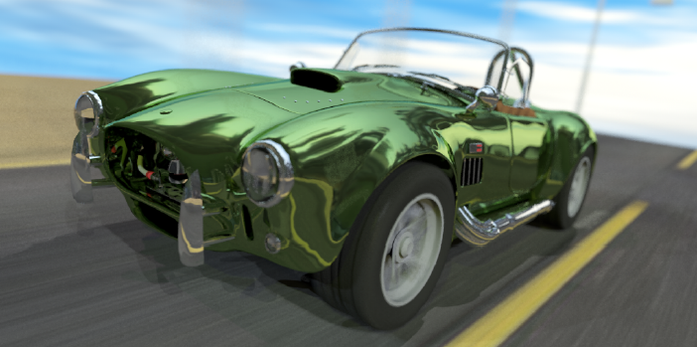
Multi-Dimensional Adaptive Sampling
Motion Blur and Depth of Field 32 samples per pixel

Slide 9
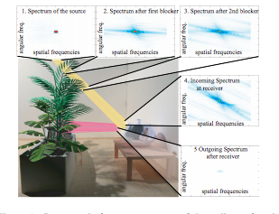
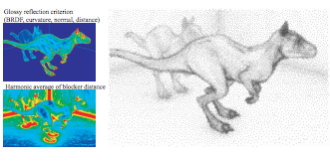
Resurgence (2008 - )
Eurographics 2015 STAR report by Zwicker et al.
Papers below are key a-priori, frequency analysis methods
Many other approaches to be discussed in class
[Durand et al. 2005] Frequency analysis light transport
Key theoretical ideas, but not initially very practical
[Chai et al. 2000] Plenoptic Sampling (wedge spectrum)
[Egan et al. 2009] First practical a-priori frequency method

Slide 10
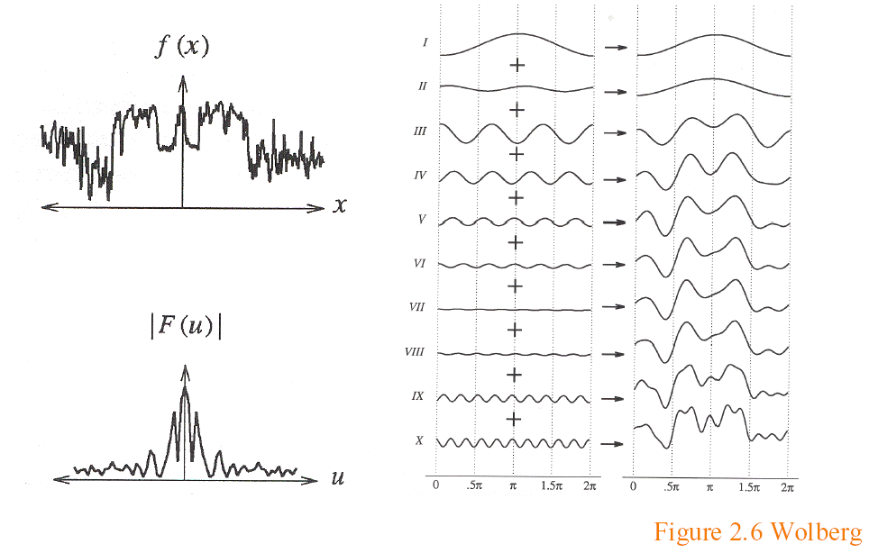
Background: Fourier Analysis
Analysis in the frequency (not spatial) domain
Sum of sine waves, with possibly different offsets (phase)
Each wave different frequency, amplitude

Slide 11
Fourier Transform
Tool for converting from spatial to frequency domain
Or vice versa
One of most important mathematical ideas
Computational algorithm: Fast Fourier Transform
One of 10 great algorithms scientific computing
Makes Fourier processing possible (images etc.)
Not discussed here, but look up if interested

Slide 12
Fourier Transform
Simple case, function sum of sines, cosines
Continuous infinite case

Slide 13
Fourier Transform
Simple case, function sum of sines, cosines
Discrete case

Slide 14
Fourier Transform: Examples 1
Single sine curve (+constant DC term)

Slide 15
Fourier Transform Examples 2
Common examples

Slide 16
Fourier Transform Properties
Common properties
Linearity:
Derivatives: [integrate by parts]
2D Fourier Transform
Convolution (next)

Slide 17
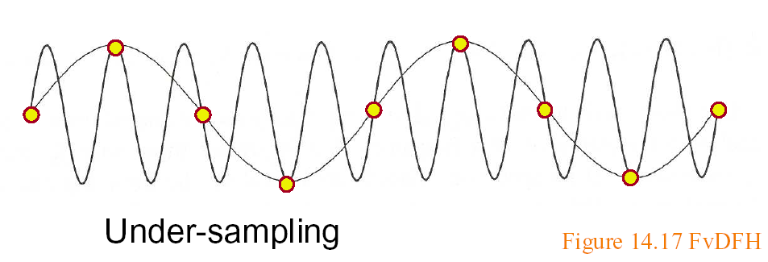
Sampling Theorem, Bandlimiting
A signal can be reconstructed from its samples, if the original signal has no frequencies above half the sampling frequency – Shannon
The minimum sampling rate for a bandlimited function is called the Nyquist rate

Slide 18
Sampling Theorem, Bandlimiting
A signal can be reconstructed from its samples, if the original signal has no frequencies above half the sampling frequency – Shannon
The minimum sampling rate for a bandlimited function is called the Nyquist rate
A signal is bandlimited if the highest frequency is bounded. This frequency is called the bandwidth
In general, when we transform, we want to filter to bandlimit before sampling, to avoid aliasing

Slide 19
Antialiasing
Sample at higher rate
Not always possible
Real world: lines have infinitely high frequencies, can’t sample at high enough resolution
Prefilter to bandlimit signal
Low-pass filtering (blurring)
Trade blurriness for aliasing

Slide 20
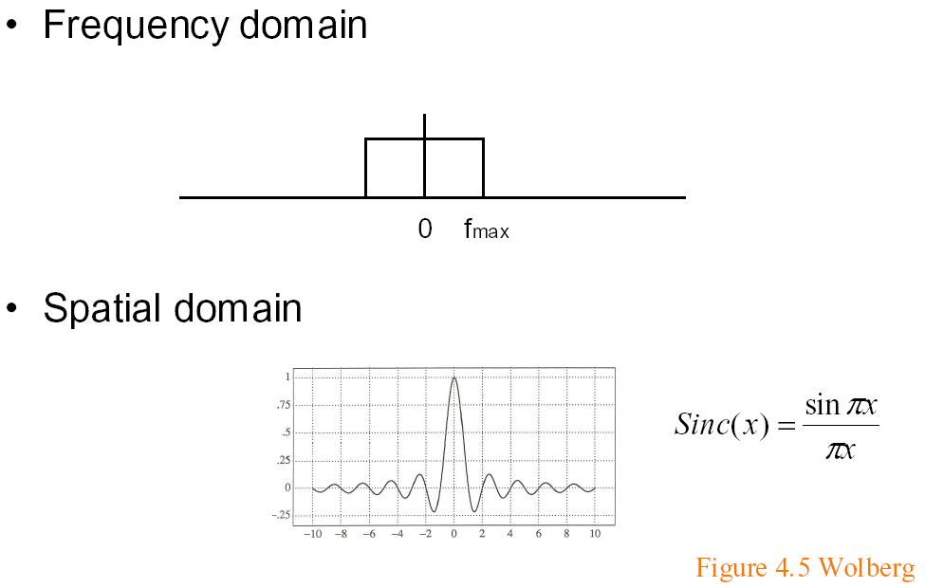
Ideal bandlimiting filter
Formal derivation is exercise
if full width f_{max} = 1

Slide 21
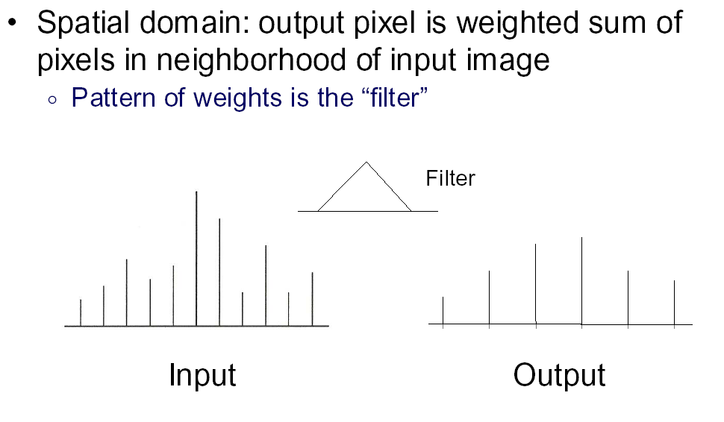
Convolution 1

Slide 22
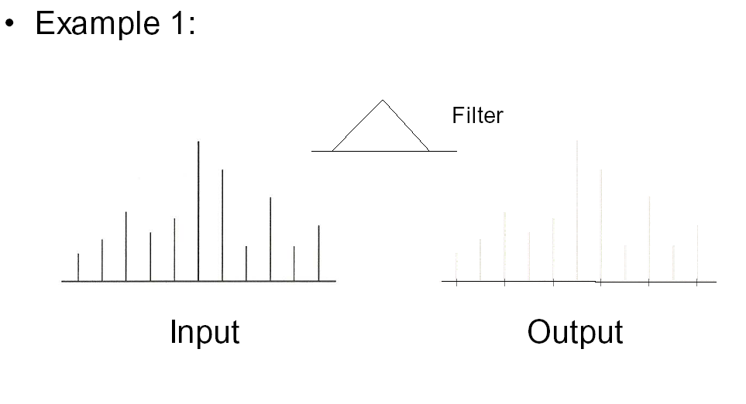
Convolution 2

Slide 23
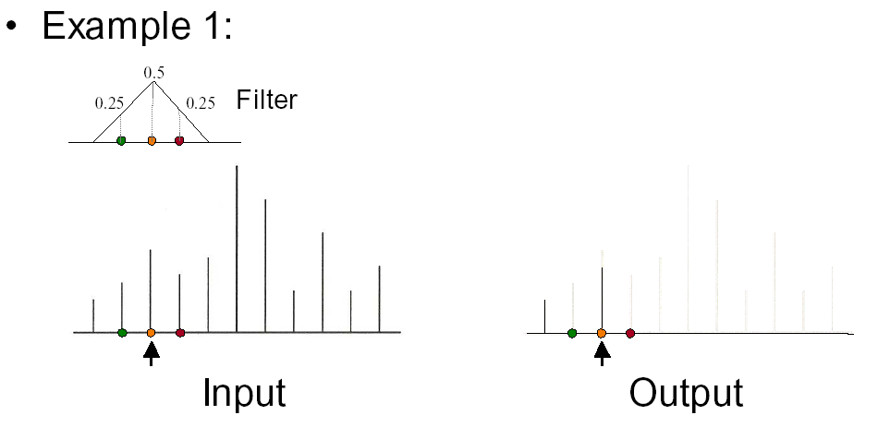
Convolution 3

Slide 24
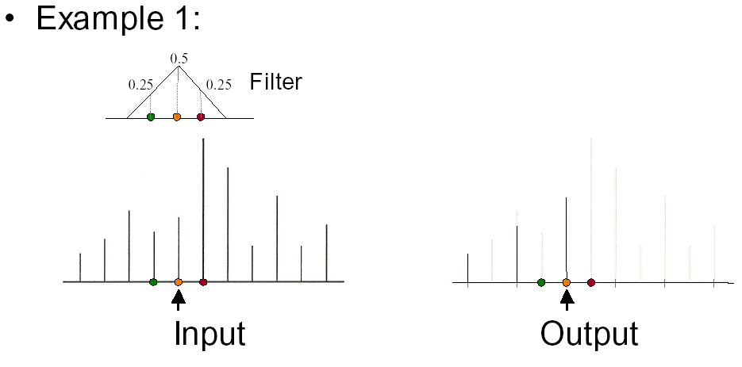
Convolution 4

Slide 25
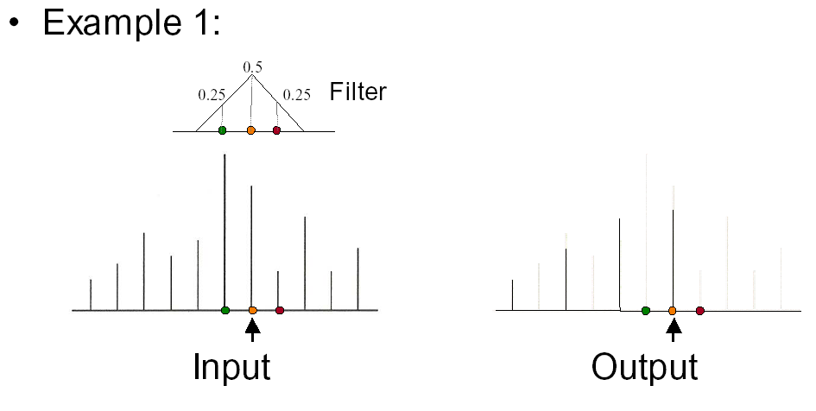
Convolution 5

Slide 26
Convolution in Frequency Domain
Convolution (f is signal ; g is filter [or vice versa])
Fourier analysis (frequency domain multiplication)

Slide 27
A Frequency Analysis of Light Transport
F. Durand, MIT CSAIL
N. Holzschuch, C. Soler, ARTIS/GRAVIR-IMAG INRIA
E. Chan, MIT CSAIL
F. Sillion, ARTIS/GRAVIR-IMAG INRIA
Notes:
Titre 2

Slide 28
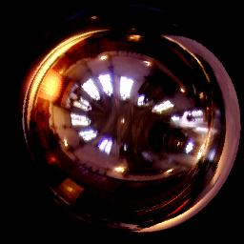
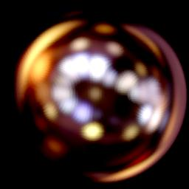
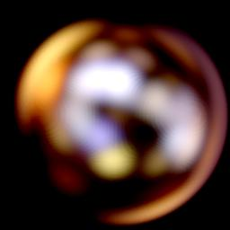
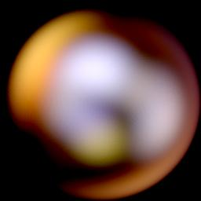
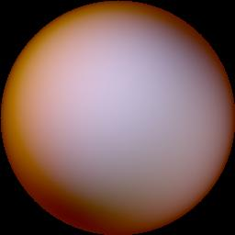
Illumination effects
Blurry reflections:
From [Ramamoorthi and Hanrahan 2001]
Notes:
Good morning. The topic of my talk is illumination and light transport. You all know some interesting illumination effects: for example, a glossy reflection function blurs the environment, as you can see here. On a specular receiver, you can identify all the features of the environment, while on glossy receivers, the environment becomes less and less identifiable. You can notice that the identifiable features on the receivers become larger and larger as the receivers become more glossy.

Slide 29
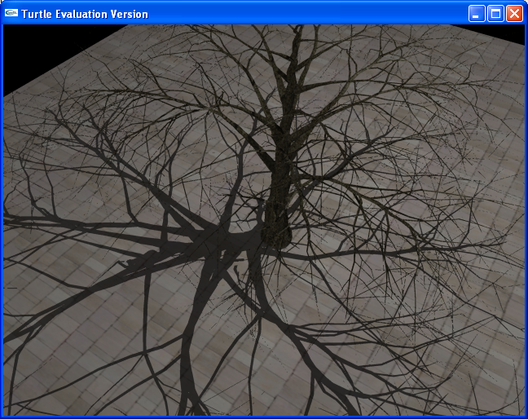
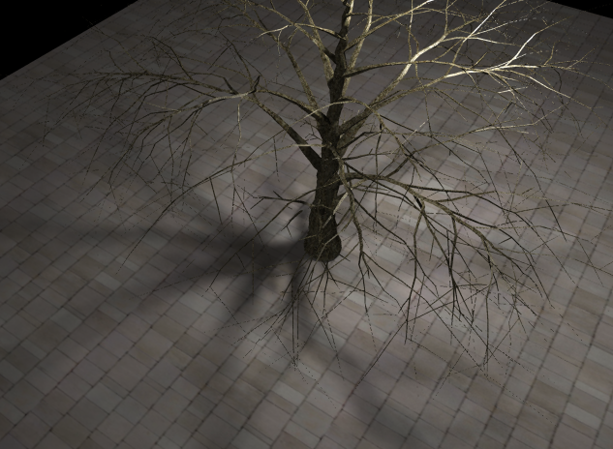
Illumination effects
Shadow boundaries:
Point light source
Area light source
© U. Assarsson 2005.
Notes:
Similarly, shadow boundaries can be either vary sharp, for example in the case of point light sources, or when the shadow casting object touches the receiver.
They can also be blurry, when the shadow casting objects are small with respect to the light source, or far from the receiver. In certain circumstances, the shadow boundary disappears completely.

Slide 30
Problem statement
How does light interaction in a scene explain the frequency content?
Theoretical framework:
Understand the frequency spectrum of the radiance function
From the equations of light transport
Notes:
Diapo très importante.
Pause de 5 secondes après chaque phrase.
Our problem is to understand the relationship between this frequency content and the light interactions in the scene.
To put things differently, we will study how the light is transported and interacts in a scene, and deduct from that the frequency spectrum of the radiance function.
Our starting point will therefore be the mathematical equations of light transport, and our end point will be the Fourier spectrum of the illumination in the scene.

Slide 31
Unified framework:
Spatial frequency (e.g. shadows, textures)
Angular frequency (e.g. blurry highlight)
Notes:
Bien souligner que c’est U-NI-FIE.
In this talk, we are going to derive a u-ni-fied framework for both spatial and angular frequencies. We will show in which circumstances high frequencies appear in the spatial or angular domains, and in which circumstances high frequencies can disappear.
We will also show that in certain circumstances, spatial frequencies can be turned into angular frequencies, or the opposite.

Slide 32
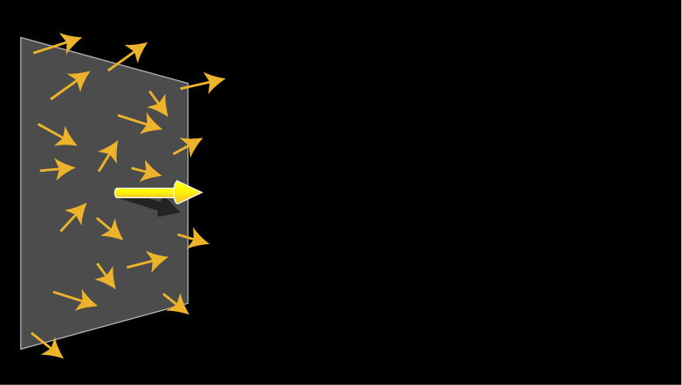
Local light field
4D light field, around a central ray
Central ray

Slide 33
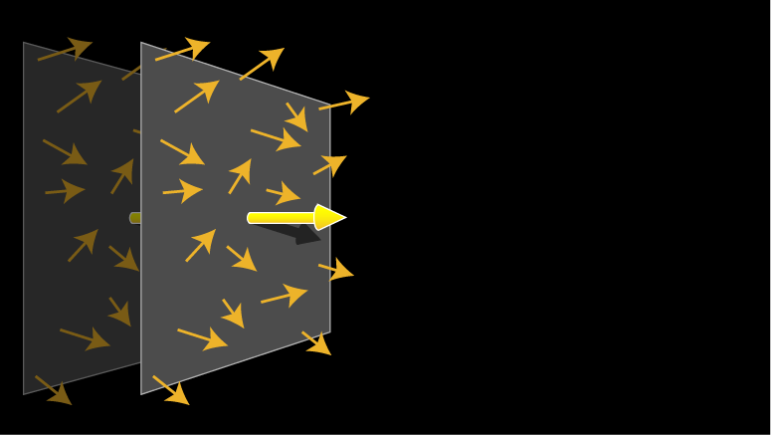
Local light field
4D light field, around a central ray
We study its spectrum during transport

Slide 34
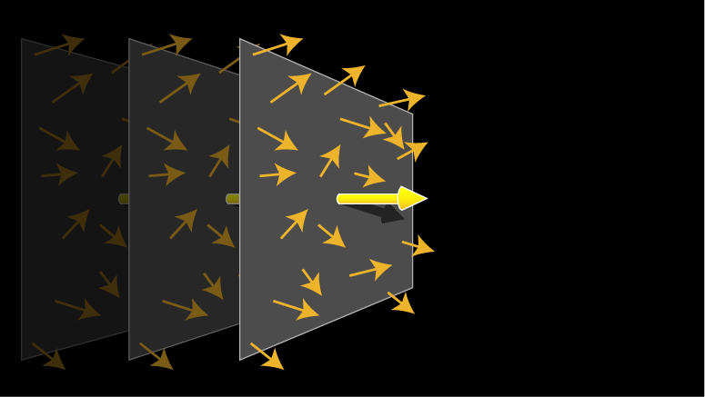
Local light field
4D light field, around a central ray
We study its spectrum during transport

Slide 35
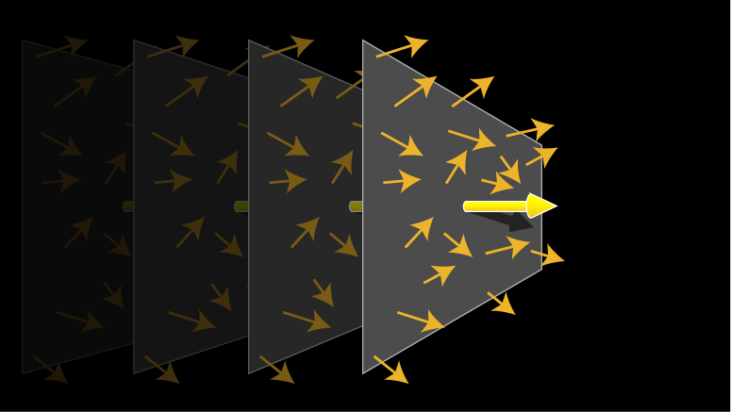
Local light field
4D light field, around a central ray
We study its spectrum during transport

Slide 36
Local light field parameterization
Space and angle
angle
space
Central ray

Slide 37
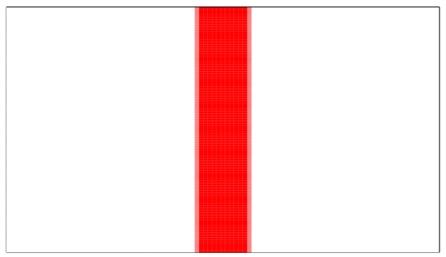
Local light field representation
Density plot:
Angle
Space
Notes:
The local light field will be represented as a density plot, with the spatial dimension on the horizontal axis, and the angular dimension on the vertical axis.
For example, here you have the local light field of an area spot light, which occupies an area in space, with a gaussian falloff in angle.

Slide 38
Local light field Fourier spectrum
We are interested in the Fourier spectrum of the local light field
Also represented as a density plot
Notes:
We are also interested in the Fourier spectrum of the local light field. This spectrum will also be represented as a density plot, with the spatial frequencies on the horizontal axis and the angular frequencies on the vertical axis.
Pause
Next slide

Slide 39
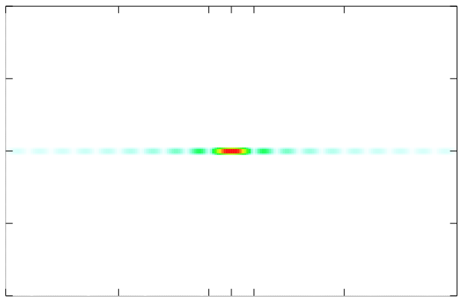
Local light field Fourier spectrum
Angular frequency
Spatial frequency
Notes:
Here, you can see the Fourier spectrum of the spot light in the previous example. Its Fourier spectrum in the spatial dimension is a sine cardinal, and its Fourier spectrum in the angular dimension is another Gaussian.
You can see here that the example contains high spatial frequencies, corresponding to the sharp cutoff at the spatial boundary, and a small number of angular frequencies.
In this presentation, you will see many plots like this one, so it is interesting to pause and look at it more closely. What it represents is a combination of spatial and angular frequencies. Something that occurs far on the horizontal axis corresponds to a high spatial frequency, that is a sharp feature. Something that occurs at the center of the horizontal axis corresponds to a low spatial frequency, that is a blurry feature. Same for the vertical axis and angular frequency. Here, the frequencies are mostly on the horizontal axis, because we have an area spot light, sharp features in the spatial dimension, blurry features in the angular dimension.

Slide 40
Fourier analysis 101
Spectrum corresponds to blurriness:
Sharpest feature has size ~ 1/F_{max}
Convolution theorem:
Multiplication of functions: spectrum is convolved
Convolution of functions: spectrum is multiplied
Classical spectra:
Box becomes sinc
Dirac becomes constant
Notes:
Before we start with the main part of the paper, I think it is worth remembering some of the most important points of Fourier analysis.
First of all, the Fourier spectrum of a function corresponds to the feature size in the function. The smallest feature in the function is of size 1/Fmax, where Fmax is the largest frequency in the Fourier spectrum. Obviously, the function should be sampled at intervals of 1/Fmax.
Second, the Fourier analysis is closely related with the integral tool called convolution. When you multiply two functions, the Fourier spectrum of their product is the convolution of their spectra. Inversely, when you take the convolution of two functions, the Fourier spectrum of the result is the multiplication of their spectra.
Finally, it is worth remembering that the Fourier transform of a box function is a sine cardinal (and reciprocally, the Fourier transform of a sine cardinal is a box function), and the Fourier transform of a constant function is a Dirac, and reciprocally.

Slide 41
Transport
Shear: x’ = x - v d
d
x
vd
v
x’
Ray space
Ray space
v (angle)
v (angle)
x (space)
x (space)

Slide 42
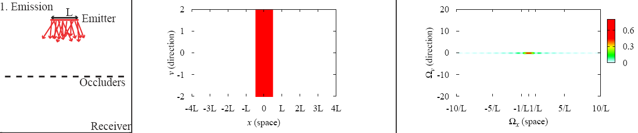
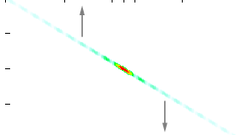
Transport in Fourier space
Shear in primal: x’ = x - v d
Shear in Fourier, along the other dimension
Ray space
Ray space
Fourier space
Fourier space
Ωv (angle)
Ωv (angle)
Ωx (space)
Ωx (space)

Slide 43
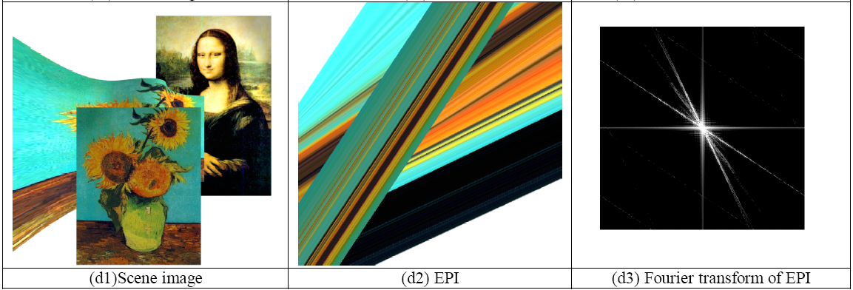
Transport becomes Shear
This is consistent with light field spectra [Chai et al. 00, Isaksen et al. 00]
From [Chai et al. 2000]
Notes:
This result is consistent with previous studies on light field parameterization, which found that the optimal sampling rate for a light field was related to the inverse of the distance to the object.

Slide 44
BRDF integration
Ray-space: convolution
Outgoing light: convolution of incoming light and BRDF
For rotationally-invariant BRDFs
Fourier domain: multiplication
Outgoing spectrum: multiplication of incoming spectrum and BRDF spectrum
Notes:
For well-behaved BRDFs, this corresponds to a convolution. The outgoing light is equal to the convolution of the incoming light and the BRDF of the receiver.
As we have seen, this means that the spectrum of the outgoing light is the product of the spectrum of the incoming light and the spectrum of the BRDF.
If the BRDF is spatially constant, then the convolution and the multiplication only take place in the angular dimension.

Slide 45
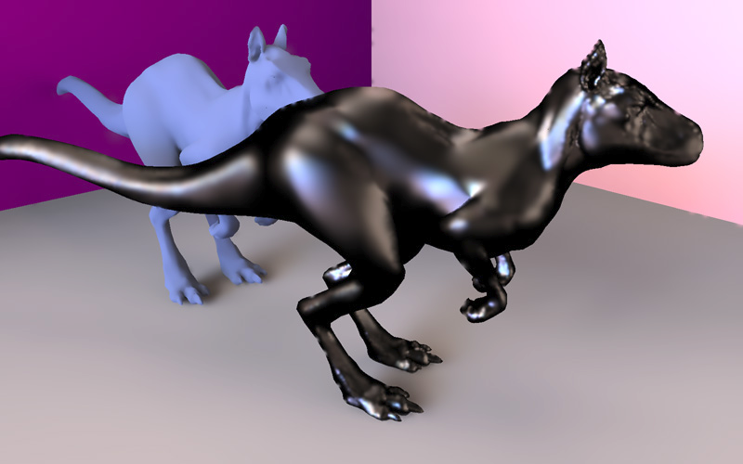
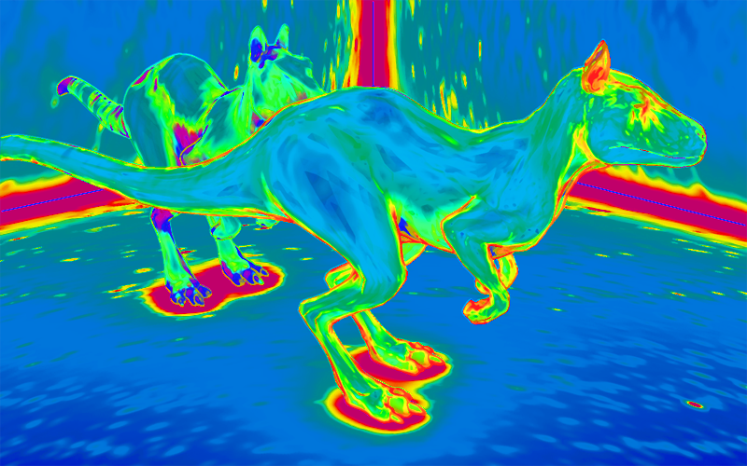
Adaptive shading sampling
Per-pixel prediction of max. frequency (bandwidth)
Based on curvature, BRDF, distance to occluder, etc.
No spectrum computed, just estimate max frequency
Per-pixel bandwidth criterion

Slide 46
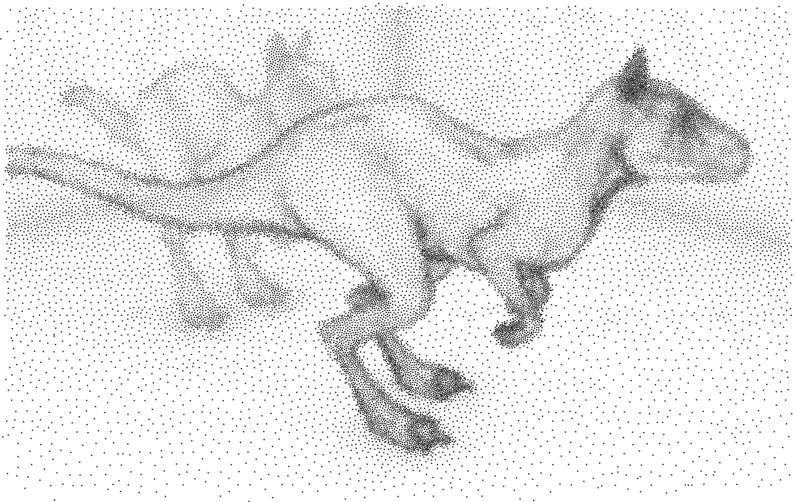
Adaptive shading sampling
Per-pixel prediction of max. frequency (bandwidth)
Based on curvature, BRDF, distance to occluder, etc.
No spectrum computed, just estimate max frequency
Shading samples

Slide 47

Uniform sampling
20,000 samples

Slide 48
Adaptive sampling
20,000 samples

Slide 49
Plenoptic Sampling
Plenoptic Sampling. Chai, Tong, Chan, Shum 00
Signal-processing on light field
Minimal sampling rate for antialiased rendering
Relates to depth range, Fourier analysis
Fourier spectra derived for 2D light fields for simplicity. Same ideas extend to 4D
Key paper in many newer methods on sheared and axis-aligned filtering for adaptive sampling

Slide 50
A Geometrical Intuition
Z_{opt}
Z_{min}
Camera i
Camera i+1

Slide 51
A Geometrical Intuition
Z_{opt}
Disparity Error
<
1 Pixel
Z_{min}
Camera i
Camera i+1
Rendering Camera

Slide 52
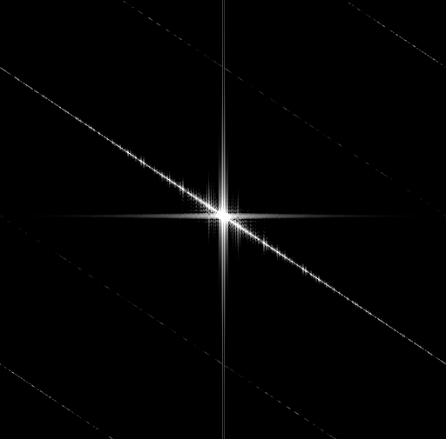
A Constant Plane
v
Z
t
t
v
Z₁
Z₁

Slide 53

Two Constant Planes
v
Z
t
Z₂
t
v
Z₁
Z₁
Z₂

Slide 54
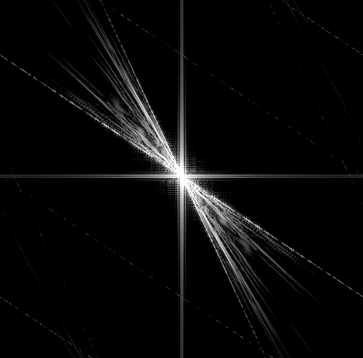
Between Two Planes
v
Z
t
Z₂
t
v
Z₁
Z₁
Z₂

Slide 55

Between Two Planes
v
Z
t
Z₂
t
v
Z₁
Z₁
Z₂
Notes:
Now we know the shape of the spectral support of the 2D continuous light field is like a wedge.

Slide 56
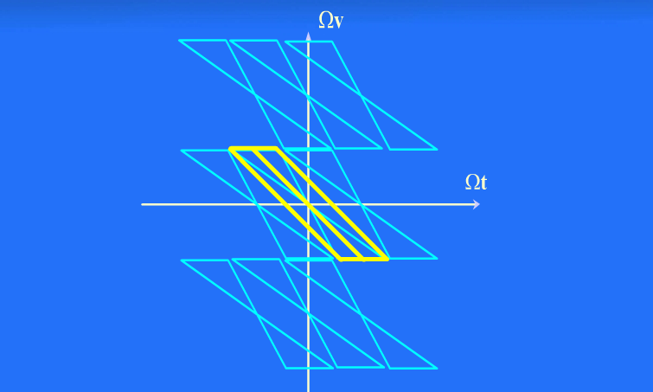
Light Field Reconstruction

Slide 57
Minimum Sampling Curve
Number of Images
Joint Image and Geometry Space
32x32
Minimum Sampling Curve
16x16
8x8
4x4
2x2
1
2
3
6
12
Accurate Depth
Number of Depth Layers

Slide 58

Frequency Analysis and Sheared Reconstruction for Rendering Motion Blur
Kevin Egan
Yu-Ting Tseng
Nicolas Holzschuch
Frédo Durand
Ravi Ramamoorthi
Columbia University
Columbia University
INRIA -- LJK
MIT CSAIL
University of California, Berkeley
Notes:
58

Slide 59
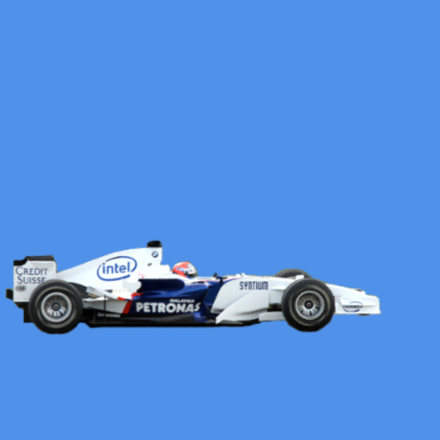

Observation
Motion blur is expensive
Motion blur removes spatial complexity
Notes:
59

Slide 60
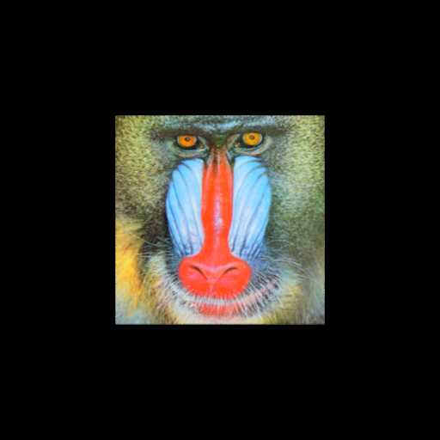
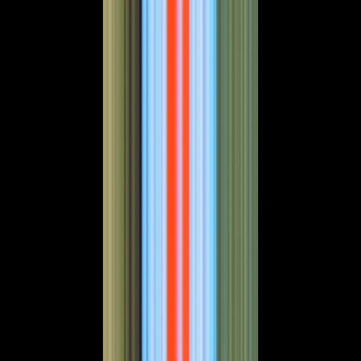
Basic Example
Space-time graph
Object not moving
f(x, y)
f(x, t)
y
TIME
x
SPACE
Notes:
60

Slide 61

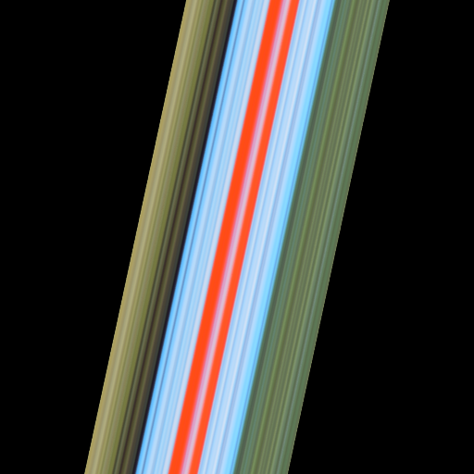

Basic Example
Low velocity, t ε [ 0.0, 1.0 ]
f(x, y)
f(x, t)
t
y
x
x
Notes:
61
And if we animate this…

Slide 62

Basic Example
High velocity, t ε [ 0.0, 1.0 ]
f(x, y)
f(x, t)
t
y
x
x
Notes:
62
And if we animate this…

Slide 63
Shear in Space-Time
shear
Object moving with low velocity
f(x, y)
f(x, t)
t
y
x
x
Notes:
63

Slide 64
Shear in Space-Time
Object moving with high velocity
f(x, y)
f(x, t)
t
y
x
x
Notes:
64

Slide 65

Shear in Space-Time
Object moving away from camera
f(x, y)
f(x, t)
t
y
x
x
Notes:
65

Slide 66


Basic Example
Applying shutter blurs across time
f(x, y)
f(x, t)
t
y
x
x
Notes:
66

Slide 67
Basic Example – Fourier Domain
Fourier spectrum, zero velocity
f(x, t)
F(Ω_{x}, Ω_{t})
texture bandwidth
Ω_{x}
t
Ω_{t}
x
Notes:
67

Slide 68
Basic Example – Fourier Domain
Low velocity, small shear in both domains
f(x, t)
F(Ω_{x}, Ω_{t})
slope = -speed
Ω_{x}
t
Ω_{t}
x
Notes:
68

Slide 69
Basic Example – Fourier Domain
Large shear
f(x, t)
F(Ω_{x}, Ω_{t})
Ω_{x}
t
Ω_{t}
x
Notes:
69

Slide 70
Basic Example – Fourier Domain
Non-linear motion, wedge shaped spectra
f(x, t)
F(Ω_{x}, Ω_{t})
Ω_{x}
t
-min speed
shutter applies blur across time
indirectly bandlimits in space
shutter bandlimits in time
-max speed
Ω_{t}
x
Notes:
70

Slide 71
Sampling in Fourier Domain
Sampling produces replicas in Fourier domain
Sparse sampling produces dense replicas
Primal Domain
Fourier Domain
Ω_{x}
t
₊
Ω_{t}
x
Notes:
71

Slide 72
Standard Reconstruction Filtering
Standard filter, dense sampling (slow)
replicas
Fourier Domain
Ω_{x}
no aliasing
Ω_{t}
Notes:
72

Slide 73
Standard Reconstruction Filter
Standard filter, sparse sampling (fast)
Fourier Domain
Ω_{x}
aliasing
Ω_{t}
Notes:
73

Slide 74
Sheared Reconstruction Filter
Our sheared filter, sparse sampling (fast)
Fourier Domain
Ω_{x}
No aliasing!
Ω_{t}
Notes:
74

Slide 75
Sheared Reconstruction Filter
Compact shape in Fourier = wide in primal
Primal Domain
Fourier Domain
x
Ω_{x}
t
Ω_{t}
Notes:
75

Slide 76


Car Scene
Our Method,
4 samples per pixel
Stratified Sampling
4 samples per pixel
Notes:
76

Slide 77

Teapot Scene
Our Method
8 samples / pix
motion blurred reflection
Notes:
77

Slide 78

Ballerina Video
Notes:
78

