Slide 1
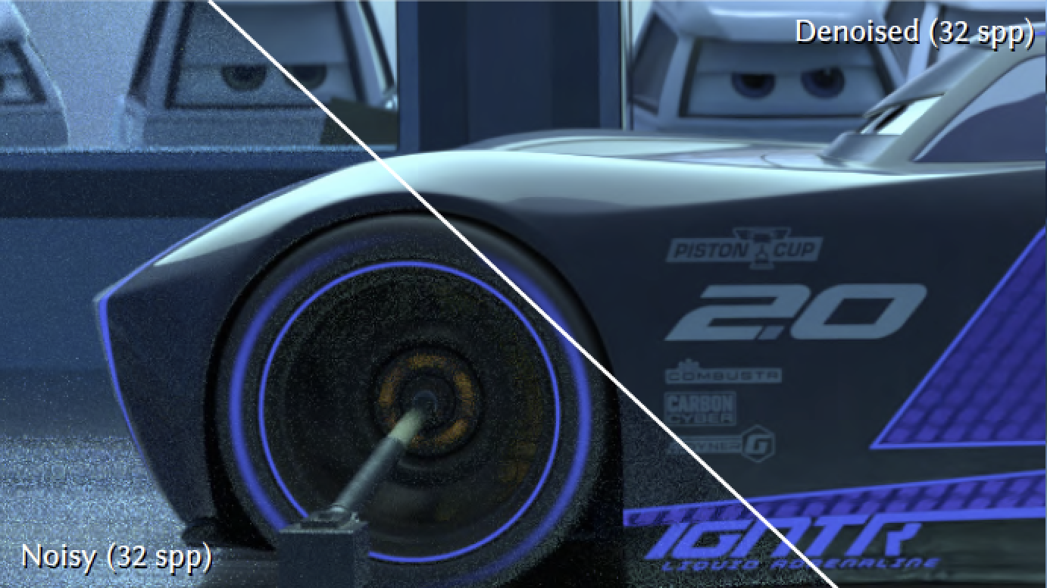
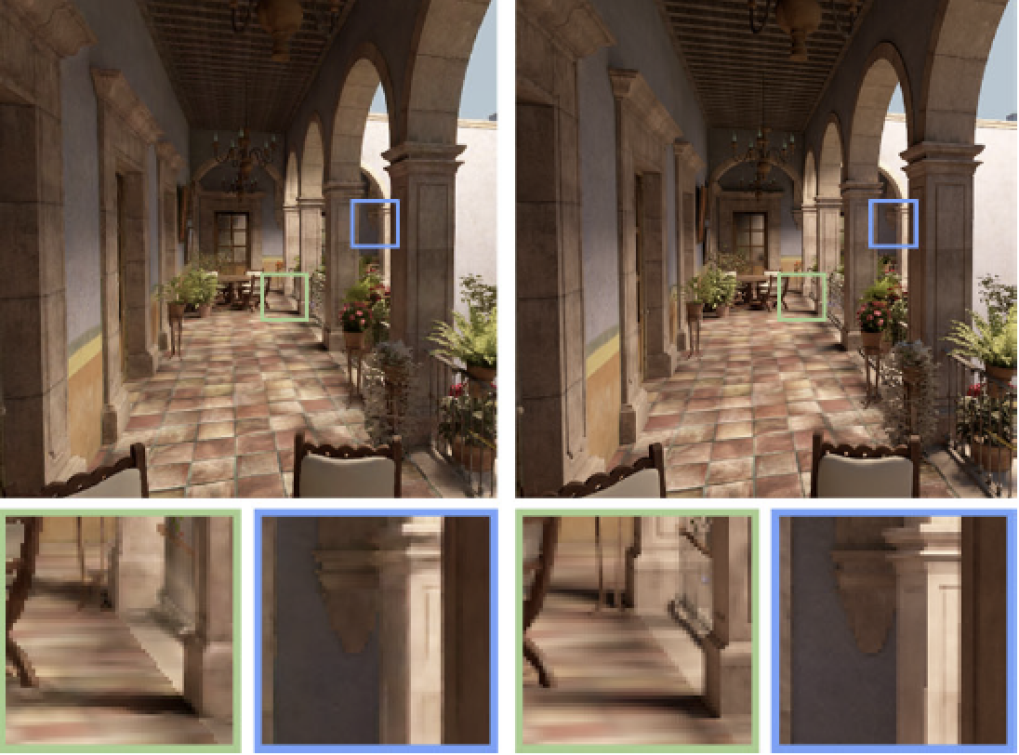
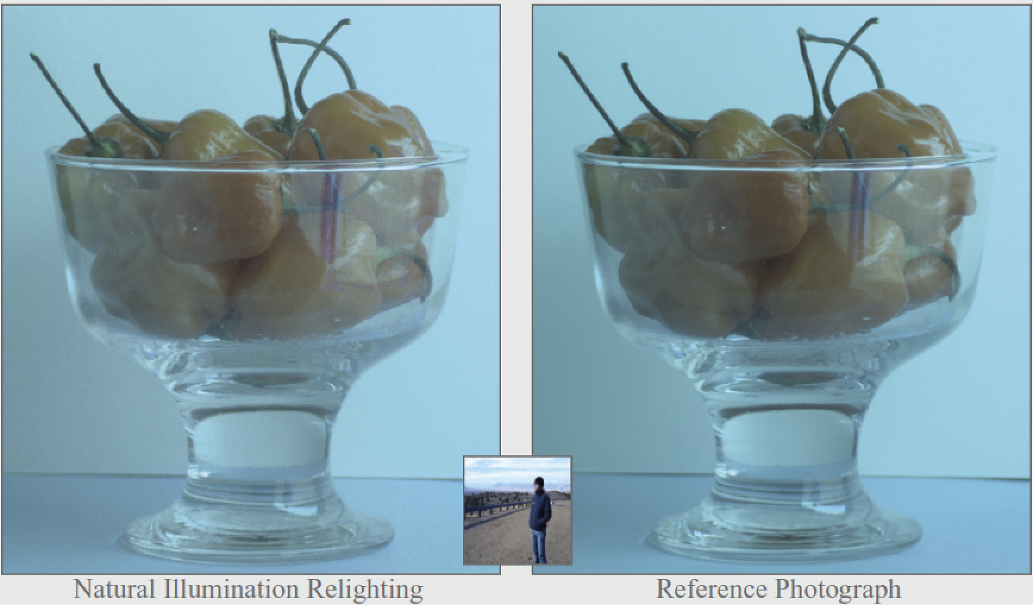
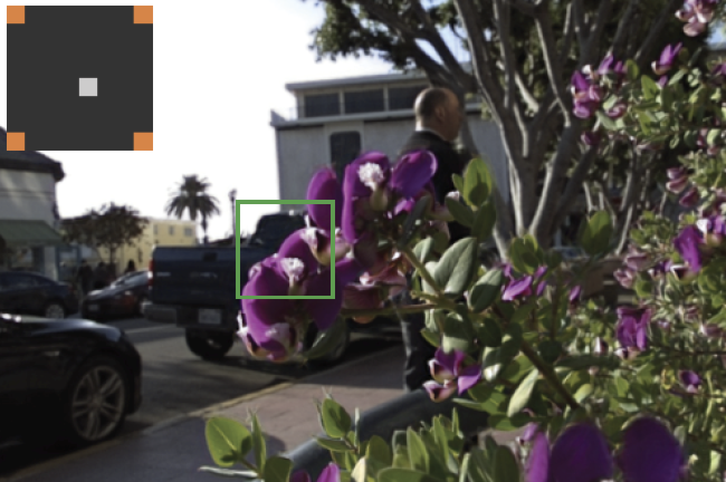
Sampling and Reconstruction of Visual Appearance
CSE 274 [Fall 2018], Lecture 2
Ravi Ramamoorthi
http://www.cs.ucsd.edu/~ravir

Slide 2
Motivation: BRDFs, Radiometry
Basics of Illumination, Reflection
Formal radiometric analysis (not ad-hoc)
Reflection Equation
Monte Carlo Rendering next week
Appreciate formal analysis in a graduate course, even if not absolutely essential in practice

Slide 3
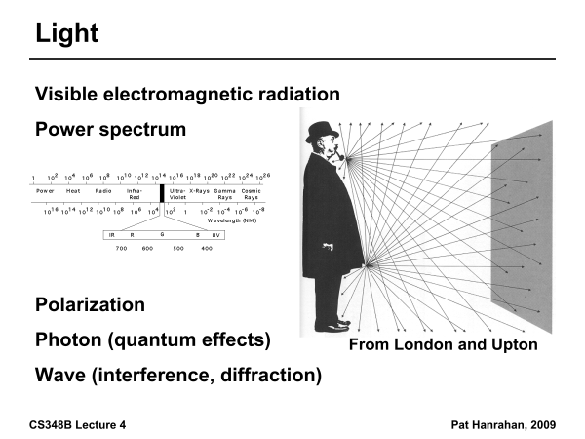

Slide 4
Radiometry
Physical measurement of electromagnetic energy
Measure spatial (and angular) properties of light
  Radiance, Irradiance
  Reflection functions: Bi-Directional Reflectance Distribution Function or BRDF
  Reflection Equation
  Simple BRDF models

Slide 5
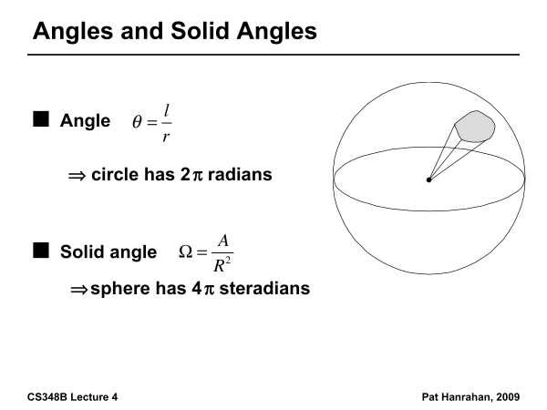

Slide 6
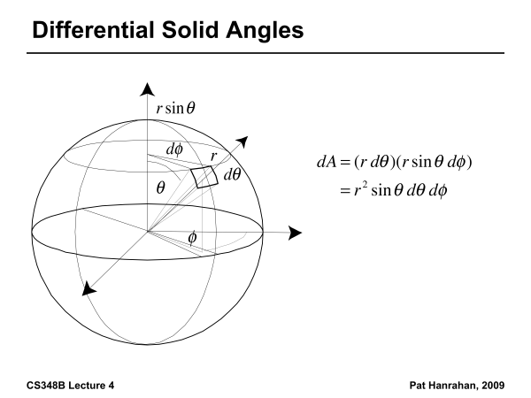

Slide 7
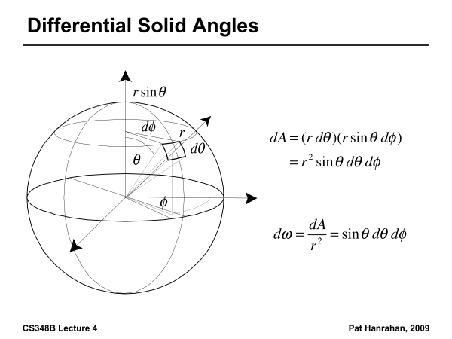

Slide 8
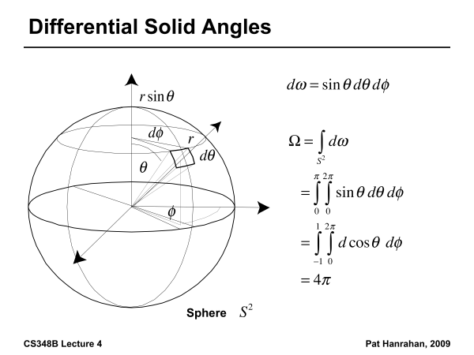

Slide 9
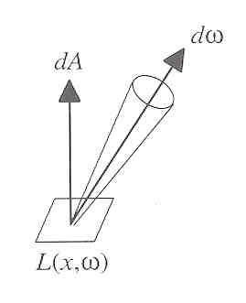
Radiance
Power per unit projected area perpendicular to the ray per unit solid angle in the direction of the ray
Symbol: L(x,ω) (W/m² sr)
Flux given by dΦ = L(x,ω) cos θ dω dA

Slide 10
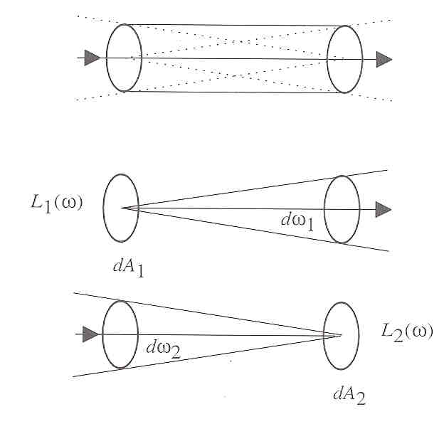
Radiance properties
Radiance constant as propagates along ray
  Derived from conservation of flux
  Fundamental in Light Transport.

Slide 11
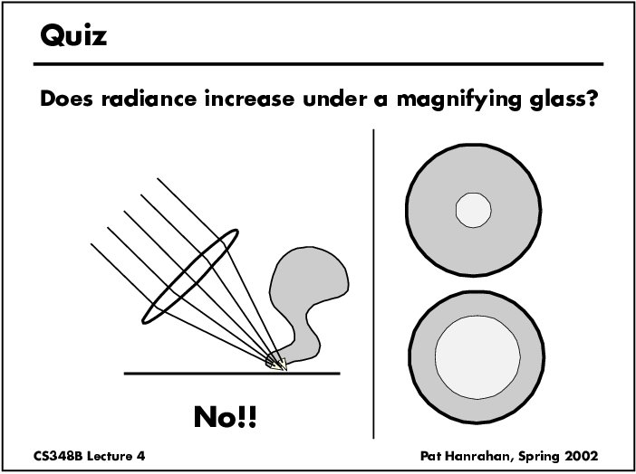

Slide 12
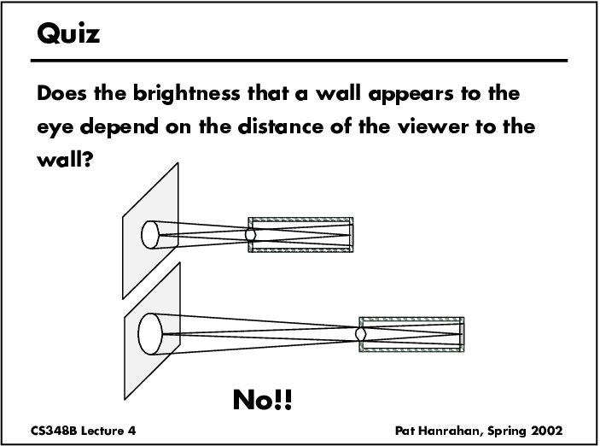

Slide 13
Radiance properties
Sensor response proportional to radiance (constant of proportionality is throughput)
  Far away surface: See more, but subtends smaller angle
  Wall equally bright across viewing distances
Consequences
  Radiance associated with rays in a ray tracer
  Other radiometric quants derived from radiance

Slide 14
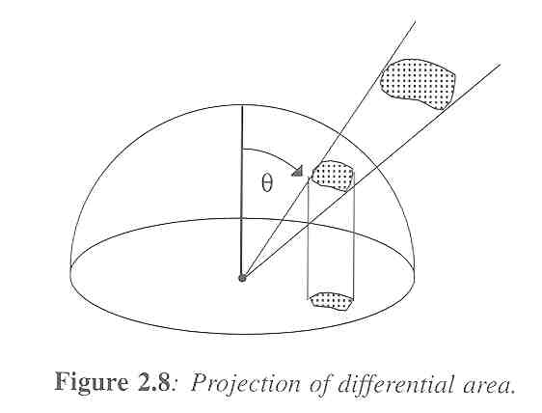
Irradiance, Radiosity
Irradiance E is radiant power per unit area
Integrate incoming radiance over hemisphere
  Projected solid angle (cos θ dω)
  Uniform illumination: Irradiance = π [CW 24,25]
  Units: W/m²
Radiant Exitance (radiosity)
  Power per unit area leaving surface (like irradiance)

Slide 15
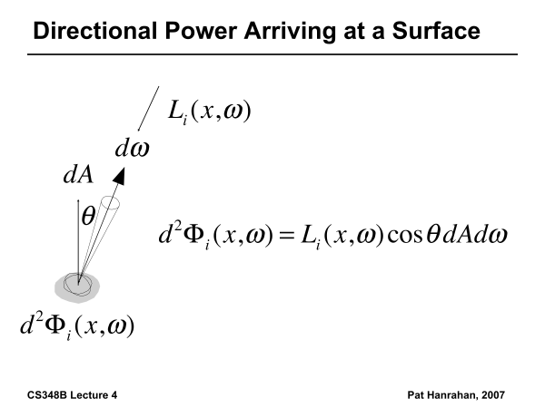

Slide 16
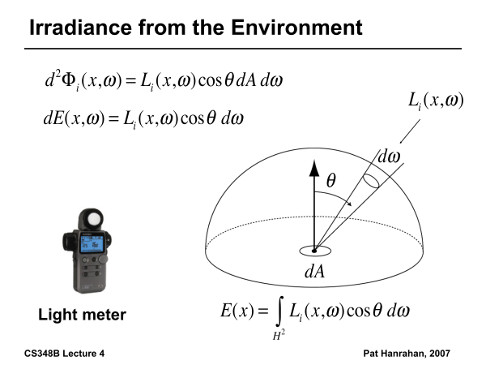

Slide 17
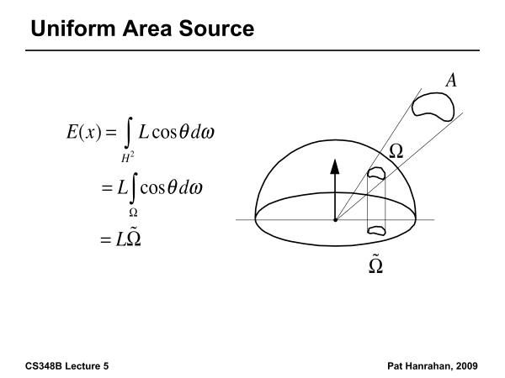

Slide 18
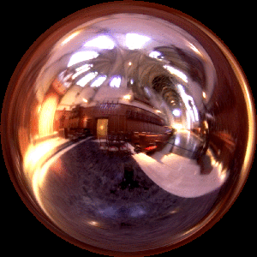

Irradiance Environment Maps
R
N
Incident Radiance
(Illumination Environment Map)
Irradiance Environment Map

Slide 19
Radiometry
Physical measurement of electromagnetic energy
Measure spatial (and angular) properties of light
  Radiance, Irradiance
  Reflection functions: Bi-Directional Reflectance Distribution Function or BRDF
  Reflection Equation
  Simple BRDF models

Slide 20
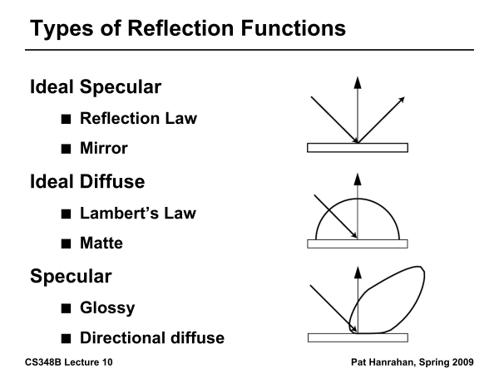

Slide 21
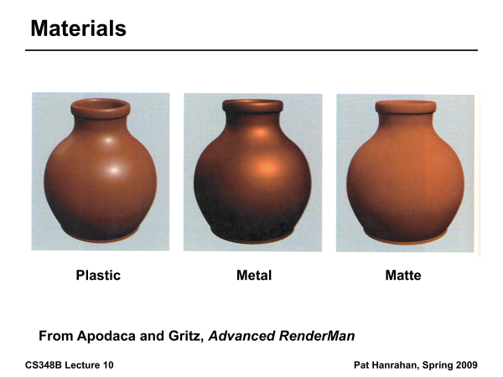

Slide 22
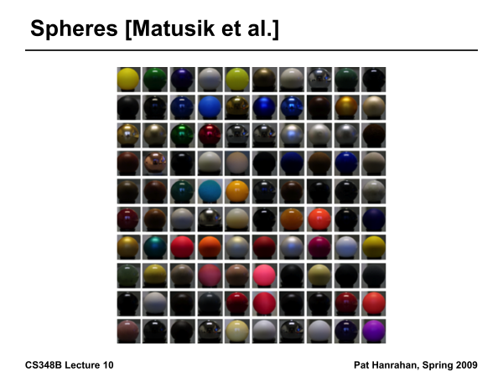

Slide 23
Building up the BRDF
Bi-Directional Reflectance Distribution Function [Nicodemus 77]
Function based on incident, view direction
Relates incoming light energy to outgoing
Unifying framework for many materials

Slide 24
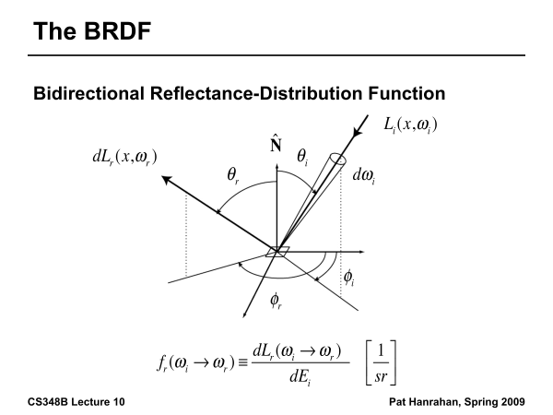

Slide 25
BRDF
Reflected Radiance proportional Irradiance
Constant proportionality: BRDF
Ratio of outgoing light (radiance) to incoming light (irradiance)
  Bidirectional Reflection Distribution Function
  (4 Vars) units 1/sr

Slide 26
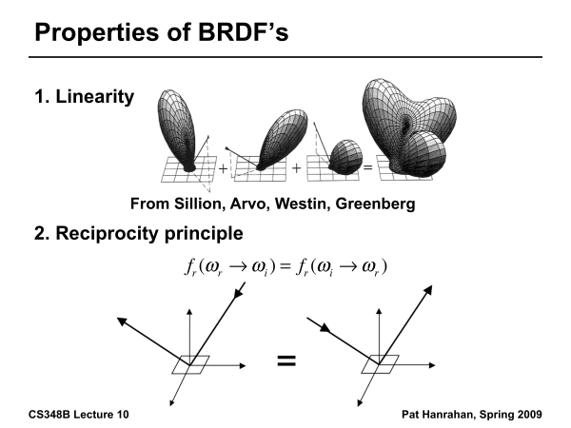

Slide 27
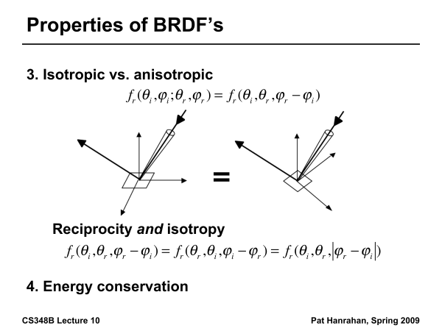

Slide 28
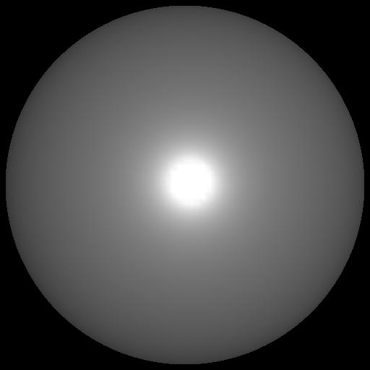

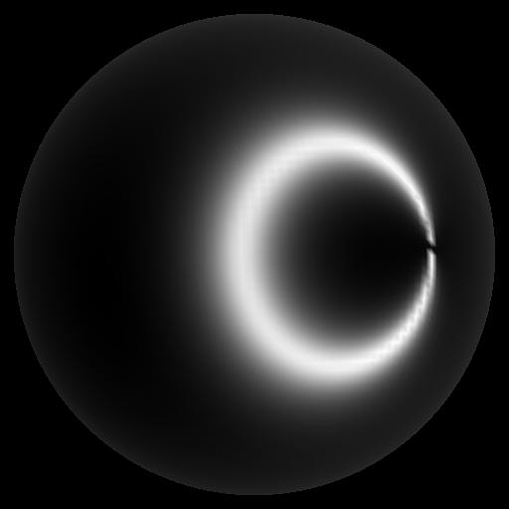
Isotropic vs Anisotropic
Isotropic: Most materials (you can rotate about normal without changing reflections)
Anisotropic: brushed metal etc. preferred tangential direction
Isotropic
Anisotropic

Slide 29
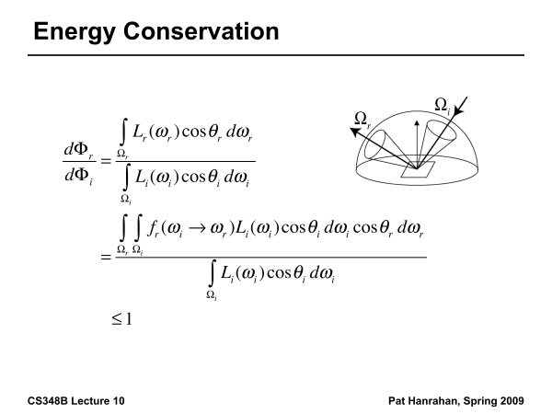

Slide 30
Reflection Equation
Reflected Light
(Output Image)
Emission
Incident
Light (from
light source)
BRDF
Cosine of
Incident angle

Slide 31
Reflection Equation
Sum over all light sources
Reflected Light
(Output Image)
Emission
Incident
Light (from
light source)
BRDF
Cosine of
Incident angle

Slide 32
Reflection Equation
Replace sum with integral
Reflected Light
(Output Image)
Emission
Incident
Light (from
light source)
BRDF
Cosine of
Incident angle

Slide 33
Radiometry
Physical measurement of electromagnetic energy
Measure spatial (and angular) properties of light
  Radiance, Irradiance
  Reflection functions: Bi-Directional Reflectance Distribution Function or BRDF
  Reflection Equation
  Simple BRDF models

Slide 34
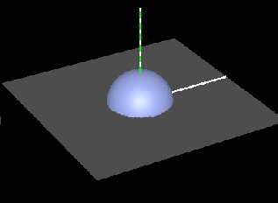
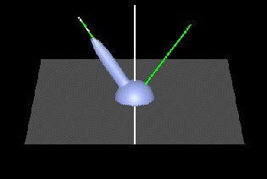
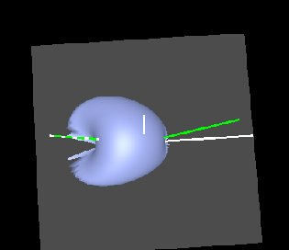
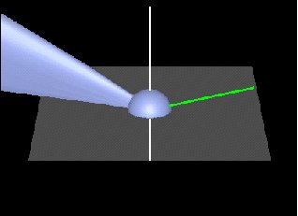
Brdf Viewer plots
Diffuse
Torrance-Sparrow
Anisotropic
bv written by Szymon Rusinkiewicz

Slide 35
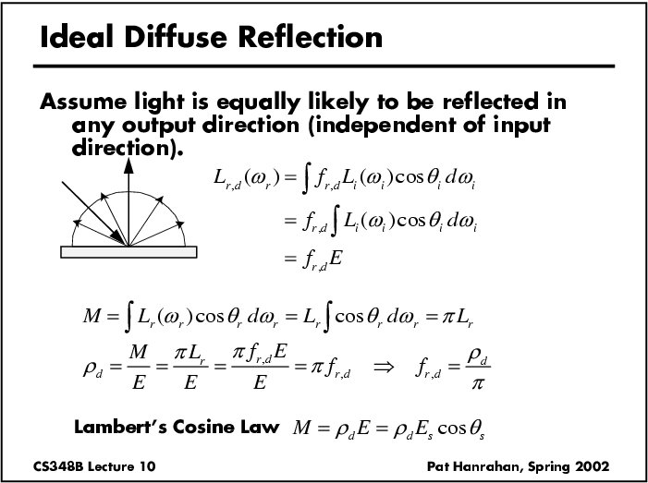

Slide 36
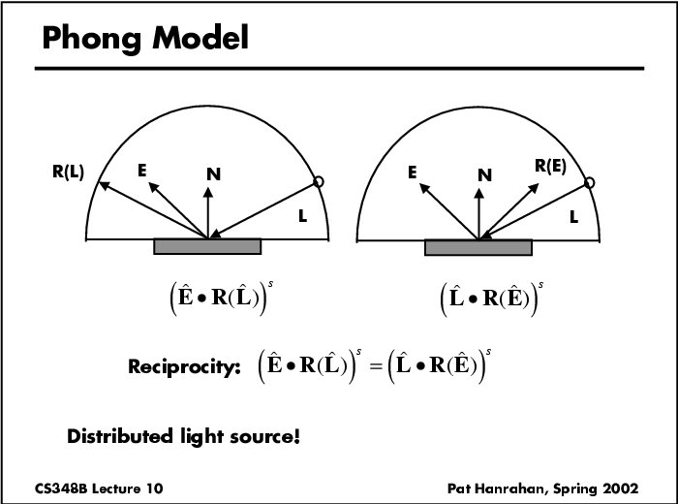

Slide 37
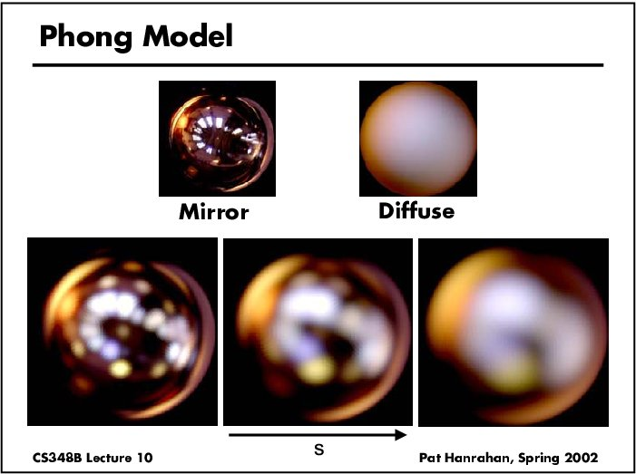
Specular Term (Phong)

Slide 38
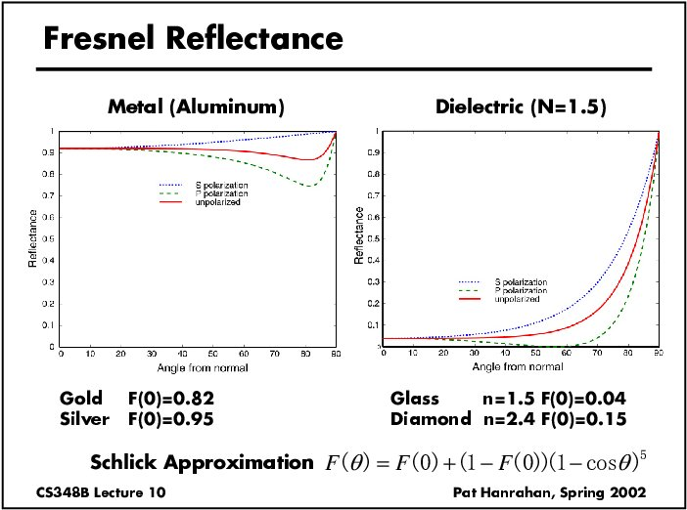

Slide 39
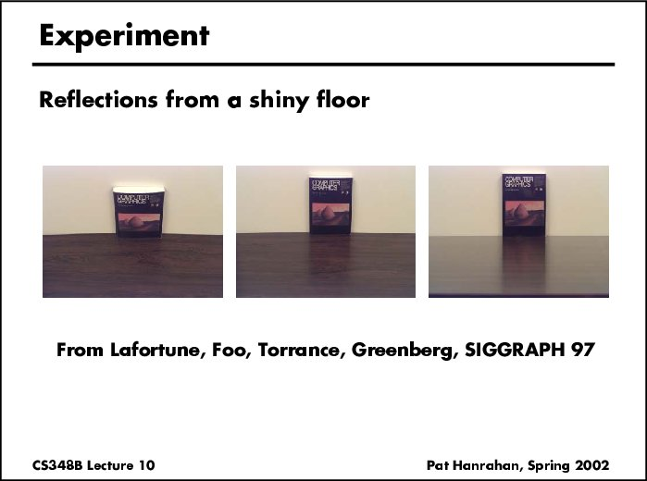

Slide 40
Torrance-Sparrow
Fresnel term:
allows for wavelength dependency
Geometric Attenuation:
reduces the output based on the amount of shadowing or masking that occurs.
Distribution:
distribution function determines what percentage of microfacets are oriented to reflect in the viewer direction.
How much of the macroscopic surface is visible to the light source
How much of the macroscopic surface is visible to the viewer

Slide 41
Other BRDF models
Empirical: Measure and build a 4D table
Anisotropic models for hair, brushed steel
Cartoon shaders, funky BRDFs
Capturing spatial variation
Very active area of research

