Slide 1
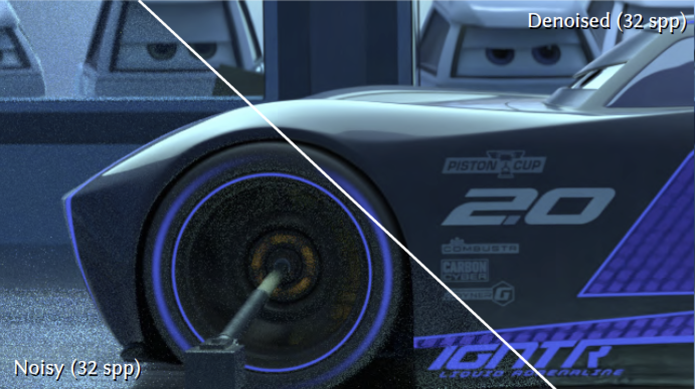
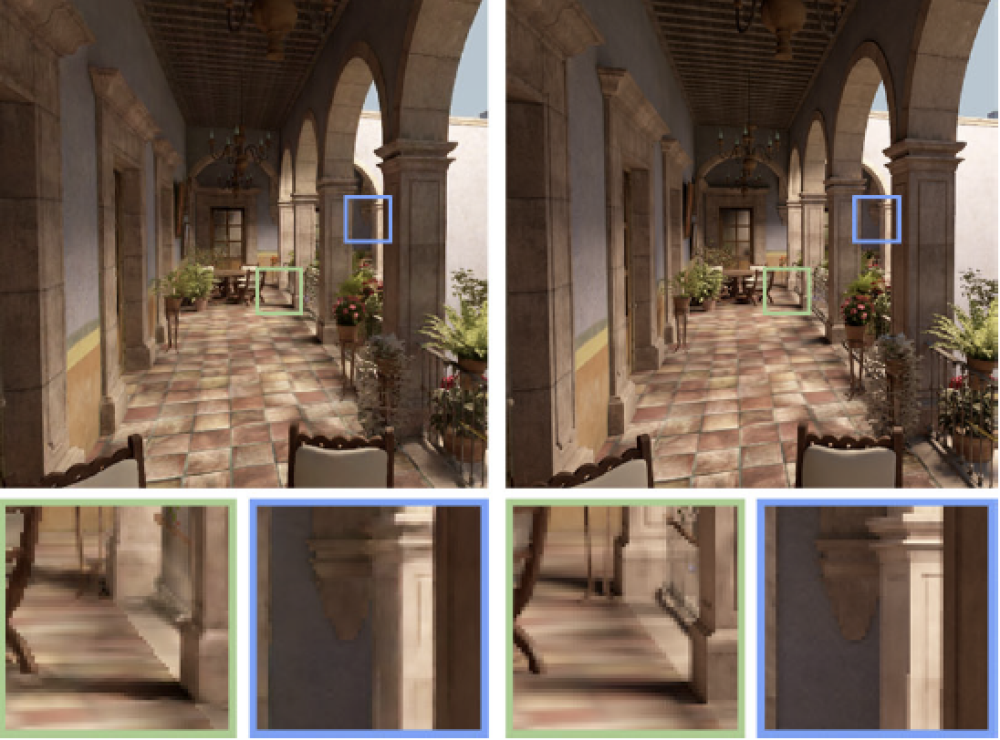
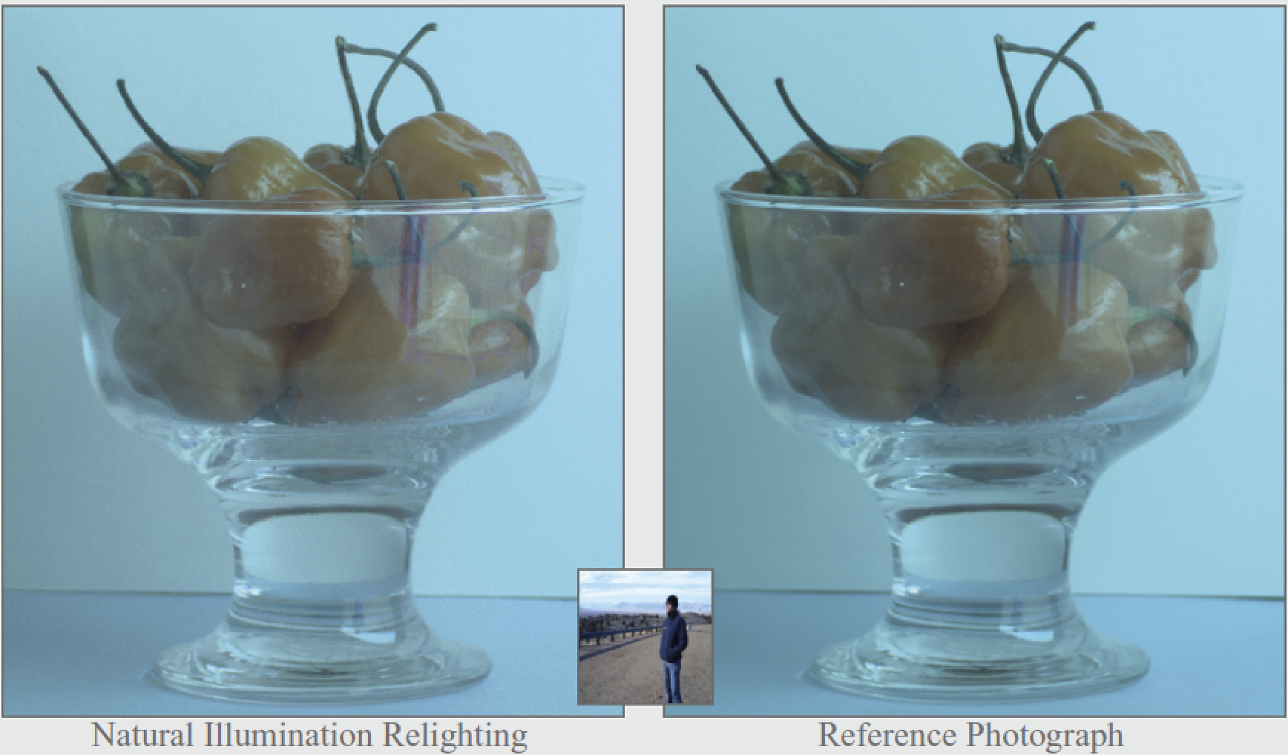
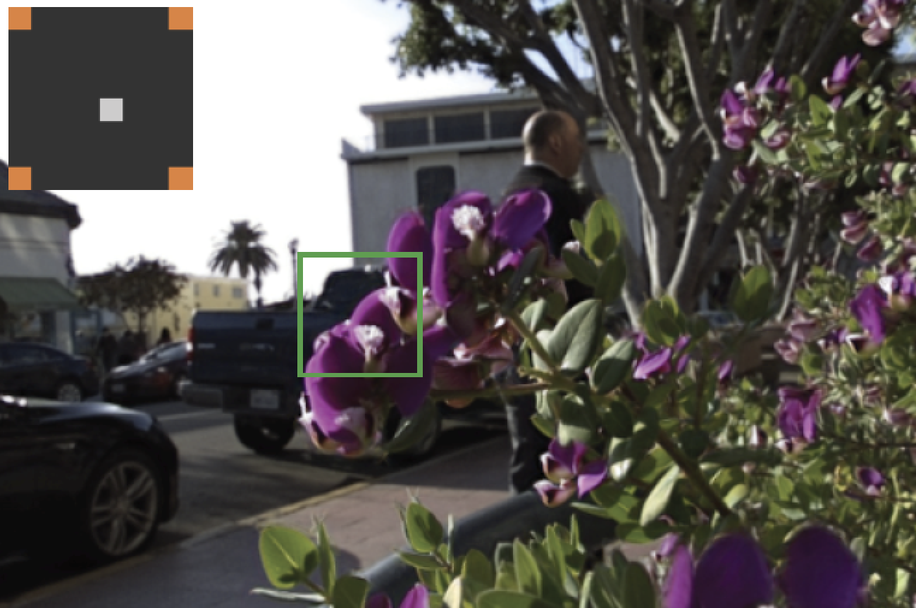
Sampling and Reconstruction of Visual Appearance
CSE 274 [Fall 2018], Lecture 13
Ravi Ramamoorthi
http://www.cs.ucsd.edu/~ravir

Slide 2
Applications
Monte Carlo Rendering (biggest application)
Light Transport Acquisition / Many Light Rendering
Light Fields and Computational Photography
Animation/Simulation (not covered in course)
Course has covered broad range of applications
And several approaches, mathematical models
End with new frontiers, current work

Slide 3
Today’s Frontiers
(Deep) Machine Learning, CNNs
Applied to image synthesis, not recognition
Have seen applications in light fields already
New frontier in Monte Carlo Rendering
Real-Time Path Tracing (towards 1spp)
New applications (VR, relighting, animation, …)
Thank you for hard work in course (good luck on final presentations and final project reports)

