Slide 1
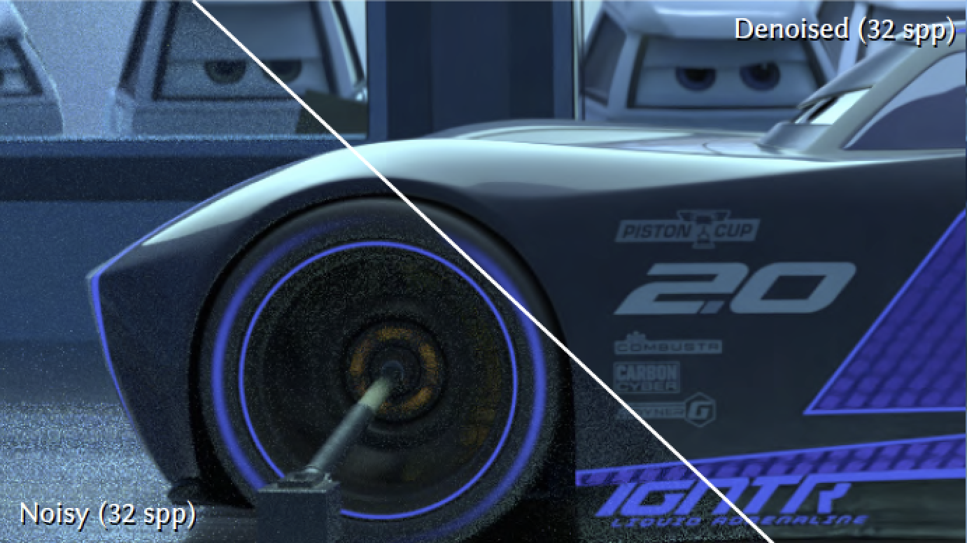
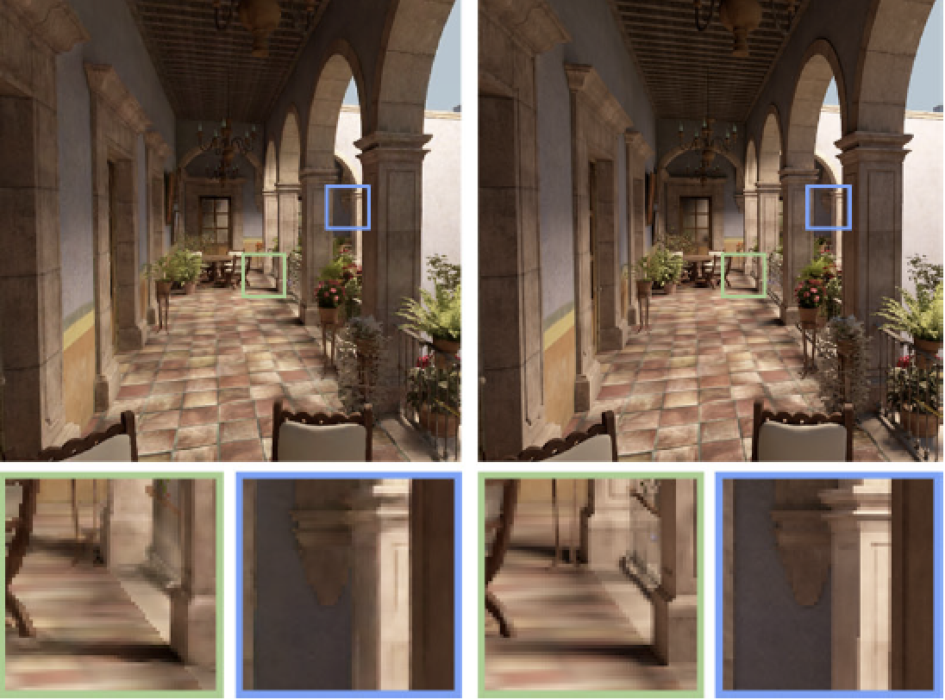
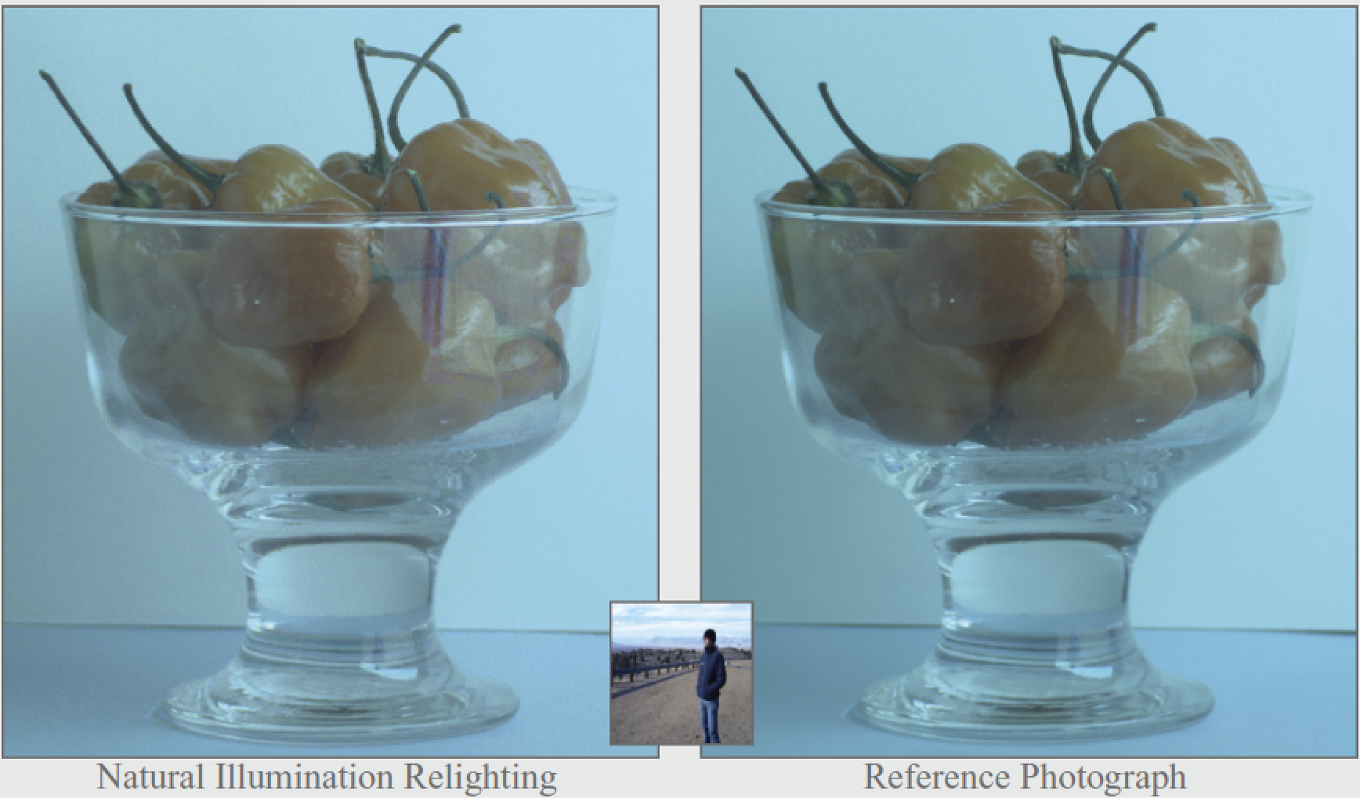
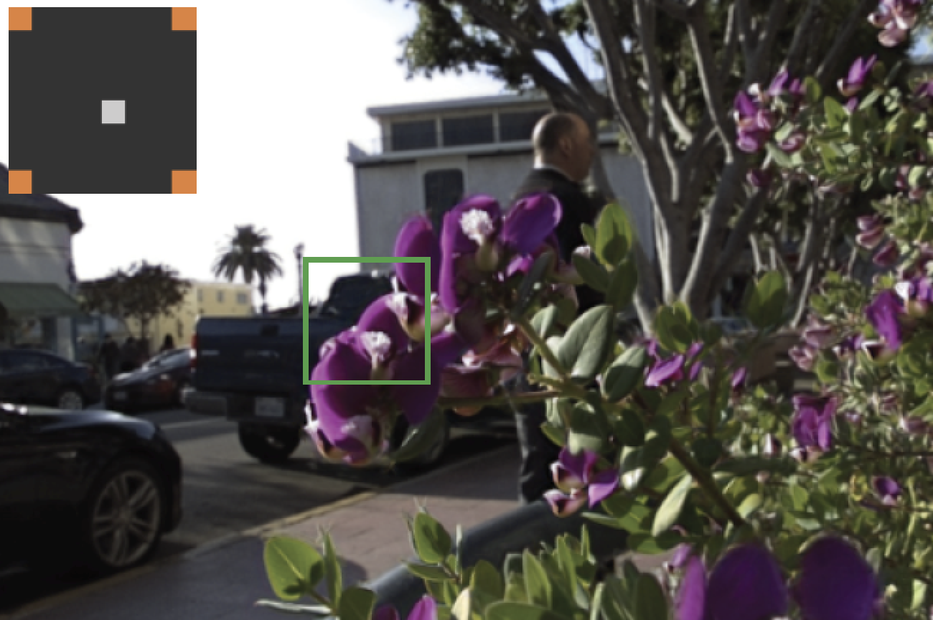
Sampling and Reconstruction of Visual Appearance
CSE 274 [Fall 2018], Lecture 11
Ravi Ramamoorthi
http://www.cs.ucsd.edu/~ravir

Slide 2
Applications
Monte Carlo Rendering (biggest application)
Light Transport Acquisition / Many Light Rendering
Light Fields and Computational Photography
Animation/Simulation (not covered in course)
Compressive sensing for light field reconstruction
Newer (deep) machine learning approaches

Slide 3
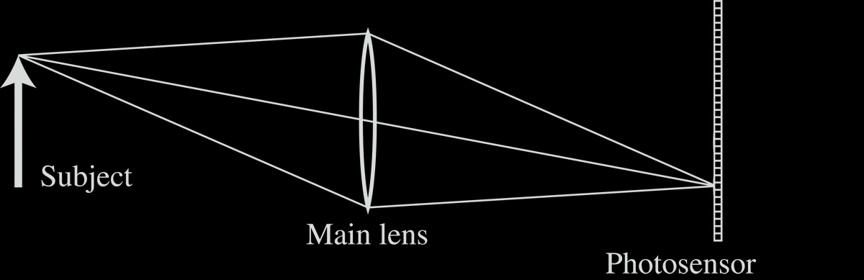
Light Field Inside a Camera
Notes:
3

Slide 4
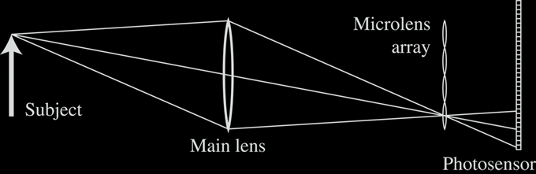
Lenslet-based Light Field camera
Light Field Inside a Camera
[Adelson and Wang, 1992, Ng et al. 2005 ]
Notes:
4

Slide 5
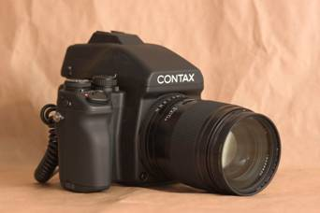
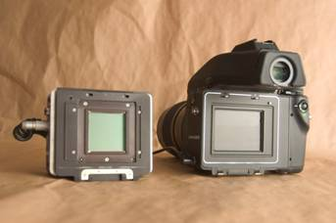
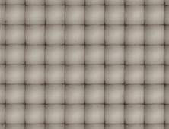
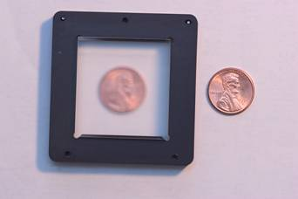
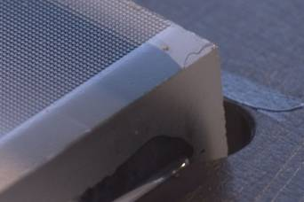
Stanford Plenoptic Camera [Ng et al 2005]
Contax medium format camera
Kodak 16-megapixel sensor
Adaptive Optics microlens array
125μ square-sided microlenses
4000 × 4000 pixels ÷ 292 × 292 lenses = 14 × 14 pixels per lens
Notes:
5

Slide 6
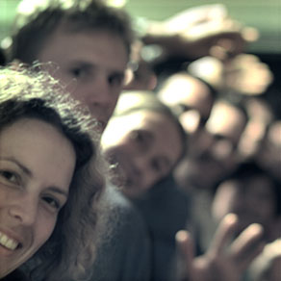
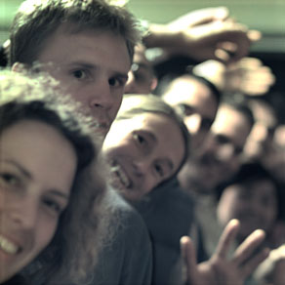
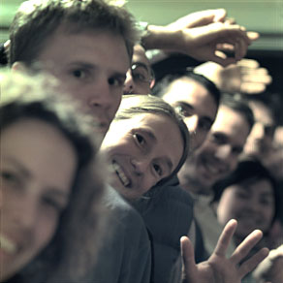
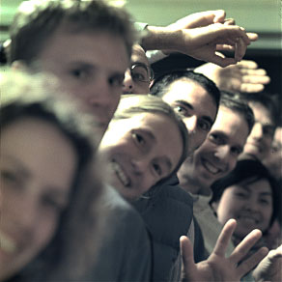

Digital Refocusing
[Ng et al 2005]
Notes:
6

Slide 7
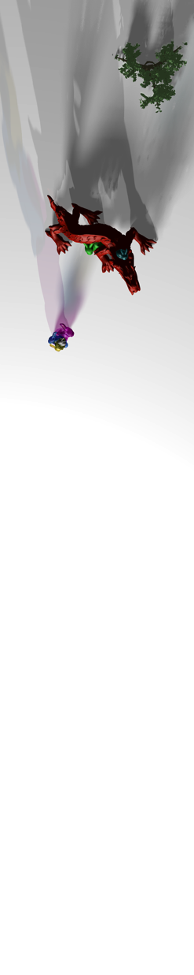
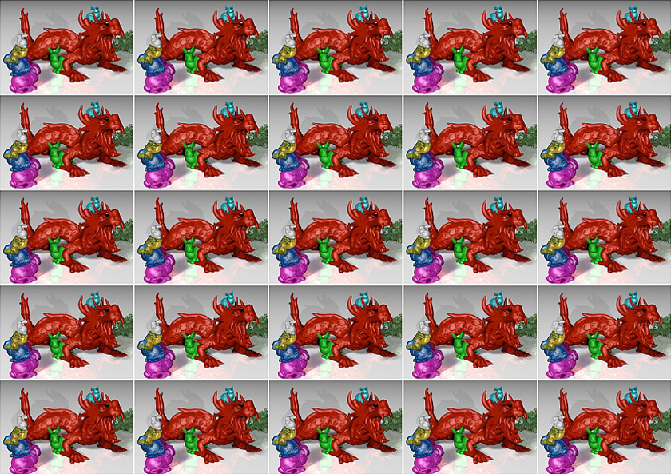
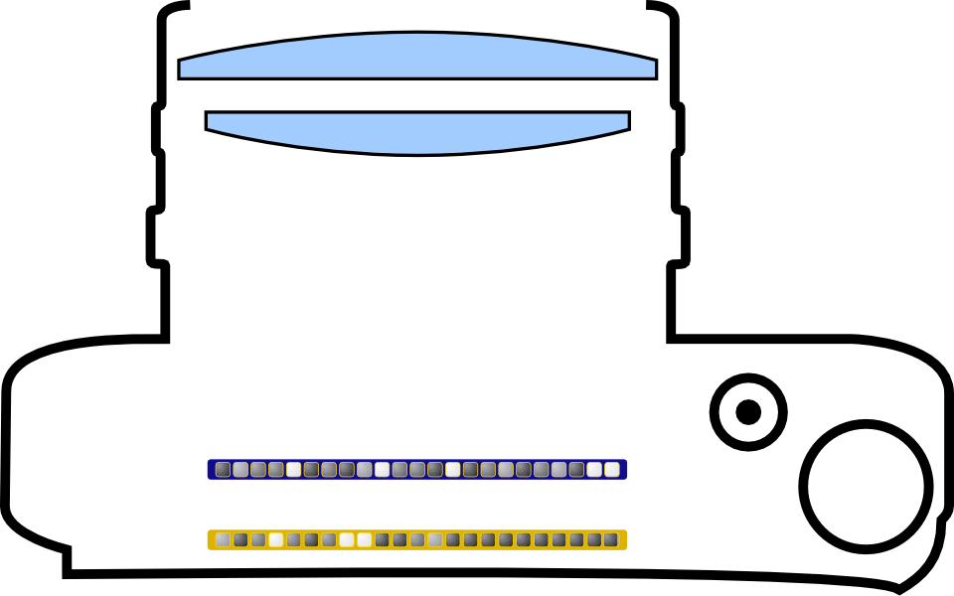
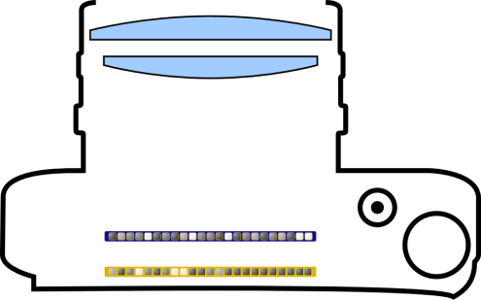
Scene from
Above
Integral Imaging
# Sensor Pixels Y
Lenslet Array
# Sensor Pixels X
[Lippman 1908], [Adelson and Wang 1992], [Ng et al. 2005]

Slide 8
Scene from
Above
Integral Imaging

Slide 9
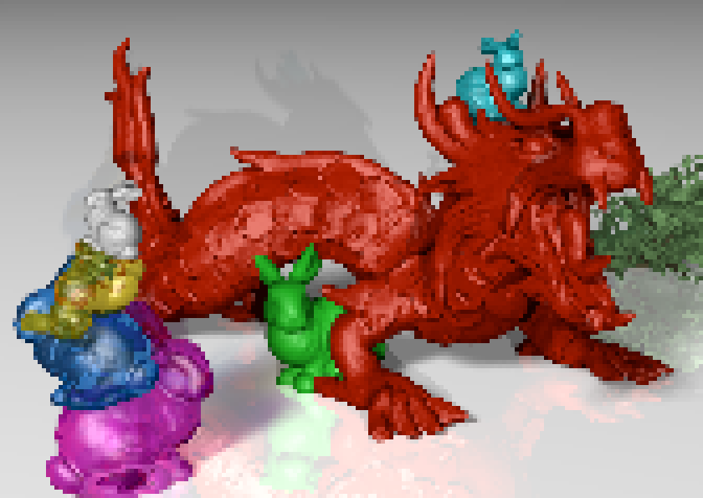
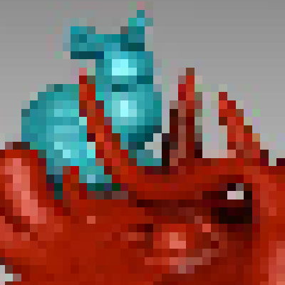
Scene from
Above
Integral Imaging: Spatio-Angular Resolution Tradeoff!
Spatio-Angular Resolution Tradeoff!
Example
Sensor with 2000 x 1000 pixels
5 x 5 light field views,
each with 400 x 200 pixels
# Sensor Pixels Y / # Views Y
our approach: explore ways to
overcome resolution tradeoff!
# Sensor Pixels X / # Views X

Slide 10
Scene from
Above
Light Field is Redundant!

