Slide 1
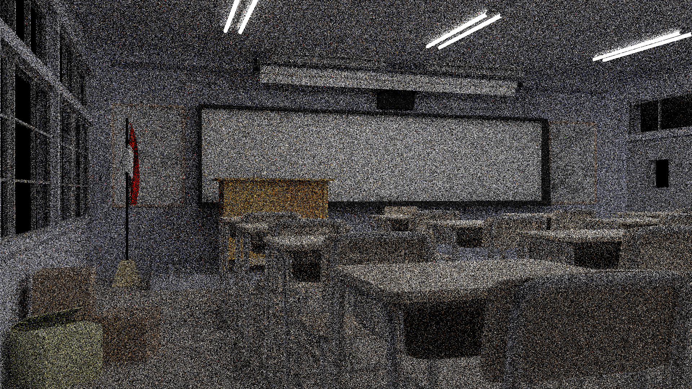

A Gentle Introduction to ReSTIR: Path Reuse in Real-time
2.4 ms (on a RTX 4090)
7.8 ms
Path Tracing (1 path per pixel)
ReSTIR PT (1 sample per pixel)
Chris Wyman, Markus Kettunen, Daqi Lin, Benedikt Bitterli, Cem Yuksel, Wojciech Jarosz, and Pawel Kozlowski

Slide 2

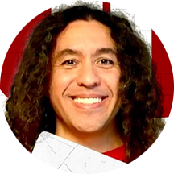


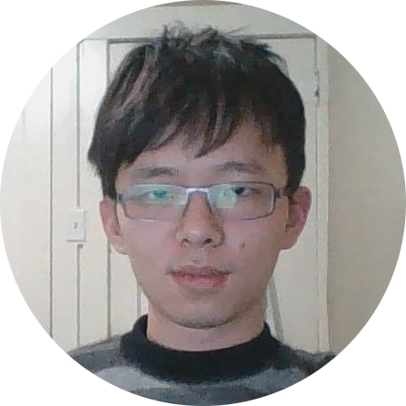
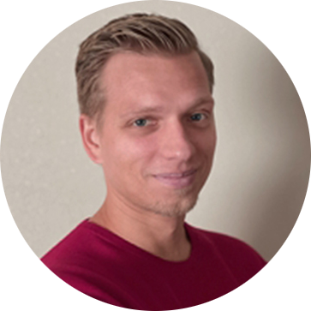

Who Are We?
Chris Wyman
Distinguished Research Scientist, NVIDIA
Cem Yuksel
Associate Professor, University of Utah
Senior Scientist, Roblox Research
Markus Kettunen
Senior Research Scientist, NVIDIA
Wojciech Jarosz **
Associate Professor, Dartmouth College
Daqi Lin
Research Scientist, NVIDIA
Pawel Kozlowski
Principal DevTech Engineer, NVIDIA
Benedikt Bitterli
Senior Research Scientist, NVIDIA
** Unfortunately, could not attend SIGGRAPH

Slide 3
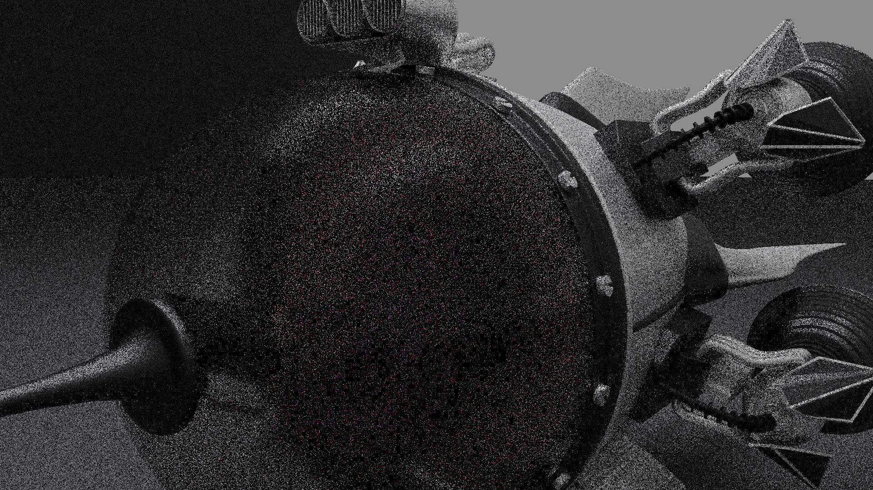
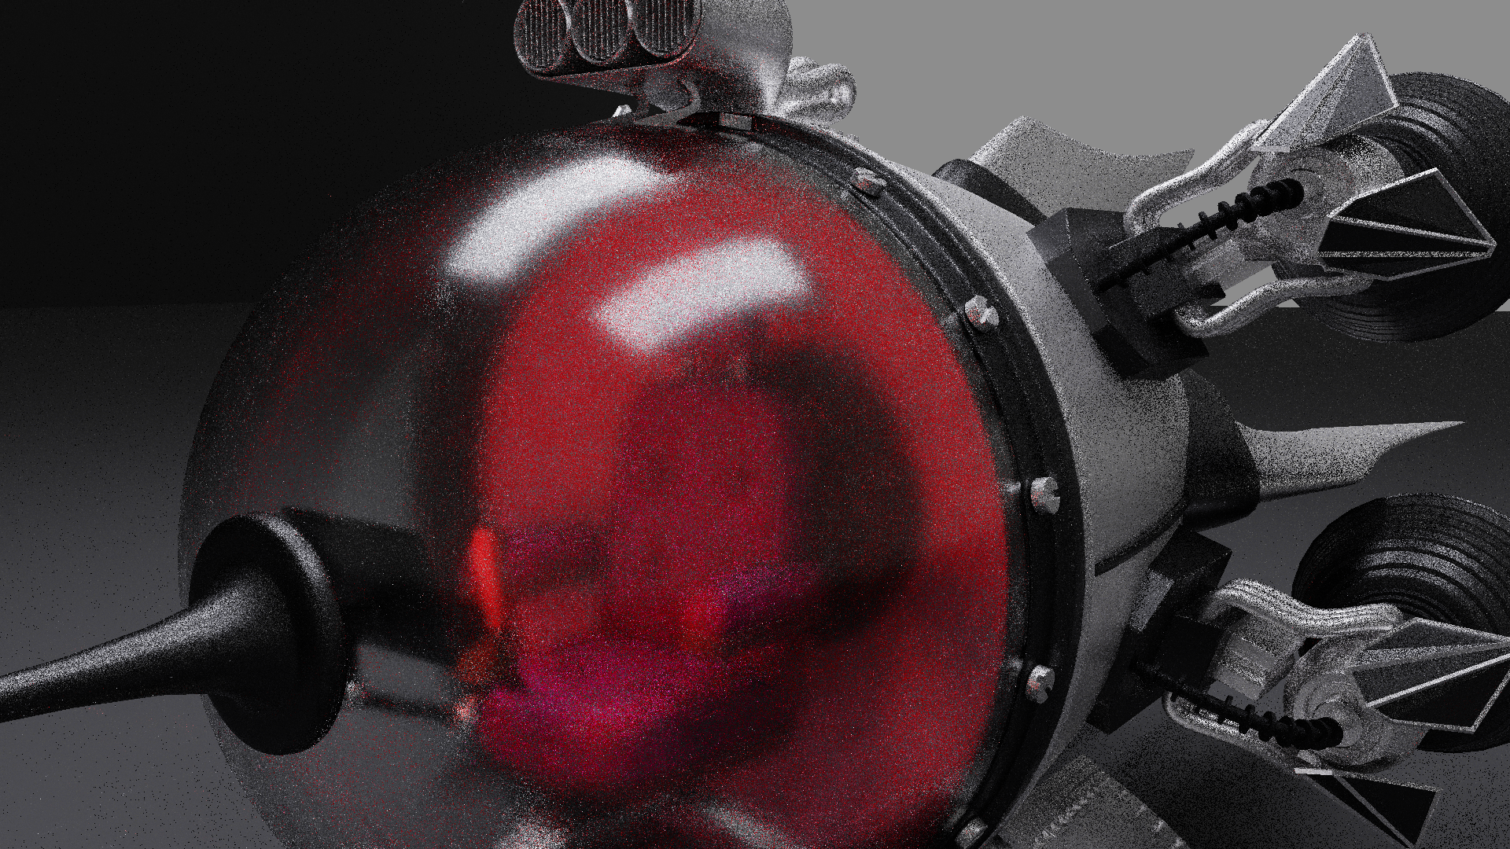
What is ReSTIR?
(Aka Resevoir-based Spatiotemporal Importance Resampling)
2.1 ms
Simply: A way to reuse samples by sharing among pixels
Ray tracing is expensive
By amortizing costs, we increase the effective sample count
ReSTIR gives a 100x to 10,000x sample count multiplier
Exact multiplier is hard to measure; handwavy
Think: A post-process denoiser, but inside the renderer
Denoiser says: “neighbors are similar, so blur colors across pixels”
ReSTIR says: “neighbors are similar, so reuse samples (or PDFs) across pixels”
Unlike denoising, ReSTIR can be unbiased
Why? In the renderer, we can reuse data before throwing important stuff away
Path tracing with 1 path per pixel
10.0 ms
ReSTIR with 1 sample per pixel

Slide 4
Today’s Schedule:
 | Topic | Speaker
2:00 – 2:05 | Welcome and introduction | Chris Wyman
2:05 – 2:20 | Motivation & preliminaries | Cem Yuksel
2:20 – 2:40 | (Generalized) resampling importance sampling (GRIS) | Markus Kettunen
2:40 – 2:55 | Spatial and temporal reuse | Benedikt Bitterli
2:55 – 3:10 | Example: Direct lighting | Benedikt Bitterli
3:10 – 3:25 | Reuse between integration domains | Markus Kettunen
3:25 – 3:45 | Extending reuse to paths | Daqi Lin
3:45 – 4:00 | Making ReSTIR fast – algorithmic changes | Daqi Lin
4:00 – 4:15 | Making ReSTIR fast – low level considerations | Chris Wyman
4:15 – 4:40 | Case study: ReSTIR in Cyberpunk 2077 | Pawel Kozlowski
4:40 – 4:50 | Panel: Future directions | All
4:50 – 5:00 | Panel: Audience Q & A | All
A roadmap & build intuition
Math for basic sample reuse;
why it works
Specific algorithms and
scaling up complexity
Thinking about optimization
Practical considerations
Where do we go next?

Slide 5
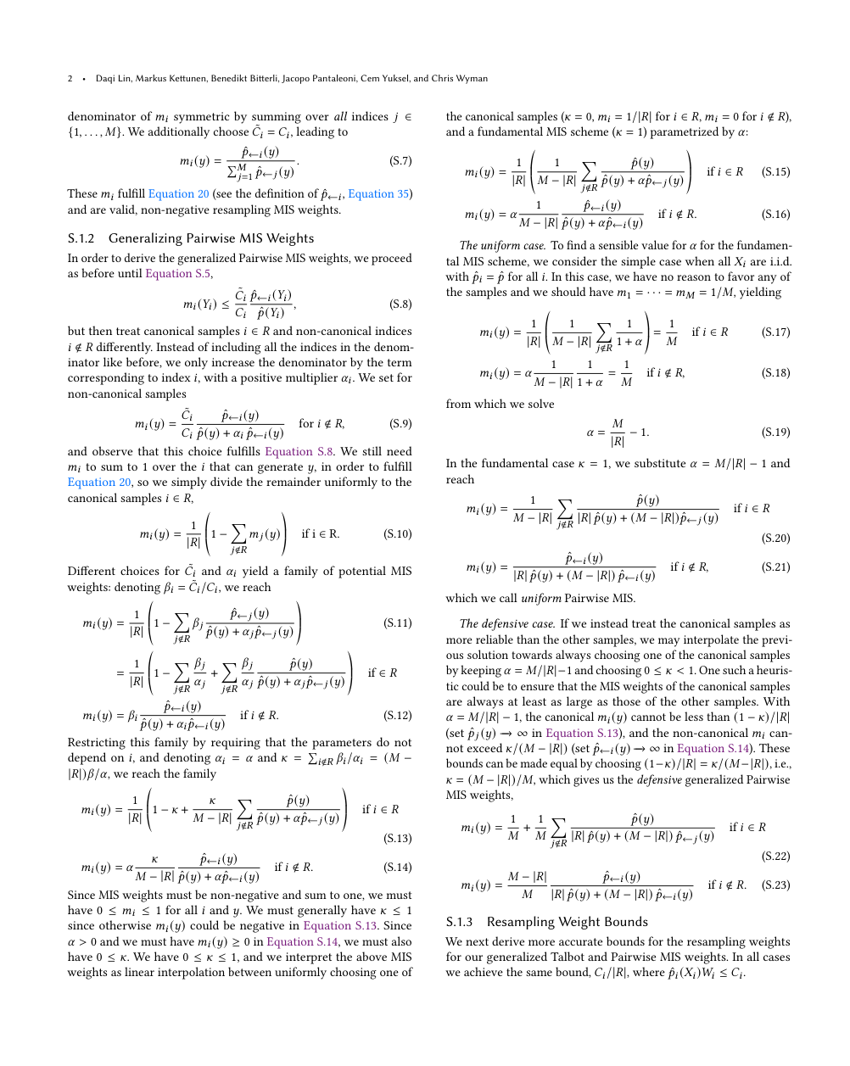
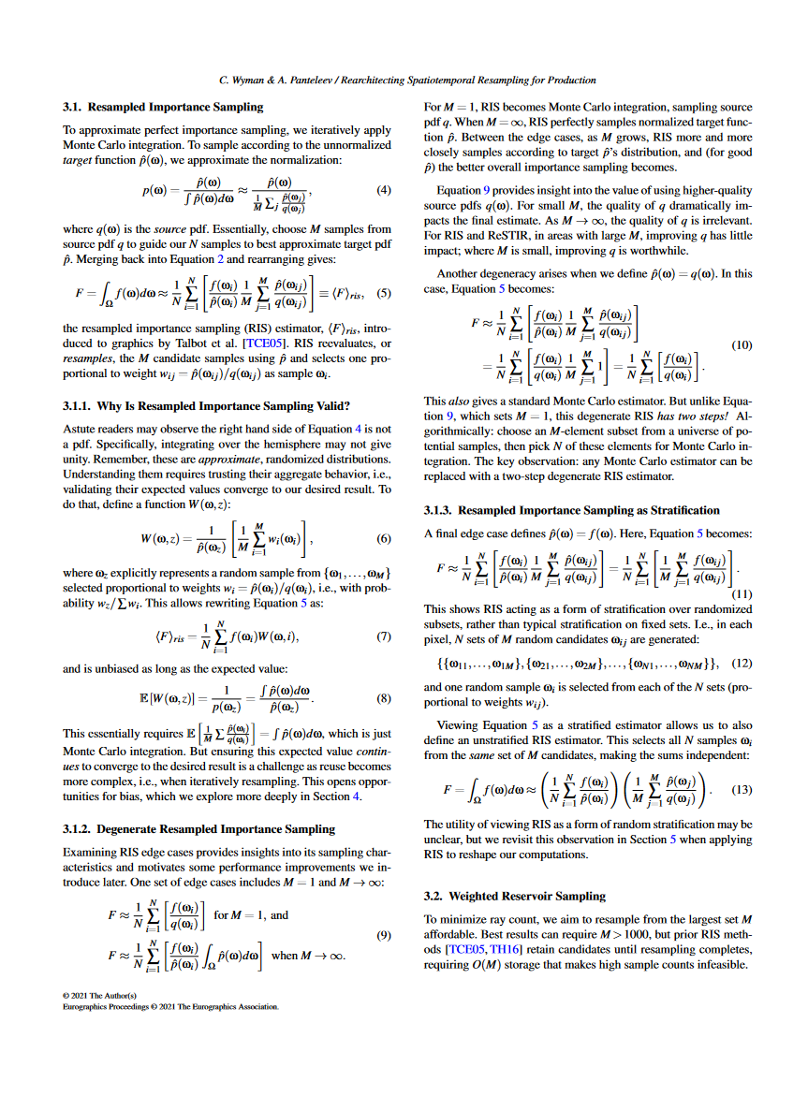
Please, Don’t Be Intimidated!
Our papers:
More than a little math
Partly b/c we’re uncovering super interesting theory
Can obscure the very simple and elegant take-aways
We’re going to try to demystify this today
Underlying idea is very simple
Discovery of ReSTIR was an accident (feel free to ask sometime)
Intuition can be built up in simple blocks

Slide 6
My High-Level Course Takeaways
Or: If you only leave learning one thing…

Slide 7

My High-Level Course Takeaways
Or: If you only leave learning one thing…
Resampling theory allows (unbiased) reuse of samples that many would not expect!
Between different integrals and even different integration domains
Allows amazing amortization; hugely important for real-time

Slide 8
My High-Level Course Takeaways
Or: If you only leave learning one thing…
Resampling theory allows (unbiased) reuse of samples that many would not expect!
Between different integrals and even different integration domains
Allows amazing amortization; hugely important for real-time
Philosophically, blurs the line between “discrete” and “continuous”
Using PDFs (i.e., continuous)? PMFs (i.e., discrete)? Nope! Unbiased contribution weights.
No longer need analytic PDFs; use better-fitting, approximate, sampled distributions
Better importance sampling → fewer rays needed; hugely important for real-time

Slide 9
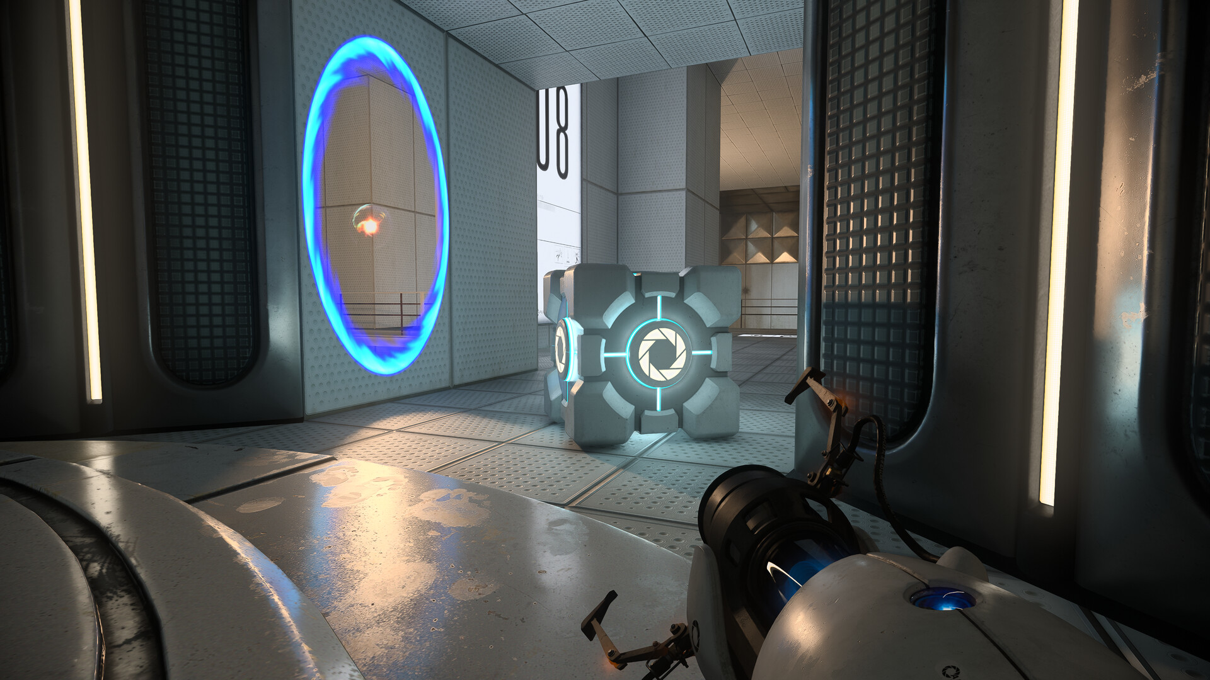
My High-Level Course Takeaways
Or: If you only leave learning one thing…
Resampling theory allows (unbiased) reuse of samples that many would not expect!
Between different integrals and even different integration domains
Allows amazing amortization; hugely important for real-time
Philosophically, blurs the line between “discrete” and “continuous”
Using PDFs (i.e., continuous)? PMFs (i.e., discrete)? Nope! Unbiased contribution weights.
No longer need analytic PDFs; use better-fitting, approximate, sampled distributions
Better importance sampling → fewer rays needed; hugely important for real-time
Applies to many problems (in rendering & maybe elsewhere)
Fast implementations already used in production today!

