Slide 1
Restir course
Reusing between domains
Notes:
I’m Markus, and I will try to explain how to apply RIS between different domains, reusing samples with shift mappings.

Slide 2

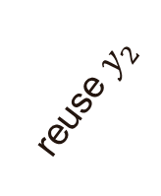


ReSTIR – in vertex space
We presented sample reuse in a single domain
Domain: secondary hits
Reused variable: secondary hit
Integrate path contribution over area
Sharing light connections
Rough surfaces need ReSTIR in vertex space!
$$x_{2}, y_{2}$$
sensor
secondary hits
pixels
reuse $y_{2}$
$$y_{1}$$
$$x_{1}$$
Notes:
In the previous sections we presented sample reuse with all pixels sharing the same domain.
We worked in the space of secondary hits, reusing and sharing secondary hits, and integrating path contributions over area.
This corresponds to sharing light connections, and this method is ideal for rough materials.

Slide 3
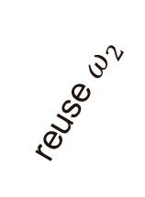



ReSTIR – in direction space
Usually in path tracing:
Work with directions $ω_{i}$
ReSTIR in direction space?
Copying directions
Misses lights...
Env maps need ReSTIR in direction space!
sensor
secondary hits
pixels
reuse $ω_{2}$
$$ω_{1}$$
$$ω_{2}$$
Notes:
Usually in path tracing we work directly with directions.
If we apply ReSTIR in the directions space, sharing directions between pixels, we easily miss lights.
But copying directions is ideal for environment maps!

Slide 4
Restir – glossy materials
What if the primary hit is at a glossy surface?
New direction far from ideal reflection?
Zero BSDF! Reusing yields nothing!
sensor
pixels
normal
non-ideal reflection
(rough) mirror
Notes:
What if the primary hit is at a glossy surface such as a mirror, and we reconnect?
Then we may change the direction far from ideal reflection, and we get zero BSDF. Reuse yields nothing.

Slide 5
Restir – glossy materials
What if the primary hit is at a glossy surface?
New direction far from ideal reflection?
Zero BSDF! Reusing yields nothing!
Perfectly specular → must apply ideal reflection!
sensor
pixels
✓
ideal reflection
normal
(rough) mirror
Notes:
If it’s a perfect mirror, the only option to reuse is to apply the ideal reflection.

Slide 6
Restir – glossy materials
What if the primary hit is at a glossy surface?
New direction far from ideal reflection?
Zero BSDF! Reusing yields nothing!
Perfectly specular → must apply ideal reflection!
Not perfectly specular:
Could e.g., reflect wrt. half-vector
sensor
pixels
half-vector
(rough) mirror
Notes:
If the material is not perfectly specular, but a little rough, we can reflect with respect to the half-vector

Slide 7
Restir – glossy materials
What if the primary hit is at a glossy surface?
New direction far from ideal reflection?
Zero BSDF! Reusing yields nothing!
Perfectly specular → must apply ideal reflection!
Not perfectly specular:
Could e.g., reflect wrt. half-vector
Glossy materials need ReSTIR in half-vector space???
sensor
pixels
half-vector
(rough) mirror
Notes:
So if we want to deal properly with glossy materials, we need to run ReSTIR in the half-vector space???

Slide 8

What’s with all these spaces?
Why do we have to pick only one domain? Why can’t we reuse how we want?
Notes:
What’s with all these spaces?
Why do we have to pick only a single domain?
Why can’t we reuse the way we want?

Slide 9

reuse freely (generalized ris)
Generalized Resampled Importance Sampling: Foundations of ReSTIR
[Lin et al. 2022]
Generalized Resampled Importance Sampling
Reuse samples between domains
Allows material-specific reuse techniques
Math framework and foundations for ReSTIR
[Lin et al. 2022]
Notes:
This made us write the GRIS paper, Generalized Resampled Importance Sampling: Foundations of ReSTIR.
We modified RIS to reuse samples between different domains. We allow material-specific reuse techniques for maximum freedom and efficiency.
This paper also lays out the ReSTIR math framework and the foundations of ReSTIR.

Slide 10
reuse freely (generalized ris)
Generalized Resampled Importance Sampling: Foundations of ReSTIR
[Lin et al. 2022]
Generalized Resampled Importance Sampling
Reuse samples between domains
Allows material-specific reuse techniques
Math framework and foundations for ReSTIR
[Lin et al. 2022]
Want to understand better?
1. Read the course notes
2. Read the GRIS paper
Notes:
If you want to understand ReSTIR better, first read our course notes, then go to the GRIS paper for any remaining questions.

Slide 11
Between domains
preliminaries
Notes:
Before we go into the modified algorithm, let’s have a look at some preliminaries.

Slide 12


preliminaries
Shifting (image space)
History:
$$T(x)$$
In gradient-domain rendering, paths are moved between pixels, shifted, to evaluate image gradients (Δ𝐼/Δ𝑥, Δ𝐼/Δ𝑦)
Paths are reused by modifying them to hit another pixel, while respecting material constraints
$$x$$
$$T(x)$$
$$x$$
Shifting (path space)
Notes:
First, a word about history.
In gradient-domain rendering, paths are moved between pixels, shifted on the image plane, to evaluate discrete image gradients.
Paths are reused by slightly modifying them to hit another pixel, while respecting material constraints.
On the right we see what shifting looks like in image space, and in path space.

Slide 13






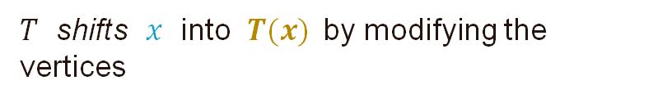
Shift mappings: concepts
$$Ω_{1}$$
offset path
$$T(x)$$
Output: ”offset path”
$$T(x)$$
$$Ω_{2}$$
pixels
$$Ω_{3}$$
$$x$$
Input: ”base path”
$$x$$
base path
Every pixel has its own path space, a domain
Shift mappings move paths between domains
$T$ shifts $x$ into $T(x)$ by modifying the vertices
Notes:
Every pixel has its own set of paths, its own path space, its own domain.
Shift mappings move paths between domains.
The input x is called the ”base path”, and the output is called the ”offset path”.
The shift mapping T shifts x into y equals T of x.

Slide 14
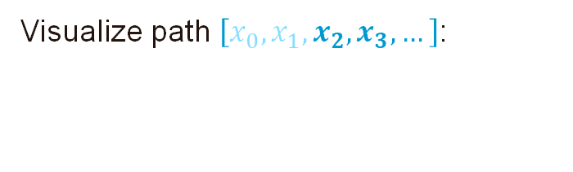





Preliminaries: shift mappings
$$x_{2}$$
sensor
Visualize path $\left[x_{0}, x_{1}, x_{2}, x_{3},…\right]\text{:}$
$$x_{4}$$
pixels
$$x_{0}$$
Treat as deterministic
$$x_{1}$$
$$x_{3}$$
Notes:
To begin, let’s visualize a path x from x_0 on, here. It starts from the sensor, goes through a lens, and then contains more vertices.
For our purposes, we treat the sensor and lens coordinates as essentially deterministic, or given, and run RIS and ReSTIR on the rest.

Slide 15






Preliminaries: shift mappings
$$x_{2}$$
$$y_{2}$$
$$y_{4}$$
sensor
Shift mapping from pixel $i$ to $j$:
$$T_{i→j}\left(\left[x_{0}, x_{1}, x_{2}, x_{3},…\right]\right)=[y_{0},y_{1},y_{2}, y_{3}, …]$$
$$x_{4}$$
$$y_{0}$$
pixels
$$x_{0}$$
Deterministic
$$x_{1}$$
$$y_{1}$$
$$x_{3}$$
$$y_{3}$$
Notes:
A shift mapping from i to j takes such a path in pixel i, and deterministically shifts it into a path in pixel j.

Slide 16


Preliminaries: shift mappings
Common Example: Reconnection shift
$$T_{i→j}\left(\left[x_{0}, x_{1}, x_{2}, x_{3},…\right]\right)=[y_{0},y_{1},x_{2}, x_{3}, …]$$
Reconnects immediately to $x_{2}$, reuses the rest.
$$x_{2}$$
(Used by ReSTIR DI and GI)
sensor
$$x_{4}$$
$$y_{0}$$
pixels
$$x_{0}$$
$$y_{1}$$
$$x_{1}$$
$$x_{3}$$
Notes:
Let’s see a common example, the reconnection shift, which is used, implicitly, for example by ReSTIR DI and GI.
The first two vertices of the result y are essentially deterministic. The reconnection shift copies the rest of the vertices from the input, reconnecting the yellow path to the blue path as soon as possible.

Slide 17



Shift mapping: definition
Domain A
Formal definition:
A shift mapping $T$ from $A$ to $B$ is a bijective function from a subset of 𝐴 to a subset of $B$
Shift mapping from A to B:
Deterministic.
A path shifts to at most one. ($T(x)$ is a function)
Two paths do not shift to same path. (Inverse $T^{−1}$ must exist)
Inverse must shift back to original. ($T^{−1}\left(T\left(x\right)\right)=x$)
Not all paths need to be shiftable
reusable
non-reusable
$$T^{−1}$$
$$T^{−1}$$
$$T^{−1}$$
$$T$$
$$T$$
$$T$$
reusable
non-reusable
Domain B
Notes:
Formally, a shift mapping T from domain A to B is a bijective function from a subset of A to a subset of B.

Slide 18
Shift mapping: definition
Domain A
Formal definition:
A shift mapping $T$ from $A$ to $B$ is a bijective function from a subset of 𝐴 to a subset of $B$
Shift mapping from A to B:
Deterministic.
A path shifts to at most one. ($T(x)$ is a function)
Two paths do not shift to same path. (Inverse $T^{−1}$ must exist)
Inverse must shift back to original. ($T^{−1}\left(T\left(x\right)\right)=x$)
Not all paths need to be shiftable
reusable
non-reusable
$$T^{−1}$$
$$T^{−1}$$
$$T^{−1}$$
$$T$$
$$T$$
$$T$$
reusable
non-reusable
Domain B
Notes:
This implies that the shift mapping is deterministic, a path shifts to at most one path,
two paths don’t shift to the same path, a path must inverse-shift back to the original, and not all paths need to be shiftable;
Some paths in a pixel simply can’t be reused with some shift mappings.

Slide 19

Shift mapping: invertibility
In practice: symmetric shift mappings ${\left(T_{i→j}\right)}^{−1}=T_{j→i}$ with the same implementation.
Implementation is free to halt and return ”undefined” if it encounters a problem such as an occlusion.
If $T_{i→j}(x)$ is defined, ensure the inverse is defined and shifts to $x$. If not, must undefine $T_{i→j}(x)$. Otherwise: bias.
Domain A
reusable
non-reusable
$$T^{−1}$$
$$T^{−1}$$
$$T^{−1}$$
$$T$$
$$T$$
$$T$$
reusable
non-reusable
Domain B
Notes:
In practice, shift mappings are usually defined in a symmetric way, such that the inverse of a shift from i to j is simply the shift from j to i, with the same implementation.

Slide 20
Shift mapping: invertibility
In practice: symmetric shift mappings ${\left(T_{i→j}\right)}^{−1}=T_{j→i}$ with the same implementation.
Implementation is free to halt and return ”undefined” if it encounters a problem such as an occlusion.
If $T_{i→j}(x)$ is defined, ensure the inverse is defined and shifts to $x$. If not, must undefine $T_{i→j}(x)$. Otherwise: bias.
Domain A
reusable
non-reusable
$$T^{−1}$$
$$T^{−1}$$
$$T^{−1}$$
$$T$$
$$T$$
$$T$$
reusable
non-reusable
Domain B
Notes:
We don’t need to know ahead of time what paths can be shifted and what can not. Just start shifting a path; if we get through, cool! If there’s a showstopper such as an occlusion, we halt and return ’undefined’.

Slide 21
Shift mapping: invertibility
In practice: symmetric shift mappings ${\left(T_{i→j}\right)}^{−1}=T_{j→i}$ with the same implementation.
Implementation is free to halt and return ”undefined” if it encounters a problem such as an occlusion.
If $T_{i→j}(x)$ is defined, ensure the inverse is defined and shifts to $x$. If not, must undefine $T_{i→j}(x)$. Otherwise: bias.
Domain A
reusable
non-reusable
$$T^{−1}$$
$$T^{−1}$$
$$T^{−1}$$
$$T$$
$$T$$
$$T$$
reusable
non-reusable
Domain B
Notes:
We must also ensure the result would inverse shift back to the original. If it doesn’t, we must halt and return ’undefined’. If we skip this check, we get bias, but the check is usually quite easy and cheap.

Slide 22














Example: non-reusable path
Forward shift ($x → y$)
Inverse shift ($y →x$)
sensor
sensor
$$y_{0}$$
pixels
$$y_{0}$$
pixels
$$x_{0}$$
$$x_{0}$$
$$x_{2}$$
$$y_{2}$$
$$y_{2}$$
$$x_{1}$$
$$y_{1}$$
$$x_{1}$$
$$y_{1}$$
$$x_{2}$$
Refraction → reflection (total internal reflection)
Reflection → reflection
Notes:
Let’s look at an example of a non-reusable case. Here, we shift the blue refracted path into the yellow path. Due to total internal reflection, the refraction turns into a reflection.

Slide 23
Example: non-reusable path
Forward shift ($x → y$)
Inverse shift ($y →x$)
sensor
sensor
$$y_{0}$$
pixels
$$y_{0}$$
pixels
$$x_{0}$$
$$x_{0}$$
$$x_{2}$$
$$y_{2}$$
$$y_{2}$$
$$x_{1}$$
$$y_{1}$$
$$x_{1}$$
$$y_{1}$$
$$x_{2}$$
Refraction → reflection (total internal reflection)
Reflection → reflection
Notes:
However, if we take the resulting yellow path, and shift it back with the same shift mapping, the output is a reflection.

Slide 24
Example: non-reusable path
Forward shift ($x → y$)
Inverse shift ($y →x$)
sensor
sensor
$$y_{0}$$
pixels
$$y_{0}$$
pixels
$$x_{0}$$
$$x_{0}$$
$$x_{2}$$
$$y_{2}$$
Not invertible
→ shift undefined
path not reusable
$$y_{2}$$
$$x_{1}$$
$$y_{1}$$
$$x_{1}$$
$$y_{1}$$
$$x_{2}$$
Refraction → reflection (total internal reflection)
Reflection → reflection
Notes:
Since the inverse does not return the original path, we must undefine it to make the shift mapping bijective; the original path is not reusable with our shift mapping.

Slide 25


Pdf and ucw change in mappings
Domain A
As we map $Y=T(X)$, the density changes
Probability density is affected
Unbiased contribution weights are also affected
Reuse between domains requires Jacobian determinants
$$T$$
Domain B
Notes:
Let’s get back to shift mapping theory. Imagine mapping multiple close-by values such as real numbers through a function. Usually, the samples spread out or clump closer – their density changes.
Similarly, as we map a random variable with a shift mapping, its density changes.
Because its a random variable, this means its probability density changes, and the same goes for the unbiased contribution weight.
This means that reusing between domains with shift mappings is going to require some Jacobian determinants.

Slide 26

Jacobian determinants
Domain A
Local scale factor: derivative $T′(x)$
Multivariate calculus: $T^{′}(x)$ is the Jacobian (matrix)
Local scale factor: Jacobian determinant $|T^{′}|$
Shift mappings: $\left|T^{′}\right|$ have simple geometric formulas 😄
$$T$$
Domain B
Notes:
This density change is governed by the derivative of the function. In multivariate calculus, the derivative is called the Jacobian matrix, and the scale factor is determined by its determinant.
Jacobian determinants of most shift mappings have simple geometric formulas, and no complicated math is required.

Slide 27
Between domains
The algorithm
Notes:
Next, let’s see how the algorithm changes.

Slide 28










candidates may be in different domains
Candidates in different domains $Ω_{i}$
$X_{1}$
$X_{3}$
e.g. close-by pixels
$X_{2}$
$X_{4}$
$$Ω_{1}$$
$$Ω_{3}$$
$$Ω_{2}$$
$$Ω_{4}$$
shift
shift
shift
e.g. current pixel
Target domain $Ω$
Notes:
Our candidate samples can be in different domains, such as in close-by pixels.
Resampling must return a sample in the target domain, for example the current pixel, so we must shift the candidates.

Slide 29








Candidates are shifted to target domain
Candidates in different domains $Ω_{i}$
$X_{1}$
$X_{3}$
e.g. close-by pixels
$X_{2}$
$X_{4}$
$T_{1}$
$T_{2}$
$T_{3}$
$T_{4}$
e.g. current pixel
$$Y_{2}$$
$$Y_{4}$$
$$Y_{1}$$
$$Y_{3}$$
Target domain $Ω$
Notes:
Here. we denote X_i shifted to the target domain by Y_i.

Slide 30


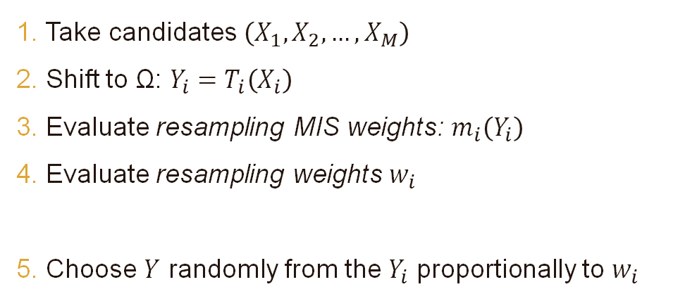

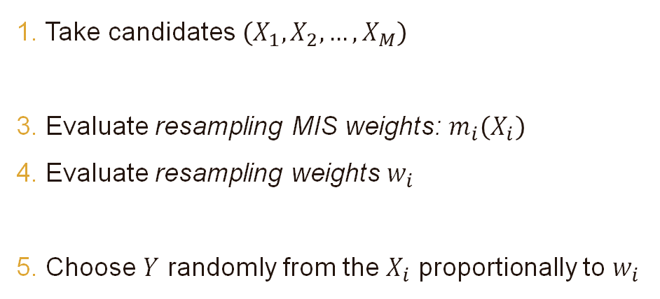
New step: shift to $Ω$
Candidates in same domain
Candidates in different domains
1. Take candidates $\left(X_{1}, X_{2},…, X_{M}\right)$
3. Evaluate resampling MIS weights: $m_{i}\left(X_{i}\right)$
4. Evaluate resampling weights $w_{i}$
5. Choose $Y$ randomly from the $X_{i}$ proportionally to $w_{i}$
1. Take candidates $\left(X_{1}, X_{2},…, X_{M}\right)$
2. Shift to Ω: $Y_{i}=T_{i}\left(X_{i}\right)$
3. Evaluate resampling MIS weights: $m_{i}\left(Y_{i}\right)$
4. Evaluate resampling weights $w_{i}$
5. Choose $Y$ randomly from the $Y_{i}$ proportionally to $w_{i}$
$$W_{Y}=\frac{1}{\hat{p}(Y)}\sum_{j=1}^{M}{w_{j}}$$
$$W_{Y}=\frac{1}{\hat{p}(Y)}\sum_{j=1}^{M}{w_{j}}$$
6. Evaluate the UCW:
6. Evaluate the UCW:
Notes:
Not much changes in the RIS algorithm. We get one extra step, shifting the candidates to the target domain.
We take the candidates, shift them to the target domain, evaluate MIS weights and resampling weights, choose Y, and evaluate the contribution weight.

Slide 31
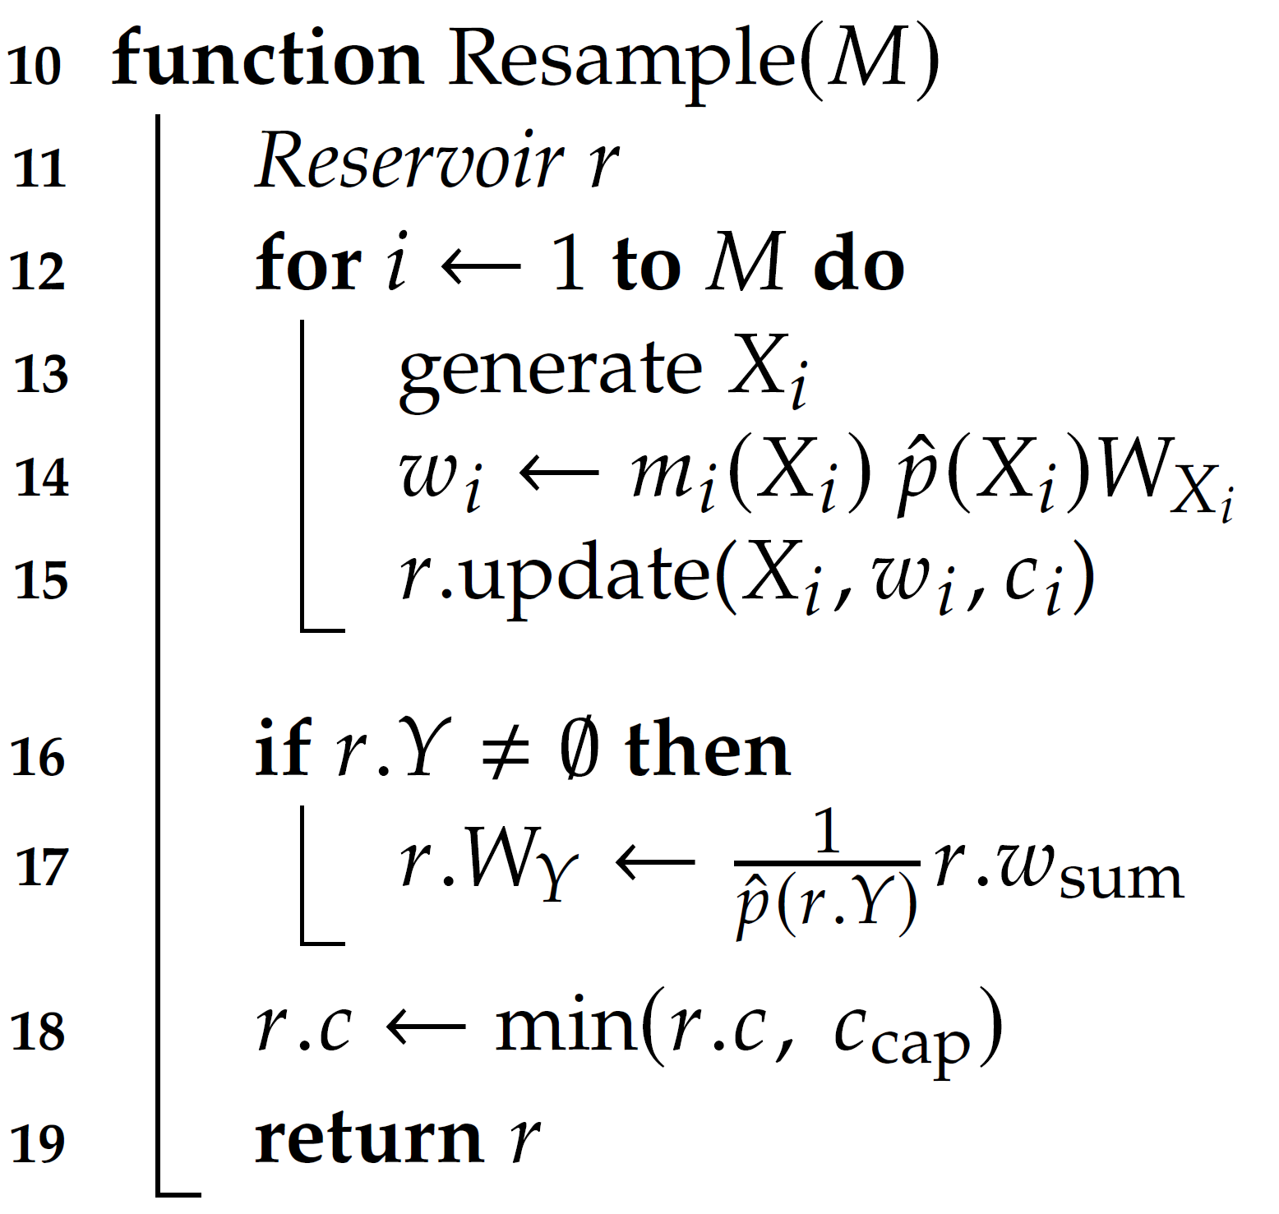
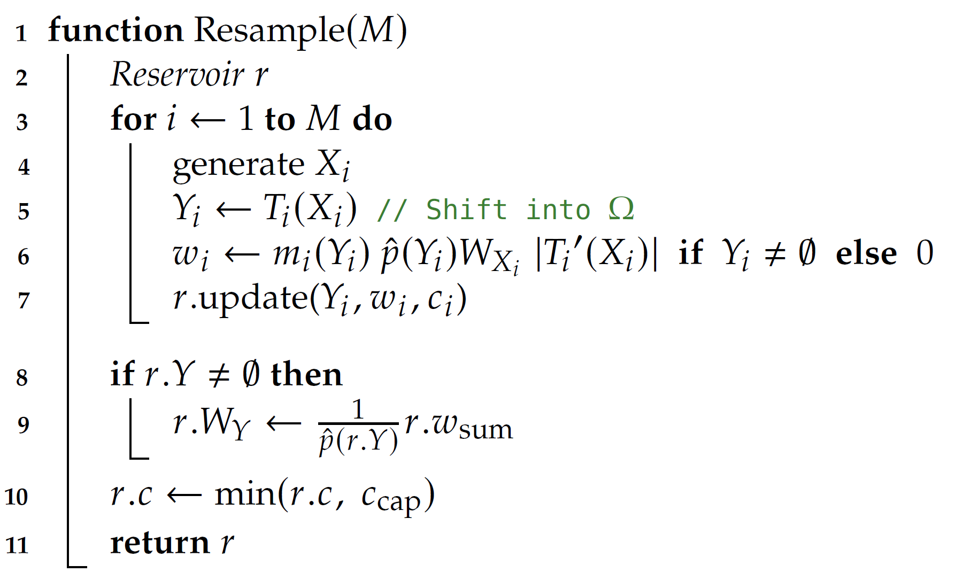
Code gets a shift and a jacobian
Candidates in same domain
Candidates in different domains
Notes:
Looking at the code, not much changes here either. We add a function call to shift the candidate to the target domain, and we need the Jacobian determinant of the shift.
As a new addition, the shift may fail, in which case the resampling weight will be zero, and this candidate won’t be chosen.

Slide 32
Between domains
Mis weights
Notes:
MIS weights computation requires a small change as well.

Slide 33


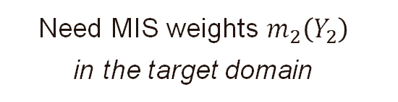



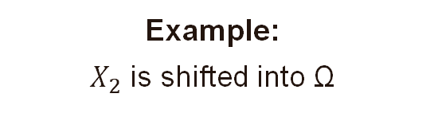

Example: shifting to $Ω$
Input domains $Ω_{i}$
Example: $X_{2}$ is shifted into Ω
$X_{2}$
$$Y_{2}=T_{2}(X_{2})$$
$T_{2}$
Need MIS weights $m_{2}\left(Y_{2}\right)$ in the target domain
$$Y_{2}$$
How?
Target domain $Ω$
Notes:
Imagine we shift this X_2 to Y_2 in the target domain. We need an MIS weight for Y_2, which is in the target domain. How can we get one?

Slide 34
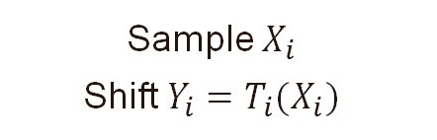
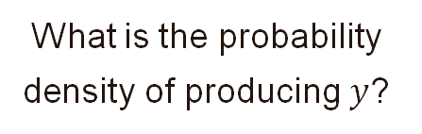


Mis weights by backward-shifting
Required for balance heuristic:
Input domains $Ω_{i}$
What is the probability density of producing $y$?
Sample $X_{i}$ Shift $Y_{i}=T_{i}(X_{i})$
$$\text{Then}\text{: } m_{i}\left(y\right)=\frac{p_{Y_{i}}(y)}{\sum_{j}{p_{Y_{j}}(y)}}$$
$$y$$
Target domain $Ω$
Notes:
If we have M candidates X_i, we have M ways of producing samples in the target domain: Sampling X_i, and shifting it to Y_i.
This gives us PDFs for the Y_i, and we can apply the balance heuristic.

Slide 35






Mis weights by backward-shifting
Denote by $x_{i}$ possible inputs that map to $y$:
Input domains $Ω_{i}$
$$y=T_{i}\left(x_{i}\right)$$
$$x_{3}$$
$$x_{4}$$
We find them by the inverse shift:
shifts undefined
$$T_{3}^{−1}$$
$T_{4}^{−1}$
$$x_{i}=T_{i}^{−1}\left(y\right)$$
Some may be undefined.
$$y$$
Target domain $Ω$
Notes:
Let’s temporarily forget about the candidate samples, and deal with a fixed lowercase y in the target domain, on the right.
There are at most M ways of producing this y: at most one x_i in each input domain can map to y.
We find these x_i by inverse shifting y.
Some of these inverse shifts may be undefined.

Slide 36
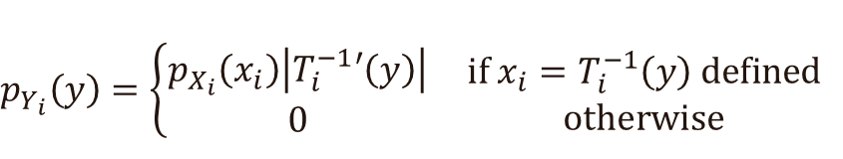


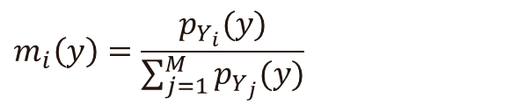
Mis weights by backward-shifting
Evaluate PDF at the input:
$$p_{X_{i}}(x_{i})$$
Input domains $Ω_{i}$
$$p_{X_{3}}( )$$
PDF transforms when we shift between $x_{i}$ and $y$:
$$p_{Y_{i}}\left(y\right)=\left\{\begin{aligned}p_{X_{i}}\left(x_{i}\right)\left|T_{i}^{−1}′\left(y\right)\right| \\ 0\end{aligned}\right. \begin{matrix}if x_{i}=T_{i}^{−1}\left(y\right) defined \\ otherwise\end{matrix}$$
Jacobian scales PDFs
$$\text{Balance} \text{heuristic}\text{:}$$
$$y$$
$$m_{i}\left(y\right)=\frac{p_{Y_{i}}(y)}{\sum_{j=1}^{M}{p_{Y_{j}}(y)}}$$
Target domain $Ω$
Notes:
Next, evaluate the input PDFs at the x_i.
We know exactly how the PDF transforms when we shift between x_i and y: by the shift’s Jacobian determinant.
If one of the domains doesn’t have a path corresponding to y, then y can’t be generated by shifting from that domain, and the PDF is zero.
Now, we can apply the balance heuristic, assuming we know the PDFs of the x_i.

Slide 37


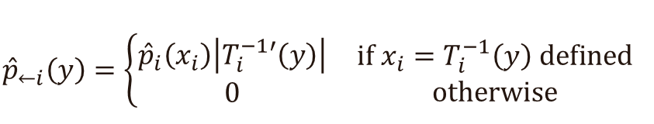
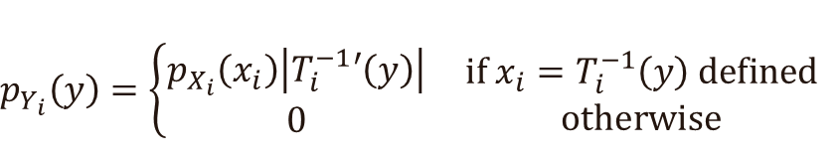




Ris: ${\hat{p}}_{i}$ as pdf proxies
Proxy for $p_{Y_{i}}$: Let’s define ${\hat{p}}_{←i}$
If inputs from RIS, we don’t know PDFs, but PDFs are approx. proportional to ${\hat{p}}_{i}$
”p-hat from i”
$$p_{Y_{i}}\left(y\right)=\left\{\begin{aligned}p_{X_{i}}\left(x_{i}\right)\left|T_{i}^{−1}′\left(y\right)\right| \\ 0\end{aligned}\right. \begin{matrix}if x_{i}=T_{i}^{−1}\left(y\right) defined \\ otherwise\end{matrix}$$
Proxy for $p_{X_{i}}$: Target function ${\hat{p}}_{i}$
$${\hat{p}}_{←i}\left(y\right)=\left\{\begin{aligned}{\hat{p}}_{i}\left(x_{i}\right)\left|T_{i}^{−1}′\left(y\right)\right| \\ 0\end{aligned}\right. \begin{matrix}if x_{i}=T_{i}^{−1}\left(y\right) defined \\ otherwise\end{matrix}$$
Need proxy for $p_{Y_{i}}$ →
$$Y_{i}=T_{i}(X_{i})$$
Notes:
But, like before, in ReSTIR, we don’t usually know these PDFs. Instead, we use p-hats as proxies.
We know the proxy for PDF of X_i is its corresponding target function pHat-i.
But we need a proxy for the PDF of Y_i in the target domain.
The solution is rather simple: We use the previous formula of p_Yi, but replace p_Xi in the red rectangle with its pHat. We call this proxy ”pHat-from i”

Slide 38
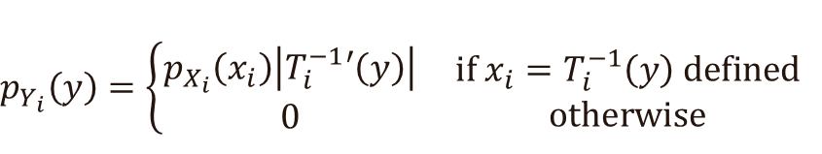
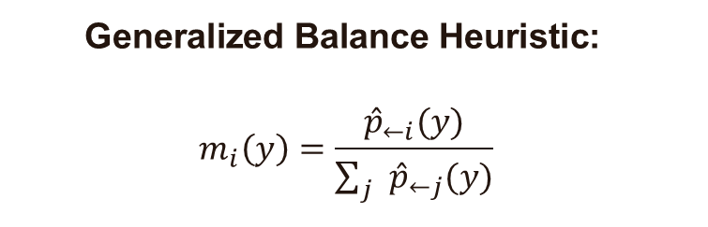
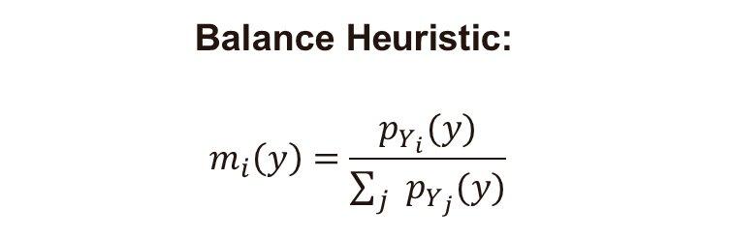

Generalized balance heuristic
$$\text{Balance} \text{Heuristic}\text{:}$$
$$m_{i}\left(y\right)=\frac{p_{Y_{i}}(y)}{\sum_{j}{p_{Y_{j}}(y)}}$$
where
$$p_{Y_{i}}\left(y\right)=\left\{\begin{aligned}p_{X_{i}}\left(x_{i}\right)\left|T_{i}^{−1}′\left(y\right)\right| \\ 0\end{aligned}\right. \begin{matrix}if x_{i}=T_{i}^{−1}\left(y\right) defined \\ otherwise\end{matrix}$$
$$\text{Generalized} \text{Balance} \text{Heuristic}\text{:}$$
$$m_{i}\left(y\right)=\frac{{\hat{p}}_{←i}(y)}{\sum_{j}{{\hat{p}}_{←j}(y)}}$$
where
$${\hat{p}}_{←i}\left(y\right)=\left\{\begin{aligned}{\hat{p}}_{i}\left(x_{i}\right)\left|T_{i}^{−1}′\left(y\right)\right| \\ 0\end{aligned}\right. \begin{matrix}if x_{i}=T_{i}^{−1}\left(y\right) defined \\ otherwise\end{matrix}$$
Pseudocode in course notes!
Notes:
This gives us the generalized balance heuristic for reuse between domains.
It’s the same as the normal balance heuristic, but uses the new PDF proxy pHat-from.
Please see our course notes for pseudocode and more insights.

Slide 39
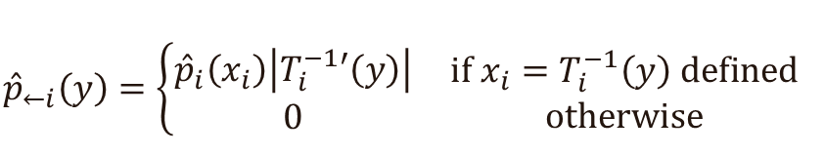
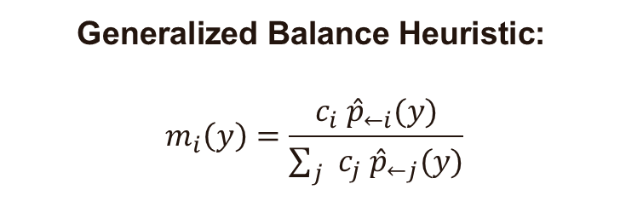
Generalized balance heuristic with confidence weights
$$\text{Generalized} \text{Balance} \text{Heuristic}\text{:}$$
$$m_{i}\left(y\right)=\frac{c_{i} {\hat{p}}_{←i}(y)}{\sum_{j}{{c_{j} \hat{p}}_{←j}(y)}}$$
where
$${\hat{p}}_{←i}\left(y\right)=\left\{\begin{aligned}{\hat{p}}_{i}\left(x_{i}\right)\left|T_{i}^{−1}′\left(y\right)\right| \\ 0\end{aligned}\right. \begin{matrix}if x_{i}=T_{i}^{−1}\left(y\right) defined \\ otherwise\end{matrix}$$
Confidence weights: Benefit from longer temporal history
Pseudocode in course notes!
Notes:
As before, we likely want to apply the confidence weights if we use this with ReSTIR, to give more weight to samples that we trust more, and enable benefitting from temporal history. Just multiply the pHat-froms with the confidence weights from the reservoirs.

Slide 40
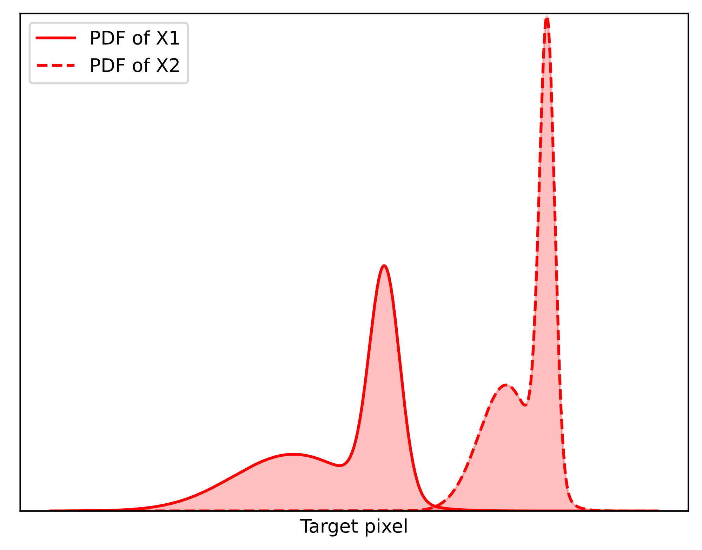
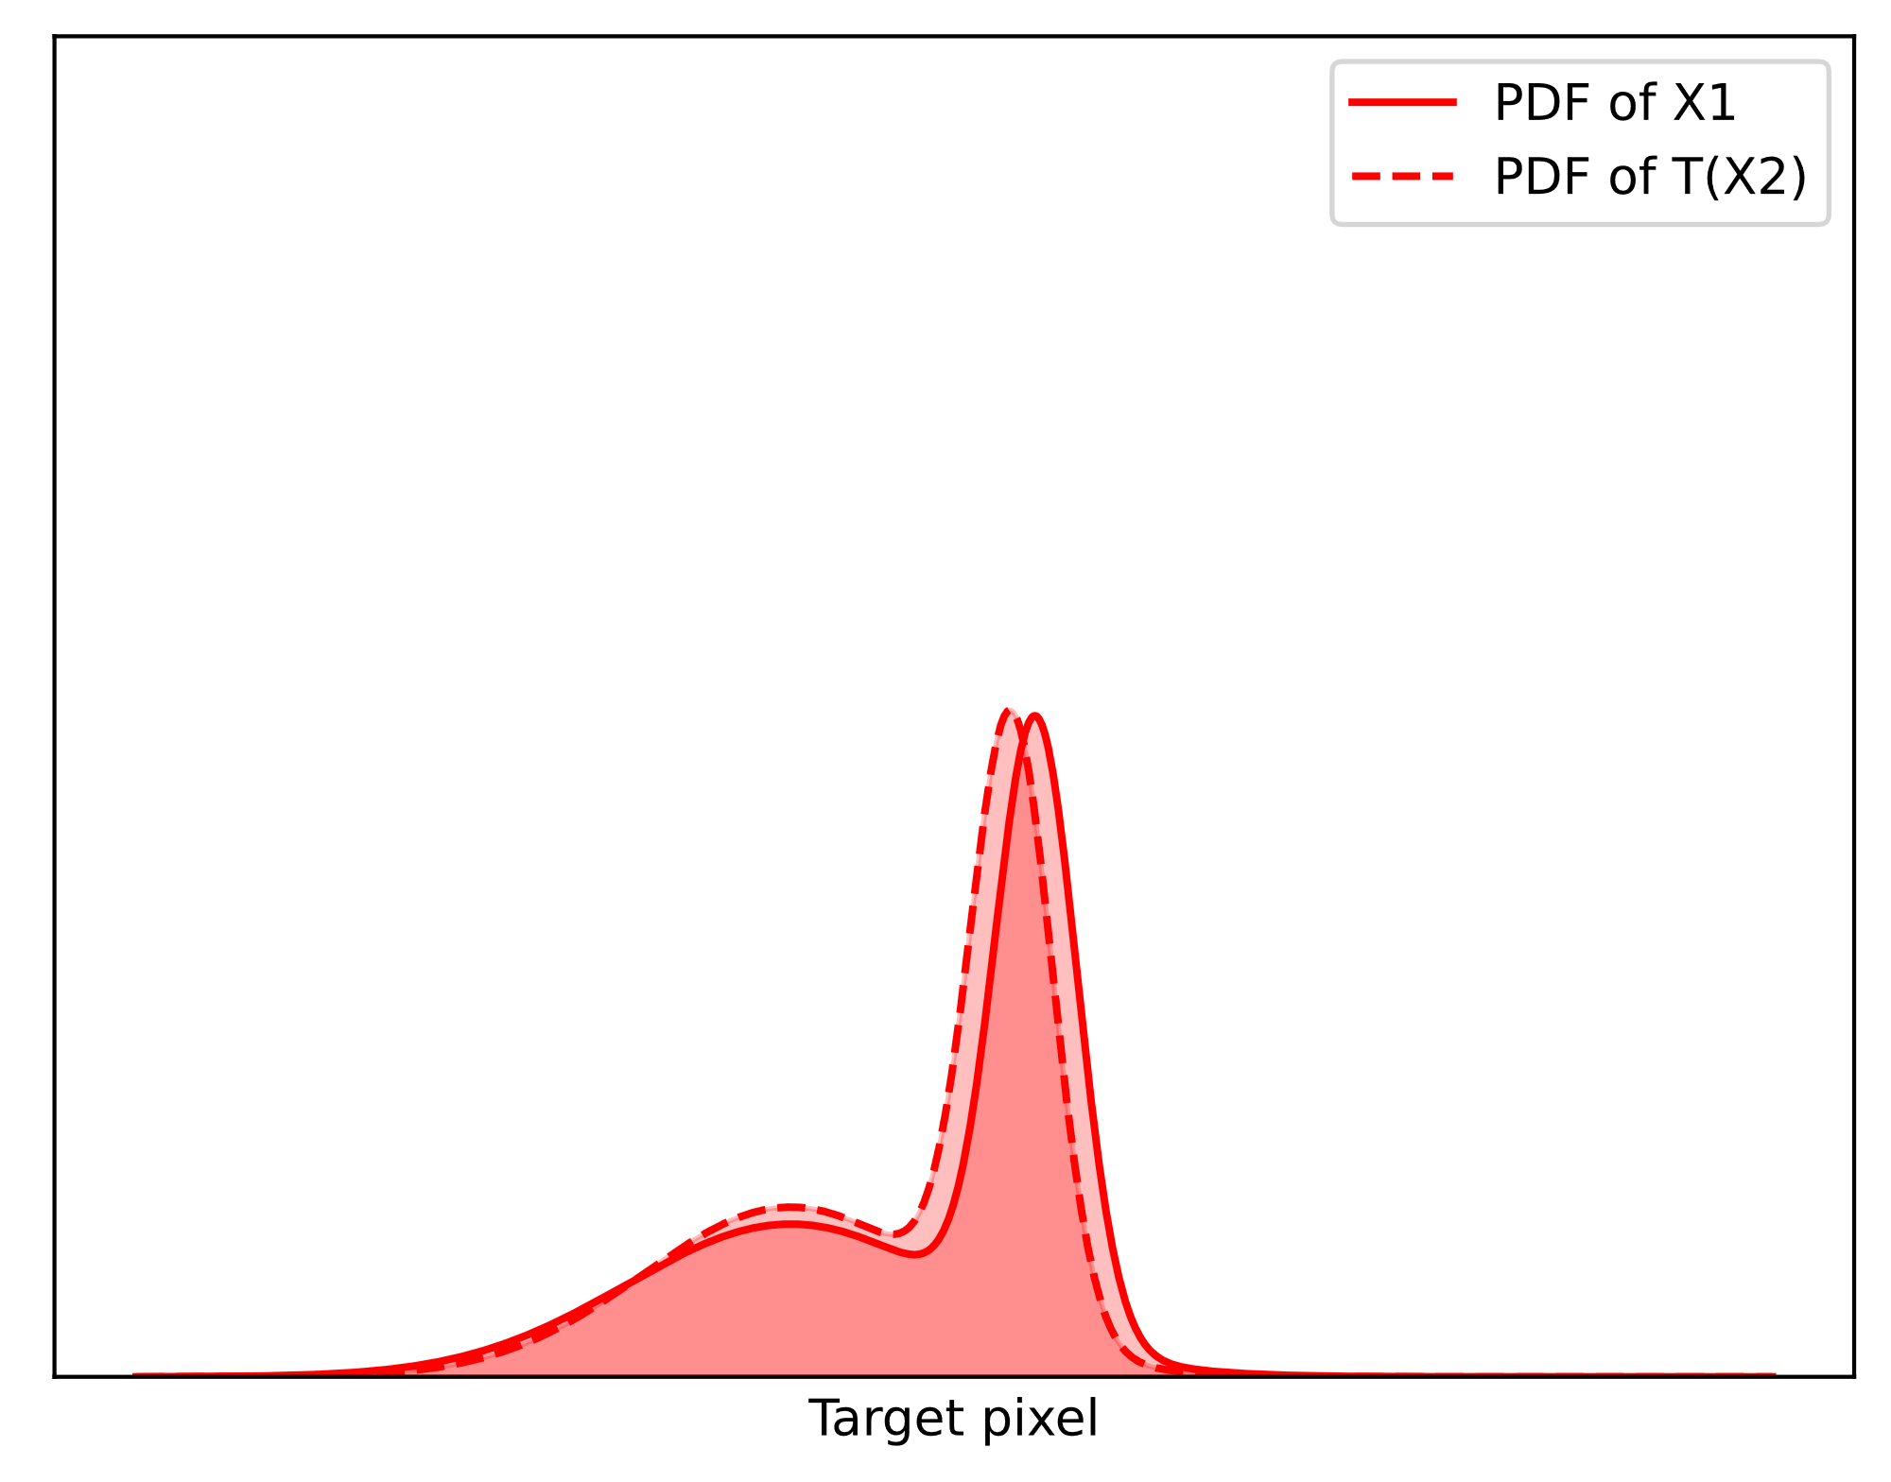
shift mapping matches pdfs
Without shift mapping
With shift mapping
Notes:
The shift mappings not only move the candidates into the target domain. They also align the PDFs by taking into account material constraints, which makes reuse more effective.

Slide 41
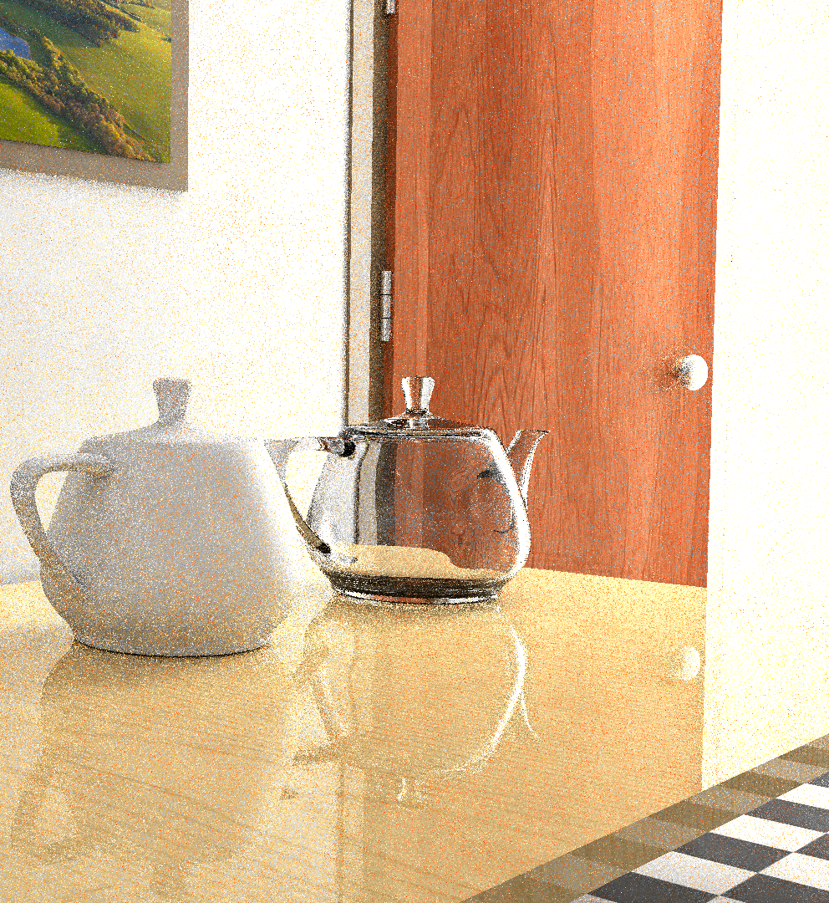
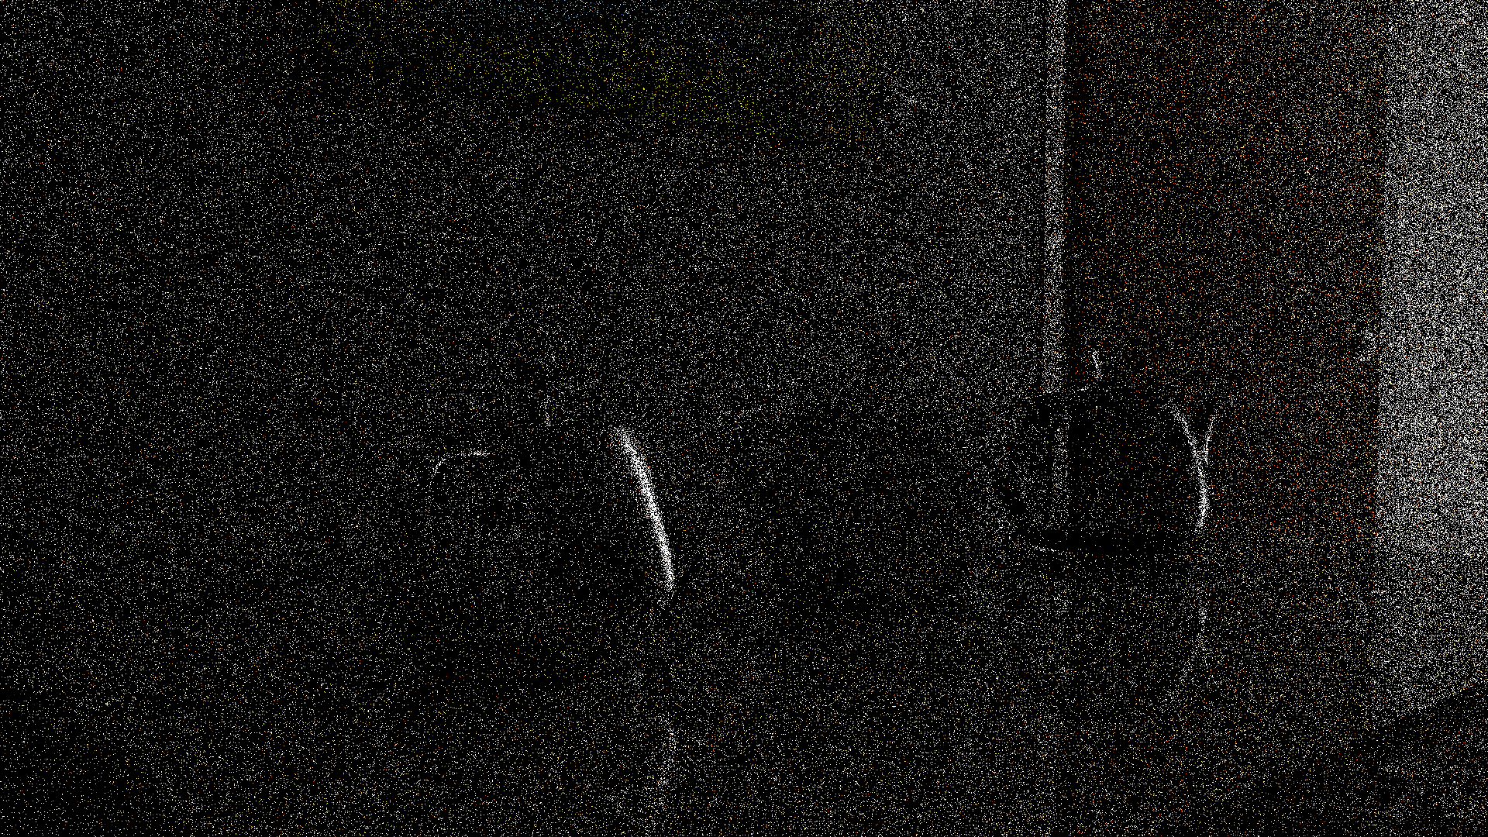
PaTh Tracing (1 SPP)
ReSTIR PT (1 spp)
[Lin et al. 2022]
Lit from another room
Glass
Metal
→ ReSTIR Path Tracing
Notes:
A ReSTIR path tracer using shift mappings and MIS weights can quite significantly improve over standard path tracing, even in scenes with complicated light transport, such as here with glass and metal objects and all light arriving from another room through a barely opened door.
That will be our next topic.

