Slide 1
Restir course
Resampled importance sampling
Notes:
I’m Markus Kettunen and I’ll try to familiarize us to resampled importance sampling.

Slide 2

Resampled importance sampling
a machine that produces samples approximately proportionally to a target distribution
RIS:
Samples $X_{1},X_{2},…, X_{M}$
RIS
One better-distributed sample
Notes:
Resampled Importance Sampling, RIS, is a machine that produces samples approximately proportionally to a user-given target function.
We give it a sequence of samples from X_1 to X_m, and it, by weighted random sampling, returns us one of the inputs, to produce one better-distributed sample.

Slide 3
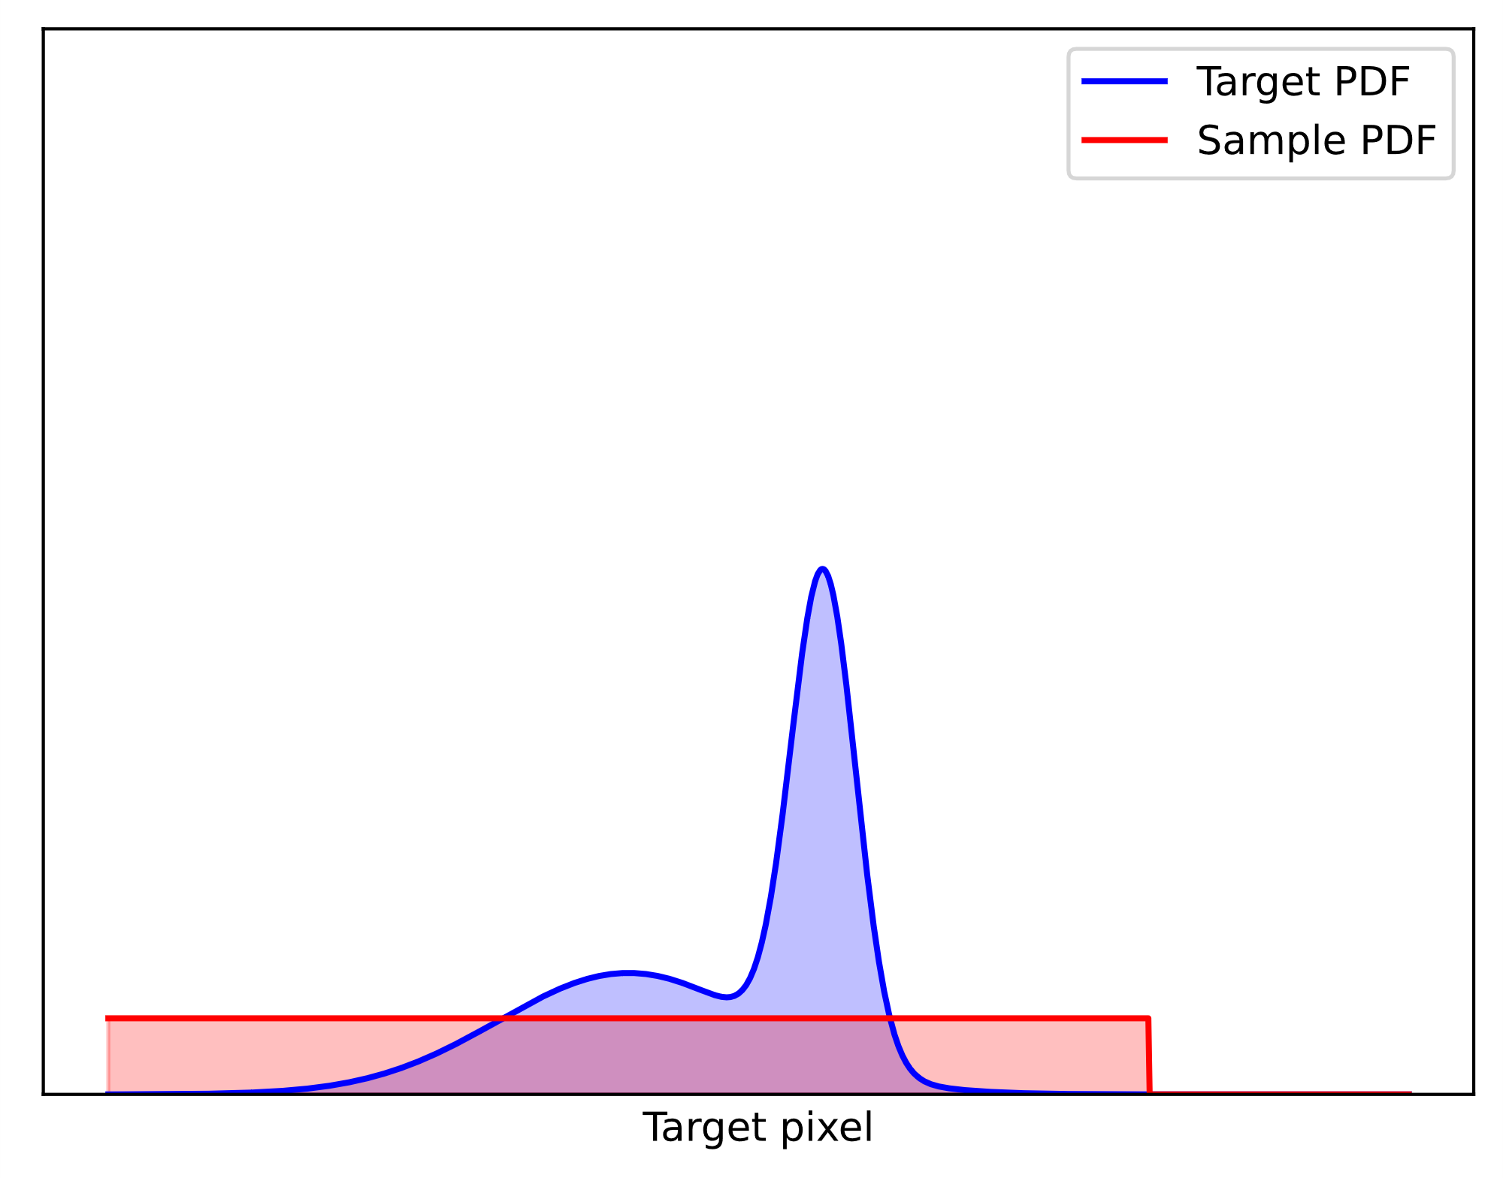



Pdf converges to target
Target distribution
$$\overline{p}$$
$$X_{1}$$
$$X_{2}$$
Input PDF
Notes:
Here, we show a target distribution in blue, and two input samples with the uniform PDF in red, as an example.
Let’s apply RIS and see the output distribution.

Slide 4
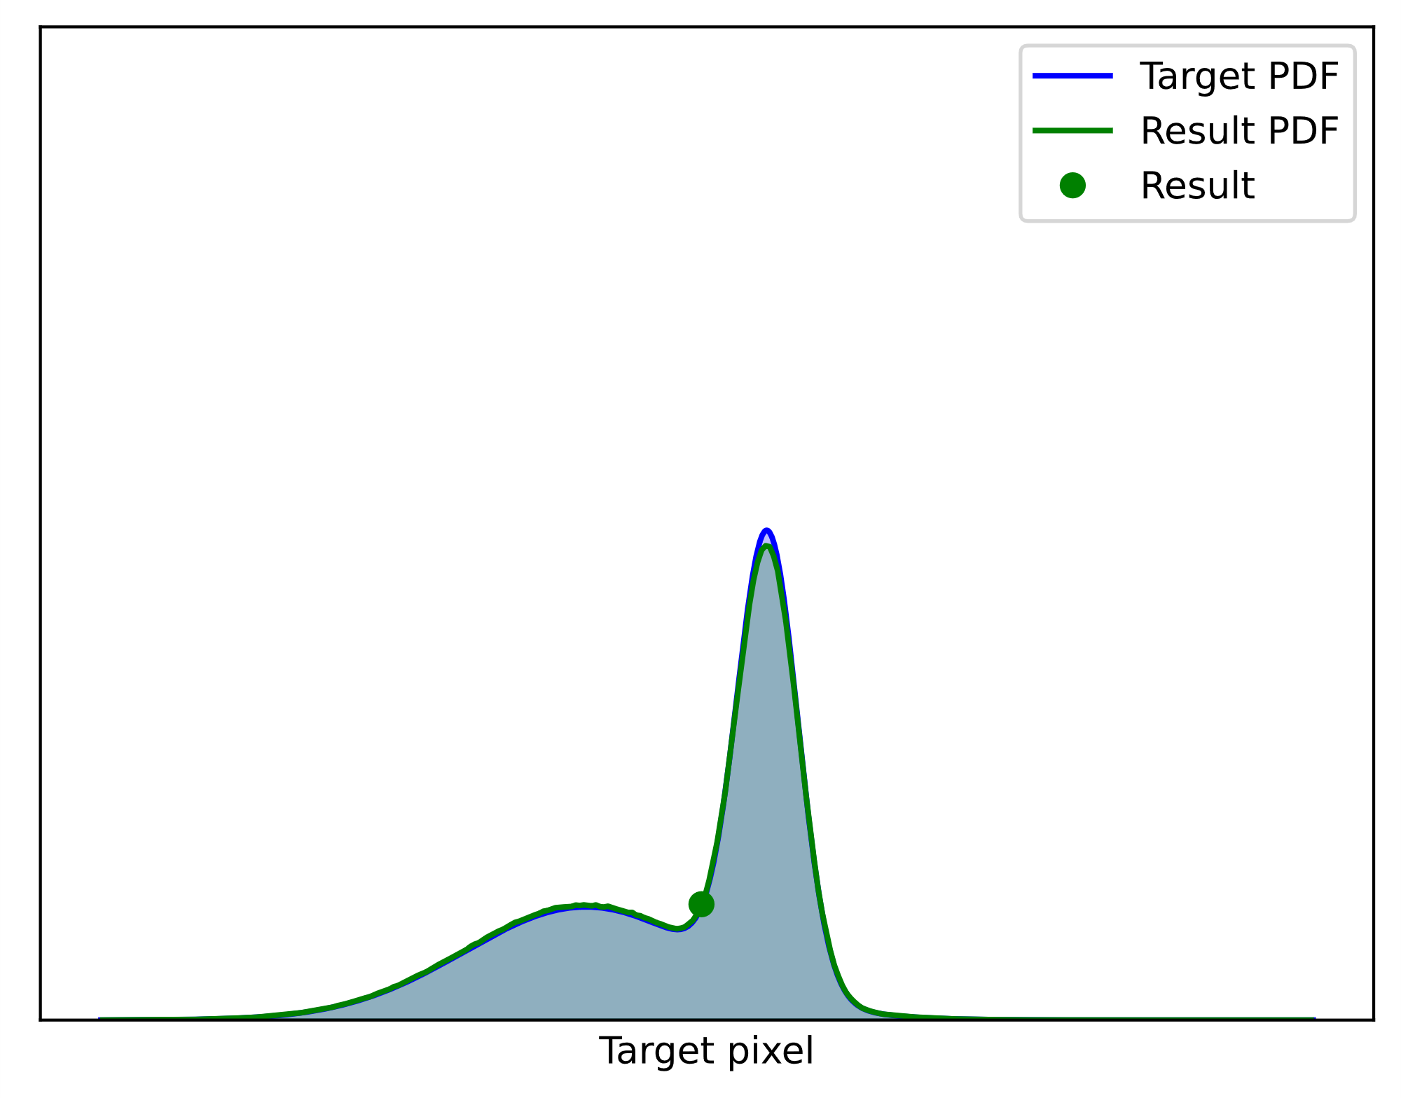


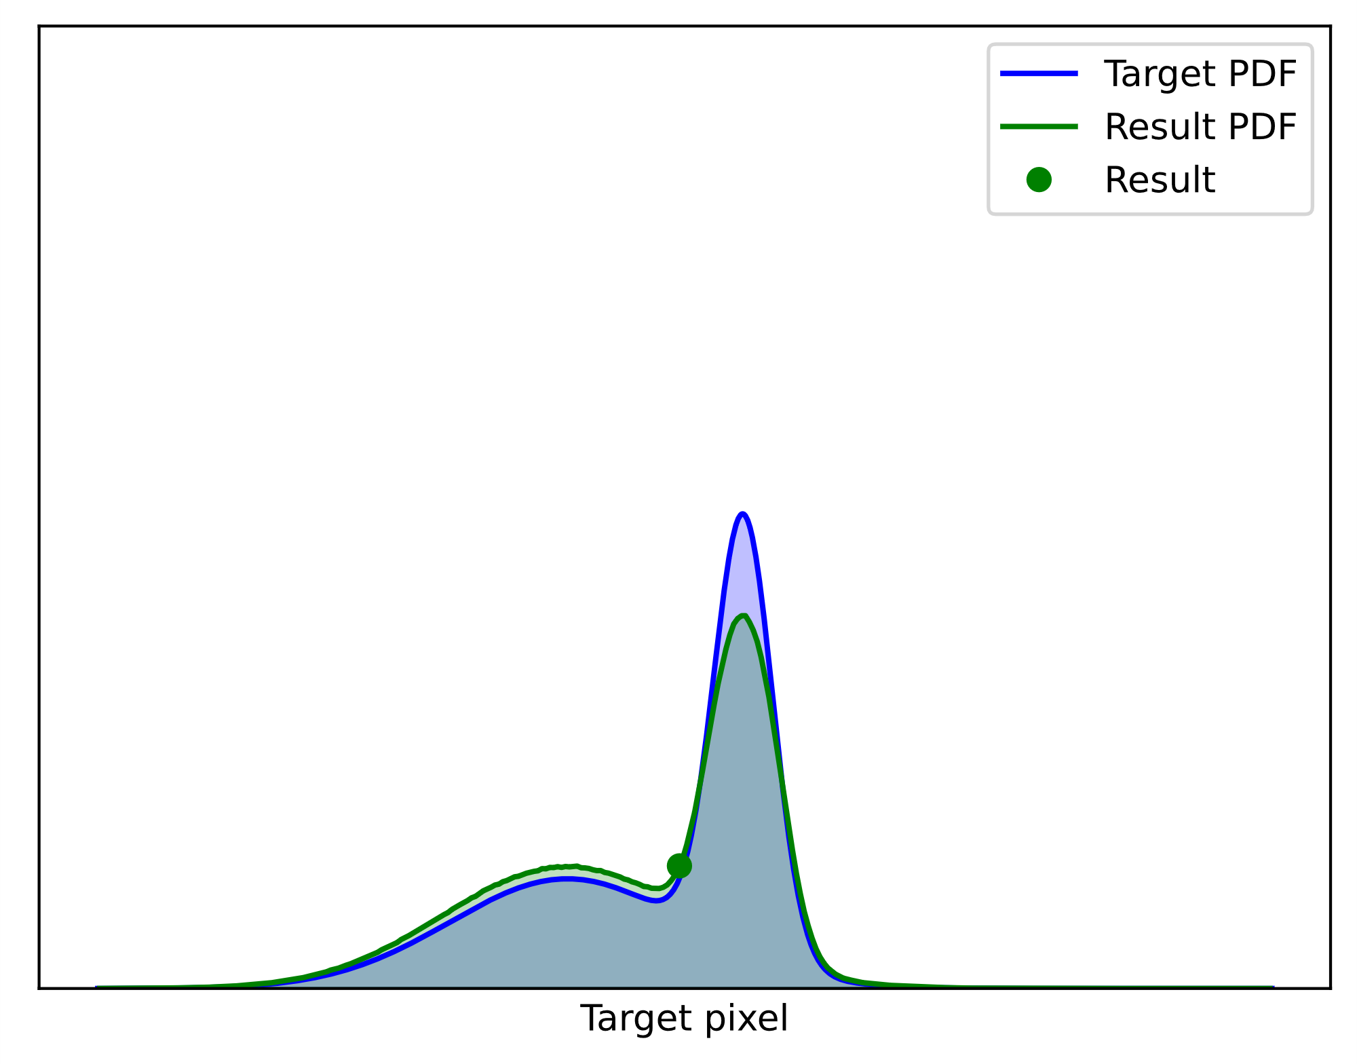
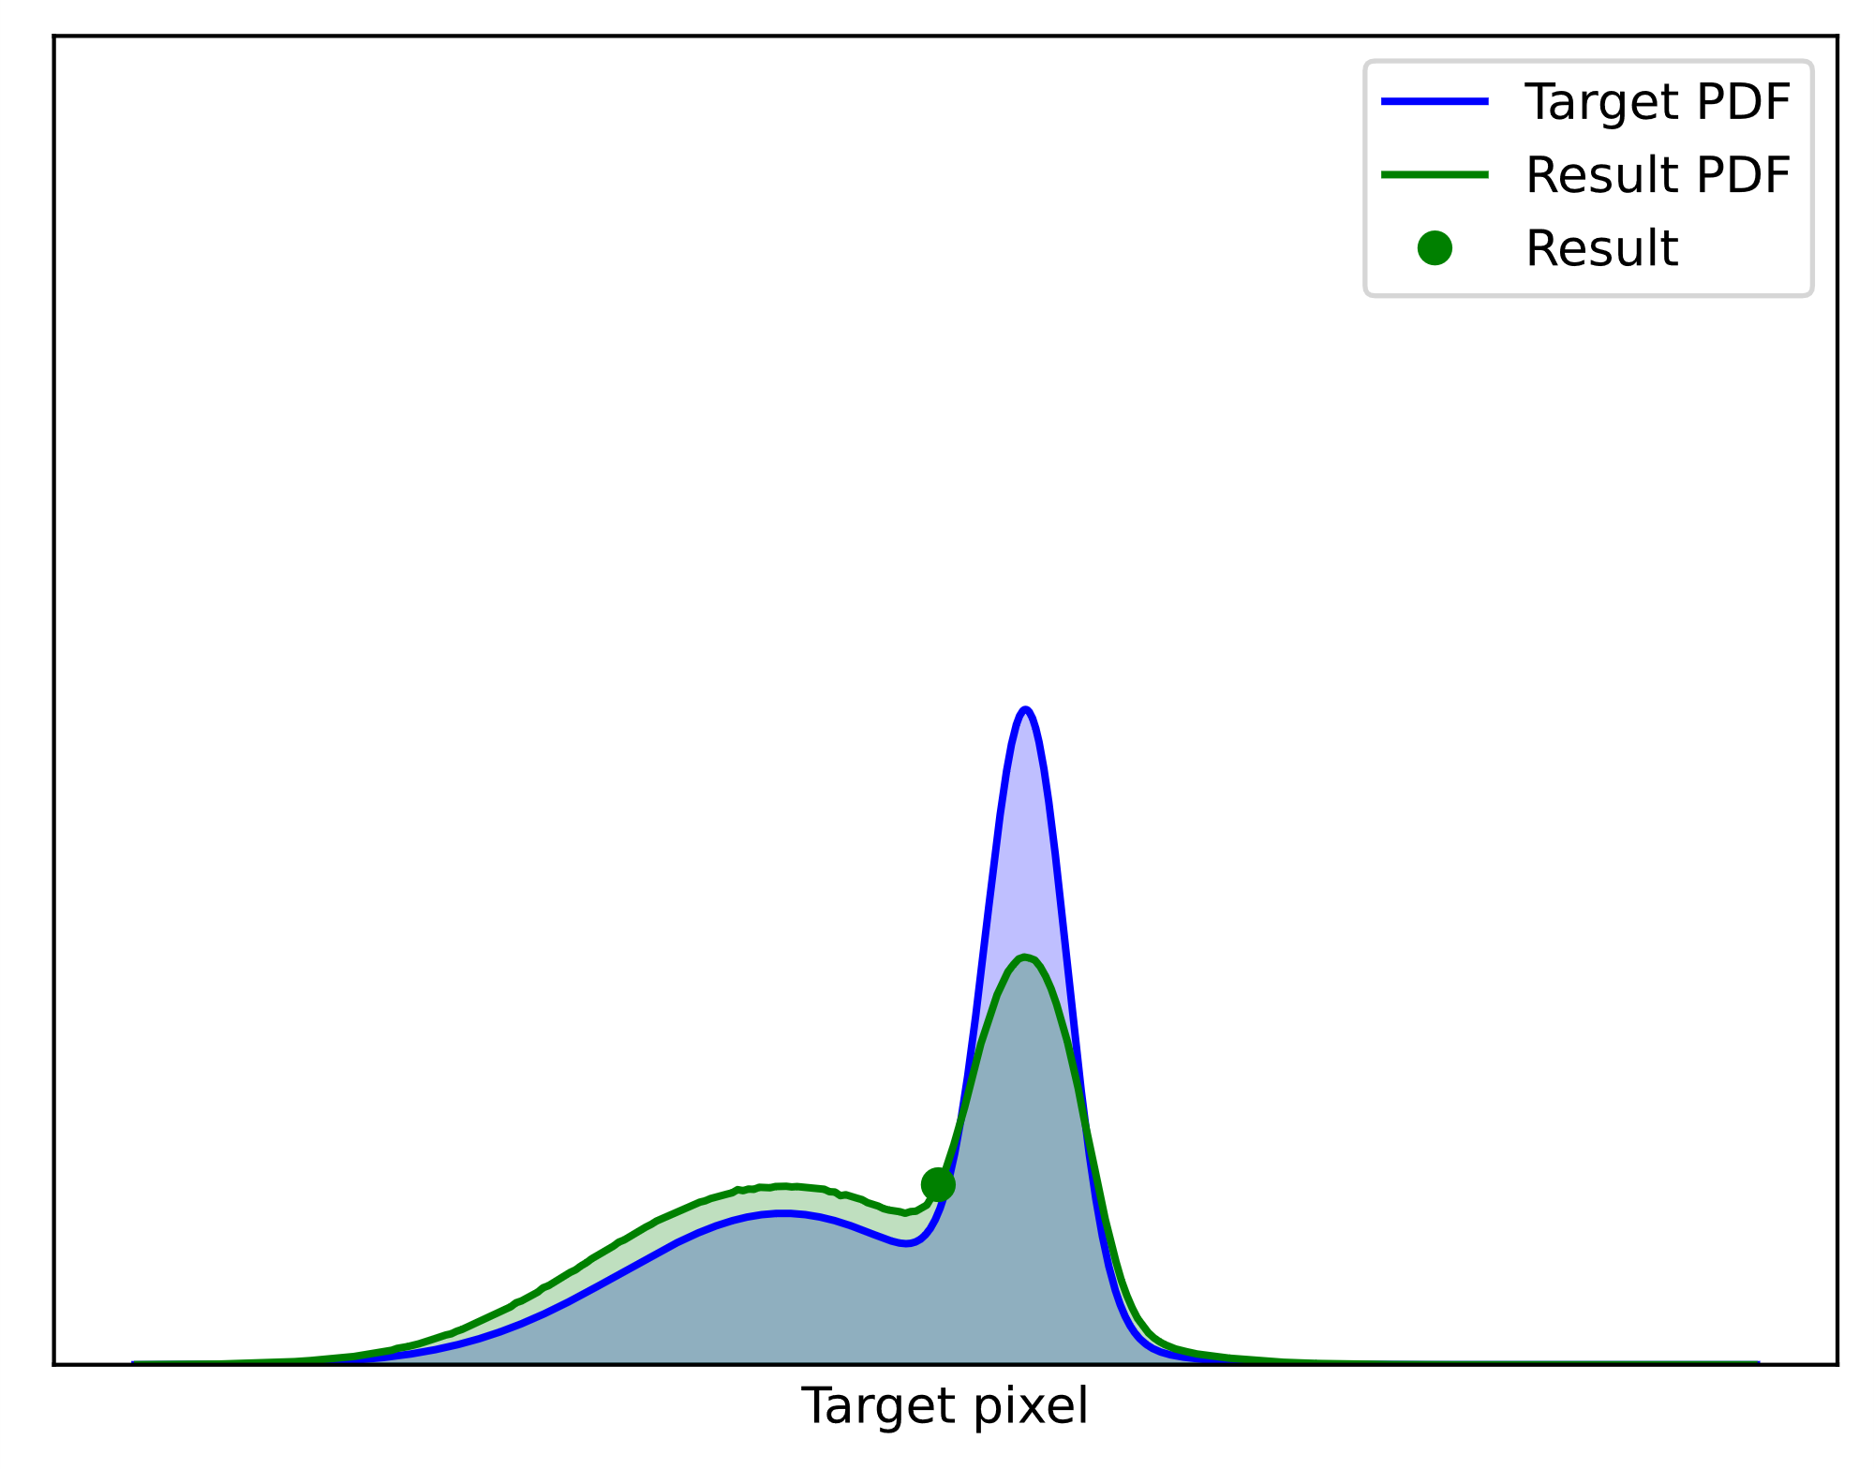
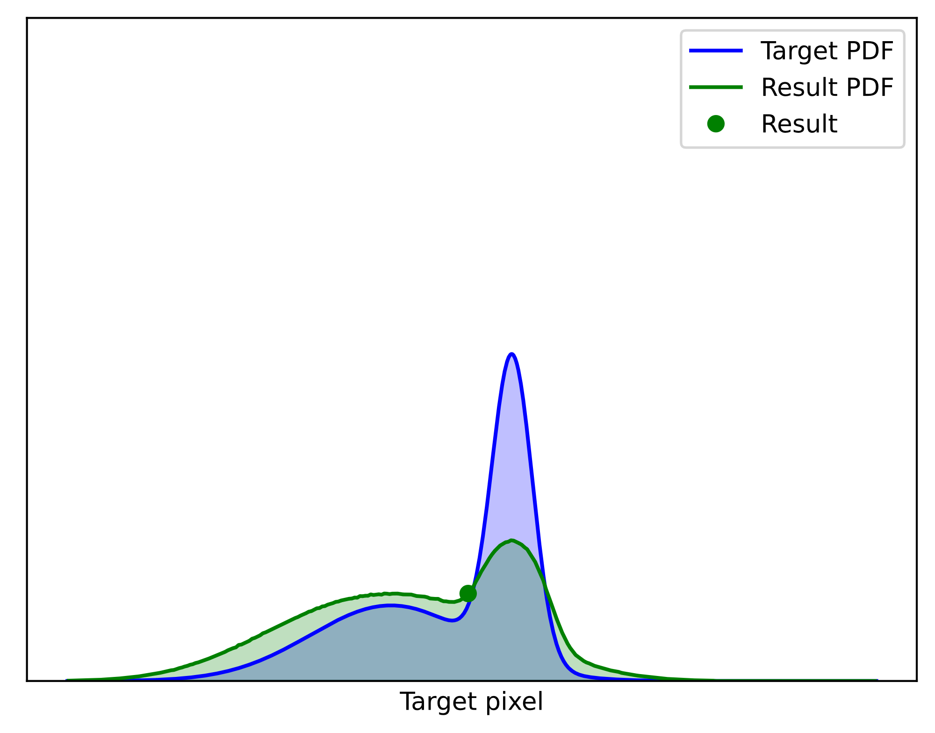
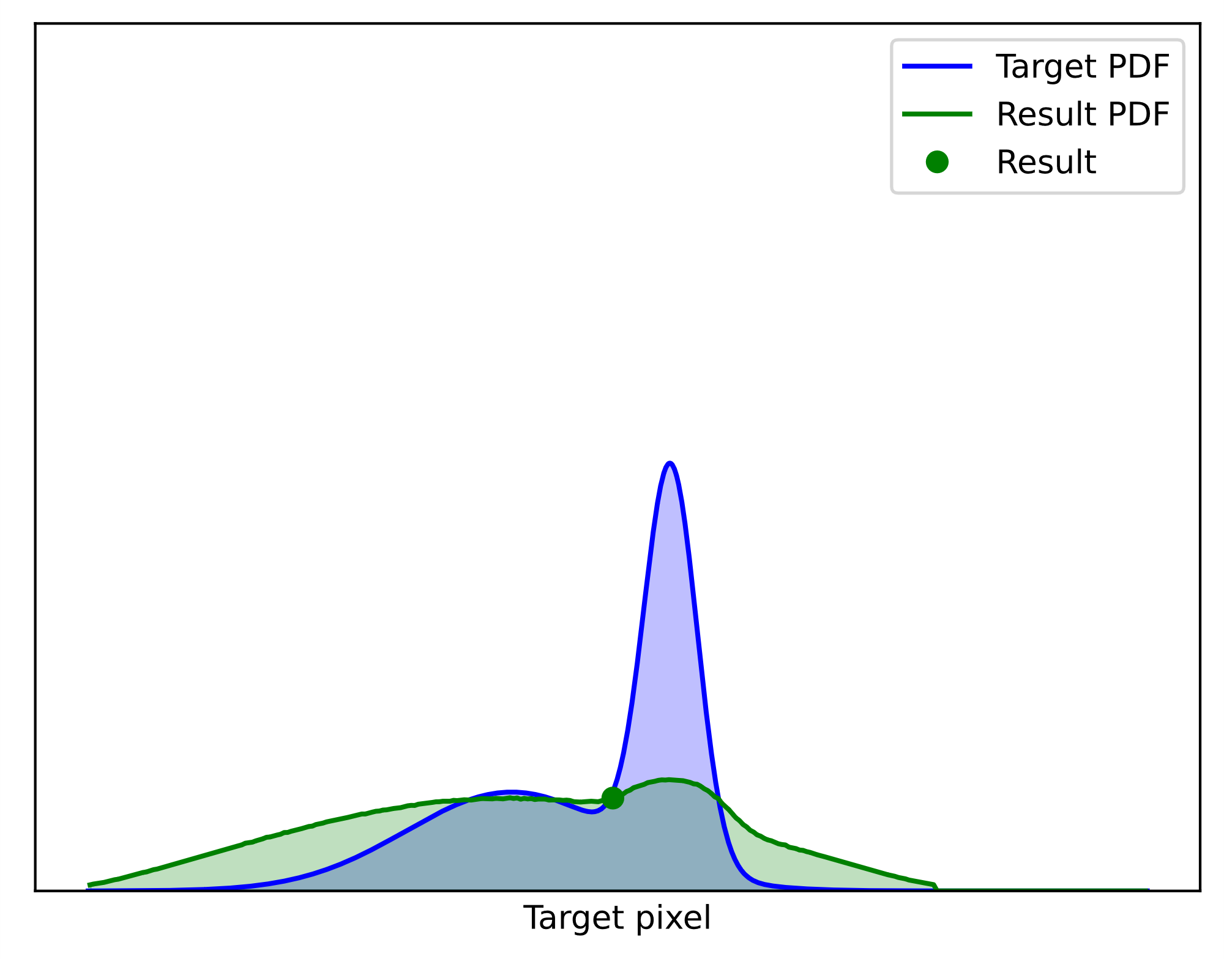

Pdf converges to target
Result distribution
$$\overline{p}$$
Let’s add more samples…
$$p$$
128
64
32
16
8
4
2
candidates
Notes:
This is the PDF of the RIS output from two candidates. Let’s increase the sample count more… 4… 8… 16… 32… 64… 128. It seems to be working! The result PDF converges towards the target!

Slide 5
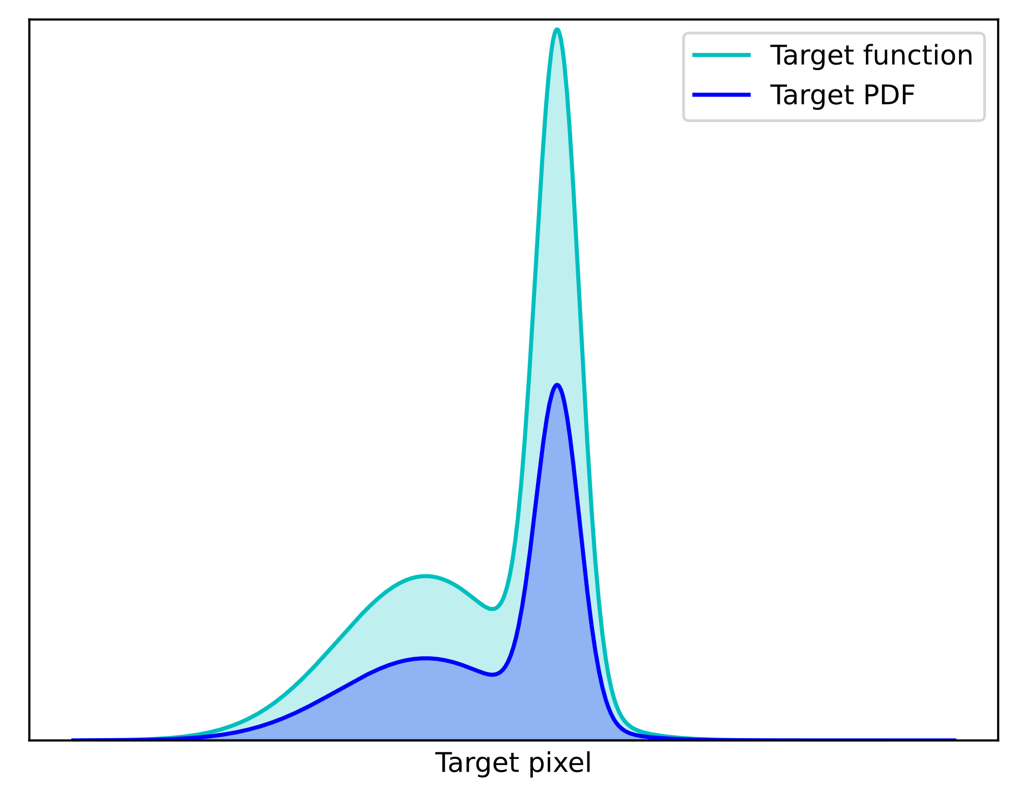

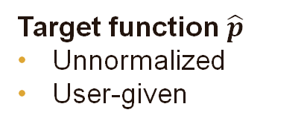
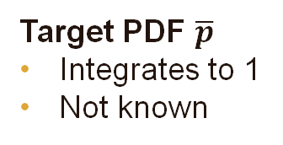
Ris: Concepts
Target function $\hat{p}$
Unnormalized
User-given
← Used in selection probabilities
Target PDF $\overline{p}$
Integrates to 1
Not known
← Result PDF approximately $\overline{p}$
Notes:
Let’s now have a look at the concepts we deal with in RIS.
We have the user-given target function p-hat, which is unnormalized, and is used for sample selection probabilities.
Its normalized version is the target PDF we already met, which integrates to 1, and is thus generally unknown. With more and more candidate samples, the PDF of the RIS output will approximate p-bar better and better.

Slide 6
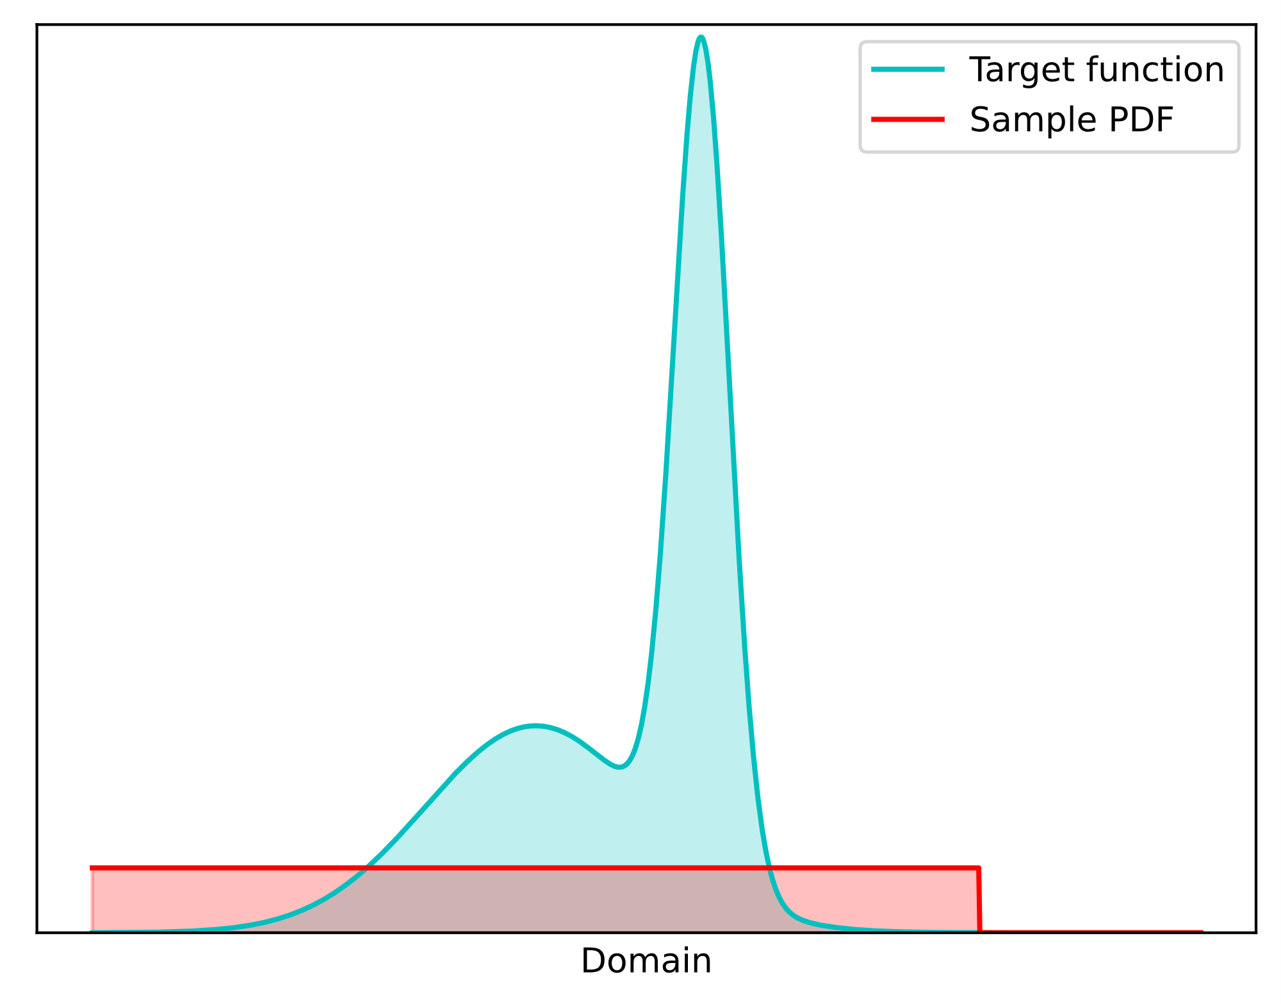









Ris On a high level
$$\hat{p}$$
User gives:
target function $\hat{p}$
candidate samples $(X_{1}, X_{2},…, X_{M})$
RIS:
evaluates resampling weights $w_{i}$ $∼\hat{p}$ for all candidates
returns one randomly, proportionally to $w_{i}$
$$X_{1}$$
$$X_{2}$$
$$X_{3}$$
$$X_{4}$$
Clever random choice
$$\hat{p}$$
$$\overline{p}$$
$$Y$$
Notes:
On a high level, the user gives RIS a the unnormalized target function, cyan in the right, and a sequence of candidate samples.
RIS evaluates resampling weights lowercase w_i, proportional to the target function, for all candidates, and returns one of the candidates randomly, proportionally to the resampling weights.

Slide 7
Ris is like path guiding – in a sense
Resampled Importance Sampling
Path Guiding
Input: Continuous random variables
Input: Continuous random variables
Fit a PDF
Cleverly pick one
Sample with improved PDF
Output: Continuous random variable
with improved PDF
Output: Continuous random variable
with improved PDF
Notes:
Some of you may be familiar with path guiding. Resampled importance sampling resembles it in some ways, but is also quite different in some ways.
Like path guiding, RIS takes as input continuous random variables.
It then cleverly picks one of the inputs, and outputs it. The result is a continuous random variable with an improved PDF.
Path guiding also takes as input as a sequence of continuous random variables. It then fits a PDF to them, and ouputs a new sample with the improved PDF.
The output is similarly a continuous random variable with an improved PDF.

Slide 8
Ris skips fitting pdf – and reuses inputs
RIS skips learning the PDF
Fit a PDF (hard with few samples)
Reuses – can’t create unlimited samples
Aggregates multiple samples into one
with a better probability density
Cleverly pick one
✓
Filters distributions (or: PDFs)
Notes:
The key difference is that RIS skips the PDF fitting – which can be nice, since fitting a PDF can be hard if we only have few samples.
But since RIS reuses samples, it can’t create unlimited new samples from a once-learned distribution, like path guiding.
Instead, RIS aggregates the candidate samples into one with a better probability density.
In a sense, RIS filters distributions, or PDFs.

Slide 9
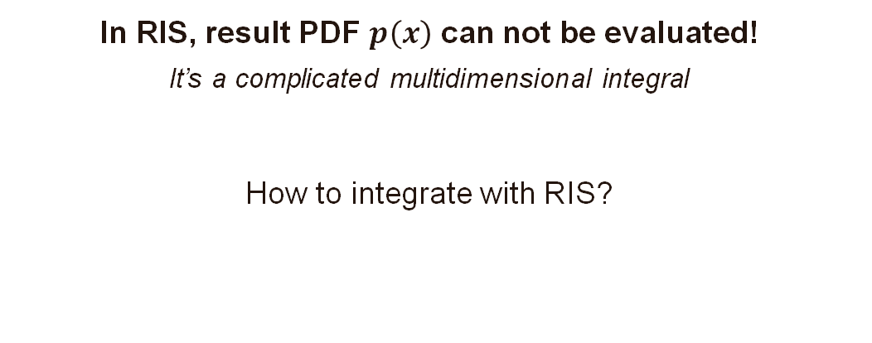
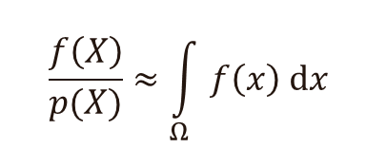
Ris result’s pdf can not be evaluated
In RIS, result PDF $p\left(x\right)$ can not be evaluated!
It’s a complicated multidimensional integral
How to integrate with RIS?
Monte Carlo integration:
$$\frac{f\left(X\right)}{p(X)}≈\int_{Ω}{f\left(x\right) dx}$$
Pixel color
Ground truth
Notes:
But there is a catch: the PDF of the resampling result is intractable, it can not be evaluated in real-time, as it’s a complicated multidimensional integral.
So if we don’t know the PDF, how can we integrate?
We know that Monte Carlo integration requires dividing f by p to estimate the integral of f… right?

Slide 10
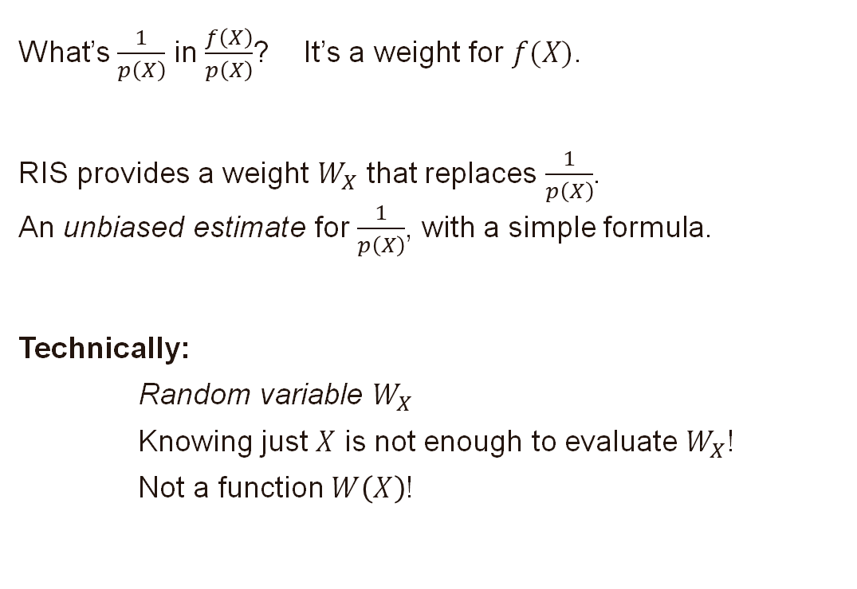
1/p(x) is a weight – but not the only one
What’s $\frac{1}{p\left(X\right)}$ in $\frac{f\left(X\right)}{p\left(X\right)}$? It’s a weight for $f(X)$.
RIS provides a weight $W_{X}$ that replaces $\frac{1}{p\left(X\right)}$.
An unbiased estimate for $\frac{1}{p\left(X\right)}$, with a simple formula.
Technically:
Random variable $W_{X}$
Knowing just $X$ is not enough to evaluate $W_{X}$!
Not a function $W\left(X\right)$!
Notes:
Let’s think for a bit – what’s the role of one-per-p in f-per-p? It’s a weight for f.
RIS provides a weight W_X, an unbiased contribution weight, that replaces 1/p.
This weight is an unbiased estimate for the reciprocal PDF, with a simple formula.
Technically, W_X is a random variable. Knowing just X is not enough to evaluate W_X, so it’s not a function W of X.

Slide 11
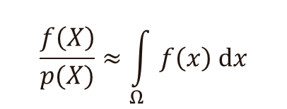
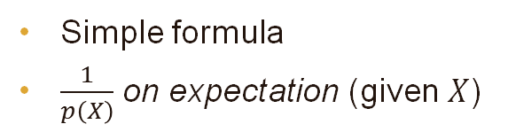
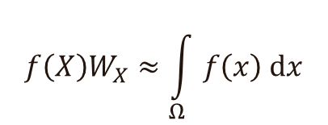
Unbiased contribution weight (UCW) allows integration
Monte Carlo with RIS:
Traditional Monte Carlo:
$$f\left(X\right)W_{X}≈\int_{Ω}{f\left(x\right) dx}$$
$$\frac{f\left(X\right)}{p(X)}≈\int_{Ω}{f\left(x\right) dx}$$
Unbiased contribution weight
Unknown in RIS
Simple formula
$\frac{1}{p\left(X\right)}$ on expectation (given $X$)
Notes:
This W_X replaces 1/p in Monte Carlo integration, and f/p(X) becomes f * W_X, allowing integration. This contribution f(X) W_X is unbiased, which explains the name unbiased contribution weight.
In RIS, unbiased contribution weights have a very simple formula, and they evaluate to 1/p(X) on expectation.

Slide 12
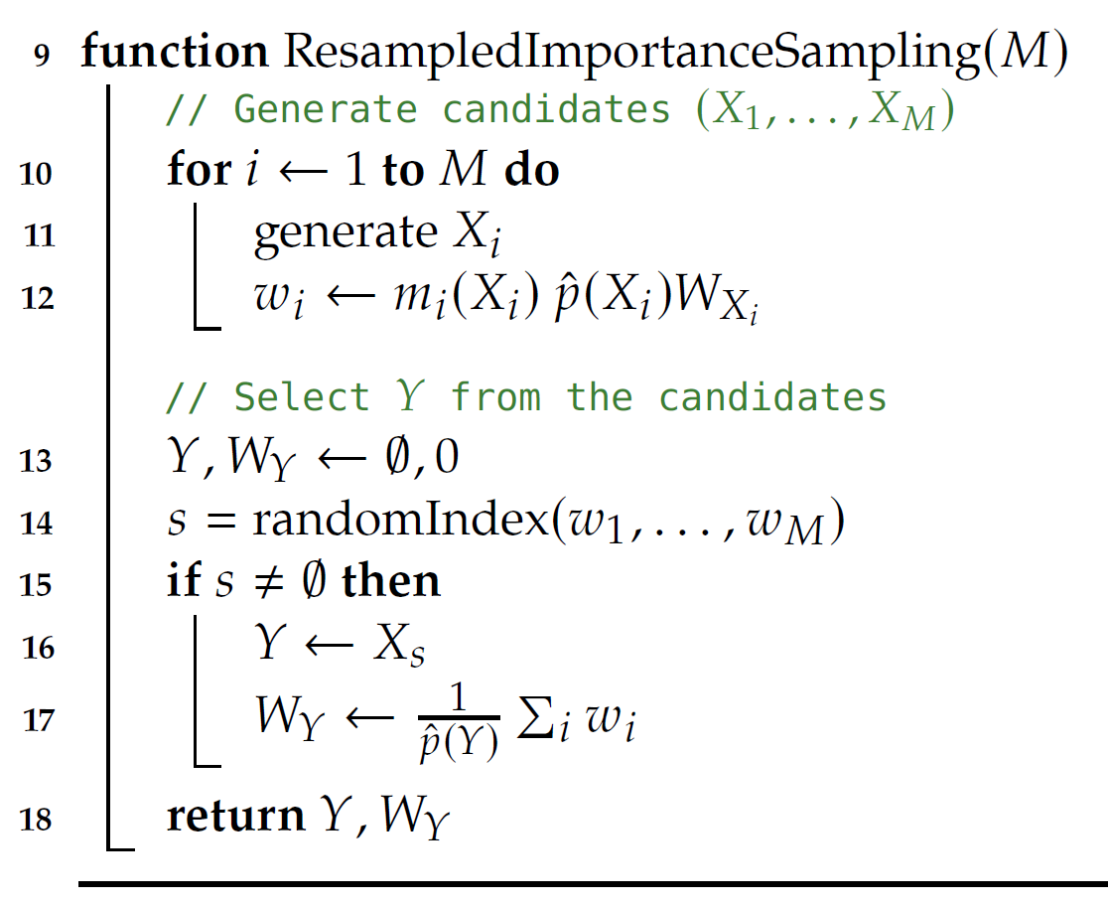
RIS: Algorithm
1. Take candidates $(X_{1}, X_{2},…, X_{M})$
Notes:
In RIS, we take as input samples from X_1 to X_M. Here, we ”generate” them on the fly, but this ”generation” could be, for example, looking them up from an array.

Slide 13
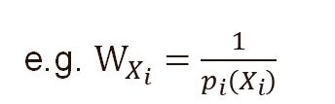
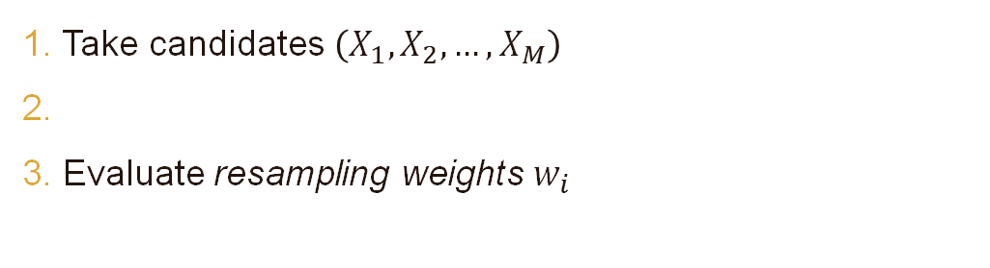
RIS: Algorithm
1. Take candidates $\left(X_{1}, X_{2},…, X_{M}\right)$
2.
3. Evaluate resampling weights $w_{i}$
e.g. $W_{X_{i}}=\frac{1}{p_{i}\left(X_{i}\right)}$
Notes:
Next, we evaluate the resampling weights. We need the target function p-hat at the sample location, multiplied by the unbiased contribution weight. If we know the PDF of X_i, we can just use its reciprocal.

Slide 14
RIS: Algorithm
1. Take candidates $\left(X_{1}, X_{2},…, X_{M}\right)$
2.
3. Evaluate resampling weights $w_{i}$
e.g. $W_{X_{i}}=\frac{1}{p_{i}\left(X_{i}\right)}$
Note: M candidates → M sampling strategies → need MIS
Notes:
It’s worth noting that the different candidates are essentially samples from different sampling strategies. Whenever we use multiple sampling strategies, we need multiple importance sampling weights.

Slide 15

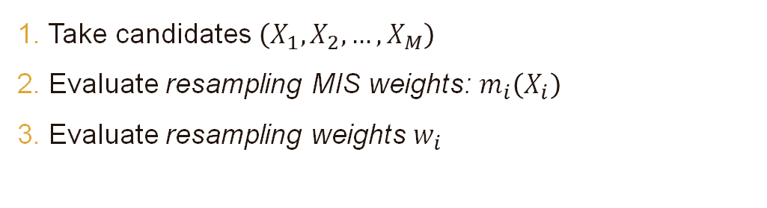
RIS: Algorithm
1. Take candidates $\left(X_{1}, X_{2},…, X_{M}\right)$
2. Evaluate resampling MIS weights: $m_{i}\left(X_{i}\right)$
3. Evaluate resampling weights $w_{i}$
e.g. $\frac{1}{M}$
e.g. $W_{X_{i}}=\frac{1}{p_{i}\left(X_{i}\right)}$
Notes:
Hence, the resampling weights must also be multiplied with the MIS weight m_i. If all samples are identically distributed, we can use 1/M.

Slide 16
RIS: Algorithm
1. Take candidates $\left(X_{1}, X_{2},…, X_{M}\right)$
2. Evaluate resampling MIS weights: $m_{i}\left(X_{i}\right)$
3. Evaluate resampling weights $w_{i}$
e.g. $\frac{1}{M}$
e.g. $W_{X_{i}}=\frac{1}{p_{i}\left(X_{i}\right)}$
4. Choose $Y$ randomly from the $X_{i}$ proportionally to $w_{i}$
[see course notes]
Notes:
Next, we select the output, Y, from the candidates X_i, proportionally to the resampling weights. See the comprehensive course notes for more information.

Slide 17

RIS: Algorithm
1. Take candidates $\left(X_{1}, X_{2},…, X_{M}\right)$
2. Evaluate resampling MIS weights: $m_{i}\left(X_{i}\right)$
3. Evaluate resampling weights $w_{i}$
e.g. $\frac{1}{M}$
e.g. $W_{X_{i}}=\frac{1}{p_{i}\left(X_{i}\right)}$
4. Choose $Y$ randomly from the $X_{i}$ proportionally to $w_{i}$
[see course notes]
$$W_{Y}=\frac{1}{\hat{p}(Y)}\sum_{j=1}^{M}{w_{j}}$$
5. Evaluate the UCW:
Notes:
If at least one resampling weight was positive, we save the chosen candidate sample and evaluate its contribution weight.

Slide 18

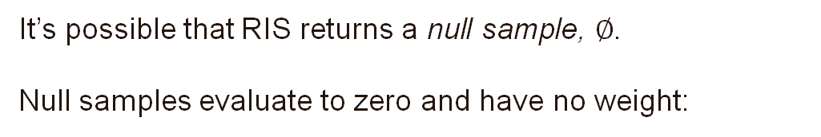
Null sample
It’s possible that RIS returns a null sample, $∅$.
Null samples evaluate to zero and have no weight:
$$\hat{p}\left(∅\right)=0$$
$$f\left(∅\right)=0$$
$$W_{∅}=0$$
Notes:
It’s possible that all X_i had pHat zero – then no sample is chosen and we return a null sample that evaluates to zero and has no weight.

Slide 19
Ris
A note about formulation
Notes:
Next, a note about the formulation –some of you might have read earlier ReSTIR papers, which might have used a slightly different formulation.

Slide 20

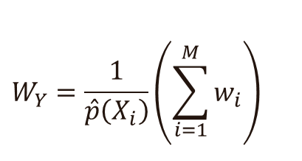
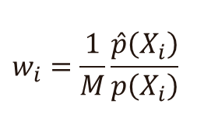
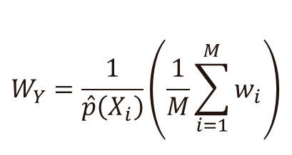
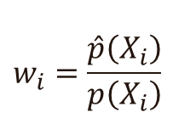
Old vs modern formulation
If you know early versions of ReSTIR:
Old formulation:
Modern formulation:
$$W_{Y}=\frac{1}{\hat{p}\left(X_{i}\right)}\left(\frac{1}{M}\sum_{i=1}^{M}{w_{i}}\right)$$
$$W_{Y}=\frac{1}{\hat{p}\left(X_{i}\right)}\left(\sum_{i=1}^{M}{w_{i}}\right)$$
$$w_{i}=\frac{\hat{p}\left(X_{i}\right)}{p\left(X_{i}\right)}$$
[Lin et al. 2022]
$$w_{i}=\frac{1}{M}\frac{\hat{p}\left(X_{i}\right)}{p\left(X_{i}\right)}$$
$\frac{1}{M}$is a MIS weight, not ”averaging factor”
[Lin et al. 2022]
Generalized Resampled Importance Sampling: Foundations of ReSTIR
Notes:
ReSTIR papers before Generalized RIS used a formulation with a 1/M weight in the contribution weight formula, which treats this division as an ”averaging factor”.
We recommend you move on to the modern formulation: the proper interpretation of this 1/M weight is a MIS weight; its proper place is in the resampling weight lowercase-w_i, and it is not present in the contribution weight formula.
This choice significantly simplifies the math as it reduces the amount of unnecessary 1/M weights cluttering the formulas.

Slide 21
Ris
Intuition - two perspectives
Notes:
Next, I’ll try to build some intuition about RIS from two perspectives.

Slide 22
two sides of RIS
Resampled Importance Sampling is ...
Sample Aggregation
  (merging multiple samples into one)
Importance Sampling
  (improving sample distribution)
Notes:
RIS is sample aggregation, meaning, it merges multiple samples into one. And it is also importance sampling, meaning, it produces samples with an improved sample distribution.
Let us start with sample aggregation.

Slide 23
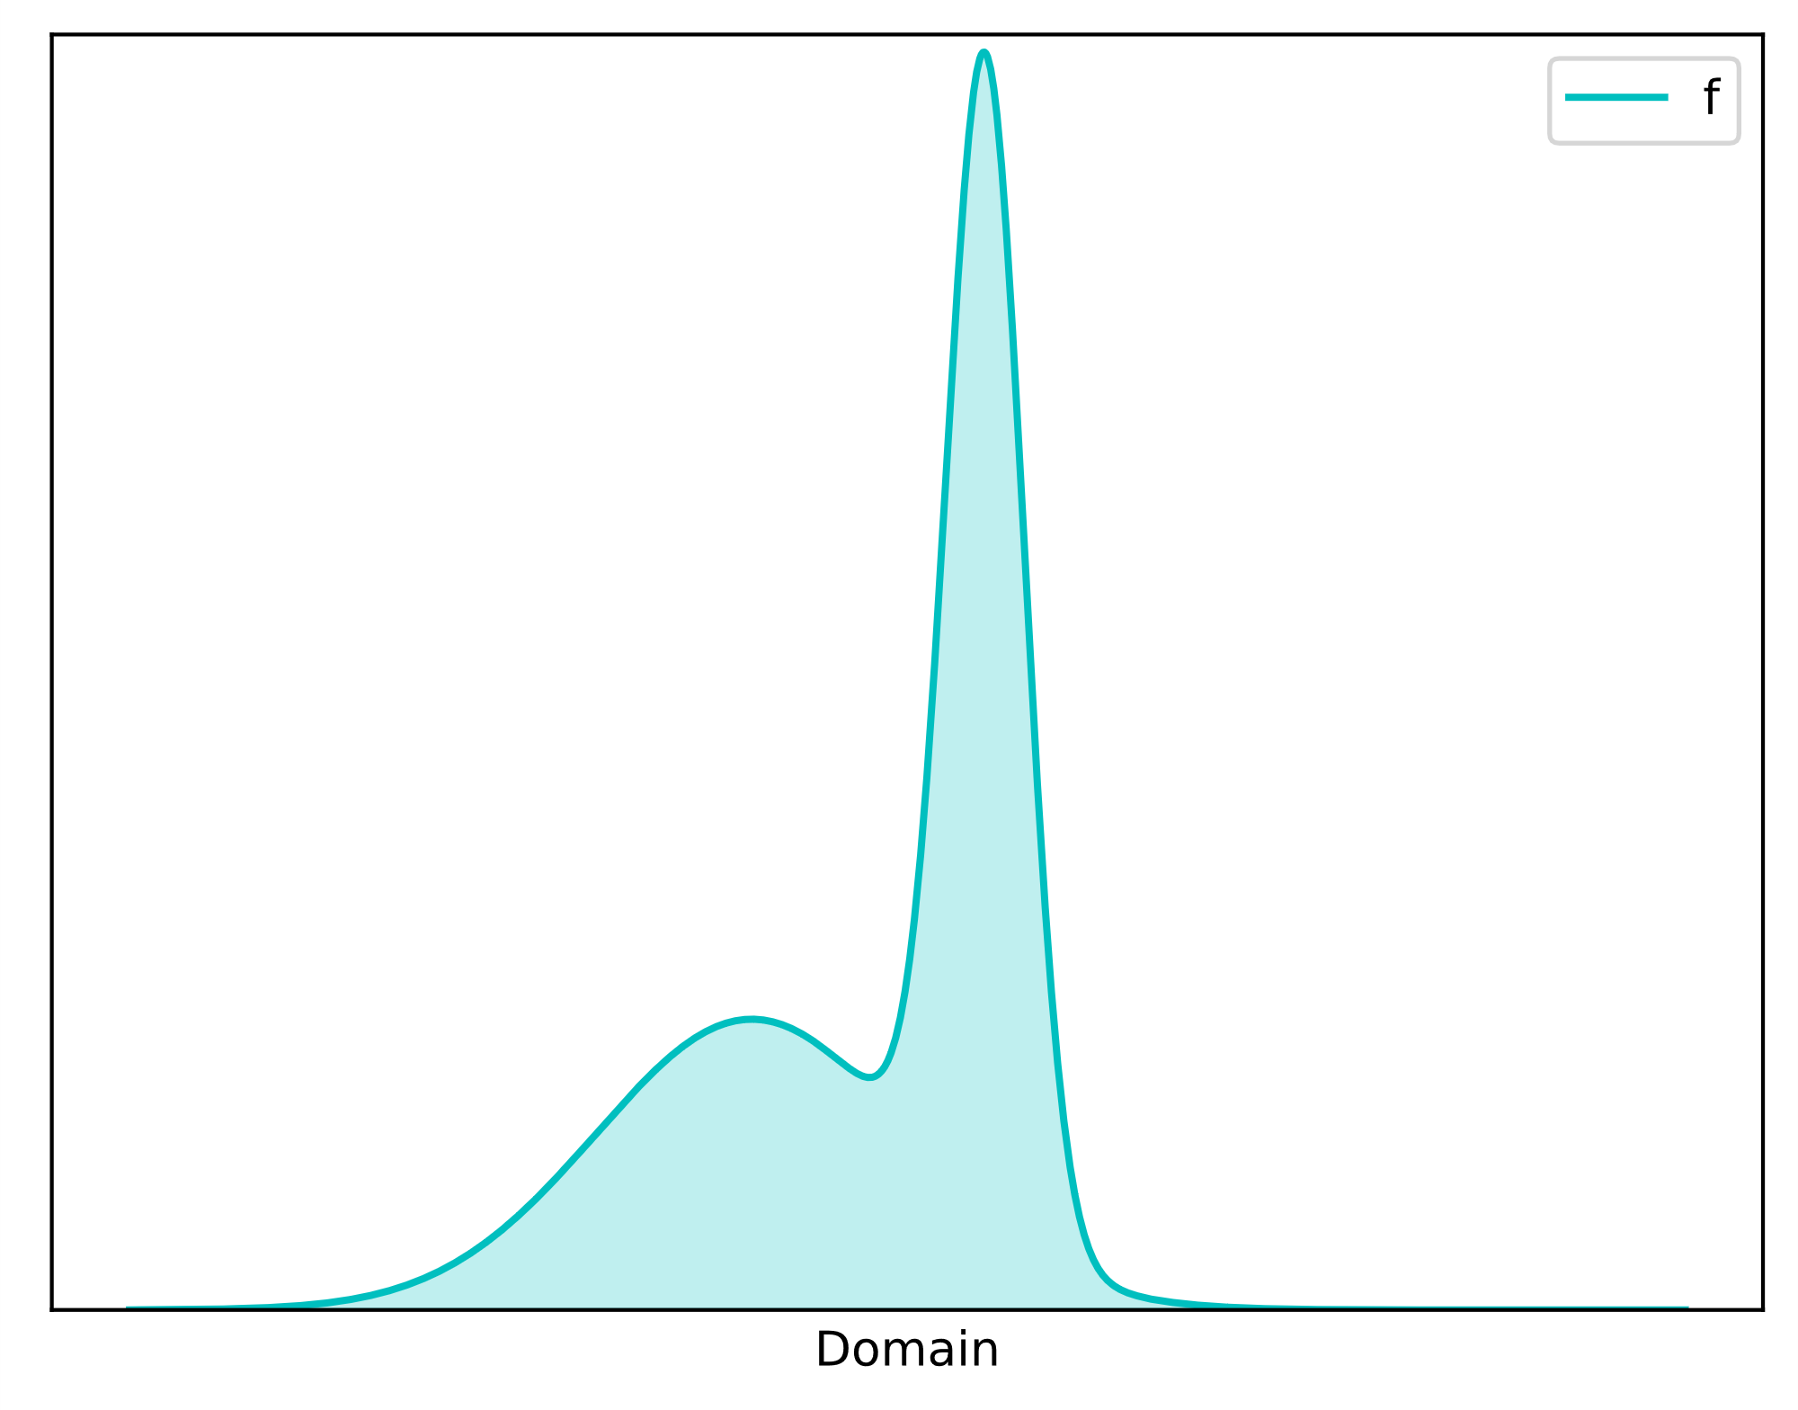






Example: simple integration
(RIS is sample aggregation)
Let’s walk through using RIS in practice.
This example shows that RIS is sample aggregation.
Let’s integrate a 1D function with one result sample $Y$.
Input: M identically distributed candidate samples $X_{i}$
Output: One sample $Y$ and contribution weight $W_{Y}$
Goal: Evaluate by
$$X_{1}$$
$$…$$
$$I=\int_{Ω}{f\left(x\right) dx}$$
$$X_{M}$$
$\left\langle I\right\rangle =f\left(Y\right)W_{Y}$
Notes:
I’ll walk you through an example that shows first, how the RIS algorithm works in practice, and second, how it performs sample aggregation.

Slide 24
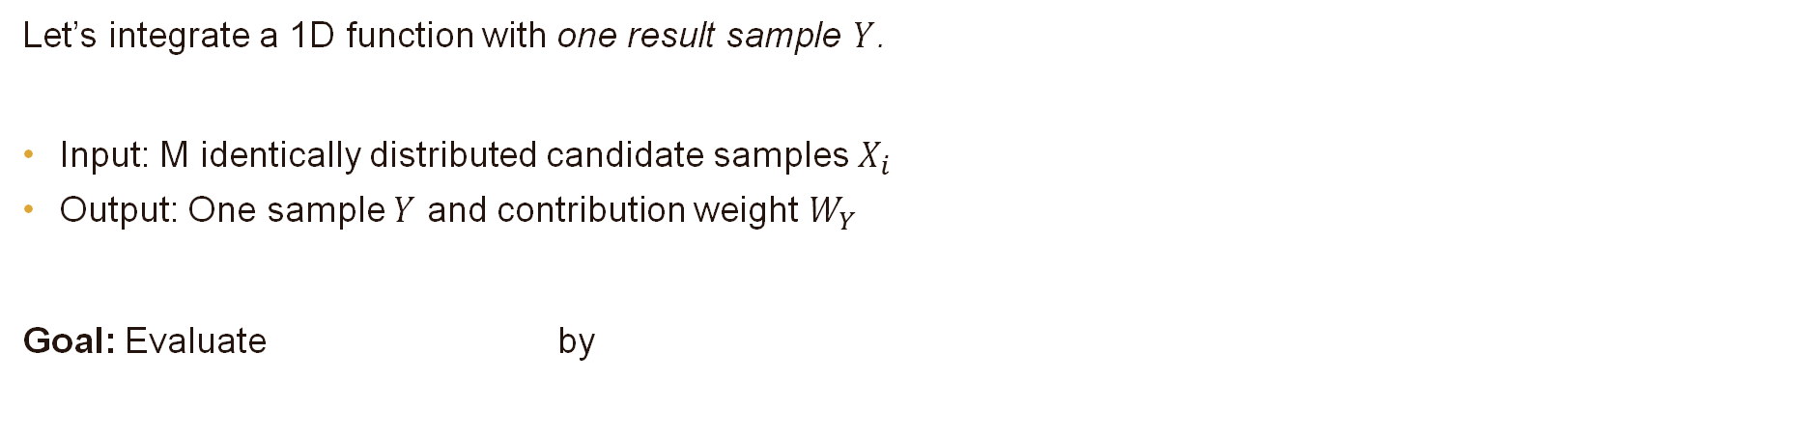
Example: simple integration
(RIS is sample aggregation)
Let’s walk through using RIS in practice.
This example shows that RIS is sample aggregation.
Let’s integrate a 1D function with one result sample $Y$.
Input: M identically distributed candidate samples $X_{i}$
Output: One sample $Y$ and contribution weight $W_{Y}$
Goal: Evaluate by
$$X_{1}$$
$$…$$
$$I=\int_{Ω}{f\left(x\right) dx}$$
$$X_{M}$$
$\left\langle I\right\rangle =f\left(Y\right)W_{Y}$
Notes:
Let’s integrate the 1D function on the right with a single RIS output Y.
We take M identically distributed candidates X_i, select one with RIS, and evaluate the contribution weight.
We then use the estimator f(Y) W_Y, where W_Y replaces the division by PDF, to estimate the integral.

Slide 25
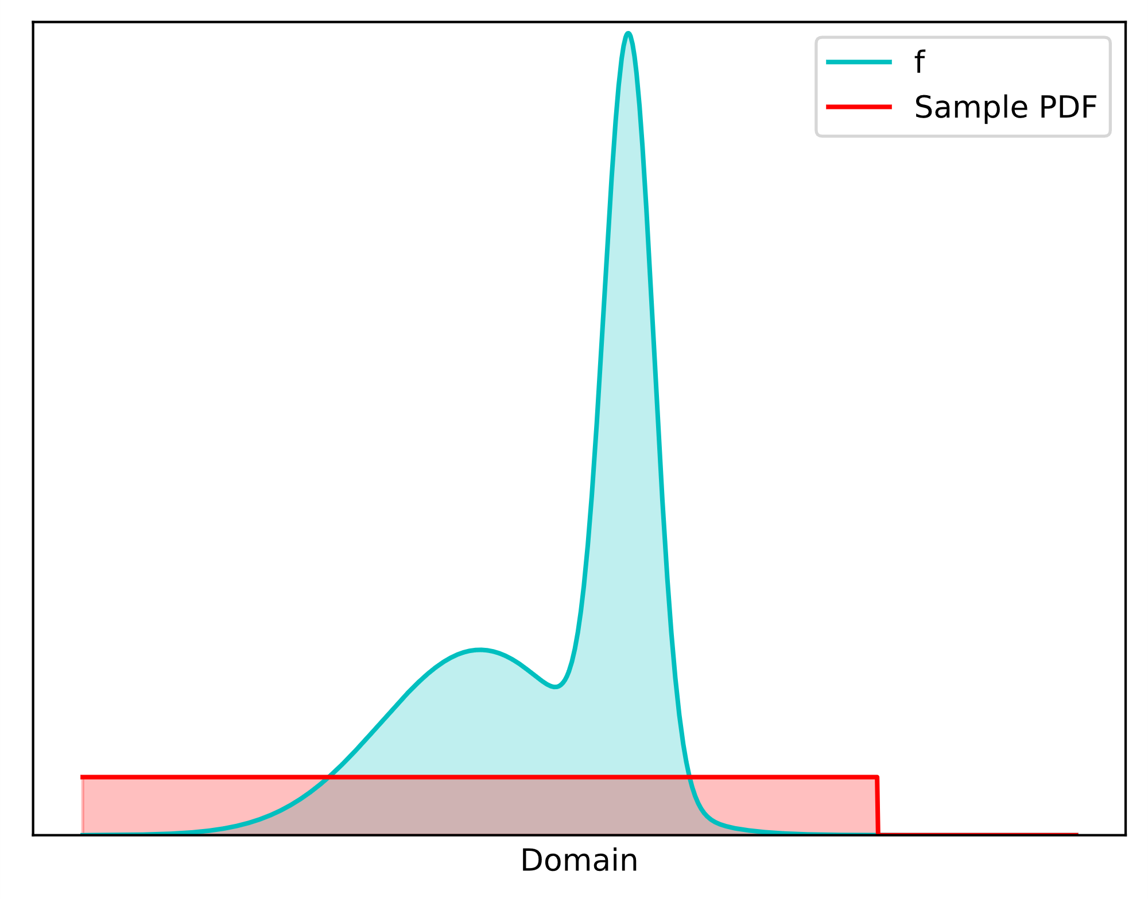




Example: simple integration
(RIS is sample aggregation)
Take the $M$samples
Evaluate resampling weights $w_{i}=m_{i}\left(X_{i}\right) \hat{p}\left(X_{i}\right)W_{X_{i}}$
Choose $Y$ proportionally to $w_{i}=\frac{1}{M}\frac{f\left(X_{i}\right)}{p\left(X_{i}\right) }$
All samples identically distributed: $\frac{1}{M}$
Best if we can afford it: $\hat{p}\left(x\right)=f\left(x\right)$
  We know $p:$ $W_{X_{i}}=\frac{1}{p\left(X_{i}\right)}$
$$X_{1}$$
$$…$$
$$X_{M}$$
Notes:
First, we take M samples.

Slide 26
Example: simple integration
(RIS is sample aggregation)
Take the $M$samples
Evaluate resampling weights $w_{i}=m_{i}\left(X_{i}\right) \hat{p}\left(X_{i}\right)W_{X_{i}}$
Choose $Y$ proportionally to $w_{i}=\frac{1}{M}\frac{f\left(X_{i}\right)}{p\left(X_{i}\right) }$
All samples identically distributed: $\frac{1}{M}$
Best if we can afford it: $\hat{p}\left(x\right)=f\left(x\right)$
  We know $p:$ $W_{X_{i}}=\frac{1}{p\left(X_{i}\right)}$
$$X_{1}$$
$$…$$
$$X_{M}$$
Notes:
Then, we evaluate the resampling weights.

Slide 27
Example: simple integration
(RIS is sample aggregation)
Take the $M$samples
Evaluate resampling weights $w_{i}=m_{i}\left(X_{i}\right) \hat{p}\left(X_{i}\right)W_{X_{i}}$
Choose $Y$ proportionally to $w_{i}=\frac{1}{M}\frac{f\left(X_{i}\right)}{p\left(X_{i}\right) }$
All samples identically distributed: $\frac{1}{M}$
Best if we can afford it: $\hat{p}\left(x\right)=f\left(x\right)$
  We know $p:$ $W_{X_{i}}=\frac{1}{p\left(X_{i}\right)}$
$$X_{1}$$
$$…$$
$$X_{M}$$
Notes:
Since all the samples are identically distributed, we can use MIS weights 1/M.
We choose to use f as the target function p-hat; that’s the best choice quality-wise, although sometimes it could be too expensive.
Since we know the PDF, we use the reciprocal PDF as the contribution weight.

Slide 28
Example: simple integration
(RIS is sample aggregation)
Take the $M$samples
Evaluate resampling weights $w_{i}=m_{i}\left(X_{i}\right) \hat{p}\left(X_{i}\right)W_{X_{i}}$
Choose $Y$ proportionally to $w_{i}=\frac{1}{M}\frac{f\left(X_{i}\right)}{p\left(X_{i}\right) }$
All samples identically distributed: $\frac{1}{M}$
Best if we can afford it: $\hat{p}\left(x\right)=f\left(x\right)$
  We know $p:$ $W_{X_{i}}=\frac{1}{p\left(X_{i}\right)}$
$$X_{1}$$
$$…$$
$$X_{M}$$
Notes:
Then, we choose Y from the candidates proportionally to the resampling weights.

Slide 29
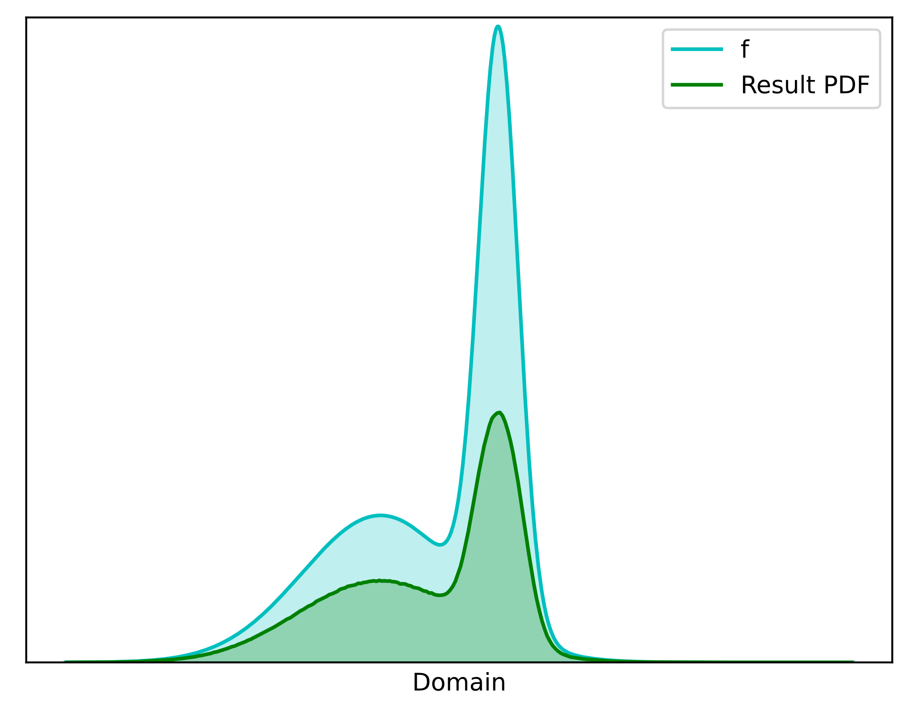





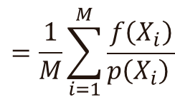
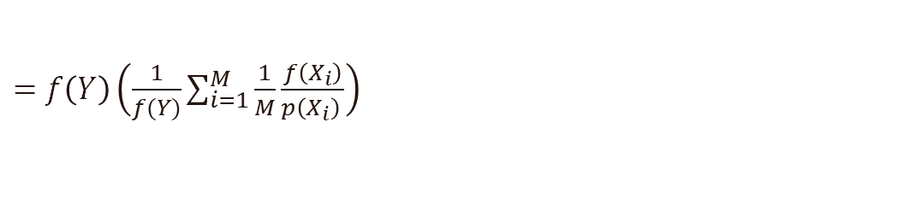
Example: simple integration
(RIS is sample aggregation)
$$W_{Y}=\frac{1}{\hat{p}(Y)}\sum_{i=1}^{M}{w_{i}}$$
4. Evaluate contribution weight
5. Integrate: $\left\langle I\right\rangle =f\left(Y\right)W_{Y}$
$$f\left(x\right)$$
$$\frac{1}{M}\frac{f\left(X_{i}\right)}{p\left(X_{i}\right) }$$
$$Y$$
$=$ $f\left(Y\right)\left(\frac{1}{f(Y)}\sum_{i=1}^{M}{\frac{1}{M}\frac{f\left(X_{i}\right)}{p\left(X_{i}\right) }}\right)$
!
$$=\frac{1}{M}\sum_{i=1}^{M}{\frac{f\left(X_{i}\right)}{p\left(X_{i}\right) }}$$
Notes:
Now that we have Y, we need its unbiased contribution weight, since the PDF cannot be evaluated. The formula is very simple: 1/phat times the weight sum.
If you know the old ReSTIR papers, note that there is no division by M in the formula, because MIS weights are included in the resampling weights.

Slide 30

Example: simple integration
(RIS is sample aggregation)
$$W_{Y}=\frac{1}{\hat{p}(Y)}\sum_{i=1}^{M}{w_{i}}$$
4. Evaluate contribution weight
5. Integrate: $\left\langle I\right\rangle =f\left(Y\right)W_{Y}$
We chose: $f\left(Y\right)$
$$\frac{1}{M}\frac{f\left(X_{i}\right)}{p\left(X_{i}\right) }$$
$$Y$$
$=$ $f\left(Y\right)\left(\frac{1}{f(Y)}\sum_{i=1}^{M}{\frac{1}{M}\frac{f\left(X_{i}\right)}{p\left(X_{i}\right) }}\right)$
!
$$=\frac{1}{M}\sum_{i=1}^{M}{\frac{f\left(X_{i}\right)}{p\left(X_{i}\right) }}$$
Notes:
We use f as the target function, and substitute our resampling weights.

Slide 31


Example: simple integration
(RIS is sample aggregation)
$$W_{Y}=\frac{1}{\hat{p}(Y)}\sum_{i=1}^{M}{w_{i}}$$
4. Evaluate contribution weight
5. Integrate: $\left\langle I\right\rangle =f\left(Y\right)W_{Y}=…=$
We chose: $f\left(Y\right)$
$$\frac{1}{M}\frac{f\left(X_{i}\right)}{p\left(X_{i}\right) }$$
!
$$Y$$
$$\frac{1}{M}\sum_{i=1}^{M}{\frac{f\left(X_{i}\right)}{p\left(X_{i}\right) }}$$
Notes:
Evaluating the estimator f(Y) W_Y, we get a familiar formula: the Monte Carlo estimator of the M identically distributed candidates samples!

Slide 32
Example: simple integration
(RIS is sample aggregation)
$$W_{Y}=\frac{1}{\hat{p}(Y)}\sum_{i=1}^{M}{w_{i}}$$
4. Evaluate contribution weight
5. Integrate: $\left\langle I\right\rangle =f\left(Y\right)W_{Y}=…=$
We chose: $f\left(Y\right)$
$$\frac{1}{M}\frac{f\left(X_{i}\right)}{p\left(X_{i}\right) }$$
!
$$Y$$
$$\frac{1}{M}\sum_{i=1}^{M}{\frac{f\left(X_{i}\right)}{p\left(X_{i}\right) }}$$
One-sample RIS estimator = traditional Monte Carlo estimator with M samples!
Notes:
Let’s pause for a while –
The ONE RIS sample produces the same result as the M input samples.
RIS aggregates the inputs into one sample.

Slide 33

Ris is an aggregation machine
We got single sample that’s as good as the inputs combined!
How? Improved PDF! (By weighted selection)
$$Y$$
RIS is an aggregation machine
$$Y$$
With $\hat{p}≠f$, the result is somewhat worse due to $Var\left(\frac{f}{\hat{p}}\right)$
Notes:
So, we got one sample that’s as good as the inputs combined!
How can that be? The explanation is that the weighted selection by RIS improves the PDF of the output sample, and this is reflected in the UCW.
This makes RIS into an aggregation machine!
Note, though, that we get best results with pHat = f; otherwise, there is some inefficiency from the varying ratio of f and pHat.

Slide 34
two sides of RIS
Resampled Importance Sampling is ...
Sample Aggregation
  (merging multiple samples into one)
Importance Sampling
  (improving sample distribution)
Notes:
This leads us to the second part, that RIS is importance sampling, that is, it improves the sample distribution.
We just saw how aggregation explains the importance sampling, but let’s visualize using RIS for importance sampling by an example.

Slide 35
Visualize: bsdf importance sampling
[Talbot 2005]: Importance Resampling for Global Illumination
RIS is ”blind importance sampling” (same code for all BSDFs).
Example: Assume complicated BSDF with no importance sampler.
We can easily importance sample with RIS. (may be inefficient)
Notes:
One of the first uses of RIS was ”blind” or ”automatic” BSDF importance sampling, in the sense that the same code implements importance sampling for any BSDF. All we need is the ability to evaluate the BSDF.
Let’s demonstrate this by producing well-distributed samples for a complicated BSDF. This method is very easy, although it could be less efficient than specialized importance samplers.

Slide 36
Visualize: bsdf importance sampling
[Talbot 2005]: Importance Resampling for Global Illumination
RIS is ”blind importance sampling” (same code for all BSDFs).
Example: Assume complicated BSDF with no importance sampler.
We can easily importance sample with RIS. (may be inefficient)
1. Generate many directions $X_{i}$ with known PDF $p$
Notes:
Just generate multiple direction candiates with some PDF.

Slide 37

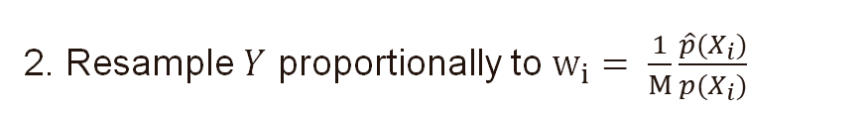
Visualize: bsdf importance sampling
[Talbot 2005]: Importance Resampling for Global Illumination
RIS is ”blind importance sampling” (same code for all BSDFs).
Example: Assume complicated BSDF with no importance sampler.
We can easily importance sample with RIS. (may be inefficient)
1. Generate many directions $X_{i}$ with known PDF $p$
e.g., $\hat{p}=BSDF·cos$
2. Resample $Y$ proportionally to $w_{i}= \frac{1}{M}\frac{\hat{p}(X_{i})}{p(X_{i})}$
Notes:
Resample one of them, Y, proportionally to the resampling weights. We can use for example BSDF times cosine as the target function.

Slide 38

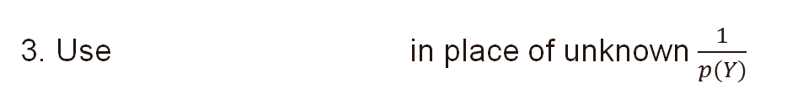
Visualize: bsdf importance sampling
[Talbot 2005]: Importance Resampling for Global Illumination
RIS is ”blind importance sampling” (same code for all BSDFs).
Example: Assume complicated BSDF with no importance sampler.
We can easily importance sample with RIS. (may be inefficient)
1. Generate many directions $X_{i}$ with known PDF $p$
e.g., $\hat{p}=BSDF·cos$
2. Resample $Y$ proportionally to $w_{i}= \frac{1}{M}\frac{\hat{p}(X_{i})}{p(X_{i})}$
$$W_{Y}=\frac{1}{\hat{p}\left(Y\right)}\sum_{i=1}^{M}{w_{i}}$$
3. Use in place of unknown $\frac{1}{p(Y)}$
Notes:
Once we have the sample, we evaluate its unbiased contribution weight and use in in place of the unknown reciprocal PDF.

Slide 39
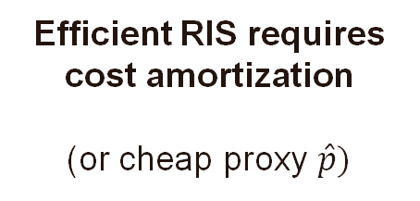
Visualize: bsdf importance sampling
[Talbot 2005]: Importance Resampling for Global Illumination
RIS is ”blind importance sampling” (same code for all BSDFs).
Example: Assume complicated BSDF with no importance sampler.
We can easily importance sample with RIS. (may be inefficient)
Efficient RIS requires cost amortization
(or cheap proxy $\hat{p})$
1. Generate many directions $X_{i}$ with known PDF $p$
e.g., $\hat{p}=BSDF·cos$
2. Resample $Y$ proportionally to $w_{i}= \frac{1}{M}\frac{\hat{p}(X_{i})}{p(X_{i})}$
$$W_{Y}=\frac{1}{\hat{p}\left(Y\right)}\sum_{i=1}^{M}{w_{i}}$$
3. Use in place of unknown $\frac{1}{p(Y)}$
Notes:
In practice, efficient RIS requires cost sharing, amortization, e.g., between pixels or frames, or using a cheap proxy target function.

Slide 40
Ris
mis weights and Convergence
Notes:
Next, let’s have a closer look at MIS weights and how they help with convergence.

Slide 41
Recap: Pdf converges to target
$$\overline{p}$$
Let’s see it again...
$$X_{1}$$
$$X_{2}$$
Notes:
Let’s see the convergence animation of RIS again.

Slide 42
Recap: Pdf converges to target
$$\overline{p}$$
Let’s see it again...
It converges!
$$p$$
128
64
32
16
8
4
2
candidates
Notes:
... As we see, it still converges.

Slide 43
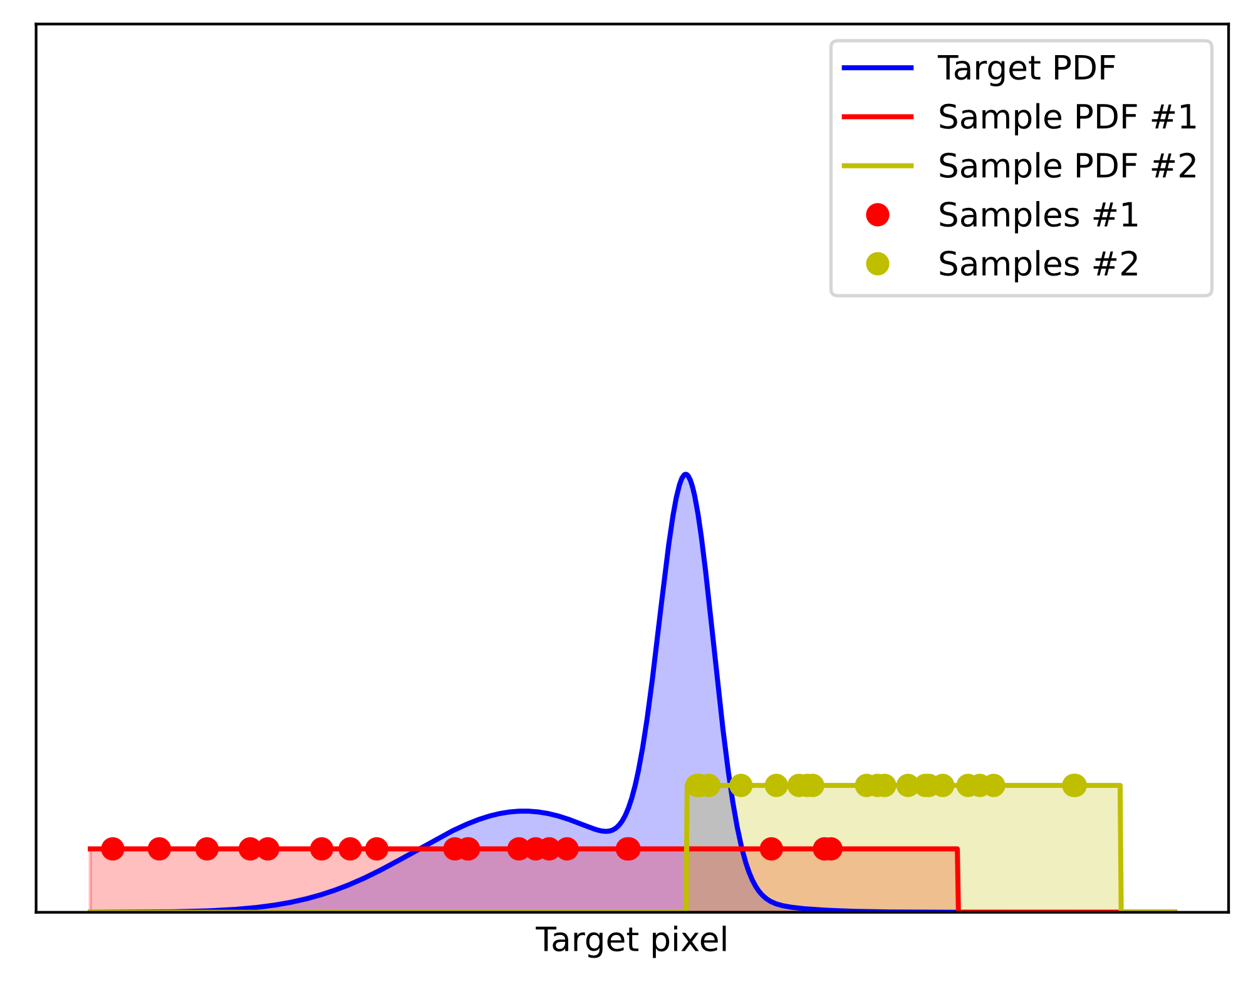

Mis weights are required
RIS with improper MIS weights
Assume candidates not identically distributed
Can not use $m_{i}=\frac{1}{M}$.
Why?
Notes:
However, in this case the candidates were identically distributed. What if they are not?
Then we can’t use the 1/M weights like before.
Why is that? Why bother?

Slide 44
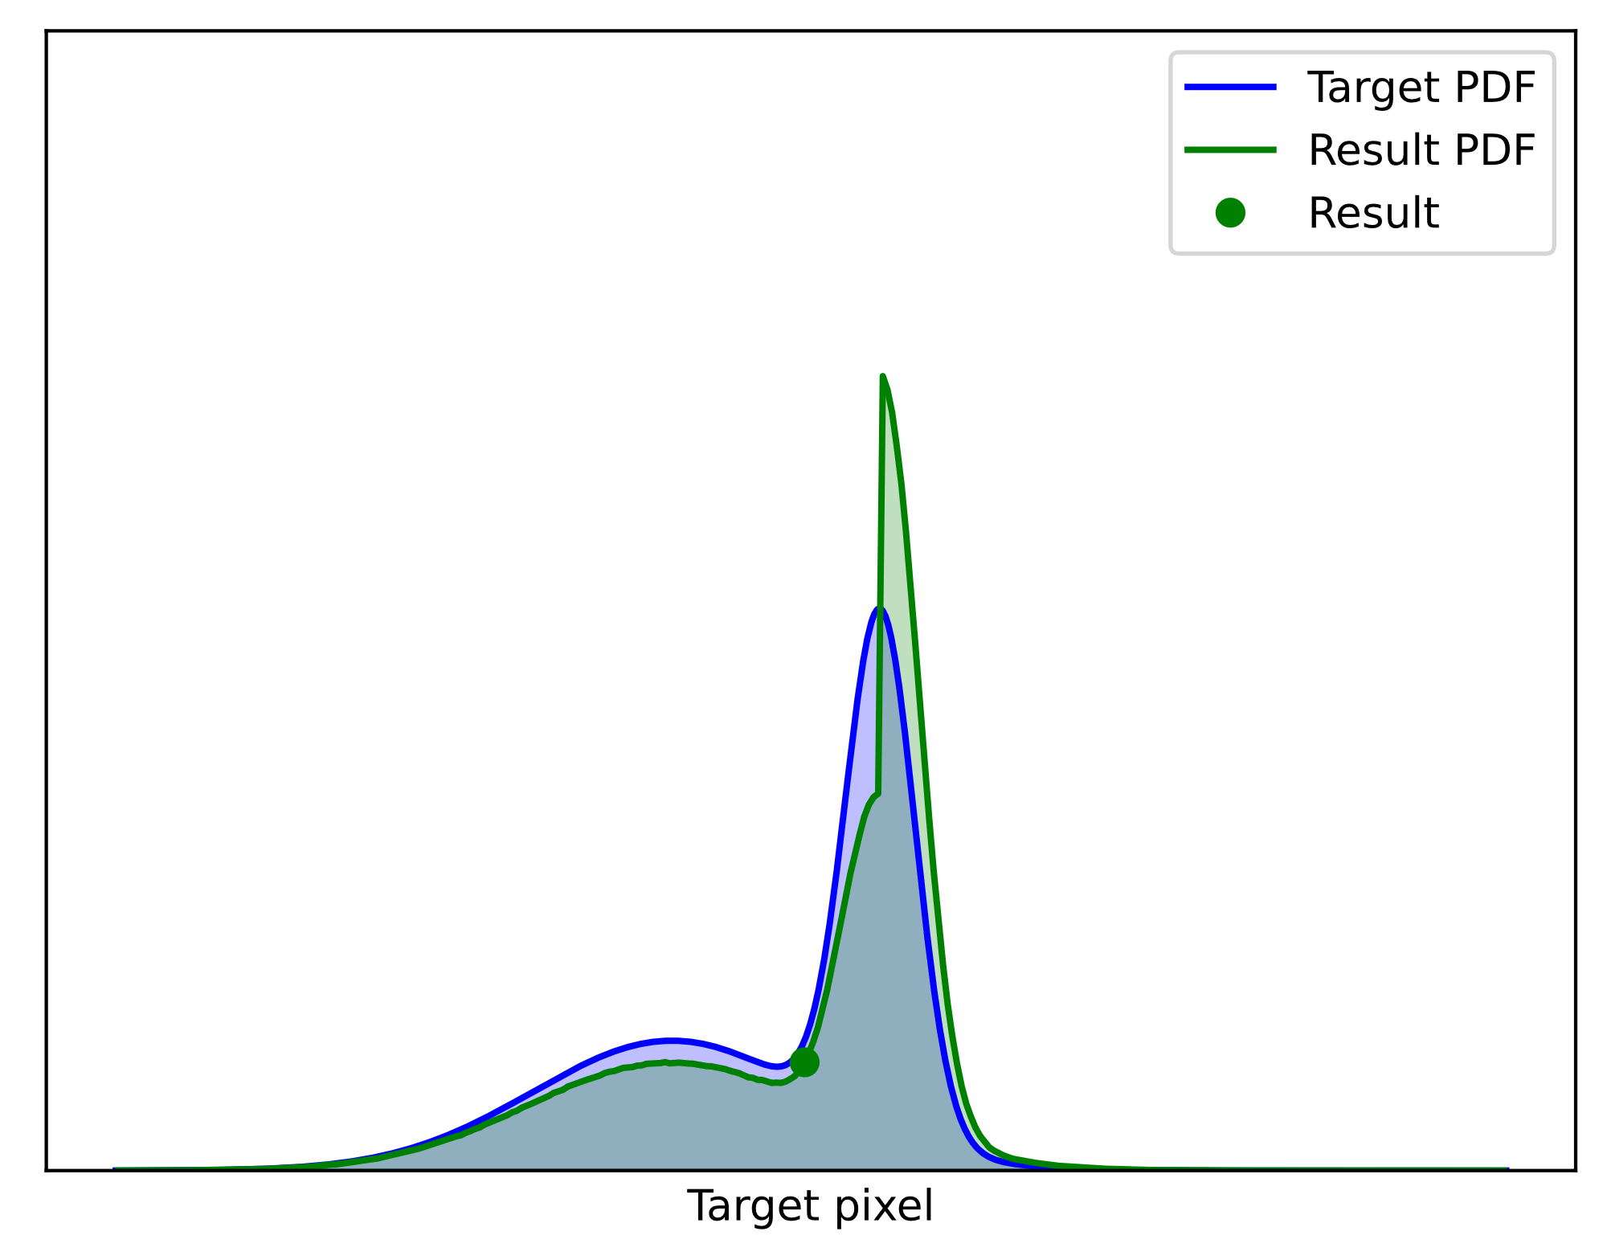

Mis weights are required
RIS with improper MIS weights
Assume candidates not identically distributed
Can not use $m_{i}=\frac{1}{M}$.
Why?
Non-convergence
and bias!
Notes:
Well, because this can result in non-convergence and bias, just like neglecting MIS weights can in standard Monte Carlo integration.

Slide 45
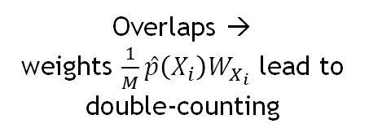

Mis weights fix over and undercounting
Overlaps →
weights $\frac{1}{M}\hat{p}\left(X_{i}\right)W_{X_{i}}$ lead to double-counting
Need resampling MIS weights,
$$m_{i}\left(X_{i}\right) \hat{p}\left(X_{i}\right)W_{X_{i}}$$
Samples cover
different parts of Ω
Notes:
The candidates cover different parts of the integration domain.
<c>We get overlaps, and 1/M weights lead to double-counting.
<c>We must normalize with proper resampling MIS weights.
.

Slide 46
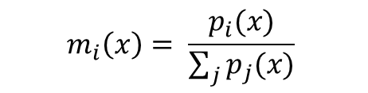
Mis weights fix over and undercounting
Overlaps →
weights $\frac{1}{M}\hat{p}\left(X_{i}\right)W_{X_{i}}$ lead to double-counting
Need resampling MIS weights,
$$m_{i}\left(X_{i}\right) \hat{p}\left(X_{i}\right)W_{X_{i}}$$
Samples cover
different parts of Ω
[ Veach 1995]
Balance Heuristic
[ Talbot 2005]
$$m_{i}\left(x\right)= \frac{p_{i}(x)}{\sum_{j}{p_{j}(x)}}$$
Notes:
Talbot proposed using Veach’s balance heuristic

Slide 47
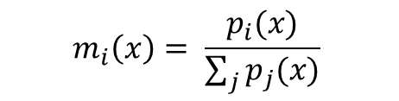


Iterative ris: we don’t know the pdfs
In ReSTIR, we chain RIS:
$X_{1}, …, X_{M}$ come from RIS
Resampling weights are easy:
$$w_{i}=m_{i}\left(X_{i}\right) \hat{p}\left(X_{i}\right)W_{X_{i}}$$
Balance Heuristic
$$m_{i}\left(x\right)= \frac{p_{i}(x)}{\sum_{j}{p_{j}(x)}}$$
PDFs of RIS outputs are not known…
Notes:
In ReSTIR, we chain multiple applications of RIS.
That is, the samples come from RIS.
The resampling weights are easy to compute – the same formula works.
But the balance heuristic requires PDFs, which we don’t know.

Slide 48

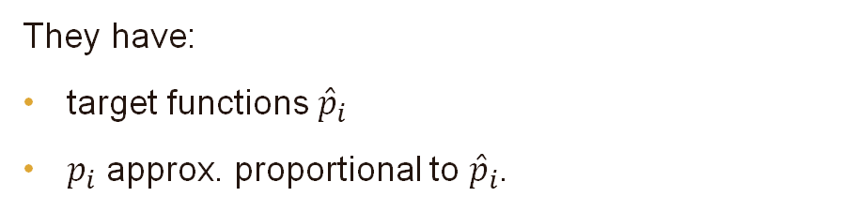


Generalized balance heuristic:
Replace PDF with $\hat{p}$
Balance Heuristic
If candidates come from RIS,
$$m_{i}\left(x\right)= \frac{p_{i}(x)}{\sum_{j}{p_{j}(x)}}$$
They have:
target functions ${\hat{p}}_{i}$
$p_{i}$ approx. proportional to ${\hat{p}}_{i}$.
Generalized
Balance Heuristic
Use ${\hat{p}}_{i}$ as proxy for $p_{i}$
$$m_{i}\left(x\right)= \frac{{\hat{p}}_{i}(x)}{\sum_{j}{{\hat{p}}_{j}(x)}}$$
Not ideal, but removes bias!
Notes:
But, since the candidates come from RIS, they have their own target functions, pHat-i, and their PDFs are approximately proportional to the target functions.
Hence, we can use the target functions pHat-i as proxies for the PDFs.
This gives us the generalized balance heuristic, using pHats in place of PDFs.
This is not a perfect solution due to, e.g., different normalizations of pHats, but it does remove the bias.

Slide 49




What mis weights to use?
If candidates $X_{1}, …, X_{M}$ have
RIS with 1/M weights
Same distributions:
$m_{i}=\frac{1}{M}$ is perfect
Same supports:
$m_{i}=\frac{1}{M}$ is correct but: singular outliers
(if any PDF can be low)
Same as in integration:
$\frac{1}{2}·\frac{f\left(X_{1}\right)}{p_{1}\left(X_{1}\right)}+\frac{1}{2}·\frac{f\left(X_{2}\right)}{p_{2}(X_{2})}$
Notes:
If the candidates are identically distributed, we can use 1/M MIS weights, which is nice and cheap.
If the candidates are differently distributed but have the same supports – each individually covers the target function – then 1/M weights are unbiased, but can result in singular outliers if any PDF can be low.
This is really the same as in integration: if the PDFs are very different, we should use proper MIS like the balance heuristic instead of constant weights.

Slide 50

Gen. balance heuristic: convergence, no bias
gen. balance heuristic removes bias
RIS with 1/M weights
Approaches target PDF
Stays like this
Notes:
Using the generalized balance heuristic recovers convergence and removes bias.

Slide 51
Ris
summary
Notes:
To summarize what we have learned,

Slide 52

Summary
RIS aggregates M samples into one
PDF is intractable, $W_{Y}$ replaces $1/p$
Use balance heuristic if samples not identically distributed
Notes:
RIS aggregates M samples into one
The PDF is intractable, but that’s not a problem: unbiased contribution weights replace the reciprocal PDF
Use the balance heuristic if the samples are not identically distributed.

