Slide 1
Preliminaries
Cem Yuksel

Slide 2

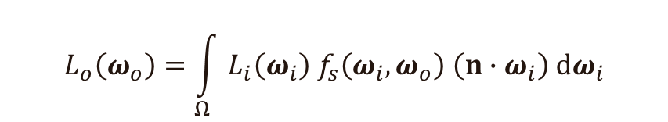
Integration
The rendering equation
$$L_{o}\left(ω_{o}\right)=\int_{Ω}{L_{i}\left(ω_{i}\right){ f}_{s}\left(ω_{i},ω_{o}\right) \left(n∙ω_{i}\right) dω_{i}}$$
$$I=\int_{Ω}{f\left(x\right) dx}$$

Slide 3
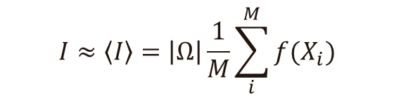


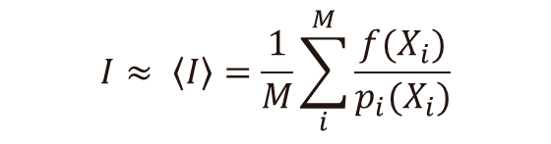

Integration
Integral
Monte Carlo integration:
$$I=\int_{Ω}{f\left(x\right) dx}$$
Importance sampling:
$$I≈\left\langle I\right\rangle =\left|Ω\right|\frac{1}{M}\sum_{i}^{M}{f(X_{i})}$$
$$I≈ \left\langle I\right\rangle =\frac{1}{M}\sum_{i}^{M}{\frac{f(X_{i})}{p_{i}(X_{i})}}$$
uniform random distribution of $X_{i}$
using a probability density function (PDF) $p_{i}(X_{i})$ for $X_{i}$
$$p_{i}(X_{i})=\frac{1}{\left|Ω\right|}$$

Slide 4

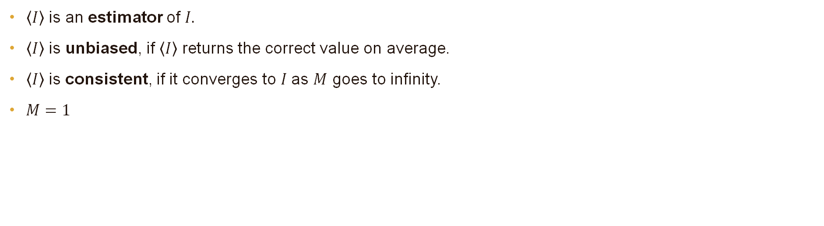
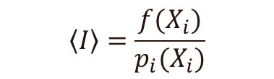
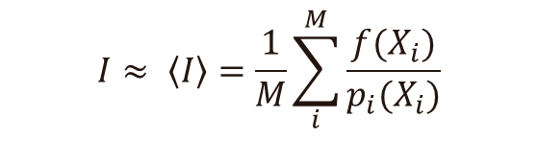
Monte Carlo Integration
$$I=\int_{Ω}{f\left(x\right) dx}$$
$$I≈ \left\langle I\right\rangle =\frac{1}{M}\sum_{i}^{M}{\frac{f(X_{i})}{p_{i}(X_{i})}}$$
$\left\langle I\right\rangle$ is an estimator of $I.$
$\left\langle I\right\rangle$ is unbiased, if $\left\langle I\right\rangle$ returns the correct value on average.
$\left\langle I\right\rangle$ is consistent, if it converges to $I$as $M$ goes to infinity.
$M=1$
$$\left\langle I\right\rangle =\frac{f(X_{i})}{p_{i}(X_{i})}$$

Slide 5

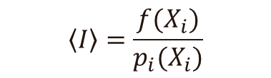
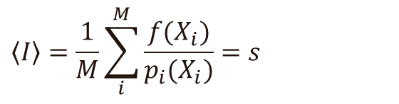
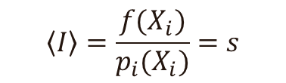

Monte Carlo Integration
$$\left\langle I\right\rangle =\frac{f(X_{i})}{p_{i}(X_{i})}$$
$$p_{i}(X_{i})∝f(X_{i})$$
$$p_{i}\left(X_{i}\right)=s f(X_{i})$$
$$\left\langle I\right\rangle =\frac{f(X_{i})}{p_{i}(X_{i})}=s$$
$$\left\langle I\right\rangle =\frac{1}{M}\sum_{i}^{M}{\frac{f(X_{i})}{p_{i}(X_{i})}}=s$$

Slide 6
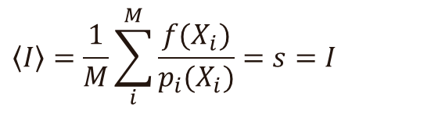
Monte Carlo Integration
$$\left\langle I\right\rangle =\frac{f(X_{i})}{p_{i}(X_{i})}$$
$$p_{i}(X_{i})∝f(X_{i})$$
$$p_{i}\left(X_{i}\right)=s f(X_{i})$$
$$\left\langle I\right\rangle =\frac{f(X_{i})}{p_{i}(X_{i})}=s$$
$$\left\langle I\right\rangle =\frac{1}{M}\sum_{i}^{M}{\frac{f(X_{i})}{p_{i}(X_{i})}}=s=I$$

Slide 7
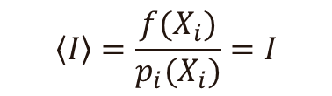

Monte Carlo Integration
$$\left\langle I\right\rangle =\frac{f(X_{i})}{p_{i}(X_{i})}$$
$$p_{i}(X_{i})∝f(X_{i})$$
$$p_{i}\left(X_{i}\right)=I f(X_{i})$$
perfect importance sampling
$$\left\langle I\right\rangle =\frac{f(X_{i})}{p_{i}(X_{i})}=I$$

Slide 8
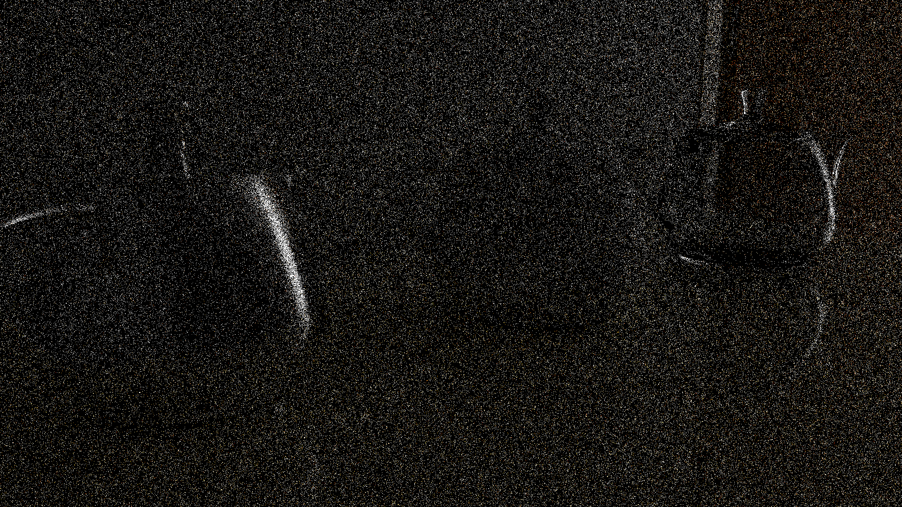
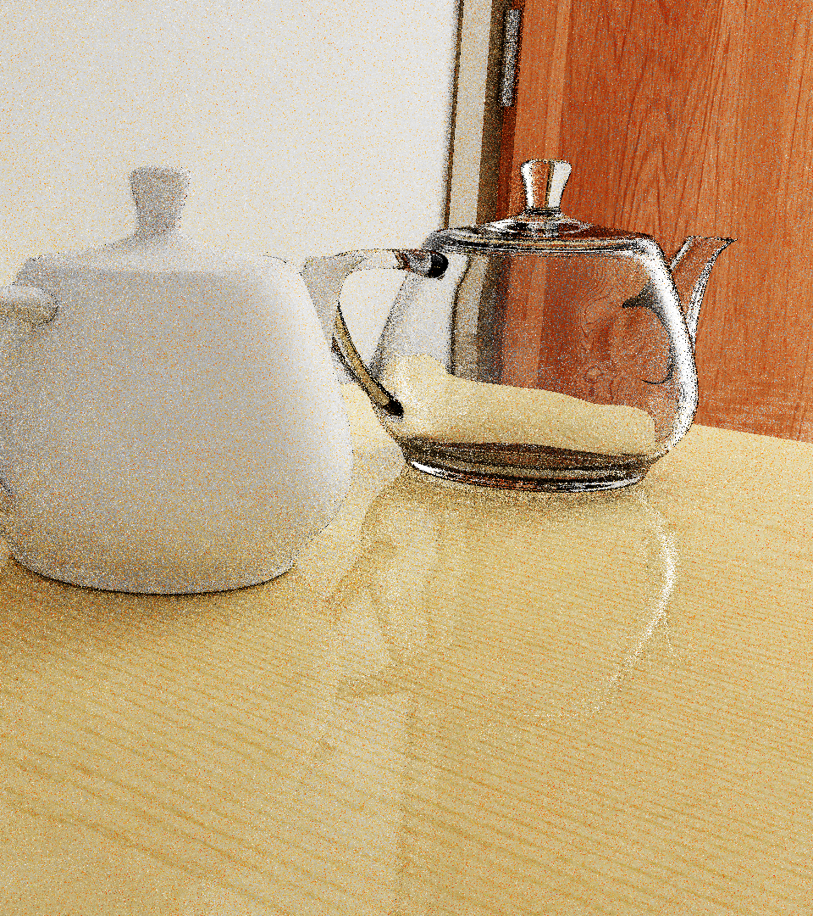
Path Tracing (1 spp)
ReSTIR PT (1 spp)
Notes:
The input of ReSTIR PT is just 1 spp path tracing.

Slide 9


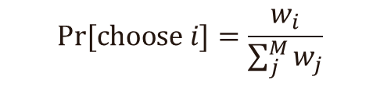

Resampled Importance Sampling (RIS)
Generate a set of $M$samples $X_{1},…,X_{M}$using $p_{i}\left(X_{i}\right)$
Choose one sample $X_{i}$ from this set proportional to $w_{i}$
What is the PDF of $X$?
Monte Carlo integration:
$$Pr⁡[choose i]=\frac{w_{i}}{\sum_{j}^{M}{w_{j}}}$$
$$\left\langle I\right\rangle =\frac{f(X)}{p(X)}=f\left(X\right)\frac{1}{p(X)}$$
$$\left\langle I\right\rangle =f\left(X\right) W_{X}$$

Slide 10

Resampled Importance Sampling (RIS)
Generate a set of $M$samples $X_{1},…,X_{M}$using $p_{i}\left(X_{i}\right)$
Choose one sample $X_{i}$ from this set proportional to $w_{i}$
What is the PDF of $X$?
Monte Carlo integration:
$$Pr⁡[choose i]=\frac{w_{i}}{\sum_{j}^{M}{w_{j}}}$$
$$\left\langle I\right\rangle =f\left(X\right) W_{X}$$

Slide 11
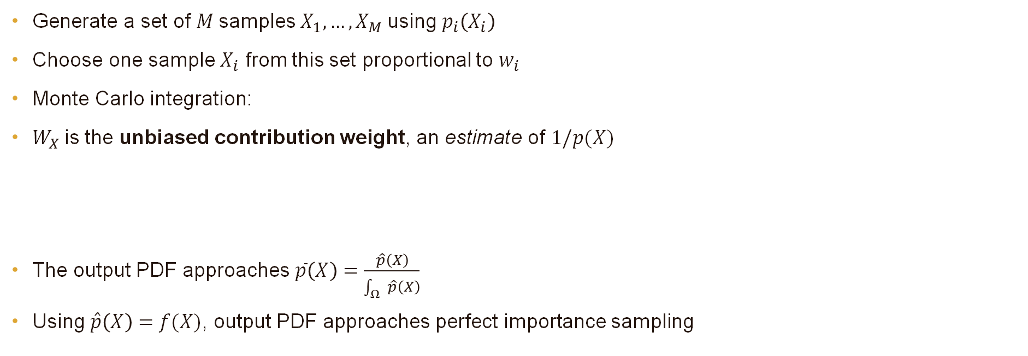

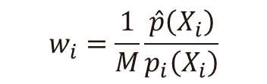

Resampled Importance Sampling (RIS)
Generate a set of $M$samples $X_{1},…,X_{M}$using $p_{i}\left(X_{i}\right)$
Choose one sample $X_{i}$ from this set proportional to $w_{i}$
Monte Carlo integration:
$W_{X}$is the unbiased contribution weight, an estimate of $1/p(X)$
The output PDF approaches $\overline{p}\left(X\right)=\frac{\hat{p}\left(X\right)}{\int_{Ω}{\hat{p}\left(X\right)}}$
Using $\hat{p}\left(X\right)=f(X)$, output PDF approaches perfect importance sampling
$$Pr⁡[choose i]=\frac{w_{i}}{\sum_{j}^{M}{w_{j}}}$$
$$\left\langle I\right\rangle =f\left(X\right) W_{X}$$
target function
$$w_{i}=\frac{1}{M}\frac{\hat{p}\left(X_{i}\right)}{p_{i}\left(X_{i}\right)}$$
$$W_{X}=\frac{1}{\hat{p}\left(X\right)}\sum_{i}^{M}{w_{i}}$$
not practical

Slide 12

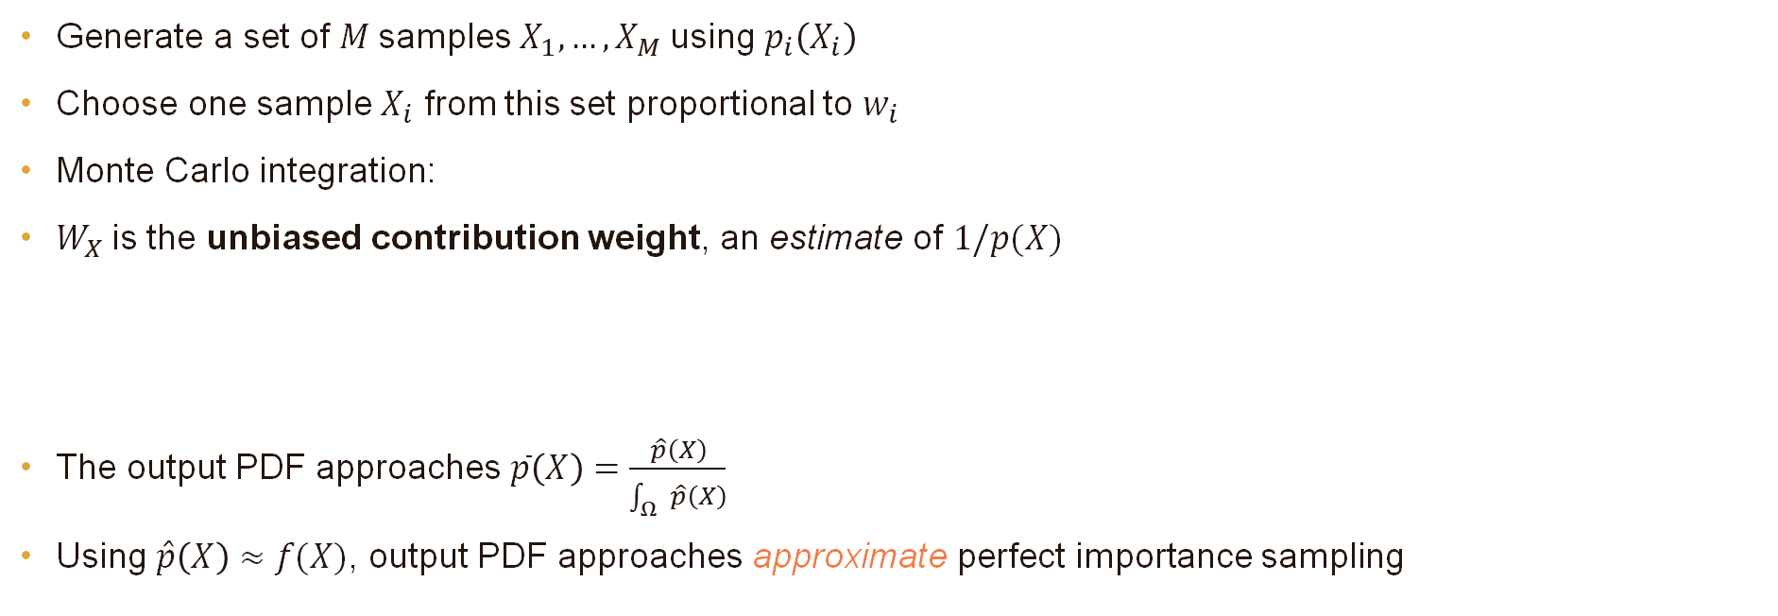
Resampled Importance Sampling (RIS)
Generate a set of $M$samples $X_{1},…,X_{M}$using $p_{i}\left(X_{i}\right)$
Choose one sample $X_{i}$ from this set proportional to $w_{i}$
Monte Carlo integration:
$W_{X}$is the unbiased contribution weight, an estimate of $1/p(X)$
The output PDF approaches $\overline{p}\left(X\right)=\frac{\hat{p}\left(X\right)}{\int_{Ω}{\hat{p}\left(X\right)}}$
Using $\hat{p}\left(X\right)≈f(X)$, output PDF approaches approximate perfect importance sampling
$$Pr⁡[choose i]=\frac{w_{i}}{\sum_{j}^{M}{w_{j}}}$$
$$\left\langle I\right\rangle =f\left(X\right) W_{X}$$
target function
$$w_{i}=\frac{1}{M}\frac{\hat{p}\left(X_{i}\right)}{p_{i}\left(X_{i}\right)}$$
$$W_{X}=\frac{1}{\hat{p}\left(X\right)}\sum_{i}^{M}{w_{i}}$$
practical with $\hat{p}\left(X\right)$ cheaper than $f\left(X\right)$

Slide 13
Spatiotemporal Reuse (ReSTIR)
pixel at the current frame
previous frame
previous frame – 1
previous frame – 2

Slide 14



Supports
$supp\left(f\right)$ is set of all $x$ where $f\left(x\right)≠0$
$supp\left(X\right)$ is set of all values $x$ it can take with $p\left(x\right)>0$
$supp\left(f\right)⊆supp\left(X\right)$
$supp\left(f\right)$
$supp\left(X\right)$

Slide 15

Supports
$supp\left(f\right)$ is set of all $x$ where $f\left(x\right)≠0$
$supp\left(X\right)$ is set of all values $x$ it can take with $p\left(x\right)>0$
$supp\left(f\right)⊆supp\left(X\right)$
$supp\left(f\right)$
$supp\left(X\right)$

Slide 16


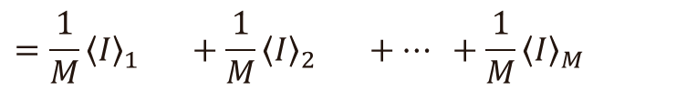

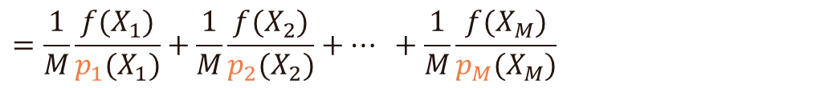
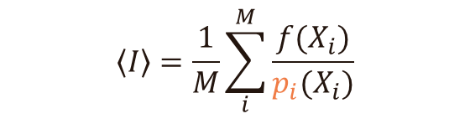
Multiple Importance Sampling (MIS)
Monte Carlo integration
Generate samples $X_{i}$ with different PDFs $p_{i}(X_{i})$
$$\left\langle I\right\rangle =\frac{1}{M}\sum_{i}^{M}{\frac{f(X_{i})}{p(X_{i})}}$$
$$\left\langle I\right\rangle =\frac{1}{M}\sum_{i}^{M}{\frac{f(X_{i})}{p_{i}(X_{i})}}$$
$$=\frac{1}{M}\frac{f(X_{1})}{p_{1}(X_{1})}+\frac{1}{M}\frac{f(X_{2})}{p_{2}(X_{2})}+… +\frac{1}{M}\frac{f(X_{M})}{p_{M}(X_{M})}$$
$$m_{i}=\frac{1}{M}$$
$$=\frac{1}{M}{\left\langle I\right\rangle }_{1} +\frac{1}{M}{\left\langle I\right\rangle }_{2} +… +\frac{1}{M}{\left\langle I\right\rangle }_{M}$$
$$=m_{1}{\left\langle I\right\rangle }_{1} +m_{2}{\left\langle I\right\rangle }_{2} +… +m_{M}{\left\langle I\right\rangle }_{M}$$
MIS weight

Slide 17






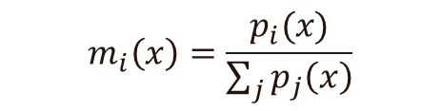
Multiple Importance Sampling (MIS)
Using different MIS weights $m_{i}(X_{i})$
MIS weights must satisfy
$\sum_{i}{m_{i}\left(x\right)}=1$ for any $x$ within the support of $X_{i}$
$m_{i}\left(x\right)=0$ if $x∉supp\left(X_{i}\right)$
Balance heuristic
$supp\left(X_{2}\right)$
$$\left\langle I\right\rangle =\sum_{i}^{M}{m_{i}(X_{i})\frac{f(X_{i})}{p_{i}(X_{i})}}$$
$supp\left(f\right)$
$supp\left(X_{3}\right)$
$supp\left(X_{1}\right)$
$$m_{i}\left(x\right)=\frac{p_{i}(x)}{\sum_{j}{p_{j}\left(x\right)}}$$

