Slide 1
What Does Optimizing ReSTIR Look Like?
Chris Wyman

Slide 2
What’s the Optimization Challenge?

Slide 3
What’s the Optimization Challenge?
When first building RTXDI from our 2020 ReSTIR paper
  NVIDIA perf analysis team essentially said, “go redesign your algorithm” (though in a much nicer way)

Slide 4
What’s the Optimization Challenge?
When first building RTXDI from our 2020 ReSTIR paper
  NVIDIA perf analysis team essentially said, “go redesign your algorithm” (though in a much nicer way)
Why?
  We randomly pick lights, randomly combine neighbors, randomly shoot rays
  Essentially, ReSTIR aims for peak incoherence
  Not the traditional way towards performance GPU code; our perf analysis team was unamused
  We had high memory divergence and high execution divergence

Slide 5
What’s the Optimization Challenge?
When first building RTXDI from our 2020 ReSTIR paper
  NVIDIA perf analysis team essentially said, “go redesign your algorithm” (though in a much nicer way)
Why?
  We randomly pick lights, randomly combine neighbors, randomly shoot rays
  Essentially, ReSTIR aims for peak incoherence
  Not the traditional way towards performance GPU code; our perf analysis team was unamused
  We had high memory divergence and high execution divergence
It is easy to get a 32x slowdown by serializing threads in a warp
  With just five if statements using random predicates
  Even fewer if non-ReSTIR ray tracing code already introduces divergence (likely)

Slide 6
What’s the Optimization Challenge?
When first building RTXDI from our 2020 ReSTIR paper
  NVIDIA perf analysis team essentially said, “go redesign your algorithm” (though in a much nicer way)
Why?
  We randomly pick lights, randomly combine neighbors, randomly shoot rays
  Essentially, ReSTIR aims for peak incoherence
  Not the traditional way towards performance GPU code; our perf analysis team was unamused
  We had high memory divergence and high execution divergence
It is easy to get a 32x slowdown by serializing threads in a warp
  With just five if statements using random predicates
  Even fewer if non-ReSTIR ray tracing code already introduces divergence (likely)
Let’s look at some example optimizations to improve on this!

Slide 7
What’s the Optimization Challenge?
Theoretically, ReSTIR (DI) cost is “independent” of scene complexity & close to constant time

Slide 8
What’s the Optimization Challenge?
Theoretically, ReSTIR (DI) cost is “independent” of scene complexity & close to constant time
  Select a M independent samples (on a random light)
  Reweight M samples
  Pick one of M samples (according to new weight)
  Trace ray (to validate visibility)
  Combine 1 temporal and 1-3 spatial neighbors
  Reweight current, temporal, spatial samples
  Pick one (of the reweighted samples)
  Trace ray (to validate visibility)
  Shade

Slide 9
What’s the Optimization Challenge?
Theoretically, ReSTIR (DI) cost is “independent” of scene complexity & close to constant time
  Select a M independent samples (on a random light)
  Reweight M samples
  Pick one of M samples (according to new weight)
  Trace ray (to validate visibility)
  Combine 1 temporal and 1-3 spatial neighbors
  Reweight current, temporal, spatial samples
  Pick one (of the reweighted samples)
  Trace ray (to validate visibility)
  Shade
Only steps dependent on scene complexity
… not typically the bottleneck

Slide 10
What’s the Optimization Challenge?
Theoretically, ReSTIR (DI) cost is “independent” of scene complexity & close to constant time
  Select a M independent samples (on a random light)
  Reweight M samples
  Pick one of M samples (according to new weight)
  Trace ray (to validate visibility)
  Combine 1 temporal and 1-3 spatial neighbors
  Reweight current, temporal, spatial samples
  Pick one (of the reweighted samples)
  Trace ray (to validate visibility)
  Shade
Surprisingly… This step scaled poorly
Only steps dependent on scene complexity
… not typically the bottleneck

Slide 11
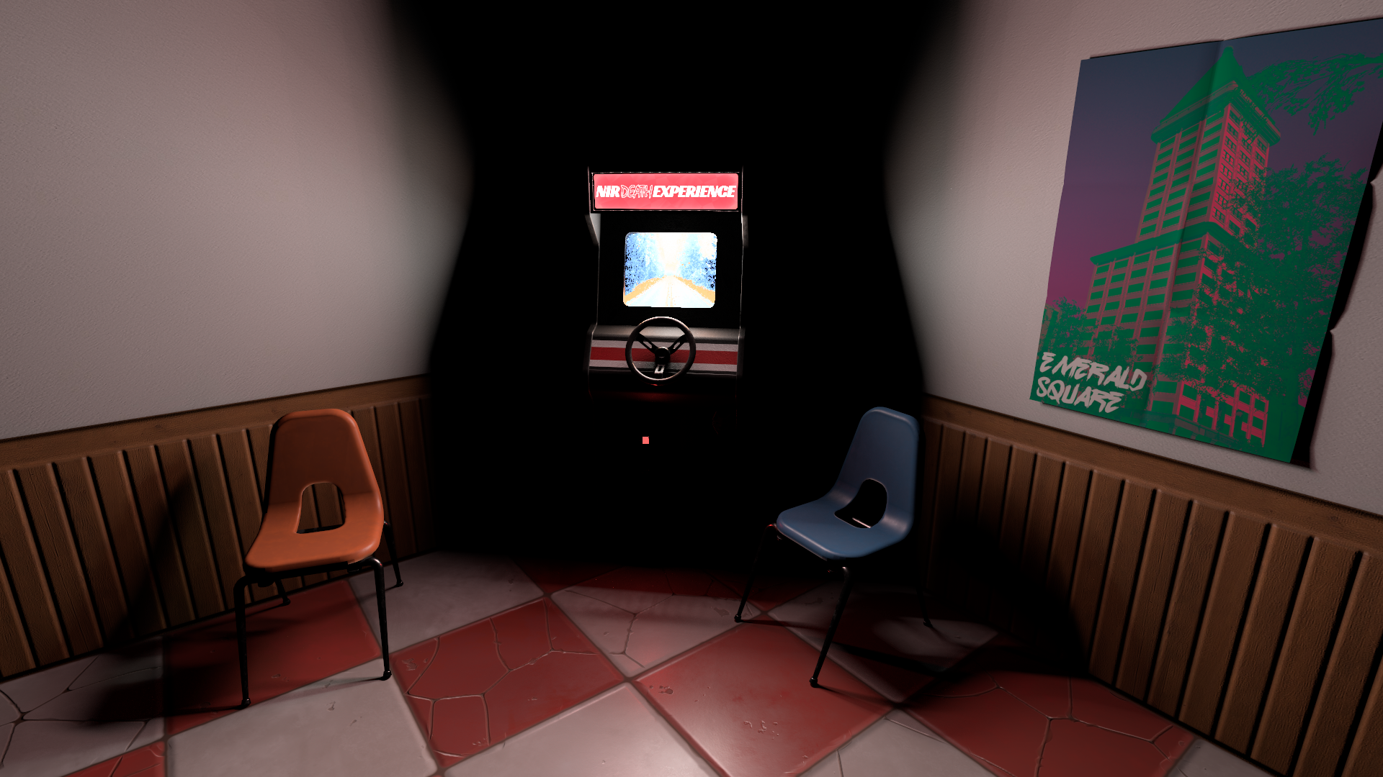
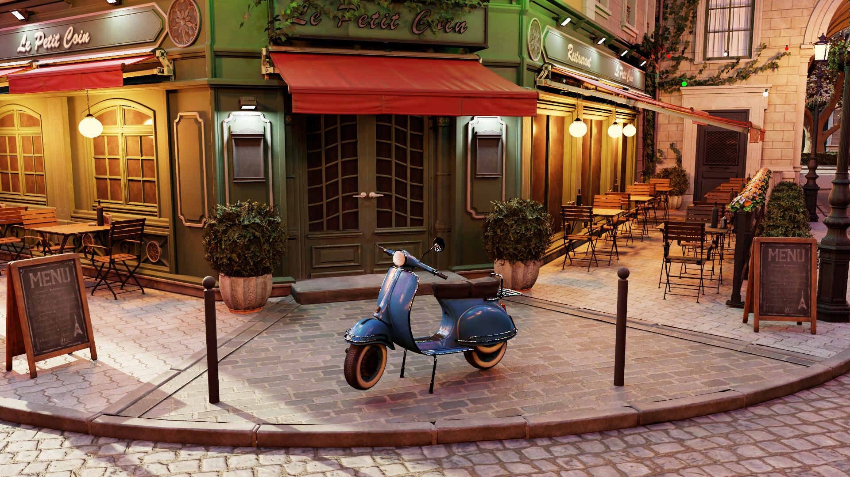
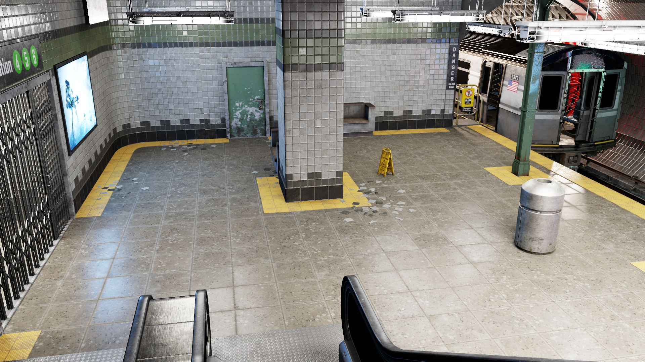
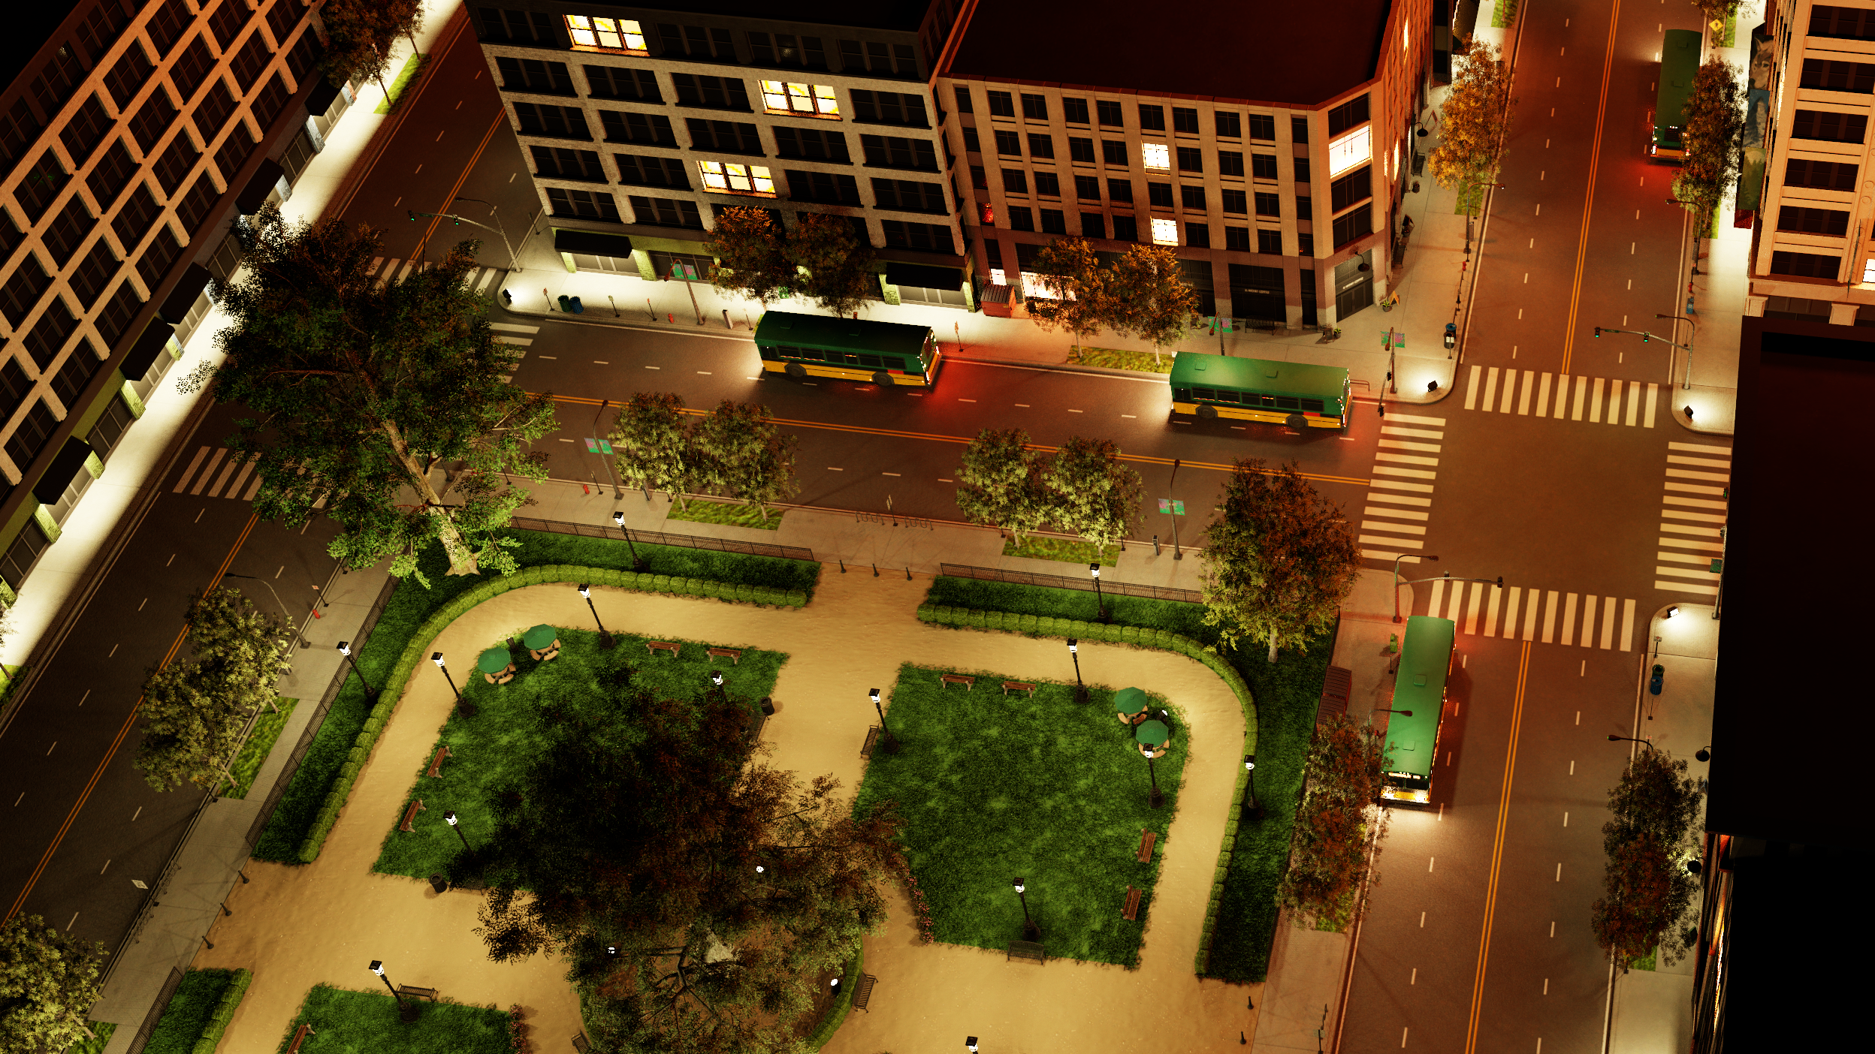
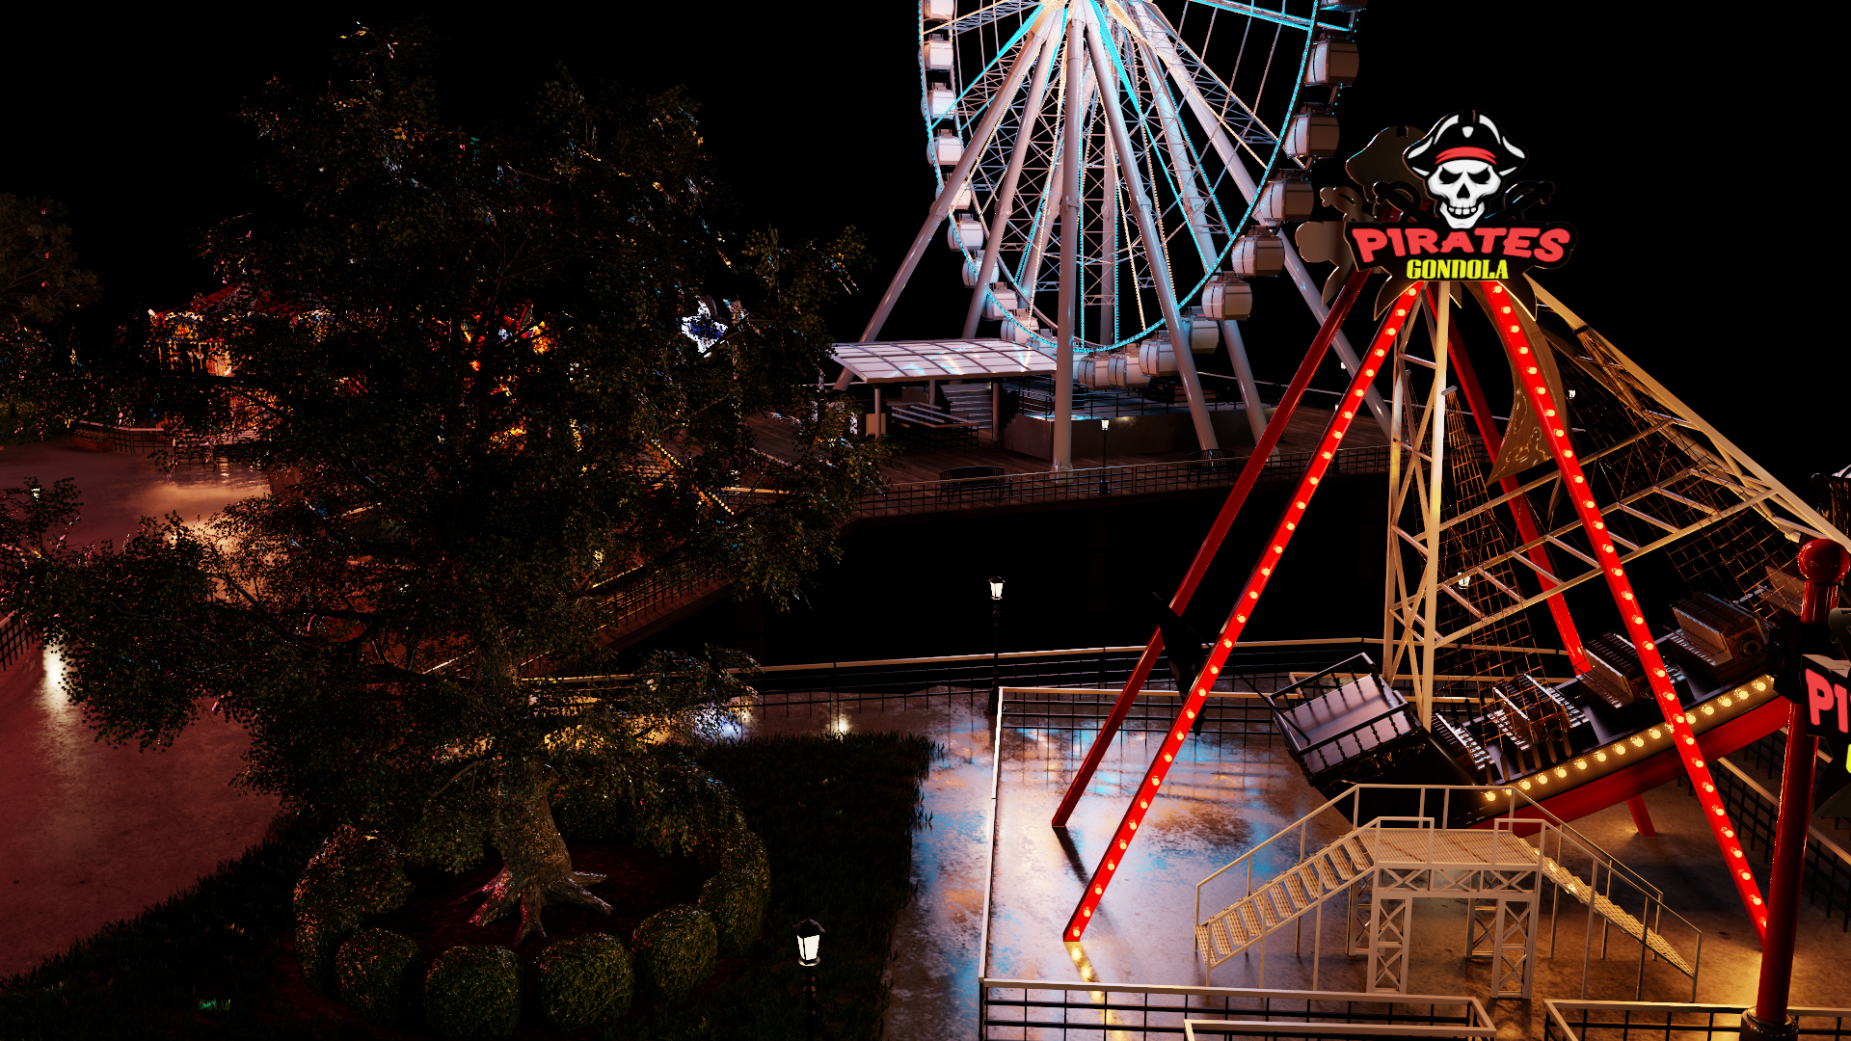
What’s the Optimization Challenge?
milliseconds (very old timings)

Slide 12
What’s the Optimization Challenge?
milliseconds (very old timings)
Basically, linear in number of candidate samples

Slide 13
What’s the Optimization Challenge?
25x or more difference in cost!!
Mostly miss L2
milliseconds (very old timings)
Mostly hit L2
Mostly hit L1

Slide 14
What’s the Optimization Challenge?
25x or more difference in cost!!
Mostly miss L2
Key Takeaway:
Highly randomized sampling is bad for caching!
Mostly hit L2
Mostly hit L1

Slide 15
Does this Mean ReSTIR is GPU-Unfriendly?

Slide 16
Does this Mean ReSTIR is GPU-Unfriendly?
No!
  It means we must think carefully about caching
  In fact, ReSTIR can improve cache coherency!

Slide 17
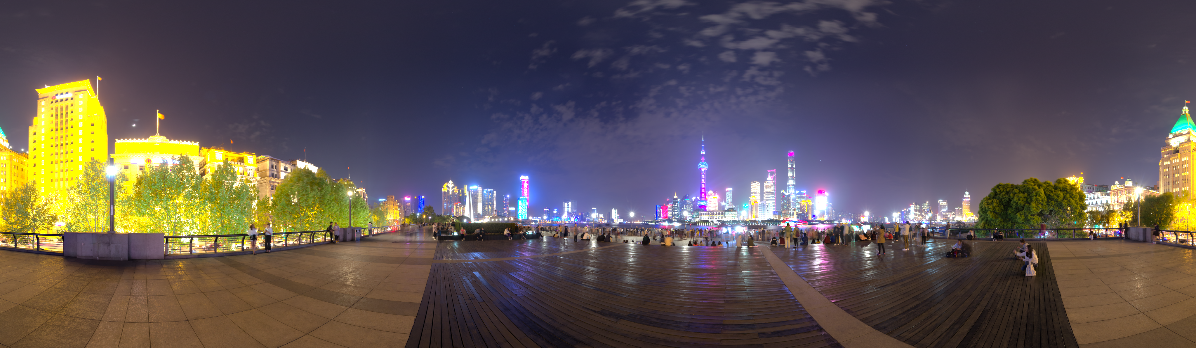
Does this Mean ReSTIR is GPU-Unfriendly?
No!
  It means we must think carefully about caching
  In fact, ReSTIR can improve cache coherency!
What do I mean?
  Consider this Shanghai Bund environment (from Polyhaven)

Slide 18
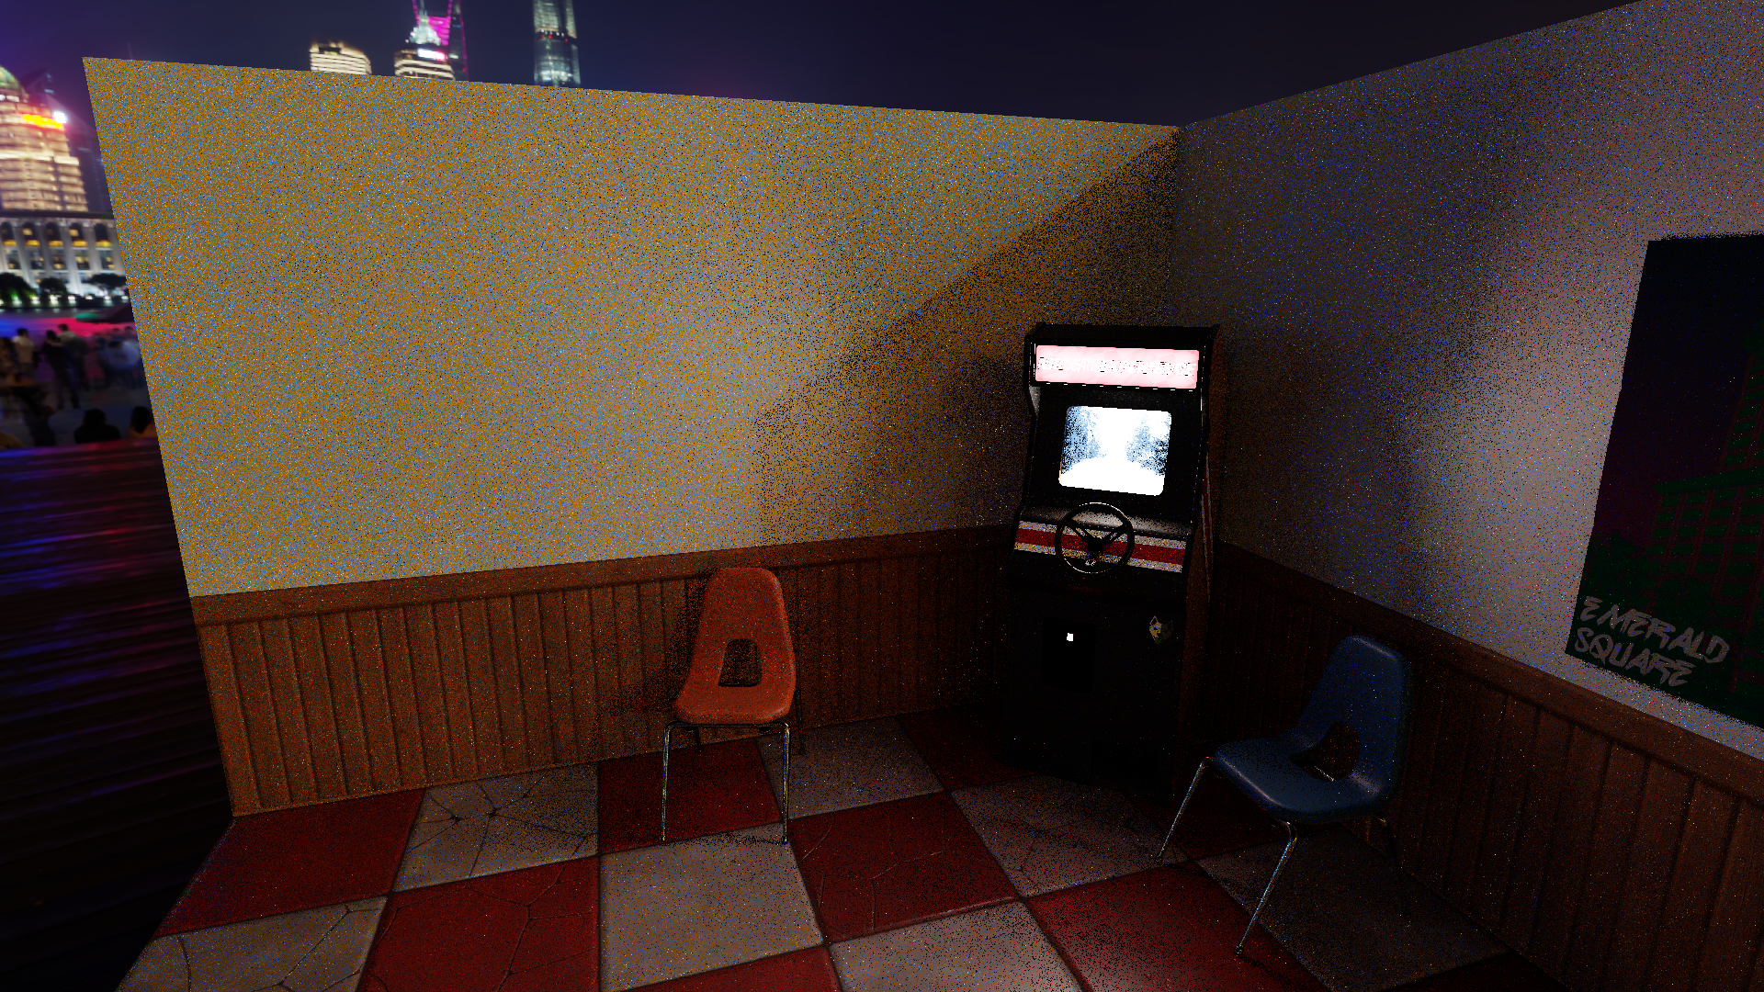
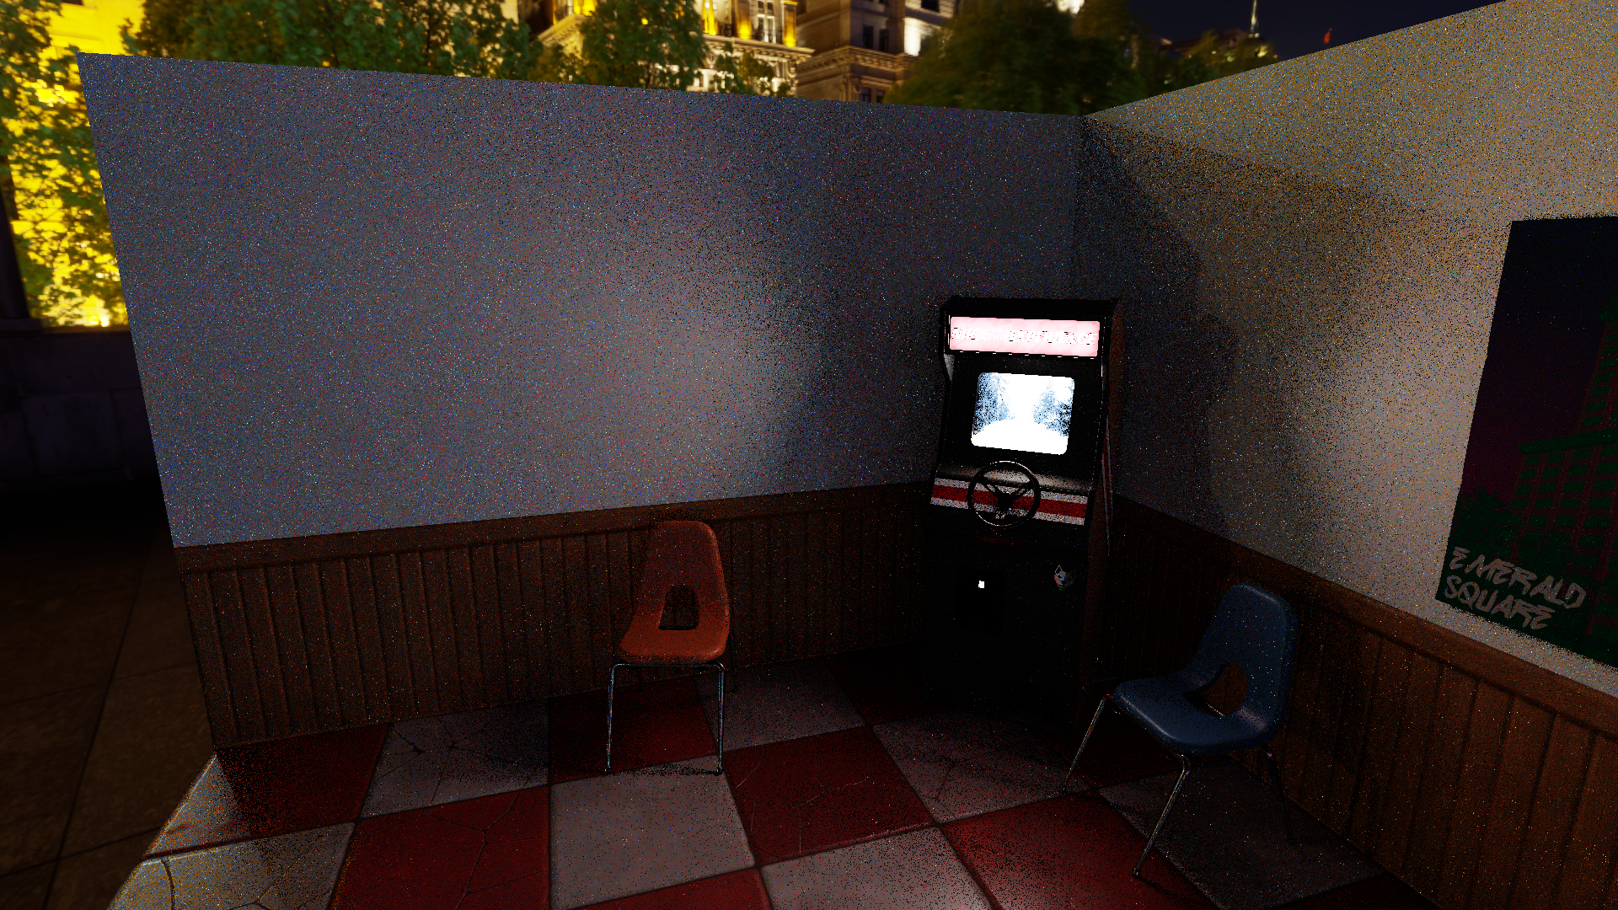
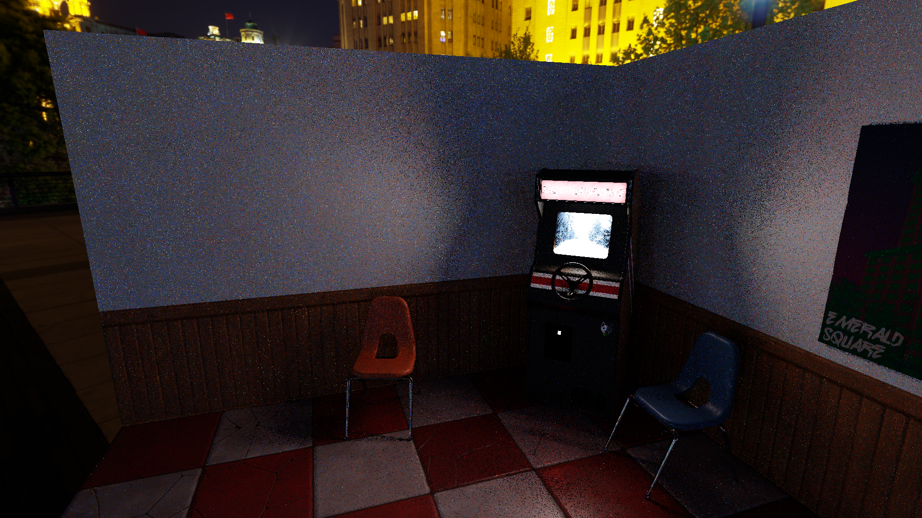
Does this Mean ReSTIR is GPU-Unfriendly?
No!
  It means we must think carefully about caching
  In fact, ReSTIR can improve cache coherency!
What do I mean?
  Consider this Shanghai Bund environment (from Polyhaven)
Lighting this simple Arcade, with various map rotations

Slide 19
Does this Mean ReSTIR is GPU-Unfriendly?
No!
  It means we must think carefully about caching
  In fact, ReSTIR can improve cache coherency!
What do I mean?
  Consider this Shanghai Bund environment (from Polyhaven)
Lighting this simple Arcade, with various map rotations
Mostly sample yellow side
Mostly sample blue side
Visibility-led sampling
Sampling the BSDF lobe

Slide 20
Does this Mean ReSTIR is GPU-Unfriendly?
No!
  It means we must think carefully about caching
  In fact, ReSTIR can improve cache coherency!
What do I mean?
  Consider this Shanghai Bund environment (from Polyhaven)
Lighting this simple Arcade, with various map rotations
Mostly sample yellow side
Mostly sample blue side
Visibility-led sampling
Takeaway:
ReSTIR focuses samples; outputs typically more coherent than inputs
Important lights / paths tend to change relatively slowly (coherently)
Sampling the BSDF lobe

Slide 21


A Related Q: When Sampling An Environment Map
Which should we use?

Slide 22
A Related Q: When Sampling An Environment Map
Which should we use?
  Q: Different answer if running to convergence?
  Q: Different answer if only using 1 ray per pixel?
  Q: Different answer if subset changes each frame?

Slide 23
A Related Q: When Sampling An Environment Map
Which should we use?
  Q: Different answer if running to convergence?
  Q: Different answer if only using 1 ray per pixel?
  Q: Different answer if subset changes each frame?
Crude low-res map clearly fits in L1 cache
Some middle-ground probably fits in L2 cache
Downloaded 4k HDR may not fit in cache; every pixel may grab new cache line

Slide 24
So: Can We LoD Samples for Non-Environments?

Slide 25
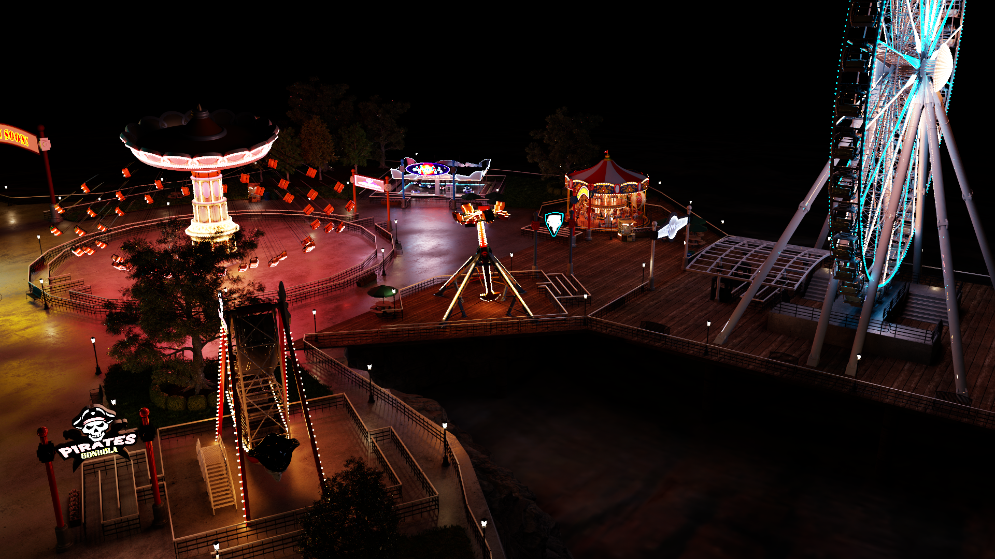
So: Can We LoD Samples for Non-Environments?
Consider our Amusement Park
  3 million emissive triangles

Slide 26
So: Can We LoD Samples for Non-Environments?
Consider our Amusement Park
  3 million emissive triangles
Rendering at 1920 x 1020
  Touch < 2 million emissives during shading

Slide 27
So: Can We LoD Samples for Non-Environments?
Consider our Amusement Park
  3 million emissive triangles
Rendering at 1920 x 1020
  Touch < 2 million emissives during shading
Basically: ReSTIR does stochastic LoD
  And it works just fine
  … so can we do even more?

Slide 28
So: Can We LoD Samples for Non-Environments?
Consider our Amusement Park
  3 million emissive triangles
Rendering at 1920 x 1020
  Touch < 2 million emissives during shading
Basically: ReSTIR does stochastic LoD
  And it works just fine
  … so can we do even more?
What if we selected from only 300,000 emissives? (out of 3 million)
Or: What if only 1 in 10
bulbs were used?

Slide 29
So: Can We LoD Samples for Non-Environments?
Consider our Amusement Park
  3 million emissive triangles
Rendering at 1920 x 1020
  Touch < 2 million emissives during shading
Basically: ReSTIR does stochastic LoD
  And it works just fine
  … so can we do even more?
What if we selected from only 300,000 emissives? (out of 3 million)
  Really only matters for nearby lights… But ReSTIR could always select the wrong nearby light; reuse addresses this
Doesn’t much
matter here
Or: What if only 1 in 10
bulbs were used?

Slide 30
So: Can We LoD Samples for Non-Environments?
… a list of 3 million lights …
Typical naive candidate selection
  Each pixel selects some (incoherent) light candidates
  Cost depends on likelihood of samples being in cache

Slide 31
So: Can We LoD Samples for Non-Environments?
… a list of 3 million lights …
Potential LoD approach
  First fill subsets (blue) with randomly selected lights
  Each pixel selects all its candidates from a single subset

Slide 32
So: Can We LoD Samples for Non-Environments?
… a list of 3 million lights …
Potential LoD approach
  First fill subsets (blue) with randomly selected lights
  Each pixel selects all its candidates from a single subset
Per-pixel cost low
  Each blue subset fits in a (few) cache lines

Slide 33
So: Can We LoD Samples for Non-Environments?
… a list of 3 million lights …
Potential LoD approach
  First fill subsets (blue) with randomly selected lights
  Each pixel selects all its candidates from a single subset
Per-pixel cost low
  Each blue subset fits in a (few) cache lines
Total cost: Depends on number of subsets needed
  Turns out only a few needed per frame (128 subsets, each with 1024 lights)

Slide 34
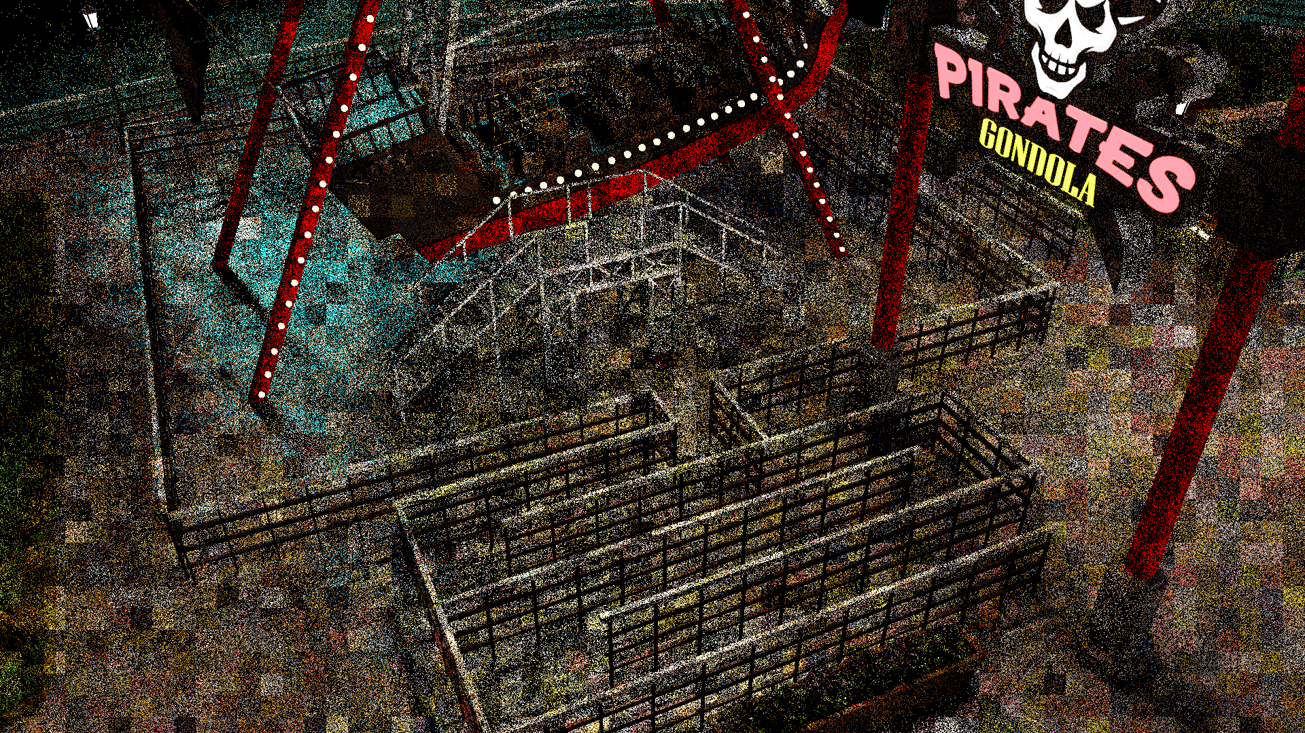
So: Can We LoD Samples for Non-Environments?
… a list of 3 million lights …
As a preprocess, each frame
  Preselect random light subsets
Clusters of pixels select candidates from same subset

Slide 35
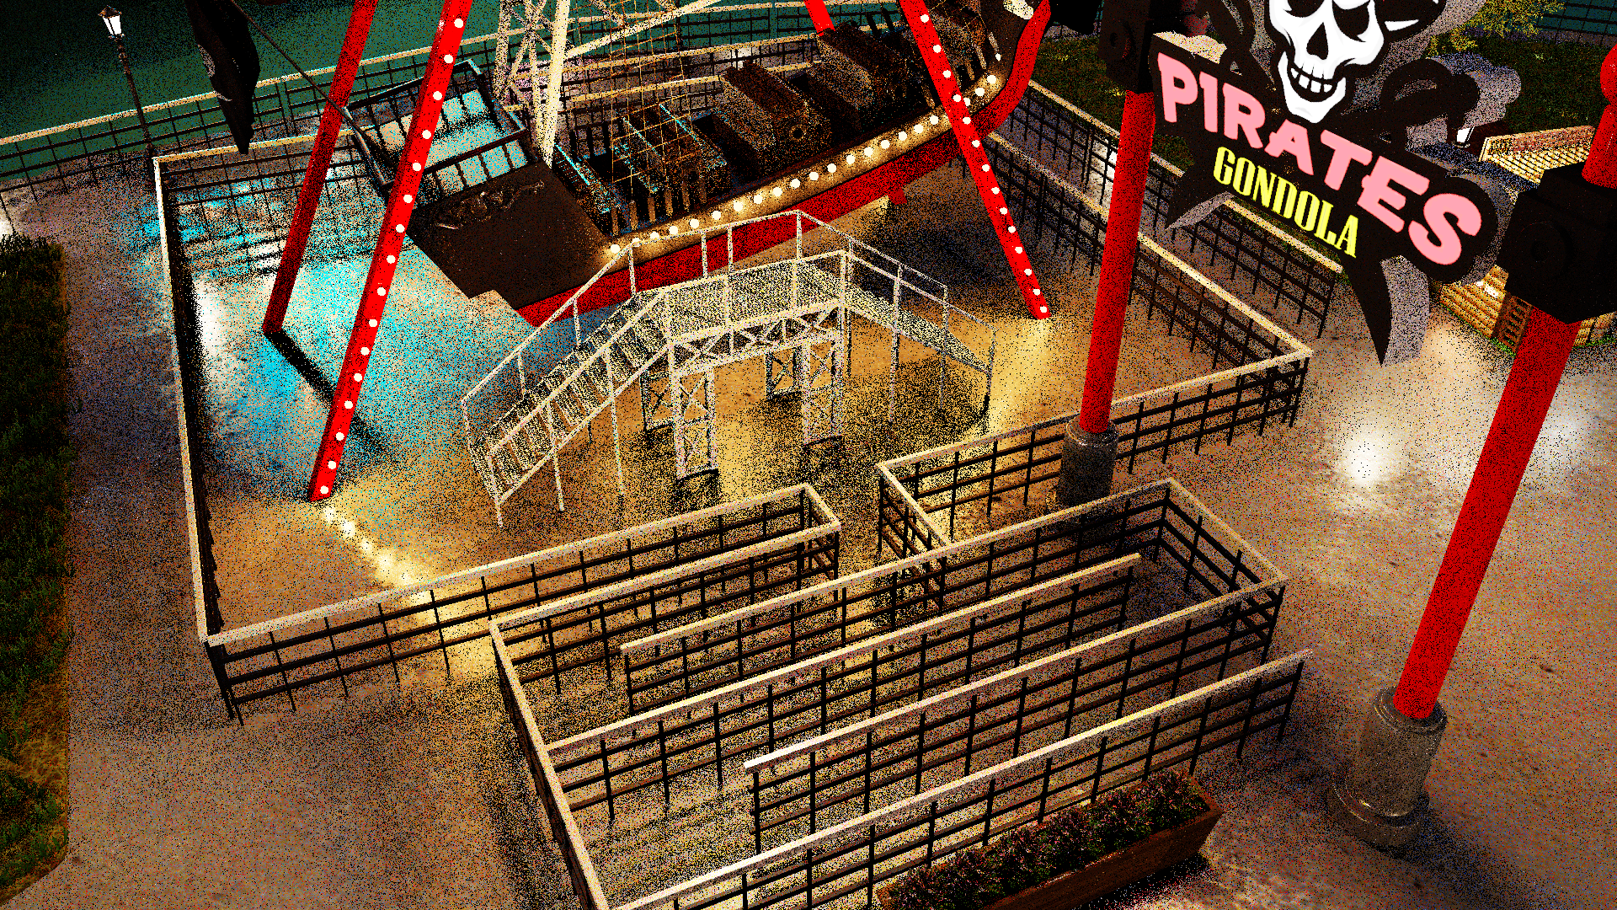
So: Can We LoD Samples for Non-Environments?
… a list of 3 million lights …
As a preprocess, each frame
  Preselect random light subsets
Clusters of pixels select candidates from same subset
Artifacts disappear after spatiotemporal reuse
  With up to 50x lower cost for candidate selection

Slide 36
Can Push This “Hierarchy” Further
… a list of 3 million lights …
…
…
…
…

Slide 37
Can Push This “Hierarchy” Further
… a list of 3 million lights …
…
…
…
…
Triangle Lights
Sphere Lights
Capsule Lights
Why? Add extra layer(s) of indirection
  Perhaps to coherently sample different light types

Slide 38
Can Push This “Hierarchy” Further
… a list of 3 million lights …
…
…
…
…
Triangle Lights
Sphere Lights
Capsule Lights
Key observations:
  Each step is another iteration of RIS
  RIS can hide memory divergence (improving caching)
  RIS can hide execution divergence (e.g., different light samplers)

Slide 39
Important to Consider Various Divergence in Code

Slide 40
Important to Consider Various Divergence in Code
Abstractly ReSTIR execution looks something like:
Pick candidates
Reweight
Select one
Trace ray(s)
Lookup neighbors
Reweight
Select one
Trace ray(s)
Shade

Slide 41
Important to Consider Various Divergence in Code
Abstractly ReSTIR execution looks something like:
Boundaries with ray tracing are super important!
Pick candidates
Reweight
Select one
Trace ray(s)
Lookup neighbors
Reweight
Select one
Trace ray(s)
Shade

Slide 42
Important to Consider Various Divergence in Code
Abstractly ReSTIR execution looks something like:
Boundaries with ray tracing are super important!
  Tracing traverses BVH, which could affect caches (identical memory lookups before and after may vary in perf)
  Sorting threads at these boundaries has impact (moving resources or adding indirections to lookups)
  Hardware-specific decisions (communication patterns during RT)
Pick candidates
Reweight
Select one
Trace ray(s)
Lookup neighbors
Reweight
Select one
Trace ray(s)
Shade

Slide 43
Important to Consider Various Divergence in Code
Abstractly ReSTIR execution looks something like:
Boundaries with ray tracing are super important!
  Tracing traverses BVH, which could affect caches (identical memory lookups before and after may vary in perf)
  Sorting threads at these boundaries has impact (moving resources or adding indirections to lookups)
  Hardware-specific decisions (communication patterns during RT)
All impact divergence in interesting ways
  Sometimes unexpected ways (splitting kernels here is often beneficial, to start, even if not optimal)
  Regularly found ways to trade memory ↔ execution divergence to get best balance
Pick candidates
Reweight
Select one
Trace ray(s)
Lookup neighbors
Reweight
Select one
Trace ray(s)
Shade

Slide 44
“Reusing” Visibility
** Warning: Very tricky; the easiest way to get unknown error is visibility reuse

Slide 45
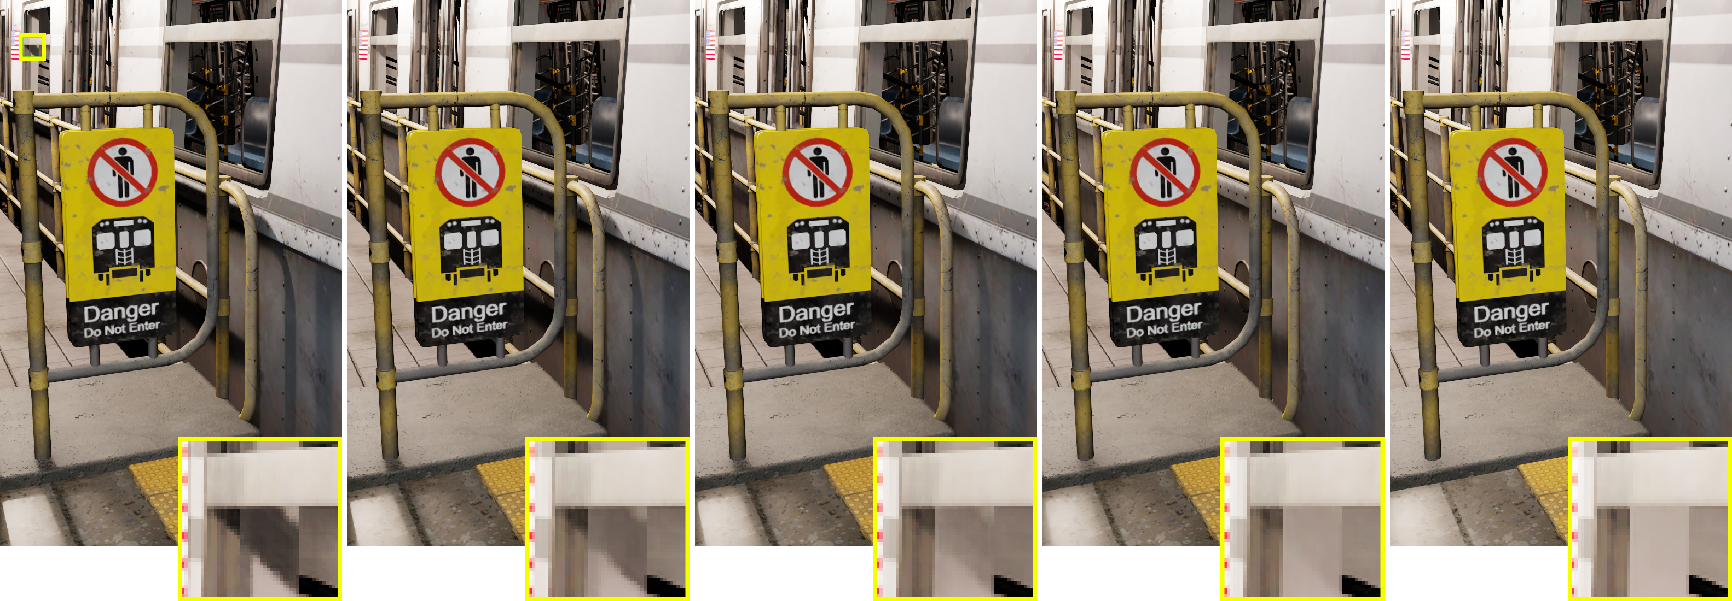
“Reusing” Visibility
** Warning: Very tricky; the easiest way to get unknown error is visibility reuse
What if two rays per pixel is too much? (in ReSTIR DI)
2 rays per pixel
1.75 rays per pixel
1.5 rays per pixel
1.25 rays per pixel
1 ray per pixel

Slide 46
“Reusing” Visibility
** Warning: Very tricky; the easiest way to get unknown error is visibility reuse
What if two rays per pixel is too much? (in ReSTIR DI)
Can reuse spatial neighbor visibility
in exchange for fading contact shadows
2 rays per pixel
1.75 rays per pixel
1.5 rays per pixel
1.25 rays per pixel
1 ray per pixel

Slide 47
“Reusing” Visibility
** Warning: Very tricky; the easiest way to get unknown error is visibility reuse
What if two rays per pixel is too much? (in ReSTIR DI)
Why is this tricky?
  Any visibility reuse introduces bias
Best approach:
  Only reuse visibility if bias can not feed forward to future frames
  I.e., visibility “reused” for one frame, then discarded
These results come from [Wyman & Panteleev 2021]
  Using “decoupled shading”
  One completely new ray used to generate future reservoirs
  Up to two visibility tests reused, but only when shading this frame’s pixels
2 rays per pixel
1.75 rays per pixel
1.5 rays per pixel
1.25 rays per pixel
1 ray per pixel

Slide 48
Summary
Easy to write poor-performing ReSTIR code
  Thanks to random rays and memory access
  Complexity of ray tracing overheads

Slide 49
Summary
Easy to write poor-performing ReSTIR code
  Thanks to random rays and memory access
  Complexity of ray tracing overheads
Does not mean ReSTIR is GPU-unfriendly
  Need to think about divergence carefully
  Add new RIS steps designed to mitigate memory or execution divergence

Slide 50
Summary
Easy to write poor-performing ReSTIR code
  Thanks to random rays and memory access
  Complexity of ray tracing overheads
Does not mean ReSTIR is GPU-unfriendly
  Need to think about divergence carefully
  Add new RIS steps designed to mitigate memory or execution divergence
Can view ReSTIR as a LoDing of integration domain
  Just like coarsening light probe textures

Slide 51
Summary
Easy to write poor-performing ReSTIR code
  Thanks to random rays and memory access
  Complexity of ray tracing overheads
Does not mean ReSTIR is GPU-unfriendly
  Need to think about divergence carefully
  Add new RIS steps designed to mitigate memory or execution divergence
Can view ReSTIR as a LoDing of integration domain
  Just like coarsening light probe textures
Visibility reuse is tricky to get right
  Can provide performance ↔ quality tradeoff knobs

Slide 53
Backup

Slide 54
What Do You Want To Optimize?

Slide 55
What Do You Want To Optimize?
Obviously: Want sampling to cost less time
  But: Not particularly useful metric; doesn’t give many clues

Slide 56
What Do You Want To Optimize?
Obviously: Want sampling to cost less time
  But: Not particularly useful metric; doesn’t give many clues
What could you optimize?
  Use fewer shadow rays (primary goal for ReSTIR DI / RTXDI)
  Use fewer light paths (primary goal for ReSTIR PT)

Slide 57
What Do You Want To Optimize?
Obviously: Want sampling to cost less time
  But: Not particularly useful metric; doesn’t give many clues
What could you optimize?
  Use fewer shadow rays (primary goal for ReSTIR DI / RTXDI)
  Use fewer light paths (primary goal for ReSTIR PT)
  Reduce sampling variance
  Reduce execution / memory divergence
  Reduce memory bandwidth
  Reduce shader register usage
  Reduce overhead of tracing rays

