Slide 1
Light Transport and Appearance Modelling
5 June 2025
Nithin Raghavan
CSE 168

Slide 2
Overview
Precomputed Radiance Transfer and Real-Time Relighting
Basis functions
Classical PRT-based methods
Neural approaches
Appearance Modelling
SVBRDFs and Measured BRDFs
Bidirectional Texture Functions (BTFs)
Classical BTF compression methods
Neural BTF compression methods
Generative approaches

Slide 3
PRT and Real-Time Relighting

Slide 4

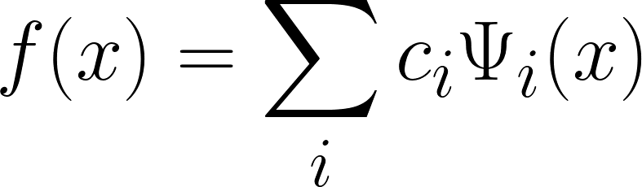
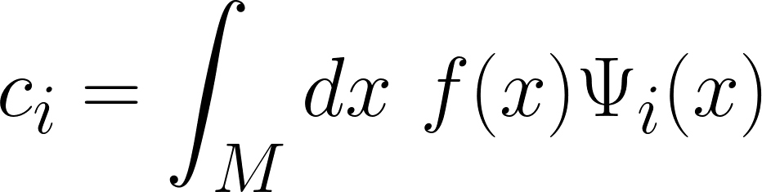
What are basis functions?
Basis vectors are functions that combine linearly to produce any arbitrary function.
These individual functions are scaled by a projection coefficient.
To get the projection coefficients, we can integrate the function alongside the relevant basis vector. This can be estimated either directly or via Monte Carlo.
Notes:
This is also called analysis by synthesis.

Slide 5
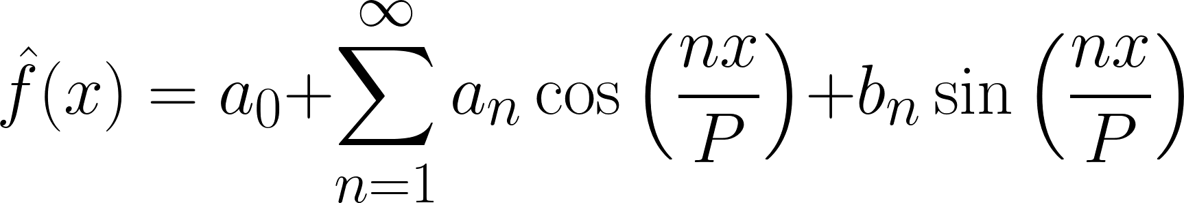
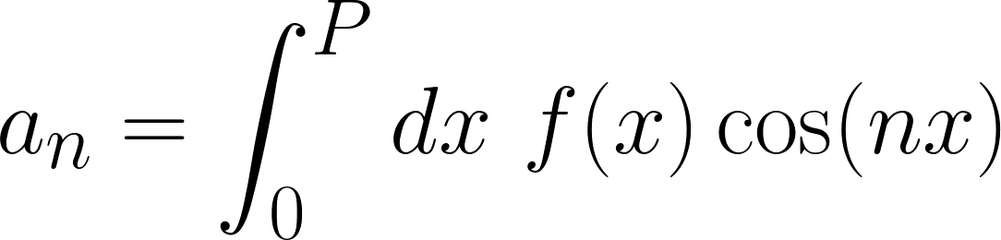
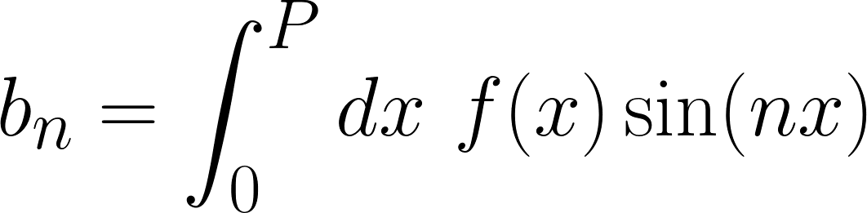
Sinusoids as Continuous Basis Functions
These are the basis functions on the circle. This defines a continuous Fourier series.
If the period P goes to infinity, we recover the continuous Fourier Transform.

Slide 6
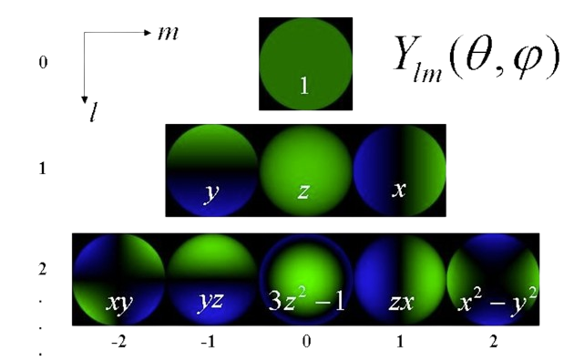
Spherical Harmonics
Defined on the sphere instead of the circle.
They are indexed by L and M
L: order or angular momentum number
M: magnetic number
Precomputation-Based Rendering (Ravi Ramamoorthi, 2009)
Notes:
These are basically analogous to sines and cosines, but on the sphere instead of the circle.
They have two parameters (theta, phi) and are also infinite like sines and cosines.

Slide 7
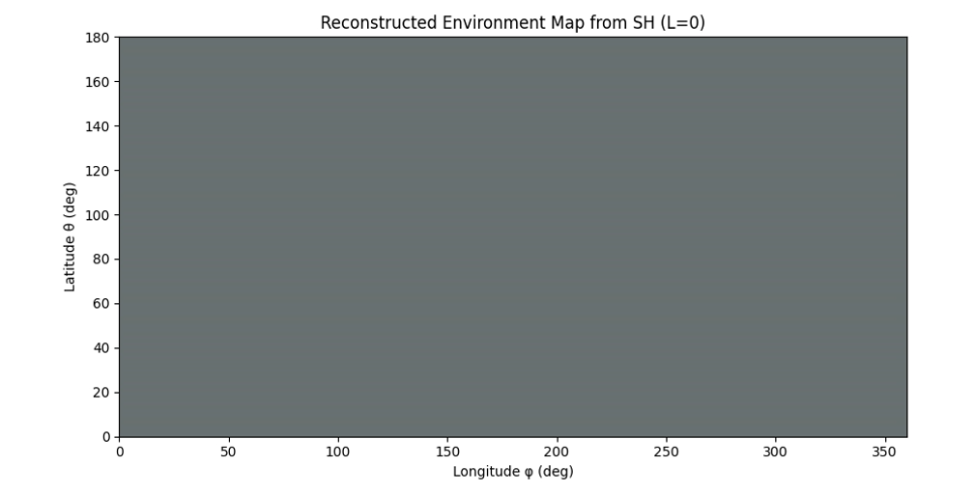
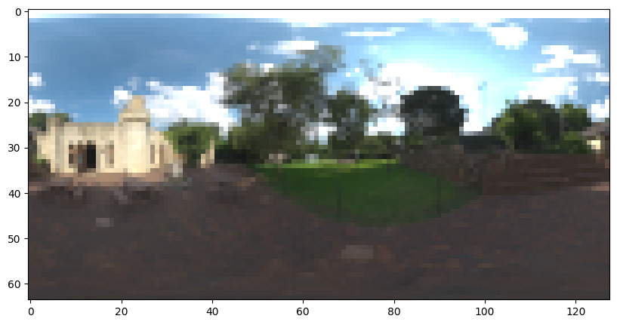
Spherical Harmonics as Basis Functions
We can expand any spherical function in terms of spherical harmonics
Examples: Normal maps, environment maps, BRDFs
Precomputation-Based Rendering (Ravi Ramamoorthi, 2009)
Notes:
Need a lot to even get near the original!

Slide 8
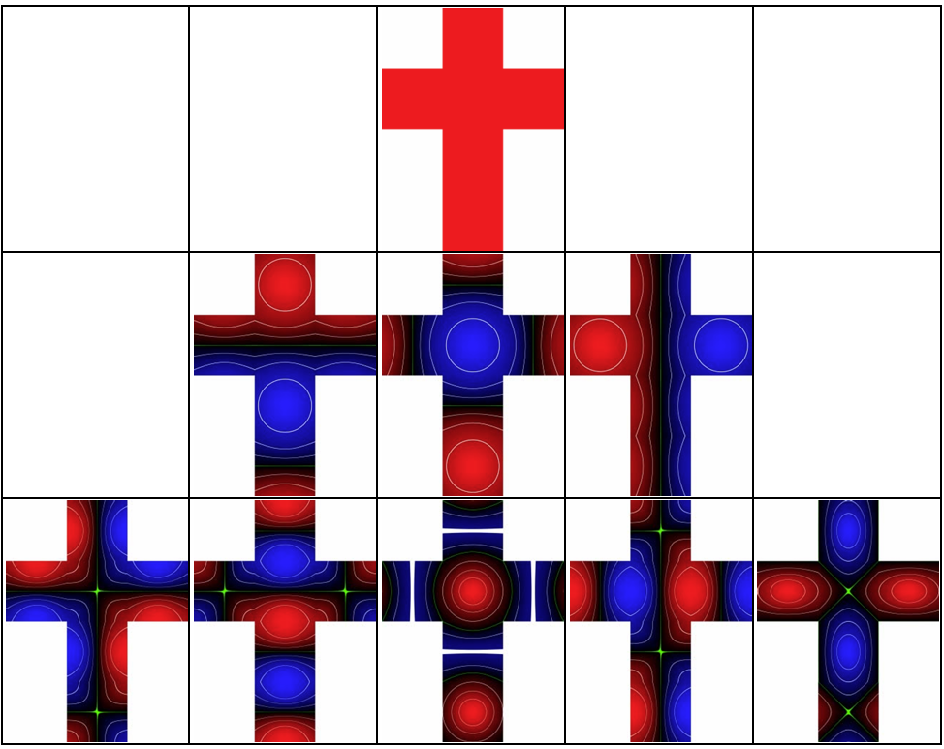
Spherical Harmonics as Basis Functions
Stupid Spherical Harmonics Tricks (Peter-Pike Sloan, 2008)

Slide 9
Spherical Harmonics as Basis Functions
Pros
Handles rotation well
Orthonormal
Can represent any continuous spherical function to arbitrary frequency
Cons
Need a lot of SH coefficients to represent any high-frequency function!
Notes:
Need a lot to even get near the original!

Slide 10
Discrete Basis Functions
Spherical Harmonics and Sinusoids are continuous basis functions
Discrete basis functions are used when there are only a fixed number of degrees of freedom in the input function.
Example: an image has HxWx3 pixels. Total: H*W*3 degrees of freedom

Slide 11
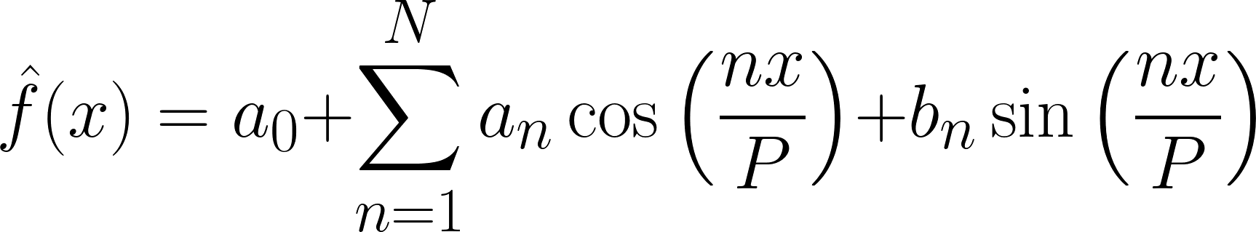
Discrete Fourier Basis Functions
A discrete Fourier series only has a finite set of sines and cosines.
We can turn our integral into a summation (or matrix multiplication).
The discrete Fourier transform is a set of discrete basis functions.

Slide 12
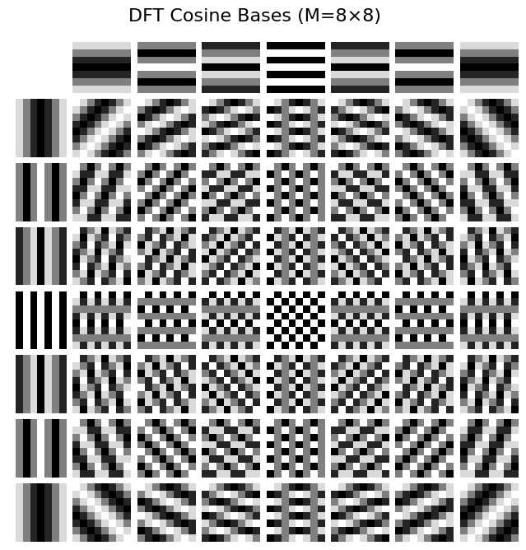
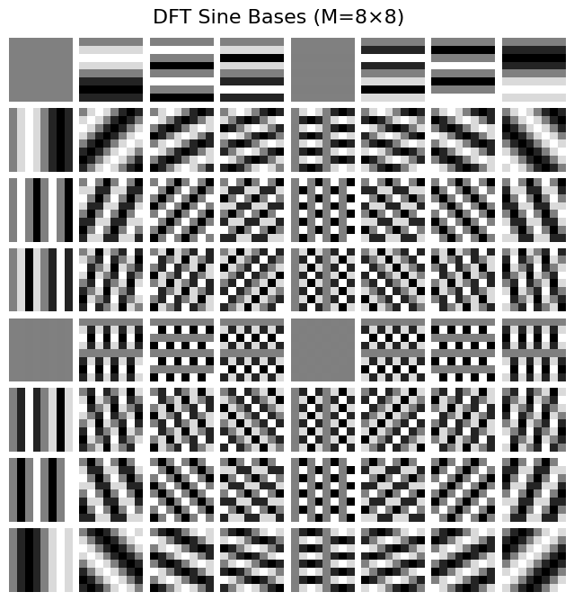
Discrete Fourier Basis Functions

Slide 13
Discrete Wavelets
Similar to discrete Fourier transform
Constructed from averages and differences
Several types: Haar, Daubechies, CDF 9/7 (JPEG wavelet)
Aims to be as sparse as possible
Top-K selection: since wavelets are sparse, one can take only the top K and discard the rest; this will retain most of the power.
Notes:
[8 4 1 3]
[6 2] [2 -1]
[4] [2]

Slide 14
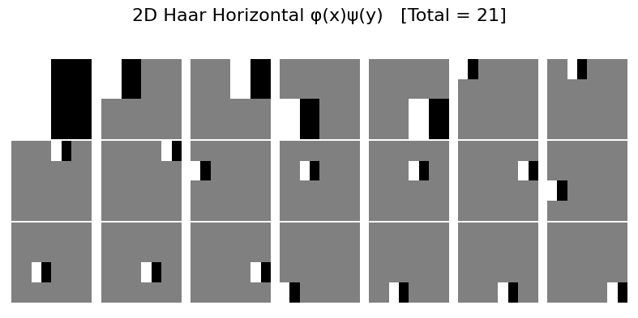
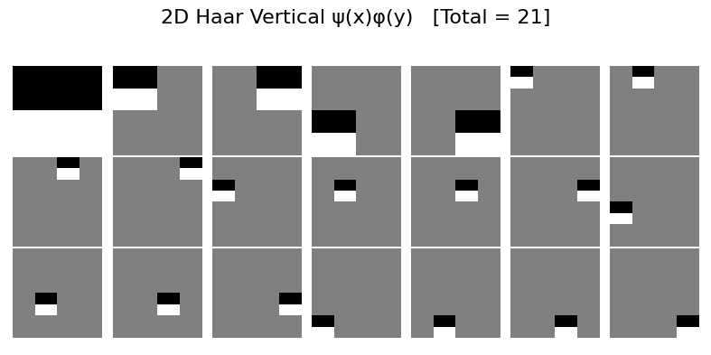
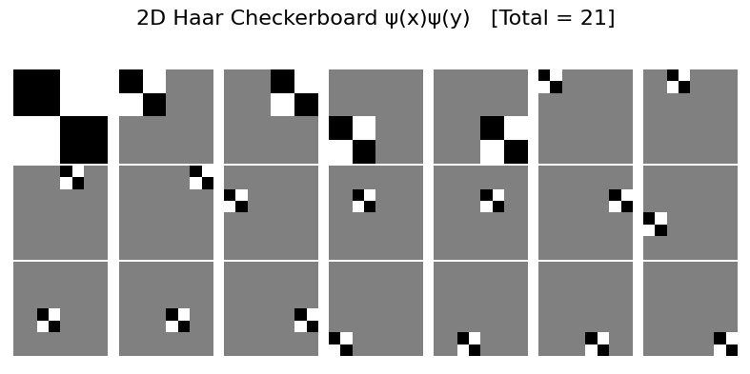
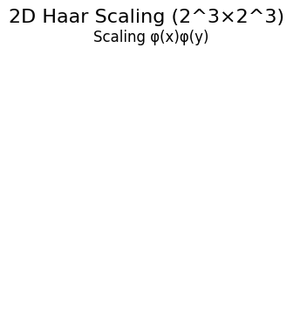
Discrete Haar Basis Functions

Slide 15
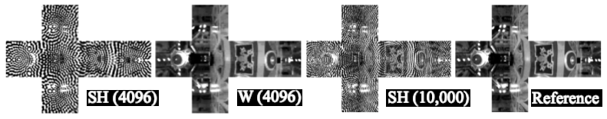
Environment Reconstruction
Reference
Reconstruction with 4096 spherical harm.
Reconstruction with 10,000 spherical harm.
Reconstruction with 4096 wavelets
Ng, Ren, et al. All-frequency shadows using non-linear wavelet lighting approximation. ACM Trans. Graph. 22, 3 (July 2003), 376–381. https://doi.org/10.1145/882262.882280

Slide 16
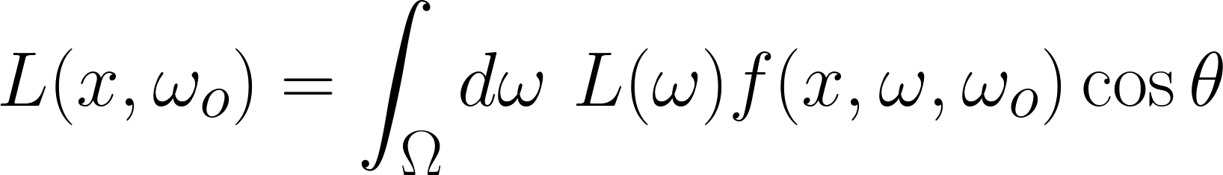
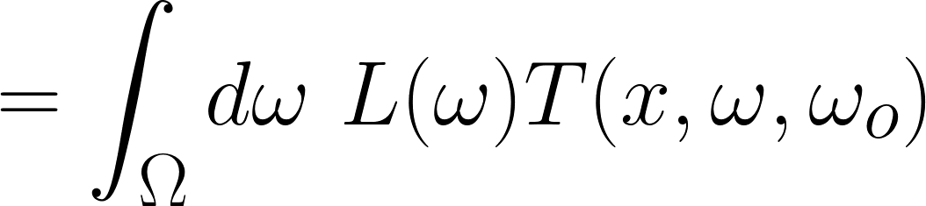
Recap: Precomputed Radiance Transfer
Rendering equation is a transfer function

Slide 17
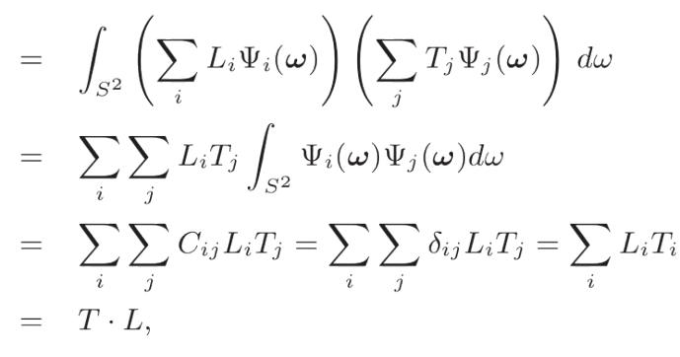

Recap: Precomputed Radiance Transfer
Represent L and T in terms of orthonormal basis vectors.
Assume all materials are diffuse, so T only depends on the lighting.
Ren Ng, Ravi Ramamoorthi, and Pat Hanrahan. "Triple Product Wavelet Integrals for All-Frequency Relighting". In ACM SIGGRAPH, pages 477–487, July 2004.

Slide 18
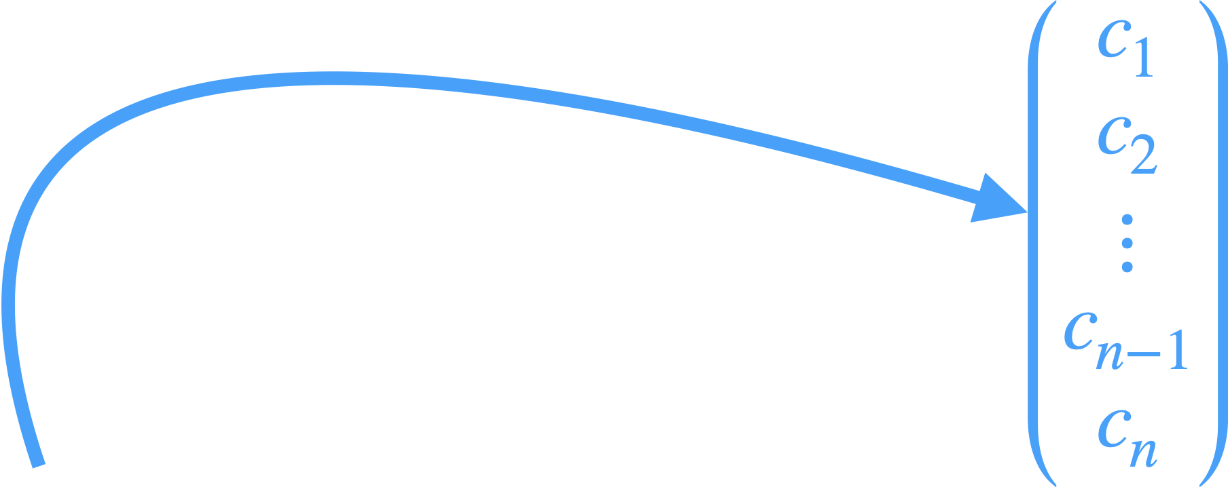
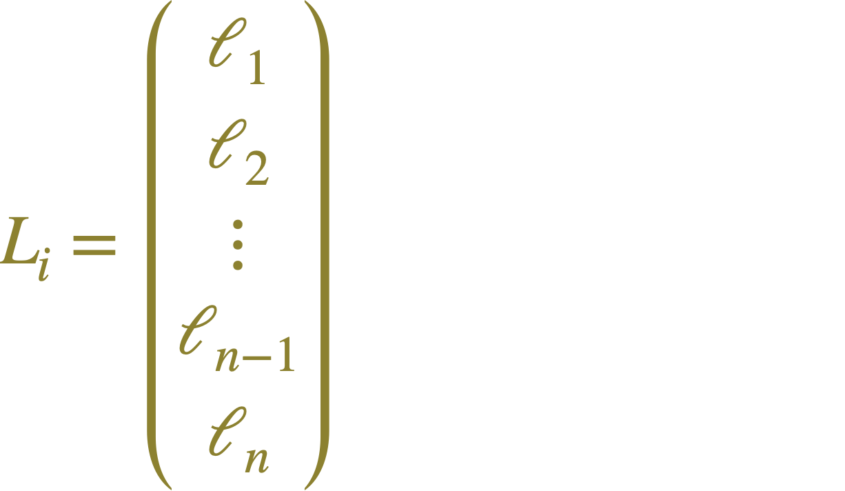
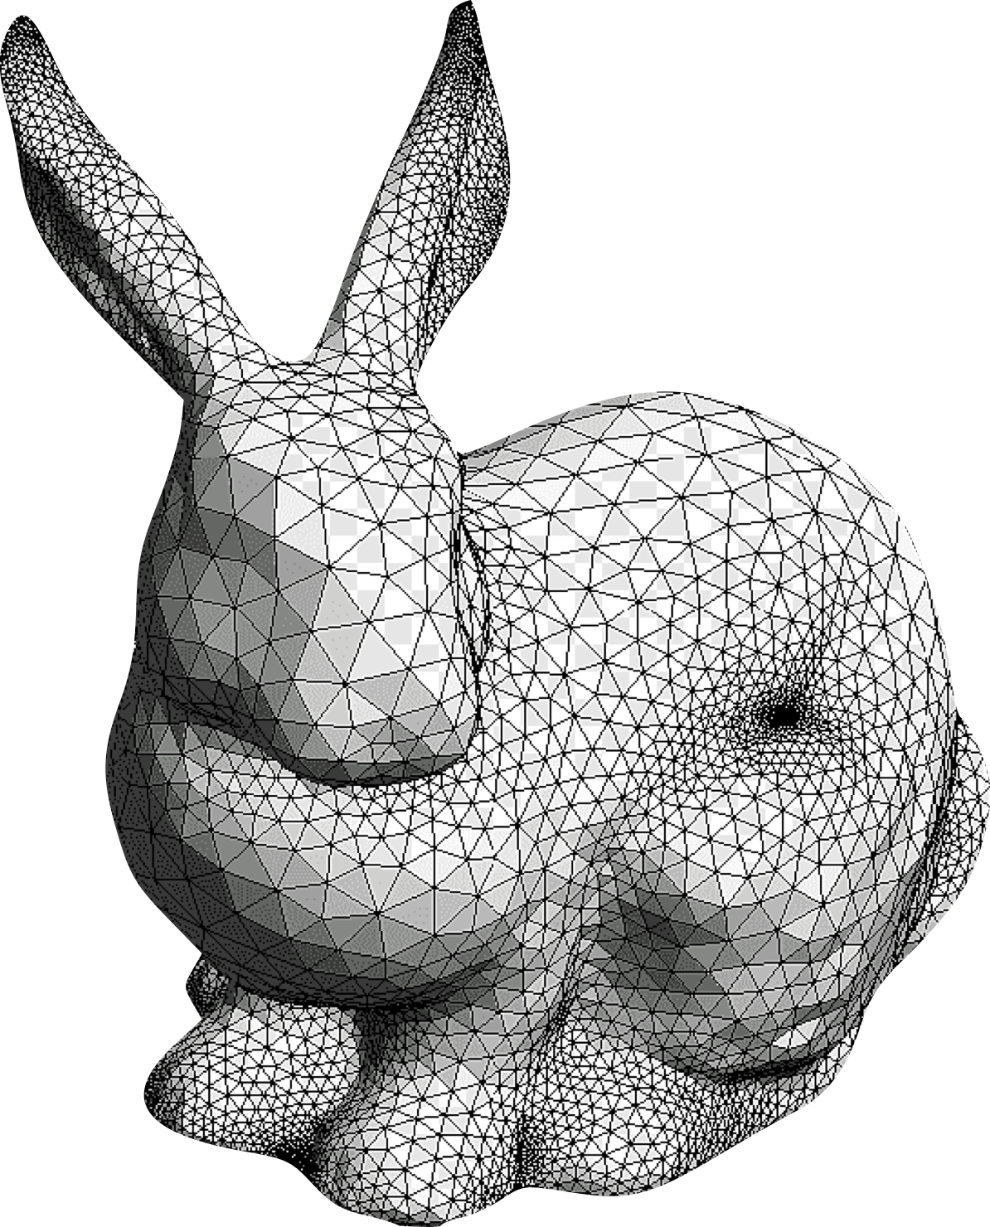


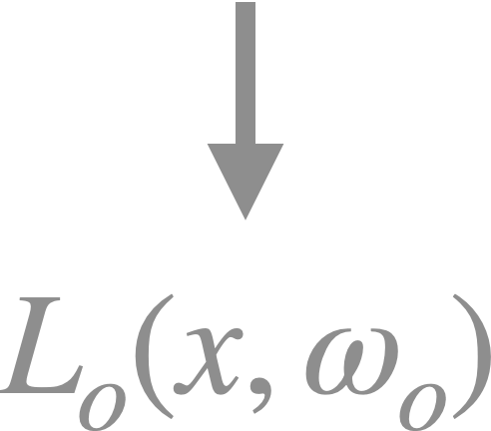
Recap: Precomputed Radiance Transfer
Obtain the exitant radiance via dot product!
Sloan, P.-P., et al. Precomputed radiance transfer for real-time rendering in dynamic, low-frequency lighting environments. ACM Trans. Graph. 21-3 (2002)
Notes:
If the light and transfer are represented in an orthonormal basis, then our image B is just a dot product of their coefficient vectors!
Intuition: store a vector at each vertex v of your mesh.
When relighting, compute the dot product between the new environment and the stored vector.

Slide 19



Glossy Precomputed Radiance Transfer
Discretize over viewing direction and store a different vector for each one.
This stores a matrix instead of a vector at each point.
When rotating the camera, discretize the direction.
Lighting Direction
Viewing Direction
Vertex Position
Sloan, P.-P., et al. Precomputed radiance transfer for real-time rendering in dynamic, low-frequency lighting environments. ACM Trans. Graph. 21-3 (2002)
Notes:
If the light and transfer are represented in an orthonormal basis, then our image B is just a dot product of their coefficient vectors!
Intuition: store a vector at each vertex v of your mesh.
When relighting, compute the dot product between the new environment and the stored vector.

Slide 20
Glossy Precomputed Radiance Transfer
Problem: this is huge!
Six-dimensional tensor
For 512x512 image, with 128x128x6 cubemap, with 128x128 view discretization, the T matrix is 105 terabytes!
How can we compress this?
Lighting Direction
Viewing Direction
Vertex Position
Sloan, P.-P., et al. Precomputed radiance transfer for real-time rendering in dynamic, low-frequency lighting environments. ACM Trans. Graph. 21-3 (2002)
Notes:
If the light and transfer are represented in an orthonormal basis, then our image B is just a dot product of their coefficient vectors!
Intuition: store a vector at each vertex v of your mesh.
When relighting, compute the dot product between the new environment and the stored vector.

Slide 21
Recap: Precomputed Radiance Transfer
If these coefficient vectors are spherical harmonics, then generally low-frequency lighting can be represented, but it can be rotated smoothly.
If materials are diffuse, this doesn’t matter anyway!
This makes it used in industry everywhere.
Dense: there’s no easy way to compress these
Sloan, P.-P., et al. Precomputed radiance transfer for real-time rendering in dynamic, low-frequency lighting environments. ACM Trans. Graph. 21-3 (2002)

Slide 22
Recap: Precomputed Radiance Transfer
If these coefficient vectors are discrete wavelets, then glossy materials can be represented.
Global illumination with changing view is hard, since these are not continuous.
Sparse – can represent high-frequency very easily using top-K selection
Rotation is not continuous – unless large wavelet rotation matrices are stored, flickering is seen when the environment map is rotated.
Sloan, P.-P., et al. Precomputed radiance transfer for real-time rendering in dynamic, low-frequency lighting environments. ACM Trans. Graph. 21-3 (2002)

Slide 23
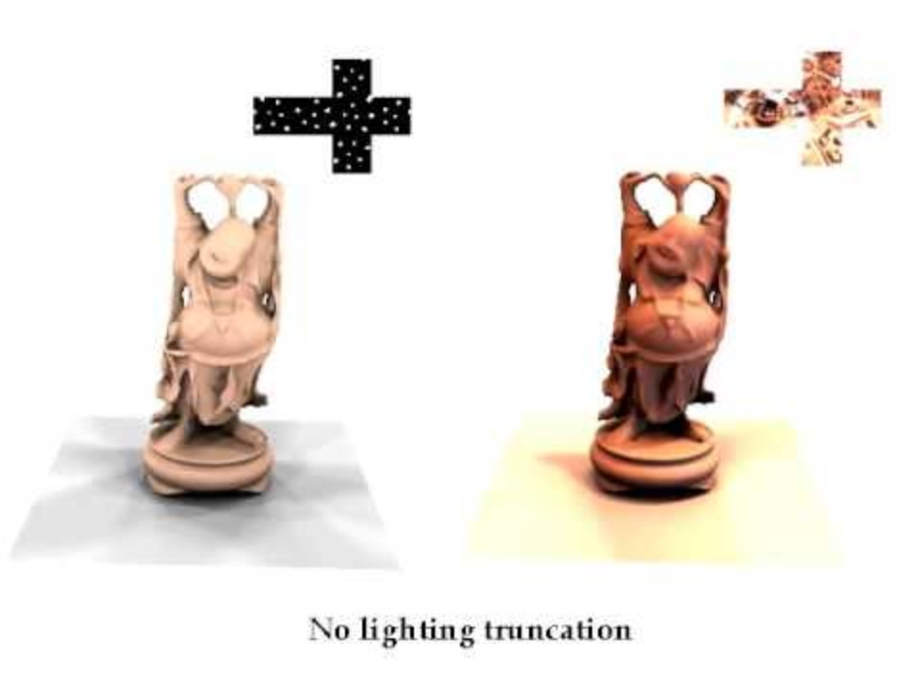
All-Frequency Shadows with Haar Wavelets

Slide 24
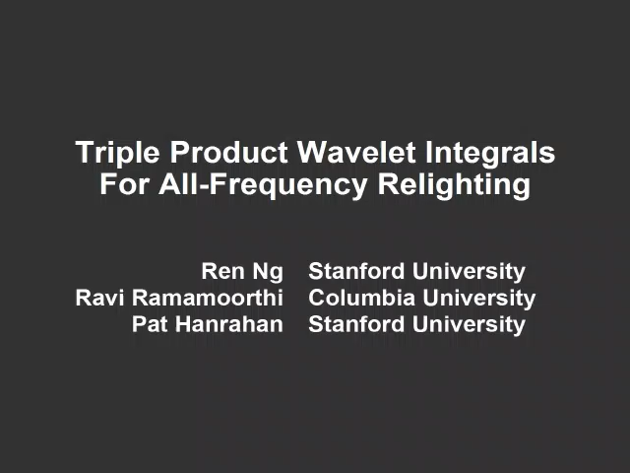
Direct Illumination with Haar Wavelets

Slide 25
How can we compress PRT vectors?
Assume we have dense PRT matrices.
Example: using clustered PCA to represent a signal of normals on surface
Combination of two things: PCA and vector quantization
Slides borrowed from Peter-Pike Sloan’s CPCA slides (2003)

Slide 26
Compressing a Signal of Normals
Left: signal of normals
1D normals represented as angle on a circle
Slides borrowed from Peter-Pike Sloan’s CPCA slides (2003)

Slide 27
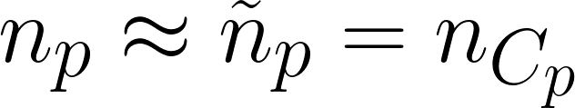
VQ: signal, not spatial
Slides borrowed from Peter-Pike Sloan’s CPCA slides (2003)
Notes:
Vector quantization is a simple but common compression technique. It groups the signal into a small number of clusters of similar samples, 3 in this example.
These similarities are based on the spread of the data values themselves, and not the locations.

Slide 28
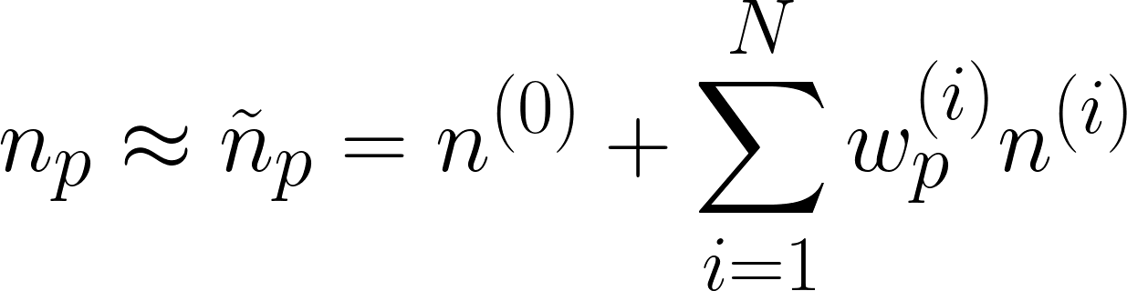
PCA: spatial, but global signal
Slides borrowed from Peter-Pike Sloan’s CPCA slides (2003)
Notes:
Principal component analysis is another common compression technique.
Given a signal in some high dimensional space, PCA computes an optimal lower dimensional linear approximation to the signal, in a least squares sense.
This is done by computing the mean of the signal, and a set of basis vectors.
In this case we are projecting the signal from 2D down to a single line. Each sample is then replaced by its projection coefficients in this new basis.
While the signal is a 1D manifold, it is clearly not globally linear.
But a linear approximation *is* appropriate locally – on the circle the tangent is a good local approximation to the signal.

Slide 29
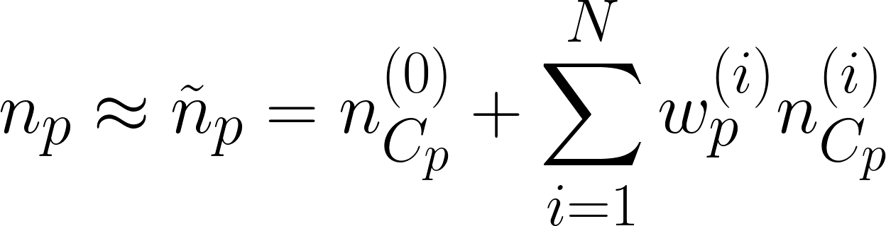
Clustered PCA: Combine both!
Slides borrowed from Peter-Pike Sloan’s CPCA slides (2003)

Slide 30
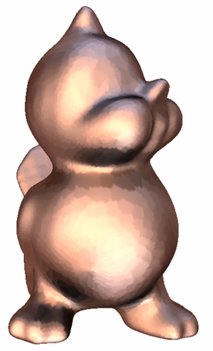
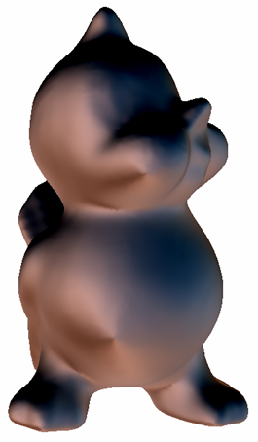
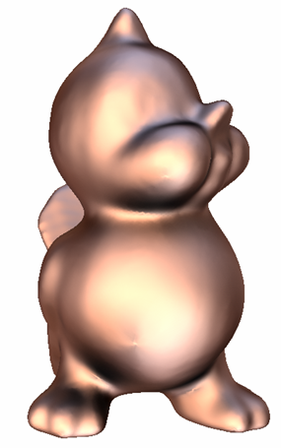
Clustered PCA
VQ
PCA
CPCA
Slides borrowed from Peter-Pike Sloan’s CPCA slides (2003)
Notes:
Here we see quality obtained when a bird model is rendered at equal frame rates using 3 compression techniques.
With VQ, piecewise-constant reconstruction artifacts are apparent.
This signal is clearly not represented well with global PCA – there is substantial energy loss.
CPCA does a good job of approximating the signal, with fairly low error.

Slide 31
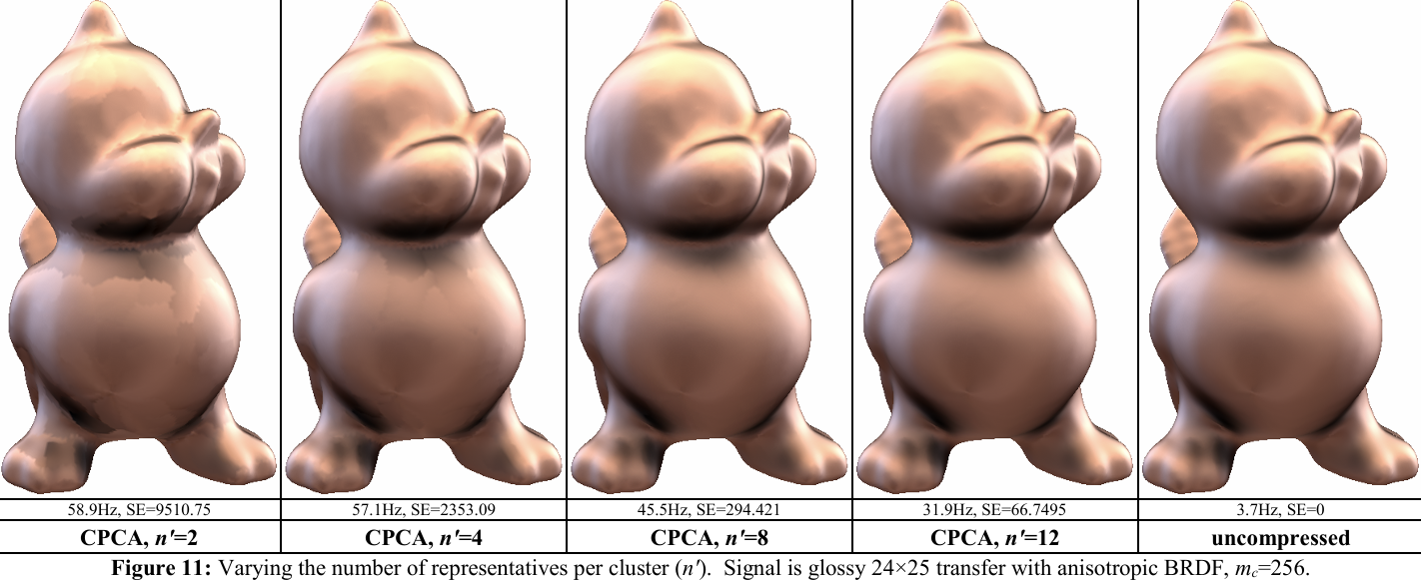
Glossy Precomputed Radiance Transfer
Just apply this to light transport matrices instead.
1D -> 625D (25 x 25)
Slides borrowed from Peter-Pike Sloan’s CPCA slides (2003)

Slide 32



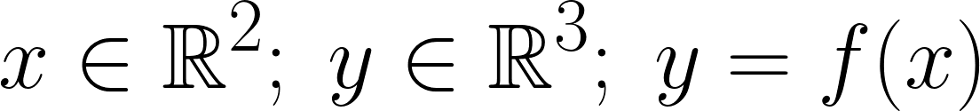
Cluster Discontinuity Problem
Blockwise PCA
Clustered PCA
[NNJ05]
[SHH03]
Slides borrowed from Ari Silvennoinen’s SIGGRAPH slides (2021)
Notes:
PCA bases are independent, which result in discontinuities between clusters
the clusters are independent, so the reconstruction model, it tries to obtain this image but it’s unable to do so because the clusters are not co-operating, or communicating with each other.

Slide 33
Approaching Cluster Discontinuity
Back to basics: any function can be expanded in terms of basis functions
PRT hinges on this to store each projection coefficient per vertex
But this basis decomposition may not be the best to compress.

Slide 34
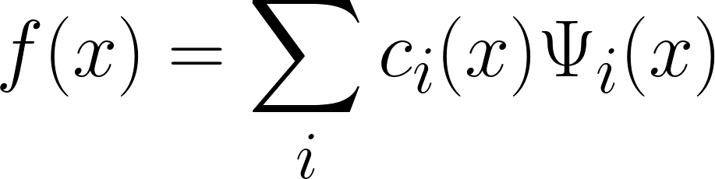
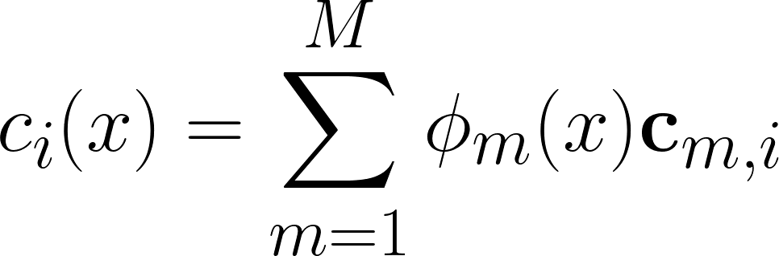
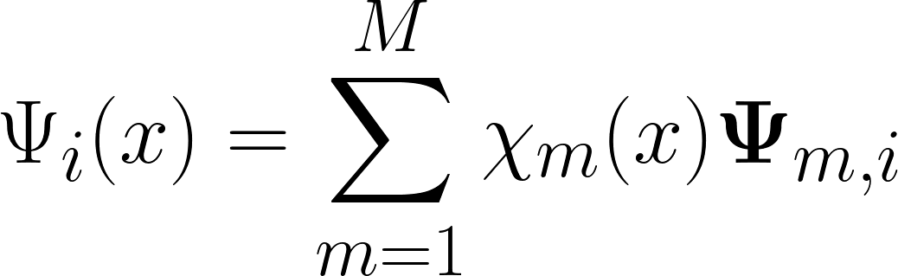
Solution: Moving Basis Decomposition
Just represent the projection coefficients themselves as functions of x!
These are both separately represented as a bilinear interpolation over a texture (so we maintain piecewise-continuity)
Notes:
This is called a moving basis because instead of having a fixed, global projection coefficient representation, we instead have different projection coefficients depending on where in space you are.
Essentially, we move the problem of combining spatial and data representations back to the fundamental definition of basis decomposition itself.

Slide 35

Solution: Moving Basis Decomposition
f(x)
ŷ(x)
φi(x)
χi(x)
Slides borrowed from Ari Silvennoinen’s SIGGRAPH slides (2021)
Notes:
This is called a moving basis because instead of having a fixed, global projection coefficient representation, we instead have different projection coefficients depending on where in space you are.
Essentially, we move the problem of combining spatial and data representations back to the fundamental definition of basis decomposition itself.

Slide 36
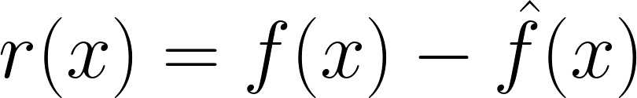
Moving Basis Decomposition for PRT
Densely sample the PRT matrices at each vertex
Use gradient descent or another optimization algorithm to learn two differentiable textures: one for coefficient and one for basis
Optimize over the reconstruction loss
End up with two piecewise-linear textures that can be smoothly interpolated anywhere.
Notes:
This is called a moving basis because instead of having a fixed, global projection coefficient representation, we instead have different projection coefficients depending on where in space you are.
Essentially, we move the problem of combining spatial and data representations back to the fundamental definition of basis decomposition itself.

Slide 37
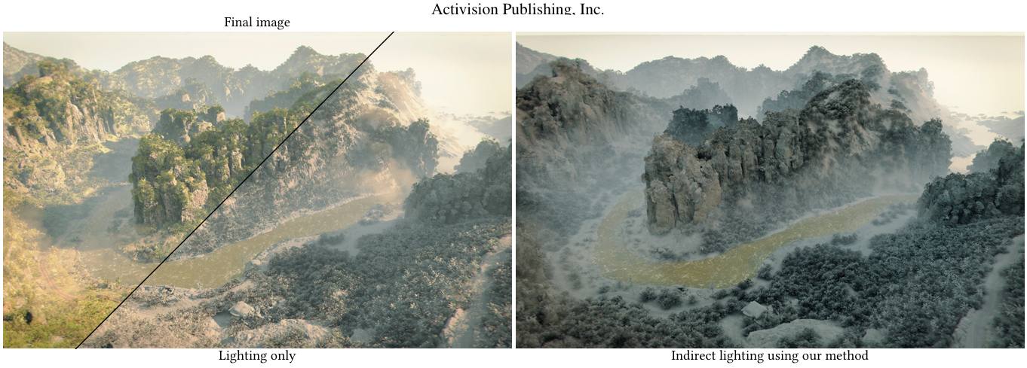
Large Scale PRT
Slides borrowed from Ari Silvennoinen’s SIGGRAPH slides (2021)
Notes:
PCA bases are independent, which result in discontinuities between clusters
the clusters are independent, so the reconstruction model, it tries to obtain this image but it’s unable to do so because the clusters are not co-operating, or communicating with each other.

Slide 38
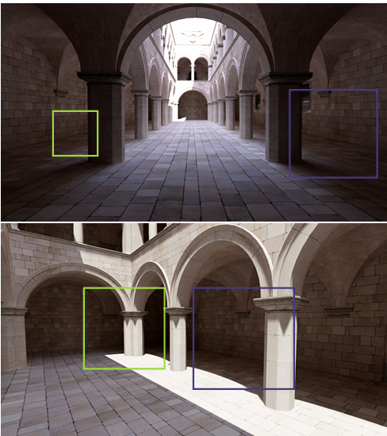
Hard to learn Glossy Elements
Moving Basis Decomposition is independent of the choice of PRT method used.
Traditional PRT technique; hard to implement glossy materials!
Other data-driven methods may have to be used.
Notes:
Moving Basis Decomposition is independent of the choice of PRT method used.
Meaning, to apply it to glossy materials, one has to discretize over viewing direction and sample densely.

Slide 39
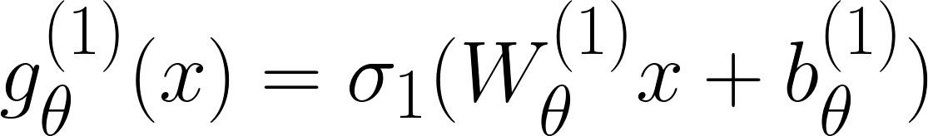
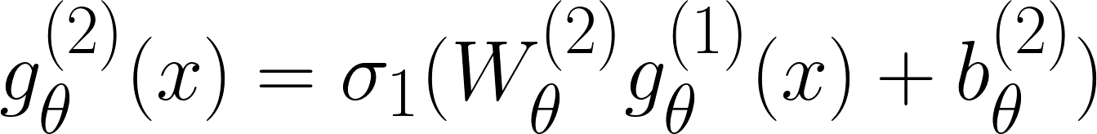
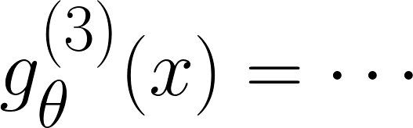
Neural Networks
Neural networks are a class of differentiable functions
Defined as a composition of affine transformations and nonlinearities
Universal function approximation
Notes:
Universal function approximation: An MLP of sufficient size can learn any possible function.

Slide 40
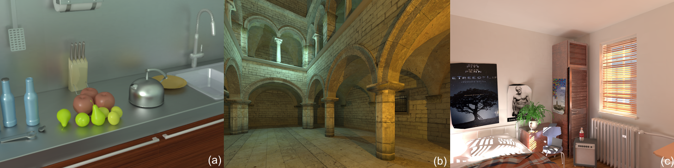
Neural Networks as PRT Regressors
Can we directly learn the view-dependent glossy transport by training a neural network directly?
Yes! (to an extent)
Peiran Ren, Jiaping Wang, Minmin Gong, Stephen Lin, Xin Tong, and Baining Guo. 2013. Global illumination with radiance regression functions. ACM Trans. Graph. 32, 4, Article 130 (July 2013), 12 pages. https://doi.org/10.1145/2461912.2462009
Notes:
Universal function approximation: An MLP of sufficient size can learn any possible function.

Slide 41
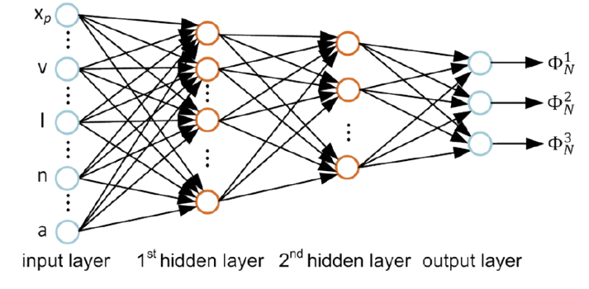
Radiance Regression Functions
How do we input an environment map to our network?
Hard: instead, just consider directional lights
Inputs to our neural network: view dir, light dir, position, normal, albedo
Peiran Ren, Jiaping Wang, Minmin Gong, Stephen Lin, Xin Tong, and Baining Guo. 2013. Global illumination with radiance regression functions. ACM Trans. Graph. 32, 4, Article 130 (July 2013), 12 pages. https://doi.org/10.1145/2461912.2462009
Notes:
Environment maps are hard to parameterize. Let’s approximate them with a bunch of directional lights.

Slide 42
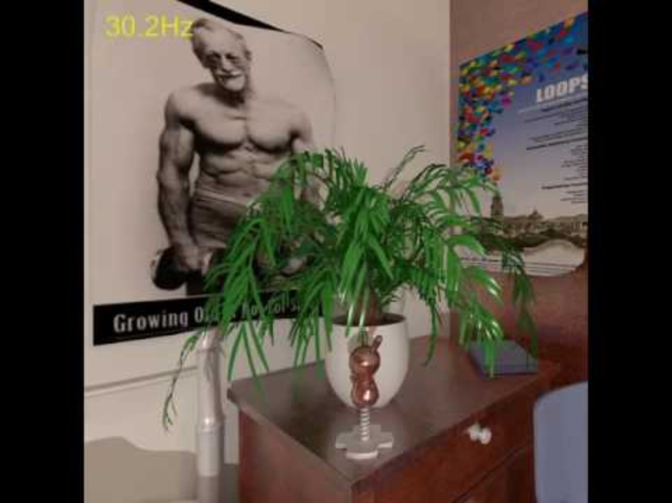
Radiance Regression Functions
Works well! Gets diffuse caustics and even gets glossy reflections too!
But it’s too slow to render a full environment.
Peiran Ren, Jiaping Wang, Minmin Gong, Stephen Lin, Xin Tong, and Baining Guo. 2013. Global illumination with radiance regression functions. ACM Trans. Graph. 32, 4, Article 130 (July 2013), 12 pages. https://doi.org/10.1145/2461912.2462009
Notes:
Universal function approximation: An MLP of sufficient size can learn any possible function.

Slide 43
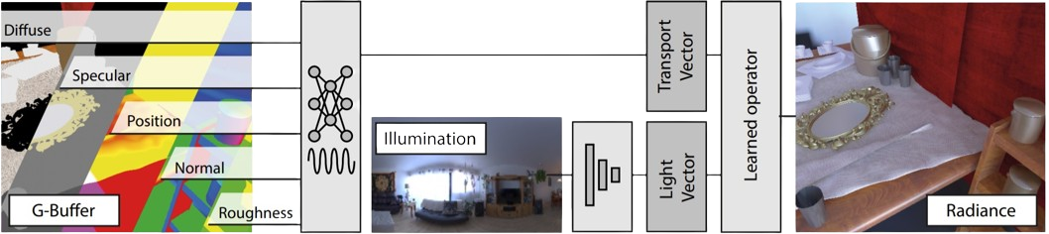
Neural Precomputed Radiance Transfer
Idea: encode the entire environment map as a learned neural feature vector.
Combine this with the G-buffer information via another learned operator to produce the final rendered color
Rainer, G., Bousseau, A., Ritschel, T. and Drettakis, G. (2022), Neural Precomputed Radiance Transfer. Computer Graphics Forum, 41: 365-378. https://doi.org/10.1111/cgf.14480
Notes:
This is a product of the environment and the lighting.

Slide 44
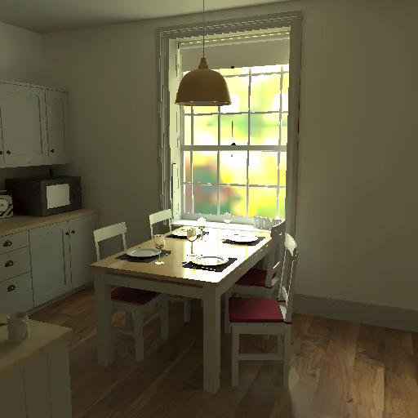
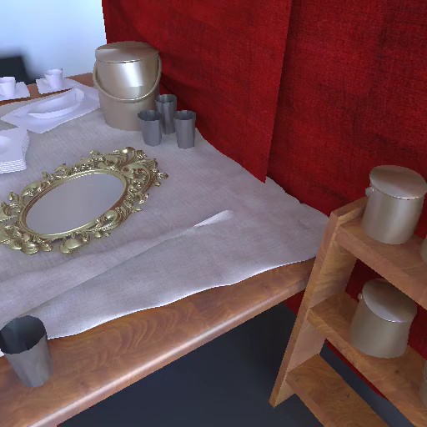
Neural Precomputed Radiance Transfer
This also produces good results!
Rainer, G., Bousseau, A., Ritschel, T. and Drettakis, G. (2022), Neural Precomputed Radiance Transfer. Computer Graphics Forum, 41: 365-378. https://doi.org/10.1111/cgf.14480
Notes:
This is a product of the environment and the lighting.

Slide 45
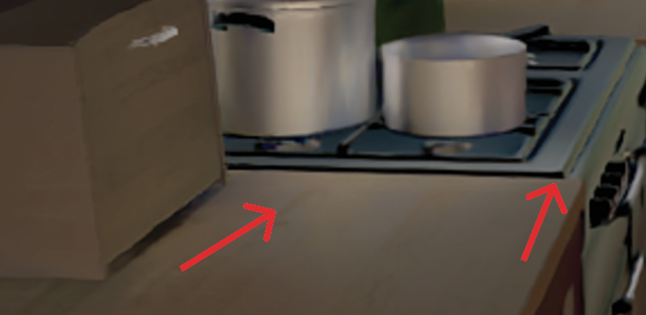

Neural Precomputed Radiance Transfer
However, this doesn’t generalize well to 1) novel environment maps, and 2) view directions far from training
Color shifts and other artifacts (lack of reflections) are seen
Raghavan, N., Xiao, Y., Lin, K.-E., Sun, T., Bi, S., Xu, Z., Li, T.-M. and Ramamoorthi, R. (2023), Neural Free-Viewpoint Relighting for Glossy Indirect Illumination. Computer Graphics Forum, 42: e14885. https://doi.org/10.1111/cgf.14885
Notes:
Left is NPRT, right is reference

Slide 46
Problems with Pure Neural Methods
Neural networks require a lot of data to generalize
For complex scenes, naïve sampling quickly becomes intractable
Could generalize better by reducing the complexity of the problem
But how do we do this?
Notes:
Left is NPRT, right is reference

Slide 47
Problems with Pure Neural Methods
Previous work has shown that wavelets give us high-frequency details while only a few are selected.
Exact lighting can be obtained via dot product.
What if we instead directly output wavelet coefficients instead of RGB/radiance values?
Notes:
Could this solve the two previous problems?

Slide 48

Direct Wavelet Output
This works much better at reducing color shifts from strange environments.
Raghavan, N., Xiao, Y., Lin, K.-E., Sun, T., Bi, S., Xu, Z., Li, T.-M. and Ramamoorthi, R. (2023), Neural Free-Viewpoint Relighting for Glossy Indirect Illumination. Computer Graphics Forum, 42: e14885. https://doi.org/10.1111/cgf.14885
Notes:
Could this solve the two previous problems?

Slide 49

Direct Wavelet Output
This also works for obtaining glossy indirect illumination at angles far from training!
Here, we see a glossy caustic on a reflective floor.
GT
Ours
NPRT
Raghavan, N., Xiao, Y., Lin, K.-E., Sun, T., Bi, S., Xu, Z., Li, T.-M. and Ramamoorthi, R. (2023), Neural Free-Viewpoint Relighting for Glossy Indirect Illumination. Computer Graphics Forum, 42: e14885. https://doi.org/10.1111/cgf.14885
Notes:
Could this solve the two previous problems?

Slide 50










Direct Wavelet Output
Direct Lighting
(From established methods)
2D Haar Transform
Indices of top K selection
Wavelet index 1
+
Wavelet index …
Denoiser
Wavelet index k
CP
MLP
Full Illumination
Index into feature grid with hit point
Dot Product
Normals, Roughness Reflected Directions
First Hit Position
Indirect Lighting
Raghavan, N., Xiao, Y., Lin, K.-E., Sun, T., Bi, S., Xu, Z., Li, T.-M. and Ramamoorthi, R. (2023), Neural Free-Viewpoint Relighting for Glossy Indirect Illumination. Computer Graphics Forum, 42: e14885. https://doi.org/10.1111/cgf.14885
Notes:
Could this solve the two previous problems?

Slide 51

Direct Wavelet Output
Raghavan, N., Xiao, Y., Lin, K.-E., Sun, T., Bi, S., Xu, Z., Li, T.-M. and Ramamoorthi, R. (2023), Neural Free-Viewpoint Relighting for Glossy Indirect Illumination. Computer Graphics Forum, 42: e14885. https://doi.org/10.1111/cgf.14885
Notes:
Could this solve the two previous problems?

Slide 52
Direct Wavelet Output
Raghavan, N., Xiao, Y., Lin, K.-E., Sun, T., Bi, S., Xu, Z., Li, T.-M. and Ramamoorthi, R. (2023), Neural Free-Viewpoint Relighting for Glossy Indirect Illumination. Computer Graphics Forum, 42: e14885. https://doi.org/10.1111/cgf.14885
Notes:
Could this solve the two previous problems?

Slide 53
Appearance Modelling

Slide 54

Disney BSDF
Recall: the Disney BSDF is a combination of GGX-based BSDFs that have metallic, sheen, clearcoat components, and more.
These material coefficients can be represented as a texture.
https://cseweb.ucsd.edu/~tzli/cse272/wi2024/homework1.pdf
Notes:
From left to right: basecolor,normals,height,roughness,andmetalliccomponents.

Slide 55




SVBRDFs
Spatially-varying BRDF (usually associated with Disney BSDF)
Notes:
From left to right: basecolor,normals,height,roughness,andmetalliccomponents.

Slide 56
Measured vs Analytic BRDFs
Analytic BRDF: model.
Statistical ensemble of explicit functions with certain parameters
Many are microfacet, but don’t have to be
Measured BRDF: empirical dataset.
Obtained by physically sampling a real‐world material’s reflectance under many combinations of incoming/outgoing directions
Measured using a gonioreflectometer
Measurements are taken on a regular grid in elevation (θ) and azimuth (φ)
Notes:
(roughness, diffuse, specular, etc)

Slide 57
Measured vs Analytic BRDFs
Analytic BRDF: model.
Statistical ensemble of explicit functions with certain parameters
Many are microfacet, but don’t have to be
Measured BRDF: empirical dataset.
Obtained by physically sampling a real‐world material’s reflectance under many combinations of incoming/outgoing directions
Measured using a gonioreflectometer
Measurements are taken on a regular grid in elevation (θ) and azimuth (φ)
Notes:
(roughness, diffuse, specular, etc)

Slide 58

Gonioreflectometers
Notes:
(roughness, diffuse, specular, etc)

Slide 59

Measured vs Analytic BRDFs
Analytic BRDFs are way faster to compute
Not necessarily realistic, but look good enough
Measured BRDFs are exact, but expensive to store and expensive to look up
Also dependent on the resolution of the measurements
Lots of research has gone into compressing these, or identifying them with analytic BRDFs
Tiancheng Sun, Henrik Wann Jensen, and Ravi Ramamoorthi. 2018. Connecting measured BRDFs to analytic BRDFs by data-driven diffuse-specular separation. ACM Trans. Graph. 37, 6, Article 273 (December 2018), 15 pages. https://doi.org/10.1145/3272127.3275026

Slide 60

MERL dataset
Dataset of 100 real-world measured BRDFs
https://cdfg.csail.mit.edu/wojciech/brdfdatabase

Slide 61
Bidirectional Texture Functions (BTFs)
Measured BRDFs have two constraints:
Helmholtz reciprocity: switching the light and view directions gives the same result
Completely flat surface
But real-world materials almost never follow these constraints!
Have lots of holes or bumps or ridges
Subsurface scattering, other meso-scale effects
BTF: Bidirectional Texture Function
Generalization of measured BRDF: dataset but without these constraints
Captured the same way as a normal BRDF

Slide 62
Classical BTF Compression
Traditionally, methods like CPCA have been used to compress BTFs.
Matrix factorization (SVD) and low-rank storage
Wavelets + dithering and quantizing
Interpolation generally only done in position-space and not view- or lighting-space, causing significant artifacts.

Slide 63

BTF Compression: Learned Dictionary
By learning a dictionary of basis vectors, one can improve the classical methods by representing new BTFs as a sparse linear combination directly in 4 dimensions.
Kavoosighafi, B., Frisvad, J. R., Hajisharif, S., Unger, J., & Miandji, E. (2023). SparseBTF: Sparse representation learning for bidirectional texture functions. In T. Ritschel & A. Weidlich (Eds.), Eurographics Symposium on Rendering. The Eurographics Association. https://doi.org/10.2312/sr.20231123

Slide 64

BTF Compression: Neural Autoencoder
An autoencoder can directly compress measured BTF results.
Since neural networks are continuous, the measurements can be directly interpolated.
Rainer, G., Jakob, W., Ghosh, A., & Weyrich, T. (2019). Neural BTF compression and interpolation. Computer Graphics Forum, 38(4), [pages not specified]. https://doi.org/10.1111/cgf.13633
Notes:
However, artifacts due to underconstrained VAE

Slide 65

BTF Compression + Parallax: NeuMIP
Combine the auto-decoder framework with parallax mapping using two neural networks
Also works really well!

Slide 66

Image-to-Material: Ill-posed problem
Is it possible to get a full material with specular/diffuse properties and complex meso-scale patterns from just a single image
This is a significantly ill-posed problem
Powerful neural generative methods are required

Slide 67
Generative Models
These are machine learning models that learns a joint probability distribution of the input and the output
Basically, learn the underlying patterns and distributions of data to generate new, similar data
Many architectures have been used for these purposes
Generative Adversarial Networks
Diffusion-based models

Slide 68
Generative Networks Model SVBRDFs
The most straightforward thing to try would be to model an analytic SVBRDF as a set of textures
Parameters of a Disney or GGX-based BRDF
Then, output these directly via a GAN- or diffusion-based model
No different than outputting regular images
These work well but could be better.
Textures are generally not pixel-aligned or tileable
Also miss a lot of mesoscale patterns

Slide 69

Generative Networks Model SVBRDFs
Vecchio, G., Sortino, R., Palazzo, S., & Spampinato, C. (2024). MatFuse: Controllable material generation with diffusion models. In Proceedings of the IEEE/CVF Conference on Computer Vision and Pattern Recognition (CVPR) (pp. 4429–4438).

Slide 70

Generative Networks Model SVBRDFs
Condition
SVBRDF maps
Vecchio, G., Sortino, R., Palazzo, S., & Spampinato, C. (2024). MatFuse: Controllable material generation with diffusion models. In Proceedings of the IEEE/CVF Conference on Computer Vision and Pattern Recognition (CVPR) (pp. 4429–4438).

Slide 71
Could Generative Nets Output Differently?
Representing the material as an analytic SVBRDF works, but is limiting.
Could it be possible to represent these with BTFs?
After all, NeuMIP itself outputs textures decoded with neural networks!
Problem: Can NeuMIP be extended to work universally?

Slide 72



Universal NeuMIP
Previous methods could generally only handle a single BTF for compression and interpolation.
However, NeuMIP, despite its simplicity, is robust enough to be able to handle a significant range of materials with complex diffuse and specular properties.

Slide 73

Generative Training on NeuMIP Textures
Since we showed that a universal NeuMIP can work, we can now generate the textures by applying a diffusion model.
Similar to Stable Diffusion training – but with material textures instead of images

Slide 74

Generative BTF Results
Due to pixel-based training (instead of latent), and power of universal NeuMIP-based decoder, we can take real captures and send them to BTFs!

Slide 75

Generative BTF Results
Due to pixel-based training (instead of latent), and power of universal NeuMIP-based decoder, we can take real captures and send them to BTFs!

Slide 76

Generative BTF Results
It can even support text to BTF directly.

Slide 77

Generative BTF Results
It can even support text to BTF directly.

Slide 78
Thank you!

