Slide 1




Computer Graphics II: Rendering
CSE 168 [Spr 26], Lecture 8: Indirect Lighting Details Ravi Ramamoorthi
http://viscomp.ucsd.edu/classes/cse168/sp26

Slide 2
To Do
Homework 2 (Direct Lighting) due today!!
Homework 3 (Path Tracer, Indirect Lighting) May 5
Assignment is on edX edge
START EARLY
This lecture goes through details of indirect lighting, Monte Carlo path tracing for the assignment
Ask re any questions

Slide 3
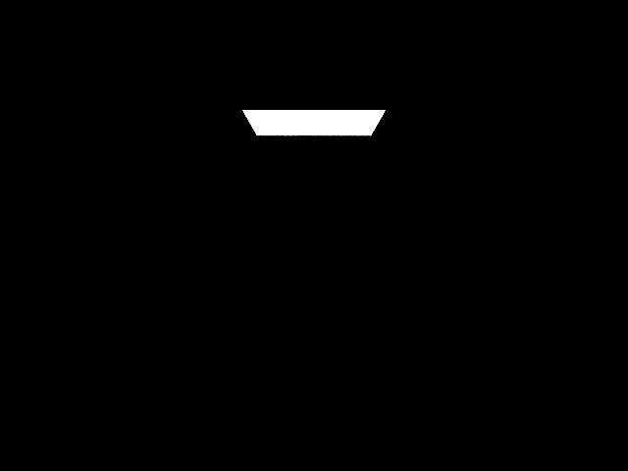
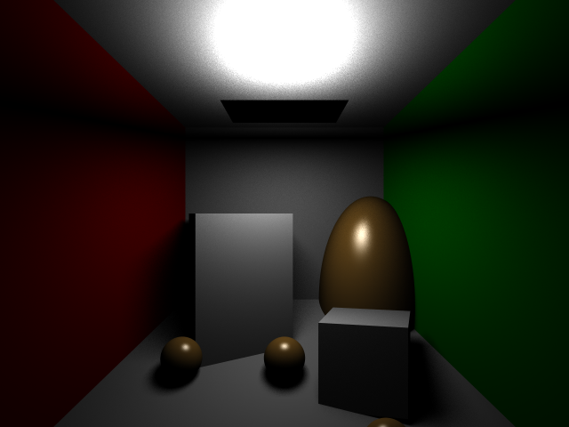
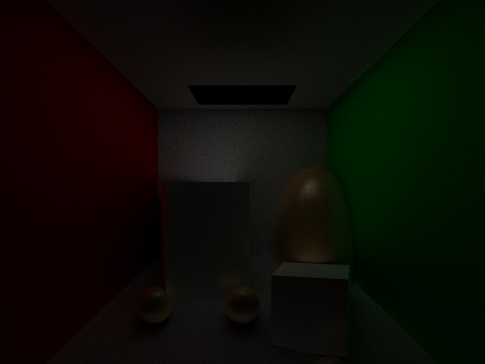
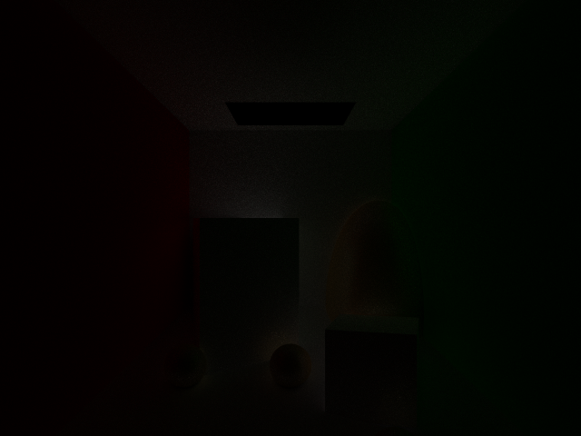
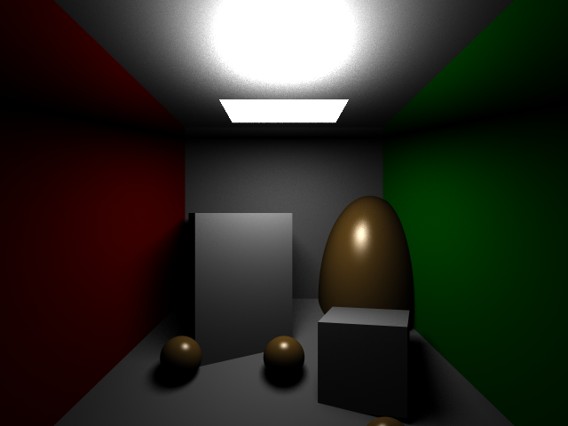
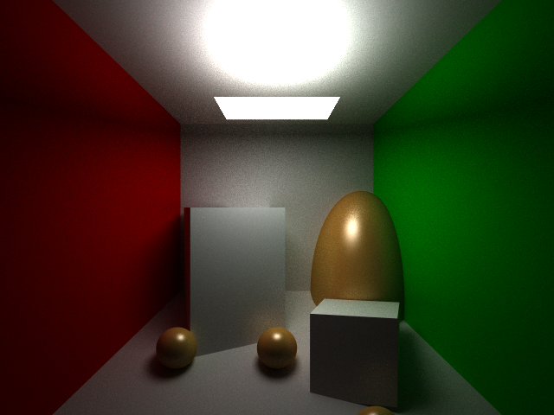
Indirect Lighting
Core of path tracing, global illumination
Supports multiple bounces of light, color bleeding
General paths, general visual effects
Light Source (0 bounces)
Direct Lighting (1 bounce)
Indirect Lighting (2 bounces)
Indirect Lighting (3 bounces)

Slide 4
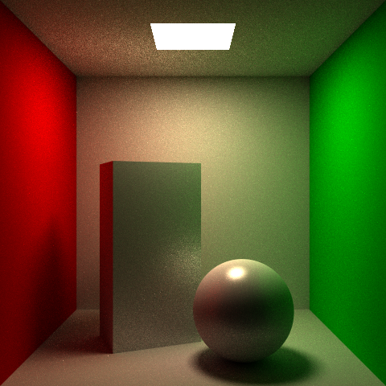
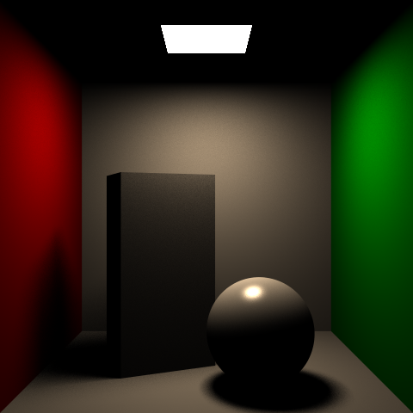
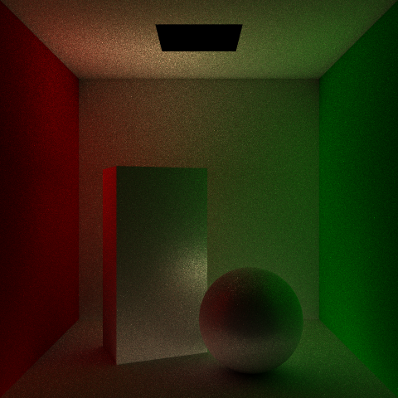
Indirect Lighting
Core of path tracing, global illumination
Supports multiple bounces of light, color bleeding
General paths, general visual effects
Full Scene
Direct Lighting
Indirect Lighting

Slide 5
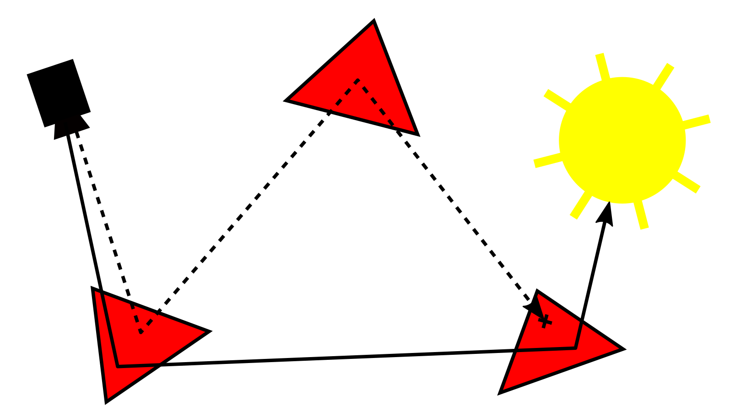
Indirect Lighting
Core of path tracing, global illumination
Supports multiple bounces of light, color bleeding
General paths, general visual effects

Slide 6
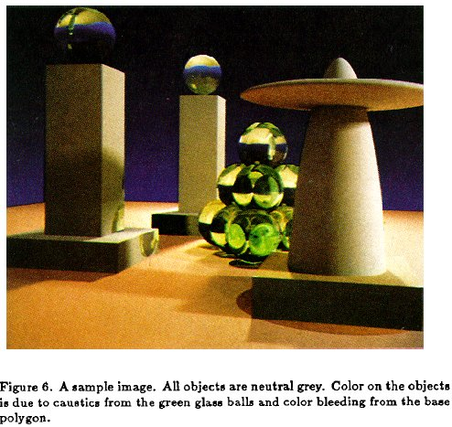
Rendering Equation (Kajiya 86)
Paper introduced rendering equation, path tracing, importance sampling still used today

Slide 7
Reflection Equation
Replace sum with integral
Reflected Light
(Output Image)
Emission
Incident
Light (from
light source)
BRDF
Cosine of
Incident angle

Slide 8
Rendering Equation
Surfaces (interreflection)
Reflected Light
(Output Image)
Emission
Reflected
Light
BRDF
Cosine of
Incident angle
UNKNOWN
KNOWN
UNKNOWN
KNOWN
KNOWN

Slide 9
Rendering Equation
Assignment: slight change in notations
Monte Carlo estimator (hemisphere, not area light)
  Randomly generate sample on hemisphere (total 2π steradians)
Not ideal; each L_{r} call recursively estimated
  Can lead to exponential growth in samples, termination condition
  Set fixed depth D = 5 to guarantee termination for now
Instead, consider single path without splitting
  N = 1 after primary visibility or first bounce (all N for first bounce)
  Actually render N images, average (Single path vs “bushy tree”)

Slide 10
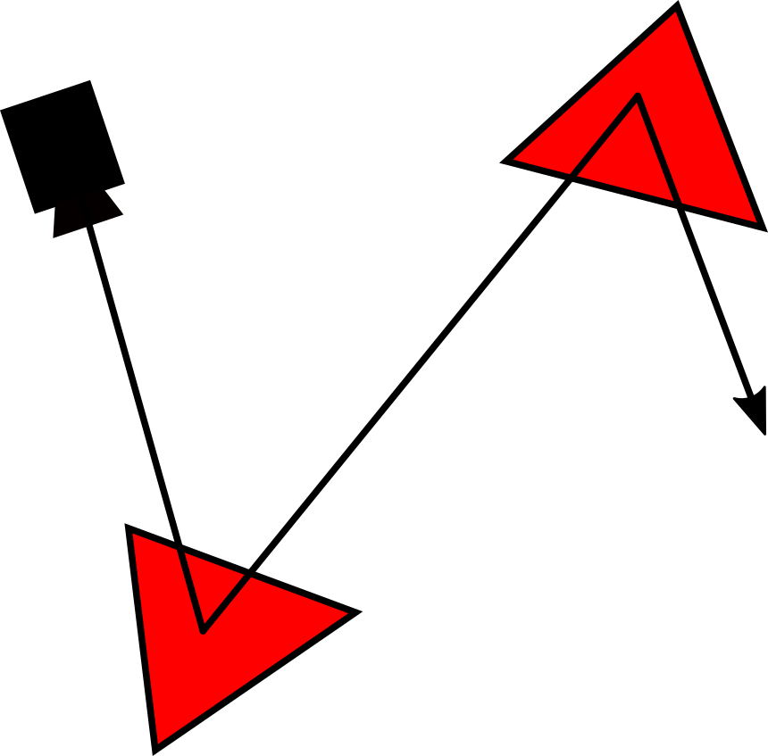
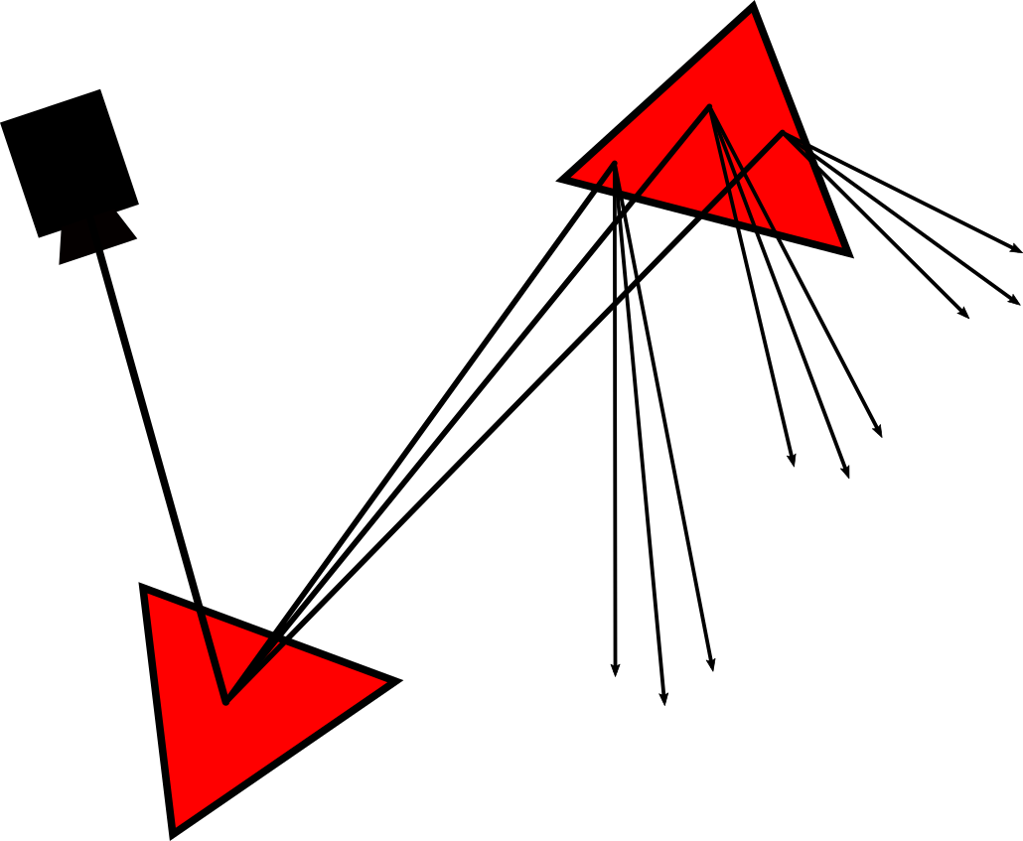
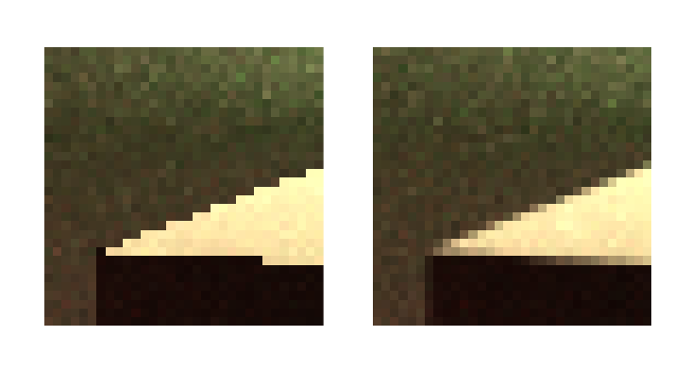
Path Construction
Single path vs bushy tree
  Conceptually simplest to render N 1-sample images
  And then average them
Antialiasing within pixel for “free” (consider pixel having unit area, jitter ray in that, instead of shooting through midpoint)

Slide 11
Sampling Upper Hemisphere
Uniform directional sampling: how to generate random ray on a hemisphere?
Option #1: rejection sampling
  Generate 3 random numbers (x,y,z), with x,y,z in –1..1
  If x²+y²+z² > 1, reject
  Normalize (x,y,z)
  If pointing into surface (ray dot n < 0), flip to -ray

Slide 12
Sampling Upper Hemisphere
Option #2: inversion method
  In polar coords, density must be proportional to sin θ (remember d(solid angle) = sin θ dθ dϕ)
  Integrate, invert ➔ cos⁻¹
Recipe is (start with two random numbers ξ_{1,} ξ₂ in 0…1)
  Generate ϕ in 0..2π ϕ=2πξ₂
  Generate z in 0..1 z=ξ₁
  Let θ = cos⁻¹ z θ=acos(ξ₁)
  (x,y,z) = (sin θ cos ϕ, sin θ sin ϕ, cos θ)
Rotate according to surface normal (z goes to normal)
  Normal is (α,β) with α = acos(n_{z}) and β=atan2(n_{y,}n_{x})
  Rotation matrix R = R_{z}(β)R_{y}(α) then do R*(x,y,z)

Slide 13
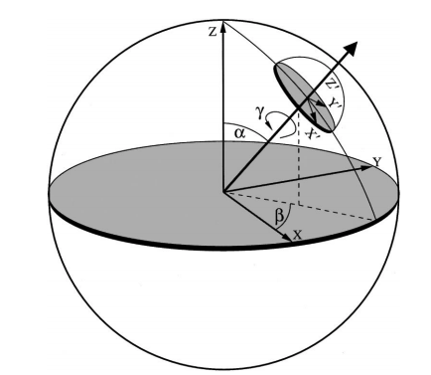
Sampling Upper Hemisphere
Two random numbers ξ_{1,} ξ₂ in 0…1
  Generate ϕ in 0..2π ϕ=2πξ₂
  Generate z in 0..1 z=ξ₁
  Let θ = cos⁻¹ z θ=acos(ξ₁)
  (x,y,z) = (sin θ cos ϕ, sin θ sin ϕ, cos θ)
Rotate according to surface normal (z goes to normal)
  Normal is (α,β) with α = acos(n_{z}) and β=atan2(n_{y,}n_{x})
  Rotation matrix R = R_{z}(β)R_{y}(α) then do R*(x,y,z)

Slide 14
Or Create Local Coordinate Frame
Simpler, may be useful for texture etc.
  Can use any one of 3 methods (rejection, rotation, coordinate frame but assignment spec coord. frame)
Associate w with normal (+z = n). Need u, v

Slide 15
Create Local Coordinate Frame
First, compute u,v,w to create orthonormal frame
  Vector a is arbitrary (use random or up vector)
  Be careful when a close to n, use alternative vector
Now, compute ray direction ω
  (x,y,z) are scalar coordinates; u,v,w are vectors above

Slide 16
Assignment so far (checkpoint 1)
Sample hemisphere at each bounce
  Evaluate full MC estimator with N = 1 for each ray
  Upto depth D = 5. Final ray D = 5 returns emit L_{e} only
  Most rays will actually be 0 (do not hit light source)
  Very inefficient, but render this, will improve on it next

Slide 17
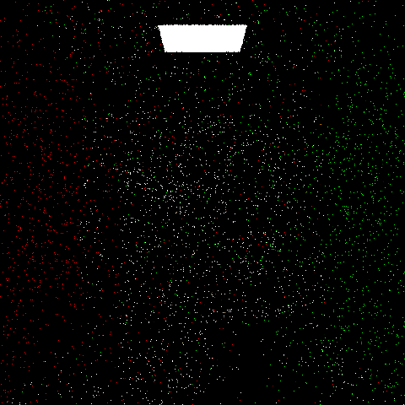
1 sample per pixel

Slide 18
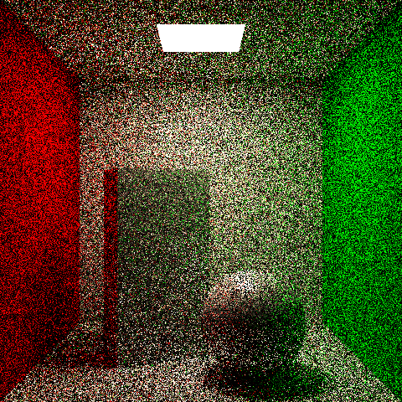
64 samples per pixel (may be slow)

Slide 19
Separating Direct/Indirect
Also called next event estimation (NEE)
Already know how to do direct (homework 2)
  By sampling/integrating area light source
  But vanilla path tracing previously is very inefficient
  Chance of hitting the light source is very small
So separate direct and indirect
  Estimate “next event” on light source for direct
  Focus energies on “hard” indirect light vs “easy” direct
Simplest of variance reduction methods
  Monte Carlo Path tracing always works, is gold standard
  But challenge is making it fast, removing noise

Slide 20
Separating Direct/Indirect
Formally split incident light at a point
Reflected light has emission, direct, indirect
Emission is easy, and we already know direct
Indirect is now evaluated by path tracing

Slide 21
Separating Direct/Indirect: Notes
Note that L_{o} above = L_{d} + L_{I} only(not L_{r}: no emission)
Implementation
  At each intersection in path tracer, execute direct lighting
    For simplicity, only one (unstratified) ray for each area light
    Ultimately, we will average many primary samples
  Add in emission where appropriate (light sources only)
  Execute indirect lighting above (randomly sample path)
  To avoid double counting, indirect rays don’t see emission
    If an indirect ray ever strikes a light source, terminate immediately
    Without accumulating the light source’s emission

Slide 22
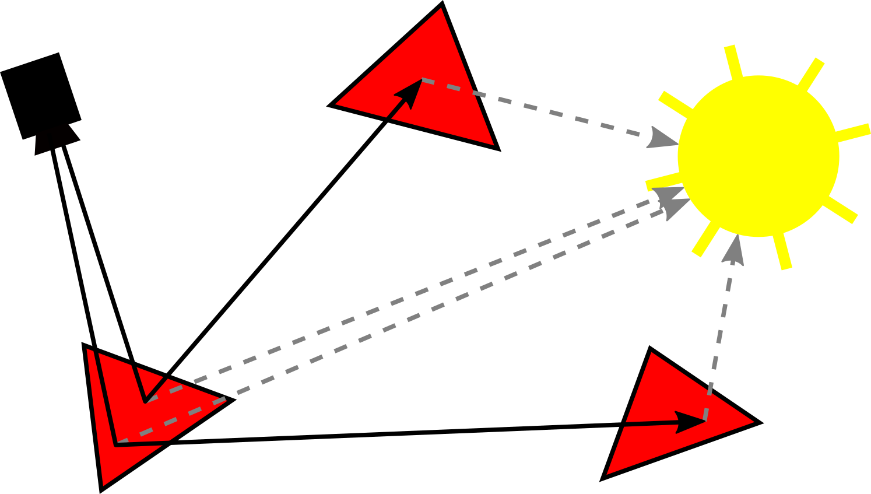
Implementation: Corner Cases
Emission from first intersected surface (light sources) should be added, but no emission on subsequent bounces
Since next event estimation / direct light effectively extends path by a bounce, trace indirect ray to depth D – 1
Render Cornell box 1 spp, 64 spp D = 5, single unstratified direct light sample per intersection

Slide 23
1 sample per pixel (no NEE)

Slide 24
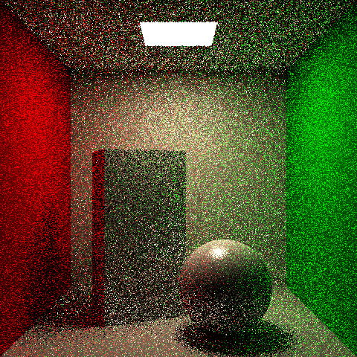
1 sample per pixel (with NEE)

Slide 25
64 samples per pixel (without NEE)

Slide 26
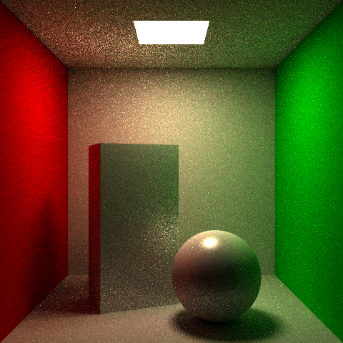
64 samples per pixel (with NEE)

Slide 27
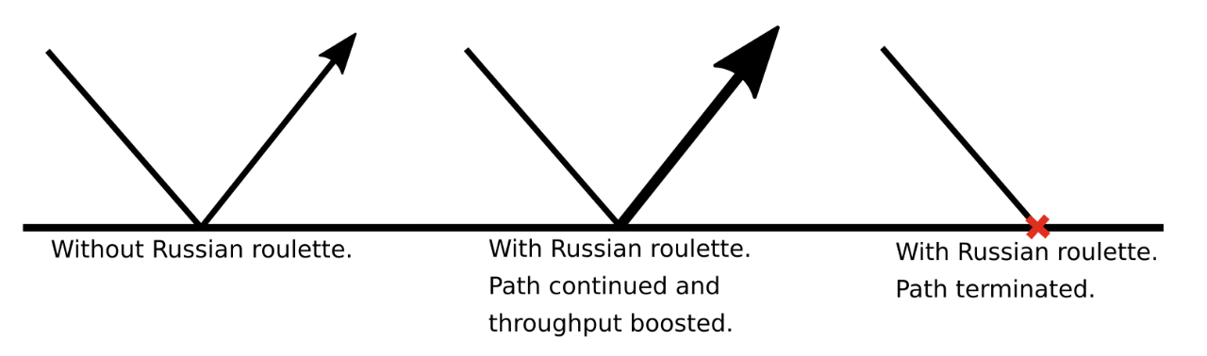
Russian Roulette
Clipping to fixed depth D undesirable
  Leads to bias, some complex paths need high D
  Continue ray even when throughput is very small
  In practice, rays may terminate if exit scene, but this can’t formally be guaranteed (hall of mirrors, closed box)
Russian roulette unbiased at infinite depth
  Terminate (probabilistically) low throughput paths
  Increase energy of paths kept alive

Slide 28
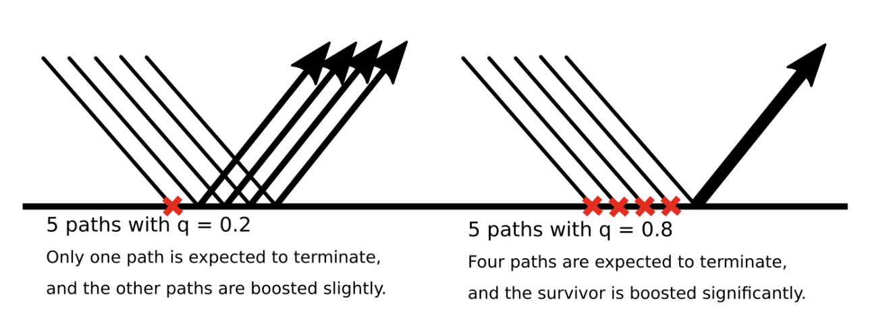
Russian Roulette Termination
Terminate path with some probability q
  If terminated, obviously throughput is 0
  If left alive, multiply (boost) throughput T by 1/(1-q)
  Create fewer higher-energy paths (e.g. if q = 0.1, 10 equal paths reduces to 9 (expected) each 10/9 energy. If instead q = 0.9, reduce to 1 path with 10 times energy)
  Keep total energy constant, unbiased (0*q + (1-q)/(1-q))
  Probability q controls how aggressive termination (depends on throughput, can increase variance)

Slide 29
Choosing Probability
Choose probability q inversely on throughput
Russian Roulette applied (only) in indirect
  Determine direct (and emission on first bounce) as usual (no boosting or termination is applied)
  Then find throughput for ray so far (BRDF, cosine, 2π terms product each bounce), pick random number in 0…1
    If number < q terminate (no indirect ray is shot)
    Otherwise, boost throughput by 1/(1-q), shoot indirect

Slide 30
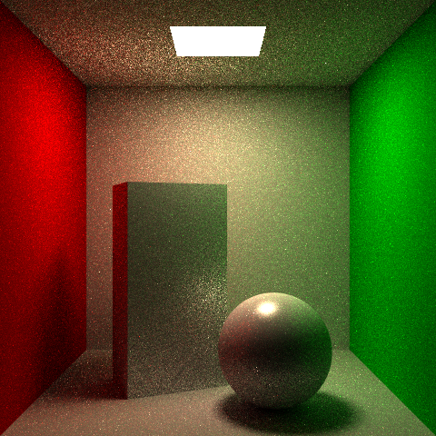
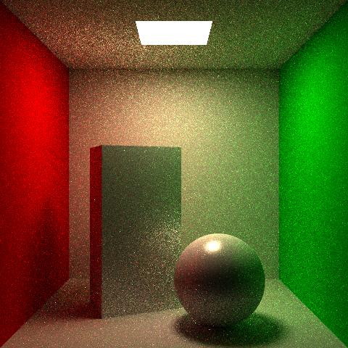
Russian Roulette Images
D = 5, 16 samples
D = infinity, 16 samples

