Slide 1




Computer Graphics II: Rendering
CSE 168[Spr 26],Lecture 14: Environment, Texture Maps Ravi Ramamoorthi
http://viscomp.ucsd.edu/classes/cse168/sp26

Slide 2
To Do
Start working on final projects (initial results and proposal due in < 2 weeks). Ask me if problems
Adding HDR/Envmaps (this lecture) may be one component of the final project
Will briefly also talk about texture mapping

Slide 3

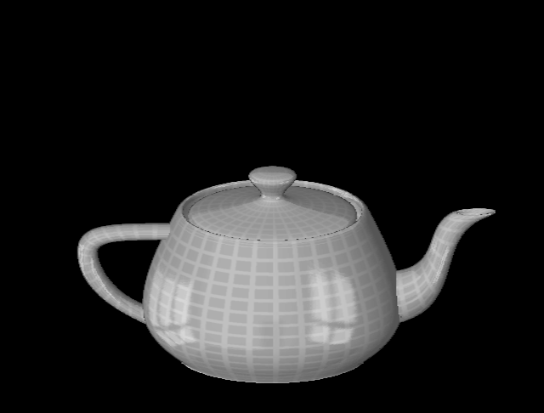
Reflection Maps
Blinn and Newell, 1976

Slide 4
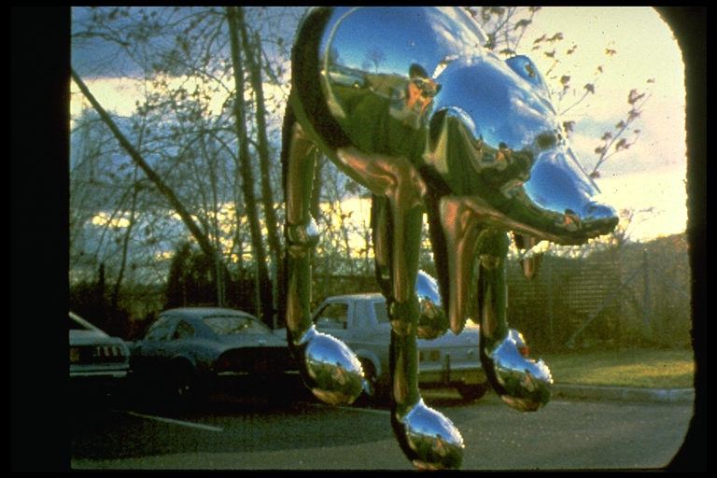
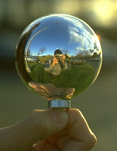
Environment Maps
Miller and Hoffman, 1984

Slide 5
Using Environment for Reflection Map
Simplest: Mirror reflections (refraction)
  Start with a simple ray tracer
  Reflected ray traced to environment (is emission/color)
  Color += reflectivity * Color of reflected ray
  Directly use envmap if miss geometry, otherwise recurse
  (As opposed to zeroing reflections if miss geometry)
  Easy to do in ray tracer. For path tracer, if reflected ray is sampled (BRDF has mirror component)
Reflected ray color look into envmap
Reflected ray color of object (recurse)

Slide 6
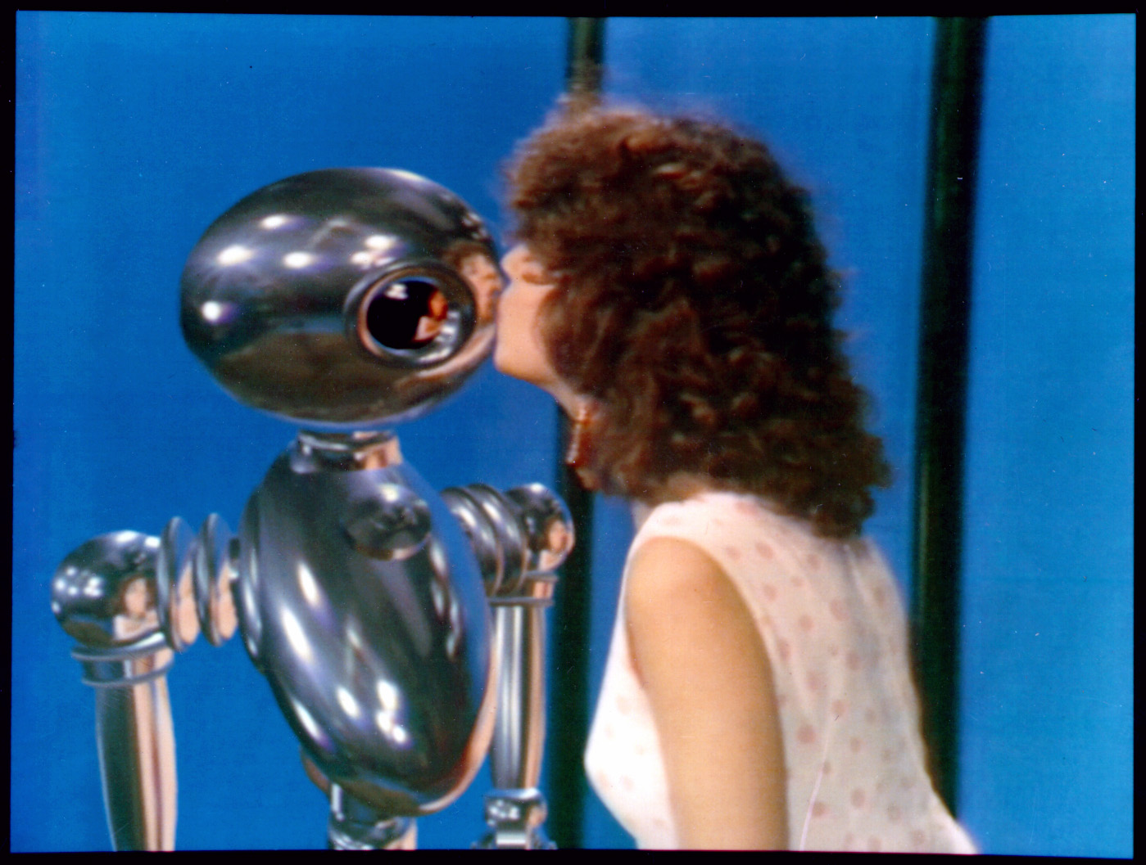
Environment Maps
Interface, Chou and Williams (ca. 1985)

Slide 7
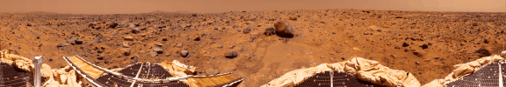
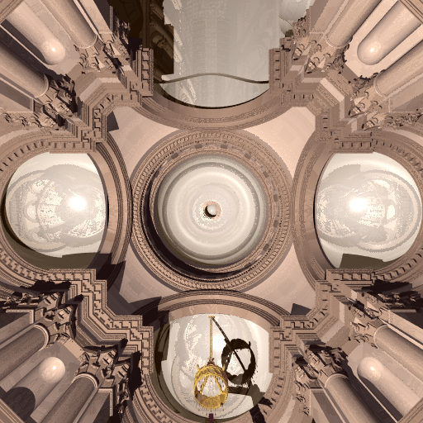
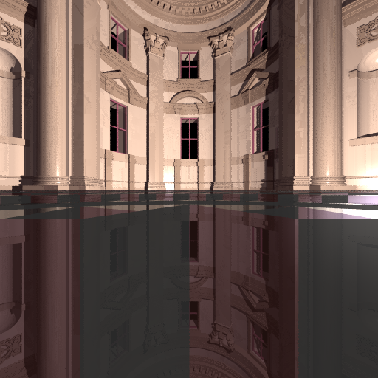
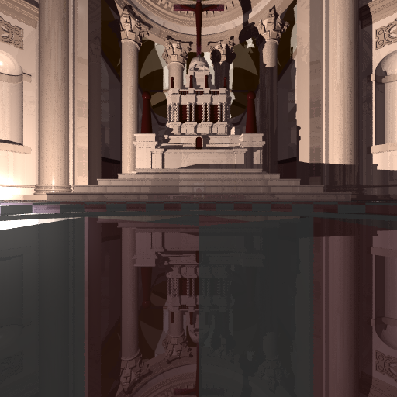
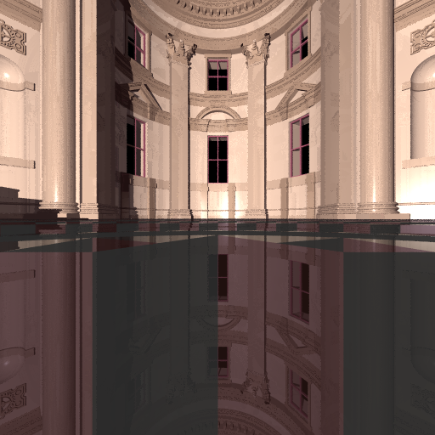
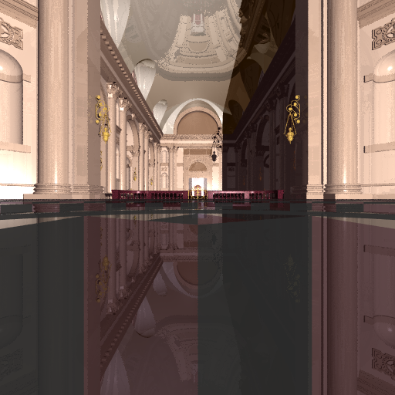

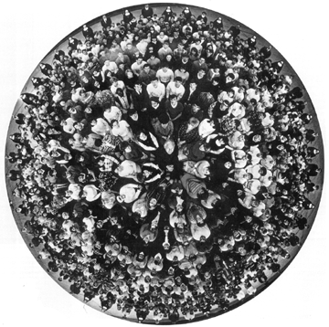
Environment Maps
Cylindrical Panoramas
180 degree fisheye
Photo by R. Packo
Cubical Environment Map

Slide 8
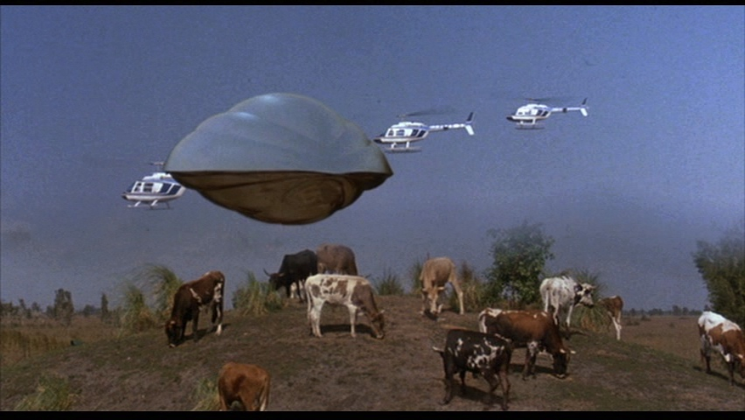
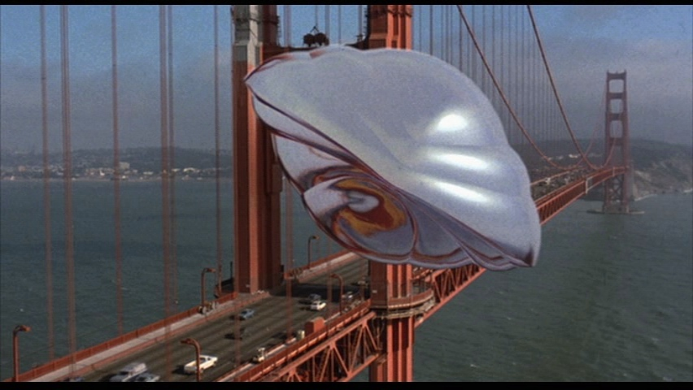
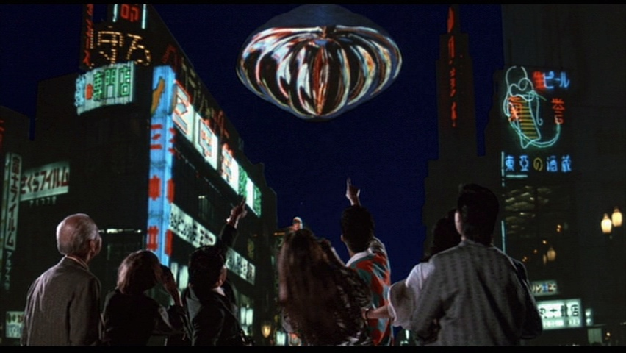
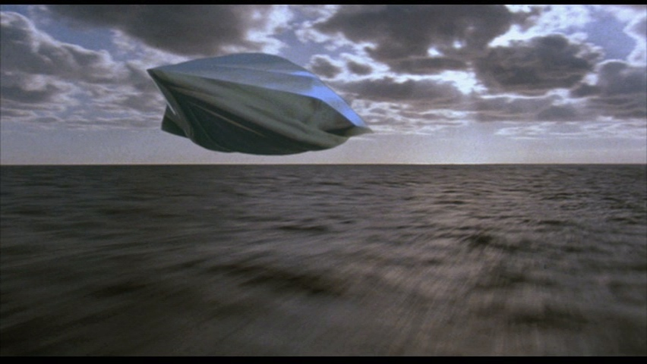
Reflection Maps in the Movies
From history, pauldebevec.com/ReflectionMapping
First movie, Flight of the Navigator 1986

Slide 9
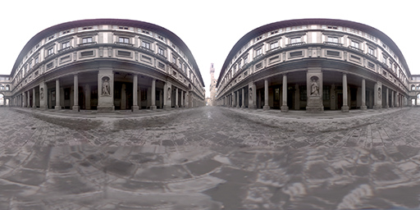
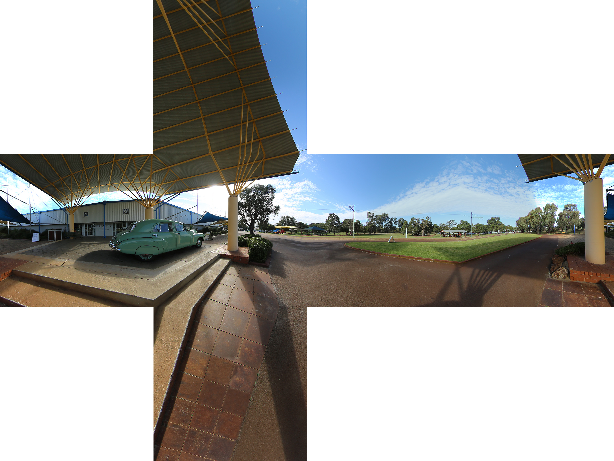
Environment Map Representations
Simplest lat-long spherical coords (θ,φ)
  Convert direction to spherical coords, direct lookup
Cubemaps popular (6 faces of cube)
  Take biggest (abs) of (x,y,z)
  Divide/renorm by it to get coords
  E.g. if +z, use x/z, y/z, z=+1
  Cubemap coord to vec: normalize
  Easy convert bet cube, latlong

Slide 10
High Dynamic Range
Ratio of brightest to darkest environment regions can be a million to 1. High Dynamic Range HDR
Acquiring (floating point) HDR envmaps is good
Tonemap as needed for display (large topic)
Accurate HDR values needed for accuracy
  When considering diffuse/specular BRDFs
  Tonemap mirror reflections, viewing environment
  Photograph a mirror ball with HDR or use many HDR envmaps found online
  See Debevec 97, 98 for discussion of HDR
  (HDR Imaging images from Wikipedia)

Slide 11
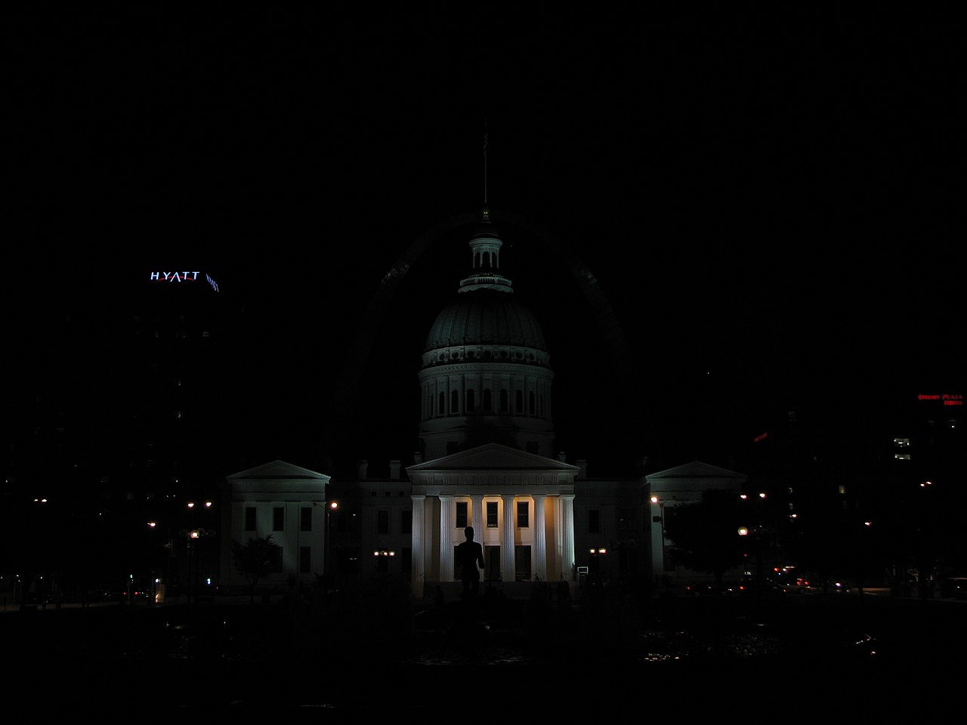
HDR Imaging

Slide 12
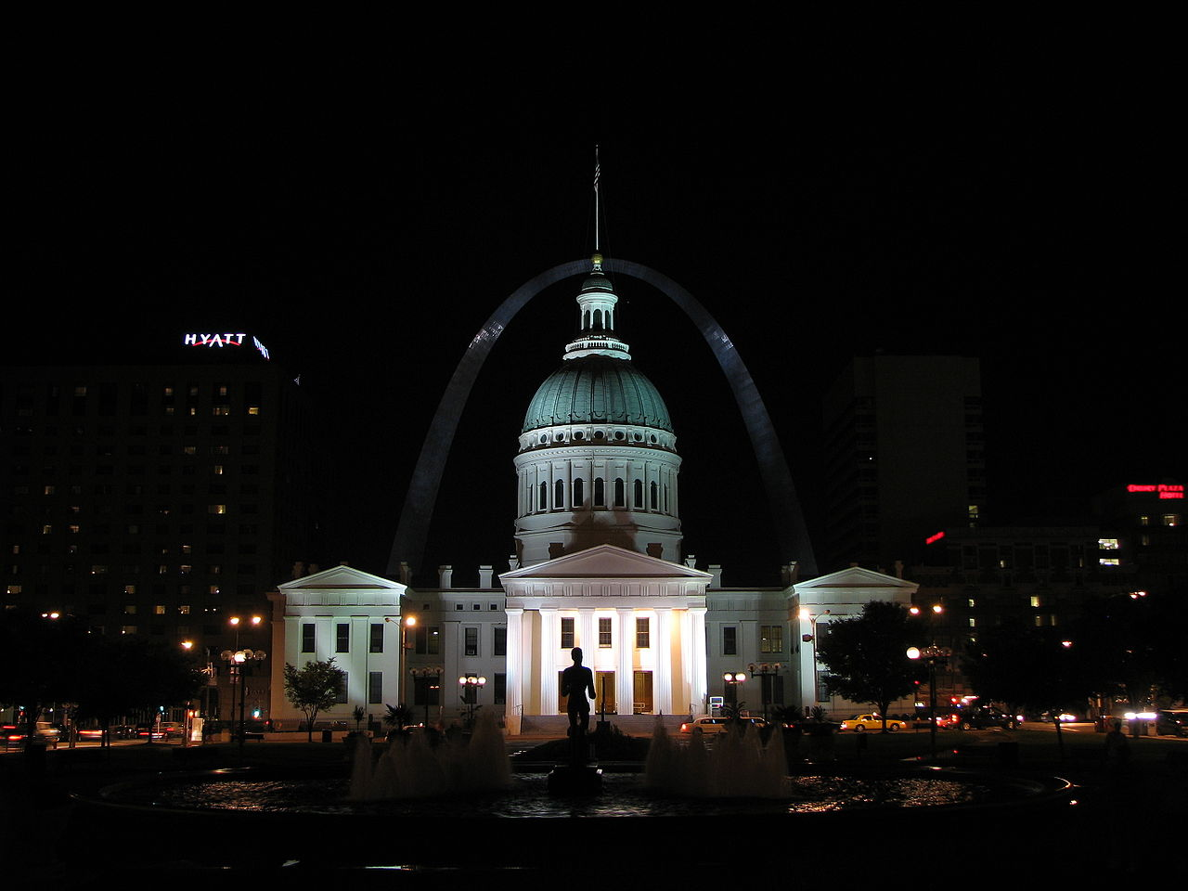
HDR Imaging

Slide 13
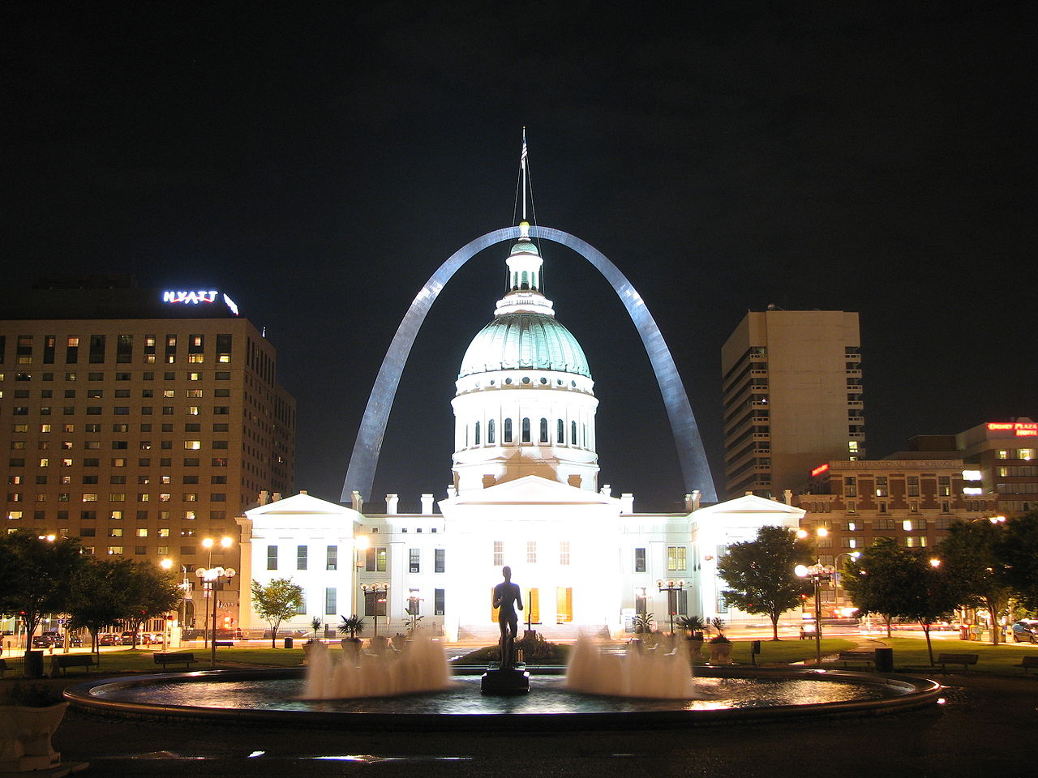
HDR Imaging

Slide 14
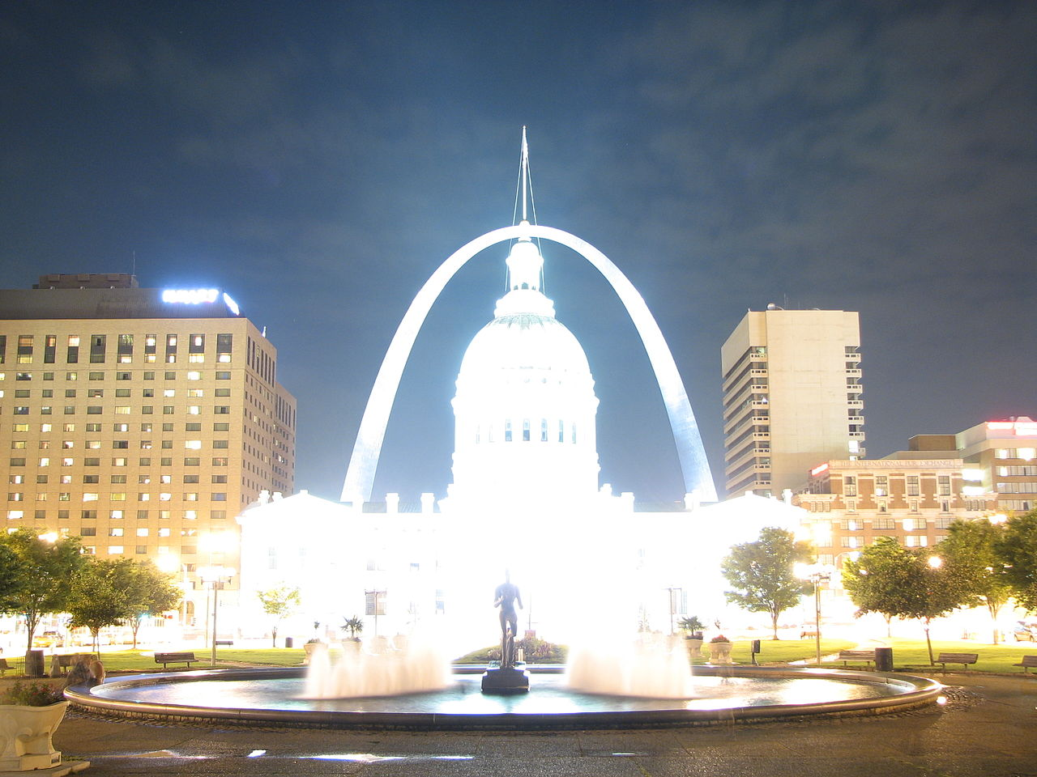
HDR Imaging

Slide 15
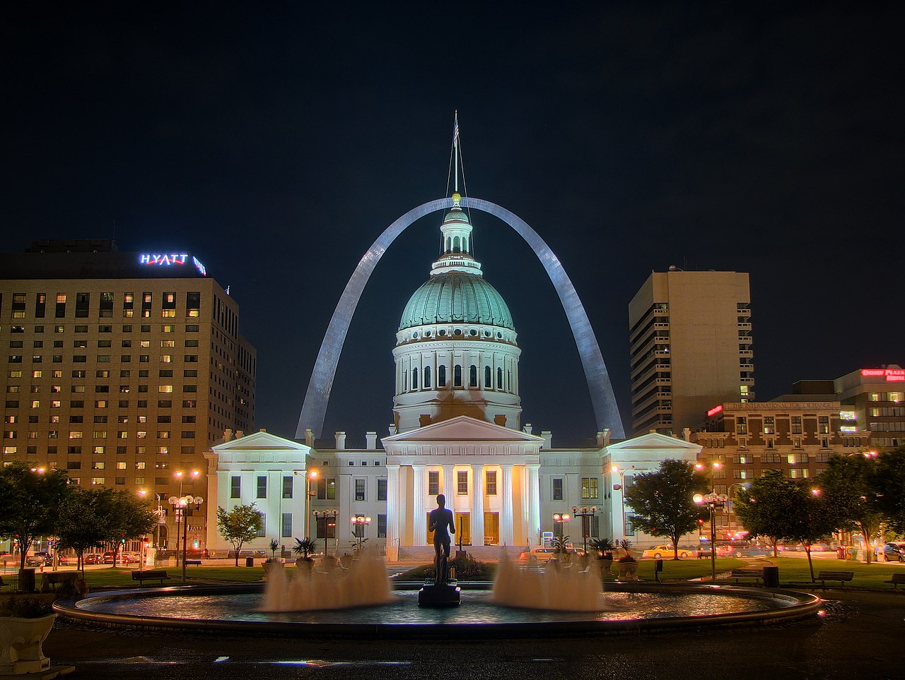
HDR Imaging

Slide 16
Environment Maps Generally
Mirror reflections good but not general
Can we render all effects with envmap?
Simple idea, envmap on large sphere around scene
  When path leaves scene, it hits envmap
  Consider emission (radiance) from given envmap pixel
  Significant noise/aliasing for high-frequency HDR envmaps (e.g. you may almost always miss the sun)
Challenge is we effectively have millions of lights
  Need to importance sample the environment map
  Effectively extend next-event estimation to envmaps
  Or identify bright lights (Debevec 98,99 asked undergraduates to trace this out manually!)

Slide 17
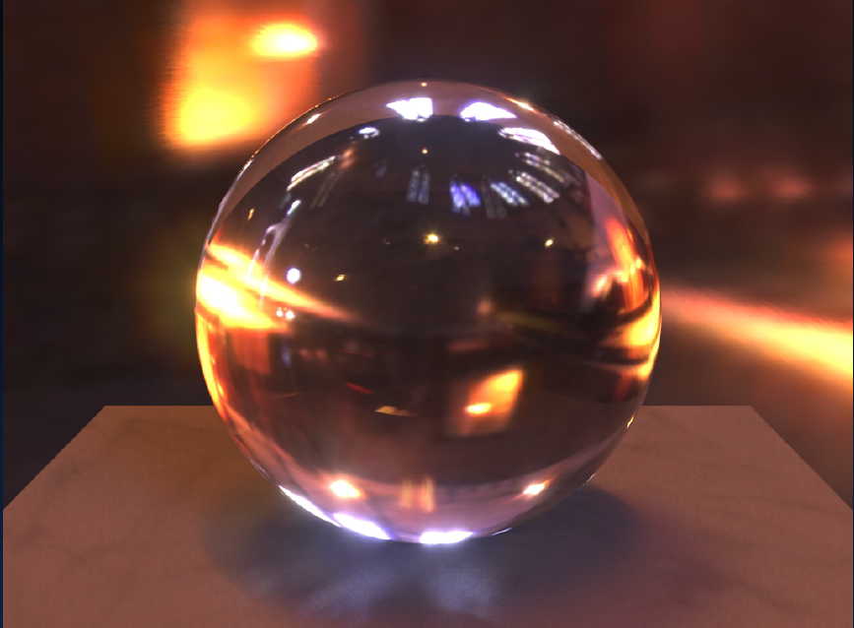
HDR Environment Illumination

Slide 18
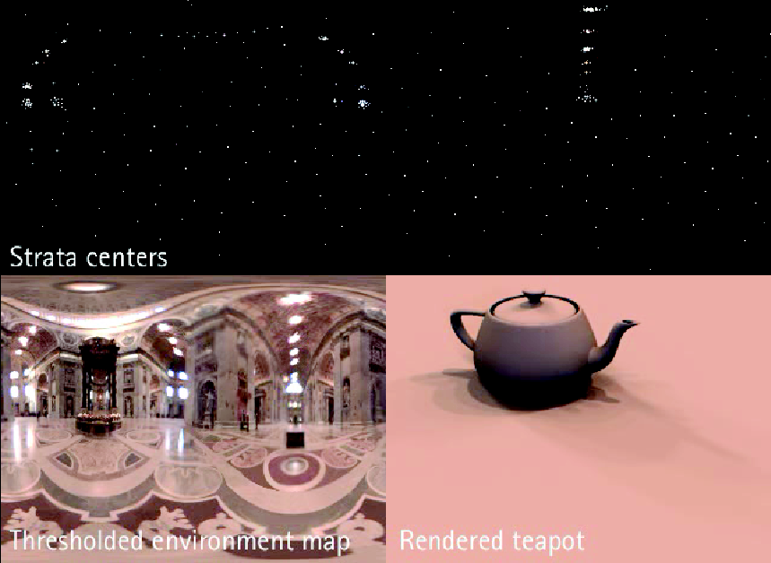
Structured Importance Sampling
Goal: Reduce environment to point lights

Slide 19
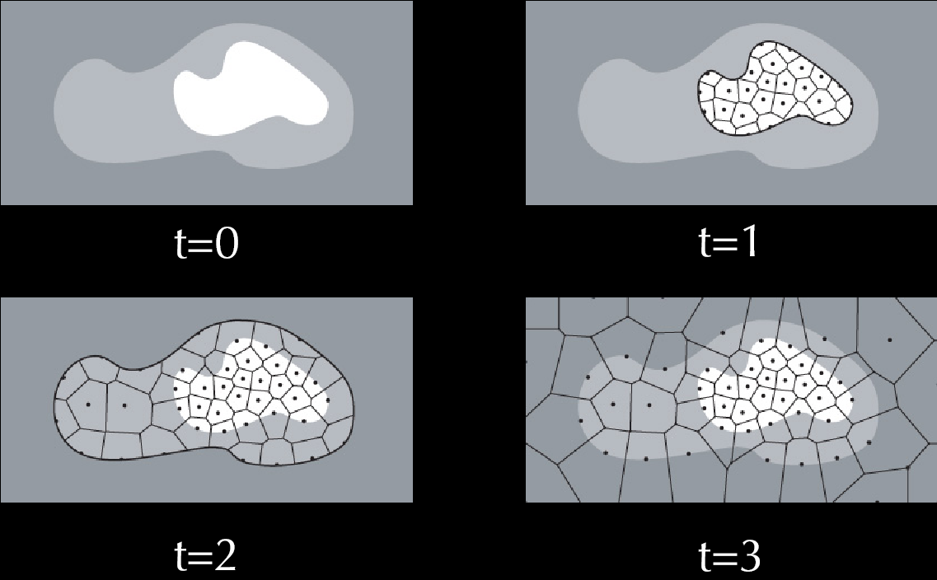
Hierarchical Stratification

Slide 20
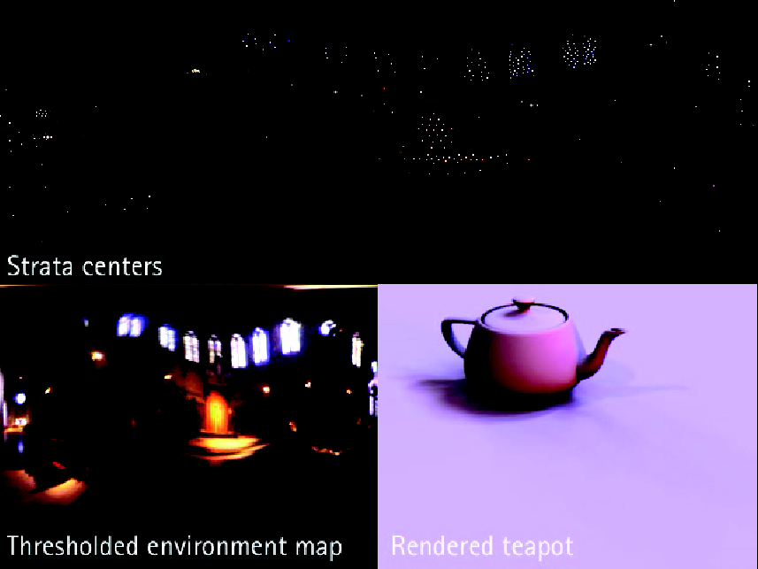
Structured Importance Sampling

Slide 21
Lat-Long Importance Sampling
Simple alternative (PBRT book)
Multidimensional importance sampling θ,φ
  Generate a numerical 1D CDF along φ integrating over all θ
  For each φ generate a numerical CDF over θ
  Essentially creates axis-aligned (lat-long) cells
  Compatible with any sampling scheme (stratified)
  I implemented this at Pixar (circa 2011)
  Done properly, PDF (almost) cancels lighting (can work out on board). Many subtleties involved, MIS
Other Simplifications
  Integrate lighting in strata to create point lights
  Jitter only for visibility (if at all)

Slide 22
Sampling General 2D Distributions
Treat Lighting as general 2D distribution
  Doing this for 1 color channel, take avg for probs
Normalize to convert to probability to sample from
  Note that probability distribution also enables MIS
  For direct lighting, illumination cancels out (careful re color)
    Will bring down a term of L_{c} / L_{avg}

Slide 23
How to Sample 2D Distribution
Form (numerical) 1D CDFs
Generate 2 random numbers in standard way
  Use numerical 1D CDF inversion to find v, then u
  Works with any sampling scheme (stratified etc.)
Note that I’ve done everything in integrals, but you will need to discretely sum, dividing by resolution (and consider factors of Pi for environment maps)
Or look up SIS paper, code (Agarwal et al. 03)

Slide 24
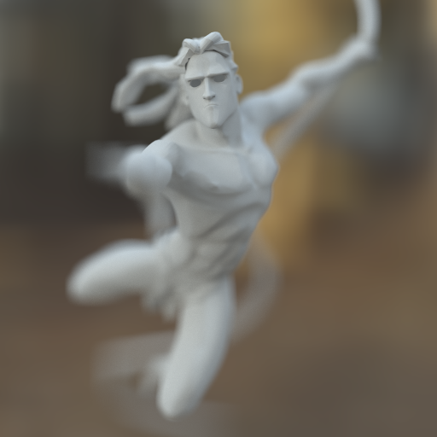
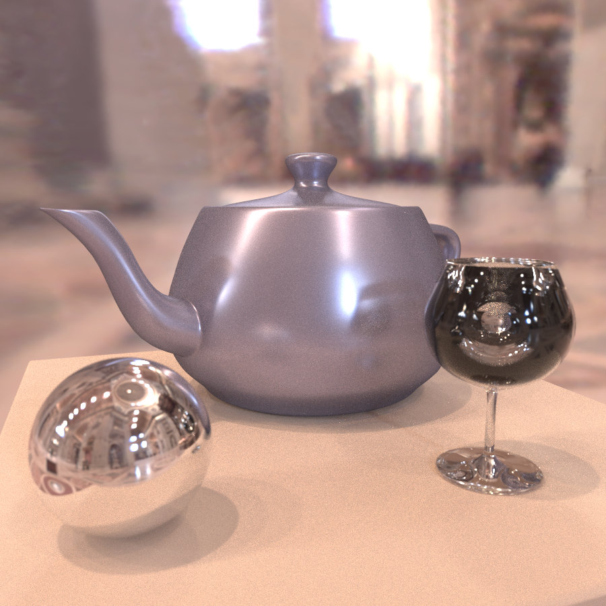
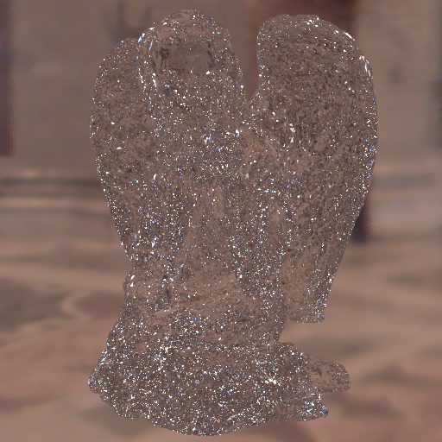
From UCB class many years ago

Slide 25
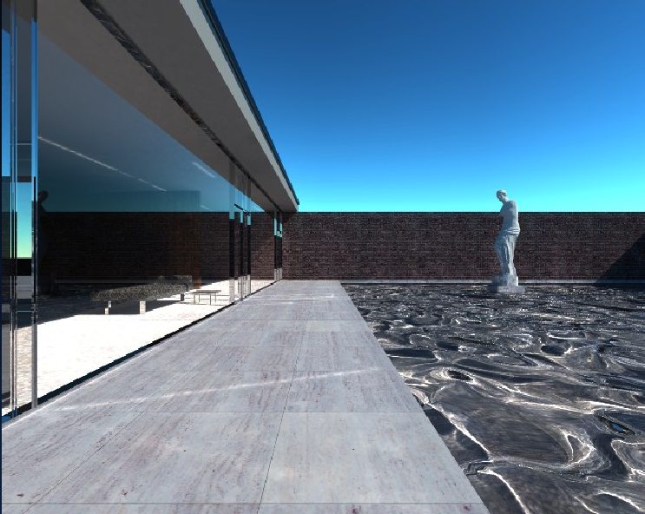
Mies House: Swimming Pool

Slide 26
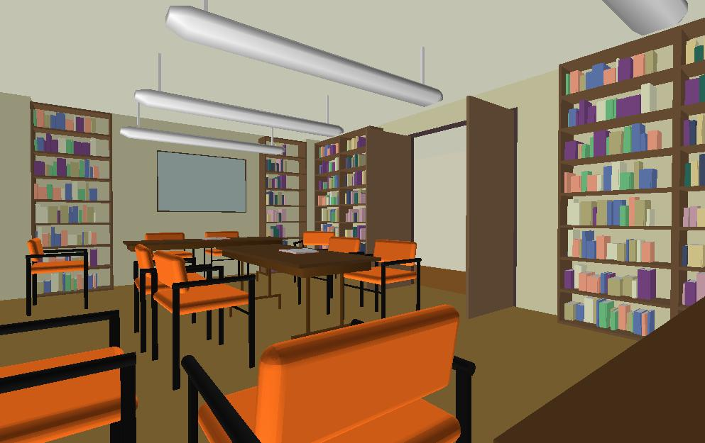
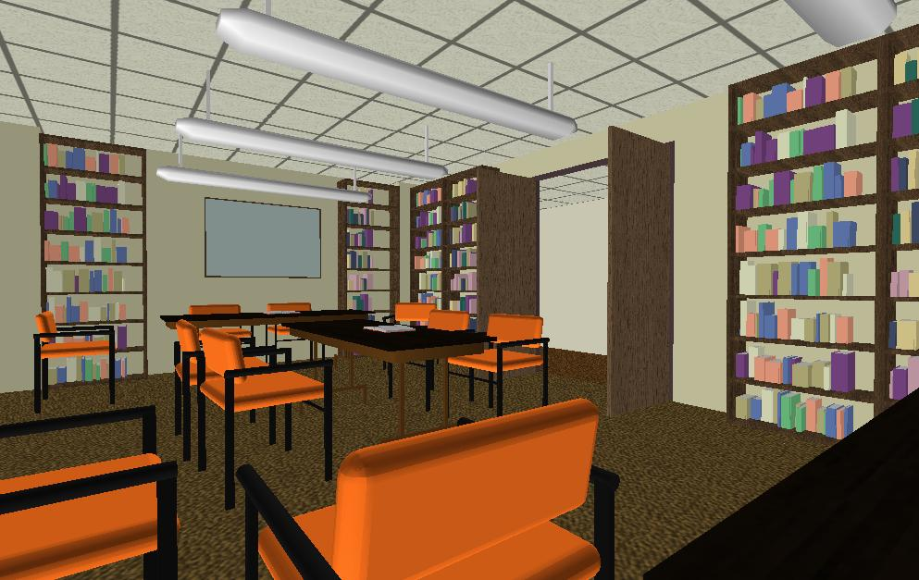
Texture Mapping
Important topic: nearly all objects textured
  Wood grain, faces, bricks and so on
  Adds visual detail to scenes
Meant as a fun and practically useful lecture
Polygonal model
With surface texture

Slide 27
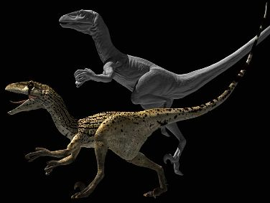
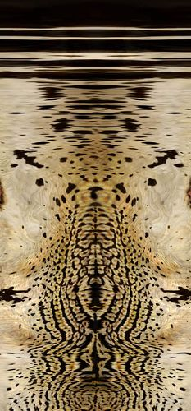
Adding Visual Detail
Basic idea: use images instead of more polygons to represent fine scale color variation

Slide 28
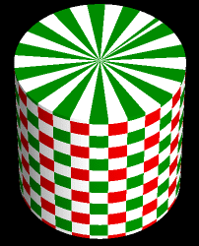
Parameterization
+
=
geometry
image
texture map
Q: How do we decide where on the geometry
each color from the image should go?

Slide 29
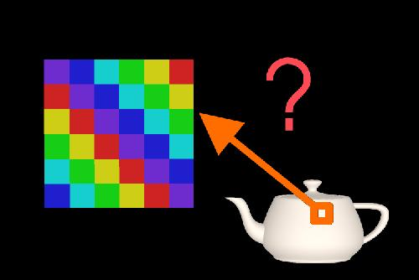
How to map object to texture?
To each vertex (x,y,z in object coordinates), must associate 2D texture coordinates (s,t)
So texture fits “nicely” over object

Slide 30
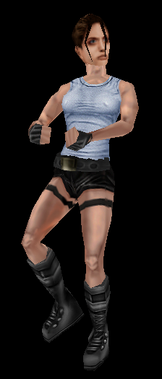
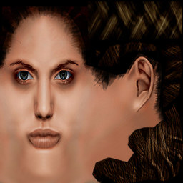
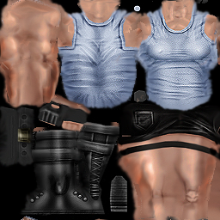
Option: it’s the artist’s problem

Slide 31
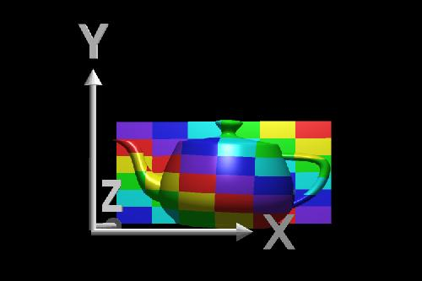
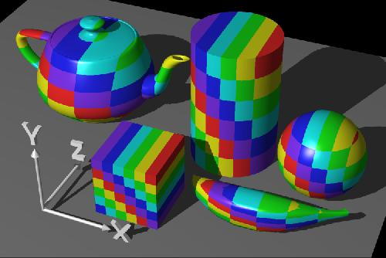
Planar mapping
Like projections, drop z coord (s,t) = (x,y)
Problems: what happens near z = 0?

Slide 32
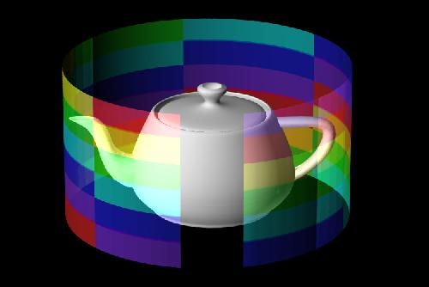
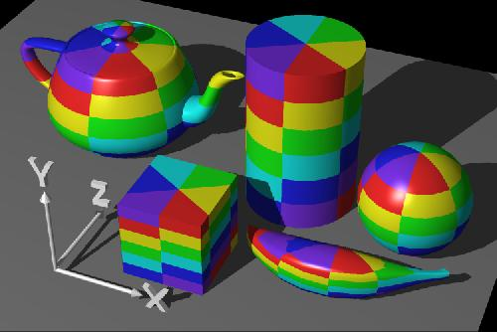
Cylindrical Mapping
Cylinder: r, θ, z with (s,t) = (θ/(2π),z)
  Note seams when wrapping around (θ = 0 or 2π)

Slide 33
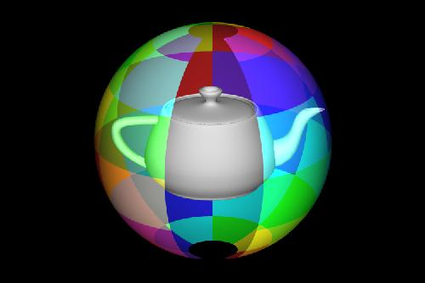
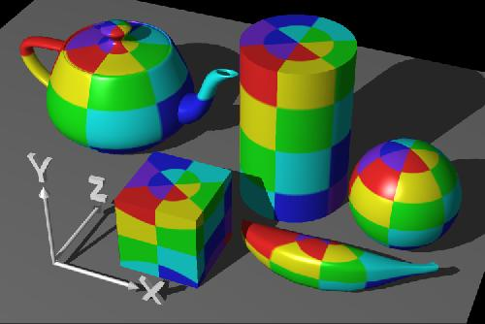
Spherical Mapping
Convert to spherical coordinates: use latitude/long.
  Singularities at north and south poles

Slide 34
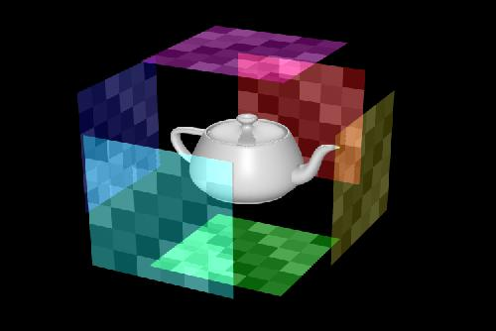
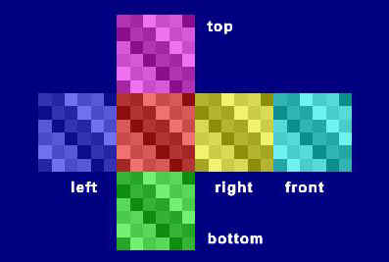
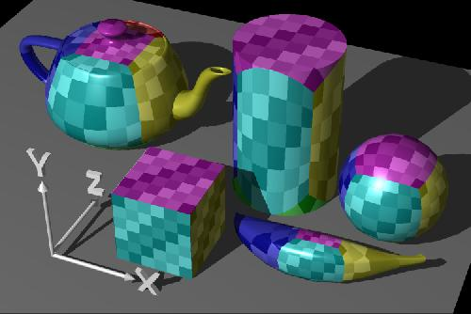
Cube Mapping

Slide 35
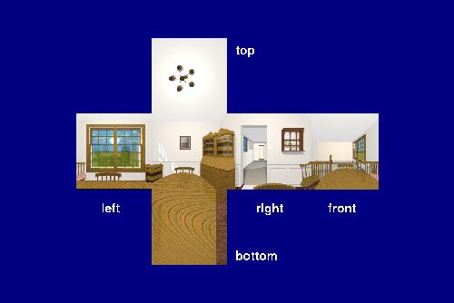
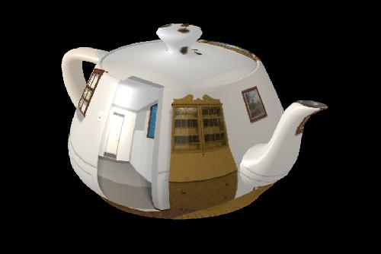
Cube Mapping

Slide 36
Interpolating Texture Coordinates
Texture Coordinates at Vertices of Triangle
How to compute coordinate at intersection?
Use barycentric coordinates from in triangle test
Same weights to combine texture coordinates
Then use texture coordinates to look up texture
Textures can also be procedural (use a formula)

Slide 37
Ray inside Triangle
B
A
α
β
P
γ
C

Slide 38
Texture Map Filtering
Naive texture mapping aliases badly
Look familiar?
int uval = (int) (u * denom + 0.5f);
int vval = (int) (v * denom + 0.5f);
int pix = texture.getPixel(uval, vval);
Actually, each pixel maps to a region in texture
  |PIX| < |TEX|
    Easy: interpolate (bilinear) between texel values
  |PIX| > |TEX|
    Hard: average the contribution from multiple texels
  |PIX| ~ |TEX|
    Still need interpolation!

Slide 39


Mip Maps
Keep textures prefiltered at multiple resolutions
  For each pixel, linearly interpolate between
  two closest levels (e.g., trilinear filtering)
  Fast, easy for hardware
Why “Mip” maps?

Slide 40


MIP-map Example
AAAAAAAGH
MY EYES ARE BURNING
No filtering:
MIP-map texturing:
Where are my glasses?

Slide 41
Texture Mapping Applications
Modulation, light maps
Bump mapping
Displacement mapping
Illumination or Environment Mapping
Procedural texturing
And many more
In physically-based rendering, texture doesn’t give color directly, rather controls some attribute (like diffuse/specular BRDF coefficient, roughness etc.)

Slide 42



Bump Mapping
Texture = change in surface normal!
Sphere w/ diffuse texture
Swirly bump map
Sphere w/ diffuse texture
and swirly bump map

Slide 43

Displacement Mapping

Slide 44
Environment Maps
Images from Illumination and Reflection Maps:
Simulated Objects in Simulated and Real Environments
Gene Miller and C. Robert Hoffman
SIGGRAPH 1984 “Advanced Computer Graphics Animation” Course Notes

Slide 45

Solid textures
Texture values indexed by 3D location (x,y,z)
  Expensive storage, or
  Compute on the fly,
  e.g. Perlin noise →

Slide 46


