Slide 1




Computer Graphics II: Rendering
CSE 168 [Spr 26], Lecture 12: High Quality Rendering Ravi Ramamoorthi
http://viscomp.ucsd.edu/classes/cse168/sp26

Slide 2
To Do
Homework 4 (importance sampling) due May 18
These lectures cover more advanced topics
  May be relevant for your final project
  Or curiosity in terms of frontiers of modern rendering

Slide 3
Motivation
Rendering Equation since 86, Path Tracer in HW 3
So, is Monte Carlo rendering solved?
Can it be made more efficient (90s until today)?
  Multiple Importance Sampling (Homework 4)
  Irradiance Caching takes advantage of coherence
  Correct sampling: Stratified, Multiple Importance, Bidirectional Path Tracing, Metropolis, VCM/UPS, …
  Photon Mapping
  Modern adaptive sampling, cut-based integration
  Advanced topics (next time)
  Denoising (next time)

Slide 4
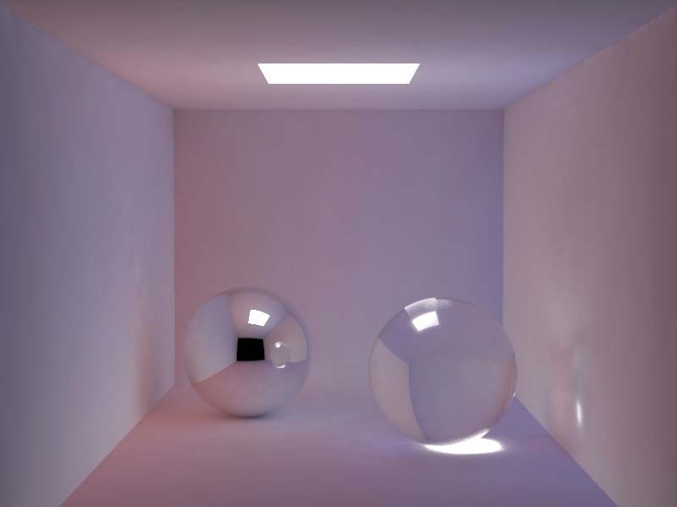
Smoothness of Indirect Lighting
Direct
Indirect
Direct + Indirect

Slide 5
Irradiance Caching
Empirically, (diffuse) interreflections low frequency
Therefore, should be able to sample sparsely
Irradiance caching samples irradiance at few points on surfaces, and then interpolates
Ward, Rubinstein, Clear. SIGGRAPH 88, A ray tracing solution for diffuse interreflection

Slide 6
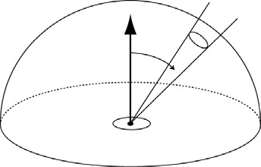


Irradiance Calculation
position
rotation
Derivation in Ward paper

Slide 7
Algorithm Outline
Find all samples with w(x) > q
if ( samples found )
  interpolate
else
  compute new irradiance
N.B. Subsample the image first and then fill in

Slide 8
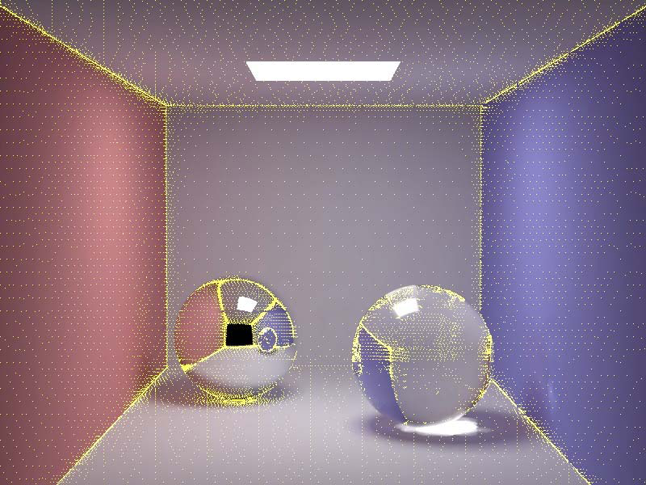
Irradiance Caching Example
Final Image
Sample Locations

Slide 9
Motivation
Rendering Equation since 86, Path Tracer in HW 3
So, is Monte Carlo rendering solved?
Can it be made more efficient (90s until today)?
  Multiple Importance Sampling (Homework 4)
  Irradiance Caching takes advantage of coherence
  Correct sampling: Stratified, Multiple Importance, Bidirectional Path Tracing, Metropolis, VCM/UPS, …
  Photon Mapping
  Modern adaptive sampling, cut-based integration
  Advanced topics (next time)
  Denoising (next time)
High level: refs on slides, ask if need to track down

Slide 10
Better Sampling
Smarter ways to Monte Carlo sample
Long history: Stratified, Importance, Bi-Directional, Multiple Importance, Metropolis
Good reference is Veach thesis
We only briefly discuss a couple of strategies

Slide 11
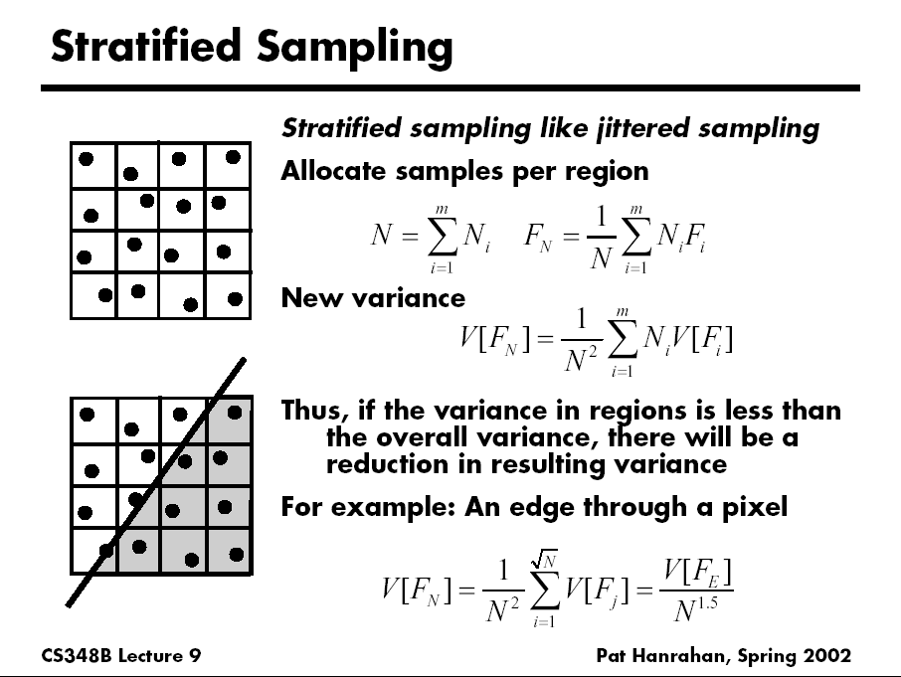
D. Mitchell 95, Consequences of stratified sampling in graphics

Slide 12
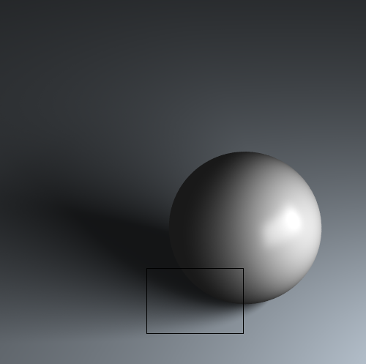
Comparison of simple patterns
Latin Hypercube
Quasi Monte Carlo
Ground Truth
Uniform
Random
Stratified
16 samples for area light, 4 samples per pixel, total 64 samples
If interested, see my paper “A Theory of Monte Carlo Visibility Sampling”
Figures courtesy Tianyu Liu

Slide 13
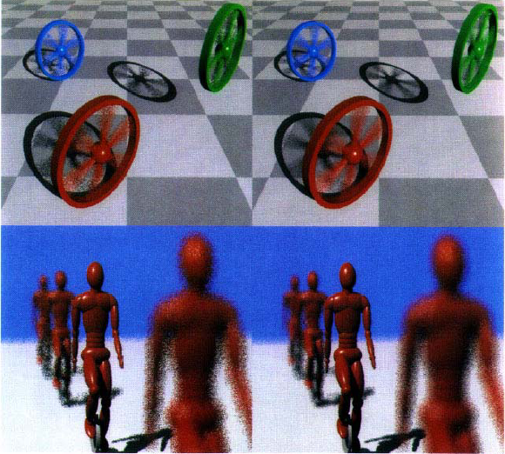
Spectrally Optimal Sampling
Mitchell 91

Slide 14
Light Ray Tracing
Backwards Ray Tracing
[Arvo 86]

Slide 15
Path Tracing: From Lights
Step 1. Choose a light ray
Step 2. Find ray-surface intersection
Step 3. Reflect or transmit
  u = Uniform()
  if u < reflectance(x)
  Choose new direction d ~ BRDF(O|I)
  goto Step 2
else if u < reflectance(x)+transmittance(x)
  Choose new direction d ~ BTDF(O|I)
  goto Step 2
else // absorption=1–reflectance-transmittance
  terminate on surface; deposit energy

Slide 16
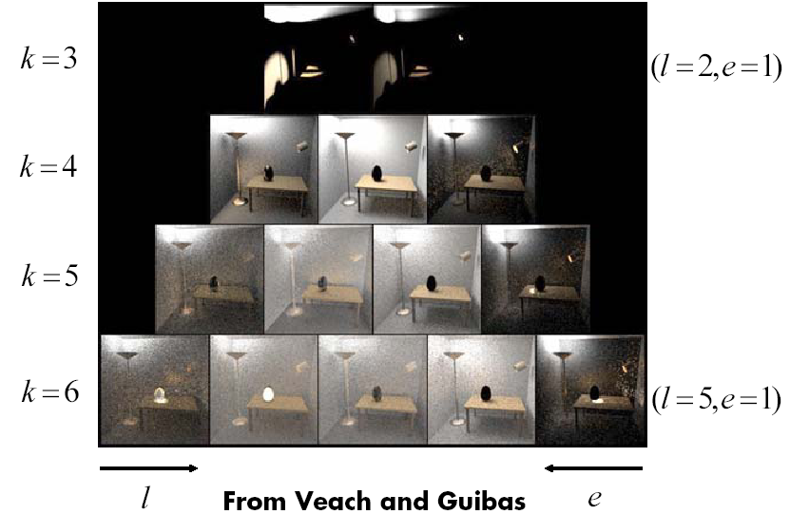
Bidirectional Path Tracing
Path pyramid (k = l + e = total number of bounces)

Slide 17
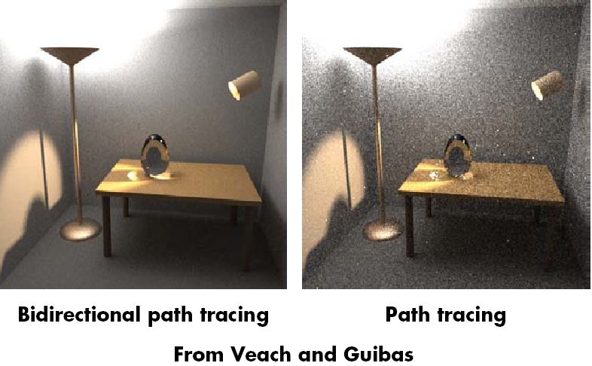
Comparison

Slide 18
Motivation
Rendering Equation since 86, Path Tracer in HW 3
So, is Monte Carlo rendering solved?
Can it be made more efficient (90s until today)?
  Multiple Importance Sampling (Homework 4)
  Irradiance Caching takes advantage of coherence
  Correct sampling: Stratified, Multiple Importance, Bidirectional Path Tracing, Metropolis, VCM/UPS, …
  Photon Mapping
  Modern adaptive sampling, cut-based integration
  Advanced topics (next time)
  Denoising (next time)
High level: refs on slides, ask if need to track down

Slide 19
Why Photon Map?
Some visual effects like caustics hard with standard path tracing from eye
May usually miss light source altogether
Instead, store “photons” from light in kd-tree
Look-up into this as needed
Combines tracing from light source, and eye
Similar to bidirectional path tracing, but compute photon map only once for all eye rays
Global Illumination using Photon Maps H. Jensen. Rendering Techniques (EGSR 1996), pp 21-30. (Also book: Realistic Image Synthesis using Photon Mapping)

Slide 20
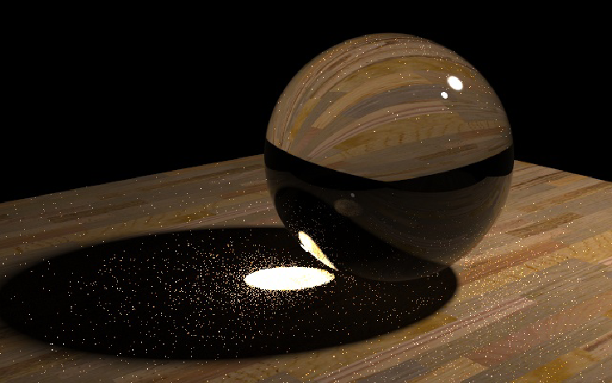
Caustics
Path Tracing: 1000 paths/pixel
Note noise in caustics
Slides courtesy Henrik Wann Jensen

Slide 21
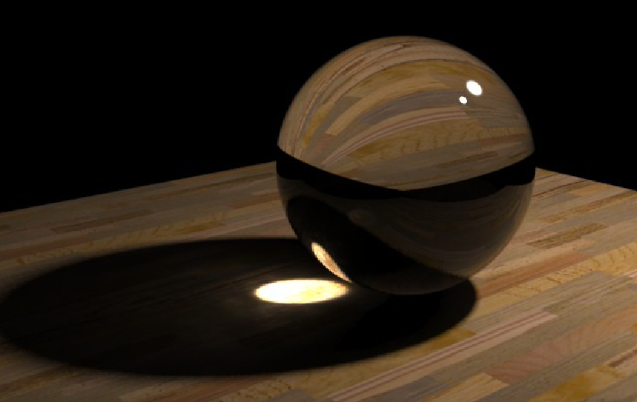
Caustics
Photon Mapping: 10000 photons
50 photons in radiance estimate

Slide 22
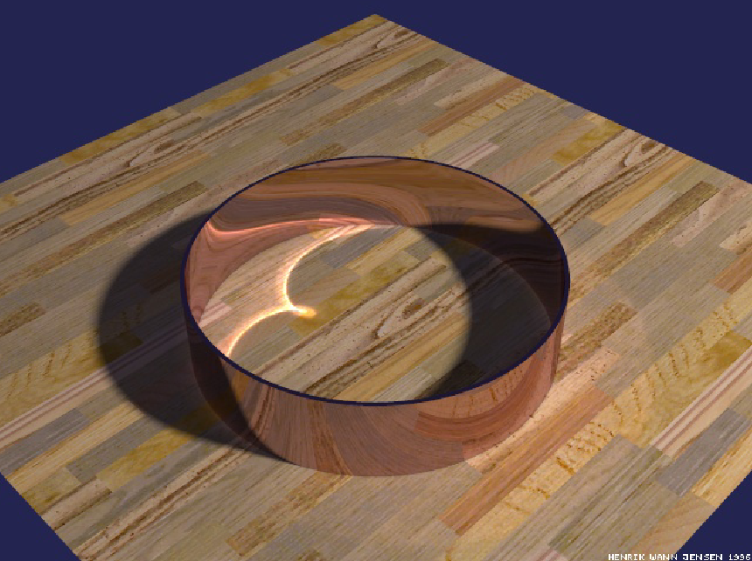
Reflections Inside a Metal Ring
50000 photons
50 photons to estimate radiance

Slide 23
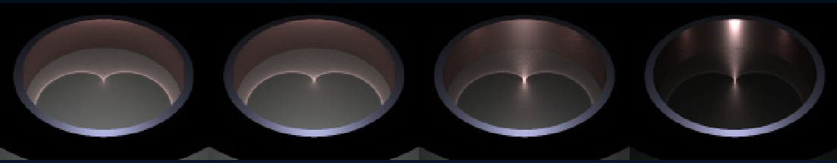
Caustics on Glossy Surfaces
340000 photons, 100 photons in radiance estimate

Slide 24
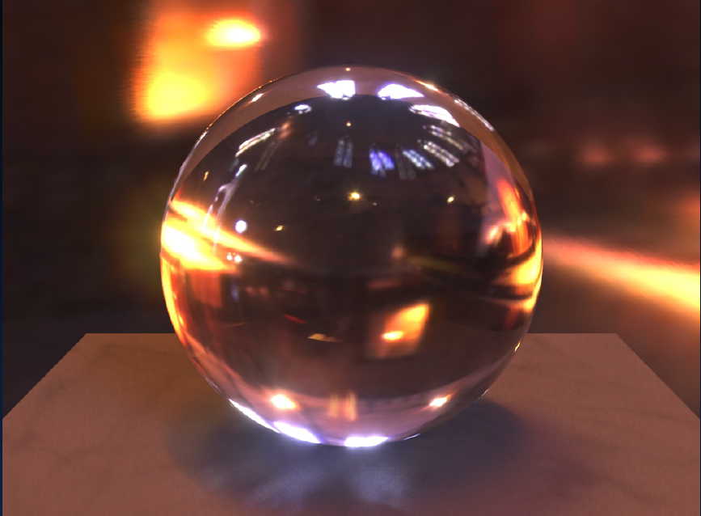
HDR Environment Illumination

Slide 25
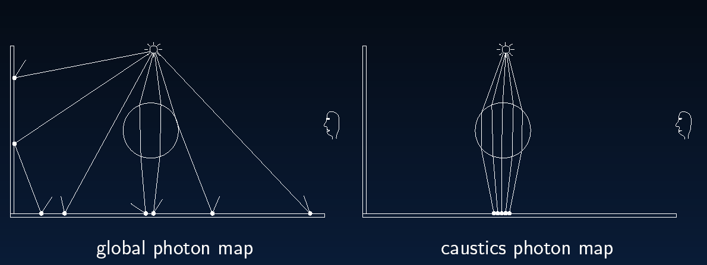
Global Illumination

Slide 26
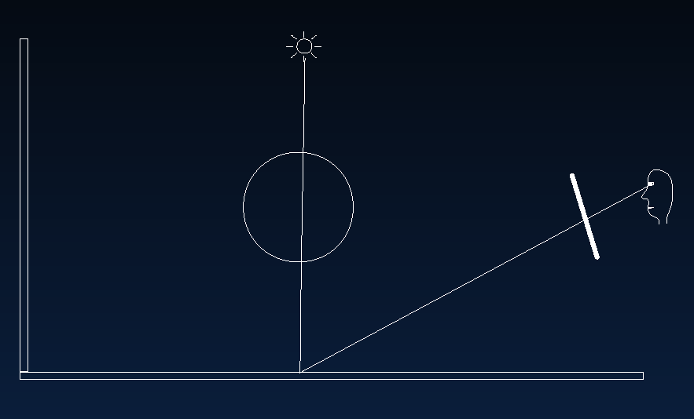
Direct Illumination

Slide 27
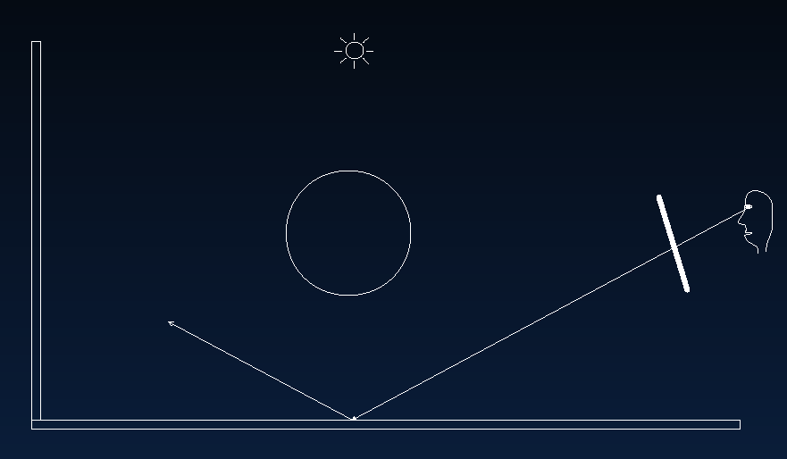
Specular Reflection

Slide 28
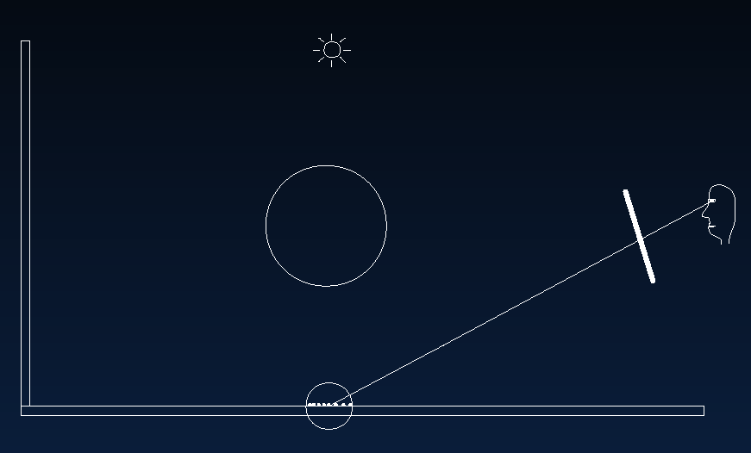
Caustics

Slide 29
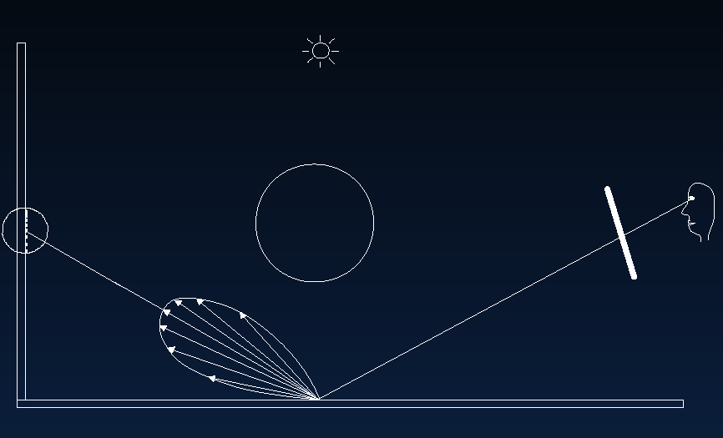
Indirect Illumination

Slide 30
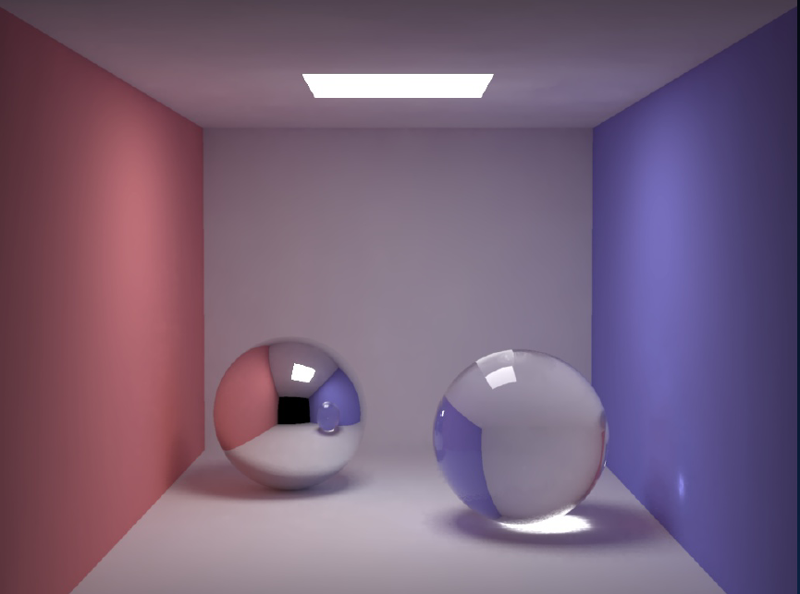
Cornell Box
200000 global photons, 50000 caustic photons

Slide 31
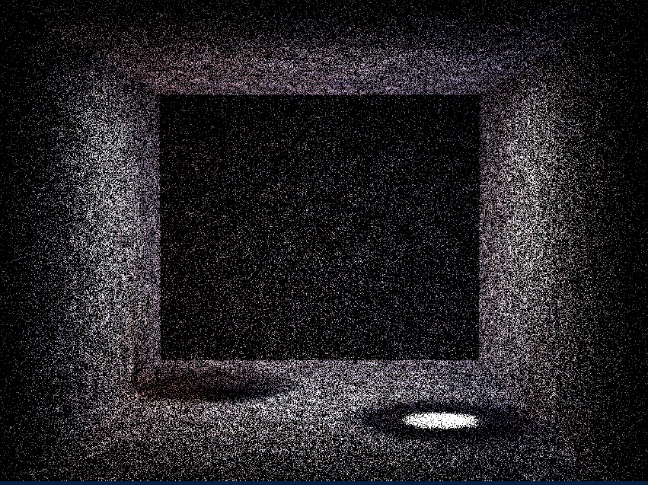
Box: Global Photons

Slide 32
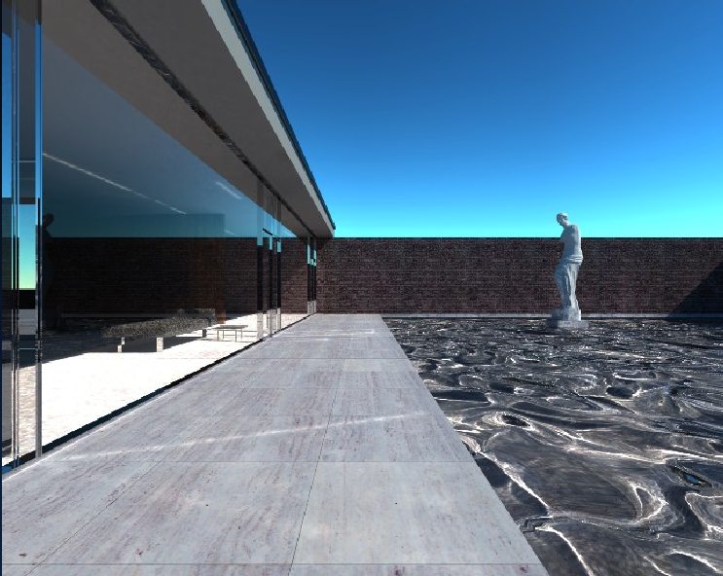
Mies House: Swimming Pool

Slide 33
Motivation
Rendering Equation since 86, Path Tracer in HW 3
So, is Monte Carlo rendering solved?
Can it be made more efficient (90s until today)?
  Multiple Importance Sampling (Homework 4)
  Irradiance Caching takes advantage of coherence
  Correct sampling: Stratified, Multiple Importance, Bidirectional Path Tracing, Metropolis, VCM/UPS, …
  Photon Mapping
  Modern adaptive sampling, cut-based integration
  Advanced topics (next time)
  Denoising (next time)
High level: refs on slides, ask if need to track down

Slide 34
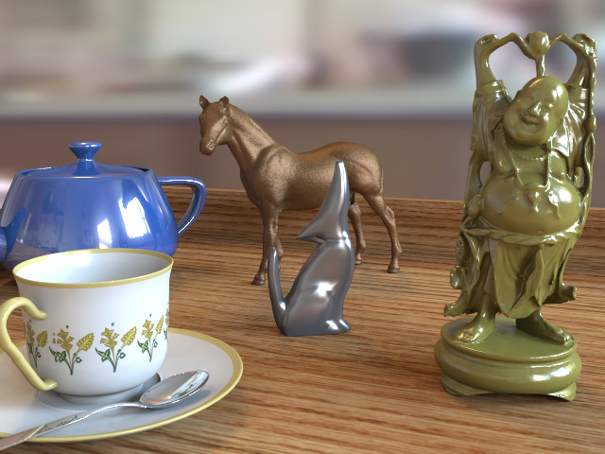
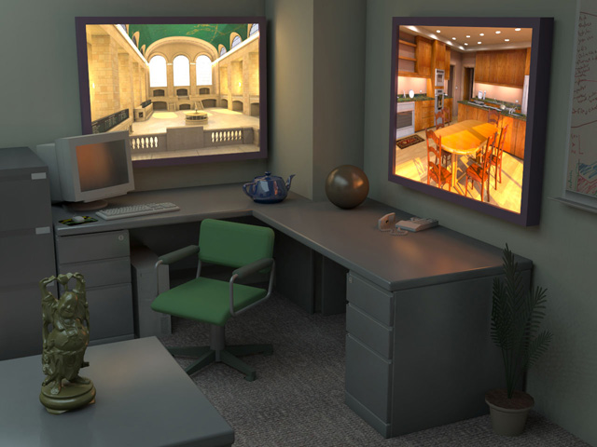
Lightcuts
Efficient, accurate complex illumination
Environment map lighting & indirect
Time 111s
Textured area lights & indirect
Time 98s
(640x480, Anti-aliased, Glossy materials)
From Walter et al. SIGGRAPH 05
Notes:
What is lightcuts? Lightcuts is a new scalable solution for efficiently computing complex illumination. Two examples are shown here. The image on the left is lit by an environment map with illumination captured from the real world, while the image on the right includes two simulated high dynamic range flat-panel displays. Both are challenging illumination problems. In addition both images include indirect illumination, glossy materials, and anti-aliasing. Yet our method was able to produce each image in under two minutes on a single machine.

Slide 35
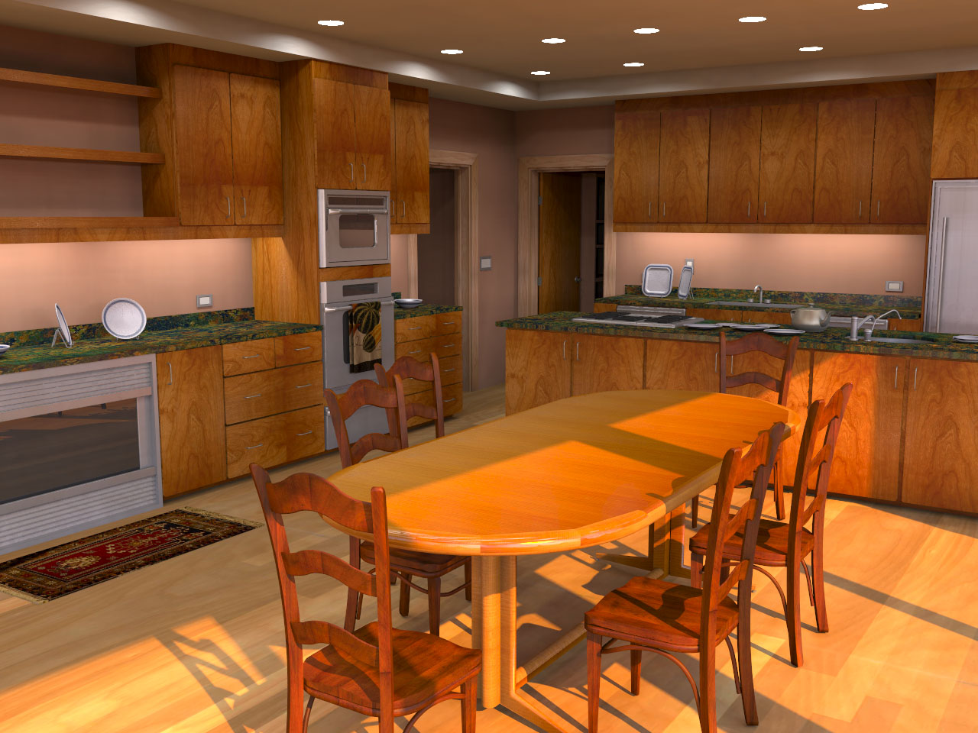
Complex Lighting
Simulate complex illumination using point lights
  Area lights
  HDR environment maps
  Sun & sky light
  Indirect illumination
Unifies illumination
  Enables tradeoffs
  between components
Area lights + Sun/sky + Indirect
Notes:
Once we have a scalable solution for many point lights, we can use this to compute other types of complex illumination. The four examples we demonstrate in the paper are area lights, high dynamic range environment maps, sun & sky light, and indirect illumination. Moreover this allows us to unify the handling of different illumination types and enables new types of tradeoffs. For example, bright illumination from one source allows coarser approximations of other sources.

Slide 36
Key Concepts
Light Cluster
Light Tree
  Binary tree of lights and clusters
Clusters
Individual
Lights
Notes:
Second is the light tree which is a binary tree of lights and clusters. The leaves of this tree are the individual lights while the interior nodes represent clusters which get progressively larger as we go up the tree.

Slide 37
Key Concepts
Light Cluster
Light Tree
A Cut
  A set of nodes that partitions the lights into clusters
Notes:
The third is a cut which is a set of nodes that partitions the lights into clusters. Here illustrated by the orange line.

Slide 38
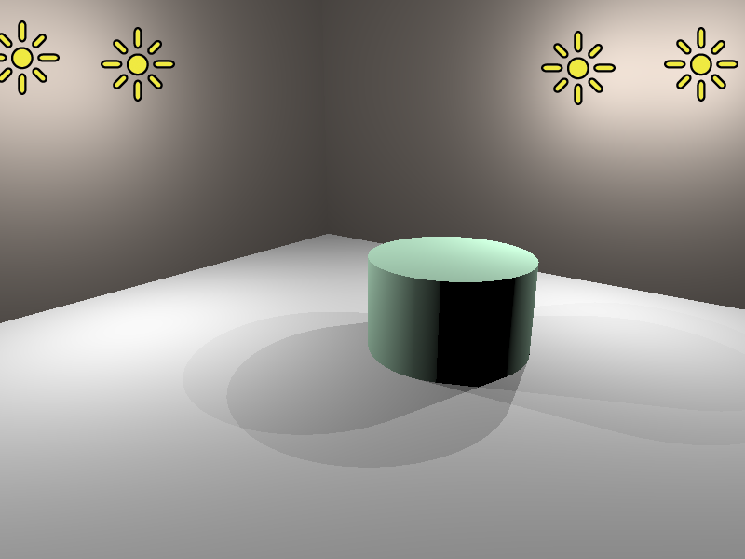
Simple Example
Light Tree
Representative
4
#1
#2
#3
#4
Light
Clusters
1
4
1
2
3
4
Individual
Lights
Notes:
Here is a simple scene with four lights and its corresponding light tree.

Slide 39
Three Example Cuts
Three Cuts
#1
#2
#4
#1
#3
#4
#1
#4
4
4
4
1
4
1
4
1
4
1
2
3
4
1
2
3
4
1
2
3
4
Notes:
And here we show three example cuts through the light tree. Highlighted above each cut are the regions where that cut produces an accurate approximation of the exact illumination.

Slide 40
Three Example Cuts
Three Cuts
#1
#2
#4
#1
#3
#4
#1
#4
4
4
4
1
4
1
4
1
4
1
2
3
4
1
2
3
4
1
2
3
4
Good
Bad
Bad
Notes:
If we look at this green point on the left of the images, the orange cut produces a good approximation while the blue and purple cuts would cause too much error.

Slide 41
Three Example Cuts
Three Cuts
#1
#2
#4
#1
#3
#4
#1
#4
4
4
4
1
4
1
4
1
4
1
2
3
4
1
2
3
4
1
2
3
4
Bad
Good
Bad
Notes:
Conversely for this point in the center of the images, the blue cut is a good approximation while the orange and purple cuts are not usable. This illustrates an important point. We will want to use different cuts in different parts of the image.

Slide 42
Three Example Cuts
Three Cuts
#1
#2
#4
#1
#3
#4
#1
#4
4
4
4
1
4
1
4
1
4
1
2
3
4
1
2
3
4
1
2
3
4
Good
Good
Good
Notes:
For this point on the right side of the images, all three cuts usable. In this case the purple cut is the best choice because it will be the cheapest to compute as it contains the fewest nodes.

Slide 43

Tableau, 630K polygons, 13 000 lights, (EnvMap+Indirect)
Avg. shadow rays per eye ray 17 (0.13%)
Notes:
Here is another results that show cases our ability to handle glossy objects. This scene is illuminated by a captured environment map and indirect illumination. And here is a short animation of this scene.

Slide 44
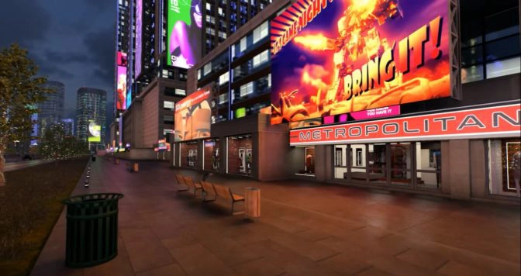
NVIDIA ReSTIR RTX DI
  Bitterli et al. 20 Spatiotemporal reservoir resampling
  Real-Time Direct Lighting from millions of lights

Slide 45
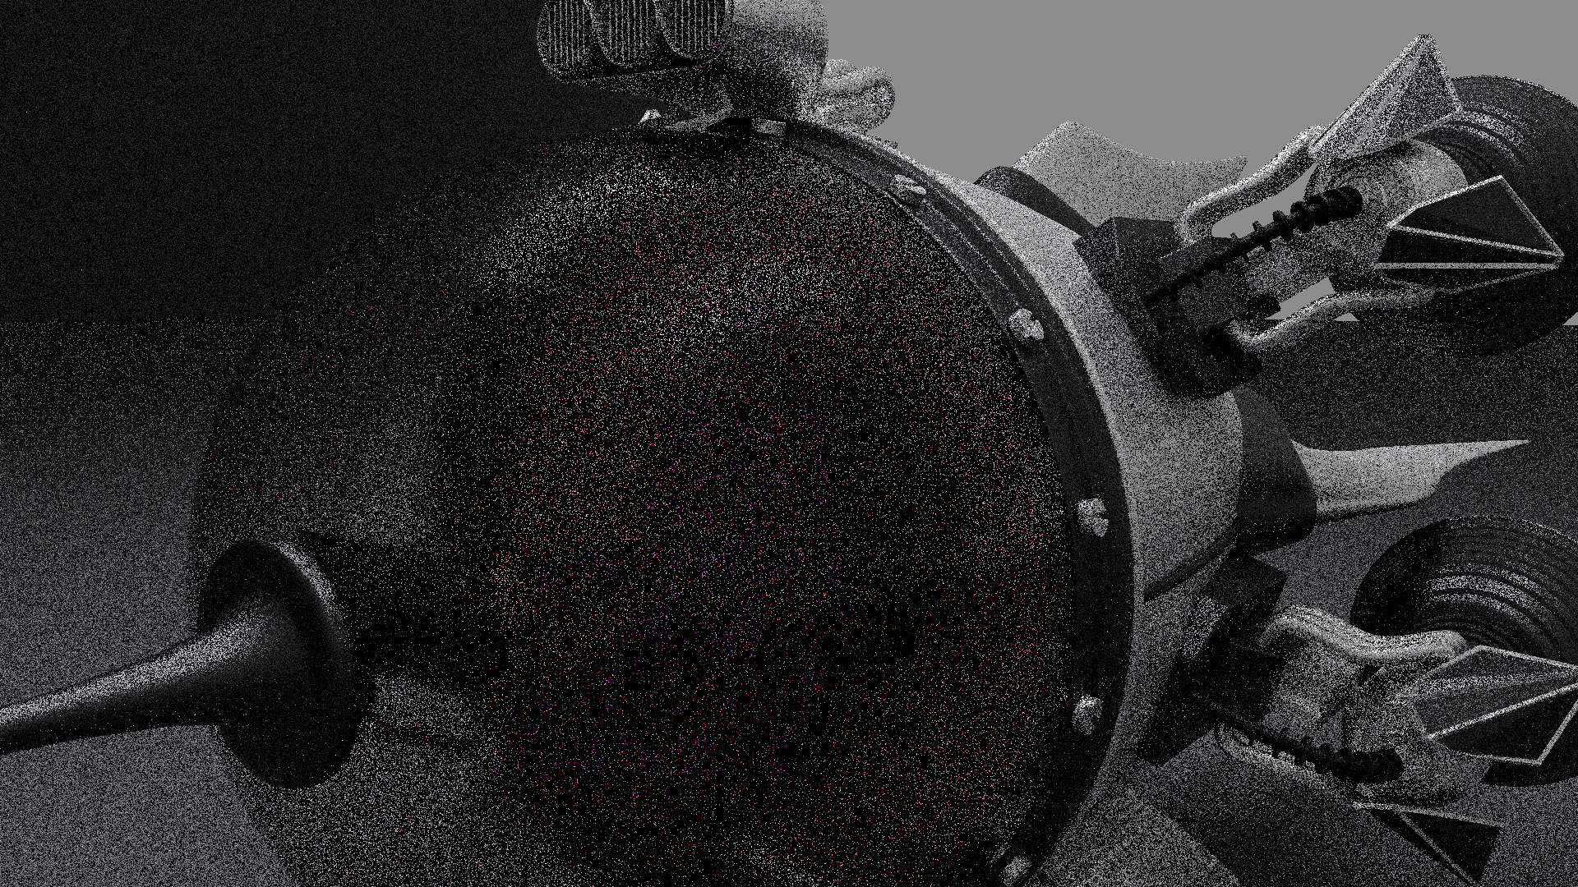
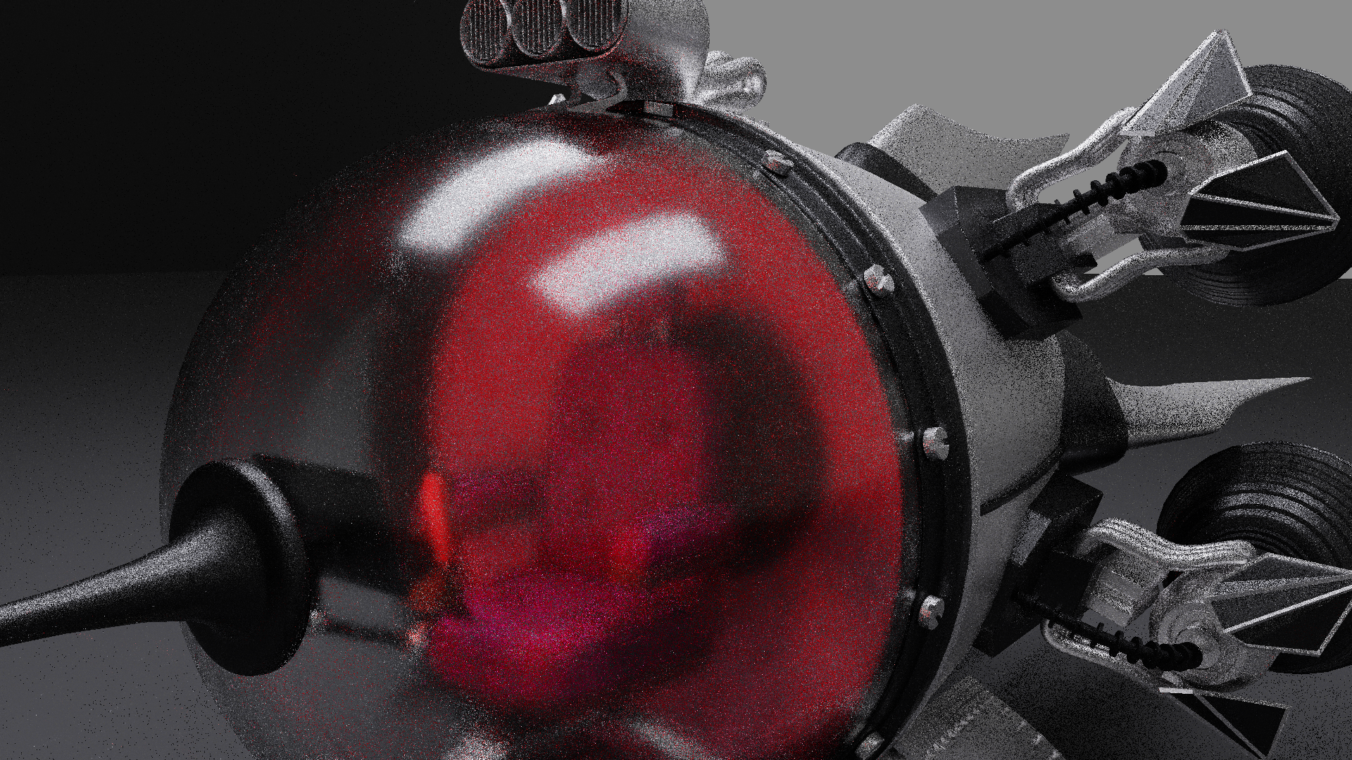
What is ReSTIR?
(Aka Resevoir-based Spatiotemporal Importance Resampling)
Simply: A way to reuse samples by sharing among pixels
  Ray tracing is expensive
  By amortizing costs, we increase the effective sample count
  ReSTIR gives a 100x to 10,000x sample count multiplier
    Exact multiplier is hard to measure; handwavy
Think: A post-process denoiser, but inside the renderer
  Denoiser says: “neighbors are similar, so blur colors across pixels”
  ReSTIR says: “neighbors are similar, so reuse samples (or PDFs) across pixels”
Unlike denoising, ReSTIR can be unbiased
  Why? In the renderer, we can reuse data before throwing important stuff away
2.1 ms
Path tracing with 1 path per pixel
10.0 ms
ReSTIR with 1 sample per pixel

Slide 46

Resampled importance sampling
a machine that produces samples approximately proportionally to a target distribution
RIS:
Samples $X_{1},X_{2},…, X_{M}$
RIS
One better-distributed sample
Notes:
Resampled Importance Sampling, RIS, is a machine that produces samples approximately proportionally to a user-given target function.
We give it a sequence of samples from X_1 to X_m, and it, by weighted random sampling, returns us one of the inputs, to produce one better-distributed sample.

Slide 47
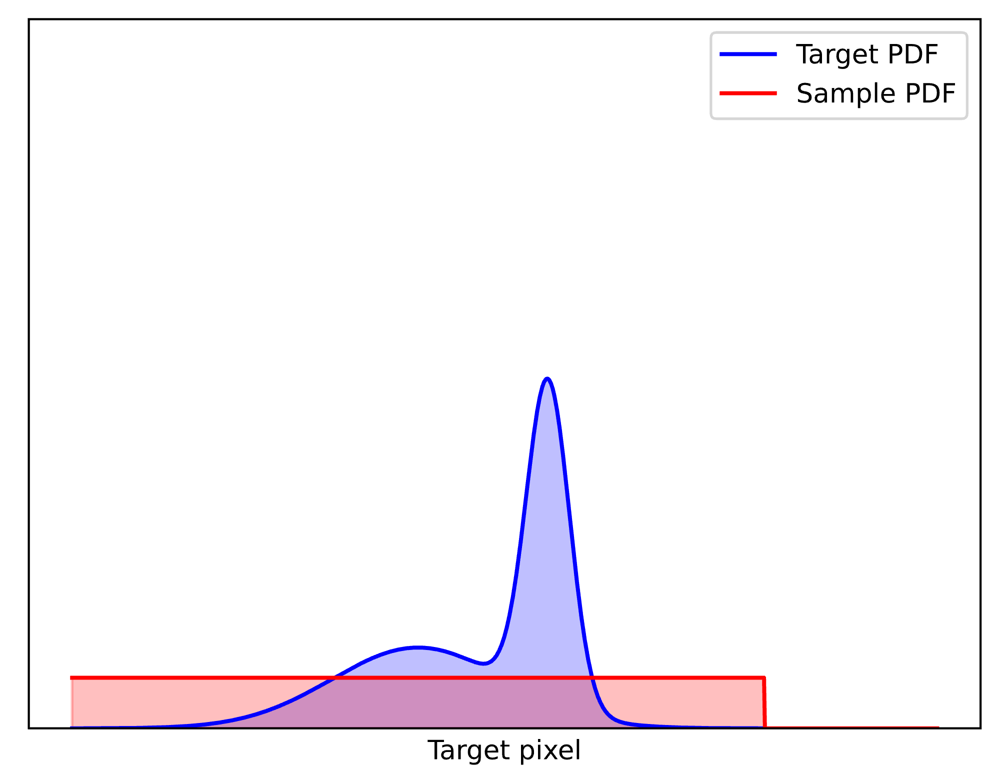



Pdf converges to target
Target distribution
$$\overline{p}$$
$$X_{1}$$
$$X_{2}$$
Input PDF
Notes:
Here, we show a target distribution in blue, and two input samples with the uniform PDF in red, as an example.
Let’s apply RIS and see the output distribution.

Slide 48
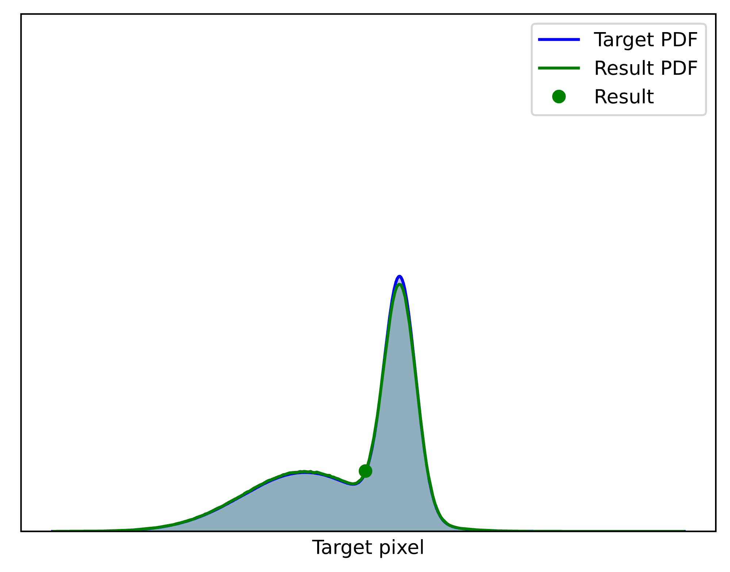


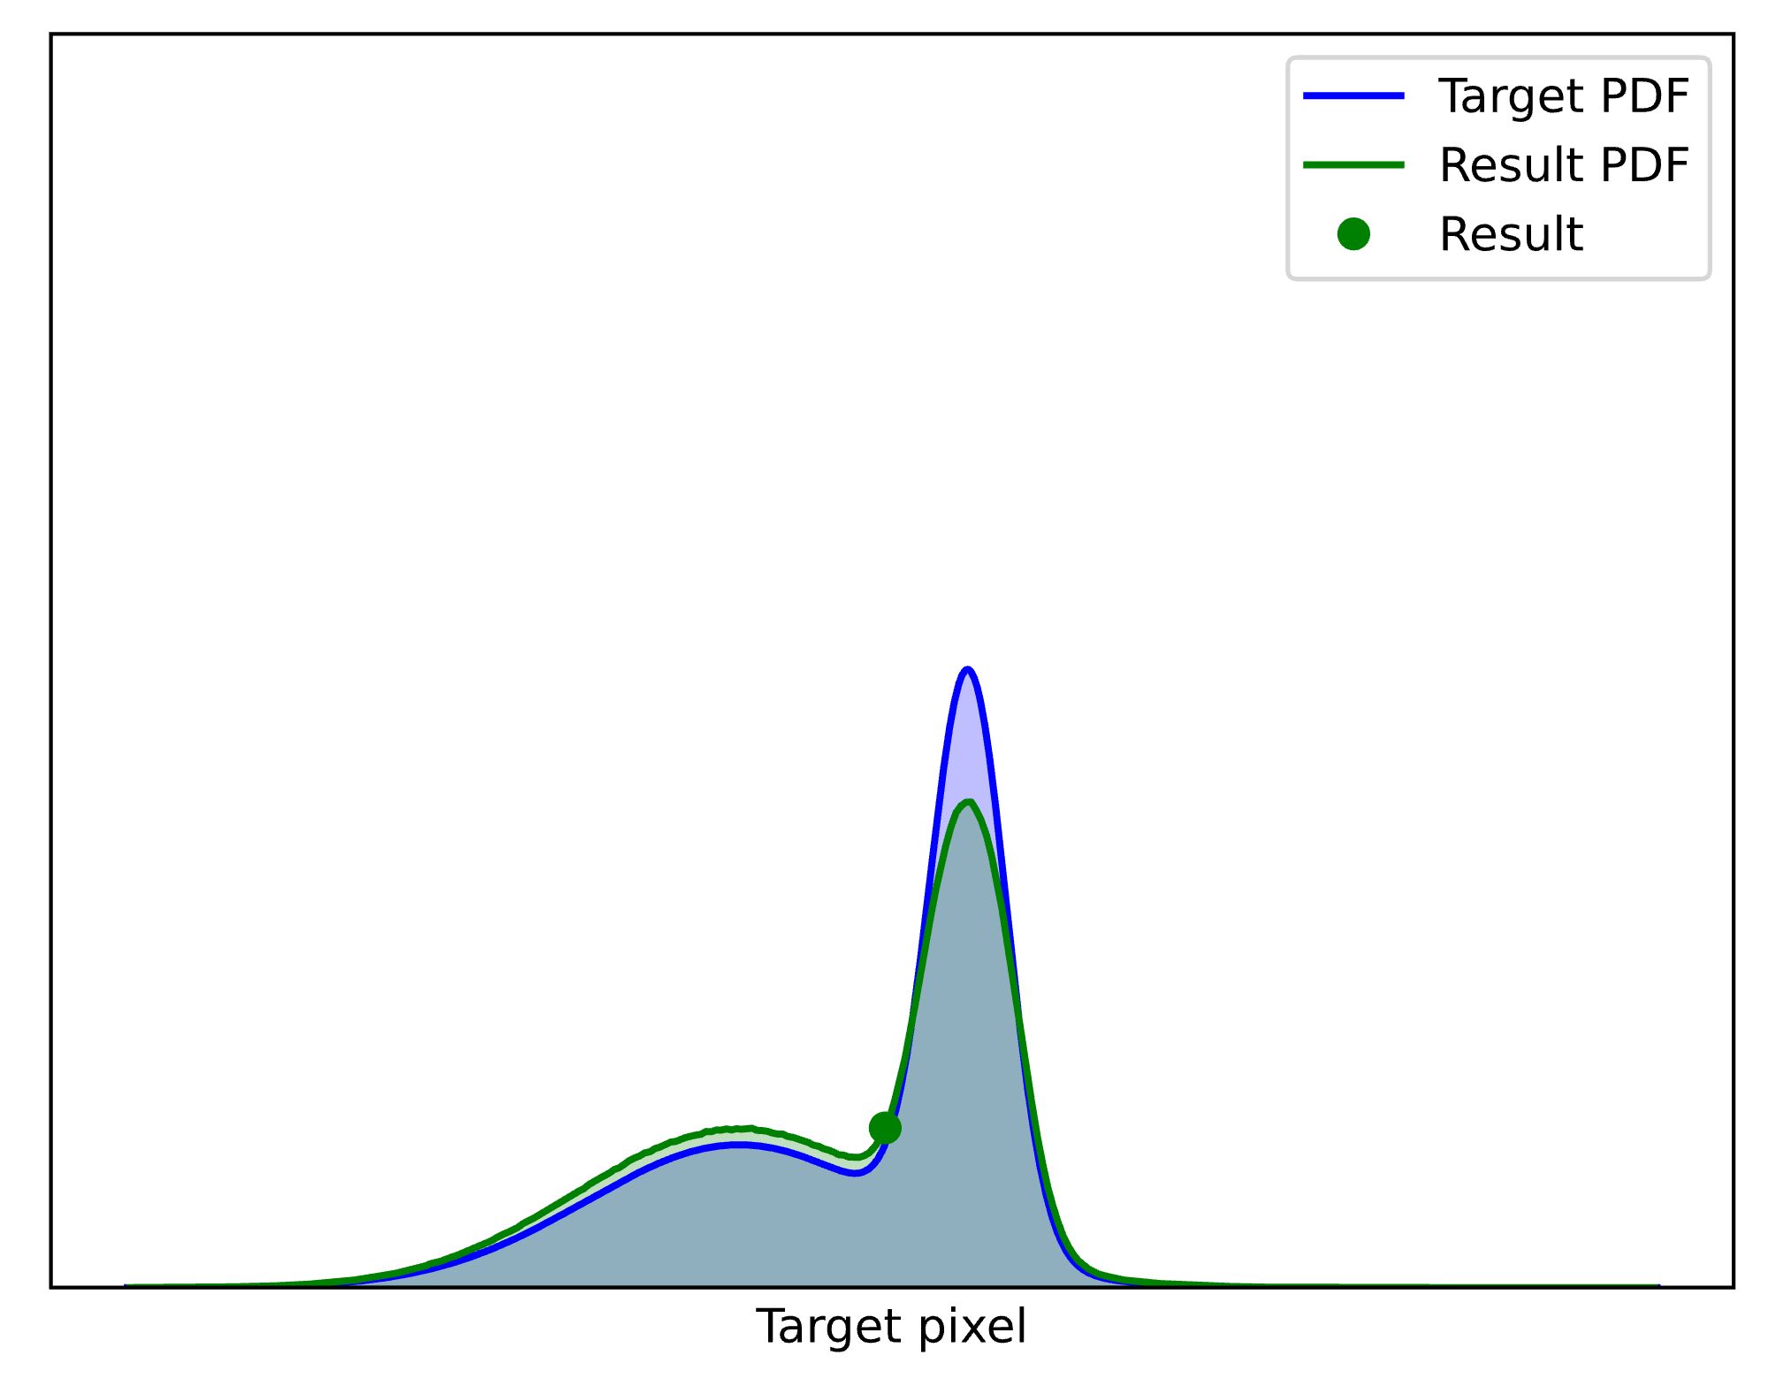
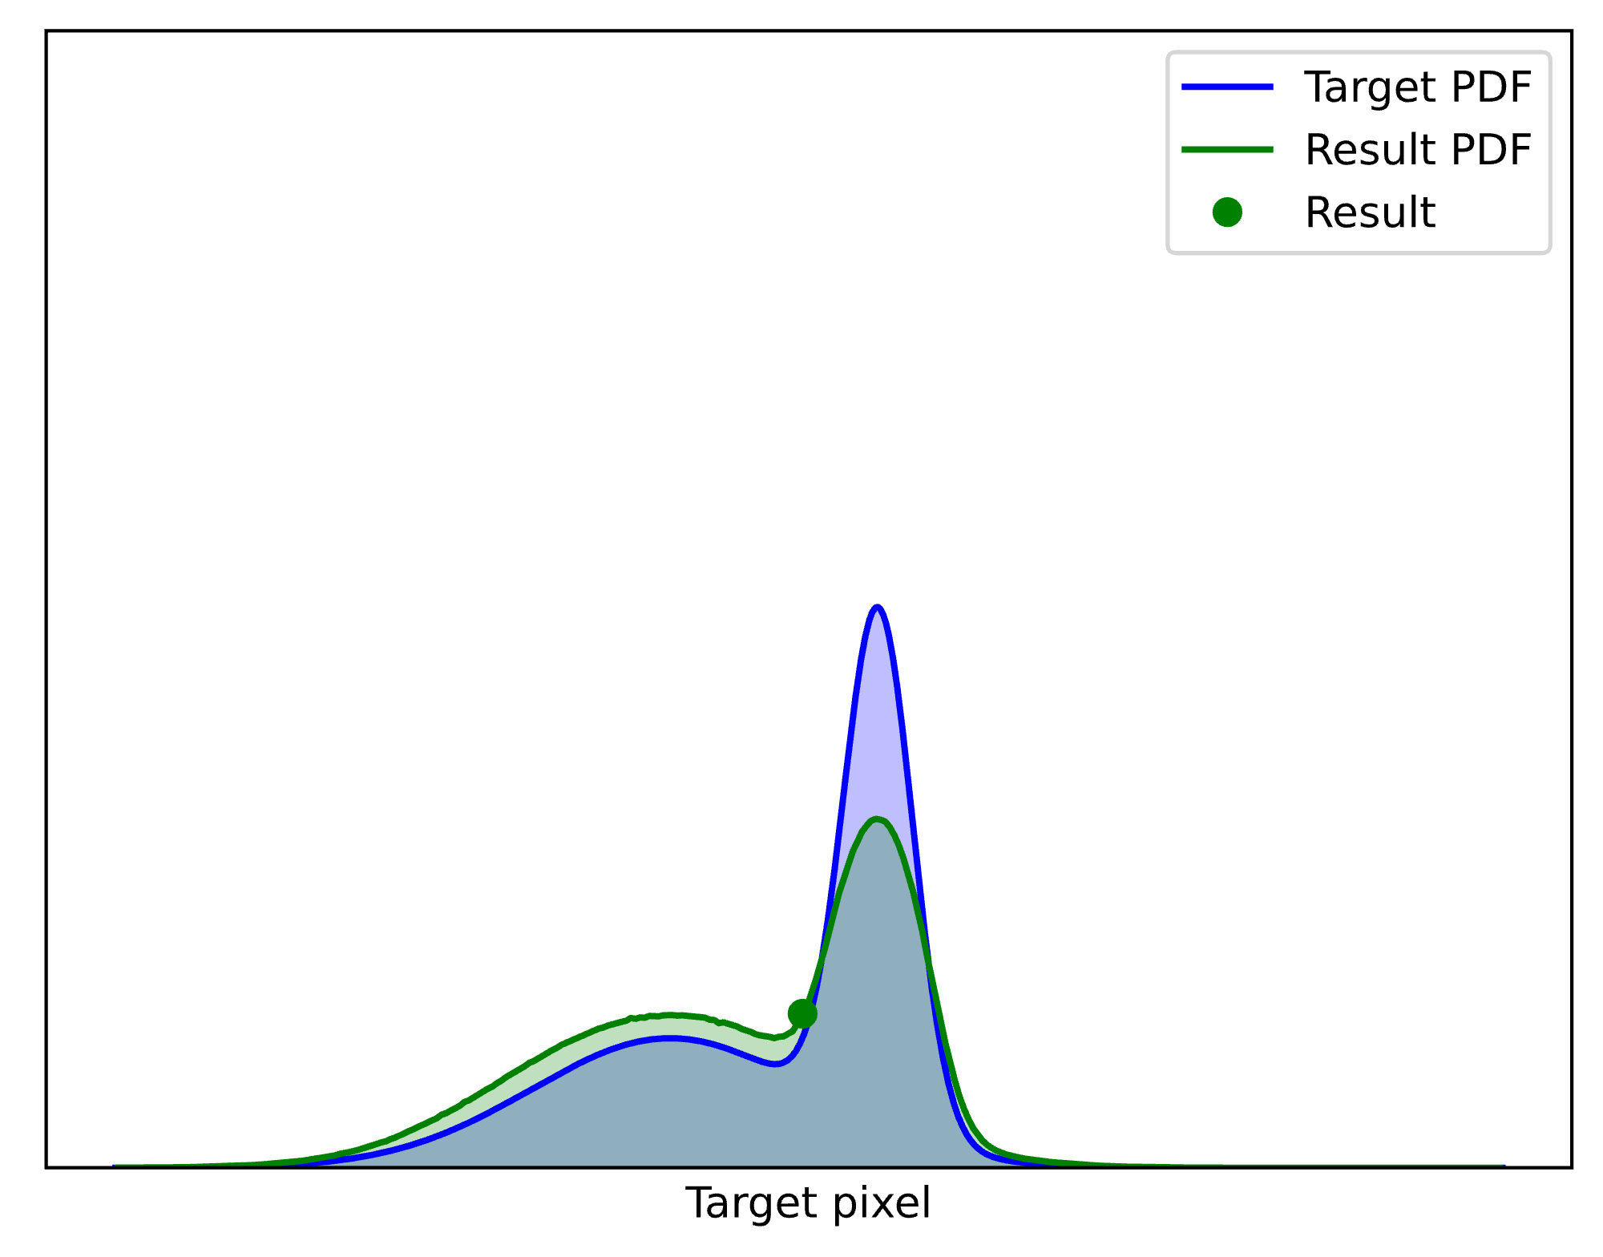
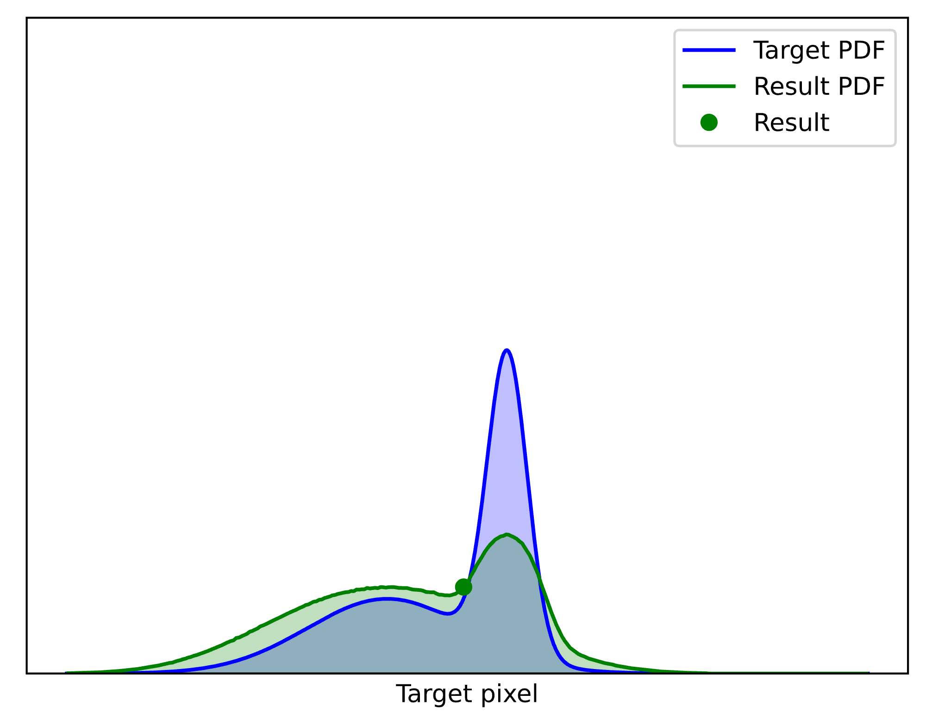
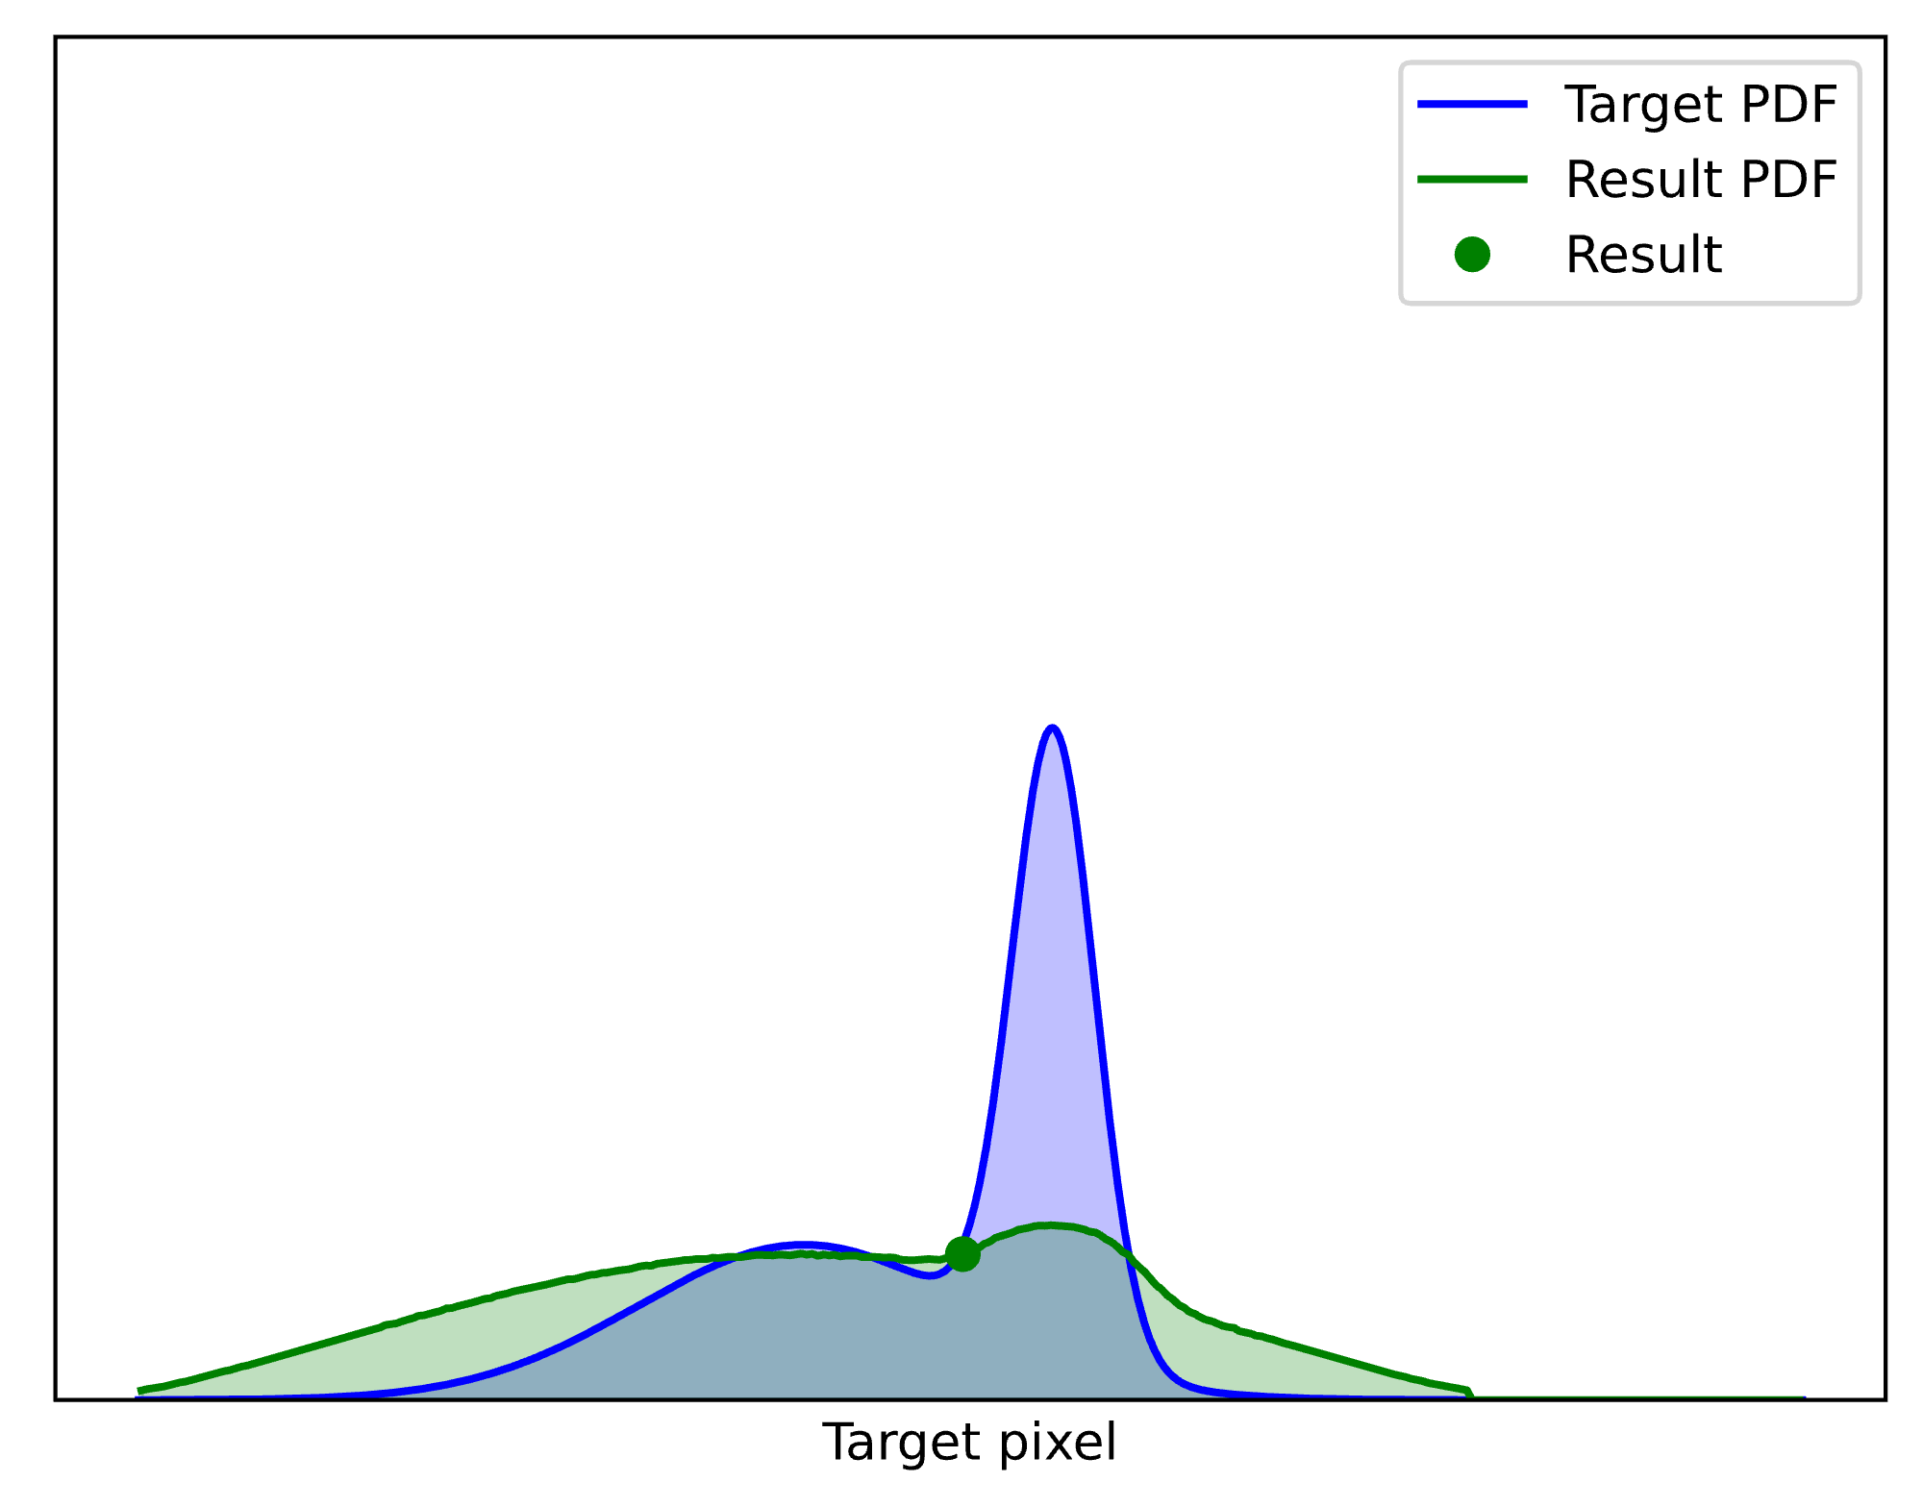

Pdf converges to target
Result distribution
$$\overline{p}$$
Let’s add more samples…
$$p$$
128
64
32
16
8
4
2
candidates
Notes:
This is the PDF of the RIS output from two candidates. Let’s increase the sample count more… 4… 8… 16… 32… 64… 128. It seems to be working! The result PDF converges towards the target!

Slide 49
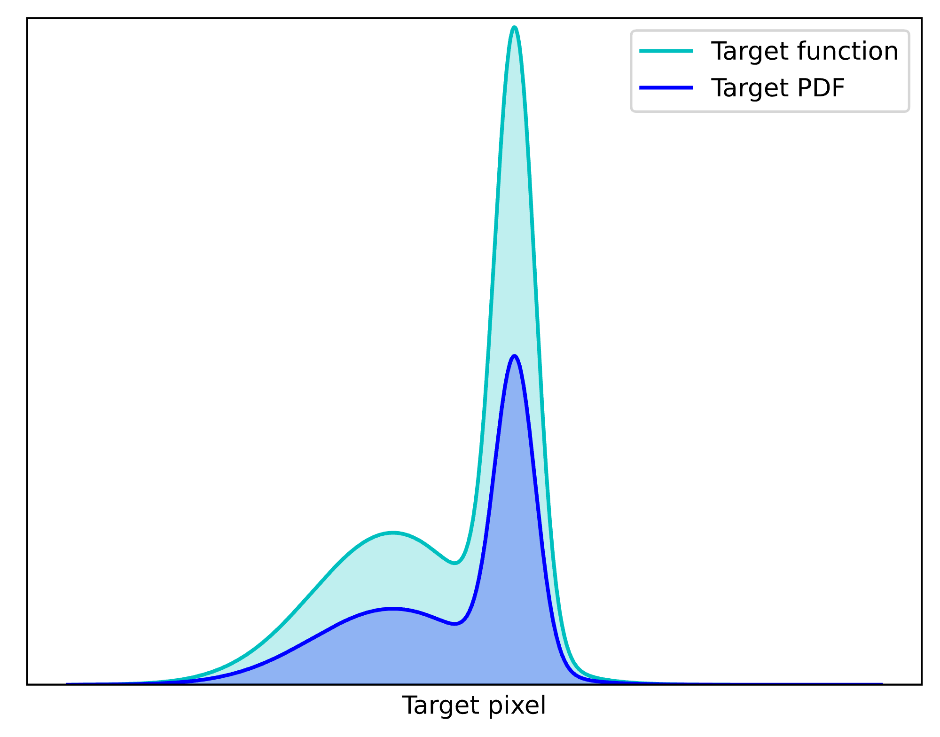


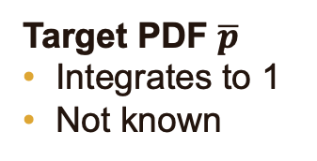
Ris: Concepts
Target function $\hat{p}$
Unnormalized
User-given
← Used in selection probabilities
Target PDF $\overline{p}$
Integrates to 1
Not known
← Result PDF approximately $\overline{p}$
Notes:
Let’s now have a look at the concepts we deal with in RIS.
We have the user-given target function p-hat, which is unnormalized, and is used for sample selection probabilities.
Its normalized version is the target PDF we already met, which integrates to 1, and is thus generally unknown. With more and more candidate samples, the PDF of the RIS output will approximate p-bar better and better.

Slide 50
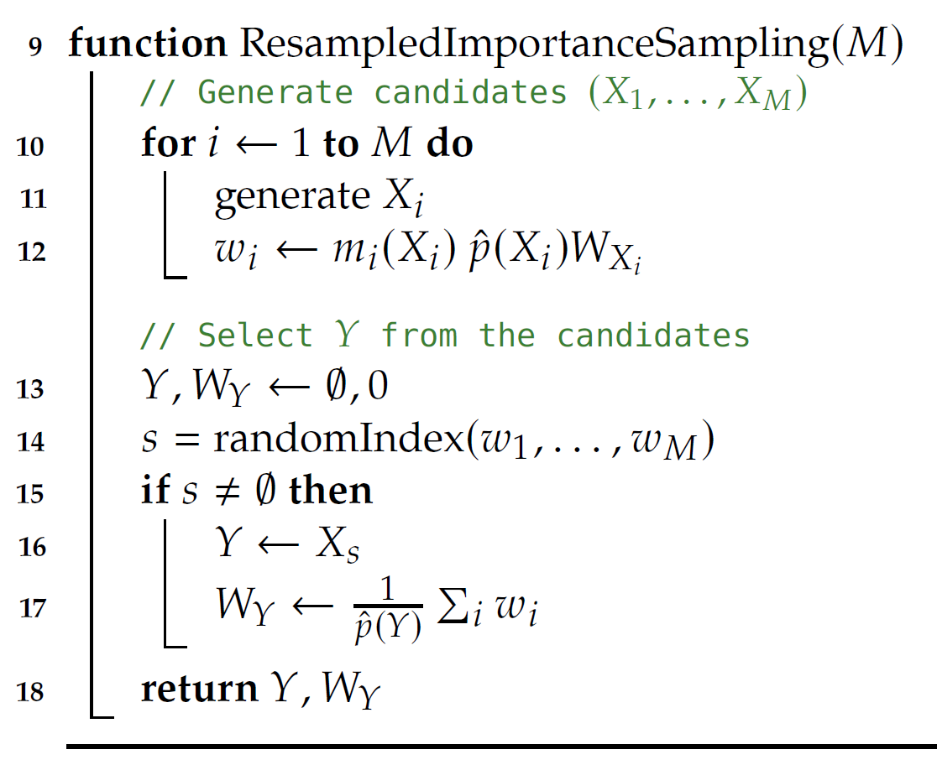
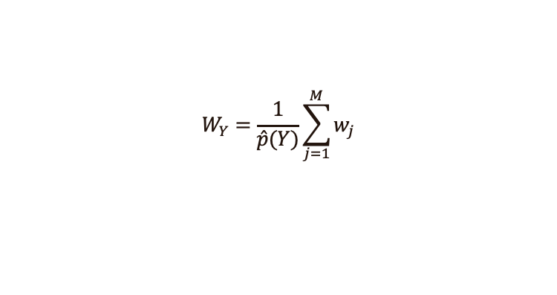


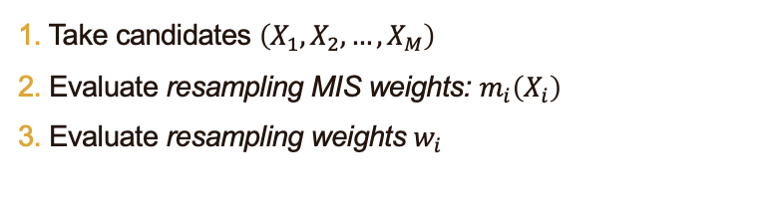
RIS: Algorithm
1. Take candidates $\left(X_{1}, X_{2},…, X_{M}\right)$
2. Evaluate resampling MIS weights: $m_{i}\left(X_{i}\right)$
3. Evaluate resampling weights $w_{i}$
e.g. $\frac{1}{M}$
e.g. $W_{X_{i}}=\frac{1}{p_{i}\left(X_{i}\right)}$
4. Choose $Y$ randomly from the $X_{i}$ proportionally to $w_{i}$
[see course notes]
$$W_{Y}=\frac{1}{\hat{p}(Y)}\sum_{j=1}^{M}{w_{j}}$$
5. Evaluate the UCW:
Notes:
If at least one resampling weight was positive, we save the chosen candidate sample and evaluate its contribution weight.

Slide 51
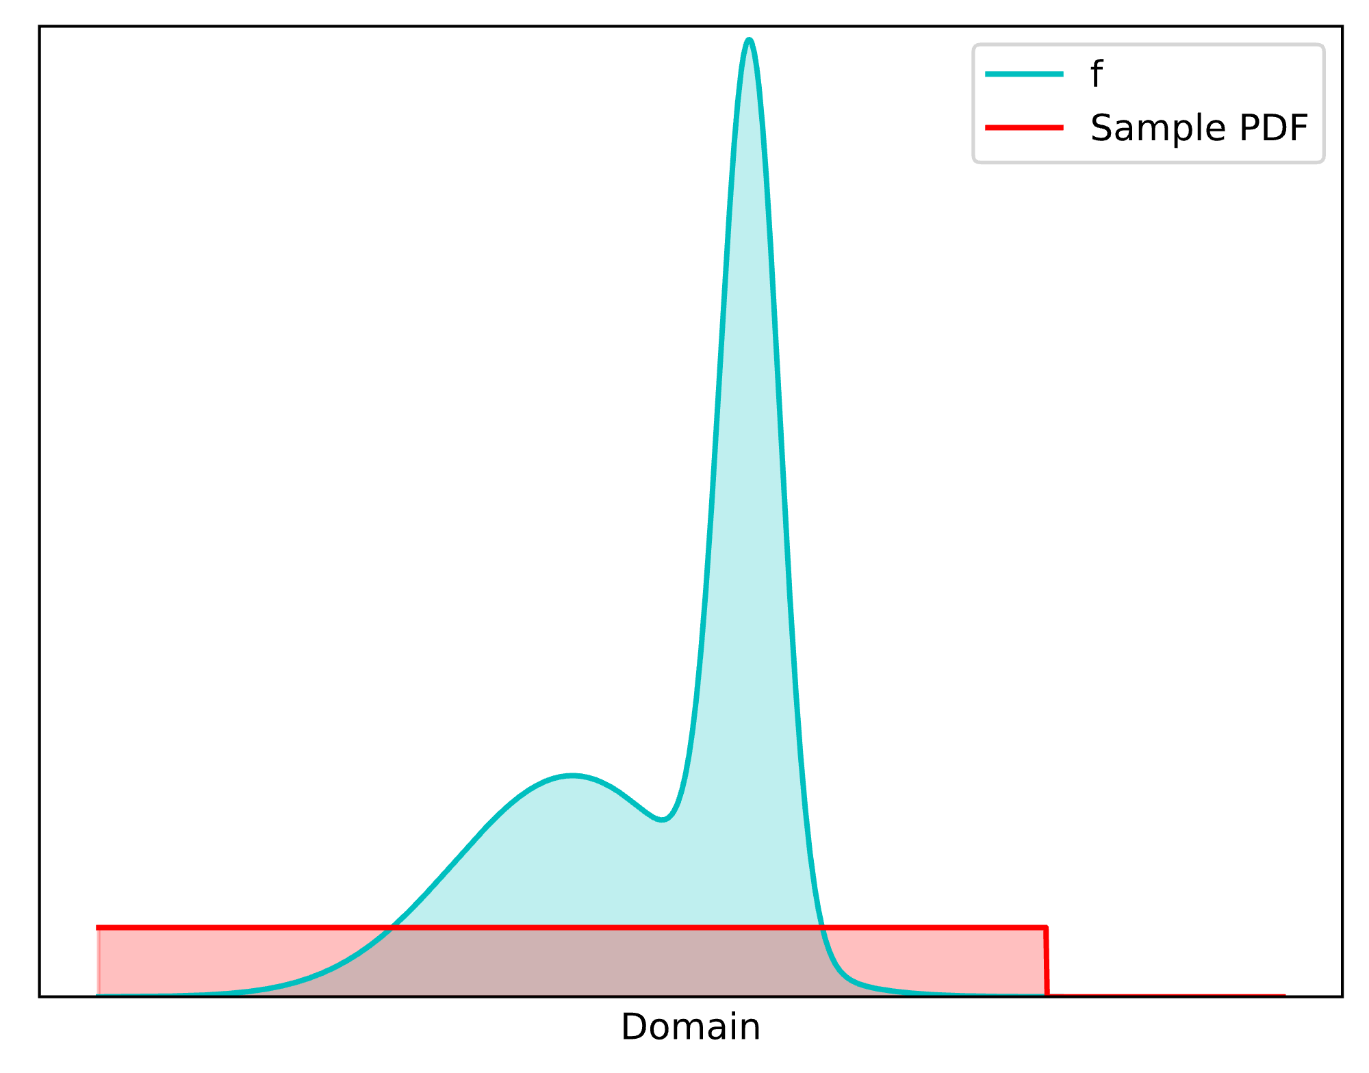







Example: simple integration
(RIS is sample aggregation)
Take the $M$samples
Evaluate resampling weights $w_{i}=m_{i}\left(X_{i}\right) \hat{p}\left(X_{i}\right)W_{X_{i}}$
Choose $Y$ proportionally to $w_{i}=\frac{1}{M}\frac{f\left(X_{i}\right)}{p\left(X_{i}\right) }$
All samples identically distributed: $\frac{1}{M}$
Best if we can afford it: $\hat{p}\left(x\right)=f\left(x\right)$
  We know $p:$ $W_{X_{i}}=\frac{1}{p\left(X_{i}\right)}$
$$X_{1}$$
$$…$$
$$X_{M}$$
Notes:
Then, we choose Y from the candidates proportionally to the resampling weights.

Slide 52
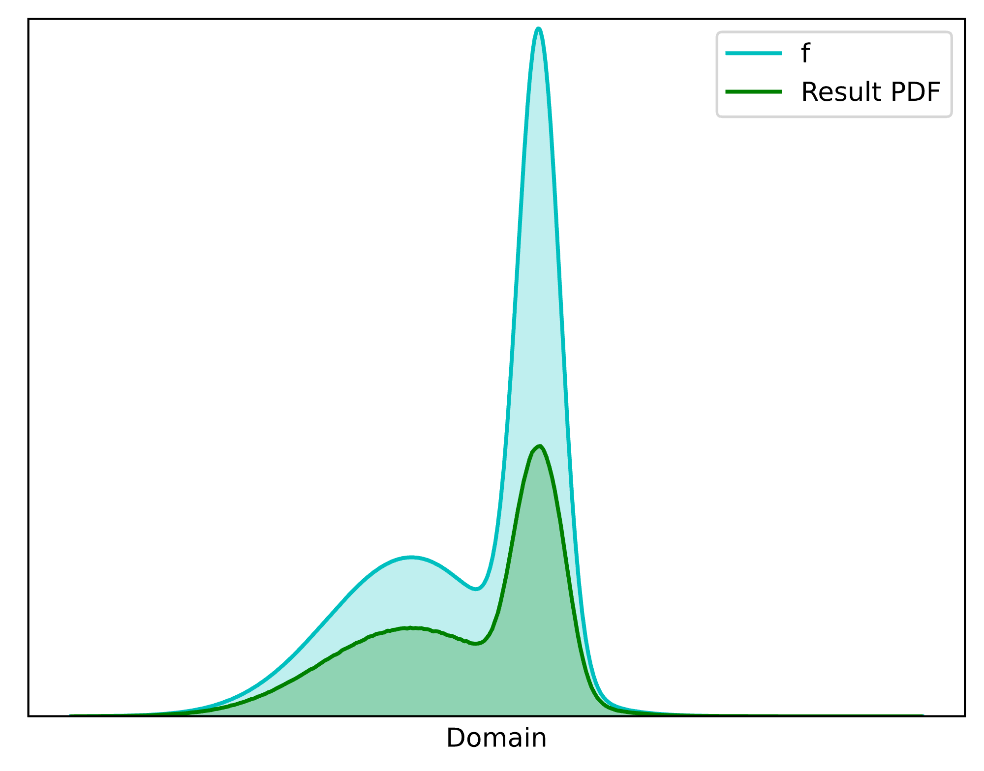
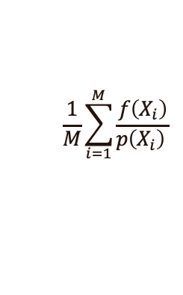




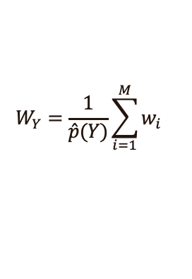
Example: simple integration
(RIS is sample aggregation)
$$W_{Y}=\frac{1}{\hat{p}(Y)}\sum_{i=1}^{M}{w_{i}}$$
4. Evaluate contribution weight
5. Integrate: $\left\langle I\right\rangle =f\left(Y\right)W_{Y}=…=$
We chose: $f\left(Y\right)$
$$\frac{1}{M}\frac{f\left(X_{i}\right)}{p\left(X_{i}\right) }$$
!
$$Y$$
$$\frac{1}{M}\sum_{i=1}^{M}{\frac{f\left(X_{i}\right)}{p\left(X_{i}\right) }}$$
One-sample RIS estimator = traditional Monte Carlo estimator with M samples!
Notes:
Let’s pause for a while –
The ONE RIS sample produces the same result as the M input samples.
RIS aggregates the inputs into one sample.

Slide 53


Ris is an aggregation machine
We got single sample that’s as good as the inputs combined!
How? Improved PDF! (By weighted selection)
$$Y$$
RIS is an aggregation machine
$$Y$$
With $\hat{p}≠f$, the result is somewhat worse due to $Var\left(\frac{f}{\hat{p}}\right)$
Notes:
So, we got one sample that’s as good as the inputs combined!
How can that be? The explanation is that the weighted selection by RIS improves the PDF of the output sample, and this is reflected in the UCW.
This makes RIS into an aggregation machine!
Note, though, that we get best results with pHat = f; otherwise, there is some inefficiency from the varying ratio of f and pHat.

Slide 54
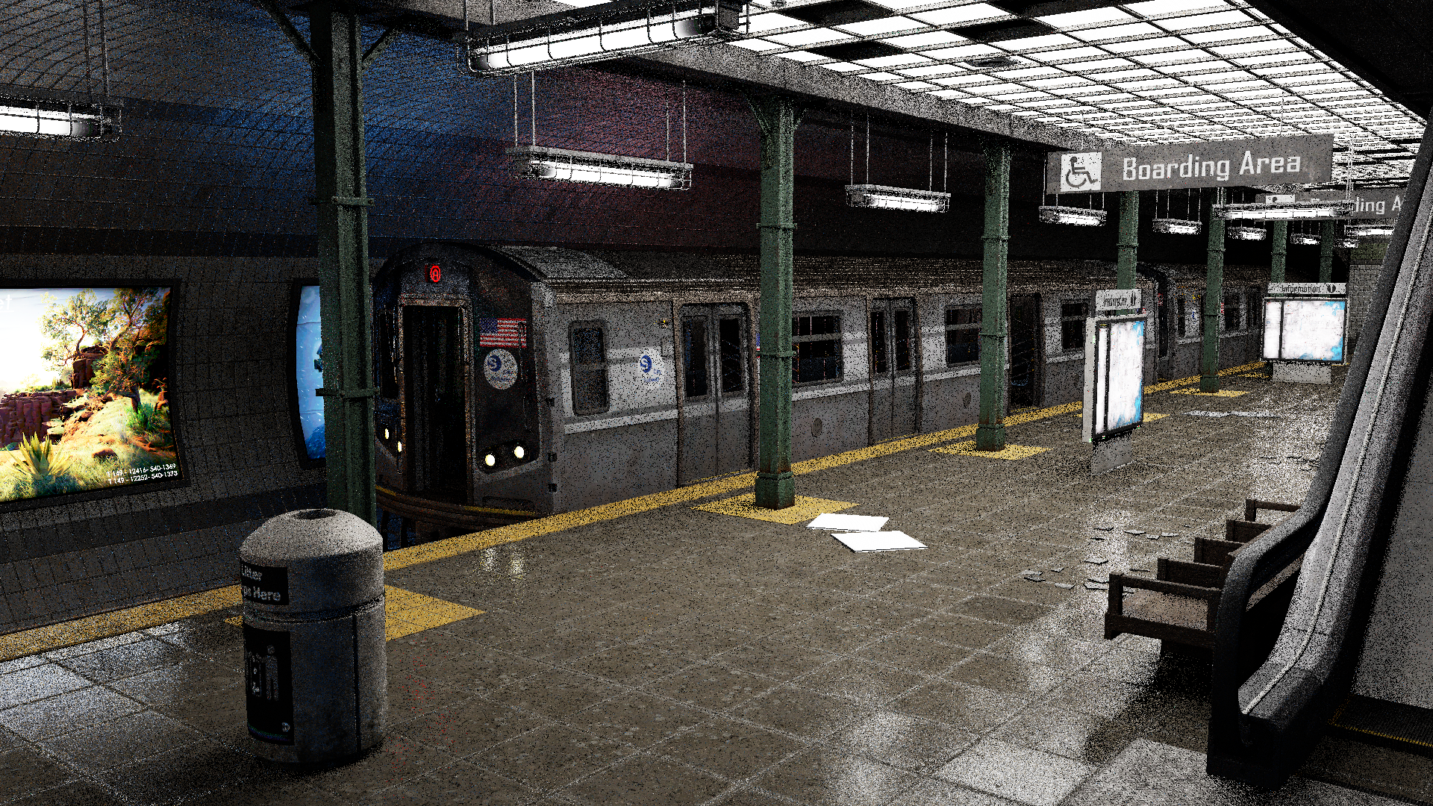
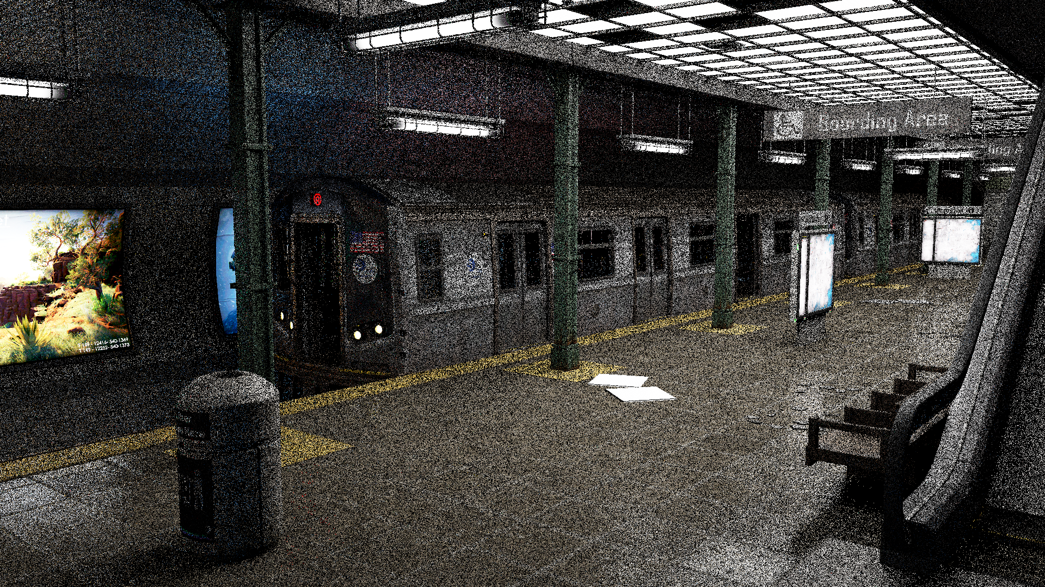
Temporal Reuse
Previous Frame
Current Frame
Notes:
We can take this one step further by reusing samples not just within a single frame, but across multiple frames too.
If we look up our current pixel in the previous frame, we’re likely going to find a good sample there for reuse.

Slide 55
Temporal Reuse
t-4
t-3
t-2
t-1
t
Notes:
If we do temporal reuse in every frame, we feed forward better and better samples in time, and we continually improve our sample distribution as we render.

Slide 56
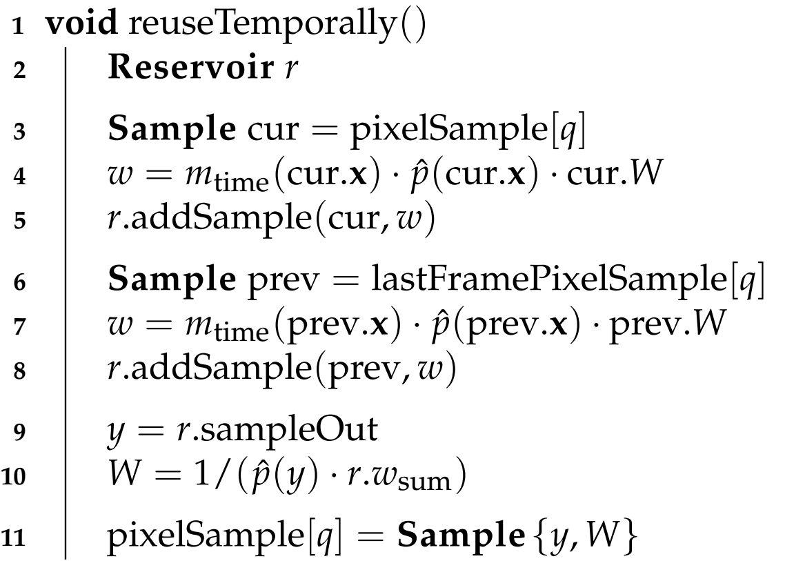

Temporal Reuse
Render passes:
generateSamples()
reuseTemporally()
reuseSpatially()
reuseSpatially()
…
shadePixel()
Notes:
Implementing this is very simple. Let's make a new pass with the same RIS boiler plate. All that we do here is add the current frame's sample, and mix in the sample from the previous frame, given that we keep the previous buffer of samples around. Aside from how we produce the samples, everything else in this pass is just the same RIS code we've seen before.
Let’s see what this buys us.

