Slide 1




Computer Graphics II: Rendering
CSE 168 [Spr 26], Lecture 1: Overview and Ray Tracing
Ravi Ramamoorthi
http://viscomp.ucsd.edu/classes/cse168/sp26/

Slide 2
Goals
Systems: Write a modern 3D image synthesis program (path tracer with importance sampling)
Theory: Mathematical aspects and algorithms underlying modern physically-based rendering
Topics: Other modern topics like image-based, real-time, precomputed, volumetric rendering
This course is not about the specifics of 3D rendering software like PBRT, Mitsuba etc. New, we optionally encourage OptiX, a real-time raytracing API for NVIDIA GPUs

Slide 3
Instructor
Ravi Ramamoorthi http://www.cs.ucsd.edu/~ravir
  PhD Stanford, 2002 [with Pat Hanrahan, 2020 Turing Award] “Spherical Harmonic Lighting” widely used in games (e.g. Halo series), movies (e.g. Avatar), etc. (Adobe, …)
  At Columbia 2002-2008, UC Berkeley 2009-2014
  “Monte Carlo denoising” inspired raytracing offline, real-time
  At UCSD since Jul 2014: Director, Center for Visual Computing
  Awards for research: White House PECASE (2008), SIGGRAPH Significant New Researcher (2007), ACM Fellow
  https://www.youtube.com/watch?v=qpyCXqXGe7I
  Computer Graphics online MOOC (CSE 167x) finalist for two edX Prizes. Will use CSE 168 MOOC on edX edge as a feedback system

Slide 4
Course Staff
Ravi Ramamoorthi, ravir@cs.ucsd.edu
Teaching Assistants:
  Nithin Raghavan [n2raghavan@ucsd.edu]
  Please see website (and piazza) for office hours etc.

Slide 5
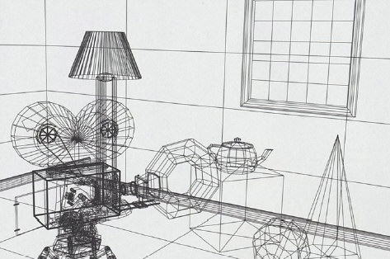
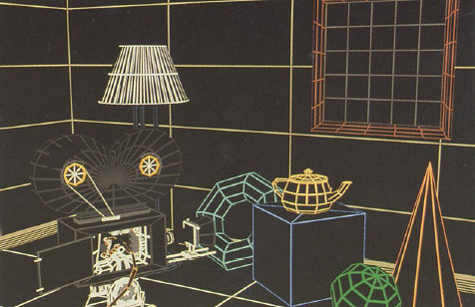
Rendering: 1960s (visibility)
  Roberts (1963), Appel (1967) - hidden-line algorithms
  Warnock (1969), Watkins (1970) - hidden-surface
  Sutherland (1974) - visibility = sorting
Images from FvDFH, Pixar’s Shutterbug
Slide ideas for history of Rendering courtesy Marc Levoy
Notes:
1970s
illustrations taken from FvDFH

Slide 6
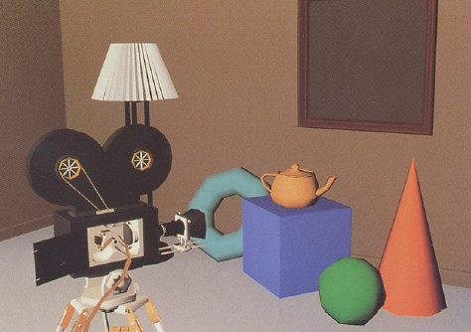
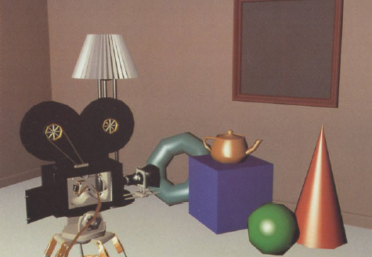
Rendering: 1970s (lighting)
1970s - raster graphics
  Gouraud (1971) - diffuse lighting, Phong (1974) - specular lighting
  Blinn (1974) - curved surfaces, texture
  Catmull (1974) - Z-buffer algorithm (2020 Turing Award)
Notes:
1970s
illustrations taken from FvDFH

Slide 7
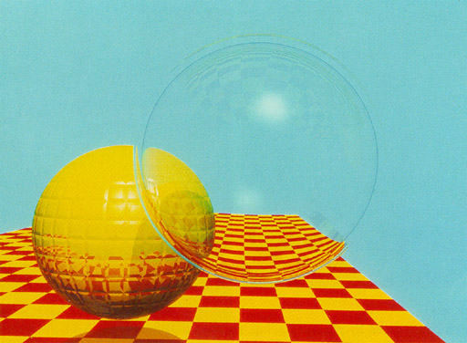
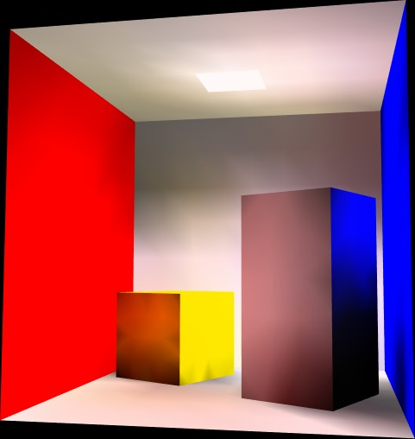
Rendering (1980s, 90s: Global Illumination)
early 1980s - global illumination
  Whitted (1980) - ray tracing
  Goral, Torrance et al. (1984) radiosity
  Kajiya (1986) - the rendering equation, path tracing (this is what this course is about, modern rendering)
Notes:
1980s
illustrations taken from Siggraph proceedings
global illumination
ray tracing = Monte Carlo evaluation of the rendering equation
radiosity = finite element evaluation of the rendering equation

Slide 8
Why Study Computer Graphics Rendering?
Applications (Movies, Games, Digital Advertising, Lighting Simulation, Digital Humans, Virtual Reality)
Fundamental Intellectual Challenges
  Create photorealistic virtual world
  Understand physics and computation of light transport
  Physically-based rendering has replaced ad-hoc approaches in industry (offline ~ 2011, real-time ~2018)
Beautiful Imagery: Realistic Computer Graphics
  2020 Turing Award given for CGI in Filmmaking
Assume taken CSE 167 or equivalent (+done well)
  This is a challenging course, work starts immediately
  (First 2 weeks on raytracing may be review for some)

Slide 9
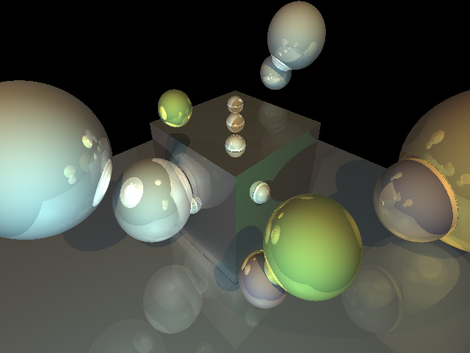
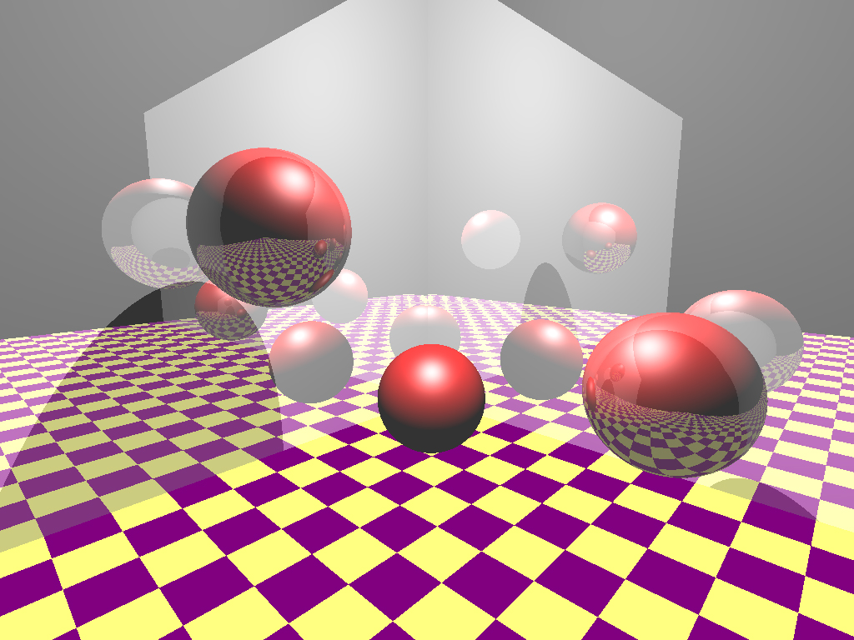
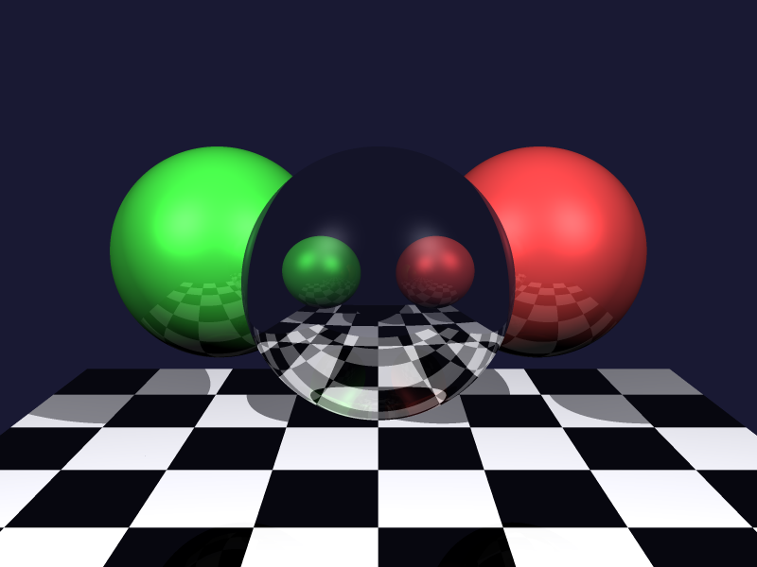
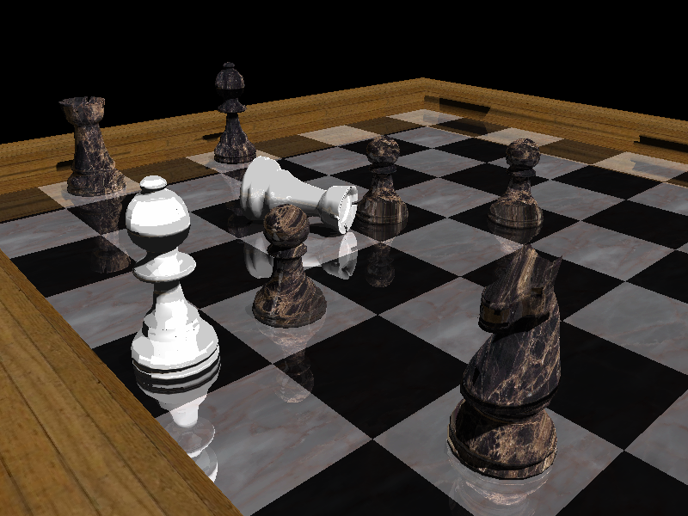
Image Synthesis Examples
Collage from 2007

Slide 10
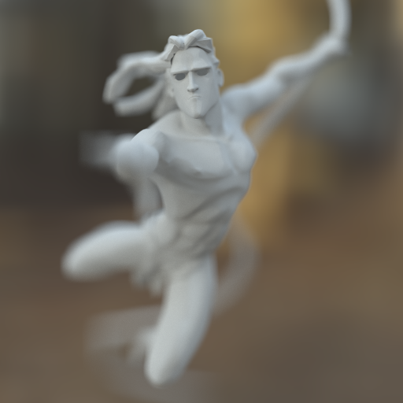
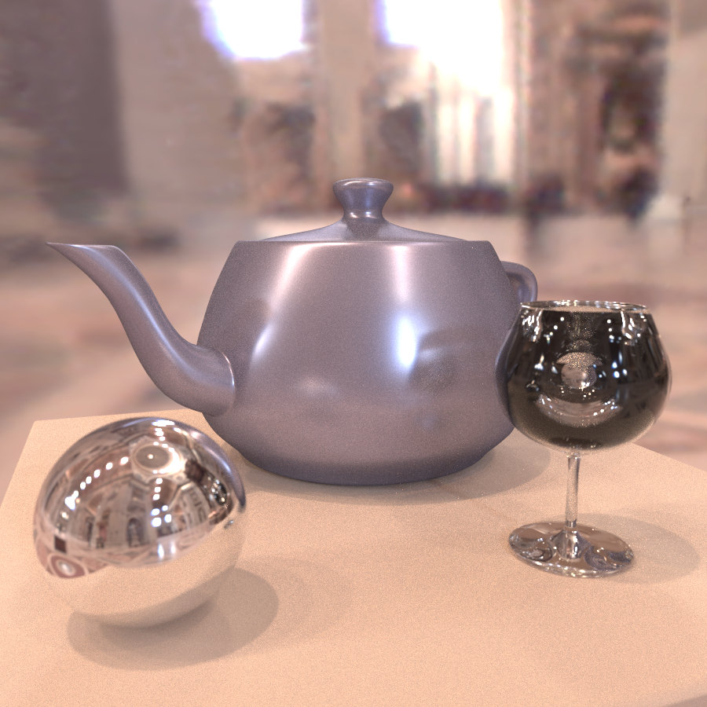
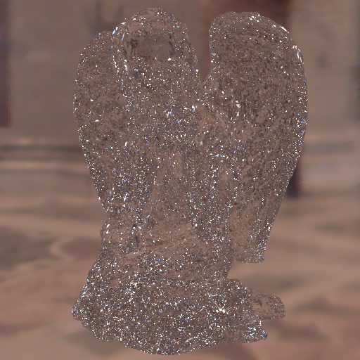
From UCB CS 294 16 years ago
Daniel Ritchie and Lita Cho

Slide 11

CSE 168 Contest 2007: Butterfly

Slide 12
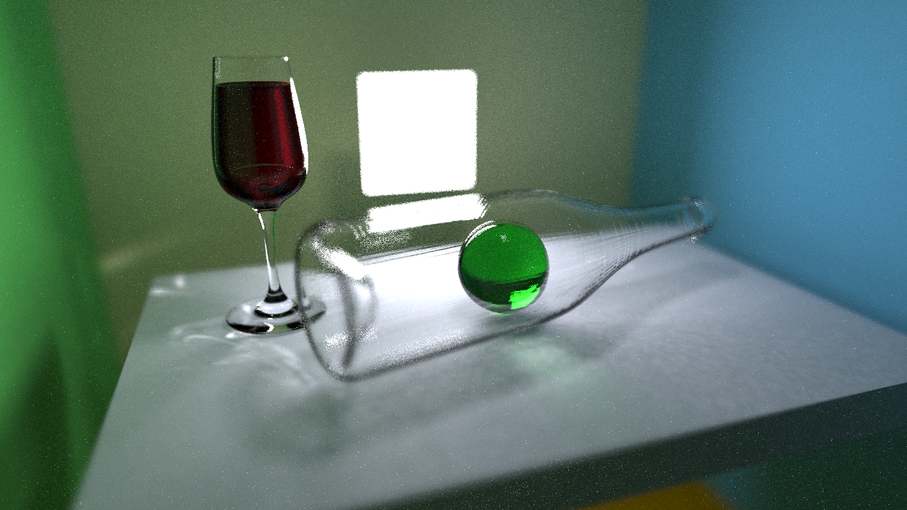
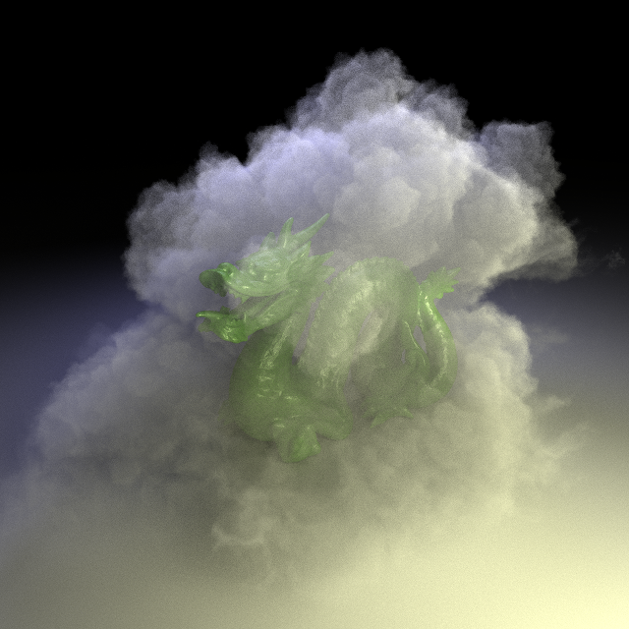
CSE 168 Spring 2020

Slide 13

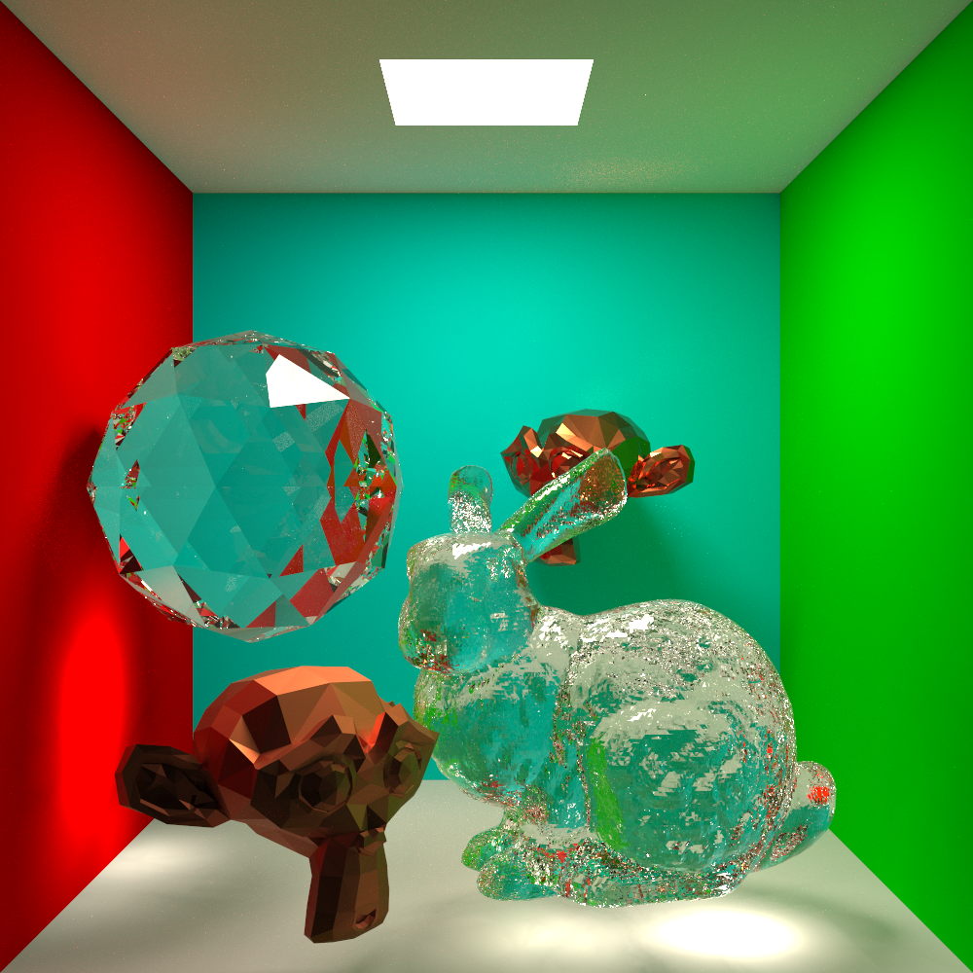
CSE 168 Spring 2021

Slide 14
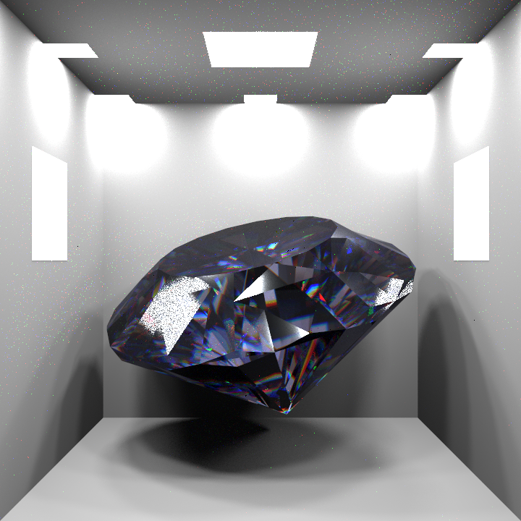
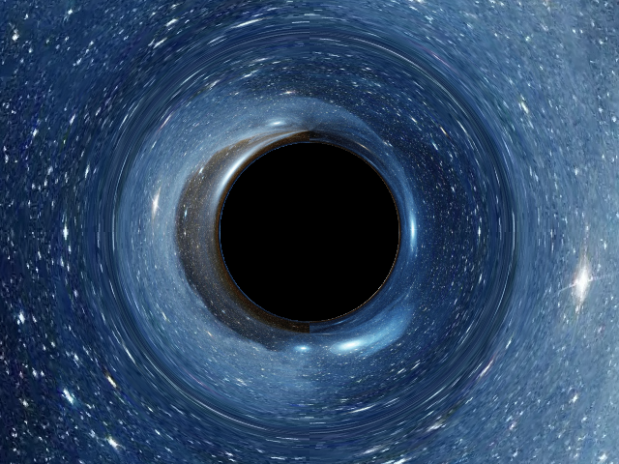
CSE 168 Spring 2025

Slide 15
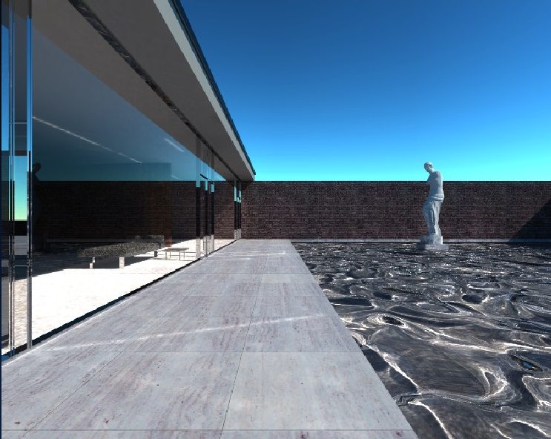
Mies House: Swimming Pool

Slide 16
Logistics
Website https://viscomp.ucsd.edu/classes/cse168/sp26/168.html has most of the information (look at it carefully)
We will be leveraging full MOOC infrastructure (use private SPOC)
  Please join course course on edX edge: DEMO
  Compulsory for most assignments, feedback systems
  Must still submit “official” CSE 168 assignment (see website)
  Please do ask us if you are confused; we are here to help
  No required texts; optional PBRT book, Digital Image Synthesis
  Office hours: after class (Tu/Thu 11-12) in CSE 4118
Course newsgroup on Piazza, or can use edX edge directly
Website for late, collaboration policy (groups of 2), etc
Do try to attend class sessions (and discussions, keep assigned section)
Questions?

Slide 17
This is a Modernized Course
Teach Modern Physically-Based Rendering and Path Tracing, as used in industry (Prof. consulted with Pixar on change to physically-based shading, importance sampling in 2011, written many key papers; consults NVIDIA)
Emphasis on step-by-step development, get it right (lots of subtle math, compare to reference solutions)
Focus on offline but discuss real-time, image-based, PRT
Homework starts right away, due in 2 weeks
  New developments: NVIDIA OptiX ray-tracing API like OpenGL, since 2018 RTX cards 10G rays/second Video
Encourage (but optional) use of OptiX. If you use this, setup yourself but basic skeleton provided. Or really slow.

Slide 18
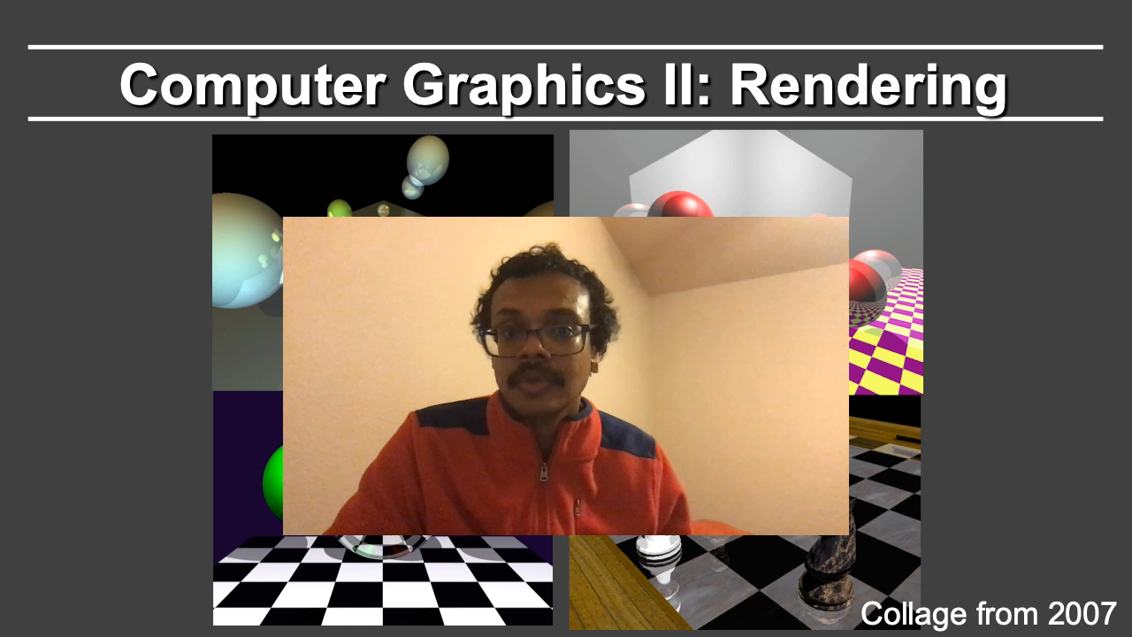
UCSD Online Overview Video

Slide 19
Innovation: Feedback Servers
Feedback/Grading servers for homeworks 1-4
Submit images, compare to original
  Program generates difference images, report url
  Can get feedback multiple times; submit final url
  All run on edX edge (also have alternative standalone)
“Feedback” not necessarily grading
  Can run extra test cases, look at code, grade fairly
  But use of feedback servers/edX edge is mandatory
  Note for this course; unlike 167 results not deterministic, will give information re noise/variance
  Can use any laptop/desktop, do it offline or in OptiX
Will test out with HW 1 images

Slide 20
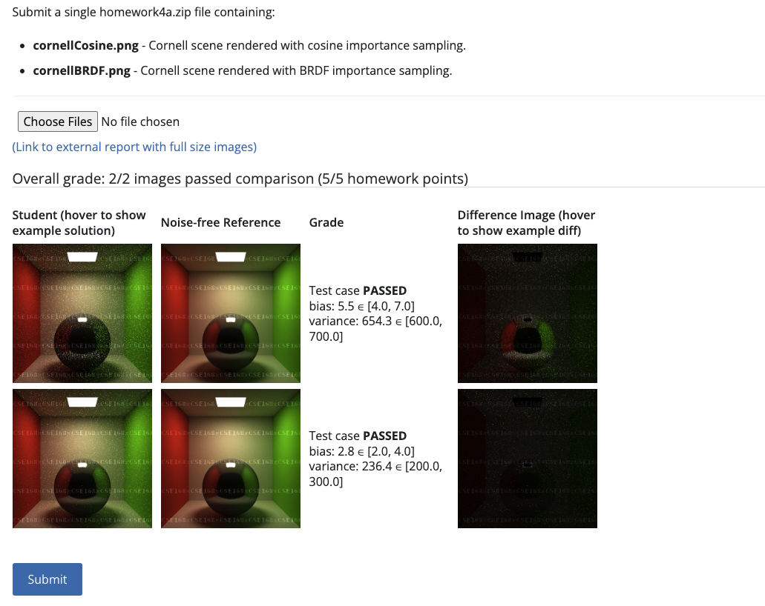
Demo of edX edge, Feedbacks

Slide 21
Workload
Lots of fun, rewarding but may involve significant work
  Previous reviews: “Undergraduate in name only” ”Most time consuming course at UCSD”
5 programming projects; almost all are time-consuming. Can be done in groups of two. START EARLY !!
Graded entirely on programming, weights on 168 website
  Writeups on 168 website for assignments really good, look at them
Prerequisites: CSE 167, did well, enjoyed it
First homework last assignment in my CSE 167
  Little bit of sink or swim to continue in course (but we will also provide OptiX, embree references after assignment is due)
  But not everyone has done a raytracer before, some additional requirements for those who have already done one
Should be a difficult, but fun and rewarding course

Slide 22
Quick Inclusion Note
Since I do occasionally get asked this question:
You are welcome to take this course if color-blind
  Let me know if I create too many red-green metamers
  Some of the best-known computer graphics researchers have been color-blind (ask re some stories)
And for most other vision issues
  We’ve even had computer graphics award winners who have been extremely nearsighted (legally blind)

Slide 23
CSE 168 is only a first step
If you enjoy CSE 168 and do well:
CSE 165 (VR course; Weibel)
Next winter: 169 (Animation)
Graduate: CSE 272, 274 (Topics), 273, many 291s

Slide 24
To Do
Look at website
Various policies for course. E-mail if confused.
Sign up for edX edge, Piazza, etc.
Skim assignments if you want. All are ready
Assignment 1, Due Apr 13 (see website).
Any questions?
Start now with raytracing lecture

Slide 25
Effects needed for Realism
(Soft) Shadows
Reflections (Mirrors and Glossy)
Transparency (Water, Glass)
Interreflections (Color Bleeding)
Complex Illumination (Natural, Area Light)
Realistic Materials (Velvet, Paints, Glass)
And many more

Slide 26
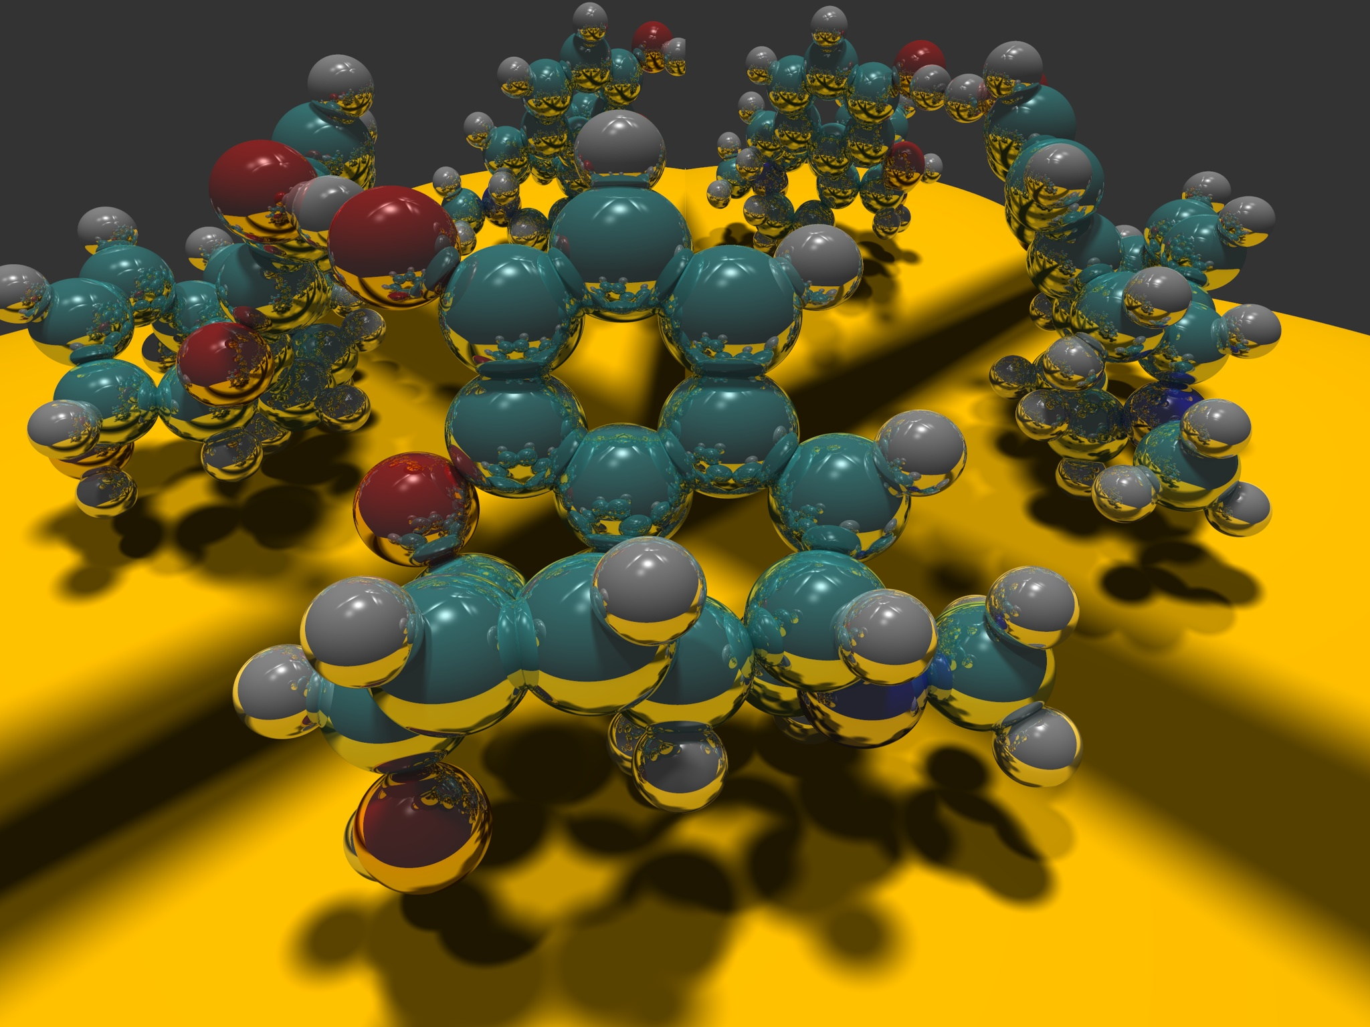
Image courtesy Paul Heckbert 1983

Slide 27
Ray Tracing
Different Approach to Image Synthesis as compared to Hardware pipeline (OpenGL)
Pixel by Pixel instead of Object by Object
Easy to compute shadows/transparency/etc

Slide 28
Outline
History
Basic Ray Casting (instead of rasterization)
  Comparison to hardware scan conversion
Shadows / Reflections (core algorithm)
Optimizations
Current Research

Slide 29
Ray Tracing: History
Appel 68
Whitted 80 [recursive ray tracing]
  Landmark in computer graphics
Lots of work on various geometric primitives
Lots of work on accelerations
Current Research
  Real-Time raytracing (historically, slow technique)
  Ray tracing architecture

Slide 30
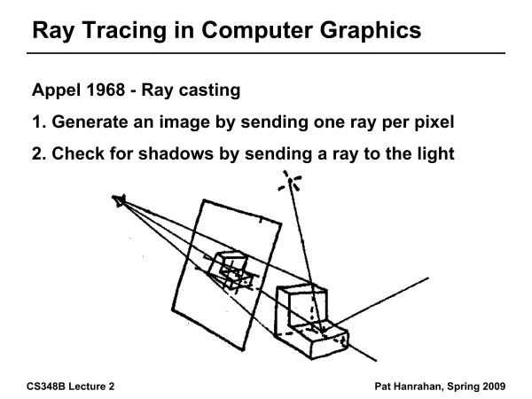
Ray Tracing History

Slide 31
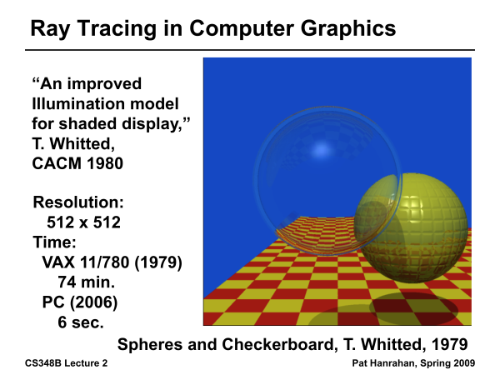
Ray Tracing History

Slide 32
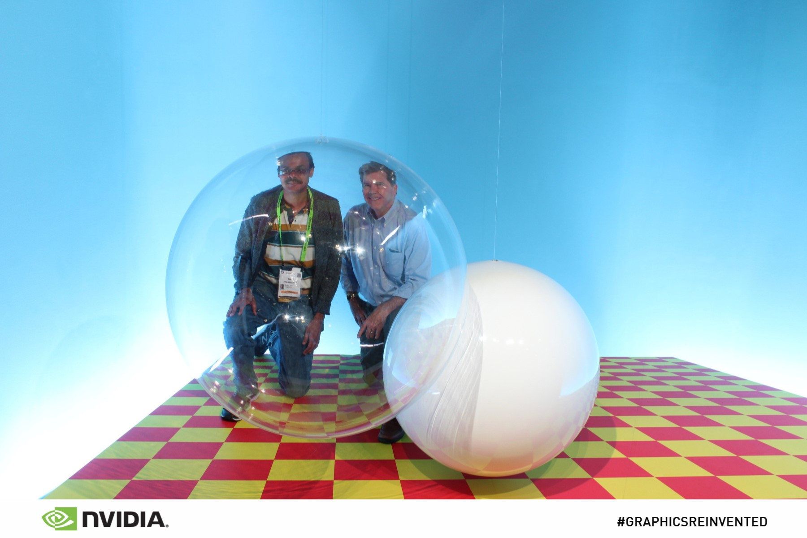
From SIGGRAPH 18
Real Photo: Instructor and Turner Whitted at SIGGRAPH 18

Slide 33
Outline
History
Basic Ray Casting (instead of rasterization)
  Comparison to hardware scan conversion
Shadows / Reflections (core algorithm)
Optimizations
Current Research

Slide 34
Ray Casting
Produce same images as with OpenGL
  Visibility per pixel instead of Z-buffer
  Find nearest object by shooting rays into scene
  Shade it as in standard OpenGL

Slide 35
Ray Casting
Virtual Viewpoint
Virtual Screen
Objects
Multiple intersections: Use closest one (as does OpenGL)
Ray misses all objects: Pixel colored black
Ray intersects object: shade using color, lights, materials

Slide 36
Comparison to hardware scan-line
Per-pixel evaluation, per-pixel rays (not scan-convert each object). On face of it, costly
But good for walkthroughs of extremely large models (amortize preprocessing, low complexity)
More complex shading, lighting effects possible

Slide 37
Outline in Code
Image Raytrace (Camera cam, Scene scene, int width, int height)
{
Image image = new Image (width, height) ;
for (int i = 0 ; i < height ; i++)
for (int j = 0 ; j < width ; j++) {
Ray ray = RayThruPixel (cam, i, j) ;
Intersection hit = Intersect (ray, scene) ;
image[i][j] = FindColor (hit) ;
}
return image ;
}

Slide 38
Finding Ray Direction
Goal is to find ray direction for given pixel i and j
Many ways to approach problem
  Objects in world coord, find dirn of each ray (we do this)
  Camera in canonical frame, transform objects (OpenGL)
Basic idea
  Ray has origin (camera center) and direction
  Find direction given camera params and i and j
Camera params as in gluLookAt
  Lookfrom[3], LookAt[3], up[3], fov

Slide 39
Similar to gluLookAt derivation
gluLookAt(eyex, eyey, eyez, centerx, centery, centerz, upx, upy, upz)
Camera at eye, looking at center, with up direction being up
Up vector
Eye
Center
From 167 lecture on deriving gluLookAt

Slide 40
Constructing a coordinate frame?
We want to associate w with a, and v with b
  But a and b are neither orthogonal nor unit norm
  And we also need to find u
From 167 basic math lecture - Vectors: Orthonormal Basis Frames

Slide 41
Camera coordinate frame
We want to position camera at origin, looking down –Z dirn
Hence, vector a is given by eye – center
The vector b is simply the up vector
Up vector
Eye
Center

Slide 42
Canonical viewing geometry
βv
-w
αu

Slide 43
Outline in Code
Image Raytrace (Camera cam, Scene scene, int width, int height)
{
Image image = new Image (width, height) ;
for (int i = 0 ; i < height ; i++)
for (int j = 0 ; j < width ; j++) {
Ray ray = RayThruPixel (cam, i, j) ;
Intersection hit = Intersect (ray, scene) ;
image[i][j] = FindColor (hit) ;
}
return image ;
}

Slide 44
Ray/Object Intersections
Heart of Ray Tracer
  One of the main initial research areas
  Optimized routines for wide variety of primitives
Various types of info
  Shadow rays: Intersection/No Intersection
  Primary rays: Point of intersection, material, normals
  Texture coordinates
Work out examples
  Triangle, sphere, polygon, general implicit surface

Slide 45
Ray-Sphere Intersection
C
P₀

Slide 46
Ray-Sphere Intersection
Substitute
Simplify

Slide 47
Ray-Sphere Intersection
2 real positive roots: pick smaller root
Both roots same: tangent to sphere
One positive, one negative root: ray origin inside sphere (pick + root)
Complex roots: no intersection (check discriminant of equation first)
Solve quadratic equations for t

Slide 48
Ray-Sphere Intersection
Intersection point:
Normal (for sphere, this is same as coordinates in sphere frame of reference, useful other tasks)

Slide 49
Ray-Triangle Intersection
One approach: Ray-Plane intersection, then check if inside triangle
Plane equation:
B
A
C

Slide 50
Ray-Triangle Intersection
One approach: Ray-Plane intersection, then check if inside triangle
Plane equation:
Combine with ray equation:
B
A
C

Slide 51
Ray inside Triangle
Once intersect with plane, still need to find if in triangle
Many possibilities for triangles, general polygons (point in polygon tests)
We find parametrically [barycentric coordinates]. Also useful for other applications (texture mapping)
B
A
α
β
P
γ
C

Slide 52
Ray inside Triangle
B
A
α
β
P
γ
C

Slide 53
Other primitives
Much early work in ray tracing focused on ray-primitive intersection tests
Cones, cylinders, ellipsoids
Boxes (especially useful for bounding boxes)
General planar polygons
Many more
Consult chapter in Glassner (handed out) for more details and possible extra credit

Slide 54
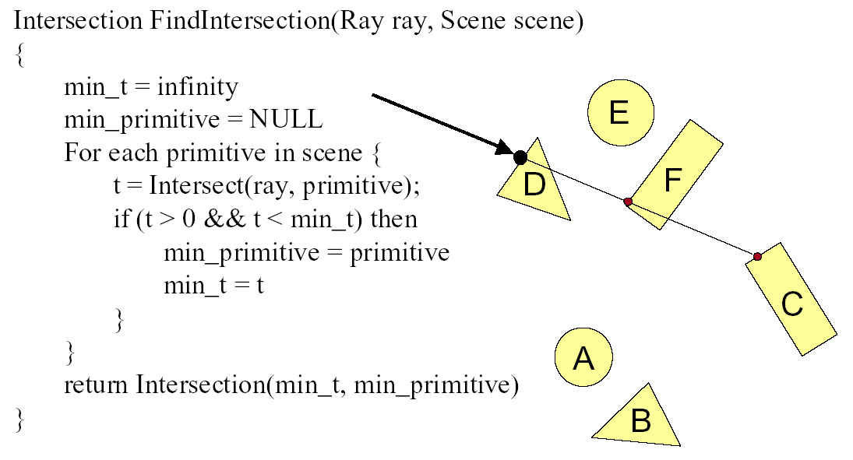
Ray Scene Intersection

Slide 55
Transformed Objects
E.g. transform sphere into ellipsoid
Could develop routine to trace ellipsoid (compute parameters after transformation)
May be useful for triangles, since triangle after transformation is still a triangle in any case
But can also use original optimized routines

Slide 56
Ray-Tracing Transformed Objects
We have an optimized ray-sphere test
  But we want to ray trace an ellipsoid…
Solution: Ellipsoid transforms sphere
  Apply inverse transform to ray, use ray-sphere
  Allows for instancing (traffic jam of cars)
  Same idea for other primitives

Slide 57
Transformed Objects
Consider a general 4x4 transform M
  Will need to implement matrix stacks like in OpenGL
Apply inverse transform M⁻¹ to ray
  Locations stored and transform in homogeneous coordinates
  Vectors (ray directions) have homogeneous coordinate set to 0 [so there is no action because of translations]
Do standard ray-surface intersection as modified
Transform intersection back to actual coordinates
  Intersection point p transforms as Mp
  Distance to intersection if used may need recalculation
  Normals n transform as M^{-t}n. Do all this before lighting

Slide 58
Outline
History
Basic Ray Casting (instead of rasterization)
  Comparison to hardware scan conversion
Shadows / Reflections (core algorithm)
Optimizations
Current Research

Slide 59
Shadows
Light Source
Virtual Viewpoint
Virtual Screen
Objects
Shadow ray to light is blocked: object in shadow
Shadow ray to light is unblocked: object visible

Slide 60
Shadows: Numerical Issues
Numerical inaccuracy may cause intersection to be
below surface (effect exaggerated in figure)
Causing surface to incorrectly shadow itself
Move a little towards light before shooting shadow ray

Slide 61
Outline in Code
Image Raytrace (Camera cam, Scene scene, int width, int height)
{
Image image = new Image (width, height) ;
for (int i = 0 ; i < height ; i++)
for (int j = 0 ; j < width ; j++) {
Ray ray = RayThruPixel (cam, i, j) ;
Intersection hit = Intersect (ray, scene) ;
image[i][j] = FindColor (hit) ;
}
return image ;
}

Slide 62
Lighting Model
Similar to OpenGL
Lighting model parameters (global)
  Ambient r g b
  Attenuation const linear quadratic
Per light model parameters
  Directional light (direction, RGB parameters)
  Point light (location, RGB parameters)

Slide 63
Material Model
Diffuse reflectance (r g b)
Specular reflectance (r g b)
Shininess s
Emission (r g b)
All as in OpenGL

Slide 64
Shading Model
Global ambient term, emission from material
For each light, diffuse specular terms
Note visibility/shadowing for each light (not in OpenGL)
Evaluated per pixel per light (not per vertex)

Slide 65
Mirror Reflections/Refractions
Virtual Viewpoint
Virtual Screen
Objects
Generate reflected ray in mirror direction,
Get reflections and refractions of objects

Slide 66
Recursive Ray Tracing
For each pixel
  Trace Primary Eye Ray, find intersection
  Trace Secondary Shadow Ray(s) to all light(s)
    Color = Visible ? Illumination Model : 0 ;
  Trace Reflected Ray
    Color += reflectivity * Color of reflected ray

Slide 67
Recursive Shading Model
Highlighted terms are recursive specularities [mirror reflections] and transmission (latter is extra credit)
Trace secondary rays for mirror reflections and refractions, include contribution in lighting model
GetColor calls RayTrace recursively (the I values in equation above of secondary rays are obtained by recursive calls)

Slide 68
Problems with Recursion
Reflection rays may be traced forever
Generally, set maximum recursion depth
Same for transmitted rays (take refraction into account)

Slide 69
Turner Whitted 1980

Slide 70
Effects needed for Realism
(Soft) Shadows
Reflections (Mirrors and Glossy)
Transparency (Water, Glass)
Interreflections (Color Bleeding)
Complex Illumination (Natural, Area Light)
Realistic Materials (Velvet, Paints, Glass)
Discussed in this lecture
Not discussed but possible with distribution ray tracing
Hard (but not impossible) with ray tracing; radiosity methods
All are possible with path tracing developed in this course

Slide 71
Some basic add ons
Area light sources and soft shadows: break into grid of n x n point lights
  Use jittering: Randomize direction of shadow ray within small box for given light source direction
  Jittering also useful for antialiasing shadows when shooting primary rays
More complex reflectance models
  Simply update shading model
  But at present, we can handle only mirror global illumination calculations
Some of these required for those who have already done a raytracer (167 with Chern or me)

Slide 72
Outline
History
Basic Ray Casting (instead of rasterization)
  Comparison to hardware scan conversion
Shadows / Reflections (core algorithm)
Optimizations
Current Research

Slide 73
Acceleration
Testing each object for each ray is slow
  Fewer Rays
    Adaptive sampling, depth control
  Generalized Rays
    Beam tracing, cone tracing, pencil tracing etc.
  Faster Intersections
    Optimized Ray-Object Intersections
    Fewer Intersections

Slide 74
Acceleration Structures
Bounding boxes (possibly hierarchical)
  If no intersection bounding box, needn’t check objects
Bounding Box
Ray
Spatial Hierarchies (Oct-trees, kd trees, BSP trees)

Slide 75
Ray Tracing Acceleration Structures
Bounding Volume Hierarchies (BVH)
Uniform Spatial Subdivision (Grids)
Binary Space Partitioning (BSP Trees)
  Axis-aligned often for ray tracing: kd-trees
Conceptually simple, implementation a bit tricky
  Lecture relatively high level: Start early
  Remember that acceleration a small part of grade
  But will struggle in future if developing in software

Slide 76
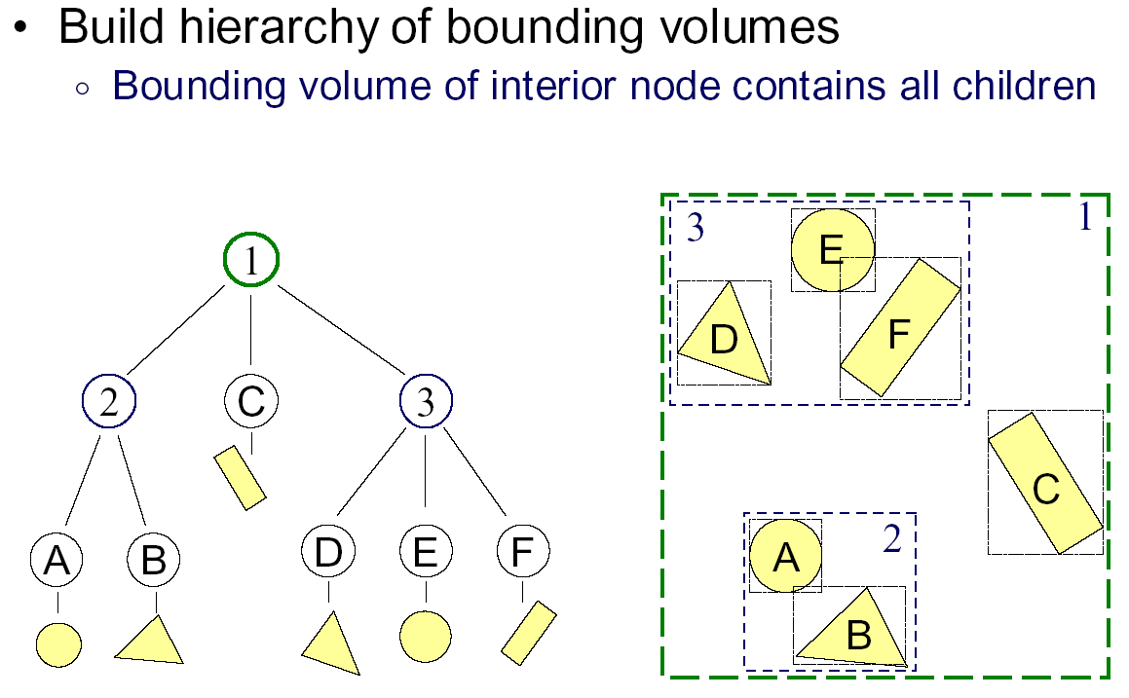
Bounding Volume Hierarchies 1

Slide 77
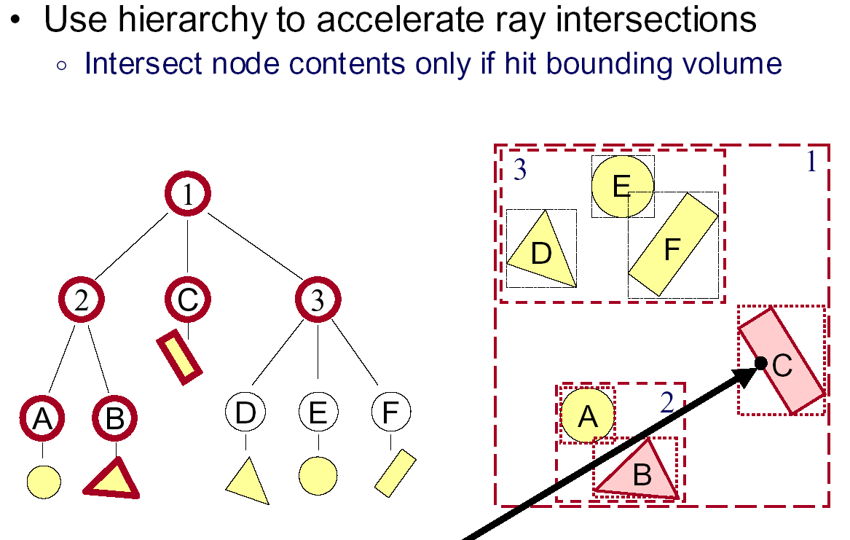
Bounding Volume Hierarchies 2

Slide 78
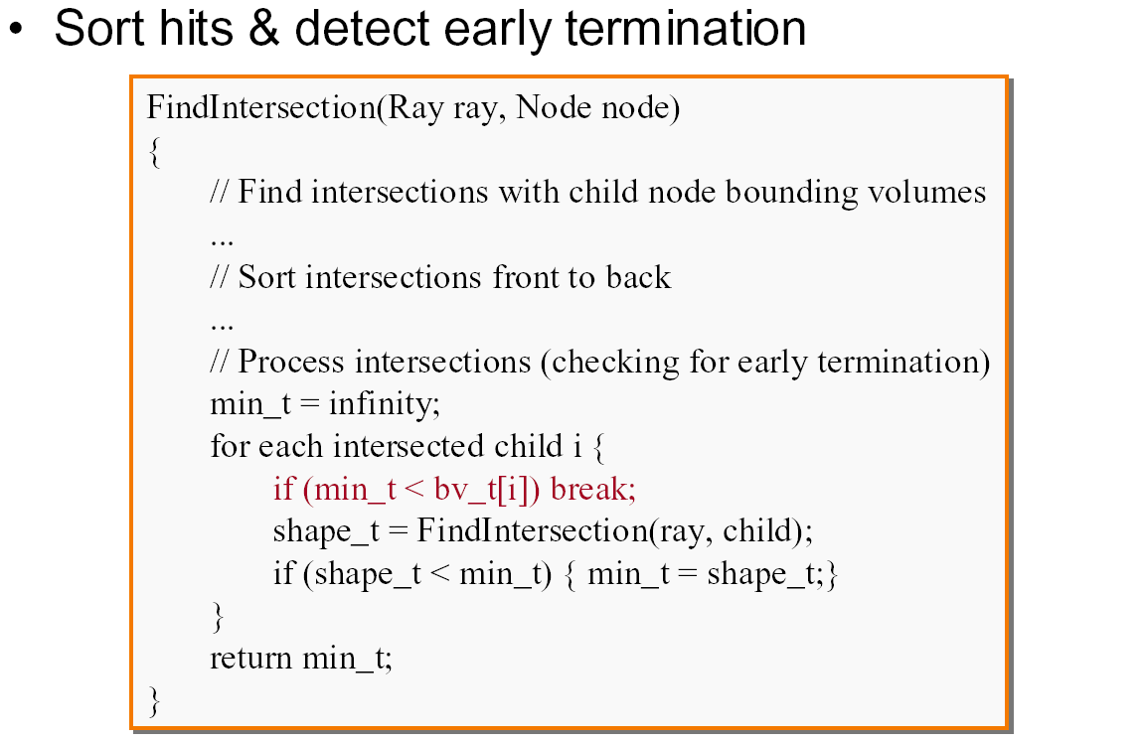
Bounding Volume Hierarchies 3

Slide 79
Acceleration Structures: Grids

Slide 80
Acceleration and Regular Grids
Simplest acceleration, for example 5x5x5 grid
For each grid cell, store overlapping triangles
March ray along grid (need to be careful with this), test against each triangle in grid cell
More sophisticated: kd-tree, oct-tree bsp-tree
Or use (hierarchical) bounding boxes
Try to implement some acceleration in HW

Slide 81
Note on Optix, Code Reuse
No Copying Code previous students, solutions, or any online resources
AI agents like chatGPT may be used only as a search engine for example for explaining the way specific commands are used, but you should not copy code from them.
No posting code online including to github
Some students felt skeleton only for OptiX unfair
  And in spring 20 tried copying to compensate. Bad!!
Optix skeleton only Optix setup, no raytracing
  Because writing from scratch in new language is hard
  Acceleration structures are built-in, can use
  Still likely harder option, because of learning curve (but great performance for course)

Slide 82
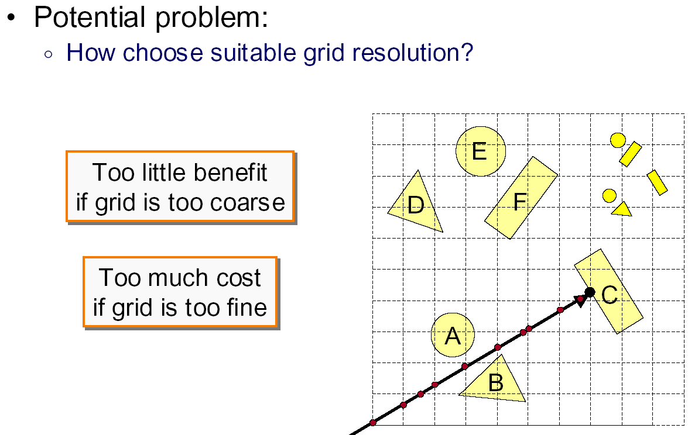
Uniform Grid: Problems

Slide 83
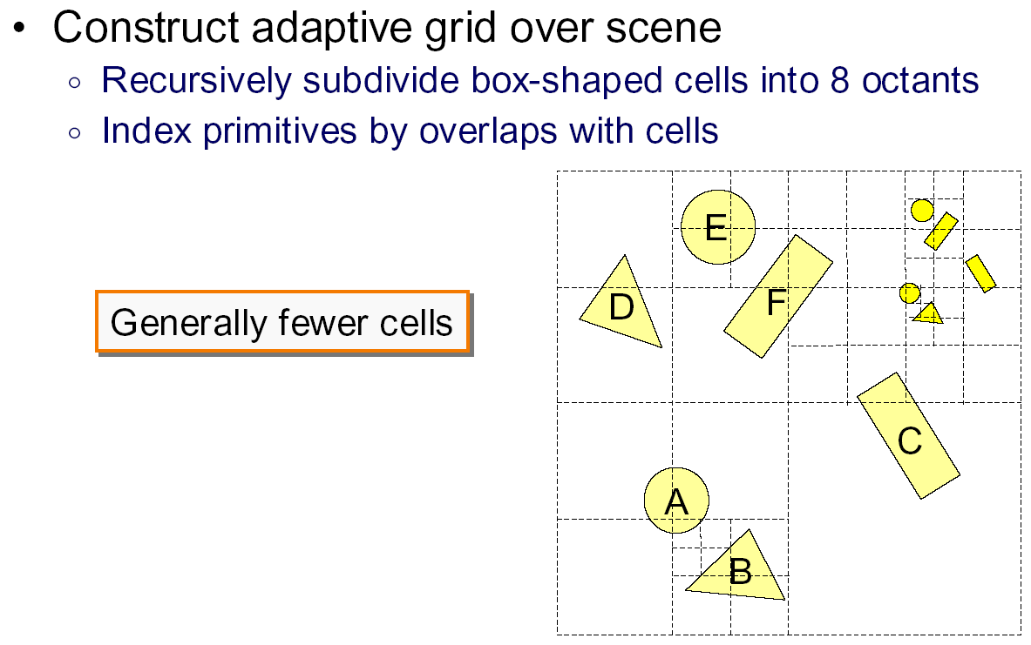
Octree

Slide 84
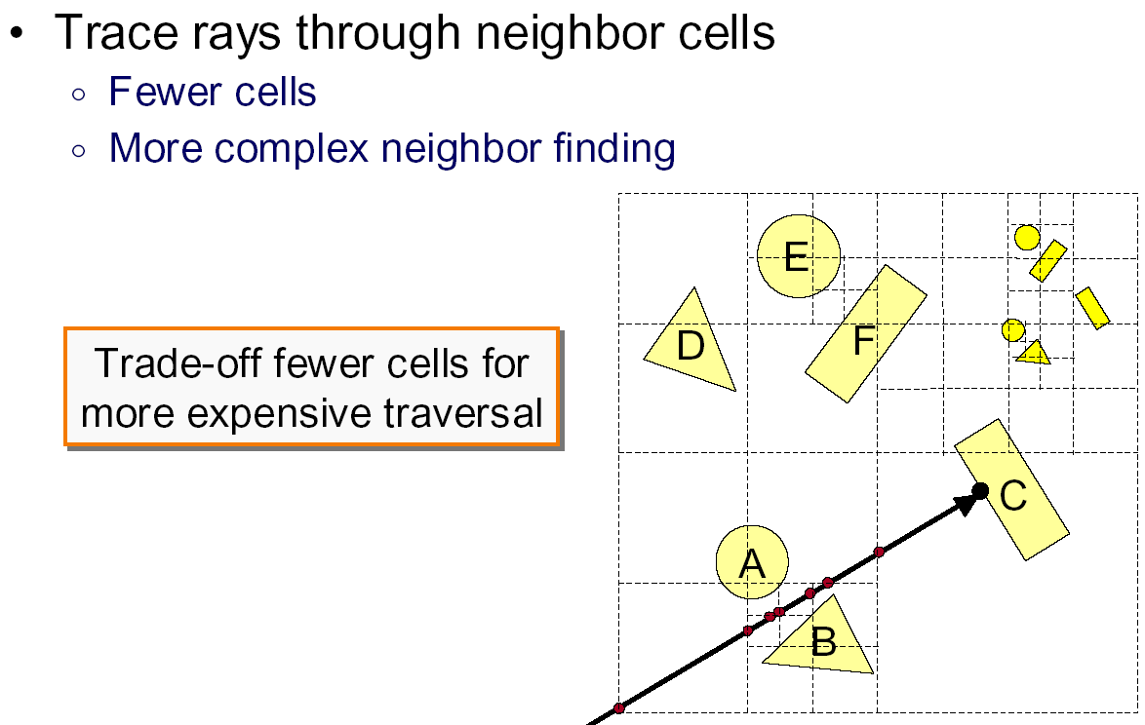
Octree traversal

Slide 85
Math of 2D Bounding Box Test
Can you find a t in range
No intersection if x and y ranges don’t overlap

Slide 86
Bounding Box Test
Ray-Intersection is simple coordinate check
Intricacies with test, see Shirley book
Hierarchical Bounding Boxes
Ray

Slide 87
Hierarchical Bounding Box Test
If ray hits root box
  Intersect left subtree
  Intersect right subtree
  Merge intersections (find closest one)
Standard hierarchical traversal
  But caveat, since bounding boxes may overlap
At leaf nodes, must intersect objects

Slide 88
Creating Bounding Volume Hierarchy
function bvh-node::create (object array A, int AXIS)
  N = A.length() ;
  if (N == 1) {left = A[0]; right = NULL; bbox = bound(A[0]);}
  else if (N == 2) {
    left = A[0] ; right = A[1] ;
    bbox = combine(bound(A[0]),bound(A[1])) ;
  else
    Find midpoint m of bounding box of A along AXIS
    Partition A into lists of size k and N-k around m
    left = new bvh-node (A[0…k],(AXIS+1) mod 3) ;
    right = new bvh-node(A[k+1…N-1],(AXIS+1) mod 3);
    bbox = combine (left -> bbox, right -> bbox) ;
From page 305 of Shirley book

Slide 89
Area Heuristics
Instead of mid-point of bounding box, alternating axes, pick the axis and the location to split carefully
The algorithm can test several splitting planes (at least 9 recommended) across x,y,z and chooses best one
Area Heuristic: min considering areas of each child box and number of primitives contained in each
Longer for construction but better balanced
Ideally speeds up raytracing (in Optix BVH built in)
(Optional, but if interested read up on Surface Area Heuristic [SAH] and similar methods. Also see fast updates for animations, dynamic scenes)

Slide 90
Uniform Spatial Subdivision
Different idea: Divide space rather than objects
In BVH, each object is in one of two sibling nodes
  A point in space may be inside both nodes
In spatial subdivision, each space point in one node
  But object may lie in multiple spatial nodes
Simplest is uniform grid (have seen this already)
Challenge is keeping all objects within cell
And in traversing the grid

Slide 91
Traversal of Grid High Level
Next Intersect Pt?
Irreg. samp. pattern?
But regular in planes
Fast algo. possible
(more on board)

Slide 92
BSP Trees
Used for visibility and ray tracing
  Book considers only axis-aligned splits for ray tracing
  Sometimes called kd-tree for axis aligned
Split space (binary space partition) along planes
Fast queries and back-to-front (painter’s) traversal
Construction is conceptually simple
  Select a plane as root of the sub-tree
  Split into two children along this root
  Random polygon for splitting plane (may need to split polygons that intersect it)
BSP slides courtesy Prof. O’Brien

Slide 93
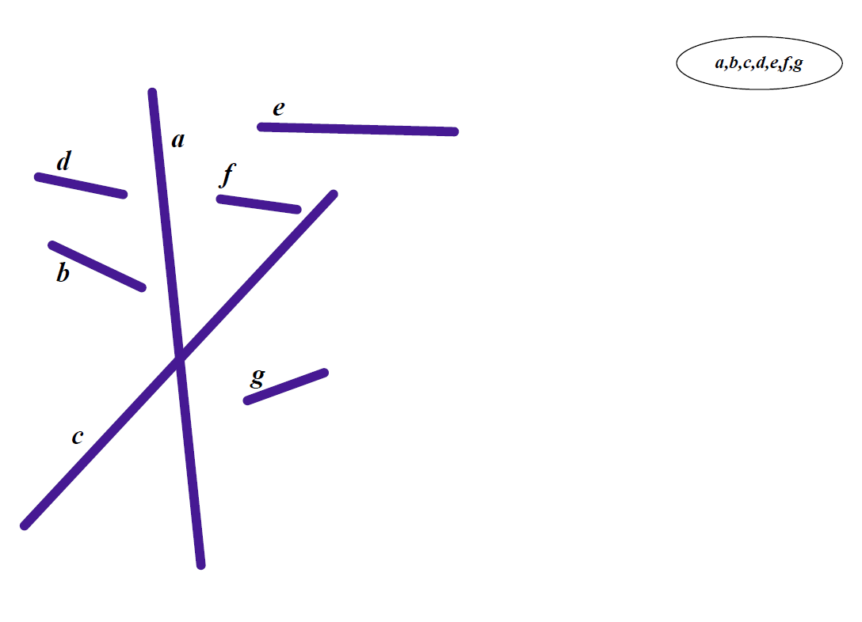
Initial State

Slide 94
First Split

Slide 95
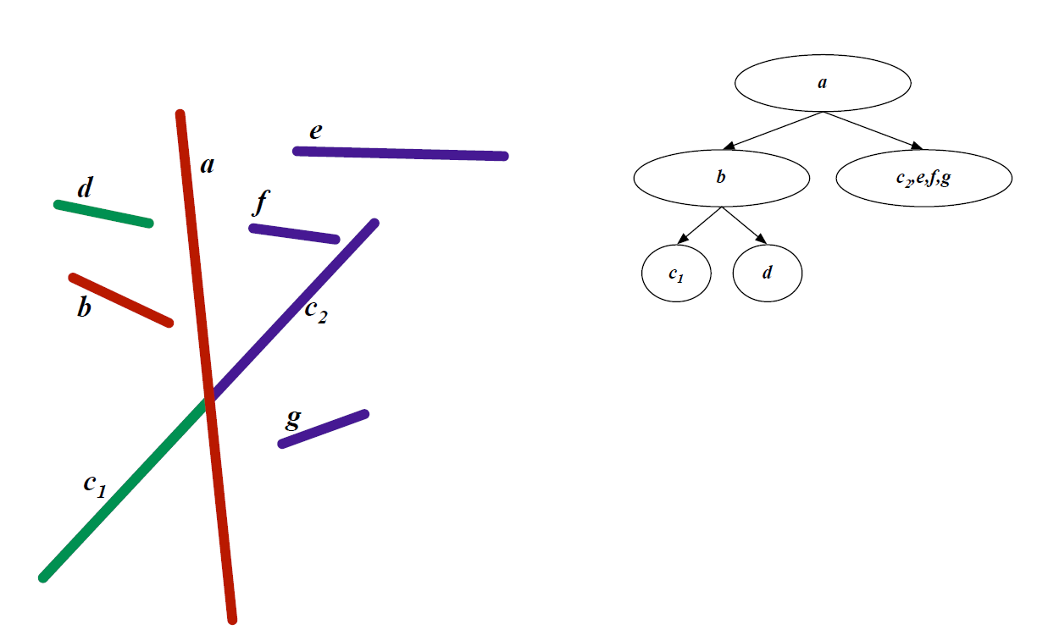
Second Split

Slide 96
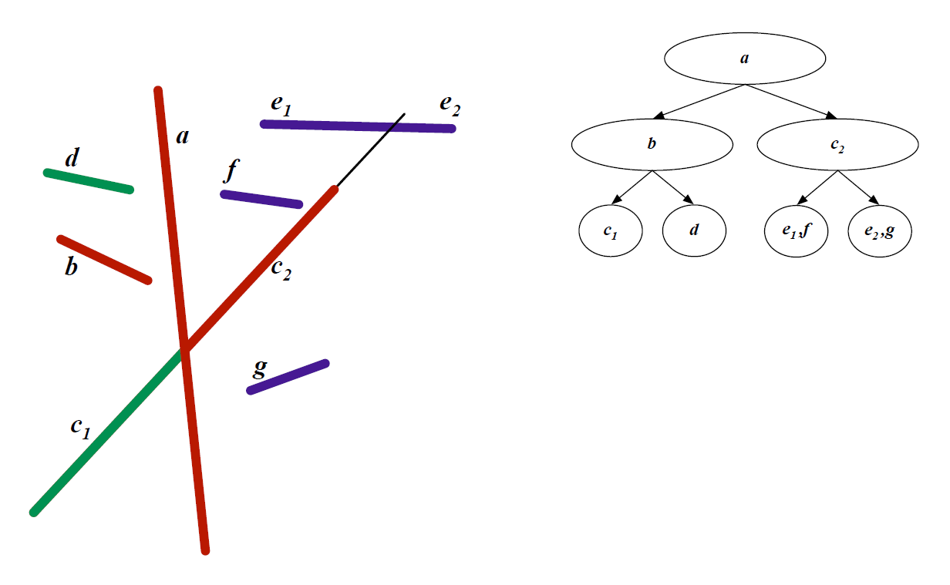
Third Split

Slide 97
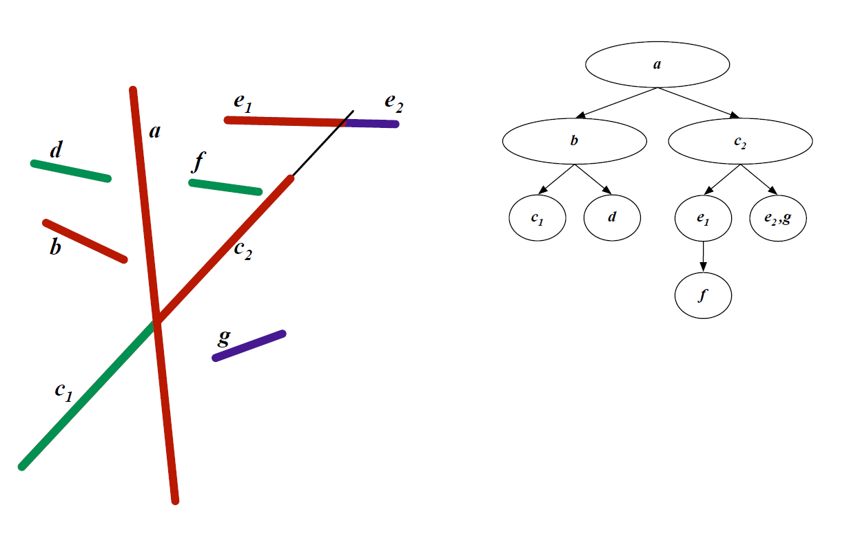
Fourth Split

Slide 98
Final BSP Tree

Slide 99
BSP Trees Cont’d
Continue splitting until leaf nodes
Visibility traversal in order
  Child one
  Root
  Child two
Child one chosen based on viewpoint
  Same side of sub-tree as viewpoint
BSP tree built once, used for all viewpoints

Slide 100
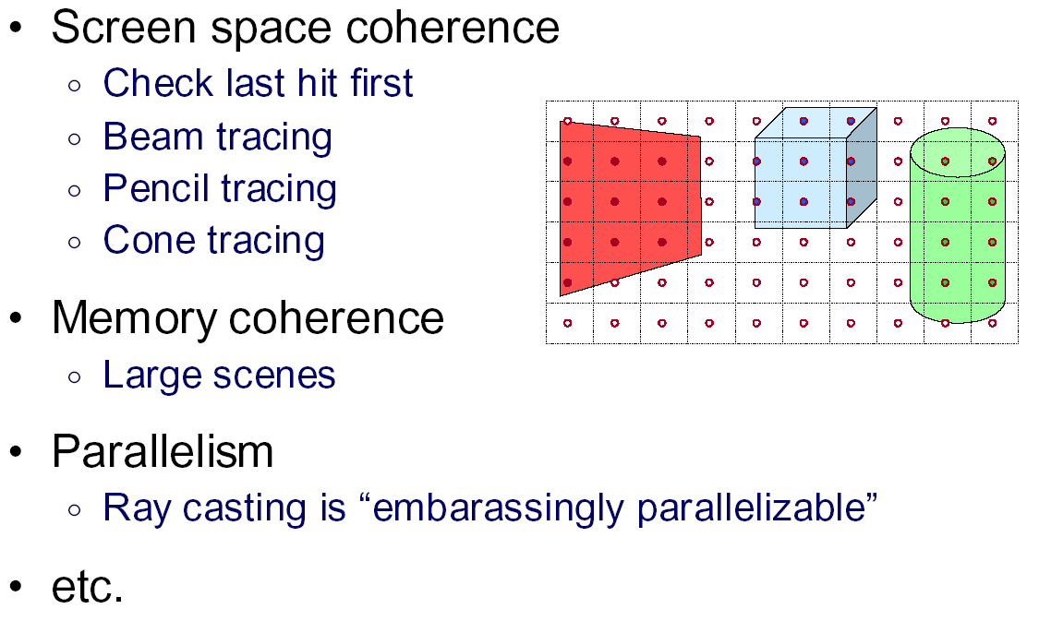
Other Accelerations

Slide 101
Outline
History
Basic Ray Casting (instead of rasterization)
  Comparison to hardware scan conversion
Shadows / Reflections (core algorithm)
Optimizations
Current Research

Slide 102
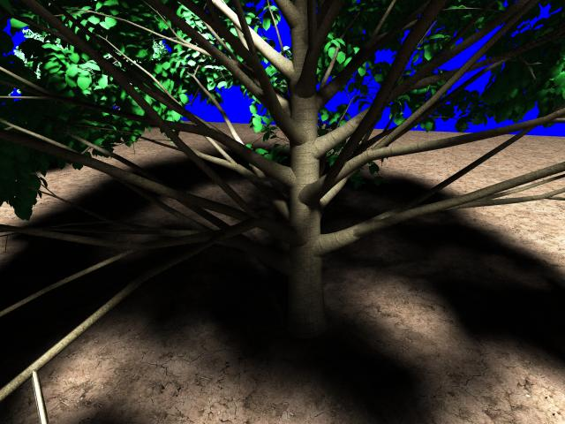
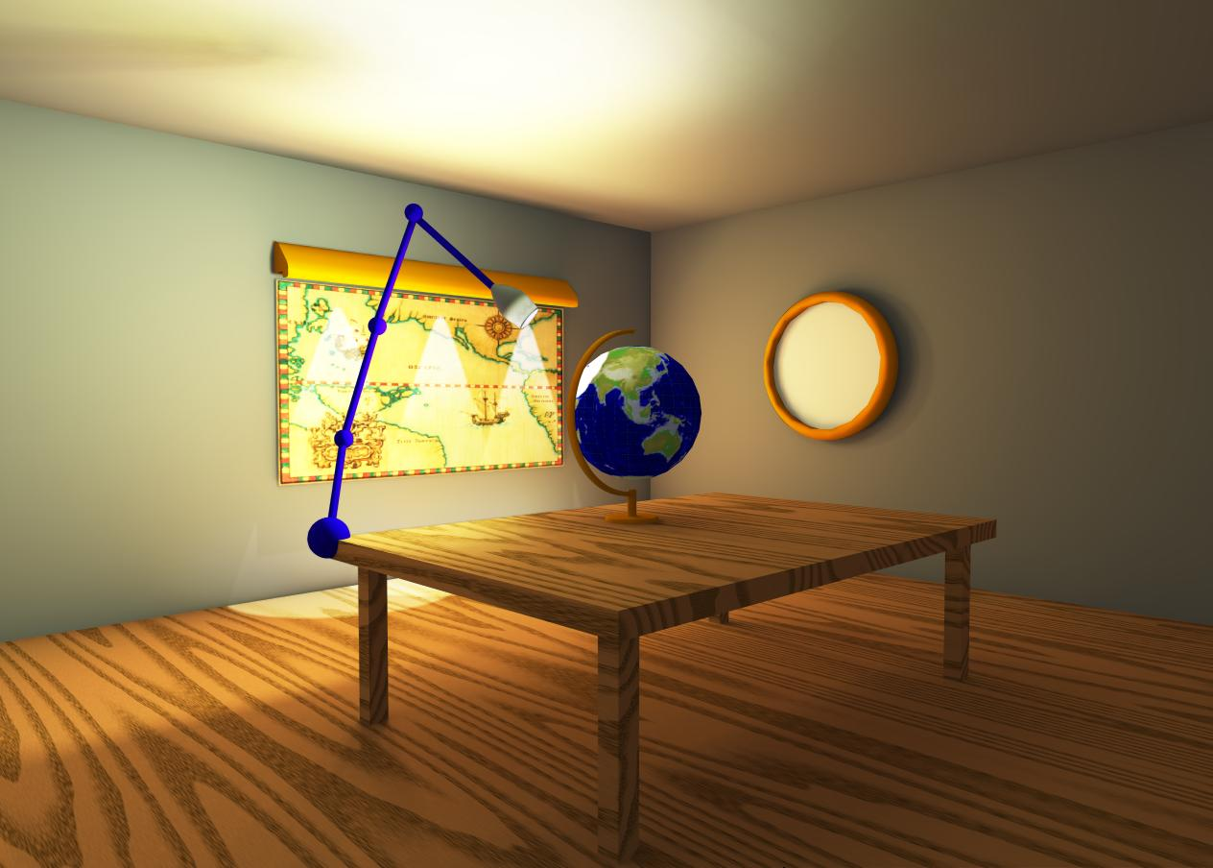
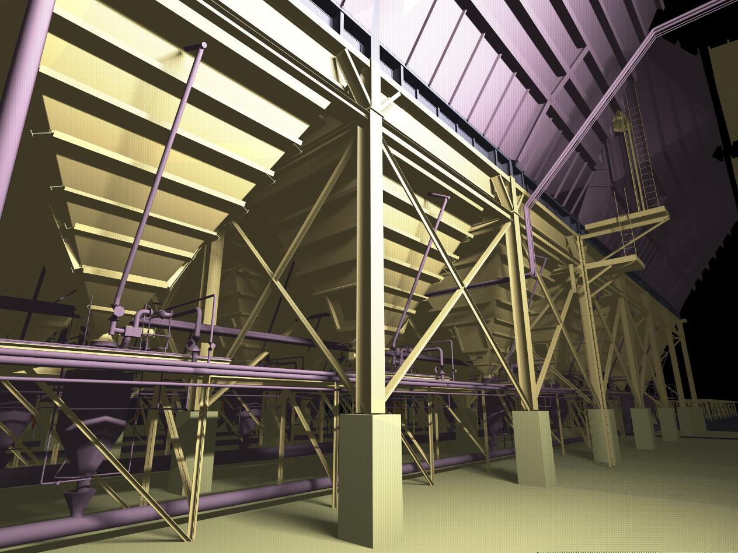
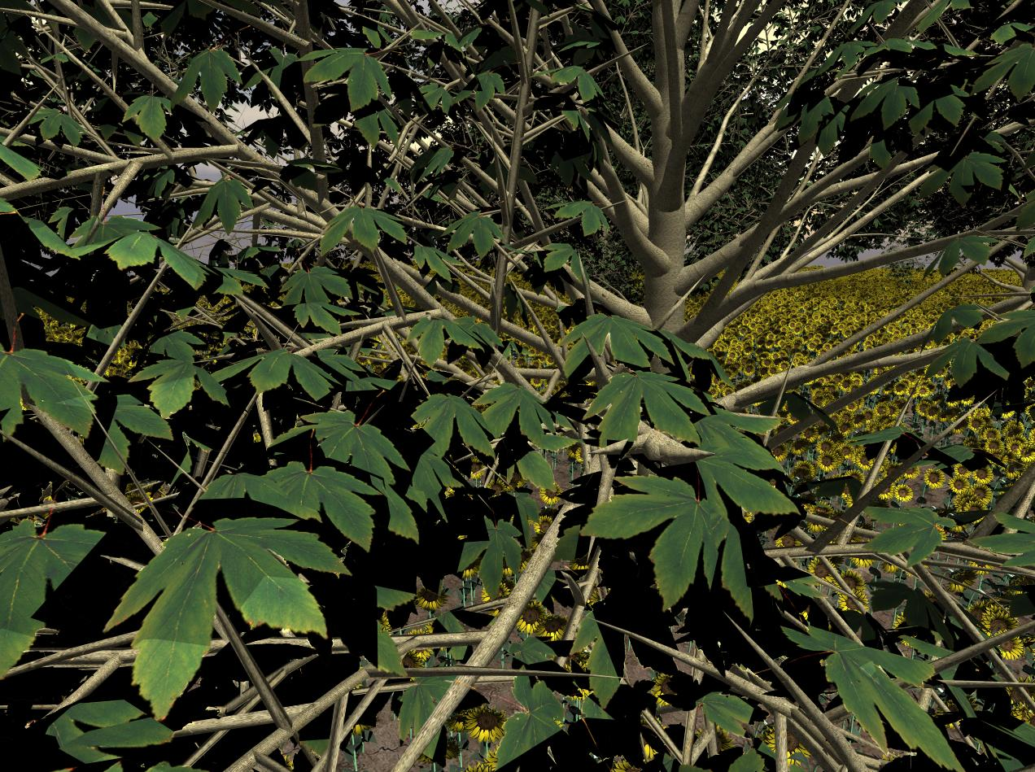

Slide 103
Interactive Raytracing
Ray tracing historically slow
Now viable alternative for complex scenes
  Key is sublinear complexity with acceleration; need not process all triangles in scene
Allows many effects hard in hardware
  Today graphics hardware and software (NVIDIA Optix 6, RTX chips 10G+ rays per second).Video
  Tiger Demo (NVIDIA; see slide)

Slide 104
Raytracing on Graphics Hardware
Modern Programmable Hardware general streaming architecture
Can map various elements of ray tracing
Kernels like eye rays, intersect etc.
In vertex or fragment programs
Convergence between hardware, ray tracing
[Purcell et al. 2002, 2003]
http://graphics.stanford.edu/papers/photongfx

Slide 105
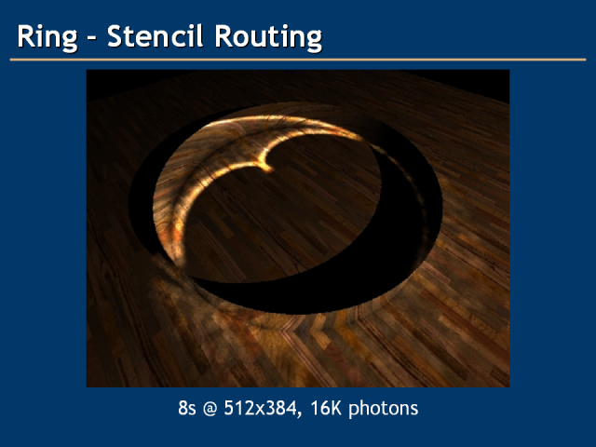
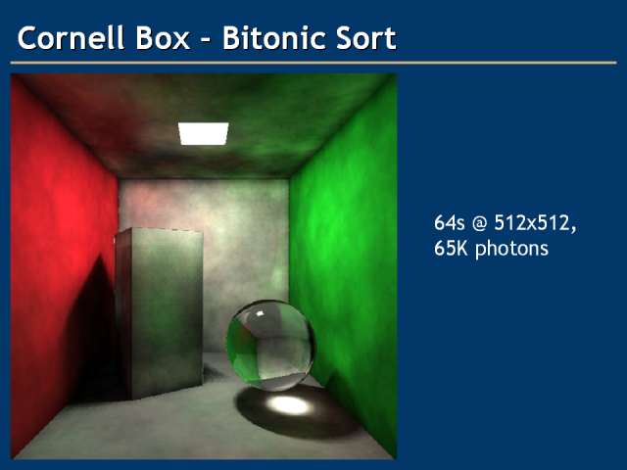
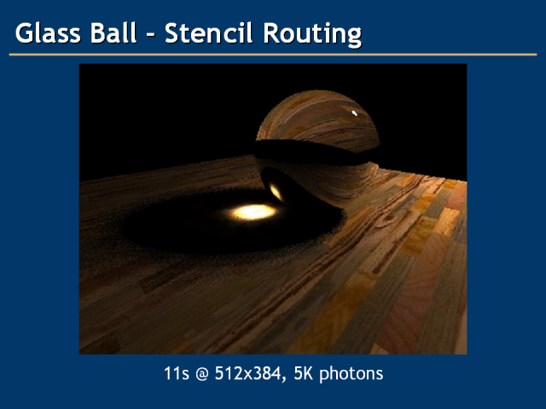
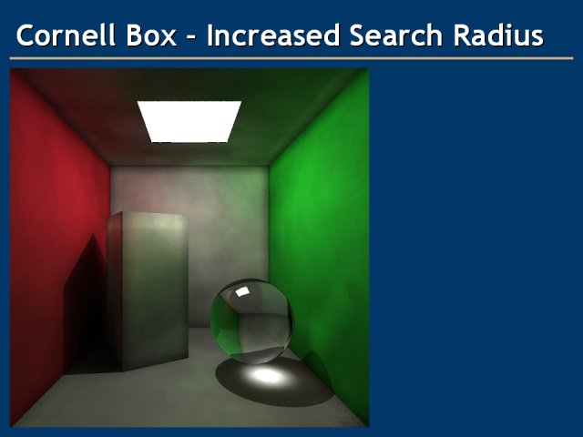

Slide 106
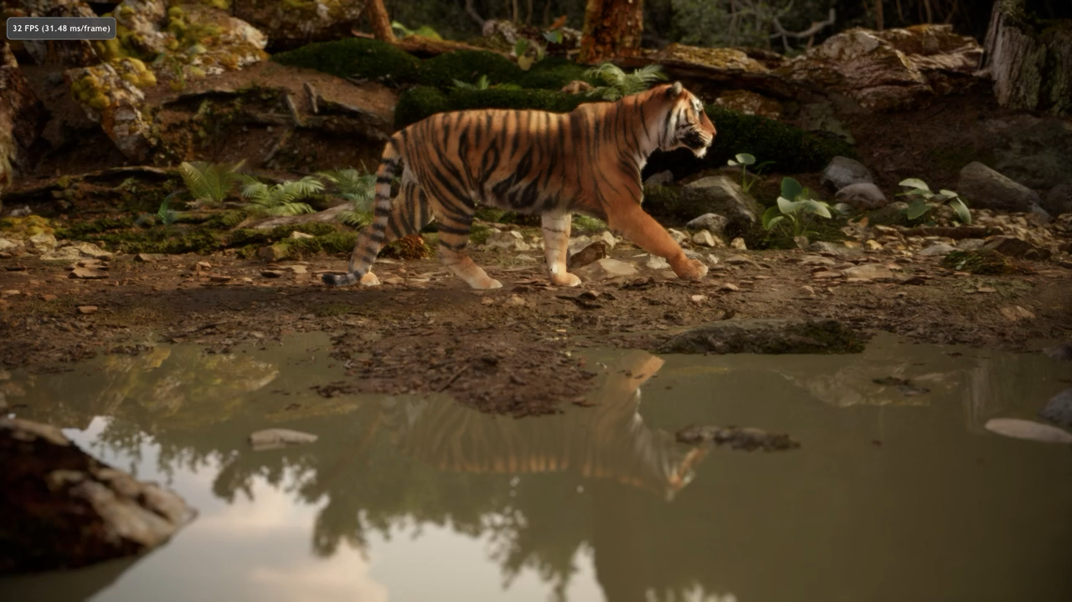
Today: Real-Time Denoising at 1spp
NVIDIA Tiger Demo 2021

