Slide 1




Computer Graphics II: Rendering
CSE 168 [Spr 25], Lecture 7: Monte Carlo Path Tracing Ravi Ramamoorthi
http://viscomp.ucsd.edu/classes/cse168/sp25

Slide 2
To Do
Homework 2 (direct lighting) due in two days
Next assignment path tracing (on edX edge). This lecture covers much of that material

Slide 3
Motivation
General solution to rendering and global illumination
Suitable for a variety of general scenes
Based on Monte Carlo methods
Enumerate all paths of light transport

Slide 4
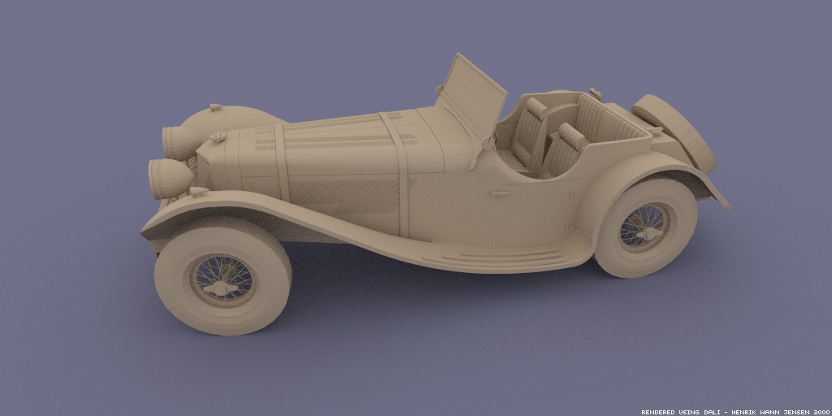
Monte Carlo Path Tracing
Big diffuse light source, 20 minutes
Jensen

Slide 5
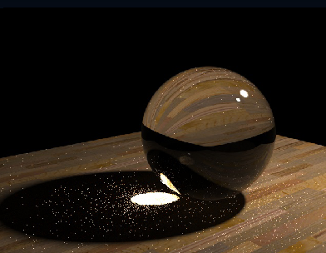
Monte Carlo Path Tracing
1000 paths/pixel
Jensen

Slide 6
Monte Carlo Path Tracing
Advantages
  Any type of geometry (procedural, curved, ...)
  Any type of BRDF (specular, glossy, diffuse, ...)
  Samples all types of paths (L(SD)*E)
  Accuracy controlled at pixel level
  Low memory consumption
  Unbiased - error appears as noise in final image
Disadvantages (standard Monte Carlo problems)
  Slow convergence (square root of number of samples)
  Noise in final image

Slide 7
Monte Carlo Path Tracing
Integrate radiance
for each pixel
by sampling paths
randomly
Specular
Surface
Light
Eye
Pixel
x
Diffuse Surface

Slide 8
Simple Monte Carlo Path Tracer
Step 1: Choose a ray (u,v,θ,ϕ ) [per pixel]; assign weight = 1
Step 2: Trace ray to find intersection with nearest surface
Step 3: Randomly choose between emitted and reflected light
  Step 3a: If emitted,
  return weight’ * Le
  Step 3b: If reflected,
  weight’’ *= reflectance
  Generate ray in random direction
  Go to step 2

Slide 9
Sampling Techniques
Problem: how do we generate random points/directions during path tracing and reduce variance?
  Importance sampling (e.g. by BRDF)
  Stratified sampling
Eye
x
Surface

Slide 10
Outline
Motivation and Basic Idea
Implementation of simple path tracer
Variance Reduction: Importance sampling
Other variance reduction methods
Specific 2D sampling techniques

Slide 11
Simplest Monte Carlo Path Tracer
For each pixel, cast n samples and average
  Choose a ray with p=camera, d=(θ,ϕ ) within pixel
  Pixel color += (1/n) * TracePath(p, d)
TracePath(p, d) returns (r,g,b) [and calls itself recursively]:
  Trace ray (p, d) to find nearest intersection p’
  Select with probability (say) 50%:
    Emitted:
    return 2 * (Le_{red}, Le_{green}, Le_{blue}) // 2 = 1/(50%)
    Reflected:
    generate ray in random direction d’
    return 2 * f_{r}(d ➔d’) * (n•d’) * TracePath(p’, d’)

Slide 12
Simplest Monte Carlo Path Tracer
For each pixel, cast n samples and average over paths
  Choose a ray with p=camera, d=(θ,ϕ) within pixel
  Pixel color += (1/n) * TracePath(p, d)
TracePath(p, d) returns (r,g,b) [and calls itself recursively]:
  Trace ray (p, d) to find nearest intersection p’
  Select with probability (say) 50%:
    Emitted:
    return 2 * (Le_{red}, Le_{green}, Le_{blue}) // 2 = 1/(50%)
    Reflected:
    generate ray in random direction d’
    return 2 * f_{r}(d ➔d’) * (n•d’) * TracePath(p’, d’)

Slide 13
Simplest Monte Carlo Path Tracer
For each pixel, cast n samples and average
  Choose a ray with p=camera, d=(θ,ϕ ) within pixel
  Pixel color += (1/n) * TracePath(p, d)
TracePath(p, d) returns (r,g,b) [and calls itself recursively]:
  Trace ray (p, d) to find nearest intersection p’
  Select with probability (say) 50%:
    Emitted:
    return 2 * (Le_{red}, Le_{green}, Le_{blue}) // 2 = 1/(50%)
    Reflected:
    generate ray in random direction d’
    return 2 * f_{r}(d ➔d’) * (n•d’) * TracePath(p’, d’)
Weight = 1/probability
Remember: unbiased
requires having f(x) / p(x)

Slide 14
Simplest Monte Carlo Path Tracer
For each pixel, cast n samples and average
  Choose a ray with p=camera, d=(θ,ϕ) within pixel
  Pixel color += (1/n) * TracePath(p, d)
TracePath(p, d) returns (r,g,b) [and calls itself recursively]:
  Trace ray (p, d) to find nearest intersection p’
  Select with probability (say) 50%:
    Emitted:
    return 2 * (Le_{red}, Le_{green}, Le_{blue}) // 2 = 1/(50%)
    Reflected:
    generate ray in random direction d’
    return 2 * f_{r}(d ➔d’) * (n•d’) * TracePath(p’, d’)
Path terminated when
Emission evaluated

Slide 15
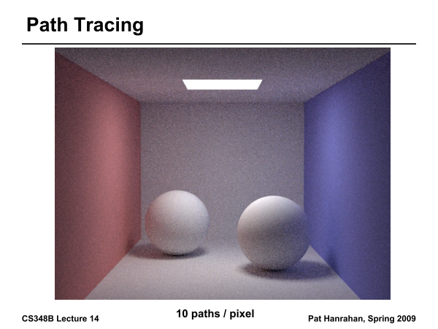

Slide 16
Arnold Renderer (M. Fajardo)
Works well diffuse surfaces, hemispherical light

Slide 17
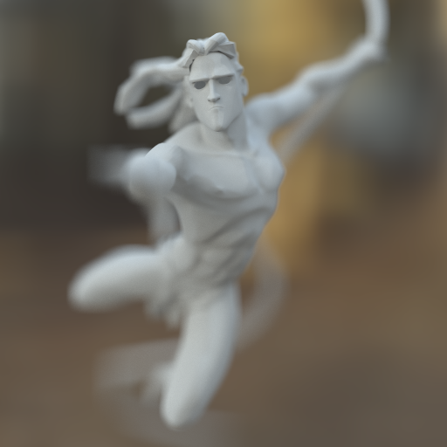
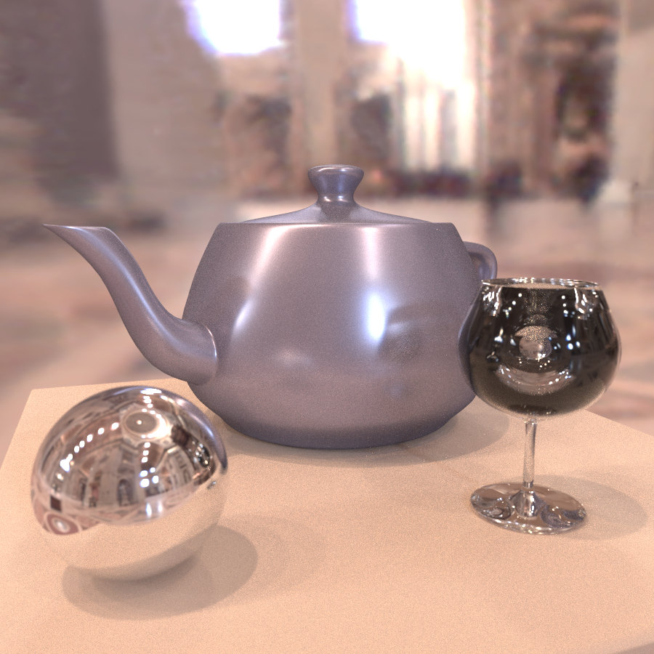
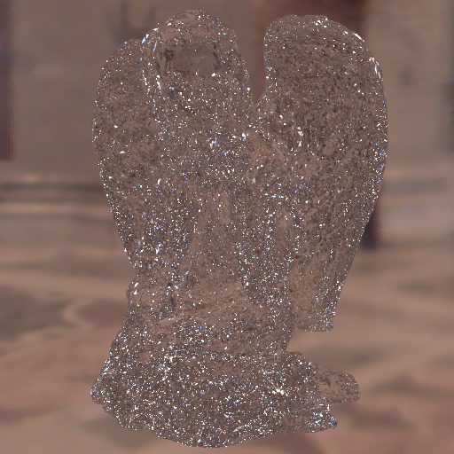
From CS 283(294) many years ago
Daniel Ritchie and Lita Cho

Slide 18
Advantages and Drawbacks
Advantage: general scenes, reflectance, so on
  By contrast, standard recursive ray tracing only mirrors
This algorithm is unbiased, but horribly inefficient
  Sample “emitted” 50% of the time, even if emitted=0
  Reflect rays in random directions, even if mirror
  If light source is small, rarely hit it
Goal: improve efficiency without introducing bias
  Variance reduction using many of the methods discussed for Monte Carlo integration last week
  Subject of much interest in graphics in 90s till today

Slide 19
Outline
Motivation and Basic Idea
Implementation of simple path tracer
Variance Reduction: Importance sampling
Other variance reduction methods
Specific 2D sampling techniques

Slide 20
Importance Sampling
Pick paths based on energy or expected contribution
  More samples for high-energy paths
  Don’t pick low-energy paths
At “macro” level, use to select between reflected vs emitted, or in casting more rays toward light sources
At “micro” level, importance sample the BRDF to pick ray directions
Tons of papers in 90s on tricks to reduce variance in Monte Carlo rendering
Importance sampling now standard in production. I consulted on Pixar’s system (~2011)

Slide 21
Importance Sampling
Can pick paths however we want, but contribution weighted by 1/probability
  Already seen this division of 1/prob in weights to emission, reflectance
E(f(x))
x₁
x_{N}

Slide 22
Simplest Monte Carlo Path Tracer
For each pixel, cast n samples and average
  Choose a ray with p=camera, d=(θ,ϕ) within pixel
  Pixel color += (1/n) * TracePath(p, d)
TracePath(p, d) returns (r,g,b) [and calls itself recursively]:
  Trace ray (p, d) to find nearest intersection p’
  Select with probability (say) 50%:
    Emitted:
    return 2 * (Le_{red}, Le_{green}, Le_{blue}) // 2 = 1/(50%)
    Reflected:
    generate ray in random direction d’
    return 2 * f_{r}(d ➔d’) * (n•d’) * TracePath(p’, d’)

Slide 23
Importance sample Emit vs Reflect
TracePath(p, d) returns (r,g,b) [and calls itself recursively]:
  Trace ray (p, d) to find nearest intersection p’
  If Le = (0,0,0) then p_{emit}= 0 else p_{emit}= 0.9 (say)
  If random() < p_{emit} then:
    Emitted:
    return (1/ p_{emit}) * (Le_{red}, Le_{green}, Le_{blue})
    Else Reflected:
    generate ray in random direction d’
    return (1/(1- p_{emit})) * f_{r}(d ➔d’) * (n•d’) * TracePath(p’, d’)

Slide 24
Importance sample Emit vs Reflect
TracePath(p, d) returns (r,g,b) [and calls itself recursively]:
  Trace ray (p, d) to find nearest intersection p’
  If Le = (0,0,0) then p_{emit}= 0 else p_{emit}= 0.9 (say)
  If random() < p_{emit} then:
    Emitted:
    return (1/ p_{emit}) * (Le_{red}, Le_{green}, Le_{blue})
    Else Reflected:
    generate ray in random direction d’
    return (1/(1- p_{emit})) * f_{r}(d ➔d’) * (n•d’) * TracePath(p’, d’)
Can never be 1 unless
Reflectance is 0

Slide 25
Outline
Motivation and Basic Idea
Implementation of simple path tracer
Variance Reduction: Importance sampling
Other variance reduction methods
Specific 2D sampling techniques

Slide 26
More variance reduction
Discussed “macro” importance sampling
  Emitted vs reflected
How about “micro” importance sampling
  Shoot rays towards light sources in scene
  Distribute rays according to BRDF

Slide 27

One Variation for Reflected Ray
Pick a light source
Trace a ray towards that light
Trace a ray anywhere except for that light
  Rejection sampling
Divide by probabilities
  1/(solid angle of light) for ray to light source
  1/(2 $π$ – solid angle) for non-light ray
  So mult by solid angle for ray to light, and 2 $π$ – solid angle non-light ray
  Use two rays so no extra factor of 2 needed

Slide 28
Russian Roulette
Maintain current weight along path
(need another parameter to TracePath)
Terminate ray iff |weight| < const.
Be sure to weight by 1/probability

Slide 29
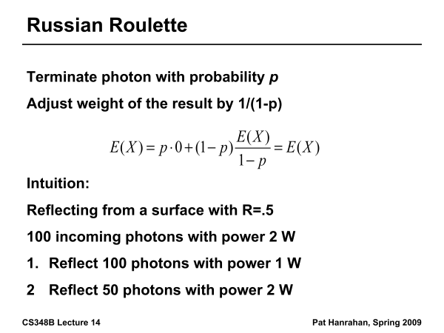

Slide 30
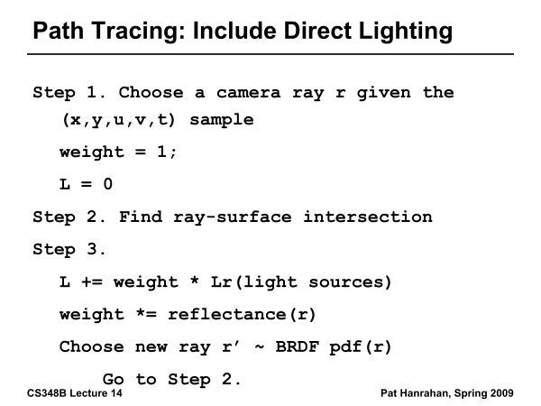

Slide 31
Monte Carlo Extensions
Unbiased
  Bidirectional path tracing
  Metropolis light transport
Biased, but consistent
  Noise filtering
  Adaptive sampling
  Irradiance caching

Slide 32
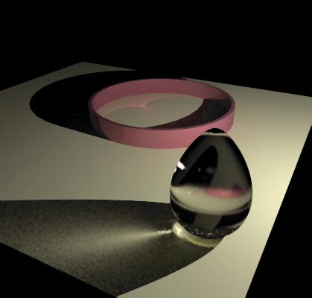
Monte Carlo Extensions
Unbiased
  Bidirectional path tracing
  Metropolis light transport
Biased, but consistent
  Noise filtering
  Adaptive sampling
  Irradiance caching
RenderPark

Slide 33
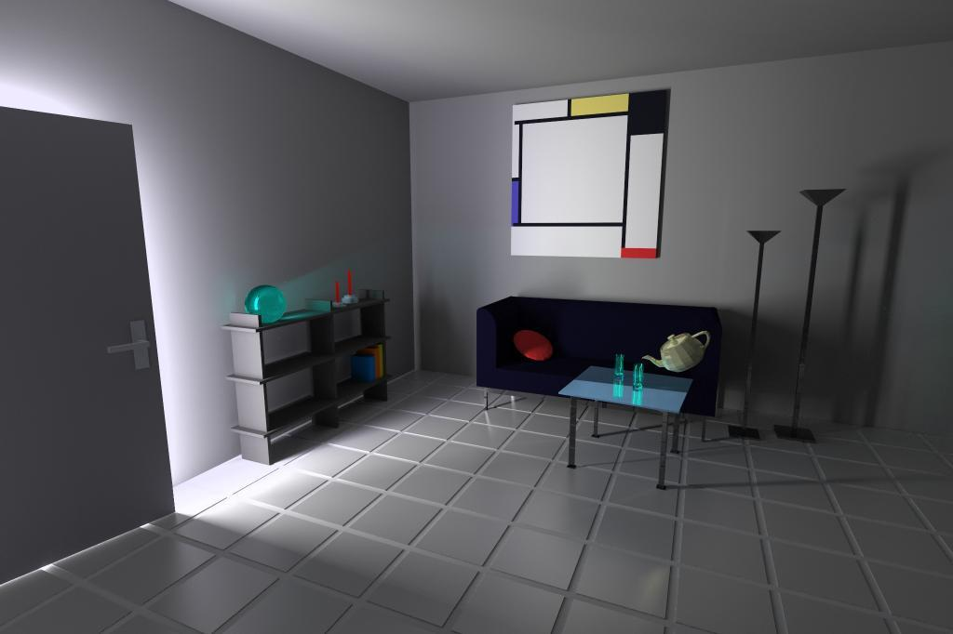
Monte Carlo Extensions
Unbiased
  Bidirectional path tracing
  Metropolis light transport
Biased, but consistent
  Noise filtering
  Adaptive sampling
  Irradiance caching
Heinrich

Slide 34
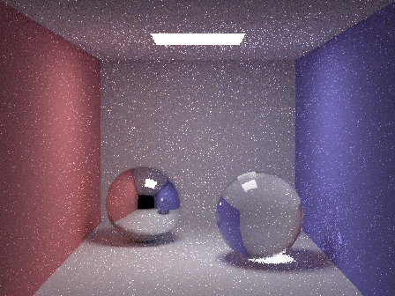

Monte Carlo Extensions
Unbiased
  Bidirectional path tracing
  Metropolis light transport
Biased, but consistent
  Noise filtering
  Adaptive sampling
  Irradiance caching
Unfiltered
Filtered
Jensen

Slide 35
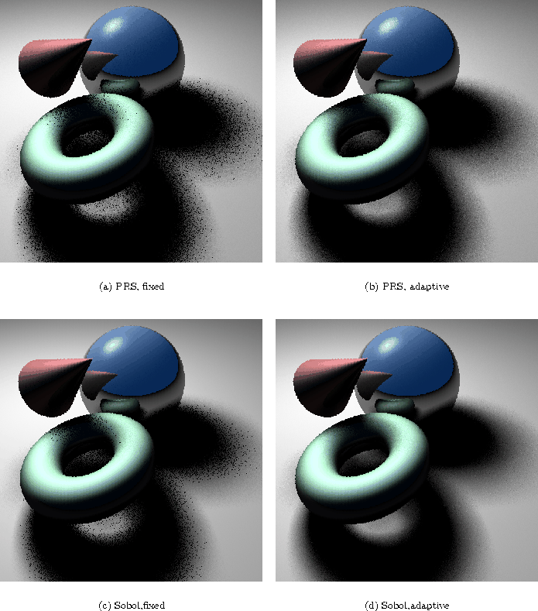
Monte Carlo Extensions
Unbiased
  Bidirectional path tracing
  Metropolis light transport
Biased, but consistent
  Noise filtering
  Adaptive sampling
  Irradiance caching
Fixed
Adaptive
Ohbuchi

Slide 36
Monte Carlo Extensions
Unbiased
  Bidirectional path tracing
  Metropolis light transport
Biased, but consistent
  Noise filtering
  Adaptive sampling
  Irradiance caching
Jensen

Slide 37
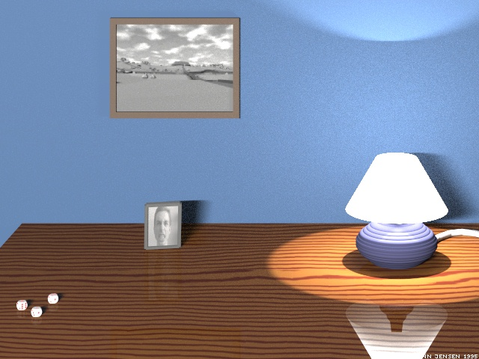
Monte Carlo Path Tracing Image
2000 samples per pixel, 30 computers, 30 hours
Jensen

Slide 38
Outline
Motivation and Basic Idea
Implementation of simple path tracer
Variance Reduction: Importance sampling
Other variance reduction methods
Specific 2D sampling techniques

Slide 39
2D Sampling: Motivation
Final step in sending reflected ray: sample 2D domain
According to projected solid angle
Or BRDF
Or area on light source
Or sampling of a triangle on geometry
Etc.

Slide 40
Sampling Upper Hemisphere
Uniform directional sampling: how to generate random ray on a hemisphere?
Option #1: rejection sampling
  Generate random numbers (x,y,z), with x,y,z in –1..1
  If x²+y²+z² > 1, reject
  Normalize (x,y,z)
  If pointing into surface (ray dot n < 0), flip

Slide 41
Sampling Upper Hemisphere
Option #2: inversion method
  In polar coords, density must be proportional to sin θ (remember d(solid angle) = sin θ dθ dϕ)
  Integrate, invert ➔ cos⁻¹
So, recipe is
  Generate ϕ in 0..2π
  Generate z in 0..1
  Let θ = cos⁻¹ z
  (x,y,z) = (sin θ cos ϕ, sin θ sin ϕ, cos θ)
This is what you need to do for homework 3 (simple upper hemisphere sampling). Anything more advanced (importance sampling later in lecture) is extra (homework 4).

Slide 42
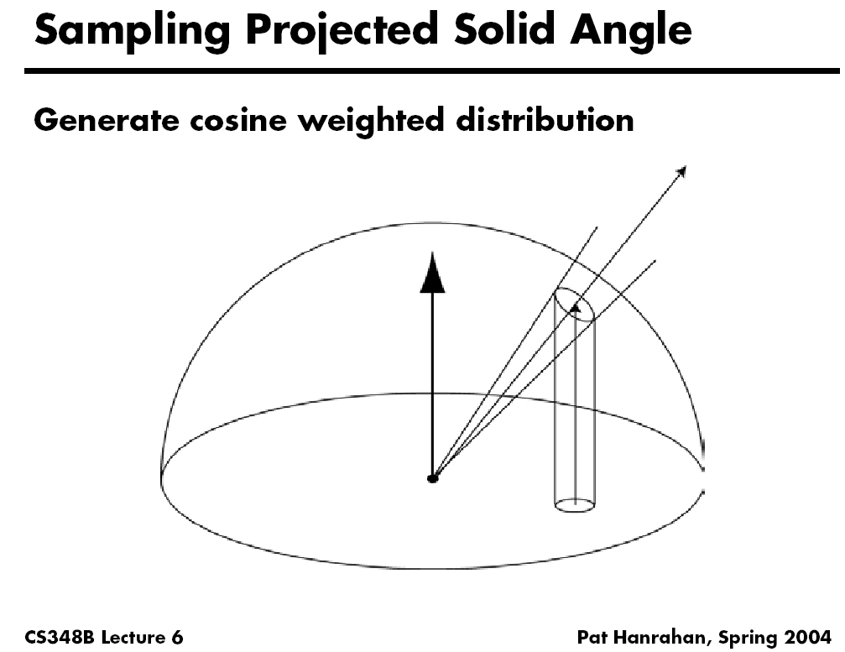

Slide 43
BRDF Importance Sampling
Better than uniform sampling: importance sampling
Because you divide by probability, ideally
probability proportional to f_{r} * cos θ_{i}

Slide 44
BRDF Importance Sampling
For cosine-weighted Lambertian:
  Density = cos θ sin θ
  Integrate, invert ➔ cos⁻¹(sqrt)
So, recipe is:
  Generate ϕ in 0..2π
  Generate z in 0..1
  Let θ = cos⁻¹ (sqrt(z))

Slide 45
BRDF Importance Sampling
Phong BRDF: f_{r} ~ cos^{n}α where α is angle between outgoing ray and ideal mirror direction
Constant scale = k_{s}(n+2)/(2π)
Can’t sample this times cos θ_{i}
  Can only sample BRDF itself, then multiply by cos θ_{i}
  That’s OK – still better than random sampling

Slide 46
BRDF Importance Sampling
Recipe for sampling specular term:
  Generate z in 0..1
  Let α = cos⁻¹ (z^{1/(n+1)})
  Generate ϕ_{α} in 0..2π
  This gives direction w.r.t. ideal mirror direction
Convert to (x,y,z), then rotate such that z points along mirror dir.

Slide 47
Summary
Monte Carlo methods robust and simple (at least until nitty gritty details) for global illumination
Must handle many variance reduction methods in practice
Importance sampling, Bidirectional path tracing, Russian roulette etc.
Rich field with many papers, systems researched even over last 10 years

