Slide 1




Computer Graphics II: Rendering
CSE 168 [Spr 25], Lecture 4: Rendering Equation Ravi Ramamoorthi
http://viscomp.ucsd.edu/classes/cse168/sp25

Slide 2
To Do
Homework 1 (ray tracer) due in a few days
Next assignment direct lighting (on edX edge). Will cover that material next week

Slide 3
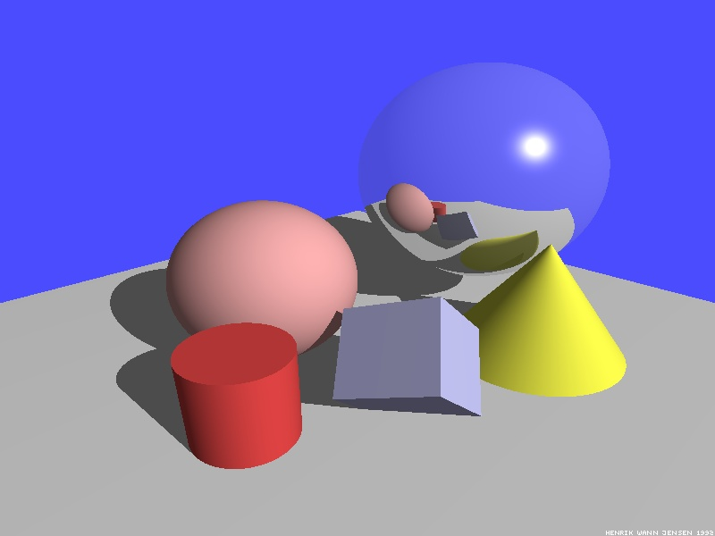
Illumination Models
Local Illumination
  Light directly from light sources to surface
  No shadows (cast shadows are a global effect)
Global Illumination: multiple bounces (indirect light)
  Hard and soft shadows
  Reflections/refractions (already seen in ray tracing)
  Diffuse and glossy interreflections (radiosity, caustics)
Some images courtesy Henrik Wann Jensen

Slide 4
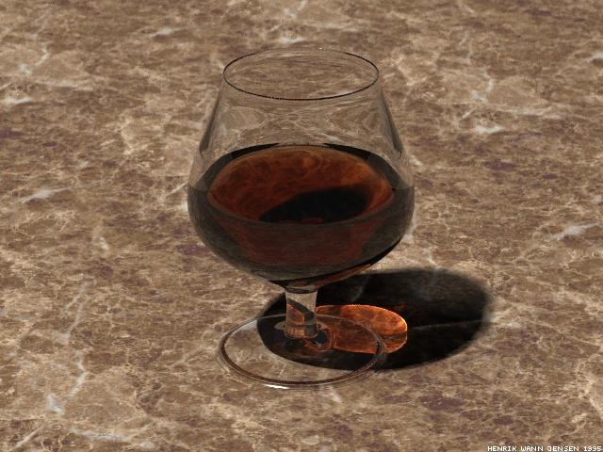
Caustics
Caustics: Focusing through specular surface
Major research effort in 80s, 90s till today

Slide 5
Overview of lecture
Theory for all global illumination methods (ray tracing, path tracing, radiosity)
We derive Rendering Equation [Kajiya 86]
  Major theoretical development in field
  Unifying framework for all global illumination
  Introduced Path Tracing: core rendering method
Discuss existing approaches as special cases
Fairly theoretical lecture (but important). Not well covered in textbooks (though see Eric Veach’s thesis). See reading if you are interested.

Slide 6
Outline
Reflectance Equation
Global Illumination
Rendering Equation
As a general Integral Equation and Operator
Approximations (Ray Tracing, Radiosity)
Surface Parameterization (Standard Form)

Slide 7
Reflection Equation
Reflected Light
(Output Image)
Emission
Incident
Light (from
light source)
BRDF
Cosine of
Incident angle

Slide 8
Reflection Equation
Sum over all light sources
Reflected Light
(Output Image)
Emission
Incident
Light (from
light source)
BRDF
Cosine of
Incident angle

Slide 9
Reflection Equation
Replace sum with integral
Reflected Light
(Output Image)
Emission
Incident
Light (from
light source)
BRDF
Cosine of
Incident angle

Slide 10
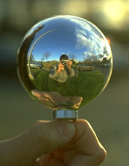
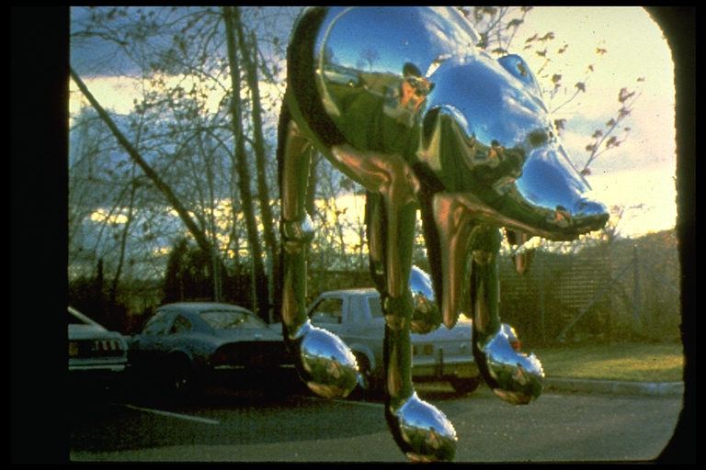
Environment Maps
Light as a function of direction, from entire environment
Captured by photographing a chrome steel or mirror sphere
Accurate only for one point, but distant lighting same at other scene locations (typically use only one env. map)
Blinn and Newell 1976, Miller and Hoffman, 1984
Later, Greene 86, Cabral et al. 87

Slide 11
The Challenge
Computing reflectance equation requires knowing the incoming radiance from surfaces
But determining incoming radiance requires knowing the reflected radiance from surfaces

Slide 12
Rendering Equation
Surfaces (interreflection)
Reflected Light
(Output Image)
Emission
Reflected
Light
BRDF
Cosine of
Incident angle
UNKNOWN
KNOWN
UNKNOWN
KNOWN
KNOWN

Slide 13
Outline
Reflectance Equation (review)
Global Illumination
Rendering Equation
As a general Integral Equation and Operator
Approximations (Ray Tracing, Radiosity)
Surface Parameterization (Standard Form)

Slide 14
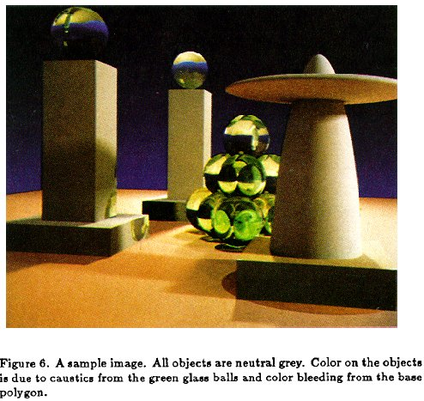
Rendering Equation (Kajiya 86)

Slide 15
Rendering Equation as Integral Equation
Reflected Light
(Output Image)
Emission
Reflected
Light
BRDF
Cosine of
Incident angle
UNKNOWN
KNOWN
UNKNOWN
KNOWN
KNOWN
Is a Fredholm Integral Equation of second kind
[extensively studied numerically] with canonical form
Kernel of equation

Slide 16
Linear Operator Theory
Linear operators act on functions like matrices act on vectors or discrete representations
Basic linearity relations hold
Examples include integration and differentiation
M is a linear operator.
f and h are functions of u
a and b are scalars
f and g are functions

Slide 17
Linear Operator Equation
Kernel of equation
Light Transport Operator
Can be discretized to a simple matrix equation
[or system of simultaneous linear equations]
(L, E are vectors, K is the light transport matrix)

Slide 18
Solving the Rendering Equation
Too hard for analytic solution, numerical methods
Approximations, that compute different terms, accuracies of the rendering equation
Two basic approaches are ray tracing, radiosity. More formally, Monte Carlo and Finite Element. Today Monte Carlo path tracing is core rendering method
Monte Carlo techniques sample light paths, form statistical estimate (example, path tracing)
Finite Element methods discretize to matrix equation

Slide 19
Solving the Rendering Equation
  General linear operator solution. Within raytracing:
  General class numerical Monte Carlo methods
  Approximate set of all paths of light in scene
Binomial Theorem
Term n corresponds to n bounces of light

Slide 20
Ray Tracing
Emission directly
From light sources
Direct Illumination
on surfaces
Global Illumination
(One bounce indirect)
[Mirrors, Refraction]
(Two bounce indirect)
[Caustics etc]

Slide 21
Ray Tracing
Emission directly
From light sources
Direct Illumination
on surfaces
Global Illumination
(One bounce indirect)
[Mirrors, Refraction]
OpenGL Shading
(Two bounce indirect)
[Caustics etc]

Slide 22
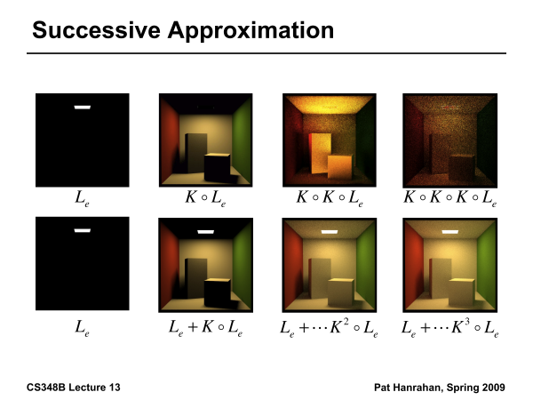

Slide 23
Outline
Reflectance Equation (review)
Global Illumination
Rendering Equation
As a general Integral Equation and Operator
Approximations (Ray Tracing, Radiosity)
Surface Parameterization (Standard Form)

Slide 24
Rendering Equation
Surfaces (interreflection)
Reflected Light
(Output Image)
Emission
Reflected
Light
BRDF
Cosine of
Incident angle
UNKNOWN
KNOWN
UNKNOWN
KNOWN
KNOWN

Slide 25
Change of Variables
Integral over angles sometimes insufficient. Write integral in terms of surface radiance only (change of variables)

Slide 26
Change of Variables
Integral over angles sometimes insufficient. Write integral in terms of surface radiance only (change of variables)

Slide 27
Rendering Equation: Standard Form
Integral over angles sometimes insufficient. Write integral in terms of surface radiance only (change of variables)
Domain integral awkward. Introduce binary visibility fn V
Same as equation 2.52 Cohen Wallace. It swaps primed
And unprimed, omits angular args of BRDF, - sign.
Same as equation above 19.3 in Shirley, except he has
no emission, slightly diff. notation

Slide 28
Radiosity Equation
Drop angular dependence (diffuse Lambertian surfaces)
Change variables to radiosity (B) and albedo (ρ)
Expresses conservation of light energy at all points in space
Same as equation 2.54 in Cohen Wallace handout (read sec 2.6.3)
Ignore factors of π which can be absorbed.

Slide 29
Discretization and Form Factors
F is the form factor. It is dimensionless and is the fraction of energy leaving the entirety of patch j (multiply by area of j to get total energy) that arrives anywhere in the entirety of patch i (divide by area of i to get energy per unit area or radiosity).

Slide 30
Form Factors

Slide 31
Matrix Equation

Slide 32
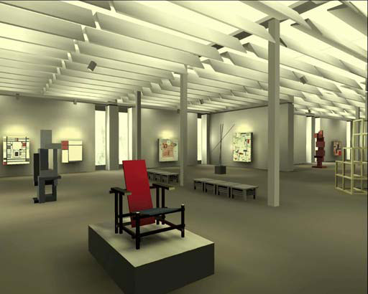
Radiosity

Slide 33
Radiosity Epitaph
Very hot topic (about 1985-1994). Some of the most beautiful images, greatest researchers; at one point 50% of SIGGRAPH papers
But visibility, meshing, discontinuities, complex BRDFs, volumes were all difficult problems
Since mid-90s, Monte Carlo (rather than finite element) methods were preferred (going back to Monte Carlo Path Tracing in Kajiya86)
Today, path tracing entirely method of choice, widely used in industry. This is what 168 teaches

Slide 34
Summary
Theory for all global illumination methods (ray tracing, path tracing, radiosity)
We derive Rendering Equation [Kajiya 86]
  Major theoretical development in field
  Unifying framework for all global illumination
Discuss existing approaches as special cases
Rest of Course: Solving the Rendering Equation (numerically using Monte Carlo Path Tracing)

