Slide 1




Computer Graphics II: Rendering
CSE 168 [Spr 25], Lecture 12: High Quality Rendering Ravi Ramamoorthi
http://viscomp.ucsd.edu/classes/cse168/sp25

Slide 2
To Do
Homework 4 (importance sampling) due May 19
These lectures cover more advanced topics
May be relevant for your final project
Or curiosity in terms of frontiers of modern rendering

Slide 3
Motivation
Rendering Equation since 86, Path Tracer in HW 3
So, is Monte Carlo rendering solved?
Can it be made more efficient (90s until today)?
Multiple Importance Sampling (Homework 4)
Irradiance Caching takes advantage of coherence
Correct sampling: Stratified, Multiple Importance, Bidirectional Path Tracing, Metropolis, VCM/UPS, …
Photon Mapping
Modern adaptive sampling, cut-based integration
Advanced topics (next time)
Denoising (next time)

Slide 4
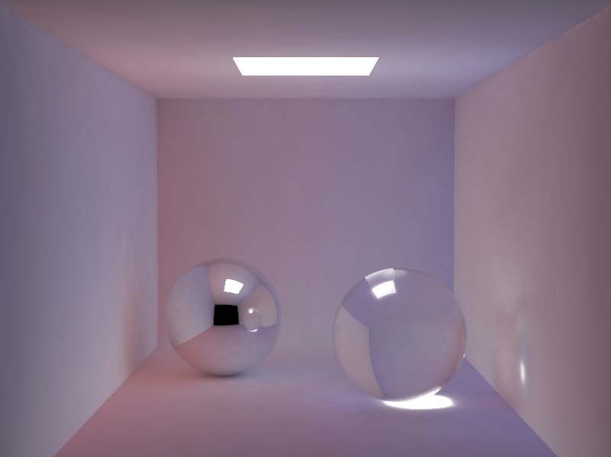
Smoothness of Indirect Lighting
Direct
Indirect
Direct + Indirect

Slide 5
Irradiance Caching
Empirically, (diffuse) interreflections low frequency
Therefore, should be able to sample sparsely
Irradiance caching samples irradiance at few points on surfaces, and then interpolates
Ward, Rubinstein, Clear. SIGGRAPH 88, A ray tracing solution for diffuse interreflection

Slide 6
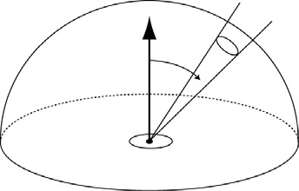


Irradiance Calculation
position
rotation
Derivation in Ward paper

Slide 7
Algorithm Outline
Find all samples with w(x) > q
if ( samples found )
interpolate
else
compute new irradiance
N.B. Subsample the image first and then fill in

Slide 8
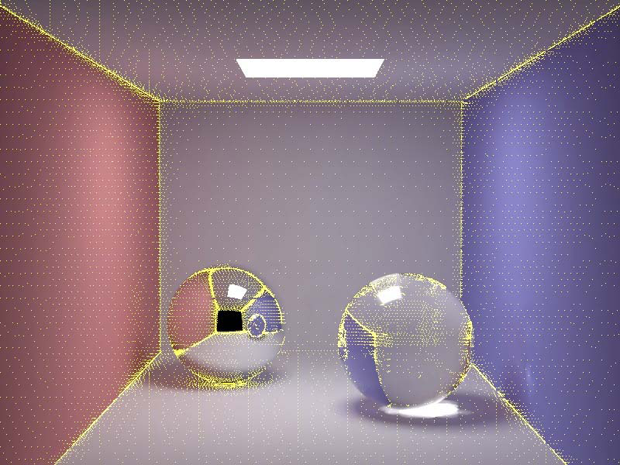
Irradiance Caching Example
Final Image
Sample Locations

Slide 9
Motivation
Rendering Equation since 86, Path Tracer in HW 3
So, is Monte Carlo rendering solved?
Can it be made more efficient (90s until today)?
Multiple Importance Sampling (Homework 4)
Irradiance Caching takes advantage of coherence
Correct sampling: Stratified, Multiple Importance, Bidirectional Path Tracing, Metropolis, VCM/UPS, …
Photon Mapping
Modern adaptive sampling, cut-based integration
Advanced topics (next time)
Denoising (next time)
High level: refs on slides, ask if need to track down

Slide 10
Better Sampling
Smarter ways to Monte Carlo sample
Long history: Stratified, Importance, Bi-Directional, Multiple Importance, Metropolis
Good reference is Veach thesis
We only briefly discuss a couple of strategies

Slide 11
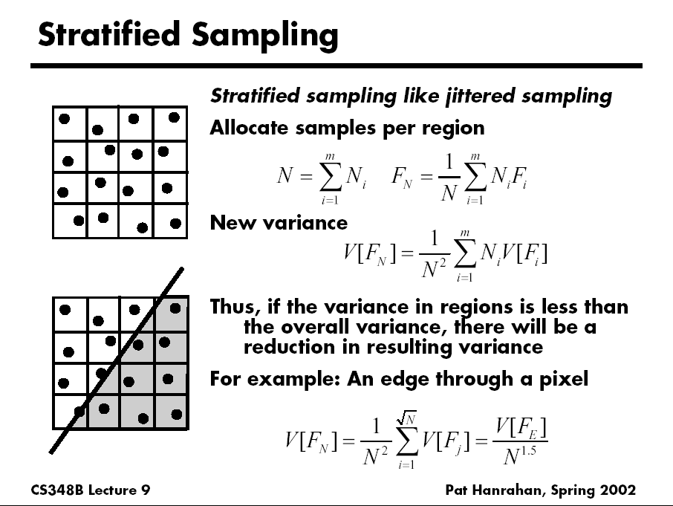
D. Mitchell 95, Consequences of stratified sampling in graphics

Slide 12
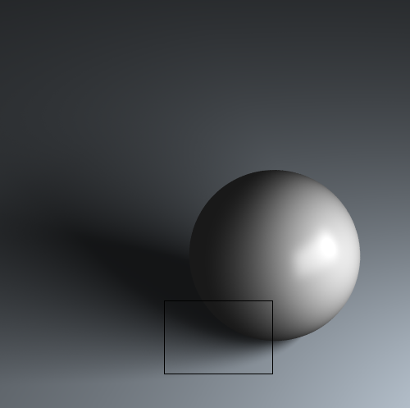
Comparison of simple patterns
Latin Hypercube
Quasi Monte Carlo
Ground Truth
Uniform
Random
Stratified
16 samples for area light, 4 samples per pixel, total 64 samples
If interested, see my paper “A Theory of Monte Carlo Visibility Sampling”
Figures courtesy Tianyu Liu

Slide 13
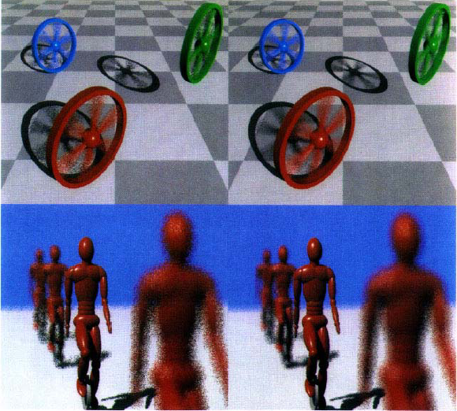
Spectrally Optimal Sampling
Mitchell 91

Slide 14
Light Ray Tracing
Backwards Ray Tracing
[Arvo 86]

Slide 15
Path Tracing: From Lights
Step 1. Choose a light ray
Step 2. Find ray-surface intersection
Step 3. Reflect or transmit
u = Uniform()
if u < reflectance(x)
Choose new direction d ~ BRDF(O|I)
goto Step 2
else if u < reflectance(x)+transmittance(x)
Choose new direction d ~ BTDF(O|I)
goto Step 2
else // absorption=1–reflectance-transmittance
terminate on surface; deposit energy

Slide 16
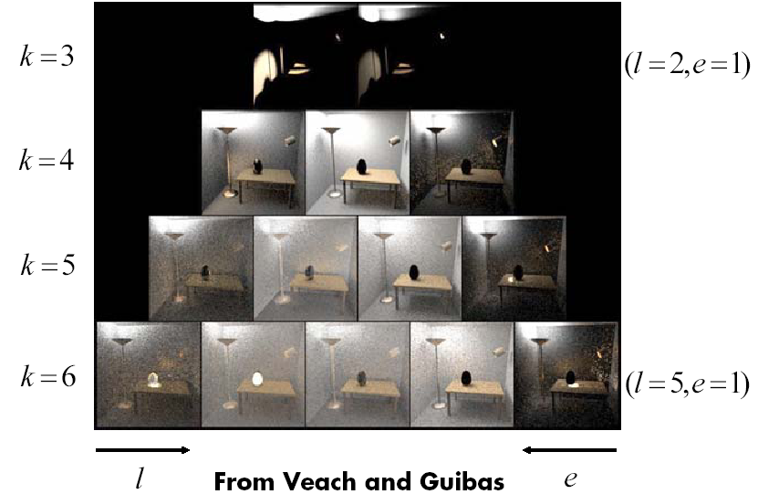
Bidirectional Path Tracing
Path pyramid (k = l + e = total number of bounces)

Slide 17
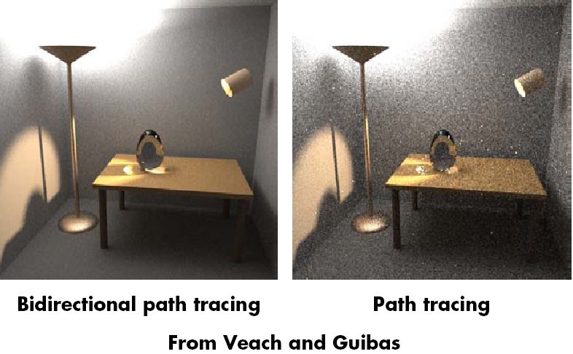
Comparison

Slide 18
Motivation
Rendering Equation since 86, Path Tracer in HW 3
So, is Monte Carlo rendering solved?
Can it be made more efficient (90s until today)?
Multiple Importance Sampling (Homework 4)
Irradiance Caching takes advantage of coherence
Correct sampling: Stratified, Multiple Importance, Bidirectional Path Tracing, Metropolis, VCM/UPS, …
Photon Mapping
Modern adaptive sampling, cut-based integration
Advanced topics (next time)
Denoising (next time)
High level: refs on slides, ask if need to track down

Slide 19
Why Photon Map?
Some visual effects like caustics hard with standard path tracing from eye
May usually miss light source altogether
Instead, store “photons” from light in kd-tree
Look-up into this as needed
Combines tracing from light source, and eye
Similar to bidirectional path tracing, but compute photon map only once for all eye rays
Global Illumination using Photon Maps H. Jensen. Rendering Techniques (EGSR 1996), pp 21-30. (Also book: Realistic Image Synthesis using Photon Mapping)

Slide 20
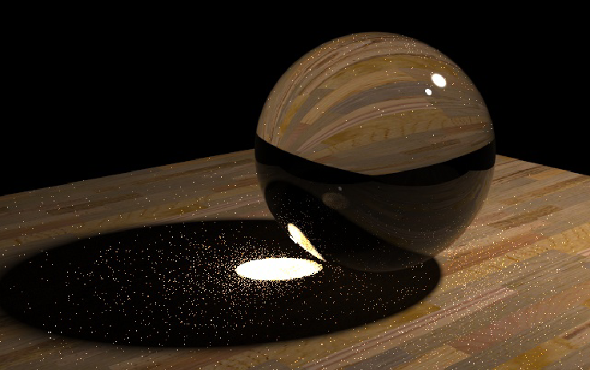
Caustics
Path Tracing: 1000 paths/pixel
Note noise in caustics
Slides courtesy Henrik Wann Jensen

Slide 21
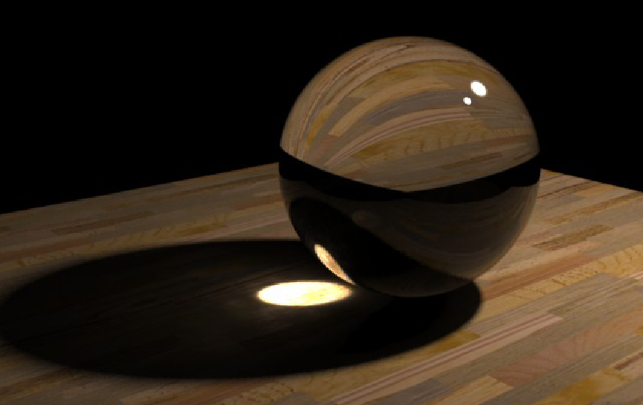
Caustics
Photon Mapping: 10000 photons
50 photons in radiance estimate

Slide 22
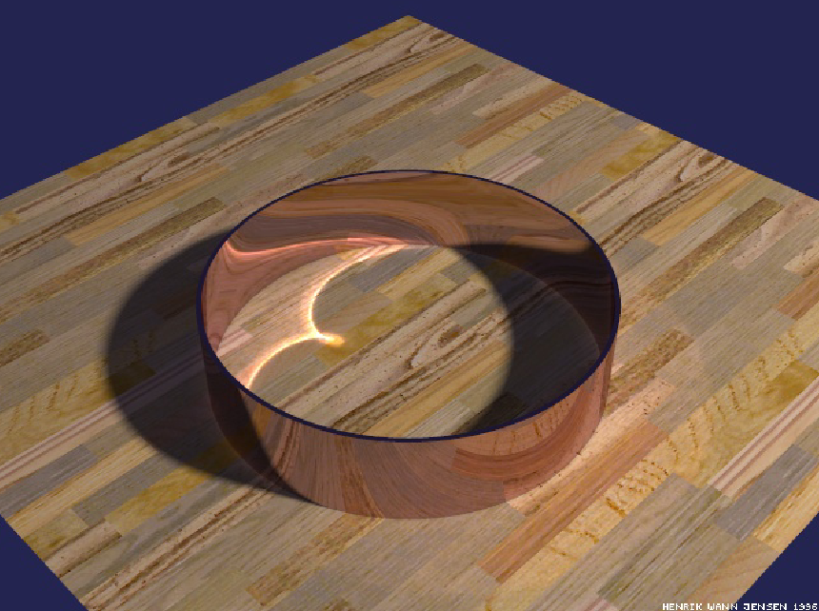
Reflections Inside a Metal Ring
50000 photons
50 photons to estimate radiance

Slide 23
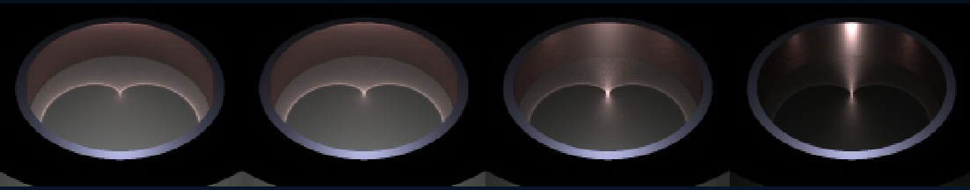
Caustics on Glossy Surfaces
340000 photons, 100 photons in radiance estimate

Slide 24
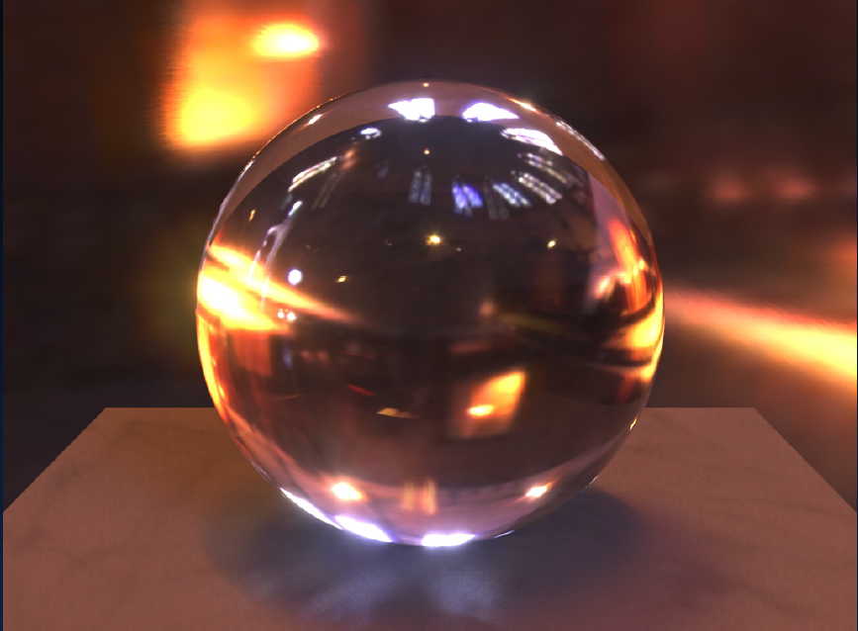
HDR Environment Illumination

Slide 25
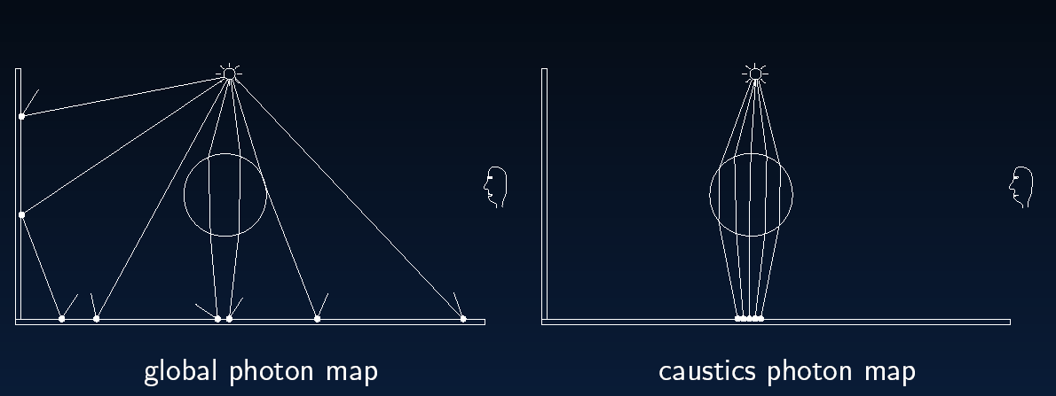
Global Illumination

Slide 26
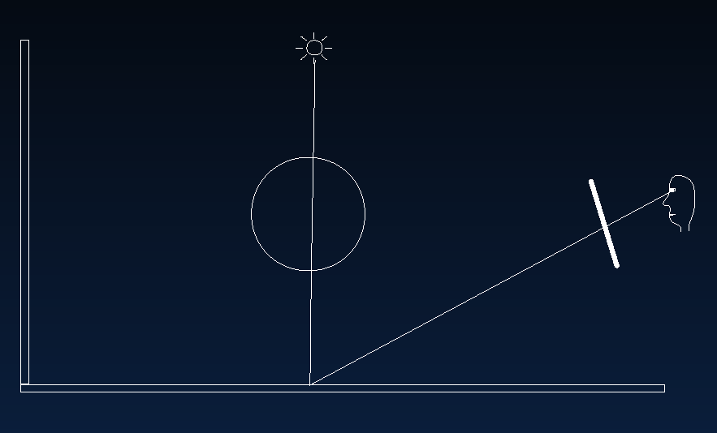
Direct Illumination

Slide 27
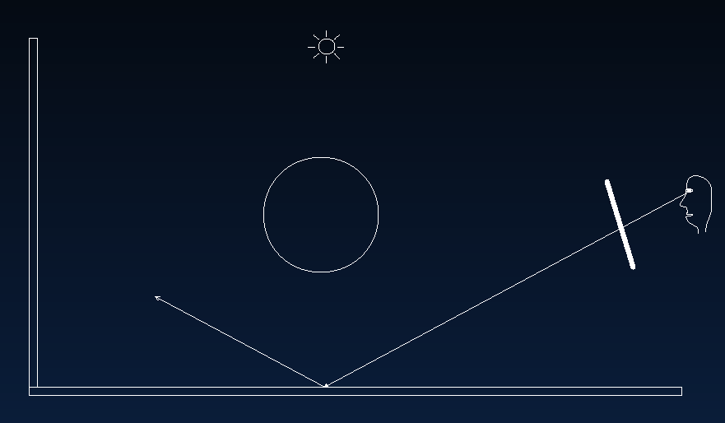
Specular Reflection

Slide 28
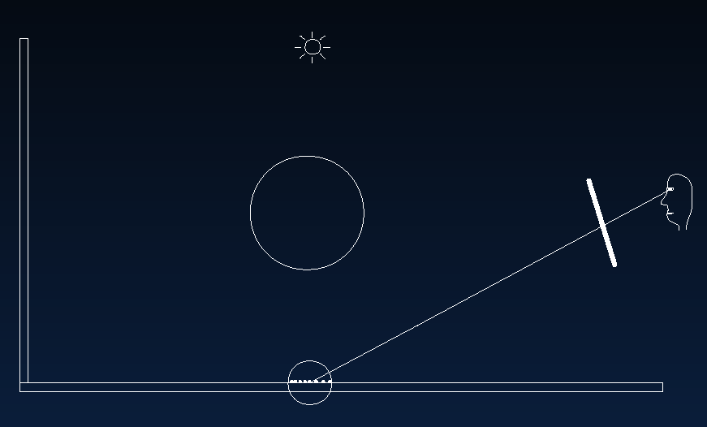
Caustics

Slide 29
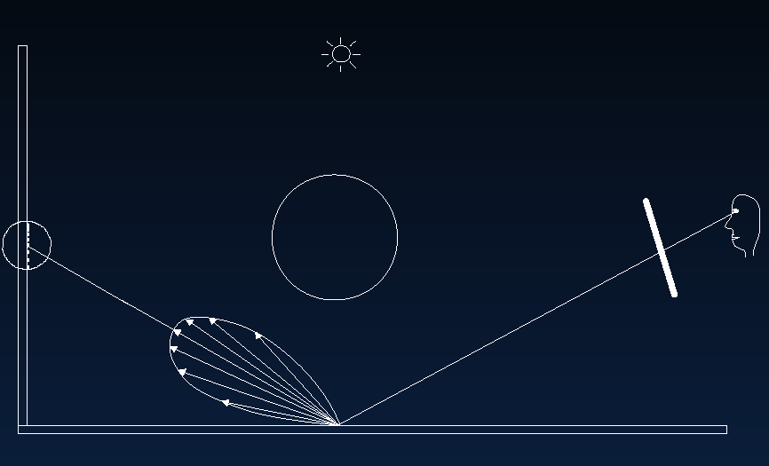
Indirect Illumination

Slide 30
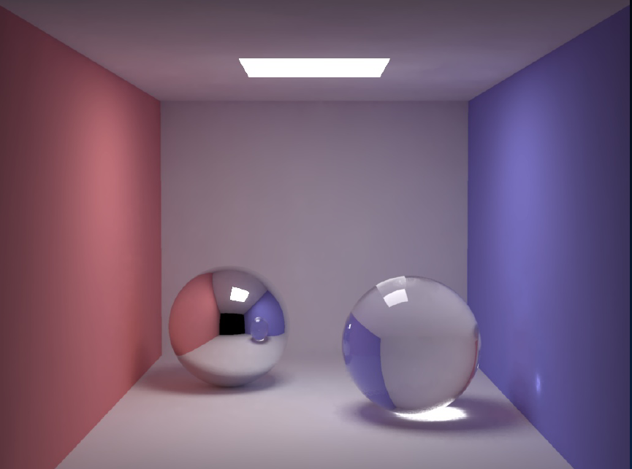
Cornell Box
200000 global photons, 50000 caustic photons

Slide 31
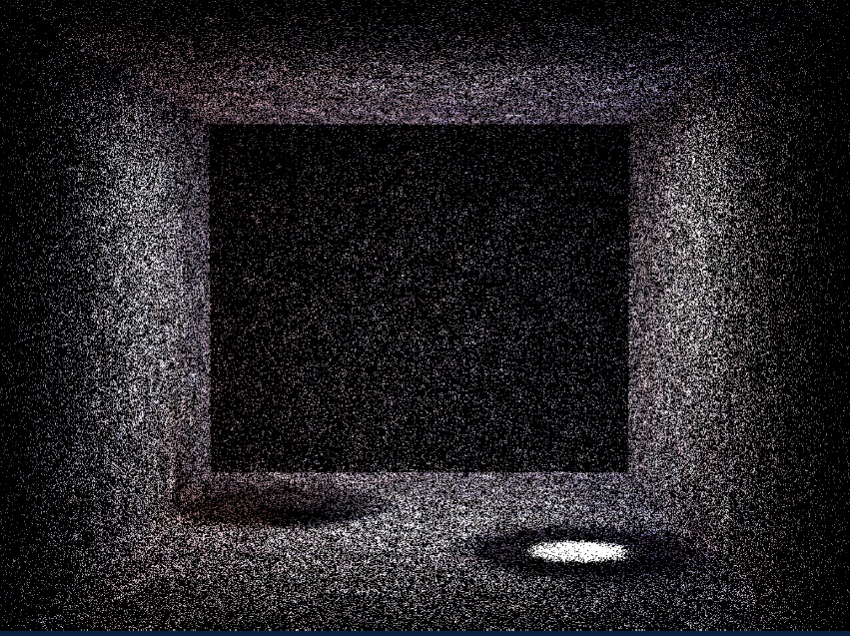
Box: Global Photons

Slide 32
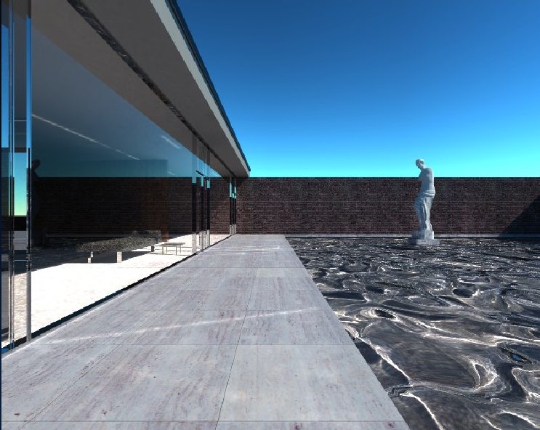
Mies House: Swimming Pool

Slide 33
Motivation
Rendering Equation since 86, Path Tracer in HW 3
So, is Monte Carlo rendering solved?
Can it be made more efficient (90s until today)?
Multiple Importance Sampling (Homework 4)
Irradiance Caching takes advantage of coherence
Correct sampling: Stratified, Multiple Importance, Bidirectional Path Tracing, Metropolis, VCM/UPS, …
Photon Mapping
Modern adaptive sampling, cut-based integration
Advanced topics (next time)
Denoising (next time)
High level: refs on slides, ask if need to track down

Slide 34
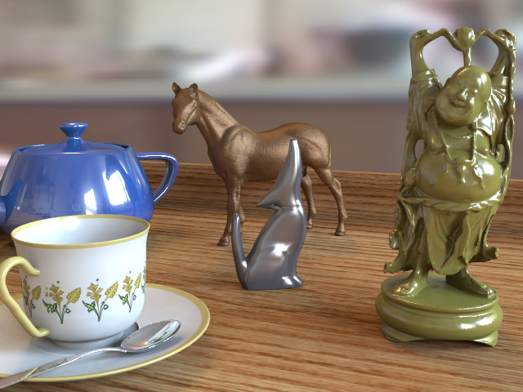
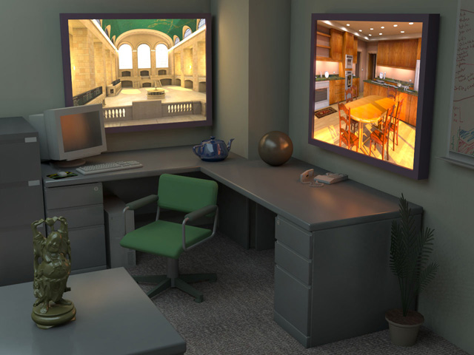
Lightcuts
Efficient, accurate complex illumination
Environment map lighting & indirect
Time 111s
Textured area lights & indirect
Time 98s
(640x480, Anti-aliased, Glossy materials)
From Walter et al. SIGGRAPH 05
Notes:
What is lightcuts? Lightcuts is a new scalable solution for efficiently computing complex illumination. Two examples are shown here. The image on the left is lit by an environment map with illumination captured from the real world, while the image on the right includes two simulated high dynamic range flat-panel displays. Both are challenging illumination problems. In addition both images include indirect illumination, glossy materials, and anti-aliasing. Yet our method was able to produce each image in under two minutes on a single machine.

Slide 35
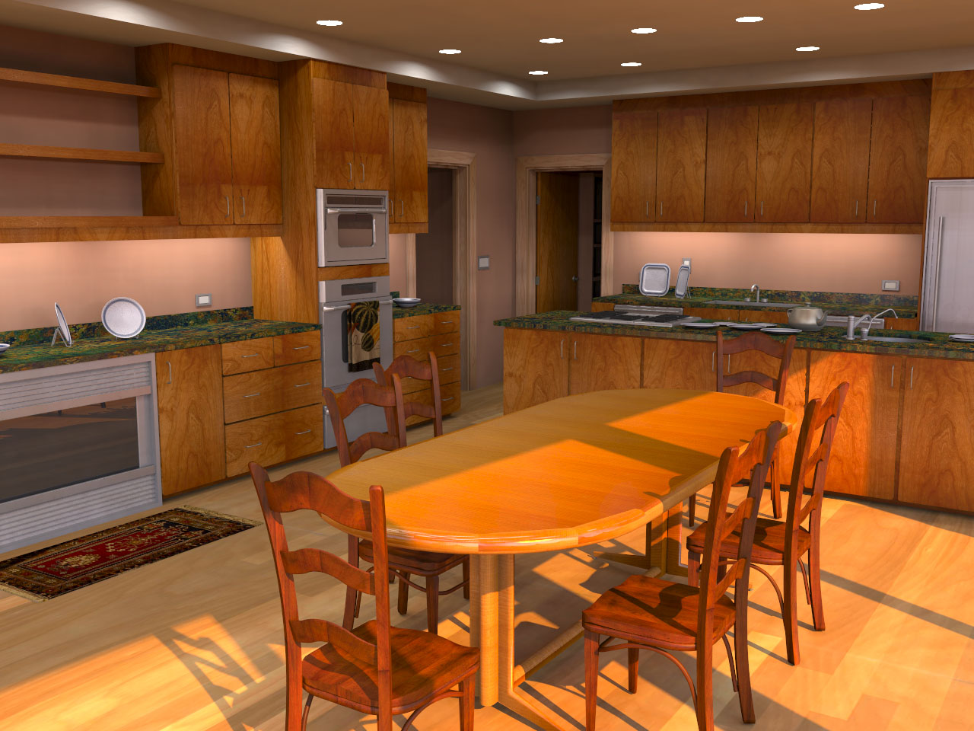
Complex Lighting
Simulate complex illumination using point lights
Area lights
HDR environment maps
Sun & sky light
Indirect illumination
Unifies illumination
Enables tradeoffs between components
Area lights + Sun/sky + Indirect
Notes:
Once we have a scalable solution for many point lights, we can use this to compute other types of complex illumination. The four examples we demonstrate in the paper are area lights, high dynamic range environment maps, sun & sky light, and indirect illumination. Moreover this allows us to unify the handling of different illumination types and enables new types of tradeoffs. For example, bright illumination from one source allows coarser approximations of other sources.

Slide 36
Key Concepts
Light Cluster
Light Tree
Binary tree of lights and clusters
Clusters
Individual
Lights
Notes:
Second is the light tree which is a binary tree of lights and clusters. The leaves of this tree are the individual lights while the interior nodes represent clusters which get progressively larger as we go up the tree.

Slide 37
Key Concepts
Light Cluster
Light Tree
A Cut
A set of nodes that partitions the lights into clusters
Notes:
The third is a cut which is a set of nodes that partitions the lights into clusters. Here illustrated by the orange line.

Slide 38
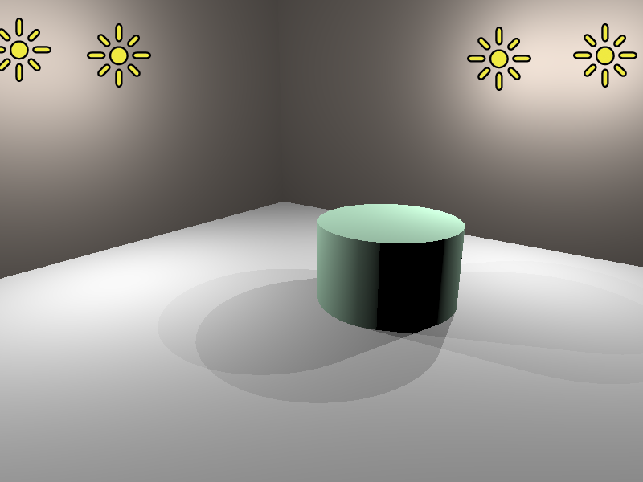
Simple Example
Light Tree
Representative
4
#1
#2
#3
#4
Light
Clusters
1
4
1
2
3
4
Individual
Lights
Notes:
Here is a simple scene with four lights and its corresponding light tree.

Slide 39
Three Example Cuts
Three Cuts
#1
#2
#4
#1
#3
#4
#1
#4
4
4
4
1
4
1
4
1
4
1
2
3
4
1
2
3
4
1
2
3
4
Notes:
And here we show three example cuts through the light tree. Highlighted above each cut are the regions where that cut produces an accurate approximation of the exact illumination.

Slide 40
Three Example Cuts
Three Cuts
#1
#2
#4
#1
#3
#4
#1
#4
4
4
4
1
4
1
4
1
4
1
2
3
4
1
2
3
4
1
2
3
4
Good
Bad
Bad
Notes:
If we look at this green point on the left of the images, the orange cut produces a good approximation while the blue and purple cuts would cause too much error.

Slide 41
Three Example Cuts
Three Cuts
#1
#2
#4
#1
#3
#4
#1
#4
4
4
4
1
4
1
4
1
4
1
2
3
4
1
2
3
4
1
2
3
4
Bad
Good
Bad
Notes:
Conversely for this point in the center of the images, the blue cut is a good approximation while the orange and purple cuts are not usable. This illustrates an important point. We will want to use different cuts in different parts of the image.

Slide 42
Three Example Cuts
Three Cuts
#1
#2
#4
#1
#3
#4
#1
#4
4
4
4
1
4
1
4
1
4
1
2
3
4
1
2
3
4
1
2
3
4
Good
Good
Good
Notes:
For this point on the right side of the images, all three cuts usable. In this case the purple cut is the best choice because it will be the cheapest to compute as it contains the fewest nodes.

Slide 43

Tableau, 630K polygons, 13 000 lights, (EnvMap+Indirect)
Avg. shadow rays per eye ray 17 (0.13%)
Notes:
Here is another results that show cases our ability to handle glossy objects. This scene is illuminated by a captured environment map and indirect illumination. And here is a short animation of this scene.

Slide 44
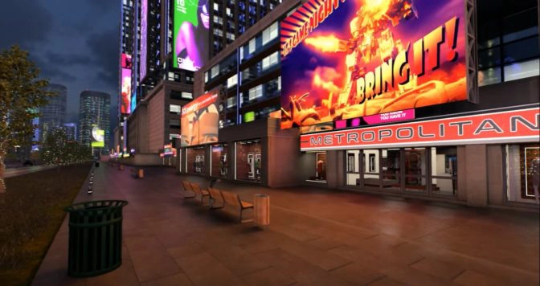
NVIDIA ReSTIR RTX DI
Bitterli et al. 20 Spatiotemporal reservoir resampling
Real-Time Direct Lighting from millions of lights

