Slide 1




Computer Graphics II: Rendering
CSE 168[Spr 25],Lecture 11: Fourier Analysis, Sampling Ravi Ramamoorthi
http://viscomp.ucsd.edu/classes/cse168/sp25

Slide 2
To Do
Start immediately on homework 4.
Start thinking about final project
This lecture gives core background on sampling and signal-processing (bear in mind image processing)
Some slides courtesy Pat Hanrahan

Slide 3
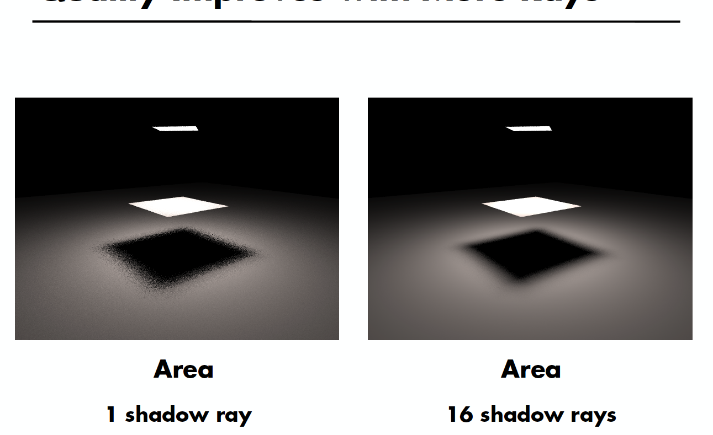
Quality Improves with More Rays

Slide 4
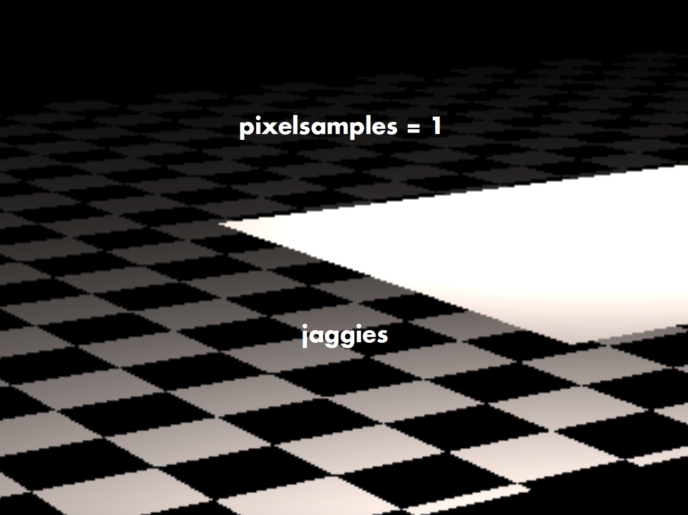

Slide 5
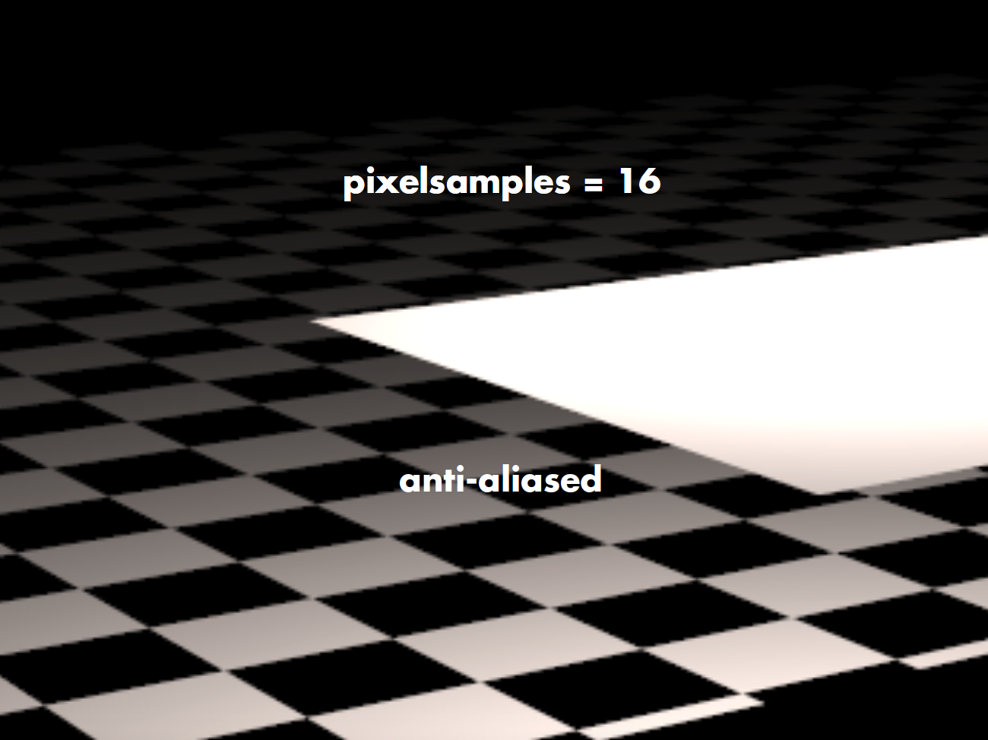

Slide 6
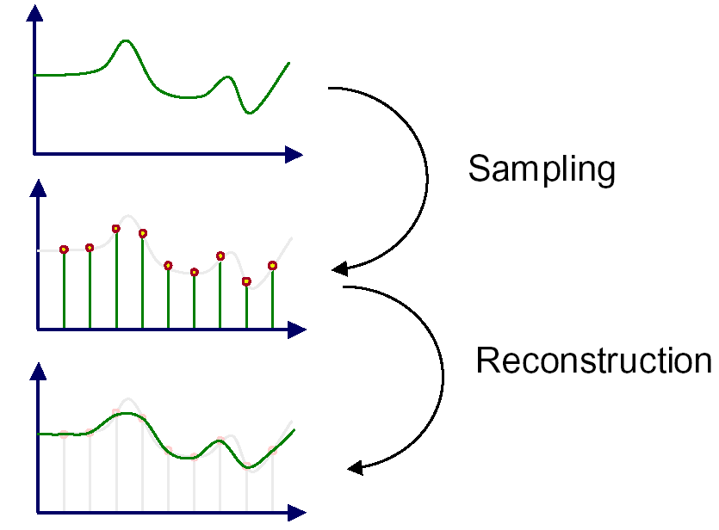
Sampling and Reconstruction
An image is a 2D array of samples
Discrete samples from real-world continuous signal

Slide 7
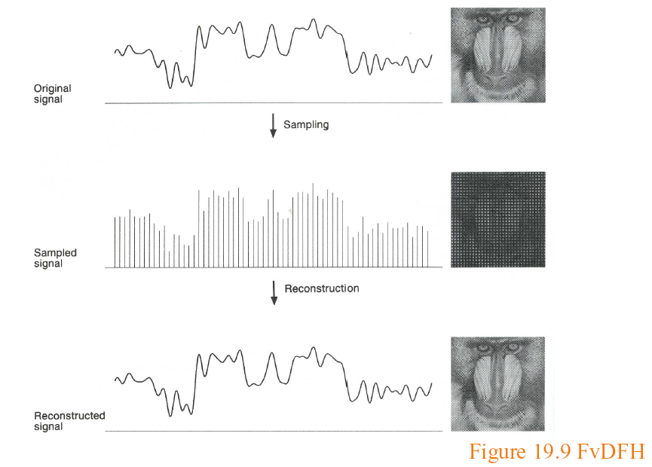
Sampling and Reconstruction

Slide 8
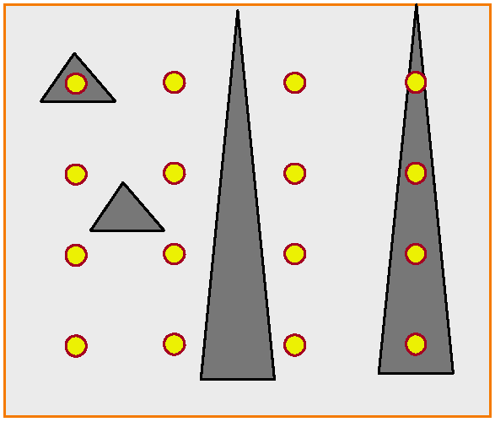
(Spatial) Aliasing

Slide 9
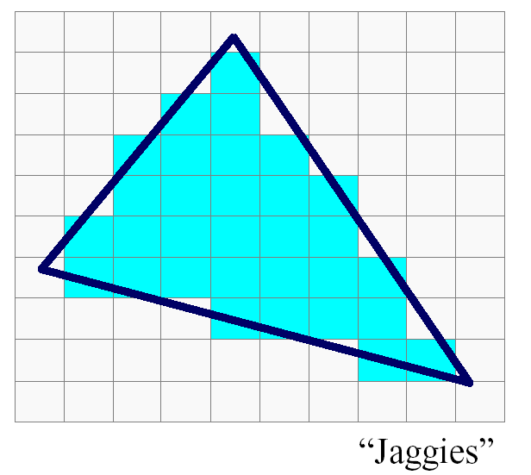
(Spatial) Aliasing
Jaggies probably biggest aliasing problem

Slide 10
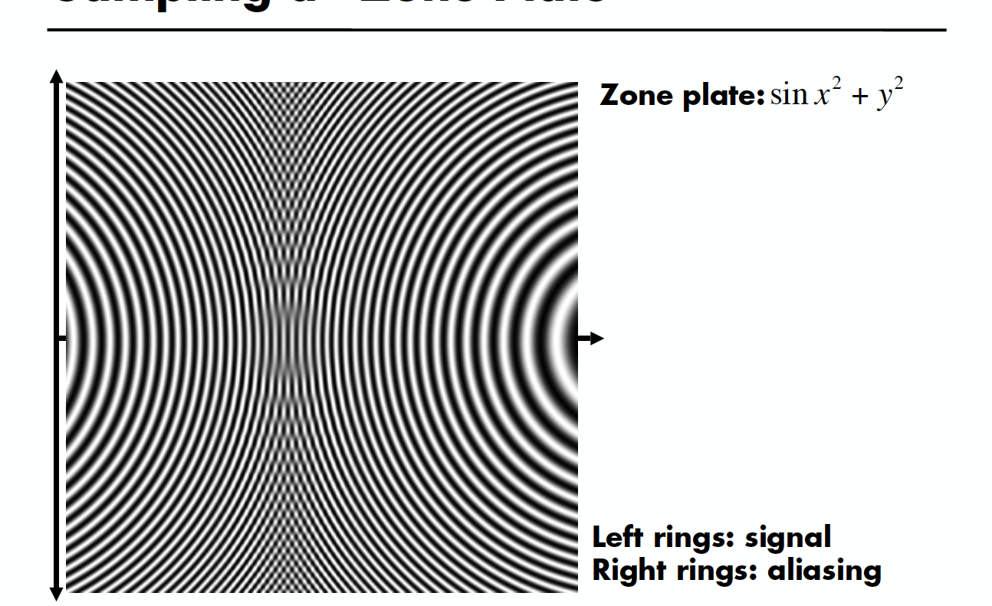
Sampling a Zone Plate

Slide 11
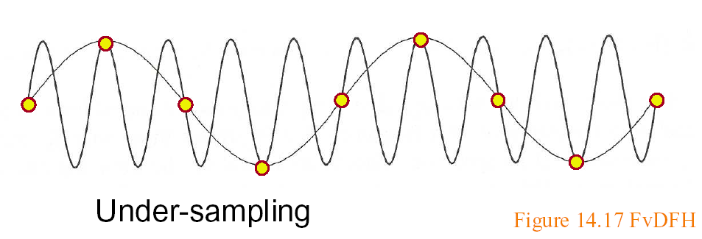
Sampling and Aliasing
Artifacts due to undersampling or poor reconstruction
Formally, high frequencies masquerading as low
E.g. high frequency line as low freq jaggies

Slide 12
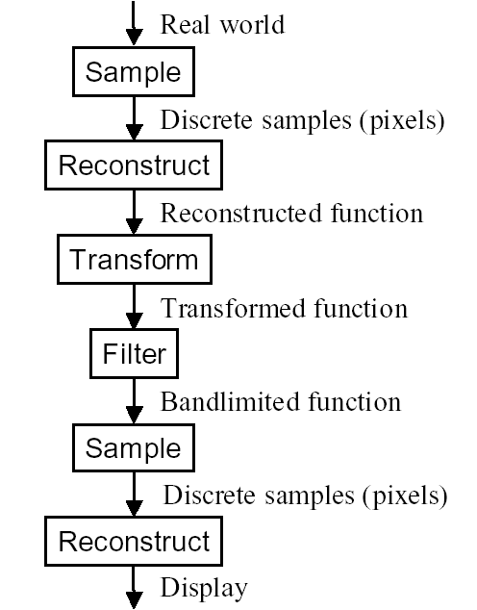
Image Processing pipeline

Slide 13
Motivation
Formal analysis of sampling and reconstruction
Important theory (signal-processing) for graphics
Also relevant in rendering, modeling, animation
Note: Fourier Analysis useful for understanding, but image processing often done in spatial domain

Slide 14
Ideas
Signal (function of time generally, here of space)
Continuous: defined at all points; discrete: on a grid
High frequency: rapid variation; Low Freq: slow variation
Images are converting continuous to discrete. Do this sampling as best as possible.
Signal processing theory tells us how best to do this
Based on concept of frequency domain Fourier analysis

Slide 15
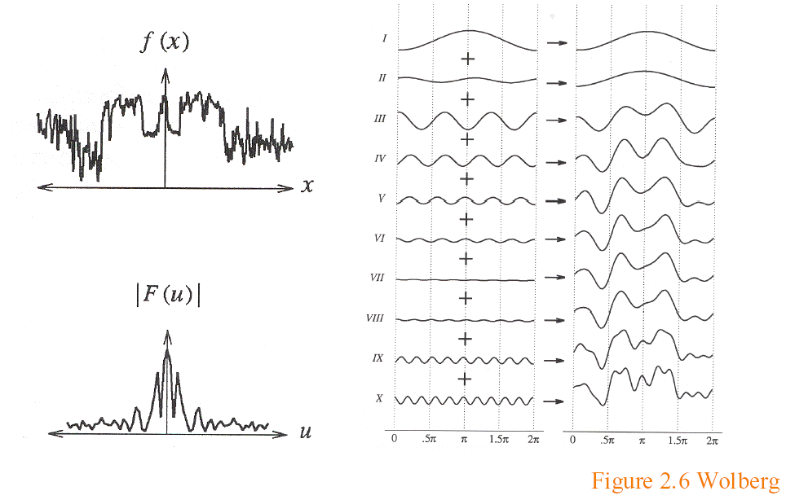
Sampling Theory
Analysis in the frequency (not spatial) domain
  Sum of sine waves, with possibly different offsets (phase)
  Each wave different frequency, amplitude

Slide 16
Fourier Transform
Tool for converting from spatial to frequency domain
Or vice versa
One of most important mathematical ideas
Computational algorithm: Fast Fourier Transform
  One of 10 great algorithms scientific computing
  Makes Fourier processing possible (images etc.)
  Not discussed here, but look up if interested

Slide 17
Fourier Transform
Simple case, function sum of sines, cosines
Continuous infinite case

Slide 18
Fourier Transform
Simple case, function sum of sines, cosines
Discrete case

Slide 19
Fourier Transform: Examples 1
Single sine curve (+constant DC term)

Slide 20
Fourier Transform Examples 2
Common examples

Slide 21
Fourier Transform Properties
Common properties
  Linearity:
  Derivatives: [integrate by parts]
  2D Fourier Transform
Convolution (next)

Slide 22
Sampling Theorem, Bandlimiting
A signal can be reconstructed from its samples, if the original signal has no frequencies above half the sampling frequency – Shannon
The minimum sampling rate for a bandlimited function is called the Nyquist rate

Slide 23
Sampling Theorem, Bandlimiting
A signal can be reconstructed from its samples, if the original signal has no frequencies above half the sampling frequency – Shannon
The minimum sampling rate for a bandlimited function is called the Nyquist rate
A signal is bandlimited if the highest frequency is bounded. This frequency is called the bandwidth
In general, when we transform, we want to filter to bandlimit before sampling, to avoid aliasing

Slide 24
Antialiasing
Sample at higher rate
  Not always possible
  Real world: lines have infinitely high frequencies, can’t sample at high enough resolution
Prefilter to bandlimit signal
  Low-pass filtering (blurring)
  Trade blurriness for aliasing

Slide 25
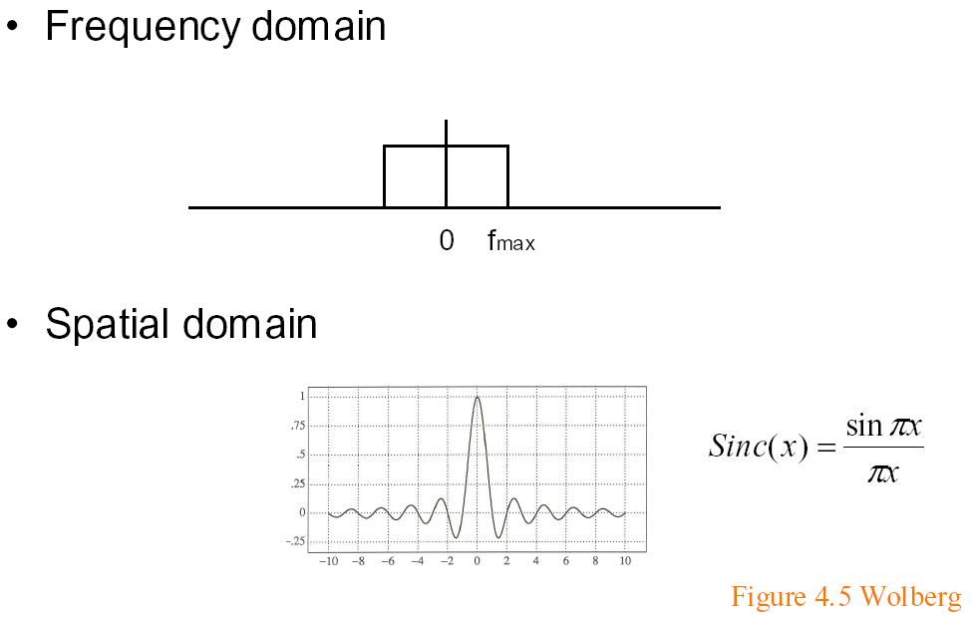
Ideal bandlimiting filter
Formal derivation is homework exercise
if full width f_{max} = 1

Slide 26
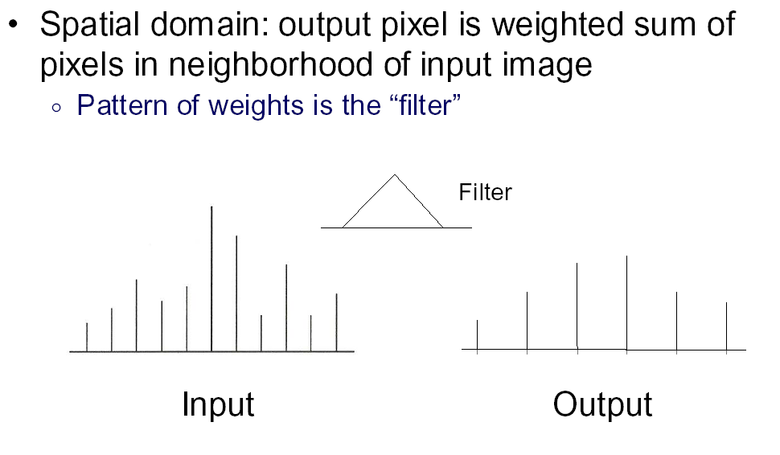
Convolution 1

Slide 27
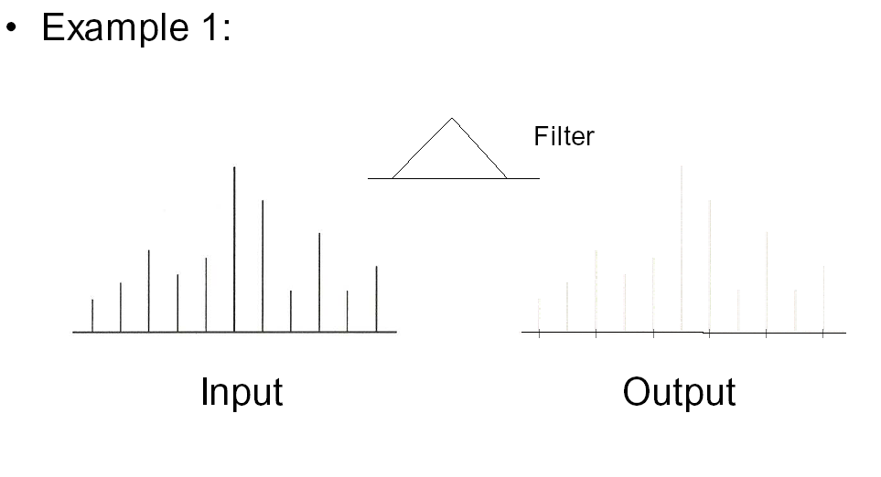
Convolution 2

Slide 28
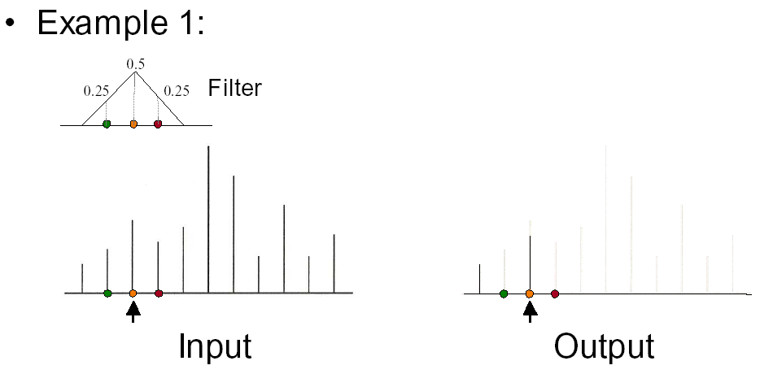
Convolution 3

Slide 29
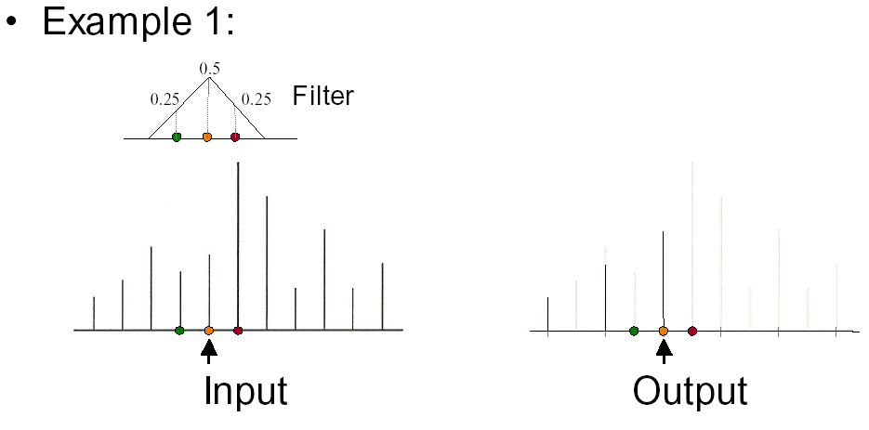
Convolution 4

Slide 30
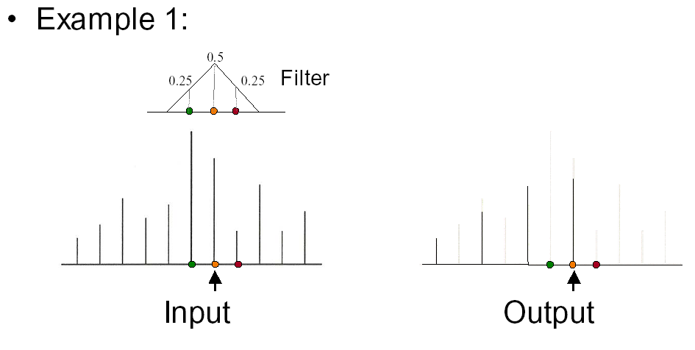
Convolution 5

Slide 31
Convolution in Frequency Domain
Convolution (f is signal ; g is filter [or vice versa])
Fourier analysis (frequency domain multiplication)

Slide 32
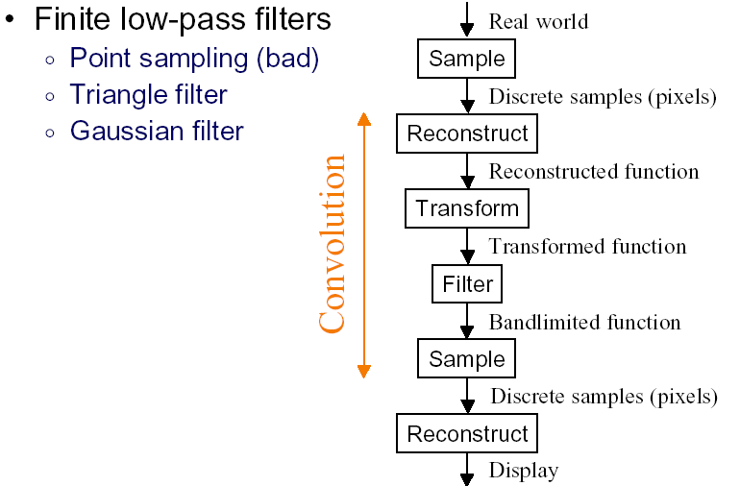
Practical Image Processing
Discrete convolution (in spatial domain) with filters for various digital signal processing operations
Easy to analyze, understand effects in frequency domain
  E.g. blurring or bandlimiting by convolving with low pass filter

Slide 33
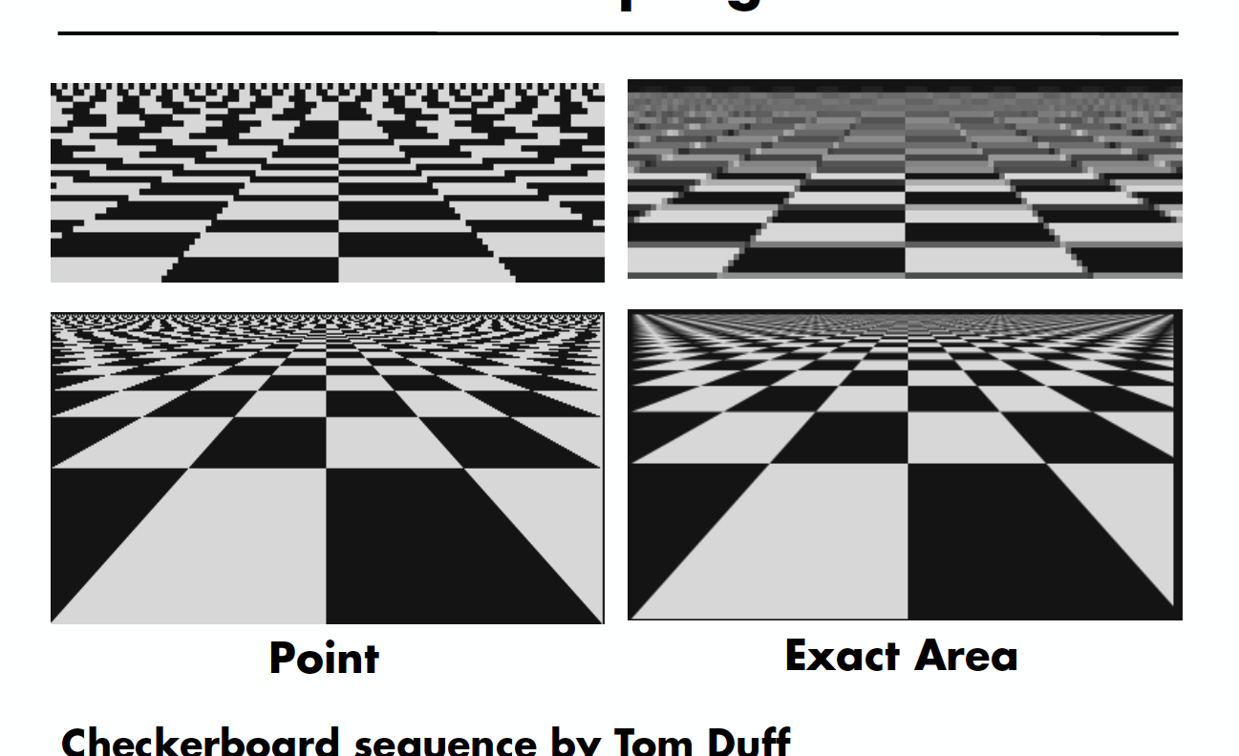
Point vs Area Sampling

Slide 34
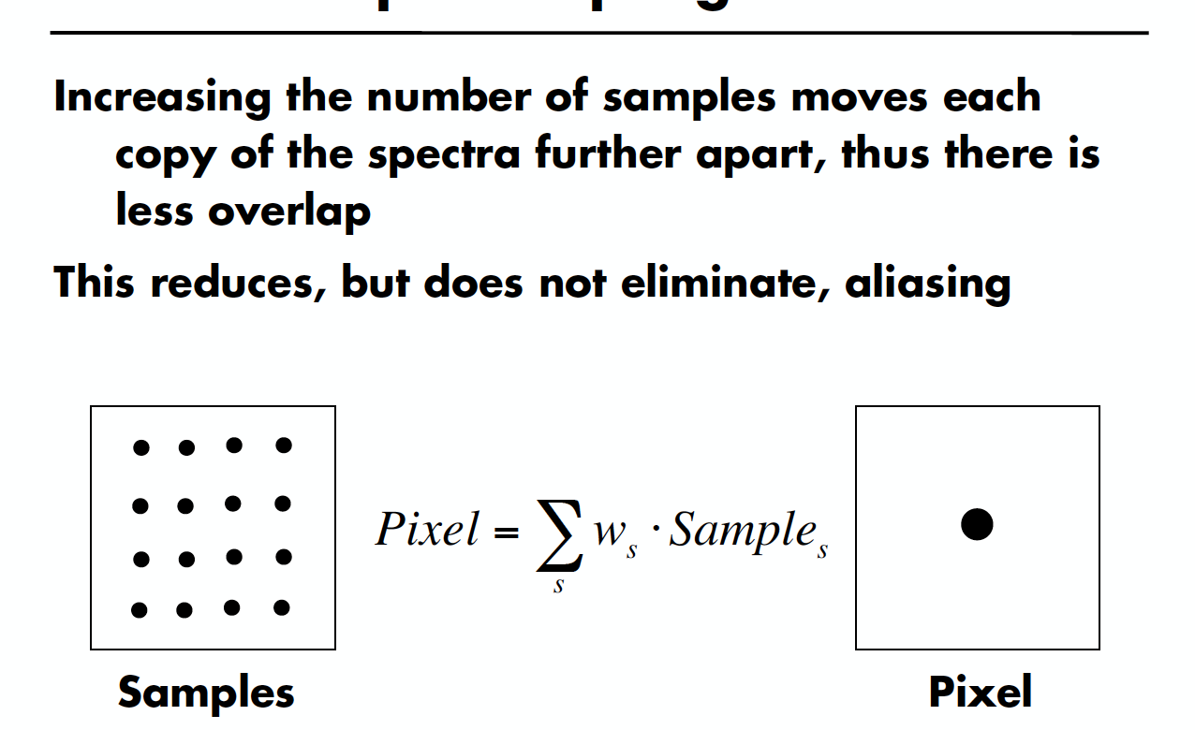
Uniform Supersampling

Slide 35
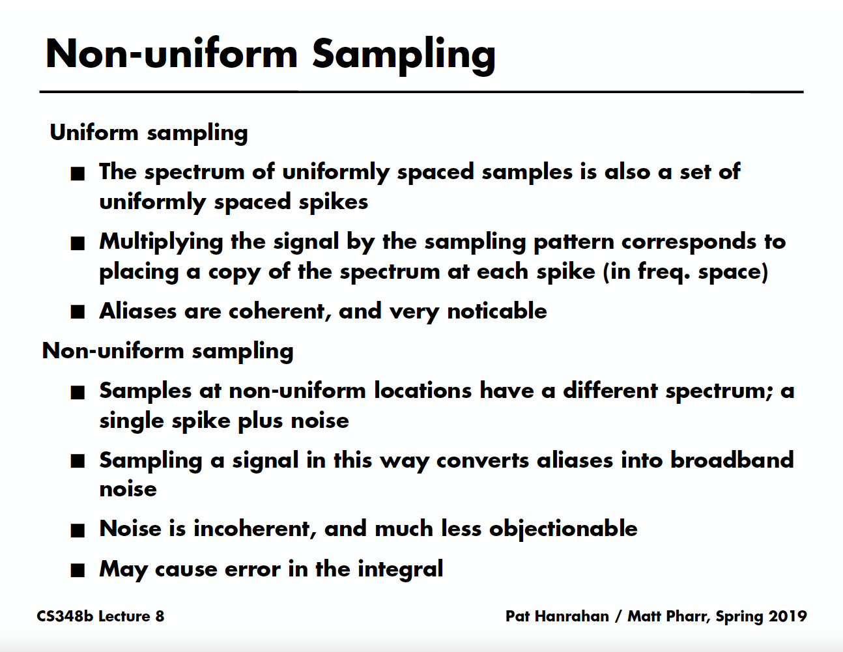

Slide 36
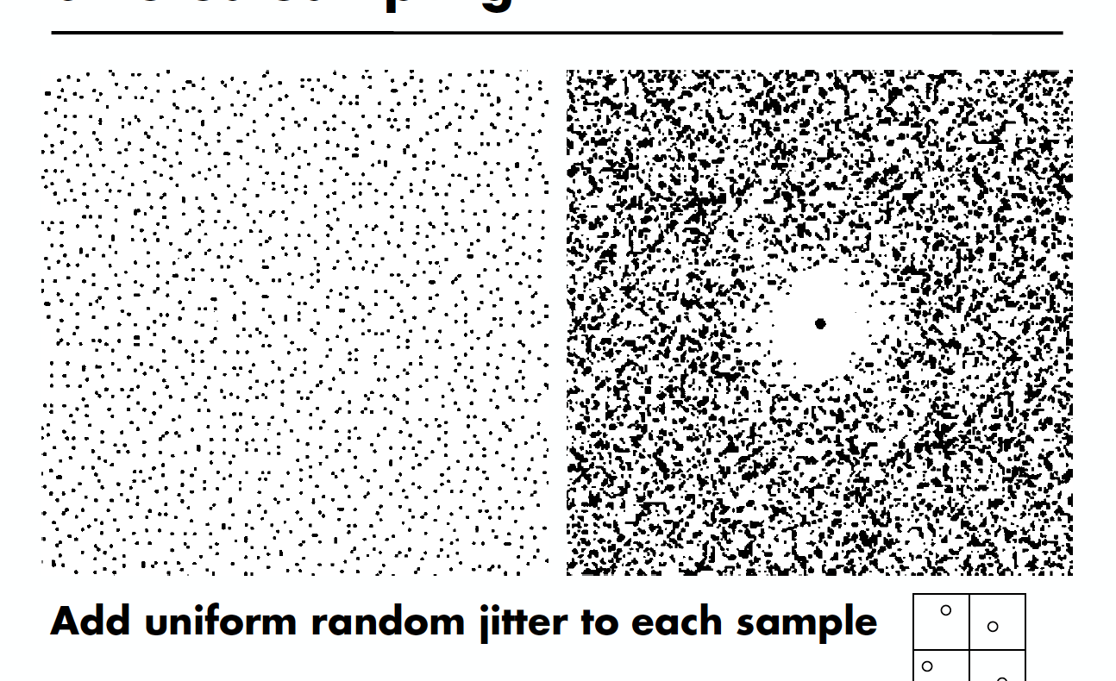
Jittered Sampling

Slide 37
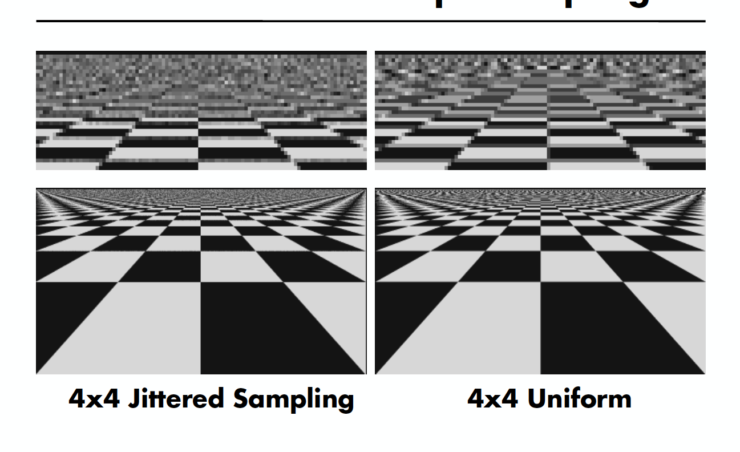
Jittered vs Uniform Supersampling

Slide 38
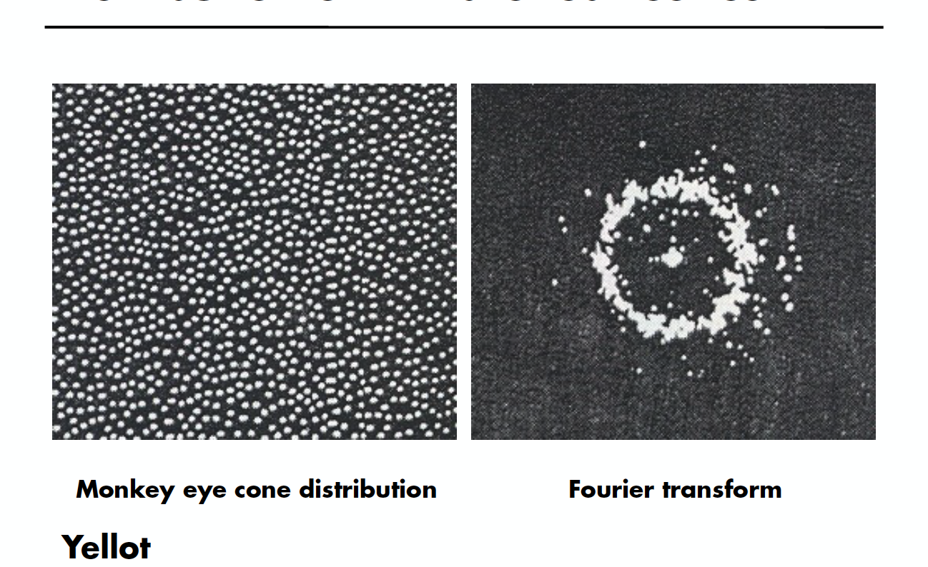
Distribution of Extrafoveal Cones

Slide 39
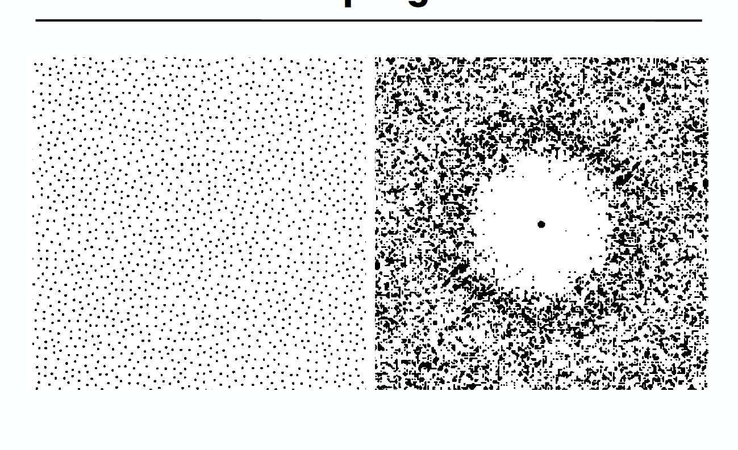
Poisson Disk Sampling

