Slide 1




Computer Graphics II: Rendering
CSE 168 [Spr 24], Lecture 6: Direct Lighting Details Ravi Ramamoorthi
http://viscomp.ucsd.edu/classes/cse168/sp24

Slide 2
To Do
Homework 2 (Direct Lighting) due Apr 25
Assignment is on UCSD Online
START EARLY
This lecture goes through details of direct lighting, visibility, Monte Carlo for the assignment
Ask re any questions

Slide 3
Area Lights
Physically correct (physically no perfect point light)
Can talk in terms of radiance at surface
Enable soft shadows, partial visibility/occlusion
Shoot multiple rays to light source, average
Need proper rendering equation for accurate result
Only direct lighting here, so reflection equation suffices

Slide 4
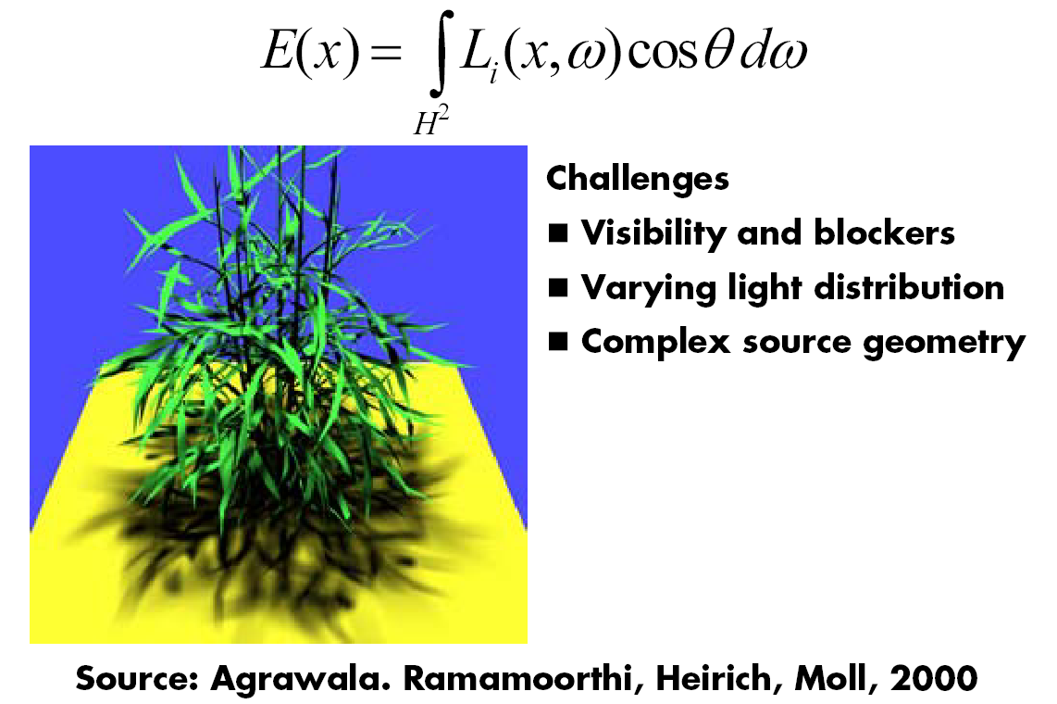
Example: Soft Shadows

Slide 5
Reflection Equation
Reflected Light
(Output Image)
Emission
Incident
Light (from
light source)
BRDF
Cosine of
Incident angle

Slide 6
Reflection Equation
Sum over all light sources
Reflected Light
(Output Image)
Emission
Incident
Light (from
light source)
BRDF
Cosine of
Incident angle

Slide 7
Reflection Equation
Replace sum with integral
Reflected Light
(Output Image)
Emission
Incident
Light (from
light source)
BRDF
Cosine of
Incident angle

Slide 8
Reflection Equation
As written in assignment (for one pixel)
Reflected Light
(Outgoing Dirn.
Drop spat. Coord. )
Emission
Incident
Light (from
area light)
BRDF
Cosine of
Incident angle
(max not explicit hw)

Slide 9
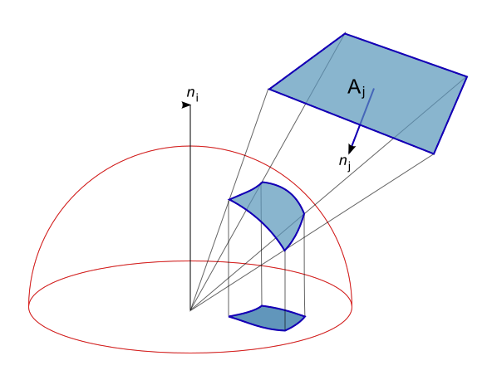
Uniform Polygonal Area Source
Integrate projection of polygon P onto sphere
Assume uniform radiance incident from light L_{i}
Assume no emission (and no occlusion for now)
Nusselt’s analog (wikipedia image) project to (unit hemi)sphere, then circle (unit disk at equator) for cosine term [but only valid for Lambertian, or modulate by BRDF]

Slide 10
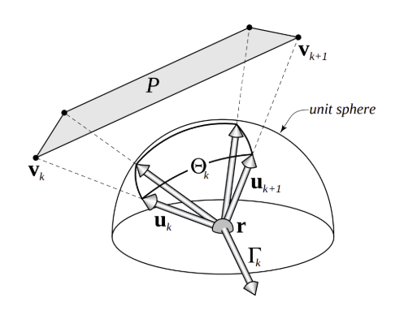
Analytic Irradiance
Analytic irradiance for a polygon [Baum89, Arvo94-95]
Useful to get precise answer, check Monte Carlo
Define “irradiance vector” [Arvo 94]

Slide 11
Analytic Irradiance
Analytic irradiance for a polygon [Baum89, Arvo94-95]
Useful to get precise answer, check Monte Carlo
Define “irradiance vector” [Arvo 94]

Slide 12
Analytic Irradiance
Analytic irradiance for a polygon [Baum89, Arvo94-95]
Useful to get precise answer, check Monte Carlo
Define “irradiance vector” [Arvo 94]

Slide 13
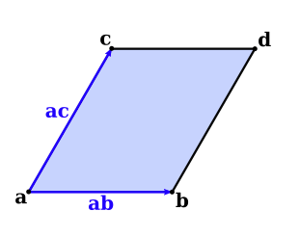
Implementing Analytic Irradiance
New parallelogram light quadLight <a> <ab> <ac> <radiance>
quadLight 0 0 0 1 0 0 0 0 1 1 1 1
Primary rays like ray tracer
Use analytic formula for shading
Add contribs. from all lights
No emission, visibility (yet)

Slide 14
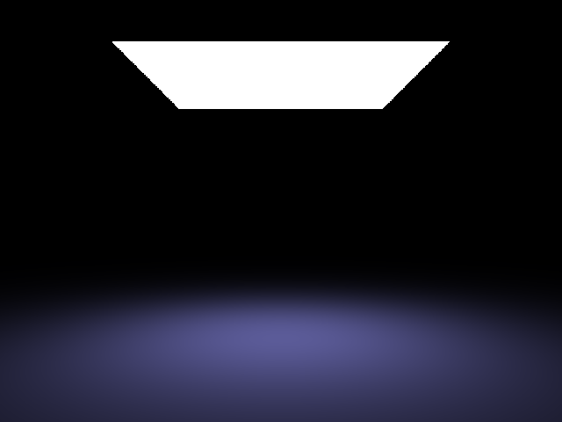
Example (No Noise)

Slide 15
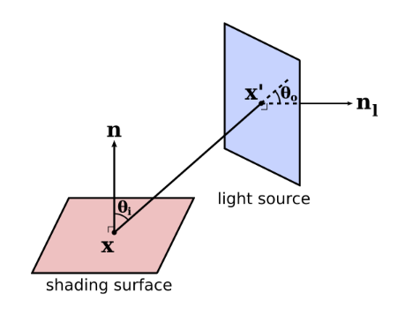
General Direct Lighting
Include (partial) visibility by tracing multiple rays
Include non-Lambertian reflectance (Phong)
Integrate over area light, change area measure

Slide 16
General Direct Lighting
Include (partial) visibility by tracing multiple rays
Include non-Lambertian reflectance (Phong)
Integrate over area light, change area measure

Slide 17
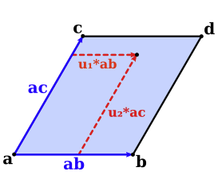
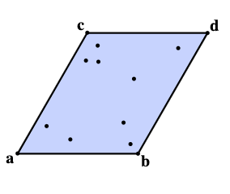
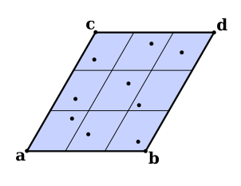
Monte Carlo Solution
Sample area light (two random numbers give x’_{k})
Random or stratified (compare)
Monte Carlo evaluation of direct lighting (N samples)

Slide 18
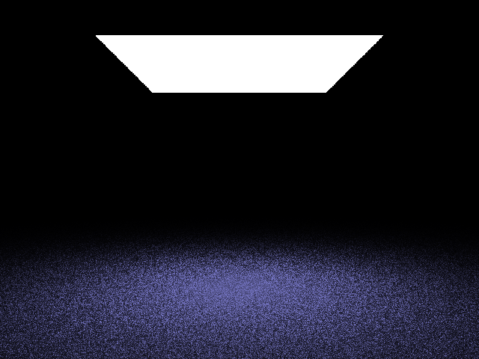
Compare to Analytic (no shadows)
Number of Samples 1 (Random)

Slide 19
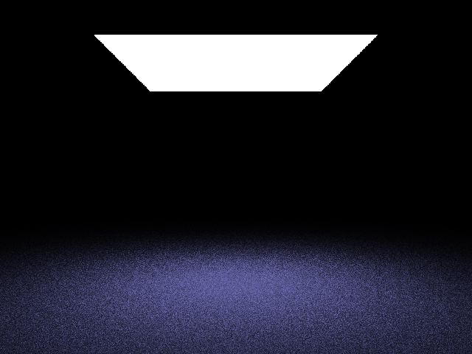
Compare to Analytic (no shadows)
Number of Samples 3 (Random)

Slide 20
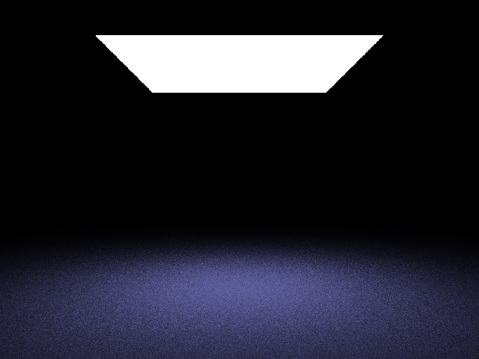
Compare to Analytic (no shadows)
Number of Samples 9 (Random)

Slide 21
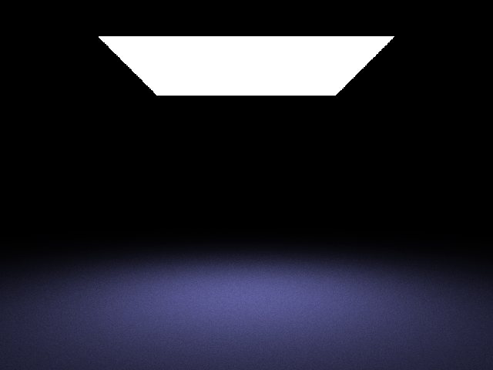
Compare to Analytic (no shadows)
Number of Samples 9 (Stratified)

Slide 22
Compare to Analytic (no shadows)
Analytic

Slide 23
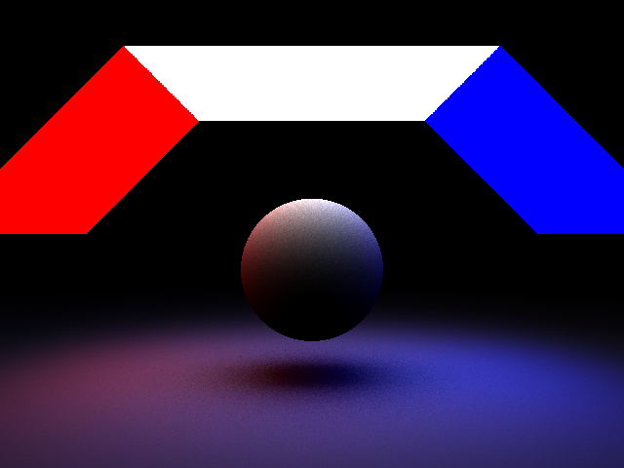
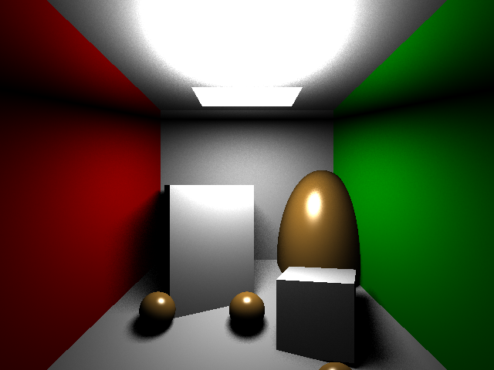
More Complex Scenes
For assignment, render with 5x5 stratified
Direct lighting only, turn off recursive raytracing etc

Slide 24
Submission (bias, variance)
Monte Carlo introduces noise
So auto-feedback can’t just pixel difference
Bias is on average how far from (analytic?) result
Monte Carlo rendering is an unbiased (bias 0) technique
High bias indicates an error in the program
Analytic should be exact (no bias or variance)
Variance is squared pixel error (RMS = stdev)
All Monte Carlo results will have some variance
May differ in variance from our solution
But our bounds are reasonable (too far off = issues?)
Focus on being correct, not just pretty
Can submit to autofeedback as many times as you want
Scores only suggestive, will grade manually

Slide 25
Submission (bias, variance)
Monte Carlo introduces noise
So auto-feedback can’t just pixel difference
Bias is on average how far from result (close to 0)
Monte Carlo rendering is an unbiased technique
High bias indicates an error in the program
Variance is squared pixel error (RMS = stdev)
May differ in variance from our solution
But our bounds are reasonable (too far off = issues?)

Slide 26
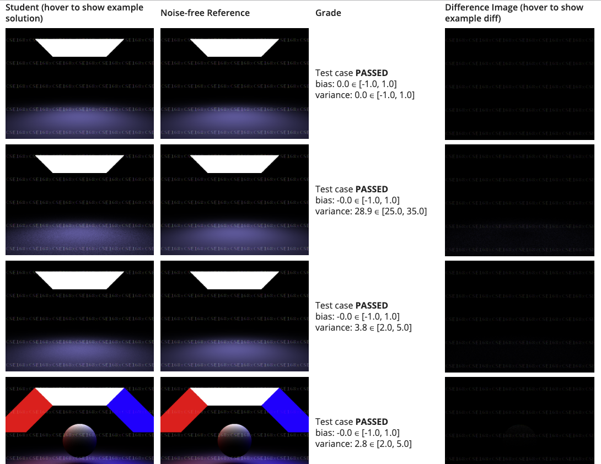
Submission (bias, variance)

Slide 27
Extra: Reducing Variance
Increase bias slightly by evaluating everything except visibility (at center [of stratum], or analytic)
Noise now only from visibility, none otherwise
No noise if no occlusions/shadows
Exact if use analytic formula (to evaluate unshadowed irradiance from each strata) instead of stratum center

Slide 28
Extra: Point Lights
Point lights not physical (but widely used)
How to include in Monte Carlo Rendering?
Units aren’t even same (can’t use radiance)
Power per solid angle, not power per unit area per solid angle
Think of as delta functions (area goes to 0, total radiance integrated over light I = L_{i} A remains same)
No cosine term for light, inverse square falloff, no integral

Slide 29
Extra: Directional Lights
First, assume small angular extent (even sun subtends an angle of 0.5 degrees)
If pure directional light (delta function), then fix product (same units as irradiance)

Slide 30
Combining Point, Directional, Area
Small angle, area expressed in radiance L_{i}
Use physical units Wm⁻² sr⁻¹
Point is in intensity Wsr⁻¹
This is not in same units (e.g. 0…1) as area lights
Need to normalize by multiplying by an area unit
Point light same intensity as area light: multiply by area
Directional is in irradiance units Wm⁻²
This is not in same units (e.g. 0…1) as area/point lights
Need to normalize by multiplying by solid angle
Directional light same intensity as area light: multiply by average solid angle subtended by area light
Directional same intensity as point: divide by average squared distance to point light, mult by 2 for avg cosine

