Slide 1




Computer Graphics II: Rendering
CSE 168 [Spr 24], Lecture 5: Monte Carlo Integration Ravi Ramamoorthi
http://viscomp.ucsd.edu/classes/cse168/sp24

Slide 2
To Do
Homework 2 (Direct Lighting) due Apr 25
Assignment is on UCSD Online
START EARLY (NOW)

Slide 3
Motivation
Rendering = integration
  Reflectance equation: Integrate over incident illumination
  Rendering equation: Integral equation
Many sophisticated shading effects involve integrals
  Antialiasing
  Soft shadows
  Indirect illumination
  Caustics

Slide 4
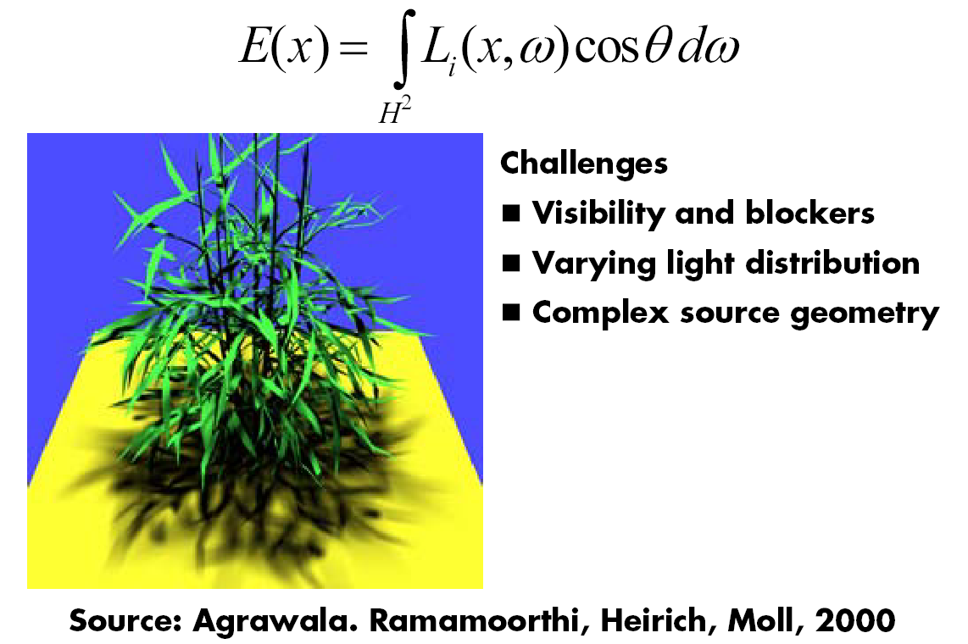
Example: Soft Shadows

Slide 5
Monte Carlo
Algorithms based on statistical sampling and random numbers
Coined in the beginning of 1940s. Originally used for neutron transport, nuclear simulations
  Von Neumann, Ulam, Metropolis, …
Canonical example: 1D integral done numerically
  Choose a set of random points to evaluate function, and then average (expectation or statistical average)

Slide 6
Monte Carlo Algorithms
Advantages
  Robust for complex integrals in computer graphics (irregular domains, shadow discontinuities and so on)
  Efficient for high dimensional integrals (common in graphics: time, light source directions, and so on)
  Quite simple to implement
  Work for general scenes, surfaces
  Easy to reason about (but care taken re statistical bias)
Disadvantages
  Noisy
  Slow (many samples needed for convergence)
  Not used if alternative analytic approaches exist (but those are rare)

Slide 7
Outline
Motivation
Overview, 1D integration
Basic probability and sampling
Monte Carlo estimation of integrals

Slide 8
Integration in 1D
f(x)
x=1
Slide courtesy of
Peter Shirley

Slide 9
We can approximate
Standard integration methods like trapezoidal
rule and Simpsons rule
Advantages:
Converges fast for smooth integrands
Deterministic
Disadvantages:
Exponential complexity in many dimensions
Not rapid convergence for discontinuities
g(x)
f(x)
x=1
Slide courtesy of
Peter Shirley

Slide 10
Or we can average
f(x)
E(f(x))
x=1
Slide courtesy of
Peter Shirley

Slide 11
Estimating the average
Monte Carlo methods (randomly choose samples)
Advantages:
Robust for discontinuities
Converges reasonably for large dimensions
Can handle complex geometry, integrals
Relatively simple implement, reason about
f(x)
E(f(x))
x₁
x_{N}
Slide courtesy of
Peter Shirley

Slide 12
Other Domains
f(x)
< f >_{ab}
x=a
x=b
Slide courtesy of
Peter Shirley

Slide 13
Multidimensional Domains
Same ideas apply for integration over …
  Pixel areas
  Surfaces
  Projected areas
  Directions
  Camera apertures
  Time
  Paths
Eye
Pixel
x
Surface

Slide 14
Outline
Motivation
Overview, 1D integration
Basic probability and sampling
Monte Carlo estimation of integrals

Slide 15
Random Variables
Describes possible outcomes of an experiment
In discrete case, e.g. value of a dice roll [x = 1-6]
Probability p associated with each x (1/6 for dice)
Continuous case is obvious extension

Slide 16
Expected Value
Expectation
For Dice example:

Slide 17
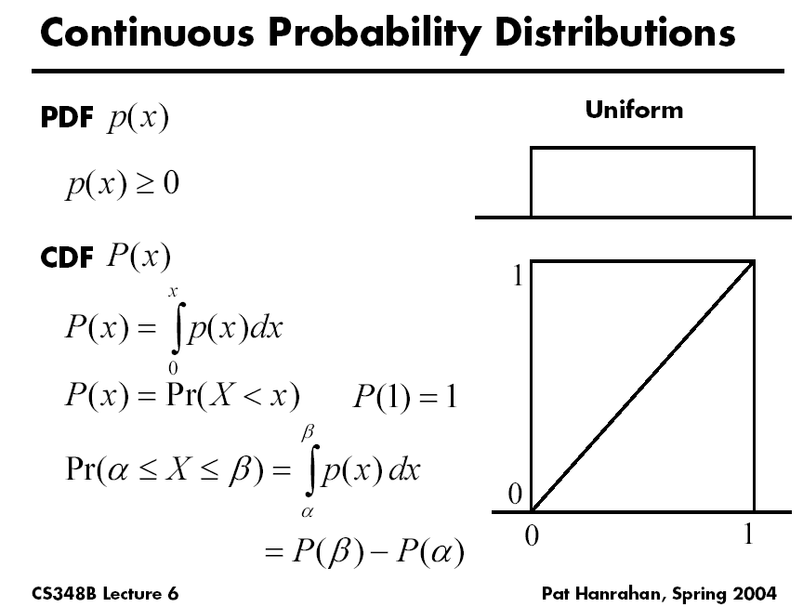

Slide 18
Sampling Techniques
Problem: how do we generate random points/directions during path tracing?
  Non-rectilinear domains
  Importance (BRDF)
  Stratified
Eye
x
Surface

Slide 19
Generating Random Points
Uniform distribution:
  Use random number generator
1
Probability
0
Ω

Slide 20
Generating Random Points
Specific probability distribution:
  Function inversion
  Rejection
  Metropolis
1
Probability
0
Ω

Slide 21
Common Operations
Want to sample probability distributions
  Draw samples distributed according to probability
  Useful for integration, picking important regions, etc.
Common distributions
  Disk or circle
  Uniform
  Upper hemisphere for visibility
  Area luminaire
  Complex lighting like an environment map
  Complex reflectance like a BRDF

Slide 22
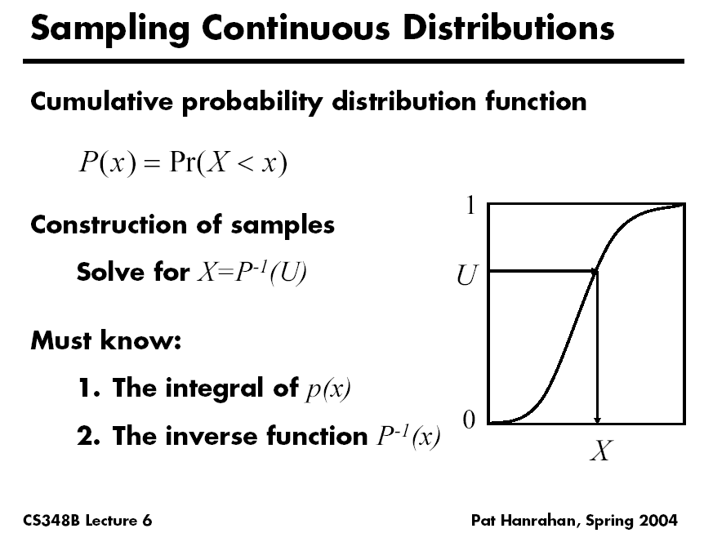

Slide 23
Generating Random Points
1
Cumulative
Probability
0
Ω

Slide 24
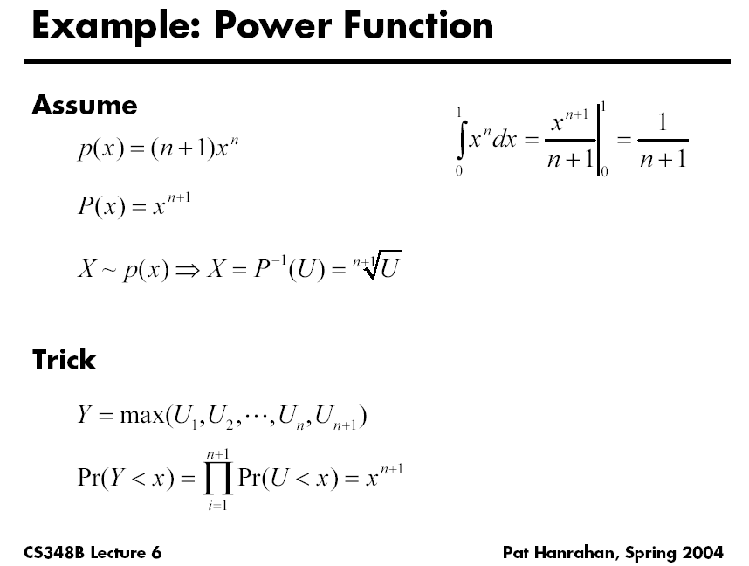

Slide 25
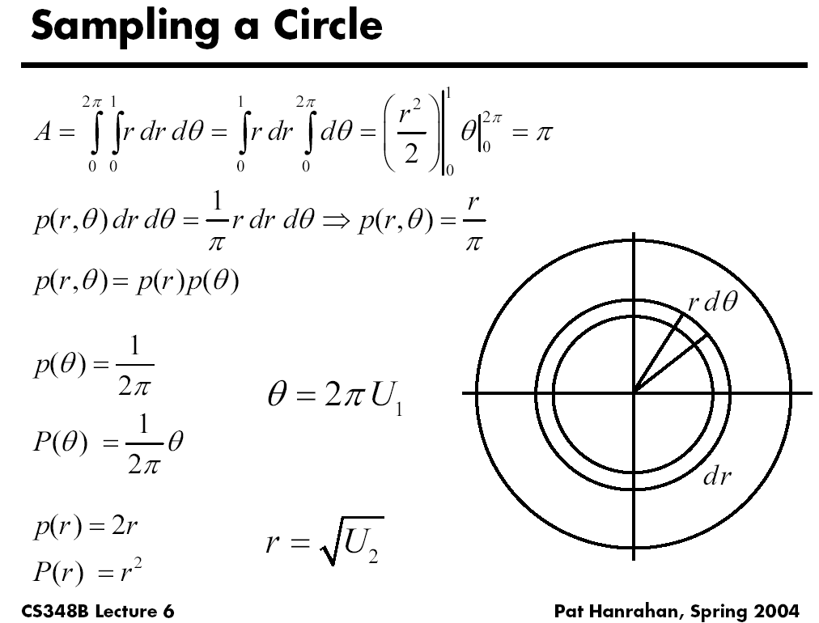

Slide 26
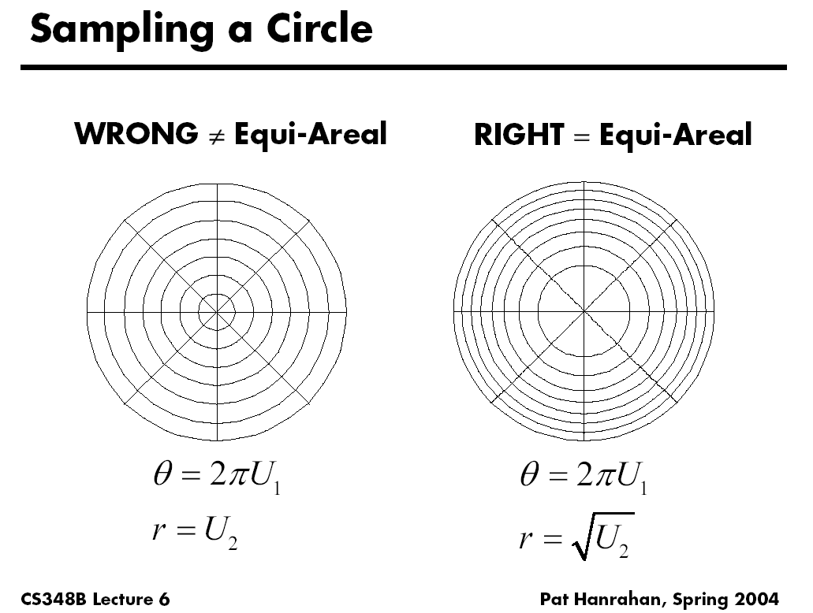

Slide 27
Rejection Sampling
1
x
x
x
x
x
x
Probability
x
x
x
x
0
Ω

Slide 28
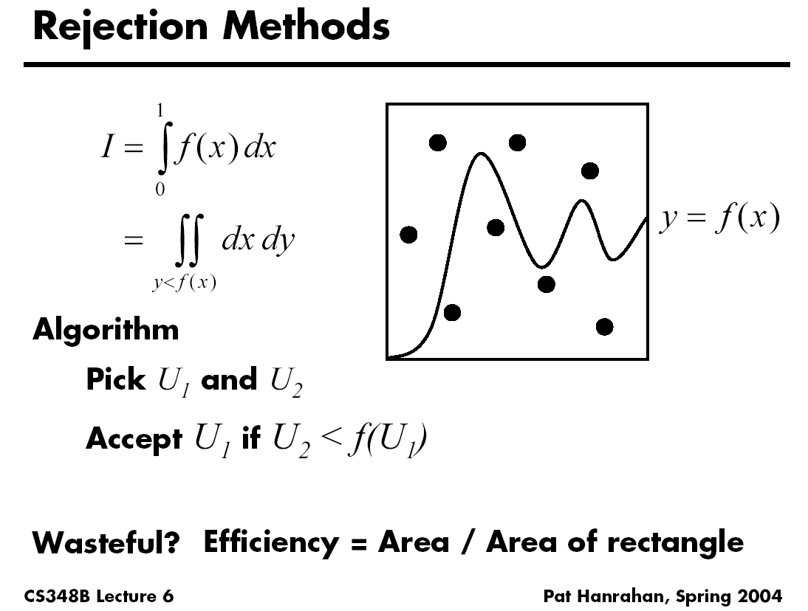

Slide 29
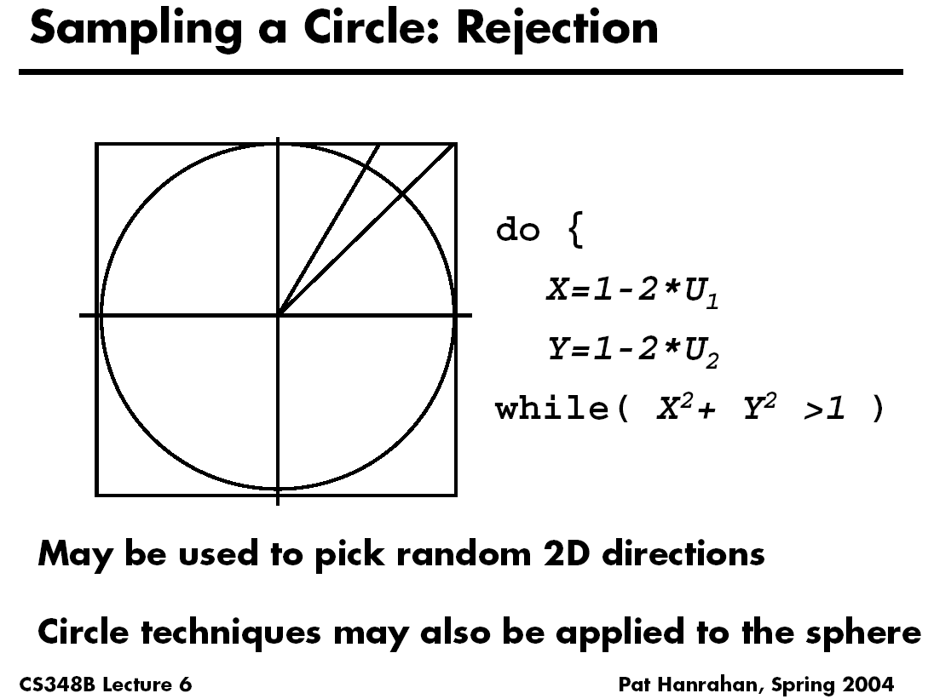

Slide 30
Outline
Motivation
Overview, 1D integration
Basic probability and sampling
Monte Carlo estimation of integrals

Slide 31
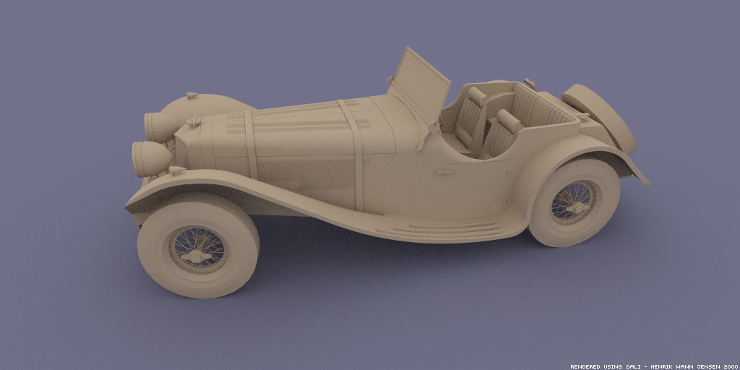
Monte Carlo Path Tracing
Big diffuse light source, 20 minutes
Motivation for rendering in graphics: Covered in detail in next lecture
Jensen

Slide 32
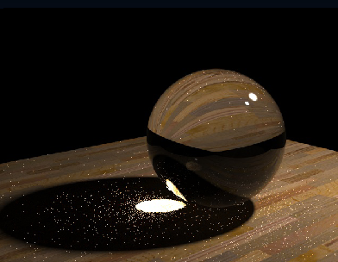
Monte Carlo Path Tracing
1000 paths/pixel
Jensen

Slide 33
Estimating the average
Monte Carlo methods (randomly choose samples)
Advantages:
Robust for discontinuities
Converges reasonably for large dimensions
Can handle complex geometry, integrals
Relatively simple implement, reason about
f(x)
E(f(x))
x₁
x_{N}
Slide courtesy of
Peter Shirley

Slide 34
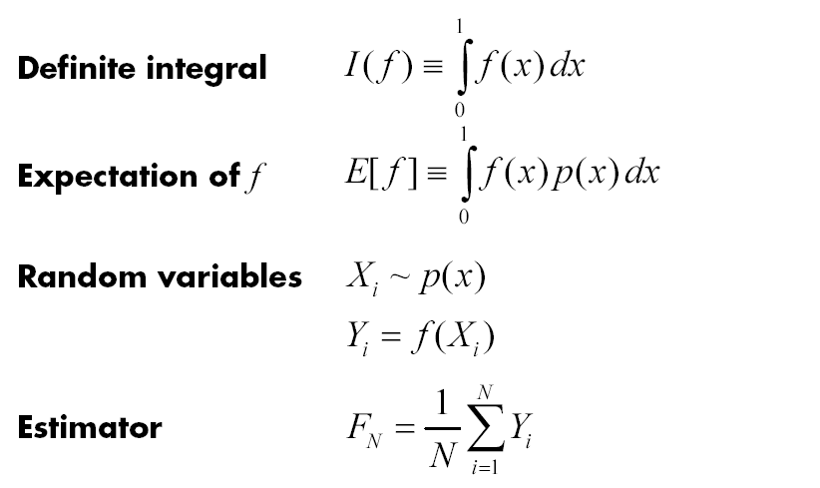
Monte Carlo Integration

Slide 35
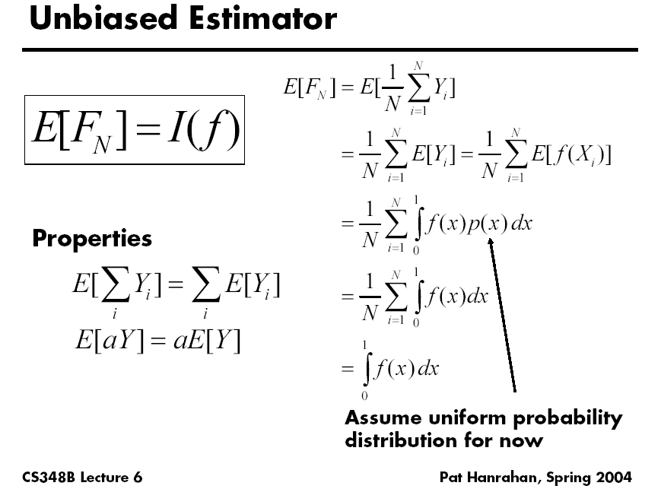

Slide 36
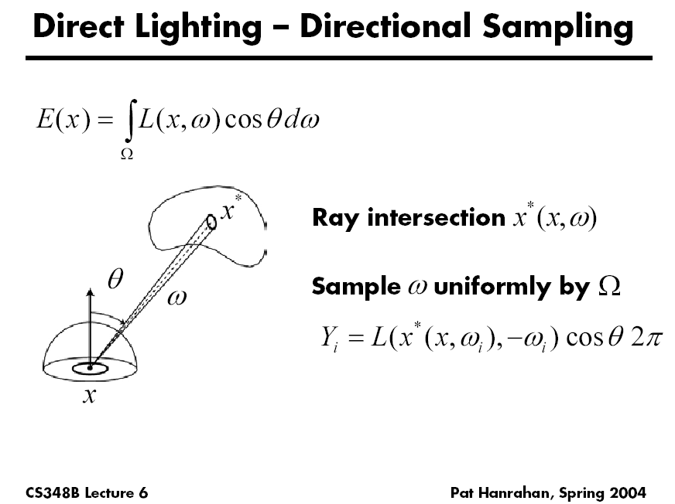

Slide 37
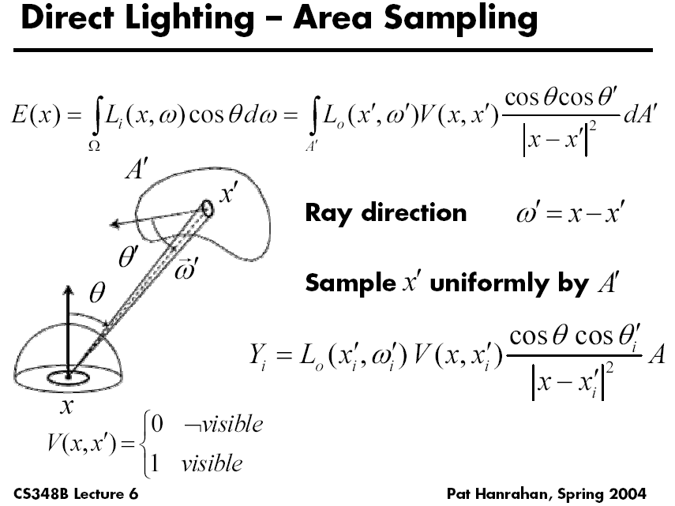

Slide 38
Variance
E(f(x))
x₁
x_{N}

Slide 39
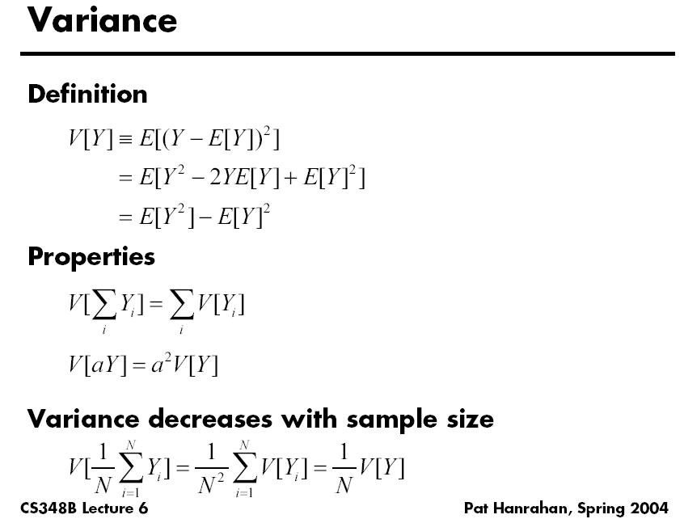

Slide 40
Variance for Dice Example?
Work out on board (variance for single dice roll)

Slide 41
Variance
Variance decreases as 1/N
Error decreases as 1/sqrt(N)
E(f(x))
x₁
x_{N}

Slide 42
Variance
Problem: variance decreases with 1/N
  Increasing # samples removes noise slowly
E(f(x))
x₁
x_{N}

Slide 43
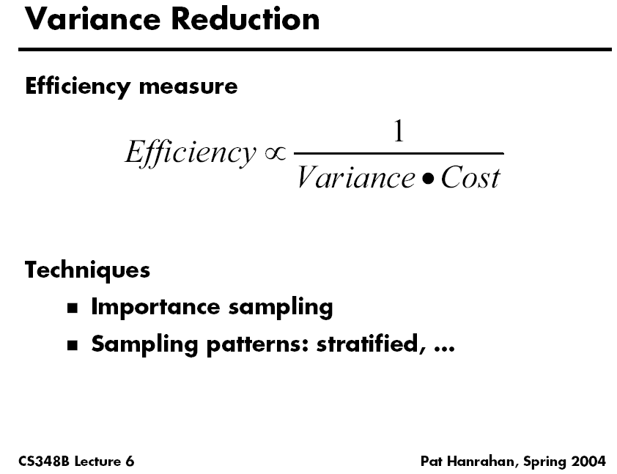

Slide 44
Variance Reduction Techniques
Importance sampling
Stratified sampling

Slide 45
Importance Sampling
Put more samples where f(x) is bigger
E(f(x))
x₁
x_{N}

Slide 46
Importance Sampling
This is still unbiased
E(f(x))
x₁
x_{N}
for all N

Slide 47
Importance Sampling
Zero variance if p(x) ~ f(x)
E(f(x))
Less variance with better
importance sampling
x₁
x_{N}

Slide 48
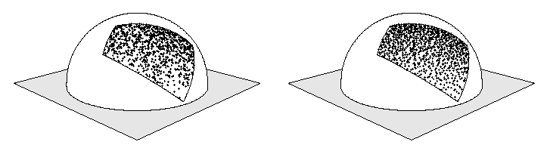
Stratified Sampling
Estimate subdomains separately
Arvo
E_{k}(f(x))
x₁
x_{N}

Slide 49
Stratified Sampling
This is still unbiased
E_{k}(f(x))
x₁
x_{N}

Slide 50
Stratified Sampling
Less overall variance if less variance
in subdomains
E_{k}(f(x))
x₁
x_{N}

Slide 51
More Information
Veach PhD thesis chapter (linked to from website)
Course Notes (links from website)
  Mathematical Models for Computer Graphics, Stanford, Fall 1997
  State of the Art in Monte Carlo Methods for Realistic Image Synthesis,
  Course 29, SIGGRAPH 2001

