Slide 1




Computer Graphics II: Rendering
CSE 168 [Spr 24], Lecture 3: Illumination and Reflection Ravi Ramamoorthi
http://viscomp.ucsd.edu/classes/cse168/sp24

Slide 2
To Do
Homework 1 (ray tracer) due Monday
Next assignment direct lighting (on UCSD online). Will cover that material next week

Slide 3
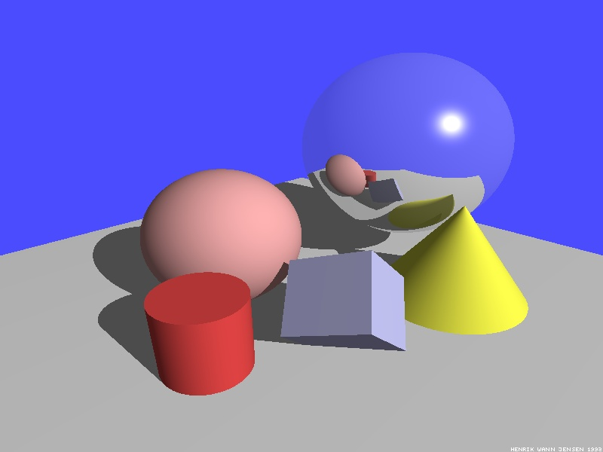
Illumination Models
Local Illumination
Light directly from light sources to surface
No shadows (cast shadows are a global effect)
Global Illumination: multiple bounces (indirect light)
Hard and soft shadows
Reflections/refractions (already seen in ray tracing)
Diffuse and glossy interreflections (radiosity, caustics)
Some images courtesy Henrik Wann Jensen

Slide 4

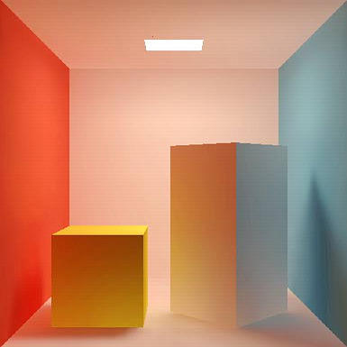
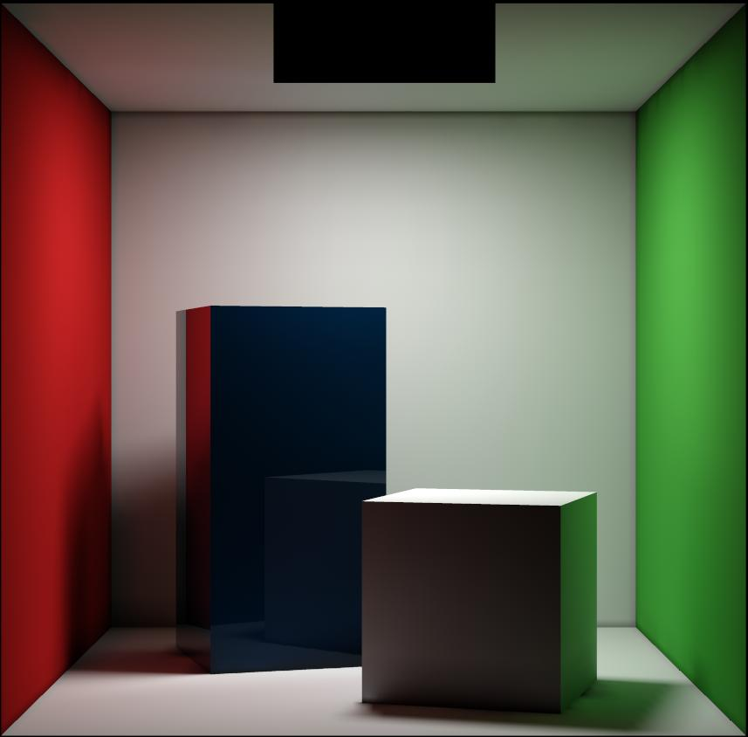
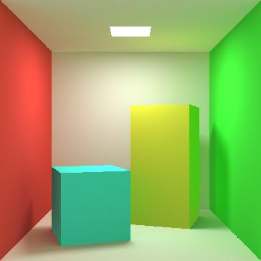
Diffuse Interreflection
Diffuse interreflection, color bleeding [Cornell Box]

Slide 5
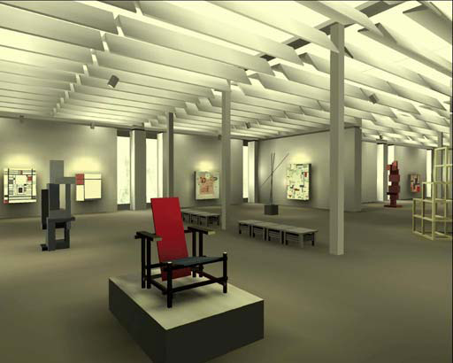
Radiosity

Slide 6
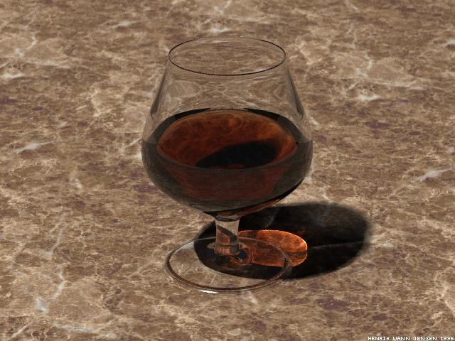
Caustics
Caustics: Focusing through specular surface
Major research effort in 80s, 90s till today

Slide 7
Motivation: BRDFs, Radiometry
Basics of Illumination, Reflection
Formal radiometric analysis (not ad-hoc)
Reflection Equation (Local Illumination)
Discussion of BRDFs
Rendering Equation (Global Illumination) on Thu
Formal analysis important for correct implementation

Slide 8
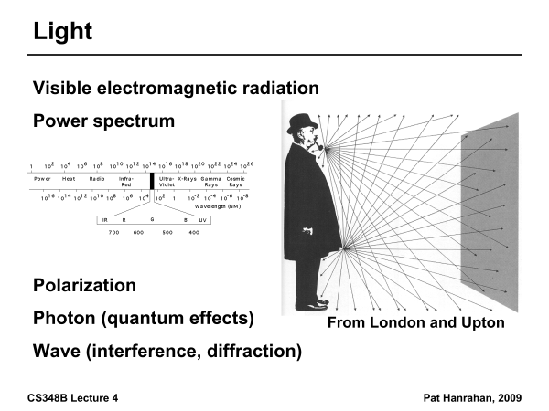

Slide 9
Radiometry
Physical measurement of electromagnetic energy
Measure spatial (and angular) properties of light
Radiance, Irradiance
Reflection functions: Bi-Directional Reflectance Distribution Function or BRDF
Reflection Equation
Simple BRDF models

Slide 10
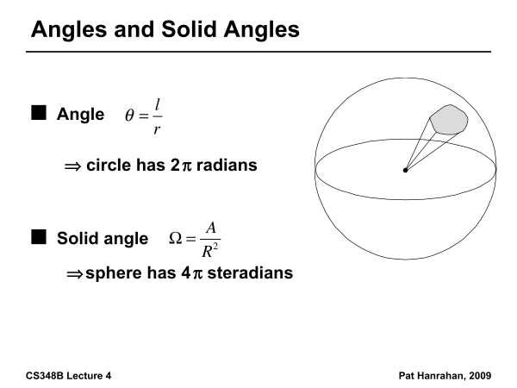

Slide 11
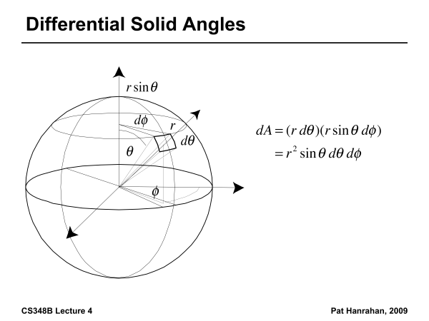

Slide 12
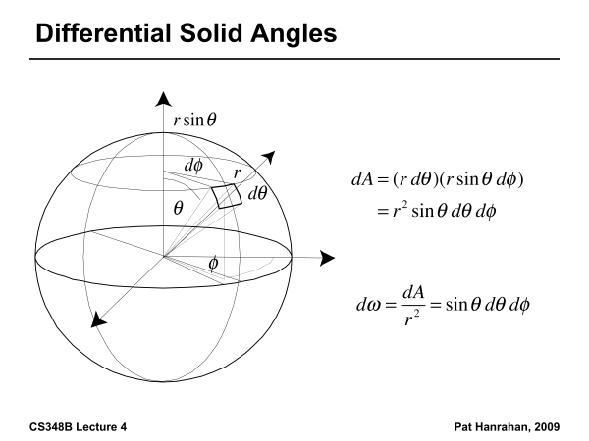

Slide 13
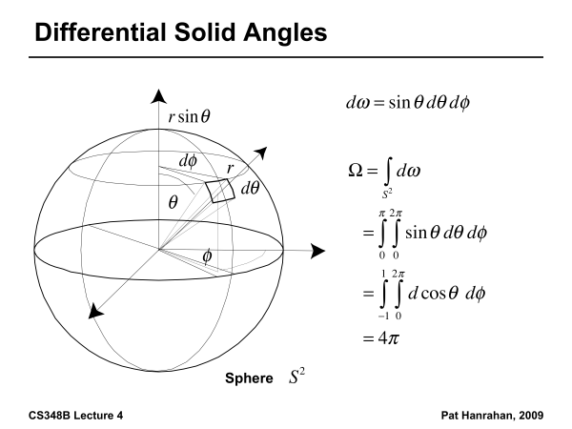

Slide 14
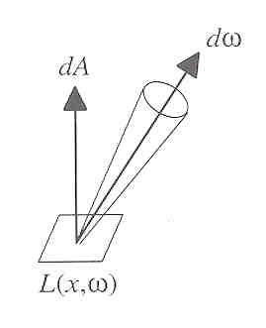
Radiance
Power per unit projected area perpendicular to the ray per unit solid angle in the direction of the ray
Symbol: L(x,ω) (W/m² sr)
Flux given by dΦ = L(x,ω) cos θ dω dA

Slide 15
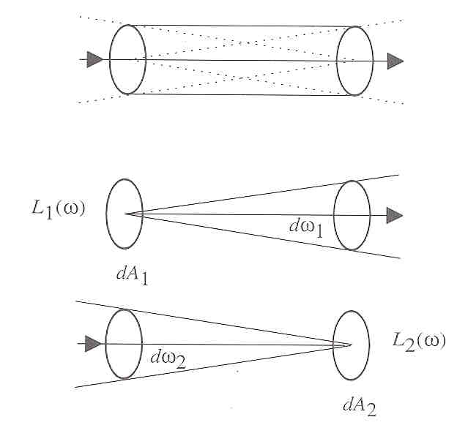
Radiance properties
Radiance constant as propagates along ray
Derived from conservation of flux
Fundamental in Light Transport.

Slide 16
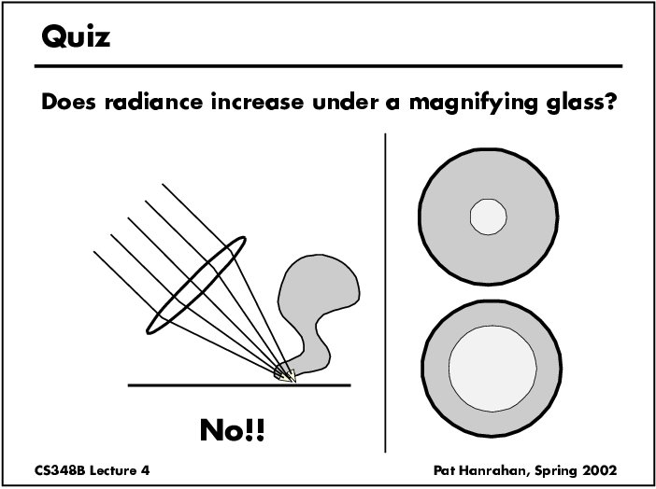

Slide 17
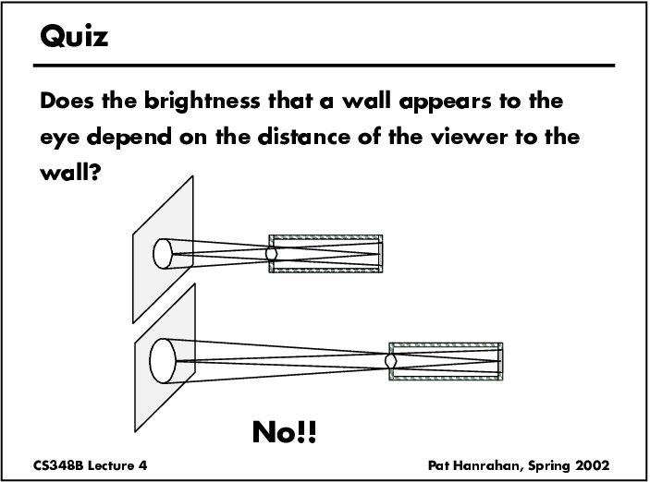

Slide 18
Radiance properties
Sensor response proportional to radiance (constant of proportionality is throughput)
Far away surface: See more, but subtends smaller angle
Wall equally bright across viewing distances
Consequences
Radiance associated with rays in a ray tracer
Other radiometric quants derived from radiance
This course primarily about computing radiance

Slide 19
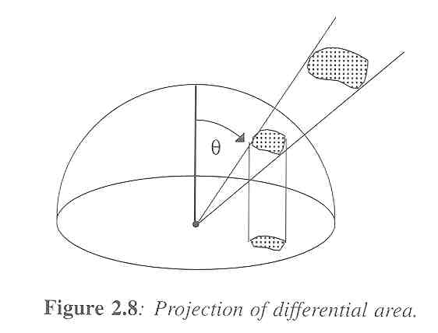
Irradiance, Radiosity
Irradiance E is radiant power per unit area
Integrate incoming radiance over hemisphere
Projected solid angle (cos θ dω)
Uniform illumination: Irradiance = π [CW 24,25]
Units: W/m²
Radiant Exitance (radiosity)
Power per unit area leaving surface (like irradiance)

Slide 20
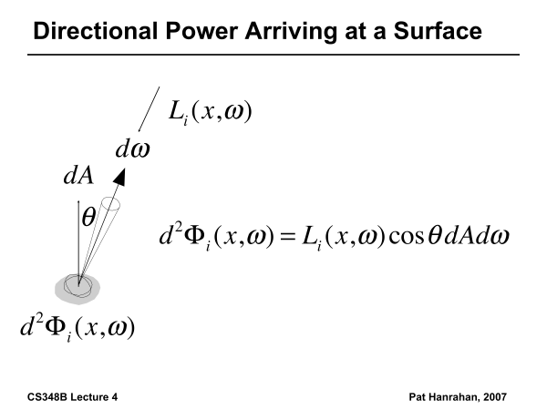

Slide 21
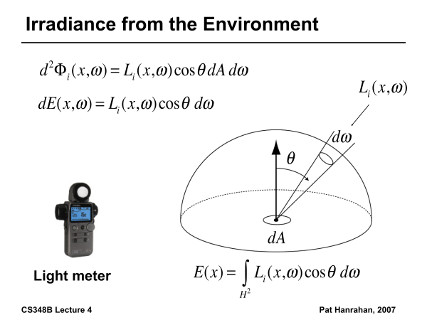

Slide 22
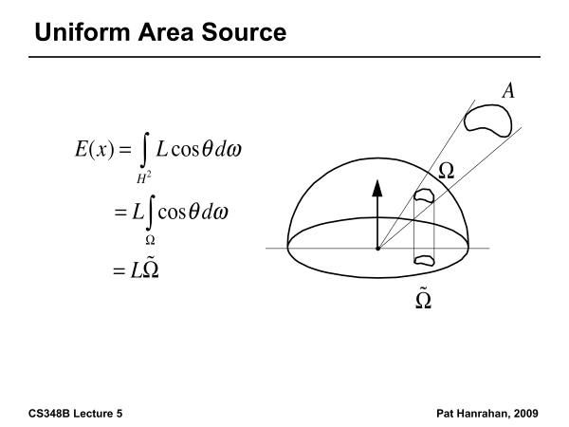

Slide 23
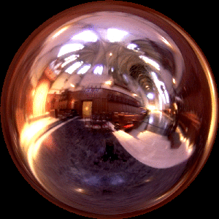
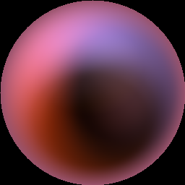
Irradiance Environment Maps
R
N
Incident Radiance
(Illumination Environment Map)
Irradiance Environment Map

Slide 24
Radiometry
Physical measurement of electromagnetic energy
Measure spatial (and angular) properties of light
Radiance, Irradiance
Reflection functions: Bi-Directional Reflectance Distribution Function or BRDF
Reflection Equation
Simple BRDF models

Slide 25
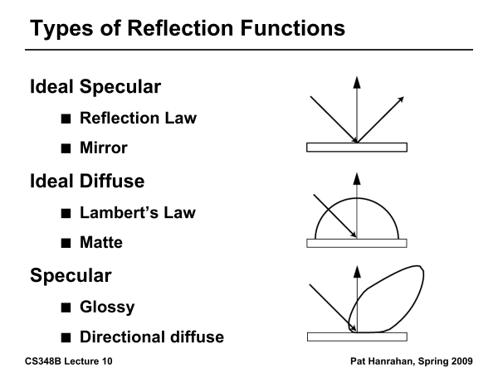

Slide 26
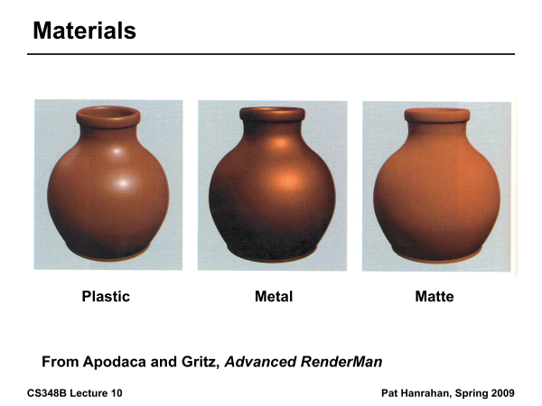

Slide 27
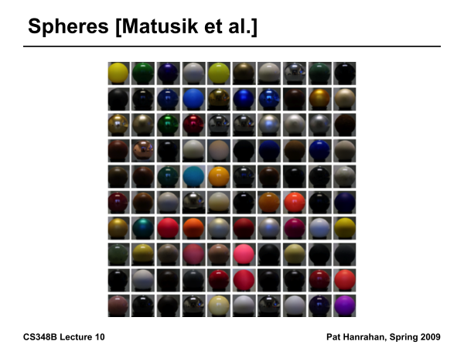

Slide 28
Building up the BRDF
Bi-Directional Reflectance Distribution Function [Nicodemus 77]
Function based on incident, view direction
Relates incoming light energy to outgoing
Unifying framework for many materials

Slide 29
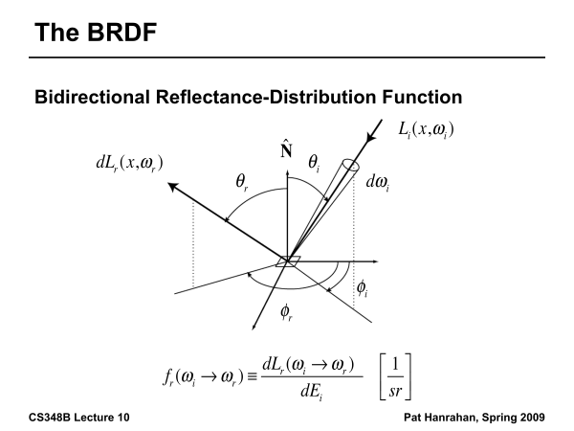

Slide 30
BRDF
Reflected Radiance proportional Irradiance
Constant proportionality: BRDF
Ratio of outgoing light (radiance) to incoming light (irradiance)
Bidirectional Reflection Distribution Function
(4 Vars) units 1/sr

Slide 31
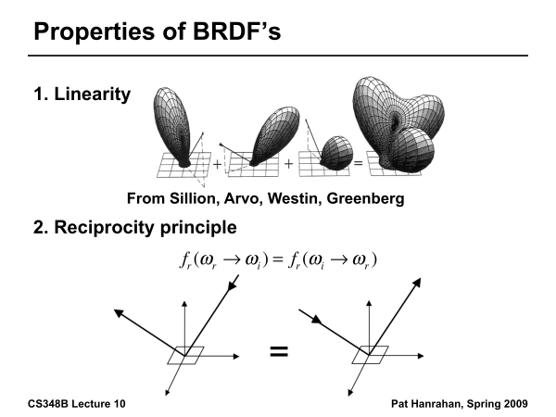

Slide 32
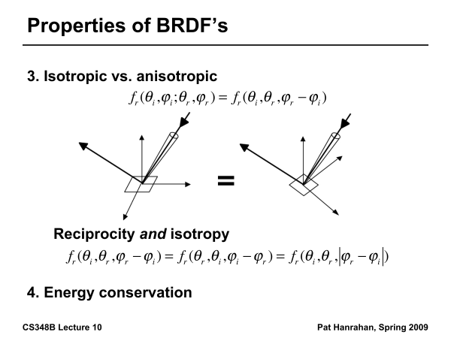

Slide 33
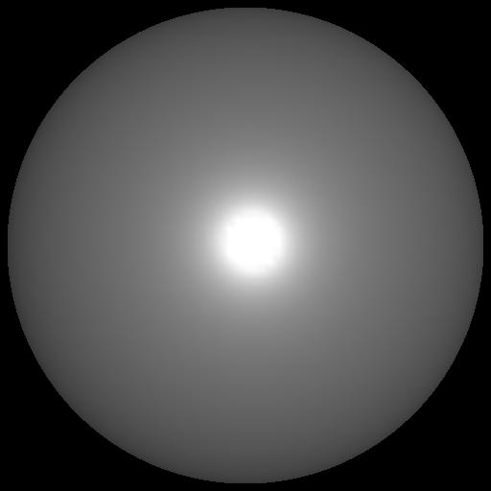

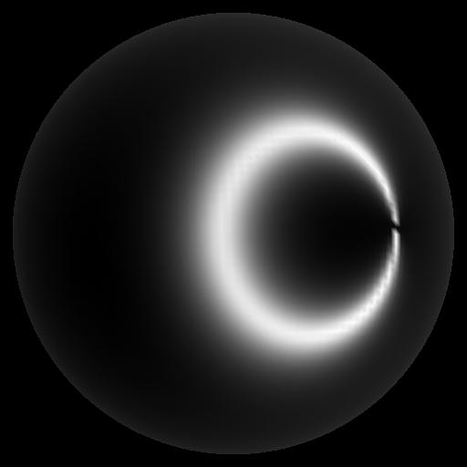
Isotropic vs Anisotropic
Isotropic: Most materials (you can rotate about normal without changing reflections)
Anisotropic: brushed metal etc. preferred tangential direction
Isotropic
Anisotropic

Slide 34
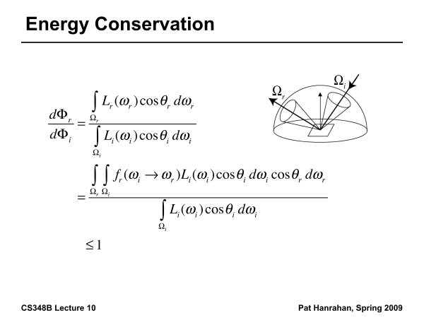

Slide 35
Reflection Equation
Reflected Light
(Output Image)
Emission
Incident
Light (from
light source)
BRDF
Cosine of
Incident angle

Slide 36
Reflection Equation
Sum over all light sources
Reflected Light
(Output Image)
Emission
Incident
Light (from
light source)
BRDF
Cosine of
Incident angle

Slide 37
Reflection Equation
Replace sum with integral
Reflected Light
(Output Image)
Emission
Incident
Light (from
light source)
BRDF
Cosine of
Incident angle

Slide 38
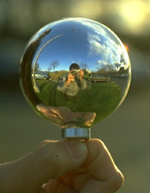
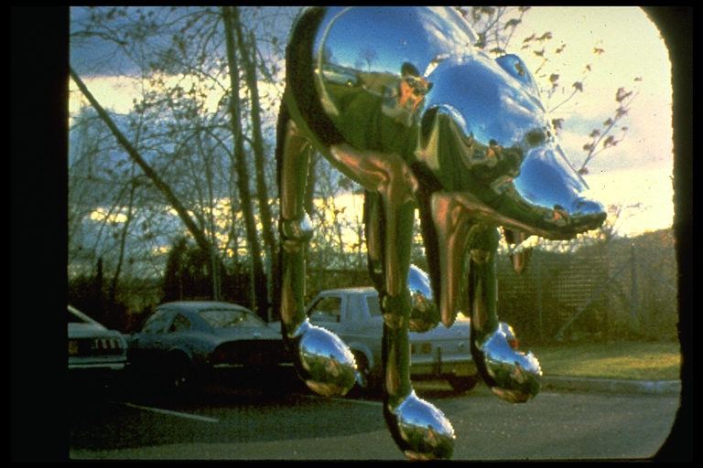
Environment Maps
Light as a function of direction, from entire environment
Captured by photographing a chrome steel or mirror sphere
Accurate only for one point, but distant lighting same at other scene locations (typically use only one env. map)
Blinn and Newell 1976, Miller and Hoffman, 1984
Later, Greene 86, Cabral et al. 87

Slide 39
Environment Maps
Environment maps widely used as lighting representation
Many modern methods deal with offline and real-time rendering with environment maps
Image-based complex lighting + complex BRDFs

Slide 40
Radiometry
Physical measurement of electromagnetic energy
Measure spatial (and angular) properties of light
Radiance, Irradiance
Reflection functions: Bi-Directional Reflectance Distribution Function or BRDF
Reflection Equation
Simple BRDF models

Slide 41
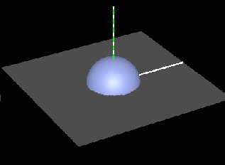
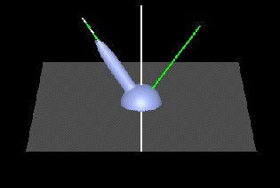
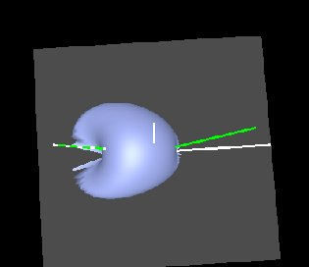
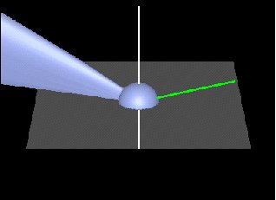
Brdf Viewer plots
Diffuse
Torrance-Sparrow
Anisotropic
bv written by Szymon Rusinkiewicz

Slide 42
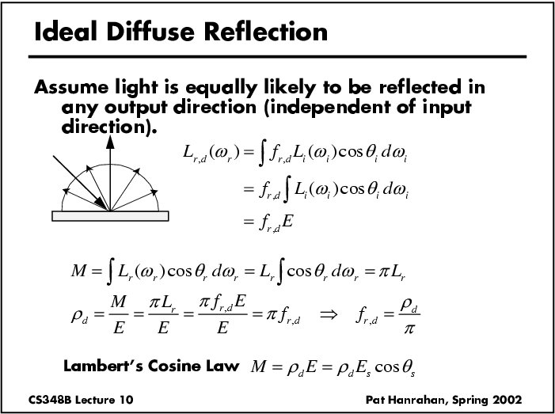

Slide 43
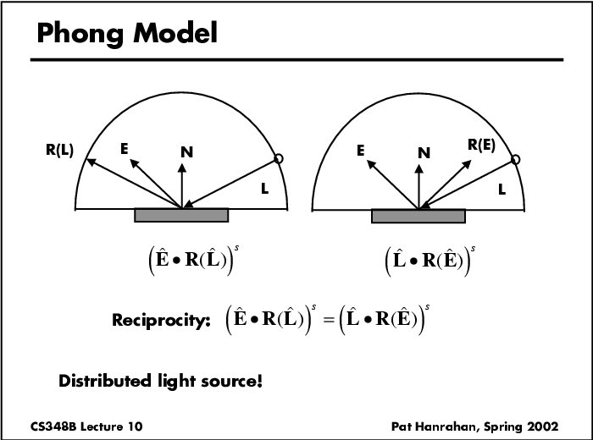

Slide 44
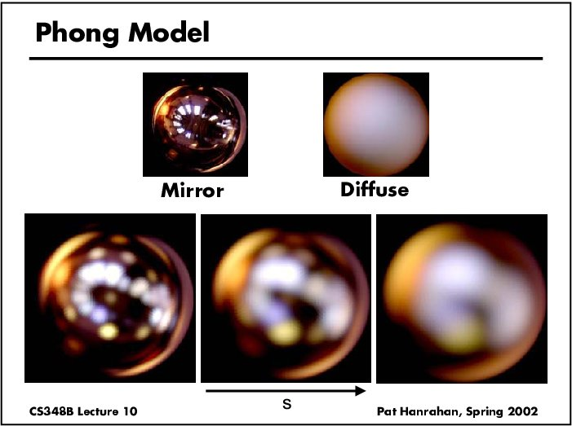
Specular Term (Phong)

Slide 45
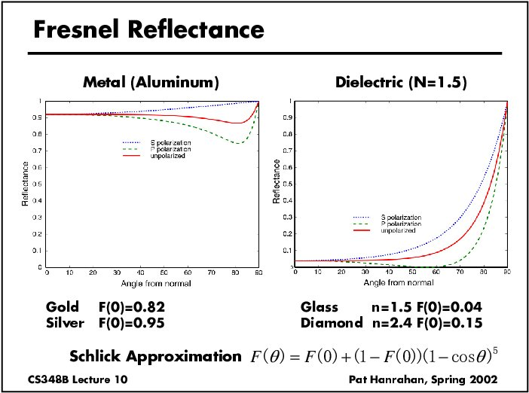

Slide 46
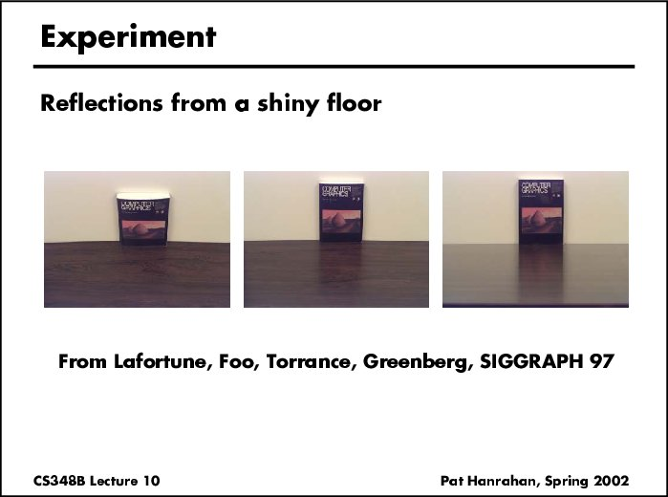

Slide 47
Torrance-Sparrow
Fresnel term:
allows for wavelength dependency
Geometric Attenuation:
reduces the output based on the amount of shadowing or masking that occurs.
Distribution:
distribution function determines what percentage of microfacets are oriented to reflect in the viewer direction.
How much of the macroscopic surface is visible to the light source
How much of the macroscopic surface is visible to the viewer

Slide 48
Other BRDF models
Empirical: Measure and build a 4D table
Anisotropic models for hair, brushed steel
Cartoon shaders, funky BRDFs
Capturing spatial variation
Very active area of research

