Slide 1




Computer Graphics II: Rendering
CSE 168[Spr 21],Lecture 15: Volumetric Rendering Ravi Ramamoorthi
http://viscomp.ucsd.edu/classes/cse168/sp21

Slide 2
To Do
Start working on final projects (initial results and proposal due in a week). Ask me if problems
Volumetric rendering (this lecture) may be one component of the final project (but hard, be careful)
Increasingly accurate appearance requires volumetric scattering (even for skin, hair, fur)
Continues to be an active area of research
Many slides courtesy Pat Hanrahan/Matt Pharr (Stanford CS 348b)
and Steve Rotenberg, Henrik Wann Jensen (UCSD CSE 168)

Slide 3
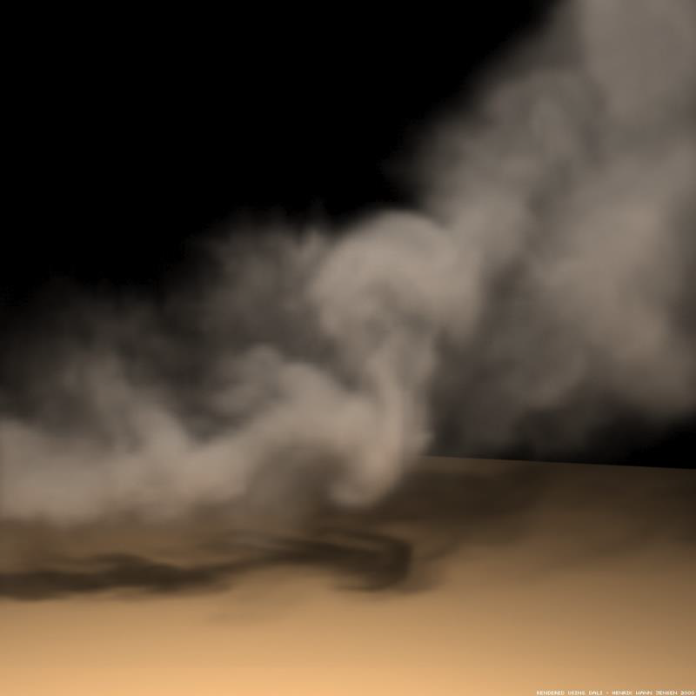
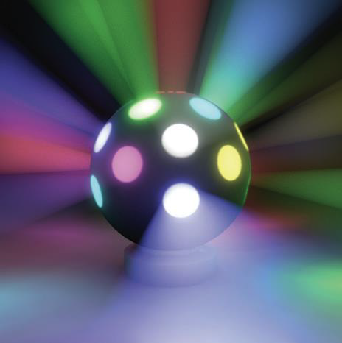
Volumetric Scattering

Slide 4
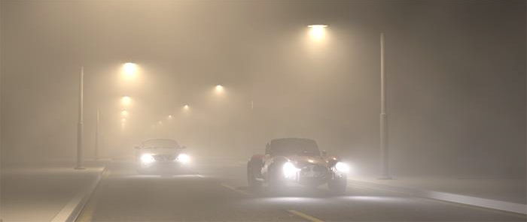
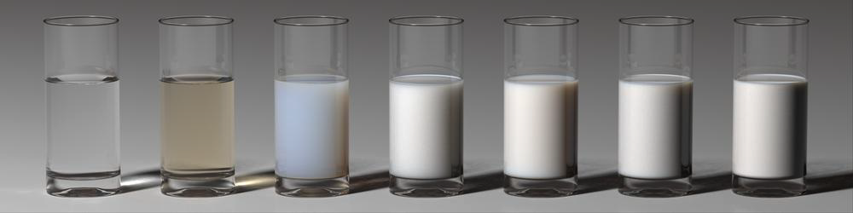
Volumetric Scattering

Slide 5
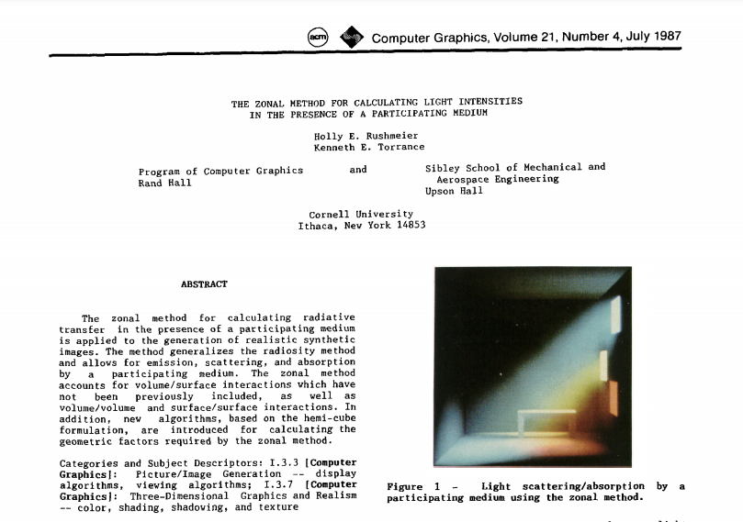
Volumetric Scattering

Slide 6
Volumetric Scattering
Participating Media (light participates via scattering)
  Volumetric phenomena like clouds, smoke, fire
  Subsurface scattering, translucency (wax, human skin)
  These are not surfaces with well-defined BRDFs
  Rather volumes where light can scatter
  Medium is often known as a participating medium
Surface Rendering: Radiance Constant along Ray
  Only true in absence of participating media
  No longer true for volumetric scattering
  Often replace ray tracing with ray marching in medium
Volumetric Properties
  BRDF replaced by phase function
  Must consider absorption and scattering in medium

Slide 7
Homogeneous vs Heterogeneous
Homogeneous: Properties constant everywhere
  Example: Fog often represented as homogeneous
Heterogeneous: Varies across space
  Example: Smoke, fire etc.
  Sometimes called inhomogeneous
Homogeneous volumes often easier
  Some computational shortcuts (transmittance etc.)
  Some analytic formulae

Slide 8
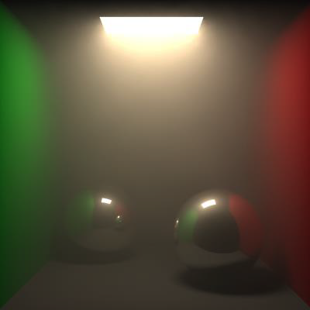
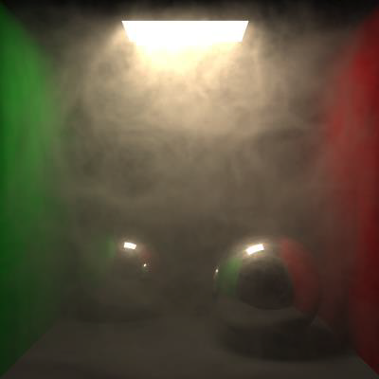
Homogeneous vs Heterogeneous

Slide 9
Volumetric Interactions
4 different processes affect radiance of a beam
  Absorption
  Out-Scattering
  Emission
  In-Scattering

Slide 10
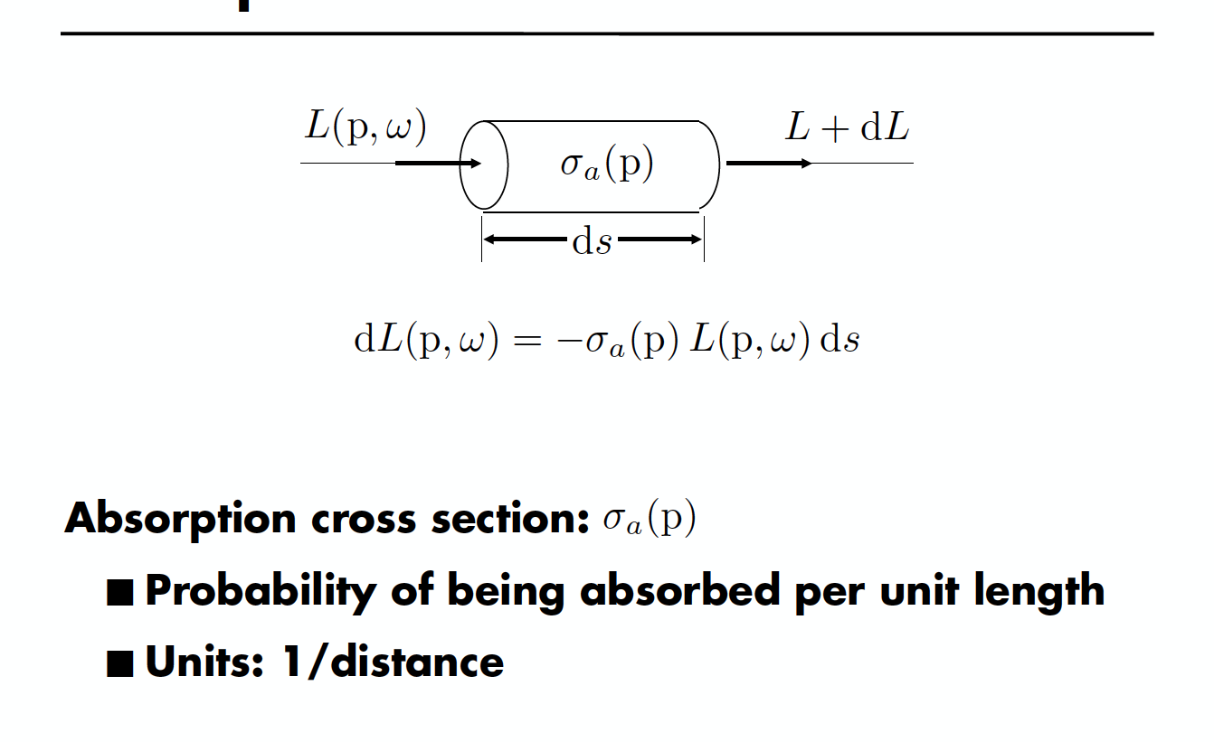
Absorption

Slide 11

Absorption

Slide 12
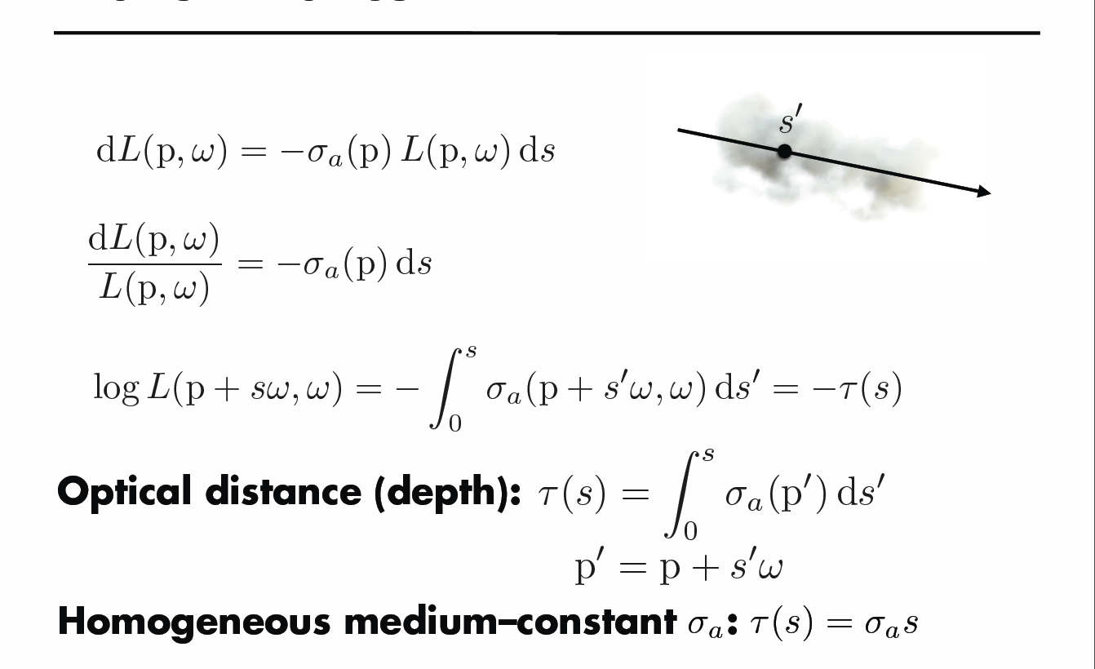
Transmittance

Slide 13
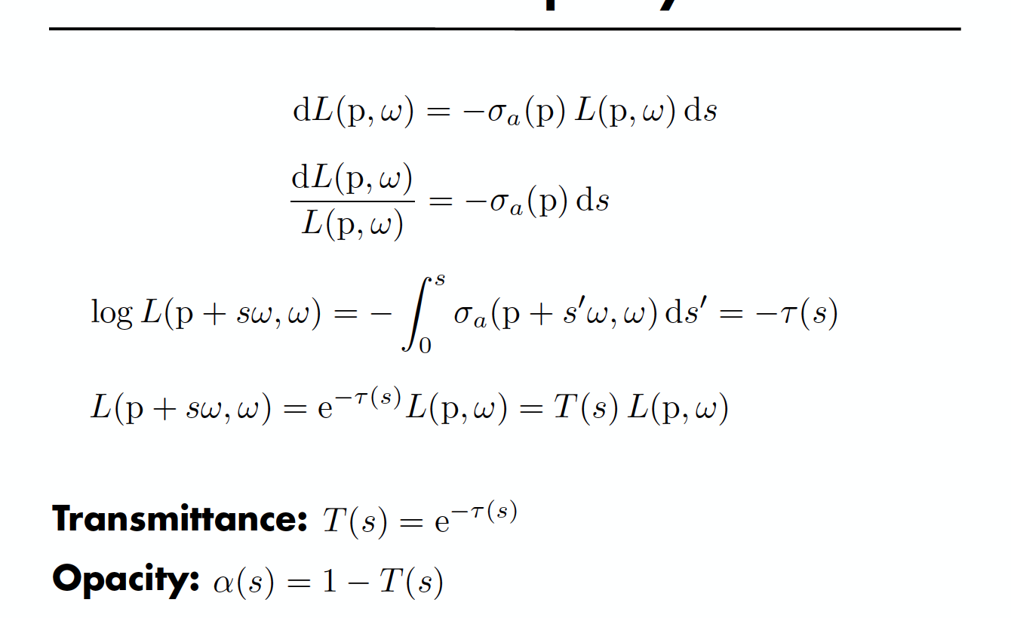
Transmittance and Opacity

Slide 14
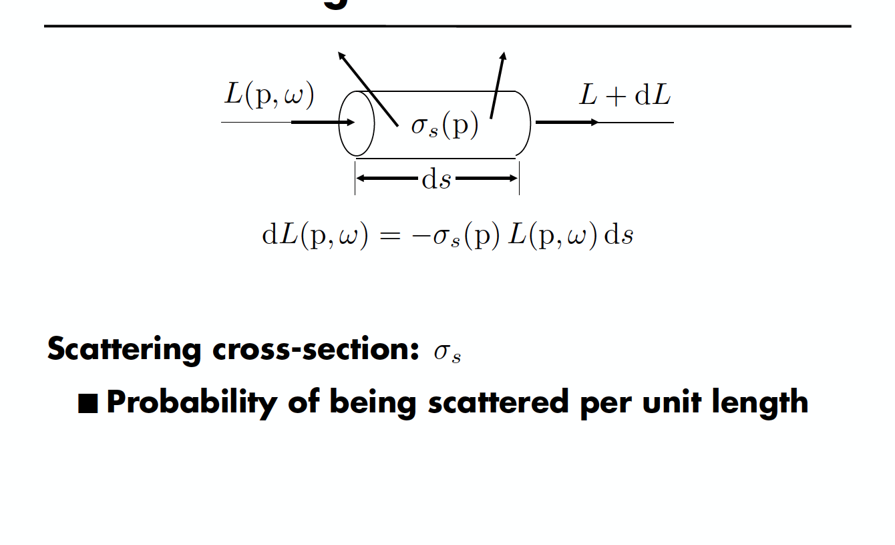
Out-Scattering

Slide 15
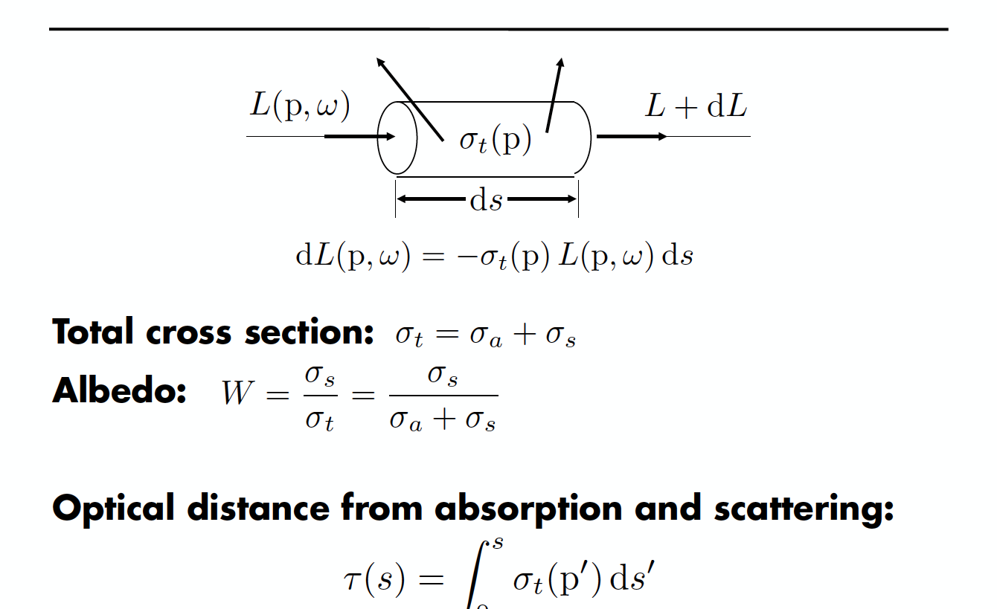
Extinction

Slide 16
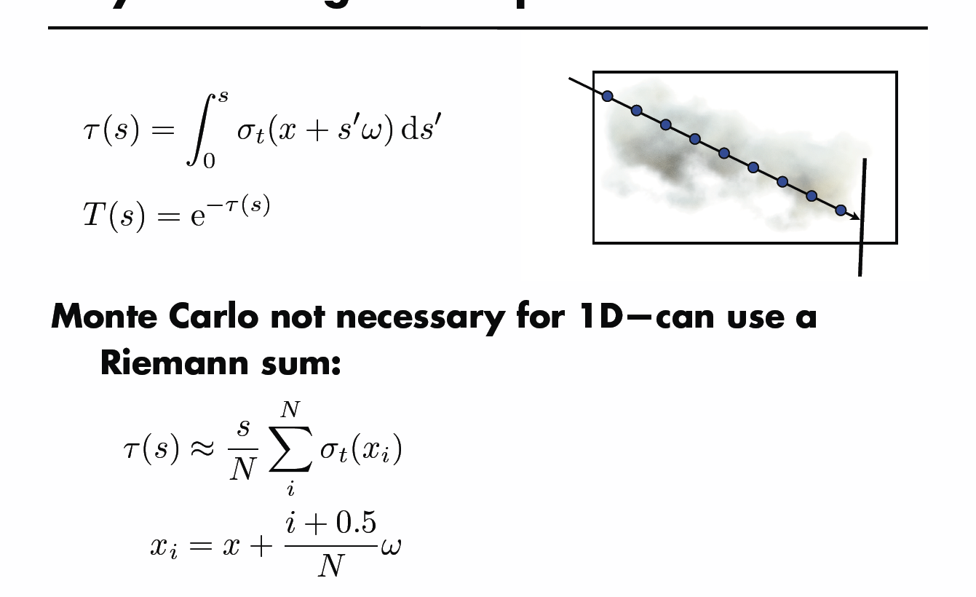
Ray Marching for Transmittance

Slide 17
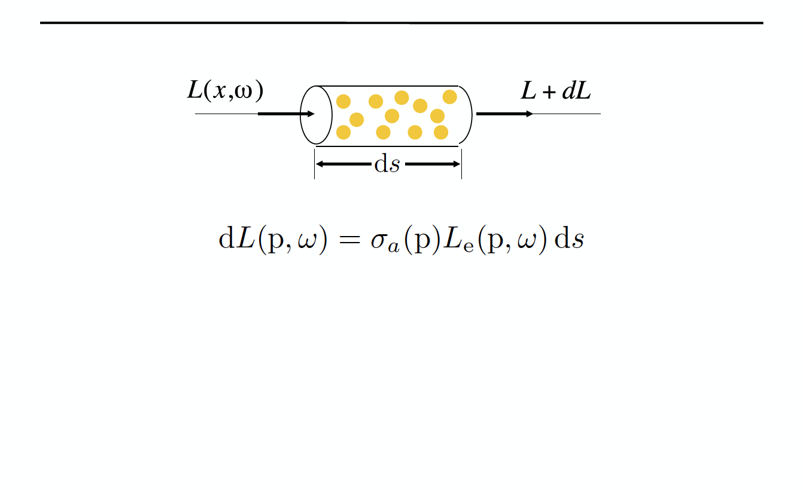
Emission

Slide 18
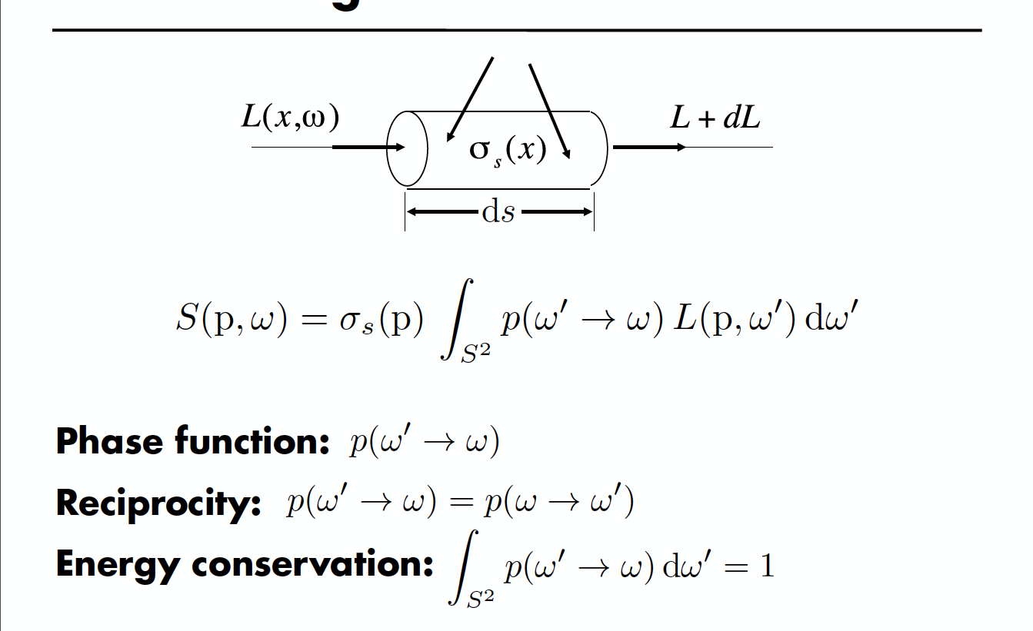
In-Scattering

Slide 19
Scattering Phase Functions
Light interacts with volume, scatters in some spherical distribution
Similar to light scattering off a surface
Phase function analogous to a surface BRDF
Depends only on cosine of incident-outgoing
Like BRDFs, volumetric phase functions must be reciprocal and conserve energy
Similar to BRDFs, we will want to do importance sampling and evaluation of phase functions

Slide 20
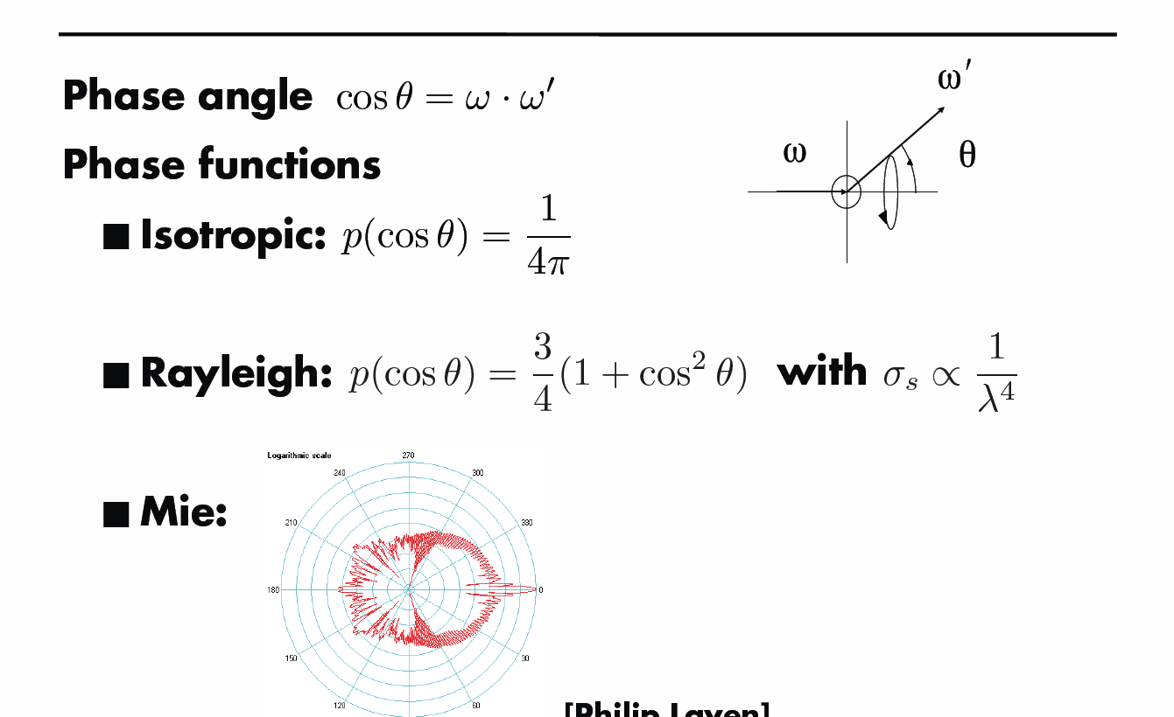
Phase Functions

Slide 21
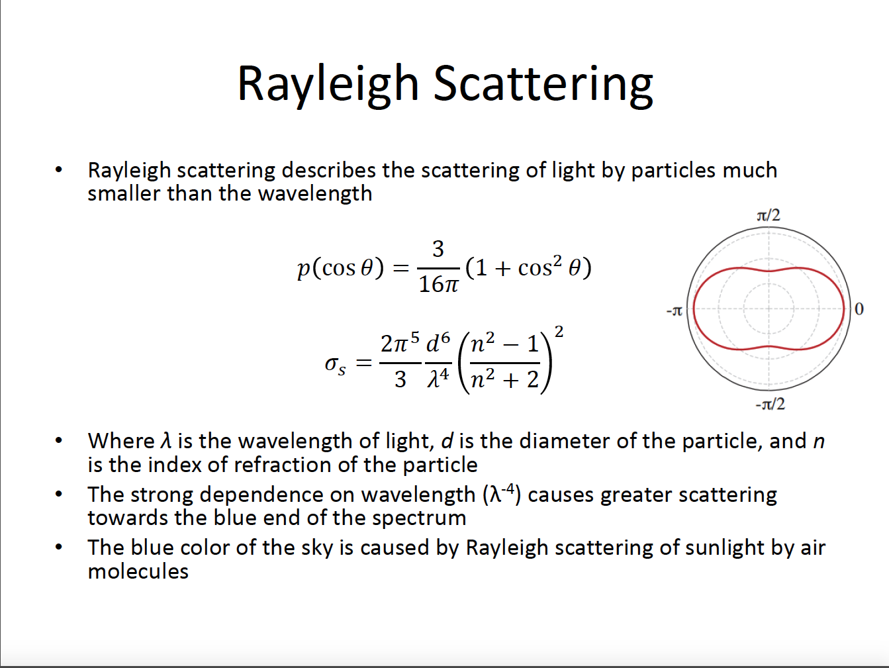

Slide 22
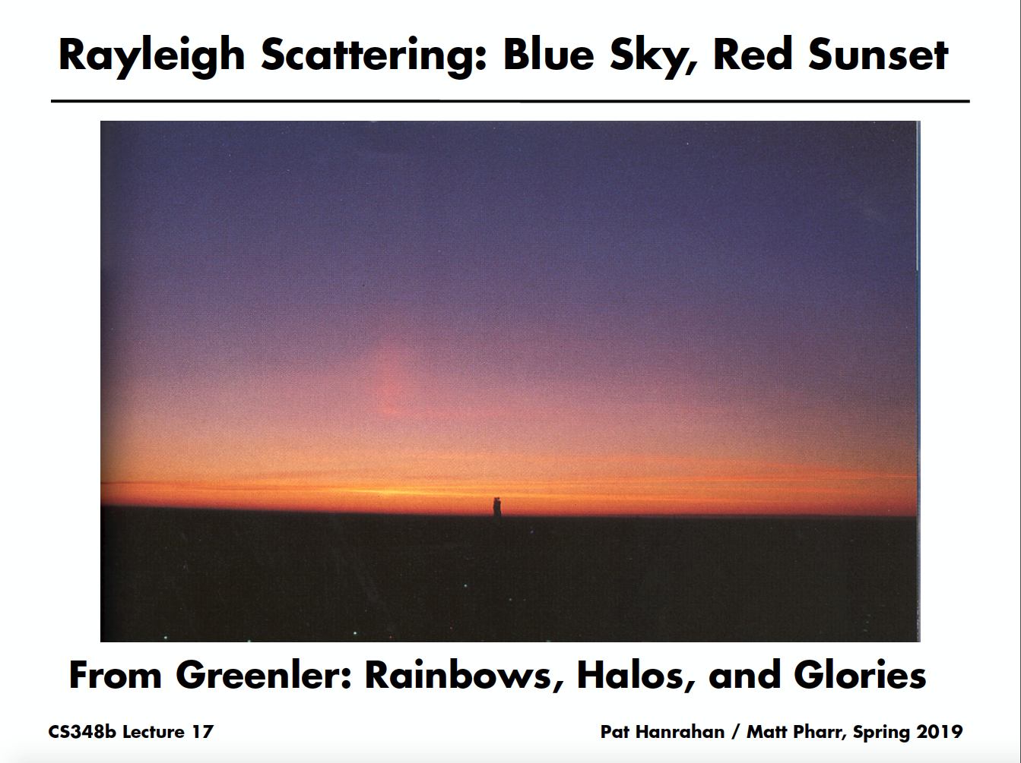

Slide 23
Mie Scattering
Scatter electromagnetic waves by spherical particles
Size of particles same scale as wavelength of light
Water droplets in atmosphere, fat droplets in milk
After Gustave Mie, Ludvig Lorenz

Slide 24
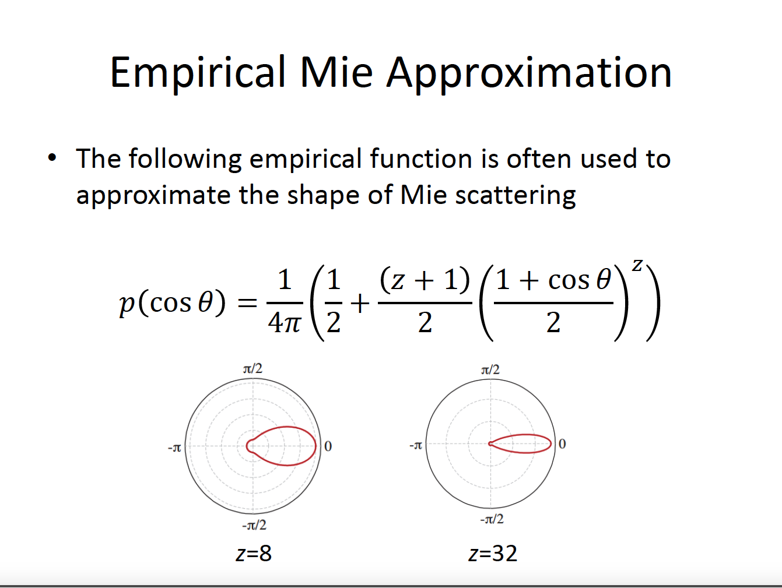
Empirical Mie Approximation

Slide 25
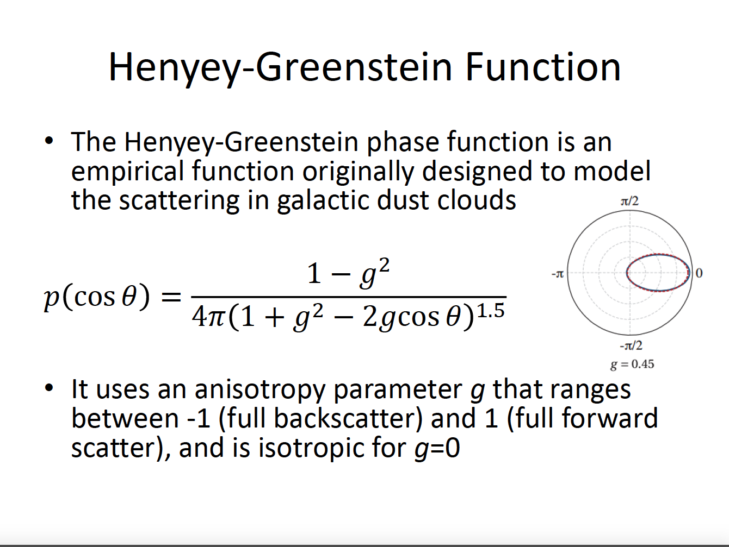

Slide 26
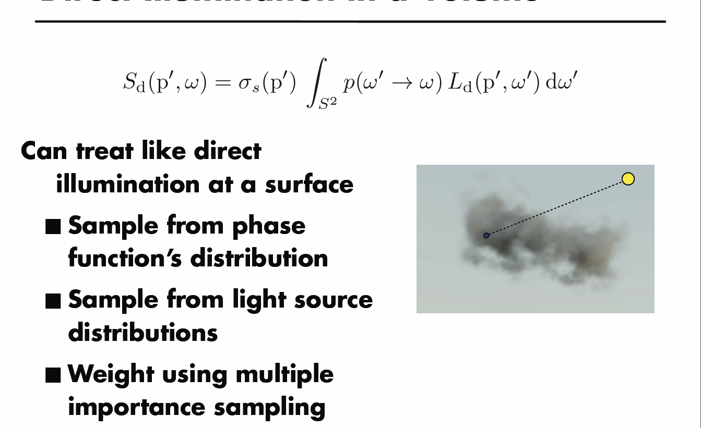
Direct Illumination in a Volume

Slide 27
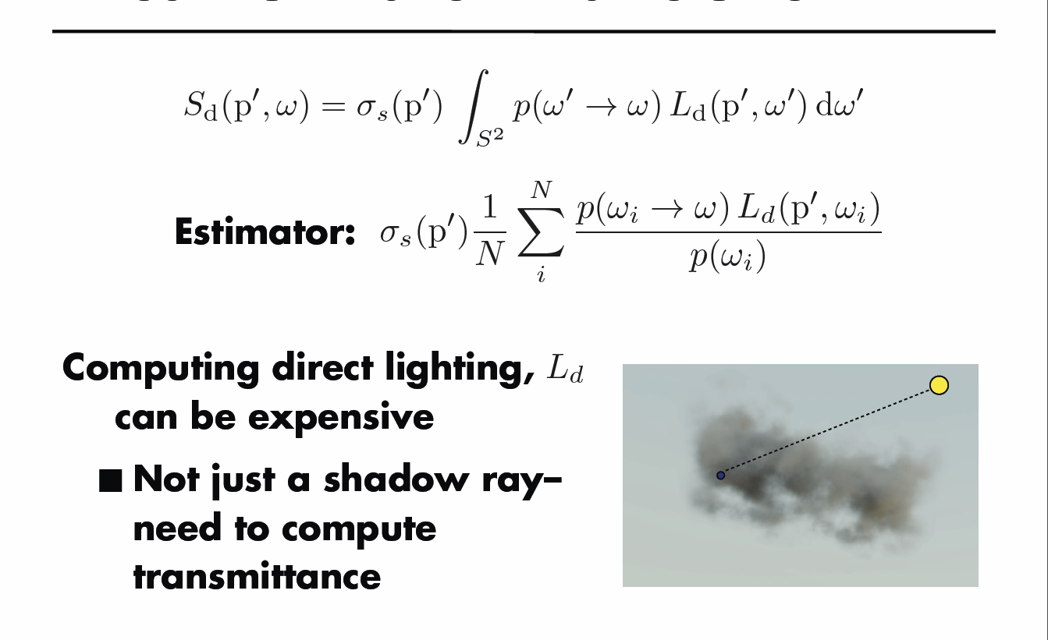
Direct Illumination in a Volume

Slide 28
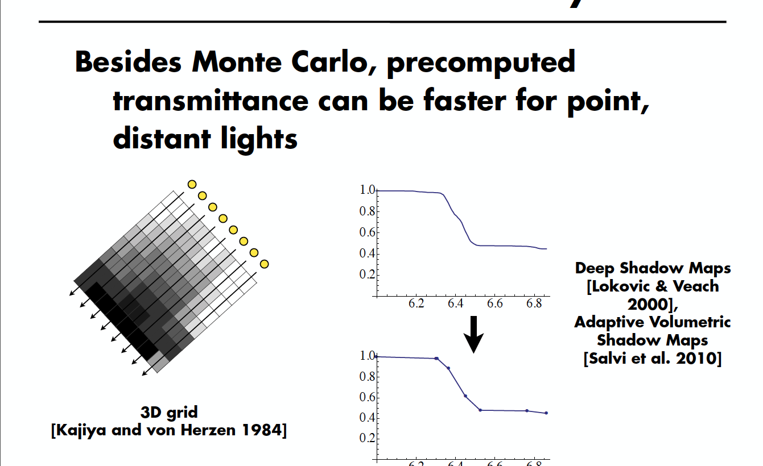
Transmittance for Shadow Rays

Slide 29
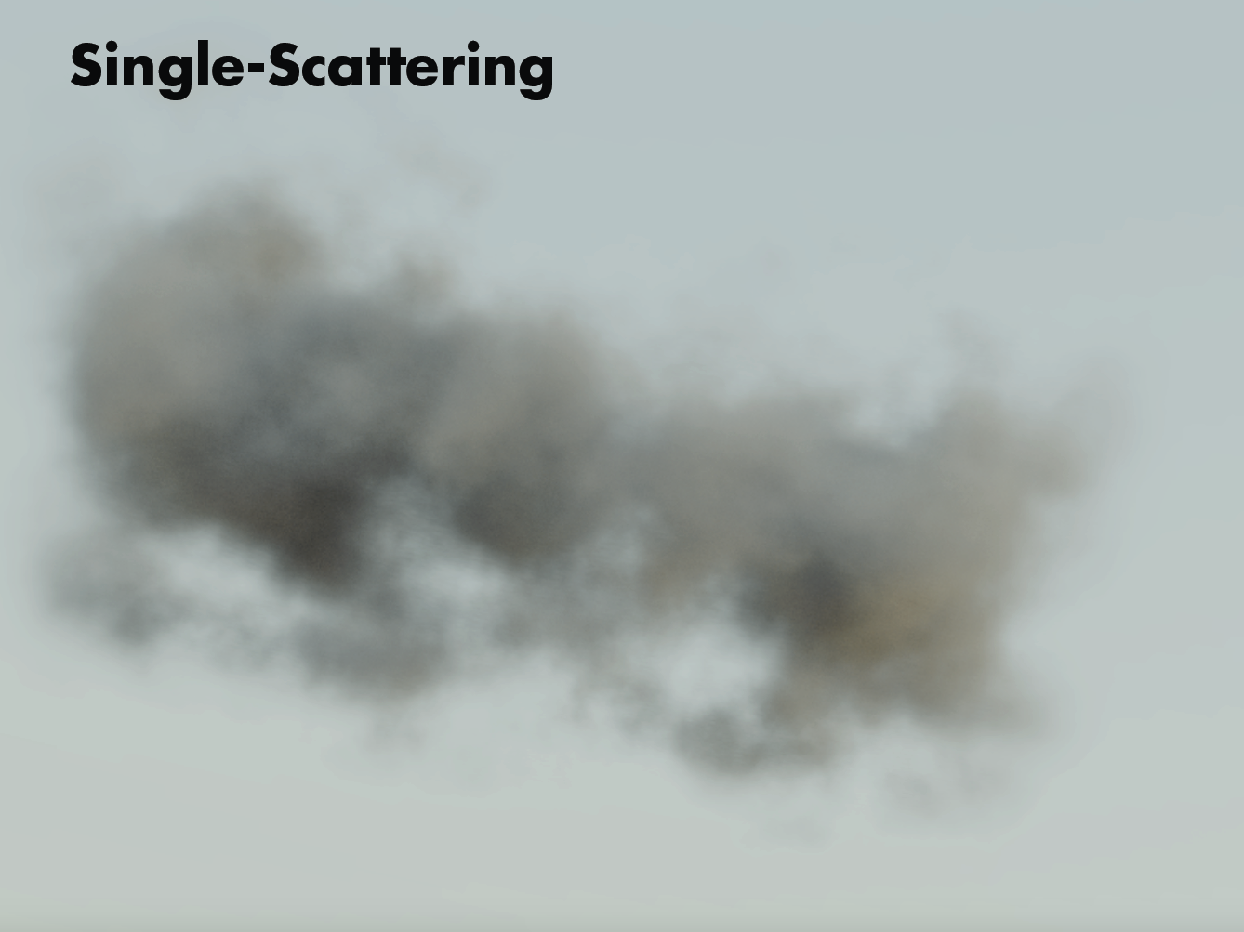

Slide 30
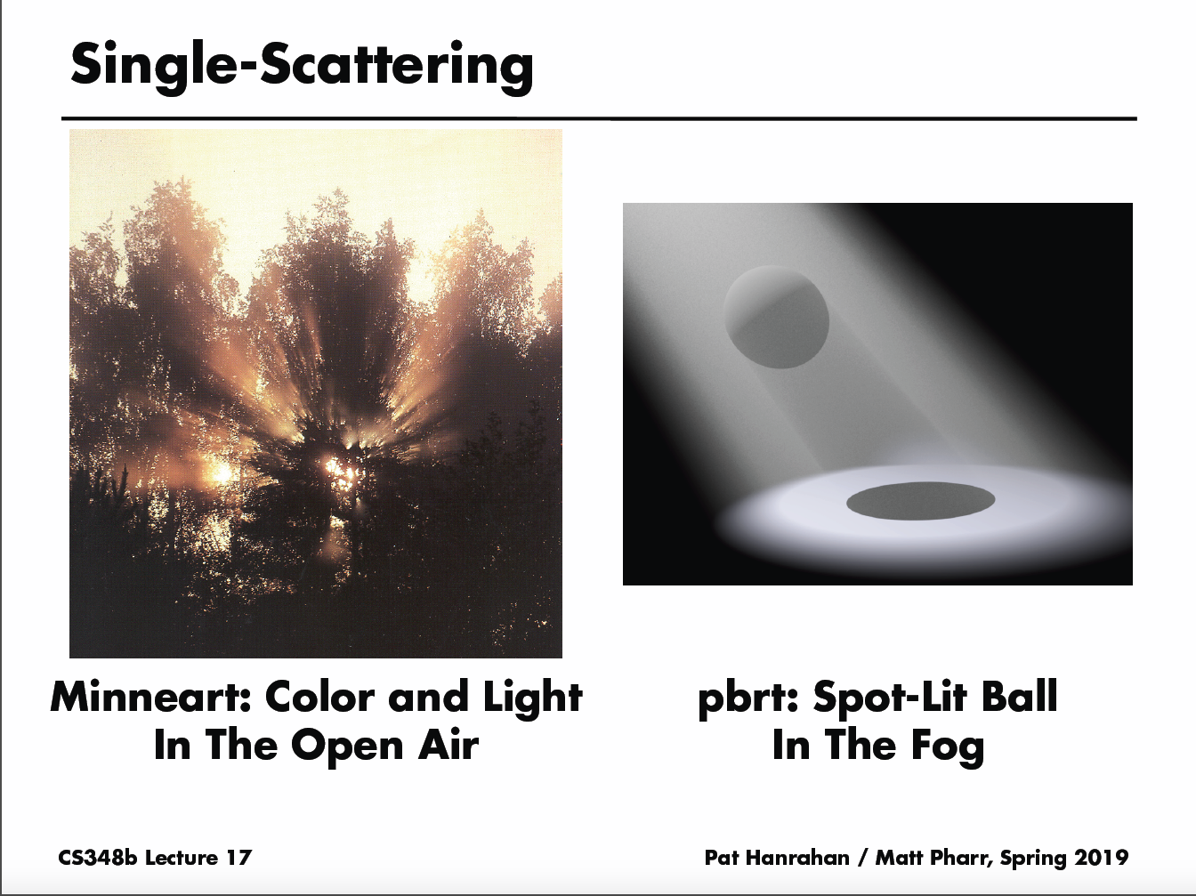

Slide 31
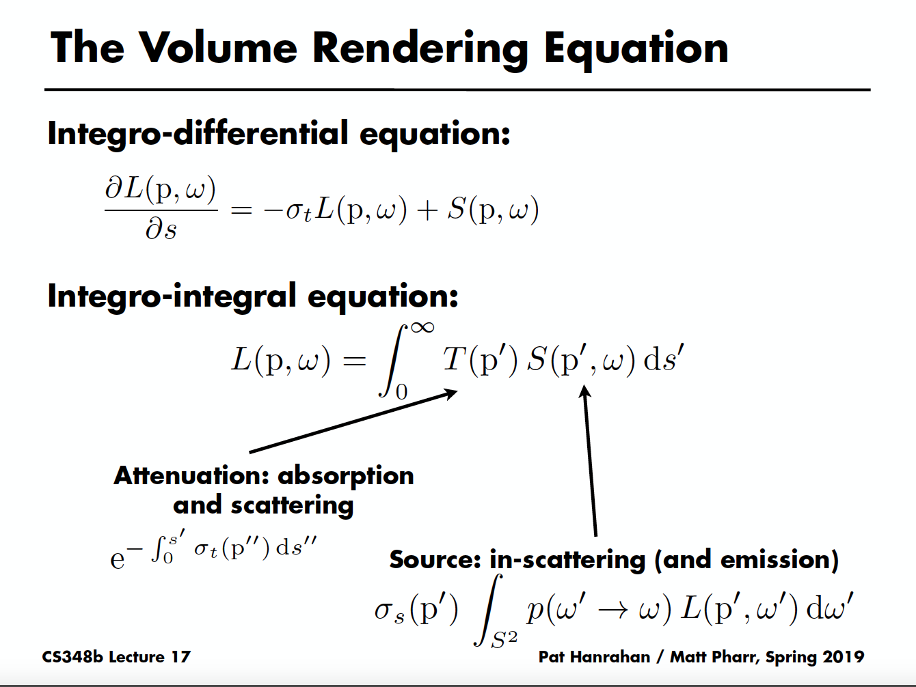
The Volume Rendering Equation

Slide 32
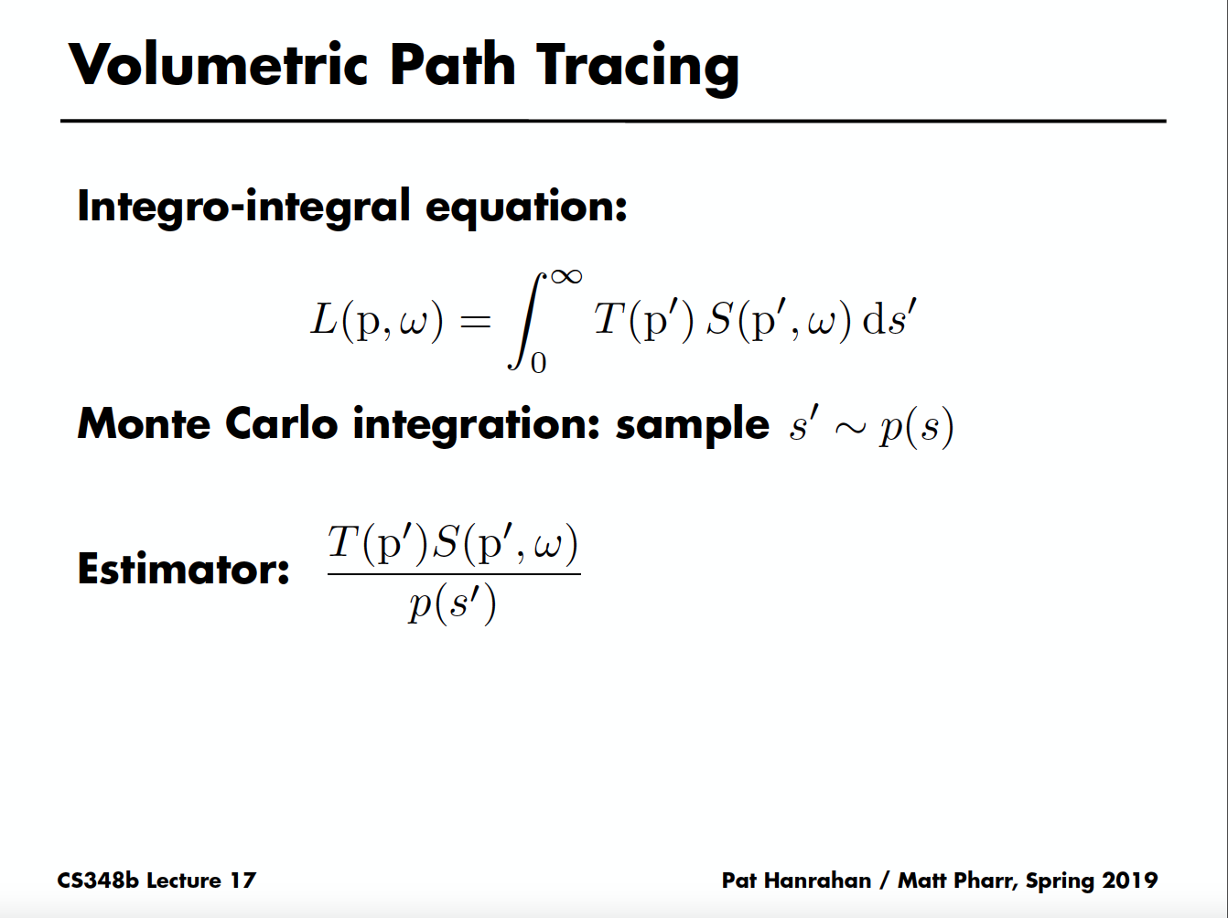

Slide 33
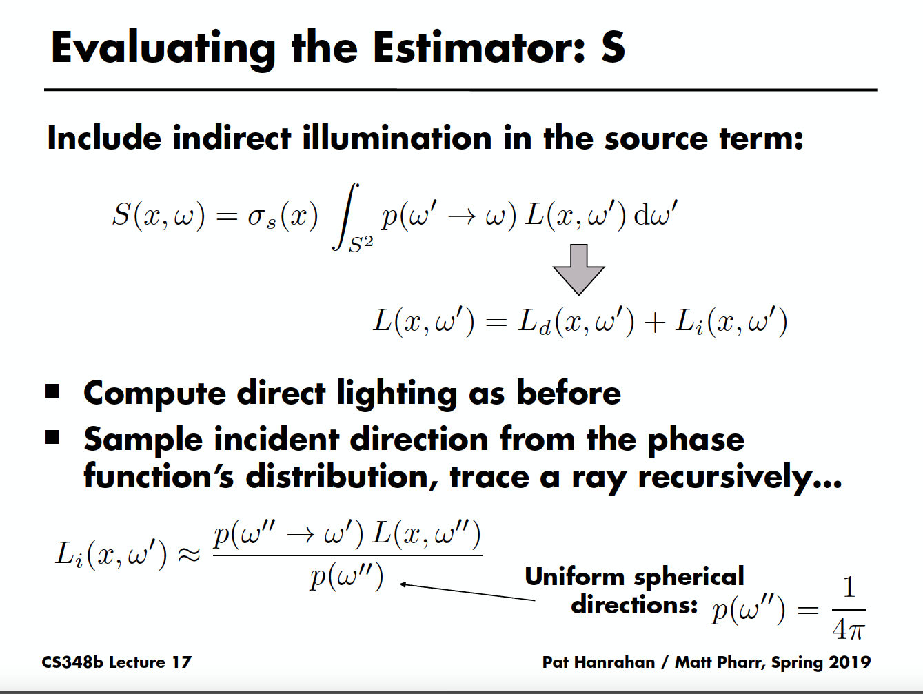

Slide 34
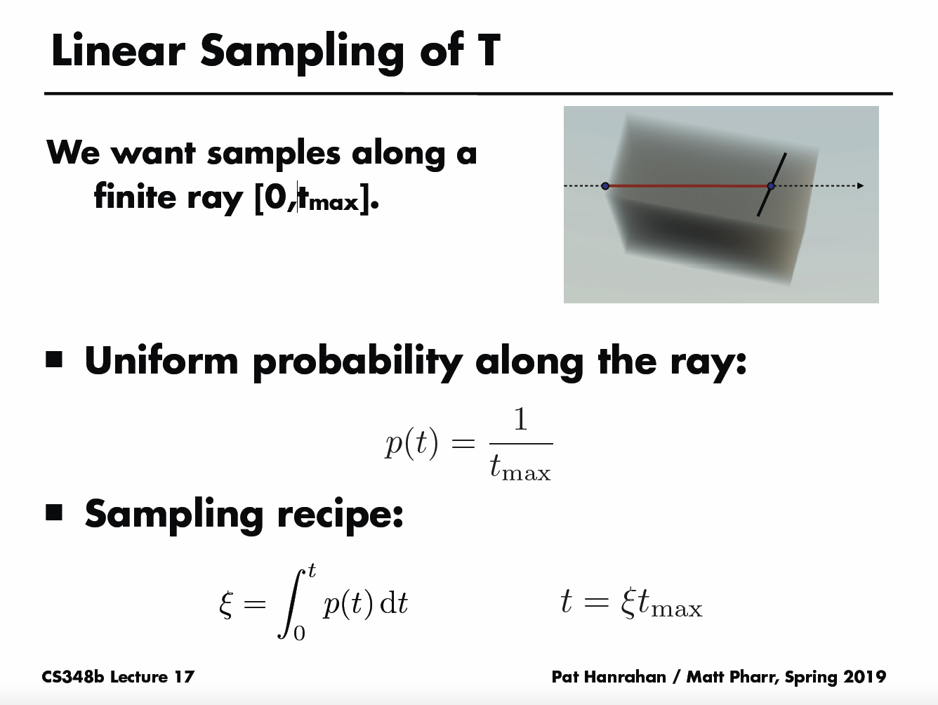

Slide 35
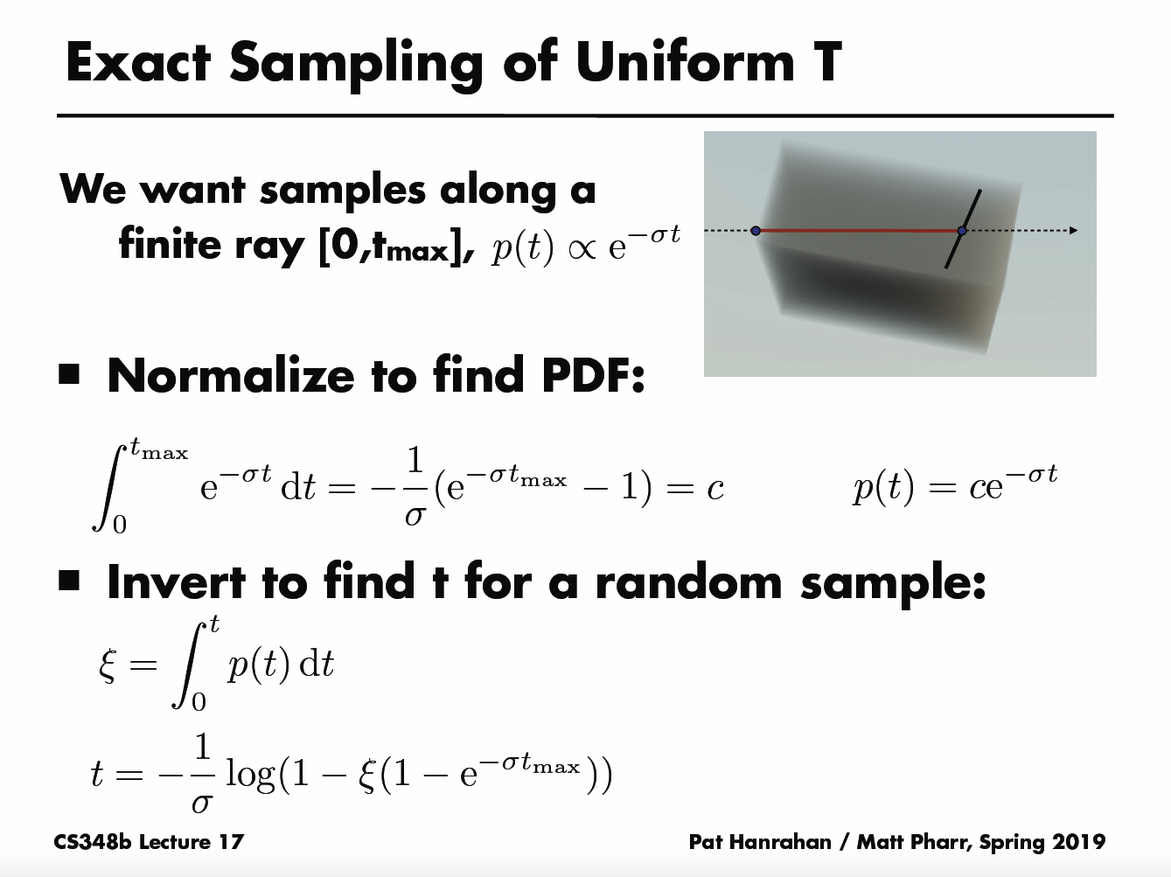

Slide 36
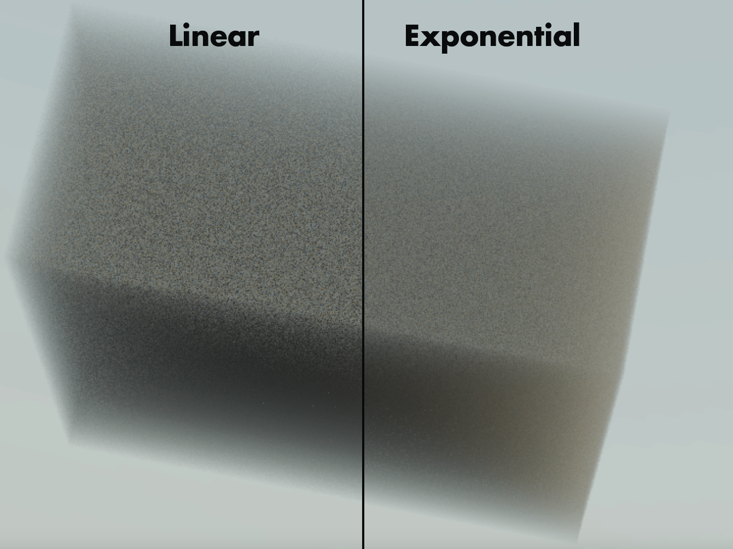

Slide 37


Slide 39
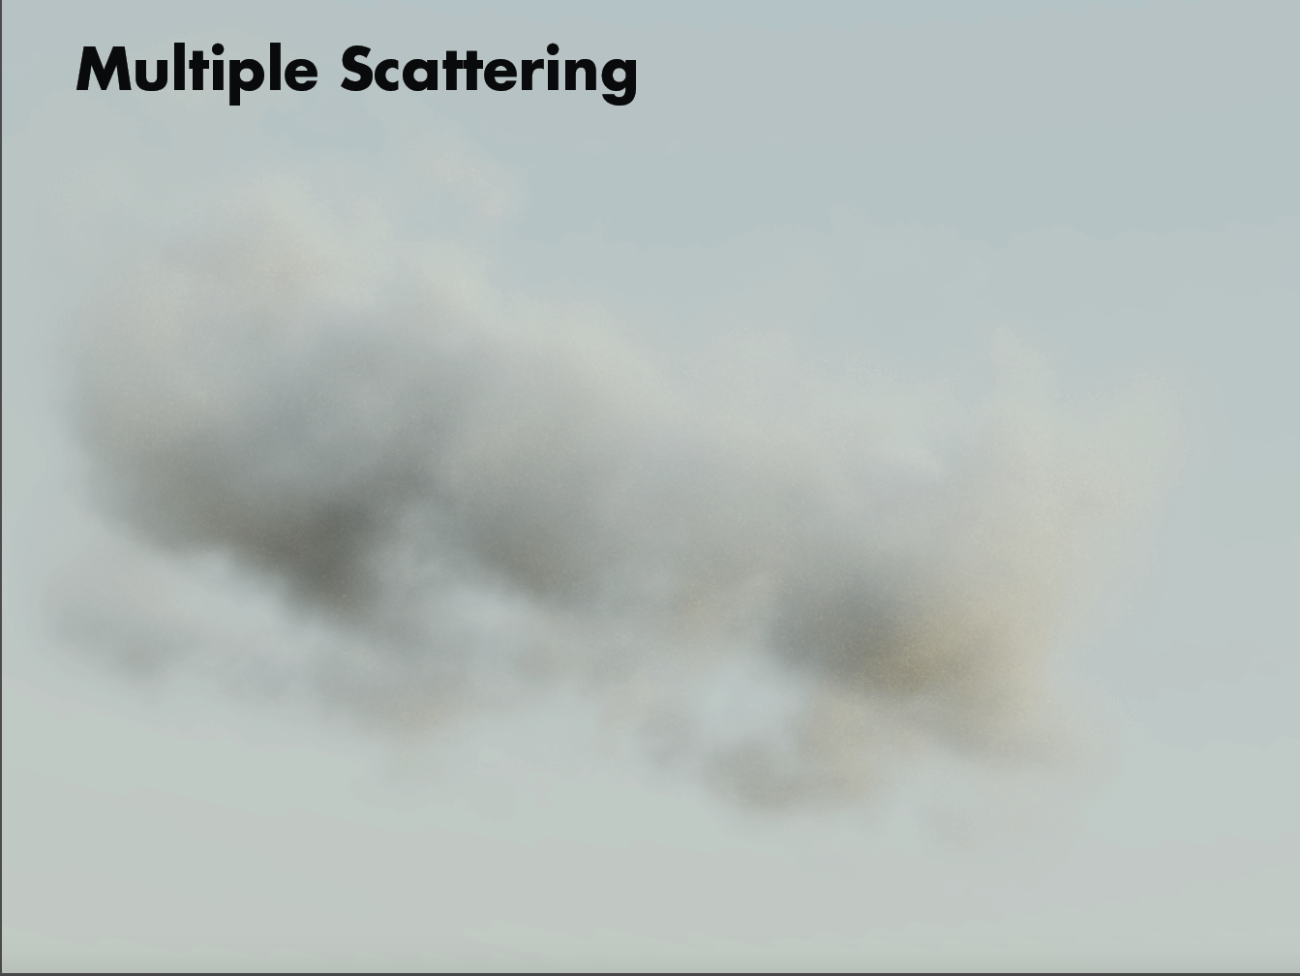

Slide 40
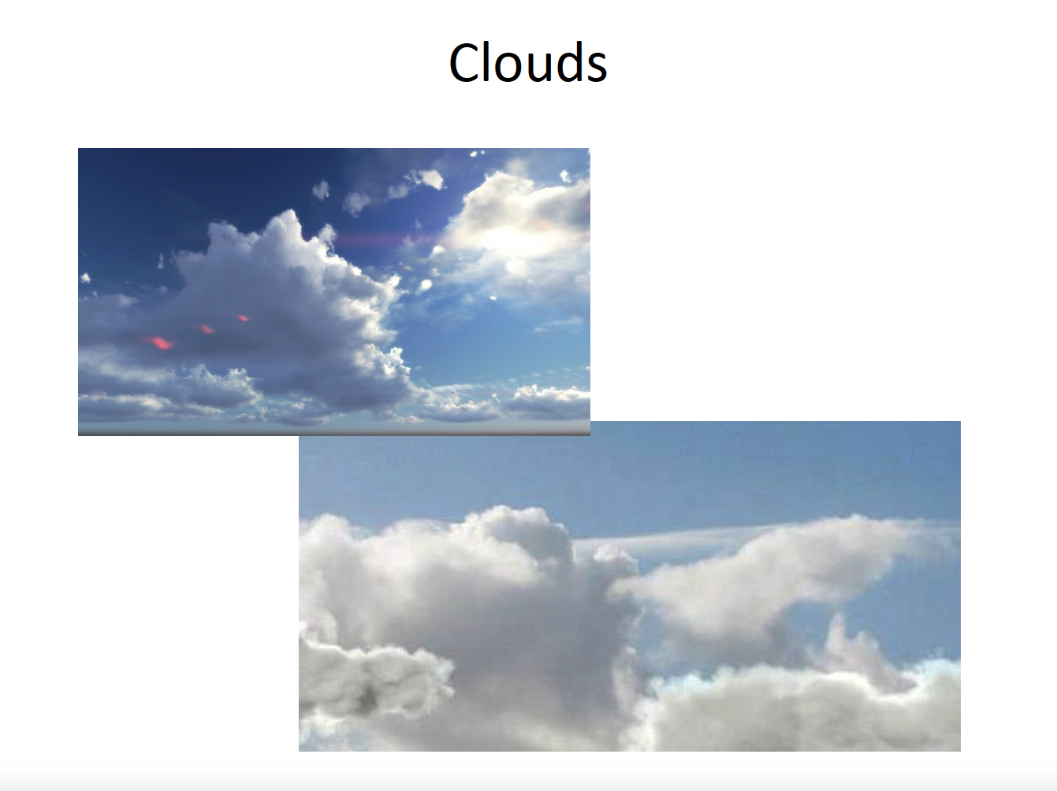

Slide 41
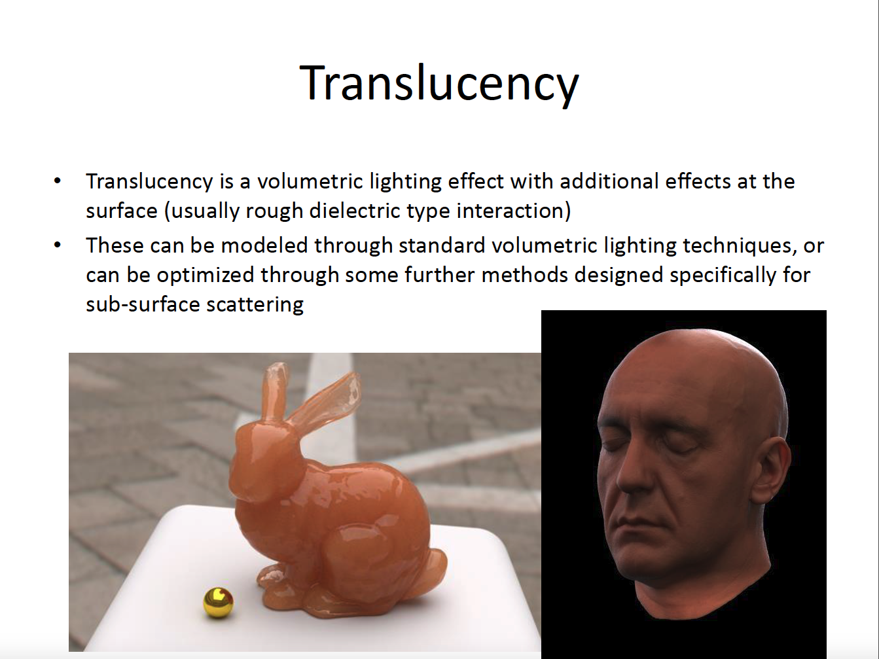

Slide 42
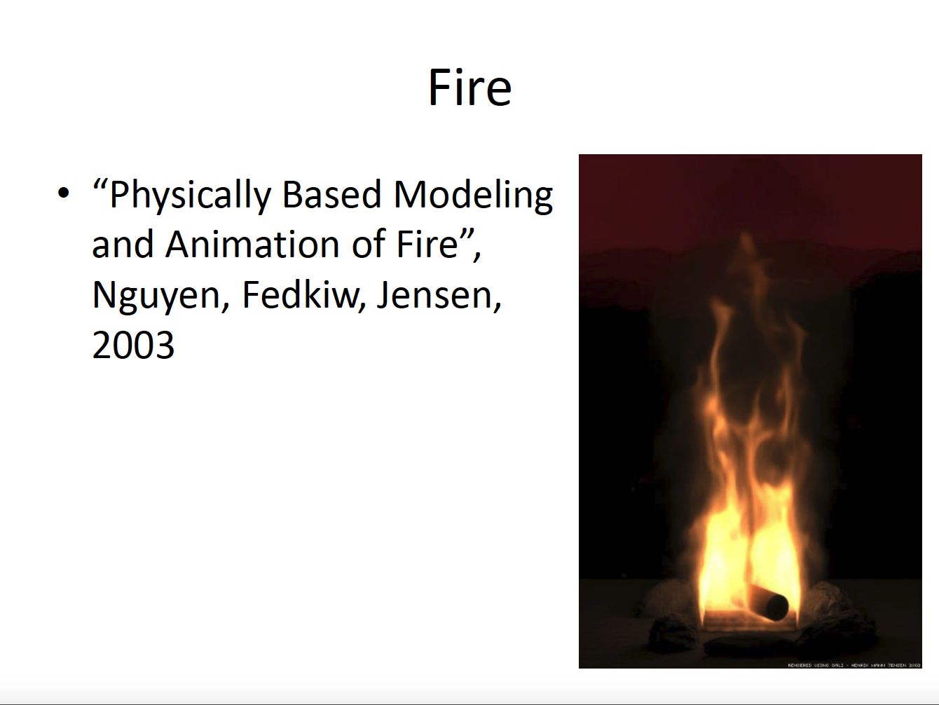

Slide 43
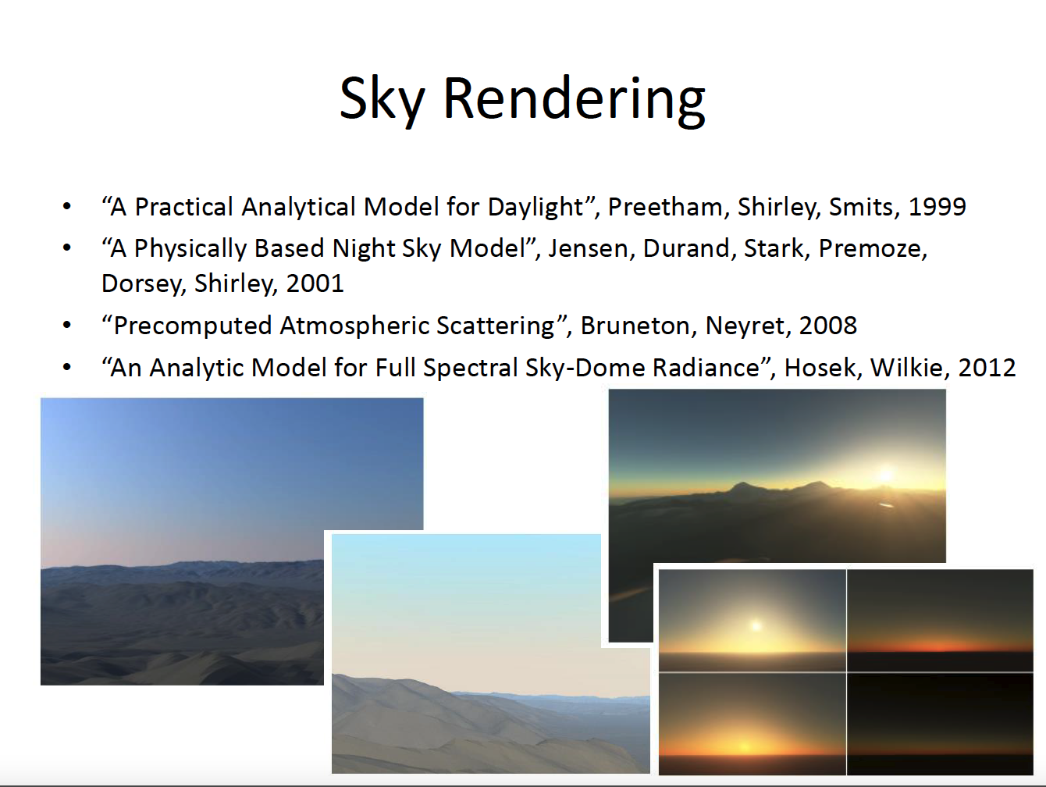

Slide 44
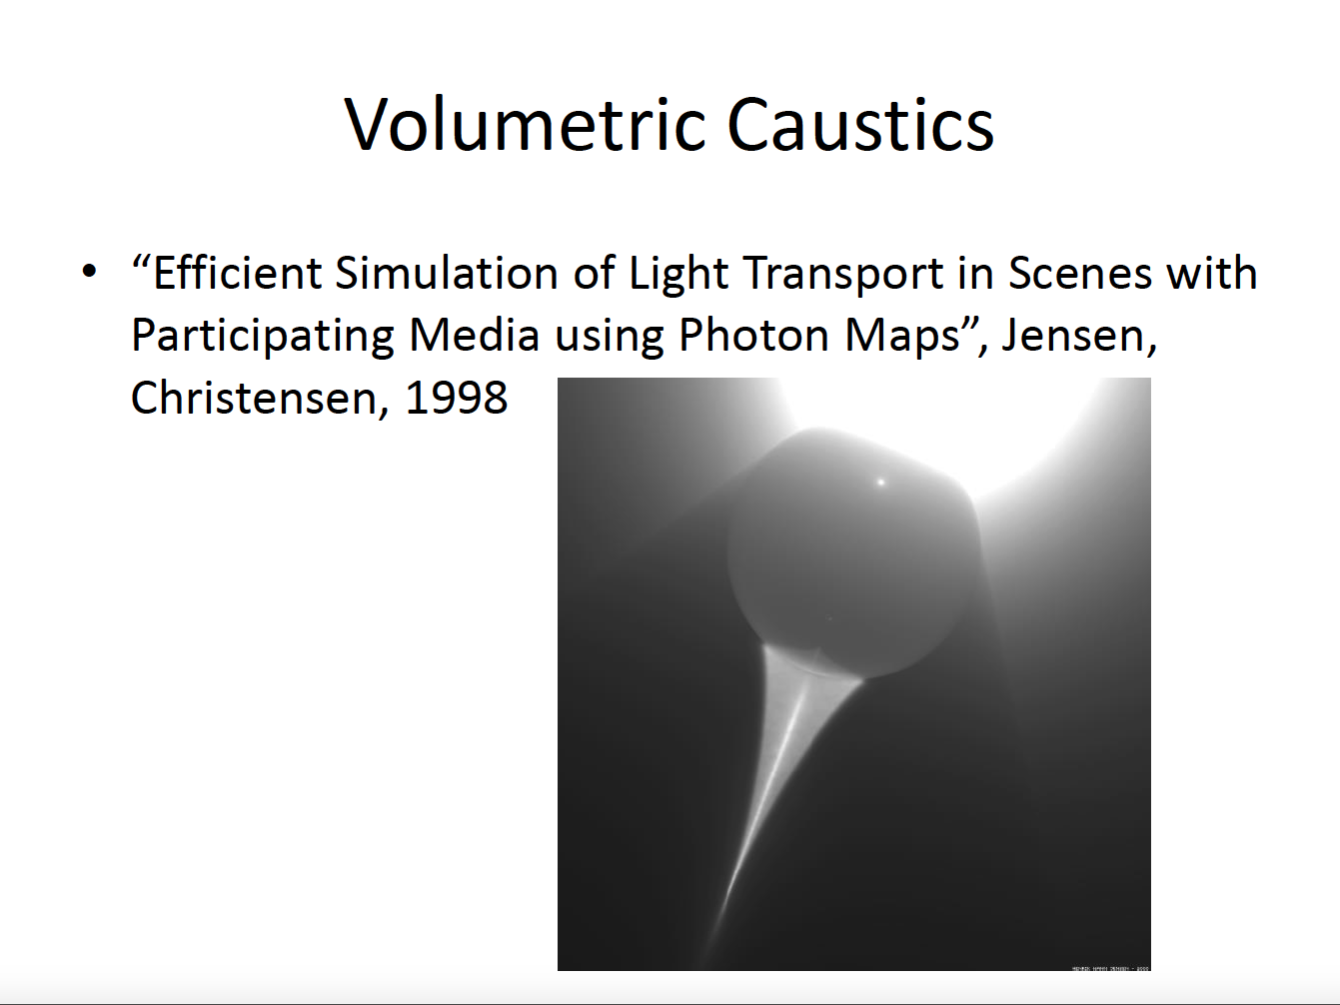

Slide 45
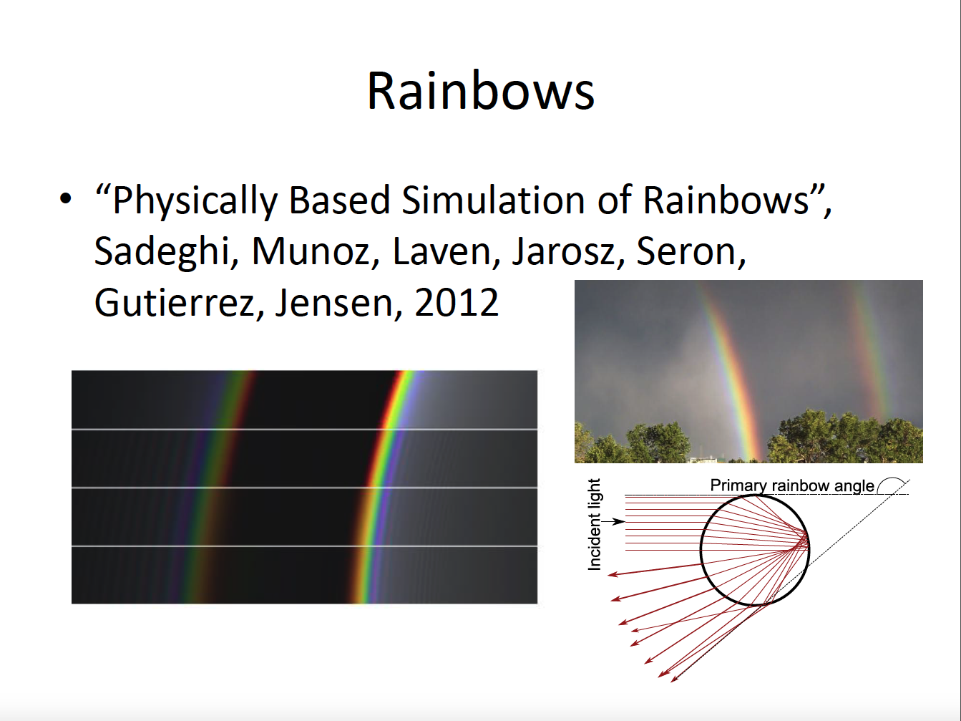

Slide 46
