Slide 1




Computer Graphics II: Rendering
CSE 168[Spr 20],Lecture 9: Importance Sampling Ravi Ramamoorthi
http://viscomp.ucsd.edu/classes/cse168/sp20

Slide 2
To Do
Start working on homework 3. Ask me if problems
Also homework 4. This lecture covers material (Lecture is designed to follow assignment closely)
Start thinking about final project

Slide 3
Importance Sampling
Talked about in Monte Carlo Path Tracing
This assignment: implement at each bounce
Use “good” pdf for sampling instead of uniform
Extension to Multiple Importance Sampling (Veach 95)
  Allows considering both lighting and BRDF sampling
  Key development in production rendering (Academy Award)
  Remains active topic of research (many papers in 2019)

Slide 4
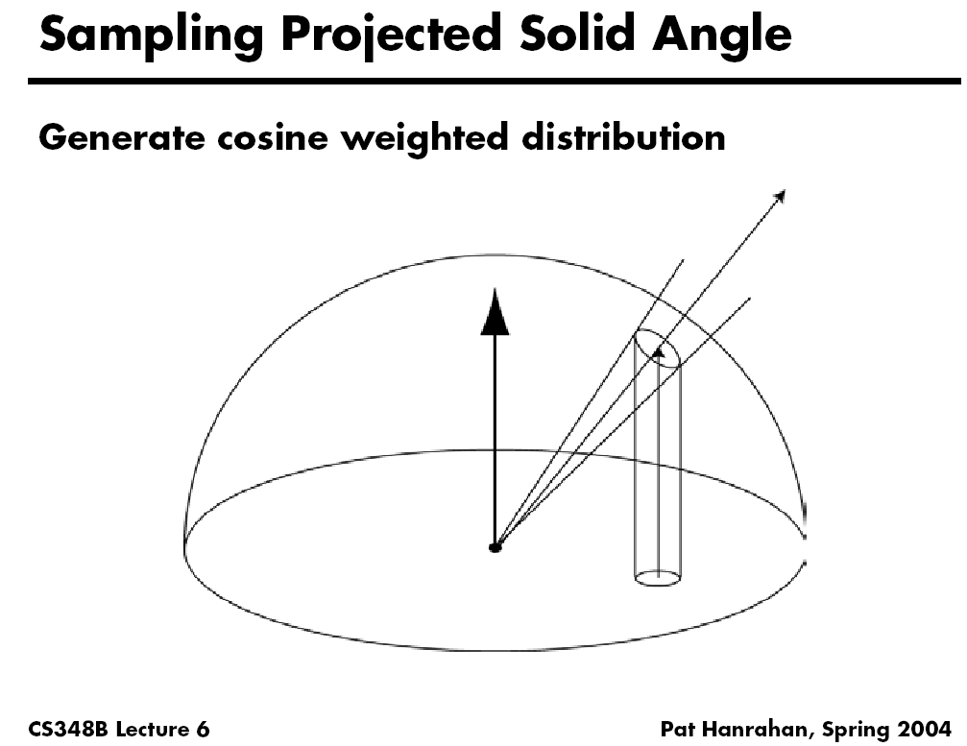

Slide 5
Cosine Importance Sampling
Include cosine term in PDF (for indirect lighting)
Previously, uniformly integrate over hemisphere
Now, consider a cosine PDF

Slide 6
Cosine Sampling Upper Hemisphere
Inversion method
  In polar coords, density must be proportional to cos θ sin θ (remember d(solid angle) = sin θ dθ dϕ)
  Integrate, invert ➔ cos⁻¹(sqrt(…))
Recipe is (start with two random numbers ξ_{1,} ξ₂ in 0…1)
  Generate ϕ in 0..2π ϕ=2πξ₂
  Generate z in 0..1 z=sqrt(ξ₁) // Note extra sqrt wrt uniform
  Let θ = cos⁻¹ z θ=acos(z) = acos(sqrt(ξ₁))
  (x,y,z) = (sin θ cos ϕ, sin θ sin ϕ, cos θ)
Rotate according to surface normal (z goes to normal)
  Or create coordinate frame (as you did for uniform sampling)
Modify indirect lighting estimator (remove ) and replace 2π with π (indirect lighting, Russian Roulette)

Slide 7
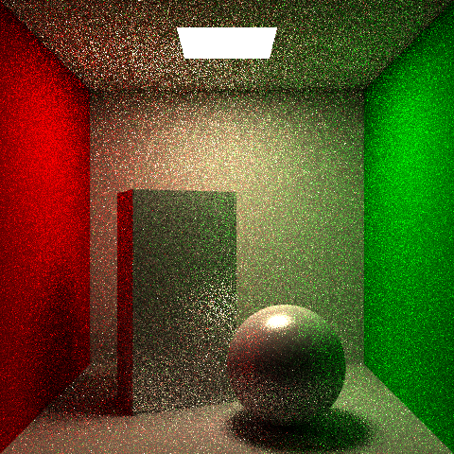
Uniform Hemisphere Sampling

Slide 8
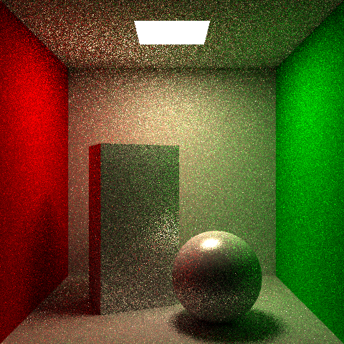
Cosine Sampling

Slide 9
Specular BRDFs
Cosine importance sampling works well for near-Lambertian BRDFs (modest improvement)
But more sophisticated sampling for specular BRDFs
Will talk about general BRDFs next lecture
For now, for assignment: Modified Phong, GGX
Sampling BRDFs in general is non-trivial
  Can simply normalize to get PDF, but sampling non-trivial
  For now, sample a simpler BRDF, then divide by PDF
  (This procedure is always guaranteed to work)

Slide 10
BRDF Importance Sampling
Phong BRDF: f_{r} ~ cos^{s}β where β is angle between outgoing ray and ideal mirror direction
Constant scale = k_{s}(s+2)/(2π)
Can’t sample this times cos θ_{i}
  Can only sample BRDF itself, then multiply by cos θ_{i}
  That’s OK – still better than random sampling

Slide 11
BRDF Importance Sampling
Recipe for sampling specular term:
  Generate z in 0..1
  Let γ = cos⁻¹ (z^{1/(s+1)})
  Generate ϕ_{γ} in 0..2π
  This gives direction w.r.t. ideal mirror direction
Convert to (x,y,z), then rotate such that z points along mirror dir.

Slide 12
Formal Modified Phong Sampling
Multiply by cosine, transport function (note colors)
Modified Phong is an approximation
Generate 3 random numbers: ξ_{0,} ξ_{1,} ξ₂ in 0…1
Use ξ₀ to decide diffuse (>t) or specular (≤t)
  Generate ϕ in 0..2π ϕ=2πξ₂
  If diffuse θ= acos(sqrt(ξ₁)) [coord. frame normal n]
  If specular θ= acos(ξ₁^{1/(s+1)}) [coord. frame refl r]
  Compute BRDF / PDF (if below visible, BRDF = 0)

Slide 13
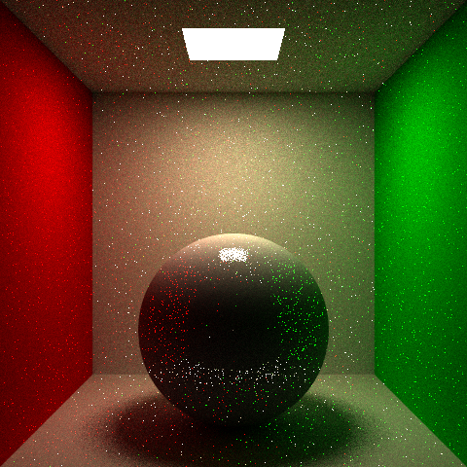
Without BRDF Importance Sampling (note near-mirror sphere)

Slide 14
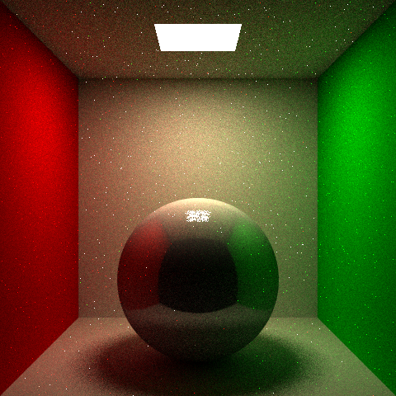
With BRDF Importance Sampling (note near-mirror sphere)

Slide 15
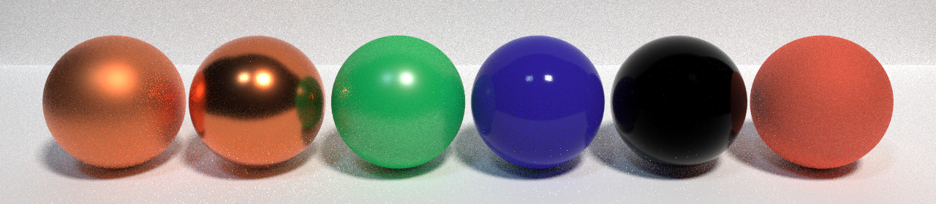
GGX Microfacet Model
Physically-Based Reflectance Model
Widely used in practice
Will discuss BRDFs in more detail next time
Brief review here, see assignment for details

Slide 16
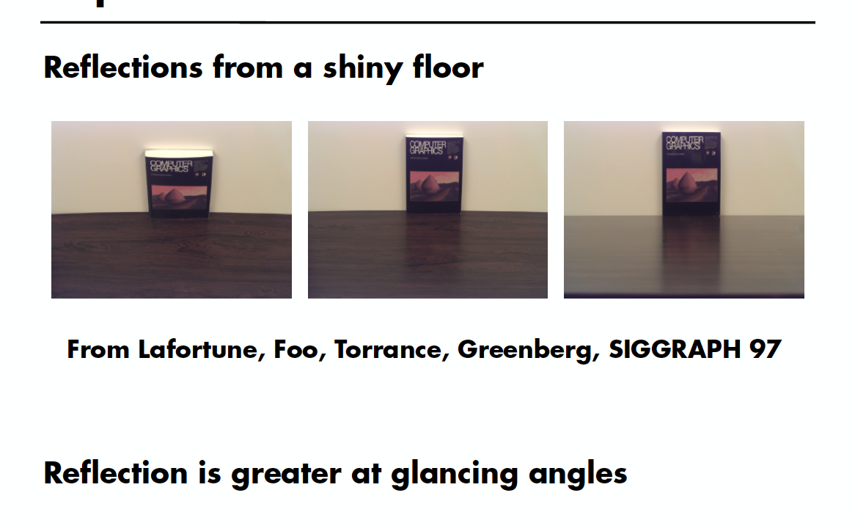
Experiment

Slide 17
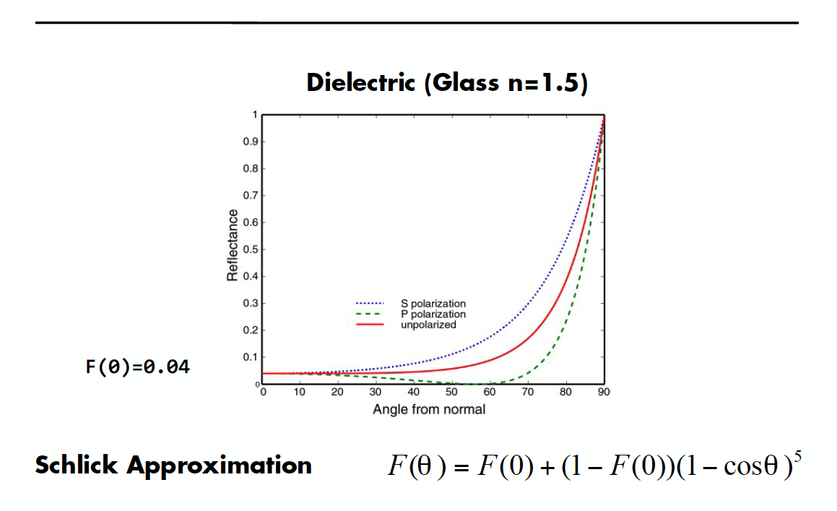
Fresnel Reflectance

Slide 18
(Cook-)Torrance-Sparrow
Assume the surface is made up grooves at the microscopic level. (General Microfacet Theory)
Assume the faces of these grooves (called microfacets) are perfect reflectors.
Take into account 3 phenomena
Shadowing
Masking
Interreflection

Slide 19
(Cook-)Torrance-Sparrow
Fresnel term:
allows for wavelength dependency
Geometric Attenuation:
reduces the output based on the amount of shadowing or masking that occurs.
Distribution:
distribution function determines what percentage of microfacets are oriented to reflect in the viewer direction.
How much of the macroscopic surface is visible to the light source
How much of the macroscopic surface is visible to the viewer

Slide 20
GGX Microfacet Model
Specular term (see assignment for G, F)
Importance Sampling PDF (includes cosine term)
  Neglects F and G terms, must do BRDF / PDF
  Note that t is clamped at a min of 0.25 to give some specular samples even for low k_{s} (because of Fresnel)

Slide 21
Importance Sampling GGX
High-Level idea similar to modified Phong
Generate 3 random numbers: ξ_{0,} ξ_{1,} ξ₂ in 0…1
Use ξ₀ to decide diffuse (>t) or specular (≤t)
  Generate ϕ in 0..2π ϕ=2πξ₂ (if specular, this is ϕ_{h})
  If diffuse θ= acos(sqrt(ξ₁)) [coord. frame normal n]
  If specular [coord. frame halfvector h]
    Must compute incident direction from outgoing, half-vector
    Rotate h about normal, reflect outgoing about half-vector
  Compute BRDF / PDF (if below visible, BRDF = 0)

Slide 22
Multiple Importance Sampling
Veach 95 classic scene (4 lights, 4 glossiness)
BRDF importance sampling only (no NEE, so no explicit direct lighting or light sampling pass)
  Mostly noisy but sharper reflections handled well
Compare with light sampling (NEE)
  Mostly better but noisy for sharp reflections
Can we combine BRDF, Light(NEE) sampling?
  MIS (Veach95) provides a way, bounds
  Very robust, works well shiny/rough etc.
  Key development in production rendering
  Remains topic of interest (many papers in 2019)

Slide 23
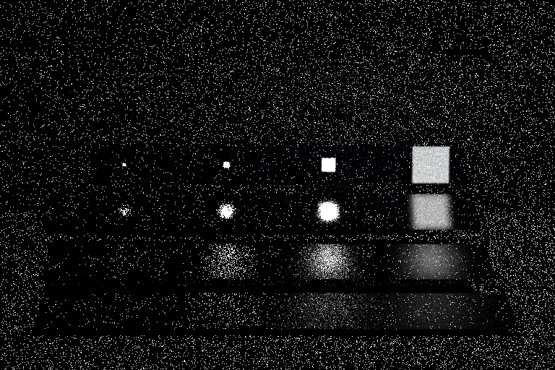
Multiple Importance Sampling
BRDF Importance Sampling (note top right images)

Slide 24
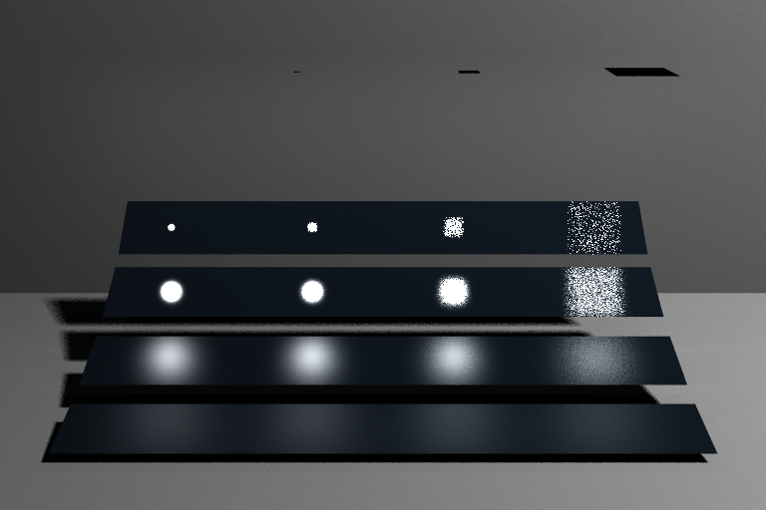
Multiple Importance Sampling
Light Sampling (Next Event Estimation for Direct Lighting)

Slide 25
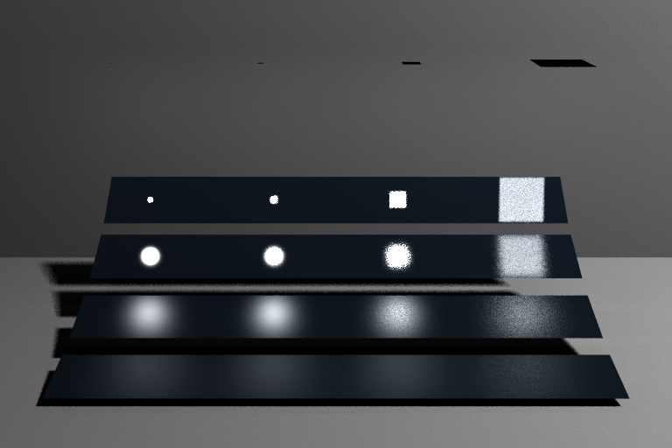
Multiple Importance Sampling
Multiple Importance Sampling (NEE+BRDF Sampling)

Slide 26
Multiple Importance Sampling
MIS relies on NEE almost everywhere, but relies on BRDF importance sampling when needed
Multi-sample: sample both distributions at each intersection
General case: N sampling techniques (inner summation is unbiased estimator each technique)
Weights must sum to 1, unbiased

Slide 27
Multiple Importance Sampling
General case: N sampling techniques (inner summation is unbiased estimator each technique)
Weights must sum to 1, unbiased
  Interesting theory (ongoing, papers in 2019)
  Veach and Guibas 95 proposed balance, power heuristics (provably “good” under certain assumptions)
  We use power heuristic with β = 2
  Subtle point: PDF must be able to be evaluated anywhere (not just own samples)
Natural abstract interface for sampling and MIS
  Eval(), Sample(), PDF() [sometimes Value() = Eval/PDF]

Slide 28
Lighting/BRDF Sampling
For now, 1 sample on light (NEE), 1 from BRDF
  We already know BRDF PDF
  Light PDF implicitly on light, convert to angle
  For multiple lights, simple normalization (see homework)
  Combine NEE and BRDF sampling (power heuristic)

Slide 29
MIS Implementation
Can be tricky, see assignment
First disable NEE, BRDF sampling for direct
  Separate NEE function, toggle light/BRDF sampling
Now implement pdf(nee)
  Beware divide by zero, see assignment for specifics
Implement weight function
  Visualize weighted lighting, weighted BRDF
  Then combine them with MIS, enable both techniques
See assignment carefully
  MIS for direct lighting only (Veach scene no indirect)
  Note gamma correction for this assignment

Slide 30
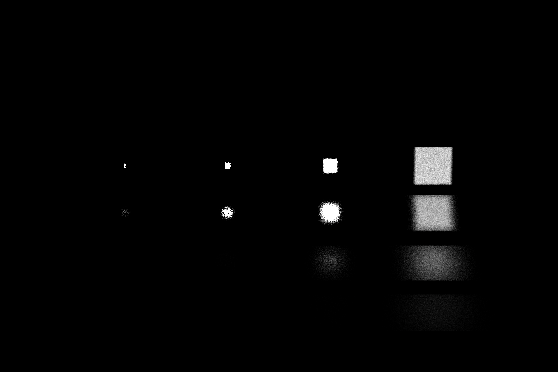
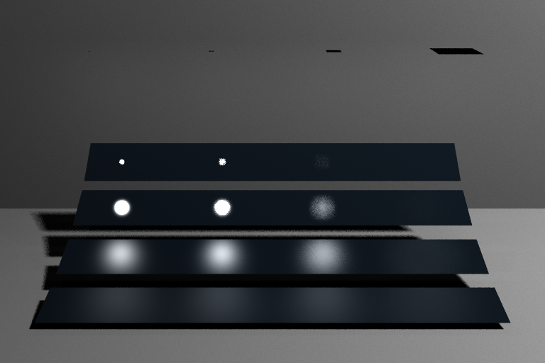
MIS weights
Weighted contribution BRDF Importance
Weighted contribution of NEE

