Slide 1




Computer Graphics II: Rendering
CSE 168 [Spr 20], Lecture 17: Image-Based Rendering Ravi Ramamoorthi
http://viscomp.ucsd.edu/classes/cse168/sp20

Slide 2
To Do
Project proposals due tomorrow (May 27)
Final Projects due Jun 9
PLEASE FILL OUT CAPE EVALUATIONS!!
KEEP WORKING HARD

Slide 3
Motivation for Lecture
Image-Based Rendering major new idea in graphics in past 25 years
Many of the rendering methods, especially precomputed techniques borrow from it
And many methods use measured data
Also, images are an important source for rendering
Sampled data rapidly becoming popular
Core IBR problem of view synthesis/light fields renewed popularity (VR other applications)

Slide 4
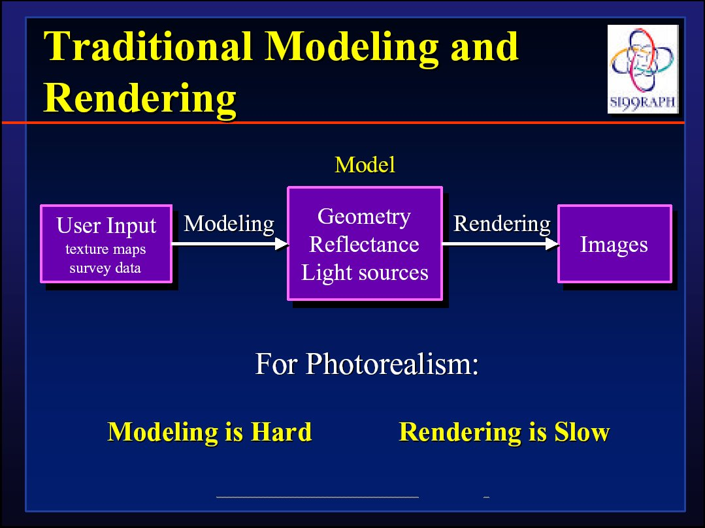
Next few slides courtesy Paul Debevec; SIGGRAPH 99 course notes

Slide 5
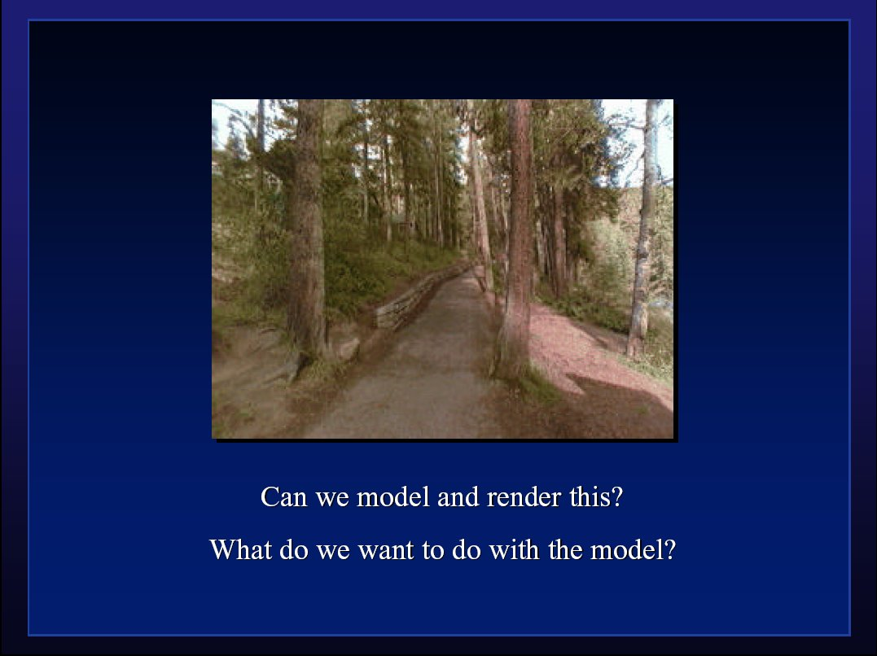

Slide 6
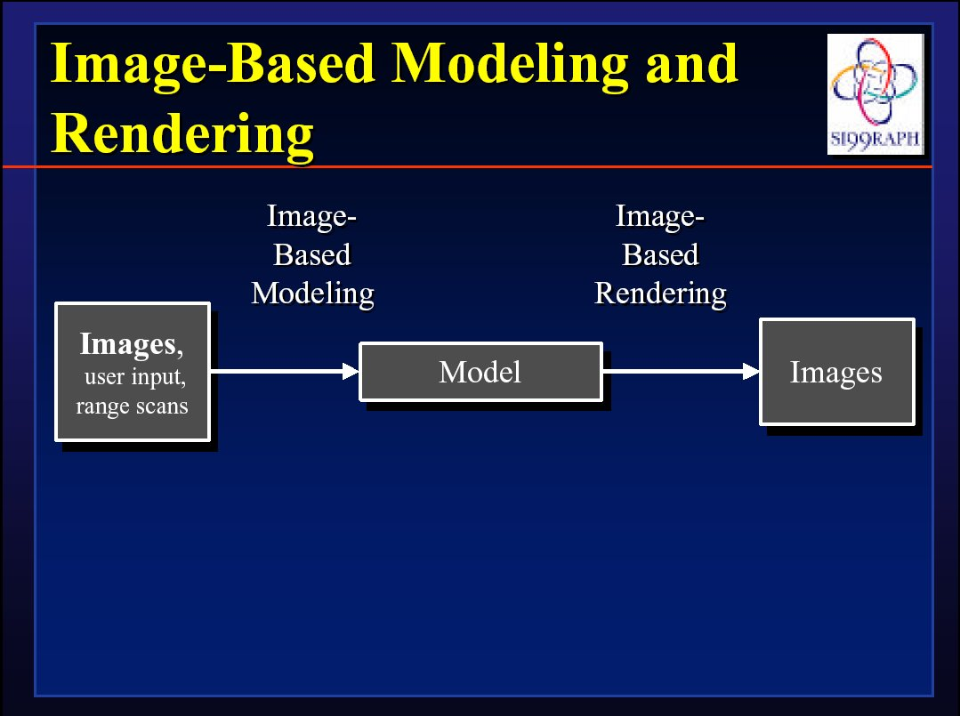

Slide 7
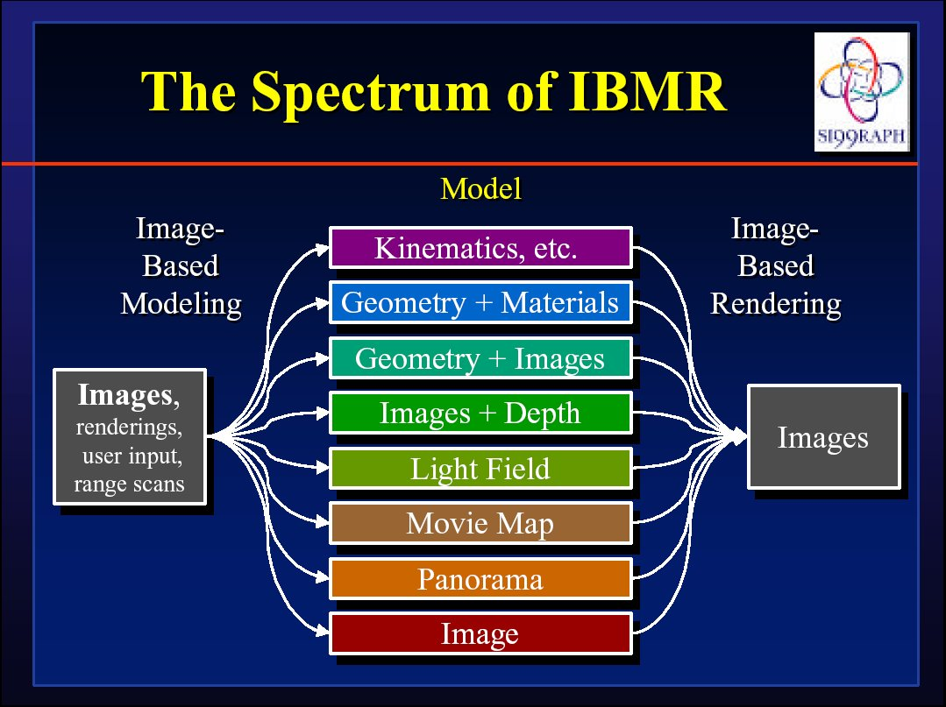

Slide 8
IBR: Pros and Cons
Advantages
  Easy to capture images: photorealistic by definition
  Simple, universal representation
  Often bypass geometry estimation?
  Independent of scene complexity?
Disadvantages
  WYSIWYG but also WYSIAYG
  Explosion of data as flexibility increased
  Often discards intrinsic structure of model?
Today, IBR-type methods also often used in synthetic rendering (e.g. real-time rendering PRT)
  General concept of data-driven graphics, appearance
  Also, data-driven geometry, animation, simulation
  Spawned light field cameras for image capture

Slide 9
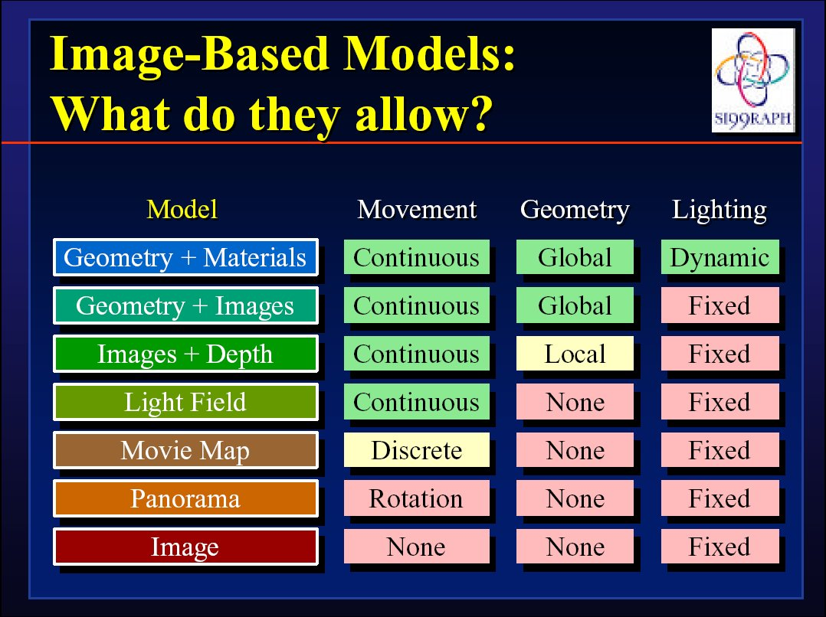

Slide 10
IBR: A brief history
Texture maps, bump maps, environment maps [70s]
Poggio MIT 90s: Faces, image-based analysis/synthesis
Mid-Late 90s
  Chen and Williams 93, View Interpolation [Images+depth]
  Chen 95 Quicktime VR [Images from many viewpoints]
  McMillan and Bishop 95 Plenoptic Modeling [Images w disparity]
  Gortler et al, Levoy and Hanrahan 96 Light Fields [4D]
  Shade et al. 98 Layered Depth Images [2.5D]
  Debevec et al. 00 Reflectance Field [4D]
  Inverse rendering (Marschner,Sato,Yu,Boivin,…)
Today: IBR hasn’t replaced conventional rendering, but has brought sampled and data-driven representations to graphics

Slide 11
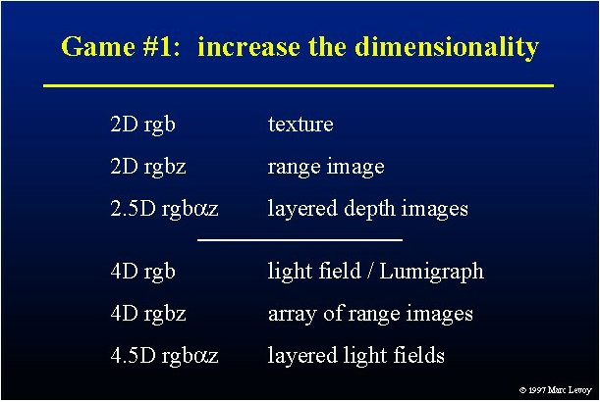

Slide 12
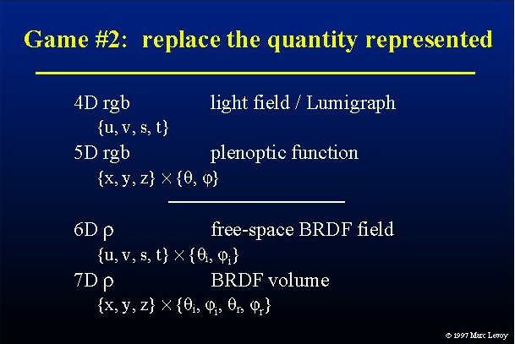

Slide 13
Outline
Overview of IBR
Basic approaches
  Image Warping
    [2D + depth. Requires correspondence/disparity]
  Light Fields [4D]
  Survey of some early work

Slide 14
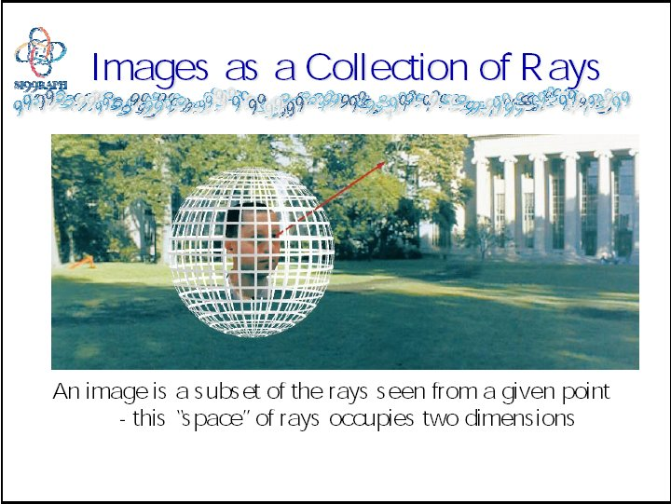
Warping slides courtesy Leonard McMillan, SIGGRAPH 99 course notes

Slide 15
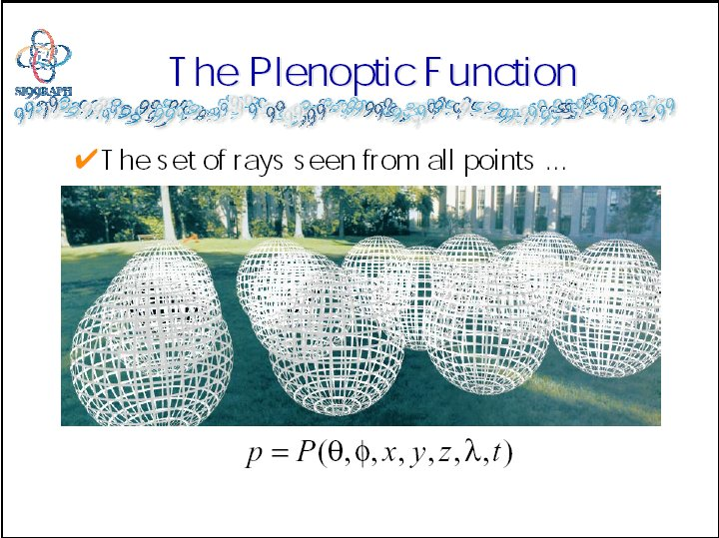

Slide 16
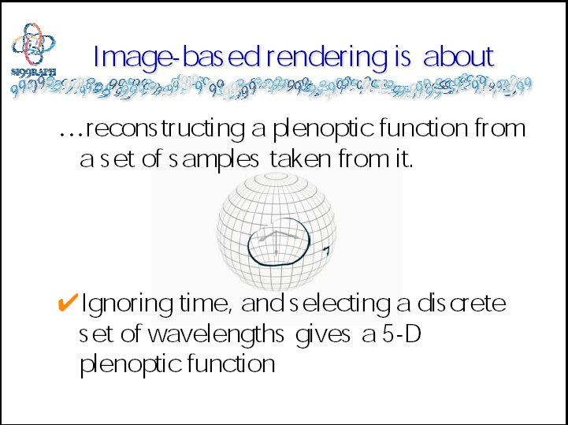

Slide 17
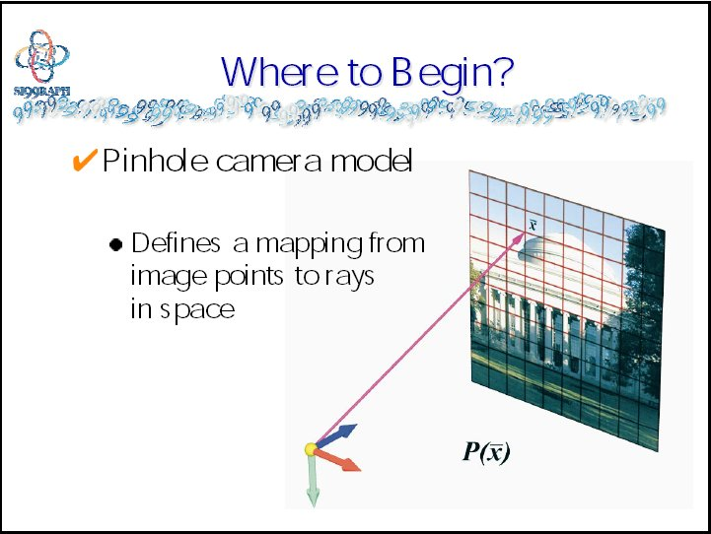

Slide 18
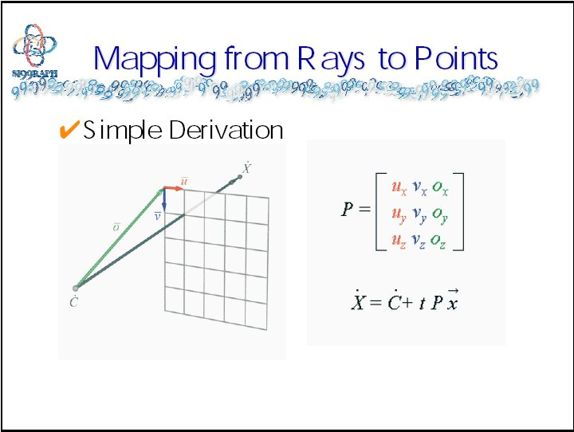

Slide 19
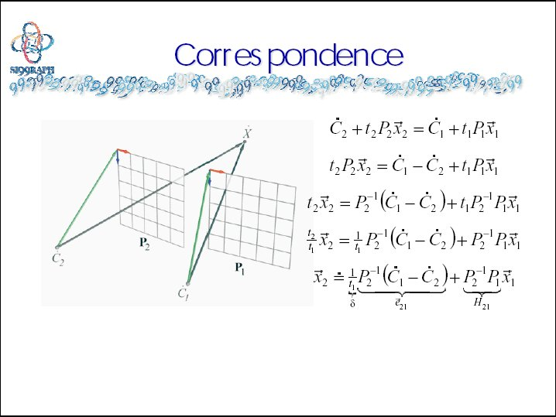

Slide 20
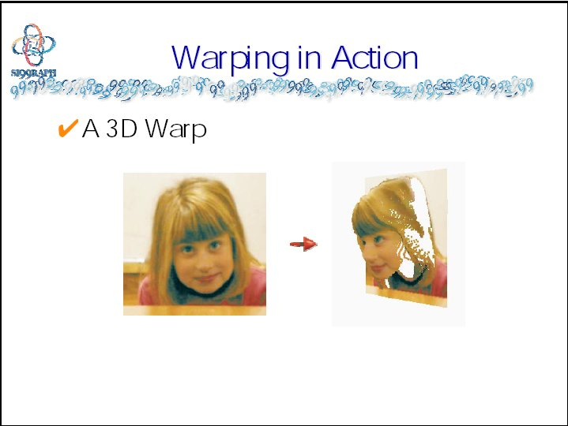

Slide 21
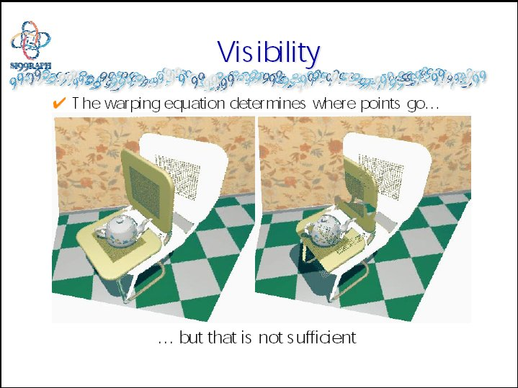

Slide 22
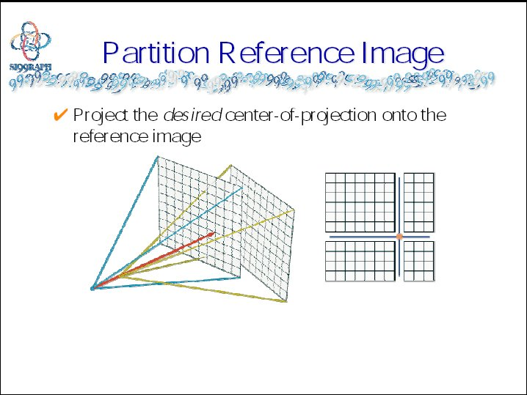

Slide 23
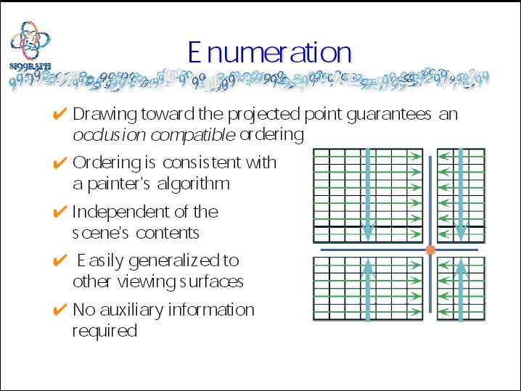

Slide 24
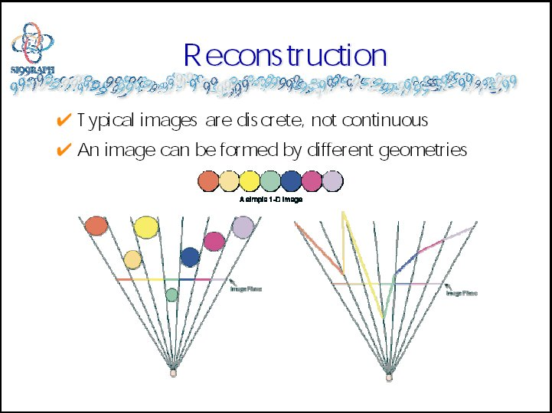

Slide 25
Outline
Overview of IBR
Basic approaches
  Image Warping
    [2D + depth. Requires correspondence/disparity]
  Light Fields [4D]
  Survey of some early work

Slide 26
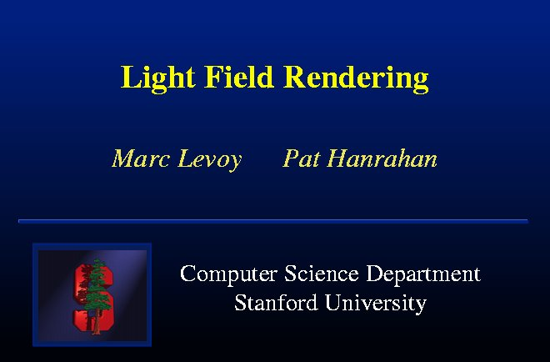

Slide 27
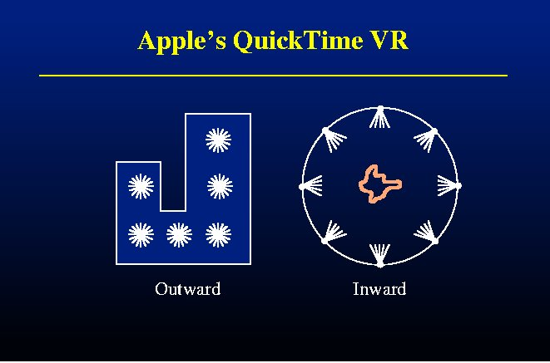

Slide 28
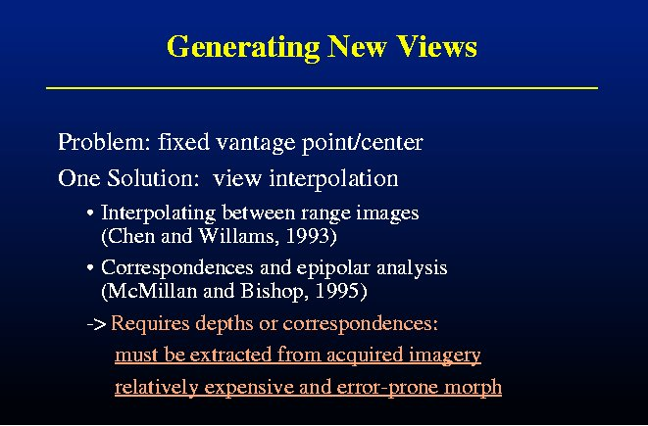

Slide 29
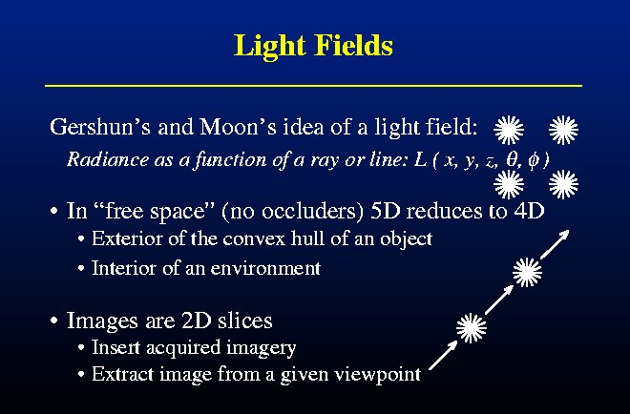

Slide 30
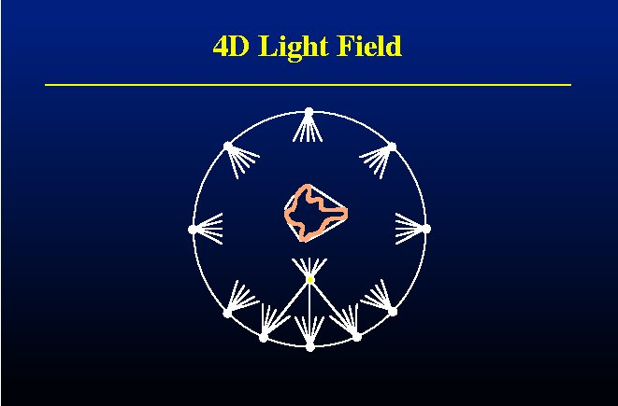

Slide 31
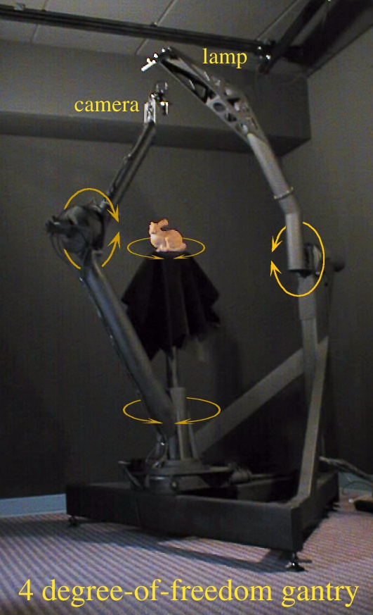
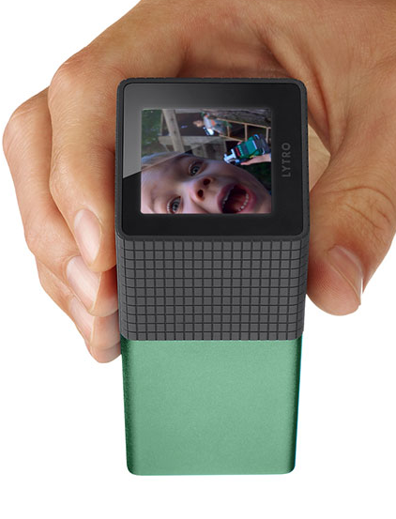
Lytro Camera

Slide 32
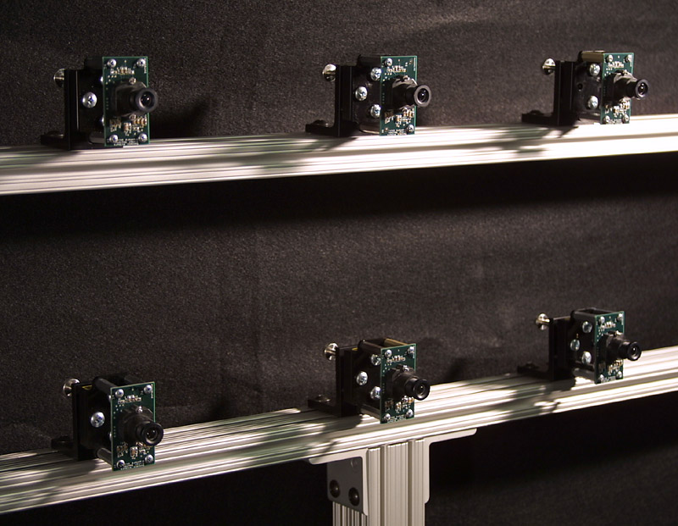

Slide 33
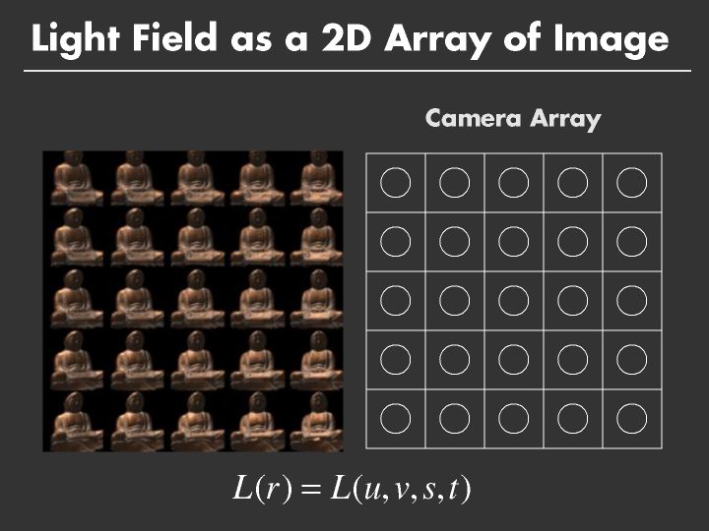

Slide 34
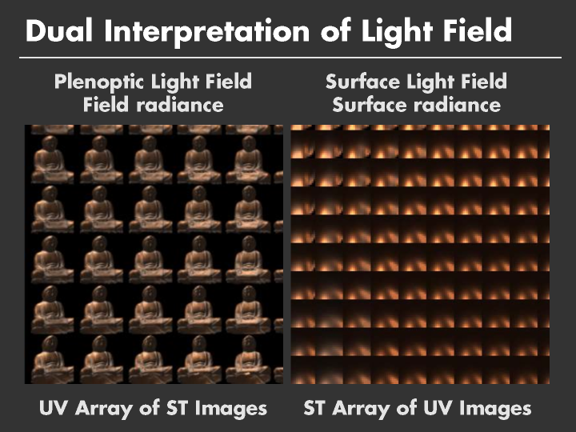

Slide 35
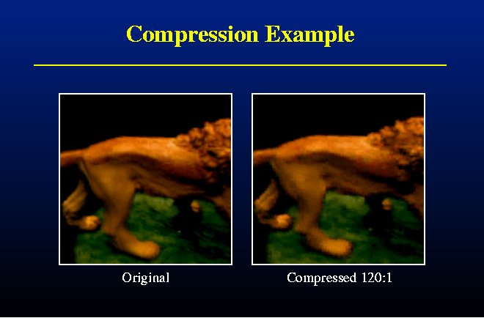

Slide 36
Outline
Overview of IBR
Basic approaches
  Image Warping
    [2D + depth. Requires correspondence/disparity]
  Light Fields [4D]
  Survey of some early work

Slide 37
Layered Depth Images [Shade 98]
Camera
Geometry
Slide from Agrawala, Ramamoorthi, Heirich, Moll, SIGGRAPH 2000
Notes:
(1:00)
First, let’s briefly consider Shade’s original formulation for the layered depth image.
To create an LDI, from a given camera location, we trace a ray thru each pixel, noting all intersections.
The LDI is just a list of layers for each pixel, with each fragment storing depth and color information.

Slide 38
Layered Depth Images [Shade 98]
LDI

Slide 39
Layered Depth Images [Shade 98]
LDI
(Depth, Color)

Slide 40
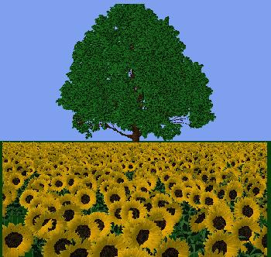

Slide 41
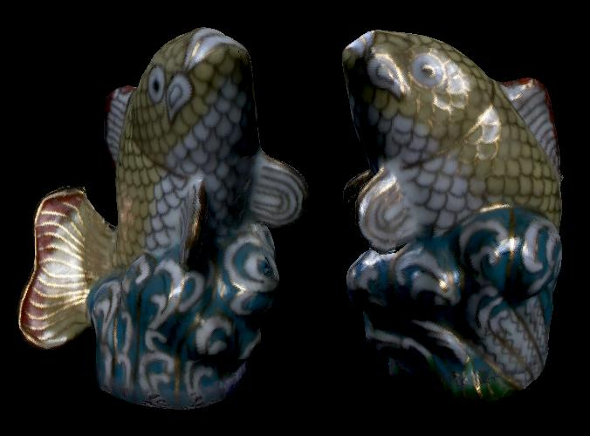
Surface Light Fields
Miller 98, Nishino 99, Wood 00
Reflected light field (lumisphere) on surface
Explicit geometry as against light fields. Easier compress

Slide 42
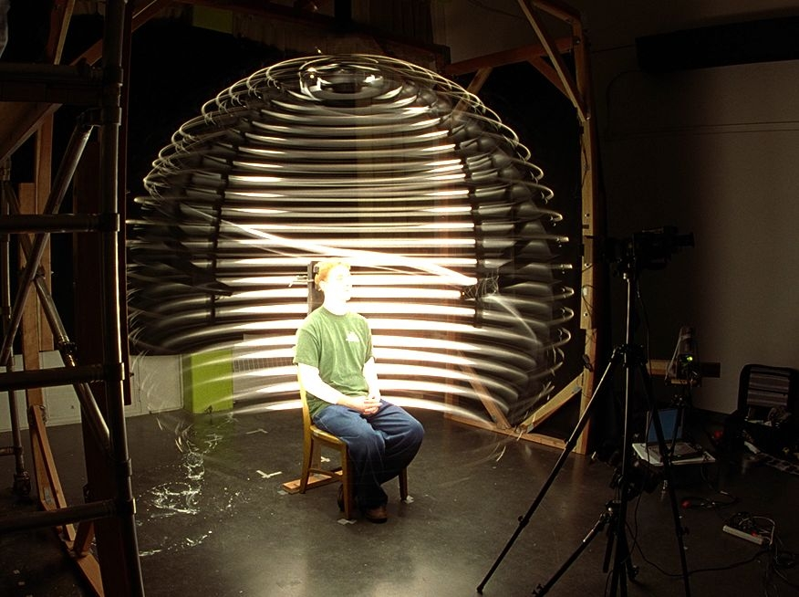
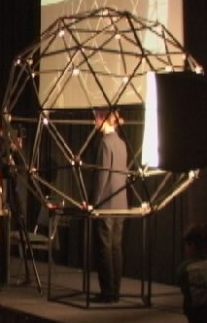
Acquiring Reflectance Field of Human Face [Debevec et al. SIGGRAPH 00]
Illuminate subject from many incident directions

Slide 43
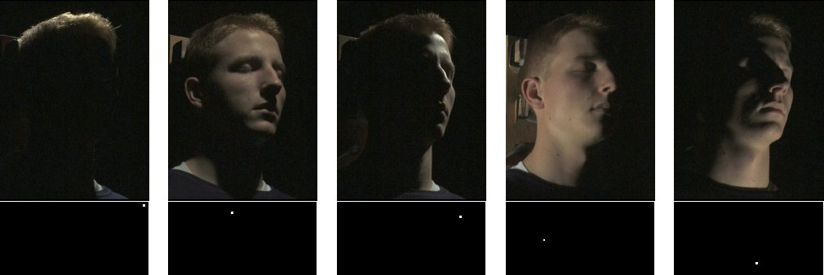
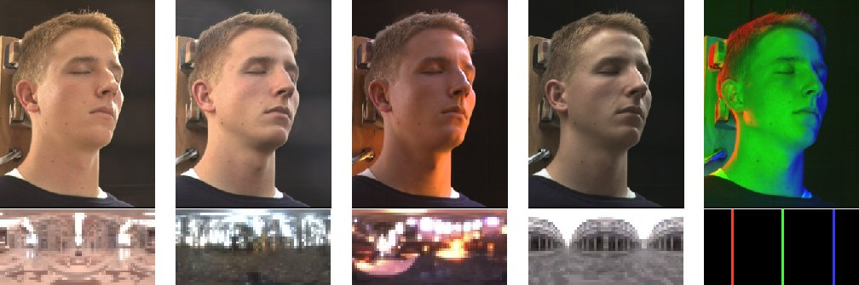
Example Images

Slide 44
Outline
Overview of IBR
Basic approaches
  Image Warping
    [2D + depth. Requires correspondence/disparity]
  Light Fields [4D]
  Survey of some recent work
    Sampled data representations

Slide 45
Conclusion (my views)
IBR initially spurred great excitement: revolutionize pipeline
But, IBR in pure form not really practical
  WYSIAYG
  Explosion as increase dimensions (8D transfer function)
  Good compression, flexibility needs at least implicit geometry/BRDF
Real future is sampled representations, data-driven method
  Acquire (synthetic or real) data
  Good representations for interpolation, fast rendering
  Much of visual appearance, graphics moving in this direction
Understand from Signal-Processing Viewpoint
  Sampling rates, reconstruction filters
  Factored representations, Fourier analysis
Light Fields fundamental in many ways, including imaging
  Renewed interest in view synthesis (Mildenhall et al. SIGGRAPH 19)

Slide 46
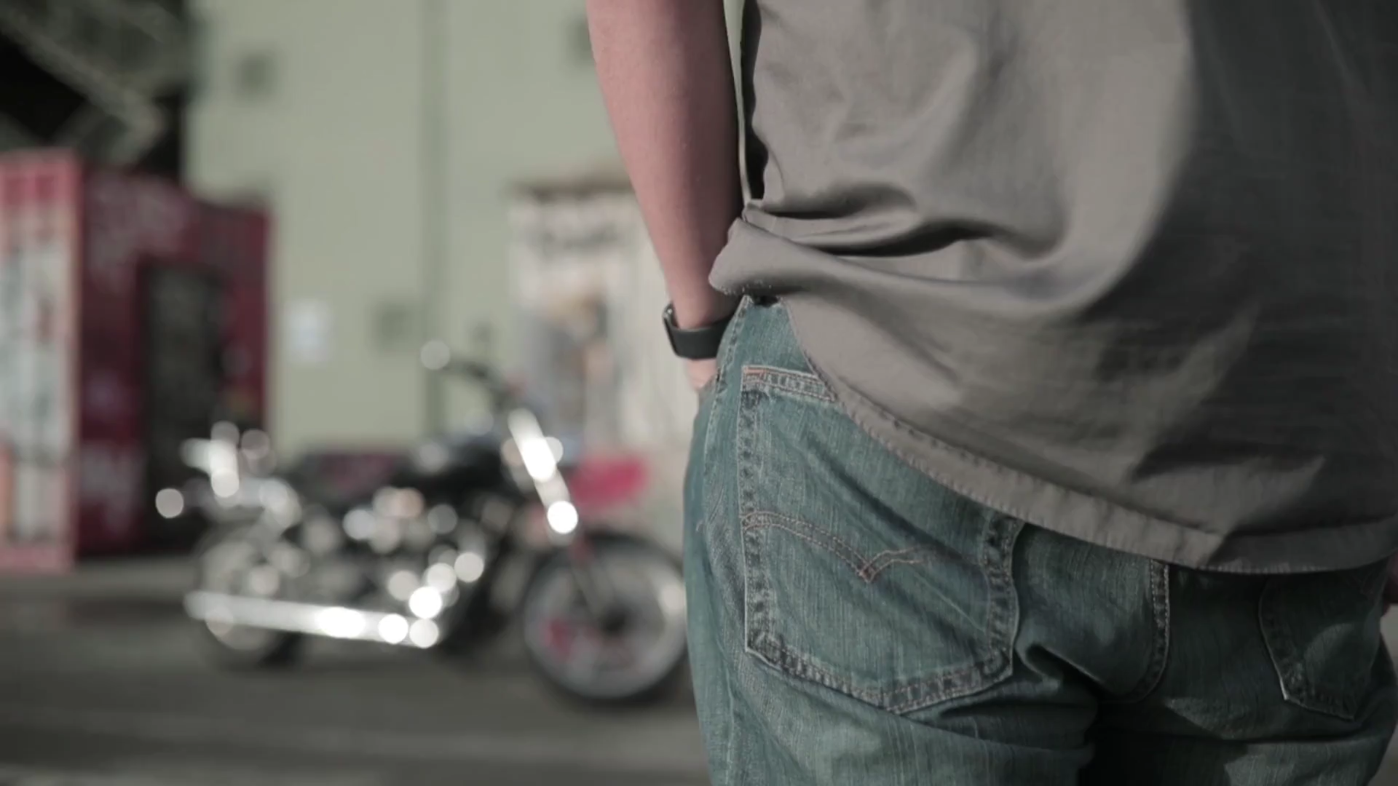
Virtual Experiences of Real-World Scenes
Notes:
We’re really interested in the problem of content capture for virtual reality, and today we’re going to talk about our system that, given a new scene, prescribes a set of input views that a user could capture in under a minute with their smartphone camera…resulting in a set of input images like this…then, after less than a minute of processing, we can render photographic-quality novel views of the scene in real time… Our system is also robust, and reliably works across a wide variety of scenes. This image-based rendering problem is called view interpolation or view synthesis, and achieving robust and high-quality results from such sparsely sampled images has traditionally been really challenging.

Slide 47
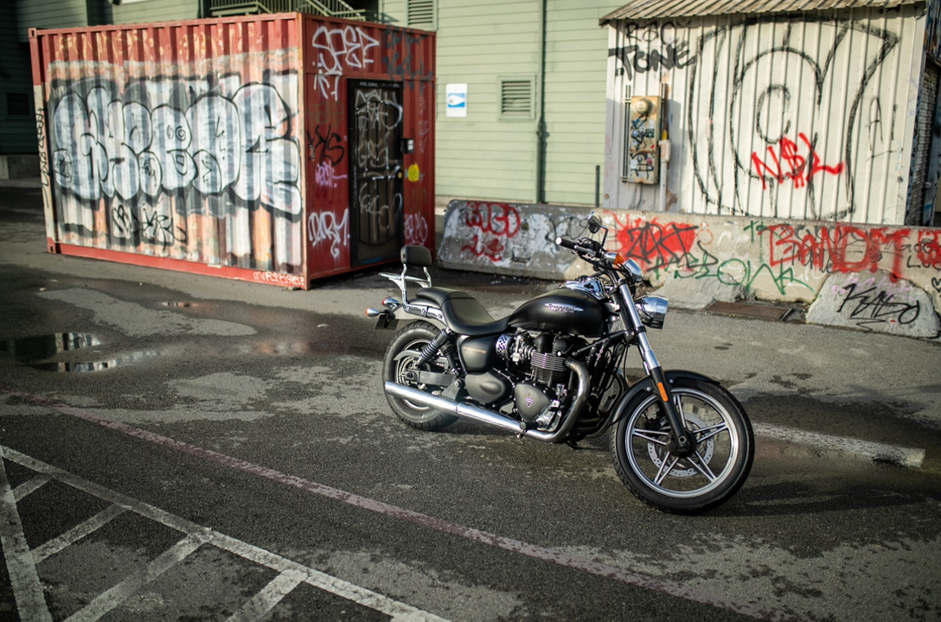
Input Images
Notes:
We’re really interested in the problem of content capture for virtual reality, and today we’re going to talk about our system that, given a new scene, prescribes a set of input views that a user could capture in under a minute with their smartphone camera…resulting in a set of input images like this…then, after less than a minute of processing, we can render photographic-quality novel views of the scene in real time… Our system is also robust, and reliably works across a wide variety of scenes. This image-based rendering problem is called view interpolation or view synthesis, and achieving robust and high-quality results from such sparsely sampled images has traditionally been really challenging.

Slide 48

Output Light Field
Notes:
We’re really interested in the problem of content capture for virtual reality, and today we’re going to talk about our system that, given a new scene, prescribes a set of input views that a user could capture in under a minute with their smartphone camera…resulting in a set of input images like this…then, after less than a minute of processing, we can render photographic-quality novel views of the scene in real time… Our system is also robust, and reliably works across a wide variety of scenes. This image-based rendering problem is called view interpolation or view synthesis, and achieving robust and high-quality results from such sparsely sampled images has traditionally been really challenging.

Slide 49
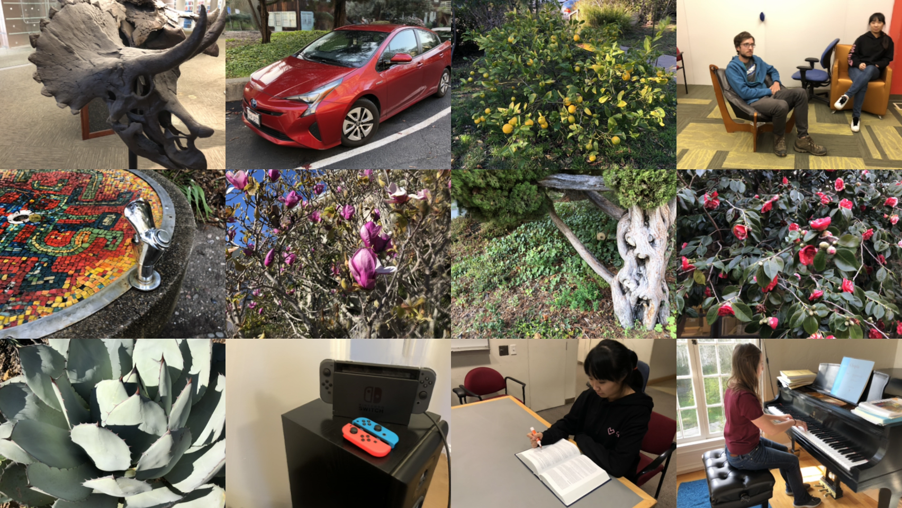
Local Light Field Fusion
Notes:
We’re really interested in the problem of content capture for virtual reality, and today we’re going to talk about our system that, given a new scene, prescribes a set of input views that a user could capture in under a minute with their smartphone camera…resulting in a set of input images like this…then, after less than a minute of processing, we can render photographic-quality novel views of the scene in real time… Our system is also robust, and reliably works across a wide variety of scenes. This image-based rendering problem is called view interpolation or view synthesis, and achieving robust and high-quality results from such sparsely sampled images has traditionally been really challenging.

