Slide 1




Computer Graphics II: Rendering
CSE 168[Spr 20],Lecture 10: Materials and BRDFs Ravi Ramamoorthi
http://viscomp.ucsd.edu/classes/cse168/sp20

Slide 2
To Do
Start working on homework 3. Ask me if problems
Also homework 4. Have covered material
Start thinking about final project
Some slides courtesy Steve Rotenberg and Pat Hanrahan

Slide 3
Materials and BRDFs
Key part of renderer: different materials/BRDFs
Abstract BRDF/Material interface (for MIS)
  Evaluate (for given incident, outgoing direction)
  Sample (given outgoing, importance sample incident)
  PDF (for MIS, evaluate sampling PDF arbitrary direction)
  Also for value of sample, need to compute eval/PDF (sometimes can simplify this, new value function=eval/PDF)
Any physical or non-physical BRDF must fit above
  Evaluation is usually easy (BRDF formula)
  Can encompass analytic formulae, table measurements
  Sampling can be hard and is crucial (see my 2004 paper for general importance sampling, special cases for some)
  PDF function can be non-trivial, make sure math correct

Slide 4
Diffuse Surfaces
Simplest Case: Lambertian Reflectance
BRDF is simply a constant:
Note energy conservation, divide albedo by π
Note cosine incident term in final evaluation
Evaluate BRDF is straightforward
Sample? Sample hemisphere (or cosine-weight)
PDF is or (if cosine-weight)
Value/weight with cosine sampling is simply

Slide 5
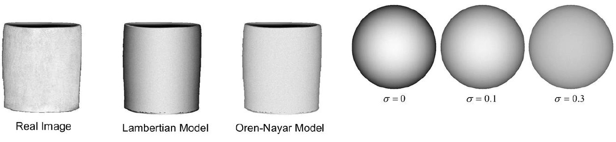
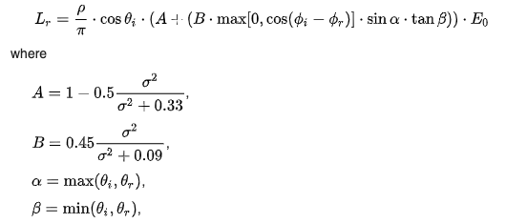
Oren-Nayar Model
Generalization of Lambert’s Reflectance Model (SIGGRAPH 94, rough diffuse [shadows, interreflections])
Importance sampling can be complicated
(but exact sampling is not required)
Simplest: Lambertian sampling/PDF
But Eval uses Oren-Nayar; Eval/PDF
(will cancel leading Lambertian term only)
From Wikipedia

Slide 6
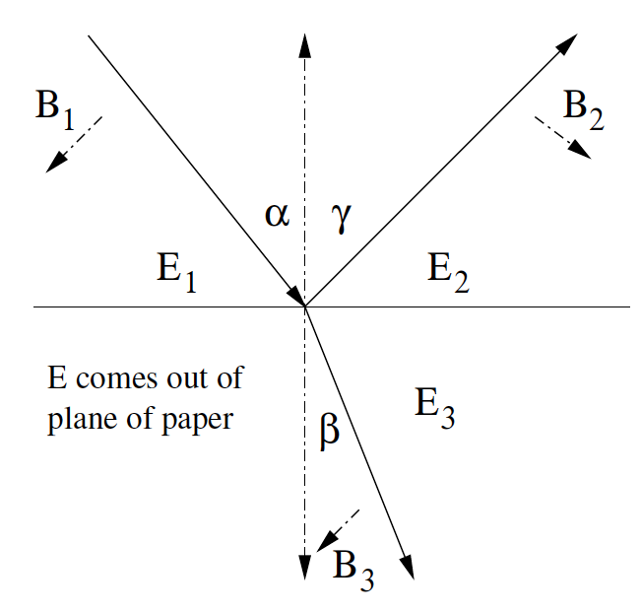
Fresnel Surfaces
Idealized Fresnel surfaces are perfectly smooth boundary between dielectric (air,glass,water) and another dielectric, or a dielectric and a metal
Beam splits into reflected/refracted (Snell’s law)

Slide 7
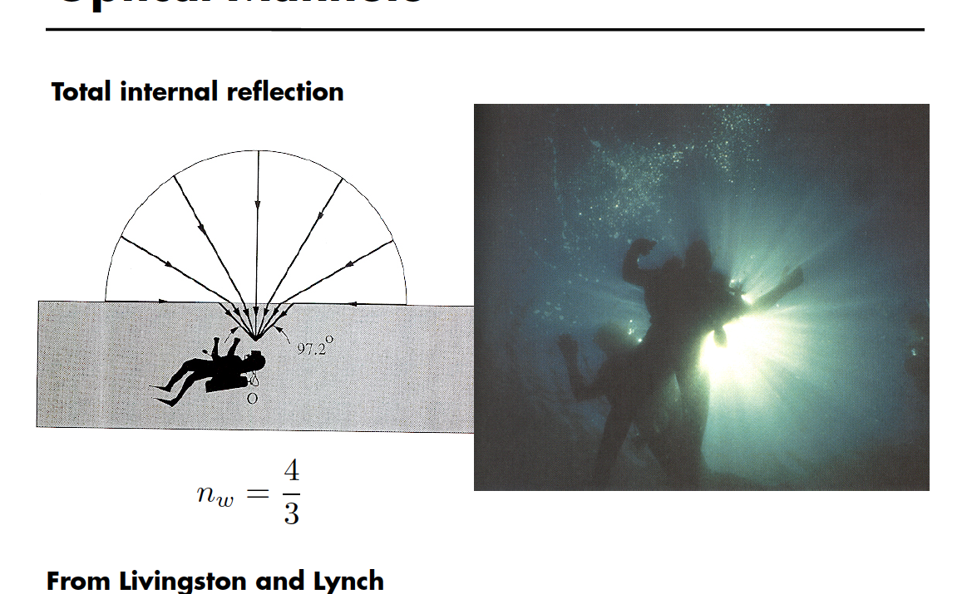
Optical Manhole

Slide 8
Fresnel Surfaces
Idealized Fresnel surfaces are perfectly smooth boundary between dielectric (air,glass,water) and another dielectric, or a dielectric and a metal
Beam splits into reflected/refracted (Snell’s law)

Slide 9
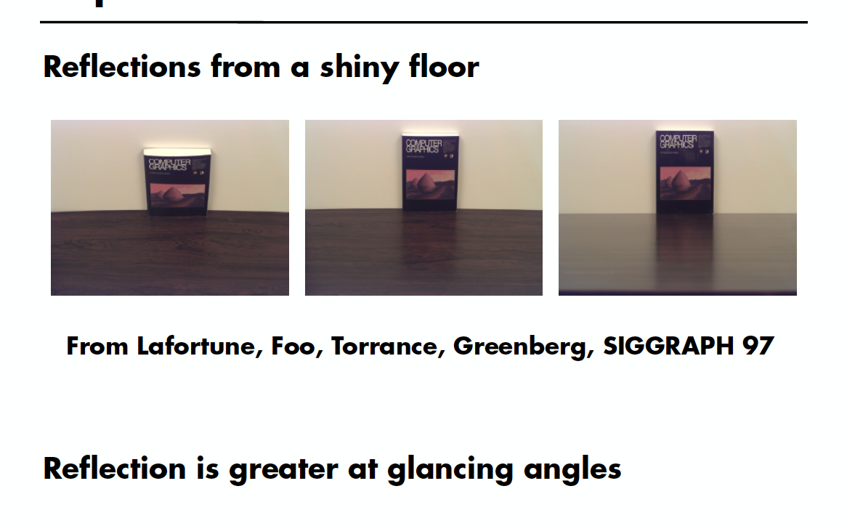
Experiment

Slide 10
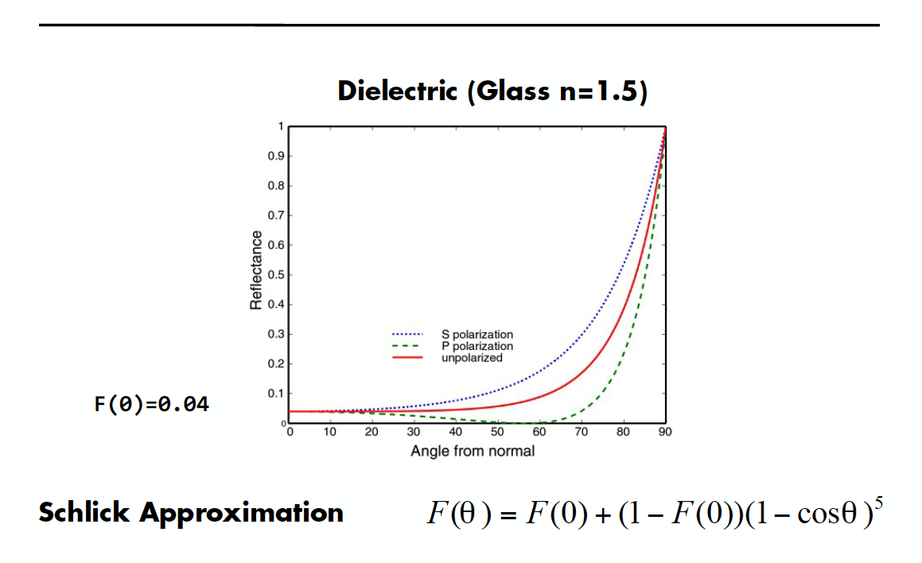
Fresnel Reflectance

Slide 11
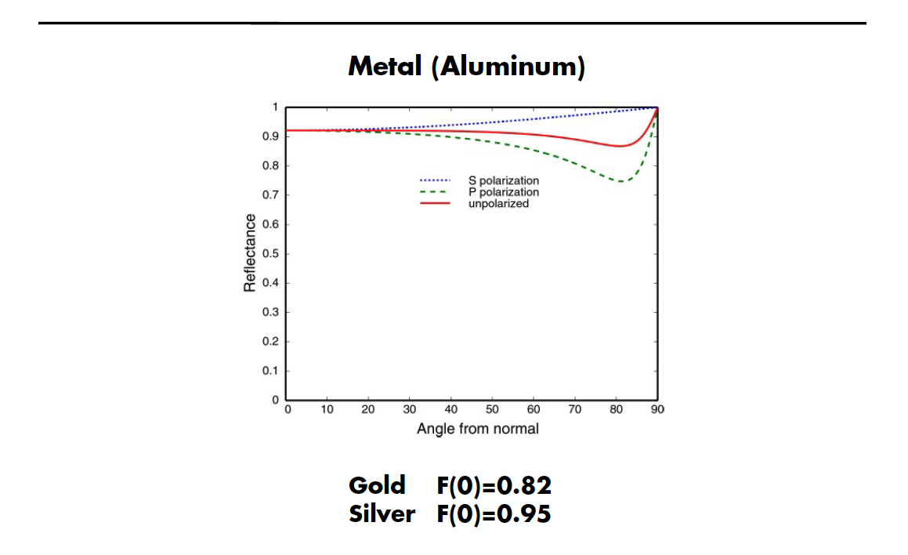
Fresnel Reflectance

Slide 12

Reflection from Metals

Slide 13
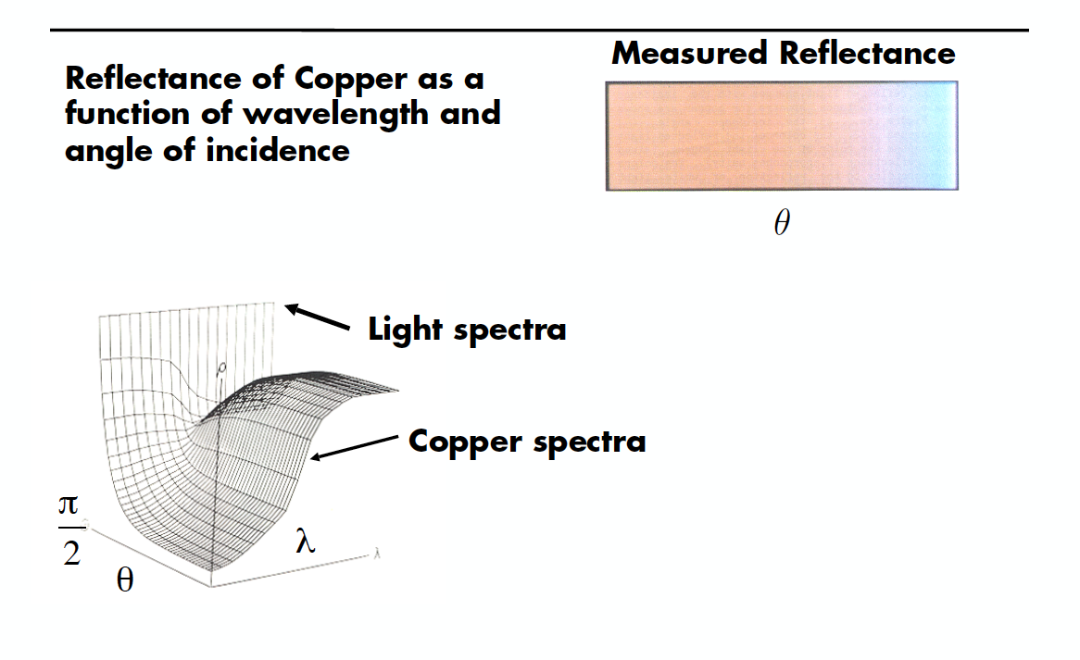
Cook-Torrance Reflection

Slide 14
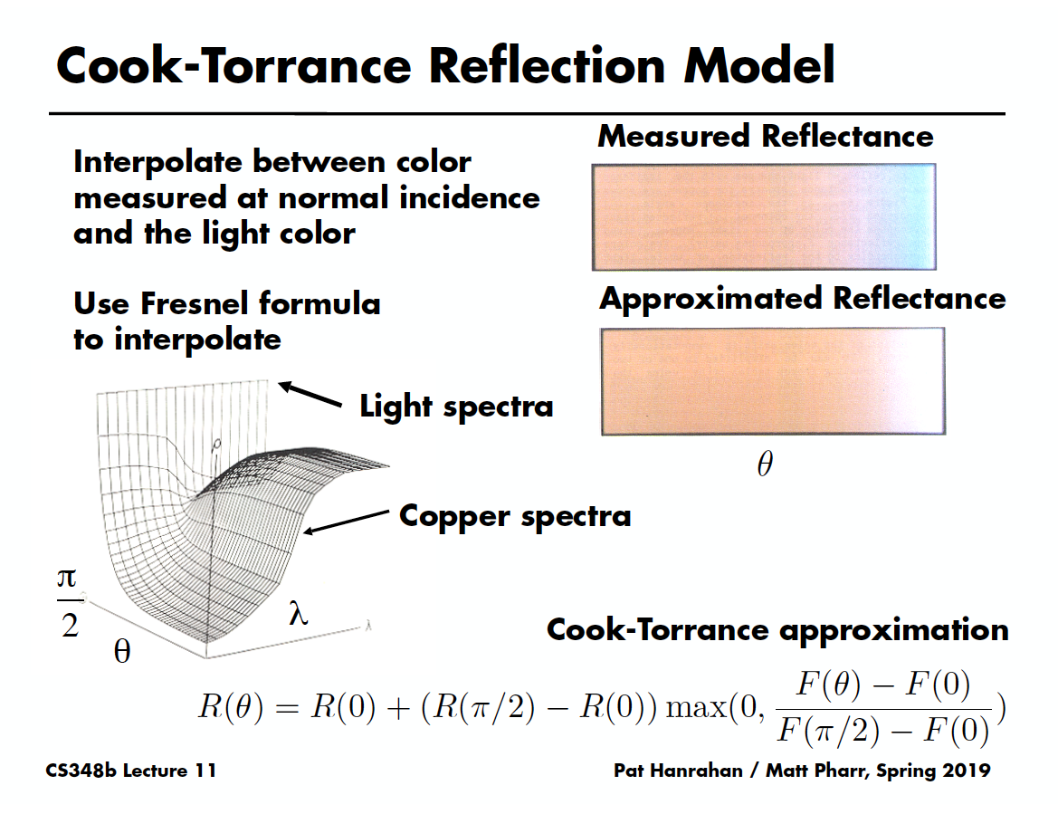
Cook-Torrance Reflection

Slide 15
(Cook-)Torrance-Sparrow
Assume the surface is made up grooves at the microscopic level. (General Microfacet Theory)
Assume the faces of these grooves (called microfacets) are perfect reflectors.
Take into account 3 phenomena
Shadowing
Masking
Interreflection

Slide 16
(Cook-)Torrance-Sparrow
Fresnel term:
allows for wavelength dependency
Geometric Attenuation:
reduces the output based on the amount of shadowing or masking that occurs.
Distribution:
distribution function determines what percentage of microfacets are oriented to reflect in the viewer direction.
How much of the macroscopic surface is visible to the light source
How much of the macroscopic surface is visible to the viewer

Slide 17
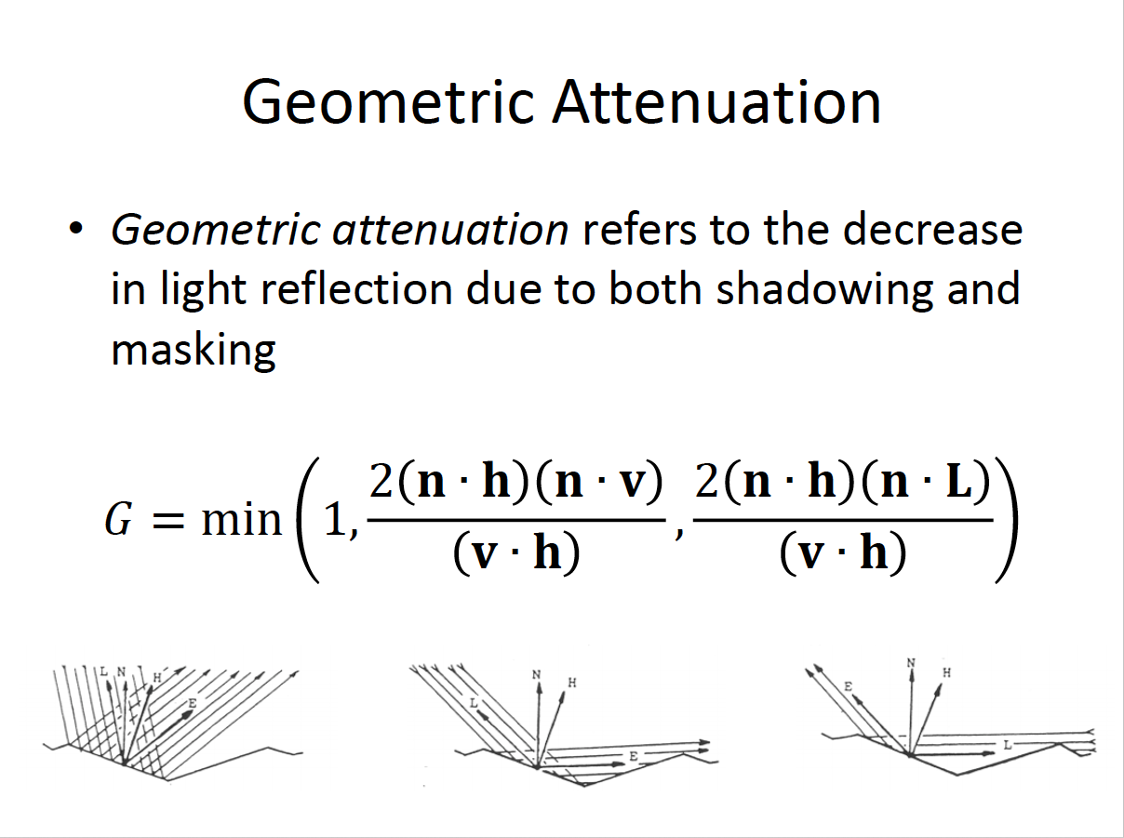

Slide 18
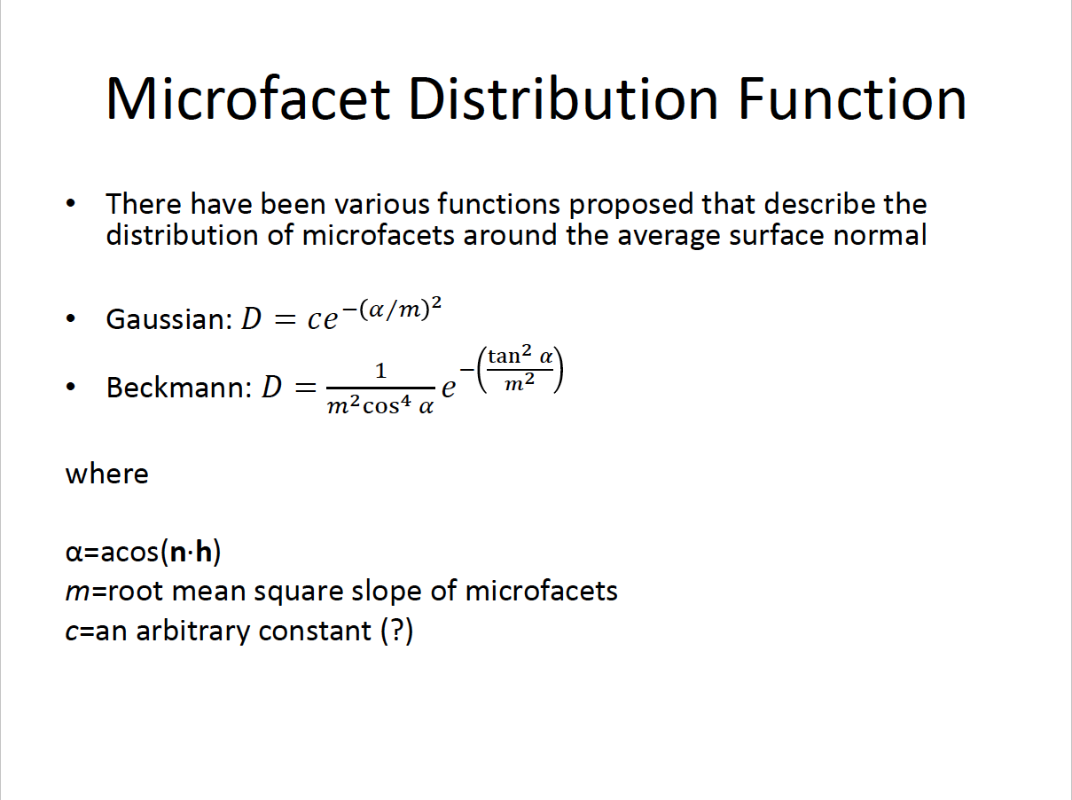

Slide 19
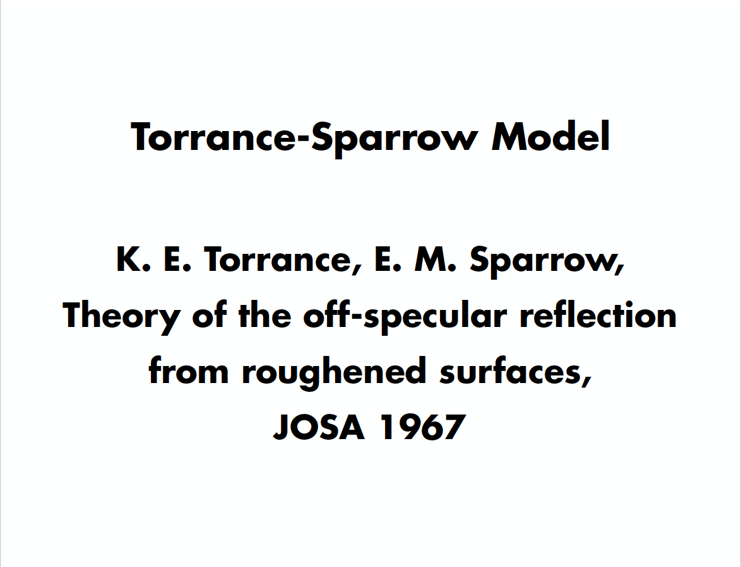

Slide 20
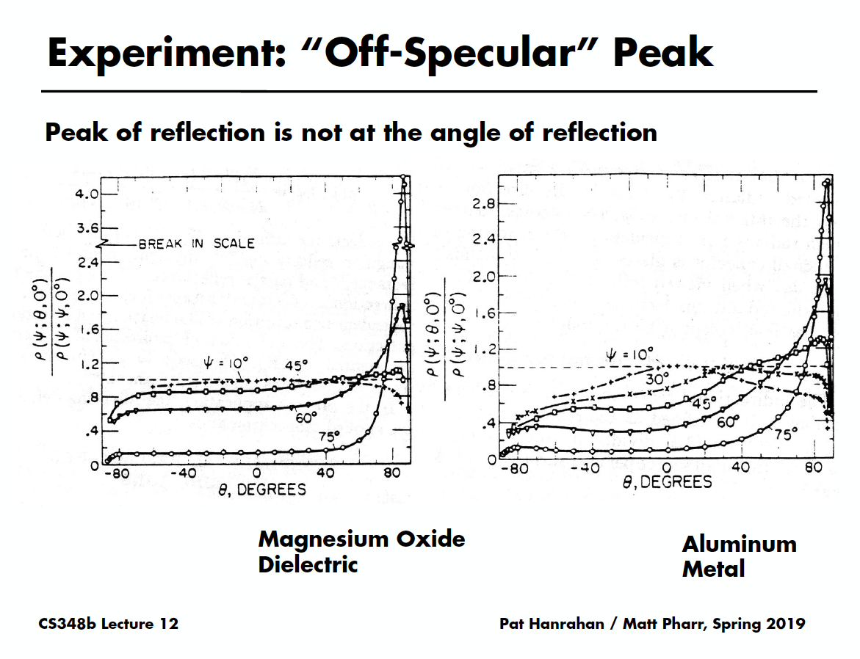

Slide 21
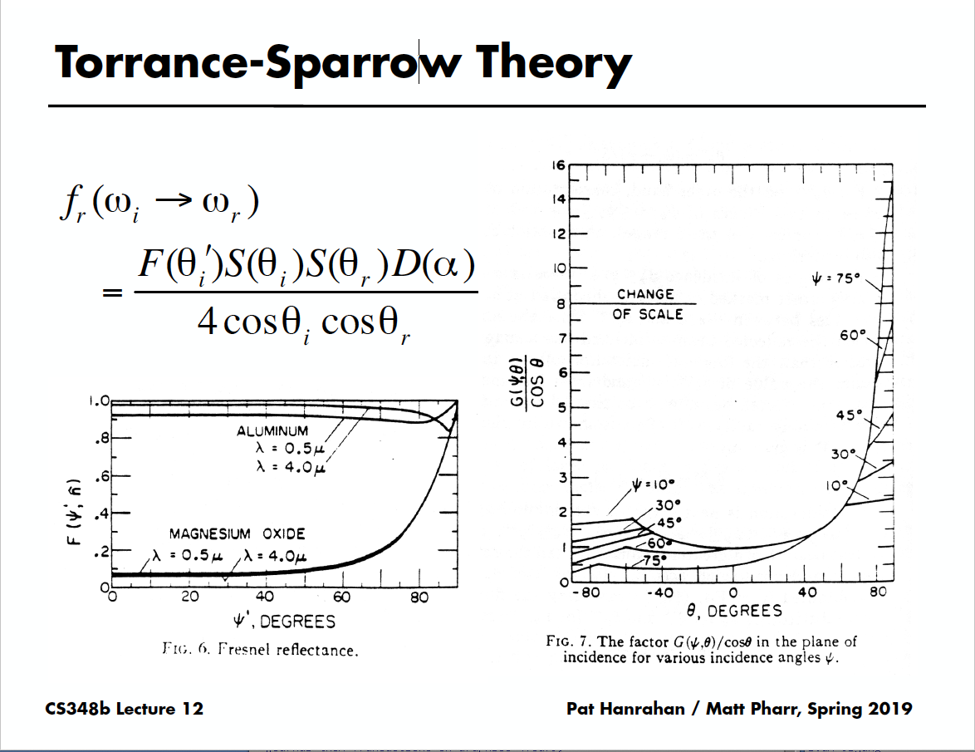

Slide 22
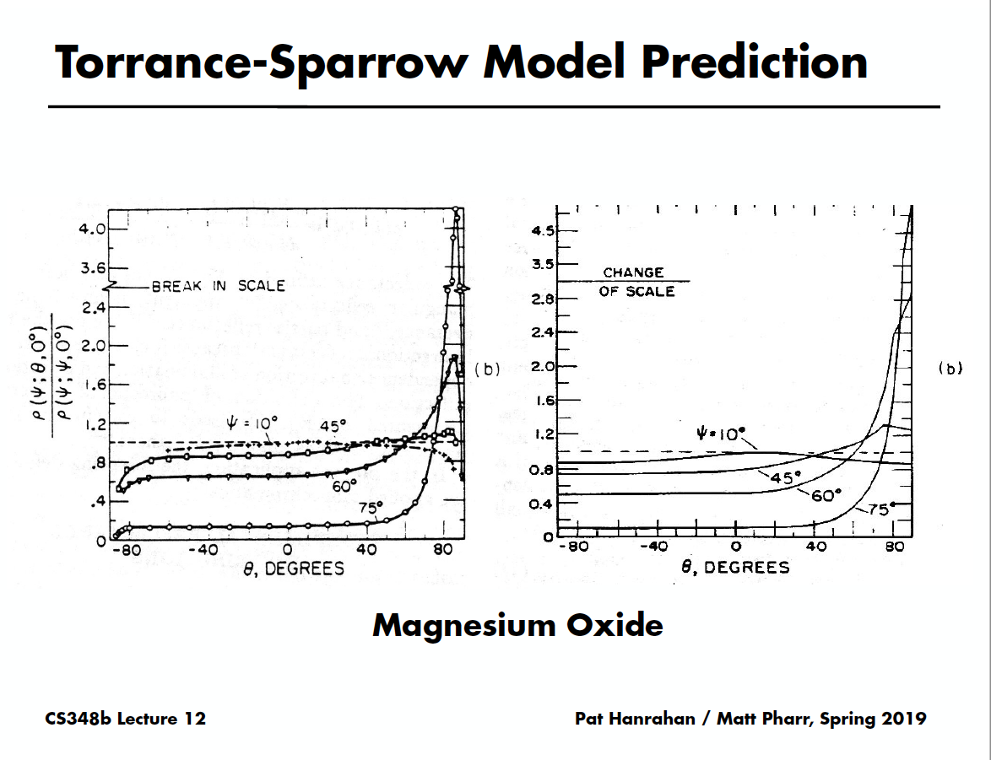

Slide 23
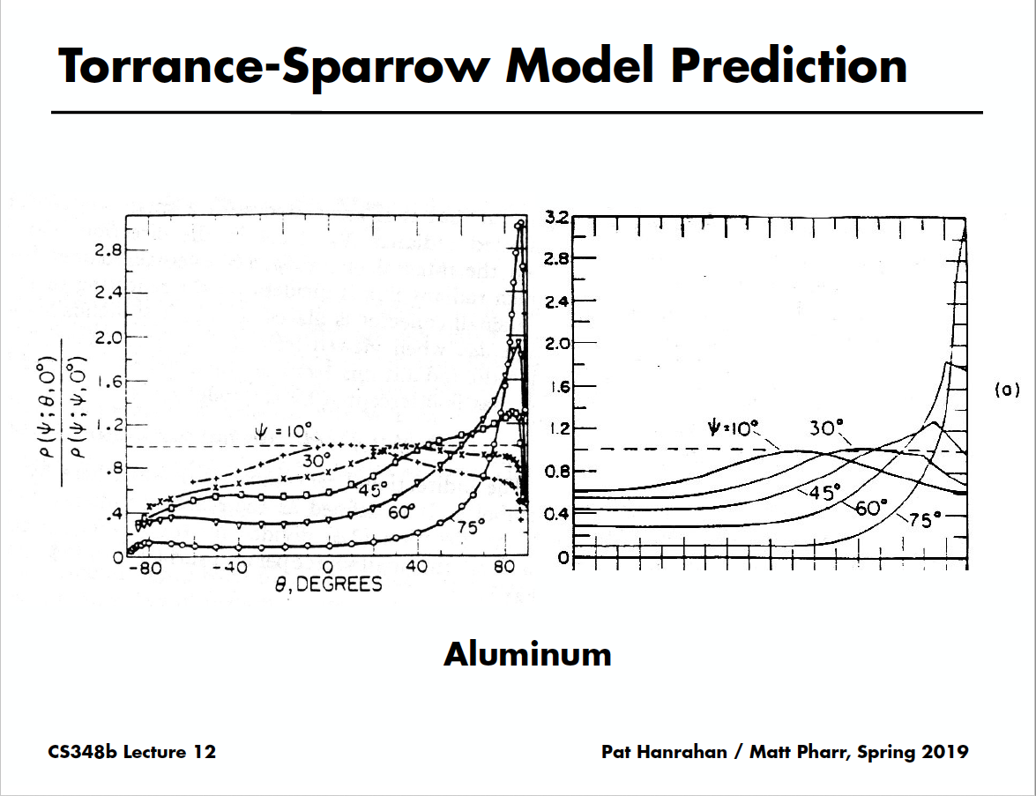

Slide 24
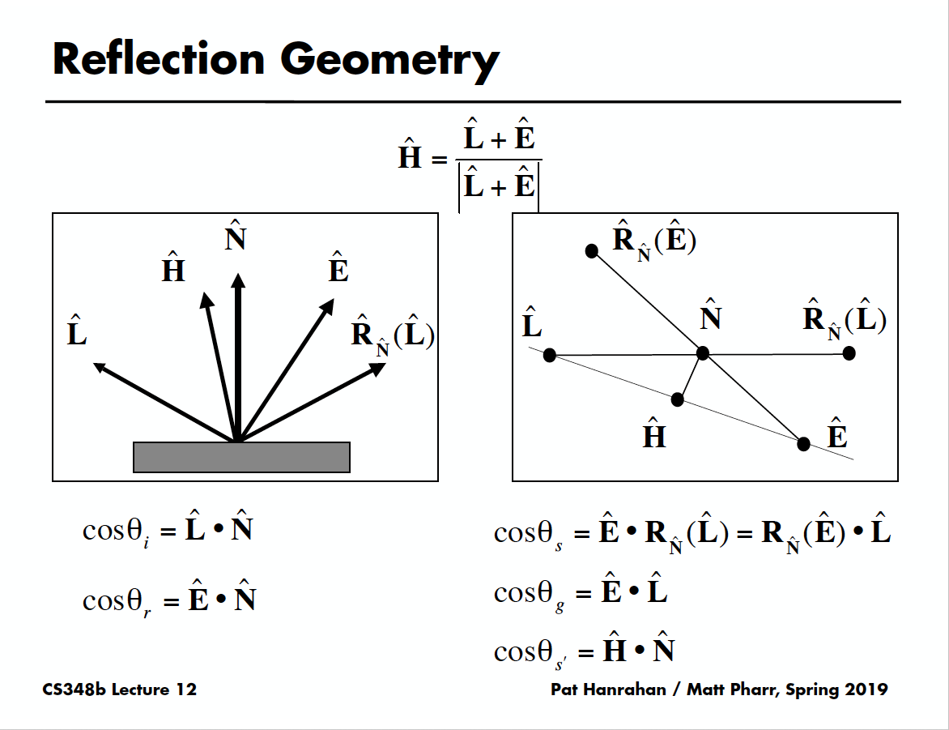

Slide 25
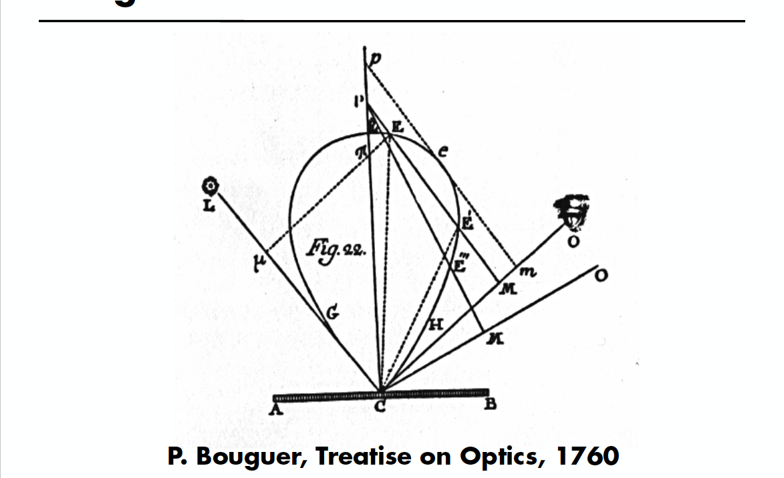
Microfacet BRDFs (“Little Faces”)

Slide 26
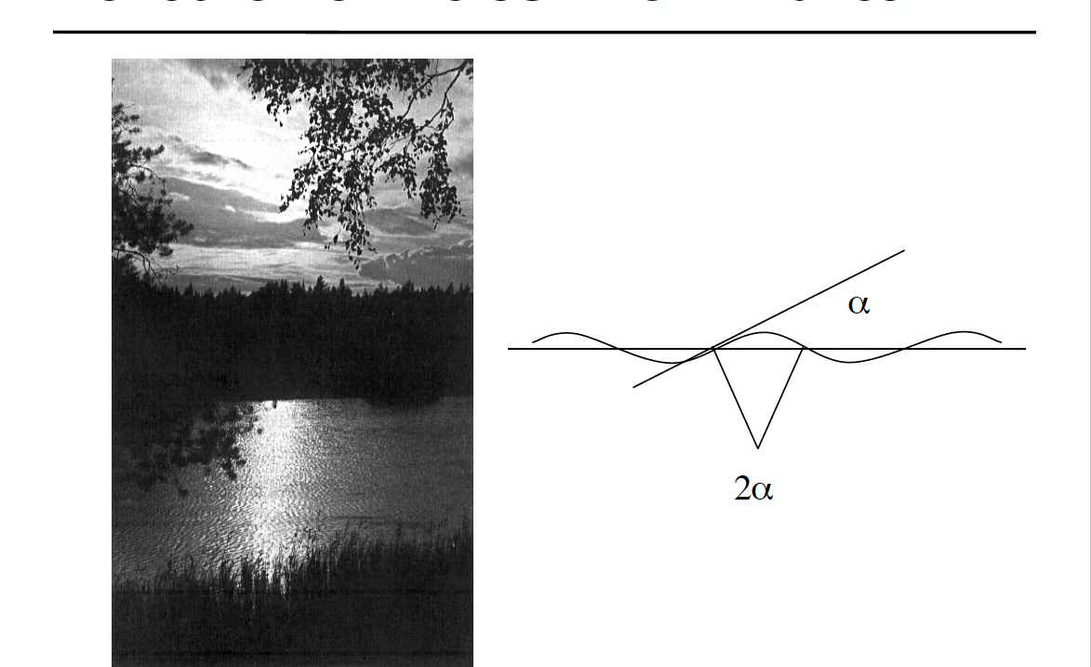
Reflection of the Sun from Waves

Slide 27
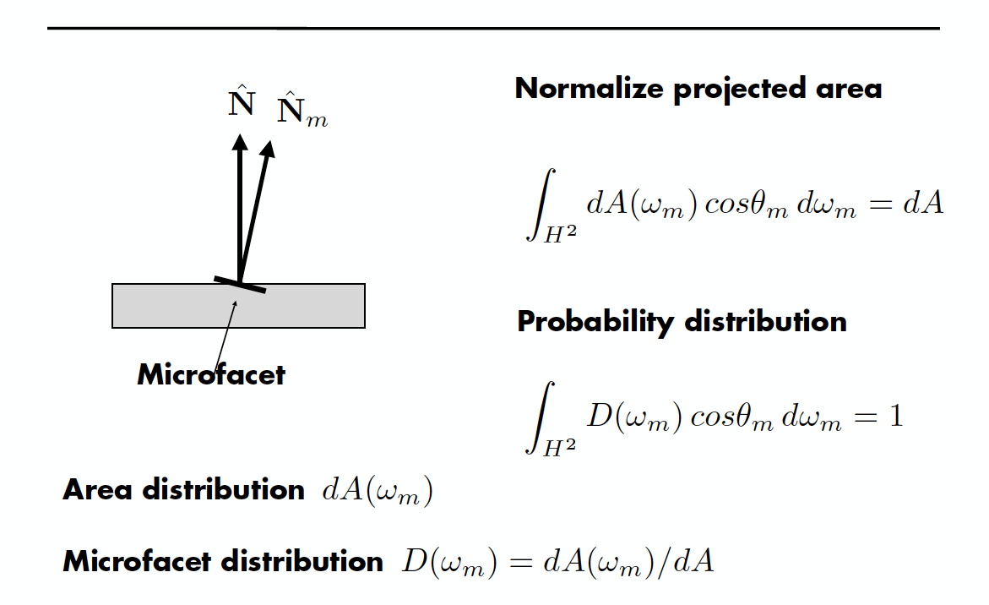
Microfacet Distributions

Slide 28
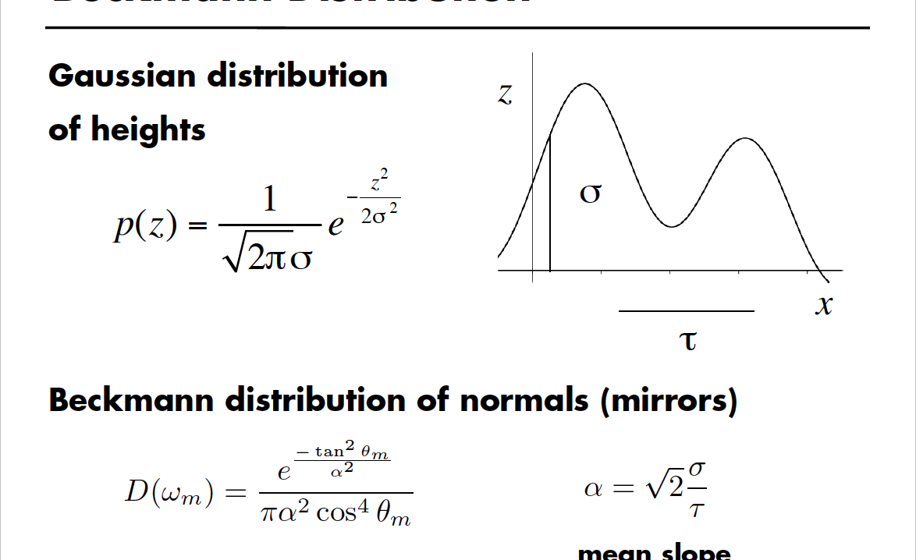
Beckmann Distribution

Slide 29
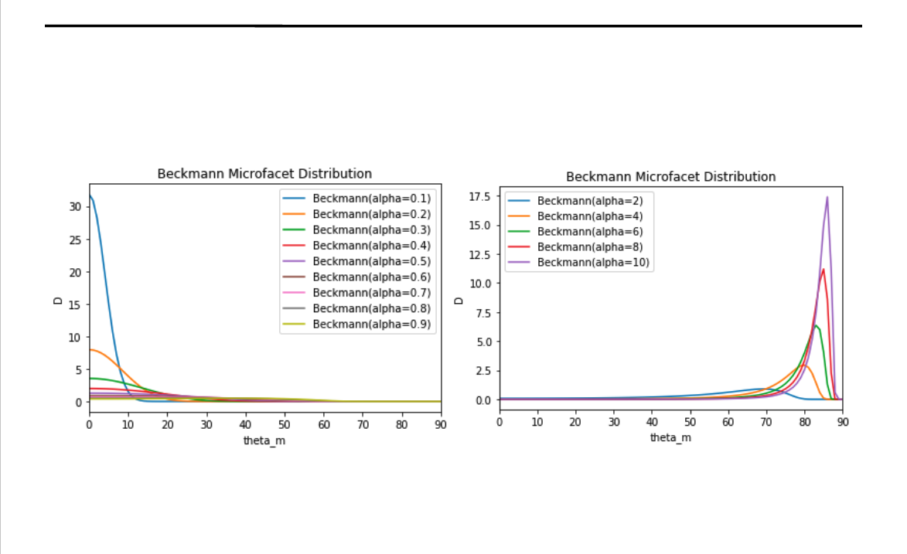
Beckmann Distribution

Slide 30
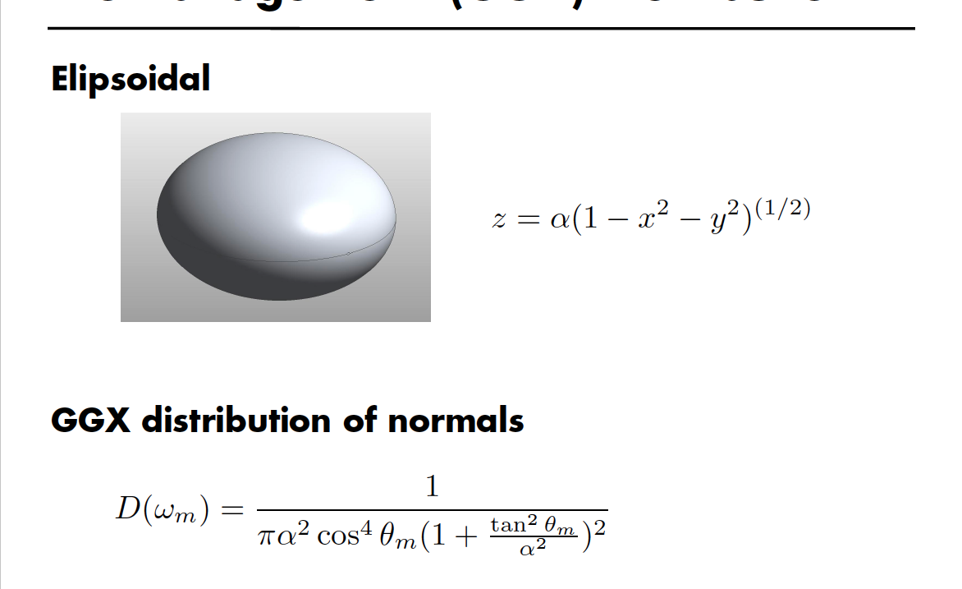
Trowbridge-Reitz (GGX) Distribution

Slide 31
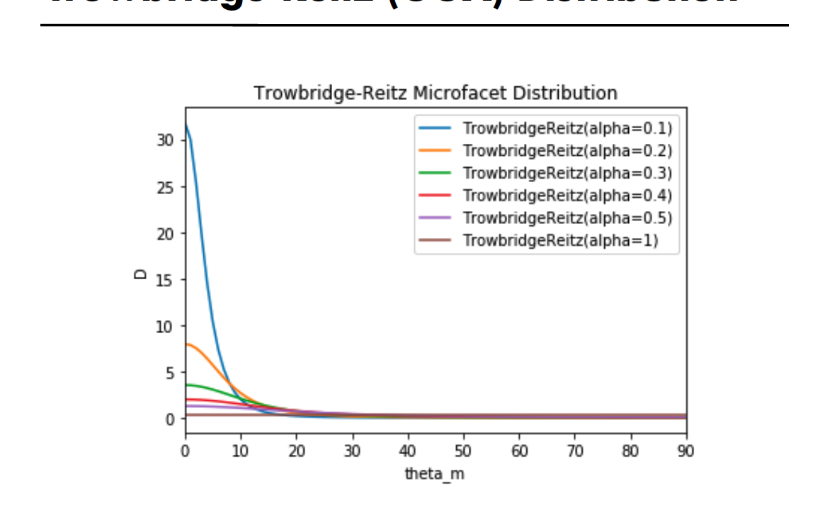
Trowbridge-Reitz (GGX) Distribution

Slide 32
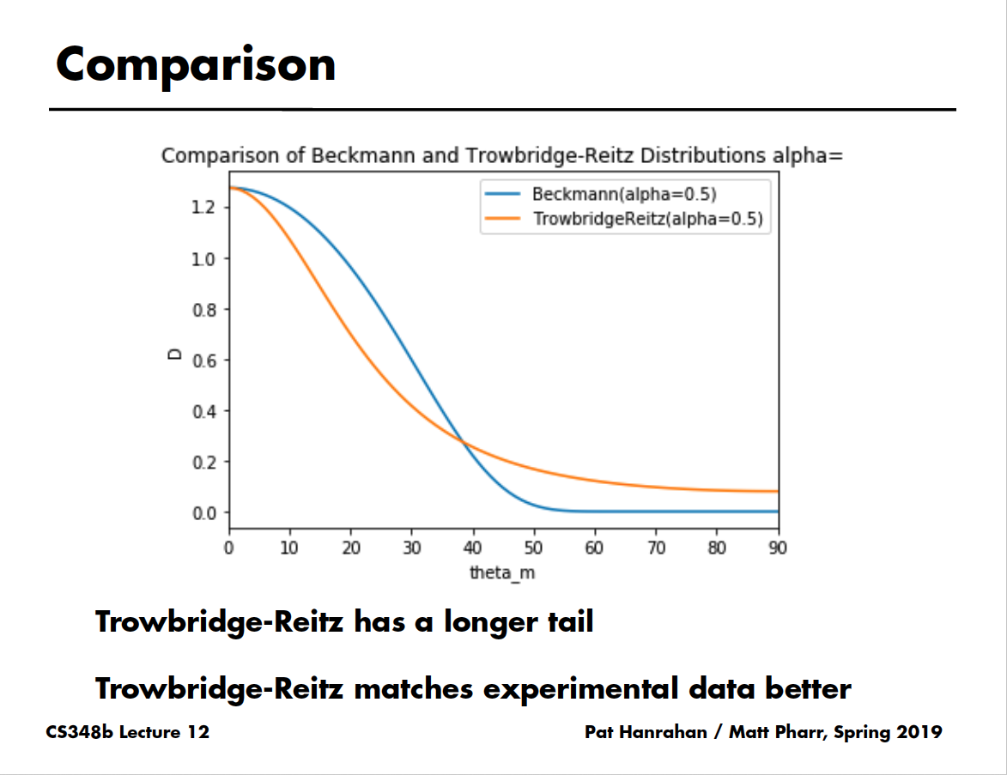

Slide 33
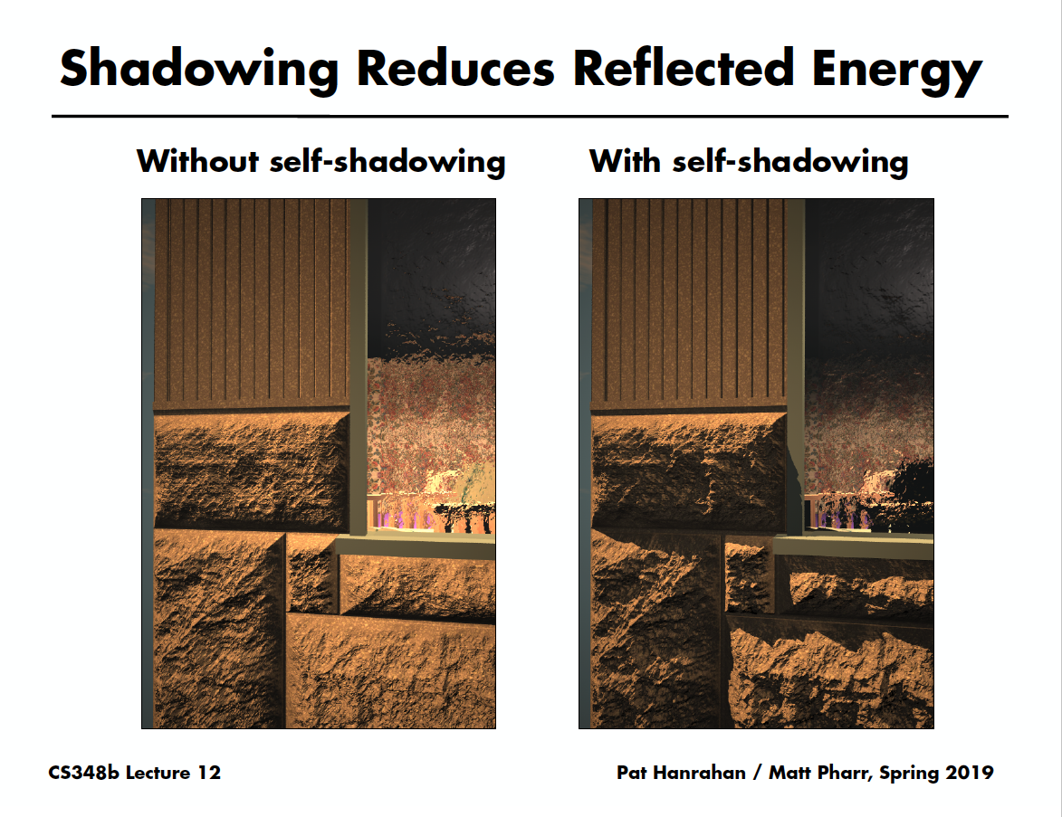

Slide 34
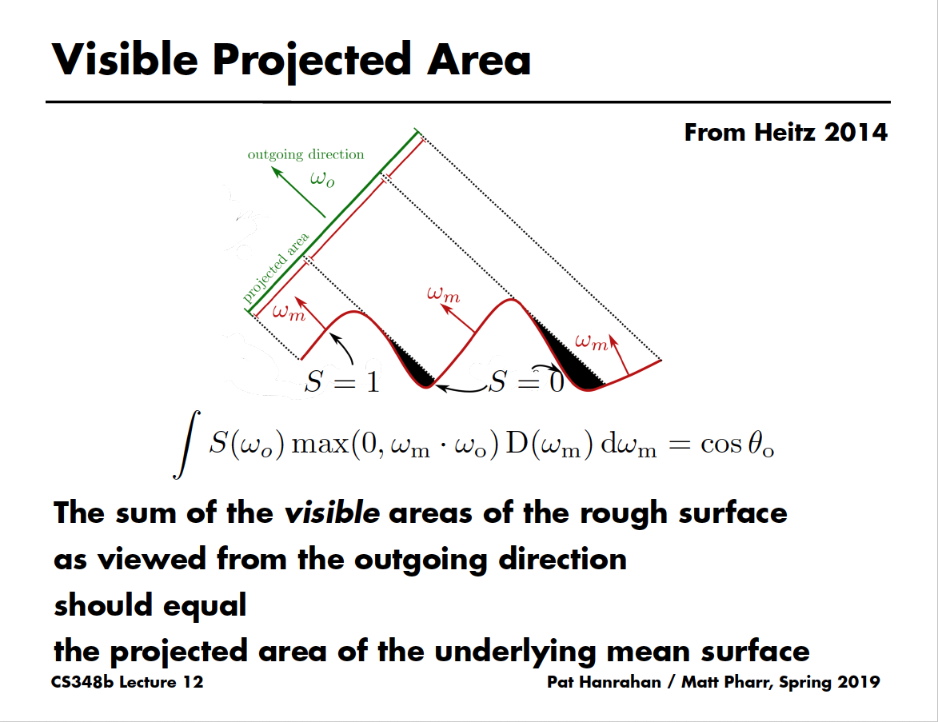

Slide 35
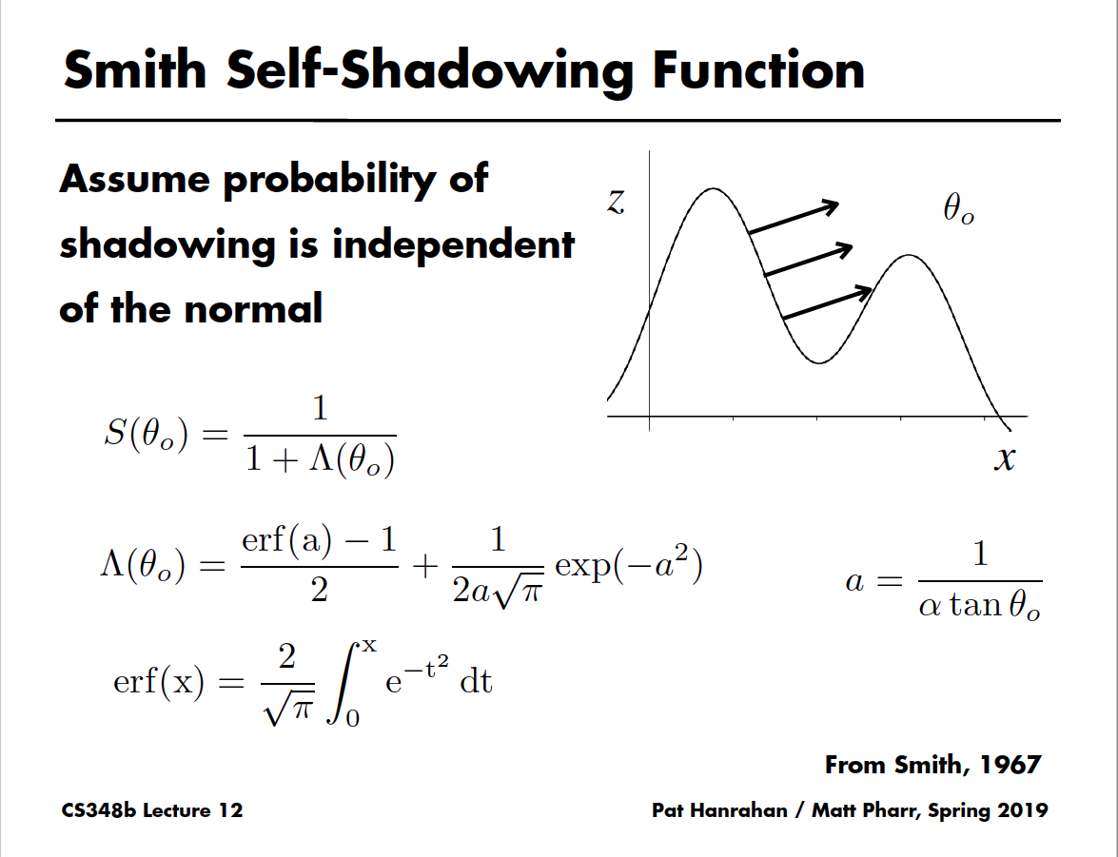

Slide 36
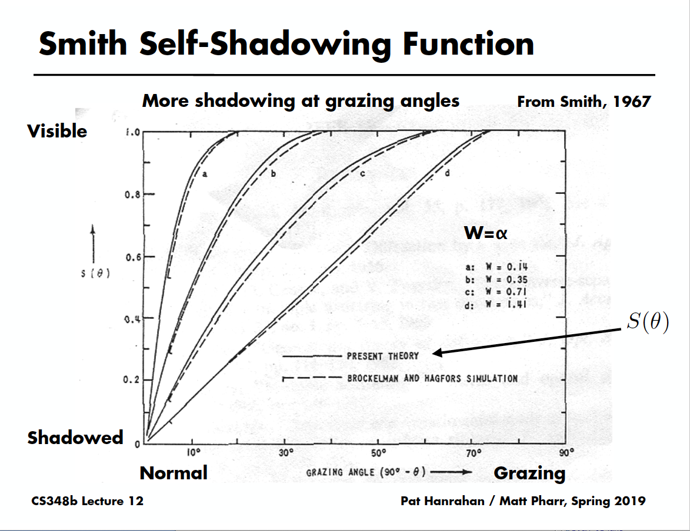

Slide 37
BRDF Sampling
Have dealt with BRDF evaluation, need importance sampling and PDF functions for MIS
In 2004, no good importance sampling schemes for most BRDFs, including common Torrance-Sparrow
From Lawrence et al. 04, factor BRDF into data-driven terms that can each be importance sampled
Now some form of light/BRDF sampling common in production (standard in RenderMan 16, 2011-)

Slide 38
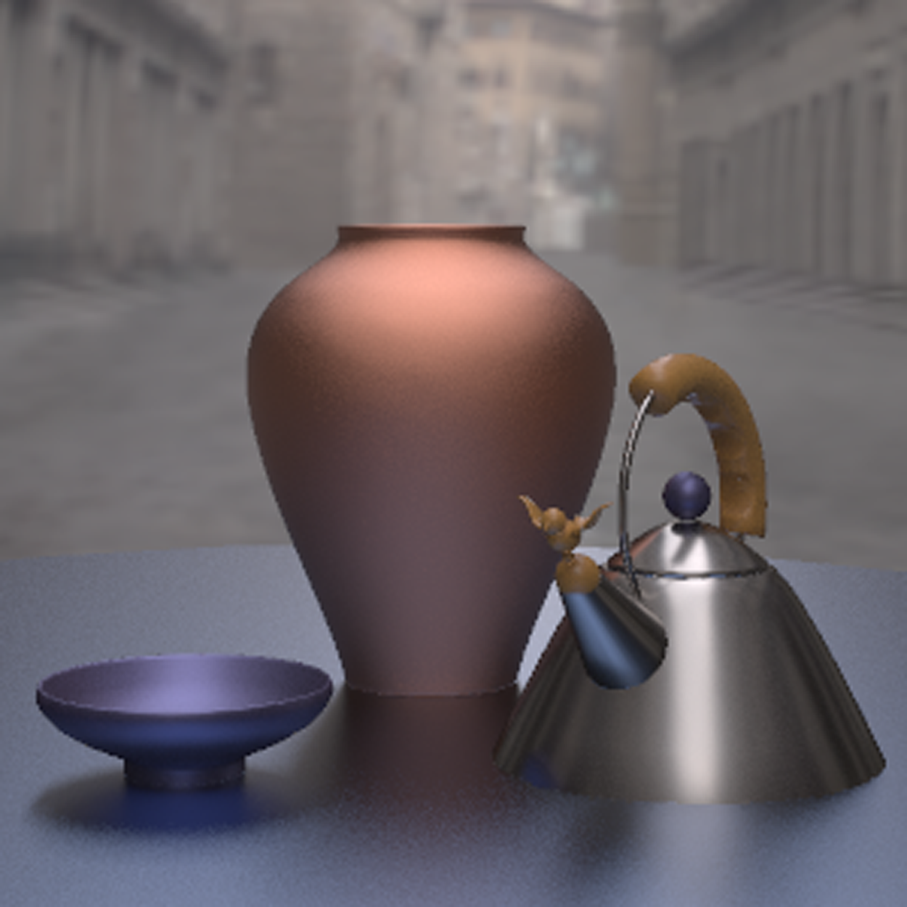
Motivation
Measured Plastic
Cook-Torrance
Measured Nickel
Measured Metallic-Blue
Notes:
So far, however, the state of the art has made it difficult to use these complex BRDFs in standard global illumination algorithms. For example, we would like to render a scene with several different measured and complex-analytic BRDFs using Monte Carlo path tracing, but there are no good techniques for importance sampling these BRDFs.
so far state of the art has made it difficult to use these complex BRDFs in global illumination algorithms where the norm is still
using simple BRDFs like the Phong that can be directly sampled.

Slide 39
Key Idea
Project 4D BRDF into sum of products of 2D function dependent on and
2D function dependent on :
depends only on the incoming direction and
some re-parameterization of the hemisphere.
Notes:
Needs animation to promote description of this key contribution…

Slide 40
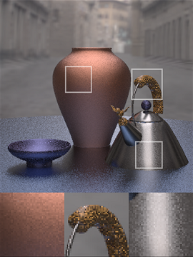
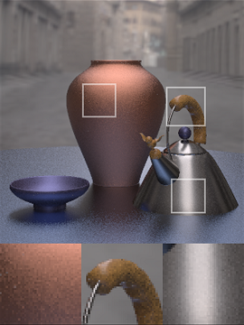
300 Samples/Pixel
Sampling Lafortune Fit
Our Method

