Slide 1
Computer Graphics
CSE 167 [Win 24], Lecture 9: Curves 1
Ravi Ramamoorthi
http://viscomp.ucsd.edu/classes/cse167/wi24

Slide 2
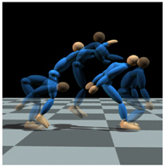
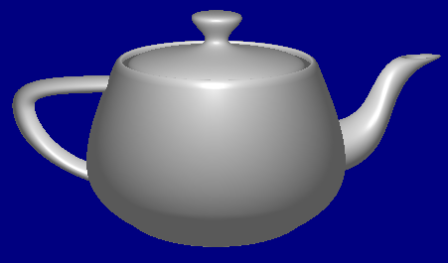
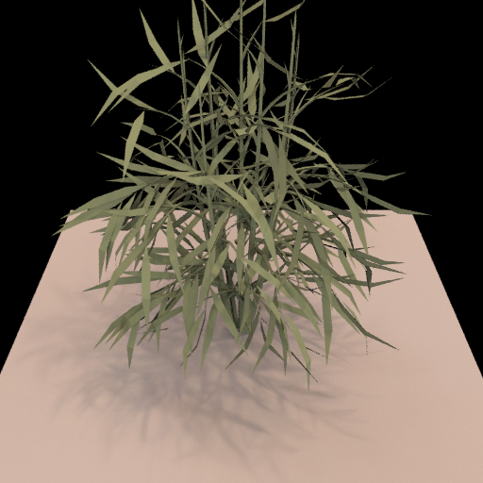
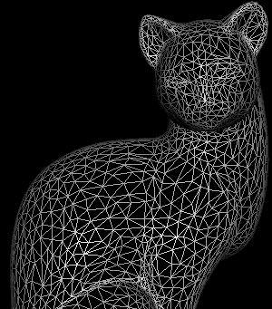
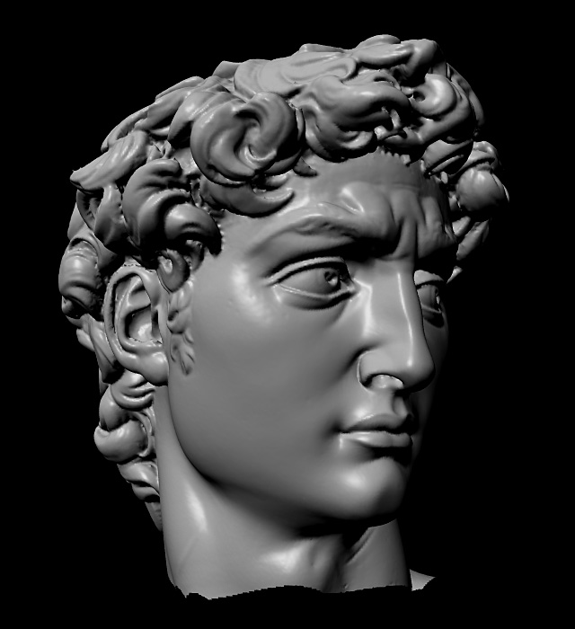
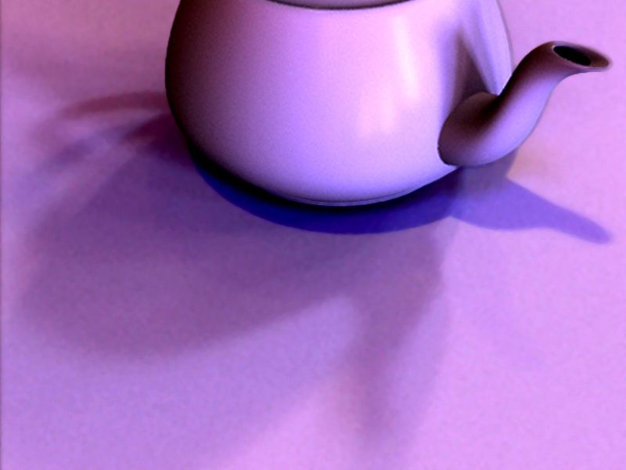
Course Outline
3D Graphics Pipeline
Modeling
Animation
Rendering

Slide 3
Graphics Pipeline
In HW 1, HW 2, draw, shade objects
But how to define geometry of objects?
How to define, edit shape of teapot?
We discuss modeling with spline curves
  Demo of HW 3 solution
Homework submission (Feb 28)
  After midterm, but please start on it before
  Not on UCSD Online, link
  See piazza for password (and code grade only)

Slide 4
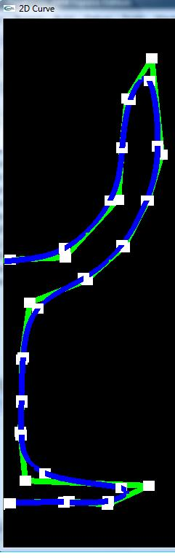
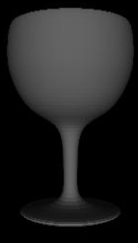
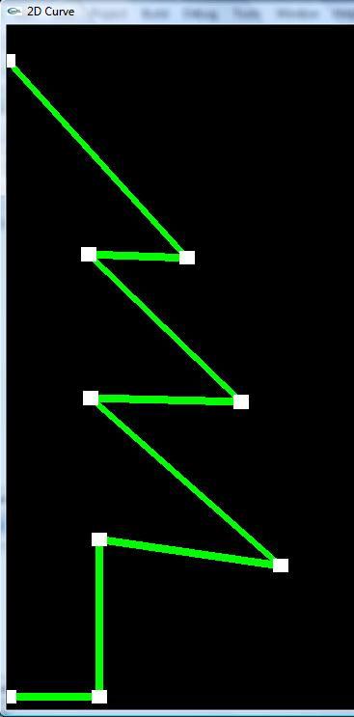
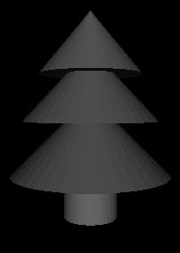
Curves for Modeling
Rachel Shiner, Final Project Spring 2010

Slide 5
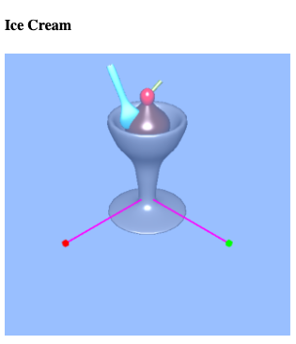
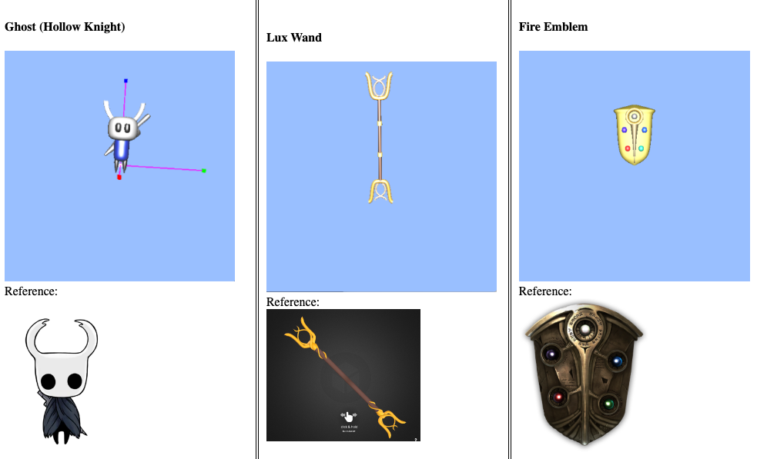

Curves for Modeling
James Zhao, HW 3 Extra Credit Winter 2023

Slide 6
Motivation
How do we model complex shapes?
  In this course, only 2D curves, but can be used to create interesting 3D shapes by surface of revolution, lofting etc
Techniques known as spline curves
This unit is about mathematics required to draw these spline curves, as in HW 3
History: From using computer modeling to define car bodies in auto-manufacturing. Pioneers are Pierre Bezier (Renault), de Casteljau (Citroen)

Slide 7
Splines Video
https://www.youtube.com/watch?v=YMl25iCCRew&list=PLWfDJ5nla8UpwShx-lzLJqcp575fKpsSO&index=13
Steve Seitz UW 5 minute videos (only first 2.5min)
Can watch other splines videos on channel, but don’t match the math as taught in this class.

Slide 8
Outline of Unit
Bezier curves
deCasteljau algorithm, explicit form, matrix form
Polar form labeling (next time)
B-spline curves (next time)
Not well covered in textbooks (especially as taught here). Main reference will be lecture notes. If you do want a printed ref, handouts from CAGD, Seidel

Slide 9
Bezier Curve (with HW3 demo)
Motivation: Draw a smooth intuitive curve (or surface) given few key user-specified control points
Demo HW 3
Control points (all that user specifies, edits)
Control
polygon
Smooth Bezier curve
(drawn automatically)

Slide 10
Bezier Curve: (Desirable) properties
Interpolates, is tangent to end points
Curve within convex hull of control polygon
Control points (all that user specifies, edits)
Control
polygon
Smooth Bezier curve
(drawn automatically)

Slide 11
Survey
Anonymous, know how things are going
Will try to use it to improve course

Slide 12
Issues for Bezier Curves
Main question: Given control points and constraints (interpolation, tangent), how to construct curve?
Algorithmic: deCasteljau algorithm
Explicit: Bernstein-Bezier polynomial basis
4x4 matrix for cubics
Properties: Advantages and Disadvantages

Slide 13
deCasteljau: Linear Bezier Curve
Just a simple linear combination or interpolation (easy to code up, very numerically stable)
P1
F(1)
Linear (Degree 1, Order 2)
F(0) = P0, F(1) = P1
F(u) = ?
F(u)
P0
P0
P1
F(0)
1-u
u
F(u) = (1-u) P0 + u P1

Slide 14
deCasteljau: Quadratic Bezier Curve
P1
Quadratic
Degree 2, Order 3
F(0) = P0, F(1) = P2
F(u) = ?
P0
P2
P0
P1
P2
1-u
u
1-u
u
1-u
u
F(u) = (1-u)² P0 + 2u(1-u) P1 + u² P2

Slide 15
Geometric interpretation: Quadratic
u
1-u
u
1-u
u

Slide 16
Geometric Interpretation: Cubic
u
u
u
u
u
u

Slide 17
deCasteljau: Cubic Bezier Curve
P1
P2
Cubic
Degree 3, Order 4
F(0) = P0, F(1) = P3
P0
P3
P0
P1
P2
P3
1-u
u
1-u
u
1-u
u
1-u
u
1-u
u
1-u
u
F(u) = (1-u)³ P0 +3u(1-u)² P1
+3u²(1-u) P2 + u³ P3

Slide 18
Summary: deCasteljau Algorithm
P1
P1
P1
P2
P0
P0
P2
P3
P0
Linear
Degree 1, Order 2
F(0) = P0, F(1) = P1
Quadratic
Degree 2, Order 3
F(0) = P0, F(1) = P2
Cubic
Degree 3, Order 4
F(0) = P0, F(1) = P3
P0
P1
P2
P0
P1
P2
P3
P0
P1
1-u
u
1-u
u
u
1-u
u
1-u
u
1-u
1-u
u
1-u
u
1-u
u
1-u
u
F(u) = (1-u) P0 + u P1
F(u) = (1-u)² P0 + 2u(1-u) P1 + u² P2
1-u
u
F(u) = (1-u)³ P0 +3u(1-u)² P1
+3u²(1-u) P2 + u³ P3

Slide 19
DeCasteljau Implementation
Can be optimized to do without auxiliary storage

Slide 20
Summary of HW3 Implementation
Bezier (Bezier2 and Bspline discussed next time)
  Arbitrary degree curve (number of control points)
  Break curve into detail segments. Line segments for these
  Evaluate curve at locations 0, 1/detail, 2/detail, … , 1
  Evaluation done using deCasteljau
Key implementation: deCasteljau for arbitrary degree
  Is anyone confused? About handling arbitrary degree?
Can also use alternative formula if you want
  Explicit Bernstein-Bezier polynomial form (next)
Questions?

Slide 21
Issues for Bezier Curves
Main question: Given control points and constraints (interpolation, tangent), how to construct curve?
Algorithmic: deCasteljau algorithm
Explicit: Bernstein-Bezier polynomial basis
4x4 matrix for cubics
Properties: Advantages and Disadvantages

Slide 22
Recap formulae
Linear combination of basis functions
Explicit form for basis functions? Guess it?

Slide 23
Recap formulae
Linear combination of basis functions
Explicit form for basis functions? Guess it?
Binomial coefficients in [(1-u)+u]^{n}

Slide 24
Summary of Explicit Form

Slide 25
Issues for Bezier Curves
Main question: Given control points and constraints (interpolation, tangent), how to construct curve?
Algorithmic: deCasteljau algorithm
Explicit: Bernstein-Bezier polynomial basis
4x4 matrix for cubics
Properties: Advantages and Disadvantages

Slide 26
Cubic 4x4 Matrix (derive)

Slide 27
Cubic 4x4 Matrix (derive)

Slide 28
Issues for Bezier Curves
Main question: Given control points and constraints (interpolation, tangent), how to construct curve?
Algorithmic: deCasteljau algorithm
Explicit: Bernstein-Bezier polynomial basis
4x4 matrix for cubics
Properties: Advantages and Disadvantages

Slide 29
Properties (brief discussion)
Demo of HW 3
Interpolation: End-points, but approximates others
Single piece, moving one point affects whole curve (no local control as in B-splines later)
Invariant to translations, rotations, scales etc. That is, translating all control points translates entire curve
Easily subdivided into parts for drawing (next lecture): Hence, Bezier curves easiest for drawing

