Slide 1
Computer Graphics
CSE 167 [Win 24], Lecture 19: High Quality Rendering
Ravi Ramamoorthi
http://viscomp.ucsd.edu/classes/cse167/wi24

Slide 2
Summary
Good luck on HW 4, written assignment
Please consider CSE 168 (Rendering) in spring

Slide 3
Monte Carlo Path Tracing
General solution to rendering and global illumination
Suitable for a variety of general scenes
Based on Monte Carlo methods
Enumerate all paths of light transport
Long history, traces back to rendering eqn Kajiya 86
(More advanced topic: Slides from CSE 168/274)
Increasingly, basis for production rendering
Path tracing today real-time in hardware (for example, using NVIDIA’s Optix, Turing, Ada RTX)

Slide 4
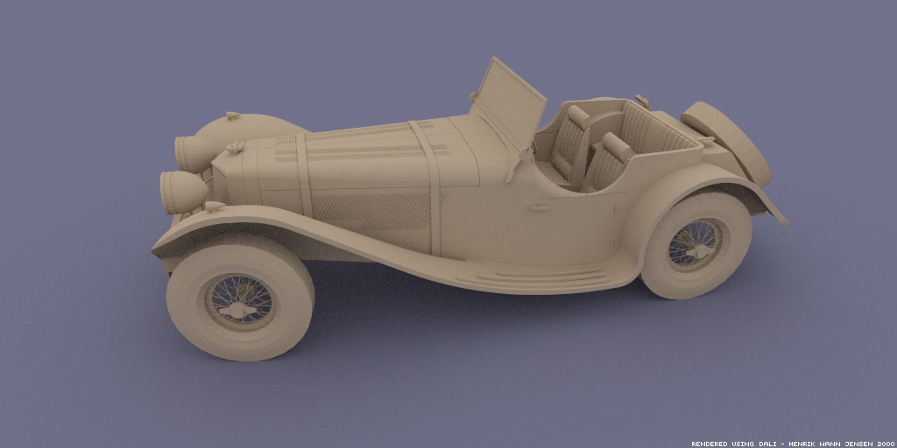
Monte Carlo Path Tracing
Big diffuse light source, 20 minutes
Jensen

Slide 5
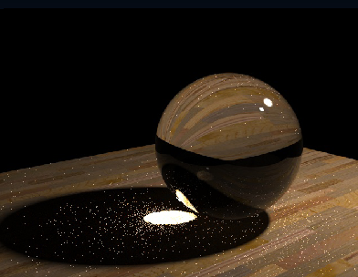
Monte Carlo Path Tracing
1000 paths/pixel
Jensen

Slide 6
Monte Carlo Path Tracing
Advantages
  Any type of geometry (procedural, curved, ...)
  Any type of BRDF or reflectance (specular, glossy, diffuse, ...)
  Samples all types of paths (L(SD)*E)
  Accuracy controlled at pixel level
  Low memory consumption
  Unbiased - error appears as noise in final image
Disadvantages (standard Monte Carlo problems)
  Slow convergence (square root of number of samples)
  Noise in final image

Slide 7
Monte Carlo Path Tracing
Integrate radiance
for each pixel
by sampling paths
randomly
Specular
Surface
Light
Eye
Pixel
x
Diffuse Surface

Slide 8
Simplest Monte Carlo Path Tracer
For each pixel, cast n samples and average
  Choose a ray with p=camera, d=(θ,ϕ ) within pixel
  Pixel color += (1/n) * TracePath(p, d)
TracePath(p, d) returns (r,g,b) [and calls itself recursively]:
  Trace ray (p, d) to find nearest intersection p’
  Select with probability (say) 50%:
    Emitted:
    return 2 * (Le_{red}, Le_{green}, Le_{blue}) // 2 = 1/(50%)
    Reflected:
    generate ray in random direction d’
    return 2 * f_{r}(d ➔d’) * (n•d’) * TracePath(p’, d’)

Slide 9
Simplest Monte Carlo Path Tracer
For each pixel, cast n samples and average over paths
  Choose a ray with p=camera, d=(θ,ϕ) within pixel
  Pixel color += (1/n) * TracePath(p, d)
TracePath(p, d) returns (r,g,b) [and calls itself recursively]:
  Trace ray (p, d) to find nearest intersection p’
  Select with probability (say) 50%:
    Emitted:
    return 2 * (Le_{red}, Le_{green}, Le_{blue}) // 2 = 1/(50%)
    Reflected:
    generate ray in random direction d’
    return 2 * f_{r}(d ➔d’) * (n•d’) * TracePath(p’, d’)

Slide 10
Simplest Monte Carlo Path Tracer
For each pixel, cast n samples and average
  Choose a ray with p=camera, d=(θ,ϕ ) within pixel
  Pixel color += (1/n) * TracePath(p, d)
TracePath(p, d) returns (r,g,b) [and calls itself recursively]:
  Trace ray (p, d) to find nearest intersection p’
  Select with probability (say) 50%:
    Emitted:
    return 2 * (Le_{red}, Le_{green}, Le_{blue}) // 2 = 1/(50%)
    Reflected:
    generate ray in random direction d’
    return 2 * f_{r}(d ➔d’) * (n•d’) * TracePath(p’, d’)
Weight = 1/probability
Remember: unbiased
requires having f(x) / p(x)

Slide 11
Simplest Monte Carlo Path Tracer
For each pixel, cast n samples and average
  Choose a ray with p=camera, d=(θ,ϕ) within pixel
  Pixel color += (1/n) * TracePath(p, d)
TracePath(p, d) returns (r,g,b) [and calls itself recursively]:
  Trace ray (p, d) to find nearest intersection p’
  Select with probability (say) 50%:
    Emitted:
    return 2 * (Le_{red}, Le_{green}, Le_{blue}) // 2 = 1/(50%)
    Reflected:
    generate ray in random direction d’
    return 2 * f_{r}(d ➔d’) * (n•d’) * TracePath(p’, d’)
Path terminated when
Emission evaluated

Slide 12
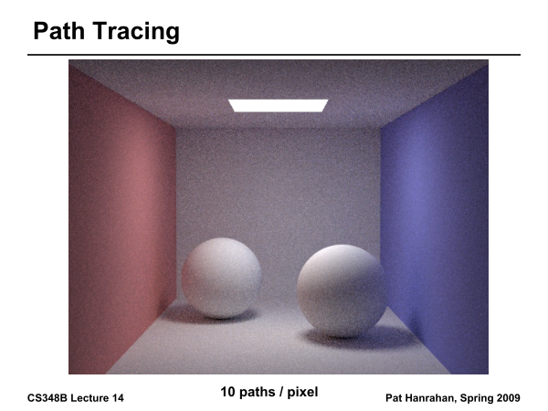

Slide 13
Arnold Renderer (M. Fajardo)
Works well diffuse surfaces, hemispherical light

Slide 14
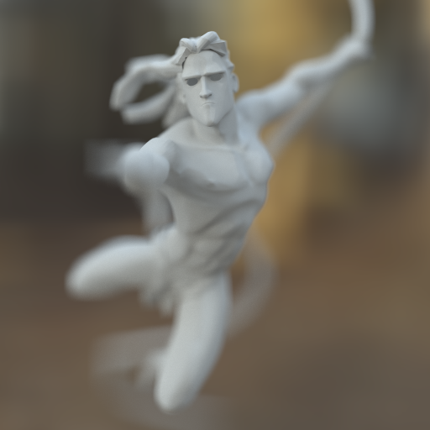
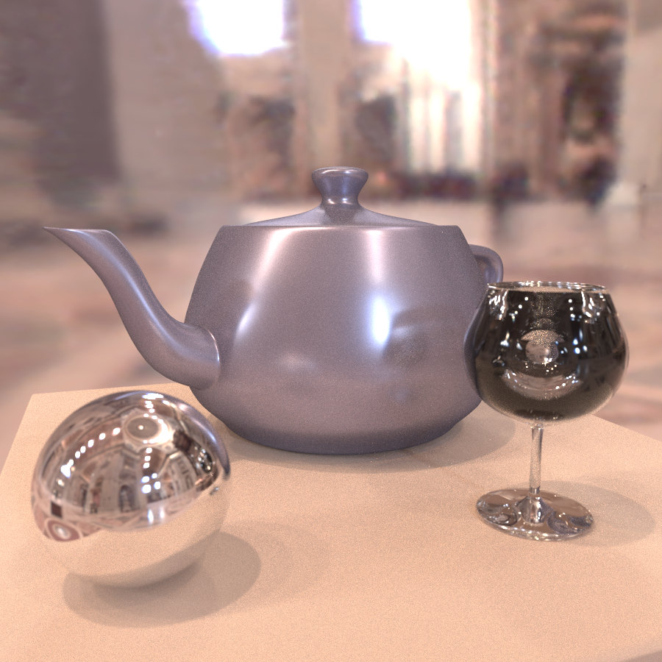
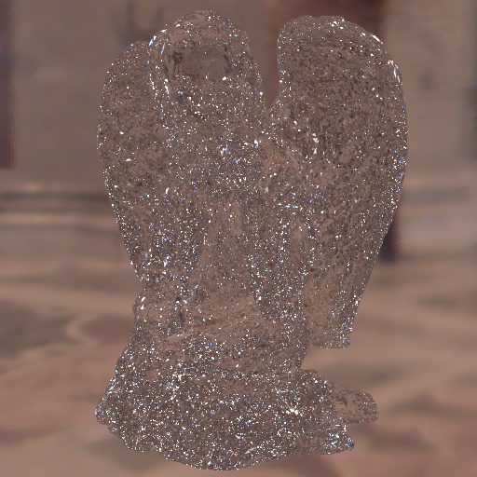
From UCB CS 294 a few years ago
Daniel Ritchie and Lita Cho

Slide 15
Importance Sampling
Pick paths based on energy or expected contribution
  More samples for high-energy paths
  Don’t pick low-energy paths
At “macro” level, use to select between reflected vs emitted, or in casting more rays toward light sources
At “micro” level, importance sample the BRDF to pick ray directions
Tons of papers in 90s on tricks to reduce variance in Monte Carlo rendering
Importance sampling now standard in production. I consulted on Pixar’s system for movies from 2012+

Slide 16
Importance Sampling
Can pick paths however we want, but contribution weighted by 1/probability
  Already seen this division of 1/prob in weights to emission, reflectance
E(f(x))
x₁
x_{N}

Slide 17
Importance sample Emit vs Reflect
TracePath(p, d) returns (r,g,b) [and calls itself recursively]:
  Trace ray (p, d) to find nearest intersection p’
  If Le = (0,0,0) then p_{emit}= 0 else p_{emit}= 0.9 (say)
  If random() < p_{emit} then:
    Emitted:
    return (1/ p_{emit}) * (Le_{red}, Le_{green}, Le_{blue})
    Else Reflected:
    generate ray in random direction d’
    return (1/(1- p_{emit})) * f_{r}(d ➔d’) * (n•d’) * TracePath(p’, d’)

Slide 18
More variance reduction
Discussed “macro” importance sampling
  Emitted vs reflected
How about “micro” importance sampling
  Shoot rays towards light sources in scene
  Distribute rays according to BRDF

Slide 19
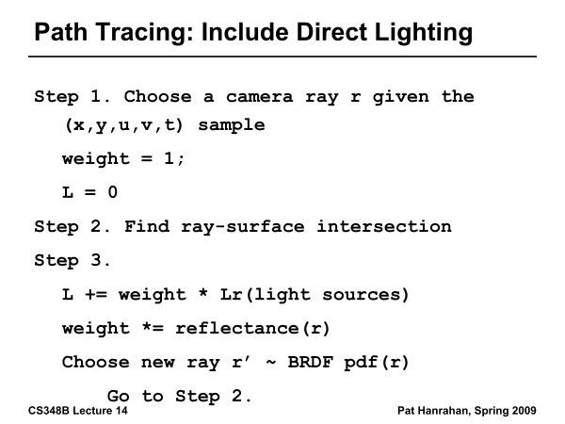

Slide 20
Monte Carlo Extensions
Unbiased
  Bidirectional path tracing
  Metropolis light transport
Biased, but consistent
  Noise filtering
  Adaptive sampling
  Irradiance caching

Slide 21
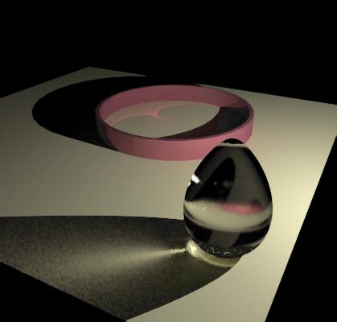
Monte Carlo Extensions
Unbiased
  Bidirectional path tracing
  Metropolis light transport
Biased, but consistent
  Noise filtering
  Adaptive sampling
  Irradiance caching
RenderPark

Slide 22
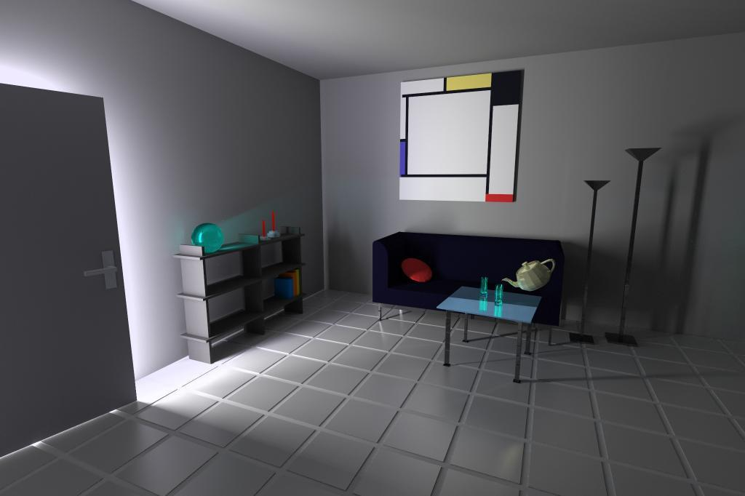
Monte Carlo Extensions
Unbiased
  Bidirectional path tracing
  Metropolis light transport
Biased, but consistent
  Noise filtering
  Adaptive sampling
  Irradiance caching
Heinrich

Slide 23
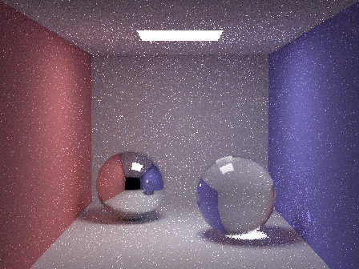

Monte Carlo Extensions
Unbiased
  Bidirectional path tracing
  Metropolis light transport
Biased, but consistent
  Noise filtering
  Adaptive sampling
  Irradiance caching
Unfiltered
Filtered
Jensen

Slide 24
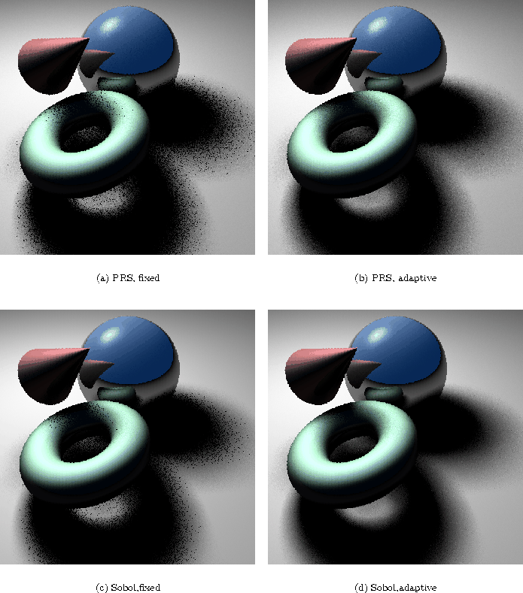
Monte Carlo Extensions
Unbiased
  Bidirectional path tracing
  Metropolis light transport
Biased, but consistent
  Noise filtering
  Adaptive sampling
  Irradiance caching
Fixed
Adaptive
Ohbuchi

Slide 25

Monte Carlo Extensions
Unbiased
  Bidirectional path tracing
  Metropolis light transport
Biased, but consistent
  Noise filtering
  Adaptive sampling
  Irradiance caching
Jensen

Slide 26
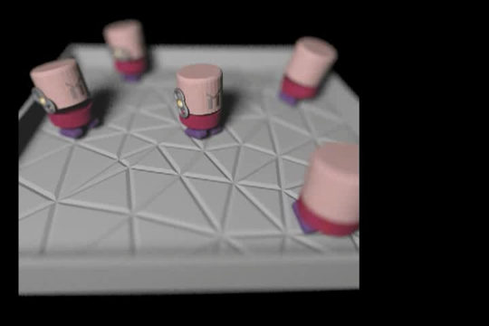
Monte Carlo Denoising

Slide 27
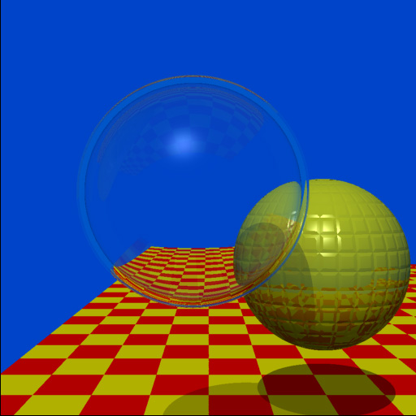
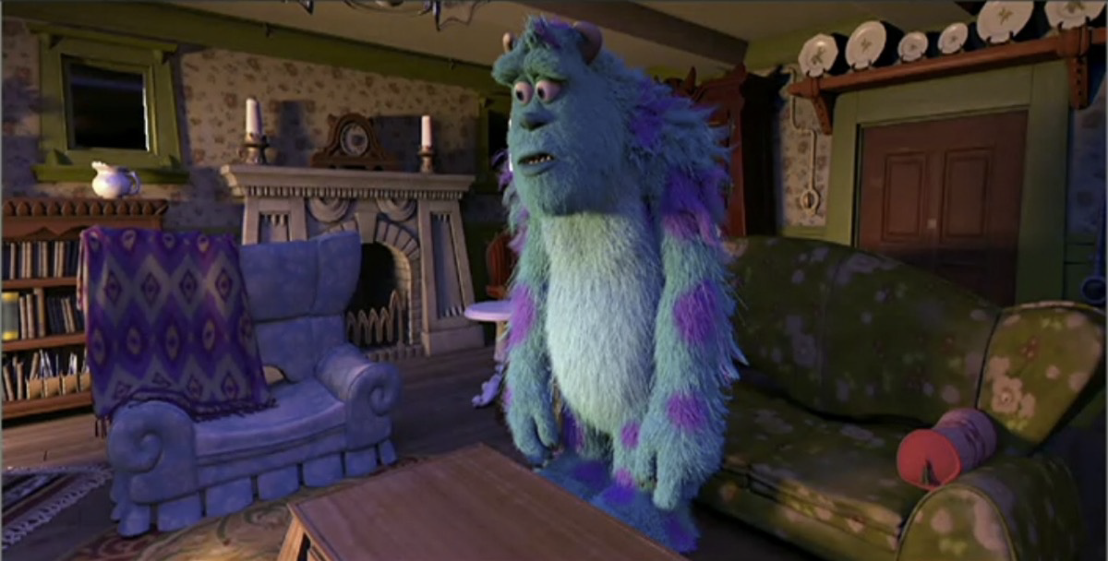
Impact: Real-Time
Extend AAF, FSF, MAAF: Predict Filter based on Deep Learning (sample and AI-based denoising)
NVIDIA software (OptiX 2017), hardware (RTX 2018)
40-year journey: ray tracing curiosity to every pixel
Whitted 79 (74 min 512x512)
NVIDIA RTX 2018, OptiX: Pixar real-time previewer

Slide 28
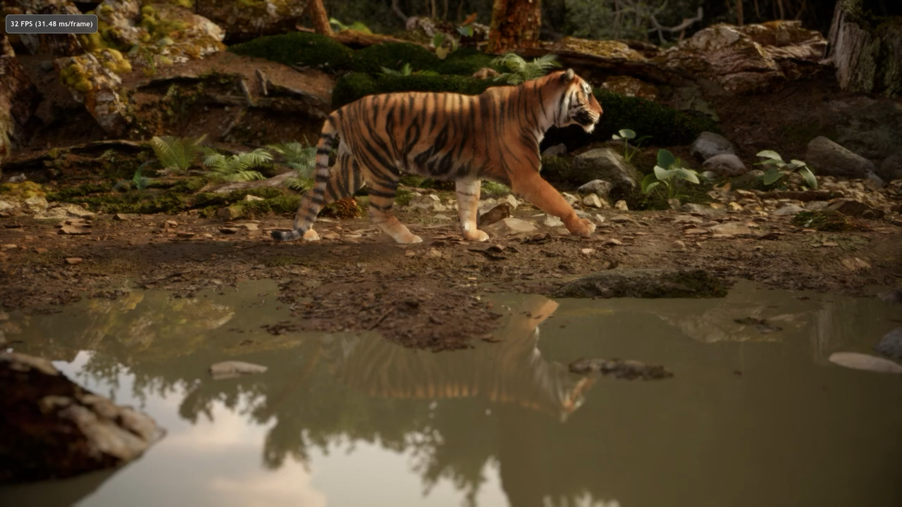
Today: Real-Time Denoising at 1spp
NVIDIA Tiger Demo 2021

Slide 29
Summary
Monte Carlo methods robust and simple (at least until nitty gritty details) for global illumination
Must handle many variance reduction methods in practice
Importance sampling, Bidirectional path tracing, Russian roulette etc.
Rich field with many papers, systems researched over last 30 years
Today, hardware for real-time ray, path tracing
Promising physically-based GPU approach

Slide 30
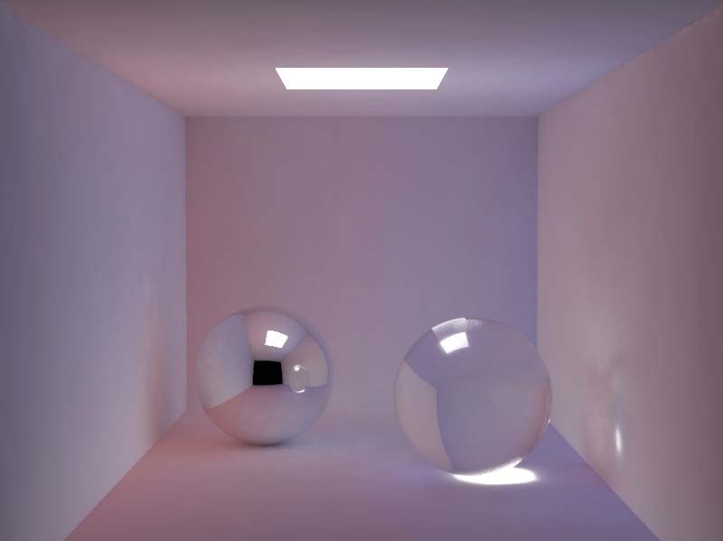
Smoothness of Indirect Lighting
Direct
Indirect
Direct + Indirect

Slide 31
Irradiance Caching
Empirically, (diffuse) interreflections low frequency
Therefore, should be able to sample sparsely
Irradiance caching samples irradiance at few points on surfaces, and then interpolates
Ward, Rubinstein, Clear. SIGGRAPH 88, A ray tracing solution for diffuse interreflection

Slide 32
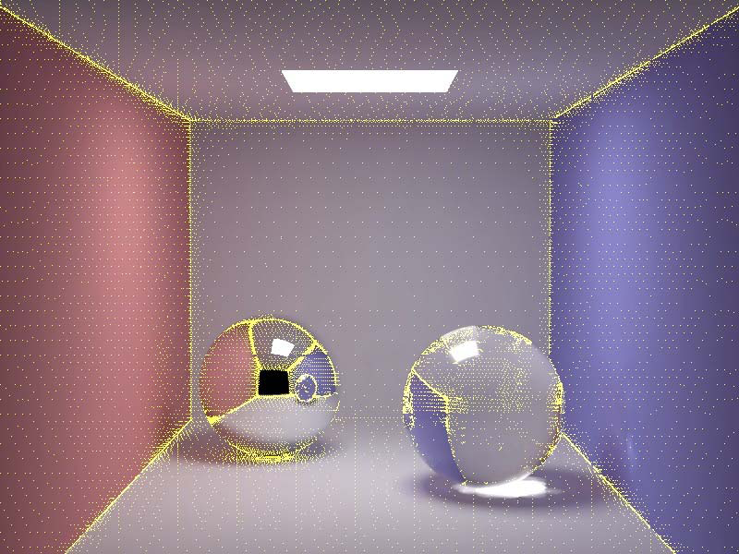
Irradiance Caching Example
Final Image
Sample Locations

Slide 33
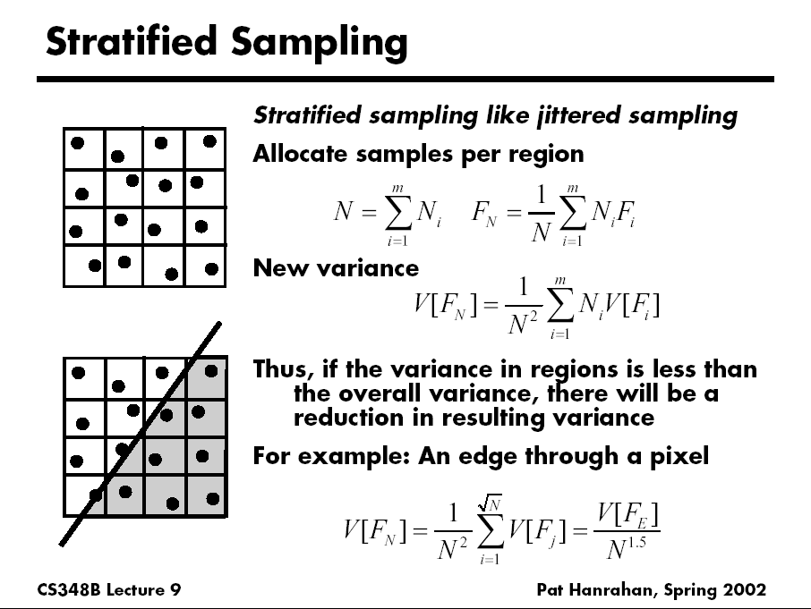
D. Mitchell 95, Consequences of stratified sampling in graphics

Slide 34
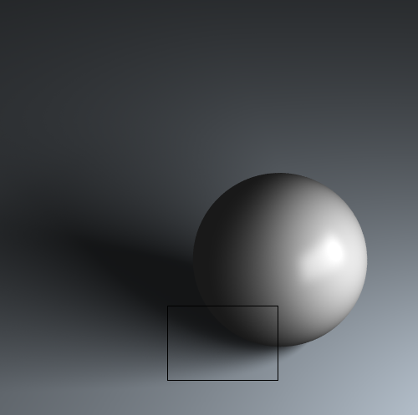
Comparison of simple patterns
Latin Hypercube
Quasi Monte Carlo
Ground Truth
Uniform
Random
Stratified
16 samples for area light, 4 samples per pixel, total 64 samples
If interested, see my recent paper “A Theory of Monte Carlo Visibility Sampling”
Figures courtesy Tianyu Liu

Slide 35
Path Tracing: From Lights
Step 1. Choose a light ray
Step 2. Find ray-surface intersection
Step 3. Reflect or transmit
  u = Uniform()
  if u < reflectance(x)
  Choose new direction d ~ BRDF(O|I)
  goto Step 2
else if u < reflectance(x)+transmittance(x)
  Choose new direction d ~ BTDF(O|I)
  goto Step 2
else // absorption=1–reflectance-transmittance
  terminate on surface; deposit energy

Slide 36
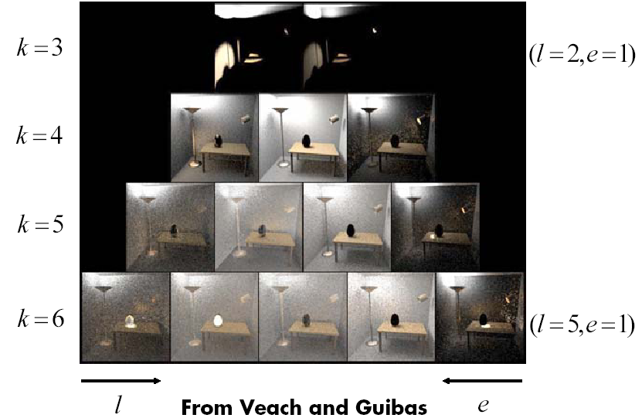
Bidirectional Path Tracing
Path pyramid (k = l + e = total number of bounces)

Slide 37
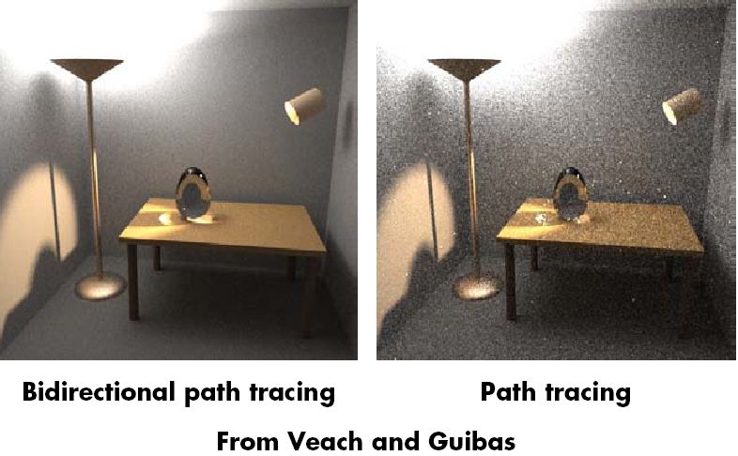
Comparison

Slide 38
Why Photon Map?
Some visual effects like caustics hard with standard path tracing from eye
May usually miss light source altogether
Instead, store “photons” from light in kd-tree
Look-up into this as needed
Combines tracing from light source, and eye
Similar to bidirectional path tracing, but compute photon map only once for all eye rays
Global Illumination using Photon Maps H. Jensen. Rendering Techniques (EGSR 1996), pp 21-30. (Also book: Realistic Image Synthesis using Photon Mapping)

Slide 39
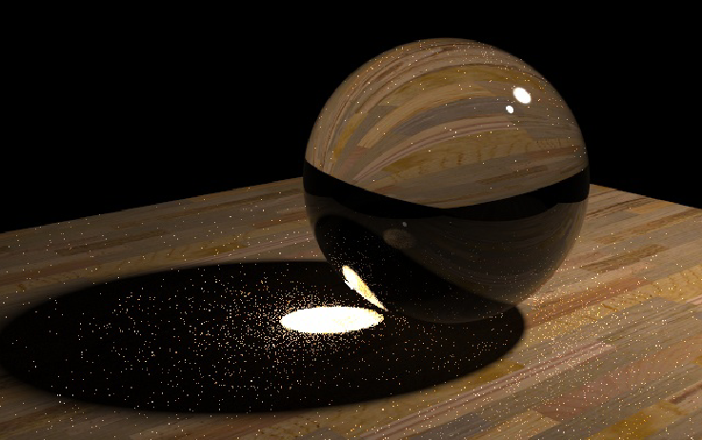
Caustics
Path Tracing: 1000 paths/pixel
Note noise in caustics
Slides courtesy Henrik Wann Jensen

Slide 40
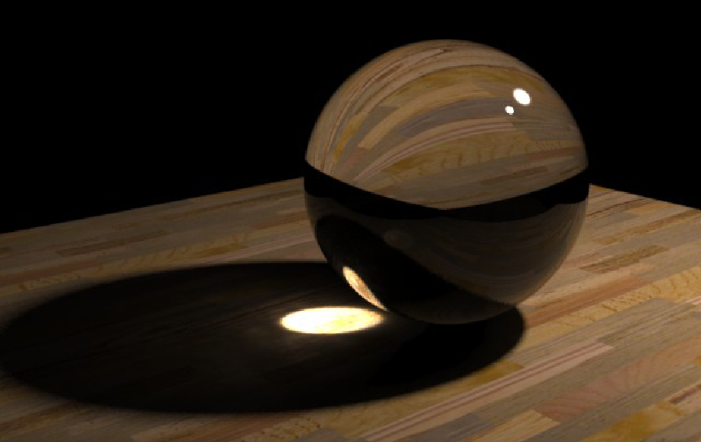
Caustics
Photon Mapping: 10000 photons
50 photons in radiance estimate

Slide 41
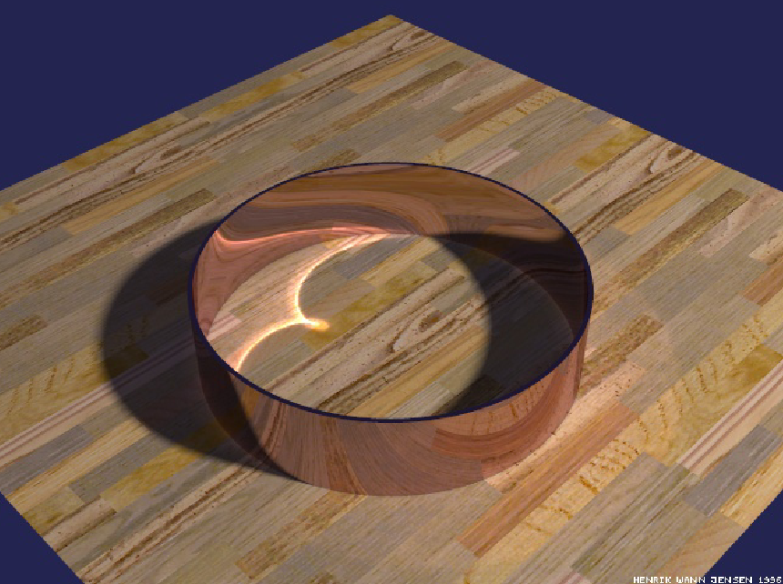
Reflections Inside a Metal Ring
50000 photons
50 photons to estimate radiance

Slide 42
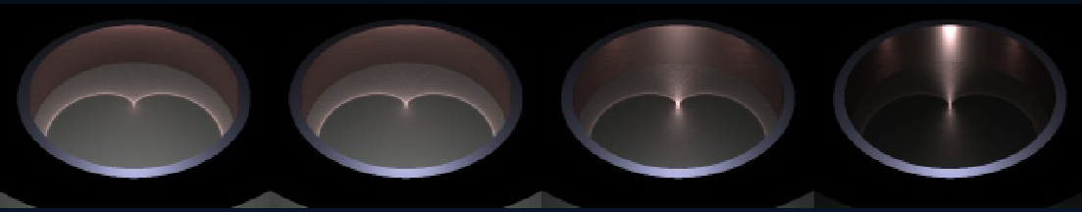
Caustics on Glossy Surfaces
340000 photons, 100 photons in radiance estimate

Slide 43
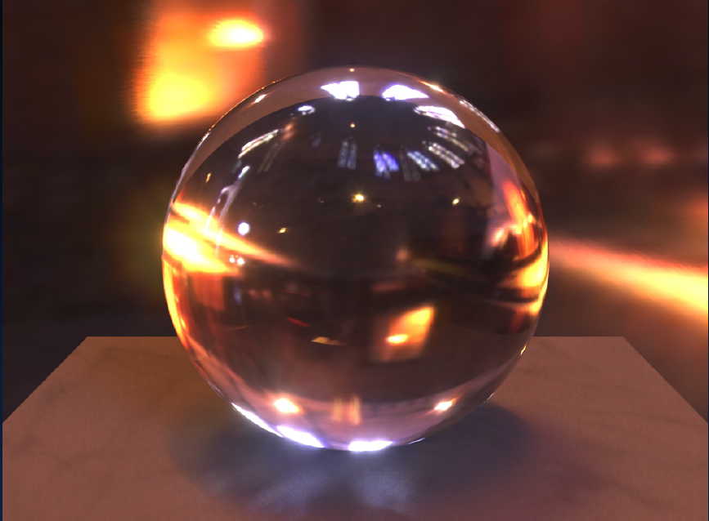
HDR Environment Illumination

Slide 44
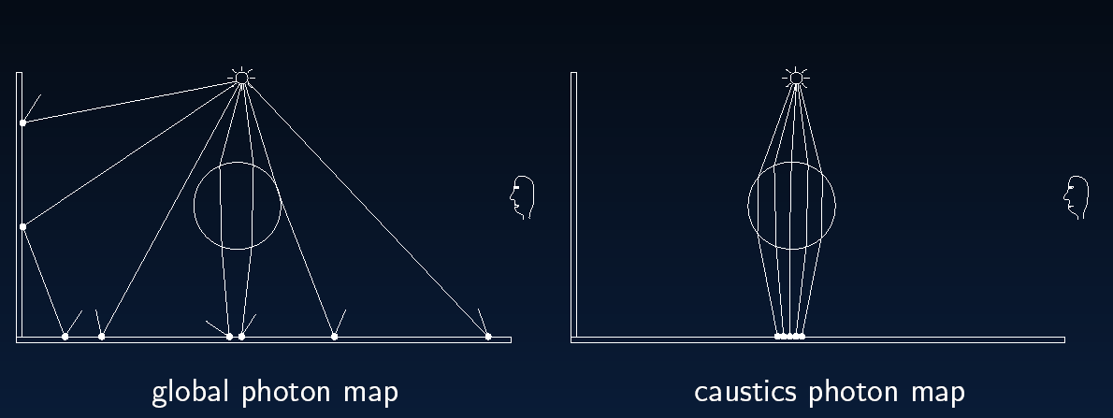
Global Illumination

Slide 45
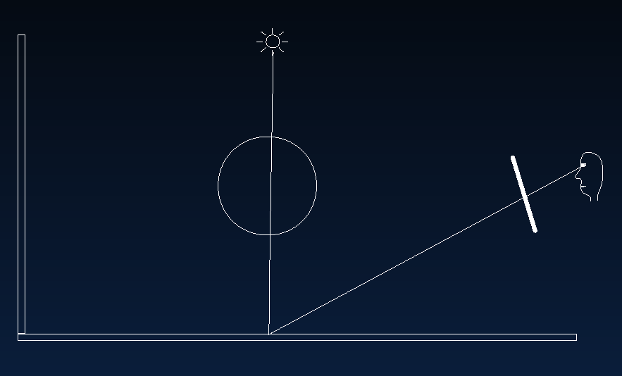
Direct Illumination

Slide 46
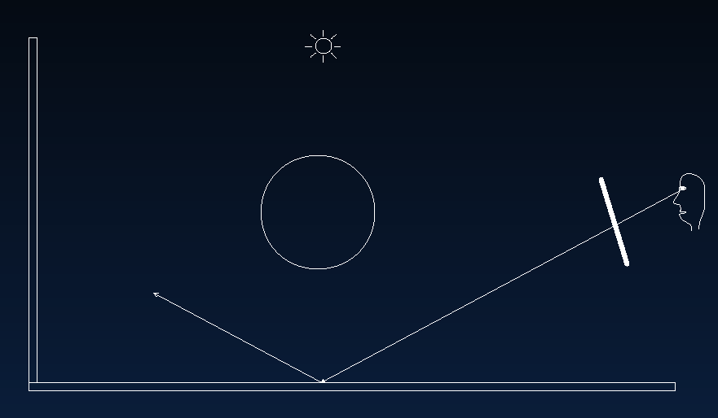
Specular Reflection

Slide 47
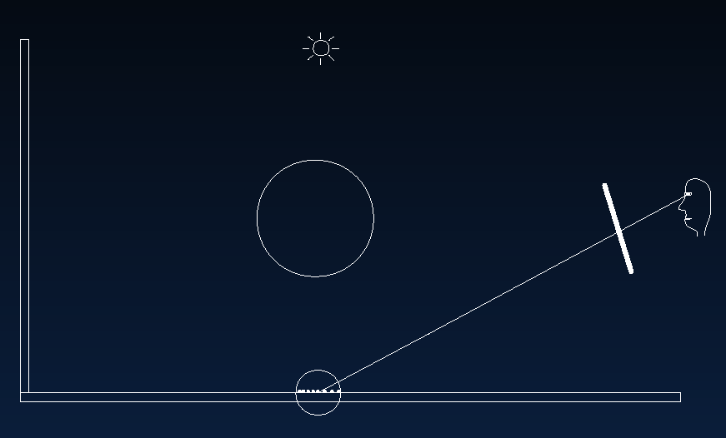
Caustics

Slide 48
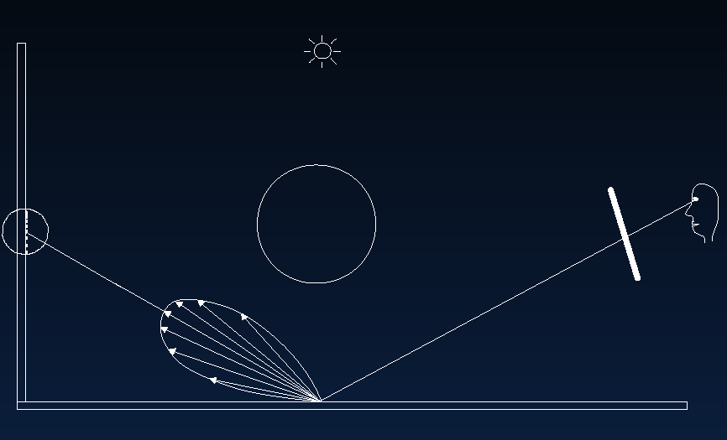
Indirect Illumination

Slide 49
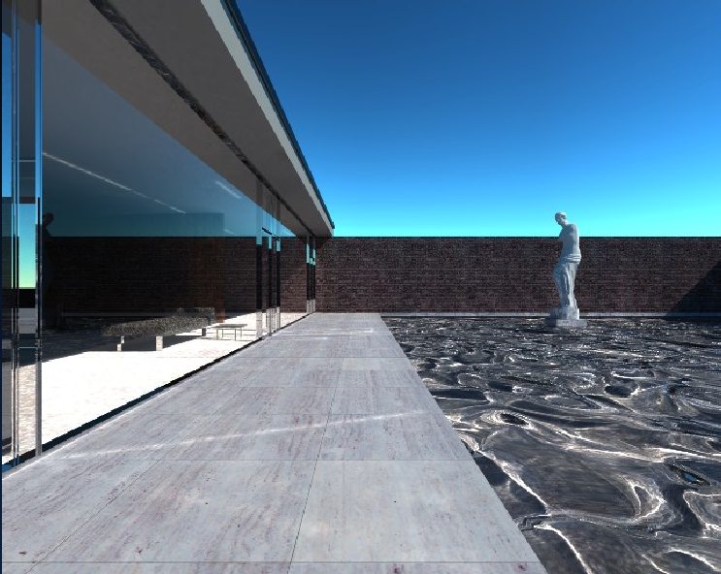
Mies House: Swimming Pool

