Slide 1
Computer Graphics
CSE 167 [Win 24], Lectures 16, 17:
Nuts and bolts of Ray Tracing
Ravi Ramamoorthi
http://viscomp.ucsd.edu/classes/cse167/wi24
Acknowledgements: Thomas Funkhouser and Greg Humphreys

Slide 2
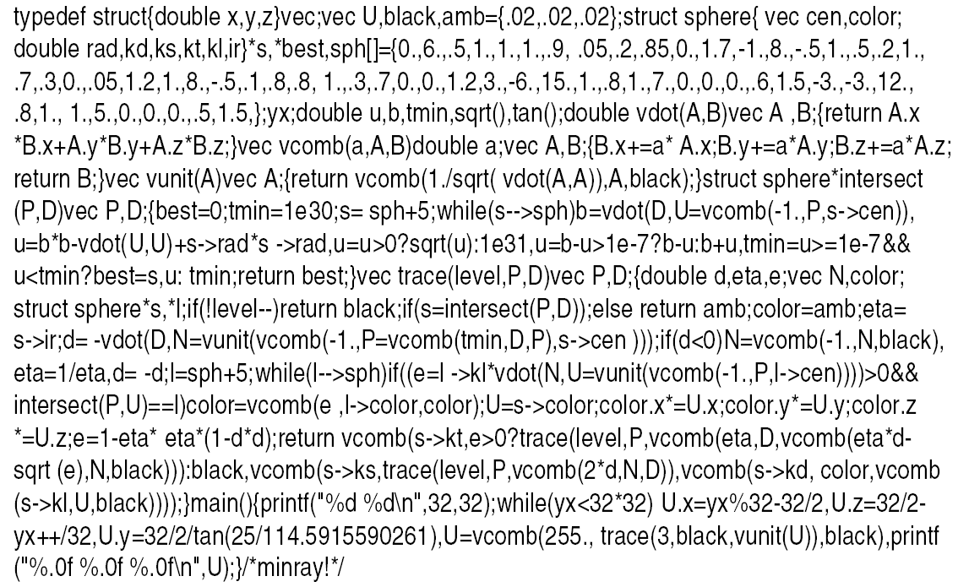
Heckbert’s Business Card Ray Tracer

Slide 3
To Do
START EARLY on HW 4
Milestone is due on Mar 8

Slide 4
Outline
Camera Ray Casting (choose ray directions)
Ray-object intersections
Ray-tracing transformed objects
Lighting calculations
Recursive ray tracing

Slide 5
Outline in Code
Image Raytrace (Camera cam, Scene scene, int width, int height)
{
Image image = new Image (width, height) ;
for (int i = 0 ; i < height ; i++)
for (int j = 0 ; j < width ; j++) {
Ray ray = RayThruPixel (cam, i, j) ;
Intersection hit = Intersect (ray, scene) ;
image[i][j] = FindColor (hit) ;
}
return image ;
}

Slide 6
Ray Casting
Virtual Viewpoint
Virtual Screen
Objects
Multiple intersections: Use closest one (as does OpenGL)
Ray misses all objects: Pixel colored black
Ray intersects object: shade using color, lights, materials

Slide 7
Finding Ray Direction
Goal is to find ray direction for given pixel i and j
Many ways to approach problem
  Objects in world coord, find dirn of each ray (we do this)
  Camera in canonical frame, transform objects (OpenGL)
Basic idea
  Ray has origin (camera center) and direction
  Find direction given camera params and i and j
Camera params as in gluLookAt
  Lookfrom[3], LookAt[3], up[3], fov

Slide 8
Similar to gluLookAt derivation
gluLookAt(eyex, eyey, eyez, centerx, centery, centerz, upx, upy, upz)
Camera at eye, looking at center, with up direction being up
Up vector
Eye
Center
From earlier lecture on deriving gluLookAt

Slide 9
Constructing a coordinate frame?
We want to associate w with a, and v with b
  But a and b are neither orthogonal nor unit norm
  And we also need to find u
From basic math lecture - Vectors: Orthonormal Basis Frames

Slide 10
Camera coordinate frame
We want to position camera at origin, looking down –Z dirn
Hence, vector a is given by eye – center
The vector b is simply the up vector
Up vector
Eye
Center

Slide 11
Canonical viewing geometry
βv
-w
αu

Slide 12
Outline
Camera Ray Casting (choosing ray directions)
Ray-object intersections
Ray-tracing transformed objects
Lighting calculations
Recursive ray tracing

Slide 13
Outline in Code
Image Raytrace (Camera cam, Scene scene, int width, int height)
{
Image image = new Image (width, height) ;
for (int i = 0 ; i < height ; i++)
for (int j = 0 ; j < width ; j++) {
Ray ray = RayThruPixel (cam, i, j) ;
Intersection hit = Intersect (ray, scene) ;
image[i][j] = FindColor (hit) ;
}
return image ;
}

Slide 14
Ray-Sphere Intersection
C
P₀

Slide 15
Ray-Sphere Intersection
Substitute
Simplify

Slide 16
Ray-Sphere Intersection
2 real positive roots: pick smaller root
Both roots same: tangent to sphere
One positive, one negative root: ray origin inside sphere (pick + root)
Complex roots: no intersection (check discriminant of equation first)
Solve quadratic equations for t

Slide 17
Ray-Sphere Intersection
Intersection point:
Normal (for sphere, this is same as coordinates in sphere frame of reference, useful other tasks)

Slide 18
Ray-Triangle Intersection
One approach: Ray-Plane intersection, then check if inside triangle
Plane equation:
B
A
C

Slide 19
Ray-Triangle Intersection
One approach: Ray-Plane intersection, then check if inside triangle
Plane equation:
Combine with ray equation:
B
A
C

Slide 20
Ray inside Triangle
Once intersect with plane, still need to find if in triangle
Many possibilities for triangles, general polygons (point in polygon tests)
We find parametrically [barycentric coordinates]. Also useful for other applications (texture mapping)
B
A
α
β
P
γ
C

Slide 21
Ray inside Triangle
B
A
α
β
P
γ
C

Slide 22
Other primitives
Much early work in ray tracing focused on ray-primitive intersection tests
Cones, cylinders, ellipsoids
Boxes (especially useful for bounding boxes)
General planar polygons
Many more
Consult chapter in Glassner (handed out) for more details and possible extra credit

Slide 23
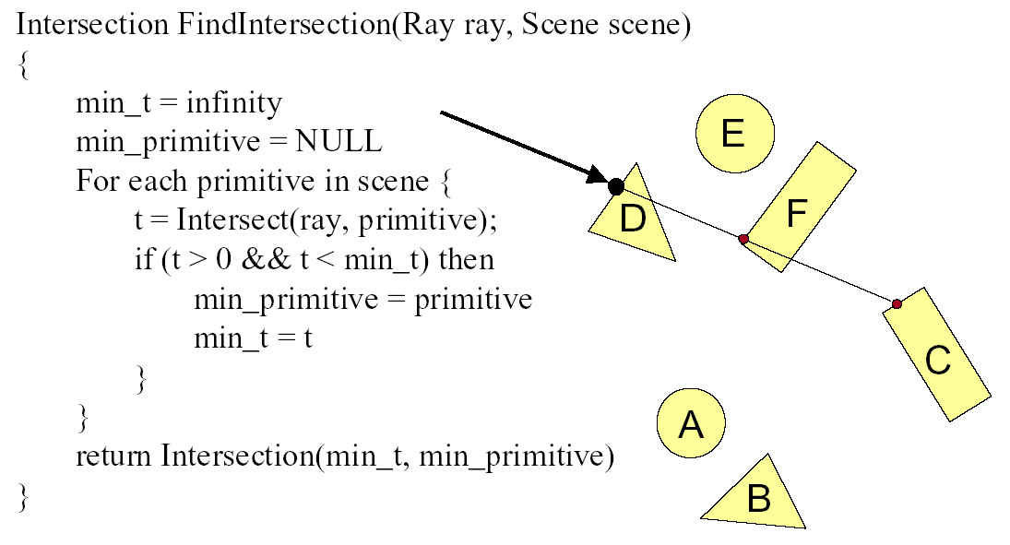
Ray Scene Intersection

Slide 24
Outline
Camera Ray Casting (choosing ray directions)
Ray-object intersections
Ray-tracing transformed objects
Lighting calculations
Recursive ray tracing

Slide 25
Transformed Objects
E.g. transform sphere into ellipsoid
Could develop routine to trace ellipsoid (compute parameters after transformation)
May be useful for triangles, since triangle after transformation is still a triangle in any case
But can also use original optimized routines

Slide 26
Ray-Tracing Transformed Objects
We have an optimized ray-sphere test
  But we want to ray trace an ellipsoid…
Solution: Ellipsoid transforms sphere
  Apply inverse transform to ray, use ray-sphere
  Allows for instancing (traffic jam of cars)
  Same idea for other primitives

Slide 27
Transformed Objects
Consider a general 4x4 transform M
  Will need to implement matrix stacks like in OpenGL
Apply inverse transform M⁻¹ to ray
  Locations stored and transform in homogeneous coordinates
  Vectors (ray directions) have homogeneous coordinate set to 0 [so there is no action because of translations]
Do standard ray-surface intersection as modified
Transform intersection back to actual coordinates
  Intersection point p transforms as Mp
  Distance to intersection if used may need recalculation
  Normals n transform as M^{-t}n. Do all this before lighting

Slide 28
Outline
Camera Ray Casting (choosing ray directions)
Ray-object intersections
Ray-tracing transformed objects
Lighting calculations
Recursive ray tracing

Slide 29
Outline in Code
Image Raytrace (Camera cam, Scene scene, int width, int height)
{
Image image = new Image (width, height) ;
for (int i = 0 ; i < height ; i++)
for (int j = 0 ; j < width ; j++) {
Ray ray = RayThruPixel (cam, i, j) ;
Intersection hit = Intersect (ray, scene) ;
image[i][j] = FindColor (hit) ;
}
return image ;
}

Slide 30
Shadows
Light Source
Virtual Viewpoint
Virtual Screen
Objects
Shadow ray to light is blocked: object in shadow
Shadow ray to light is unblocked: object visible

Slide 31
Shadows: Numerical Issues
Numerical inaccuracy may cause intersection to be
below surface (effect exaggerated in figure)
Causing surface to incorrectly shadow itself
Move a little towards light before shooting shadow ray

Slide 32
Lighting Model
Similar to OpenGL
Lighting model parameters (global)
  Ambient r g b
  Attenuation const linear quadratic
Per light model parameters
  Directional light (direction, RGB parameters)
  Point light (location, RGB parameters)
  Some differences from HW 2 syntax

Slide 33
Material Model
Diffuse reflectance (r g b)
Specular reflectance (r g b)
Shininess s
Emission (r g b)
All as in OpenGL

Slide 34
Shading Model
Global ambient term, emission from material
For each light, diffuse specular terms
Note visibility/shadowing for each light (not in OpenGL)
Evaluated per pixel per light (not per vertex)

Slide 35
Outline
Camera Ray Casting (choosing ray directions)
Ray-object intersections
Ray-tracing transformed objects
Lighting calculations
Recursive ray tracing

Slide 36
Mirror Reflections/Refractions
Virtual Viewpoint
Virtual Screen
Objects
Generate reflected ray in mirror direction,
Get reflections and refractions of objects

Slide 37
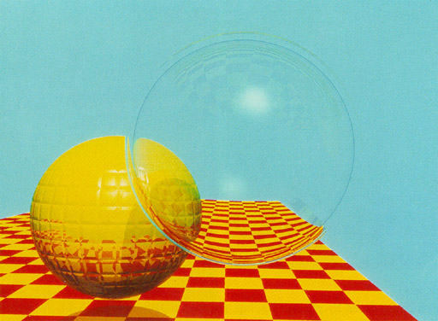
Turner Whitted 1980

Slide 38
Basic idea
For each pixel
  Trace Primary Eye Ray, find intersection
  Trace Secondary Shadow Ray(s) to all light(s)
    Color = Visible ? Illumination Model : 0 ;
  Trace Reflected Ray
    Color += reflectivity * Color of reflected ray

Slide 39
Recursive Shading Model
Highlighted terms are recursive specularities [mirror reflections] and transmission (latter is extra credit)
Trace secondary rays for mirror reflections and refractions, include contribution in lighting model
GetColor calls RayTrace recursively (the I values in equation above of secondary rays are obtained by recursive calls)

Slide 40
Problems with Recursion
Reflection rays may be traced forever
Generally, set maximum recursion depth
Same for transmitted rays (take refraction into account)

Slide 41
Effects needed for Realism
(Soft) Shadows
Reflections (Mirrors and Glossy)
Transparency (Water, Glass)
Interreflections (Color Bleeding)
Complex Illumination (Natural, Area Light)
Realistic Materials (Velvet, Paints, Glass)
Discussed in this lecture so far
Not discussed but possible with distribution ray tracing
Hard (but not impossible) with ray tracing; radiosity methods

Slide 42
Some basic add ons
Area light sources and soft shadows: break into grid of n x n point lights
  Use jittering: Randomize direction of shadow ray within small box for given light source direction
  Jittering also useful for antialiasing shadows when shooting primary rays
More complex reflectance models
  Simply update shading model
  But at present, we can handle only mirror global illumination calculations

Slide 43
Acceleration
Testing each object for each ray is slow
  Fewer Rays
    Adaptive sampling, depth control
  Generalized Rays
    Beam tracing, cone tracing, pencil tracing etc.
  Faster Intersections
    Optimized Ray-Object Intersections
    Fewer Intersections

Slide 44
Acceleration Structures
Bounding boxes (possibly hierarchical)
  If no intersection bounding box, needn’t check objects
Bounding Box
Ray
Spatial Hierarchies (Oct-trees, kd trees, BSP trees)

Slide 45
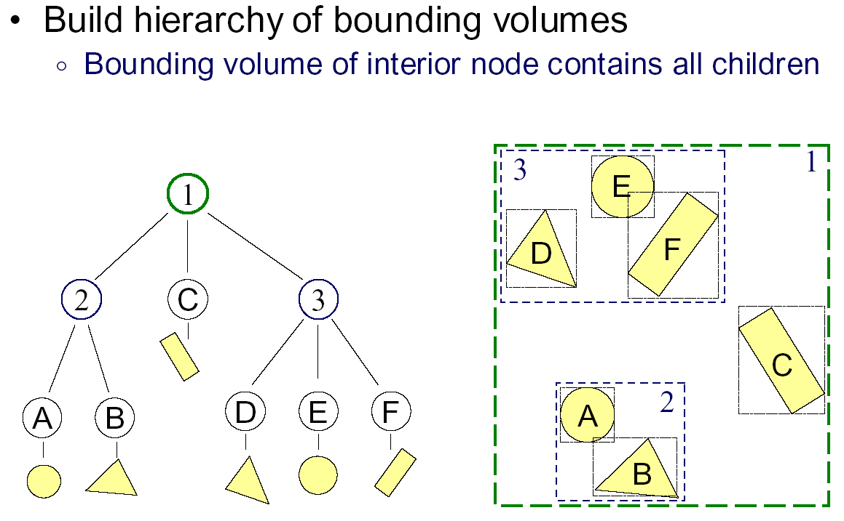
Bounding Volume Hierarchies 1

Slide 46
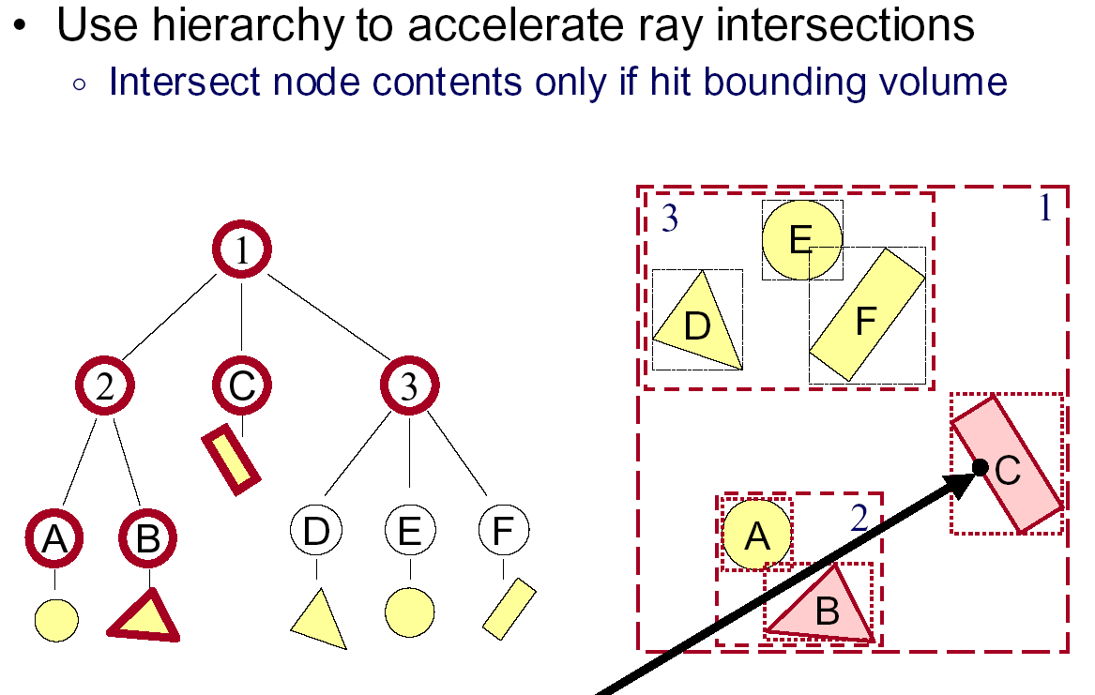
Bounding Volume Hierarchies 2

Slide 47
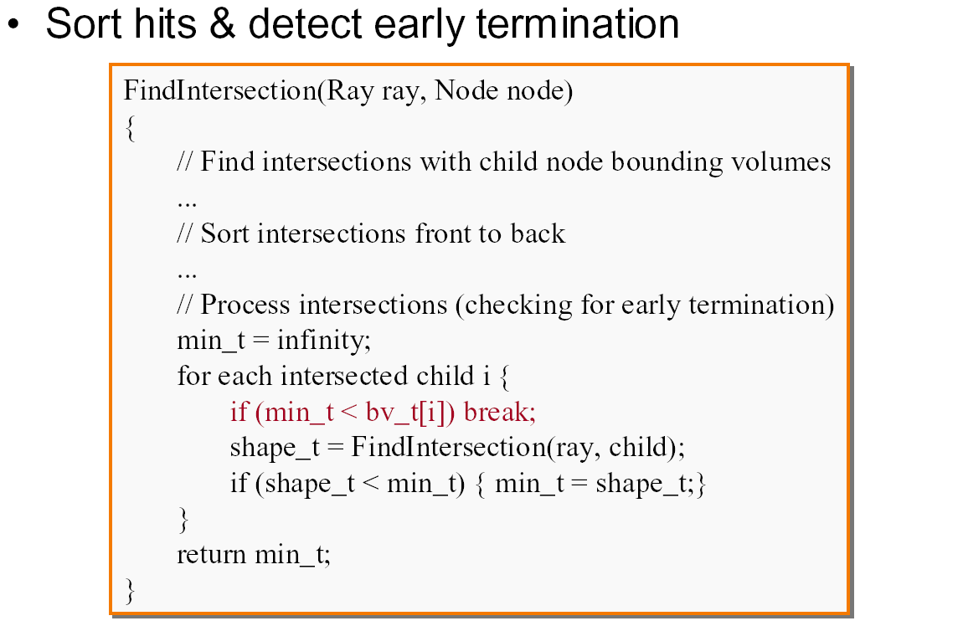
Bounding Volume Hierarchies 3

Slide 48
Acceleration Structures: Grids

Slide 49
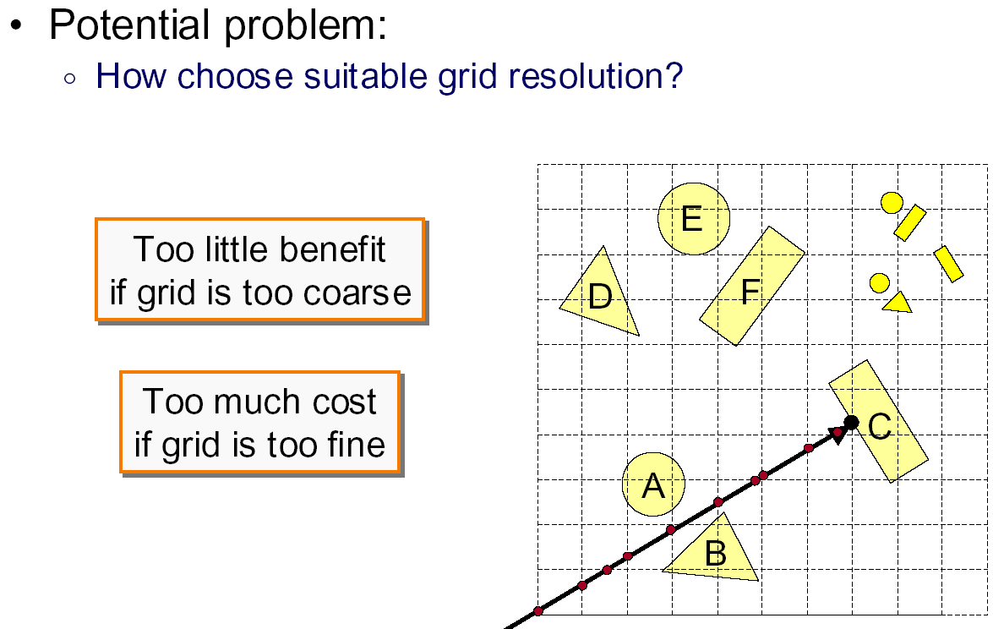
Uniform Grid: Problems

Slide 50
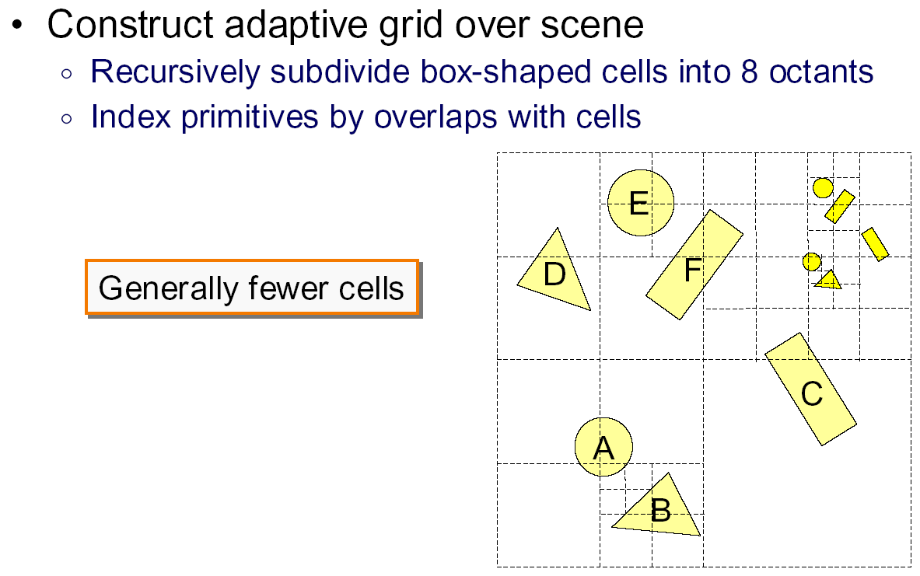
Octree

Slide 51
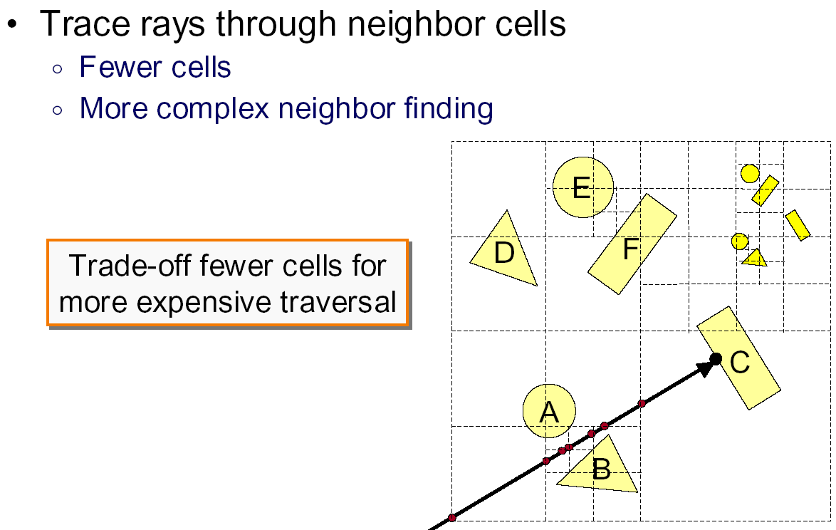
Octree traversal

Slide 52
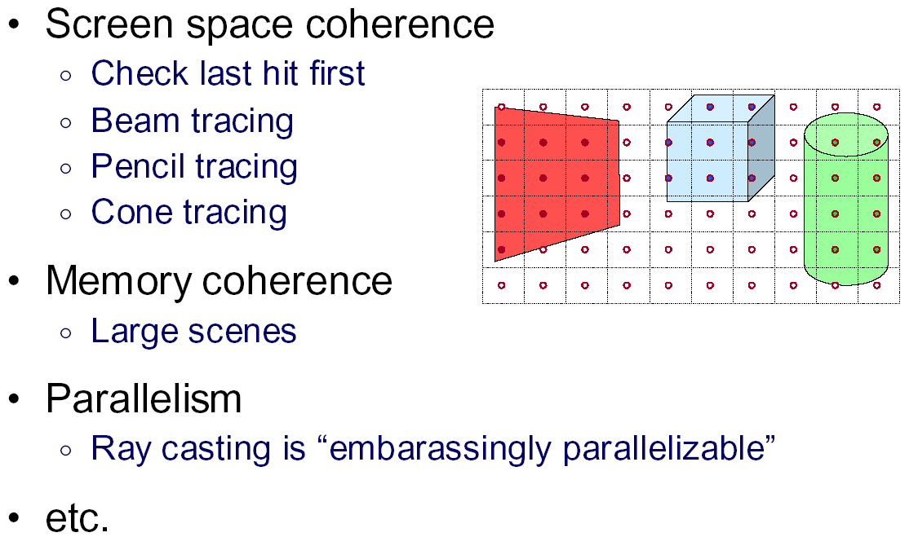
Other Accelerations

Slide 53
Course Evaluations
Fill out now, can be done on phone
Enthusiasm important to future offerings
Comments useful to future years
Some key innovations: modern OpenGL, GLSL; feedback servers (including code), UCSD online, …
Separately, please also evaluate the TAs

Slide 54
Ray Tracing Acceleration Structures
Bounding Volume Hierarchies (BVH)
Uniform Spatial Subdivision (Grids)
Binary Space Partitioning (BSP Trees)
  Axis-aligned often for ray tracing: kd-trees
Conceptually simple, implementation a bit tricky
  Lecture relatively high level: Start early, go to section
  Remember that acceleration a small part of grade

Slide 55
Math of 2D Bounding Box Test
Can you find a t in range
No intersection if x and y ranges don’t overlap

Slide 56
Bounding Box Test
Ray-Intersection is simple coordinate check
Intricacies with test, see book
Hierarchical Bounding Boxes
Ray

Slide 57
Hierarchical Bounding Box Test
If ray hits root box
  Intersect left subtree
  Intersect right subtree
  Merge intersections (find closest one)
Standard hierarchical traversal
  But caveat, since bounding boxes may overlap
At leaf nodes, must intersect objects

Slide 58
Creating Bounding Volume Hierarchy
function bvh-node::create (object array A, int AXIS)
  N = A.length() ;
  if (N == 1) {left = A[0]; right = NULL; bbox = bound(A[0]);}
  else if (N == 2) {
    left = A[0] ; right = A[1] ;
    bbox = combine(bound(A[0]),bound(A[1])) ;
  else
    Find midpoint m of bounding box of A along AXIS
    Partition A into lists of size k and N-k around m
    left = new bvh-node (A[0…k],(AXIS+1) mod 3) ;
    right = new bvh-node(A[k+1…N-1],(AXIS+1) mod 3);
    bbox = combine (left -> bbox, right -> bbox) ;
From page 305 of book

Slide 59
Uniform Spatial Subdivision
Different idea: Divide space rather than objects
In BVH, each object is in one of two sibling nodes
  A point in space may be inside both nodes
In spatial subdivision, each space point in one node
  But object may lie in multiple spatial nodes
Simplest is uniform grid (have seen this already)
Challenge is keeping all objects within cell
And in traversing the grid

Slide 60
Traversal of Grid High Level
Next Intersect Pt?
Irreg. samp. pattern?
But regular in planes
Fast algo. possible
(more on board)

Slide 61
BSP Trees
Used for visibility and ray tracing
  Book considers only axis-aligned splits for ray tracing
  Sometimes called kd-tree for axis aligned
Split space (binary space partition) along planes
Fast queries and back-to-front (painter’s) traversal
Construction is conceptually simple
  Select a plane as root of the sub-tree
  Split into two children along this root
  Random polygon for splitting plane (may need to split polygons that intersect it)
BSP slides courtesy Prof. O’Brien

Slide 62
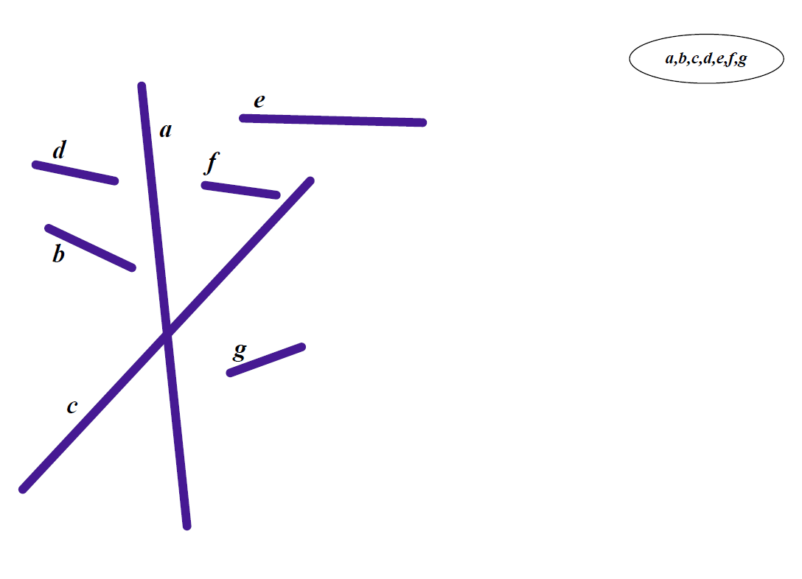
Initial State

Slide 63
First Split

Slide 64
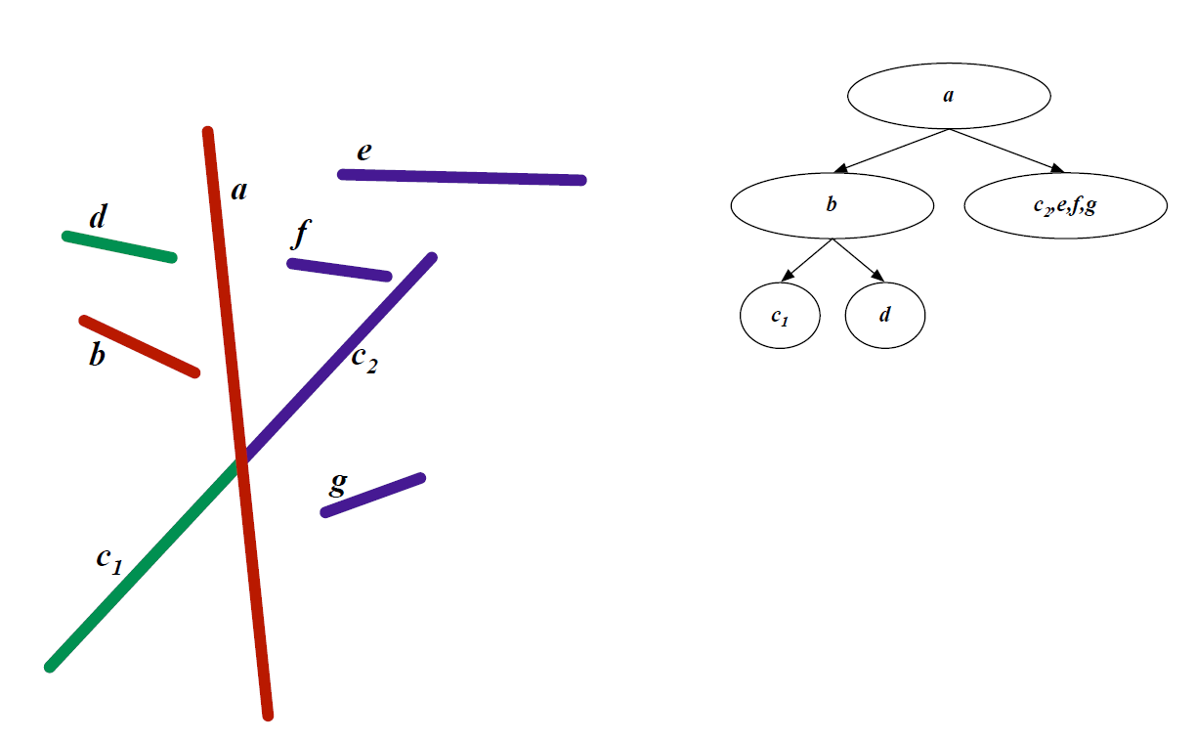
Second Split

Slide 65
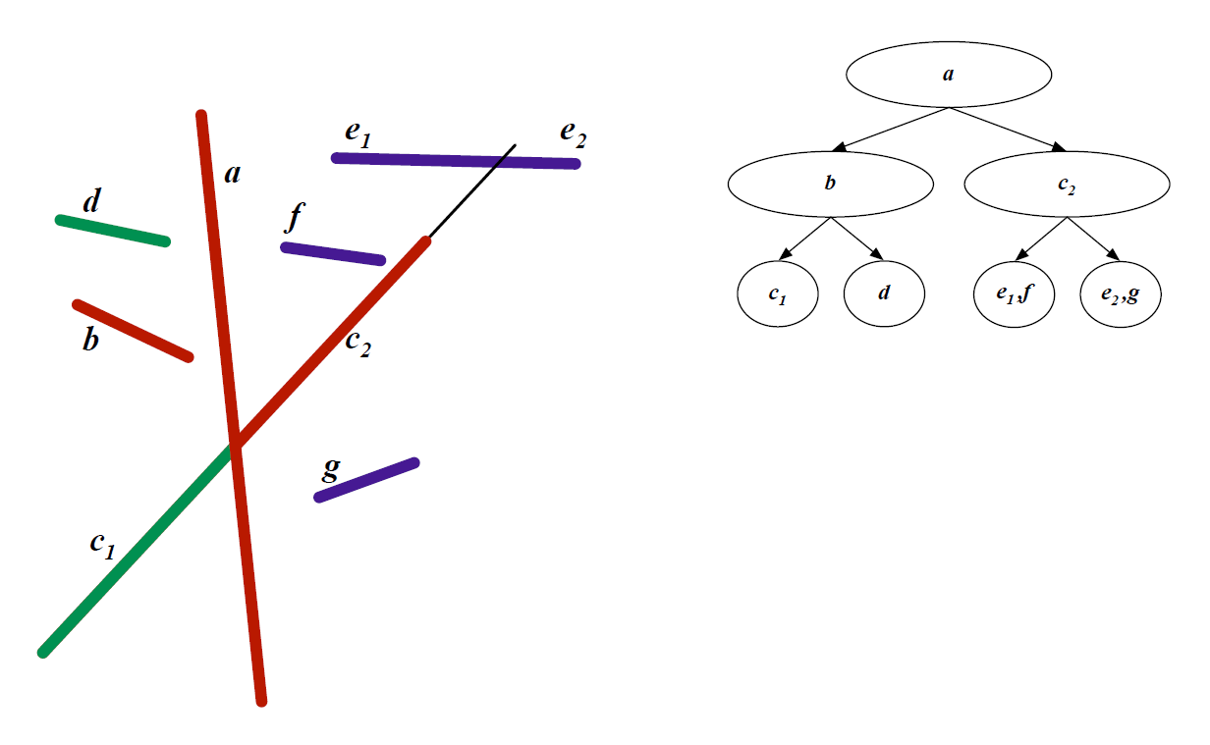
Third Split

Slide 66
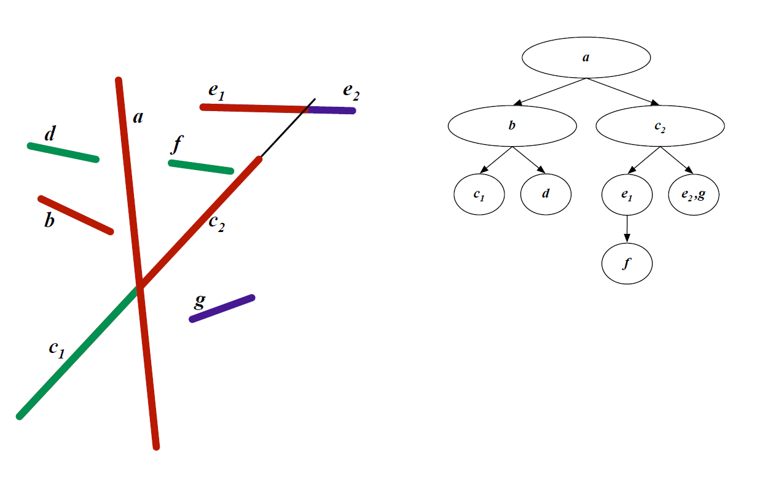
Fourth Split

Slide 67
Final BSP Tree

Slide 68
BSP Trees Cont’d
Continue splitting until leaf nodes
Visibility traversal in order
  Child one
  Root
  Child two
Child one chosen based on viewpoint
  Same side of sub-tree as viewpoint
BSP tree built once, used for all viewpoints
  More details in book
168 lectures (UCSD online) more detail re acceln

Slide 69
Interactive Raytracing
Ray tracing historically slow
Now viable alternative for complex scenes
  Key is sublinear complexity with acceleration; need not process all triangles in scene
Allows many effects hard in hardware
  Today graphics hardware and software (NVIDIA Optix 5, RTX chips claim 10G rays per second).
  Tiger Demo: Video

Slide 70
Raytracing on Graphics Hardware
Modern Programmable Hardware general streaming architecture
Can map various elements of ray tracing
Kernels like eye rays, intersect etc.
In vertex or fragment programs
Convergence between hardware, ray tracing
[Purcell et al. 2002, 2003]
http://graphics.stanford.edu/papers/photongfx

Slide 71
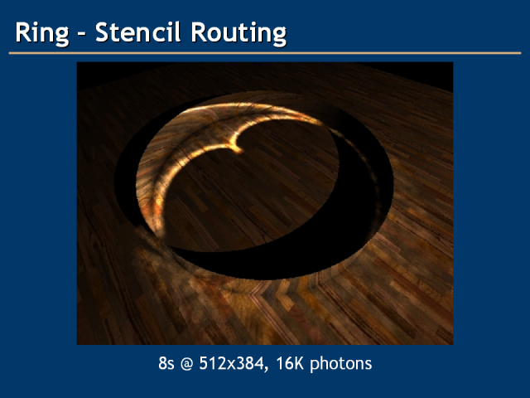
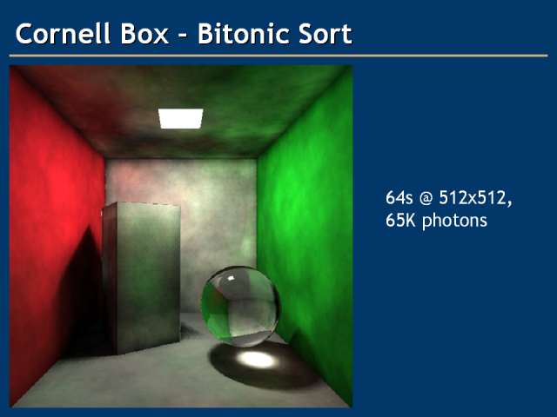
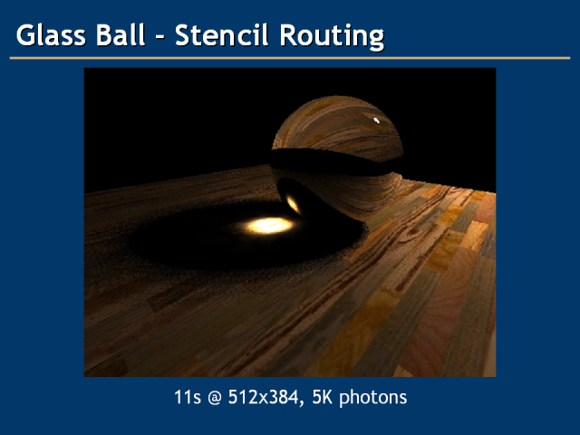
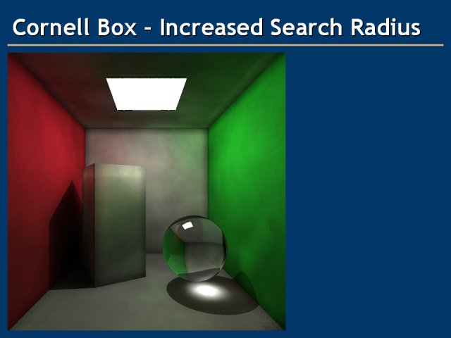

Slide 72
RayTracing 5 Minute Videos
RT 1: https://www.youtube.com/watch?v=H5TB2l7zq6s&list=PLWfDJ5nla8UpwShx-lzLJqcp575fKpsSO&index=13
RT 2: https://www.youtube.com/watch?v=mTOllvinv-U&list=PLWfDJ5nla8UpwShx-lzLJqcp575fKpsSO&index=14
RT 3: https://www.youtube.com/watch?v=tUh6gCx08LI&list=PLWfDJ5nla8UpwShx-lzLJqcp575fKpsSO&index=15

