Slide 1
Computer Graphics
CSE 167 [Win 23], Lecture 5: Viewing
Ravi Ramamoorthi
http://viscomp.ucsd.edu/classes/cse167/wi23

Slide 2
To Do
Questions/concerns about assignment 1?
Remember it is due Friday! (Jan 27).
Ask me or TAs re problems

Slide 3
Motivation
We have seen transforms (between coord systems)
But all that is in 3D
We still need to make a 2D picture
Project 3D to 2D. How do we do this?
This lecture is about viewing transformations

Slide 4
Summary: The Whole Viewing Pipeline
Eye coordinates
Model coordinates
Perspective
Transformation
(gluPerspective)
Model
transformation
Screen coordinates
World coordinates
Viewport
transformation
Camera
Transformation
(gluLookAt)
Window coordinates
Raster
transformation
Device coordinates
Slide courtesy Greg Humphreys

Slide 5
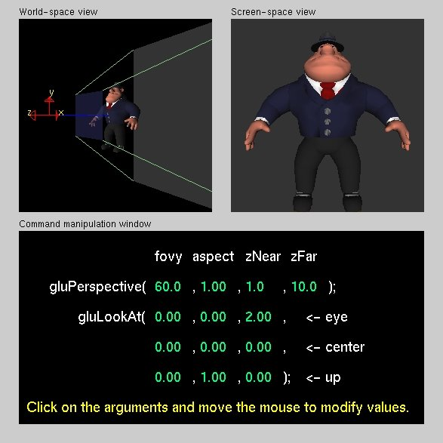
Demo (Projection Tutorial)
Nate Robbins OpenGL tutors
Projection tutorial
Download others

Slide 6
What we’ve seen so far
Transforms (translation, rotation, scale) as 4x4 homogeneous matrices
Last row always 0 0 0 1. Last w component always 1
For viewing (perspective), we will use that last row and w component no longer 1 (must divide by it)

Slide 7
Outline
Orthographic projection (simpler)
Perspective projection, basic idea
Derivation of gluPerspective (handout: glFrustum)
Brief discussion of nonlinear mapping in z

Slide 8
Projections
To lower dimensional space (here 3D -> 2D)
Preserve straight lines
Trivial example: Drop one coordinate (Orthographic)

Slide 9
Orthographic Projection
Characteristic: Parallel lines remain parallel
Useful for technical drawings etc.
Orthographic
Perspective

Slide 10
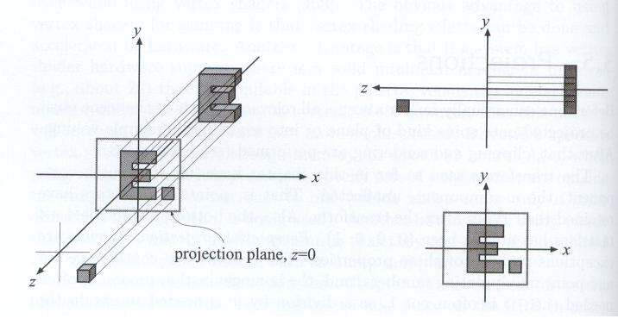
Example
Simply project onto xy plane, drop z coordinate

Slide 11
In general
We have a cuboid that we want to map to the normalized or square cube from [-1, +1] in all axes
We have parameters of cuboid (l,r ; t,b; n,f)
t
f
y
y
y
n
b
Translate
Scale
l
r
x
x
x
z
z
z

Slide 12
Orthographic Matrix
First center cuboid by translating
Then scale into unit cube
t
f
y
y
y
n
b
Translate
Scale
l
r
x
x
x
z
z
z

Slide 13
Transformation Matrix
Scale
Translation (centering)

Slide 14
Caveats
Looking down –z, f and n are negative (n > f)
OpenGL convention: positive n, f, negate internally
t
f
y
y
y
n
b
Translate
Scale
l
r
x
x
x
z
z
z

Slide 15
Final Result

Slide 16
Outline
Orthographic projection (simpler)
Perspective projection, basic idea
Derivation of gluPerspective (handout: glFrustum)
Brief discussion of nonlinear mapping in z

Slide 17
Perspective Projection
Most common computer graphics, art, visual system
Further objects are smaller (size, inverse distance)
Parallel lines not parallel; converge to single point
A
Plane of Projection
A’
B
B’
Center of projection
(camera/eye location)
Slides inspired by Greg Humphreys

Slide 18
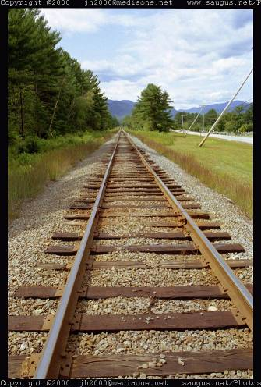
Funny things happen…

Slide 19
Perspective Video 1
https://www.youtube.com/watch?v=F5WA26W4JaM&list=PLWfDJ5nla8UpwShx-lzLJqcp575fKpsSO&index=11
Steve Seitz UW 5 minute videos
more detail regarding lenses and actual cameras than needed for course (good to know)

Slide 20
Overhead View of Our Screen
Looks like we’ve got some nice similar triangles here?

Slide 21
In Matrices
Note negation of z coord (focal plane –d)
(Only) last row affected (no longer 0 0 0 1)
w coord will no longer = 1. Must divide at end

Slide 22
Verify

Slide 23
Perspective Video 2
https://www.youtube.com/watch?v=g7Pb8mrwcJ0&list=PLWfDJ5nla8UpwShx-lzLJqcp575fKpsSO&index=12
Steve Seitz UW 5 minute videos
more detail regarding lenses and actual cameras than needed for course (good to know)

Slide 24
Outline
Orthographic projection (simpler)
Perspective projection, basic idea
Derivation of gluPerspective (handout: glFrustum)
Brief discussion of nonlinear mapping in z

Slide 25
Remember projection tutorial

Slide 26
Viewing Frustum
Far plane
Near plane

Slide 27
Screen (Projection Plane)
width
Field of view
(fovy)
height
Aspect ratio = width / height

Slide 28
gluPerspective
gluPerspective(fovy, aspect, zNear > 0, zFar > 0)
Fovy, aspect control fov in x, y directions
zNear, zFar control viewing frustum

Slide 29
Overhead View of Our Screen

Slide 30
In Matrices
Simplest form:
Aspect ratio taken into account
Homogeneous, simpler to multiply through by d
Must map z vals based on near, far planes (not yet)

Slide 31
In Matrices
A and B selected to map n and f to -1, +1 respectively

Slide 32
Z mapping derivation
Simultaneous equations?

Slide 33
Outline
Orthographic projection (simpler)
Perspective projection, basic idea
Derivation of gluPerspective (handout: glFrustum)
Brief discussion of nonlinear mapping in z

Slide 34
Mapping of Z is nonlinear
Many mappings proposed: all have nonlinearities
Advantage: handles range of depths (10cm – 100m)
Disadvantage: depth resolution not uniform
More close to near plane, less further away
Common mistake: set near = 0, far = infty. Don’t do this. Can’t set near = 0; lose depth resolution.
We discuss this more in review session

Slide 35
Summary: The Whole Viewing Pipeline
Eye coordinates
Model coordinates
Perspective
Transformation
(gluPerspective)
Model
transformation
Screen coordinates
World coordinates
Viewport
transformation
Camera
Transformation
(gluLookAt)
Window coordinates
Raster
transformation
Device coordinates
Slide courtesy Greg Humphreys

