Slide 1
Computer Graphics
CSE 167 [Win 22], Lecture 7: OpenGL Shading
Ravi Ramamoorthi
http://viscomp.ucsd.edu/classes/cse167/wi22

Slide 2
To Do
This week’s lectures have all info for HW 2
Start EARLY (milestone due Monday Jan 31)

Slide 3
Methodology for Lecture
Lecture deals with lighting (DEMO for HW 2)
Briefly explain shaders used for mytest3
  Do this before explaining code fully so you can start HW 2
  Primarily explain with reference to source code
More formal look at lighting and shading possible
  Will be discussed in more detail if you take CSE 168

Slide 4
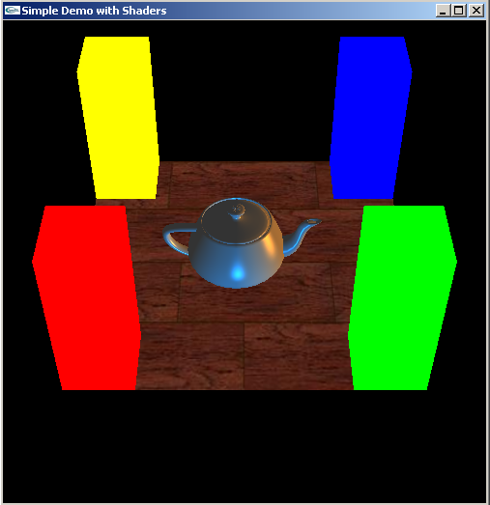
Demo for mytest3
Lighting on teapot
Blue, red highlights
Diffuse shading
Texture on floor
Update as we move

Slide 5
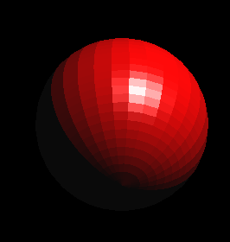
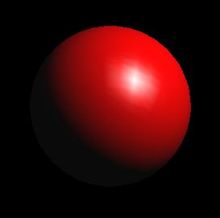
Importance of Lighting
Important to bring out 3D appearance (compare teapot now to in previous demo)
Important for correct shading under lights
The way shading is done also important
  Flat: Entire face has single color (normal) from one vertex
  Gouraud or smooth: Colors at each vertex, interpolate
glShadeModel(GL_FLAT) [old]
glShadeModel(GL_SMOOTH) [old]

Slide 6
Brief primer on Color
Red, Green, Blue primary colors
  Can be thought of as vertices of a color cube
  R+G = Yellow, B+G = Cyan, B+R = Magenta, R+G+B = White
  Each color channel (R,G,B) treated separately
RGBA 32 bit mode (8 bits per channel) often used
  A is for alpha for transparency if you need it
Colors normalized to 0 to 1 range in OpenGL
  Often represented as 0 to 255 in terms of pixel intensities
Also, color index mode (not so important)

Slide 7
Outline
Gouraud and Phong shading (vertex vs fragment)
Types of lighting, materials and shading
  Lights: Point and Directional
  Shading: Ambient, Diffuse, Emissive, Specular
Fragment shader for mytest3
  HW 2 requires a more general version of this
Source code in display routine

Slide 8
Vertex vs Fragment Shaders
Can use vertex or fragment shaders for lighting
Vertex computations interpolated by rasterizing
  Gouraud (smooth) shading, as in mytest1
  Flat shading: no interpolation (single color of polygon)
Either compute colors at vertices, interpolate
  This is standard in old-style OpenGL
  Can be implemented with vertex shaders
Or interpolate normals etc. at vertices
And then shade at each pixel in fragment shader
  Phong shading (different from Phong illumination)
  More accurate
Wireframe: glPolygonMode (GL_FRONT, GL_LINE)
  Also, polygon offsets to superimpose wireframe
  Hidden line elimination? (polygons in black…)

Slide 9
Gouraud Shading – Details
Scan line
Actual implementation efficient: difference
equations while scan converting

Slide 10
Gouraud and Errors
I₁ = 0 because (N dot E) is negative.
I₂ = 0 because (N dot L) is negative.
Any interpolation of I₁ and I₂ will be 0.
I₁ = 0
I₂ = 0
area of desired highlight

Slide 11
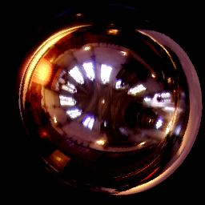
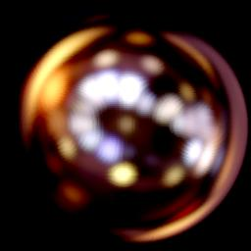
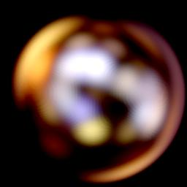
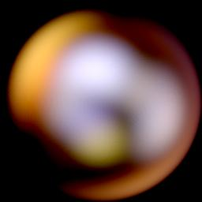
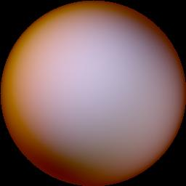
Phong Illumination Model
Specular or glossy materials: highlights
  Polished floors, glossy paint, whiteboards
  For plastics highlight is color of light source (not object)
  For metals, highlight depends on surface color
Really, (blurred) reflections of light source
Roughness

Slide 12
2 Phongs make a Highlight
Besides the Phong Illumination or Reflectance model, there is a Phong Shading model.
Phong Shading: Instead of interpolating the intensities between vertices, interpolate the normals.
The entire lighting calculation is performed for each pixel, based on the interpolated normal. (Old OpenGL doesn’t do this, but you can and will with current fragment shaders)
I₁ = 0
I₂ = 0

Slide 13
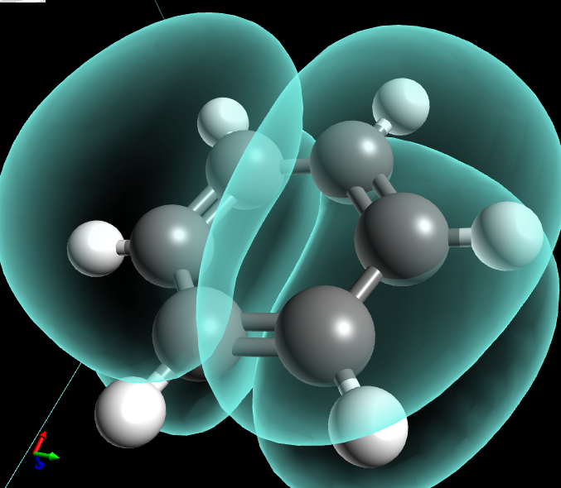
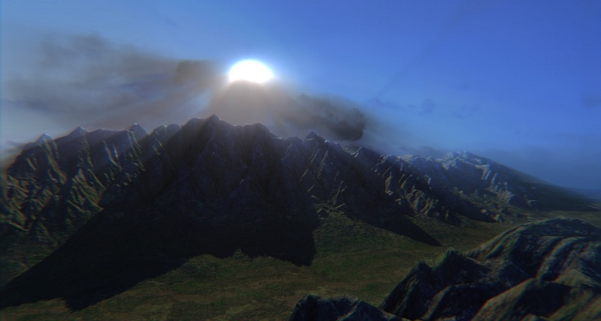
Examples and Color Plates
See OpenGL color plates (earlier eds) and glsl book
http://blog.cryos.net/categories/15-Avogadro/P3.html
http://blenderartists.org/forum/showthread.php?11430-Games-amp-Tutorials-(updated-Jan-5-2011)

Slide 14
Simple Vertex Shader in mytest3
#version 330 core // Do not use any version older than 330!
// Inputs
layout (location = 0) in vec3 position;
layout (location = 1) in vec3 normal;
layout (location = 2) in vec2 texCoords;
// Extra outputs, if any
out vec4 myvertex;
out vec3 mynormal;
out vec2 texcoord;
// Uniform variables
uniform mat4 projection;
uniform mat4 modelview;
uniform int istex ;

Slide 15
Simple Vertex Shader in mytest3
void main() {
gl_Position = projection * modelview * vec4(position, 1.0f);
mynormal = mat3(transpose(inverse(modelview))) * normal ;
myvertex = modelview * vec4(position, 1.0f) ;
texcoord = vec2 (0.0, 0.0); // Default value just to prevent errors
if (istex != 0){
texcoord = texCoords;
}
}

Slide 16
Outline
Gouraud and Phong shading (vertex vs fragment)
Types of lighting, materials and shading
  Lights: Point and Directional
  Shading: Ambient, Diffuse, Emissive, Specular
Fragment shader for mytest3
  HW 2 requires a more general version of this
Source code in display routine

Slide 17
Lighting and Shading
Rest of this lecture considers lighting
In real world, complex lighting, materials interact
We study this more formally in CSE 168
For now some basic approximations to capture key effects in lighting and shading
Inspired by old OpenGL fixed function pipeline
  But remember that’s not physically based

Slide 18
Types of Light Sources
Point
  Position, Color
  Attenuation (quadratic model)
Attenuation
  Usually assume no attenuation (not physically correct)
  Quadratic inverse square falloff for point sources
  Linear falloff for line sources (tube lights). Why?
  No falloff for distant (directional) sources. Why?
Directional (w=0, infinite far away, no attenuation)
Spotlights (not considered in homework)
  Spot exponent
  Spot cutoff

Slide 19
Material Properties
Need normals (to calculate how much diffuse, specular, find reflected direction and so on)
  Usually specify at each vertex, interpolate
  GLUT used to do it automatically for teapots etc
  (we provide meshes with normals instead for you in hw 2)
  Can do manually for parametric surfaces
  Average face normals for more complex shapes
Four terms: Ambient, Diffuse, Specular, Emissive

Slide 20
Emissive Term
Only relevant for light sources when looking directly at them
Gotcha: must create geometry to actually see light
Emission does not in itself affect other lighting calculations

Slide 21
Ambient Term
Hack to simulate multiple bounces, scattering of light
Assume light equally from all directions
Global constant
Never have black pixels

Slide 22
Diffuse Term
Rough matte (technically Lambertian) surfaces
Light reflects equally in all directions
N
-L

Slide 23
Diffuse Term
Rough matte (technically Lambertian) surfaces
Light reflects equally in all directions
N
-L

Slide 24
Specular Term
Glossy objects, specular reflections
Light reflects close to mirror direction

Slide 25
Phong Illumination Model
Specular or glossy materials: highlights
  Polished floors, glossy paint, whiteboards
  For plastics highlight is color of light source (not object)
  For metals, highlight depends on surface color
Really, (blurred) reflections of light source
Roughness

Slide 26
Idea of Phong Illumination
Find a simple way to create highlights that are view-dependent and happen at about the right place
Not physically based
Use dot product (cosine) of eye and reflection of light direction about surface normal
Alternatively, dot product of half angle and normal
  Has greater physical backing. We use this form
Raise cosine lobe to some power to control sharpness or roughness

Slide 27
Phong Formula
R
-L
E

Slide 28
Alternative: Half-Angle (Blinn-Phong)
Diffuse and specular components for most materials
N
H

Slide 29
Demo in mytest3
What happens when we make surface less shiny?

Slide 30
Outline
Gouraud and Phong shading (vertex vs fragment)
Types of lighting, materials and shading
  Lights: Point and Directional
  Shading: Ambient, Diffuse, Emissive, Specular
Fragment shader for mytest3
  HW 2 requires a more general version of this
Source code in display routine

Slide 31
Fragment Shader Setup
#version 330 core // Do not use any version older than 330!
// Inputs fragment shader are outputs of same name of vertex shader
in vec4 myvertex;
in vec3 mynormal;
in vec2 texcoord;
// Output the frag color
out vec4 fragColor;
uniform sampler2D tex ;
uniform int istex ;
uniform int islight ; // are we lighting.
uniform vec3 color;

Slide 32
Fragment Shader Variables
// Assume light 0 is directional, light 1 is a point light.
// Actual light values are passed from the main OpenGL program.
// This could be fancier. My goal is to illustrate a simple idea.
uniform vec3 light0dirn ;
uniform vec4 light0color ;
uniform vec4 light1posn ;
uniform vec4 light1color ;
// Now, set the material parameters. These could be bound to
// a buffer. But for now, I'll just make them uniform.
// I use ambient, diffuse, specular, shininess.
// Ambient is just additive and doesn't multiply the lights.
uniform vec4 ambient ;
uniform vec4 diffuse ;
uniform vec4 specular ;
uniform float shininess ;

Slide 33
Fragment Shader Compute Lighting
vec4 ComputeLight (const in vec3 direction, const in vec4 lightcolor, const in vec3 normal, const in vec3 halfvec, const in vec4 mydiffuse, const in vec4 myspecular, const in float myshininess) {
float nDotL = dot(normal, direction) ;
vec4 lambert = mydiffuse * lightcolor * max (nDotL, 0.0) ;
float nDotH = dot(normal, halfvec) ;
vec4 phong = myspecular * lightcolor * pow (max(nDotH, 0.0), myshininess) ;
vec4 retval = lambert + phong ;
return retval ;
}

Slide 34
Fragment Shader Main Transforms
void main (void)
{
if (istex > 0) fragColor = texture(tex, texcoord);
else if (islight == 0) fragColor = vec4(color, 1.0f) ;
else {
// They eye is always at (0,0,0) looking down -z axis
// Also compute current fragment position, direction to eye
const vec3 eyepos = vec3(0,0,0) ;
vec3 mypos = myvertex.xyz / myvertex.w ; // Dehomogenize
vec3 eyedirn = normalize(eyepos - mypos) ;
// Compute normal, needed for shading.
vec3 normal = normalize(mynormal) ;

Slide 35
Fragment Shader Main Routine
// Light 0, directional
vec3 direction0 = normalize (light0dirn) ;
vec3 half0 = normalize (direction0 + eyedirn) ;
vec4 col0 = ComputeLight(direction0, light0color, normal, half0, diffuse, specular, shininess) ;
// Light 1, point
vec3 position = light1posn.xyz / light1posn.w ;
vec3 direction1 = normalize (position - mypos) ;
// no attenuation
vec3 half1 = normalize (direction1 + eyedirn) ;
vec4 col1 = ComputeLight(direction1, light1color, normal, half1, diffuse, specular, shininess) ;
fragColor = ambient + col0 + col1 ;
}
}

Slide 36
Outline
Gouraud and Phong shading (vertex vs fragment)
Types of lighting, materials and shading
  Lights: Point and Directional
  Shading: Ambient, Diffuse, Emissive, Specular
Fragment shader for mytest3
  HW 2 requires a more general version of this
Source code in display routine

Slide 37
Light Set Up (in display)
/* New for Demo 3; add lighting effects */
{
const GLfloat one[] = {1,1,1,1} ;
const GLfloat medium[] = {0.5f, 0.5f, 0.5f, 1};
const GLfloat small[] = {0.2f, 0.2f, 0.2f, 1};
const GLfloat high[] = {100} ;
const GLfloat zero[] = {0.0, 0.0, 0.0, 1.0} ;
const GLfloat light_specular[] = {1, 0.5, 0, 1};
const GLfloat light_specular1[] = {0, 0.5, 1, 1};
const GLfloat light_direction[] = {0.5, 0, 0, 0}; // Dir lt
const GLfloat light_position1[] = {0, -0.5, 0, 1};
GLfloat light0[4], light1[4] ;
// Set Light and Material properties for the teapot
// Lights are transformed by current modelview matrix.
// The shader can't do this globally. So we do so manually.
transformvec(light_direction, light0) ;
transformvec(light_position1, light1) ;

Slide 38
Moving a Light Source
Lights transform like other geometry
Only modelview matrix (not projection). The only real application where the distinction is important
Types of light motion
  Stationary: set the transforms to identity before specifying it
  Moving light: Push Matrix, move light, Pop Matrix
  Moving light source with viewpoint (attached to camera). Can simply set light to 0 0 0 so origin wrt eye coords (make modelview matrix identity before doing this)

Slide 39
Modelview Light Transform
/* New helper transformation function to transform vector by modelview */
void transformvec (const GLfloat input[4], GLfloat output[4]) {
glm::vec4 inputvec(input[0], input[1], input[2], input[3]);
glm::vec4 outputvec = modelview * inputvec;
output[0] = outputvec[0];
output[1] = outputvec[1];
output[2] = outputvec[2];
output[3] = outputvec[3];
}

Slide 40
Set up Lighting for Teapot
glUniform3fv(light0dirn, 1, light0) ;
glUniform4fv(light0color, 1, light_specular) ;
glUniform4fv(light1posn, 1, light1) ;
glUniform4fv(light1color, 1, light_specular1) ;
// glUniform4fv(light1color, 1, zero) ;
glUniform4fv(ambient,1,small) ;
glUniform4fv(diffuse,1,medium) ;
glUniform4fv(specular,1,one) ;
glUniform1fv(shininess,1,high) ;
// Enable and Disable everything around the teapot
// Generally, we would also need to define normals etc.
// But the teapot object file already defines these for us.
if (DEMO > 4)
glUniform1i(islight,lighting) ; // lighting only teapot.

Slide 41
Shader Mappings in init
vertexshader = initshaders(GL_VERTEX_SHADER, "shaders/light.vert") ;
fragmentshader = initshaders(GL_FRAGMENT_SHADER, "shaders/light.frag") ;
shaderprogram = initprogram(vertexshader, fragmentshader) ;
// * NEW * Set up the shader parameter mappings properly for lighting.
islight = glGetUniformLocation(shaderprogram,"islight") ;
light0dirn = glGetUniformLocation(shaderprogram,"light0dirn") ;
light0color = glGetUniformLocation(shaderprogram,"light0color") ;
light1posn = glGetUniformLocation(shaderprogram,"light1posn") ;
light1color = glGetUniformLocation(shaderprogram,"light1color") ;
ambient = glGetUniformLocation(shaderprogram,"ambient") ;
diffuse = glGetUniformLocation(shaderprogram,"diffuse") ;
specular = glGetUniformLocation(shaderprogram,"specular") ;
shininess = glGetUniformLocation(shaderprogram,"shininess") ;

