Slide 1
Computer Graphics
CSE 167 [Win 22], Lecture 15: Ray Tracing
Ravi Ramamoorthi
http://viscomp.ucsd.edu/classes/cse167/wi22

Slide 2
To Do
Midterm is graded. Mean/Median
If you did poorly, remember only one assignment
HW 3 due tomorrow Feb 23. Any questions?
HW 4 milestone due Mar 4, full homework Mar 15
START EARLY; FIND A PARTNER IF POSSIBLE
Likely hardest assignment you will have at UCSD (but most rewarding). Some comments from edX:
The last assignment took me 50+ hours brutal but worth it
The final project (a ray tracer from scratch) was great; it’s remarkable that the instructor ... students all the tools to successfully complete it.

Slide 3
Effects needed for Realism
(Soft) Shadows
Reflections (Mirrors and Glossy)
Transparency (Water, Glass)
Interreflections (Color Bleeding)
Complex Illumination (Natural, Area Light)
Realistic Materials (Velvet, Paints, Glass)
And many more

Slide 4
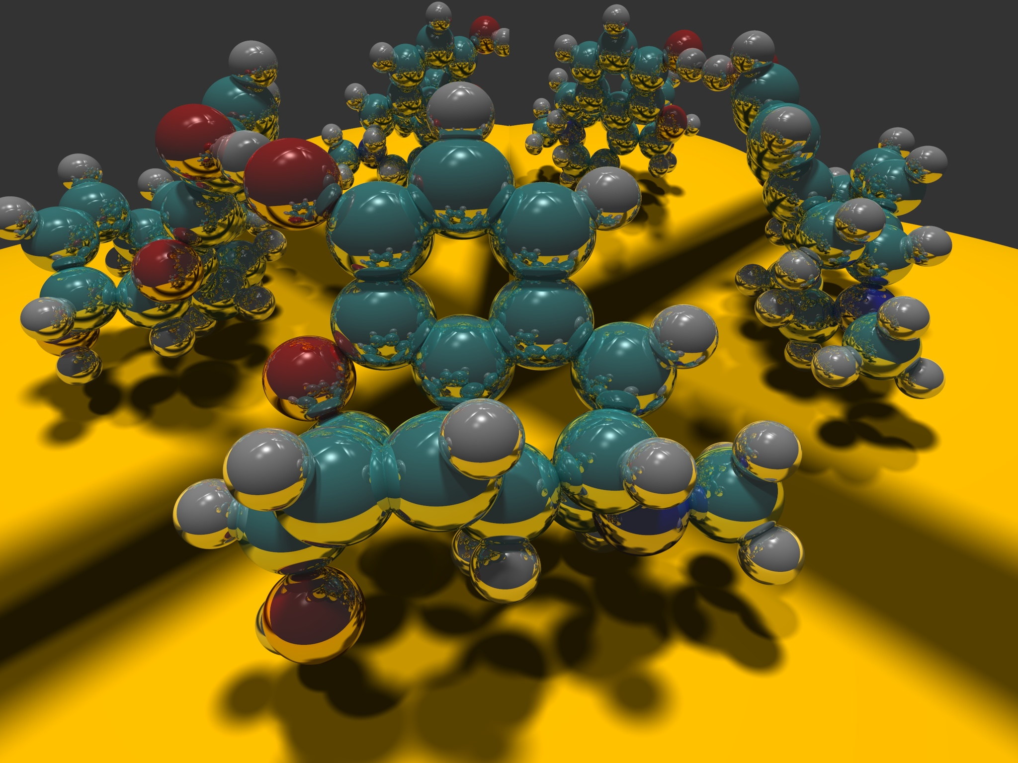
Image courtesy Paul Heckbert 1983

Slide 5
Ray Tracing
Different Approach to Image Synthesis as compared to Hardware pipeline (OpenGL)
Pixel by Pixel instead of Object by Object
Easy to compute shadows/transparency/etc

Slide 6
Outline
History
Basic Ray Casting (instead of rasterization)
Comparison to hardware scan conversion
Shadows / Reflections (core algorithm)
Ray-Surface Intersection
Optimizations
Current Research

Slide 7
Ray Tracing: History
Appel 68
Whitted 80 [recursive ray tracing]
Landmark in computer graphics
Lots of work on various geometric primitives
Lots of work on accelerations
Current Research
Real-Time raytracing (historically, slow technique)
Ray tracing architecture

Slide 8
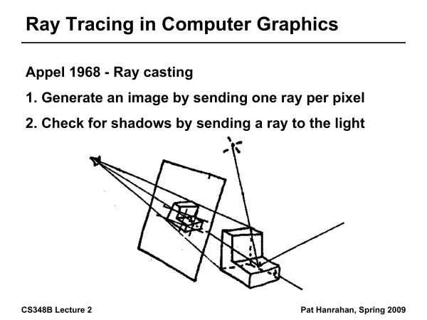
Ray Tracing History

Slide 9
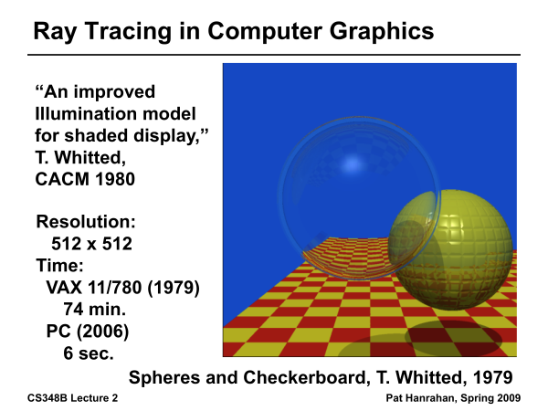
Ray Tracing History

Slide 10
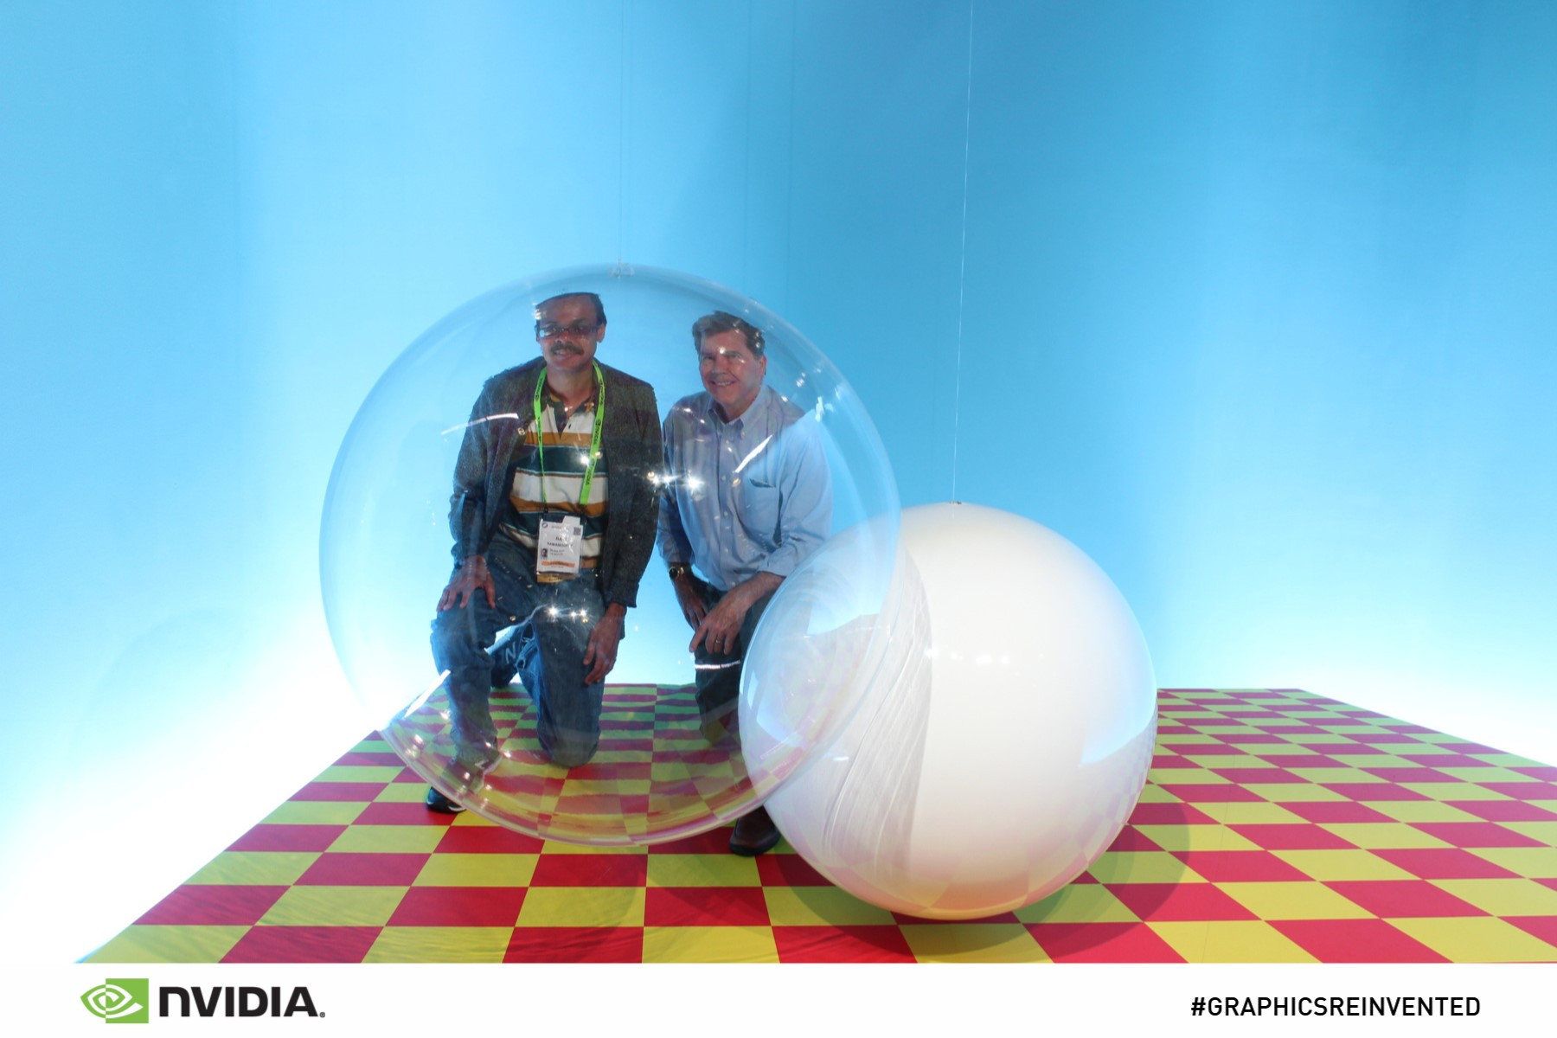
From SIGGRAPH 18
Real Photo: Instructor and Turner Whitted at SIGGRAPH 18

Slide 11
Outline in Code
Image Raytrace (Camera cam, Scene scene, int width, int height)
{
Image image = new Image (width, height) ;
for (int i = 0 ; i < height ; i++)
for (int j = 0 ; j < width ; j++) {
Ray ray = RayThruPixel (cam, i, j) ;
Intersection hit = Intersect (ray, scene) ;
image[i][j] = FindColor (hit) ;
}
return image ;
}

Slide 12
Outline
History
Basic Ray Casting (instead of rasterization)
Comparison to hardware scan conversion
Shadows / Reflections (core algorithm)
Ray-Surface Intersection
Optimizations
Current Research

Slide 13
Ray Casting
Produce same images as with OpenGL
Visibility per pixel instead of Z-buffer
Find nearest object by shooting rays into scene
Shade it as in standard OpenGL

Slide 14
Ray Casting
Virtual Viewpoint
Virtual Screen
Objects
Multiple intersections: Use closest one (as does OpenGL)
Ray misses all objects: Pixel colored black
Ray intersects object: shade using color, lights, materials

Slide 15
Comparison to hardware scan-line
Per-pixel evaluation, per-pixel rays (not scan-convert each object). On face of it, costly
But good for walkthroughs of extremely large models (amortize preprocessing, low complexity)
More complex shading, lighting effects possible

Slide 16
Outline
History
Basic Ray Casting (instead of rasterization)
Comparison to hardware scan conversion
Shadows / Reflections (core algorithm)
Ray-Surface Intersection
Optimizations
Current Research

Slide 17
Shadows
Light Source
Virtual Viewpoint
Virtual Screen
Objects
Shadow ray to light is blocked: object in shadow
Shadow ray to light is unblocked: object visible

Slide 18
Shadows: Numerical Issues
Numerical inaccuracy may cause intersection to be
below surface (effect exaggerated in figure)
Causing surface to incorrectly shadow itself
Move a little towards light before shooting shadow ray

Slide 19
Mirror Reflections/Refractions
Virtual Viewpoint
Virtual Screen
Objects
Generate reflected ray in mirror direction,
Get reflections and refractions of objects

Slide 20
Recursive Ray Tracing
For each pixel
Trace Primary Eye Ray, find intersection
Trace Secondary Shadow Ray(s) to all light(s)
Color = Visible ? Illumination Model : 0 ;
Trace Reflected Ray
Color += reflectivity * Color of reflected ray

Slide 21
Problems with Recursion
Reflection rays may be traced forever
Generally, set maximum recursion depth
Same for transmitted rays (take refraction into account)

Slide 22
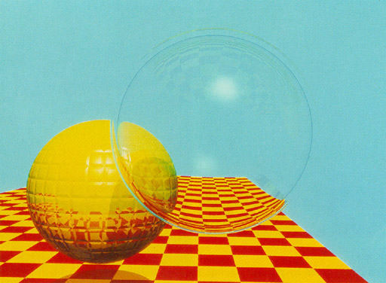
Turner Whitted 1980

Slide 23
Effects needed for Realism
(Soft) Shadows
Reflections (Mirrors and Glossy)
Transparency (Water, Glass)
Interreflections (Color Bleeding)
Complex Illumination (Natural, Area Light)
Realistic Materials (Velvet, Paints, Glass)
Discussed in this lecture
Not discussed but possible with distribution ray tracing
Hard (but not impossible) with ray tracing; radiosity methods

Slide 24
Outline
History
Basic Ray Casting (instead of rasterization)
Comparison to hardware scan conversion
Shadows / Reflections (core algorithm)
Ray-Surface Intersection
Optimizations
Current Research

Slide 25
Ray/Object Intersections
Heart of Ray Tracer
One of the main initial research areas
Optimized routines for wide variety of primitives
Various types of info
Shadow rays: Intersection/No Intersection
Primary rays: Point of intersection, material, normals
Texture coordinates
Work out examples
Triangle, sphere, polygon, general implicit surface

Slide 26
Ray-Sphere Intersection
C
P₀

Slide 27
Ray-Sphere Intersection
Substitute
Simplify

Slide 28
Ray-Sphere Intersection
2 real positive roots: pick smaller root
Both roots same: tangent to sphere
One positive, one negative root: ray origin inside sphere (pick + root)
Complex roots: no intersection (check discriminant of equation first)
Solve quadratic equations for t

Slide 29
Ray-Sphere Intersection
Intersection point:
Normal (for sphere, this is same as coordinates in sphere frame of reference, useful other tasks)

Slide 30
Ray-Triangle Intersection
One approach: Ray-Plane intersection, then check if inside triangle
Plane equation:
B
A
C

Slide 31
Ray-Triangle Intersection
One approach: Ray-Plane intersection, then check if inside triangle
Plane equation:
Combine with ray equation:
B
A
C

Slide 32
Ray inside Triangle
Once intersect with plane, still need to find if in triangle
Many possibilities for triangles, general polygons (point in polygon tests)
We find parametrically [barycentric coordinates]. Also useful for other applications (texture mapping)
B
A
α
β
P
γ
C

Slide 33
Ray inside Triangle
B
A
α
β
P
γ
C

Slide 34
Other primitives
Much early work in ray tracing focused on ray-primitive intersection tests
Cones, cylinders, ellipsoids
Boxes (especially useful for bounding boxes)
General planar polygons
Many more
Many references. For example, chapter in Glassner introduction to ray tracing (see me if interested)

Slide 35
Ray-Tracing Transformed Objects
We have an optimized ray-sphere test
But we want to ray trace an ellipsoid…
Solution: Ellipsoid transforms sphere
Apply inverse transform to ray, use ray-sphere
Allows for instancing (traffic jam of cars)
Mathematical details worked out in class

Slide 36
Transformed Objects
Consider a general 4x4 transform M
Will need to implement matrix stacks like in OpenGL
Apply inverse transform M⁻¹ to ray
Locations stored and transform in homogeneous coordinates
Vectors (ray directions) have homogeneous coordinate set to 0 [so there is no action because of translations]
Do standard ray-surface intersection as modified
Transform intersection back to actual coordinates
Intersection point p transforms as Mp
Distance to intersection if used may need recalculation
Normals n transform as M^{-t}n. Do all this before lighting

Slide 37
Outline
History
Basic Ray Casting (instead of rasterization)
Comparison to hardware scan conversion
Shadows / Reflections (core algorithm)
Ray-Surface Intersection
Optimizations
Current Research

Slide 38
Acceleration
Testing each object for each ray is slow
Fewer Rays
Adaptive sampling, depth control
Generalized Rays
Beam tracing, cone tracing, pencil tracing etc.
Faster Intersections
Optimized Ray-Object Intersections
Fewer Intersections
We just discuss some approaches at high level; chapter 13 briefly covers

Slide 39
Acceleration Structures
Bounding boxes (possibly hierarchical)
If no intersection bounding box, needn’t check objects
Bounding Box
Ray
Spatial Hierarchies (Oct-trees, kd trees, BSP trees)

Slide 40
Acceleration Structures: Grids

Slide 41
Acceleration and Regular Grids
Simplest acceleration, for example 5x5x5 grid
For each grid cell, store overlapping triangles
March ray along grid (need to be careful with this), test against each triangle in grid cell
More sophisticated: kd-tree, oct-tree bsp-tree
Or use (hierarchical) bounding boxes
Try to implement some acceleration in HW 4

Slide 42
Outline
History
Basic Ray Casting (instead of rasterization)
Comparison to hardware scan conversion
Shadows / Reflections (core algorithm)
Ray-Surface Intersection
Optimizations
Current Research

Slide 43
Interactive Raytracing
Ray tracing historically slow
Now viable alternative for complex scenes
Key is sublinear complexity with acceleration; need not process all triangles in scene
Allows many effects hard in hardware
NVIDIA OptiX ray-tracing API like OpenGL
Today: TuringRT 10G rays/second: Video

Slide 44
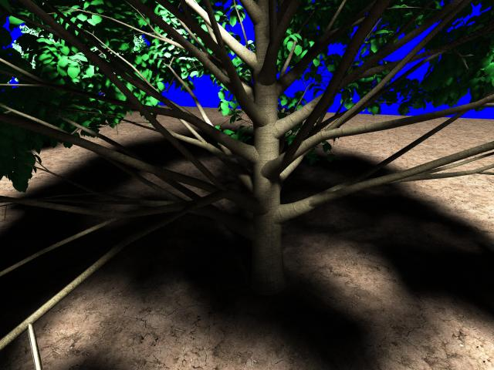
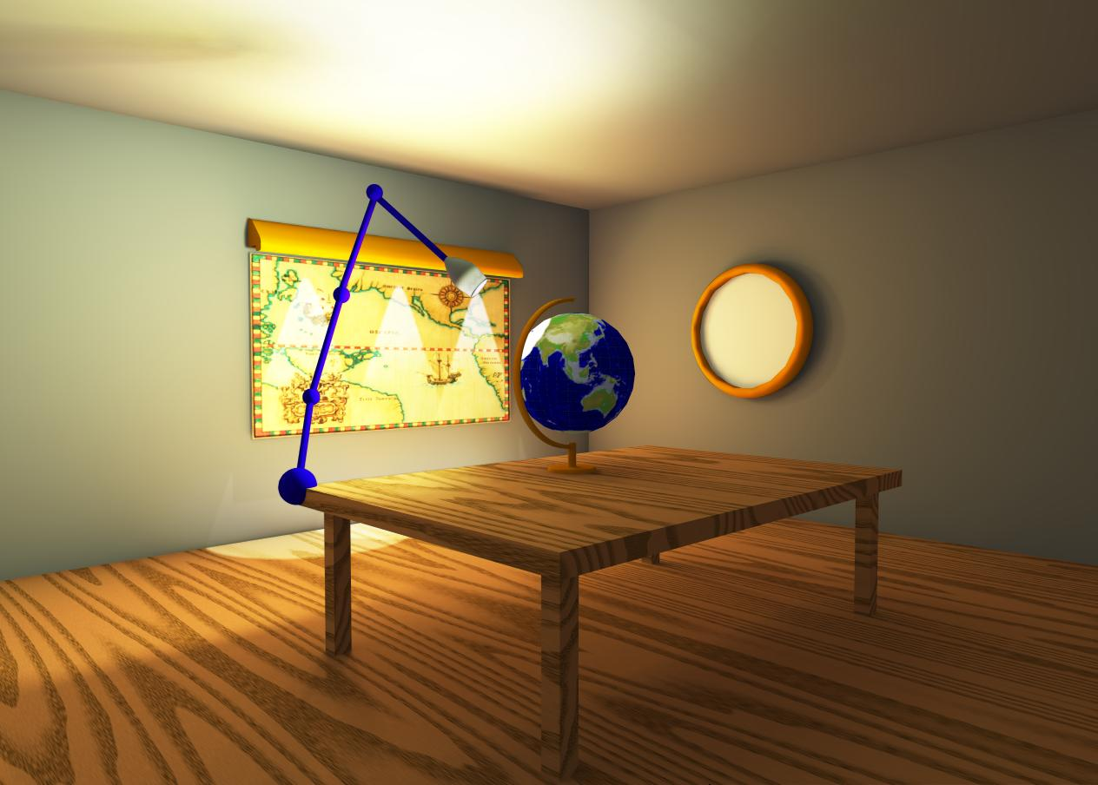
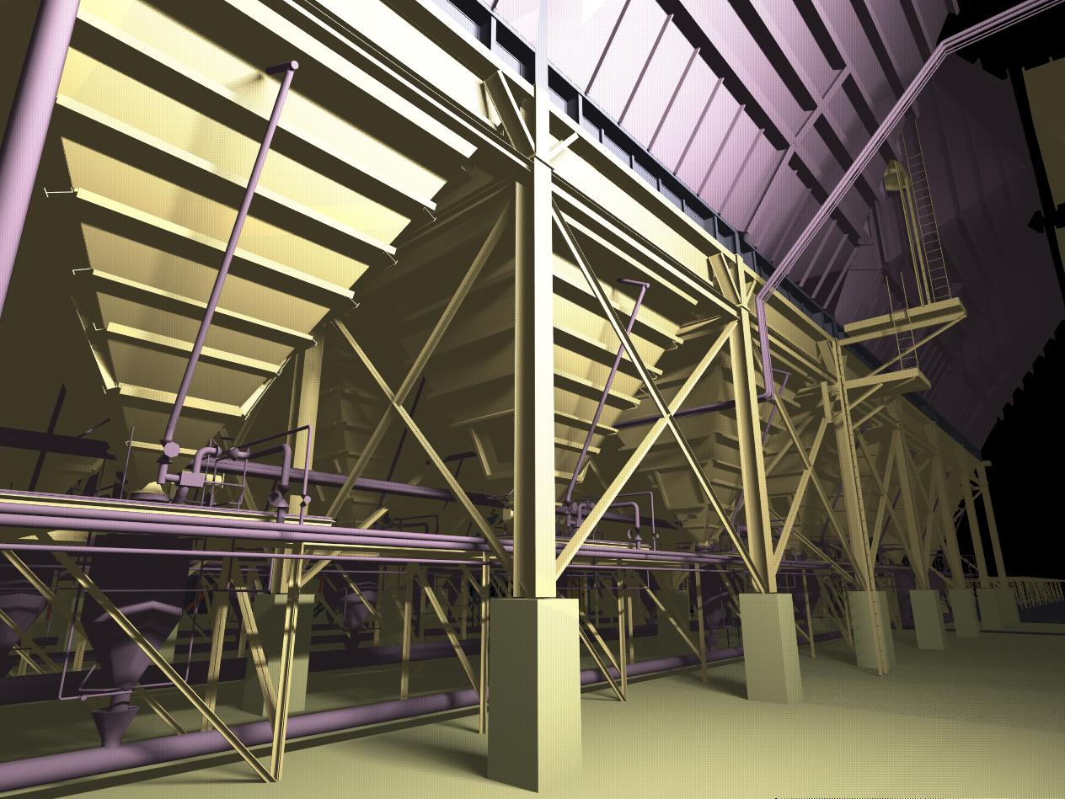
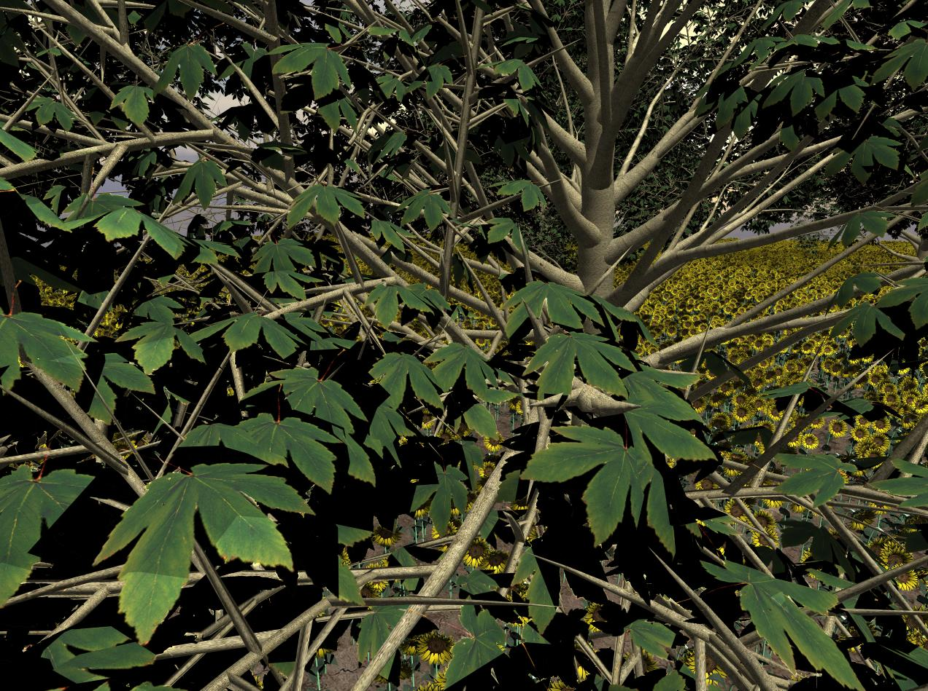

Slide 45
Raytracing on Graphics Hardware
Modern Programmable Hardware general streaming architecture
Can map various elements of ray tracing
Kernels like eye rays, intersect etc.
In vertex or fragment programs
Convergence between hardware, ray tracing
[Purcell et al. 2002, 2003]
http://graphics.stanford.edu/papers/photongfx

Slide 46
