Slide 1


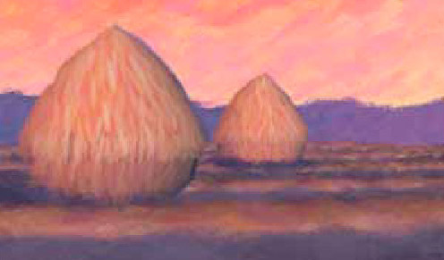
Computer Graphics
CSE 167 [Win 22], Lecture 1: Overview and History
Ravi Ramamoorthi
http://viscomp.ucsd.edu/classes/cse167/wi22

Slide 2
Goals
Systems: Write complex 3D graphics programs (real-time scene in OpenGL, offline raytracer)
Theory: Mathematical aspects and algorithms underlying modern 3D graphics systems
This course is not about the specifics of 3D graphics programs and APIs like Maya, Alias, DirectX but about the concepts underlying them.

Slide 3
Instructor
Ravi Ramamoorthi http://www.cs.ucsd.edu/~ravir
  PhD Stanford, 2002. PhD thesis developed “Spherical Harmonic Lighting” widely used in games (e.g. Halo series), movies (e.g. Avatar), etc. (Adobe, …)
  At Columbia 2002-2008, UC Berkeley 2009-2014
  “Monte Carlo denoising” inspired raytracing offline, real-time
  At UCSD since Jul 2014: Director, Center for Visual Computing
  Awards for research: White House PECASE (2008), SIGGRAPH Significant New Researcher (2007), ACM Fellow
  https://www.youtube.com/watch?v=qpyCXqXGe7I
  Have taught Computer Graphics 10+ times
  Computer Graphics online MOOC (CSE 167x) has had 100,000+ registrations, 500,000 video views. Finalist for two inaugural edX Prizes. Will use UCSD Online, auto-feedback

Slide 4

MOOC Introductory Video

Slide 5
Course Staff
Ravi Ramamoorthi
Teaching Assistants:
  Guowei Yang (g4yang@ucsd.edu)
  Bing Xu (b4xu@ucsd.edu)
  Kai-En Lin (k2lin@eng.ucsd.edu)

Slide 6
Why Study 3D Computer Graphics?
Applications (discussed next)
Fundamental Intellectual Challenges
Some content inspired by Pat Hanrahan from Stanford’s CS148

Slide 7
Entertainment
Movies: Brave, Pixar 2012

Slide 8

Entertainment
Games: Halo 3, Bungie 2007

Slide 9
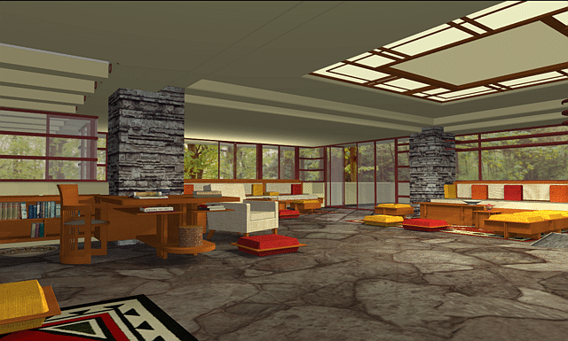
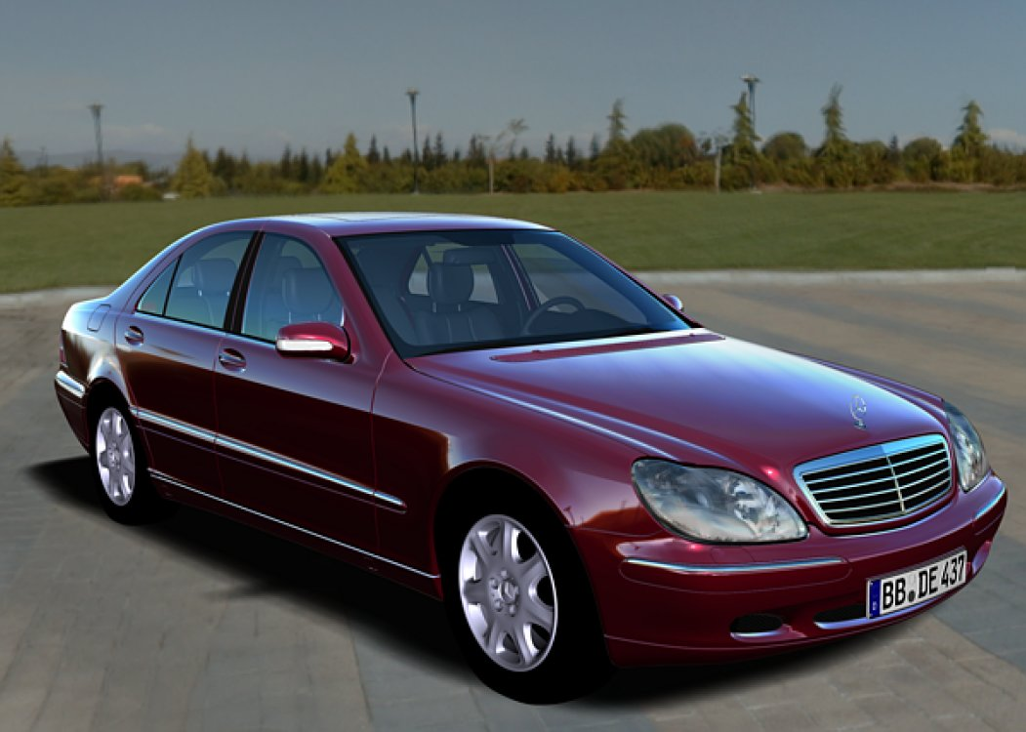
Lighting Simulation
Interior Design
Automobile Visualization

Slide 10
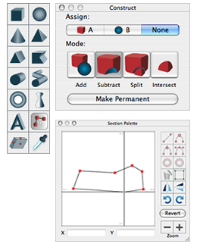
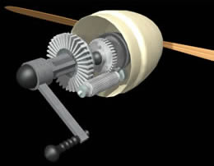
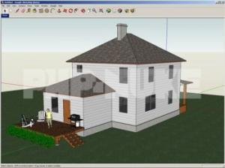
Computer Aided Design
Mechanical CAD
Architectural CAD
Electronics CAD
Casual Users
Interiors Professional
Google Sketchup

Slide 11
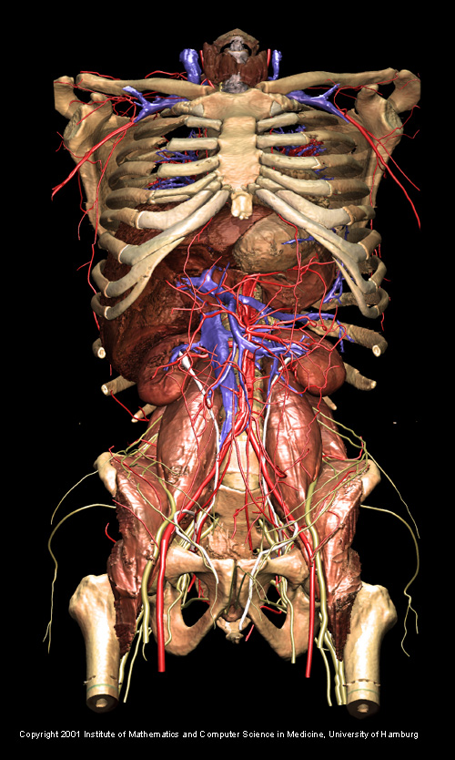
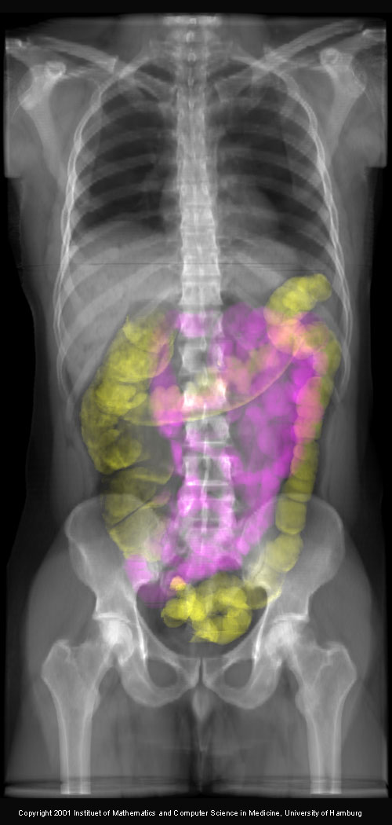
Visualization: Science and Medicine
Visible Human Project: University of Hamburg

Slide 12
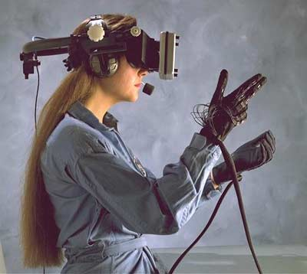
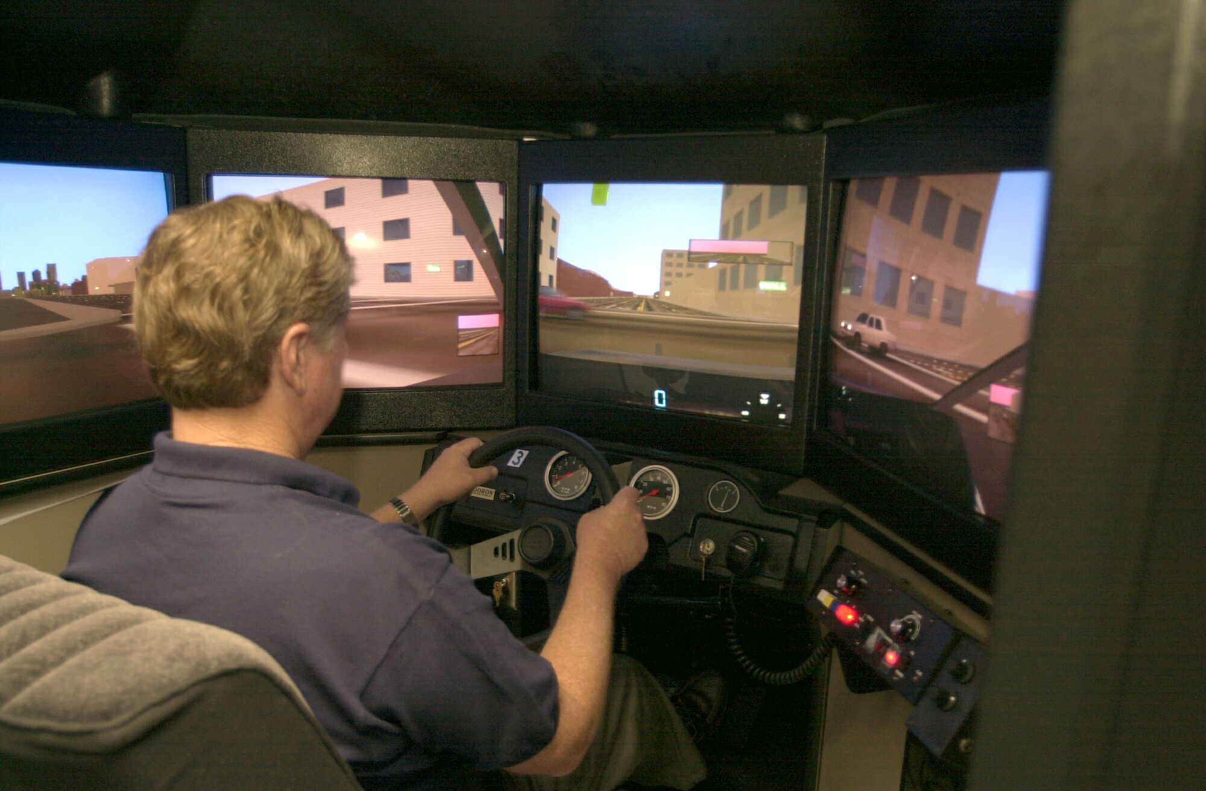
Virtual Reality
VR for design and entertainment
Simulators: Surgical, Flight, Driving, Spacecraft

Slide 13
Digital Visual Media
From text to images to video (to 3D?)
Image and video processing and photography
Multimedia computers, tablets, phones
Flickr, YouTube, WebGL
Real, Virtual Worlds (Google Earth, Metaverse)
Electronic publishing
Online gaming
3D printers and fabrication

Slide 14
Why Study 3D Computer Graphics?
Applications
Fundamental Intellectual Challenges
  Create and interact with realistic virtual world
  Requires understanding of all aspects of physical world
  New computing methods, displays, technologies
Technical Challenges
  Math of (perspective) projections, curves, surfaces
  Physics of lighting and shading
  3D graphics software programming and hardware

Slide 15
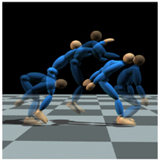
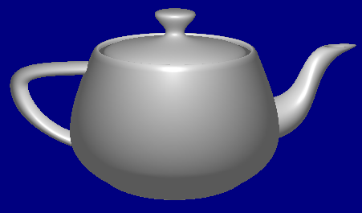
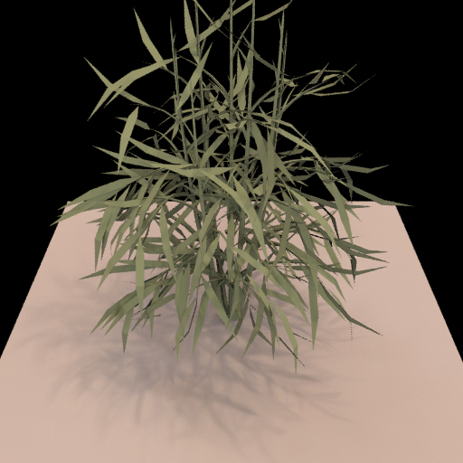
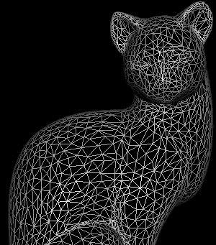
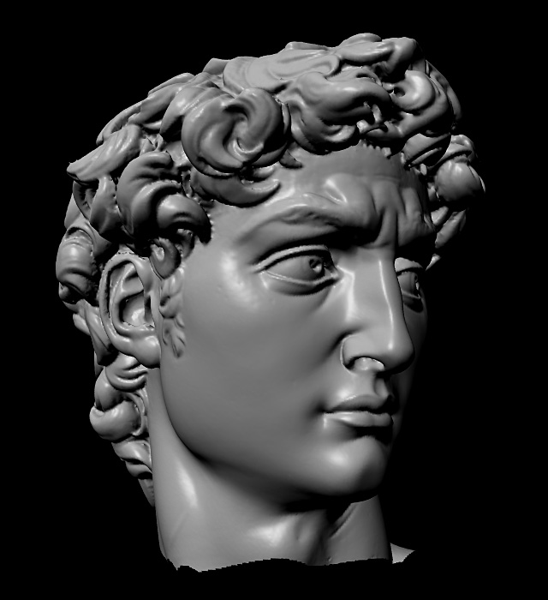
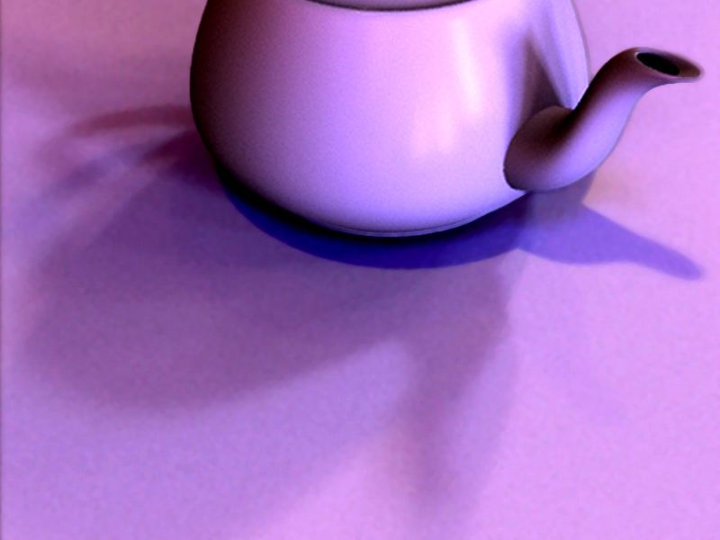
3D Graphics Pipeline
Modeling
Animation
Rendering

Slide 16
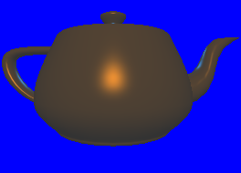
3D Graphics Pipeline
Modeling
Animation
Rendering
HW 1: Transformations (Jan 19)
Place objects in world, view them
Simple viewer for a teapot
HW 3: Curves (Feb 23)
Bezier and B-Spline curves
To model and draw objects

Slide 17
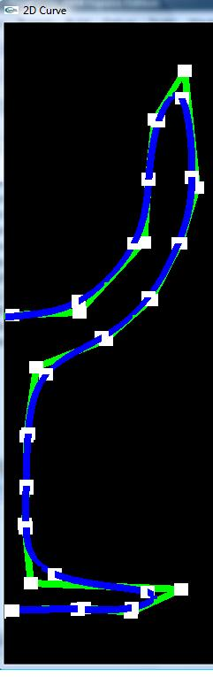
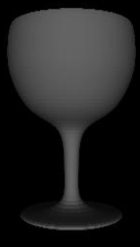
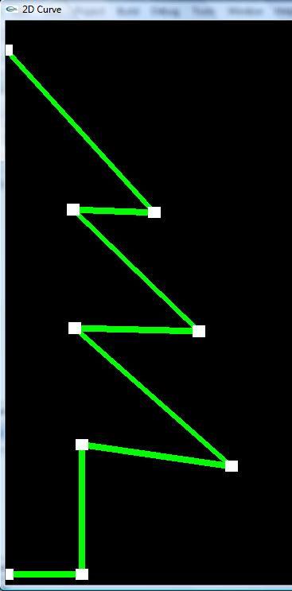
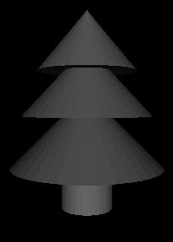
Curves for Modeling
Rachel Shiner, Final Project Spring 2010

Slide 18
3D Graphics Pipeline
Modeling
Animation
Rendering
HW 1: Transformations (Jan 19)
Place objects in world, view them
Simple viewer for a teapot
HW 2: Scene Viewer (Feb 9)
View scene, Lighting and Shading
(with GLSL programmable shaders)
HW 3: Curves (Feb 23)
Bezier and B-Spline curves
To model and draw objects
HW 4: RayTracer (Mar 15)
Realistic images with ray tracing
(two basic approaches: rasterize
And raytrace images [HW 2,4])

Slide 19
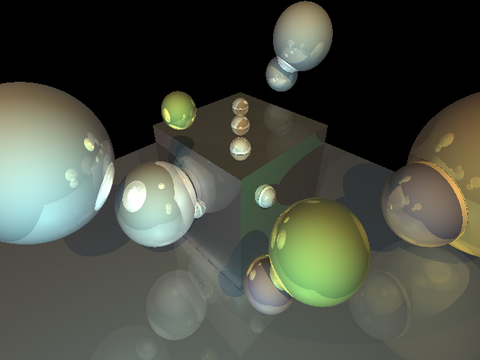
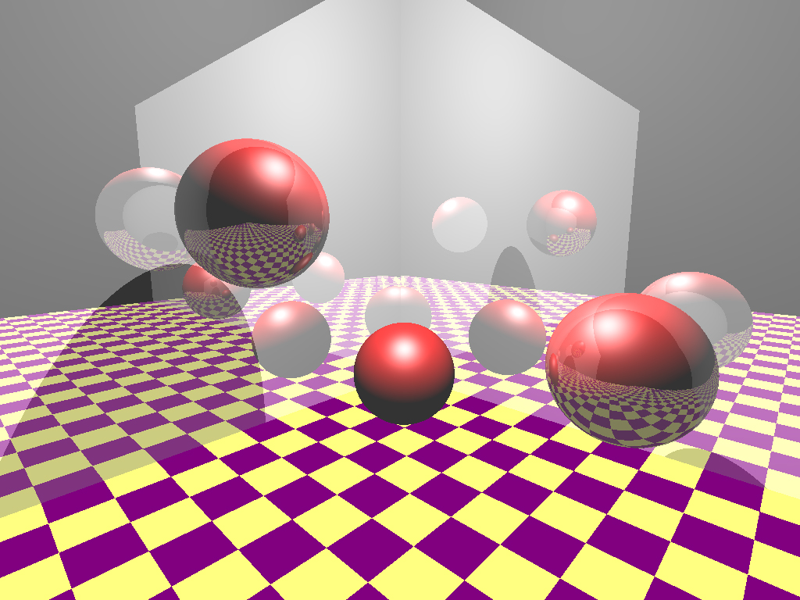
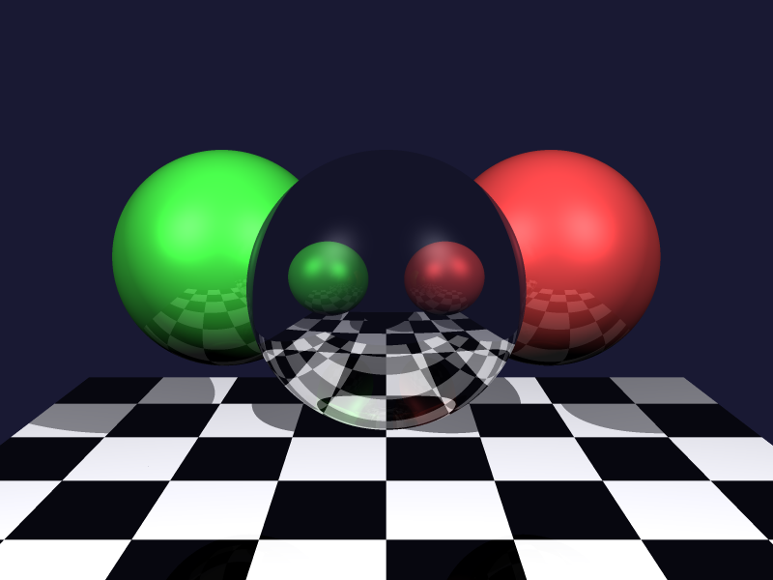
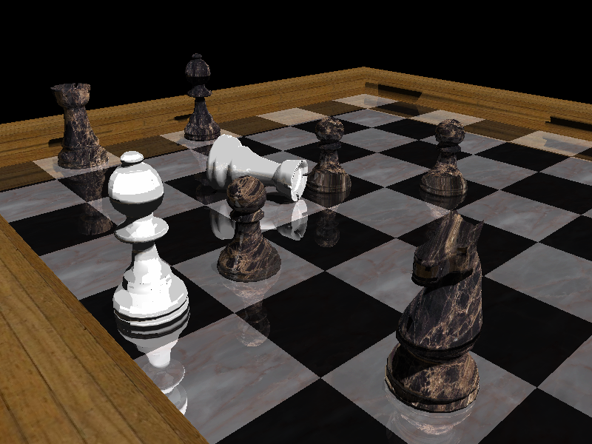
Image Synthesis Examples
Collage from 2007

Slide 20
Logistics
Website http://viscomp.ucsd.edu/classes/cse167/wi22 has most of the information (look at it carefully)
We will be leveraging MOOC infrastructure in a SPOC
  Please sign up for account at UCSD online, join course: DEMO
  UCSD online compulsory for most assignments, feedback systems
  Optional for video lectures (class may differ a bit, more), problems
  Must still submit “official” CSE 167 assignment (see website)
  Please do ask us if you are confused; we are here to help
  No required texts; OpenGL programming guide, GLSL optional
Office hours: Tu/Thu
  See website for sections, TA office hours. Sign up for sections!
Course newsgroup on Piazza
Website for late, collaboration policy, etc
Questions?

Slide 21
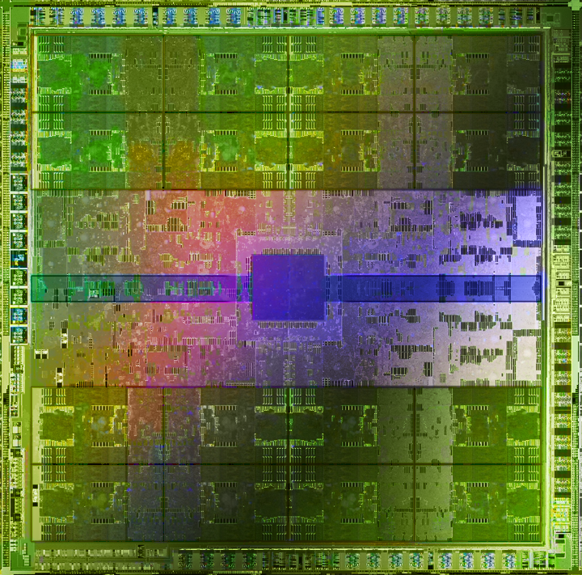
This is a Modernized Course
Modern 3D Graphics Programming with GPUs
  Modern OpenGL (3+), GLSL 330 core
  Real-time feedback servers for all homeworks
GLSL + Programmable Shaders from HW 1
Should be very portable, but need to set up your environment, compilation framework (HW 0)
NVIDIA Fermi, image from Pat Hanrahan

Slide 22
Innovation: Feedback Servers
Feedback/Grading servers for all homeworks
Submit images and/or code, compare to original
  Program generates difference images, report url
  Can get feedback multiple times; submit final url
  All (except curves homework 3) run on UCSD Online
“Feedback” not necessarily grading
  Can run extra test cases, look at code, grade fairly
  But use of feedback servers/edX edge is mandatory
Will test out immediately with HW 0 images
  HW 1 - 2 will have both code and image feedbacks
  Can use any (laptop/desktop) computer. We also try to have the basement labs fully set up.

Slide 23
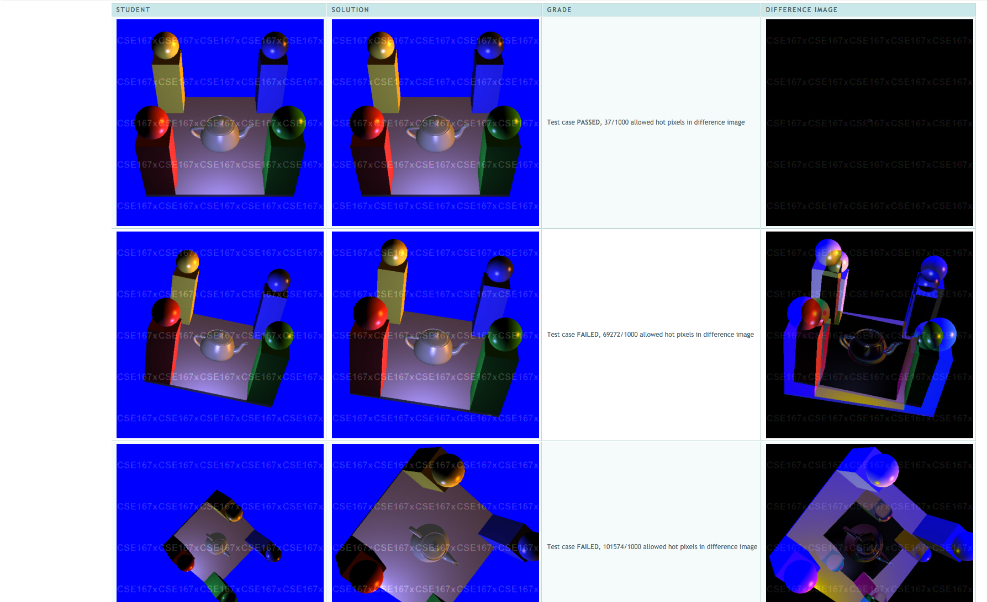
Demo of edX/UCSD Online, Feedbacks

Slide 24
Online Lectures
Online lectures and screencasts for most course:
  http://viscomp.ucsd.edu/classes/cse167/wi22/index.html
  (with English and Chinese! Subtitles [courtesy XuetangX])
  Review for CSE 167 (but still have regular classes)
  For general interest (share with non-CS 167 students)
Originally recorded in 2012 for MOOC offering
  CAVEAT: Does not include all material (curves)
  Was updated in 2017 for more recent OpenGL
  Same as video lectures on UCSD online (some errata)
Currently view lectures as complementary
  Hence, viewing them optional (e.g. miss a class)
  Please note caveats; “official” CSE 167 is in class
May separately have UCSD screencasts

Slide 25
Workload
Lots of fun, rewarding but may involve significant work
4 programming projects (+HW 0); almost all are time-consuming (individual except HW 4). START EARLY !!
Course will involve understanding of mathematical, geometrical concepts taught (tested on midterm)
  No final; will do a take-home small assignment instead
Grade mostly programming, weights on website
  Ignore weighting on edX site; we weight as on CSE 167 site
Prerequisites: Solid C/C++/Java/Python programming background. Linear algebra (review on Thu) and general math skills. No knowledge of graphics/OpenGL needed.
  Should be able to pick up C/C++, and look up some OpenGL
Should be a difficult, but fun and rewarding course

Slide 26
CSE 167 is only a first step
If you enjoy CSE 167 and do well:
In Spring: CSE 168 (Rendering continues; Li)
Next winter: CSE 169 (Animation)
Graduate: CSE 274 (Topics), many 291s, possibly 190

Slide 27
To Do
Look at website
Various policies for course. E-mail if confused.
Sign up for UCSD Online, Piazza, etc.
Skim assignments if you want. All are ready
Assignment 0, Due Jan 12 next week (see website). [both parts needed, total 10 points]
Set up compilation framework in HW 0, feedback
Any questions?

Slide 28
History
Brief history of significant developments in field
End with a video showcasing graphics
The term Computer Graphics was coined by William Fetter of Boeing in 1960
First graphic system in mid 1950s USAF SAGE radar data (developed MIT)

Slide 29
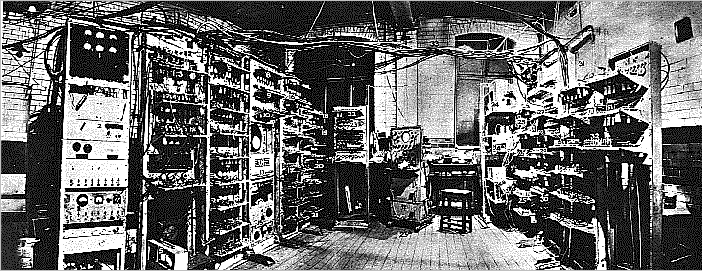
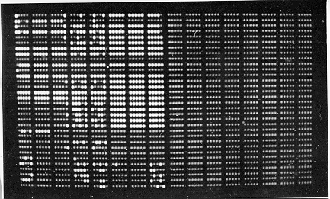
How far we’ve come: TEXT
Manchester Mark I
Display

Slide 30
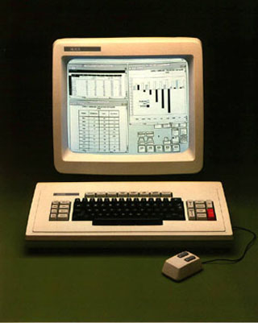
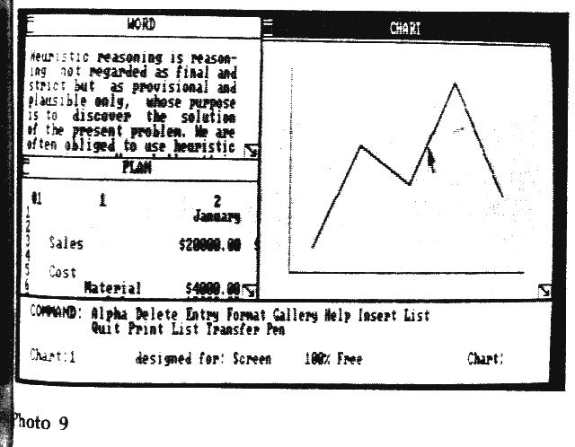
From Text to GUIs
Invented at PARC circa 1975. Used in the Apple Macintosh, and now prevalent everywhere.
Xerox Star
Windows 1.0

Slide 31
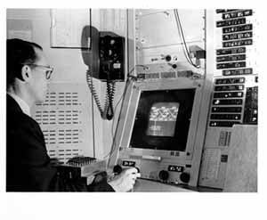
Drawing: Sketchpad (1963)
Sketchpad (Sutherland, MIT 1963)
First interactive graphics system (VIDEO)
Many of concepts for drawing in current systems
  Pop up menus
  Constraint-based drawing
  Hierarchical Modeling

Slide 32
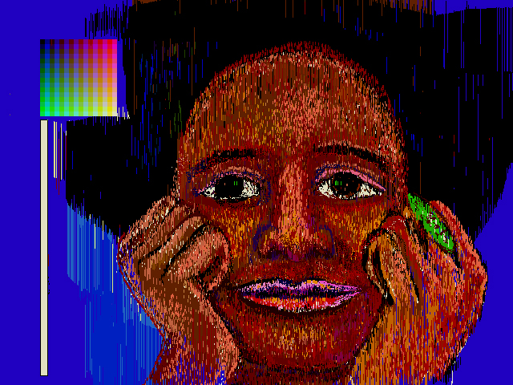
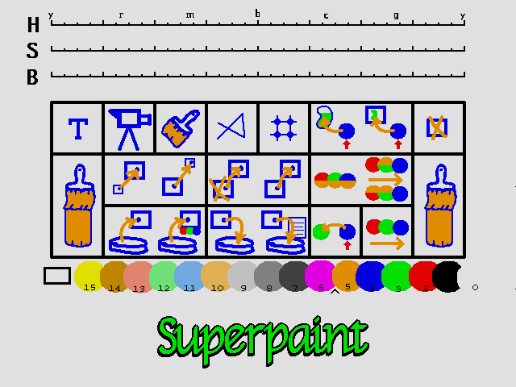
Paint Systems
SuperPaint system: Richard Shoup, Alvy Ray Smith (PARC, 1973-79)
Nowadays, image processing programs like Photoshop can draw, paint, edit, etc.

Slide 33
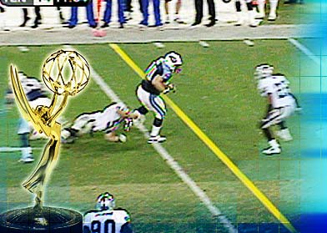
Image Processing
Digitally alter images, crop, scale, composite
Add or remove objects
Sports broadcasts for TV (combine 2D and 3D processing)

Slide 34
Modeling
Spline curves, surfaces: 70^{s} – 80^{s}
Utah teapot: Famous 3D model
More recently: Triangle meshes often acquired from real objects

Slide 35
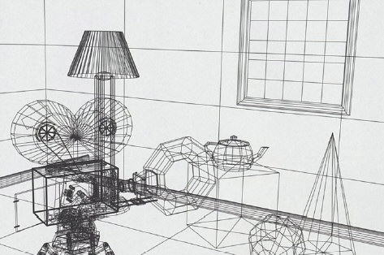
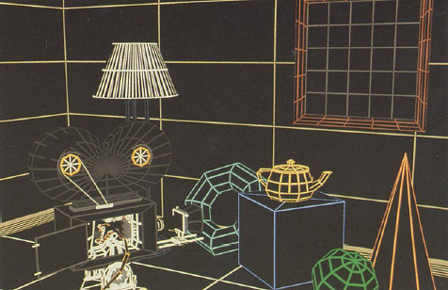
Rendering: 1960s (visibility)
  Roberts (1963), Appel (1967) - hidden-line algorithms
  Warnock (1969), Watkins (1970) - hidden-surface
  Sutherland (1974) - visibility = sorting
Images from FvDFH, Pixar’s Shutterbug
Slide ideas for history of Rendering courtesy Marc Levoy
Notes:
1970s
illustrations taken from FvDFH

Slide 36
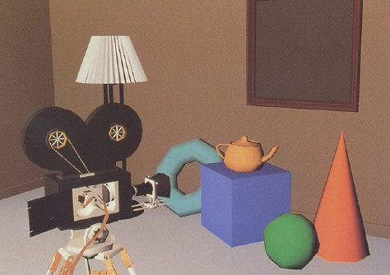
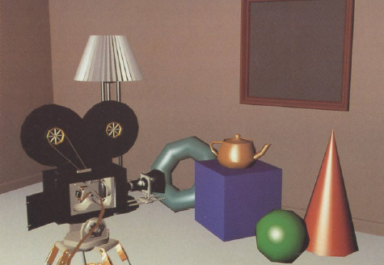
Rendering: 1970s (lighting)
1970s - raster graphics
  Gouraud (1971) - diffuse lighting, Phong (1974) - specular lighting
  Blinn (1974) - curved surfaces, texture
  Catmull (1974) - Z-buffer hidden-surface algorithm
Notes:
1970s
illustrations taken from FvDFH

Slide 37
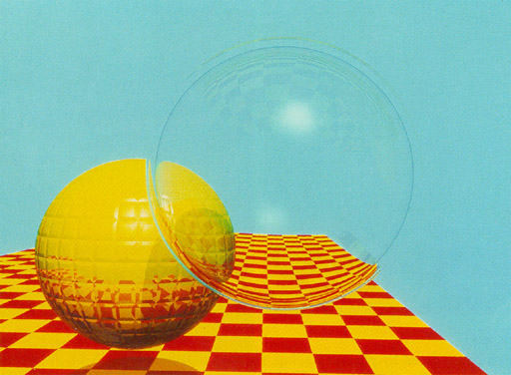
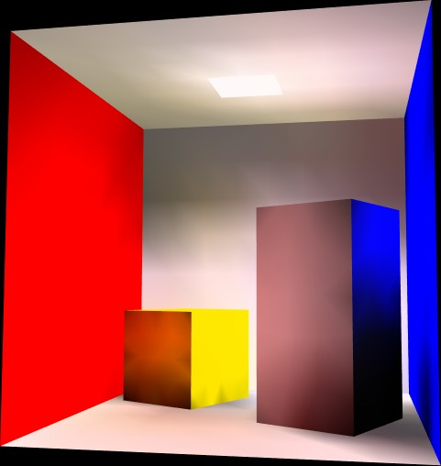
Rendering (1980s, 90s: Global Illumination)
early 1980s - global illumination
  Whitted (1980) - ray tracing
  Goral, Torrance et al. (1984) radiosity
  Kajiya (1986) - the rendering equation
Notes:
1980s
illustrations taken from Siggraph proceedings
global illumination
ray tracing = Monte Carlo evaluation of the rendering equation
radiosity = finite element evaluation of the rendering equation

Slide 38
History of Computer Animation
10 min clip from video on history of animation
http://www.youtube.com/watch?v=LzZwiLUVaKg
Covers sketchpad, animation, basic modeling, rendering
A synopsis of what this course is about
(watch offline if short on time)

