Slide 1
Computer Graphics
CSE 167 [Win 19], Lecture 9: Curves 1
Ravi Ramamoorthi
http://viscomp.ucsd.edu/classes/cse167/wi19

Slide 2
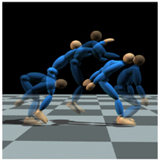
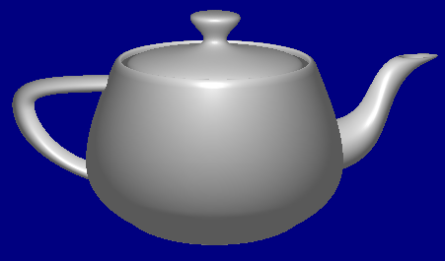
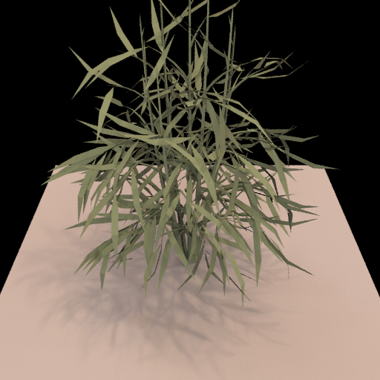
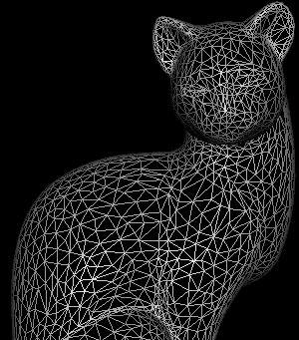
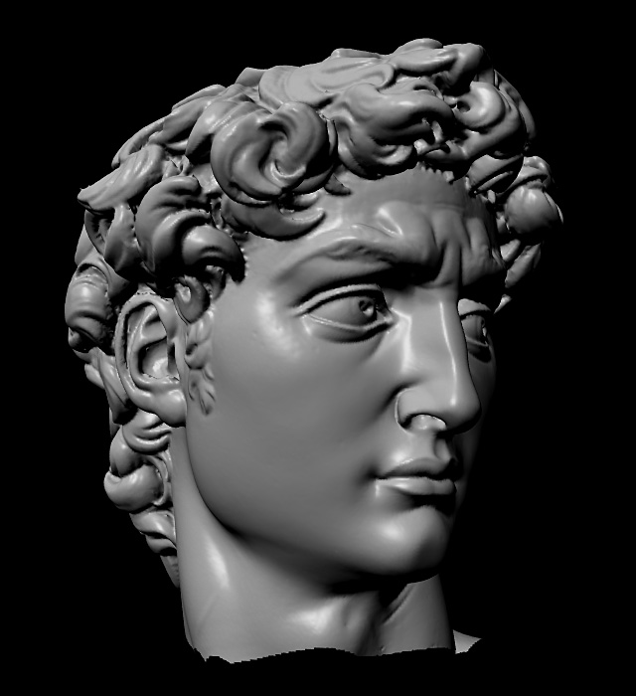
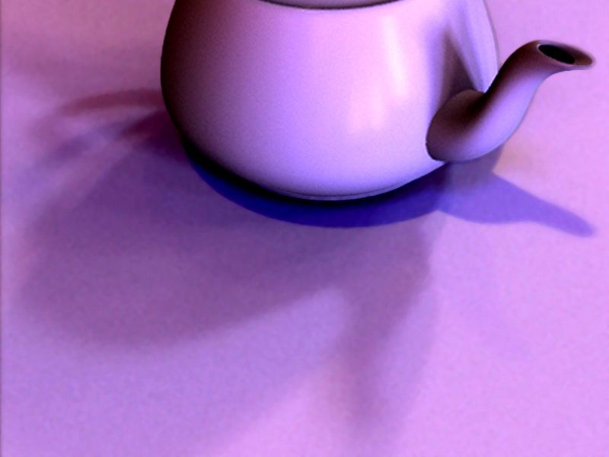
Course Outline
3D Graphics Pipeline
Modeling
Animation
Rendering

Slide 3
Graphics Pipeline
In HW 1, HW 2, draw, shade objects
But how to define geometry of objects?
How to define, edit shape of teapot?
We discuss modeling with spline curves
Demo of HW 3 solution
Homework submission (Feb 27)
After midterm, but please start on it before
Not on edX edge, http://34.219.177.190/cs167hw3/
Same password as for readings (and code grade only)

Slide 4
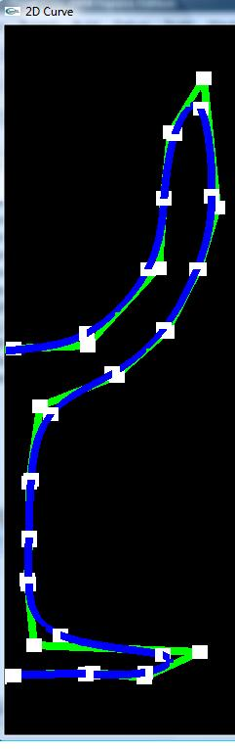
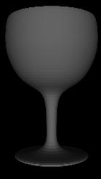
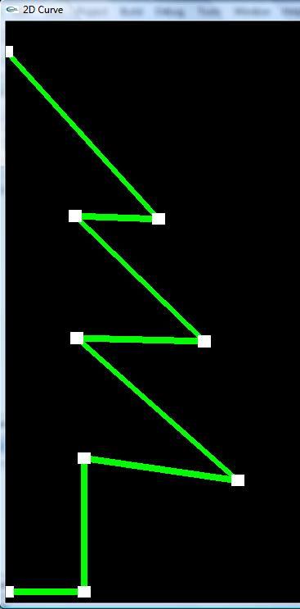
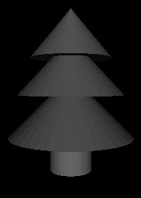
Curves for Modeling
Rachel Shiner, Final Project Spring 2010

Slide 5
Motivation
How do we model complex shapes?
In this course, only 2D curves, but can be used to create interesting 3D shapes by surface of revolution, lofting etc
Techniques known as spline curves
This unit is about mathematics required to draw these spline curves, as in HW 3
History: From using computer modeling to define car bodies in auto-manufacturing. Pioneers are Pierre Bezier (Renault), de Casteljau (Citroen)

Slide 6
Outline of Unit
Bezier curves
deCasteljau algorithm, explicit form, matrix form
Polar form labeling (next time)
B-spline curves (next time)
Not well covered in textbooks (especially as taught here). Main reference will be lecture notes. If you do want a printed ref, handouts from CAGD, Seidel

Slide 7
Bezier Curve (with HW3 demo)
Motivation: Draw a smooth intuitive curve (or surface) given few key user-specified control points
Demo HW 3
Control points (all that user specifies, edits)
Control
polygon
Smooth Bezier curve
(drawn automatically)

Slide 8
Bezier Curve: (Desirable) properties
Interpolates, is tangent to end points
Curve within convex hull of control polygon
Control points (all that user specifies, edits)
Control
polygon
Smooth Bezier curve
(drawn automatically)

Slide 9
Survey
Anonymous, know how things are going
Will try to use it to improve course

Slide 10
Issues for Bezier Curves
Main question: Given control points and constraints (interpolation, tangent), how to construct curve?
Algorithmic: deCasteljau algorithm
Explicit: Bernstein-Bezier polynomial basis
4x4 matrix for cubics
Properties: Advantages and Disadvantages

Slide 11
deCasteljau: Linear Bezier Curve
Just a simple linear combination or interpolation (easy to code up, very numerically stable)
P1
F(1)
Linear (Degree 1, Order 2)
F(0) = P0, F(1) = P1
F(u) = ?
F(u)
P0
P0
P1
F(0)
1-u
u
F(u) = (1-u) P0 + u P1

Slide 12
deCasteljau: Quadratic Bezier Curve
P1
Quadratic
Degree 2, Order 3
F(0) = P0, F(1) = P2
F(u) = ?
P0
P2
P0
P1
P2
1-u
u
1-u
u
1-u
u
F(u) = (1-u)² P0 + 2u(1-u) P1 + u² P2

Slide 13
Geometric interpretation: Quadratic
u
1-u
u
1-u
u

Slide 14
Geometric Interpretation: Cubic
u
u
u
u
u
u

Slide 15
deCasteljau: Cubic Bezier Curve
P1
P2
Cubic
Degree 3, Order 4
F(0) = P0, F(1) = P3
P0
P3
P0
P1
P2
P3
1-u
u
1-u
u
1-u
u
1-u
u
1-u
u
1-u
u
F(u) = (1-u)³ P0 +3u(1-u)² P1
+3u²(1-u) P2 + u³ P3

Slide 16
Summary: deCasteljau Algorithm
P1
P1
P1
P2
P0
P0
P2
P3
P0
Linear
Degree 1, Order 2
F(0) = P0, F(1) = P1
Quadratic
Degree 2, Order 3
F(0) = P0, F(1) = P2
Cubic
Degree 3, Order 4
F(0) = P0, F(1) = P3
P0
P1
P2
P0
P1
P2
P3
P0
P1
1-u
u
1-u
u
u
1-u
u
1-u
u
1-u
1-u
u
1-u
u
1-u
u
1-u
u
F(u) = (1-u) P0 + u P1
F(u) = (1-u)² P0 + 2u(1-u) P1 + u² P2
1-u
u
F(u) = (1-u)³ P0 +3u(1-u)² P1
+3u²(1-u) P2 + u³ P3

Slide 17
DeCasteljau Implementation
Can be optimized to do without auxiliary storage

Slide 18
Summary of HW3 Implementation
Bezier (Bezier2 and Bspline discussed next time)
Arbitrary degree curve (number of control points)
Break curve into detail segments. Line segments for these
Evaluate curve at locations 0, 1/detail, 2/detail, … , 1
Evaluation done using deCasteljau
Key implementation: deCasteljau for arbitrary degree
Is anyone confused? About handling arbitrary degree?
Can also use alternative formula if you want
Explicit Bernstein-Bezier polynomial form (next)
Questions?

Slide 19
Issues for Bezier Curves
Main question: Given control points and constraints (interpolation, tangent), how to construct curve?
Algorithmic: deCasteljau algorithm
Explicit: Bernstein-Bezier polynomial basis
4x4 matrix for cubics
Properties: Advantages and Disadvantages

Slide 20
Recap formulae
Linear combination of basis functions
Explicit form for basis functions? Guess it?

Slide 21
Recap formulae
Linear combination of basis functions
Explicit form for basis functions? Guess it?
Binomial coefficients in [(1-u)+u]^{n}

Slide 22
Summary of Explicit Form

Slide 23
Issues for Bezier Curves
Main question: Given control points and constraints (interpolation, tangent), how to construct curve?
Algorithmic: deCasteljau algorithm
Explicit: Bernstein-Bezier polynomial basis
4x4 matrix for cubics
Properties: Advantages and Disadvantages

Slide 24
Cubic 4x4 Matrix (derive)

Slide 25
Cubic 4x4 Matrix (derive)

Slide 26
Issues for Bezier Curves
Main question: Given control points and constraints (interpolation, tangent), how to construct curve?
Algorithmic: deCasteljau algorithm
Explicit: Bernstein-Bezier polynomial basis
4x4 matrix for cubics
Properties: Advantages and Disadvantages

Slide 27
Properties (brief discussion)
Demo of HW 3
Interpolation: End-points, but approximates others
Single piece, moving one point affects whole curve (no local control as in B-splines later)
Invariant to translations, rotations, scales etc. That is, translating all control points translates entire curve
Easily subdivided into parts for drawing (next lecture): Hence, Bezier curves easiest for drawing

