Slide 1
Computer Graphics
CSE 167 [Win 19], Lecture 8: OpenGL 2
Ravi Ramamoorthi
http://viscomp.ucsd.edu/classes/cse167/wi19

Slide 2
To Do
Milestone on HW 2 due on Monday Feb 4
Any questions or issues?
Continue working on HW 2. Can be difficult
Class lectures, programs primary source
Can leverage many sources (GL(SL) book, excellent online documentation, see links class website)
It is a good idea to copy (and modify) relevant segments
  But only from materials provided with the class
  Keep collaboration policy in mind: no copying from classmates etc

Slide 3
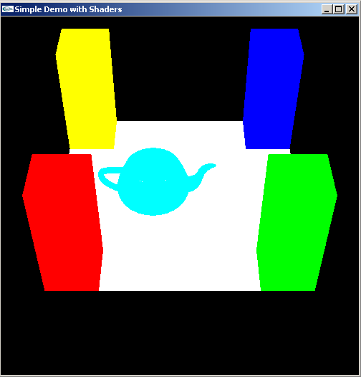
Methodology for Lecture
Make mytest1 more ambitious
Sequence of steps
Demo

Slide 4
Review of Last Demo
Changed floor to all white, added global for teapot and teapotloc, moved geometry to new header file
Demo 0 [set DEMO to 4 all features]
#include <GL/glut.h> //also <GL/glew.h>; <GLUT/glut.h> for Mac OS
#include “shaders.h”
#include “geometry.h”
int mouseoldx, mouseoldy ; // For mouse motion
GLfloat eyeloc = 2.0 ; // Where to look from; initially 0 -2, 2
GLfloat teapotloc = -0.5 ; // ** NEW ** where the teapot is located
GLint animate = 0 ; // ** NEW ** whether to animate or not
GLuint vertexshader, fragmentshader, shaderprogram ; // shaders
const int DEMO = 0 ; // ** NEW ** To turn on and off features

Slide 5
Outline
Review of demo from last lecture
Basic geometry setup for cubes (pillars), colors
  Single geometric object, but multiple colors for pillars
Matrix Stacks and Transforms (draw 4 pillars)
Depth testing (Z-buffering)
Animation (moving teapot)
Texture Mapping (wooden floor)
Best source for OpenGL is the red book and GLSL book. Of course, this is more a reference manual than a textbook, and you are better off implementing rather than reading end to end.

Slide 6
Geometry Basic Setup 1
const int numobjects = 2 ; // number of objects for buffer
const int numperobj = 3 ;
const int ncolors = 4 ;
GLUint VAOs[numobjects+ncolors], teapotVAO; // VAO (Vertex Array Object) for each primitive object
GLuint buffers[numperobj*numobjects+ncolors], teapotbuffers[3] ; // ** NEW ** List of buffers for geometric data
GLuint objects[numobjects] ; // ** NEW ** For each object
GLenum PrimType[numobjects] ;
GLsizei NumElems[numobjects] ;
// For the geometry of the teapot
std::vector <glm::vec3> teapotVertices;
std::vector <glm::vec3> teapotNormals;
std::vector <unsigned int> teapotIndices;
// To be used as a matrix stack for the modelview.
std::vector <glm::mat4> modelviewStack;

Slide 7
Geometry Basic Setup 2
// ** NEW ** Floor Geometry is specified with a vertex array
// ** NEW ** Same for other Geometry
enum {Vertices, Colors, Elements} ; // For arrays for object
enum {FLOOR, CUBE} ; // For objects, for the floor
const GLfloat floorverts[4][3] = {
{0.5, 0.5, 0.0}, {-0.5, 0.5, 0.0}, {-0.5, -0.5, 0.0}, {0.5, -0.5, 0.0}
} ;
const GLfloat floorcol[4][3] = {
{1.0, 1.0, 1.0}, {1.0, 1.0, 1.0}, {1.0, 1.0, 1.0}, {1.0, 1.0, 1.0}
} ;
const GLubyte floorinds[1][6] = { {0, 1, 2, 0, 2, 3} } ;
const GLfloat floortex[4][2] = {
{1.0, 1.0}, {0.0, 1.0}, {0.0, 0.0}, {1.0, 0.0}
} ;

Slide 8
Cube geometry (for pillars)
const GLfloat wd = 0.1 ;
const GLfloat ht = 0.5 ;
const GLfloat _cubecol[4][3] = {
{1.0, 0.0, 0.0}, {0.0, 1.0, 0.0}, {0.0, 0.0, 1.0}, {1.0, 1.0, 0.0} } ;
const GLfloat cubeverts[8][3] = {
{-wd, -wd, 0.0}, {-wd, wd, 0.0}, {wd, wd, 0.0}, {wd, -wd, 0.0},
{-wd, -wd, ht}, {wd, -wd, ht}, {wd, wd, ht}, {-wd, wd, ht}
} ;
GLfloat cubecol[8][3] ;
const GLubyte cubeinds[12][3] = {
{0, 1, 2}, {0, 2, 3}, // BOTTOM
{4, 5, 6}, {4, 6, 7}, // TOP
{0, 4, 7}, {0, 7, 1}, // LEFT
{0, 3, 5}, {0, 5, 4}, // FRONT
{3, 2, 6}, {3, 6, 5}, // RIGHT
{1, 7, 6}, {1, 6, 2} // BACK
} ;

Slide 9
Initialize Geometry Function
// This function takes in a vertex, color, index and type array
void initobject(GLuint object, GLfloat * vert, GLint sizevert, GLfloat * col, GLint sizecol, GLubyte * inds, GLint sizeind, GLenum type) {
int offset = object * numperobj ;
glBindVertexArray(VAOs[object]);
glBindBuffer(GL_ARRAY_BUFFER, buffers[Vertices + offset]);
glBufferData(GL_ARRAY_BUFFER, sizevert, vert, GL_STATIC_DRAW);
// Use layout location 0 for the vertices
glEnableVertexAttribArray(0);
glVertexAttribPointer(0, 3, GL_FLOAT, GL_FALSE, 3 * sizeof(GLfloat), 0);
glBindBuffer(GL_ARRAY_BUFFER, buffers[Colors + offset]);
glBufferData(GL_ARRAY_BUFFER, sizecol, col, GL_STATIC_DRAW);
// Use layout location 1 for the colors
glEnableVertexAttribArray(1);
glVertexAttribPointer(1, 3, GL_FLOAT, GL_FALSE, 3 * sizeof(GLfloat), 0);
glBindBuffer(GL_ELEMENT_ARRAY_BUFFER, buffers[Elements + offset]);
glBufferData(GL_ELEMENT_ARRAY_BUFFER, sizeind, inds, GL_STATIC_DRAW);
PrimType[object] = type;
NumElems[object] = sizeind;
// Prevent further modification of this VAO by unbinding it
glBindVertexArray(0);}

Slide 10
Initialize Cubes with Colors 1
void initcubes(GLuint object, GLfloat * vert, GLint sizevert, GLubyte * inds, GLint sizeind, GLenum type) {
for (int i = 0; i < ncolors; i++) {
for (int j = 0; j < 8; j++)
for (int k = 0; k < 3; k++)
cubecol[j][k] = _cubecol[i][k];
glBindVertexArray(VAOs[object + i]);
int offset = object * numperobj;
int base = numobjects * numperobj;
glBindBuffer(GL_ARRAY_BUFFER, buffers[Vertices + offset]);
glBufferData(GL_ARRAY_BUFFER, sizevert, vert, GL_STATIC_DRAW);
// Use layout location 0 for the vertices
glEnableVertexAttribArray(0);
glVertexAttribPointer(0, 3, GL_FLOAT, GL_FALSE, 3 * sizeof(GLfloat), 0);
glBindBuffer(GL_ARRAY_BUFFER, buffers[base + i]);
glBufferData(GL_ARRAY_BUFFER, sizeof(cubecol), cubecol, GL_STATIC_DRAW);

Slide 11
Initialize Cubes with Colors 2
...
// Use layout location 1 for the colors
glEnableVertexAttribArray(1);
glVertexAttribPointer(1, 3, GL_FLOAT, GL_FALSE, 3 * sizeof(GLfloat), 0);
glBindBuffer(GL_ELEMENT_ARRAY_BUFFER, buffers[Elements + offset]);
glBufferData(GL_ELEMENT_ARRAY_BUFFER, sizeind, inds, GL_STATIC_DRAW);
PrimType[object] = type;
NumElems[object] = sizeind;
// Prevent further modification of this VAO by unbinding it
glBindVertexArray(0); }
}
//in init
initobject(FLOOR, (GLfloat *) floorverts, sizeof(floorverts), (GLfloat *) floorcol, sizeof (floorcol), (GLubyte *) floorinds, sizeof (floorinds), GL_TRIANGLES) ;
initcubes(CUBE, (GLfloat *)cubeverts, sizeof(cubeverts), (GLubyte *)cubeinds, sizeof(cubeinds), GL_TRIANGLES);
loadteapot();

Slide 12
Drawing with/without Colors
// And a function to draw with them, similar to drawobject but with color
void drawcolor(GLuint object, GLuint color) {
glBindVertexArray(VAOs[object + color]);
glDrawElements(PrimType[object], NumElems[object], GL_UNSIGNED_BYTE, 0);
glBindVertexArray(0);
}
void drawobject(GLuint object) {
glBindVertexArray(VAOs[object]);
glDrawElements(PrimType[object], NumElems[object], GL_UNSIGNED_BYTE, 0);
glBindVertexArray(0);
}
void loadteapot() // See source code for details if interested

Slide 13
Outline
Review of demo from last lecture
Basic geometry setup for cubes (pillars), colors
  Single geometric object, but multiple colors for pillars
Matrix Stacks and Transforms (draw 4 pillars)
Depth testing (Z-buffering)
Animation (moving teapot)
Texture Mapping (wooden floor)
Best source for OpenGL is the red book and GLSL book. Of course, this is more a reference manual than a textbook, and you are better off implementing rather reading end to end.

Slide 14
Summary OpenGL Vertex Transforms
Object coords
(x y z w)^{t} vertex
Clip coordinates
Perspective Divide
(Dehomogenization)
Normalized Device
Coordinates
Modelview matrix
[Object Transforms
and glm::lookAt]
Viewport Transform
(glViewport)
Eye coordinates
(used for lighting)
Projection matrix
[3D to 2D, usually
glm::perspective]
Window Coords

Slide 15
Transformations
Matrix Stacks
  Old OpenGL: glPushMatrix, glPopMatrix, glLoad, glMultMatrixf
  Useful for hierarchically defined figures, placing pillars
  Current recommendation is STL stacks managed yourself, which is done in mytest2. (You must manage the stack yourself for HW 2).
Transforms
  Write your own translate, scale, rotate for HW 1 and HW 2
  Careful of OpenGL convention: In old-style, Right-multiply current matrix (last is first applied). glm operators follow this sometimes.
Also gluLookAt (glm::lookAt), gluPerspective (glm::perspective)
  Remember just matrix like any other transform, affecting modelview
  See mytest for how to best implement these ideas

Slide 16
Drawing Pillars 1 (in display)
// 1st pillar: Right-multiply modelview as in old OpenGL
pushMatrix(modelview) ; // push/pop functions for stack
modelview = modelview * glm::translate(identity, glm::vec3(-0.4, -0.4, 0.0)) ; // build translation matrix
glUniformMatrix4fv(modelviewPos, 1, GL_FALSE, &(modelview)[0][0]);
drawcolor(CUBE, 0) ;
popMatrix(modelview) ;
// 2nd pillar
pushMatrix(modelview) ;
modelview = modelview * glm::translate(identity, glm::vec3(0.4, -0.4, 0.0)) ; // build translation matrix
glUniformMatrix4fv(modelviewPos, 1, GL_FALSE, &(modelview)[0][0]);
drawcolor(CUBE, 1) ;
popMatrix(modelview) ;
// Function pushes specified matrix onto the modelview stack
void pushMatrix(glm::mat4 mat) {
modelviewStack.push_back(glm::mat4(mat)); }

Slide 17
Drawing Pillars 2
// 3rd pillar
pushMatrix(modelview);
modelview = modelview * glm::translate(identity, glm::vec3(0.4, 0.4, 0.0));
glUniformMatrix4fv(modelviewPos, 1, GL_FALSE, &(modelview)[0][0]);
drawcolor(CUBE, 2) ;
popMatrix(modelview);
// 4th pillar
pushMatrix(modelview);
modelview = modelview * glm::translate(identity, glm::vec3(-0.4, 0.4, 0.0));
glUniformMatrix4fv(modelviewPos, 1, GL_FALSE, &(modelview)[0][0]);
drawcolor(CUBE, 3) ;
popMatrix(modelview);
// This function pops a matrix from the modelview stack void popMatrix(glm::mat4& mat) {
if (modelviewStack.size()) {
mat = glm::mat4(modelviewStack.back());
modelviewStack.pop_back();
}
else { // Just to prevent errors when popping from an empty stack.
mat = glm::mat4(1.0f); }
}

Slide 18
Demo
Demo 1
Does order of drawing matter?
What if I move floor after pillars in code?
Is this desirable? If not, what can I do about it?

Slide 19
Outline
Review of demo from last lecture
Basic geometry setup for cubes (pillars), colors
  Single geometric object, but multiple colors for pillars
Matrix Stacks and Transforms (draw 4 pillars)
Depth testing (Z-buffering)
Animation (moving teapot)
Texture Mapping (wooden floor)
Best source for OpenGL is the red book and GLSL book. Of course, this is more a reference manual than a textbook, and you are better off implementing rather reading end to end.

Slide 20
Double Buffering
New primitives draw over (replace) old objects
Can lead to jerky sensation
Solution: double buffer. Render into back (offscreen) buffer. When finished, swap buffers to display entire image at once.
Changes in main and display
glutInitDisplayMode (GLUT_DOUBLE | GLUT_RGB | GLUT_DEPTH);
glutSwapBuffers() ;
glFlush ();

Slide 21
Turning on Depth test (Z-buffer)
OpenGL uses a Z-buffer for depth tests
  For each pixel, store nearest Z value (to camera) so far
  If new fragment is closer, it replaces old z, color [“less than” can be over-ridden in fragment program]
  Simple technique to get accurate visibility
  (Be sure you know what fragments and pixels are)
Changes in main fn, display to Z-buffer
  glutInitDisplayMode (GLUT_DOUBLE | GLUT_RGB | GLUT_DEPTH);
  glClear (GL_COLOR_BUFFER_BIT | GL_DEPTH_BUFFER_BIT);
In init function
  glEnable(GL_DEPTH_TEST) ;
  glDepthFunc(GL_LESS) ; // The default option

Slide 22
Demo
Demo 2
Does order of drawing matter any more?
What if I change near plane to 0?
Is this desirable? If not, what can I do about it?

Slide 23
Outline
Review of demo from last lecture
Basic geometry setup for cubes (pillars), colors
  Single geometric object, but multiple colors for pillars
Matrix Stacks and Transforms (draw 4 pillars)
Depth testing (Z-buffering)
Animation (moving teapot)
Texture Mapping (wooden floor)
Best source for OpenGL is the red book and GLSL book. Of course, this is more a reference manual than a textbook, and you are better off implementing rather reading end to end.

Slide 24
Demo
Demo 3
Notice how teapot cycles around
And that I can pause and restart animation
And do everything else (zoom etc.) while teapot moves in background

Slide 25
Drawing Teapot (in display)
// ** NEW ** Put a teapot in the middle that animates
pushMatrix(modelview);
modelview = modelview * glm::translate(identity, glm::vec3(teapotloc, 0.0, 0.0));
// The following two transforms set up and center the teapot
// Transforms right-multiply the modelview matrix (top of the stack)
modelview = modelview * glm::translate(identity, glm::vec3(0.0, 0.0, 0.1));
modelview = modelview * glm::rotate(identity, glm::pi<float>() / 2.0f, glm::vec3(1.0, 0.0, 0.0));
float size = 0.235f; // Teapot size
modelview = modelview * glm::scale(identity, glm::vec3(size, size, size));
glUniformMatrix4fv(modelviewPos, 1, GL_FALSE, &(modelview)[0][0]);
drawteapot() ;
popMatrix(modelview);
void drawteapot() {// drawteapot() function in geometry.h
glBindVertexArray(teapotVAO);
glDrawElements(GL_TRIANGLES, teapotIndices.size(), GL_UNSIGNED_INT, 0);
glBindVertexArray(0);
}

Slide 26
Simple Animation routine
// ** NEW ** in this assignment, is an animation of a teapot
// Hitting p will pause this animation; see keyboard callback
void animation(void) {
teapotloc = teapotloc + 0.005 ;
if (teapotloc > 0.5) teapotloc = -0.5 ;
glutPostRedisplay() ;
}

Slide 27
Keyboard callback (p to pause)
GLint animate = 0 ; // ** NEW ** whether to animate or not
void keyboard (unsigned char key, int x, int y)
{
switch (key) {
case 27: // Escape to quit
exit(0) ;
break ;
case 'p': // ** NEW ** to pause/restart animation
animate = !animate ;
if (animate) glutIdleFunc(animation) ;
else glutIdleFunc(NULL) ;
break ;
default:
break ;
}
}

Slide 28
Outline
Review of demo from last lecture
Display lists (extend init for pillars)
Matrix stacks and transforms (draw 4 pillars)
Depth testing or z-buffering
Animation (moving teapot)
Texture mapping (wooden floor) [mytest3]

Slide 29
New globals and basic setup
// In mytest3.cpp
GLubyte woodtexture[256][256][3] ; // texture (from grsites.com)
GLuint texNames[1] ; // texture buffer
GLuint istex ; // blend parameter for texturing
GLuint islight ; // for lighting
GLint texturing = 1 ; // to turn on/off texturing
GLint lighting = 1 ; // to turn on/off lighting
// In Display
glUniform1i(islight,0) ; // Turn off lighting (except on teapot, later)
glUniform1i(istex,texturing) ;
drawtexture(FLOOR,texNames[0]) ; // Texturing floor
// drawobject(FLOOR) ;
glUniform1i(istex,0) ; // Other items aren't textured

Slide 30
Simple Toggles for Keyboard
case 't': // ** NEW ** to turn on/off texturing ;
texturing = !texturing ;
glutPostRedisplay() ;
break ;
case 's': // ** NEW ** to turn on/off shading (always smooth) ;
lighting = !lighting ;
glutPostRedisplay() ;
break ;

Slide 31
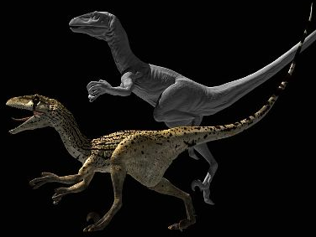
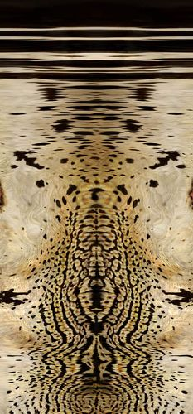
Adding Visual Detail
Basic idea: use images instead of more polygons to represent fine scale color variation

Slide 32
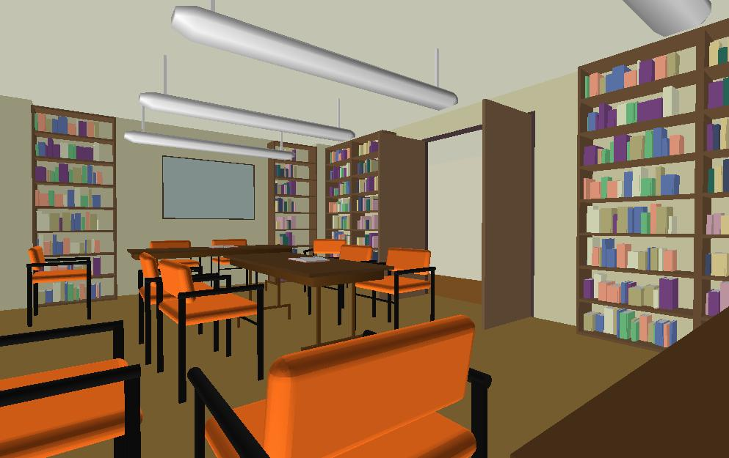
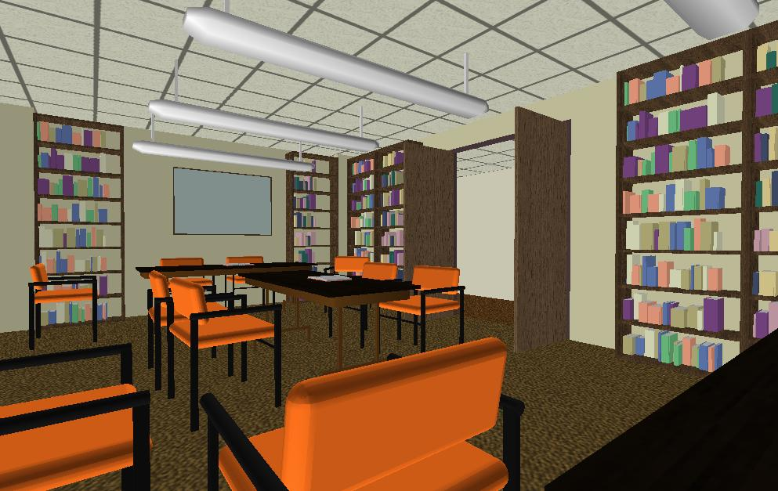
Texture Mapping
Important topic: nearly all objects textured
  Wood grain, faces, bricks and so on
  Adds visual detail to scenes
Can be added in a fragment shader
Polygonal model
With surface texture

Slide 33
Setting up texture
inittexture("wood.ppm", shaderprogram) ; // in init()
// Very basic code to read a ppm file
// And then set up buffers for texture coordinates
void inittexture (const char * filename, GLuint program) {
int i,j,k ;
FILE * fp ;
assert(fp = fopen(filename,"rb")) ;
fscanf(fp,"%*s %*d %*d %*d%*c") ;
for (i = 0 ; i < 256 ; i++)
for (j = 0 ; j < 256 ; j++)
for (k = 0 ; k < 3 ; k++)
fscanf(fp,"%c",&(woodtexture[i][j][k])) ;
fclose(fp) ;

Slide 34
Texture Coordinates
Each vertex must have a texture coordinate: pointer to texture. Interpolate for pixels (each fragment has st)
// Set up Texture Coordinates
glGenTextures(1, texNames) ;
glBindVertexArray(VAOs[FLOOR]);
glBindBuffer(GL_ARRAY_BUFFER, buffers[numobjects*numperobj+ncolors]) ;
glBufferData(GL_ARRAY_BUFFER, sizeof (floortex), floortex,GL_STATIC_DRAW);
// Use layout location 2 for texcoords
glEnableVertexAttribArray(2);
glVertexAttribPointer(2, 2, GL_FLOAT, GL_FALSE, 2 * sizeof(GLfloat), 0);
glActiveTexture(GL_TEXTURE0) ;
glEnable(GL_TEXTURE_2D) ;
glBindTexture (GL_TEXTURE_2D, texNames[0]) ;

Slide 35
Specifying the Texture Image
glTexImage2D( target, level, components, width height, border, format, type, data )
target is GL_TEXTURE_2D
level is (almost always) 0
components = 3 or 4 (RGB/RGBA)
width/height MUST be a power of 2
border = 0 (usually)
format = GL_RGB or GL_RGBA (usually)
type = GL_UNSIGNED_BYTE, GL_FLOAT, etc…

Slide 36
Texture Image and Bind to Shader
glTexImage2D(GL_TEXTURE_2D,0,GL_RGB, 256, 256, 0, GL_RGB, GL_UNSIGNED_BYTE, woodtexture) ;
glTexParameterf(GL_TEXTURE_2D, GL_TEXTURE_MAG_FILTER, GL_LINEAR) ;
glTexParameterf(GL_TEXTURE_2D, GL_TEXTURE_MIN_FILTER, GL_LINEAR) ;
glTexParameteri(GL_TEXTURE_2D, GL_TEXTURE_WRAP_S, GL_REPEAT) ;
glTexParameteri(GL_TEXTURE_2D, GL_TEXTURE_WRAP_T, GL_REPEAT) ;
// Define a sampler. See page 709 in red book, 7th ed.
GLint texsampler ;
texsampler = glGetUniformLocation(program, "tex") ;
glUniform1i(texsampler,0) ; // Could also be GL_TEXTURE0
istex = glGetUniformLocation(program,"istex") ;

Slide 37
Drawing with Texture
// And a function to draw with textures, similar to drawobject
void drawtexture(GLuint object, GLuint texture) {
glBindTexture(GL_TEXTURE_2D, texture);
glBindVertexArray(VAOs[object]);
glDrawElements(PrimType[object], NumElems[object], GL_UNSIGNED_BYTE, 0);
glBindVertexArray(0);
}

Slide 38
Final Steps for Drawing (+Demo)
Vertex shader (just pass on texture coords)
layout (location = 2) in vec2 texCoords;
out vec2 texcoord; // similar definitions for positions and normals
uniform int istex ;
void main() {
gl_Position = projection * modelview * vec4(position, 1.0f);
mynormal = mat3(transpose(inverse(modelview))) * normal ;
myvertex = modelview * vec4(position, 1.0f) ;
texcoord = vec2 (0.0, 0.0); // Default value just to prevent errors
if (istex != 0){ texcoord = texCoords;} }
Fragment shader (can be more complex blend)
uniform sampler2D tex ;
uniform int istex ;
void main (void) {
if (istex > 0) fragColor = texture(tex, texcoord) ;

Slide 39
More on Texture (very briefly)
Full lecture later in course
Optimizations for efficiency
Mipmapping
Filtering
Texture Coordinate generation
Texture Matrix
Environment Mapping
If very ambitious, read more in OpenGL

Slide 40
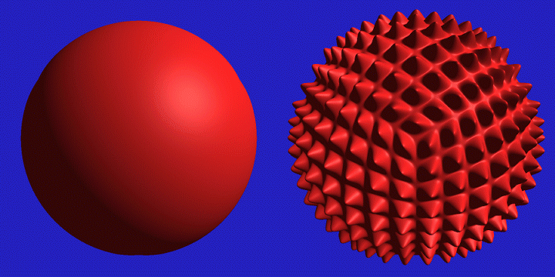
Displacement Mapping

Slide 41
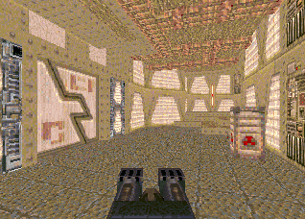
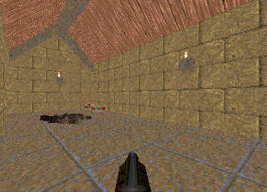

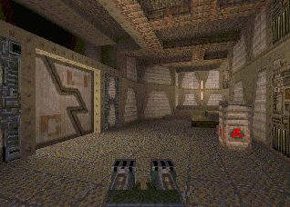
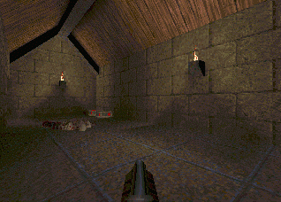
Illumination Maps
Quake introduced illumination maps or light maps to capture lighting effects in video games
Texture map:
Light map
Texture map
+ light map:

Slide 42
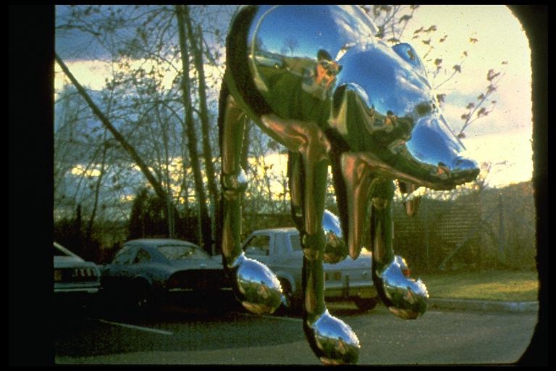

Environment Maps
Images from Illumination and Reflection Maps:
Simulated Objects in Simulated and Real Environments
Gene Miller and C. Robert Hoffman
SIGGRAPH 1984 “Advanced Computer Graphics Animation” Course Notes

Slide 43
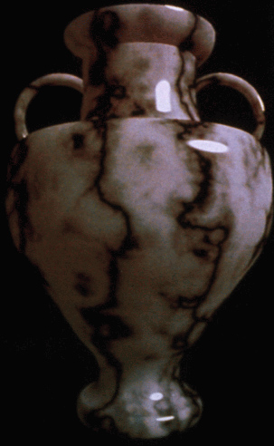
Solid textures
Texture values indexed by 3D location (x,y,z)
  Expensive storage, or
  Compute on the fly,
  e.g. Perlin noise →

Slide 44


