Slide 1
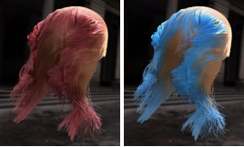

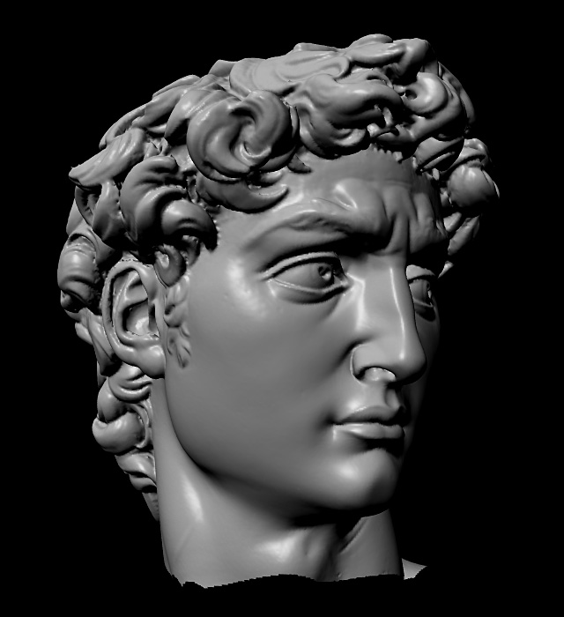

Advanced Computer Graphics
CSE 163 [Spring 2018], Lecture 8
Ravi Ramamoorthi
http://www.cs.ucsd.edu/~ravir

Slide 2
To Do
Assignment 1, Due Apr 27
  Any last minute issues or difficulties?
Assignment 2 due May 18
  Please START EARLY. Can do most after this week
  Contact us for difficulties, help finding partners etc.

Slide 3
Outline
Basic assignment overview
Detailed discussion of mesh simplification
Progressive meshes
Quadric error metrics

Slide 4
Assignment Overview
Implement complete system for mesh simplification
Plus progressive meshes
Possibly challenging assignment: start very early and proceed in incremental fashion
Choice of data structure for meshes is the key (read the assignment)
This involves fairly recent work. No one answer
  Think about the best way of proceeding, use creativity

Slide 5
Mesh Viewer (3.1)
Deliberately, no skeleton code for assignment
  Think about and implement full system from scratch
First step: Mesh viewer
  Read meshes (in simple OFF file format), view them
  Should be able to reuse some code from 167 etc.
    Please ask instructor or TA if stuck, need some help
  Shading: must average face normals per vertex (this may give you a start in implementing a mesh data structure)
  Debugging modes for shading (color each triangle
  separately with an individual color)
Software Design
  Define mesh class with display method etc.
  Use C++ STL data structures where appropriate (see assn)

Slide 6
Mesh Connectivity (3.2)
Build up mesh connectivity data structure
  Input is vertices and faces from input file
Goal is to do edge collapses in constant time
  No iteration over whole mesh
  Most of mesh unchanged
  Important questions for your data structure to answer: “What vertices neighbor my current vertex?” and “What faces neighbor my current vertex”
  Think about updating your data structure. Collapsing an edge may require more than just the edge itself. You must update every vertex or face that has changed

Slide 7
Mesh Decimation (edge collapse)
Can you handle this correctly and efficiently? Debugging examples in testpatch and plane (do these first)
Notes:
Mention what we need to compute - vertex position and
attributes

Slide 8
Mesh Decimation (edge collapse)
Can you handle this correctly and efficiently? Debugging examples in testpatch and plane (do these first)
Notes:
Mention what we need to compute - vertex position and
attributes

Slide 9
Mesh Decimation (edge collapse 3.3)
A
A
Create new vertex v (based on appropriate rule)
Find all faces/edges neighbor vertex v1 (such as A)
Change them to use v instead of v1. Do the same for v0
Depend on data structure, you need to fix all faces, edges
v1
v
X
v0
Notes:
Mention what we need to compute - vertex position and
attributes

Slide 10
Mesh Data Structure Hints
Simplest (I think): Faces store constituent vertices [indexed face set as in OFF], vertices store adjacent faces (how do you create vertex-face adjacency?)
To simplify, first create new vertex v. Adjacent faces are those adjacent to v0 or v1
For each of those faces, update to point to v instead of v0 or v1

Slide 11
Mesh Decimation (edge collapse 3.3)
A
A
Create new vertex v (based on appropriate rule like average)
Find all faces that neighbor vertex v1 (such as A)
  Simple use of vertex to face adjacency
Change them to use v instead of v1. Do the same for v0
v1
v
X
v0
Notes:
Mention what we need to compute - vertex position and
attributes

Slide 12
Mesh Decimation (edge collapse 2.3)
A
A
Find faces neighboring edge v0-v1 (such as X)
Remove from mesh
  This may involve updating face/vertex adjacency relationships etc.
  E.g. what is adjacency for v (faces adjacent to vertex?)
  Are other vertices affected in terms of adjacent faces?
Worry about triangle fins (extra credit, not discussed)
v1
v
X
v0
Notes:
Mention what we need to compute - vertex position and
attributes

Slide 13
Mesh Data Structure Hints
With indexed face set plus vertex to face adjacency, removing a face should just work (remember to delete face from vertex adjacency lists)
In general, winged edge, half-edge may be (slightly) more efficient, but also harder to implement
Ultimately, your choice and work out the details
Good luck!!

Slide 14
Mesh Decimation (edge collapse 3.3)
A
A
Find faces neighboring edge v0-v1 (such as X)
  Union of adjacent faces to vertex v0 and vertex v1
Update adjacency lists
  For all vertices, remove that face from their adjacency list
Remove face from mesh
v1
v
X
v0
Notes:
Mention what we need to compute - vertex position and
attributes

Slide 15
Implementation
Tricky
When you remove something, need to update appropriately
Work out on paper first (e.g. indexed face set plus adjacent faces for each vertex)
Depends on choice of data structure (pick easy to do)
Start with simple debugging cases (make sure not just that it looks right, but all adjacencies remain correct)

Slide 16
Outline
Basic assignment overview
Detailed discussion of mesh simplification
Progressive meshes
Quadric error metrics

Slide 17
Successive Edge Collapses
We have discussed one edge collapse, how to do that
In practice, sequence of edge collapses applied
Order etc. based on some metric (later in lecture)
So, we gradually reduce complexity of model
Progressive meshes is opposite: gradually increase complexity

Slide 18
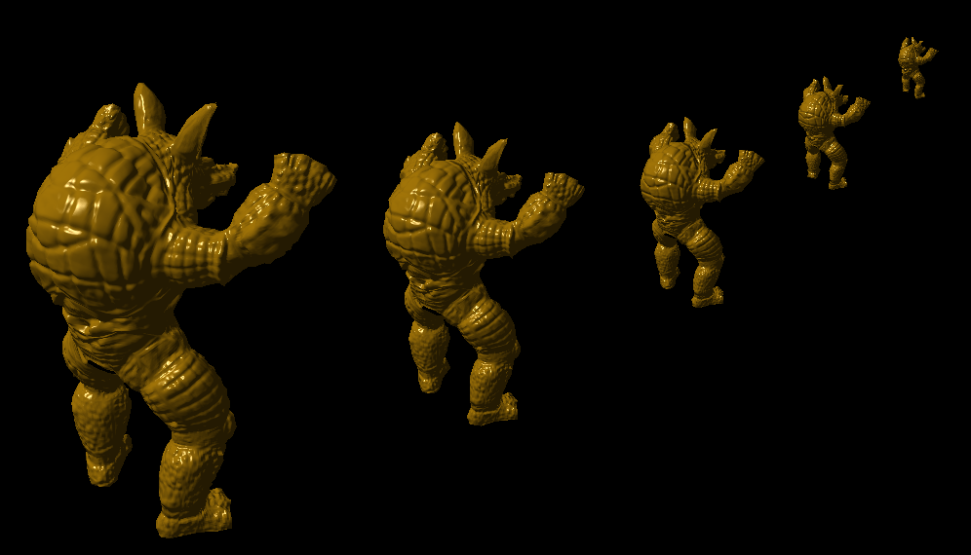
Appearance Preserving
488 tris
975 tris
1,951 tris
3,905 tris
7,809 tris
Caltech & Stanford Graphics Labs and Jonathan Cohen

Slide 19
Progressive Meshes (3.5)
Write edge collapses to file
Read in file and invert order
Key idea is vertex-split (opposite of edge-collapse)
Include some control to make model coarser/finer
E.g. Hoppe geomorph demo

Slide 20
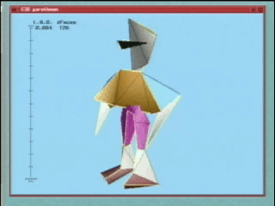
GeoMorph

Slide 21
Vertex splits
Can you handle this correctly and efficiently? Debugging examples in testpatch and plane (do these first)
Notes:
Mention what we need to compute - vertex position and
attributes

Slide 22
Implementation
Tricky
What info do you need to add something?
Work out on paper first (e.g. indexed face set plus adjacent faces for each vertex)
Start with simple debugging cases (make sure not just that it looks right, but all adjacencies remain correct)

Slide 23
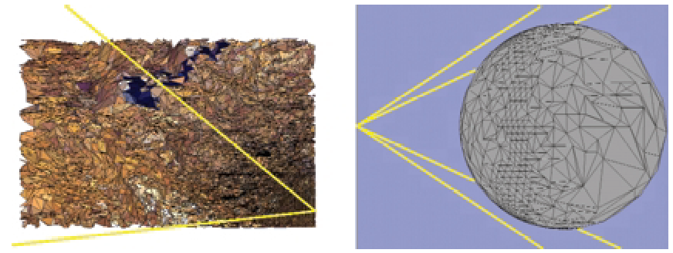
View-Dependent Simplification
Simplify dynamically according to viewpoint
  Visibility
  Silhouettes
  Lighting
Hoppe

Slide 24
Outline
Basic assignment overview
Detailed discussion of mesh simplification
Progressive meshes
Quadric error metrics

Slide 25
Quadric Error Metrics
Garland & Heckbert, SIGGRAPH 97
Greedy decimation algorithm
Pair collapse (allow edge + non-edge collapses)
Quadric error metrics:
  Evaluate potential collapses
  Determine optimal new vertex locations

Slide 26
Background: Computing Planes
Each triangle in mesh has associated plane
For a triangle, find its (normalized) normal using cross products
Plane equation?

Slide 27
Quadric Error Metrics
Based on point-to-plane distance
Better quality than point-to-point
d_{c}
d_{a}
d_{b}
a
b
c

Slide 28
Quadric Error Metrics
Sum of squared distances from vertex to planes:

Slide 29
Quadric Error Metrics
Common mathematical trick: quadratic form = symmetric matrix Q multiplied twice by a vector
Initially, distance to all planes 0, net is 0 for all verts

Slide 30
Using Quadrics
Approximate error of edge collapses
  Each vertex v has associated quadric Q
  Error of collapsing v₁ and v₂ to v’ is v’^{T}Q₁v’+v’^{T}Q₂v’
  Quadric for new vertex v’ is Q’=Q₁+Q₂

Slide 31
Using Quadrics
Find optimal location v’ after collapse:

Slide 32
Using Quadrics
Find optimal location v’ after collapse:

Slide 33
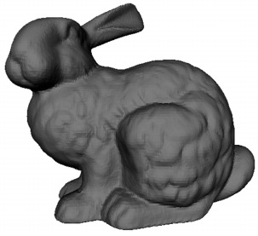
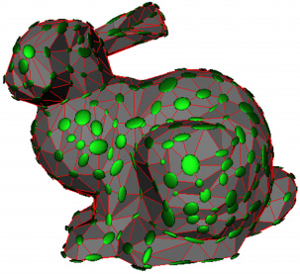

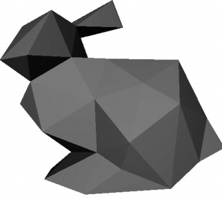
Results
Original
Quadrics
1k tris
100 tris

Slide 34
Quadric Visualization
Ellipsoids: iso-error surfaces
Smaller ellipsoid = greater error for a given motion
Lower error for motion parallel to surface
Lower error in flat regions than at corners
Elongated in “cylindrical” regions

Slide 35
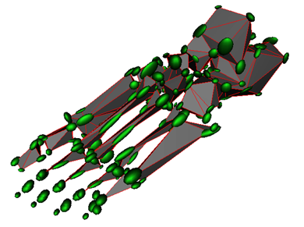
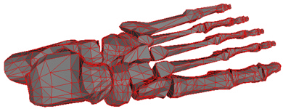
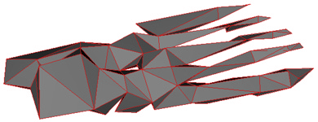
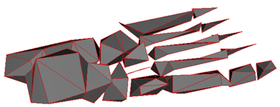
Results
Original
Quadrics
250 tris
250 tris, edge collapses only

Slide 36
Summary
First, implement basic mesh simplification on one edge
Helps to have right data structure
  Tricky since needs to be efficient and properly update
Then, implement quadric error metrics
  Tricky; we will spend most of another lecture on this
  Put edge collapses in priority queue
  Problem is that when you do one, you have to update all the neighbors as well (just as for standard edge collapse)
  And re-insert in queue (use appropriate data structure)

